Slide 1
Some remarks
Temperature increase with 12 bunches was worrying if scaling was at least linear, but with 220 bunches it remains of the order of 1C
Temperature very sensitive to bunch length, but so is pressure
→ likely a real signal, pointing to a very fast reaction time
Pressure increase with 220 bunches is clearly visible
Full closure (+/-5 mm) very similar to partial closure (+/- 3.5 mm)
Proposal to do the ramp-up with 300-600-1200 (instead of 12-300-1200)

Slide 2
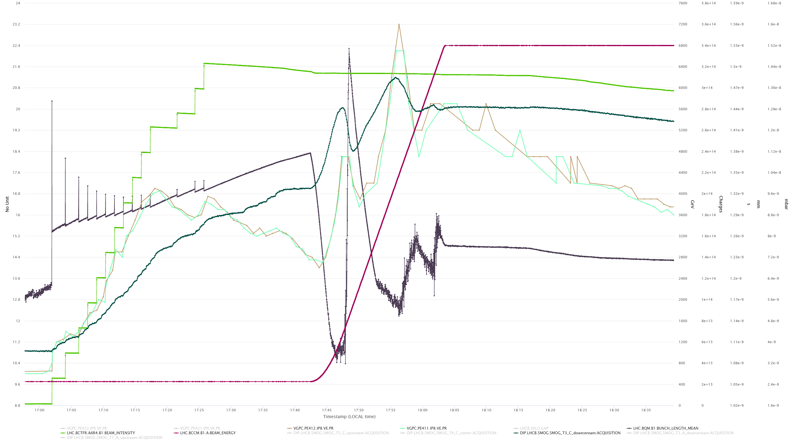
Temperature follows bunch length, but so does pressure

Slide 3
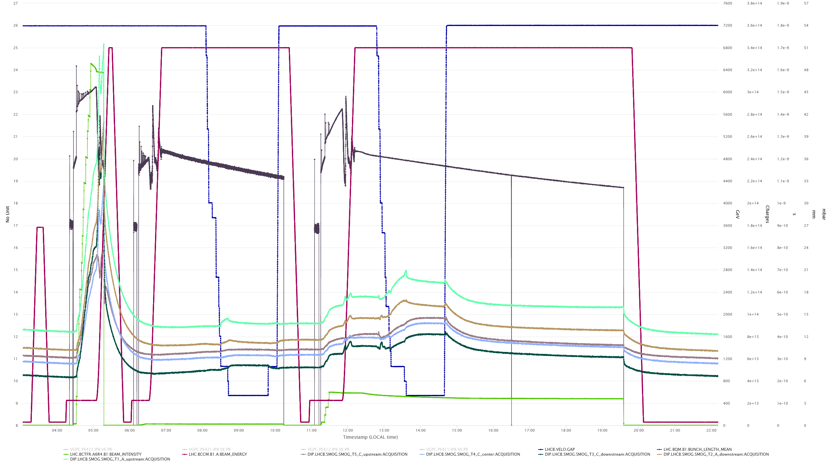
temperatures

Slide 4
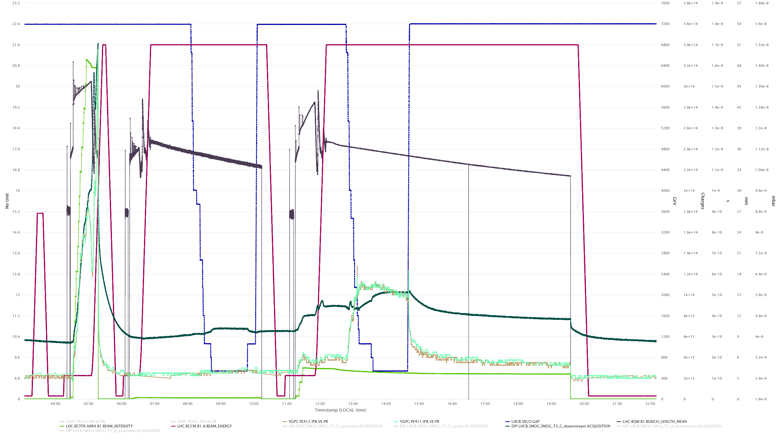
pressures

Slide 5
