Slide 1
LLRF Workshop 2022
Co-hosted by PSI and CERN
Brennan Goddard, SY Department Head, 14 October 2022

Slide 2
Past & present workshops
1st workshop in 2001 (Jlab), digital designs were starting to emerge
2nd in 2005 (CERN)
10th workshop in 2022 at CERN, there are still some analogue designs around.
In 2022: 123 participants

Slide 3


Slide 4
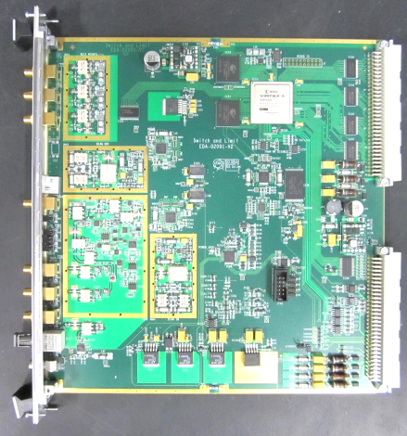

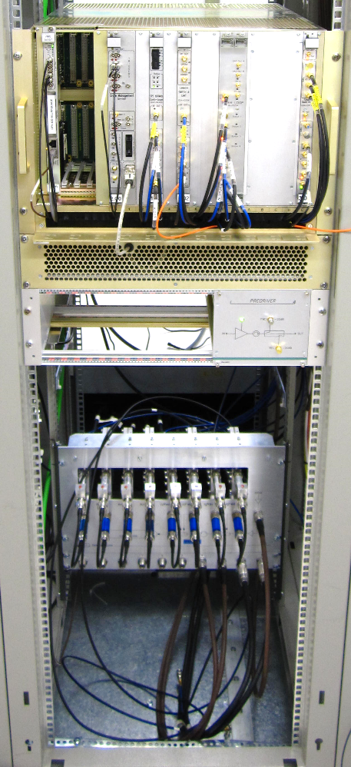
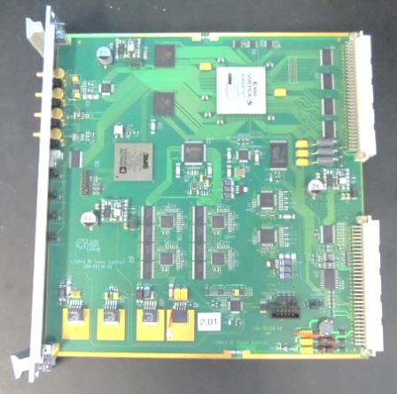
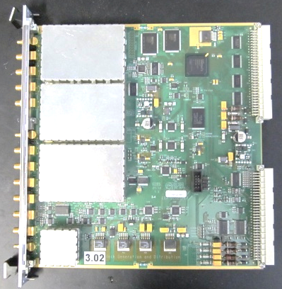
LINAC4 LLRF
Chopper
Debuncher
Buncher
Accelerating structures
Energy ramping cavity
custom designed VME boards

Slide 5
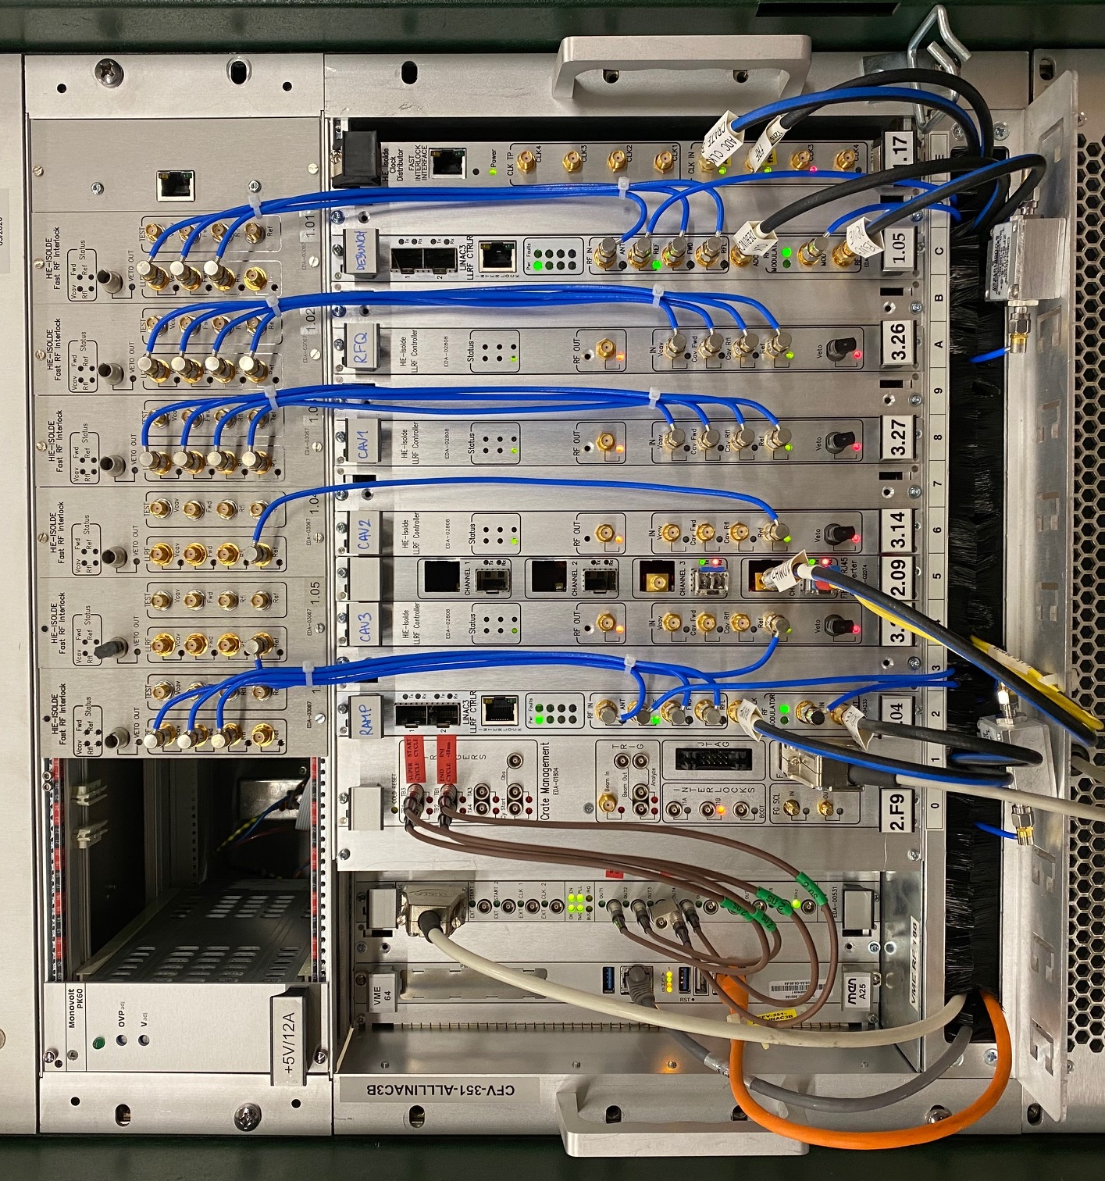
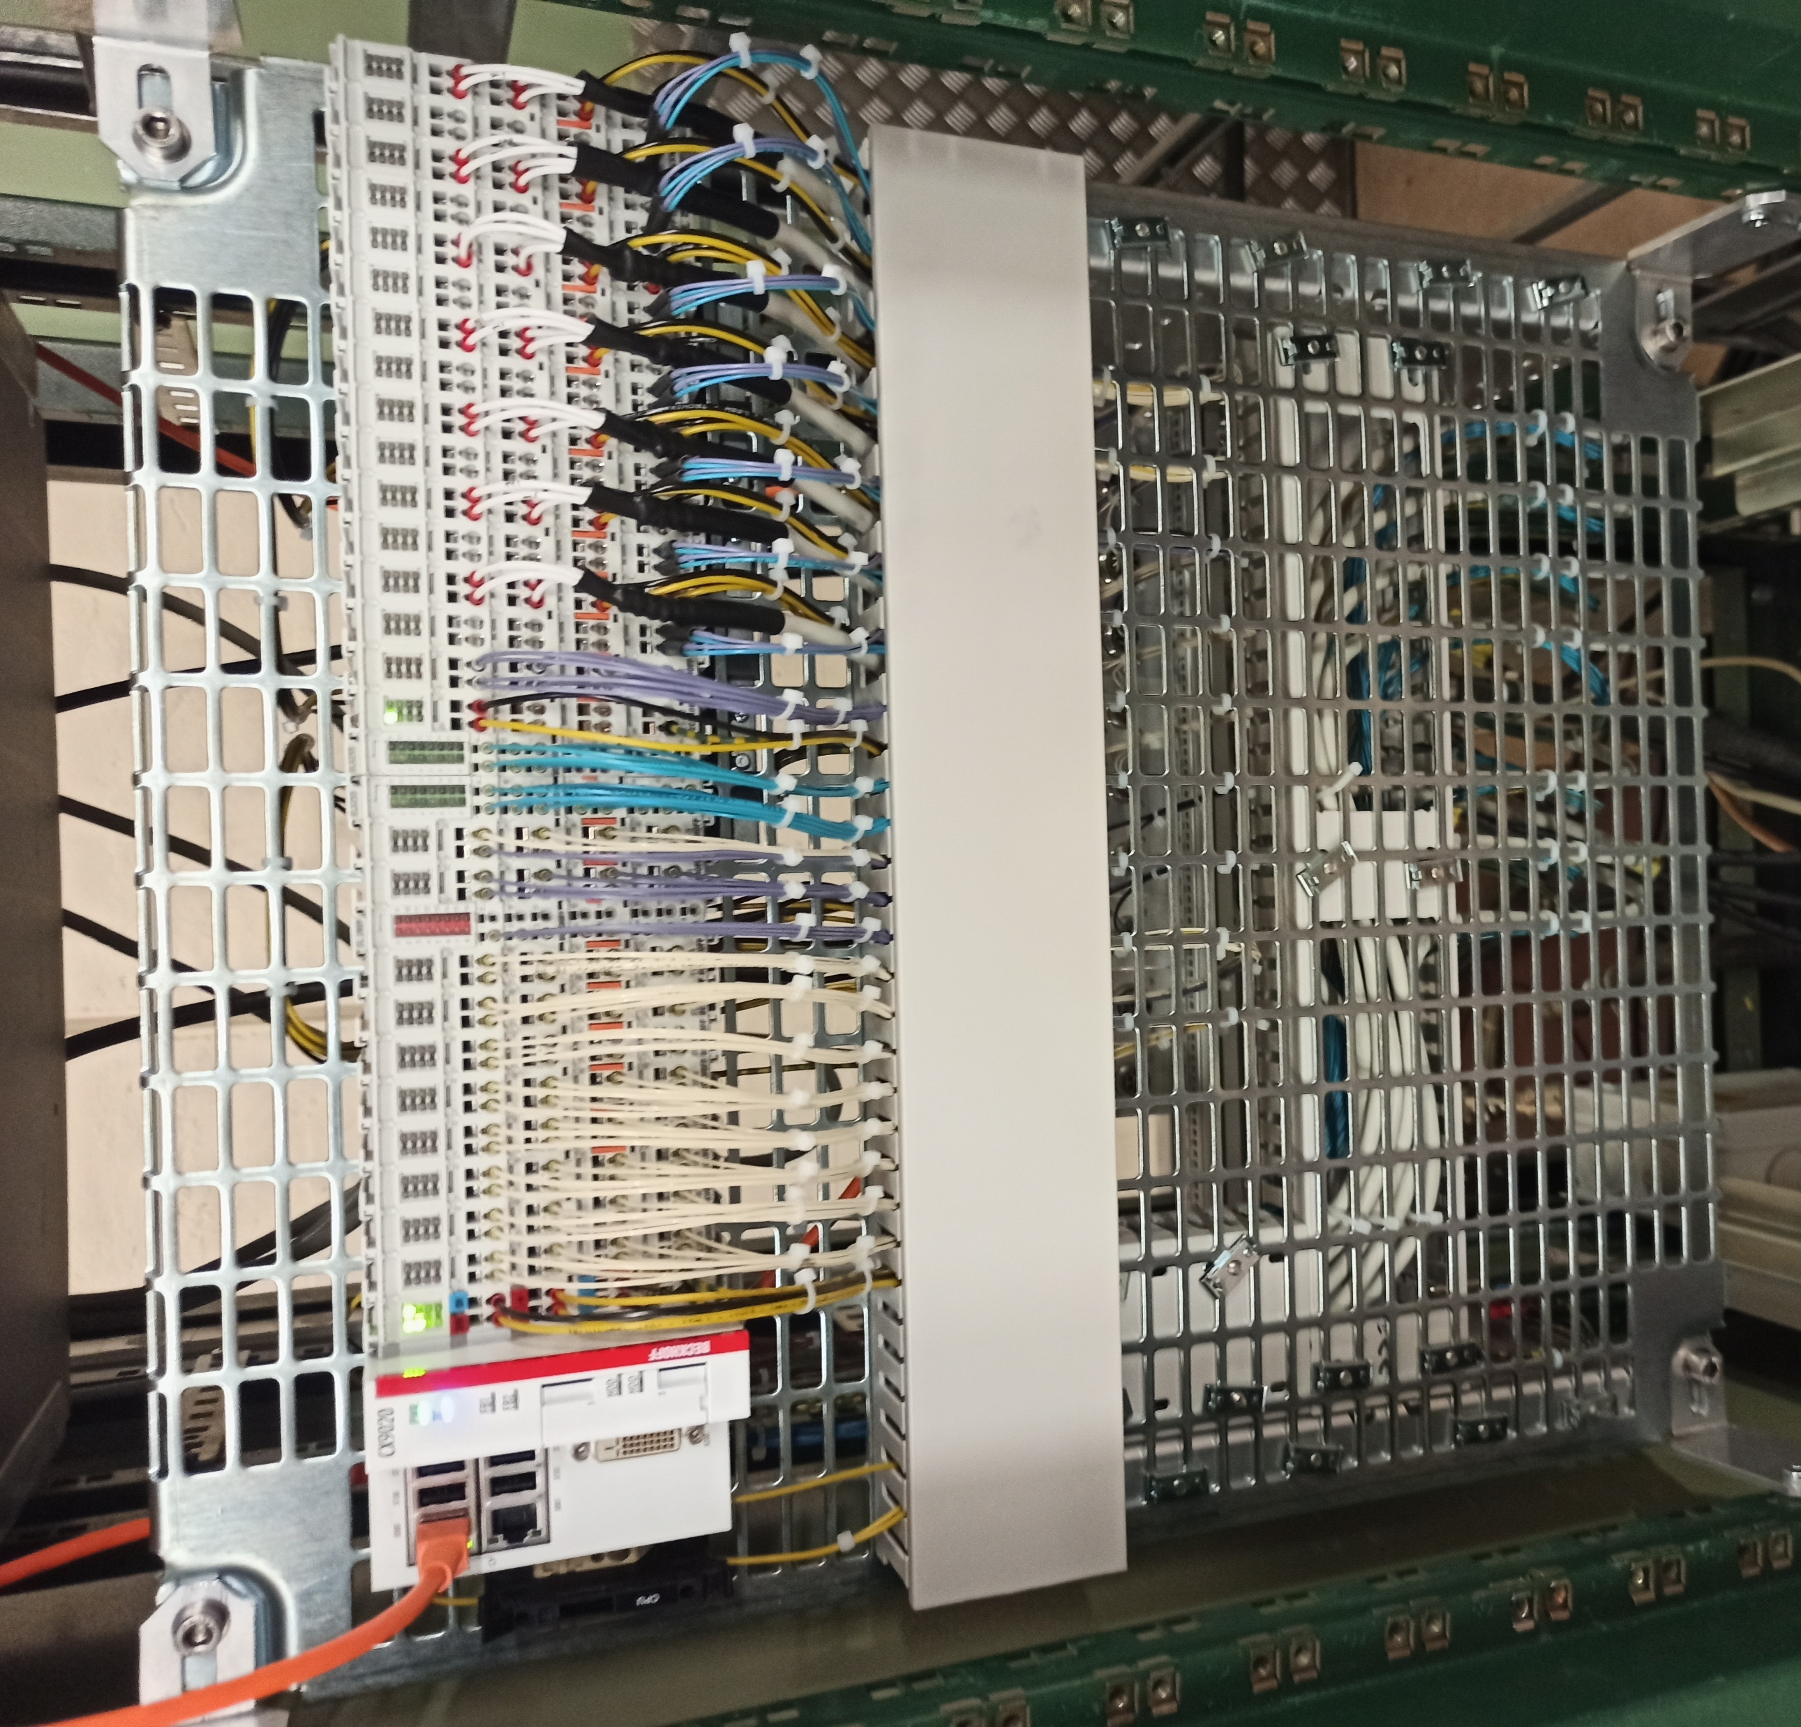
LINAC3 LLRF
Linac3 LLRF
New digital LLRF for consolidated systems.
LLRF for solid state new power amplifier is prepared (350 kW 100 MHz, replacing a tetrode based system)
LINAC3 Controls
PLC control of amplifiers and motors
Front-end software
New interlock system required for new solid state amplifiers.
Linac3 cavity PLC

Slide 6
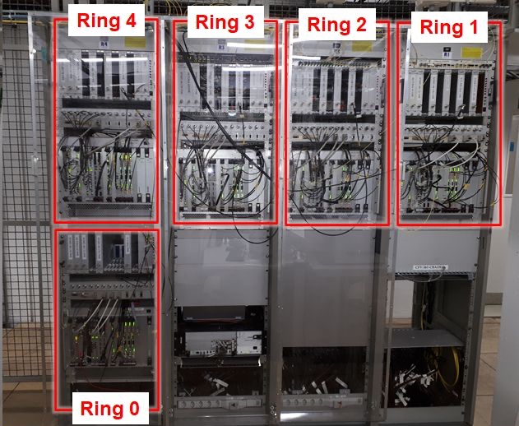
PSB LLRF
In the PSB, all cavities were replaced with wideband finemet cavities (up to 16 harmonics can be controlled)
PSB LLRF has been upgraded accordingly
Equipment in “PSB cage”
pick-up electronics in tunnel

Slide 7
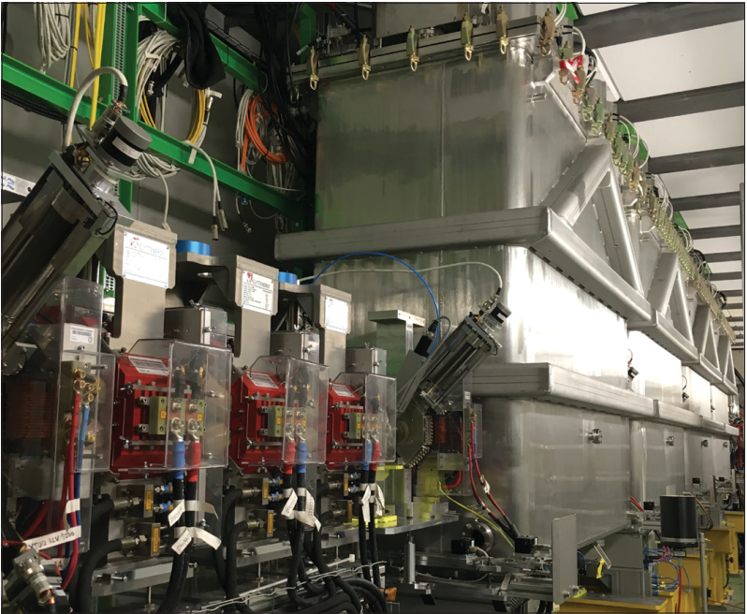
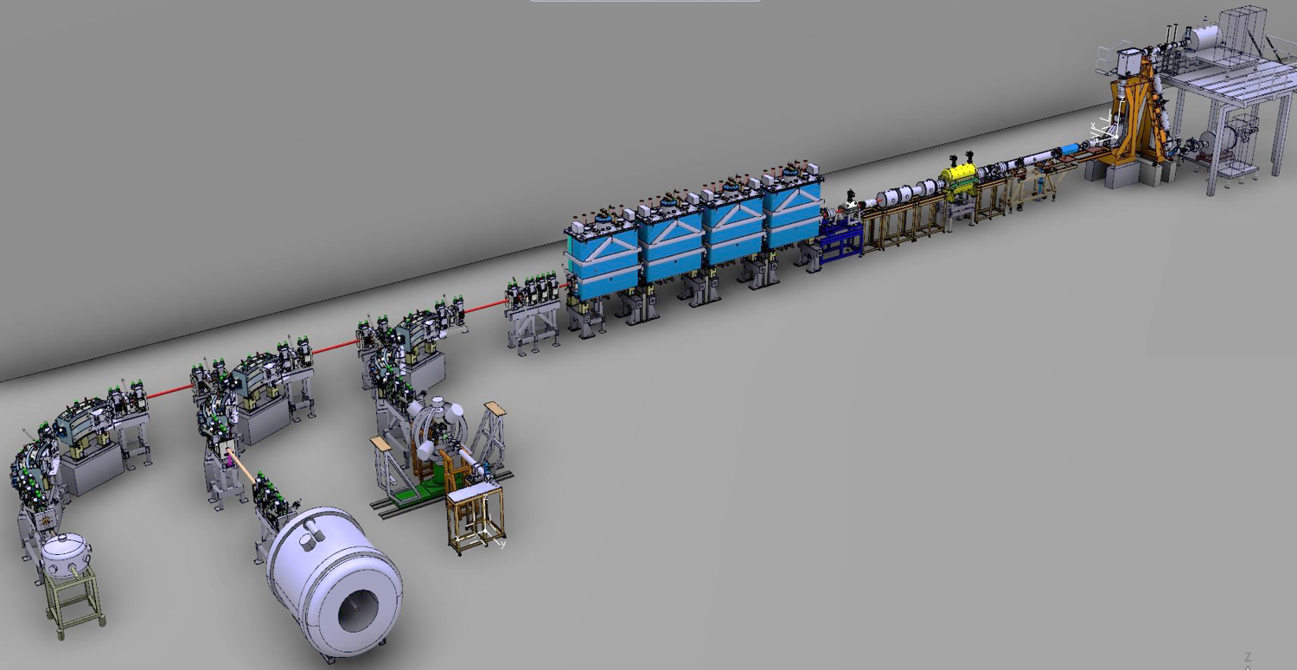


HIE ISOLDE superconducting linac
XT01
XT02
Miniball
XT03
Scattering chamber (SEC)
ISOLDE Solenoidal Spectrometer (ISS)

Slide 8
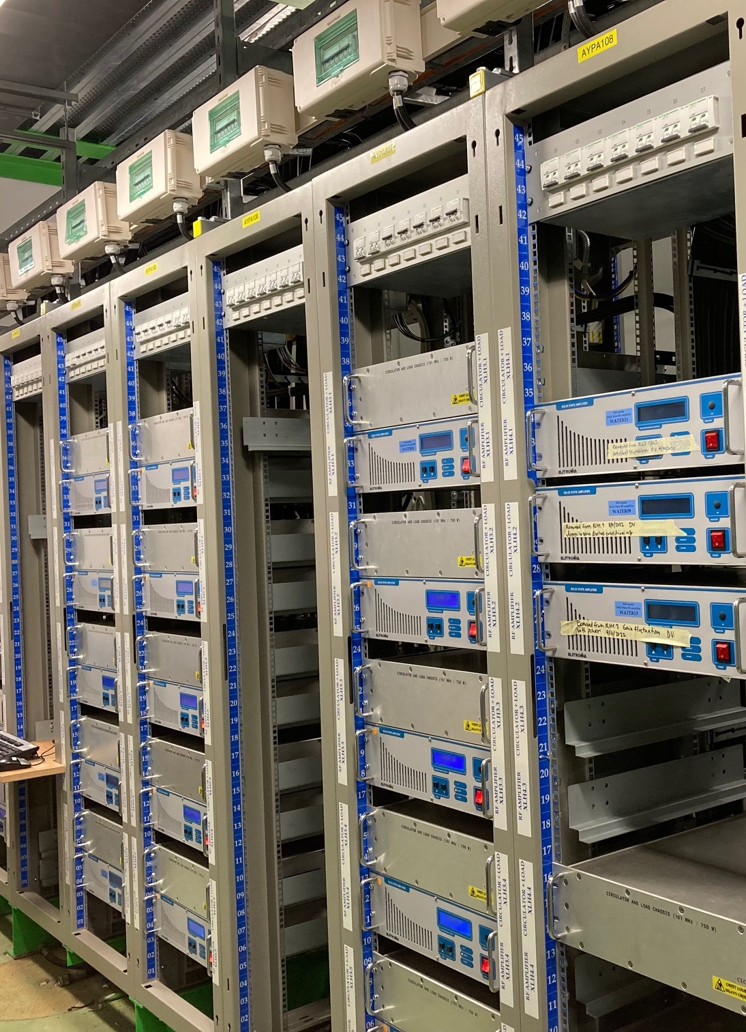
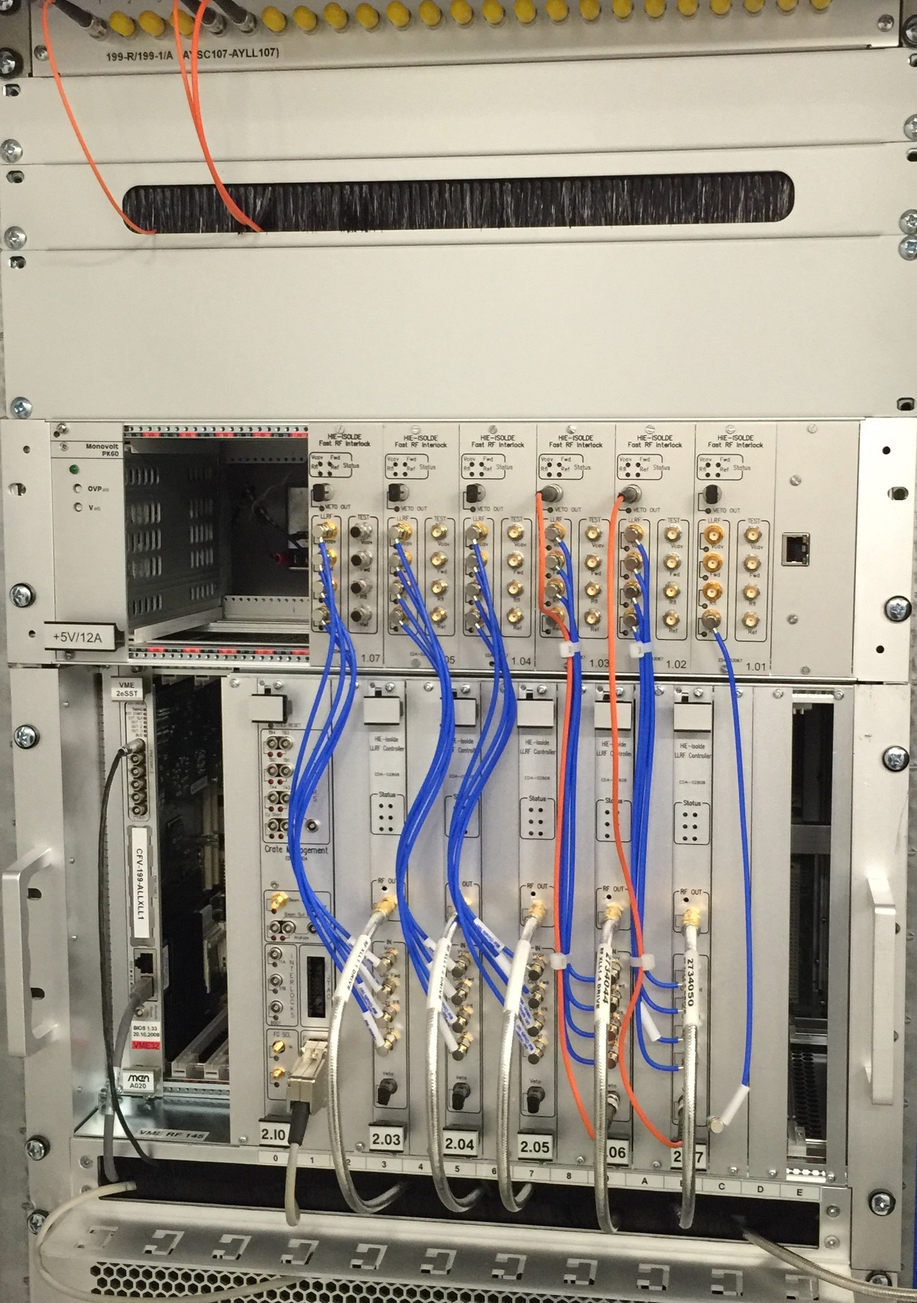
HIE Isolde RF power, LLRF & Controls
LLRF cards
Cavity controls and synchronization of superconducting LINAC
20 SC QWR at 4.5 K operating at 6 MV/m with a very small bandwidth (< 10 Hz).
reference frequency distribution
start-up of cavities in self-excited-loop mode (SEL) is a specialty
REXTRAP RF generation (VME)
RFQCB signal generation (VME)
Water cooled RF power amplifiers with RF cables bending towards linac

Slide 9
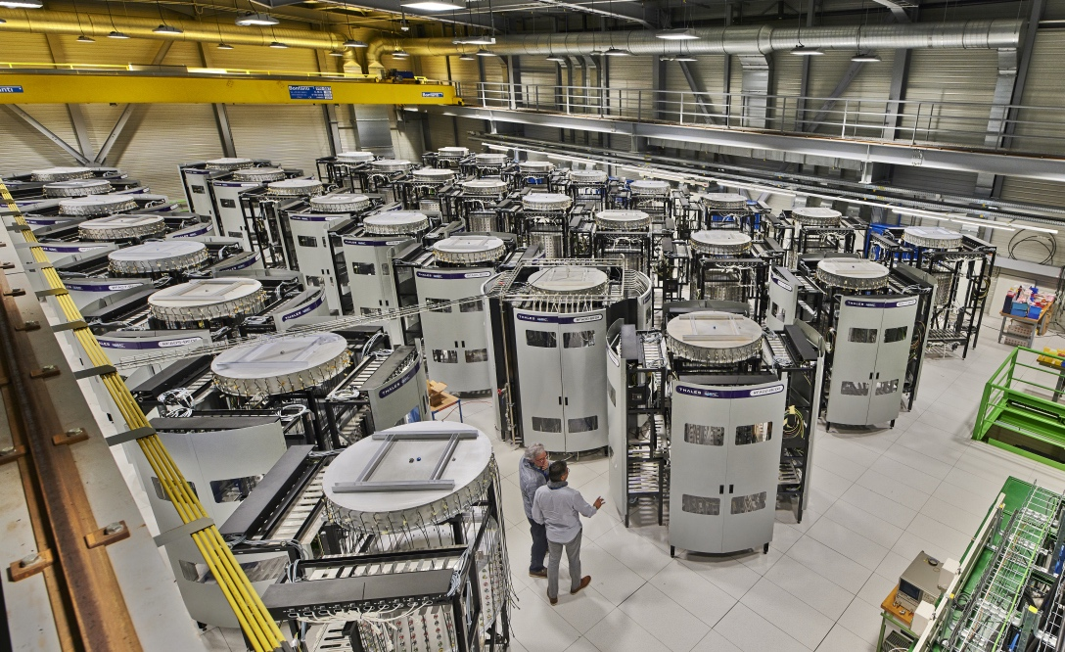
Thales 200 MHz
In operation since 2021
2 HPRF stations 750 kWcw, 1.6 MWp
2560 SSPA amplifiers 600 Wcw, 1.5 kWp
32 SSPA drivers 700 Wcw, 1.25 kWp
In total incl. spares:
3000 SSPA amplifiers
100 brazed transistors
1000 unbrazed transistors still to come.
33 towers (+ 2 which are foreseen as Siemens plant drivers)
Consolidation
Transistors declared ‘obsolete’ by NXP in 2022
Was ‘best to use’ transistor in 2017
Last buy order offered
600 kCHF (to last until 2041 with 4 broken transistors per week).
4 kCHF/unit x 1500 units = 6 MCHF

Slide 10
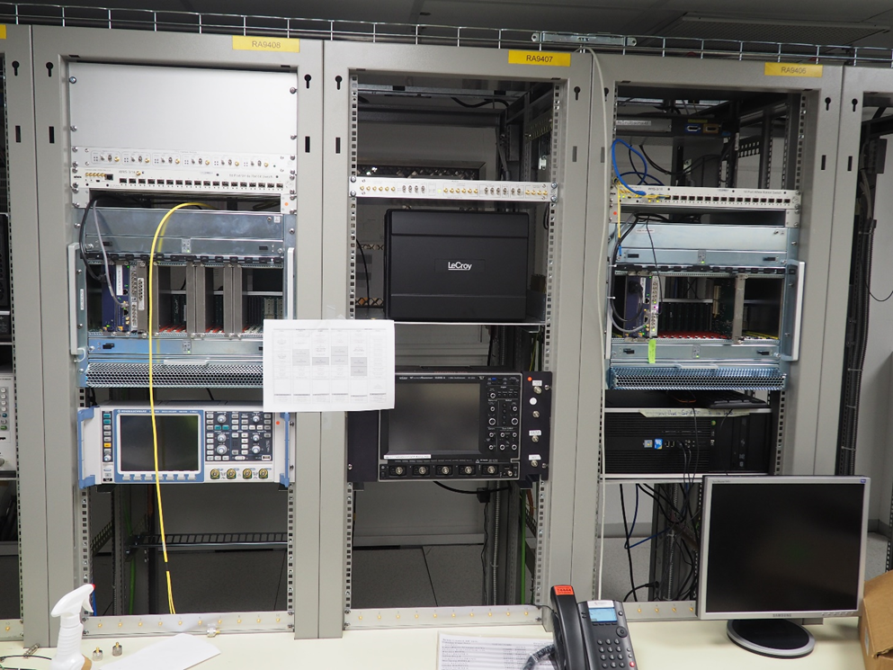
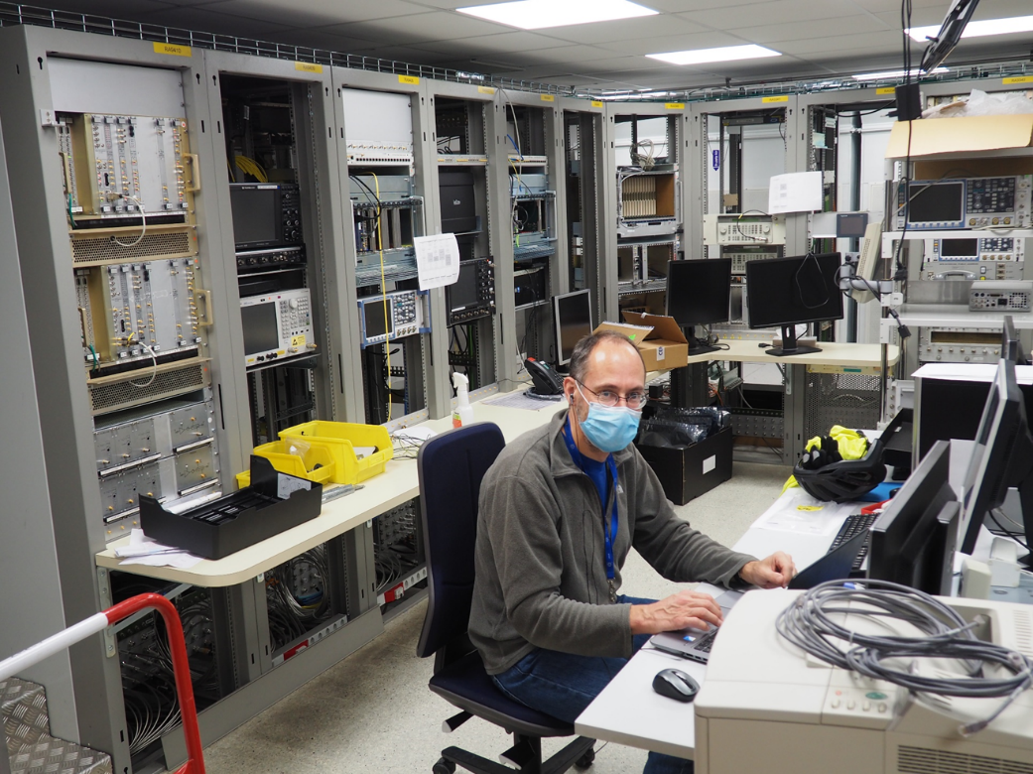
SPS LLRF
New uTCA based system using white rabbit frequency distribution,
Feedback for 200 MHz TWC (6x)
Feedback for 800 MHz TWC (2x)
Beam Control LLRF with Beam feedback loops with LLRF for acceleration
Longitudinal damper feedback loop
Blow-up generation
Synchronization to LHC, AWAKE and crab cavities

Slide 11
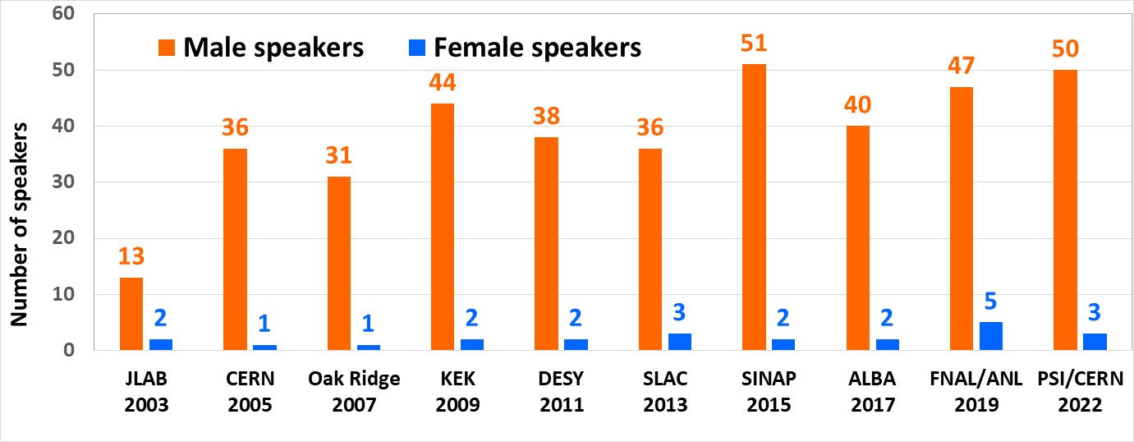



New@LLRF22 workshop: Diversity & Inclusion session
D&I in workplace strongly pushed @CERN, by EU & in most research institutes / universities
Should LLRF field try to increase its D&I?
Ex: consider gender distribution of speakers @LLRF workshops
Interactive session with CERN, PSI and FHNW (university hosting the workshop) representatives on Tuesday 11 October, 13:20 to 14:30.
Topics: D&I strategies@CERN, PSI, FHNW + discussion.
Aim: to raise awareness, to share info/strategies, to discuss new possibilities, to create networks.
Result: excellent attendance, participation & feedback from participants.
Output of initial polling on all participants
https://indico.psi.ch/event/12911/page/2476-diversity-and-inclusion-session
Notes:
11

Slide 12
Conclusion
CERNs LLRF systms are continually upgraded.
We can’t do all machines at the same time, which means that the electronics and the standards for each machine always have certain differences. Can we nevertheless try to have more standardization.
Move towards COTS components. Less in-house effort on hardware but more on firmware and software.
So far this has not resulted in less work but as the new digital systems offer much more flexibility -- which operations wants to use – it has in fact increased the work on software and operational implementation.
Enjoy the tour!

