Slide 1
the SPS Beam Quality Monitor
system specifications
  measure longitudinal beam parameters, beam pattern, correct synchronization to LHC references
  dump “bad” beam to LHC before SPS extraction
  large bandwidth and high sampling rate
    1.5-4 ns long bunches
software specifications
  specific analysis at specific times in the cycle
    inj, ramp, before extraction
    also detect instabilities
  perform last analysis very quickly
    dump/no dump in 15-20 ms
machine timing (CTIM)
CTRI
f_{RF,SPS}
VTU
f_{rev,SPS}
FESA
(cPCI)
CTRI
BA3 BIC
f_{RF,LHC,AWK}
VTU
f_{c}
beam
WCM
ADC

Slide 2
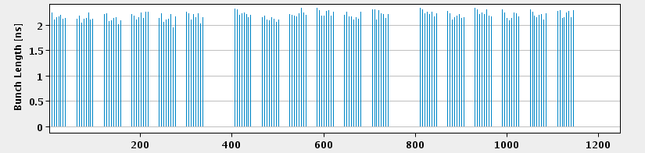
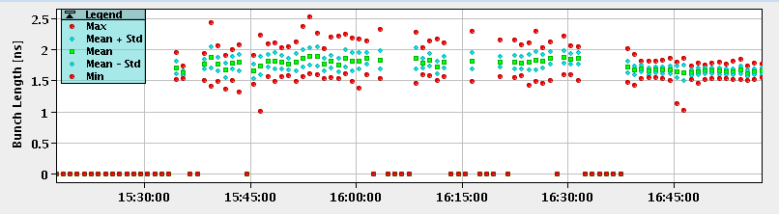
the SPS Beam Quality Monitor: OP display
functionality evolved into monitoring of longitudinal beam parameters for OP and RF
  bunch length, b-b-b intensity variations, filling schemes
  trend plots
  GUI with red/green status per parameter
  all settings in the LSA database, all results logged

Slide 3
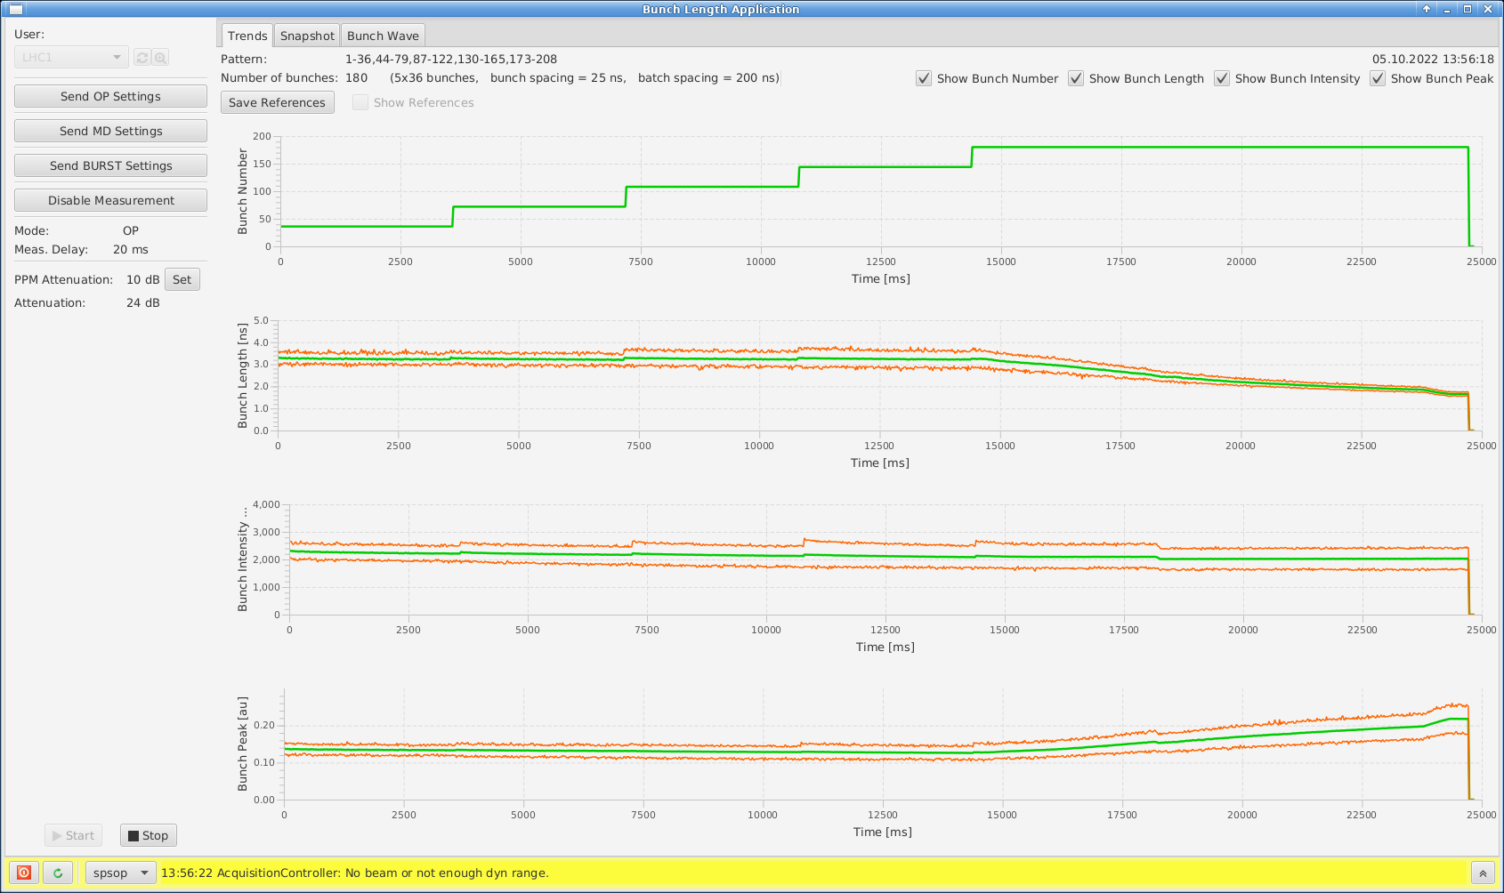
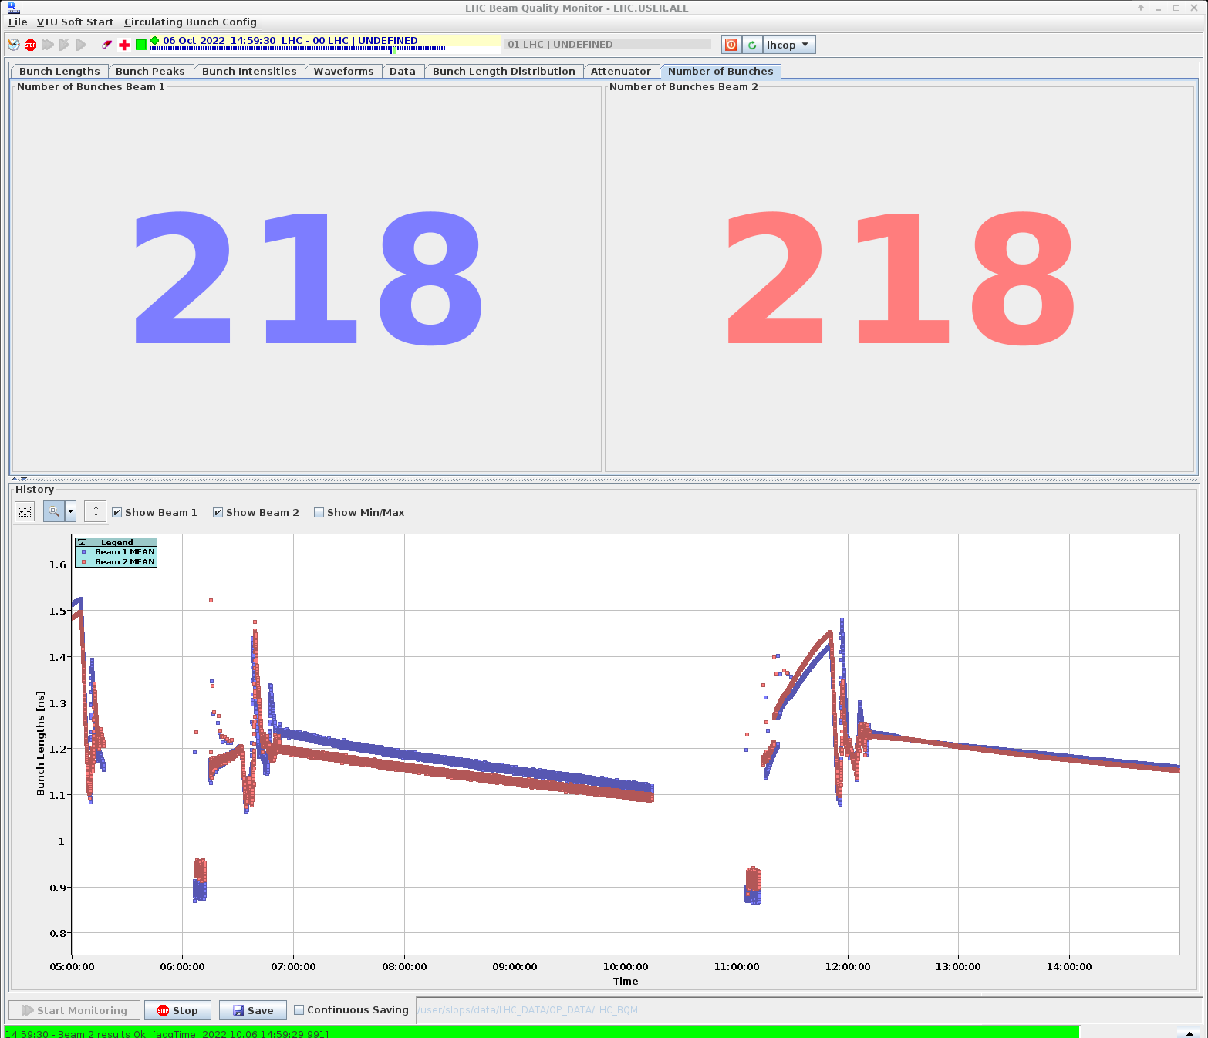
LHC Beam Quality Monitors
SPS Online Bunch Length Measurement
provides bunch length evolution
  also b-b-b peak, relative intensity per bucket, filling pattern
measures every 20 ms
online b-b-b bunch lengths
  used also for feedback on controlled long. emittance blow up
beam pattern per ring
  verified during injection process for automation of beam requests

