Slide 1
Assumptions on dipoles and quadrupoles magnetic and physical length
E. Felcini
18/10/2022

Slide 2
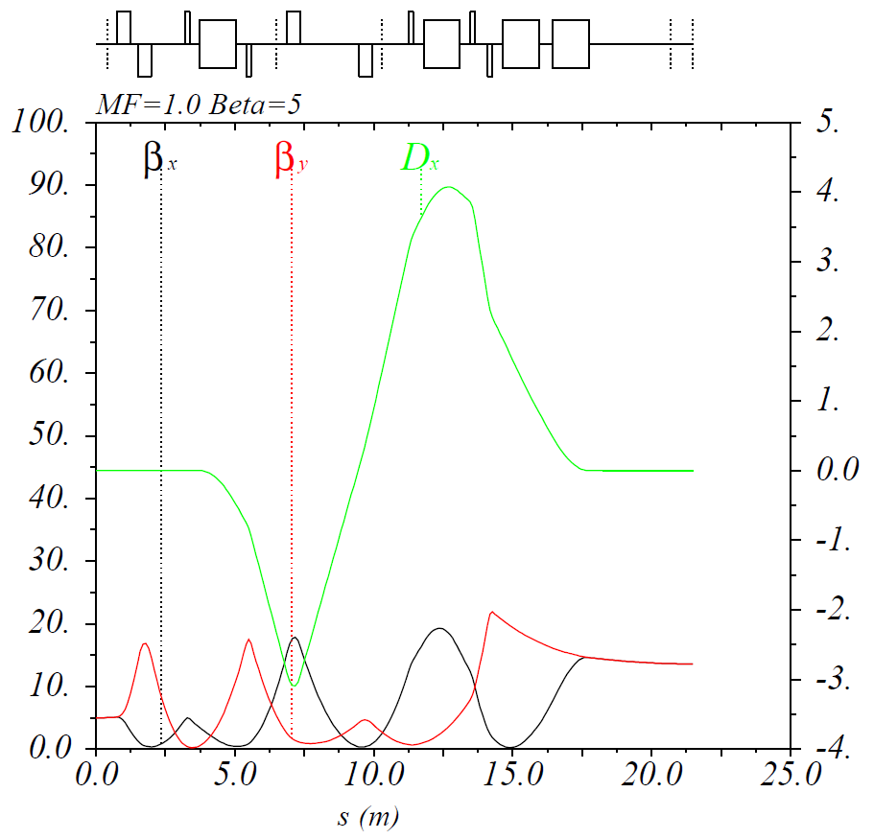
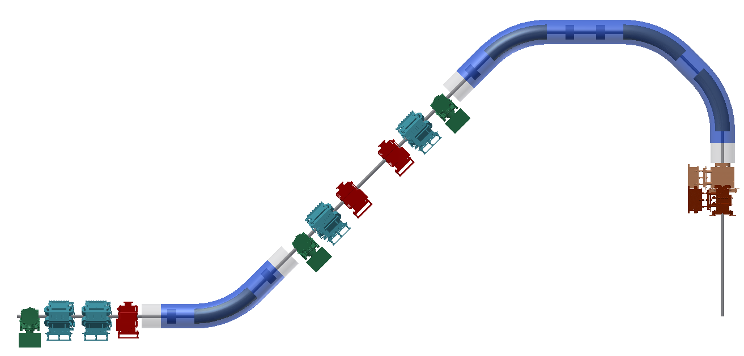
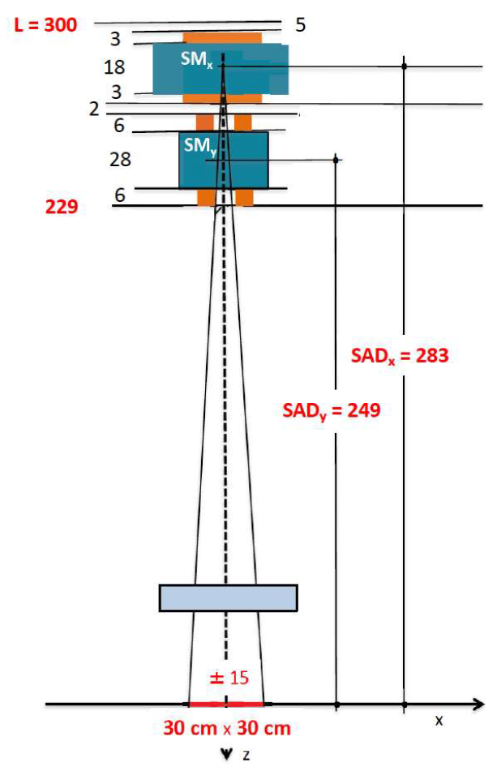
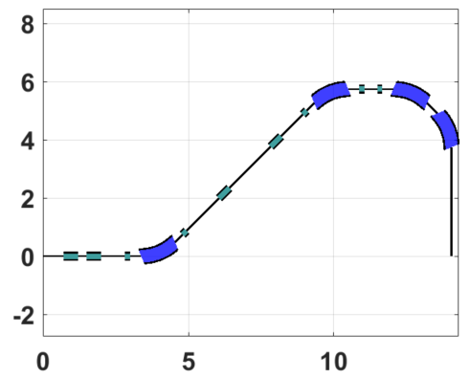
Preliminary elements integration
  cryostat
  corrector
  monitor
  cold-warm transition
5.75 m
  NC quadrupole
3.5 m
  Using existing CNAO elements, a preliminary (and rough) integration study was done
14.05 m

Slide 3
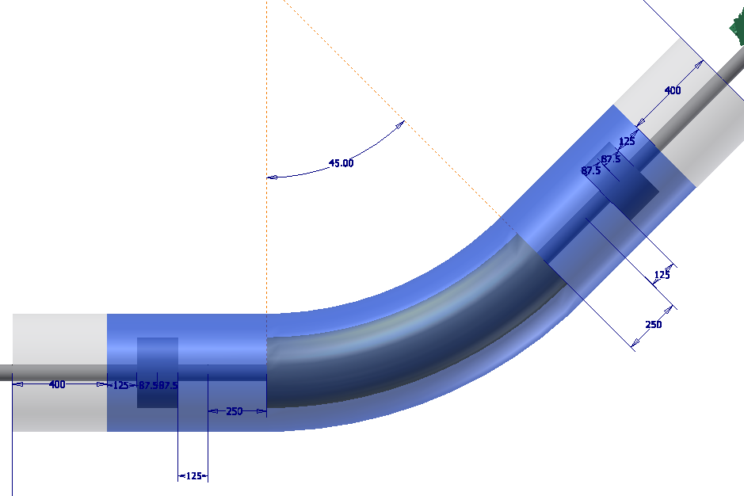
Preliminary elements integration
  SC spool-piece
  Quadrupole
  (magnetic length)
  SC spool-piece
  Quadrupole
  (magnetic length)
  cold-warm transition
  Dipole+Quadrupole heads
  Dipole+Quadrupole heads
  cold-warm transition
  SC Dipole
  (magnetic length)

Slide 4
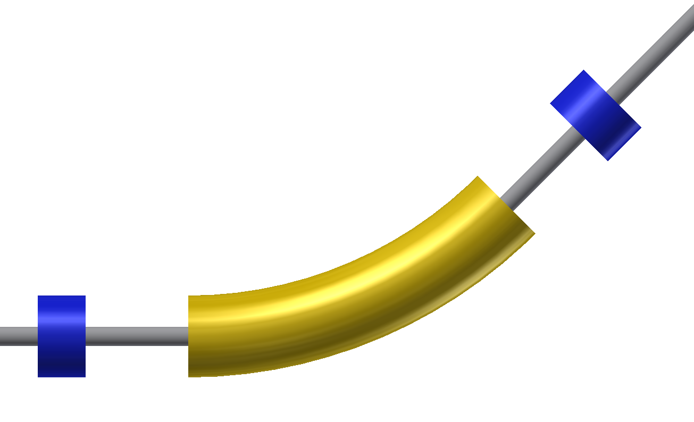
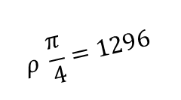
Assumptions for beam optics
magnetic length
125
175
$$ρ \frac{π}{4}=1296$$
125
magnetic length
250
425
physical length
magnetic length
125
175
125
250
1796
425
physical length
physical length

Slide 5
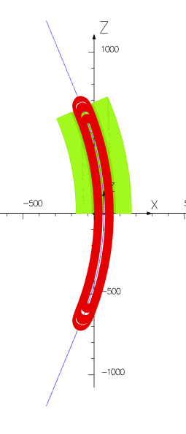
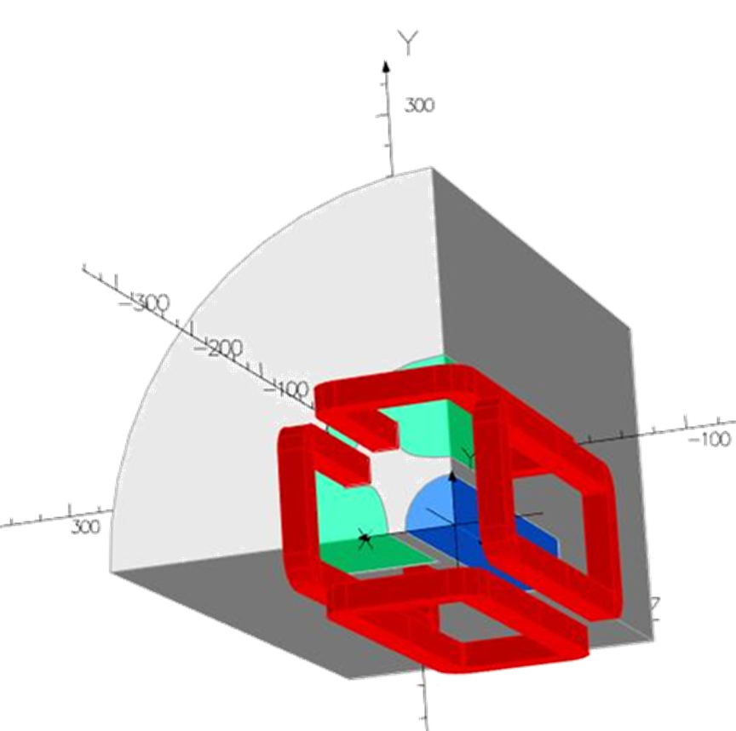
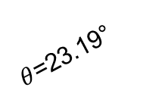
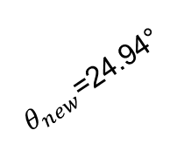
$$Courtesy of R. Valente (INFN−LASA)$$
$$Courtesy of M. Statera (INFN−LASA)$$
$θ_{new}$=24.94°
$θ$=23.19°
to my understanding…
Out of the physical length assumed for the dipole (1796 mm), the current design takes 1436 mm just for the coil (1336 mm for yoke)
360 mm (180 mm on each side) available for mechanical structure, end plates, leads, …
Does it sound reasonable?
Out of the physical length assumed for the quadrupole (425 mm), the current design takes 214 mm just for the coil (175 mm for yoke)
210 mm (105 mm on each side) available for mechanical structure, end plates, leads, …
Does it sound reasonable?

Slide 6
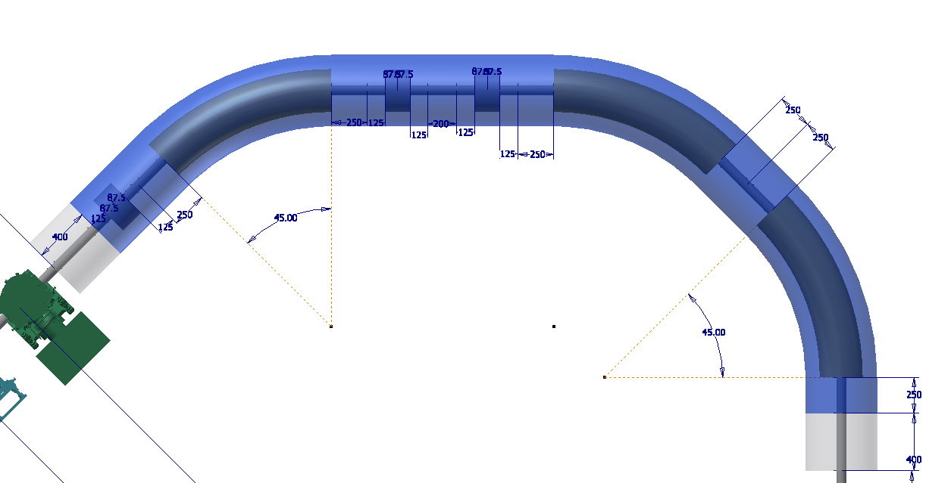
Preliminary elements integration

Slide 7
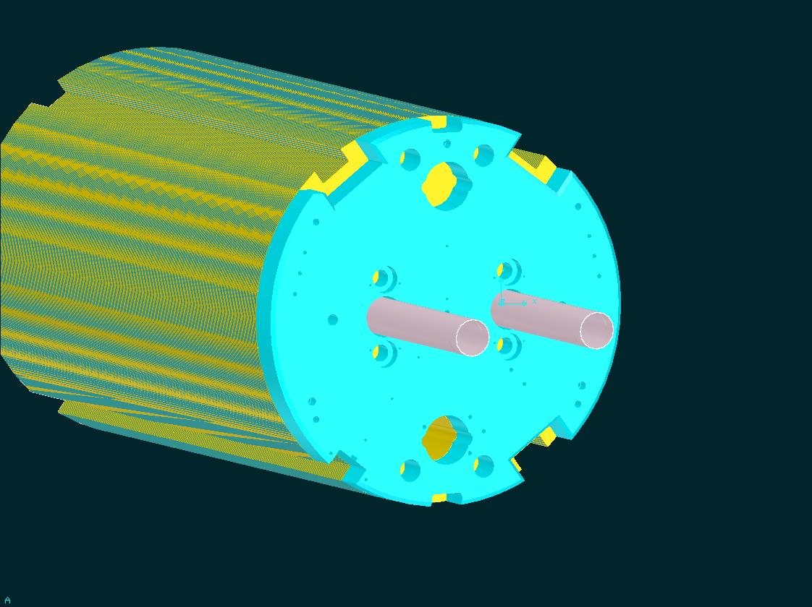
LHC MB -end part end plate

Slide 8
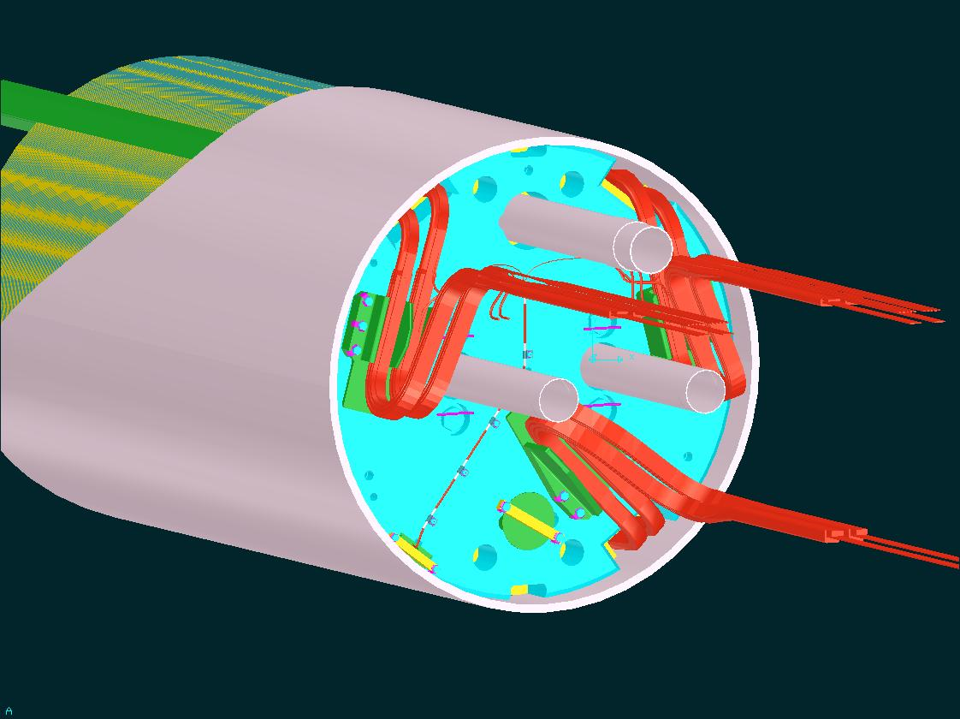
LHC Main Dipole -end part
Cu HXT

Slide 9
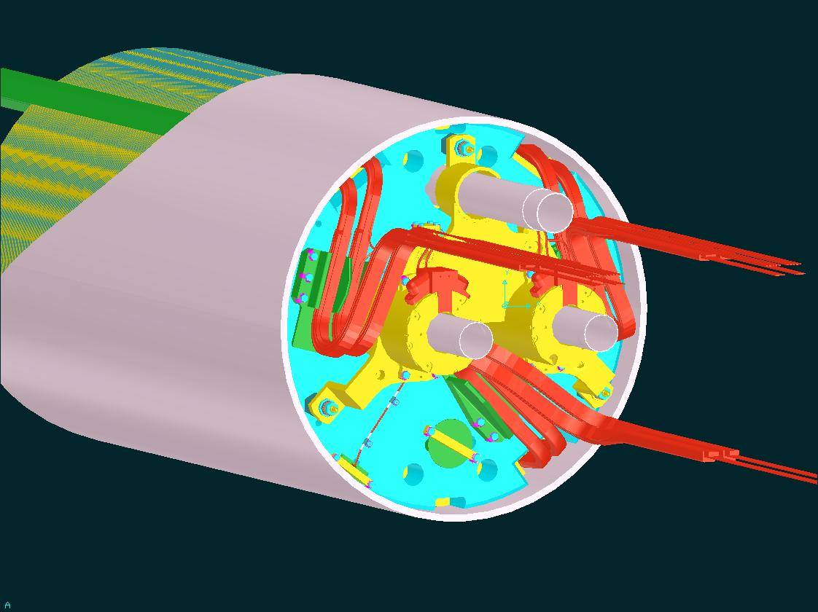
LHC Main Dipole -end part
Corrector Magnets (spool pieces)
Assembly in CMAs is purely mechanical
(tolerances of B axis wrt mech. frame given by supplier

Slide 10
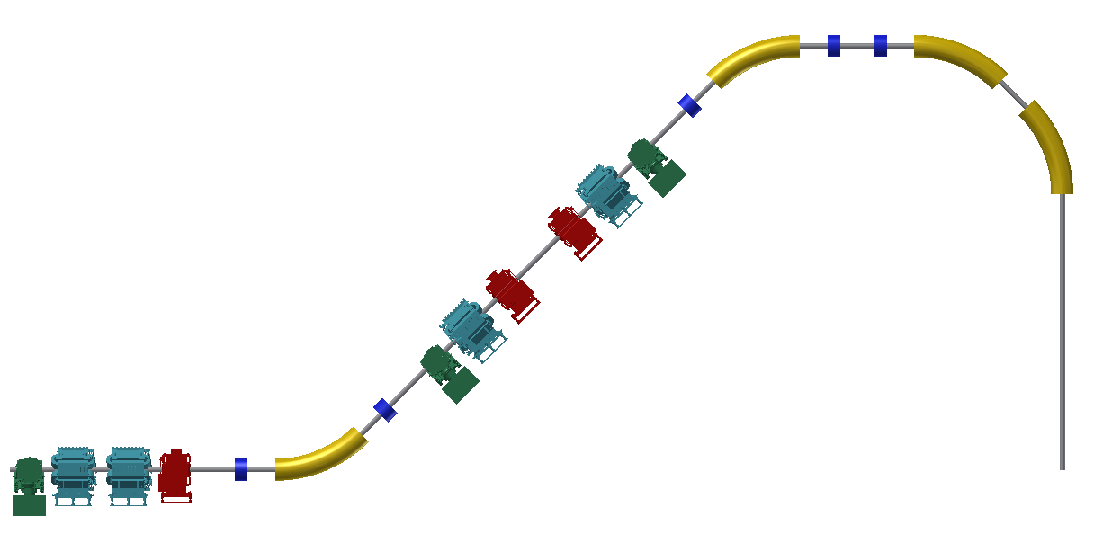
Preliminary elements integration
leads
leads(?)
But our spool piece quads may be as large in radius as the dipoles → it may be difficult to fit the current leads around the quads and extra space may be required
If requested we may also think to place the spool-piece asymmetrically (left-right) on the dipole to have more space for the current leads without increasing the gantry radius.
This would require a NEW optics optimization and the consequences need to be carefully analyzed in terms of magnet aperture and beam features at the isocenter
leads

