Slide 1


Pose (position and rotation) error (CW supports only) of SC magnets & integration strategies
CERN TE-MSC, EN-MME, RTU and UNIBS
Luca Piacentini
VPP-IZM-CERN-2020/1-0002

Slide 2
Outline
How is the pose error calculated
Benchmark of the error with FEA (solidworks)
Estimation of the error limits
Estimation of the mass of dipoles and quadrupoles (magnet + mechanical stiffeners)
Integration strategies for quads and dipoles
Differential cross section optimization strategies for supports (iso heat-load)
Results
Conclusion

Slide 3
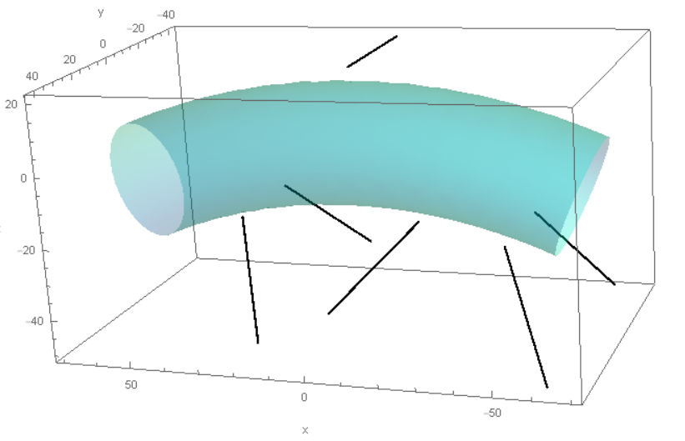
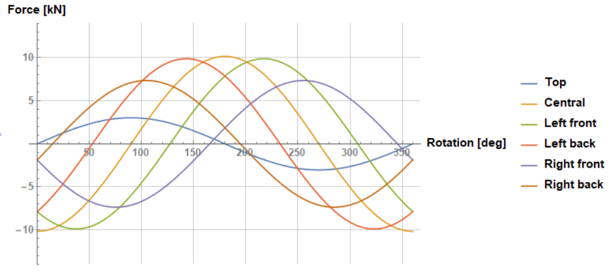
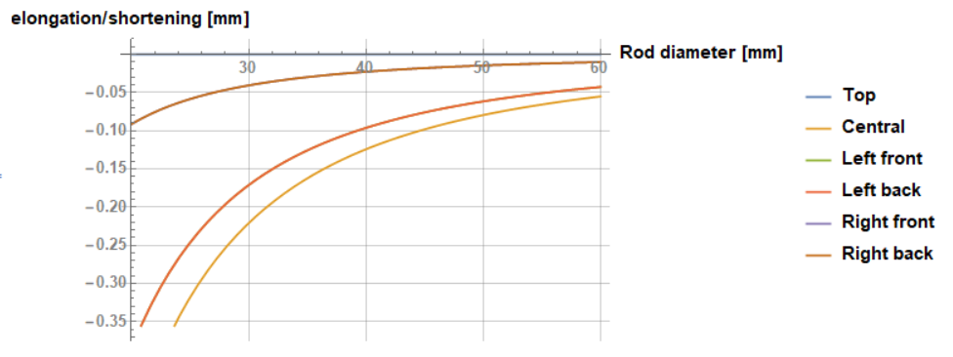
Method for pose error due to deformation of cold-warm supports
L1
g
1) Calculate forces
L4
L6
L2
L3
L5
$\overset{⃑}{F_{0°}}=\left\{0.,−10156.1,−7866.8,−7867.4,−1868.6,−1868.4\right\}$ N
2) Calculate elongation/shortening (G10 E = 26 GPa)
0) Data
L01 = 400mm
D = 30mm (just for benchmarking)
3) Calculate new supports length
$\overset{⃑}{L}=\left\{400; 399.7; 399.83; 399.83; 399.9; 399.9\right\}$ mm

Slide 4
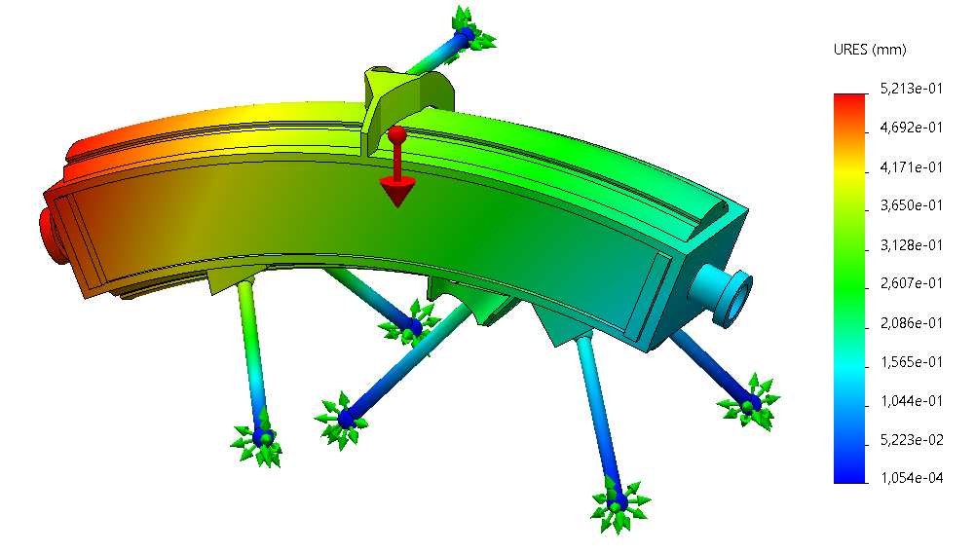

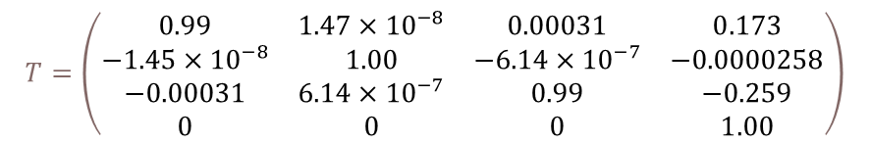
Method for pose error due to deformation of cold-warm supports
L1
5) Apply DPK algorithm
Pose:
Position
Rotations
$$T=\left(\begin{matrix} & & & p_{x} \\ & R_{z}R_{y}R_{x} & & p_{y} \\ & & & p_{z} \\ 0 & 0 & 0 & 1\end{matrix}\right)$$
g
L4
L6
$$T=\left(\begin{matrix}0.99 & 1.47×{10}^{−8} & 0.00031 & 0.173 \\ −1.45×{10}^{−8} & 1.00 & −6.14×{10}^{−7} & −0.0000258 \\ −0.00031 & 6.14×{10}^{−7} & 0.99 & −0.259 \\ 0 & 0 & 0 & 1.00\end{matrix}\right)$$
L3
L2
L5
4) Update model with the new supports length maintaining:
Fixed points
3) Calculate new supports length
6) Benchmark against FEA
$\overset{⃑}{L}=\left\{400; 399.7; 399.83; 399.83; 399.9; 399.9\right\}$ mm

Slide 5
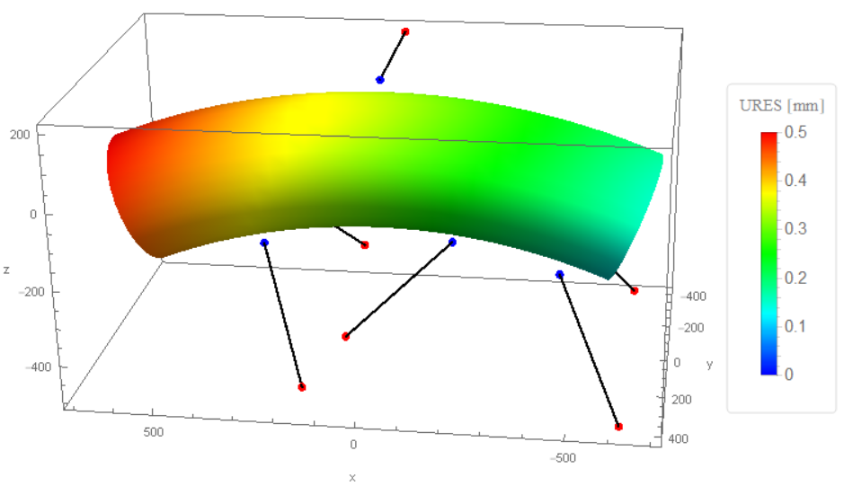

SolidWorks Benchmarking
Reaction force comparison
Cold joints displacements comparison
Visual displacement comparison
$$T=\left(\begin{matrix} & & & p_{x} \\ & R_{z}R_{y}R_{x} & & p_{y} \\ & & & p_{z} \\ 0 & 0 & 0 & 1\end{matrix}\right)$$
Computation time: order of minutes + data analysis time
Computation time: a couple of seconds & direct data analysis

Slide 6
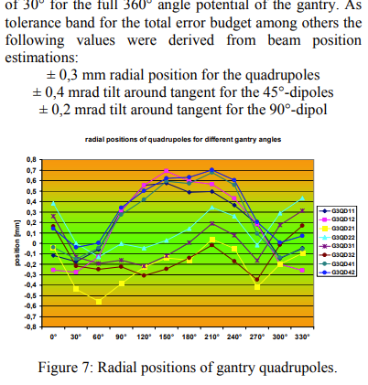




Error limits estimation
y
y
x
s
x
R
ux
Heidelberg dipole data:
90°
Estimated R = 3,7 – 4,3 m (backup)
Rotation tolerance 0,2 mrad [1]
ux = ± 0,5 – 0,6 mm
HITRI dipole data:
45°
R = 1,65 m
Given ux = ± 0,5 – 0,6 mm
Calculated rotation tolerance =
± 0,8 – 0,95 mrad
Translation tolerance = ± 0,5 – 0,6
for quadrupoles
Fuchs, R., U. Weinrich, and E. Sust. "Assembly of the carbon beam gantry at the Heidelberg Ion Therapy (HIT) accelerator." Proceedings of the EPAC-2008, Genoa, Italy (2008): 23-27.

Slide 7
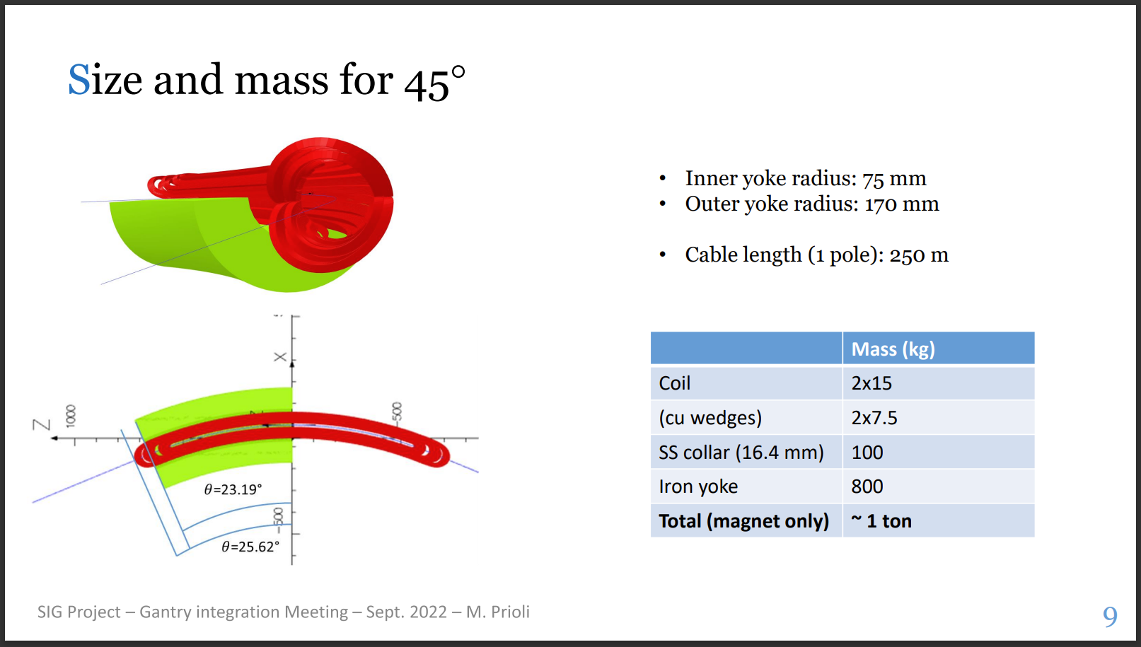
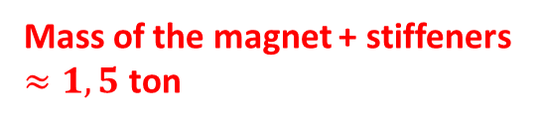
Dipoles mass estimation
Mass of the magnet + stiffeners $≈1,5$ ton

Slide 8
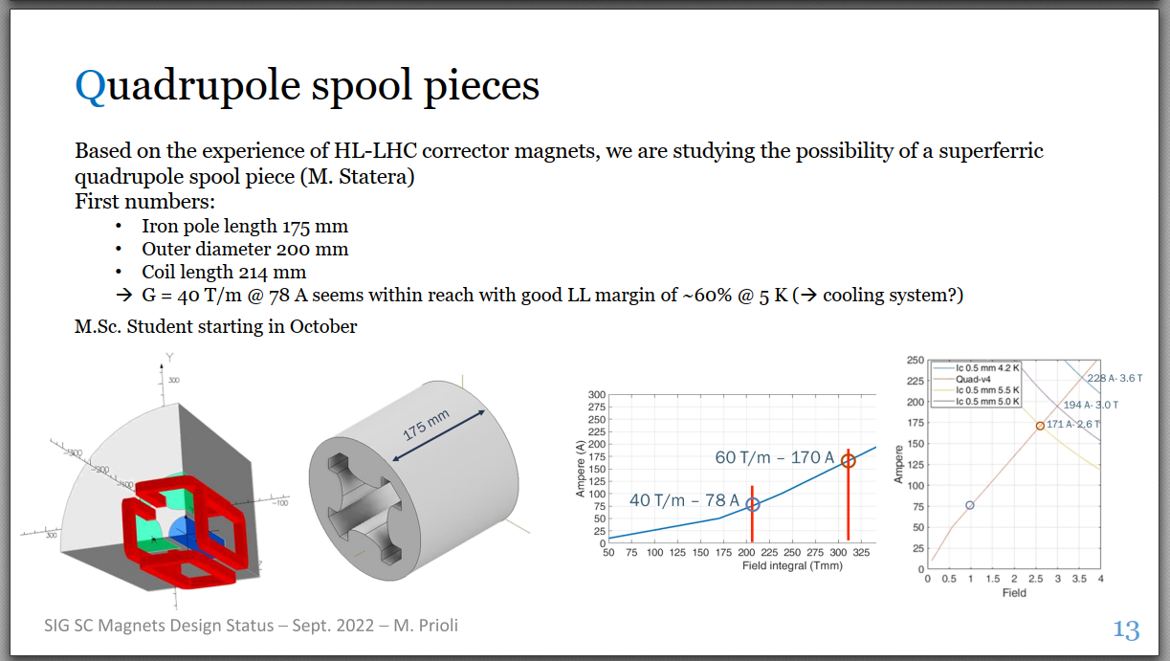
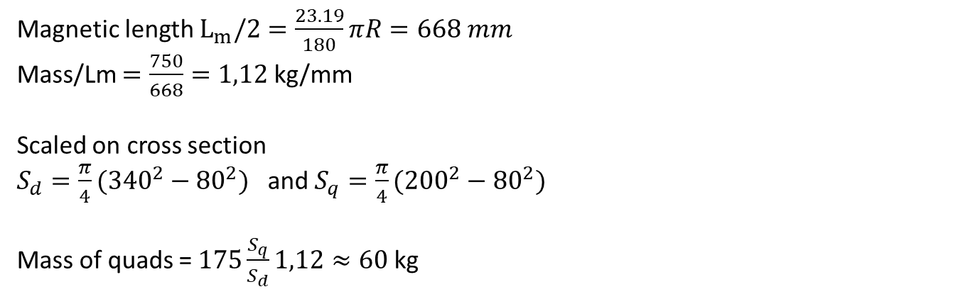
Quadrupole mass estimation
Magnetic length $L_{m}/2=\frac{23.19}{180}πR=668 mm$
Mass/Lm $=\frac{750}{668}=1,12$ kg/mm
Scaled on cross section
$S_{d}=\frac{π}{4}({340}^{2}−{80}^{2})$ and $S_{q}=\frac{π}{4}({200}^{2}−{80}^{2})$
Mass of quads = $175\frac{S_{q}}{S_{d}}1,12≈60$ kg
100 kg

Slide 9

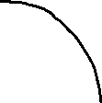



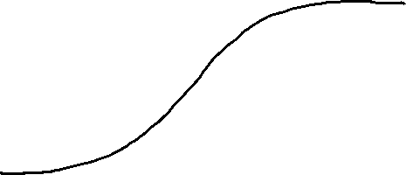




Integration strategies: quadrupoles fixed to dipoles
# | N of quads | Tot mass [kg]
Group 1 | 2 | 1700
Group 2 | 2 | 1700
Group 3 | 1 | 1600
Since the mass and centre of gravity is different, the misalignment of the dipole is different
Furthermore, the rotation & displacement can be propagated to the quadrupoles attached to the dipole

Slide 10
Integration strategies: quadrupoles fixed to dipoles (diameter = c )
Different force amplitude
Same diameter for all the legs
Deformations not homogeneous
Cross section of a single leg

Slide 11
Integration strategies: quadrupoles fixed to dipoles (local tot section)
Heat load is proportional to cross-section
Heat load is kept constant
6 x = local total cross section
Cross section for all 6 legs of a dipole
Cross section of a single support

Slide 12
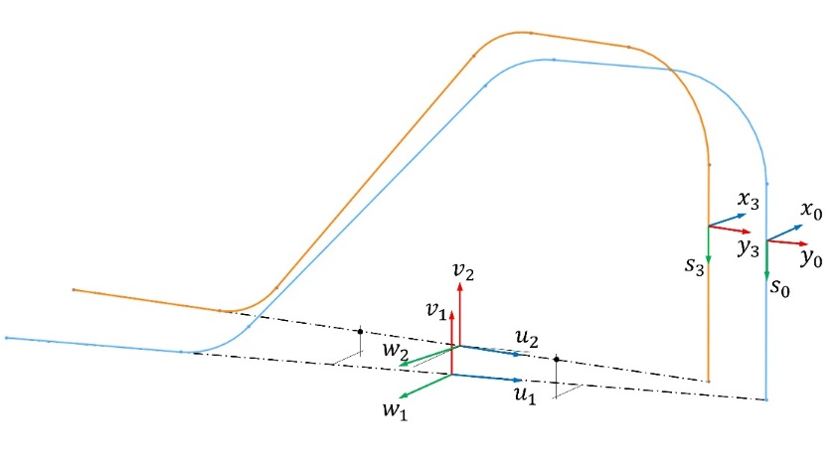
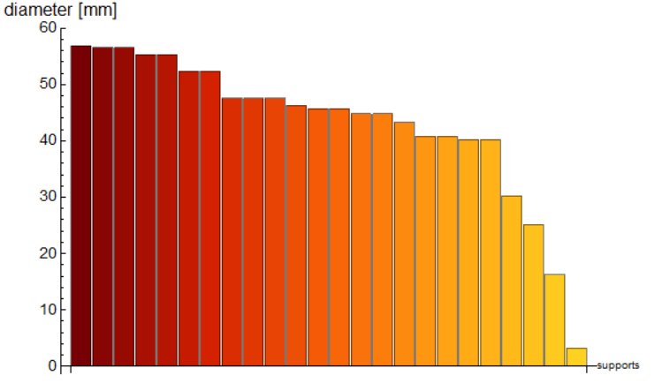
Integration strategies: quadrupoles fixed to dipoles (global tot section)
Heat load is kept constant
4 x 6 x = global total cross section
Average = 45 mm
Too small diameter (3 mm)

Slide 13
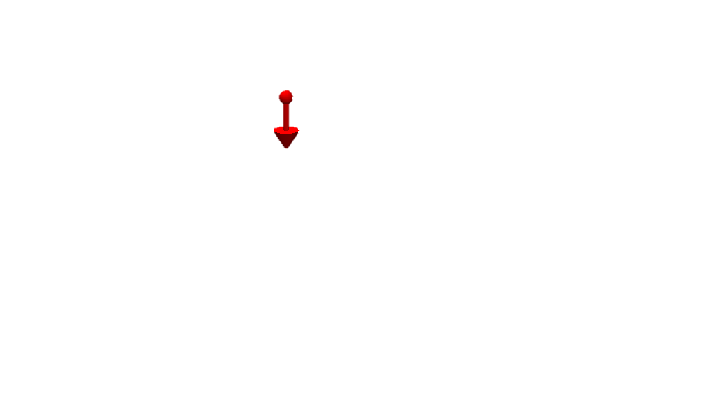
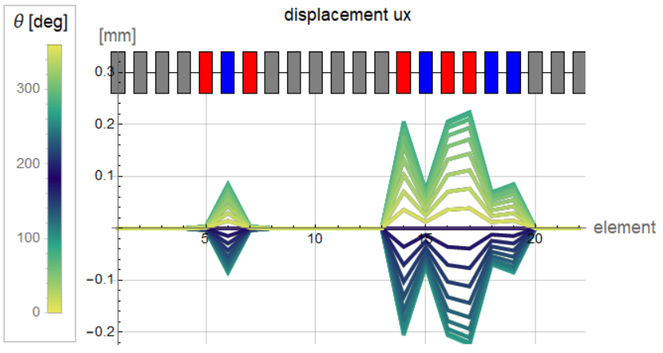
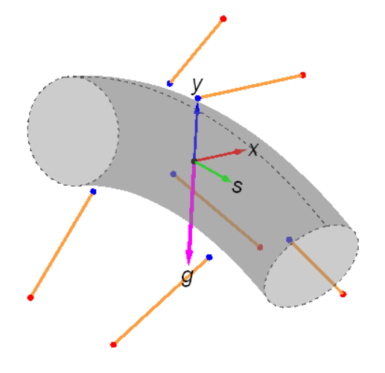

Integration strategies: quadrupoles fixed to dipoles: read results
$$θ$$
Gantry position

Slide 14
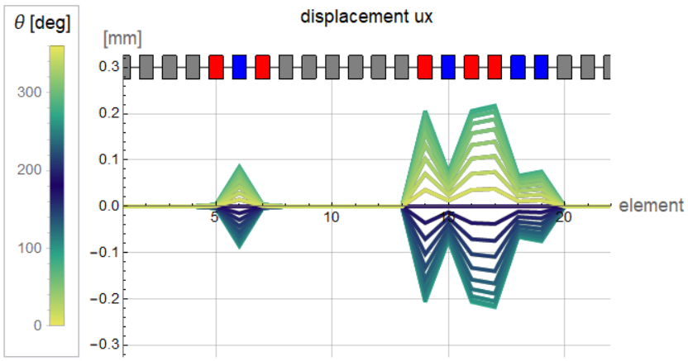
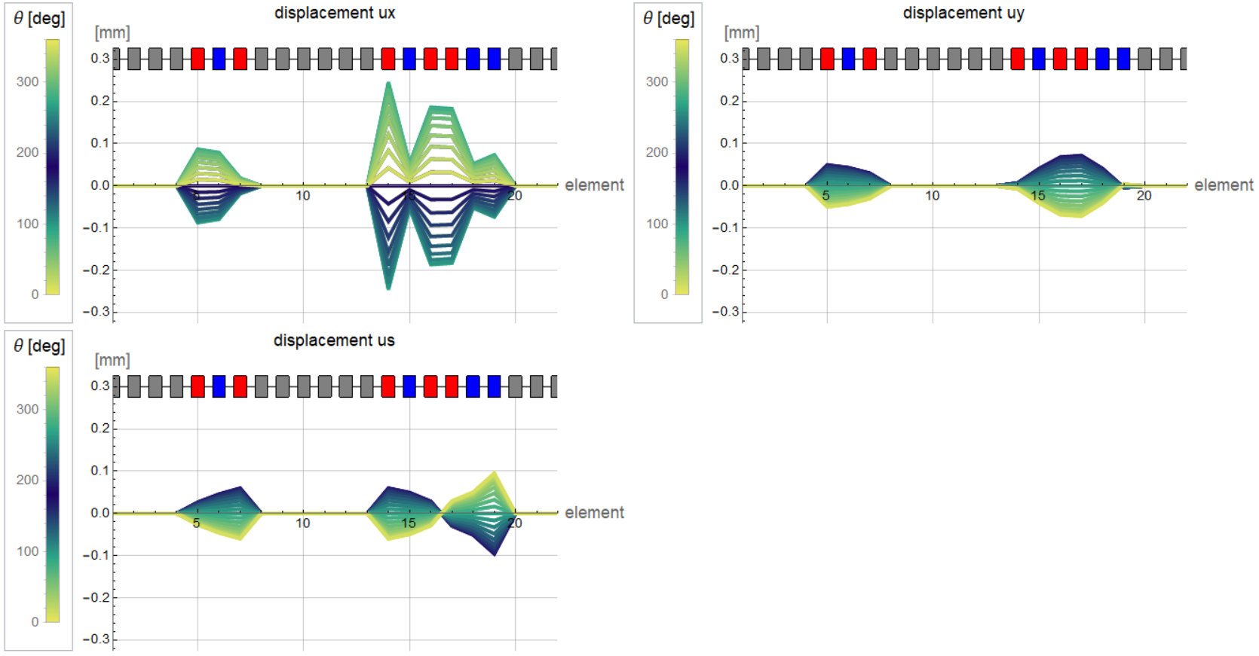
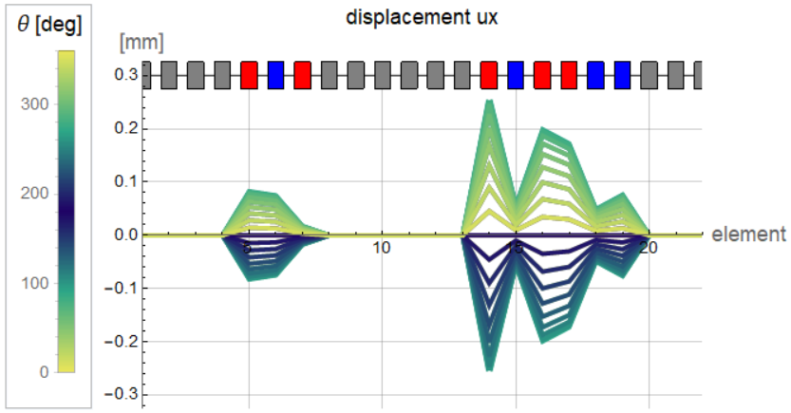
Results quadrupoles fixed to dipoles
Displacements non shared cross-section
Displacements global shared cross-section
“uy” and “us” are smaller than “ux” and are also very similar in the three approaches
Limits for quadrupoles | CW support contribution
± 0.5 - 0.6 mm | ± 0.2 – 0.25 mm (33 % - 50 %)
Displacements locally shared cross-section

Slide 15
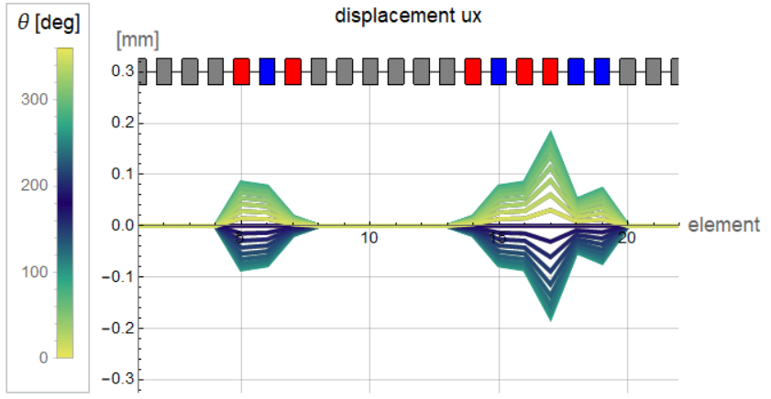
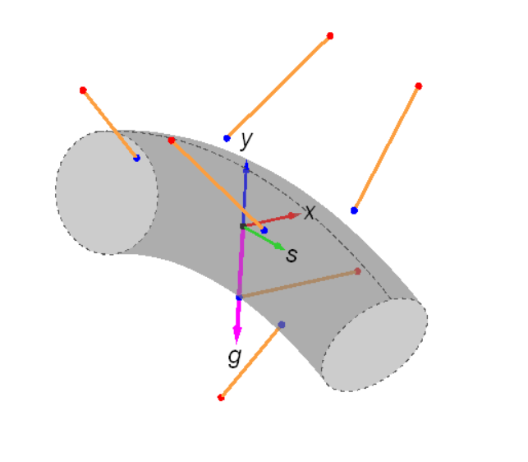

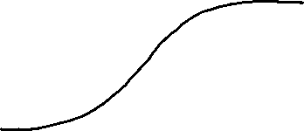



Results quadrupoles fixed to dipoles
The leg configuration between group 1 and group 2 is the reason for the huge difference in rotations for these 2 groups:
The actual leg position is not optimized!
Displacements global shared cross-section
Displacements global shared cross-section
&
Inverted supports
Inverted supports

Slide 16
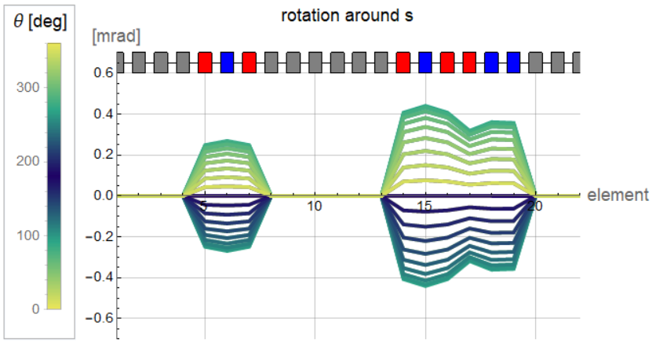
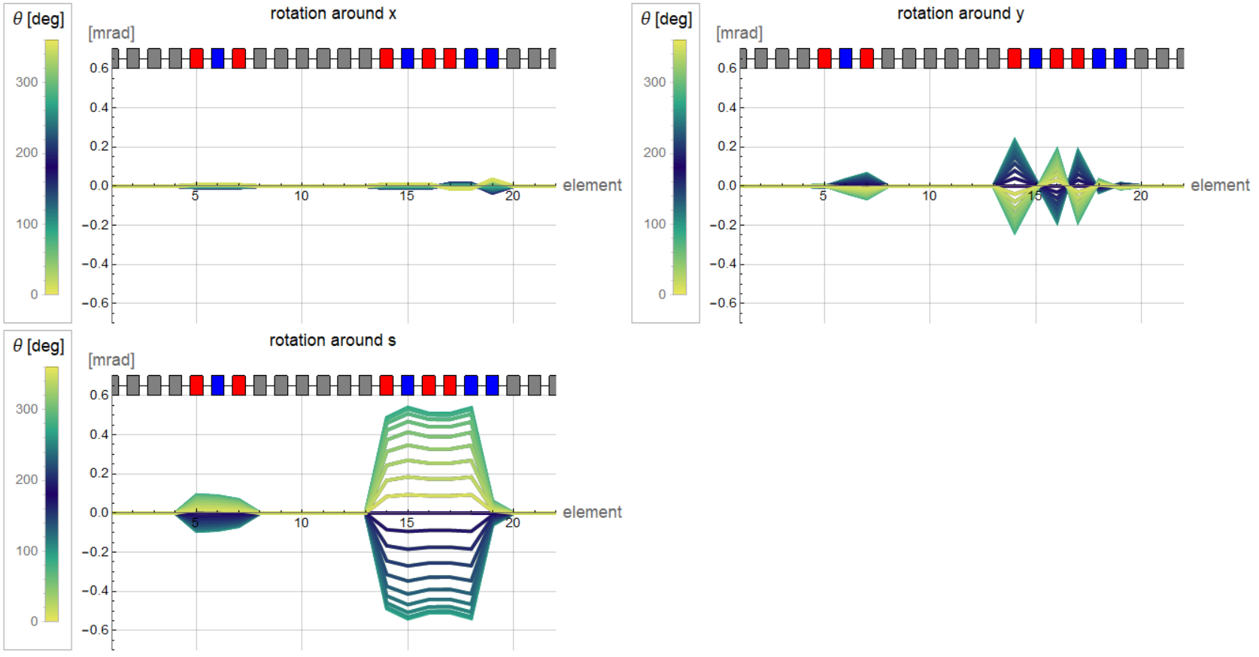
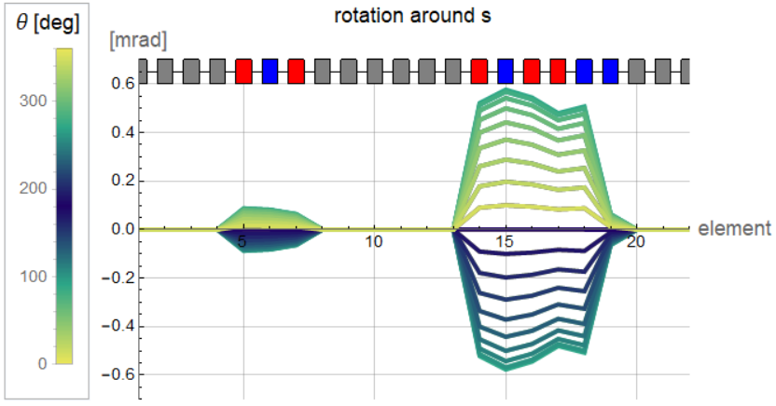
Results quadrupoles fixed to dipoles
Rotations non shared cross-section
Rotations global shared cross-section
Rotations locally shared cross-section

Slide 17
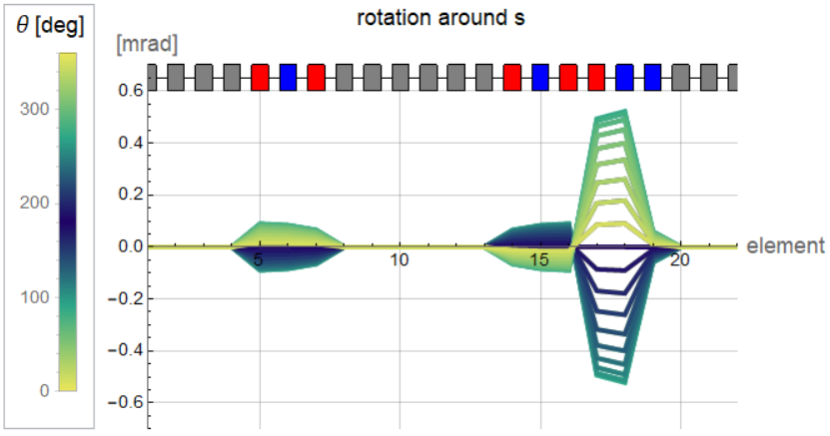
Results quadrupoles fixed to dipoles
Inverted supports
Rotations non shared cross-section
Rotations global shared cross-section
There is an improvement in rotations when applying the global tot section strategy. Going from +- 0.3 to +- 0.1 mrad for dipole 1
Limits for dipoles | CW support contribution
± 0.8 mrad | ± 0.5 mrad (62.5 %)

Slide 18
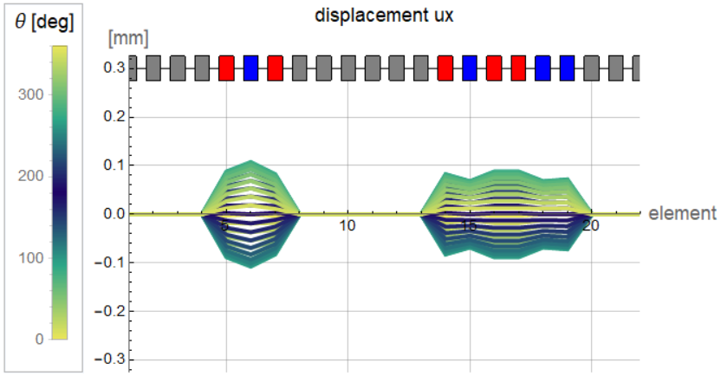
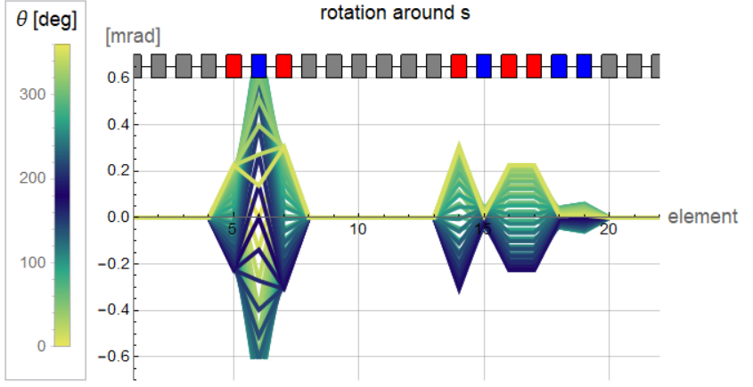
Results quadrupoles fixed to dipoles Vs independent
Heat load is kept constant

Slide 19
summary
Differential cross section optimization strategies don’t affect much the results
Results are more affected by the support configuration
Support position must be optimized
The level of optimization is too low to compare the solution in which quads are “rigidly” fixed to dipoles with respect to the one were they are fixed to the vacuum vessel
The model with independent quadrupoles does approximate better reality (for the other the rigidity of the support between quads and dipoles is not modelled at all)
Both cases show margins of improvement
Results should be checked for beam dynamics

Slide 20
Thank you for the attention

Slide 21
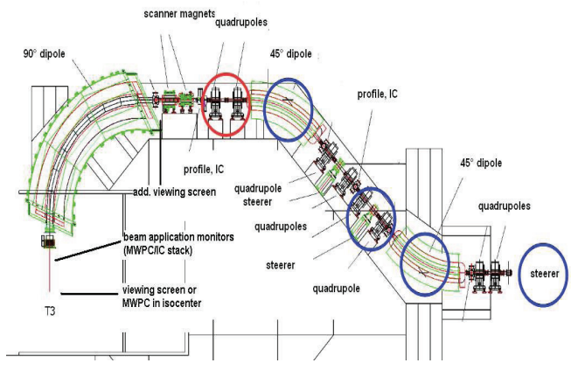
Heidelberg NC C-ion gantry
  Dipole R_ext = 3,7 m ca.
  Dipole R_orbit = 4 m ca.
6,5 meters [2]
6,5 meter [2]
R?
Galonska, M., et al. "The hit gantry: From commissioning to operation." IPAC (2013): 3636-3638.

Slide 22
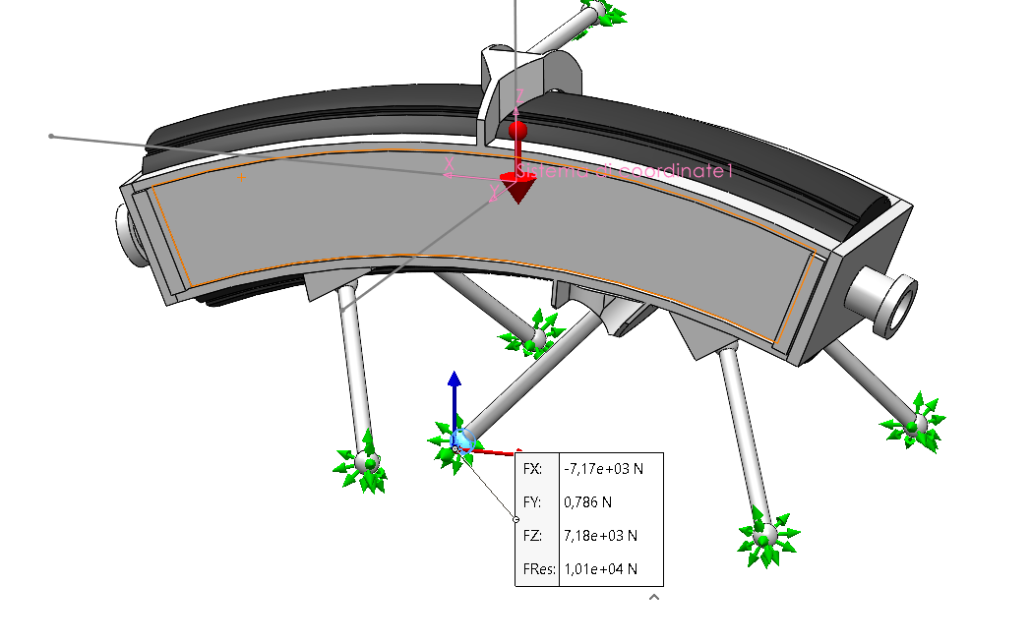
SolidWorks simulation:
Magnet body infinitely rigid
Leg material G10 E = 26 Gpa
Mass of the magnet = 2000 kg
Spherical contact modelled with surface to surface local contact
$\overset{⃑}{F_{0°}}=\left\{0.,−10156.1,−7866.8,−7867.4,−1868.6,−1868.4\right\}$ N

Slide 23
