Slide 1
Consideration on the Dipole’s Heads Curvature
E. Felcini
18/10/2022

Slide 2
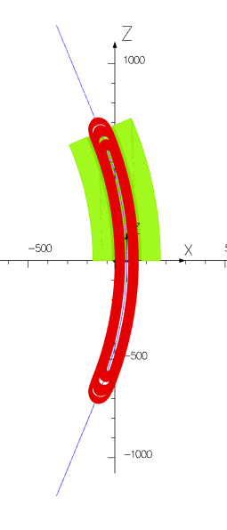


Tracking in the map
The dipole is designed to bent the particles of 45° (22.5° around z=0)
Since the magnet designed by INFN-LASA physically extends to ~25°, while the particle exits with an angle of 22.5° we loose some space in the magnet aperture (~ 2 mm).
Depending on the geoemtry of final part of the magnet (heads) we might compensate or increase this loss in aperture.
In the present design, the head geoemtry begings at 19.3°.
In this presentation, we do not enter the detail of the heads, but we just represent the schematic of the beam pipe, assuming that the winding will follow it.
$θ$=19°
$θ$=25°
$$Courtesy of R. Valente (INFN−LASA)$$

Slide 3
Where do we bend the pipe?
Curved up to 22.5°+ straight@22.5°
The pipe (and the winding) follows the path of the ideal trajectory:
Continuous shape without edges or kinks
Minimal loss in aperture
The heads winding (starting at 19°) needs to be hybrid:
curved from 19° to 22.5° and the straight
May be quite complex to wind
22.5°
straight@22.5°
Ideal trajectory

Slide 4
Where do we bend the pipe?
Curved up to 19°+ straight@22.5°
The heads are straight:
At 19° we start winding the heads directed at 22.5°
We have one kink in the winding, mechanical structure, spacers at the beginning of the heads → it may be a problem for the magnet (cut the cable/strands?)
We have a loss in aperture
19°
straight@22.5°
Ideal trajectory

Slide 5
Where do we bend the pipe?
Curved up to 19° + straight@19° + straight@22.5°
The heads are straight:
At 19° we start winding the heads directed at 19°
We have no kink in the winding, but we need to place a straight part of pipe a the end of the magnet → we may need extra space between the dipole and quad?
We have a loss in aperture
19°
straight@19°
straight@22.5°
Ideal trajectory

Slide 6
Where do we bend the pipe?
Curved up to 25° + straight@22.5°
The heads are curved:
We wind continuously on a curvature up 25.5°
We have no kink in the winding, but we need to place a straight part of pipe a the end of the magnet → we may need extra space between the dipole and quad?
We have a loss in aperture
25°
straight@22.5°
Ideal trajectory
straight@22.5°

Slide 7
If we use another trajectory?
(0,0)
Curved up to 25° + straight@22.5°
Instead of using the trajectory passing from the center of the magnet (0,0), can we find a new trajectory to minimize the overall loss in aperture?
If we want to keep the same exit angle (22.5°) of the particle following a different trajectory, we need to adjust the particle energy accordingly*.
Particle travelling in the innermost part of the magnet will cover a shorter path → shorter integrated field → to maintain 22.5° we reduce the particle energy.
25°
New ideal trajectory (e.g. 429 MeV/u)
Old ideal trajectory (e.g. 430 MeV/u)
* in reality we will adjust the magnetic field to operate at the nominal energy of 430 MeV/u to fulfil the clinical requirements. Higher particle energy means that lower field is required for the nominal energy

Slide 8
What do we gain?
Curved up to 25° + straight@22.5°
25°

Slide 9
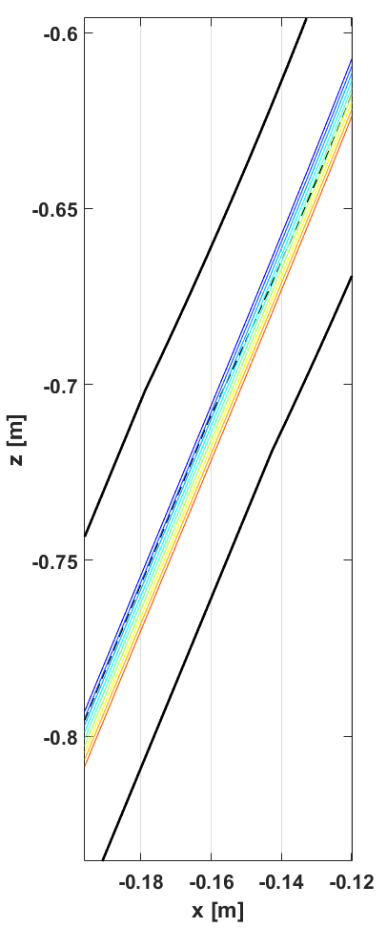
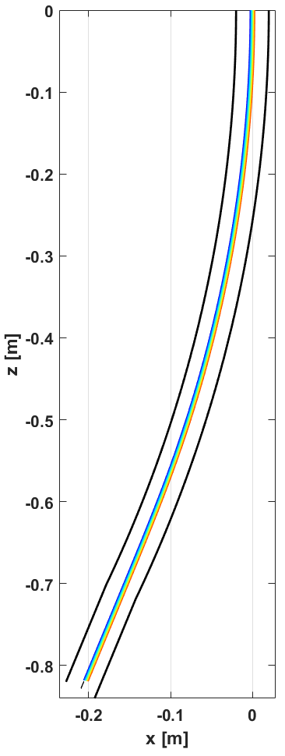
What do we gain?
Curved up to 25° + straight@22.5°
dx
E
dx [mm] | E [MeV/u] | dE/E0
-3 | 425.0085 | -0.32%
-2.25 | 425.348 | -0.24%
-1.5 | 425.6867 | -0.16%
-0.75 | 426.0246 | -0.08%
0 | 426.3618 | 0.00%
0.75 | 426.6982 | 0.08%
1.5 | 427.0339 | 0.16%
2.25 | 427.3688 | 0.24%
3 | 427.7031 | 0.31%

Slide 10
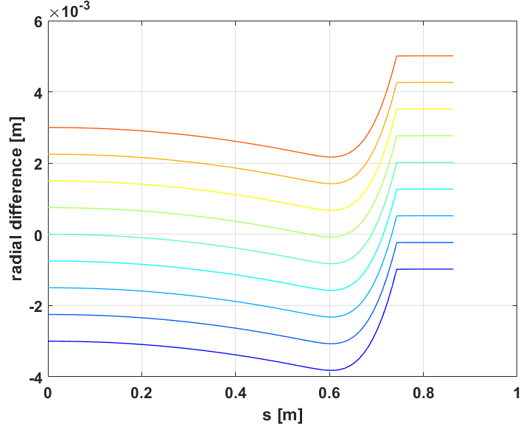
What do we gain?
Curved up to 25° + straight@22.5°
Trajectory in 0 → loss of 2 mm
Trajectory in -0.75 mm → loss of 1.5 mm

Slide 11
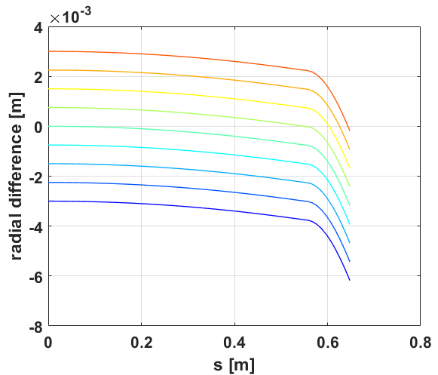
What do we gain?
Curved up to 19° + straight@19° + straight@22.5°
19°
Trajectory in 0 → loss of 3.2 mm
Trajectory in +1.5 mm → loss of 1.7 mm

Slide 12
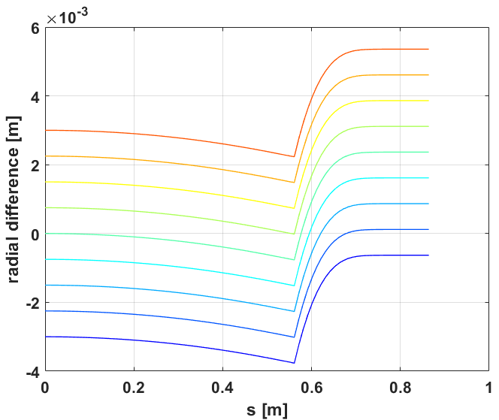
What do we gain?
Curved up to 19°+ straight@22.5°
19°
Trajectory in 0 → loss of 2.4 mm
Trajectory in -0.75 mm → loss of 1.6 mm

Slide 13
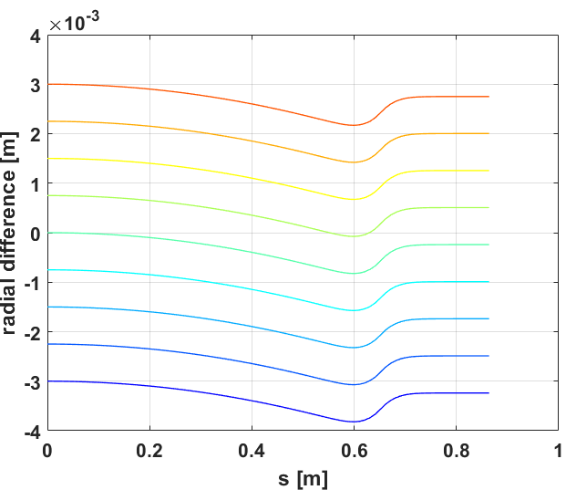
What do we gain?
Curved up to 22.5°+ straight@22.5°
22.5°
Trajectory in 0 → loss of 0.8 mm
Trajectory in +0.75 mm → loss of 0.75 mm

Slide 14
What do we gain?
Case | Loss in radius for Traj. (0,0) | Loss in radius for alternative Traj.
Curved up to 22.5°+ straight@22.5° | 0.8 mm | 0.8 mm
Curved up to 19°+ straight@22.5° | 2.4 mm | 1.6 mm
Curved up to 19° + straight@19° + straight@22.5° | 3.2 mm | 1.7 mm
Curved up to 25° + straight@22.5° | 2 mm | 1.5 mm
Hybrid heads
Minimal loss
Straight heads
Kink in the winding
Straight heads
NO kink in the winding
Extra space for quad (?)
Curved heads
NO kink in the winding
Extra space for quad (?)

