Slide 1
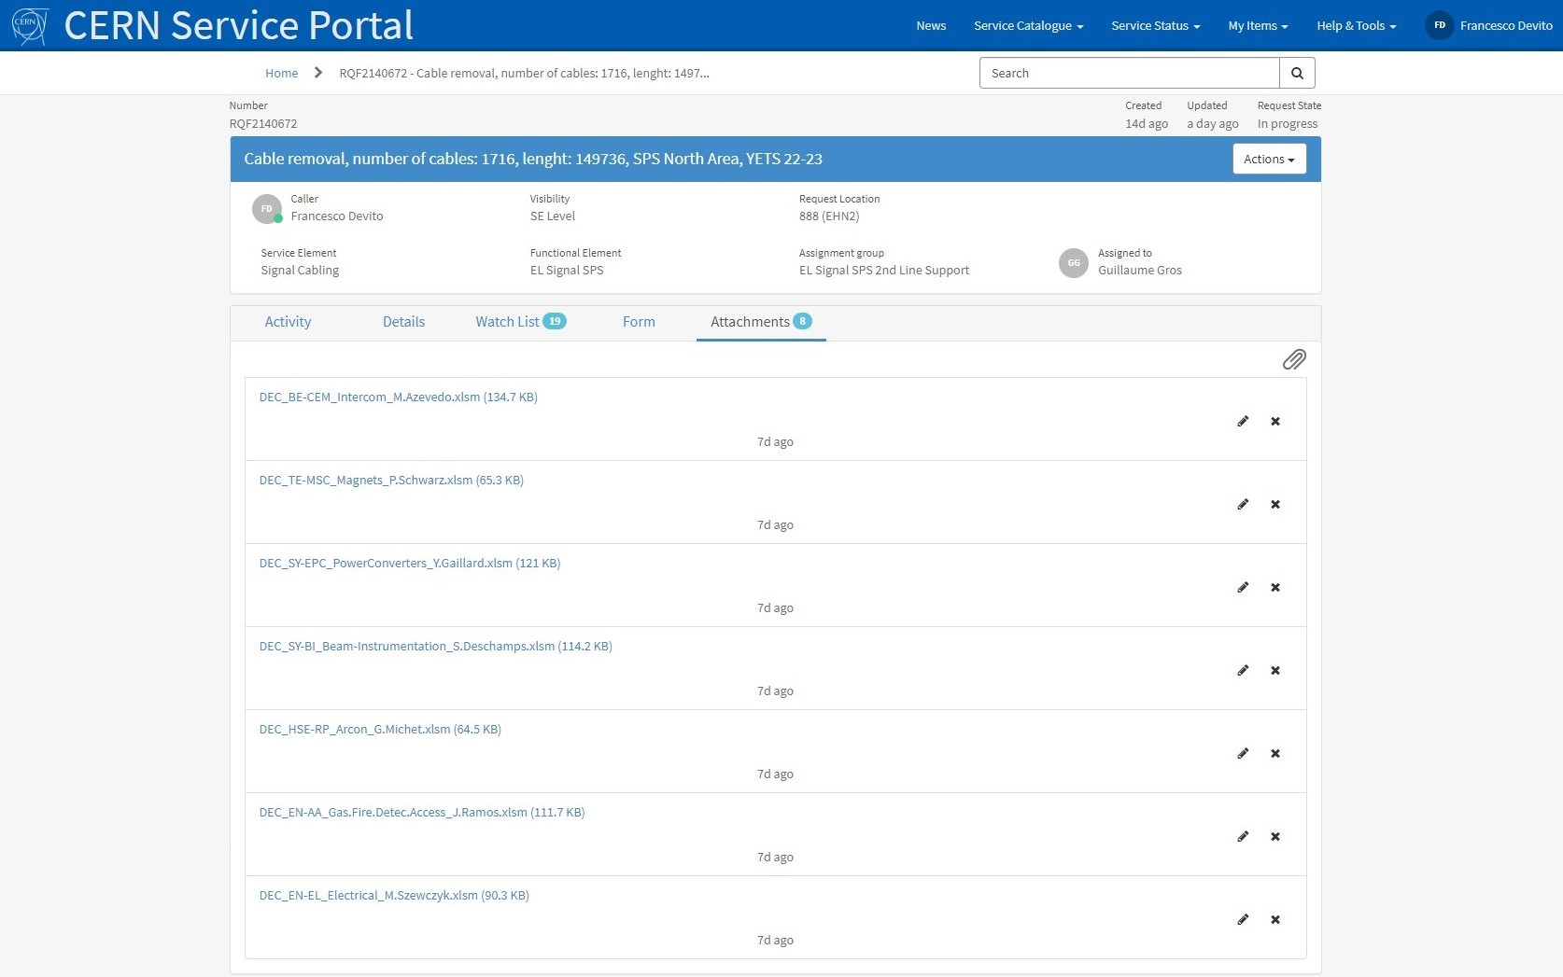
DECs Ticket Status
Ticket Link
RQF2140672

Slide 2
DEC BE-EA Beam Instrumentation / Compass / Orphan
BE-EA
Cables
No Ref.
Cables
Orphan
Cables
BE-EA Cables: (AD: Evalué, à déposer) Confirmed by Stefano Levorato and Johannes Bernhard
No Referenced Cables: (AV: Evalué, à vérifier sur place) To be confirmed By Stefano Levorato in place
Orphan Cables: (AV: Evalué, à vérifier sur place) To be confirmed By Stefano Levorato in place

