Slide 1




North Area Consolidation
Decabling Working Group
Meeting #13
19th of October 2022
Michael JECKEL
on behalf of NA-CONS
BEAMS
DEPARTMENT

Slide 2
Approval of minutes

Slide 3
Review of actions
Action | Description | Responsible | Status
1 | ECR to remove SPS INTERCOM & PAGE 1 TV systems in the NA | I. Kozsar | In progress
2 | Collect DECs from different groups | M. Jeckel | In progress
3 | Prepare list of systems together with corresponding electrical circuits that need to remain operational | S. Levorato | In progress
4 | Prepare list of systems together with corresponding electrical circuits that need to remain operational | M. Szewczyk | In progress
5 | Prepare list of systems together with corresponding electrical circuits that need to remain operational | T. Barbe | In progress
6 | Prepare list of systems together with corresponding electrical circuits that need to remain operational | J. Ramos | In progress
7 | Prepare list of systems together with corresponding electrical circuits that need to remain operational | F. Juban | In progress
8 | Investigate on Liquid Krypton control cables from ECN3 | F. Duval | Done
9 | Investigate on SPS-EPO DATAPLEX | Y. Gaillard | Done
10 | Investigate on power needs for the gas system (BG82) | D. Jaillet | In progress
11 | Prepare identification, labelling and disconnection procedure for obsolete cables in EHN2/BA82 during YETS22/23 | M. Jeckel | Done
12 | Prepare Safety Request Form (SRF) for decabling in EHN2/BA82 during YETS22/23 | M. Jeckel | pending
13 | Prepare ECR for decabling in EHN2/BA82 during YETS22/23 | A.Charalambous | In progress
14 | Prepare Lockoout procedure for EHN2/BA82 Decabling during YETS22/23 | M. Jeckel | pending
15 | Prepare workplan for EHN2/BA82 Decabling during YETS22/23 | M. Jeckel | Done

Slide 4
New actions
F. Devito Check access condition for decabling (cherry picker & scaffolding)
N. Broca Label all Gas Detection cables to be removed with a “privat” cable number NB01-NB49
P. Durand Label all Fire Detection cables to be removed with a “privat” cable number PD01-PD88
All Link Persons Prepare “proper” DEC latest by 1st of December including column M, X,AI & AJ
Ideally: M = AD: Evalué, à déposer X & AI: DOV: Trouvé- obsolete-deconnecté-violet
AJ: Cable length

Slide 5
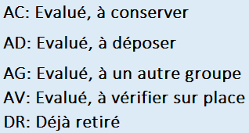
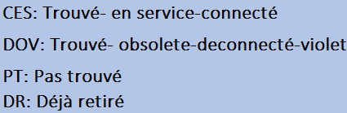
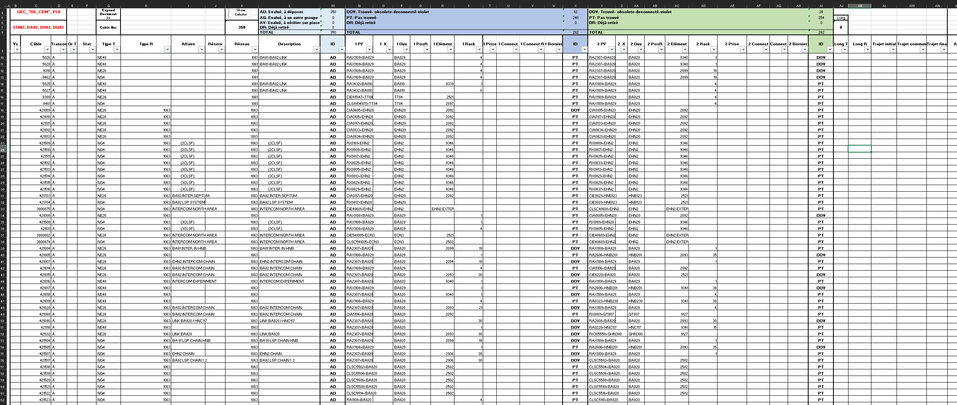

DEC Demande d’Enlèvement de Câbles
Cable
length
M
X
AI
AJ
Some of the columns in the template are “hide” and you have to “unhide”.

Slide 6
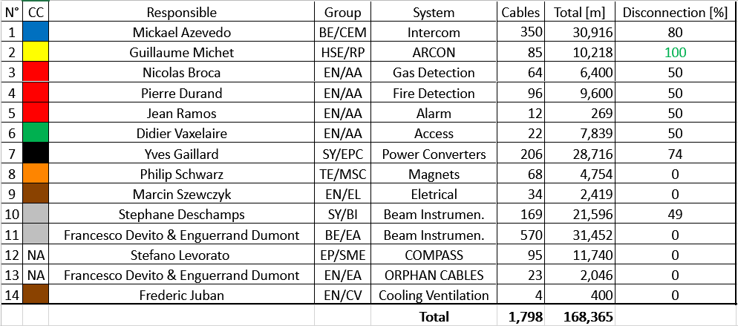
Summary

Slide 7
Documentation for EHN2
NACONS - PROCEDURE IDENTIFICATION, ETIQUETAGE ET DECONNEXION DES CABLES OBSOLETES EDMS: 2788834
ECR De-cabling Campaign EHN2 YETS 2022/23 EDMS: 2775911
Lock out procedure for EHN2 decabling EDMS: xxxxx
Safety Request Form (SRF) - Decabling activity in EHN2 EDMS: xxxxx

Slide 8
Next NA-DWG Meeting
Wednesday 9th of November 2022

Slide 9
Thank you for your attention !
Questions ?

