Slide 1







Project North Area Consolidation
Identification TT81-TT85 @ YETS 2023-2024
EHN1
Enguerrand DUMONT
BE-EA-PR
October 19th 2022

Slide 2
Summary
Area concerned from TT81 to TT85
Sharepoint : Pre-DEC
Possible intervention periods

Slide 3
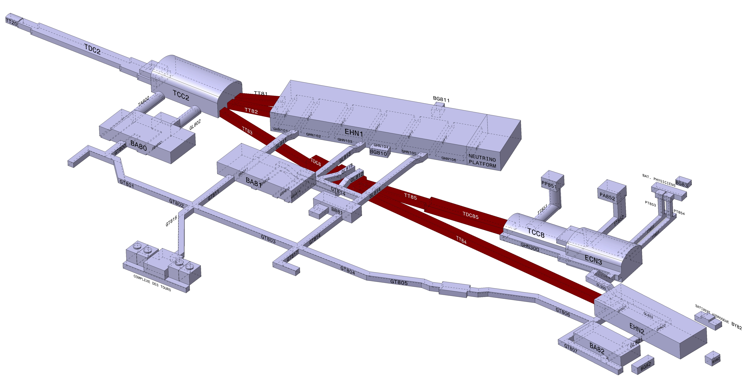
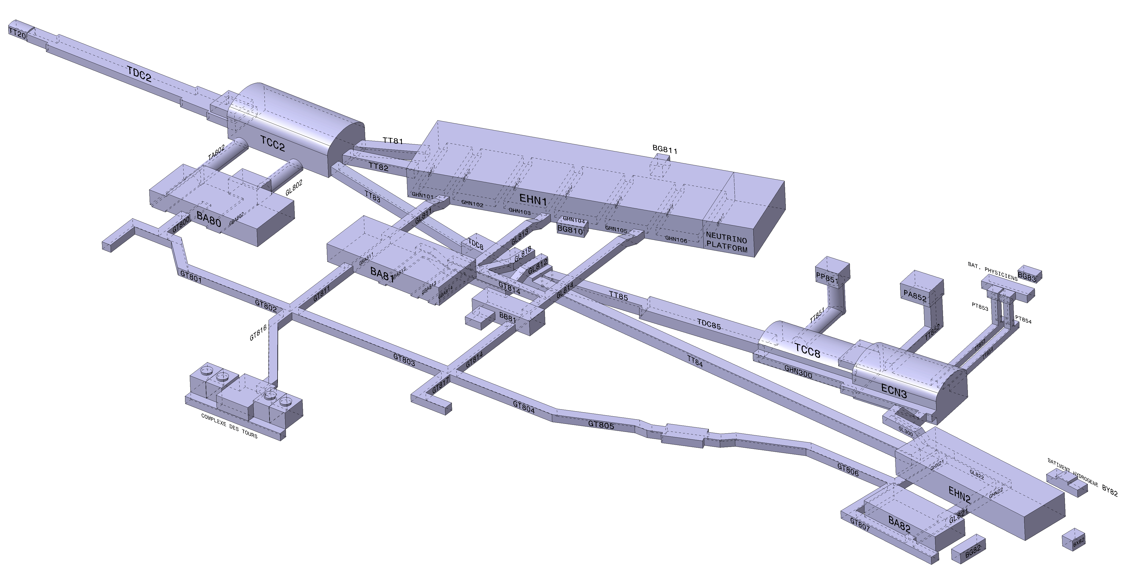
Area concerned from TT81 to TT85

Slide 4
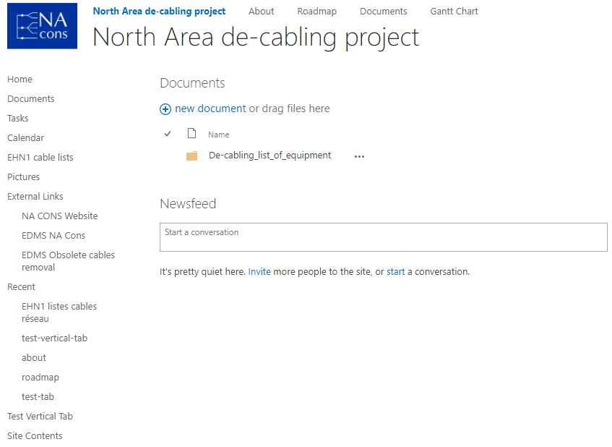
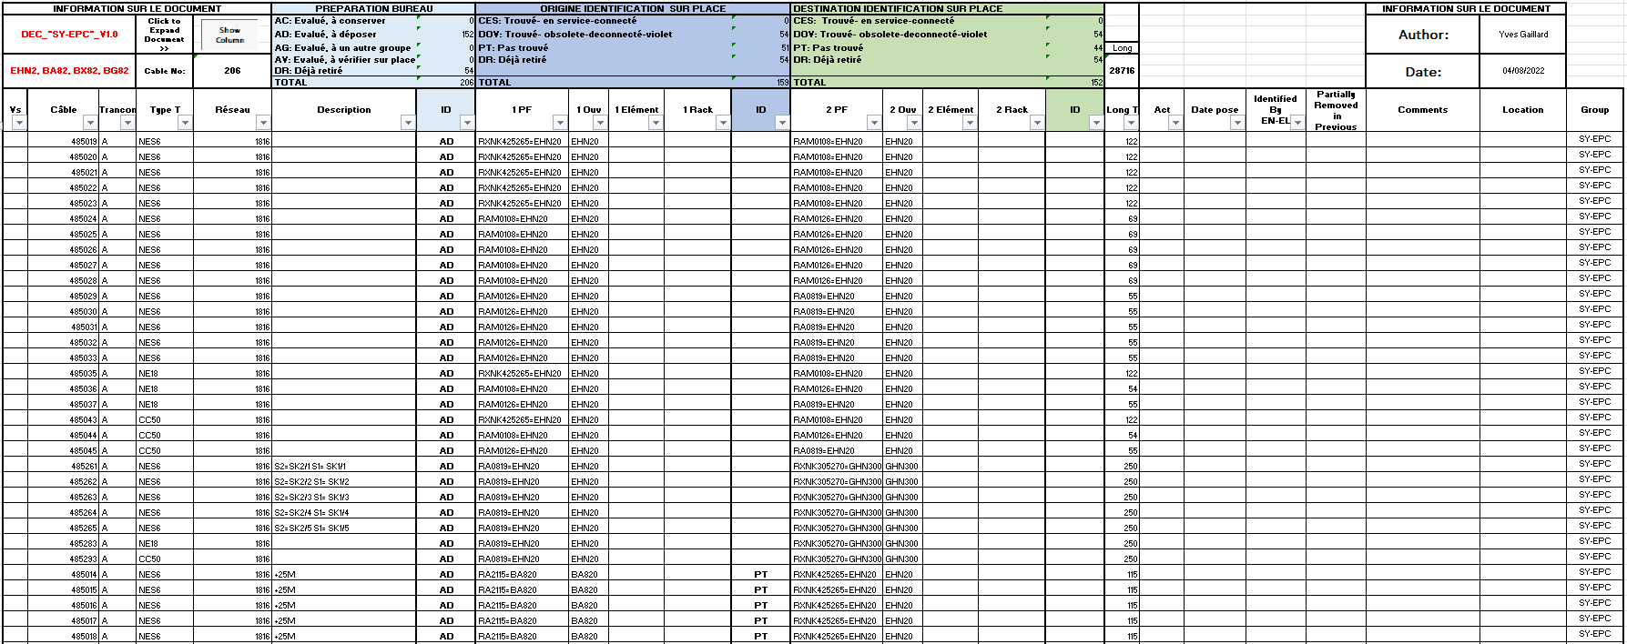
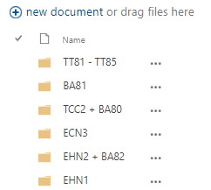
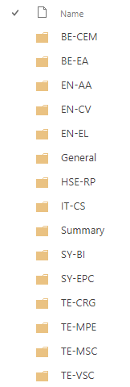




Sharepoint : Pre-DEC

Slide 5
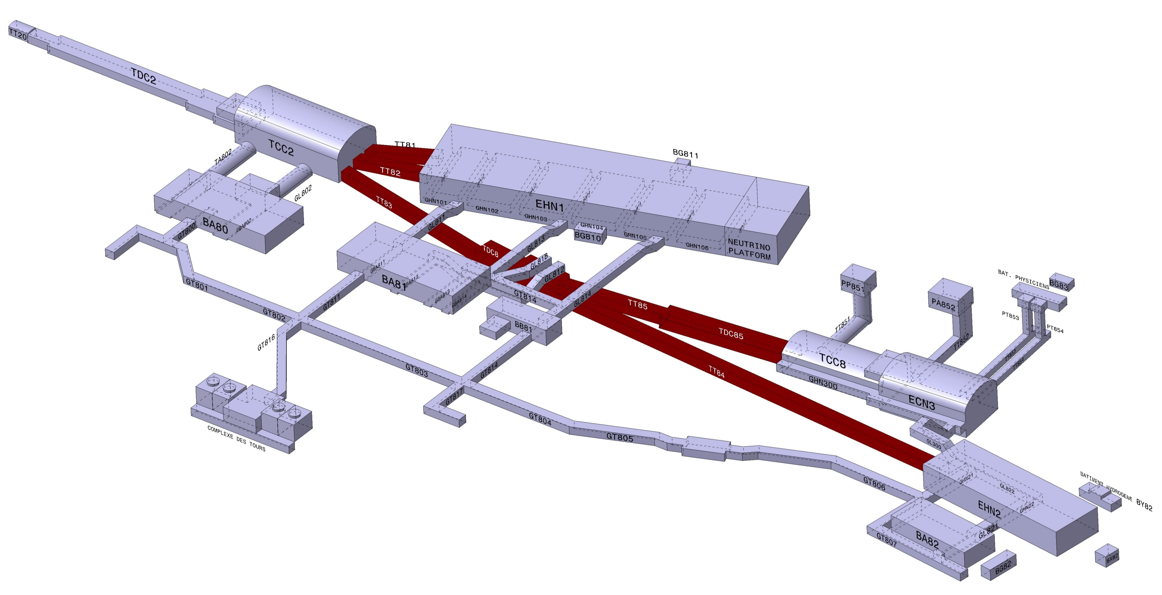
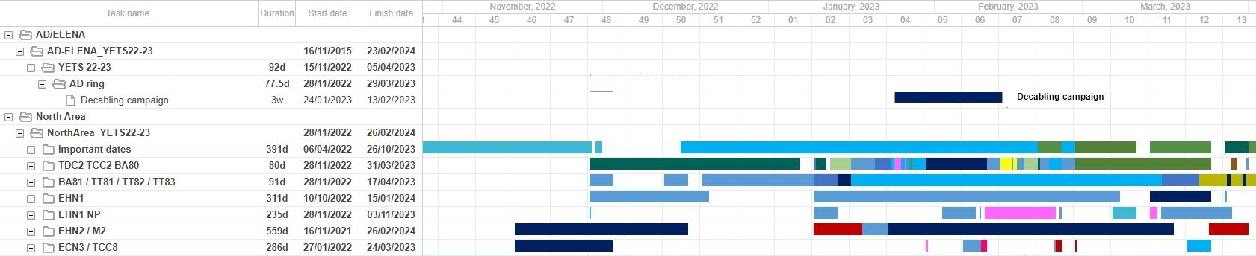
Possible intervention periods
TT81 and TT82:
-> From 6-12-2022
-> To 21-12-2022
TT83 ; TT84 ; TT85 ; TDC8 and TDC85:
-> Start 5-01-2023
-> To 24-01-2023
-> Restart 14-02-2023
-> To 24-02-2023
Closure CERN

Slide 6


Thanks you for your attention

