Slide 1
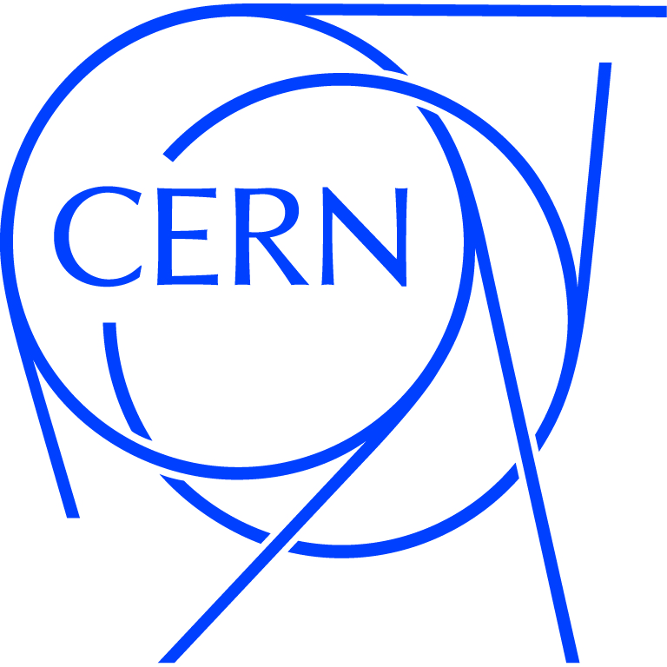
IFAST IIF PITCH
Permanent Magnet for High Efficiency Klystrons
PM4HEK
CERN
&
ELYTT
Submitted by:
Nuria Catalan Lasheras
Senior physicist SY/RF

Slide 2
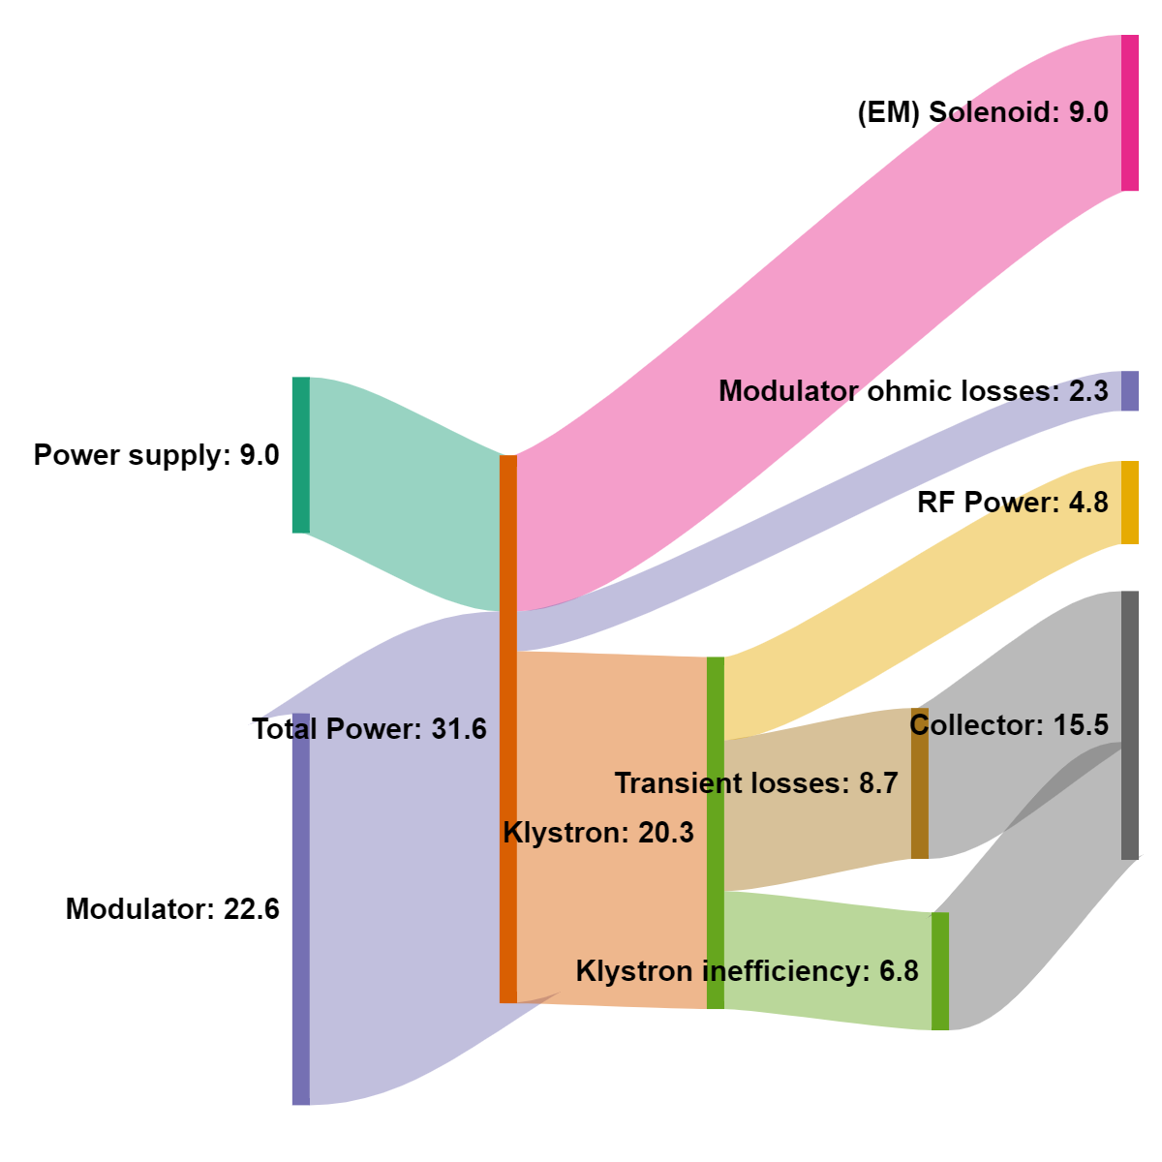
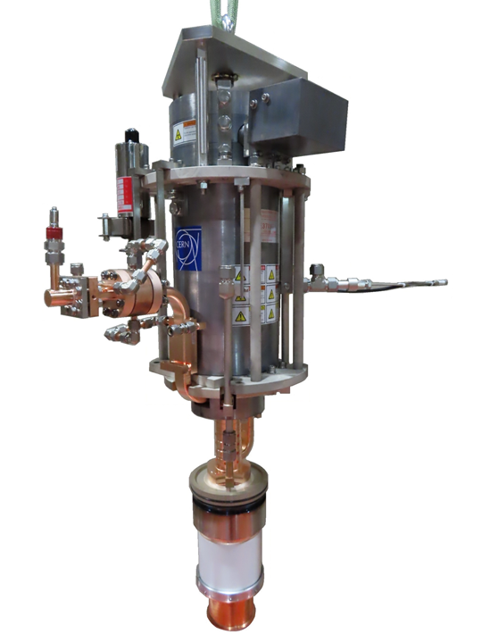
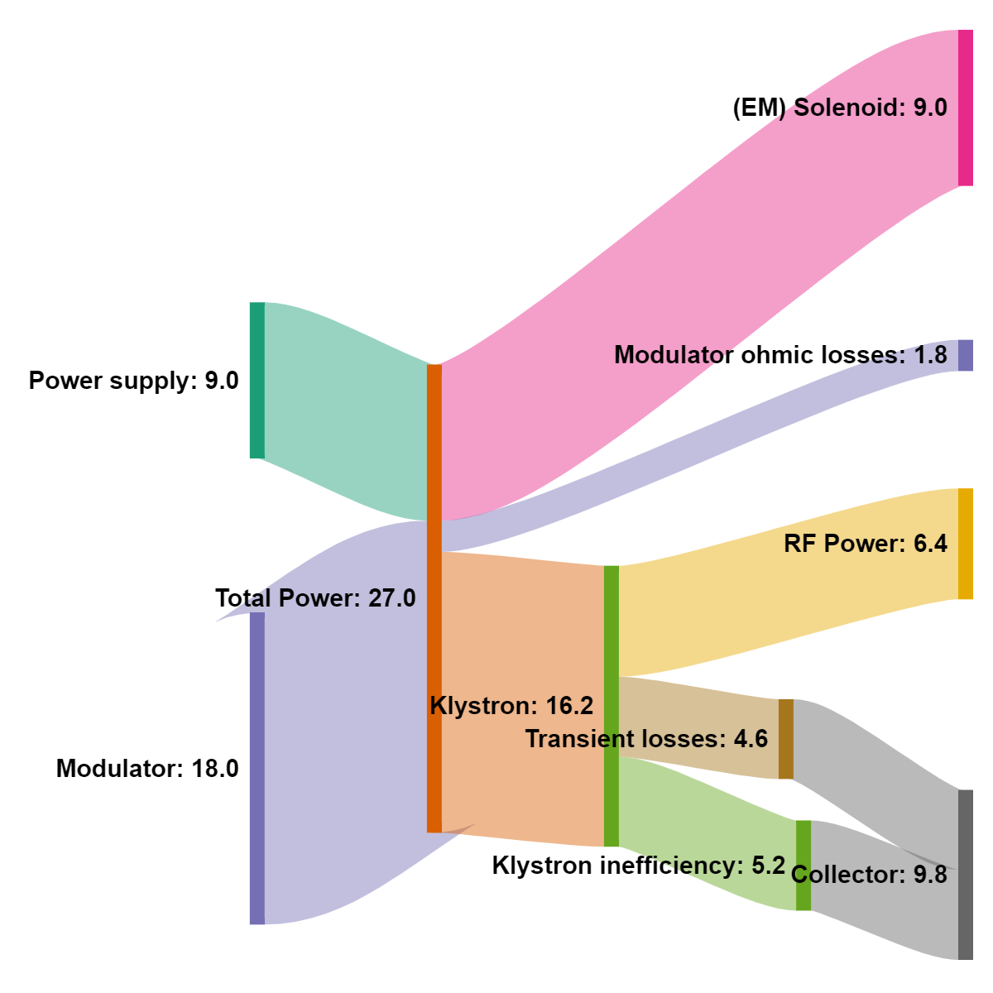
Background and aim
Catalogue tube
AC/RF source efficiency 15.2%
Klystrons need an electromagnetic solenoid to guide the electrons on a vacuum tube.
Electrical and cooling energy required by them represents a large fraction of the total energy, especially in low duty cycle pulsed systems.
The contribution of the magnet is only enhanced when designing and building high efficiency klystrons. 28% to 32%
We want to design and build a permanent magnet solenoid for an available klystron
The final product will reduce the operational costs of any accelerator together with the associated carbon footprint.
New HE Klystron
AC/RF source efficiency 23.7%

Slide 3
Technical overview
A team led by Dr. I. Syratchev has been working for the last 8 years on the development of the tools and techniques to improve klystrons for accelerators.
  https://indico.cern.ch/event/1138197/contributions/4821294/
CERN collaboration with U. Lancaster, and University of Chengdu (7 members)
Design and simulation software KLYC benchmarked against available codes with striking similar results and much faster computational speed.
Collaboration with klystron manufacturers on producing operational prototypes.
  One tube built by CANON ETD (Japan) has achieved an efficiency of 54% from an original 43% design. https://cerncourier.com/a/cern-and-canon-demonstrate-efficient-klystron/
  A new tube is under construction in Thales as part of the IFAST 11.2 work package.
We would like to design and build a permanent magnet solenoid for the high efficiency 12 GHz, 8 MW pulsed klystron to reduce further the energy consumption and CO2 footprint
Nuria Catalan Lasheras – IFAST IIF pitch Sep. 2022

Slide 4
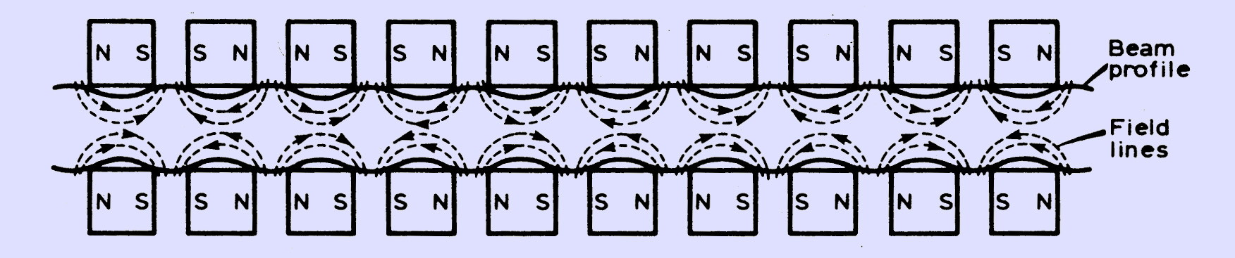
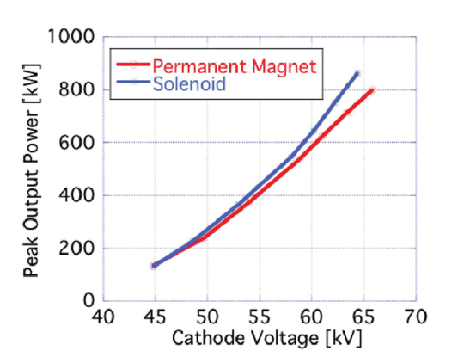
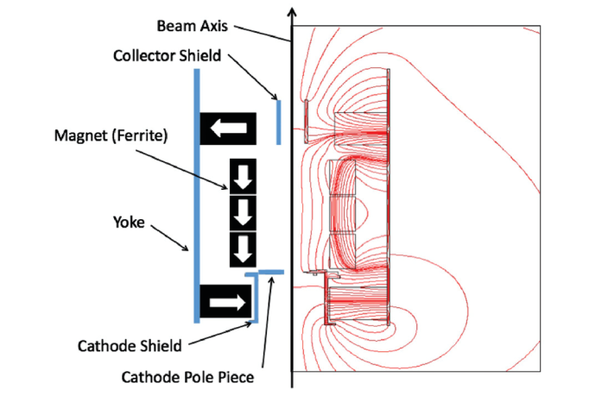
Technical overview /2
Most tubes in the market use electromagnets as focusing field for a klystron
Periodic permanent magnet (PPM) configuration consists of alternating polarity rings set around the RF cavities
  (DOI:10.1109/JRPROC.1954.274515).
  https://accelconf.web.cern.ch/l02/PAPERS/TU465.PDF
This topology produces an oscillating envelope for the electron beam and generate losses along the tube.
High efficiency klystrons require a much tighter control of the beam
Already demonstrated PM pure solenoid by KEK/CANON (DOI:10.1109/JRPROC.1954.274515) (TRL6) with some loss of performance
We propose to use a pure solenoid topology optimized together with the klystron dynamics in operation conditions (TRL7)

Slide 5
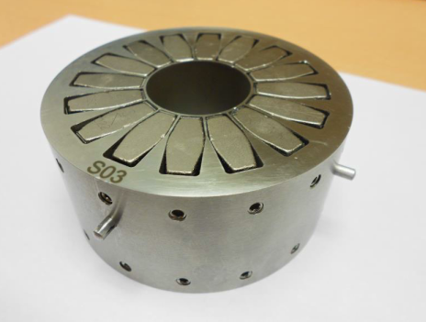
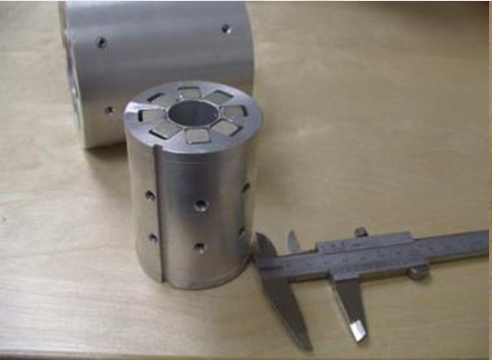
ELYTT experience
ELYTT team: Led by J. Lucas. Ample experience in permanent magnets and (EM) solenoids for klystrons.
The team in Elytt has designed and built magnets, power supplies, and energy storage systems for highly exigent science universities and laboratories (ITER, CERN, DESY, GSI, SESAME, etc.).
Their team consists of engineers with large experience in the area of high technologies together with a high-quality manufacturing unit in the north of Spain.

Slide 6
Work plan
Work package | Partner in charge | Description
WP1: Magnet specification | CERN | Definition of magnetic field profile, mechanical envelope. Setting up of the verification process
WP2: Design of the PM solenoid | ELYTT | Design of the magnetic channel, verifications in klystron simulations. Manufacturing drawings
WP3: Magnet fabrication | ELYTT | Procurement of tooling and materials. Manufacturing,. Assembly
WP4: Magnet tests | CERN | Magnetic tests in stand alone magnet. Insertion in the klystron and RF tets
WP5: Industrialization | ELYTT | Cost optimization, Industrialization model, ISO standardization

Slide 7
Work schedule

Slide 8
Risks analysis
Risk | Likelyhood | Mitigation
Supply chain problems | Likely | PM material already identified. Start procurement from CERN stores as soon as project approved
Cost overrun | Unlikely | Eventual overrun covered by CERN HE budget
Integration of solenoid proves dificult | Unlikely | Decision during the design phase Sacrifice klystron-only efficiency against total system efficiency Redesign and re-fabricate klystron with new ancillaries. As a CERN spare and with CERN funding

Slide 9
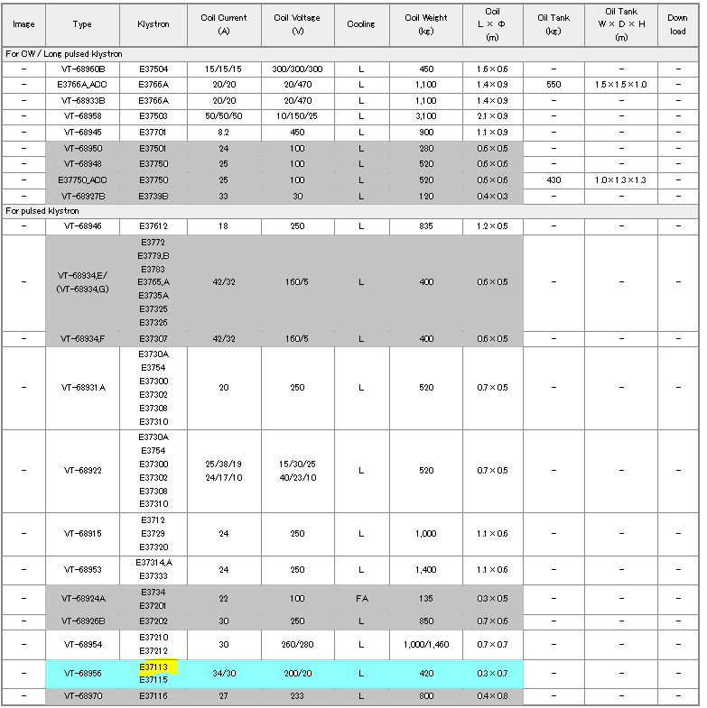
Applications and Impact
Klystrons are used for communications, defense, industry, medical, radar, and scientific applications. Their use in accelerators represents only a small fraction of the current market.
The solenoid currently used by CANON fits two different klystrons used for science, industry and radar.
After validation of the prototype in operational conditions, the technology can be transferred to a large fraction of products already available (short channel and high frequency).
Similar products also commercialized by CPI and THALES
  https://etd.canon/en/product/category/microwave/klystron.html

Slide 10
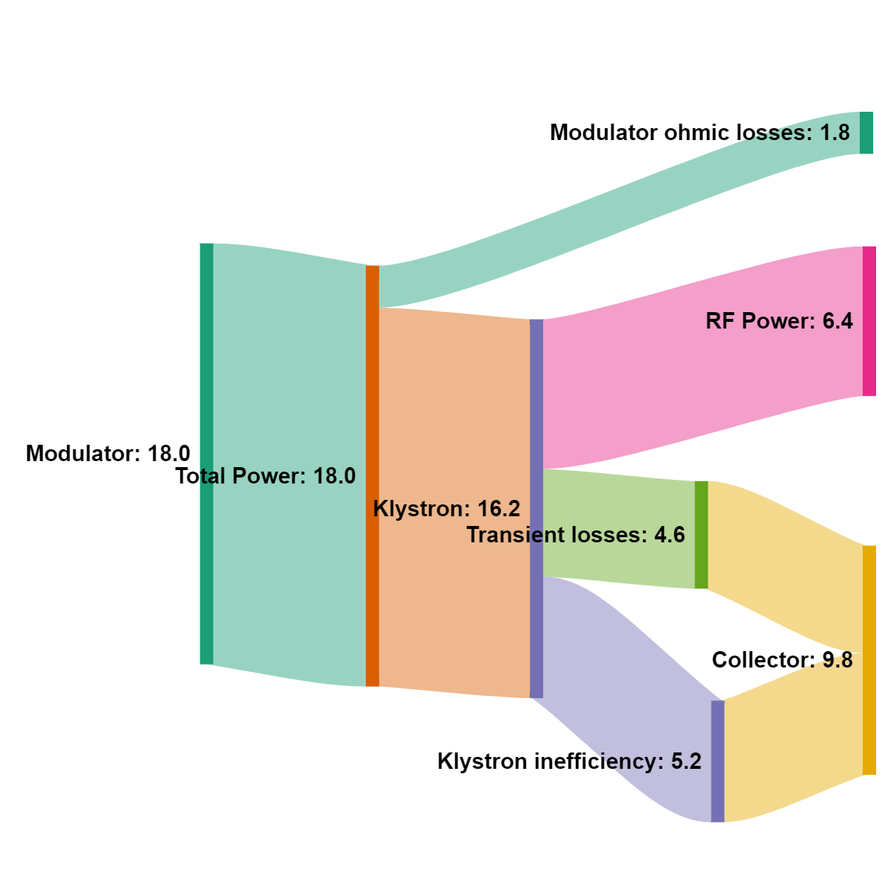
Business plan and commercialization
Final product might be sold to CANON by the consortium. Potential licensing to ELYTT as exclusive manufacturer
We (CERN and ELYTT) are already in contact with all three main klystron manufacturers. Ultimate clients of the product
Engineering services for similar products to be delivered by ELYTT with support from CERN
Klystron manufacturer does not have a strong interest or knowledge to develop the technology
Ultimate client for klystron however has great interest on:
  reducing the electricity bill,
  reducing capital investment (no power supplies, no cooling of solenoid),
  have a smaller footprint (embarked solutions like cargo scanners, X-rays…)
Commercialization, scalability, industrialization and manufacturability will be studied as part of the project
HE tube with PM solenoid
AC/RF source efficiency 35.5%

Slide 11
Resources and budget
Work package | Resources (total 115 KEuros)
WP1: Magnet specification | CERN: Fellow and supervision covered by CERN funding ~0.3 FTE
WP2: Design of the PM solenoid | ELYTT: design team 20 K CERN: Fellow and supervision covered by CERN funding ~0.3 FTE
WP3: Magnet fabrication | ELYTT: production team 60K CERN: Travel 10K
WP4: Magnet tests | ELYTT: design and production team 10 KE CERN: travel 5 K
WP5: Industrialization study | ELYTT: commercial team 10K

Slide 12
Questions
Could you express in quantitative and verifiable terms the improvements with respect to the state-of-the-art that your project is pursuing. 9 kW power saving in a single system. 23.7% to 35.5% efficiency
What are the characteristics of the magnet and are there possible technical challenges in integrating it in the klystron? Permanent magnets. Integration may prove difficult around input/output windows
What it the level of co-funding, in any, in the project? 0.6FTE from HE-klystron project plus eventual klystron modifications (<100K)
What are the key parameters to be measured when performing the magnetic stand alone test and the klystron RF tests and what are the values expected to be achieved? Magnetic field value and profile ~ 0.4 T
It seems strange that the interest of possible customers for the benefits of the technology does not induce and interest on the klystron producers. Are there aspects that make this technology unattractive for klystron producers? Generally small market, specialised R&D needed, and lack of magnet expertise

Slide 13
Contact information
Primary Contact
Nuria Catalan Lasheras
Senior PhysiCIST CERN SY/RF
Mobile: +41754110152
E-MAIL: nuria.catalan.lasheras@cern.ch

