Slide 1
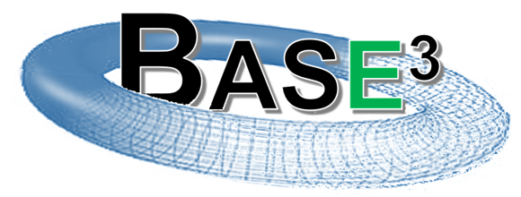


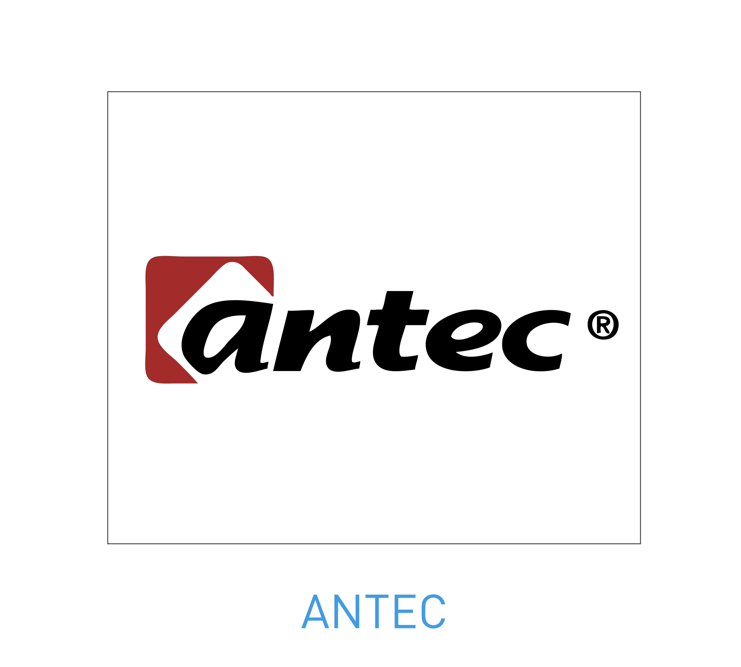
Boosting Accelerator-SMES for Enhancing their Energy-consumption Efficiency
PARTNERS
    CIEMAT (Lead Organization and IFast Member, R&D Institute)
    CYCLOMED Technologies (Industrial and iFast Member, Start-up company)
    ANTEC Magnets (Industrial Partner, SME company)
Luis Garcia-Tabarés, CIEMAT
Carlos Hernando, CYCLOMED Technologies
IFAST IIF PITCH CERN, GENEVA NOVEMBER 16th 2022
1

Slide 2
Content
    Introduction: The Problem
    Our Proposal: Concept & Background. The Preferable Choices
    Project Phases and Workplan
    Resources and Budget
    Risk Analysis
    Application and Impact
    Business Plan and Commercialization Phases
IFAST IIF PITCH CERN, GENEVA NOVEMBER 16 2022

Slide 3
Introduction: The Problem
A ROUND-TRIP PROBLEM
The pulsed operation of some accelerators components (cycled magnets, special power supplies, etc) may have and impact on the grid stability inducing voltage drops or frequency fluctuations.
A lack of quality of the power grid like voltage drops & sags or frequency excursions may affect the operation of the Accelerator.
Device | Characteristics | Results – Real installations (examples)
 |  | Facility (energy/power)
KESS | > 90% Efficiency > Fast response > Infinite Nº of Cycles > Maintenance Req. COMMERCIAL | Fusion JT-60 (1300 MJ) Accelerator J-PARC (original design) (51 MVA)
ESS Super-Caps | > 95% Efficiency > Fast response > Degradation > Repetitive life (~100.000) MEDIUM-HIGH TRL | Accelerators: BNL-AGS; CERN-PS (12 MJ)
SMES | > 95% Efficiency > Fast response > Infinite Nº of Cycles > Maintenance Req. > AC Losses limitation LOW TRL (HTS) | Accelerator BNL NSLS (2.4 MJ) Accelerator J-PARC (enhanced design) (90MVA)
THE GENERAL SOLUTION: USING AN ENERGY STORAGE SYSTEM AS A POWER FILTER
The solution to the above mentioned problem is to use a fast energy storage system which will act as a filter to smooth the power taken from the grid. Eventually it will also act as an Uninterruptible Power Supply.
IFAST IIF PITCH CERN, GENEVA NOVEMBER 16 2022

Slide 4
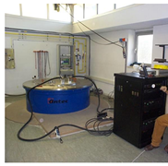
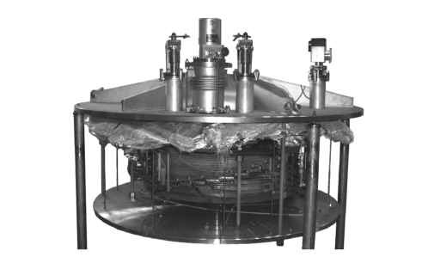
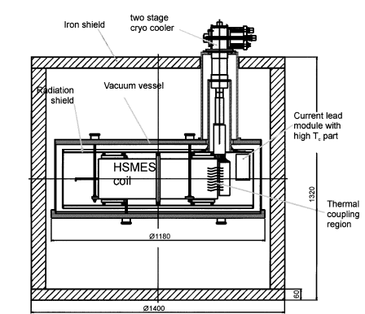
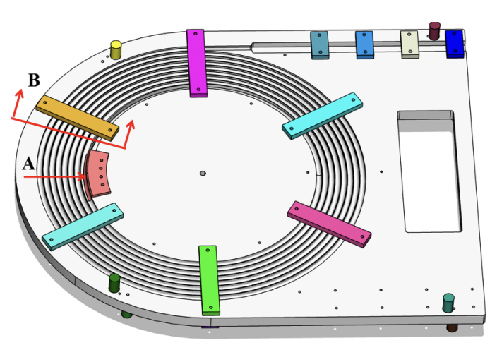

Our Proposal (I): Concept & Background
A modular SMES based on HTS and a He gas cooling system to guarantee an optimum refrigeration to the magnet
General SMES Pros | Specific BASE3 SMES Pros | SMES Cons
* No moving parts * Fast response time * High Power Density * Infinite Charge/Discharge cycles * Low Environmental Impact | * Modularity allowing to be scaled to different electrical requirements * Refrigeration system aimed at efficiently evacuating the heat produced by AC losses | * Low energy density * Presently, high CAPEX * Dependence of HTS wire development * Requirements of technically advanced operation personnel
1984
1997
1999
2003
2006
2008
2009
2022
2022
SMES based on NbTi installed at the Tacoma Substation
10 MW, 30 MJ.
CIEMAT & ANTEC collaborated in the AMAS 500 SMES
for improving grid power quality
500 kVA, 1 MJ,
Toroidal SMES, based on NbTi, for grid stabilization
1 MW, 3.6 MJ
HTS SMES
UPS system
20 kVA, 150 kJ
SMES installed at the Electra Synchrotron Light facility as protecting device
1.2 MW, 2.6 MJ
SMES, based on Bi2212 for a power pulse source.
814 kJ, 315 A
SMES based on YBCO wire for 100 MVA/2 GJ class load fluctuation compensating
100 MVA, 2.4 GJ
YBCO tape based SMES for fluctuation suppression and energy compensation of the power system of a particle accelerator
1MJ
H2020 Project granted to a consortium in which CIEMAT, CYCLOMED & ANTEC are included to analyse maritime applications of SMES & other Energy Storage Systems
IFAST IIF PITCH CERN, GENEVA NOVEMBER 16 2022

Slide 5
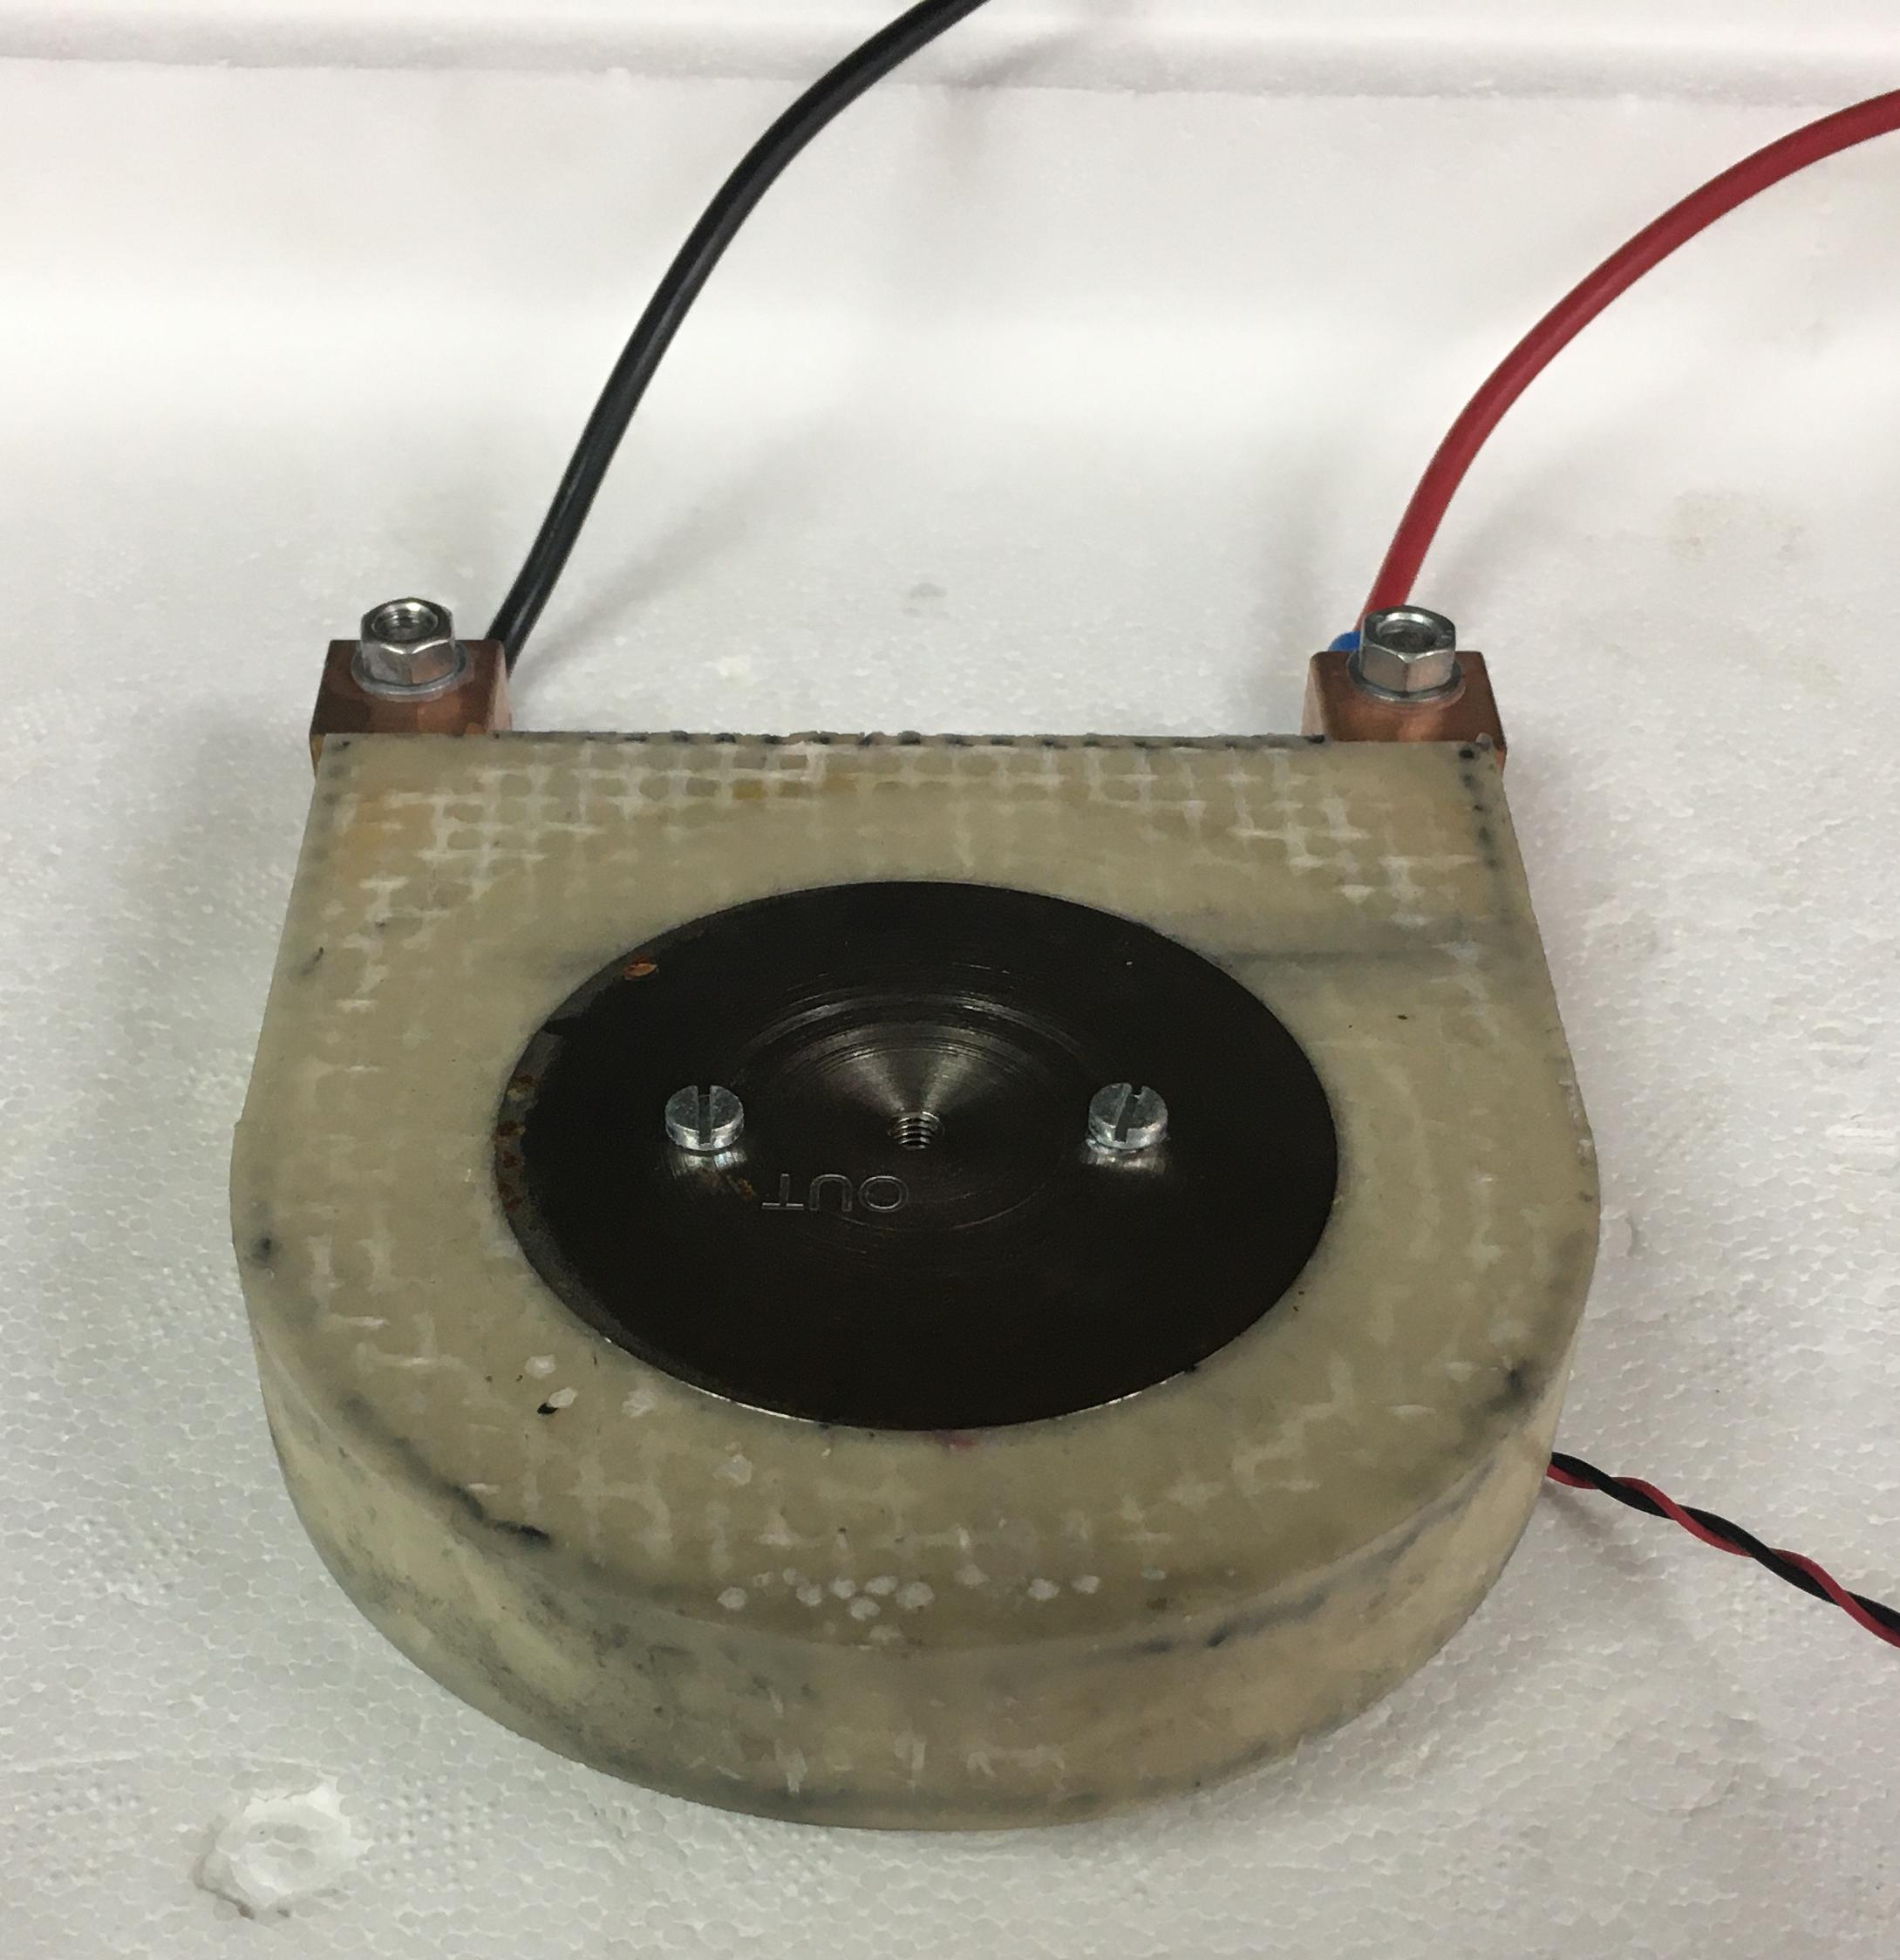
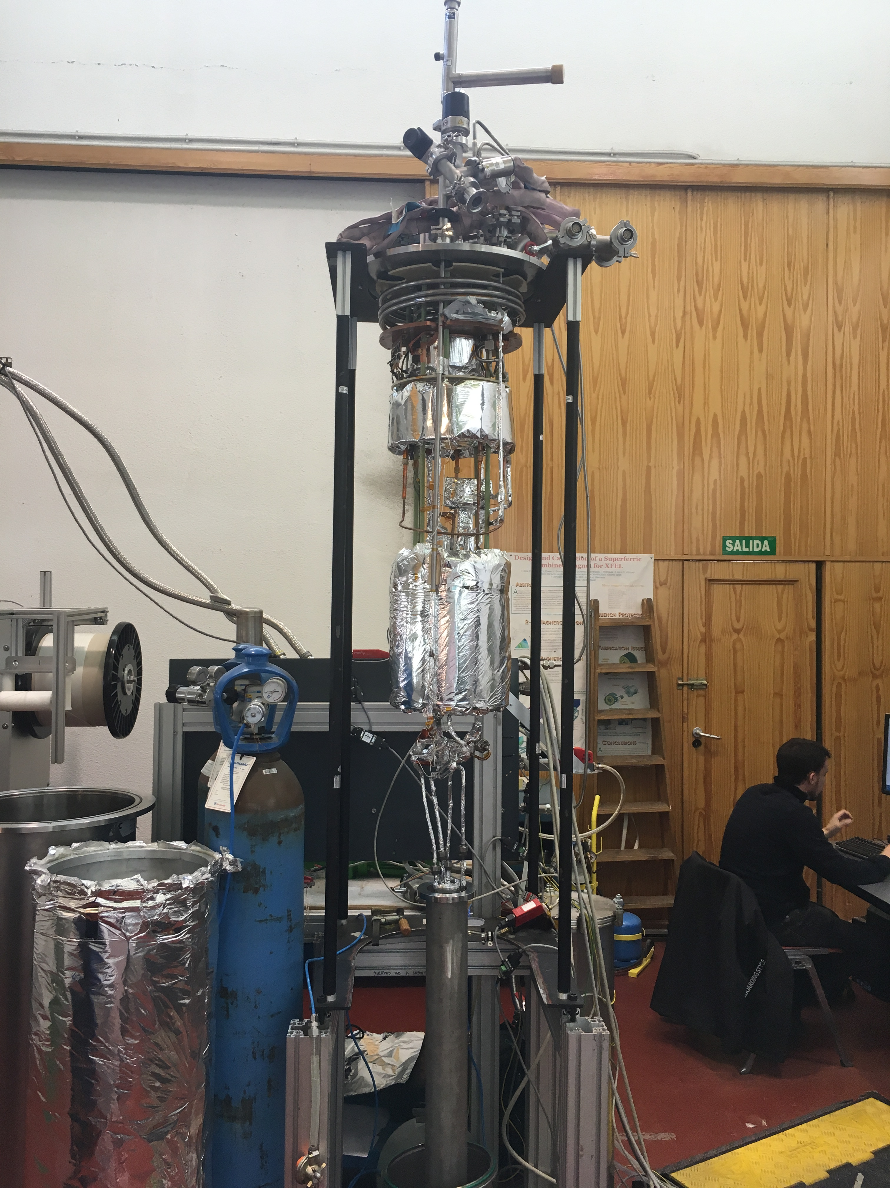
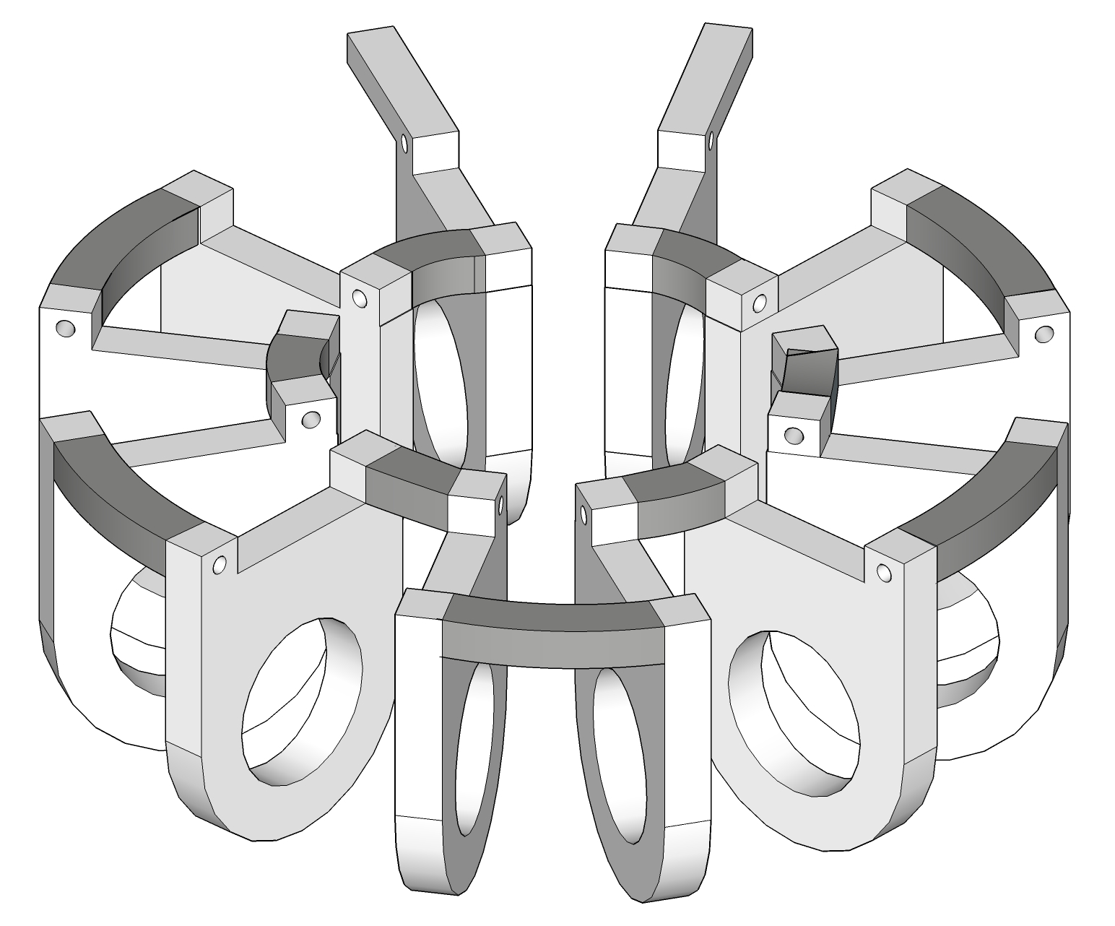
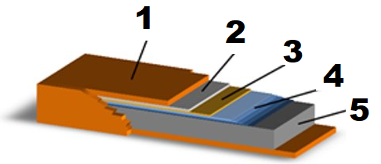
Our Proposal (II): The Preferable Choices
 | Type | Description | Advantages | Disadvantages
Material | Conventional HTS tape | REBCO tapes as a first choice. BiSCCO 2212 and BiSCCO 2223 will also be considered. | High critical temperature Less power required by the refrigeration system. Easier to remove AC losses. | Currently expensive. High AC losses which must be reduced.
Topology | MODULAR TOROIDAL | Toroidal arrangement of individual double-pancake solenoids . Solenoids made from double-pancake coils will also be considered. | Very low leakage flux. Easy to assemble from individual magnets easy to fabricate. Easy scalability and adaptation to different applications (modularity). | Lower magnetic energy density (J/Kg).
Refrigeration | CSS | Forced-flow configuration with the Cryogenic Supply System, where helium gas is circulated through the magnet and cooled down with a cryocooler. | Released heat is extracted very close to where it is produced (the wire) since the gas is circulated through the magnet and not removed from conduction. | More complex system than other solutions like conduction cooled devices.
MATERIAL:
1. CU stabilisation (opt.)
2. Ag cao layer
3. REBCO layer
4. Buffer layer stack
5. Substrate
WIRE
ARRANGEMENT
REFRIGERATION
IFAST IIF PITCH CERN, GENEVA NOVEMBER 16 2022

Slide 6
Project Phases
TRL=3
TRL=4
Design, Modelling & simulation
Manufacturing
Validation & Testing
The project includes a specific work package (WP7) about business development in order to create new market opportunities and benefits to society, disseminate and exploit the project results, including management of IPR.
Business Plan & Dissemination
Design of the magnet and the cryostat as well as the adaptation of the CSS. The system will be modelled and simulated, especially for calculation of AC losses
The magnet will be made from a commercial HTS coil. The CSS will be adapted from an existing unit and the cryostat will be done ad hoc
Static & Dynamic tests will be performed. The first to characterise the magnet critical current vs temperature and the second to evaluate AC losses when ramping the magnet.
Reminders:
TRL3: Critical Function, i.e., Proof of Concept Established. Applied research continues and early stage development begins. Includes studies and initial laboratory measurements to validate analytical predictions of separate elements of the technology. Examples include research on materials, components, or processes that are not yet integrated.
TRL4: Laboratory Testing/Validation of Alpha Prototype Component/Process. Design, development and lab testing of technological components are performed. Results provide evidence that applicable component/process performance targets may be attainable based on projected or modelled systems.
Cryogenic Supply System
Power Converter
SC MAGNET
SC MAGNET
IFAST IIF PITCH CERN, GENEVA NOVEMBER 16 2022

Slide 7
Work Plan
Deliverables:
  D1 System Design Report (M7)
  D2 SMES System: D2.1 Magnet / D2.2 Cryostat / D2.3 CSS
  D3 Laboratory Tests Results Report
Milestones:
  M1 System Designed
  M2 Magnet Fabricated in Its Cryostat
  M3 Experimental facility ready Incl. Cooling System & Power Supply
Consortium Background:
  CIEMAT:
  - SC Laboratory
  - Manufacturing of SC Accelerator - Magnets. - Power Converters.
  CYCLOMED:
  - Cryosystem
  - SC Accelerators Magnets
  ANTEC:
  - SC & Resistive Magnets

Slide 8

Resources and budget
CIEMAT is a public research institute depending on the Ministry of Science and Innovation. The Technology Department is one of the five Departments in which CIEMAT is organized and it is where the Electrical Engineering Division belongs. The division has more than 30 years of experience in superconducting magnets, cryogenics and power electronics
Team and organizational expertise fully dedicated to the project
  CIEMAT: Electric Eng. Division (Accelerator Unit & Power Systems): 1,5 FTE (Full-time equivalent)
  CMT: 2 FTE
Industry participation and involvement
  ANTEC : 1 FTE
Budget and resources provided by the consortium and IIF
CYCLOMED Technologies is a Spanish company specialized in superconductivity and cryogenics. Founded in 2019 for the development and commercial exploitation of a superconducting particle accelerator aimed at radioisotope production
Budget breakdown
ANTEC Magnets designs and manufactures state-of-the-art magnetic systems and components for all types of applications. It is specialized in the manufacture of electromagnets (resistive and superconducting) and permanent magnets special configurations (Halbach etc.).

Slide 9
Risk Analysis
Description of risk | Impact & Likelihood | Proposed risk-mitigation measures
* Partner fails to perform committed tasks | I: High L: Low | > The consortium is relatively redundant. One partner can undertake the tasks of the others > Externalization of tasks
* Conflicts or disagreements in the consortium | I: High L: Low | > Establishing a management structure and a clear assignment of responsibilities
* Delays in critical path deliverables * Non-compliance with specifications | I: High L: Low | > A back-up provider will be always consider (especially for HTS coils) > A small safety margin has been considered for integration in the project schedulle
* System is unable to achieve nominal temperature | I: Low L: Medium | > Coils will be designed to work with a safe temperature margin to allow extracting more power with the refrigerator working at higher temperatures
* AC losses above expected | I: Medium L: High | > Increasing working temperature to increase power extraction capacity (see previous point) > A.C Losses Model reconfiguration & analysis of other future wire alternatives.
IFAST IIF PITCH CERN, GENEVA NOVEMBER 16 2022

Slide 10
Selected Applications and Impact
TYPE | APPLICATION | DESCRIPTION | IMPACT
ACCELERATORS & SCIENTIFIC FACILITIES | Cycled Magnet Power Management | Power recovery of cycled magnets | > Reduction of size and cost of electrical protection systems > Reduction of the electricity bill > More energy efficient accelerators (less reactive power consumption)
 | Powering of Pulsed Power Supplies for Accelerator Components | Powering of modulators for klystrons
 | Grid Power Filters for Pulsed Facilities | Reduction of power peaks to the grid for experimental facilities running in pulsed mode (Fusion, Ultra High Field pulsed magnets, Hyperloop,…)
 | UPS for Grid Disturbances Load Protection | Fast protection of high power loads and safe shutdown of the accelerator | > More reliable accelerators with less impact of shutdowns
SOCIAL APPLICATIONS | UPS for Grid Disturbances Critical Load Protection | Fast protection of high power loads in delicate fabrication processes | > Reduction of costs due to unexpected grid disturbances
 | Fast Cycling Load Levelling | Short period peak shaving. Part of load levelling hybrid systems in combination with batteries or fuel cells and microgrids or for renewable energies applications. | > More efficient grids with more penetration of renewables in the overall context of energy storage
 | Hybrid Vessels | Peak support to Electric & Hybrid vessel (ships) for manouvring and harbour operation | > Substitution of fossil fuel based vessel with hybrid o full electric sustainable ships

Slide 11
Business Plan
Use case. Business plan (*)
 | DESCRIPTION
Hadron Therapy | Sustainable medical accelerators Advanced medical equipment to treat cancer. Local control of tumors and lower toxicity to healthy tissue Requires accelerators with large load consumptions.
Business model | Market & Revenue: 5 P-HT centers in 2009, 15 in 2017, and 33 in 2021 just in Europe with expected double digit CAGR for the next decade for the HT sector worldwide. Sector growth, and need for sustainability will drive demand for Energy Storage solutions in the accelerator area, in which our proposed solution will thrive due to its key competitive advantages: high nº of duty cycles, and low specific cost per kW. Proposed direct sales business model since partners has established connections in the medical accelerator area
Use case | CNAO: a multi-modal European clinical center (protons and carbon ions to 250 MeV and 4800 MeV respectively) *Support letter CNAO director. Power consumption: Est. consumption of 100 kW for the dipole magnets with a deceleration period of 0.5s in pulsed mode. Advantages: Incorporating a 100 kW SMES (Est. CAPEX: 80-100k€). Energy savings: Energy can be recovered in the deceleration phase / 90% efficiency 45kJ could de recuperated per cycle, which with a 200€/MWh electricity cost yields 0.25c€ savings per cycle. Est. nº of cycles per year are about 3M, thus 7.5k€ savings per year. Pay-back of 11 years. Grid stability: SMES can provide dynamic stability during voltage sags or act as a UPS to assure correct the operation of the facility.
IPR Status | Current status: There is no existing patent to protect the proposed solution and results on the CSS have been published IP Strategy: The consortium will adopt a mixed IP strategy, combining industrial secret with dedicated patents on specific subsystems
(*) Selected among several other possible options
1 doi: 10.1016/J.APENERGY.2014.09.081.

Slide 12
The commercialization
Concept & Market research
Prototype testing
Product development
Go To Market
IIF
EU Grants
EU Grants - EIC Accelerator
Private Funding
Product development phases
TRL 6: Prototype System Verified. System/process prototype demonstration in an operational environment- (Beta prototype system level).
TRL 7: Integrated Pilot System Demonstrated. System/process prototype demonstration in an operational environment-(integrated pilot system level).
TRL 8: System Incorporated in Commercial Design. Actual system/process completed and qualified through test and demonstration- (Pre-commercial demonstration).
Funding path to market
TRL 3 TRL 4 TRL6 TRL8
Jan. 2023
IFAST Innovation Fund
Test & Validate the technology. Confirm market interest.
March-Sept 2024
> HORIZON-INFRA-2024-TECH-01-02 (*)
> EIC Pathfinder
Develop full prototype (TRL 6/7). Define partners, in the accelerator sector, to test the technology.
2nd Sem. 2026
EIC Accelerator
Test product in real conditions. Open new collaborations: medical accelerators.
Year 2028/2029
Go to Market
Expand to new sectors, find new partners (Energy, aerospace or military).
IFAST IIF PITCH CERN, GENEVA NOVEMBER 16 2022

Slide 13
Contact information
NAME: Luis Garcia-Tabarés
PHONE: +34 913 357 196
MOBILE: +34 629 211 247
E-MAIL: luis.garcia@ciemat.es
WEBSITE: https://www.ciemat.es
NAME: Carlos Hernando
PHONE: +34 675 419 755‬
E-MAIL: c.hernando@cyclomed.tech
WEBSITE: http://cyclomed.tech
13

Slide 14
Back up Slide
(*) Preliminary information for the HORIZON-INFRA-2024-TECH-01-02: New technologies and solutions for reducing the environmental and climate footprint of RIs
Scope: The aim of this topic is to deliver innovative technologies and solutions which reduce the environmental and climate footprint of RIs through the full life cycle of research infrastructures. Proposals should identify common methodologies, among the concerned RIs, to assess environmental impact and strategies to reduce it.
Proposals should address the following aspects, as relevant:
new technologies and solutions for research infrastructures enabling transformative resource efficiency (e.g. energy consumption) and reduction of environmental (including climate-related) impacts, including, when relevant, more sustainable and efficient ways of collecting, processing and providing access to data;
validation and prototyping;
training of RI staff for the operation and use of the new solutions;
action plans to deploy the new developments at wider scale and ensure their sustainability;
measures to ensure an environmentally effective integration of the solutions in the local contexts;
societal engagement to foster acceptance of the solutions in the local and regional communities.

