Slide 1

AM applications of refractory metals for ION Source
Beneficiaries:
INFN – National Institute for Nuclear Physics (PD and LNL)
CERN ISOLDE
TANIOBIS GmbH
Industrial partners:
GE UPPSALA
SAES GETTERS S.p.A.
EOS - Electro Optical Systems, Finland Oy
TRIUMF
Eng. Adriano Pepato
Dirigente Tecnologo INFN
Project Evaluation, November 16th, 2022

Slide 2
SUMMARY
Introduction
Project Objectives
  addressable and obtainable market
  environmental challenges
TRL status
Project Organization
Work Package and Timetable
Milestones and Deliverable
Budget
Extra slides

Slide 3





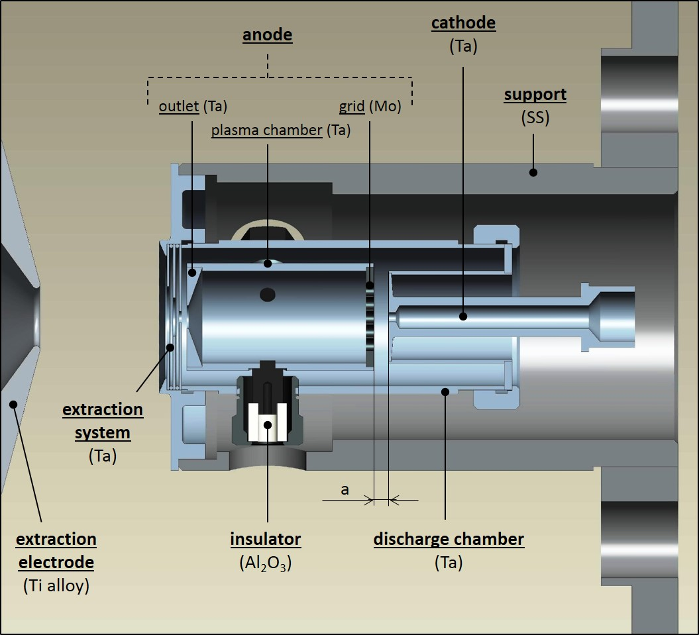

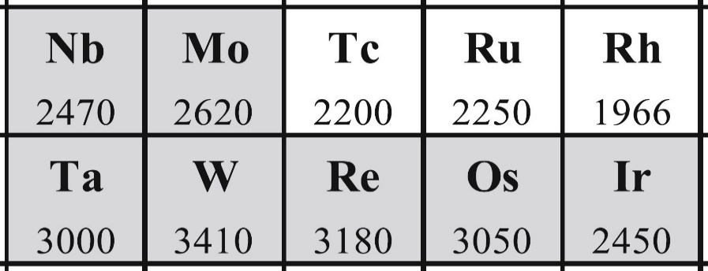
1. Introduction
Use of the ISOL technique for the production of radioactive ion beams
Traditional FEBIAD Ion Source – SPES Project
Courtesy of the SPES Group
production target
primary beam driver
transfer line
Development and characterization of AM Ref. Met.
Critical component:
Affects the RB intensity
ion source
+
+
+
+
+
Operation Temperatures 2000 ÷ 2200 °C
W and Mo → good for NON-STRUCTURAL components (anode)
→ susceptability to crack when processed by LPBF
Ta and Nb → Perfect for STRUCTURAL components (cathode)
→ particularly suitable to be processed by LPBF
Need of Refractory Metals
Ultra-High temperature materials
experimental areas
mass separator

Slide 4
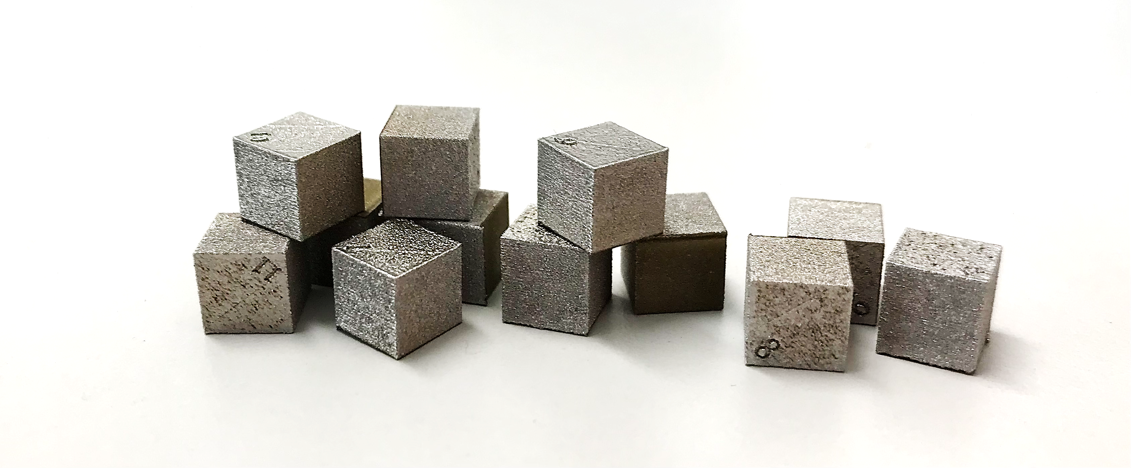

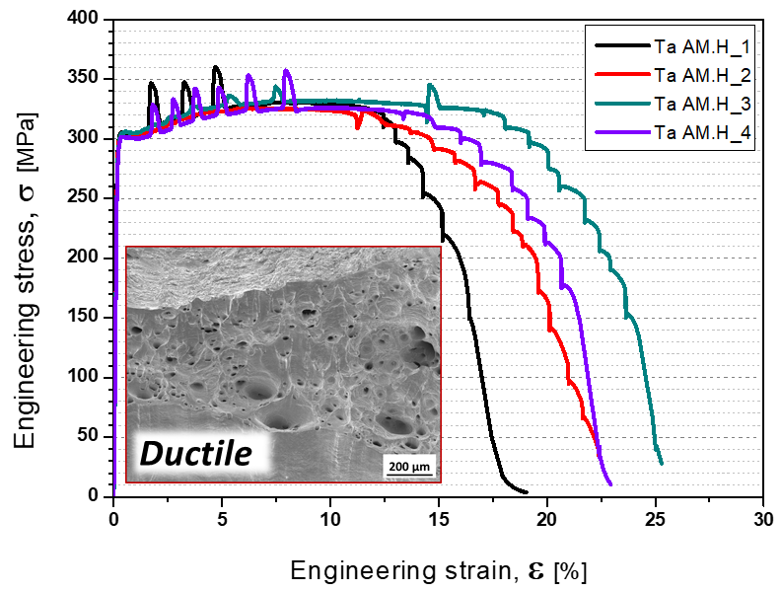
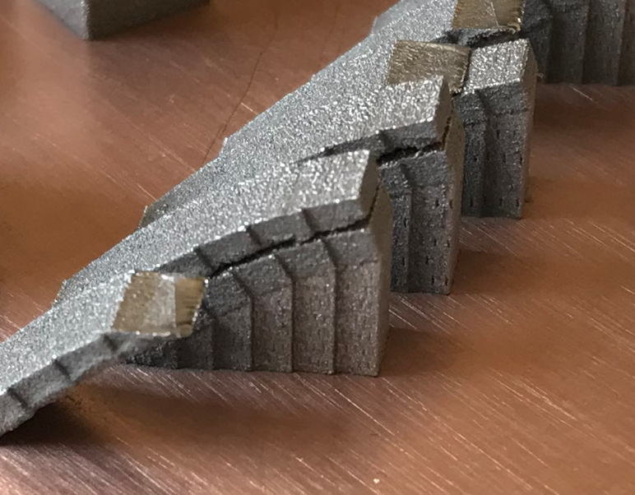
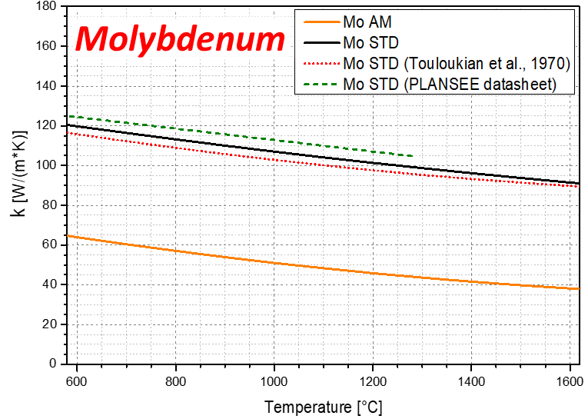
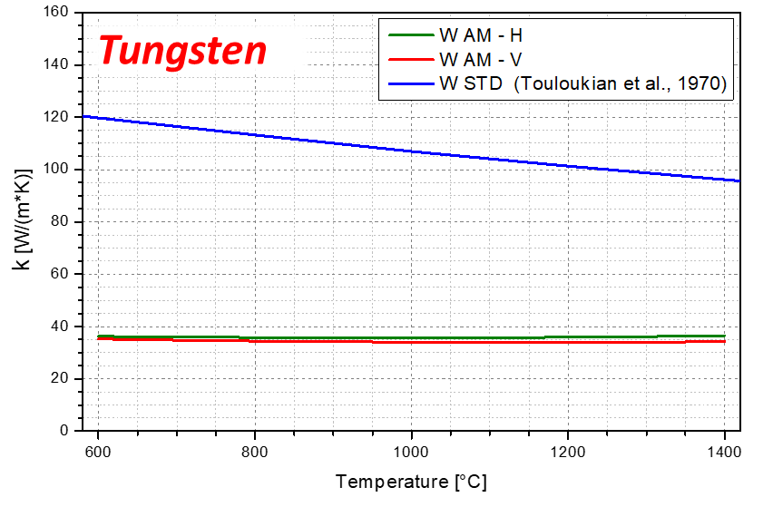
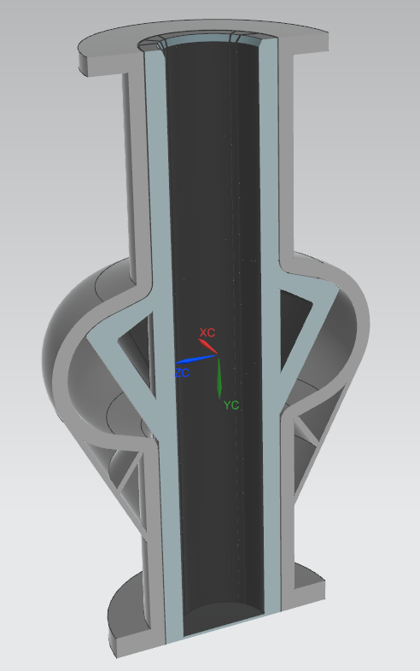
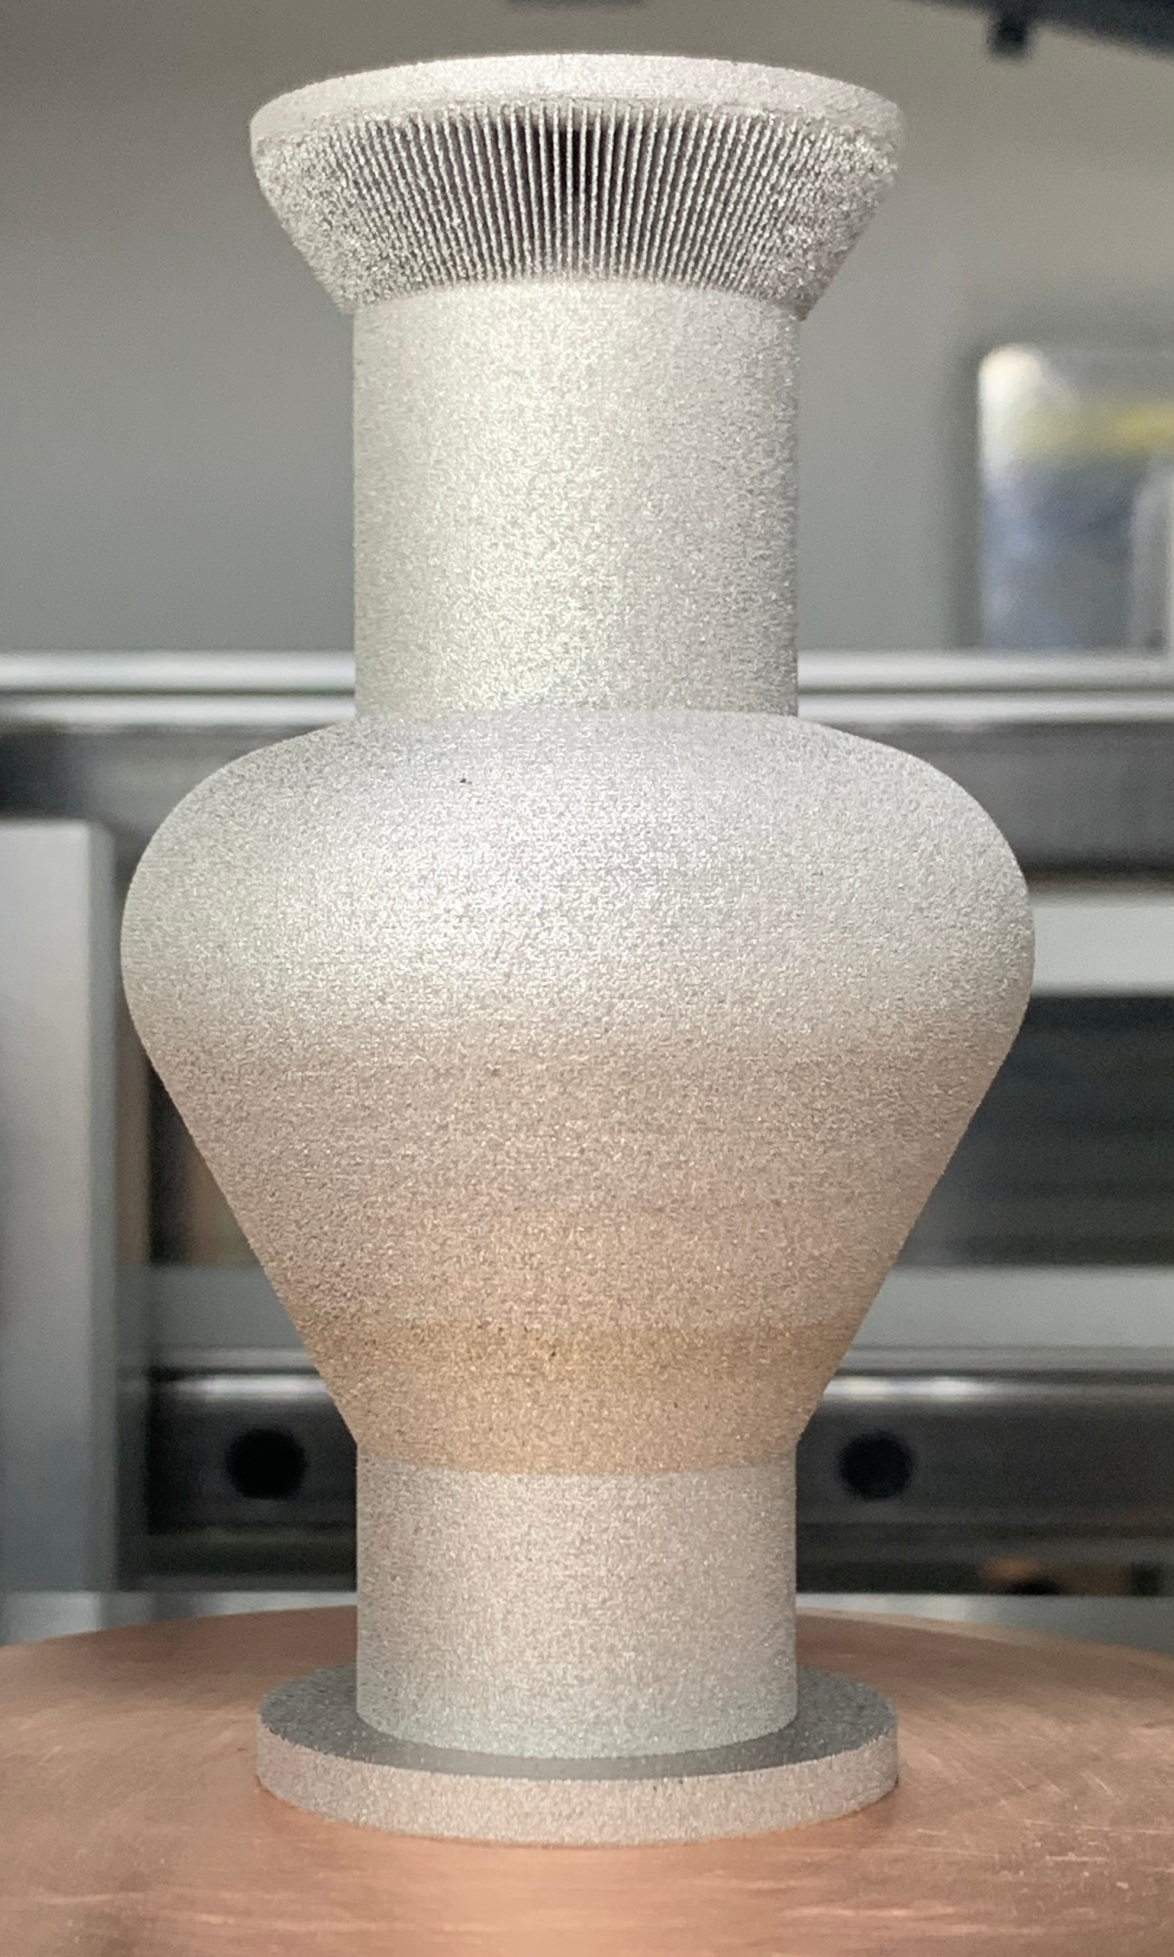
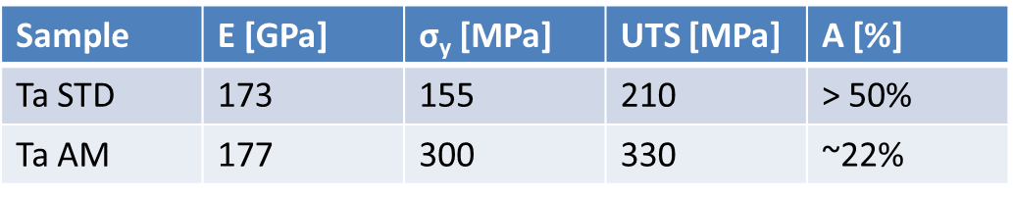
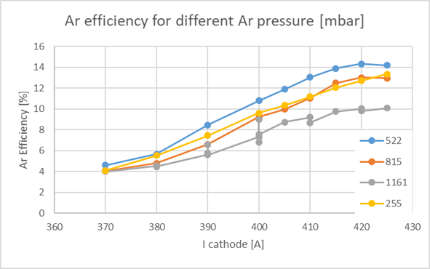
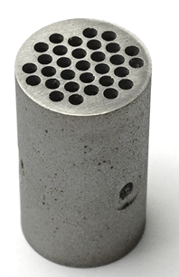
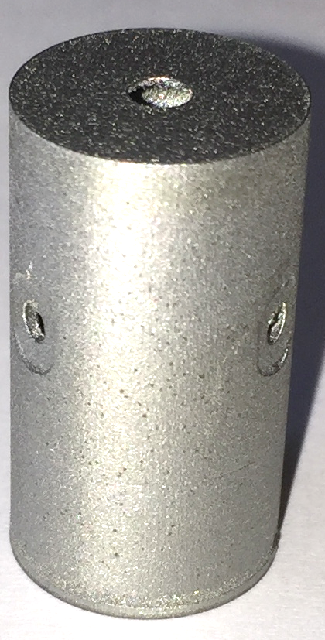
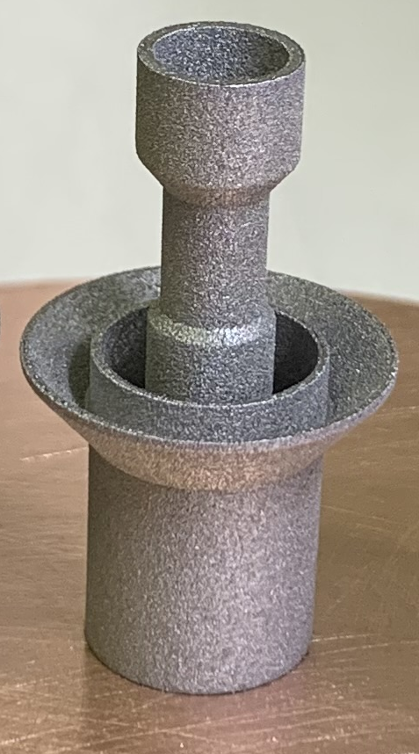
1b. AM Material Properties
• High Density (> 99.8%)
• High Density (> 99.8%)
• High Density (> 99.9%)
• High Density (> 99.6%)
• Mechanical properties higher than STD tantalum
• Extreme geometrical integrity during the production process
• Thermal and mechanical properties lower than STD
• Thermal and mechanical properties lower than STD
• Suitable for NON-STRUCTURAL components (i.e. Anode)
Ionization efficiency using AM Mo Anode comparable to STD Ta Anode
AM Anode - Mo
• Suitable for STRUCTURAL components (ex. Cathode)
AM Cathode - Ta
AM SRF 6GHz cavity - Nb

Slide 5
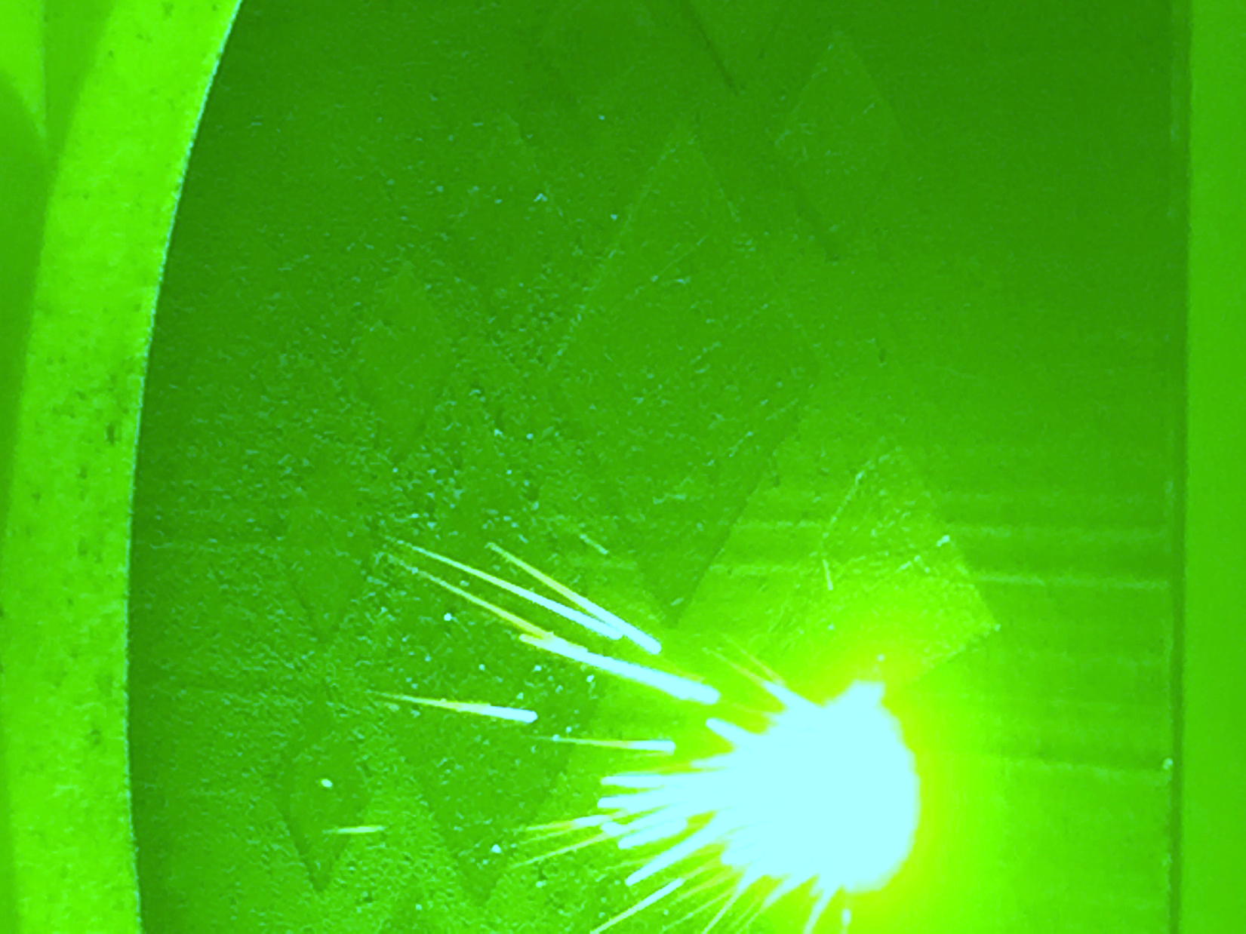
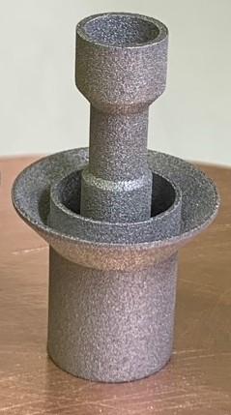
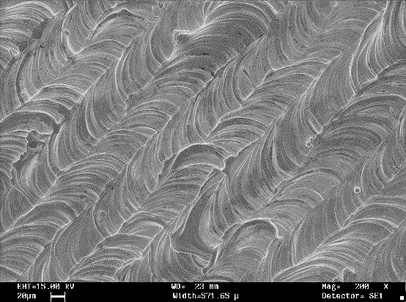

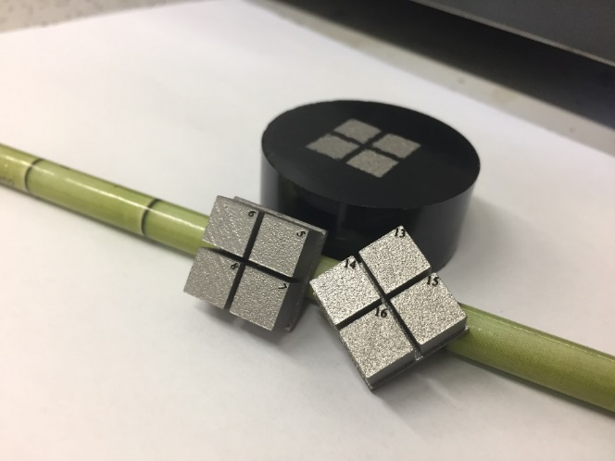

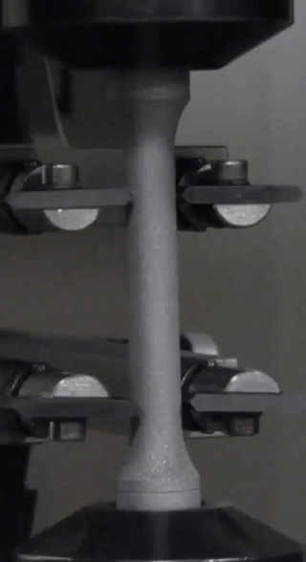
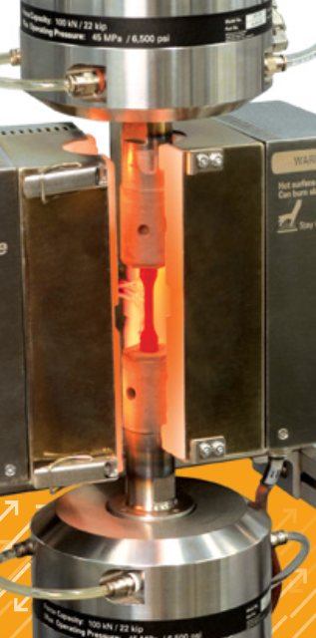
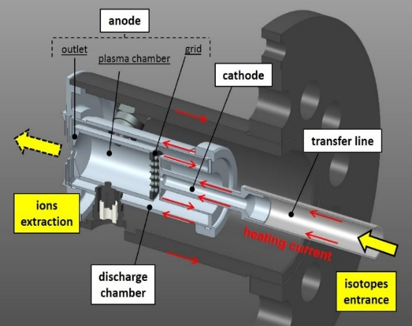
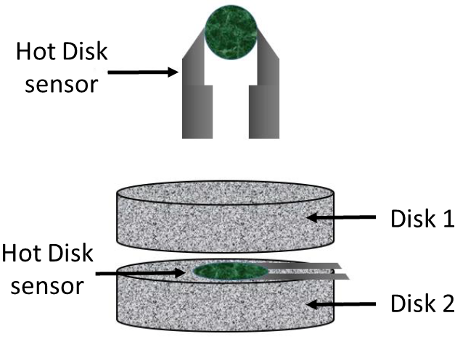
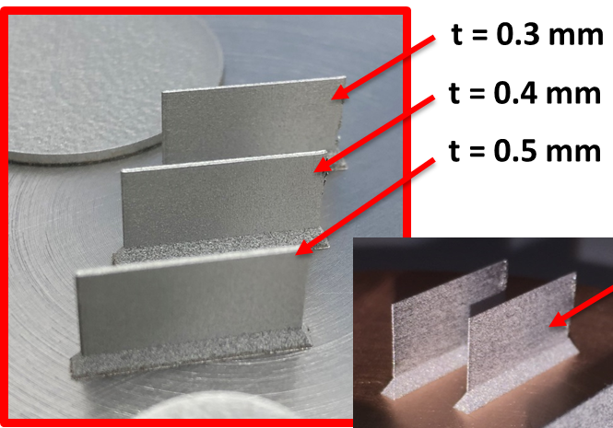
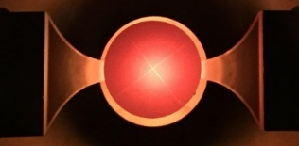

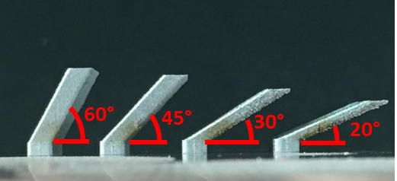

2. Project Objectives
Development of new Refractory Metals Alloys specifically Design for Additive Manufacturing DfAM (LPBF process)
→ Define the best element choice in order to improve the physical performance of the ion sources (Ta-based and/or Nb-based alloys) or to solve the fabrication defects related to pure metals production (W-based and/or Mo-based alloys).
Production & Process
Parameters tuning
State of the Art: Pure Mo and W characterization
DOI: j.addma.2021.102277 ; j.matlet.2021.130763 ; 10.1007/s00501-021-01109-y
AM Mo Anode
AM Mo Cathode
Quantitative and verifiable output:
Characterization of Refractory metals produced by LPBF
→ Metallurgical properties
→ Electrical & Thermal properties
→ Mechanical properties
Microstructural
& Surfaces morphology analyses
Geometrical Characterization
RT & HT Thermal & Electrical Characterization
RT & HT
Mechanical Characterization
Prototype production & testing

Slide 6
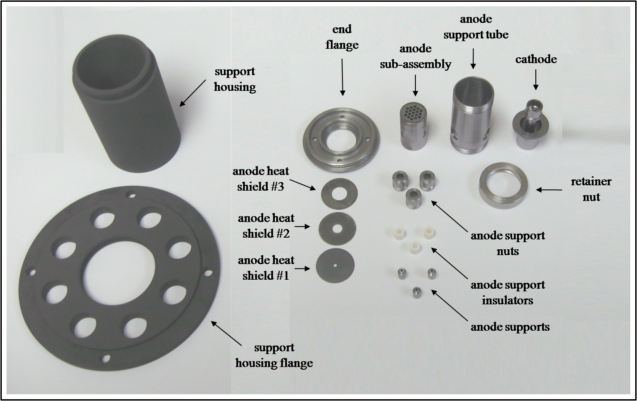
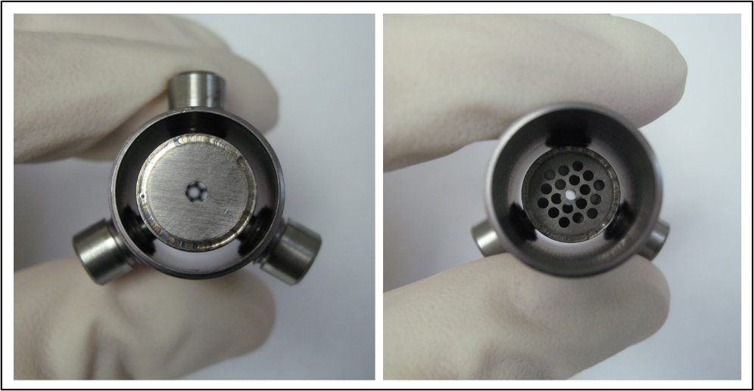
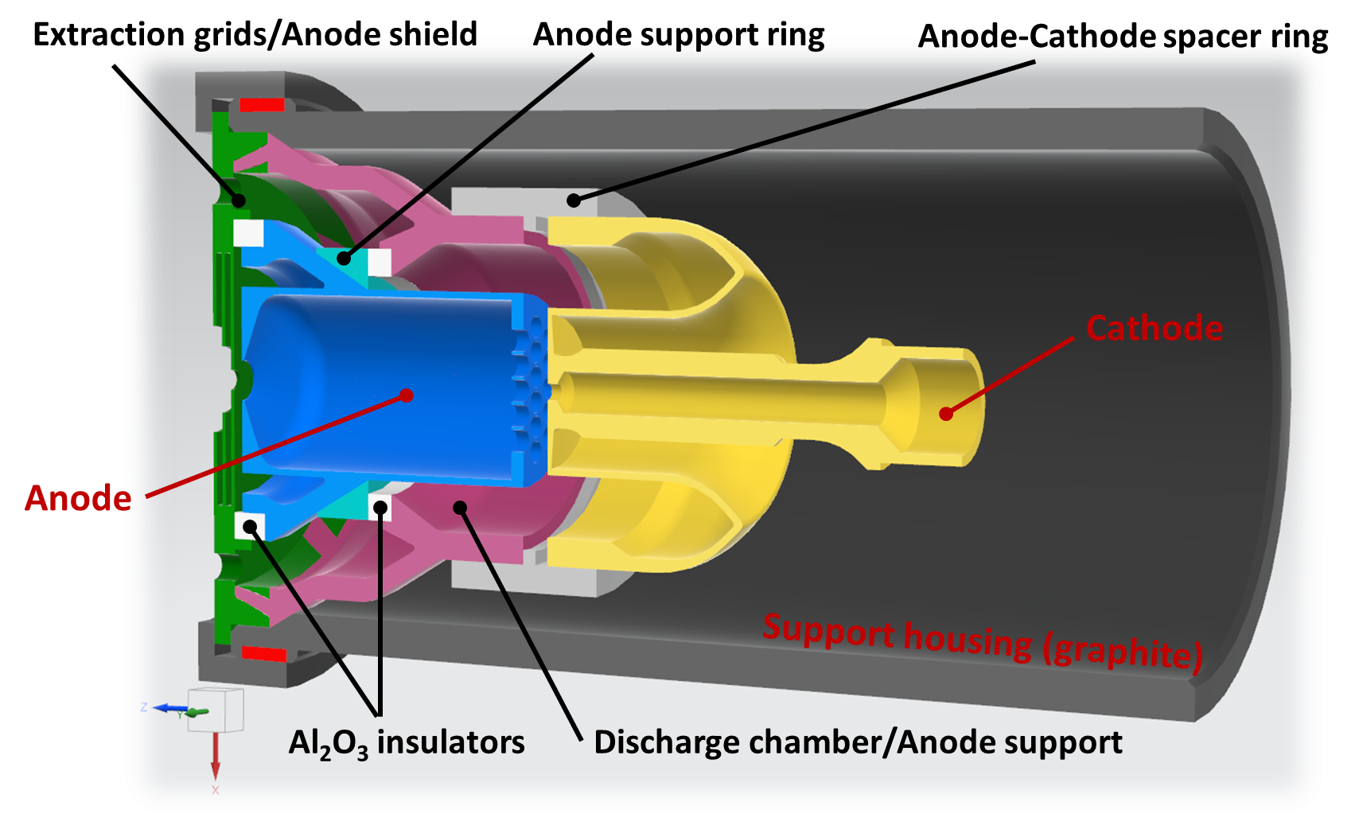
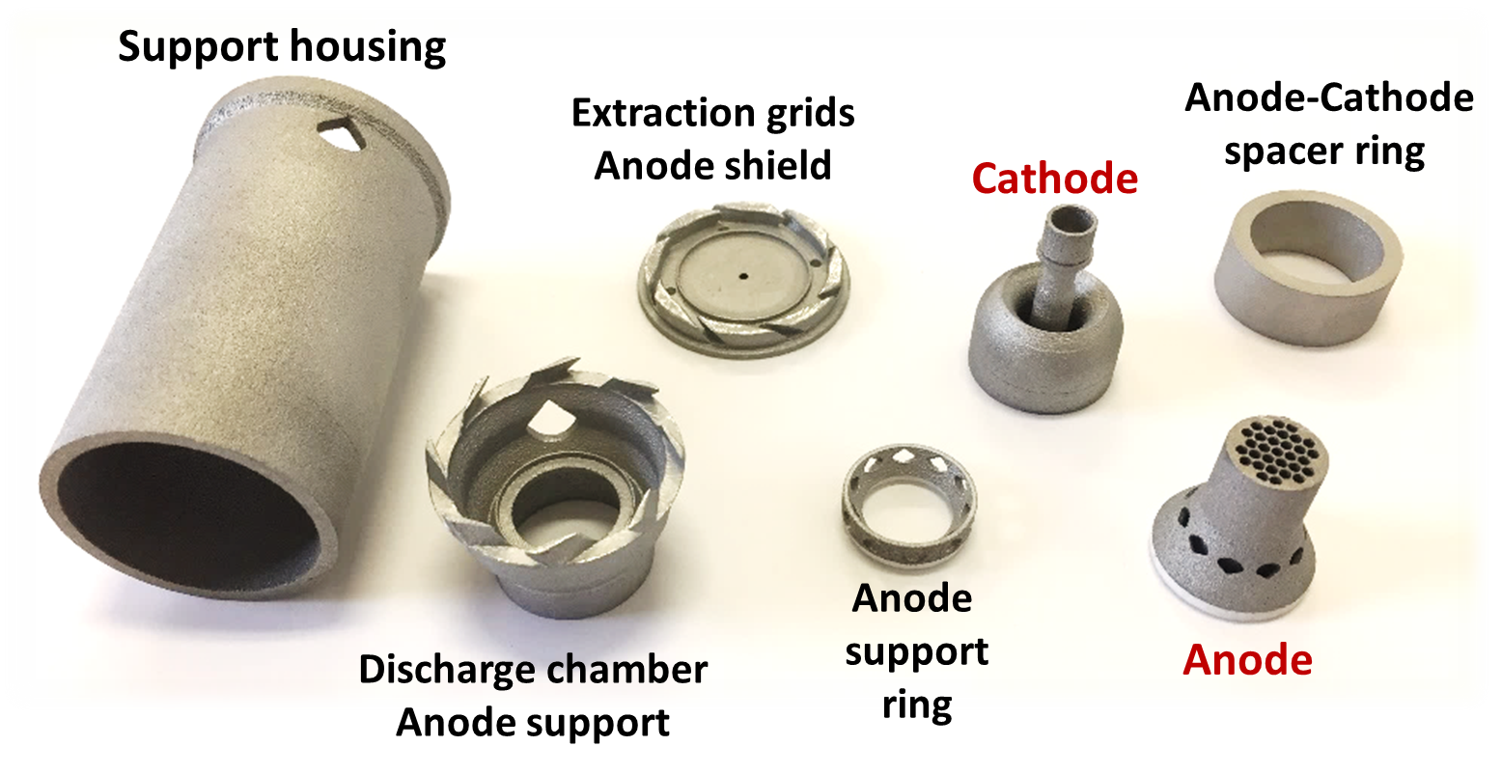
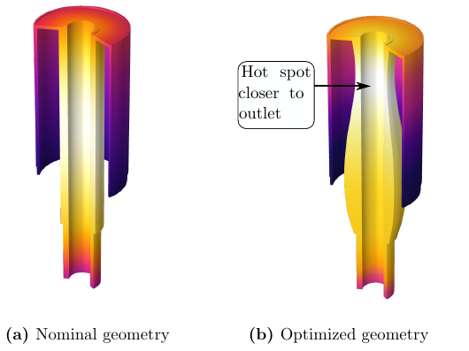
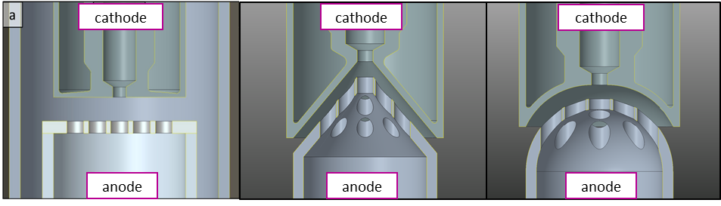
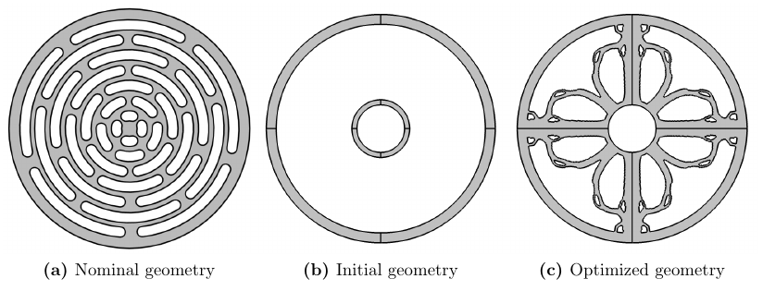
2. Project Objectives
Development and Off-line/On-line test of a New ION source designed for Additive Manufacturing production in order to:
Improve the Assembly phase: components n° reduction (from n° components > 20 → to max 8 components)
Develop a topological optimized design for the ION source physical performance improvement
Optimized Cathode shape
Anode Grid generative design
Optimized Cathode-Anode interface
State of the Art: Old traditional design of the FEBIAD Ion Source
DOI: https://doi.org/10.1063/1.4933081
Quantitative and verifiable output:
AM ION Source → New DfAM Ionization efficiency estimation

Slide 7



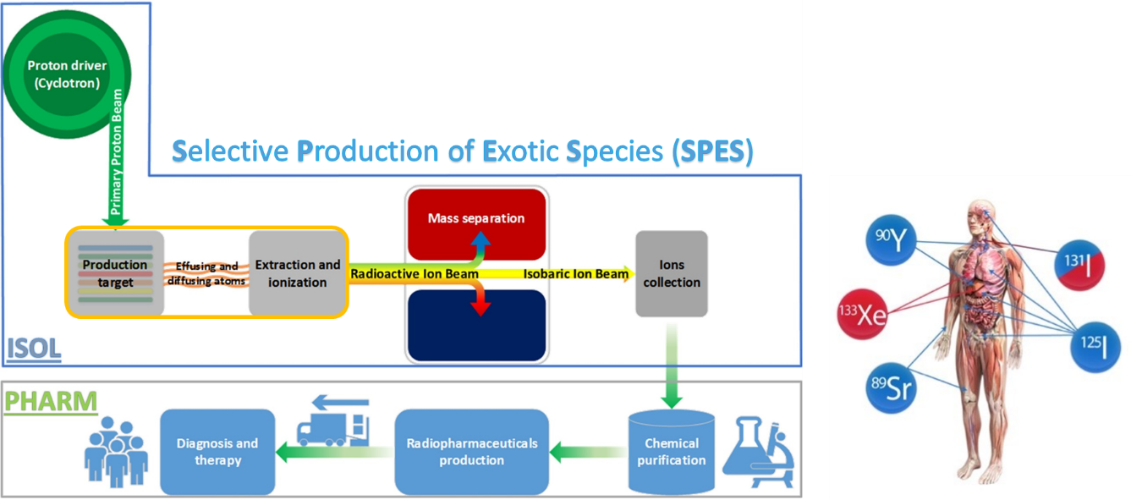
POTENTIAL APPLICATIONS of AM - ISOL Ion Sources
expected impact of the project in term of: addressable and obtainable market
investigate the feasibility of using ISOL technology to produce radionuclides as radiopharmaceutical precursors.
Commercialization and Market Analysis:
The goal is to confirm the AM technology and the FEBIAD-like ion sources for the
- MEDICAL RADIO THERAPY
- RADIOACTIVE ION BEAMS
Palenzuela et al., 2021
https://doi.org/10.3389/fmed.2021.689281
how the project addresses the environmental challenges
Ballan et al., 2021
https://doi.org/10.1016/
• AM technology reduced the amount of wasted material
• The un-melted powder can be entirely recycled
• Post-processing, which involved material waste and high energy consumption, are almost completely avoided.
• ISOL technologies for production of medical radionuclides can become a green alternative to nuclear fission reactors.

Slide 8
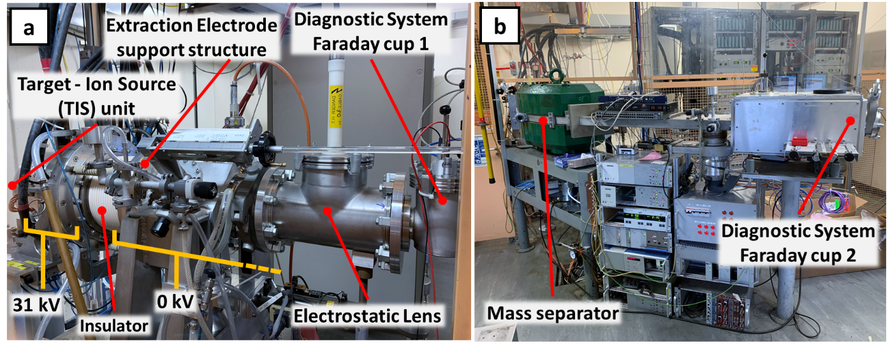
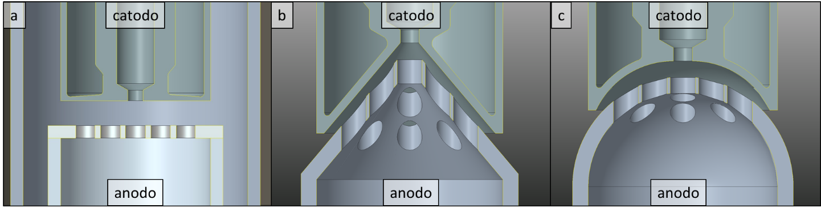
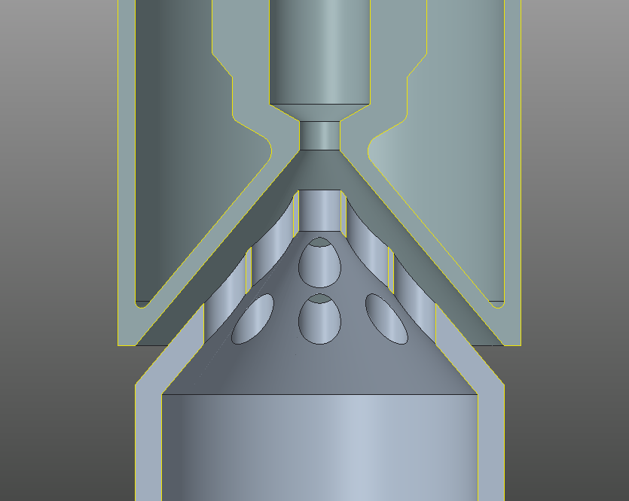
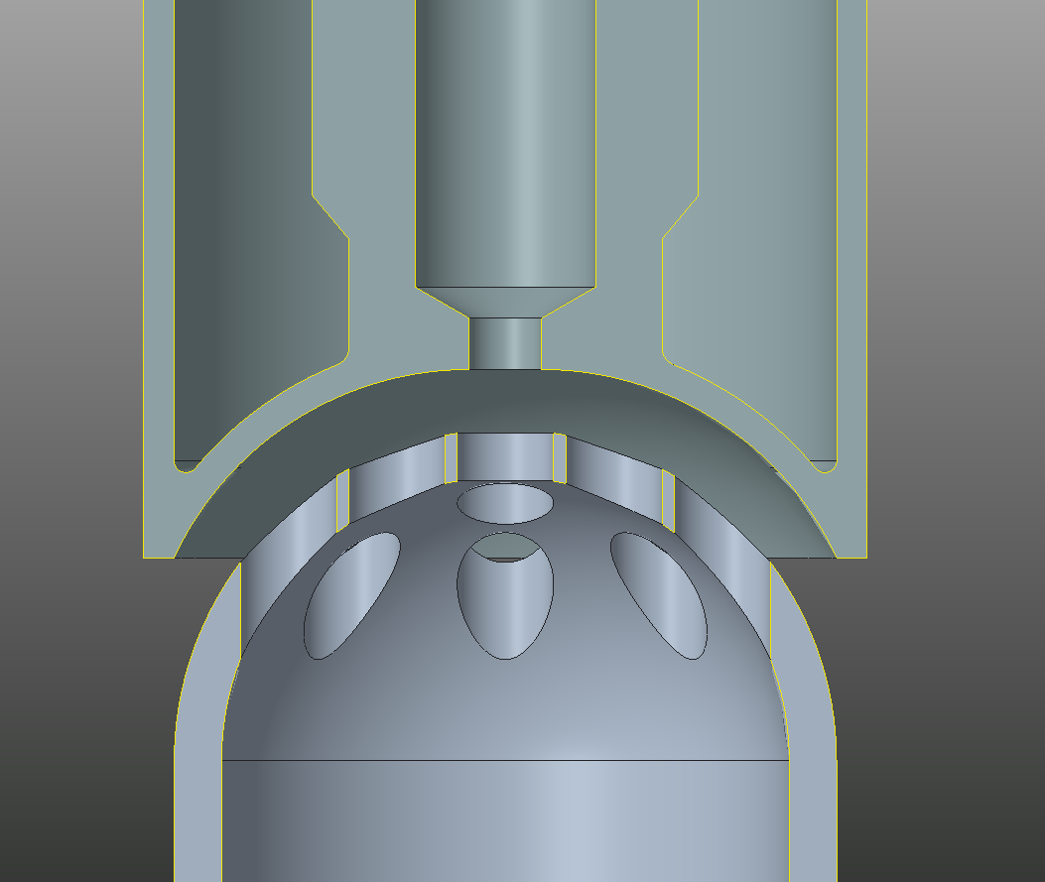
3. TRL status
2022
Ionization efficiency using AM Mo Anode comparable to STD Ta Anode
• AM Ta Cathode and Mo Anode traditional geometry production
The current TRL
• Proof of Concept Test of the AM ION Source and Prototype production
→ TRL 4
• Off-line Test of the AM Mo Anode with the traditional geometry
2025
• Production and characterization of samples with innovative refractory metal alloys and/or composite powders.
cathode
cathode
cathode
The TRL at the end of the Project
• Development of a fully refractory metals Ion Source with new Design for AM for off-line / on-line tests.
→ TRL 5
• Radioactive ion beam production (on-line) with FEBIAD Ion Sources containing AM components at CERN and/or TRIUMF.
anode
anode
anode
Future
Estimated time for TRL 6
“Technology demonstrated in relevant environment (industrially relevant environment in the case of key enabling technologies)”
2026-2027

Slide 9




4. Project Organization
Organizational Expertise
Material Characterization & Product Development
Production & Supply
of Refractory Metals
Product OFF-LINE and ON-LINE testing
Test on Potential application
(Medical Radioisotope)
Commercialization and Market Analyses
Final component AM production
Supporting company
WP1. Development and Characterization of Innovative Refractory Metals and their Alloys by AM Technology
WP2. Development of Additively Manufactured Ion Source Components
WP3. High Temperature Tests and Beam Production with Additively Manufactured Ion Source Components

Slide 10
5. Work Package and Timetable
WP1. Development and Characterization of Innovative Refractory Metals and their Alloys by AM Technology | year 1 |  |  |  | year 2 |  |  |  | End of IIF
 | M3 | M6 | M9 | M12 | M15 | M18 | M21 | M22 | M26
T1.1. Production and characterization of Additively Manufactured Ta and/or Ta-based alloys. |  |  |  |  |  |  |  |  | MS.1
T1.2. Production and characterization of Additively Manufactured Nb and/or Nb-based alloys.
T1.3. Identification and Development of refractory metal alloys and/or composite powders specifically designed for LPBF process.
T1.4. Production and characterization of samples with innovative refractory metal alloys and/or composite powders.
WP2. Development of Additively Manufactured Ion Source Components | year 1 |  |  |  | year 2 |  |  |  | End of IIF
 | M3 | M6 | M9 | M12 | M15 | M18 | M21 | M22 | M26
T2.1. Multiphysics Simulation of Ion Sources with dedicated numerical models. |  |  |  |  |  |  |  |  | MS.2
T2.2. Redesign of specific Ion Source components for an improved assembly repeatability considering hybrid AM-traditional techniques.
T2.3. Development of innovative Additively Manufactured free-form geometries to improve the performance of specific Ion Source components.
T2.4. Development of a fully AM Ion Source prototype for off-line / on-line tests.
WP3. High Temperature Tests and Beam Production with Additively Manufactured Ion Source Components | year 1 |  |  |  | year 2 |  |  |  | End of IIF
 | M3 | M6 | M9 | M12 | M15 | M18 | M21 | M22 | M26
T3.1. High temperature tests of AM Ion Source components. |  |  |  |  |  |  |  |  | MS.3
T3.2. Thermionic emission tests of AM FEBIAD cathodes and anodes.
T3.3. Stable ion beam production (off-line) with FEBIAD Ion Sources containing AM components at CERN and/or INFN-LNL.
T3.4. Radioactive ion beam production (on-line) with FEBIAD Ion Sources containing AM components at CERN and/or TRIUMF.

Slide 11
6. Milestone and Deliverable
WP1 milestones |  | Date
MS.1 | Production and characterization of Additively Manufactured Ta and/or Ta-based alloys. | M26
 | Production and characterization of Additively Manufactured Nb and/or Nb-based alloys.
 | Identification and development of refractory metal alloys and/or composite powders specifically designed for LPBF process.
 | Production and characterization of samples with innovative refractory metal alloys and/or composite powders.
WP2 milestones |  | Date
MS.2 | Development of Multiphysics numerical models for the simulation of FEBIAD Ion Sources. | M26
 | Redesign of specific FEBIAD Ion Source components for an improved assembly repeatability.
 | Multiphysics Simulation of FEBIAD Ion Sources with innovative free-form geometries.
 | Production of free-form cathodes and anodes for ISOL FEBIAD Ion Sources.
 | Production of a fully AM FEBIAD Ion Source prototype.
WP3 milestones |  | Date
MS.3 | High temperature tests of AM Ion Source components. | M26
 | Thermionic emission tests of AM FEBIAD cathodes and anodes.
 | First off-line ionization tests with a hybrid AM-traditional ion source prototype.
 | First off-line ionization tests with a fully AM ion source prototype.
 | On-line beam production at CERN-ISOLDE and/or TRIUMF with a FEBIAD Ion Source containing AM components.
WP1, D1 (M24): Written report on the production and characterization of samples with innovative refractory metal alloys and/or composite powders.
WP2, D1 (M24): Production of a fully AM FEBIAD Ion Source prototype with related CAD documentation.
WP3, D1 (M24): Written report on test with FEBIAD Ion Sources containing AM components.

Slide 12
INFN-PD In-Kind Contributions
Item | FTE months | personnel costs (EUR) | capital costs (EUR) | type of capital cost | Sum (EUR)
AM Sample production for material characterization | 3 | 8000 | 10000 | Infrastructure consumables | 18000
AM ion source components design | 2 | 5000 | 0 | None required | 5000
AM ion source production | 3 | 8000 | 10000 | Infrastructure consumables | 18000
Post-processing mechanical workshop | 3 | 6000 | 4000 | Infrastructure consumables | 10000
Total | 11 | 17000 | 8000 |  | 51000
7. Budget
TANIOBIS In-Kind Contributions → 25000 EUR
SAES-GETTERS In-Kind Contributions → 20000 EUR
GE-UPPSALA In-Kind Contributions → 14700 EUR
EOS In-Kind Contributions → 10000 EUR
    TOTAL IN-KIND: 326 k€
INFN-LNL In-Kind Contributions
Item | FTE months | personnel costs (EUR) | capital costs (EUR) | type of capital cost | Sum (EUR)
Numerical Simulations | 1.5 | 3000 | 0 | None required | 3000
Thermal-electrical characterization | 1 | 4000 | 2000 | Infrastructure consumables | 6000
Mechanical characterization | 1 | 4000 | 2000 | Infrastructure consumables | 6000
Offline Studies | 2 | 6000 | 4000 | Infrastructure consumables | 10000
Total | 5.5 | 17000 | 8000 |  | 25000
THE FUNDING REQUIRED: 100 k€
  INFN-PD → 50 k€
    Personnel: 25 k€
    Consumables: 15 k€
    Travels: 10 k€
  INFN-LNL → 25k€
    Personnel: 15 k€
    Consumables: 4 k€
    Travels: 6 k€
  ISOLDE-FACILITY-CERN → 25k€
    Consumables: 20 k€
    Travels: 5 k€
CERN In-Kind Contributions
Item | FTE months | personnel costs (EUR) | capital costs (EUR) | type of capital cost | Sum (EUR)
Numerical Simulations | 1 | 10000 | 0 | None required | 10000
Offline Studies​ | 2 | 20000 | 10000 | two offline target assemblies and infrastructure consumables​, computer tomography, material testing | 30000
Online Studies | 1 | 10000 | 10000 | Online target assembly and tests | 20000
Total | 4 | 40000 | 20000 |  | 60000
TRIUMF In-Kind Contributions
Item | FTE months | personnel costs (EUR) | capital costs (EUR) | type of capital cost | Sum (EUR)
Numerical Simulations | 2 | 14.800 | 0 | None required | 14.800
Offline Studies | 3 | 22.200 | 17.760 | two offline target assemblies and infrastructure consumables | 39.960
Online Studies | 3 | 22.200 | 21.830 | Online target assembly, NRE | 44.030
Online Material Irradiations | 2 | 14.800 | 7.030 | Irradiation sample holders, sample preparation consumables | 21.830
Total | 10 | 74.000 | 46.620 |  | 120.620

Slide 13
Thank you for your attention!
Contact information
PEPATO ADRIANO
TITLE: DIRIGENTE TECNOLOGO
PHONE: +39 049 9677015
MOBILE: +39 393 4342517
E-MAIL: adriano.pepato@pd.infn.it
WEBSITE: https://www.pd.infn.it/eng/

Slide 14
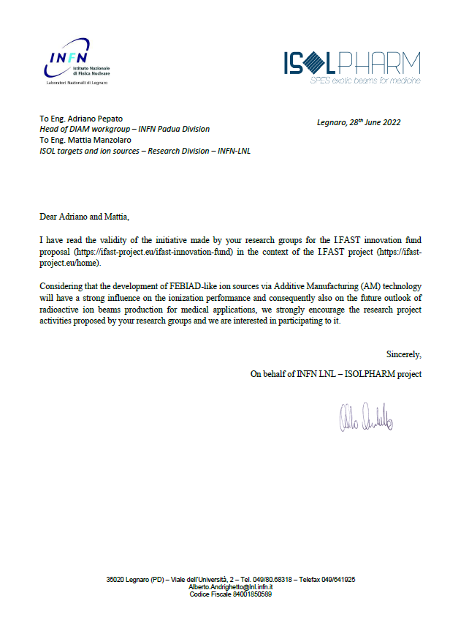
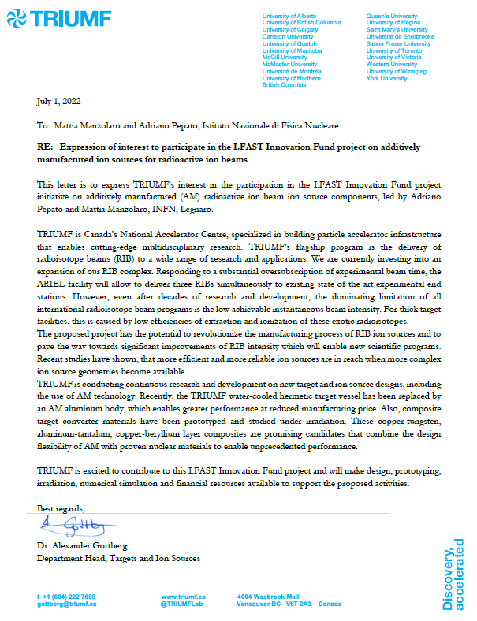
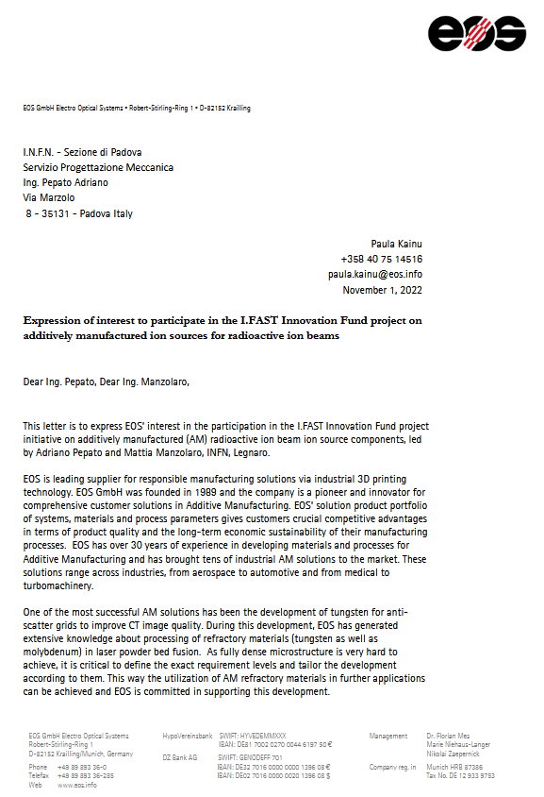
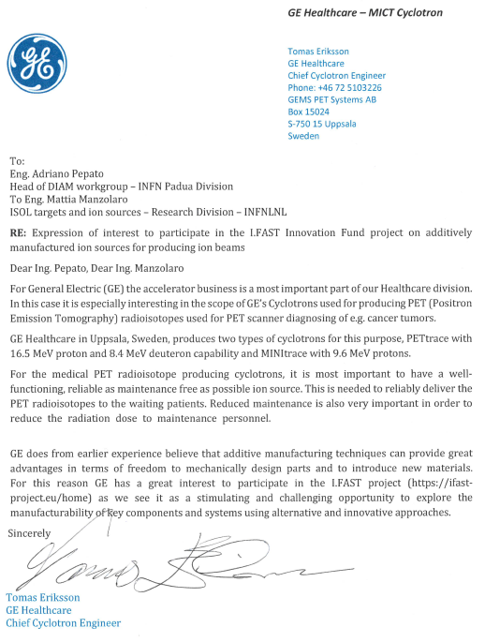
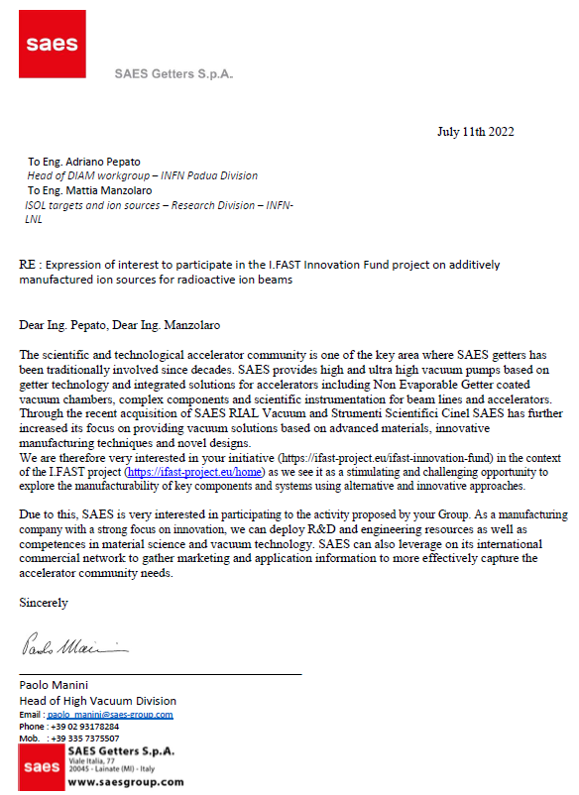
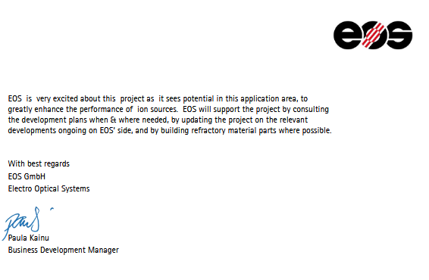

Slide 15
Extra. Personnel
INFN - PD
Name | Expertise – Activity in the project | WP | FTE months
Adriano Pepato | Project coordinator, DIAM technical coordinator | 1,2,3 | 1
Matteo Turcato |  | 1,2,3 | 2
Marco Romanato |  | 1,2,3 | 2
Daniele Mazzaro |  | 1,2,3 | 3
INFN - LNL
Name | Expertise – Activity in the project | WP | FTE months
Mattia Manzolaro | FEBIAD-like Ion Source development, SPES ISOL machine management, | 1,2,3 | 0.5
Michele Ballan | FEBIAD-like Ion Source development, thermal and electrical characterization, offline ion source studies | 1,2,3 | 2
Lisa Centofante | FEBIAD-like Ion Source development, mechanical characterization, offline ion source studies | 1,2,3 | 2
Alberto Monetti | FEBIAD-like Ion Source development, mechanical characterization, offline ion source studies | 1,2,3 | 1
TRIUMF
Name | Expertise – Activity in the project | WP | FTE months
Alexander Gottberg | Radioactive beam ion beam production, radiation damage in materials, TRIUMF coordinator | 2,3 | 2
Thomas Day Goodacre | Radioactive beam ion sources, coordinator of offline ion source studies | 2,3 | 3
Carla Babcock | Online radioactive beam ion beam production, coordinator of online ion source studies | 2,3 | 1
Ferran Boix Pamies | Material irradiation studies, microstructure, mechanical properties, coordinator of irradiation studies | 2,3 | 3
Fernando Maldonado | Numerical simulations (thermal, mechanical, electromechanical, electron and ion beam tracking) | 2,3 | 2

Slide 16
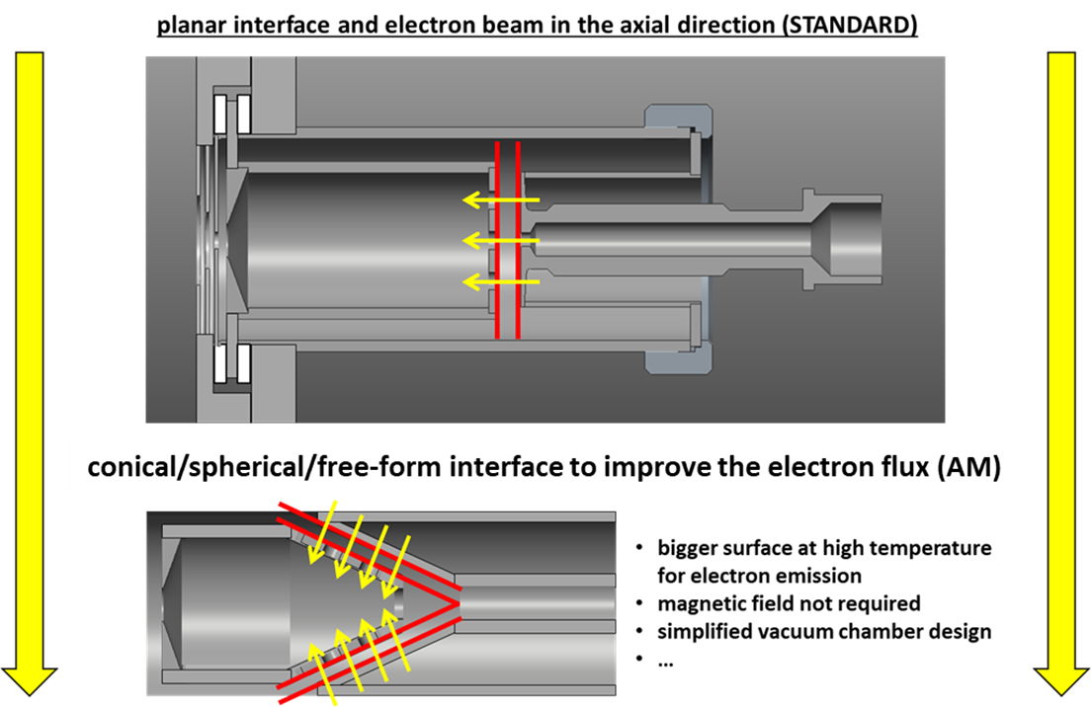
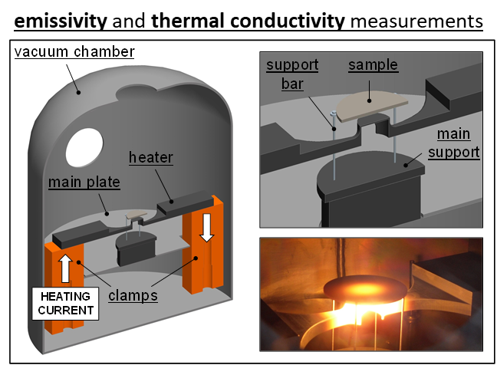
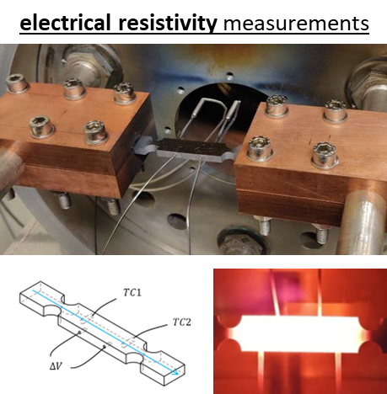
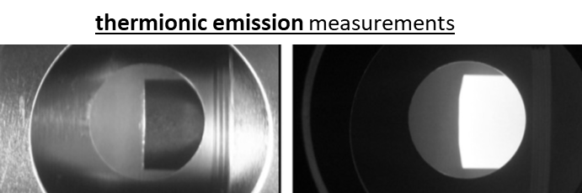
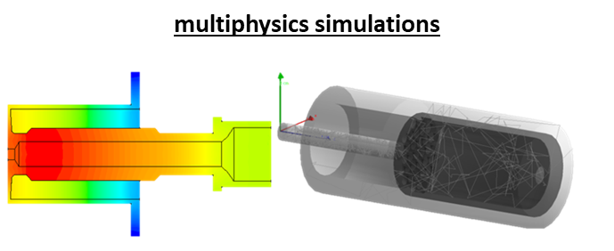
INFN-LNL Contributions

Slide 17
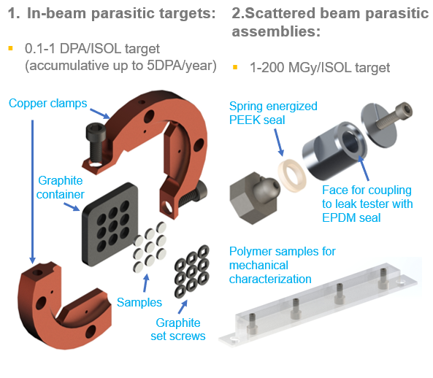
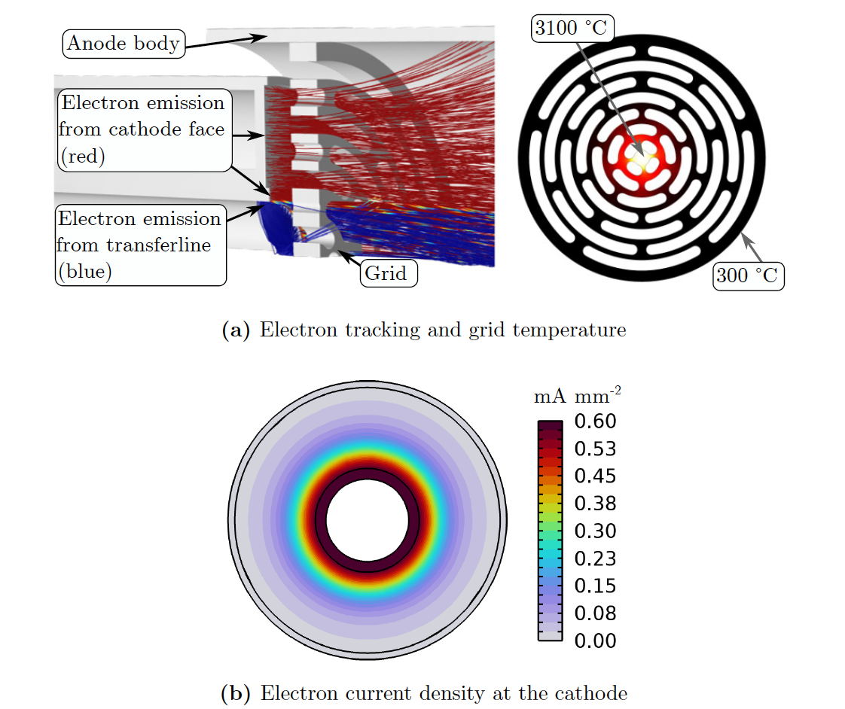

TRIUMF Contributions
TRIUMF is Canada’s Particle Accelerator Centre and is operating FEBIAD-type ion sources to produce radioactive isotope beams for fundamental research, as well as for medical and material applications. Summary of recent FEBIAD studies at TRIUMF: http://hdl.handle.net/1828/14082
Contributions to this project are in-kind and aligned with available expertise and priorities at TRIUMF
Support development of new ion source geometries through numerical FEA and multi-physics simulations to assess the temperature profile, the electron beam density, the electric field distribution inside of the anode and finally the ionization efficiency and ion beam emittance. This will result in qualifying a set of geometries for experimental studies.
Full ion sources of selected geometries will be manufactured by through this collaboration and integrated into dedicated TRIUMF radioisotope beam production target assemblies. These assemblies are used for offline studies assessing the performance of the ion source to ionize stable ion beam with high efficiency and reliability to validate the manufacturing processes, as well as the performance improvements predicted from the newly available complex geometries.
To qualify the AM methodology for this application, material irradiation damage studies will be conducted using an existing 500 MeV irradiation station. Different refractory AM materials will be qualified for high-energy and high-power particle irradiation by assessing their mechanical properties before, during and after irradiation.
After offline validation, a selected geometry will be integrated into an online TRIUMF radioisotope production target and submitted to 500 MeV proton beam. These online studies will act as TRL5 for the production of radioactive isotope beams using tailor-made AM ion source.
Cathode shape-optimization
Grid generative-design-optimization

Slide 18
SAES Getters contribution
SAES getters is an Italian company with a strong focus on accelerator community to which it supplies NEG pumps since the 70s and more recently vacuum chambers, components and scientific instrumentation for synchrotron beamlines through SAES RIAL Vacuum and Cinel (both 100% part of the SAES Group).
SAES is relatively new to AM but keen to explore the opportunities of this technology for accelerator components like the ion sources with improved efficiency and design.
SAES will dedicate marketing and commercial resources to map the existing facilities, evaluate the applicability and advantages of the FEBIAD design, quantity the potential needs and the technical requirements. This should provide a clear perspective about the potential market, the requirements and also a viable route to the technology diffusion.
SAES will also take care of exploring the IP matter through its internal IP office.
As a manufacturing company, SAES is also potentially interested in manufacturing and selling the ion sources themselves. We will explore this opportunity in the course of the project.
The project leader for SAES is Dr. Michele Mura, Head of the Divisional Development Lab. One senior technician and a sales/marketing expert will support the technical and market scouting activity, respectively.
A total of 4 months (2 people for 2 months) over the span of the project will be deployed. The estimated cost is 20KEuro which will be fully absorbed by SAES as in kind contribution to the project.

Slide 19
The possible contribution requested to EOS:
Production of samples for material properties evaluation (ex. Cubes for density measurement, samples for mechanical static test, cylinder of 40mm diameter and 20mm high for thermal properties) using one of the selected refractory metals alloy Mo-based (ex. TZM) as well as optionally Nb and/or Ta
Production of non-structural components prototype of the ION Source (ex. Anode – about 30 mm high and 15 mm diameter) using one of the selected refractory metals alloy Mo or W-based aforementioned.
Requirements:
Use of a LPBF machine that
  allows the platform to be heated up to 450°C and/or 800°C
  allows the application of a controlled cool down (ex. at a rate of 100 °C per hour).
  Reference: the machine that EOS has supplied to PLANSEE (see the link of the paper below).
State of the Art: https://doi.org/10.1016/j.ijrmhm.2020.105369
What is provided to EOS:
The powders, which will be purchased using the budget provided by the project (pre-processing step)
The material characterization using the sample produced by EOS (post-processing step) as well as in-application (ion source) performance data
Contribution/support for process parameters tuning based on INFN DIAM experience with pure refractory metals production and characterization.

Slide 20
In-kind contribution:
EOS will contribute by producing samples as described in this document
In-kind contribution elements:
Engineering resources
Machine operation resources
Machine time (up to 5 jobs per system type)
Total in-kind contribution: 8 000 – 10 000 €
At EOS Finland, we only have a system that can go up to 450C. We have within our ecosystem another system that can go up to 800C,
I need to check about the control on the cooldown, how this is managed
We would potentially be interested in supporting the project in the Niobium efforts as well – if agreeable to the project, I’ll discuss with our R&D
In this project, besides the characterization data we would like to receive also detailed application performance data (I assume this is already part of the frame work?): FINE
The in-kind contribution is 8-10k€ because of the uncertainty on the 800C trials and bringing in of Nb, as well as the amount of work finally involved for process settings finding for the higher temperatures

Slide 21
In-kind contribution: TANIOBIS
Markus Weinmann wrote:
we decided to provide you up to 50 kg of Ta or Nb and will support your project with a discount for the powder purchase and personnel efforts in the range of 25.000 €.

