Slide 1

IFAST IIF PITCH
Demonstration of additive manufacturing for large and complex shaped vacuum chambers by Plasma Metal Deposition (PMD®)
RHP Technology GmbH (I-FAST partner)
Company Partner: SBI GmbH
Submitted by:
Dr. Erich Neubauer
RHP Technology GmbH

Slide 2
Background and aim (I)
SBI is an SME which is well known in plasma welding technology and as provider of additive manufacturing systems (PMD)
RHP is I-FAST partner and has demonstrated the successful use of the PMD process for manufacturing of complex structures relevant for space application.
Plasma Metal Deposition (PMD) is an additive manufacturing method which allows to fabricate near net shape components

Slide 3
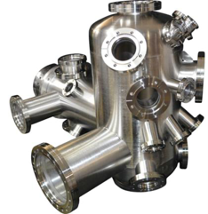
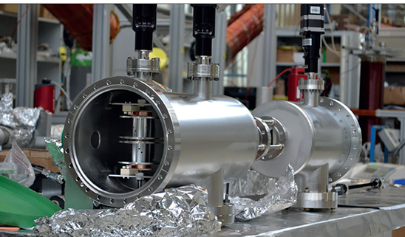
Background and aim (II)
Accelerator science and technology requires several vacuum chambers as well as chambers for analysis systems
There are many other areas, e.g. thin film deposition, semiconductor manufacturing or analytics which require vacuum chambers
The PMD allows to realize complex shapes and reduces the amount of raw materials required.
Therefore, PMD has a positive impact on the environmental footprint.

Slide 4
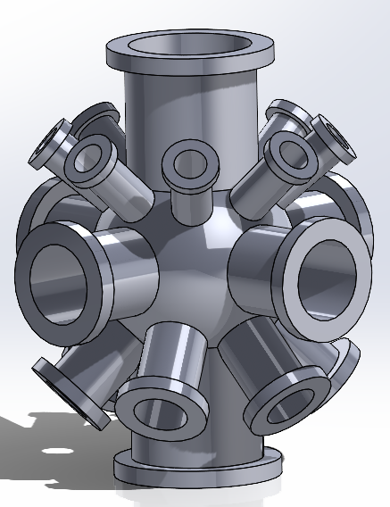
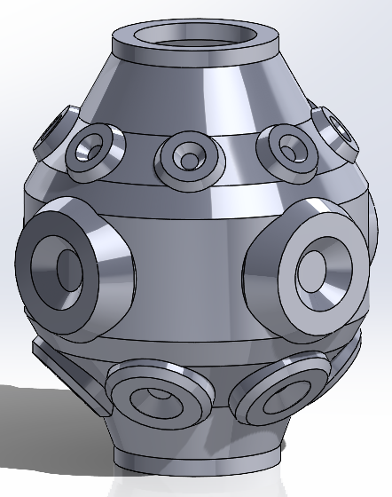
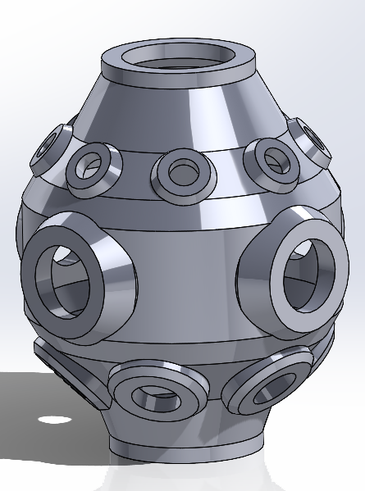
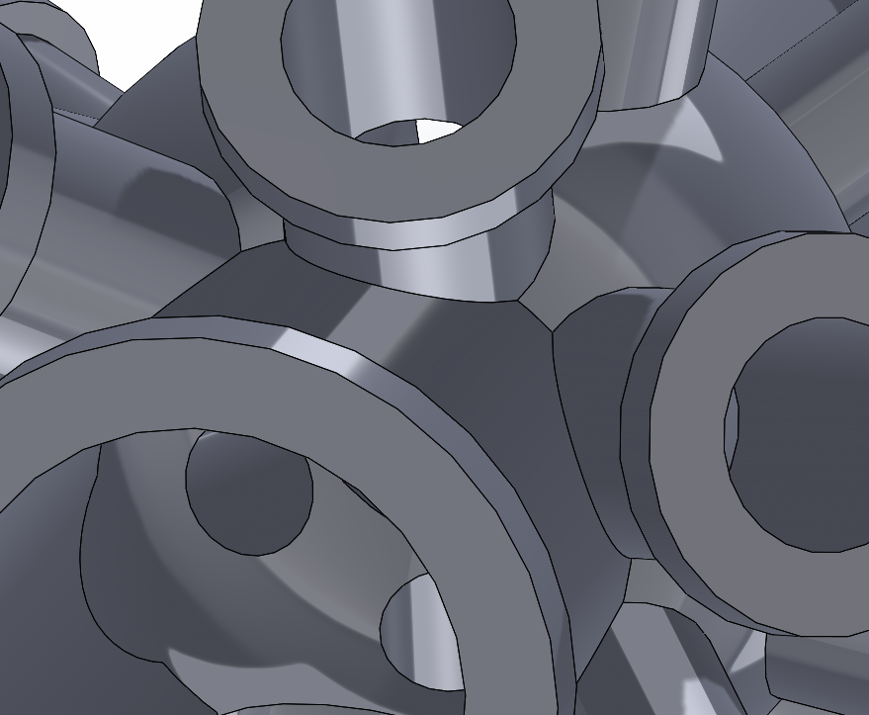
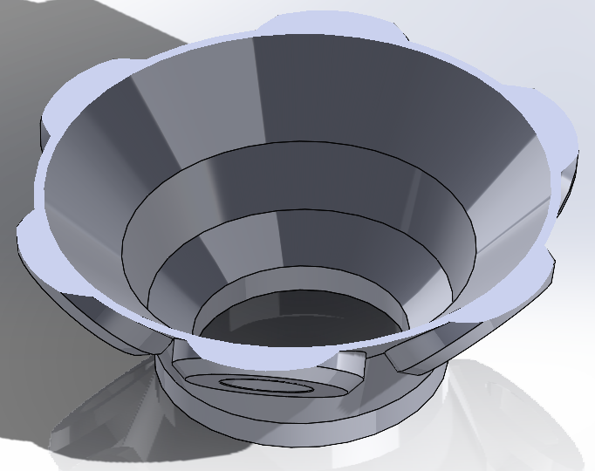
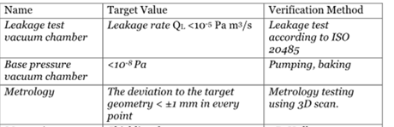


Preliminary design of demonstrator
Proposed evaluation of demonstrator
Measurement of the maximum vacuum level achieved:
Determination of leakage rate
Metrology of the geometry – 3D scan //roughness
Assessment of microstructure/ porosity level on test coupon level
Extraction and mechanical testing of samples
Monitoring of building process
Final "buy to use" ratio
Estimated printing time: 40h
Ø250mm
500mm
460mm
>60 kg required including of waste for milling of flanges
Building of ca. 40 kg
Final weight after machining: ca. 30kg
24 kg
~40 kg

Slide 5
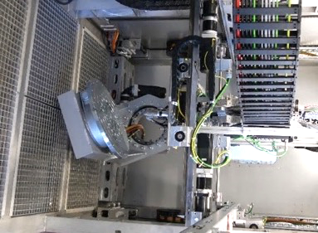
Benefits by using PMD
A generic model of a vacuum chamber is proposed to integrate different features (flange sizes/angels etc) in one demonstrator to demonstrate:
Reduction of material waste by 30 % and more possible
Reduction of integration steps (tool path generation-building-machining) compared to multiple welding operations (>20)
Less stock material required => only wire + building platforms – instead of four different flanges + main vessel
Significant less components which have to be sourced and integrated (typically >20 versus 2 for PMD)
Reduction of lead time (less than 2 weeks possible: one week building + 1 week milling versus several weeks )
Cost efficient, especially for alloys such as Titanium

Slide 6
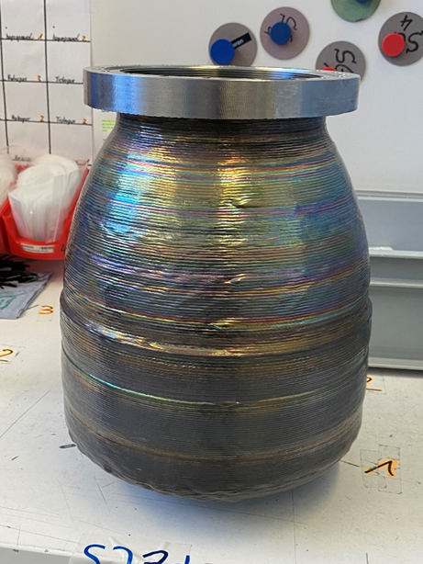
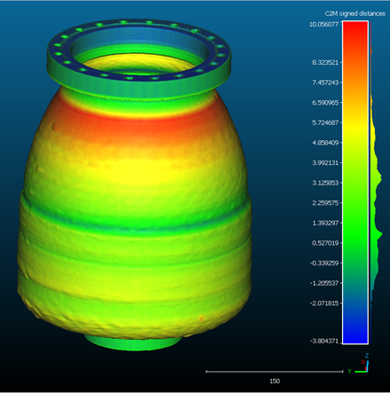
Technical overview/ TRL status
RHP has demonstrated within a feasibility for the European Space Agency the suitability of the PMD process for a vacuum application.
The manufacturing technology was validated in the lab environment (TRL4)
The goal is the validation of the technology on a complex and larger chamber including the exposure of the chamber to industrial relevant environment => TRL 5
In a next step the same system can be tested and demonstrated including various analytical devices. This includes demonstration of multiple bake out and cycling (TRL6)

Slide 7
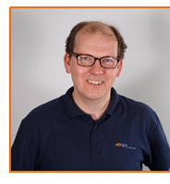


Work Plan and team (1)
Core team:
  RHP: Erich Neubauer, Founder and Managing Director of RHP; responsible for technology development at RHP and more than 20 years of experience
  RHP: E. Ariza; Head of Additive Manufacturing and background in aerospace engineering
  SBI: J. Niedermeyer: AM specialist at SBI with background in welding technology

Slide 8
Work Plan and team (2)
WP 1: Design of demopart for vacuum chamber (Jan 2023 – April 2023)
  WP 1.1: Design of vacuum chamber – demonstrator part (01/23-02/23)
  WP 1.2: Tool path generation for subsize model and full size model (03/23-04/23)
  WP 1.3. Modification of torch/build platform/preparation of jigs for mounting (01/23-04/23)
    MS1: Manufacturing Readiness review (April 2023)
    D1: Design of chamber and and detailed Manufacturing plan (April 2023)
WP 2: Manufacturing of demonstrator chamber (May 2023 – September 2023)
  WP 2.1: Manufacturing of subsize model and assessment (05/23-06/23)
  WP 2.2: Manufacturing of full size model (07/23-08/23)
  WP 2.3. Finishing of vacuum chamber (09/23-09/23)
    MS2: Demo part available/ test readiness review (September 2023)
    D2: Manufacturing Report => PAYMENT 1 (September 2023)
WP 3: Analysis of vacuum chamber and technology assessment (October 2023-Dezember 2023)
  WP 3.1: Testing of vacuum chamber and metrology (10/23-11/23)
  WP 3.2: Technology assessment and plan for upscaling of technology (10/23-12/23)
  WP 3.3. IP analysis and IP protection (10/23-12/23)
    MS3: Manufacturing Readiness review (December 2023)
    D3: Final Report => PAYMENT 2 (December 2023)

Slide 9
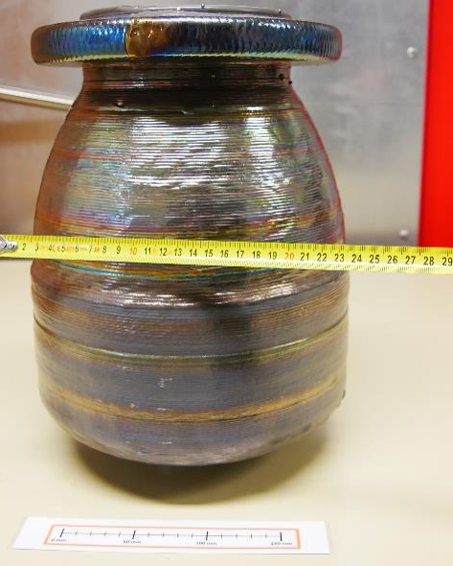
Risk analysis
  The manufacturing of large structures contains a certain risk such as deformation and warpage => additional heat treatment might be required
  Large structures might be linked to issues in welding parameters => using of monitoring systems and inspection systems will be employed (data logging)
  Issues with surface finish – surface roughness might impact on the pumping duration when evacuating => additional post treatment might required /e.g. blasting or trovalisation

Slide 10
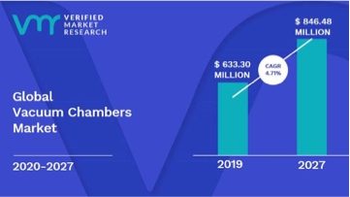
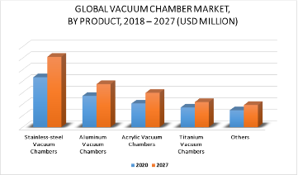
Applications and impact
  The Global vacuum chamber market shows an average of 4,7% annual growth rate
  The market will expand to 846 Mio Euro in 2027
  The dominating market will be chambers made from stainless steel but also titanium chambers are required.
  Besides large research infrastructure thin film technology and semiconductor are additional areas of interest
Vacuum Chamber Forecast7
Comparison of vacuum chamber forecast by material8

Slide 11
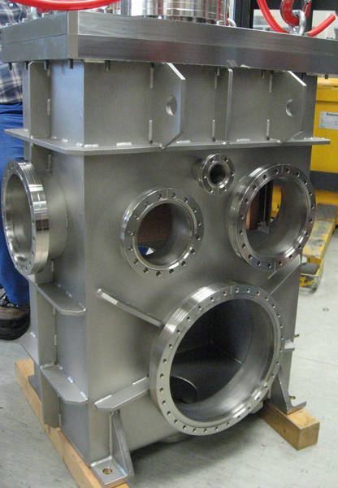
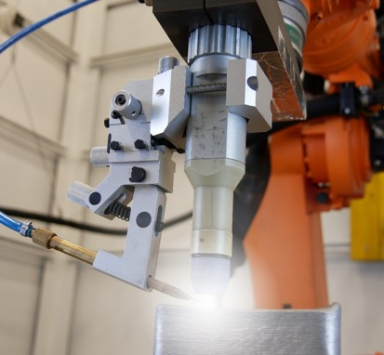
The commercialization
First step is the successful demonstration of a complex vacuum chamber geometry
Due to the limitation of the available PMD systems, SBI will develop and build a larger systems in future (based on a robotic system) allowing to prepare structures with size of several meters
The addressable market is mainly found in high specific areas, e.g. in big science as well as companies which are working in the fabrication of analytical systems or even thin film deposition equipment.
Targeting > 1% of global market in a 5 years time frame would result in a market of close to 10 Mio. Euro (investment in additional equipment required).
Using of available manufacturing equipment for smaller sized chambers, e.g. 50-100 units per year would be possible resulting in a turnover of 1-2 Mio. Euro.

Slide 12
Resources and budget (Total: 100.000 Euro)
RHP costs
  Material costs: 15.000 Euro (for wire, base plates, milling tools
  Third party contracts: non destructive inspection and finishing of flanges: 15.000 Euro
  Personal Costs Researchers and PMD team: E. Ariza (450 h), E. Neubauer (150h); technicians: 600h: 45.000 Euro
SBI costs
  Material costs: 5.000 Euro for adaption of system
  Personal Costs Researcher: J. Niedermayer (300h) and technicians team (300h) at SBI: 20.000 Euro

Slide 13
Contact information
Primary Contact
Erich Neubauer
Title: Dr
Phone: 0043 2255 20600
Mobile: 0043 6509151074
E-MAIL: e.ne@rhp.at
WEBSITE: www.rhp-technology.com
SOCIAL MEDIA:https://www.linkedin.com/company/rhp-technology/mycompany/

Slide 14
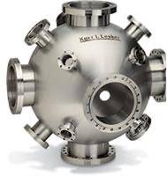
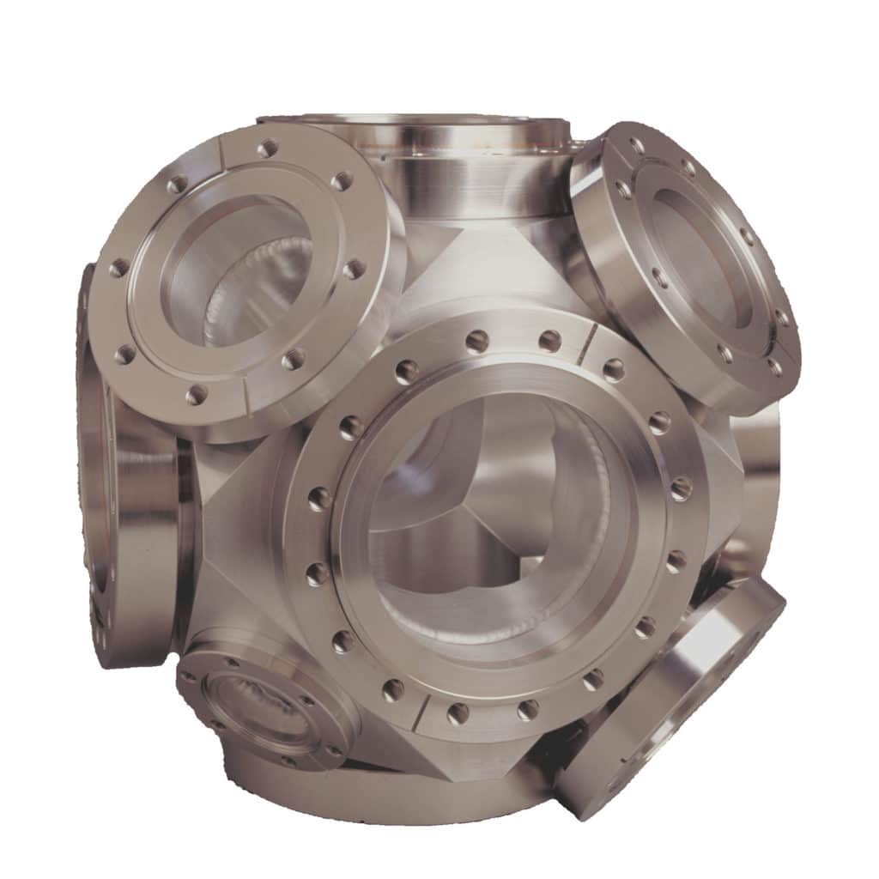
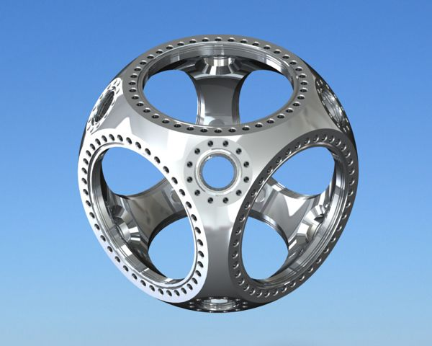
Manufacturing of vacuum chambers
Manufacturing today requires different manufacturing techniques, .e.g. sheet metal forming (requires tooling), alignment of components followed by welding, milling and inspection
Some chambers are machined from a block which requires intensive milling
Chambers for XHV (Extreme High Vacuum) are made preferred from Titanium alloys where low magnetic permeability of titanium is a key advantage
140 kg raw material required
ca. 14 kg remain after milling

Slide 15
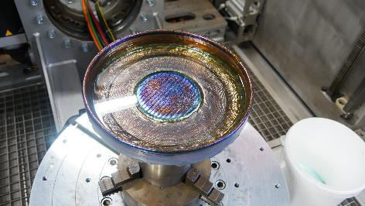
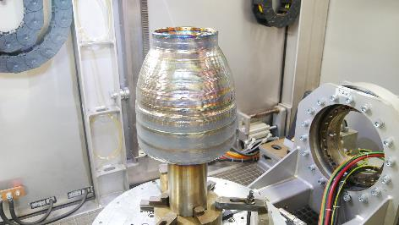
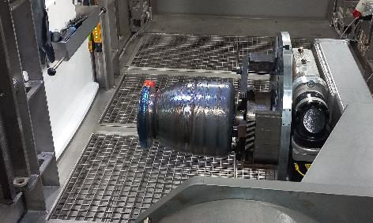
Technical overview
The first test vehicle of a vacuum chamber was made by a plasma arc combined with wire fed.
Using the PMD system of SBI with slight modifications we target to demonstrate the manufacturing of a vacuum chamber with size of >1 meter.

Slide 16
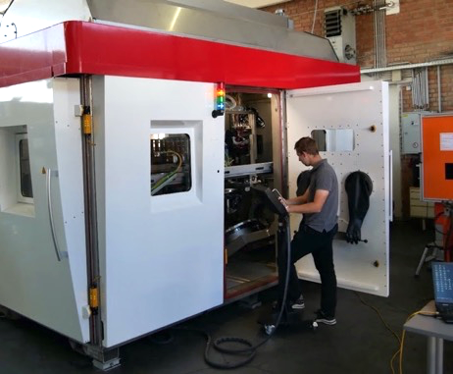
Business Plan
PMD is a method which allows to prepare complex shapes in combination which high deposition rates
RHP is owner of the trademark “Plasma Metal Deposition” and the demonstration of the successful use of this technology will enable SBI to expand its activities to large PMD systems
SBI and RHP are targeting to exploit the technology as follows
  RHP as technology provider and service provider for the manufacturing of vacuum chambers
  SBI as technology enabler of selling PMD systems for manufacturing of vacuum chambers

Slide 17
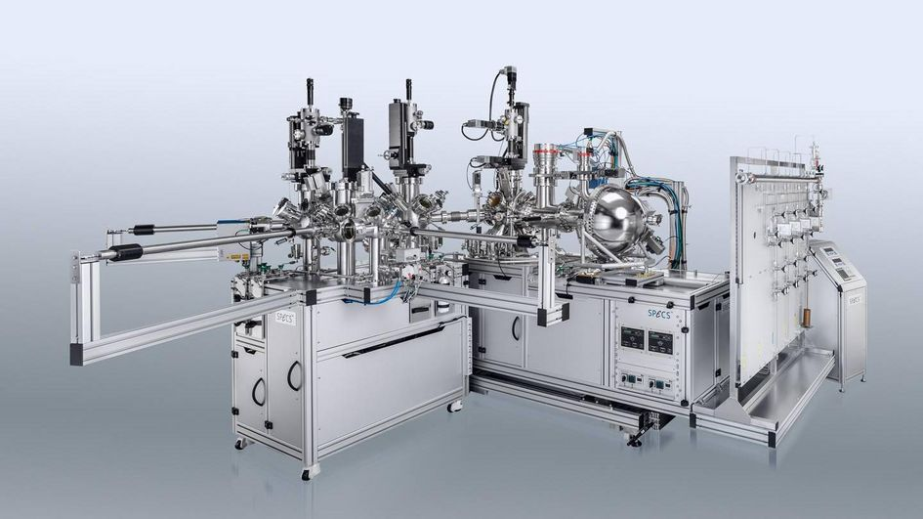
Additional in-kind contribution
RHP has identified the company SPECS as a potential cooperation partner for performing additional vacuum related tests
SPECS is a worldwide known company proving high vacuum analytical systems for various industries
Target is to get support from SPECS for assessment of results

