Slide 1
ISOLDE Technical Report
71st Meeting of the INTC – 8th November 2022
Joachim Vollaire (Technical Coordinator) on behalf of ISOLDE Technical Teams

Slide 2

Outline
Restart of REX/HIE Linac / Status of the facility(update since June)
Machine Development: 1.7 GeV proton beam to GPS
Update on target lifecycle
Conclusions and Perspectives

Slide 3
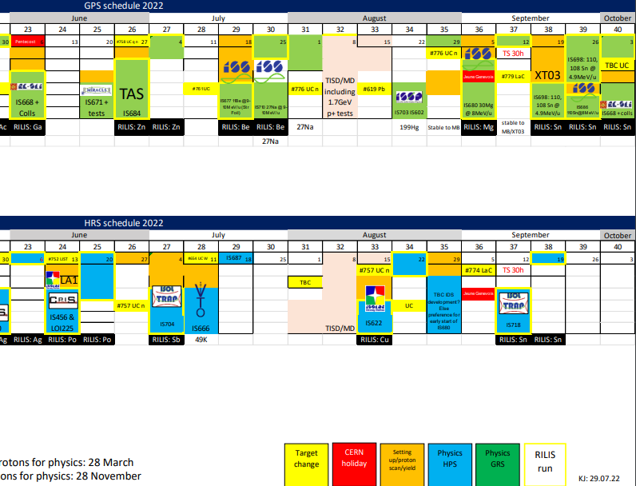
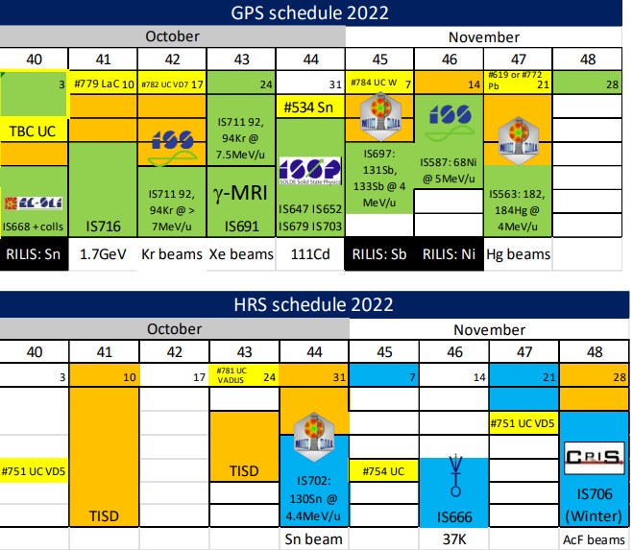
ISOLDE 2022 Schedule
Last INTC Meeting
Physics with protons not impacted by CERN decision to anticipate the start of the YETS (energy saving measure)
One week of winter physics being discussed

Slide 4
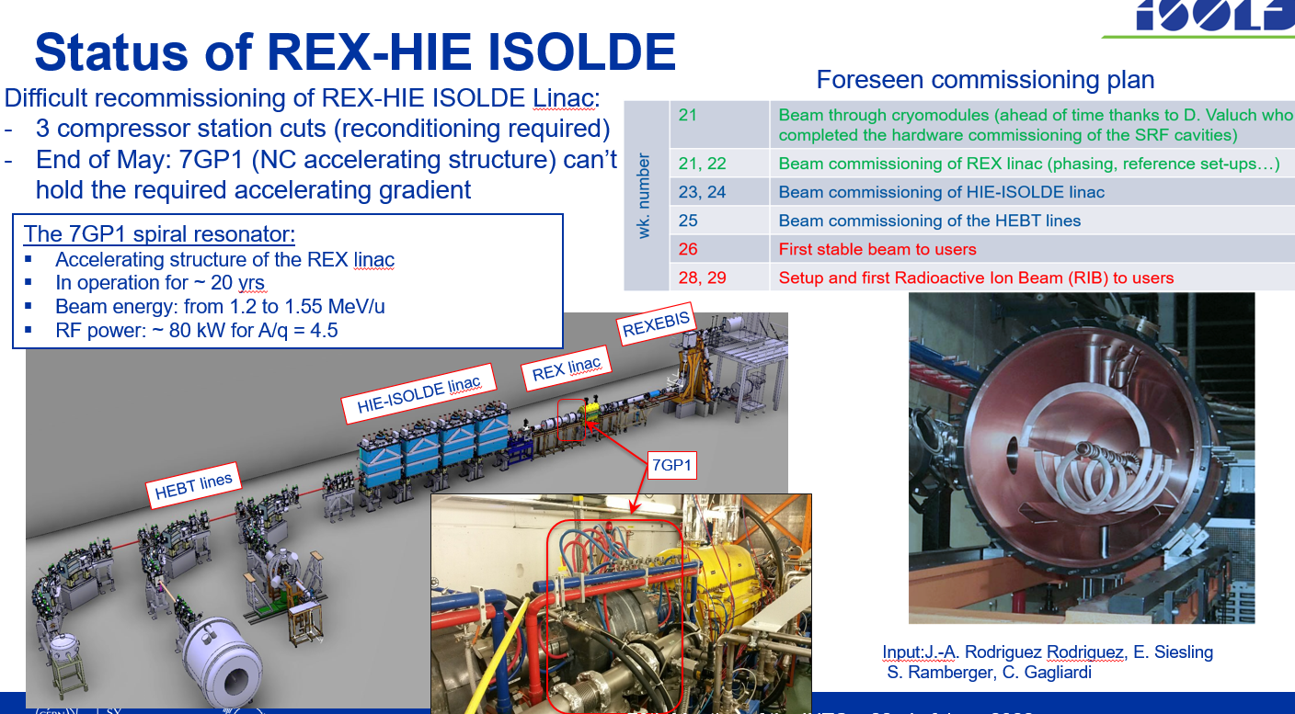
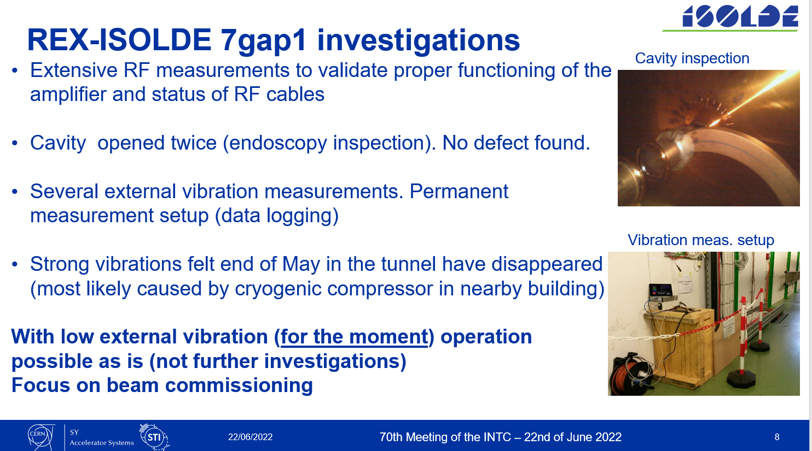
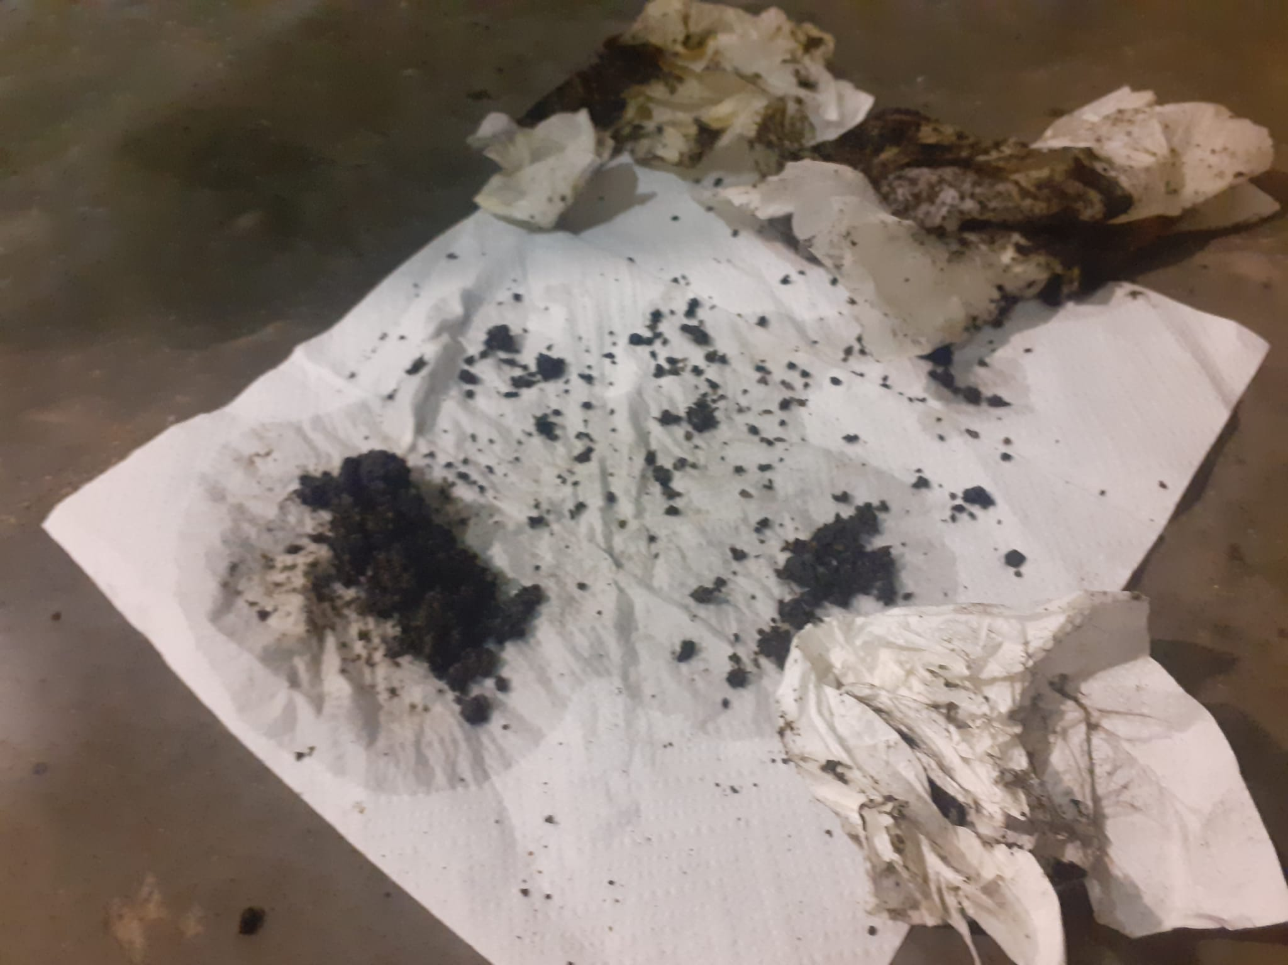
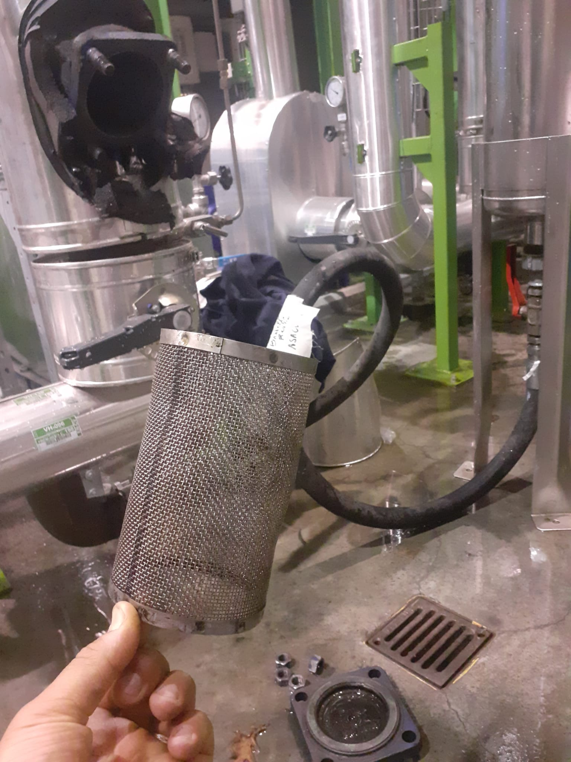
REX-HIE ISOLDE Linac restart
Reminder end of June report
Recommissioning of the REX-HIE Linac was on the critical path end of June (7Gap1 cavity)
Beginning July (04/07), increase of the RF amplifiers temperature for REX
Investigations by EN-CV: RF amplifiers clogged by dirt (suspended matter found in water)
Follow-up (mitigation of the pollution) and cleaning led to another 2 weeks “delay”
S. Deleval IEFC report

Slide 5
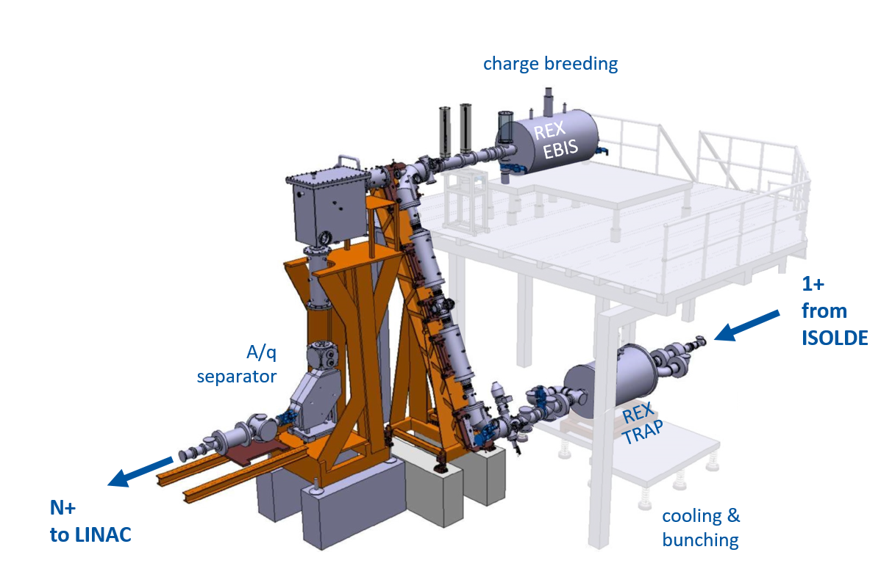
REX-HIE ISOLDE Linac restart and operation
Despite all technical problems encountered and with a reduced program (OP measurements, stable beams to experiment) HE physics could restart as per schedule (week 29)
Problems REX-EBIS solenoid magnet (1997):
  Two unexplained rapid Lhe boil-off since July
  Quenches at higher field, so operating at 1.5 T (2 T nominal)
  LHe level probe has stopped working
Action Plan for the EBIS solenoid magnet:
Repair of TwinEBIS ongoing (Lhe consumption x3)
Investigation of REXEBIS solenoid in Dec/Jan
Decision (repair in situ/exchange)
Technical support from TE-MSC for activities (repair of the TwinEBIS and future work on the EBIS solenoid)
From F. Wenander presentation (Mini-consolidation and improvement workshop)
+ Long term consolidation plan for REX-EBIS and REX-TRAP initiated (BE-ABP-HSL)

Slide 6
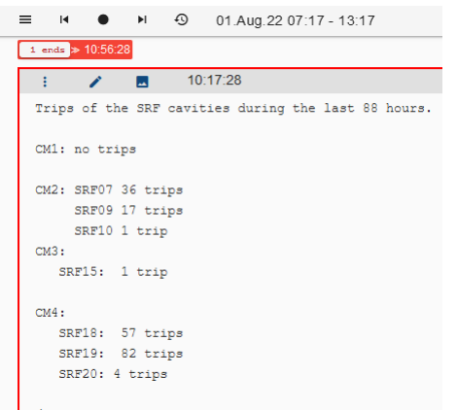
REX-HIE ISOLDE Linac restart and operation
Frequent SRF cavities trips (high sensitivity to vibrations, Lhe pressure variations…) and loss of available accelerating gradient after the winter thermal cycle
Issue being closely followed by RF expert in collaboration with TE-CRG (change in operating parameters of the cryo-plant)
RF optimized the cavity sequencer to restart the cavity faster after a trip to reduce downtime.
D. Valuch | REX HIE issues: SRF cavities trips report

Slide 7
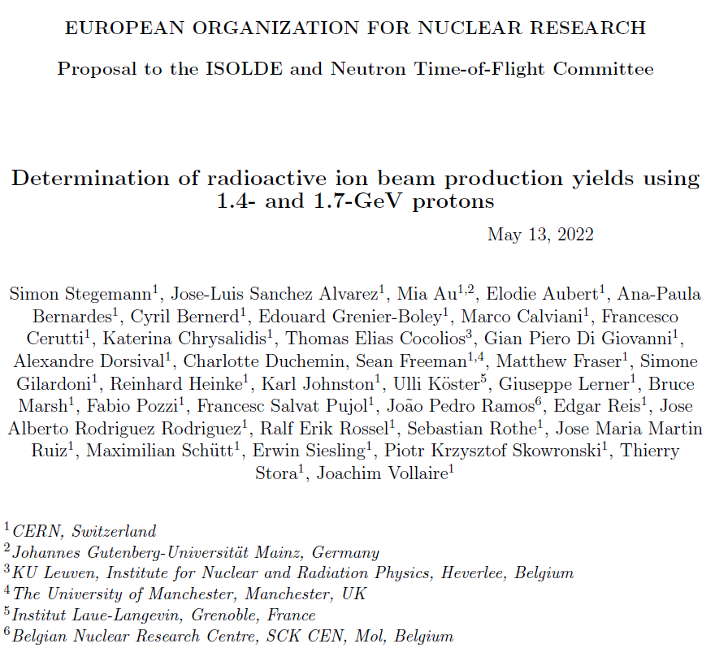
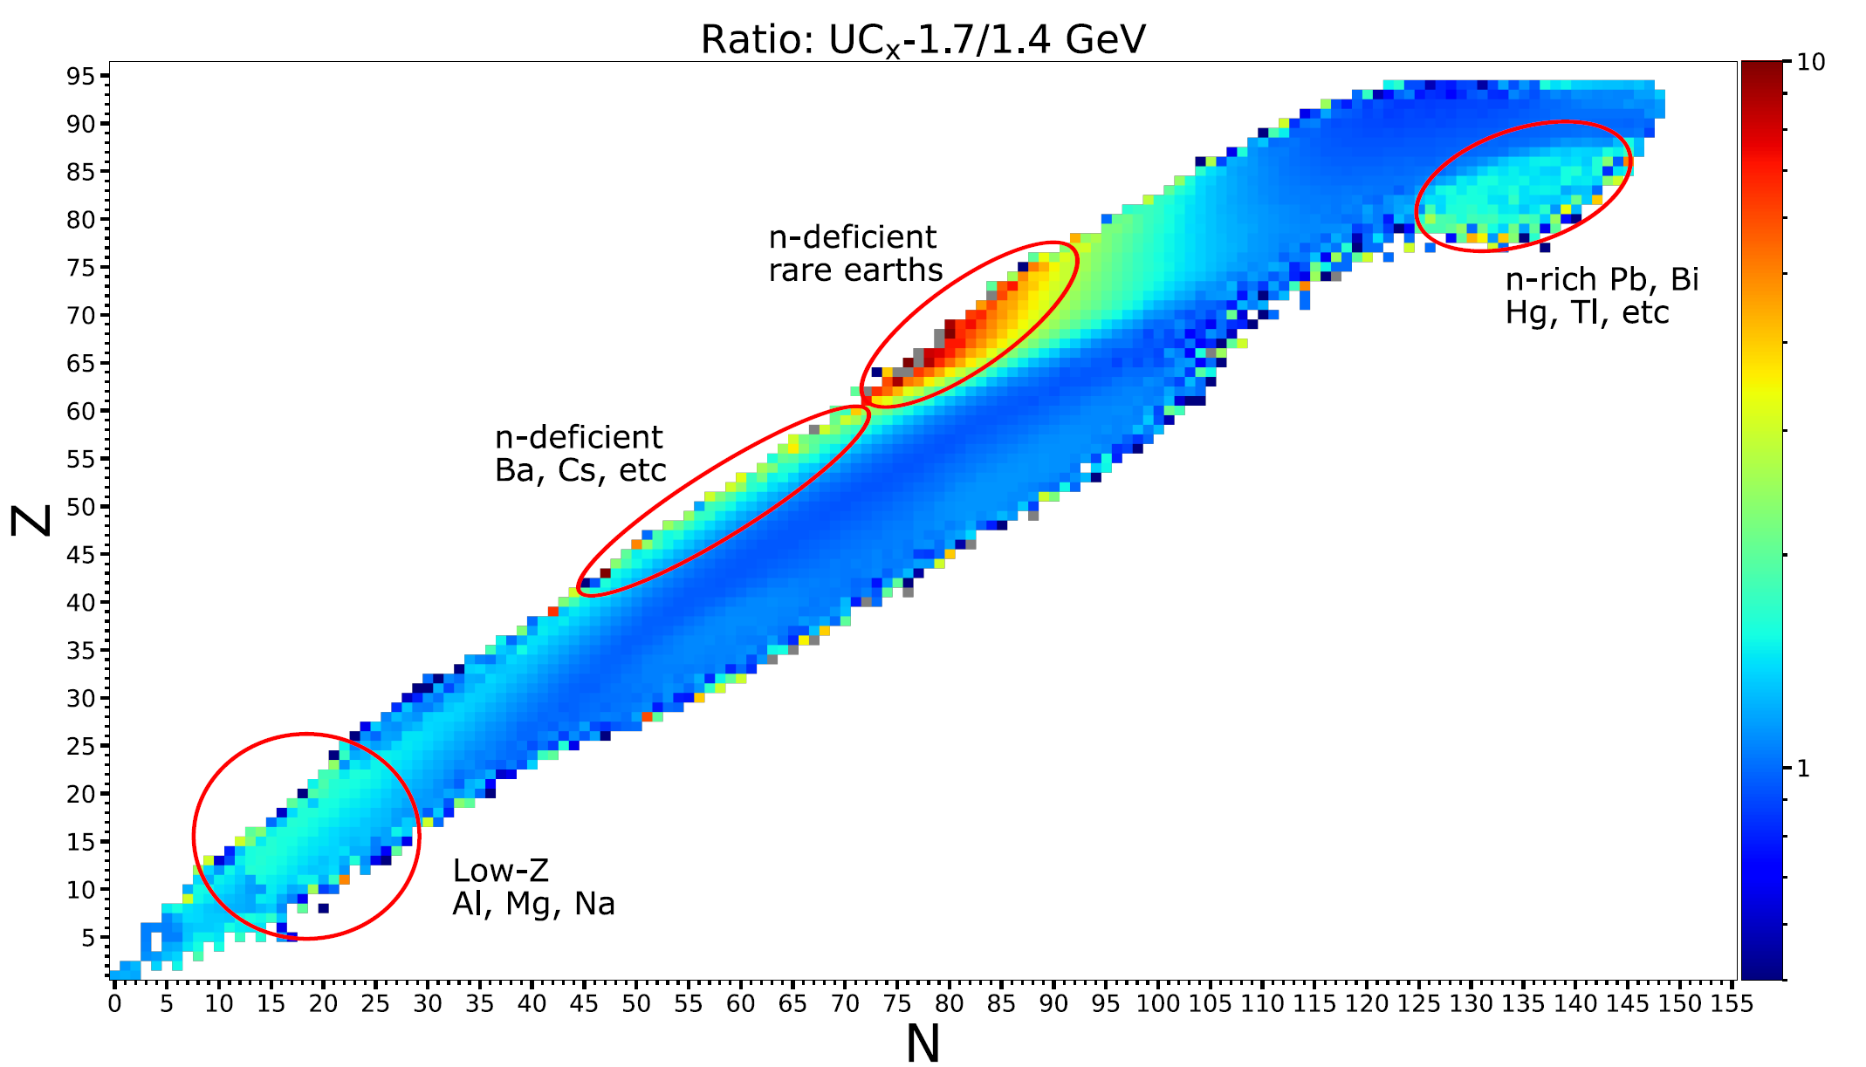
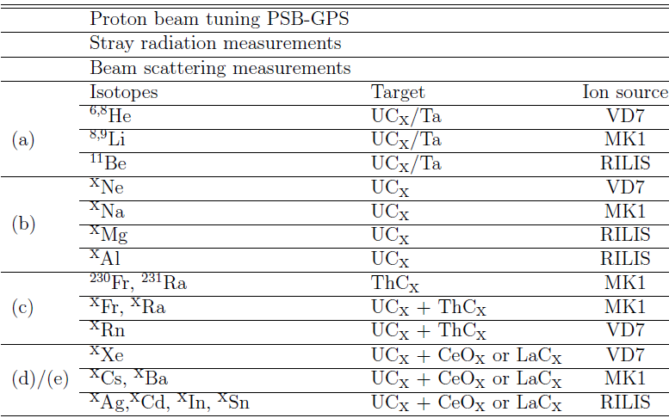
Machine Development: 1.7 GeV beam test (GPS)
FLUKA (MC calculation)
ISOLDE could receive 2.0 GeV from the PS Booster with infrastructure (dumps) and proton beam line upgrades
S. Stegemann & al

Slide 8
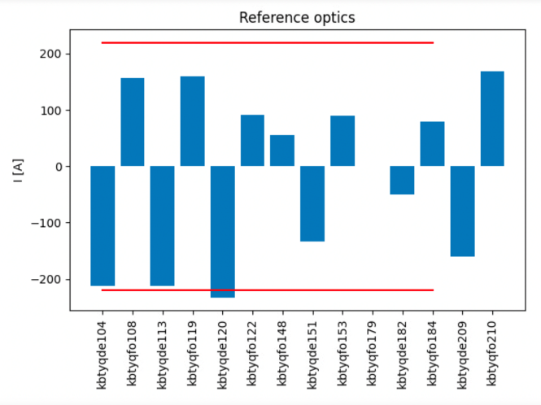
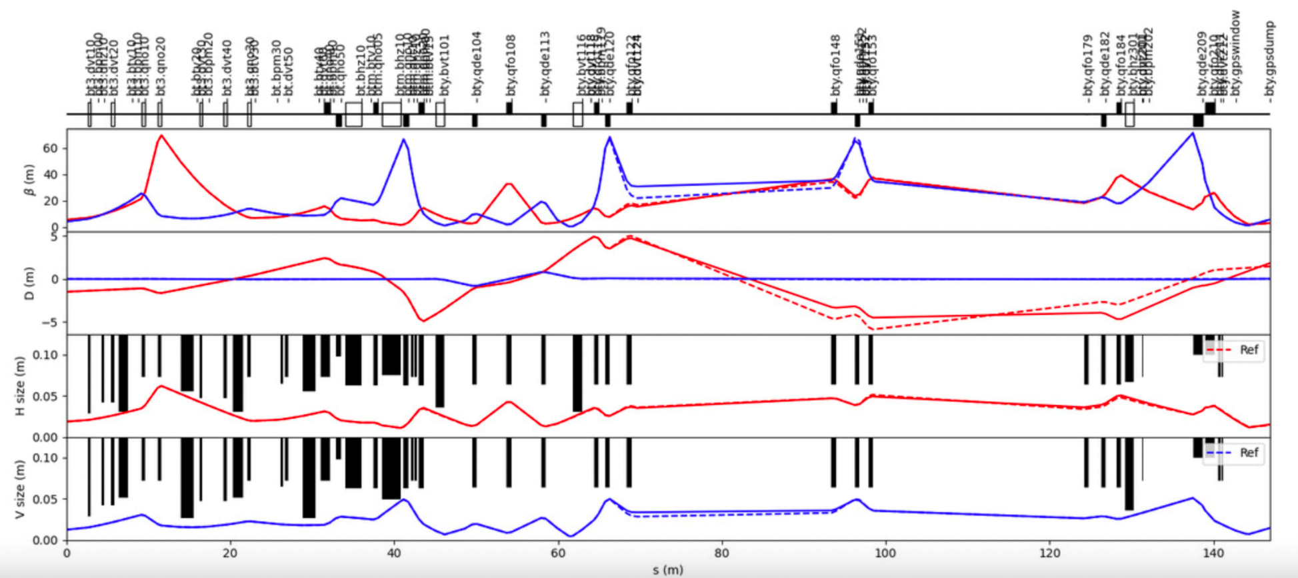
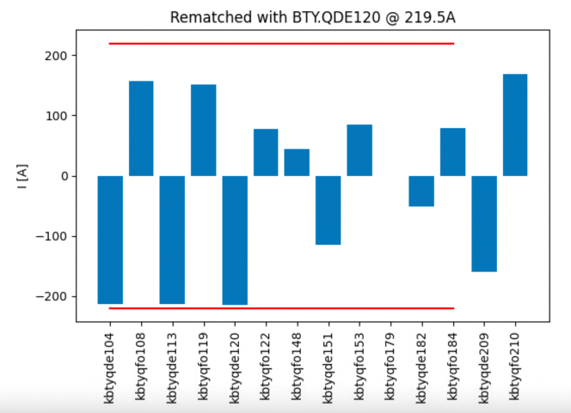
Machine Development: 1.7 GeV beam test (GPS)
Rematched BTY-line optics at 1.7 GeV (possible for GPS only)
Limited to 1.7 GeV by power converter current in BTY vertical dipoles
Optics rematched to keep all quadrupole settings within power converter limits for 1.7 GeV
M. Fraser (SY-ABT)

Slide 9
Machine Development: 1.7 GeV beam test (GPS)
Measurements in August: UCx target + Ta-surface (MK1) ion source. Many surface ionized species of interest (large mass range). Four different laser ionization schemes
Measurements in October: LaCx target + Ta-surface (MK1) ion source + Sn laser ionization)
Analysis ongoing (lot of data collected) but preliminary results confirm the gains using 1.7 GeV for several isotopes of interest
Results agree well with MC calculations (extrapolations for 2.0 GeV)
Future:
  Data analysis from present beamtime
  Explore other regions of the nuclear chart
  Further study proton beam transport to ISOLDE
Presentation in the ISOLDE Users Workshop end of the year

Slide 10
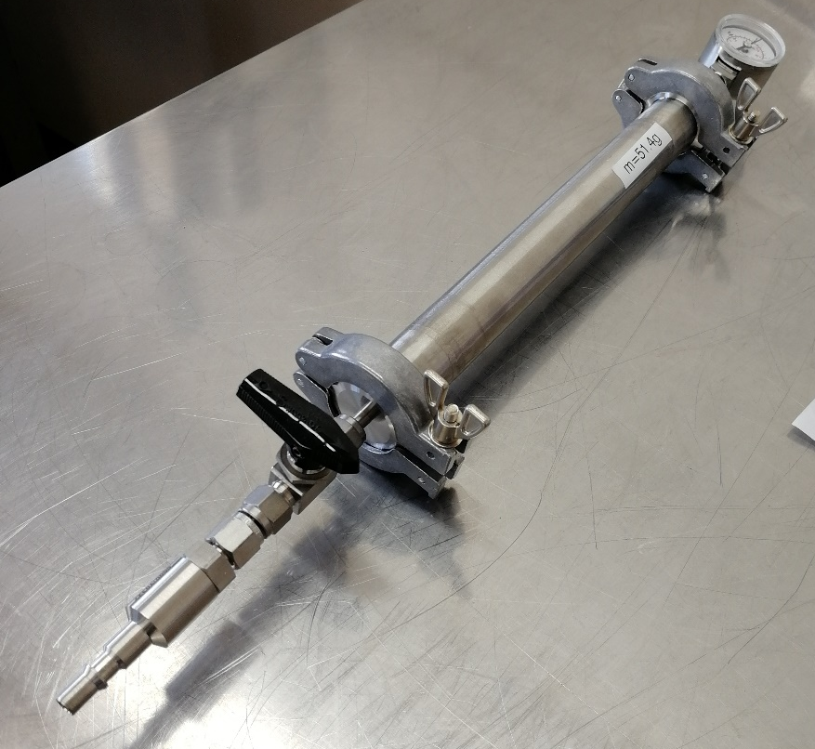
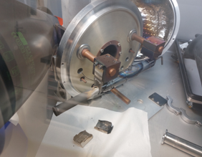
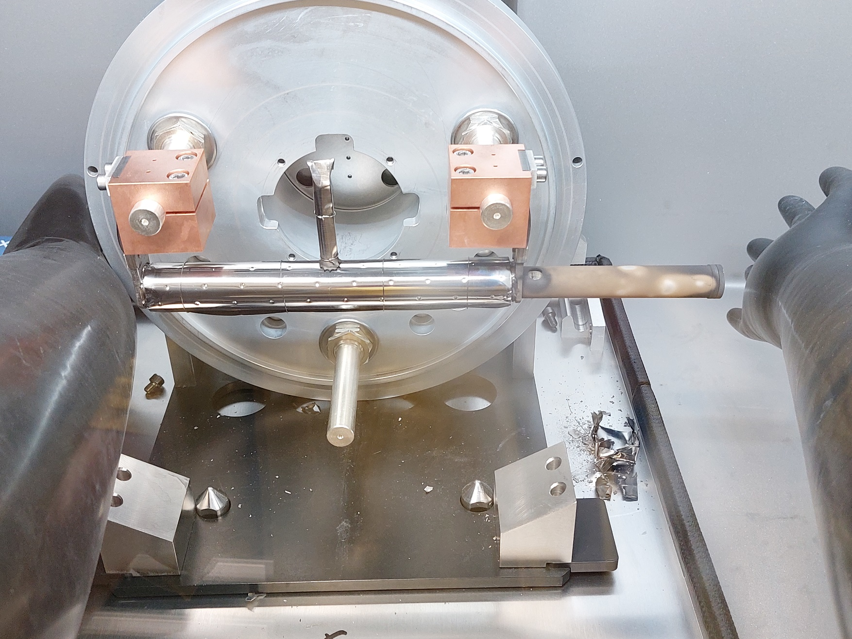
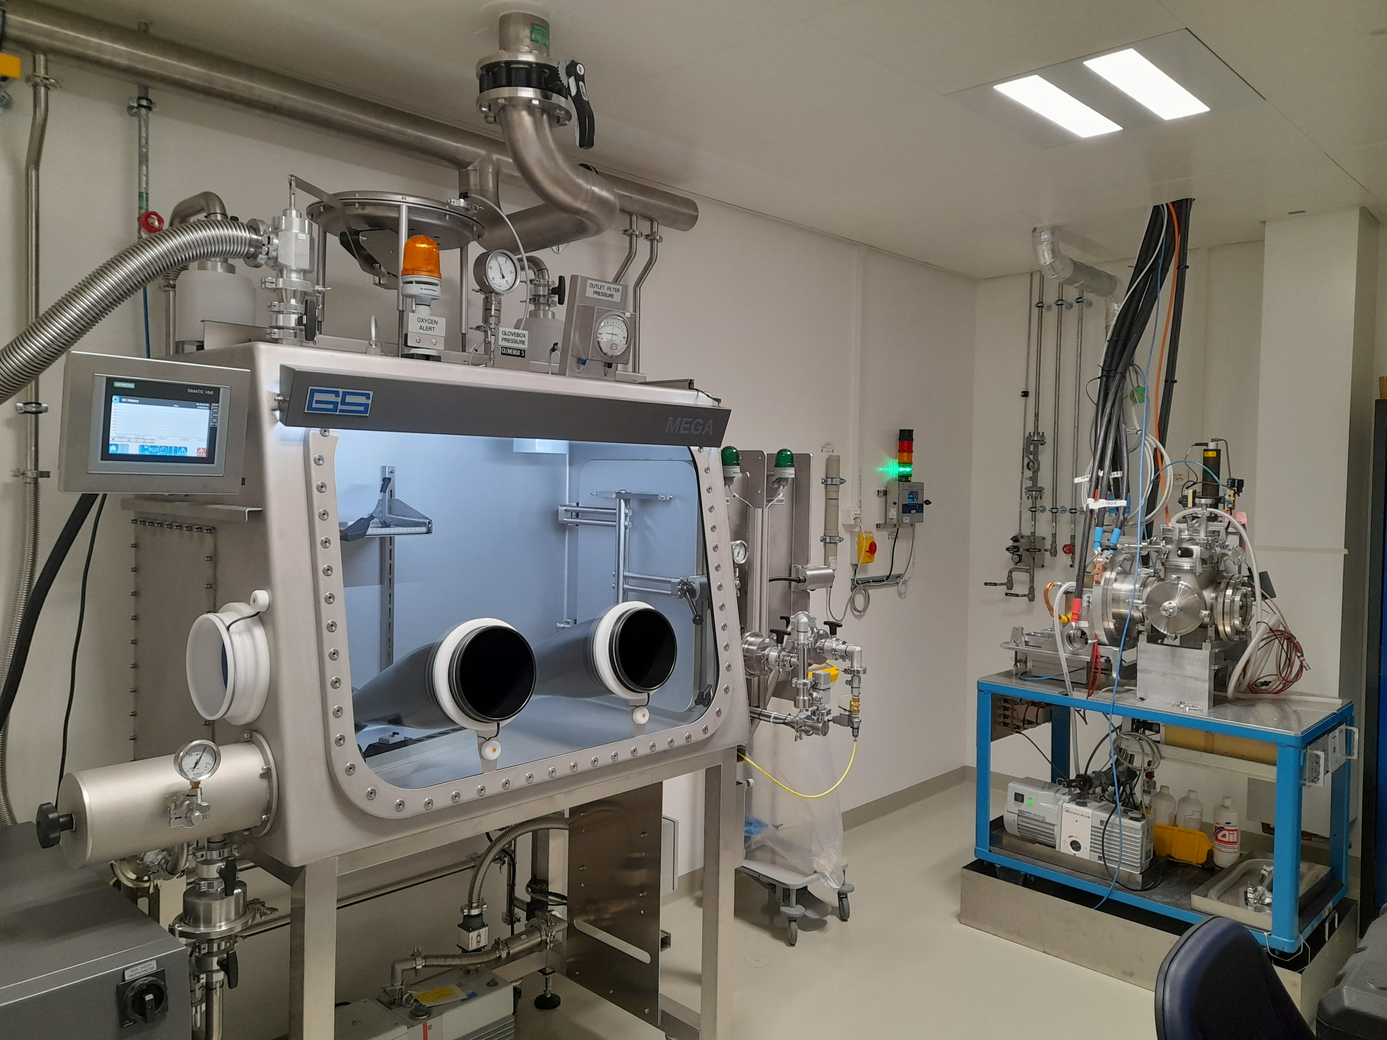
Update on target production
LaCx production and charge transfer (very reactive target material)
Storage of pressed un-carburized La(OH)₃+C pills
Storage of carburized LaC_{x}
Inerted GB5: Transfer of carburized charge into storage capsule
PPM levels of O₂
Batch production
Inerted GB5: Transfer of carburized charge from storage capsule into ISOLDE target.
Fast transfer to ISOLDE front-end
Minimized risk of material re-oxidation
One of the new nano-laboratory glove box
S. Stegemann, E. Reis & Target team courtesy

Slide 11
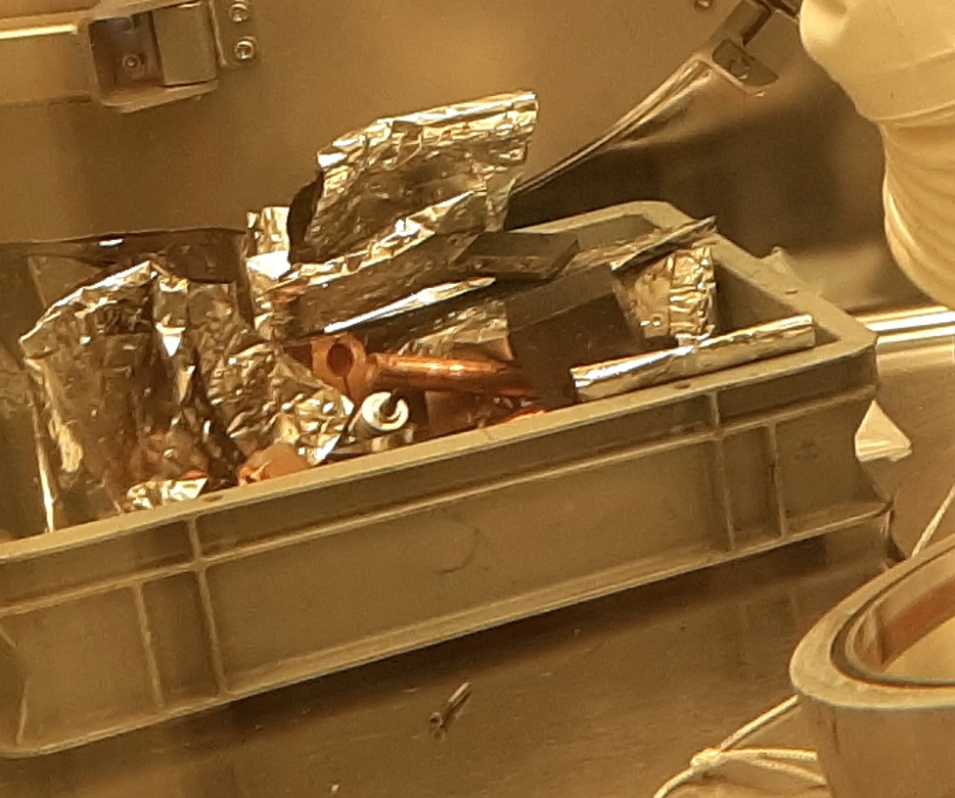
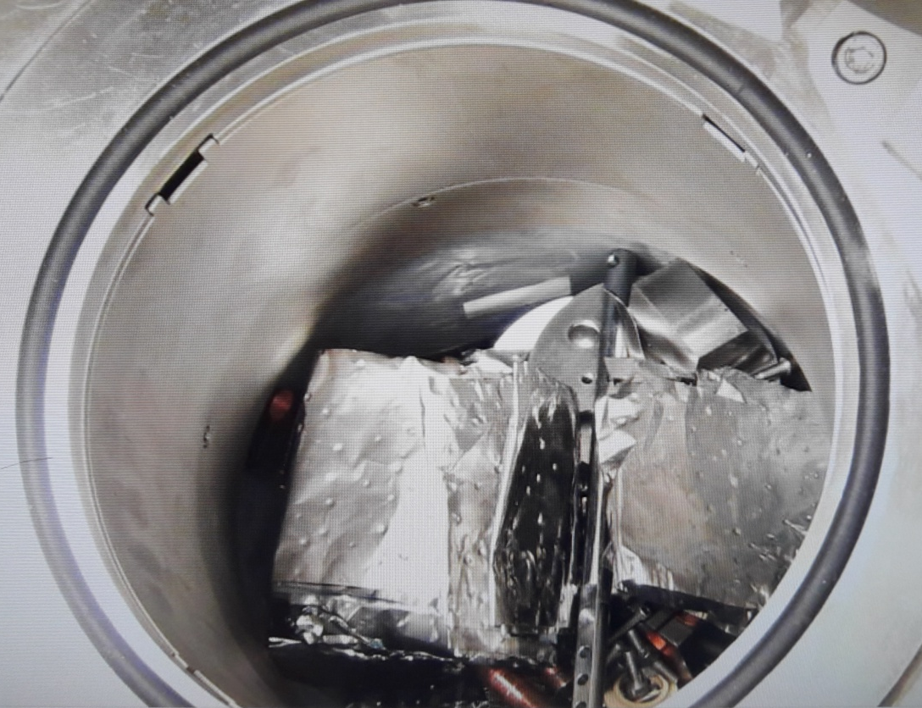
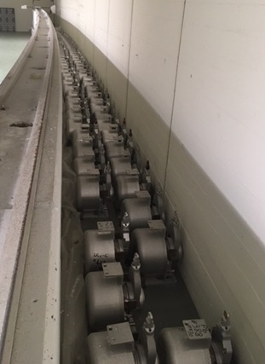
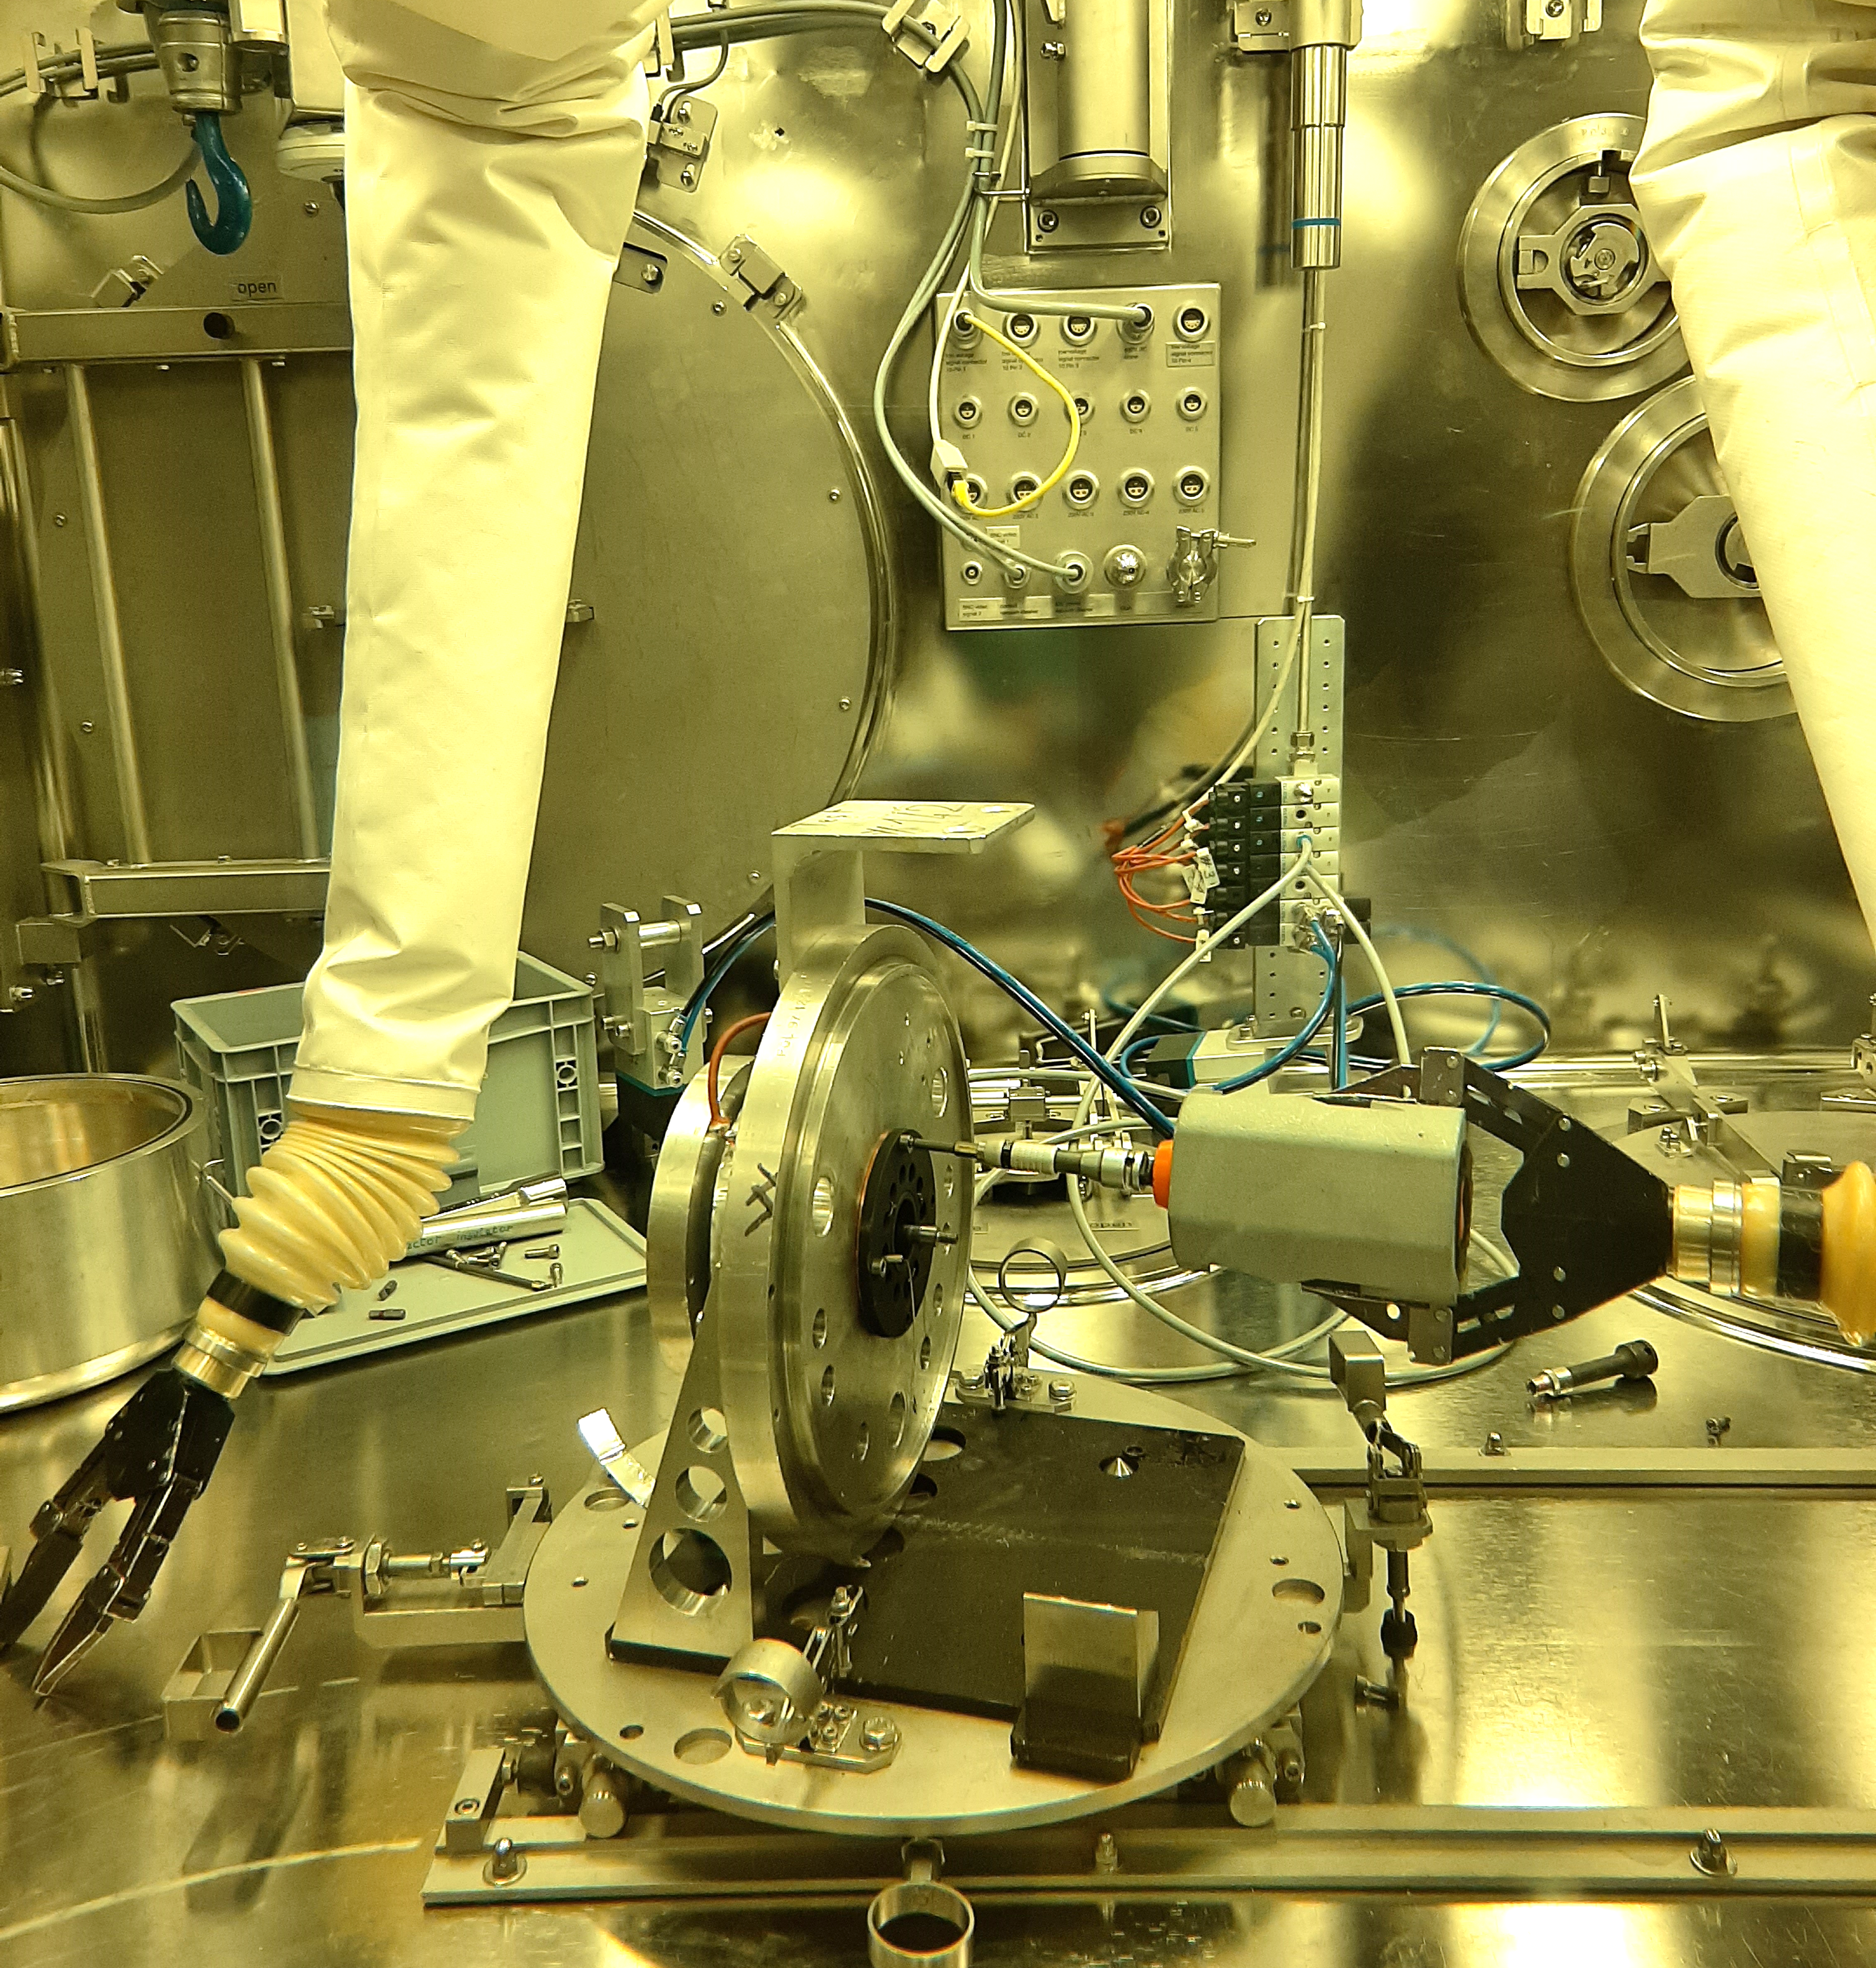
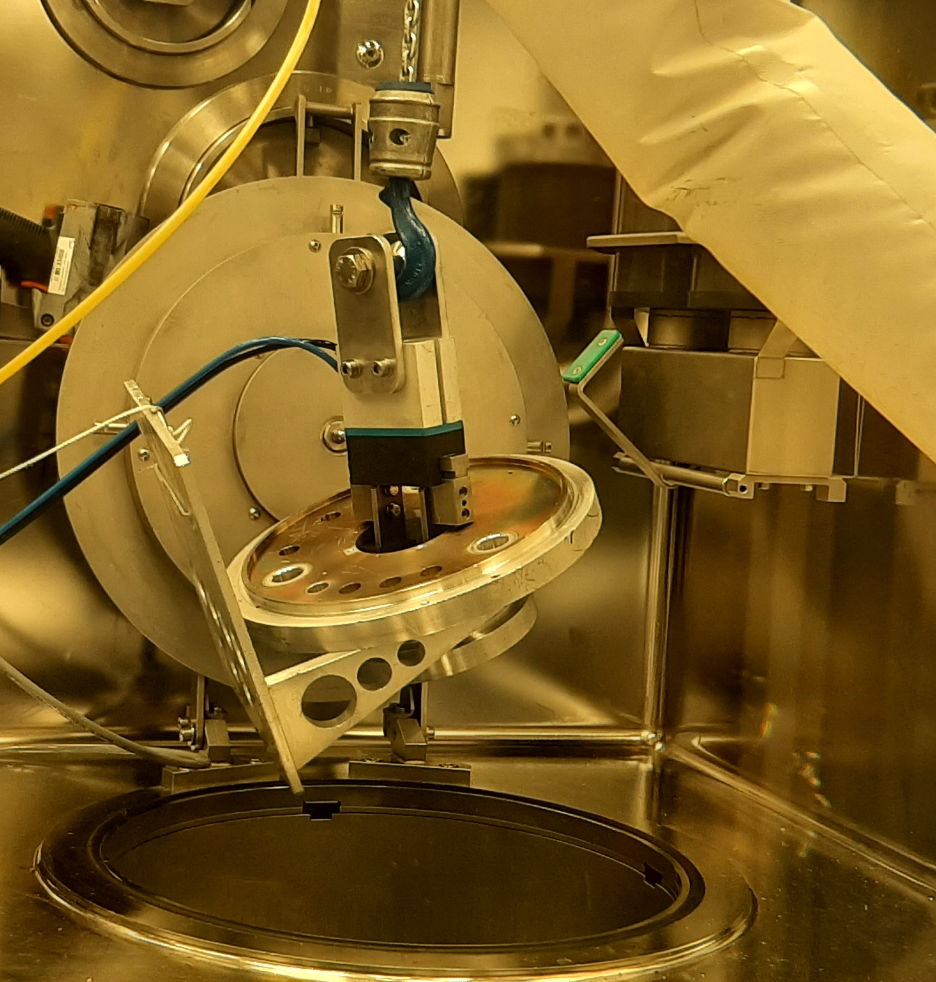
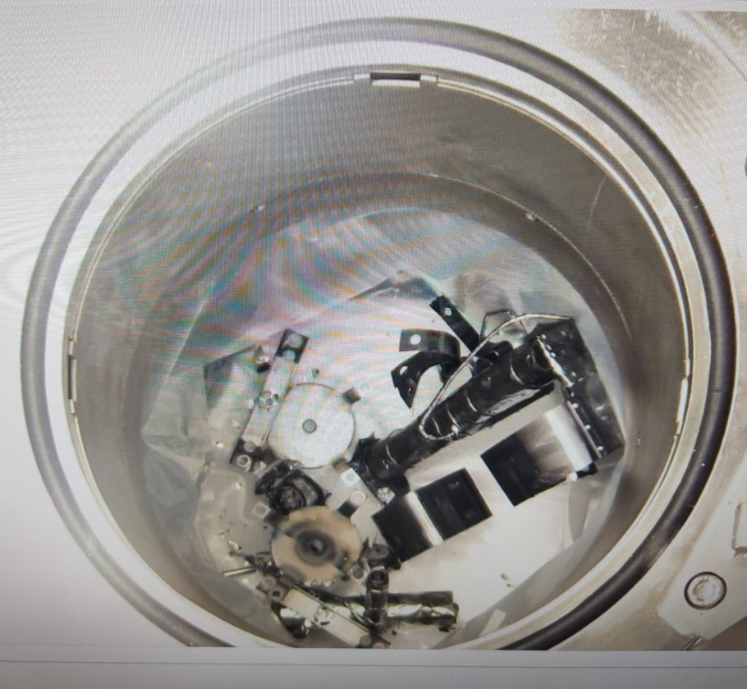
Closing the target lifecycle (disposal)
Two tantalum targets dismantled inside the ISOLDE Hot Cell (very important milestone)
Storage of used targets
S. De Man & B. Fost courtesy

Slide 12
Conclusions and Perspectives
Challenging run but very successful overall run: several problems encountered but solved thanks to the effort and commitment of all teams supporting the facility
First run above 1.4 GeV ! Very important milestone to pave the way to an energy increase (excellent synergy between different teams)
Dismantling of 2 radioactive targets (ISOLDE Hot Cell Commissioning)
For the coming YETS:
  Finalization of control and electrical supply of the primary areas ventilation system (started during LS2)
  Standard YETS intervention in the target and separator areas will start after the ventilation is operational again (end of February). Normal maintenance and investigations of technical problems (target clamping on HRS)
  EBIS solenoid magnet repair

