Slide 1
Off-line TAS measurements of the long-lived nuclei ^{152,155}Tb and ^{76,77}Br for their relevance in medicine and neutrino physics.
E. Nácher
Instituto de Física Corpuscular – CSIC, Valencia (Spain)
J.A. Briz
Universidad Complutense de Madrid, Madrid (Spain)
U. Köster
ILL, Grenoble (France) / CERN, Geneve (Switzerland)
et al.

Slide 2
Intro: Beta decay and TAS
Beta decay: often the first source of experimental information on nuclear structure far from the drip lines. Info on nuclear structure: decay scheme and beta strength (S_{β})
Measuring the S_{β}(E) means measuring the beta intensity distribution I_{β}(E): very far from trivial (explanation coming next…)
We propose here to measure accurately the I_{β}(E) distribution in the β⁺/EC-decay of ^{76,77}Br and ^{152,155}Tb using the Total Absorption Spectroscopy (TAS) technique (explanation coming next…)

Slide 3
The experimental technique
Why don’t we just measure at the IDS?
Medium mass and heavy nuclei: large level density at high energy.
^{A}Z
β⁺
real feeding
Very fragmented I_{β/EC} distribution and γ de-excitation pattern.
γ
^{A}Z-1

Slide 4
The experimental technique
Why don’t we measure just at the IDS?
Medium mass and heavy nuclei: large level density at high energy.
^{A}Z
β⁺
real feeding
Very fragmented I_{β/EC} distribution and γ de-excitation pattern.
apparent feeding
HPGe arrays do the great job of the level scheme and gamma branching ratios, but not so great at I_{β/EC}(E) and S_{β}(E)
γ
^{A}Z-1
HPGe
HPGe
γ₁’
Hardy et al., Physics Letters B 71 (1977)
γ₂
γ₁

Slide 5
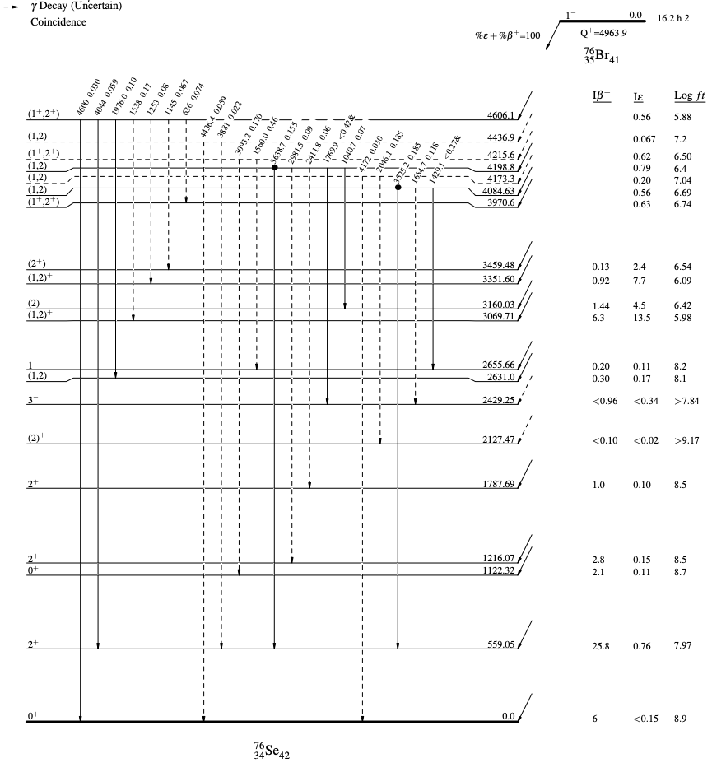
The experimental technique
Why don’t we measure just at the IDS?
^{A}Z
β⁺
real feeding
apparent feeding
γ
^{A}Z-1
⁷⁶Br decay: 38 unplaced gamma rays: wrong levels, wrong gamma strength, wrong beta population and beta strength…
¹⁵²Tb decay: 635 gamma rays detected,
248 remain unplaced
HPGe
HPGe
γ₁’
γ₂
γ₁

Slide 6
The experimental technique
Total Absorption Spectroscopy (Ideal case)
β
NaI
E₂
γ2
γ1
E₁
γ1
γ2
I_{β/EC}
N
E₂
E
Review of the TAS technique: Rubio et al., J. Phys. G 44 (2017)
Development of TAS analysis techniques: Taín et al., NIM A571 (2007)

Slide 7
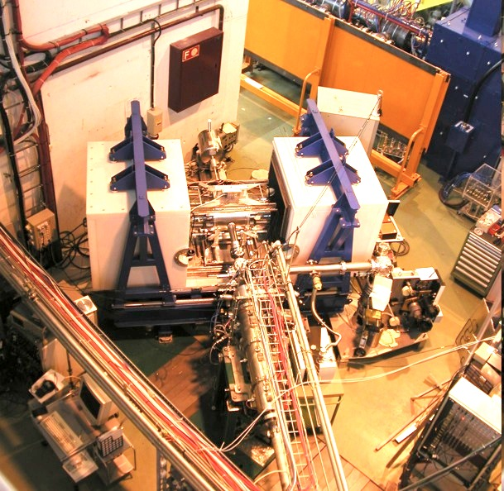
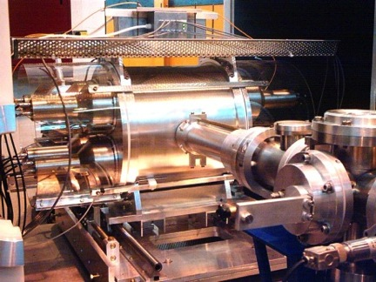
The experimental technique
Lucrecia, the TAS at ISOLDE
  Main NaI(Tl) cylinder: Ø38 cm x 38 cm
  Ancillary detectors: Ge telescope + plastic scintillator

Slide 8
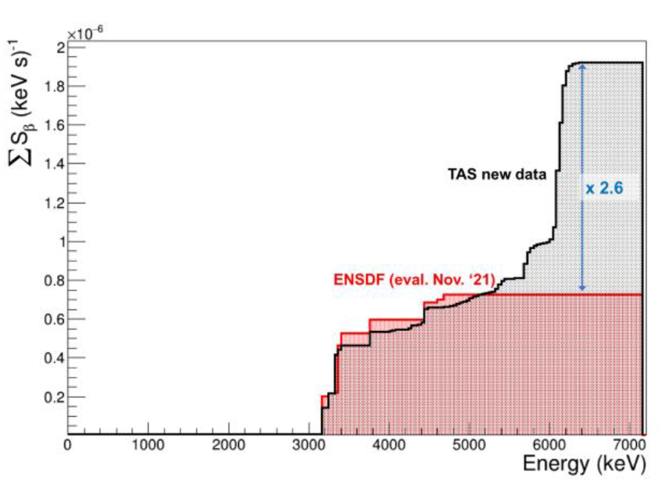
The experimental technique
One example to illustrate what we can do close to the stability valley: ⁶⁴Ga decay
⁶⁴Ga
TAS measurement
TAS recalculated spectrum
GEANT4 - ENSDF
This case, along with ⁶⁶Ga, are relevant for isospin mixing studies

Slide 9
The isotopes of interest
Radio-isotopes used in medicine: important to know accurately the beta intensity distribution I_{β}(E). This tells us:
  The total EC/β⁺ ratio (specially relevant for PET isotopes)
  The ratio between energy per decay in the form of γ-rays and the energy per decay in the form of β particles (relevant for all isotopes used in medicine)
Essential to calculate the dose administered to the patient and its spatial distribution both in diagnosis using PET or SPECT cameras and in treatment (brachytherapy and theranostics). Used by simulation codes and therapy planners.
The beta decay of radio-isotopes of use or potential use in medicine must be well studied and the I_{β}(E) must be accurate and reliable

Slide 10
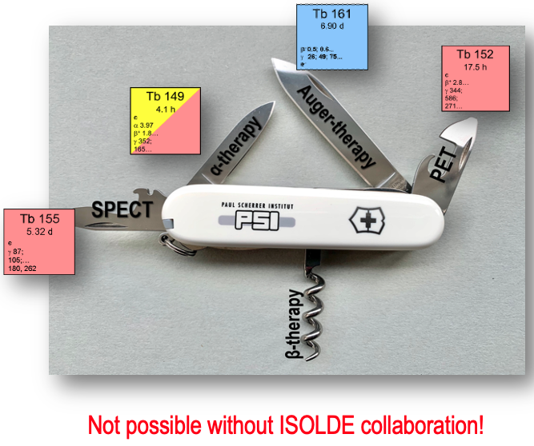
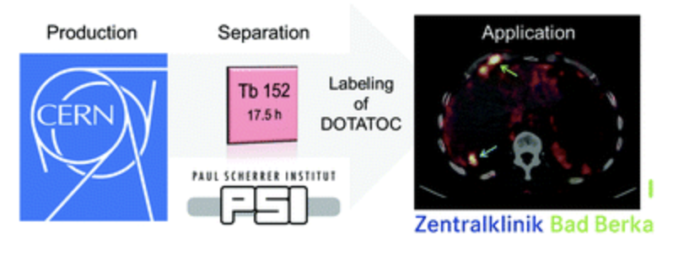
The isotopes of interest
⁷⁶Br, ¹⁵²Tb and ¹⁵⁵Tb are used in medicine within radiolabelled molecules for PET and SPECT imaging or as theranostic pairs for treatment.
PET/CT image of a patient with neuroendocrine neoplasm of the terminal ileum obtained after injection of ¹⁵²Tb-DOTATOC
Taken from Richard P. Baum et al., “Clinical evaluation of the radiolanthanide terbium-152: first-in-human PET/CT with 152Tb-DOTATOC” , Dalton Transactions 42 (2017), DOI: 10.1039/c7dt01936j
Fig. taken from a talk by Nick van der Meulen (PSI)

Slide 11
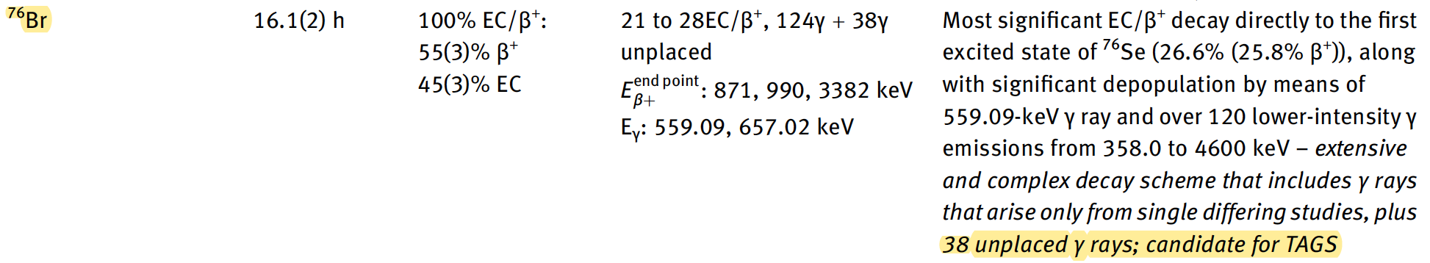
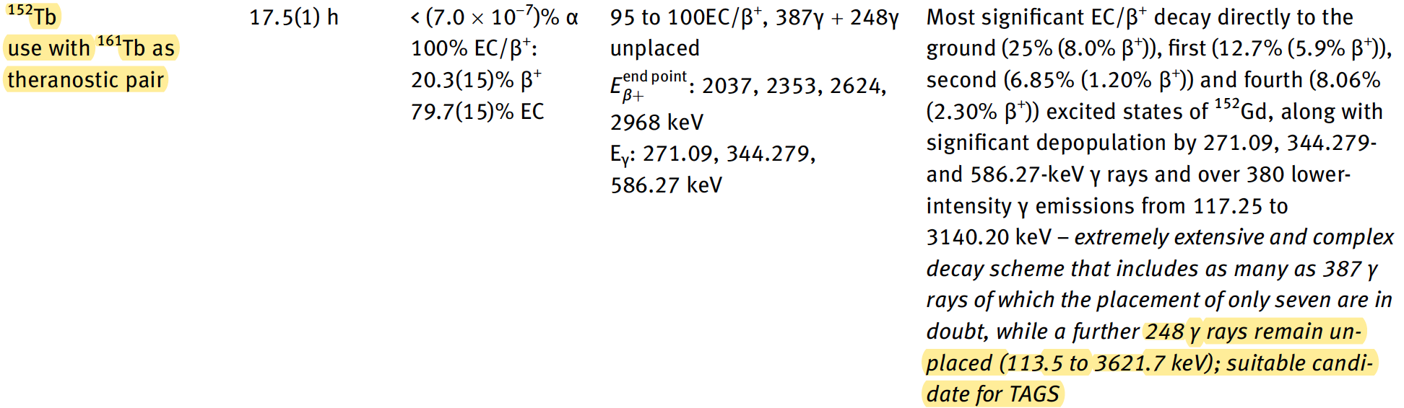
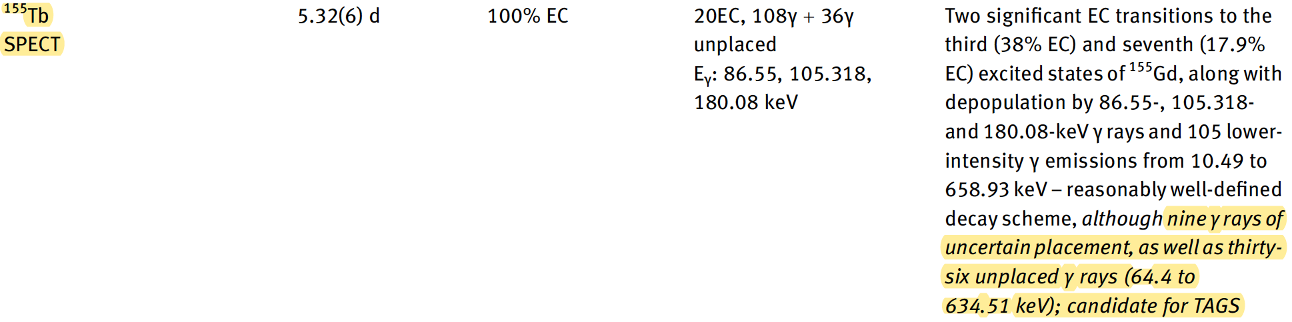
The isotopes of interest
⁷⁶Br, ¹⁵²Tb and ¹⁵⁵Tb are used in medicine as radiolabelled molecules for PET and SPECT imaging or as theranostic pairs for treatment.
These three isotopes, among others, have been identified by Nichols [NIC22]
as needing for a TAGS measurement
[NIC22] Nichols A. L., "Status of the decay data for medical radionuclides". Radiochim. Acta 110, 609-644 (2022)

Slide 12
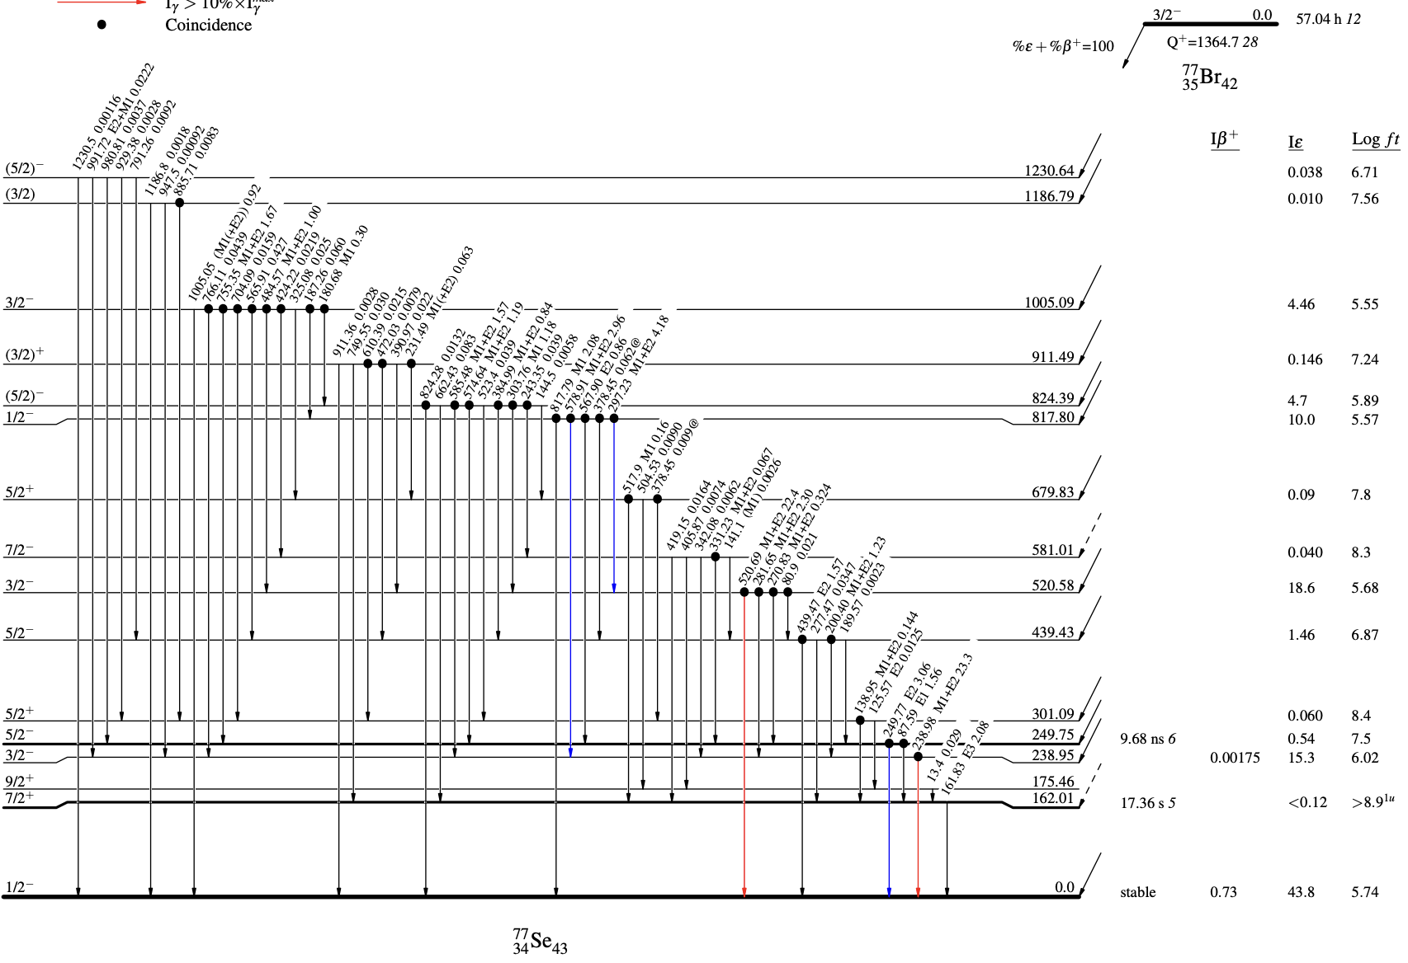
The isotopes of interest
3/2⁻ from (n,n’γ)
1364.27
?
The absolute mass of the neutrino can be directly studied in a model-independent way by examining the slight distortion of the electron-capture spectrum (full energy!!) near the endpoint [GAS17, AKE21].
⁷⁷Br comes from the same T-IS as ⁷⁶Br for free and is one of the most promising ultra-low Q-value decay [GAM19]. It is an allowed transition 400 eV below the window.
[AKE21] M. Aker, et al., "First direct neutrino-mass measurement with sub-eV sensitivity" Nature Physics 18 (2022) 160
[GAS17] L. Gastaldo, K. Blaum, K. Chrysalidis, T. Day Goodacre, et al., Eur. Phys. J.: Spec. Top. 226, 1623 (2017)
[GAM19] N.D. Gamage, et al., "Identification and investigation of possible ultra-low Q value β decay candidates", Hyperfine Interact. 2019, 240

Slide 13
The isotopes of interest
The absolute mass of the neutrino can be directly studied in a model-independent way by examining the slight distortion of the electron spectrum near the endpoint [GAS17, AKE21].
⁷⁷Br comes from the same T-IS as ⁷⁶Br for free and is one of the most promising ultra-low Q-value decay [GAM19]. It is an allowed transition 400 eV below the window.
T_{1/2} ~ 2 days ➔ different sources starting at 5 kBq and doubling activity (up to 80 kBq) allow for a very long measurement accumulating huge statistics.
[AKE21] M. Aker, et al., "First direct neutrino-mass measurement with sub-eV sensitivity" Nature Physics 18 (2022) 160
[GAS17] L. Gastaldo, K. Blaum, K. Chrysalidis, T. Day Goodacre, et al., Eur. Phys. J.: Spec. Top. 226, 1623 (2017)
[GAM19] N.D. Gamage, et al., "Identification and investigation of possible ultra-low Q value β decay candidates", Hyperfine Interact. 2019, 240

Slide 14
Beam-time request
  We need to measure activities ranging from 5 to 10 kBq, this means producing sources of 5 to 80 kBq max, easily achievable in some long (seconds to minutes) collections at GLM or LA1… or even from MEDICIS!
  With a normal behaviour of target-ion-source we should not need more than 1 shift per ion source: 1 shift for Br isotopes, 1 shift for Tb isotopes. These shifts do not need any specific allocation in the Schedule, but should just be added to an ongoing experiment using the appropriate T-IS.
  We do need purity: may require some decay time before measuring (rare earths contamined by Ce or Eu molecular compounds), or radiochemical separation at PSI (?)

Slide 15
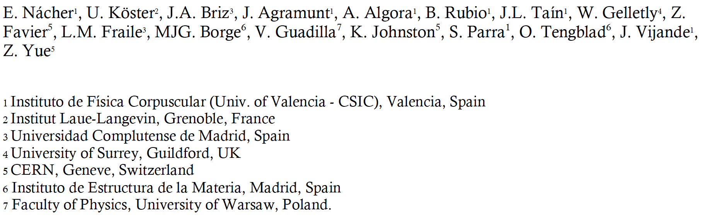
Off-line TAS measurements of the long-lived nuclei ^{152,155}Tb and ^{76,77}Br for their relevance in medicine and neutrino physics
-> Funding guaranteed for the next 3 years
-> 1 PhD student 3 yr (+1?) fully devoted to this project

Slide 16
Backup slides

Slide 17
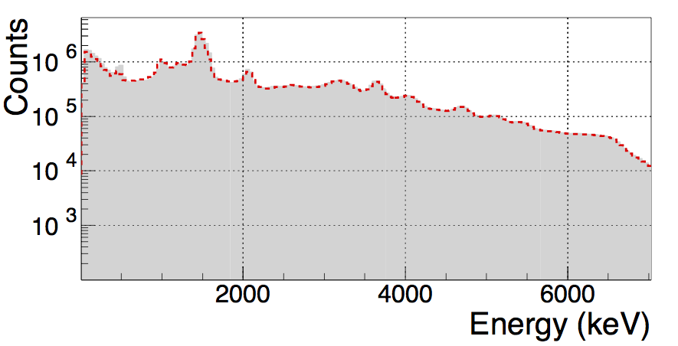
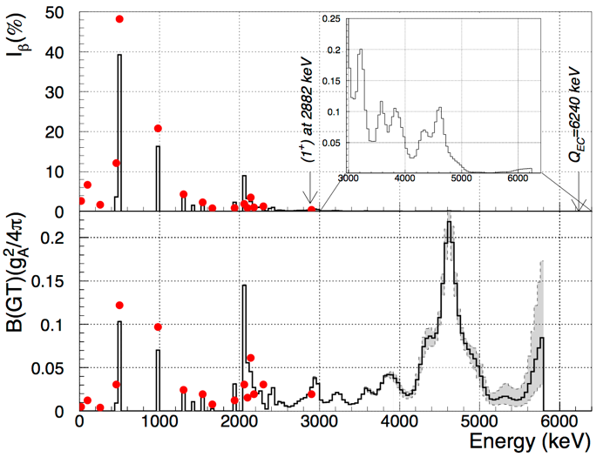

ANALYSIS
E. Nacher, Istros 2019
⁷⁶Sr is one of the most striking cases in which MOST of the B(GT) was missing in high-resolution experiments
Red spots: high-resolution results, last level at
2.9 MeV (Ph. Dessagne et al. Eur. Phys. J. 20 (2004))

Slide 18
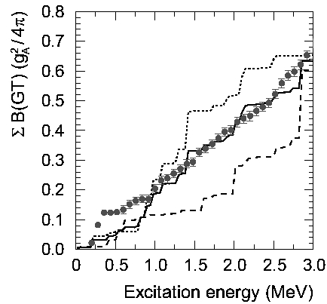
Nuclear deformation around A=70
β-decay of ^{72,74}Kr and ^{76,78,80}Sr measured in different runs during 2001-2002 at ISOLDE.
The shape of the ground state can be inferred from the B(GT) distribution.
  E. Nácher, A. Algora et al, Phys. Rev. Lett. 92 (2004)
  E. Poirier, F. Marechal et al, Phys. Rev. C69 (2004)

Slide 19
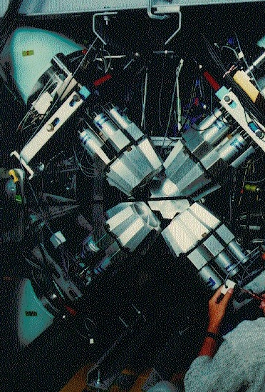
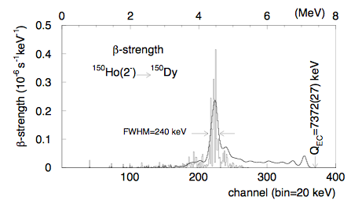
Pandemonium: TAS vs Cluster-Cube
A total of 295 levels and 1064 gamma-rays
Gamma photopeak efficiency: 19% at 1332 keV
S_{β}^{HR} / S_{β}^{TAS} = 0.4
A. Algora et al., PRC 68 (2003) 034301

Slide 20
Total Absorption Spectroscopy
β−feeding
NaI
E₂
γ2
E₁
γ1
γ1
Ideal case
γ2
I_{β}
N
E₂
E

Slide 21
Total Absorption Spectroscopy
X-ray detector
N
NaI
EC
N
E₂
E
Positron detector
γ1
Real case
β⁺
γ2
E₂
E
2 photons (511 keV)
back to back
Unfolding
algorithm (EM)
I_{β}
Review of the TAS technique: Rubio et al., J. Phys. G 44 (2017)
Development of TAS analysis techniques: Taín et al., NIM A571 (2007)
E₂
E

Slide 22
Analysis of TAS data
The TAS inverse problem [1]:
Expectation-Maximisation algorithm [2] applied to this problem [1]:
[1] J. L. Taín et al., Nucl. Inst. and Methods A 571 (2007) 728
[2] A. P. Dempster et al., J. R. Statist. Soc. B 39 (1977) 1.

Slide 23

The Response Function
4123
1369
2754
At ~5 kHz:
1h… 1e-4
10h… 1e-5
100h… 1e-6
200h... 5e-7
5235
²⁴Na
5235
4123
1369
0
²⁴Mg
β-decay of ²⁴Na: test bench for our simulations

Slide 24
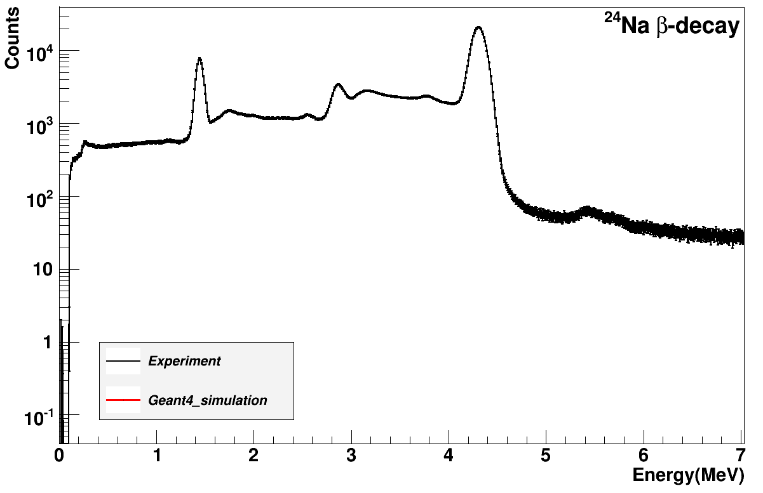
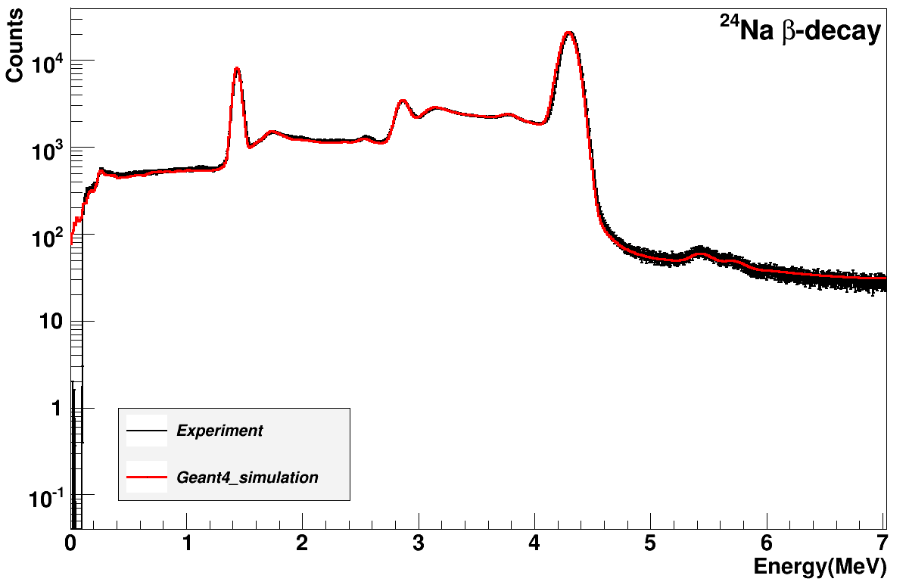
The Response Function
4123
1369
2754
²⁴Na
5235
4123
1369
0
²⁴Mg
β-decay of ²⁴Na: test bench for our simulations

Slide 25
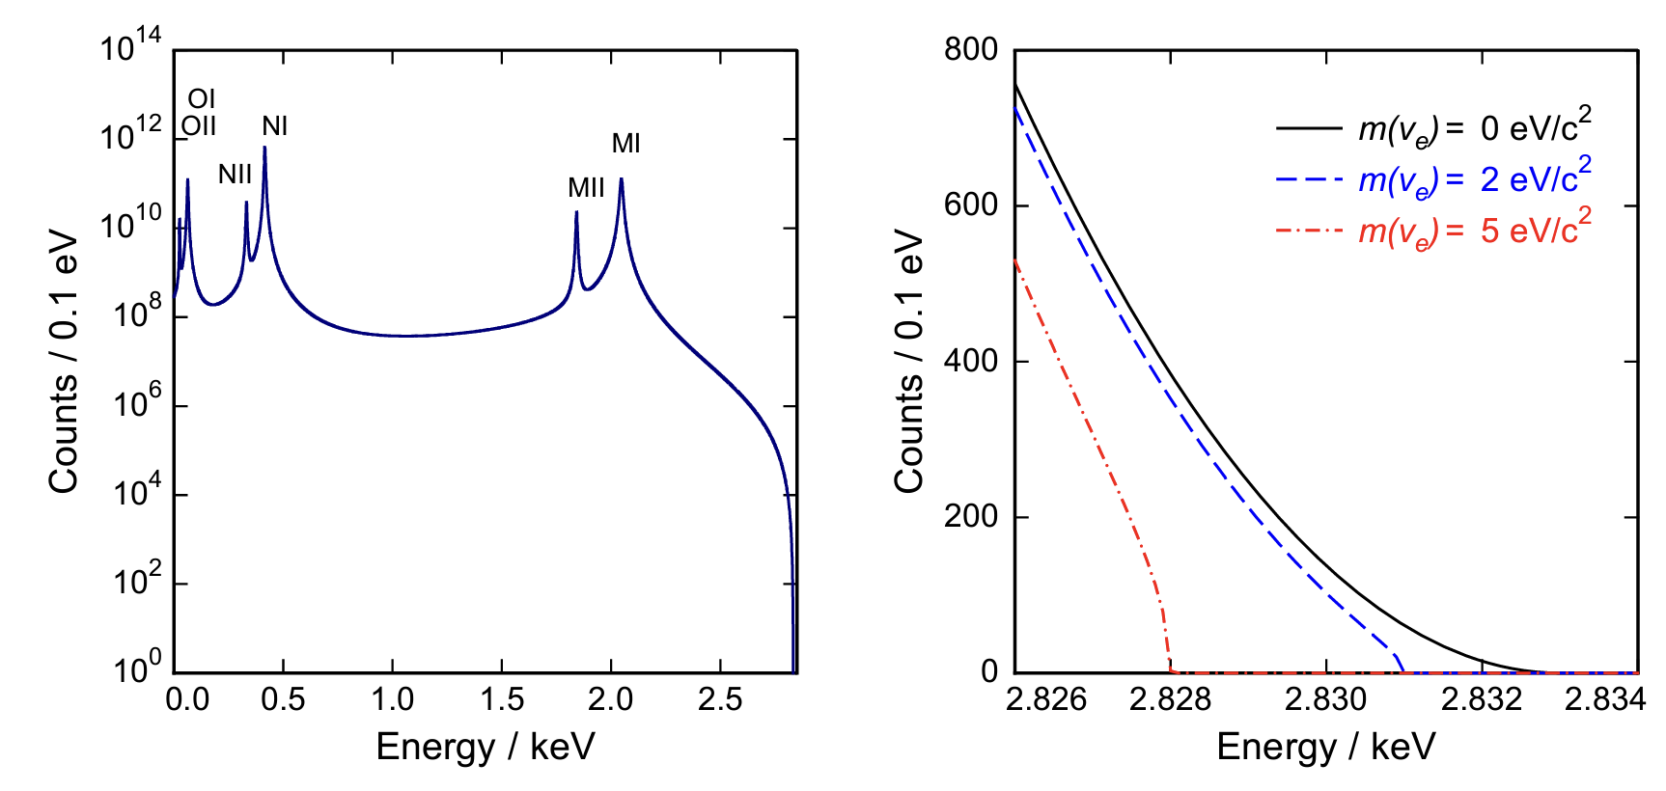
Ultra-low EC decay and m_{ν}
EC-decay of ¹⁶³Ho: calorimetric measurement, distortion at the endpoint
Ultra-low Q-value decay: 2.6 keV (400 eV in our case ⁷⁷Br)

Slide 26
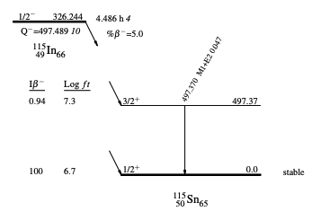
Ultra-low EC decay and m_{ν}
β-decay of ¹¹⁵In: b.r. ~ 1e-2
Ultra-low Q-value decay: 120 eV!! (400 eV in our case ⁷⁷Br)
f(Z=53, Q-E=10 keV) = 1.5e-5 f(Z=35, Q-E=10 keV) = 6.2e-6

Slide 27
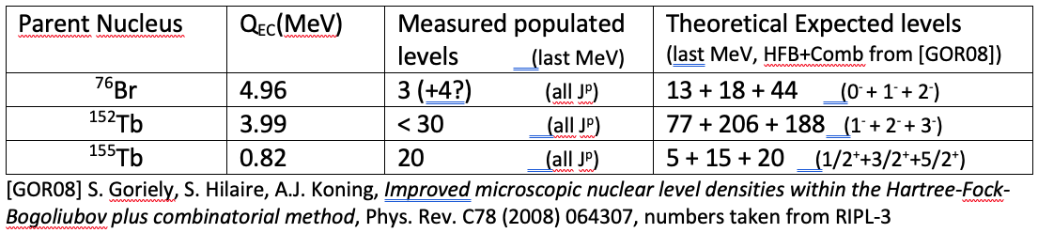
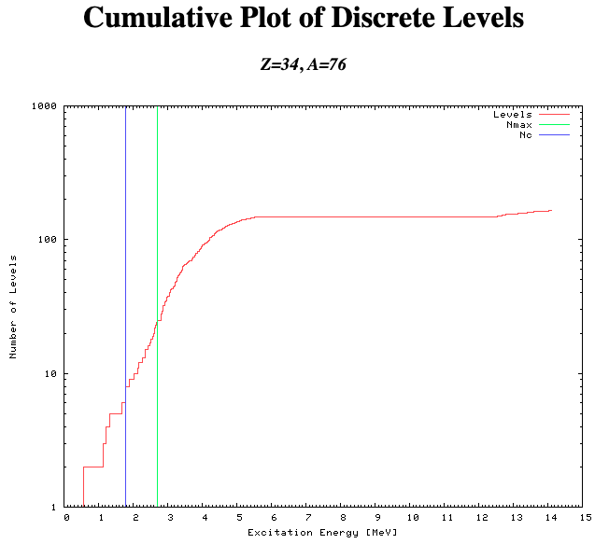
RIPLE-3 calc…

