Slide 1
Transition probabilities of low-lying excited states in ²¹⁰Po and ²¹⁰Pb
G. Georgiev¹, G. Rainovski², A.E. Stuchbery³, Zs. Podolyák⁴, A. Andreyev⁵, D.L. Balabanski⁶, A. Blazhev⁷,
F. Browne⁸, F. Dunkel⁷, L.M. Fraile⁹, L. Gaffney¹⁰, K. Gladnishki², J. Jolie⁷, T. Kibedi³, D. Kocheva²,
A. Kusoglu^{6,13}, G. J. Lane³, J. Ljungvall¹, V. Manov², AJ Mitchel³, N. Pietralla¹¹, M. Scheck¹², M. Stoyanova², K. Stoychev¹, N. Warr⁷, V. Werner¹¹
¹ IJCLab, Orsay, France; ² Faculty of Physics, Sofia University St. Kl. Ohridski, Bulgaria; ³ The Australian National University, Canberra, Australia; ⁴ University of Surrey, Guildford, UK; ⁵ University of York, York, UK; ⁶ ELI-NP, IFIN, Bucharest, Romania; ⁷ IKP, University of Cologne, Germany; ⁸ ISOLDE, CERN, Geneva, Switzerland; ⁹ Universidad Complutense, Madrid, Spain; ¹⁰ University of Liverpool, Liverpool, UK; ¹¹ TU Darmstadt, Darmstadt, Germany; ¹² University of the West of Scotland, Paisley, UK; ¹³ University of Istanbul, Istanbul, Turkey

Slide 2
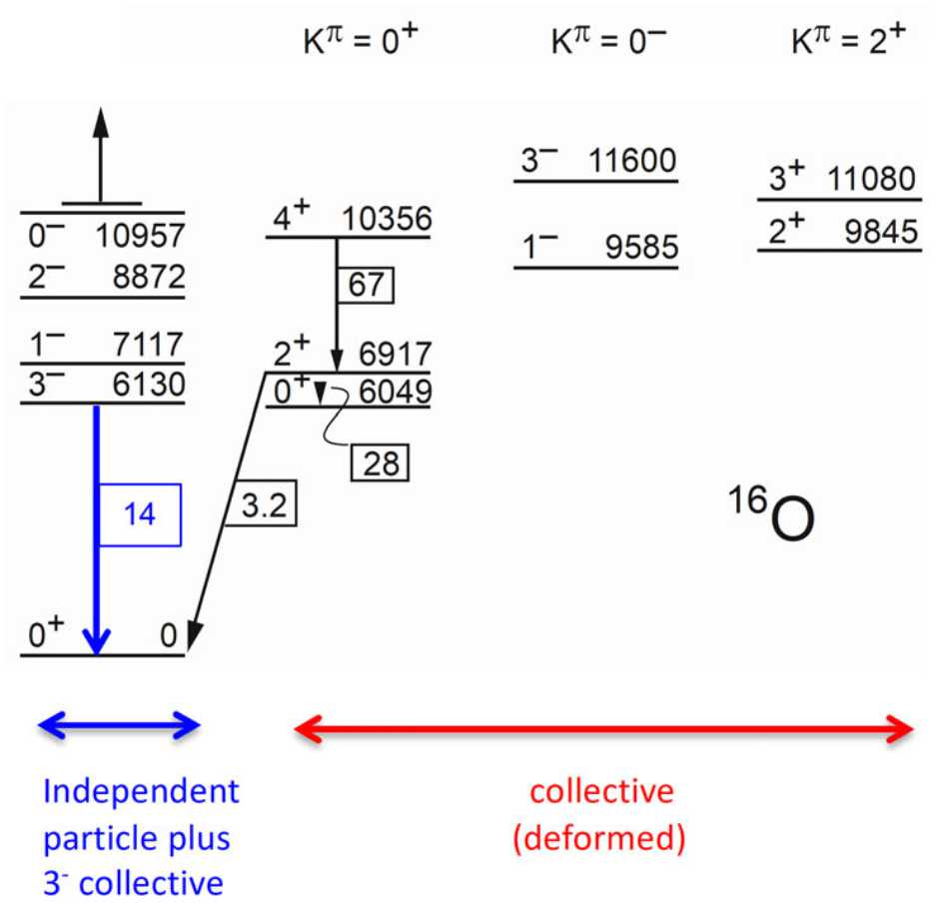
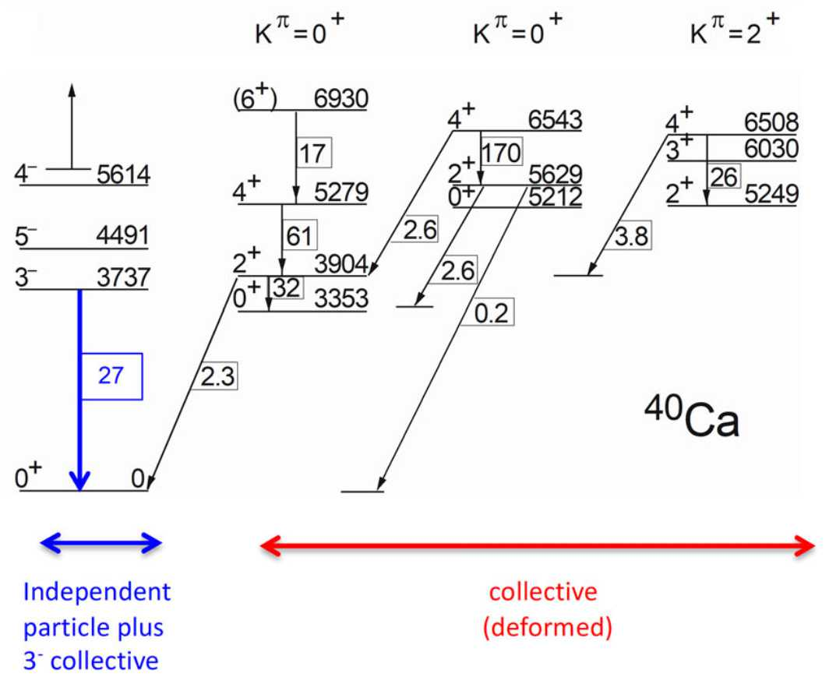
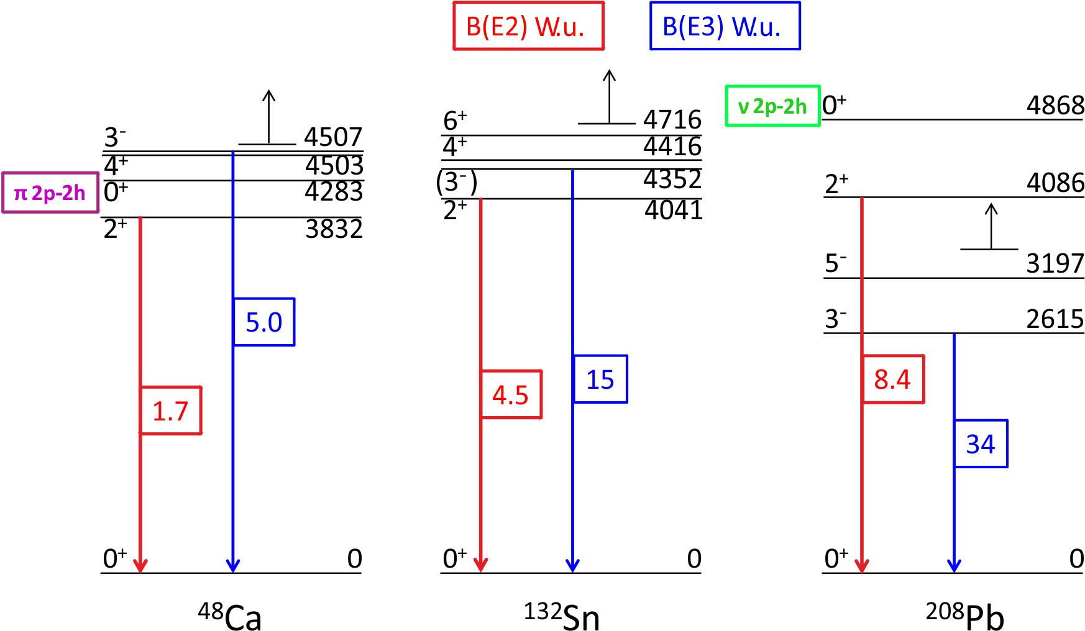
How magic are the doubly magic nuclei?
A.E. Stuchbery and J.L. Wood,
Physics 2022, 4(3), 697-773
N=Z doubly magic nuclei (¹⁶O and ⁴⁰Ca)
→ examples of shape coexistence at the level of fist excited states
N > Z doubly magic nuclei (⁴⁸Ca, ¹³²Sn, ²⁰⁸Pb)
→ octupole correlations at the (very) low excitation energies
Do we understand the structure of ²⁰⁸Pb and its vicinity???

Slide 3
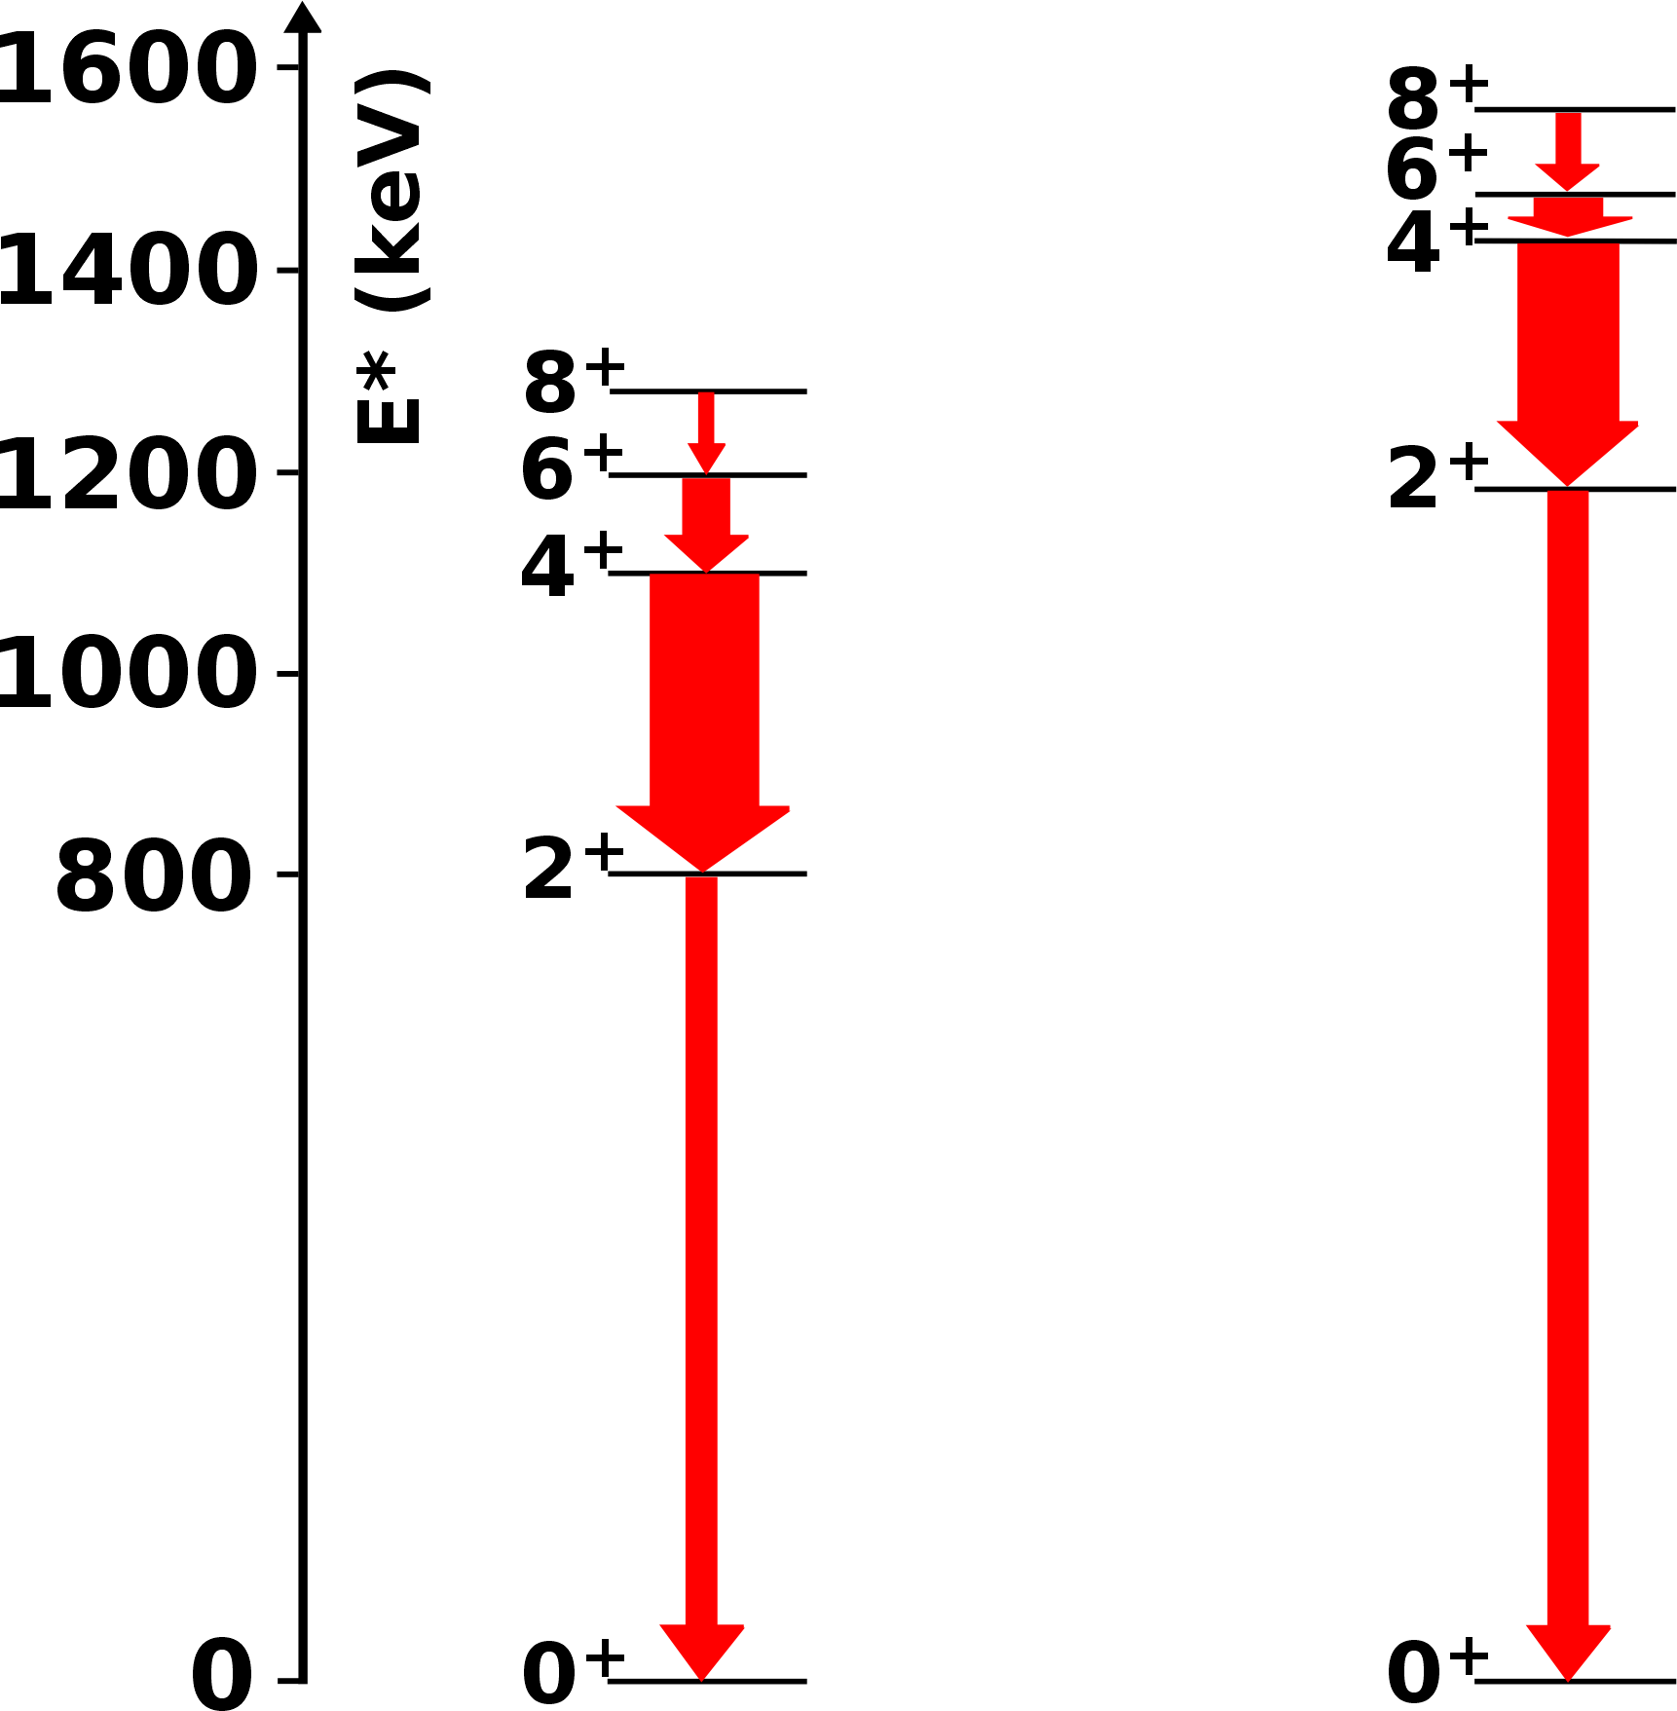
Properties of the 2-particle configurations above ²⁰⁸Pb
ν = 2
Z = 82
N = 126
The energies of the yrast 2⁺, 4⁺, 6⁺, and 8⁺ states follow seniority-like pattern of decreasing energy splitting between adjacent states with increasing spin;
The magnetic moments of the 6⁺ and the 8⁺ states are known in both nuclei:
g(8⁺;²¹⁰Pb) = - 0.312(8) g(8⁺;²¹⁰Po) = + 0.891(6)
g(6⁺;²¹⁰Pb) = - 0.312(15) g(6⁺;²¹⁰Po) = + 0.913(8)
ν = 0
²¹⁰Pb
2 neutrons
²¹⁰Po
2 protons
In both nuclei the structure of the 2⁺, 4⁺, 6⁺, and 8⁺ states is dominated by the seniority 2 configuration
ν(g_{9/2})²
π(h_{9/2})²

Slide 4
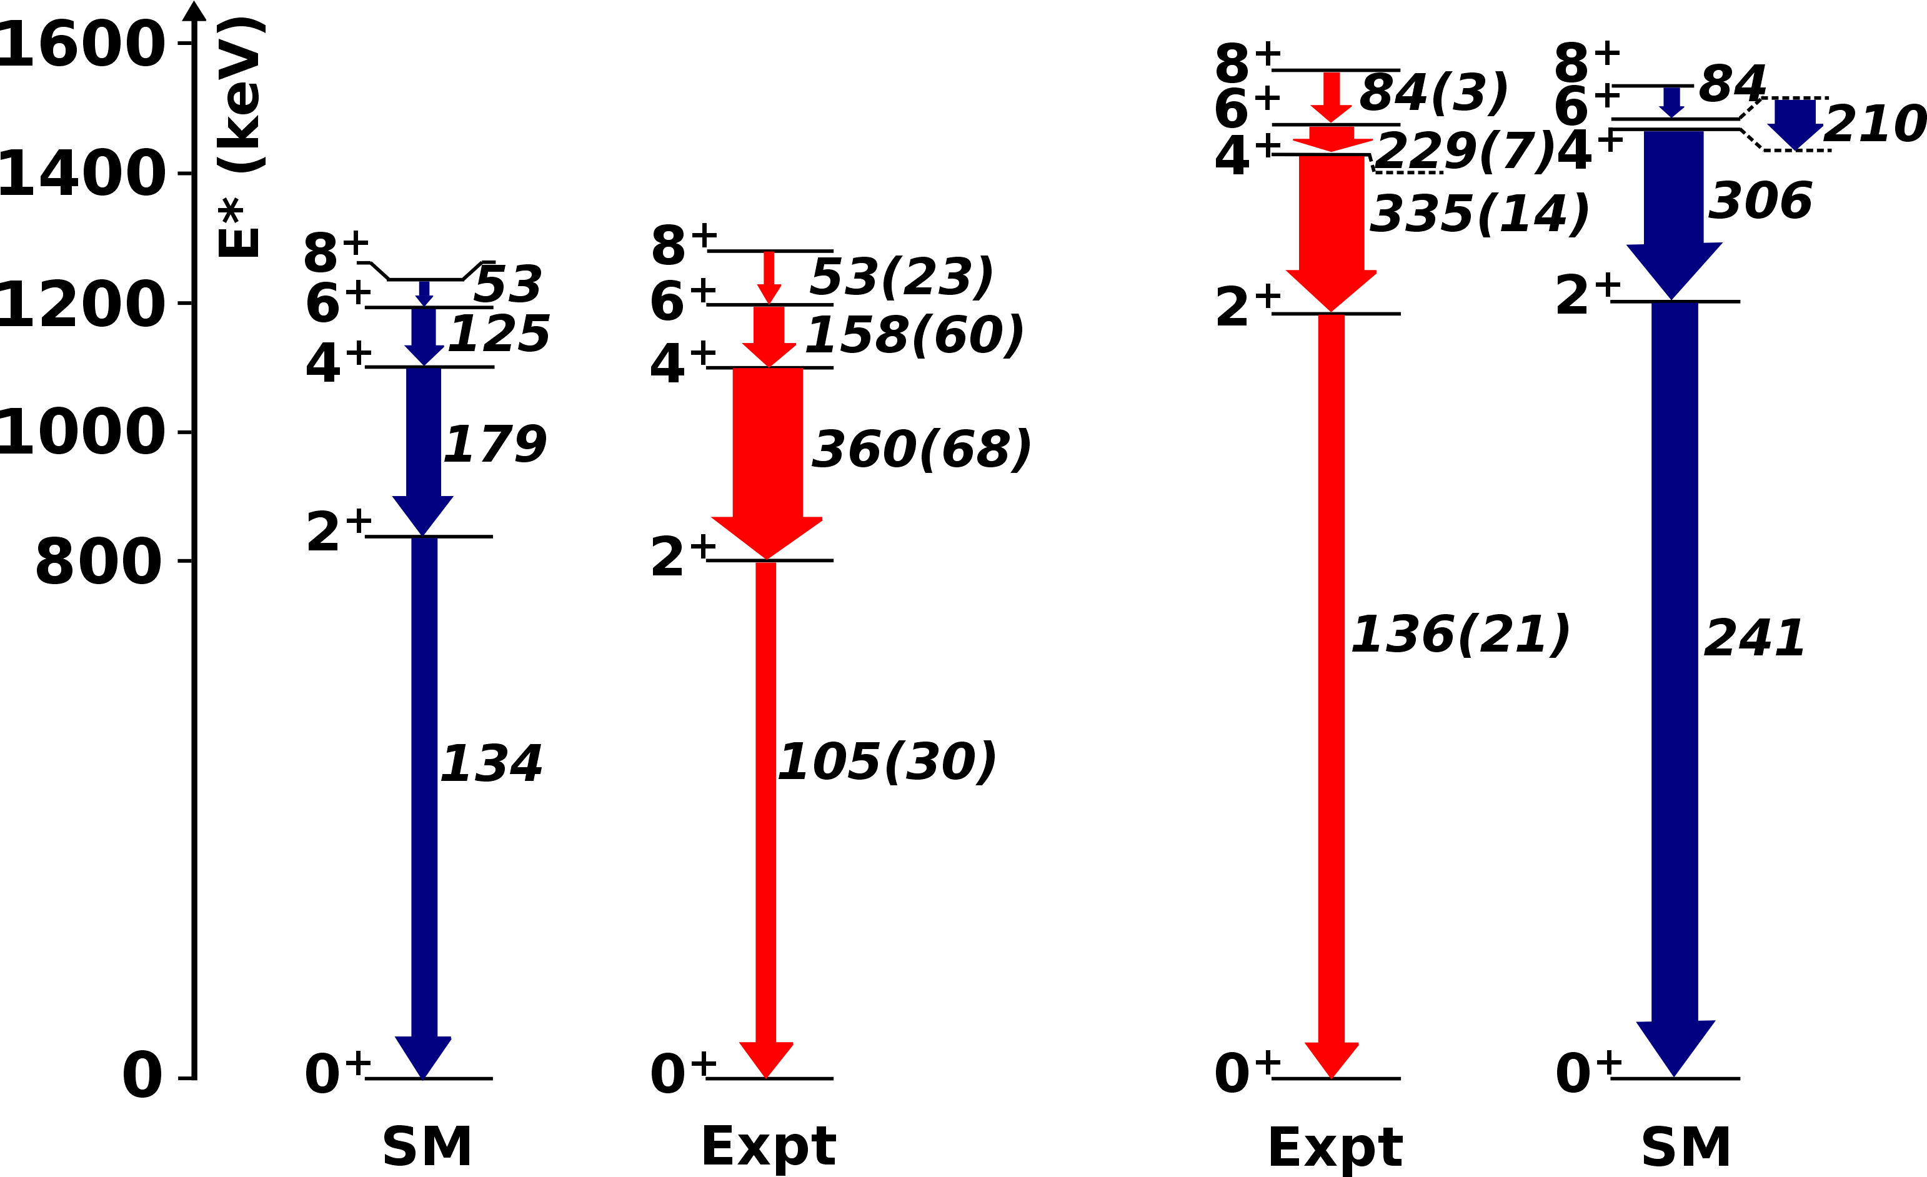
Properties of the 2 – particle configurations above ²⁰⁸Pb
Shell model calculations
Kuo-Herling interaction (E. K. Warburton and B. A. Brown, Phys. Rev. C 43, 602 (1991)).
2 protons in (2p_{1/2}, 2p_{3/2}, 1f_{5/2}, 1f_{7/2}, 0h_{9/2}, 0i_{13/2}) and 2 neutrons in (3s_{1/2}, 2d_{3/2}, 2d_{5/2}, 1g_{7/2}, 1g_{9/2}, 0h_{11/2}, 0j_{15/2})
(e_{π},e_{ν}) = (1.44e, 0.91e) fixed to the B(E2;8⁺₁ → 6⁺₁) values in ²¹⁰Po and ²¹⁰Pb, respectively
Results:
Almost perfect reproductions of the energies of the yrast states;
²¹⁰Pb
²¹⁰Po
Good agreement between the experimental and the calculated static moments;
Good agreement between all experimental and theoretical B(E2) but the B(E2; 2⁺₁ → 0⁺₁) values (and B(E2; 4⁺₁ → 2⁺₁) in ²¹⁰Pb)
The problem is present in all shell model calculations available in this mass region (CD Bonn potential, H208 interaction) but also appears in QPM calculations.

Slide 5
Properties of the 2 – particle configurations above ²⁰⁸Pb?
Two hypothesis:
There are some deficiencies in the shell model
The experimental results for the lifetimes of the 2⁺₁ states of ²¹⁰Pb and ²¹⁰Po contain systematic errors.
²¹⁰Po: B(E2; 2⁺₁ → 0⁺₁)
C. Ellegaard et al., Nucl. Phys. A206, 83 (1973)
(d,d’) & (p,p’) 42(9) e²fm⁴
The same technique used for the B(E2; 2⁺₁ → 0⁺₁) of ²¹⁰Pb
D. Kocheva et al., Eur. Phys. J. A53, 175 (2017)
DSAM in a transfer reaction 136(21) e²fm⁴
Shell model gives 241 e²fm⁴
Possible impact of the long-lived states feeding the level of interest - is it correctly accounted for?
M.S.M. Gerathy et al., Phys. Lett. B823, 136738 (2021). A. E. Stuchbery and J. L. Wood, Physics 4, 697 (2022).
…. The discrepancy between theory and experiment for the 2⁺ state in ²¹⁰Po (1.8(3)W.u. cf. 3.4W.u.) is well known and has been attributed to a lack of particle-hole excitations in the theoretical calculations [31,36,37]. However, it should also be recognized that the data evaluators for the A=210 mass chain [38] note that the 2⁺ lifetime measurement in ²¹⁰Po should be tested, so excessive interpretation of this potential discrepancy is not warranted. …

Slide 6
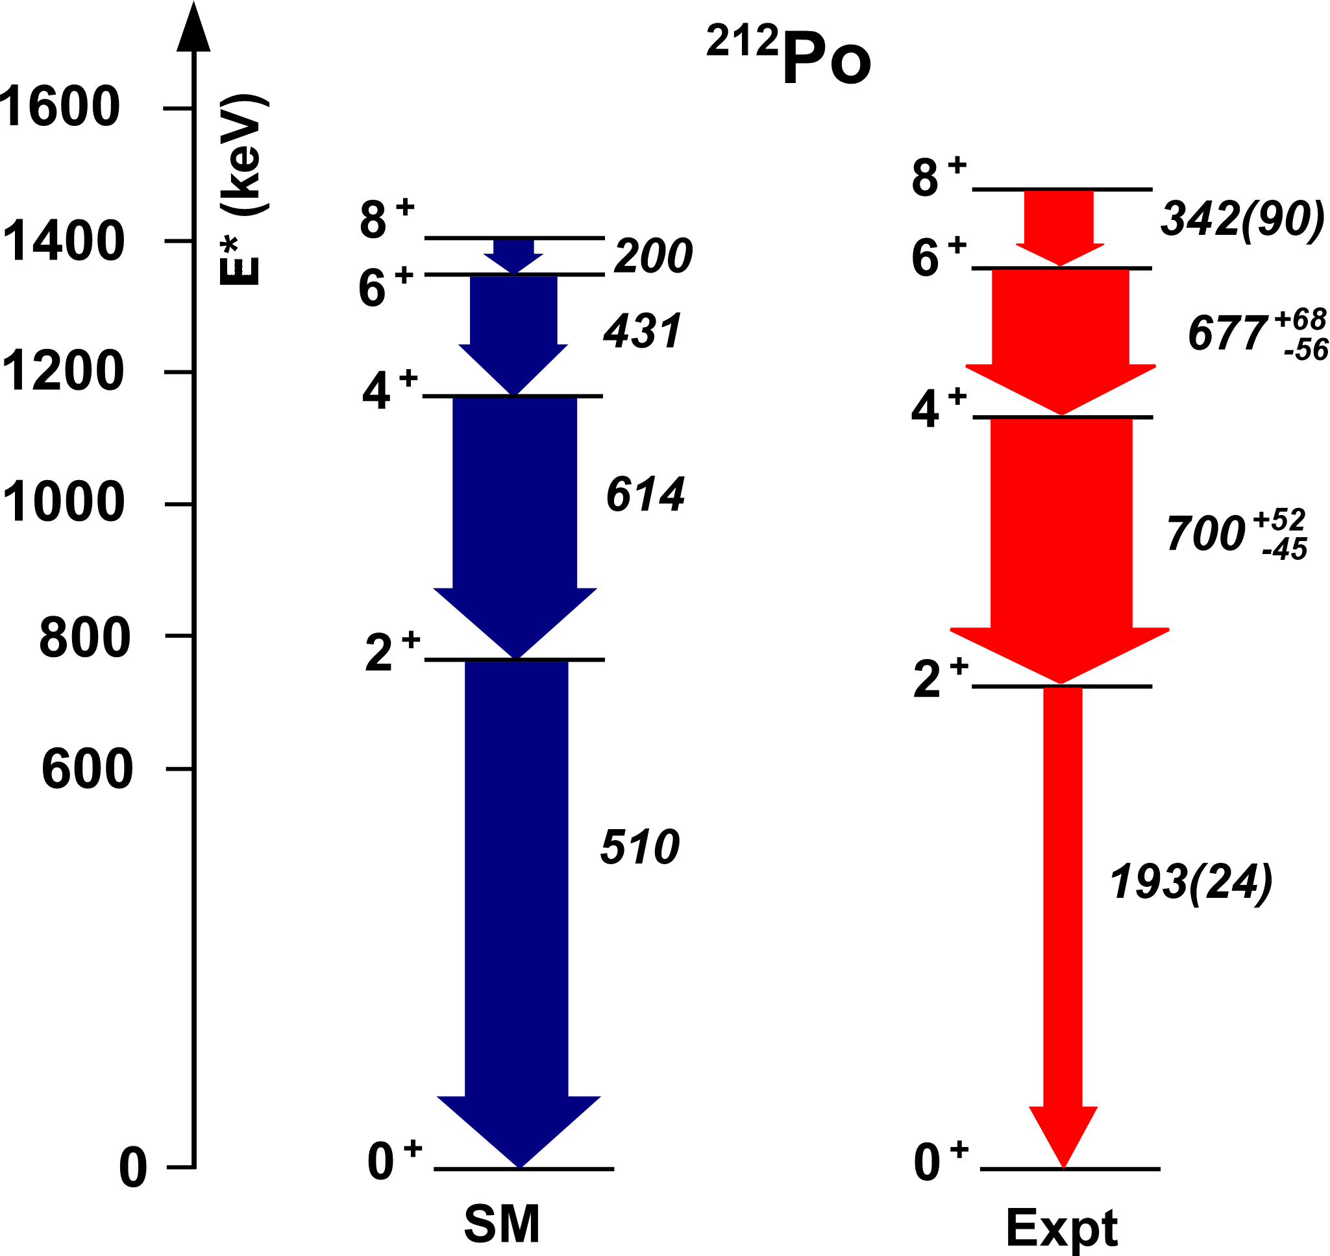
Properties of the 2 – particle configurations above ²⁰⁸Pb?
It is necessary to remeasure/test/verify the B(E2; 2⁺₁ → 0⁺₁) values in ²¹⁰Po and ²¹⁰Pb and eventually the B(E2; 4⁺₁ → 2⁺₁) value in ²¹⁰Pb by using alternative experimental methods!
Z = 82
N = 126
To understand the structures of the “open shell” nuclei north-east of ²⁰⁸Pb we have to understand completely the properties of the simplest 2-particle configurations above ²⁰⁸Pb.

Slide 7
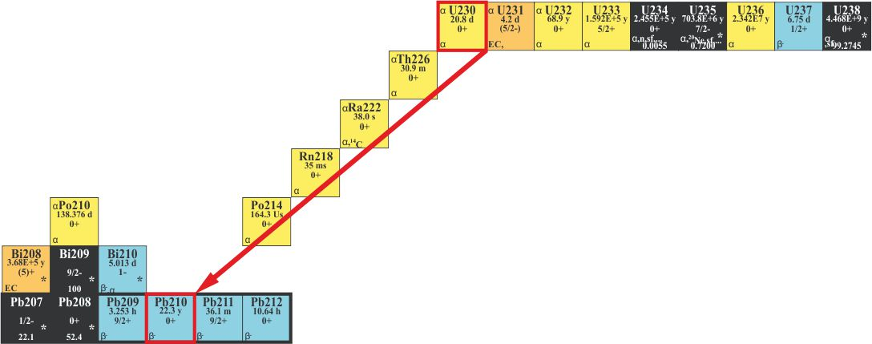
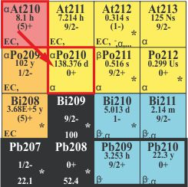
RIB production from ISOLDE and experimental details
²¹⁰Pb – produced in UC_{x} target as a daughter of ²³⁰U (20.8 d) – not released
during target irradiation
  (conservative) in-target production estimate ~1x10⁷ p/µC
²¹⁰Po – considering only ²¹⁰At decay (8.3h) – cold target irradiation
  (conservative) in-target production estimate ~1x10⁸ p/µC
RILIS Ionization efficiencies, corrected (B. Marsh,private communication):
  ~5 % for Po (estimated, no mass marker available)
  ~25 % for Pb (using the new ionization scheme)
Charge breeding and low-energy transport (F. Wenander) → ~5%
Post-acceleration (J.A. Rodriguez) → 75%
Beam intensity on Miniball target – at least 2x10⁵ pps for 1 day of beam on target
Considering all of the above efficiencies those intensities should be achievable after:
- 1 week irradiation of UCx target (@ 1 µA) – in the ²¹⁰Pb case
- 1.5 days of a cold target irradiation (@ 1 µA) – in the ²¹⁰Po case

Slide 8
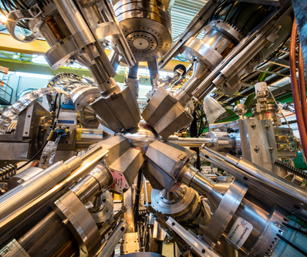

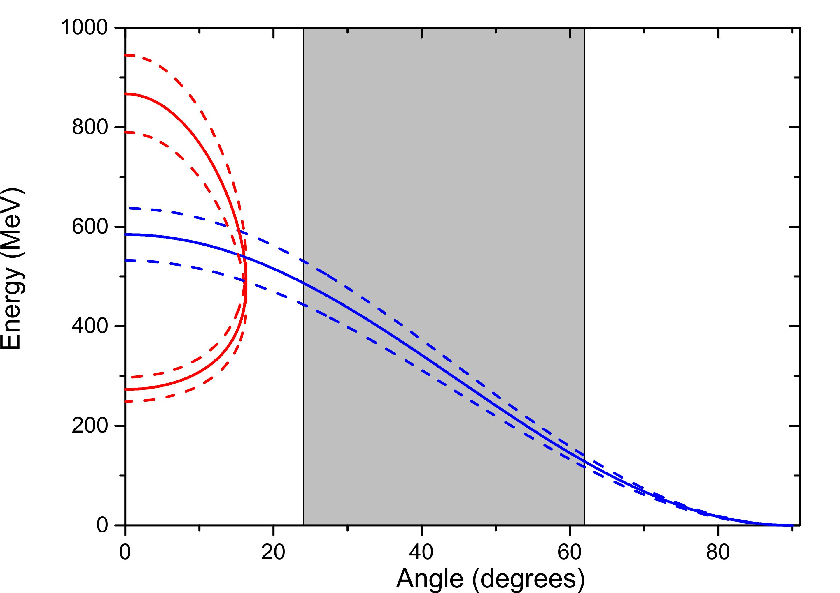
Coulomb excitation using Miniball @ 4.5 MeV/u
Heavy beam (²¹⁰Po/²¹⁰Pb) @ 4.5 MeV on
Light target – ⁵⁸Ni of 2 mg/cm²
Kinematics →
912 γ ‘s per day in the 2⁺₁ → 0⁺₁ in ²¹⁰Po (3% statistical uncertainty).
2352 γ ‘s per day in the 2⁺₁ → 0⁺₁ in ²¹⁰Pb (2% statistical uncertainty).
  55 γ ‘s per day in the 4⁺₁ → 2⁺₁ in ²¹⁰Pb (13% statistical uncertainty).

Slide 9
Beam-time request
Summary of requested shifts (modified):
3 shifts (1 day) with 2x10⁵ pps ²¹⁰Po beam at 4.5 MeV/u on a ⁵⁸Ni target;
  from a “cold irradiated” UC_{x} target
  a total of 10¹⁰ ²¹⁰Po ions @ Miniball target
3 shifts (1 day) with 2x10⁵ pps ²¹⁰Pb beam at 4.5 MeV/u on a ⁵⁸Ni target
  from (any) already used UC_{x} (RILIS) target
2 x 1 shift for tuning/calibrations with beam (at lower beam intensity)
  → A total of 8 shifts (without protons) requested

Slide 11
Yield estimates, Thierry Stora and Simon Stegemann
 | In-target prod 210At [/muC] | Comment |  |  | Eff. Cascade [%] | Comment
FLUKA | 1.00E+08 | > taking pessimistic one |  | production | 93.75% | build-up for irrad time (4*Thalf)
ABRABLA | 2.00E+08 |  |  | release | 100.00% | long-lived-> assume all is released
 |  |  |  | ionization | 40.00% | https://doi.org/10.1016/j.nimb.2008.05.142
 |  |  |  | transport | 5.00%
 |  |  |  | post-acc | 80.00%
 |  |  |  | Post-acc yield 210Po [/muC]
 |  |  |  | 1.50E+06
 | In-target prod 230U [/muC] | Comment |  |  | Eff. Cascade [%] | Comment
FLUKA | 6.00E+08 |  |  | production | 21.54% | build-up for irrad time (7d)
ABRABLA | 8.00E+07 | > taking pessimistic one |  | release | 100.00% | long-lived-> assume all is released
 |  |  |  | ionization | 30.00% | RILIS improved scheme x10
 |  |  |  | transport | 5.00%
 |  |  |  | post-acc | 80.00%
 |  |  |  | Post-acc yield 210Pb [/muC]
 |  |  |  | 2.07E+05

