Slide 1
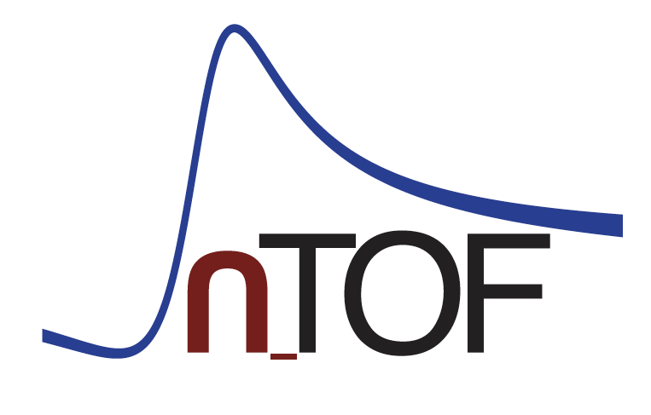
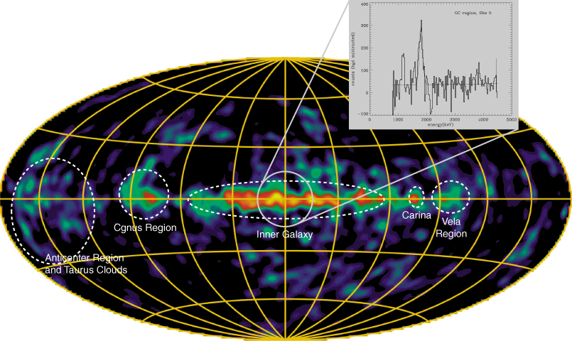
CERN-INTC-2022-035 / INTC-P-406-ADD-1
Silicon strip detector test for ²⁶Al(n, p) and ²⁶Al(n, α) measurements at neutron energies above 150 keV, relevant for ²⁶Al production in massive stars
Claudia Lederer-Woods, Peter Black, Thomas Davinson, Nikolay Sosnin, Philip J Woods, and the n_TOF Collaboration

Slide 2
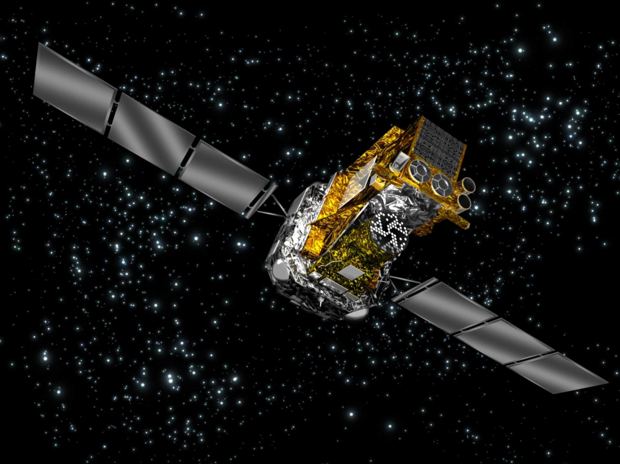
Cosmic γ-ray emitter
Galactic ²⁶Al (T_{1/2}~7x10⁵ y) can be detected by satellite telescopes via its characteristic γ-ray emission
Main Origin of ²⁶Al in massive stars (Diehl et al, Nature 439 (2006))
Key nuclear uncertainties for theoretical predictions of abundances: ²⁶Al(n,p) and ²⁶Al(n,α) reaction rates [Iliadis et al., Astrophys. J. Supp. 193, 16 (2011)]

Slide 3
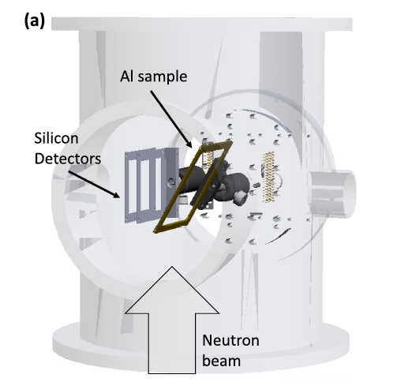
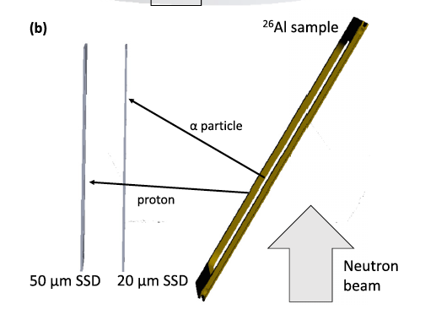
Measurement at n_TOF EAR-2
Detection setup at 2016 measurement at EAR-2
Lederer-Woods et al., PRC 104, L022803 (2021)
Lederer-Woods et al. PRC 104, L032803 (2021)

Slide 4
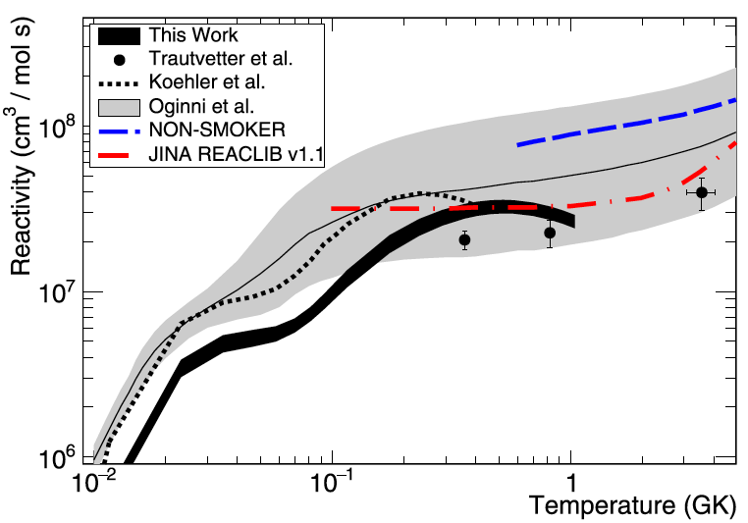
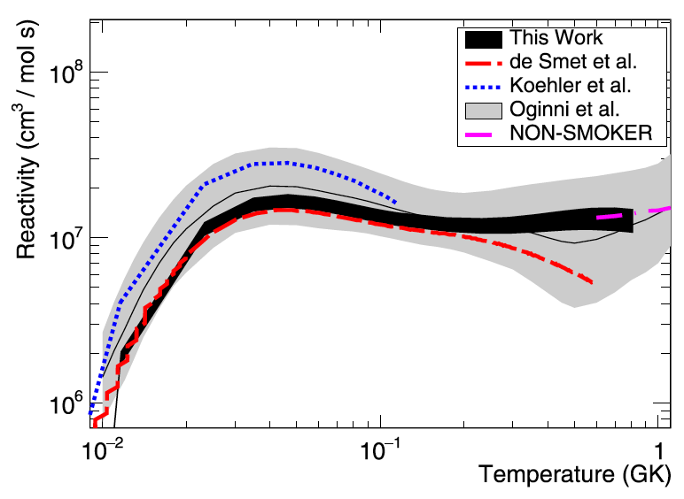
Stellar Reaction Rates
²⁶Al(n,p)
Cross sections measured up to ~150 keV neutron energy, reaction rates reliable up to ~0.5 GK
Data allow accurate predictions of ²⁶Al destruction in low mass AGB.
Good agreement with presolar grain abundances using n_TOF data (Battino, Lederer-Woods, et al., submitted to MNRAS)
Lederer-Woods et al., PRC 104, L022803 (2021)
²⁶Al(n,α)
BUT: Battino et al. study found that more accurate data are still needed at high neutron energy, relevant to ²⁶Al abundances in massive stars (T~1GK)
Lederer-Woods et al. PRC 104, L032803 (2021)

Slide 5
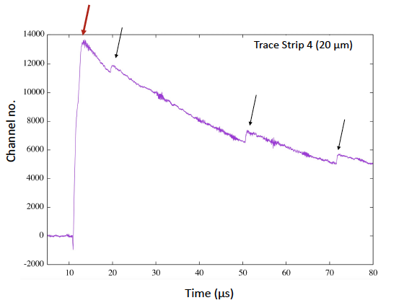
High neutron energy limit
Measurement was performed with a large neutron beam collimation. Therefore, silicon detectors were very close or even intercepting the neutron beam.
Preamplifier trace of one strip of the thin 20 μm silicon detector (thicker detector worse)
γ-flash
alpha
alpha
alpha

Slide 6
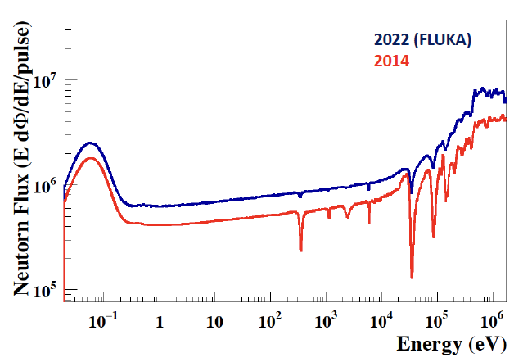
New spallation target vs old

Slide 7
Aims
Neutron flux with new spallation target is higher and has less absorption dips → small beam collimation (which leads to less background from gamma-flash) makes measurement possible
Plan: test silicon strip detectors of various thicknesses at realistic distances from the neutron beam. Measure well known reactions, i.e. ⁶Li(n,t) and¹⁰B(n,α) in addition to empty chamber.
If energy range can be extended: submit another proposal for a new measurement at n_TOF EAR-2 in 2023.
Beam time request: 1x10¹⁷ protons

