Slide 1
n_TOF Technical Report at the 71st INTC Meeting
Oliver Aberle, SY-STI-TCD
08/11/2022

Slide 2
Agenda
FTN line
Target in operation
NEAR

Slide 3
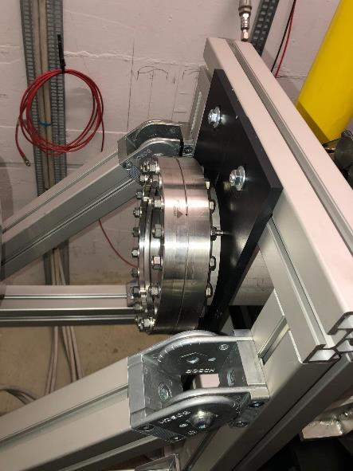
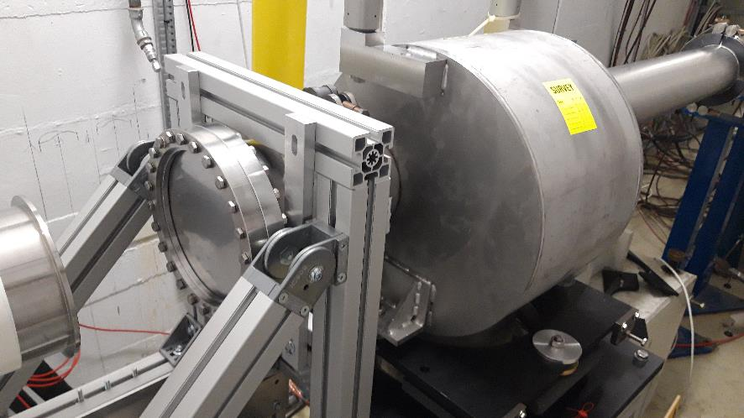
FTN line now 2022
Increased diameter DN160 to DN 200: Operation fully under control

Slide 4
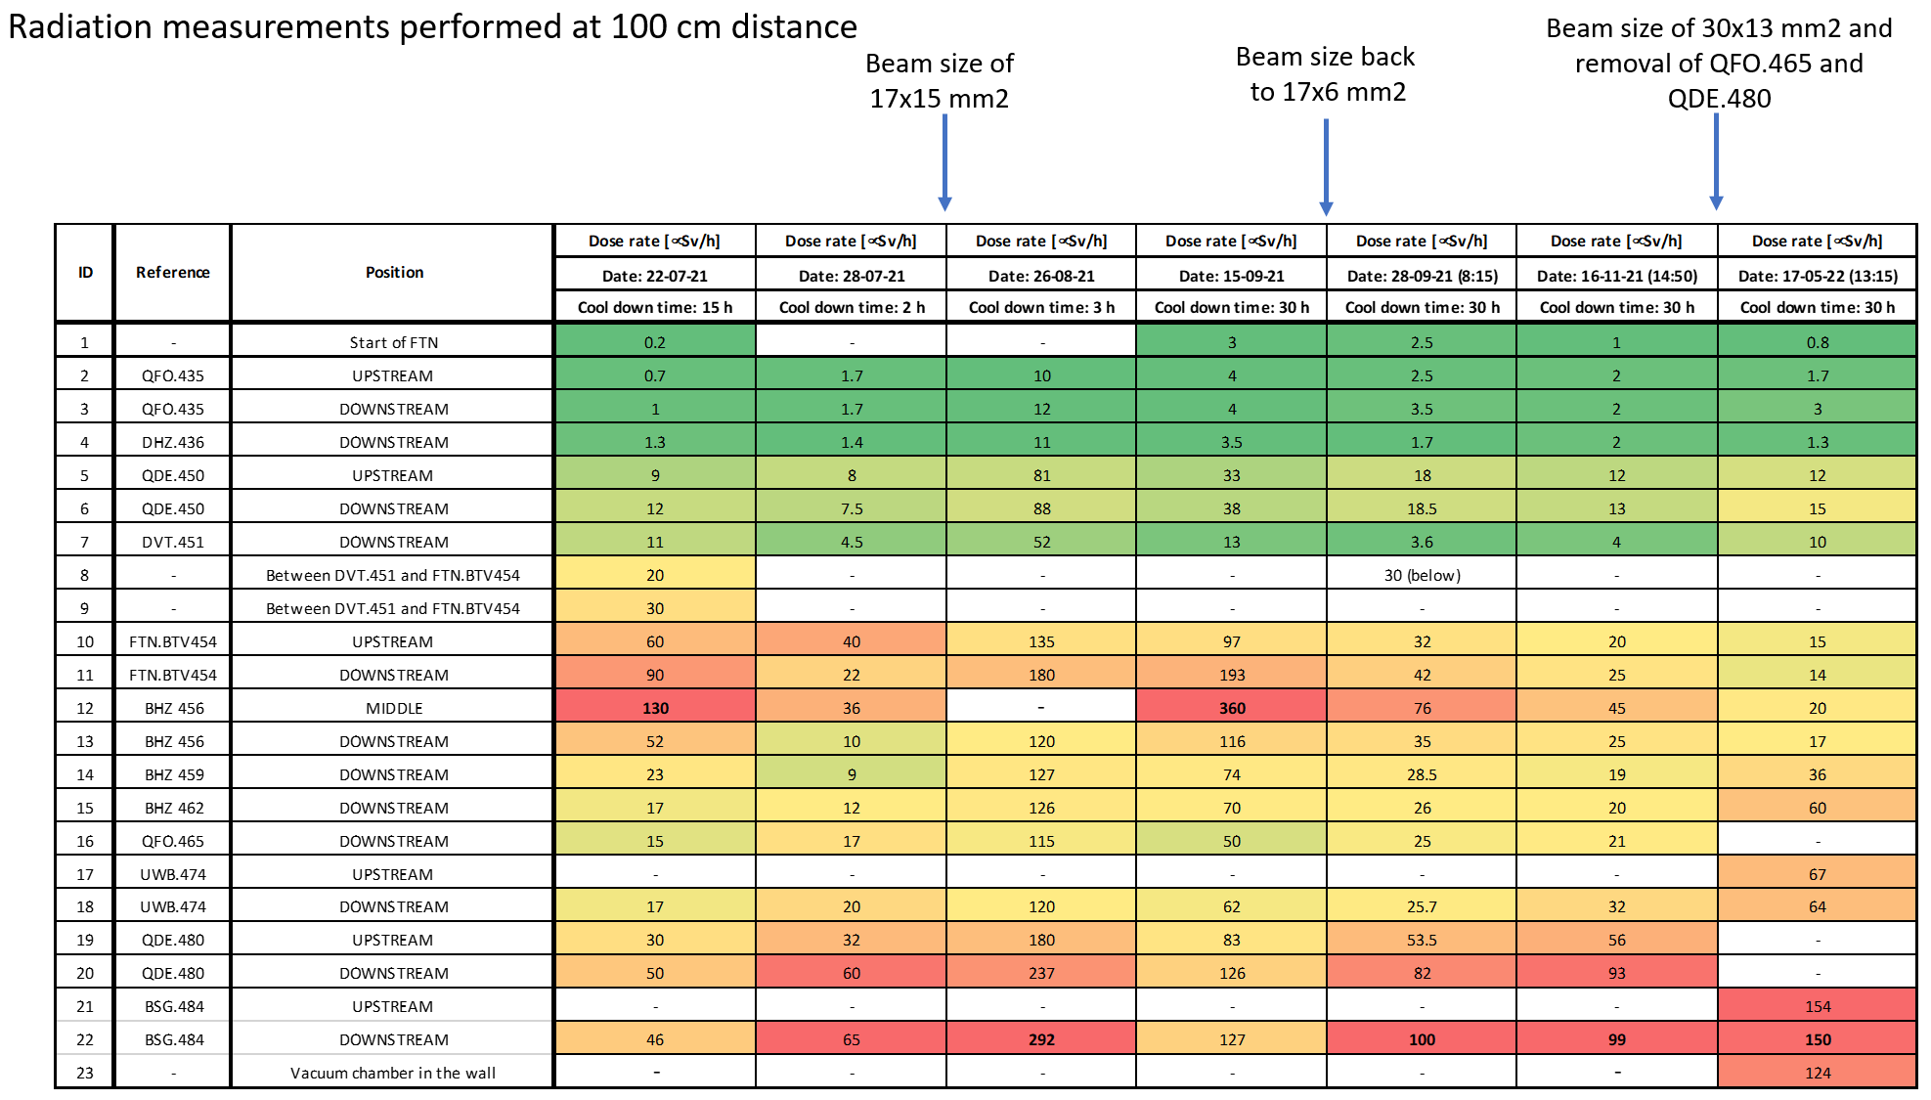
FTN line
courtesy F. Pozzi

Slide 5
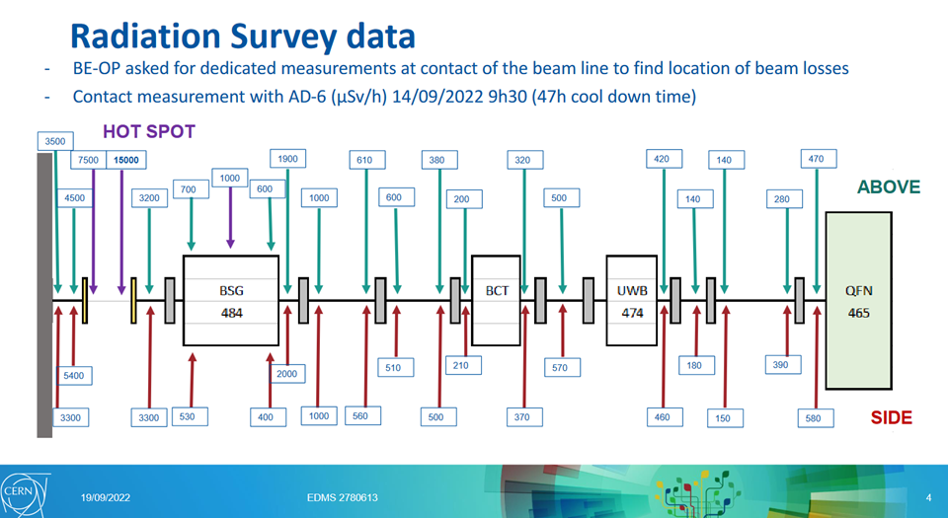
FTN line – RP survey during TS2
Hot spot a sum of several contributors
Beam windows (independent of aperture)
SEM wires
Target
Losses on beam pipes and tanks
Possible dose reduction deemed small compared to effort needed – This configuration is now base line until LS3.
Maintenance and spare situation for Ti-beam window and SEM grid to be revised
https://indico.cern.ch/event/1209843/attachments/2534812/4362242/20221018_Minutes 6th FTN Meeting.pdf

Slide 6
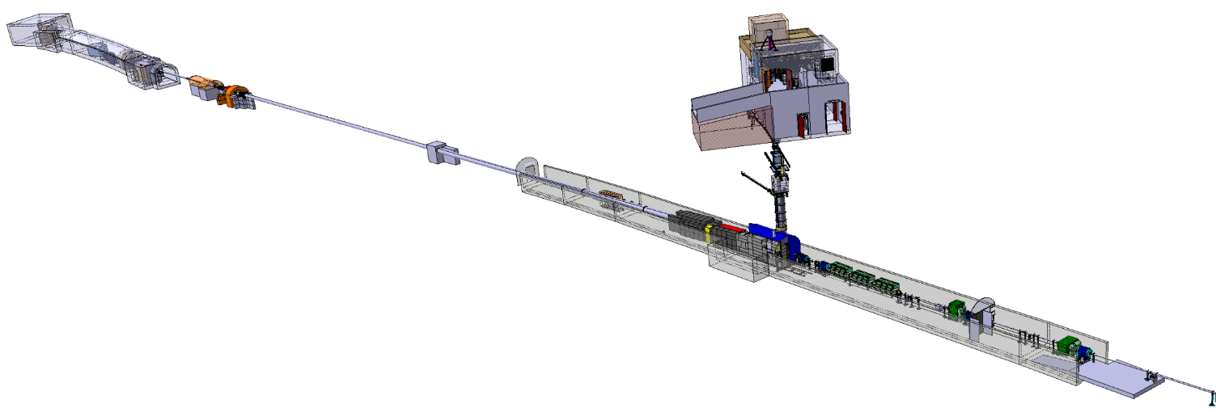
n_TOF target

Slide 7
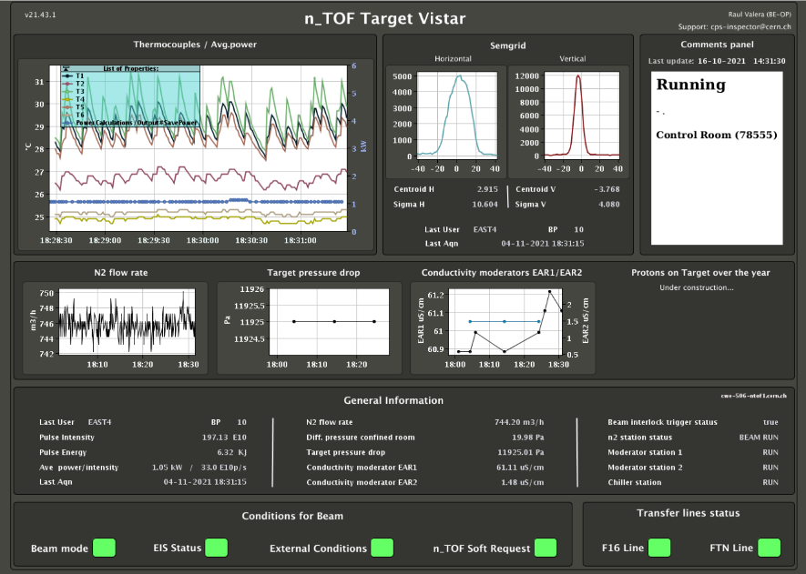
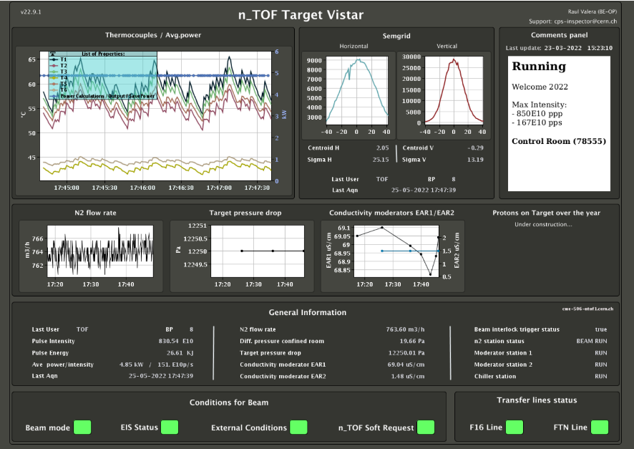
n_TOF spallation target #3
First beam on target received on 19th July 2021
Work on optics and proton line modifications, defined setting during 2022.
MD during September to push intensity limits
2021
2022

Slide 8
n_TOF spallation target #3
MD on Wednesday 28.September: Increase of average intensity for the n_TOF beam
8h07: 200e10 p/s
https://logbook.cern.ch/elogbook-server/GET/showEventInLogbook/3624599
9h38: 220e10 p/s
https://logbook.cern.ch/elogbook-server/GET/showEventInLogbook/3624641
Around 12h increase N₂ flux of the target cooling loop.
15h30: back to 160e10 p/s
https://logbook.cern.ch/elogbook-server/GET/showEventInLogbook/3624872
From operation no issue for these changes in intensity. The limitation is the availability of PS cycles

Slide 9
n_TOF water cooling station

Slide 10
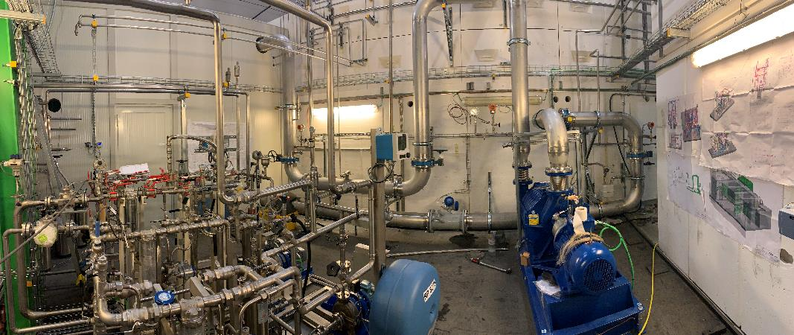
Target #3 cooling and moderator station
Target nitrogen cooling required the full replacement of the target cooling and moderator circuits
Major efforts from CV to develop the technology to match the specifications and RP requests
(EDMS 2068336)
Comments from the visit of the French and Suisse authorities (global confinement)
Running with nominal operation settings for cooling (e.g. 780 (Nm³/h) for nitrogen cooling)
and both moderator loops, efficiency as specified. Leak rate well below the design values!
Under pressure room for filters (RP)
Moderators (2x)
Charcoal + HEPA filters
N₂ compressor
This Photo by Unknown Author is licensed under CC BY-NC

Slide 11
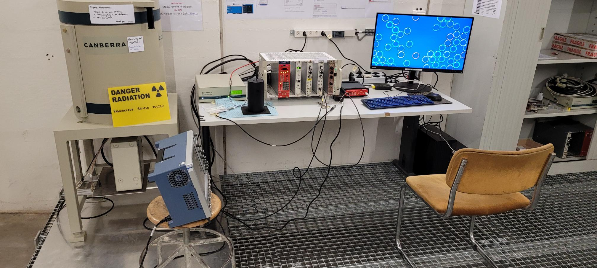
n_TOF Experiment activities
New Ge-detector in B804 (next to entry door of EAR1)

Slide 12
n_TOF Ventilation – EAR1
Renovation of ventilation for the type A area 1.
Controls to be updated to the CV standard.
More flexibility to handle operational situation for access, beam and flush mode.
Remote access to intervene on faults and error messages
Intervention scheduled for December, the ventilation system will be disabled during several periods. Combined with the annual maintenance work and filter exchange.

Slide 13
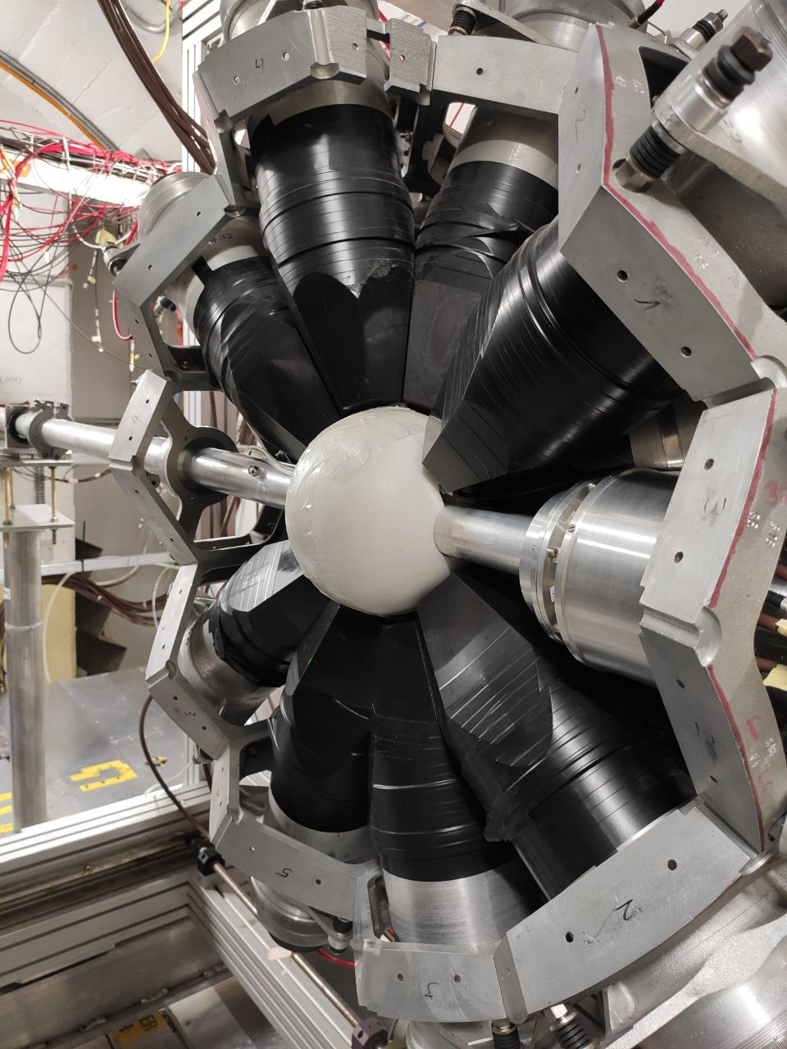
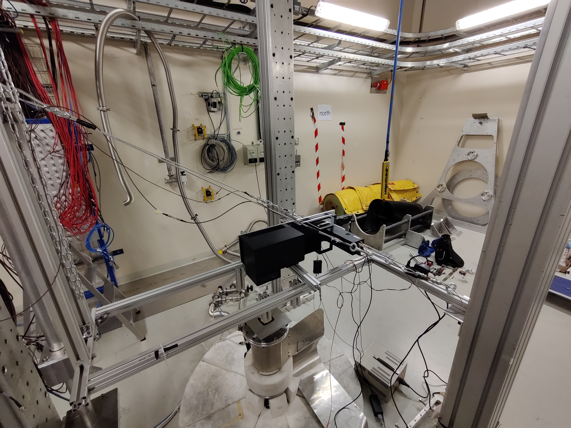
EAR 1: Pu-239 capture setup EAR 2: Neutron imaging
Two measurements running at the moment… many more in Nikolas’ talk

Slide 14
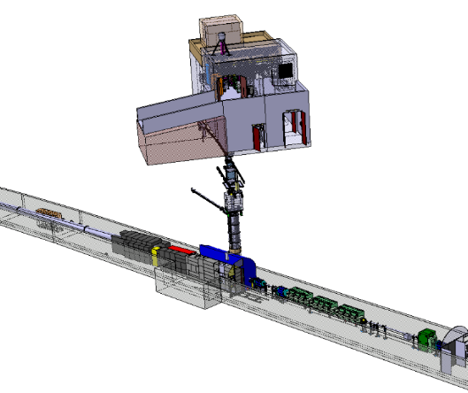
n_TOF target shielding - NEAR
recently published paper https://journals.aps.org/prab/abstract/10.1103/PhysRevAccelBeams.25.103001

Slide 15
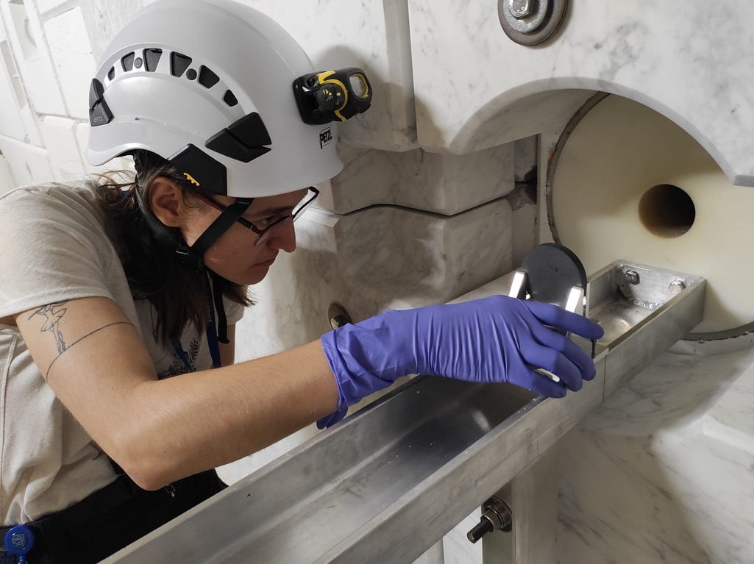
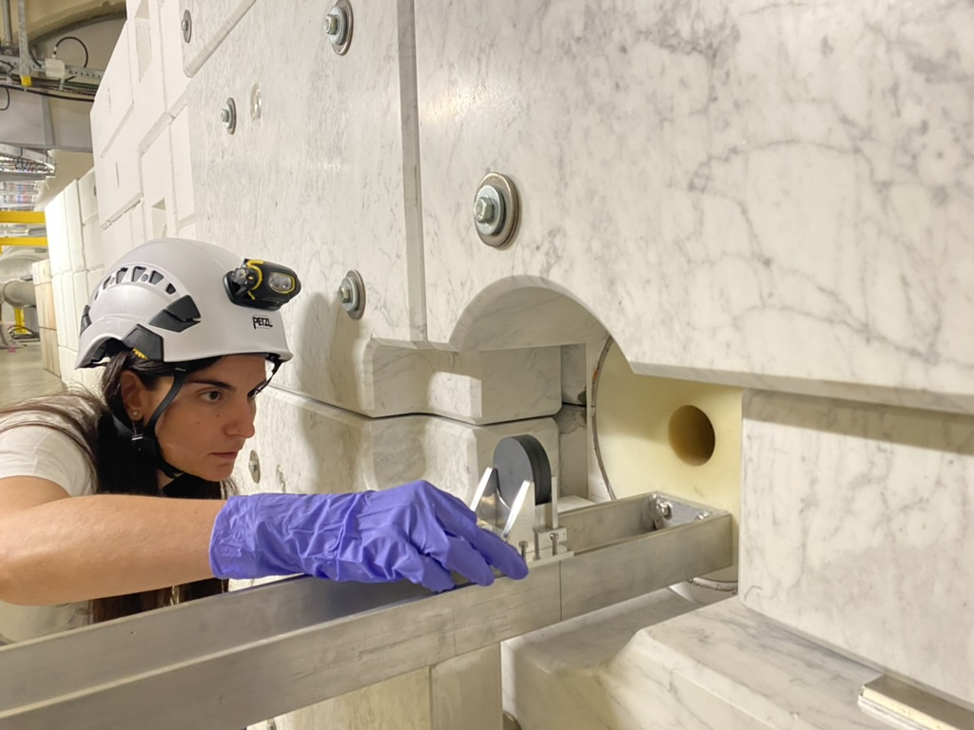
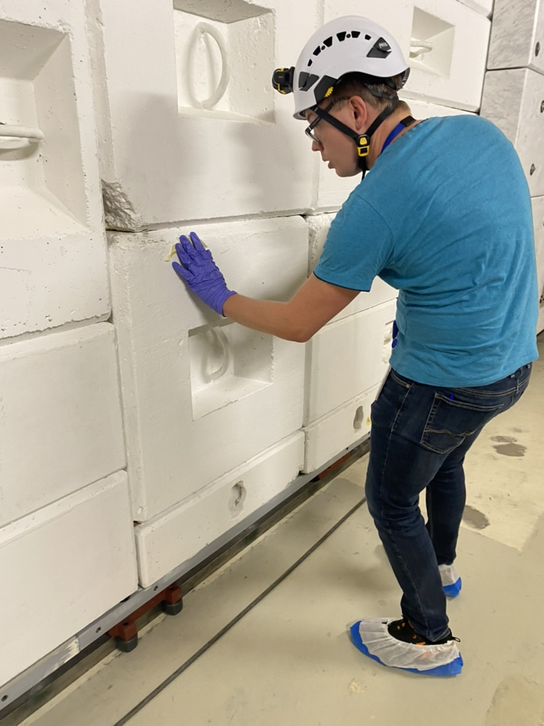
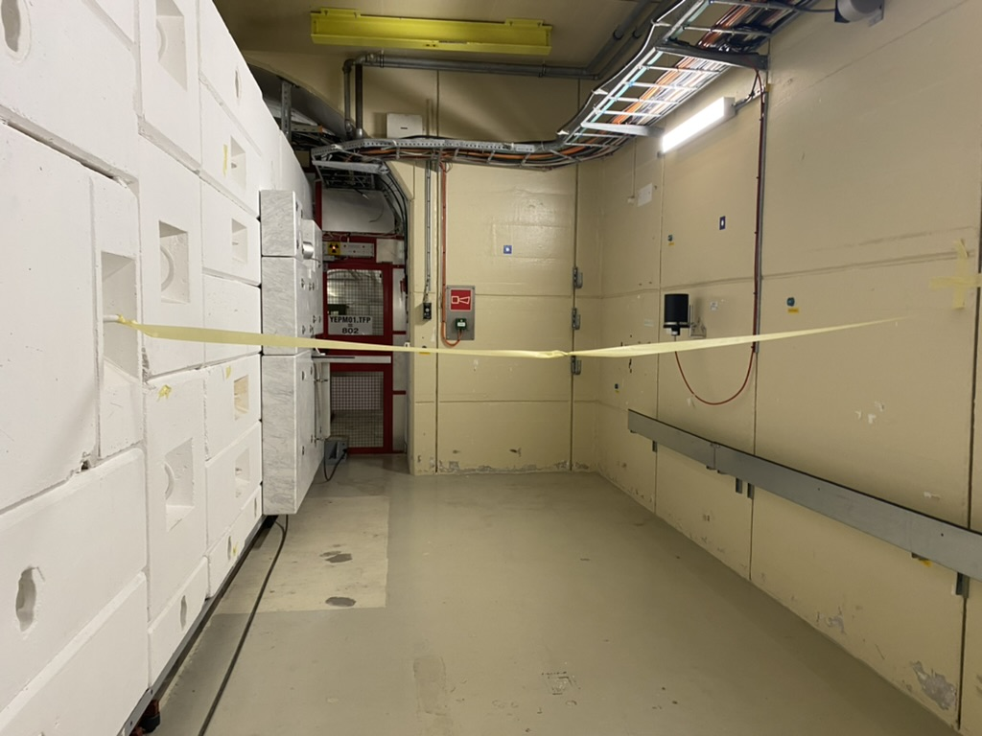
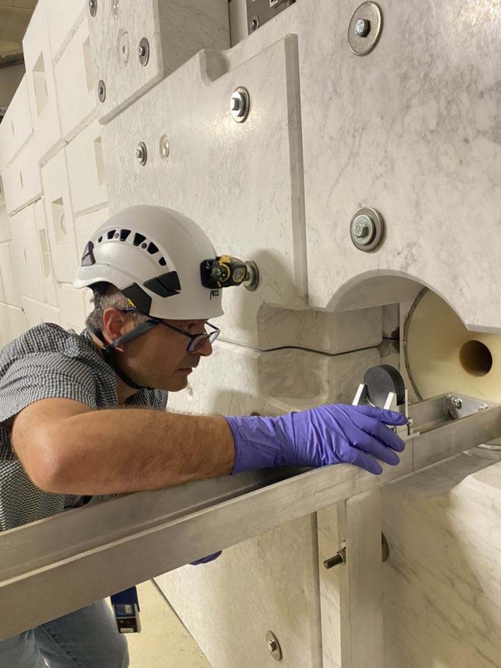
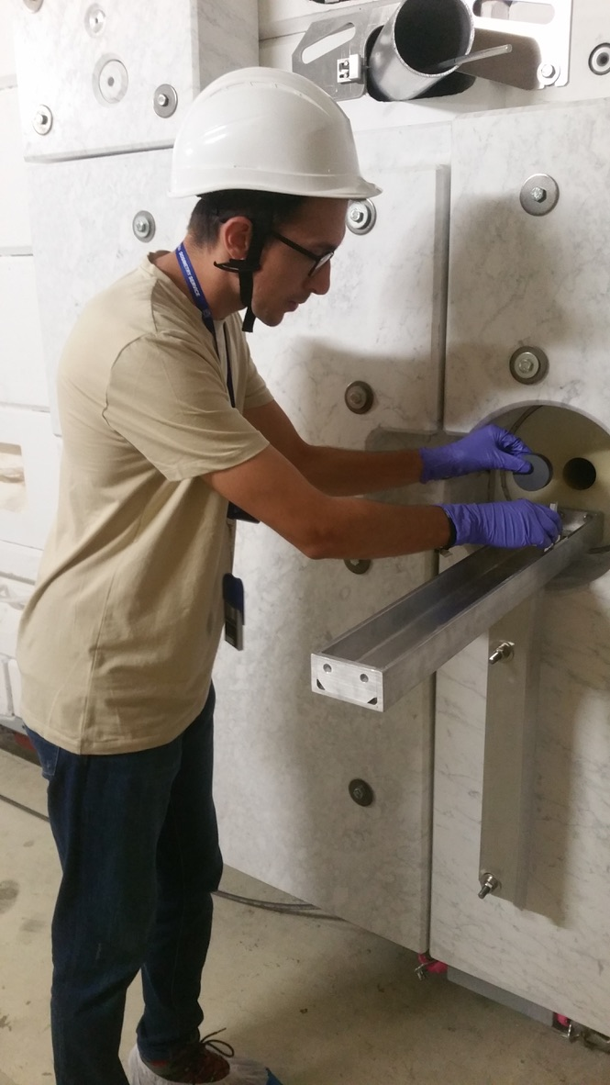
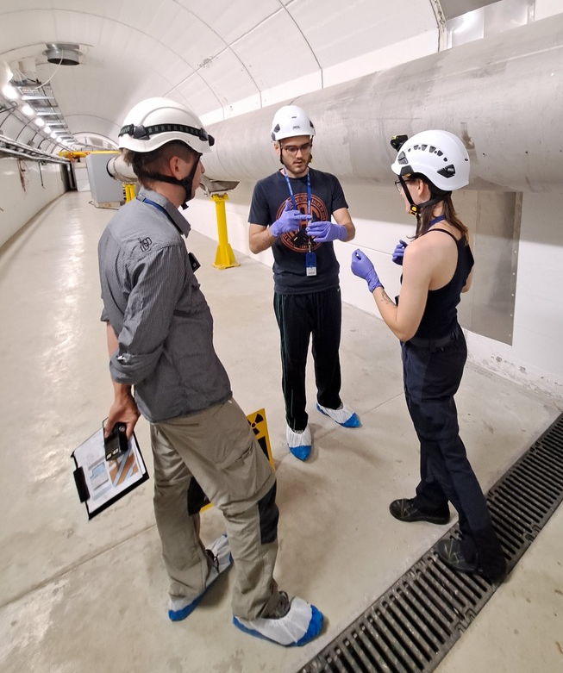
2022 – NEAR n-TOF activities
- parasitic
New organisation – Access every two weeks
Very succesfull
INTC-I-241 Measurement of the radiation background at the n_TOF NEAR facility to study the feasibility of cyclic activation experiments
INTC-P-623 Neutron capture cross section measurements by the activation method at the n_TOF NEAR Station (19 access in 2022)

Slide 16
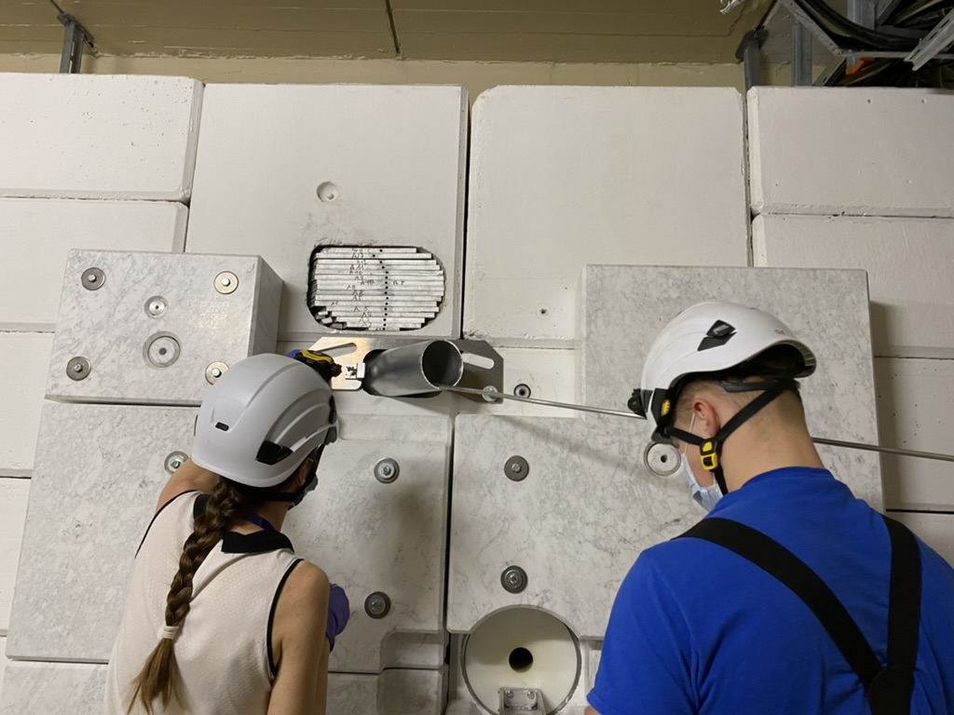
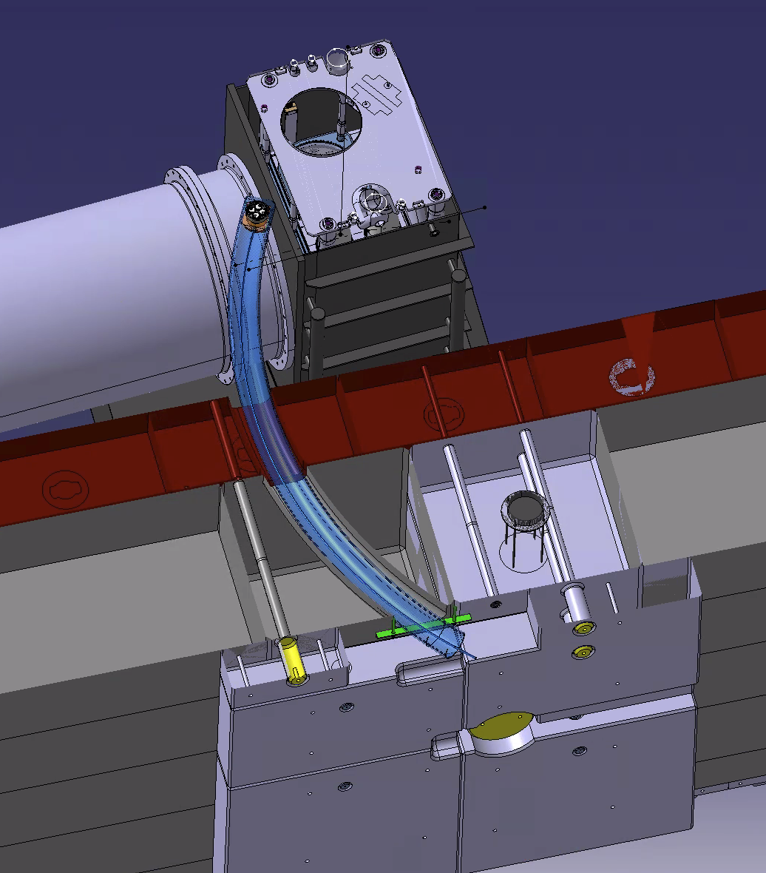
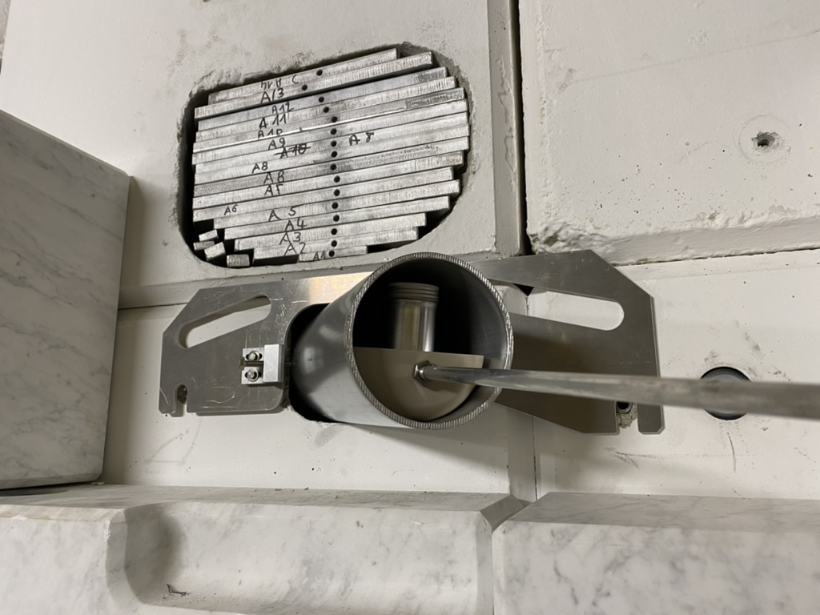
2022 - R2M activities
Irradiation shelf on target pool
24 sample positions
Similar irradiation than in 2021
New in 2022
UNIQUE IRRADIATION CONDITIONS

Slide 17
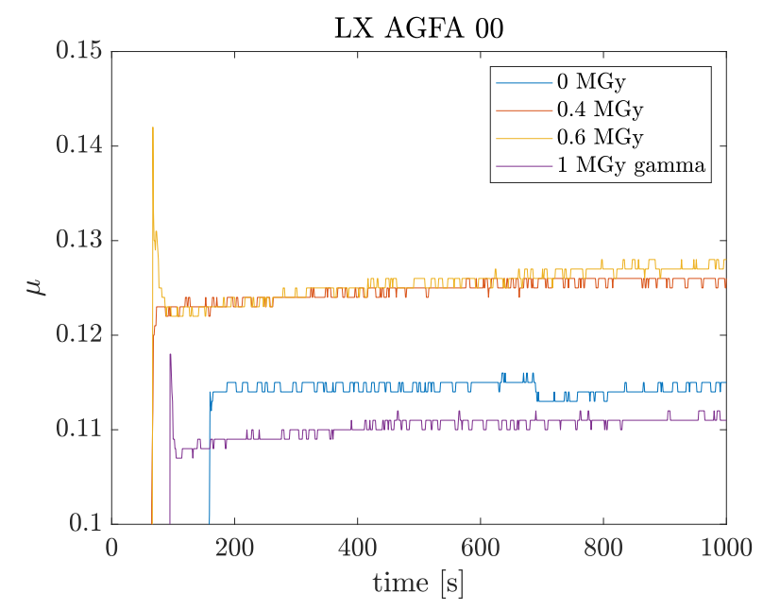
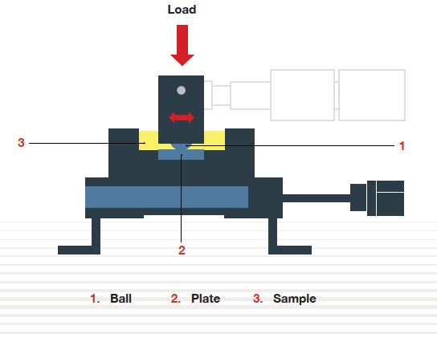
2022 - R2M activities
11 commercial lubricants
0.4 - 2.5 MGy by end 2022
Neutron component 67 - 81% in organic materials
Wide range of analyses ongoing (structural, chemical, tribological…), differences with gamma
PROOF OF RELEVANCE
Lubricant still working
Clear dependence on irradiation type!
Testing of friction coefficient on lubricants using HFRR
PCS, HFRR brochure
HRFF test results for fresh and irradiated grease Lubrilog LX AGFA 2
25°C, 10Hz, 0.25mm stroke, 1kg load
Acknowledgement: D.Senajova/SY-STI
Notes:
Additional info (if needed):
4 dose points per material
HFRR = High Frequency Reciprocating Rig
HFRR test principle : a stainless steel ball is loaded against a stainless steel disc with a layer of lubricant. The ball oscillates in a controlled way, the instrument measures the coefficient of friction during the test
LX AGFA 00 is a polyphenyl ether (PPE)-based grease, amongst the most resistant to radiation
At 1 MGy, conventional lubricants are expected to fail, this one still works, it’s a very good result (we have gamma-irradiated samples that still work after 5 MGy)
The difference between gamma and NEAR results demonstrates the need for this type of irradiation station

Slide 18
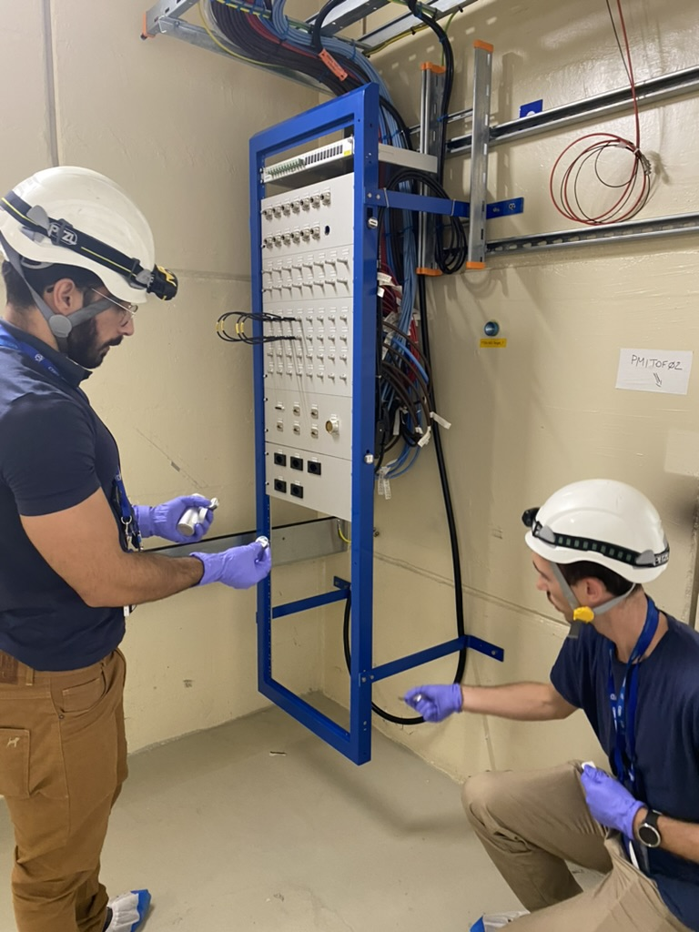
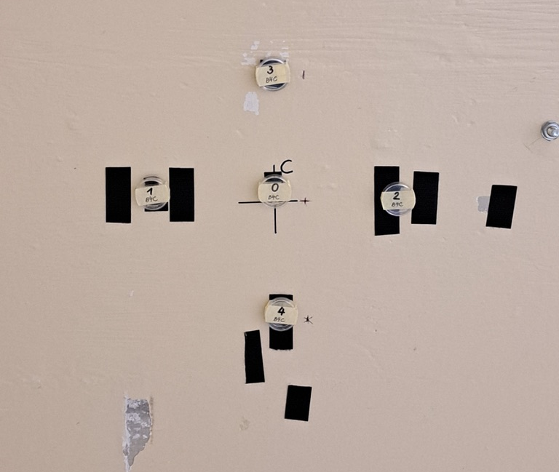
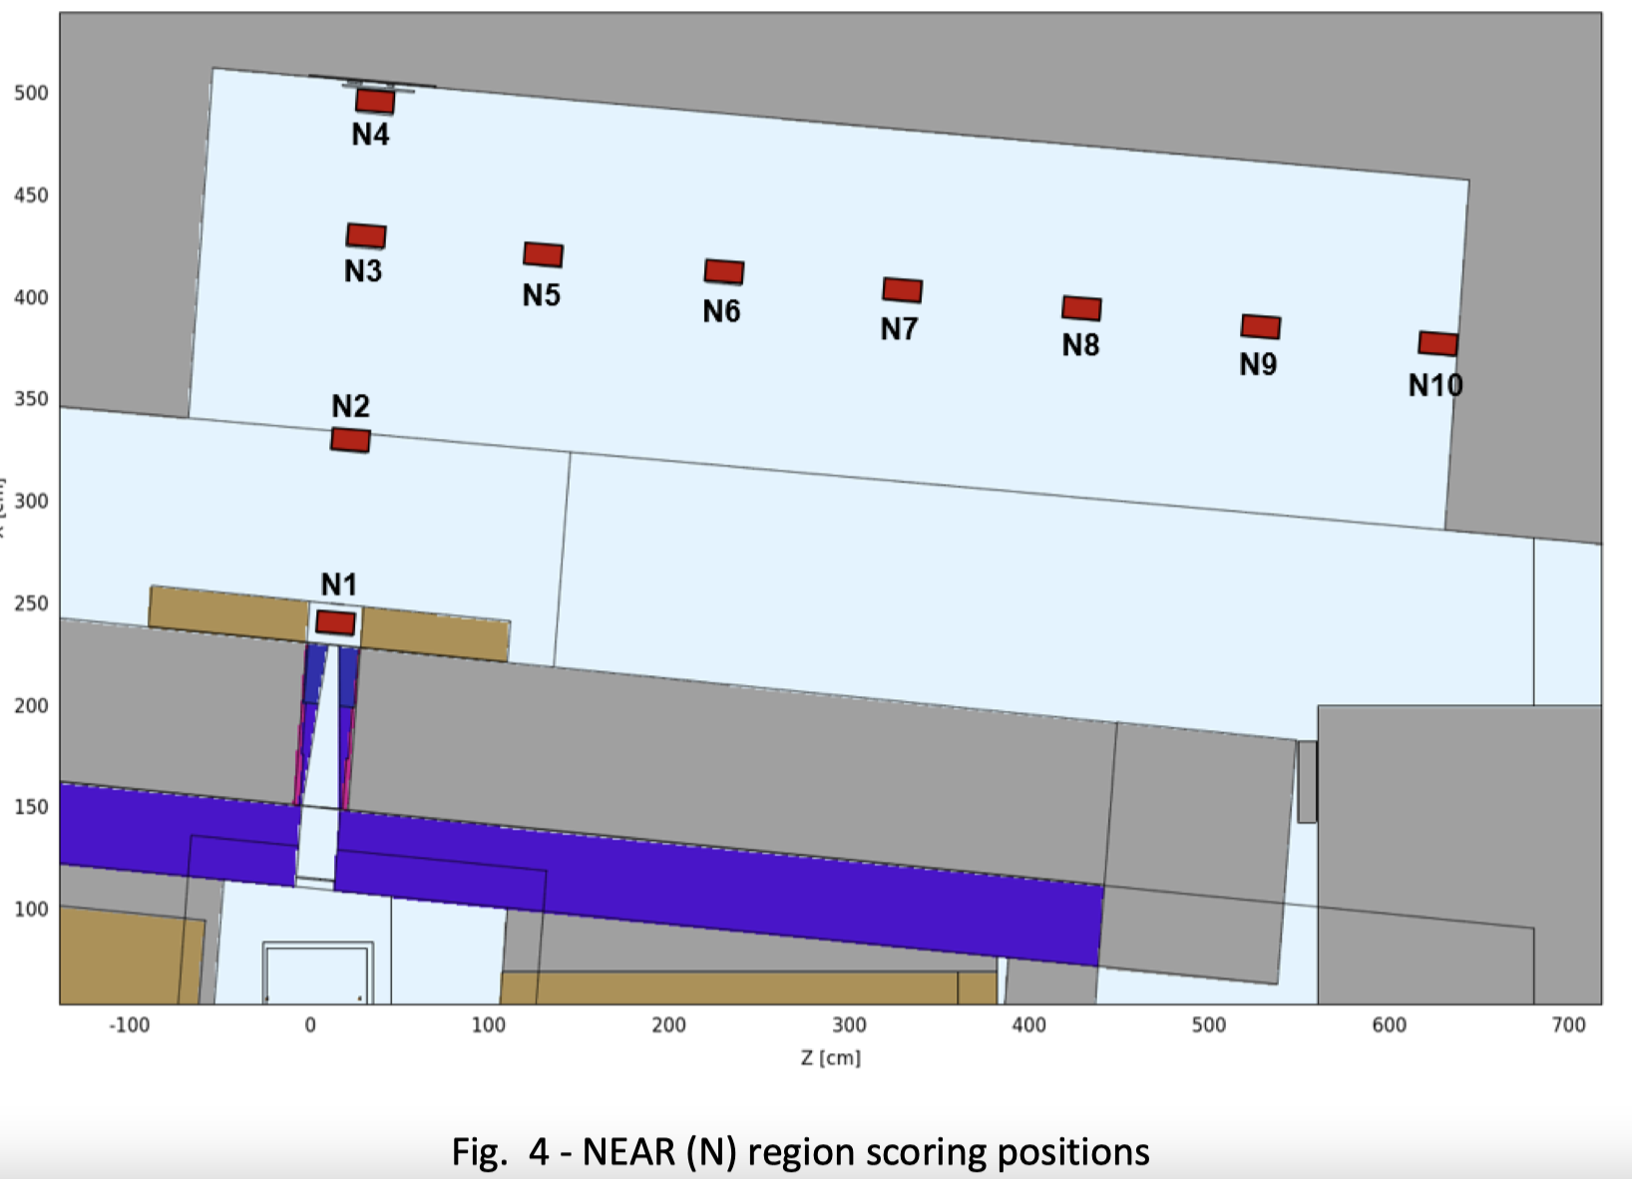
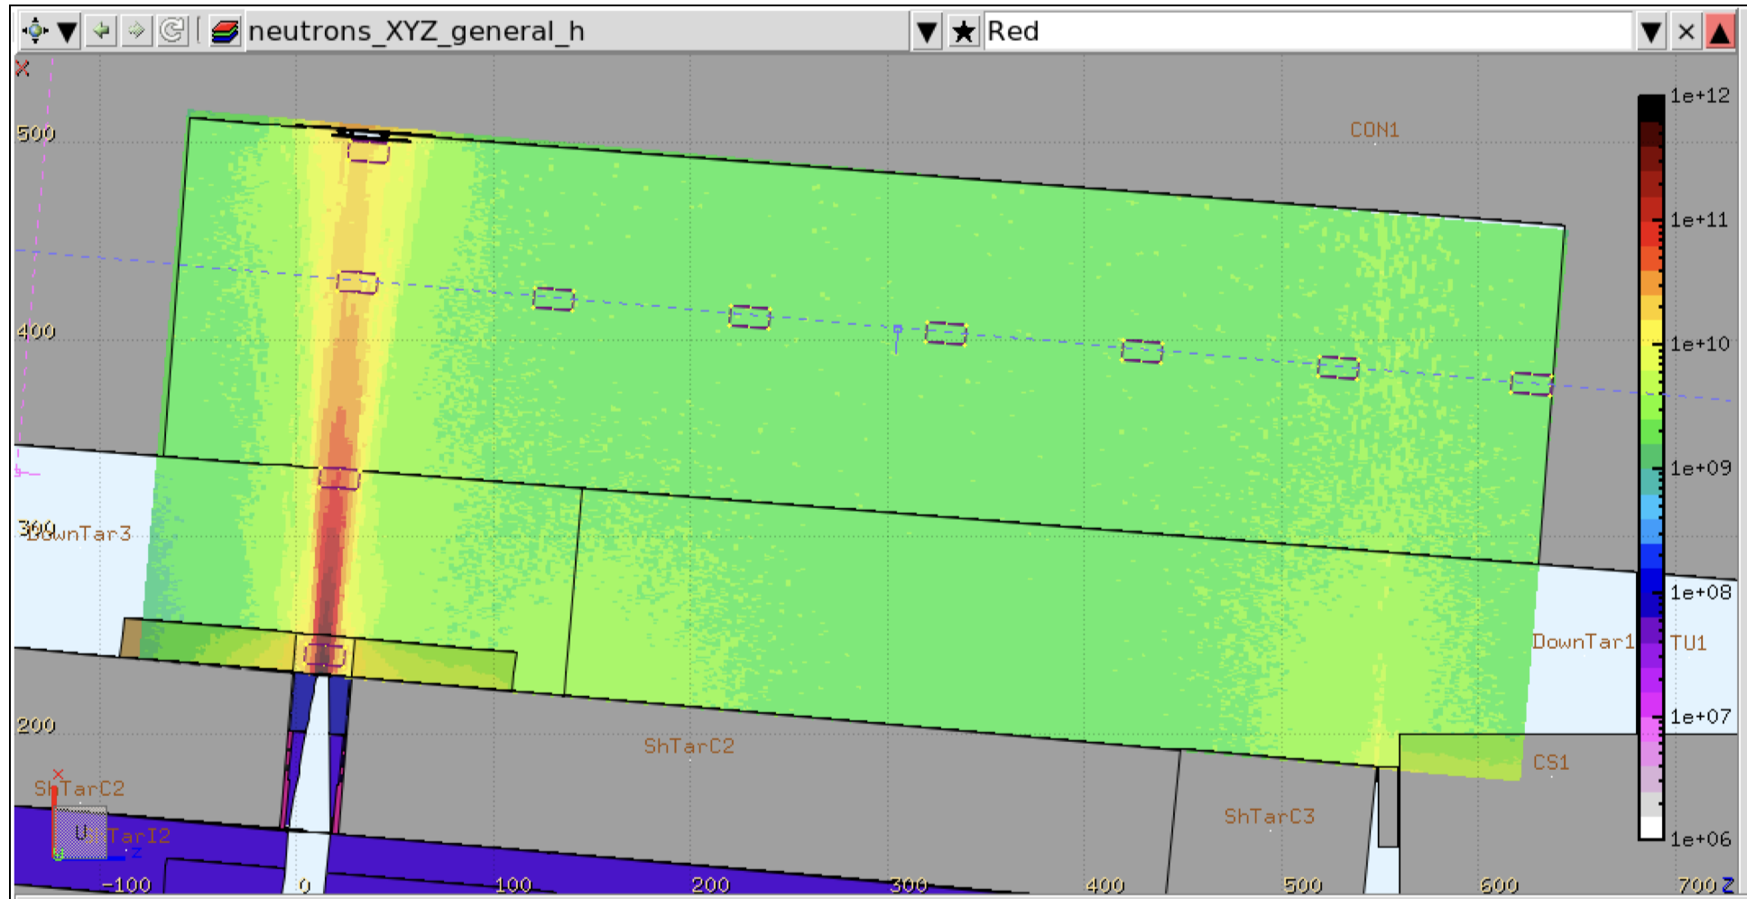
2022 - R2E activities
FLUKA study on the typical radiation quantities used for R2E irradiation campaigns - EDMS 2769573 by Matteo Cecchetto
N10
High-Level Dosimeters* installed at NEAR to confirm NEAR FLUKA simulations
N4
*results will be available during next YETS - EDMS 2698775

Slide 19
Conclusions
Target performance without limitations, FTN beam line modifications successful
Excellent performances and availability of the facility during 2022!
Implementation of the ASN-OFSP safety recommendations ongoing
New safety file includes modifications implemented during LS2
EMDS 2604713 - n_TOF Target Facility Safety Overview
New safety file for EAR 1 in work
New Ge detector installed, NEAR activities settled
Consolidation of the alignment system – ongoing

Slide 20
Thank you!

