Slide 1
PyHEADTAIL examples
David Amorim, Sébastien Joly, Benoit Salvant
All our thanks to
Kevin Li, Lotta Mether, Elias Métral and Michael Schenk
CERN BE/ABP-HSC
and
Martial Fol and Saïd Errghioui (AZIMUTEC),
Marie Gauthier, Coline Morin, Stephanie Vandergooten et Lise Ribet (ESI)
Reference: http://kli.web.cern.ch/kli/

Slide 2
Agenda
Goals
Plan
Introduction to PyHEADTAIL
Structure of ipython files
Tracking examples
Setting up the environment
  Virtual box
  Ubuntu
  Anaconda
  PyHEADTAIL

Slide 3
Goals
Run macroparticle simulations with a state-of-the-art open source tracking code (PyHEADTAIL)
Simulate several case-studies related to the course
Play with beam parameters and observe the impact on the longitudinal beam dynamics

Slide 4
Plan
2h towards the end of the longitudinal beam dynamics course
Notebooks set up on swan.cern.ch
A virtual box with examples can be set up on your own simulation environment on your own PC (see installation guidelines at the end of these slides)
You may choose another set-up if you prefer
The procedure and examples are also on the JUAS Indico site.
Note: we should expect incompatibilities on different platforms/browsers linked to open-source codes!

Slide 5
Agenda
Goals
Plan
Introduction to PyHEADTAIL
Structure of ipython files
Tracking examples
Setting up the environment
  Virtual box
  Ubuntu
  Anaconda
  PyHEADTAIL

Slide 6
Introduction to PyHEADTAIL
Open source macroparticle tracking code developed at CERN:
Download link: https://github.com/PyCOMPLETE/PyHEADTAIL
Primary use: tracking simulation of collective effects in synchrotron accelerators
  Transverse and longitudinal beam dynamics (with feedback)
  Electron/ion cloud
  Impedances
  Space charge
Reference:
Introduction to PyHEADTAIL: USPAS course by Kevin Li et al (2015)
Not the only code of his kind!
  BLOND: longitudinal dynamics simulation code https://blond.web.cern.ch/
  HEADTAIL: the father of PyHEADTAIL! G. Rumolo et al (reference)
  elegant: 6D tracking code developed at Argonne National Lab (link)
  mbtrack and sbtrack: R. Nagaoka et al “Studies of Collective Effects in SOLEIL and DIAMOND Using the Multiparticle Tracking Codes sbtrack and mbtrack”, PAC09, Vancouver, May 2009.
  ORBIT (http://web.ornl.gov/~jzh/JHolmes/ORBIT.html), pyORBIT (http://sourceforge.net/projects/py-orbit/)
  And so many others!

Slide 7
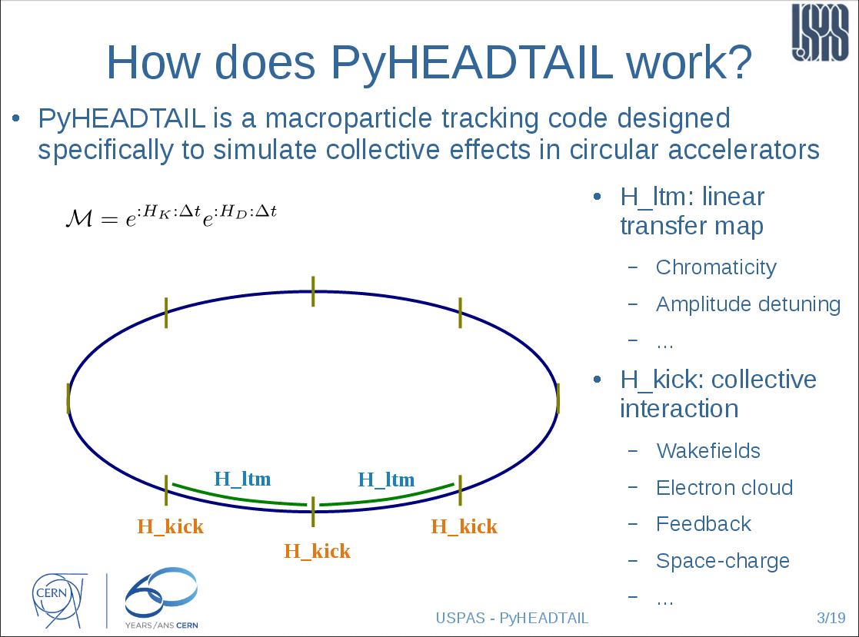
introduction to PyHEADTAIL
Courtesy Kevin Li
USPAS 2015

Slide 8
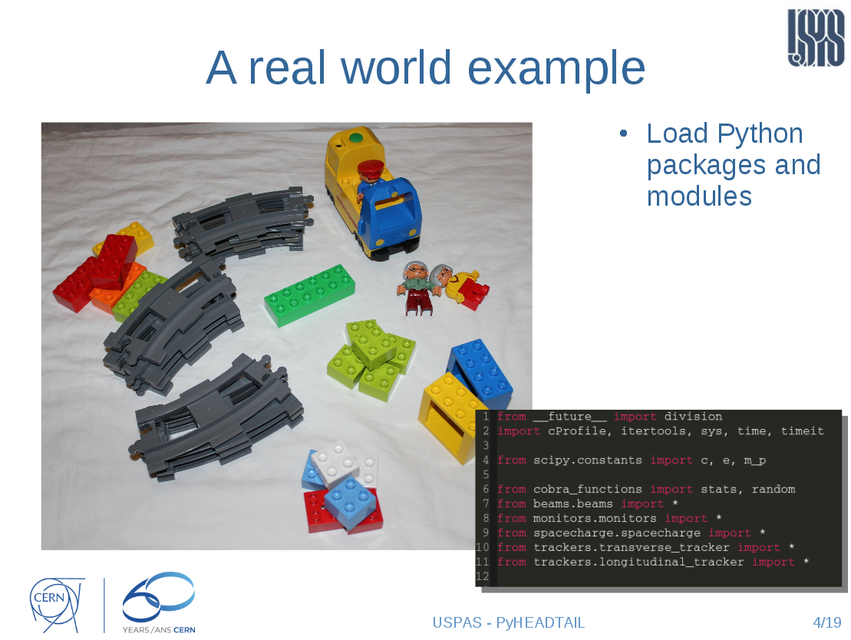
introduction to PyHEADTAIL
Courtesy Kevin Li
USPAS 2015

Slide 9
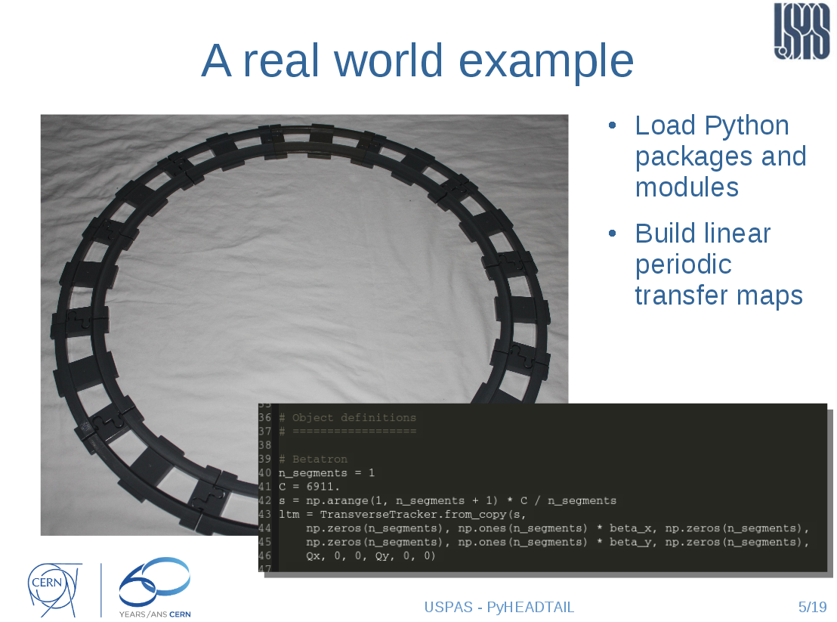
introduction to PyHEADTAIL
Courtesy Kevin Li
USPAS 2015

Slide 10
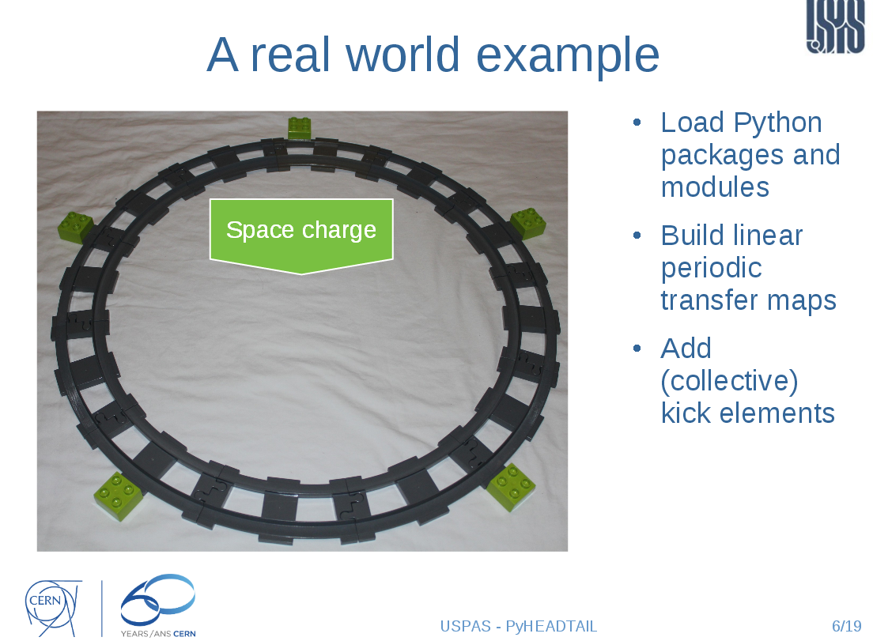
introduction to PyHEADTAIL
Courtesy Kevin Li
USPAS 2015

Slide 11
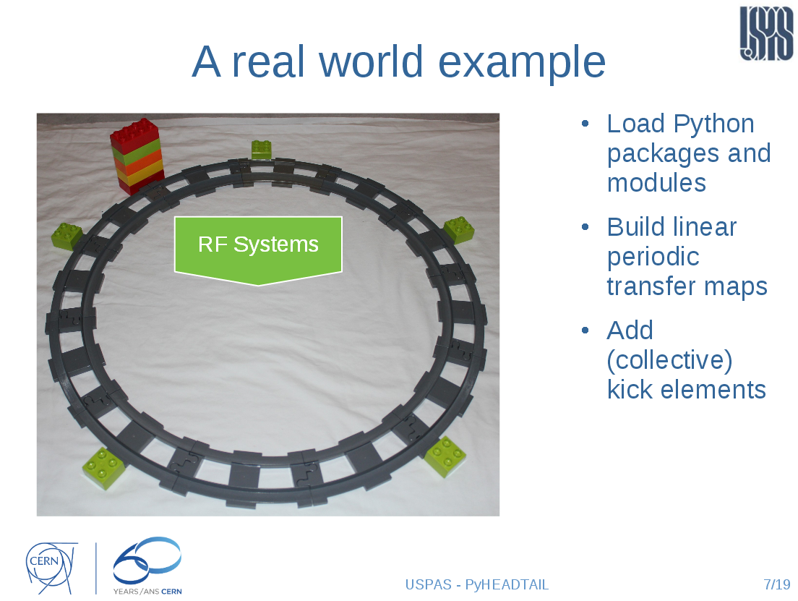
introduction to PyHEADTAIL
Courtesy Kevin Li
USPAS 2015

Slide 12
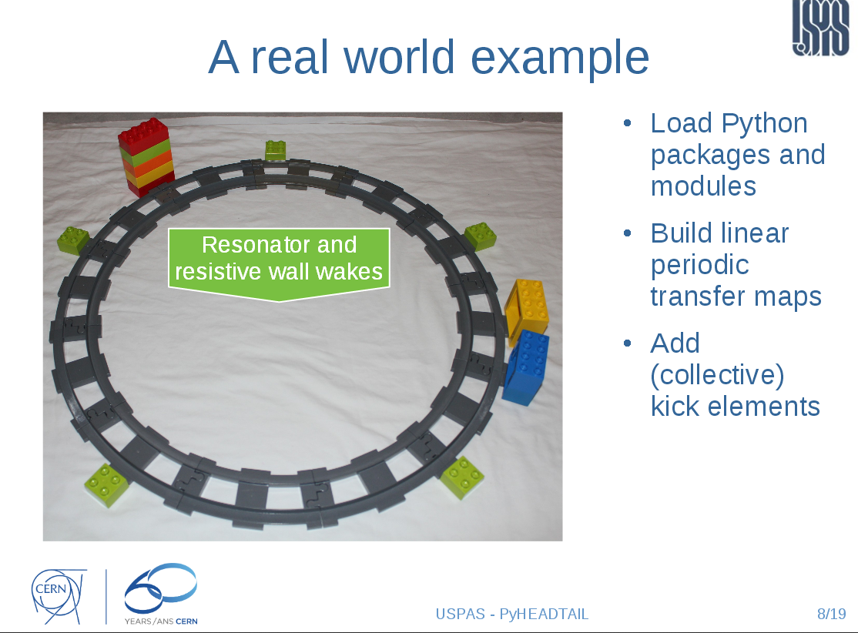
introduction to PyHEADTAIL
Courtesy Kevin Li
USPAS 2015

Slide 13
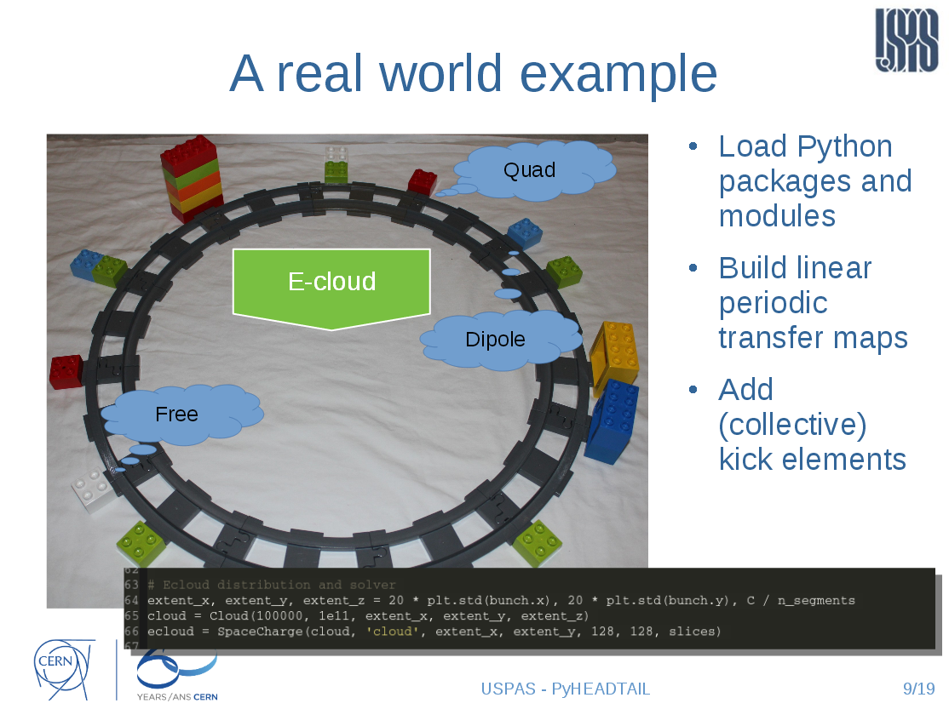
introduction to PyHEADTAIL
Courtesy Kevin Li
USPAS 2015

Slide 14
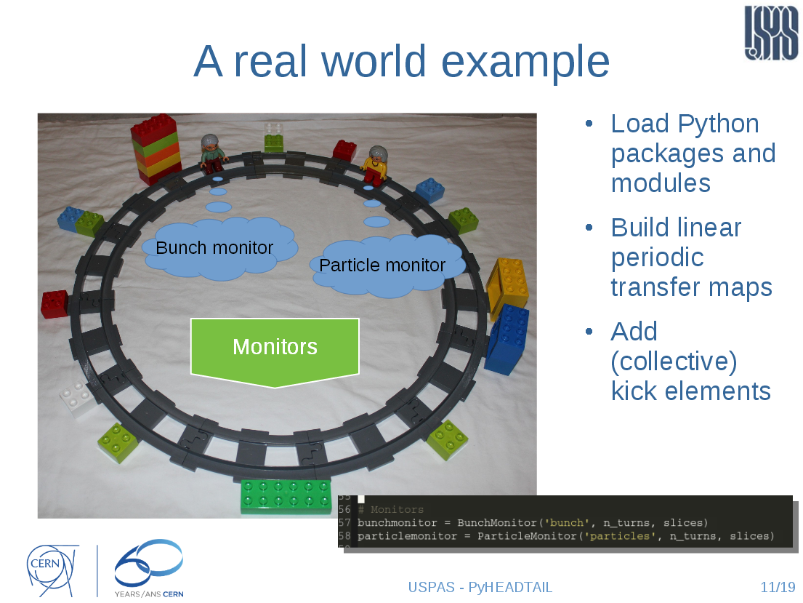
introduction to PyHEADTAIL
Courtesy Kevin Li
USPAS 2015

Slide 15
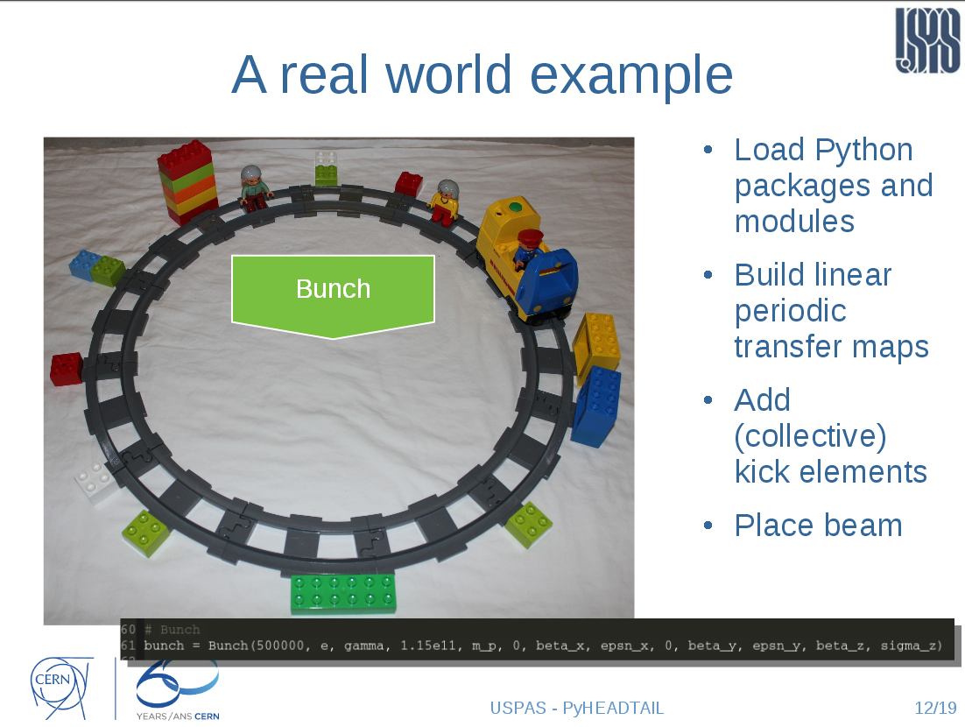
introduction to PyHEADTAIL
Courtesy Kevin Li
USPAS 2015

Slide 16
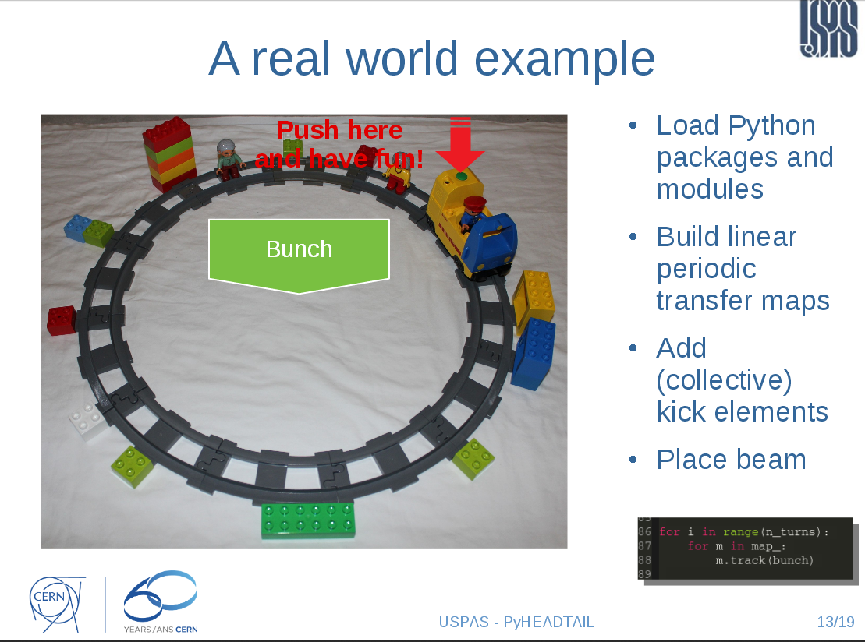
introduction to PyHEADTAIL
Courtesy Kevin Li
USPAS 2015

Slide 17
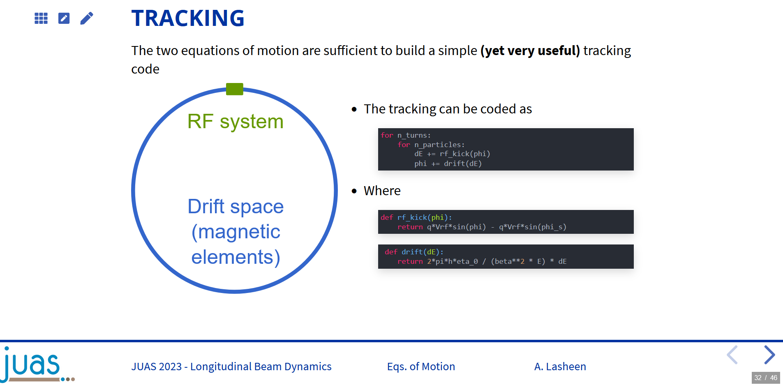
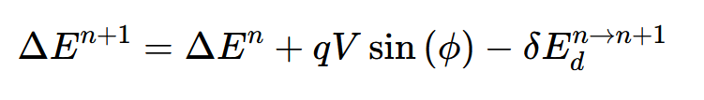
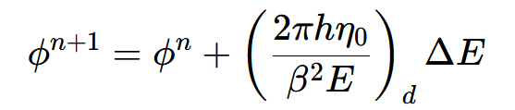
In our case: only RF systems

Slide 18
Agenda
Goals
Plan
Introduction to PyHEADTAIL
Structure of ipython files
Tracking examples
Setting up the environment
  Virtual box
  Ubuntu
  Anaconda
  PyHEADTAIL

Slide 19
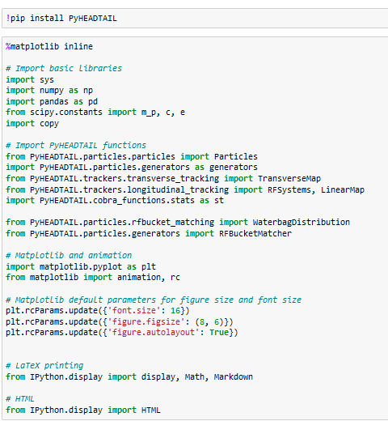
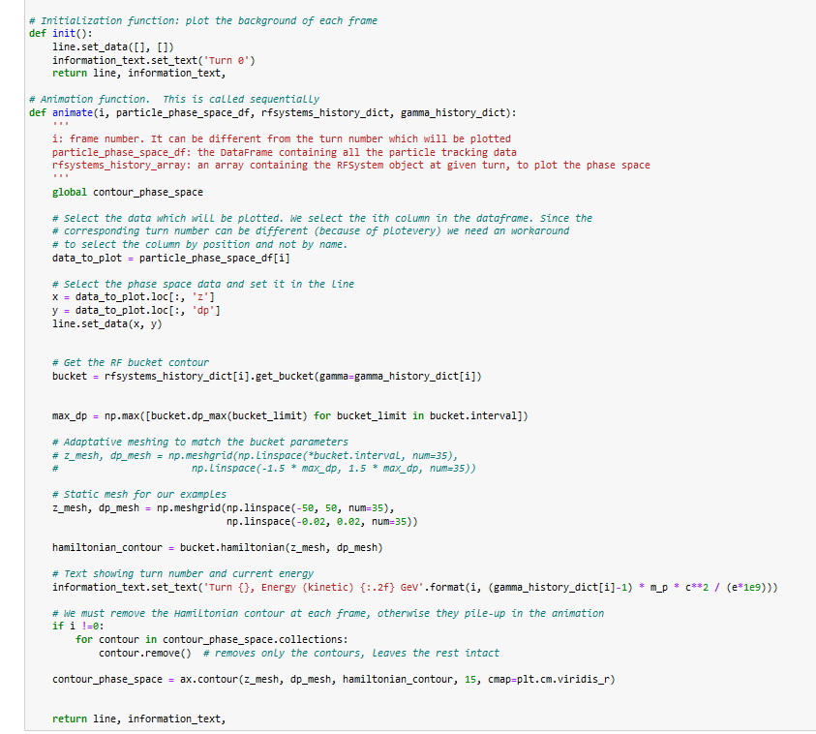
Structure of the Python notebook (1)
Install PyHEADTAIL
And import
required libraries
and functions
Define functions
to display the RF bucket
and the particle motion
track
monitor
plot

Slide 20
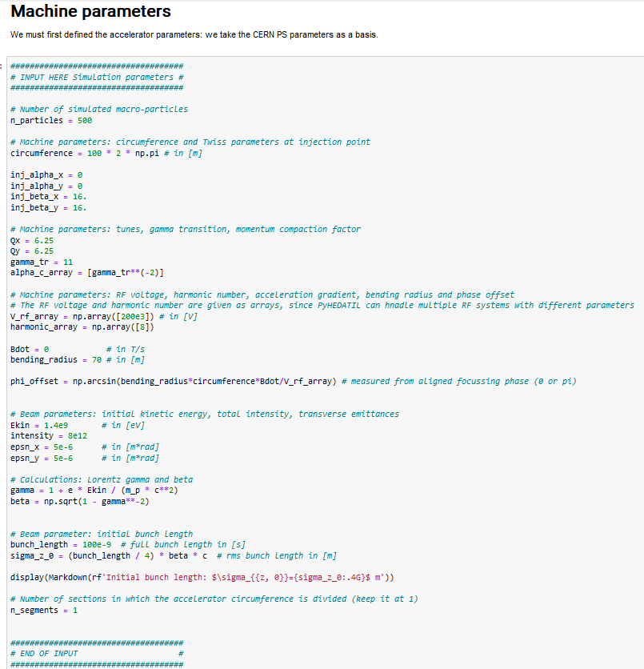
Structure of the Python notebook (2)
Number of simulated particles
Machine circumference (in m)
Relativistic gamma at transition
Set beam and machine
parameters
RF voltage (in V)
Harmonic number
Rate of magnetic field change (in T/s)
Bending radius in m
Kinetic energy (in eV)
Bunch length (in s)

Slide 21
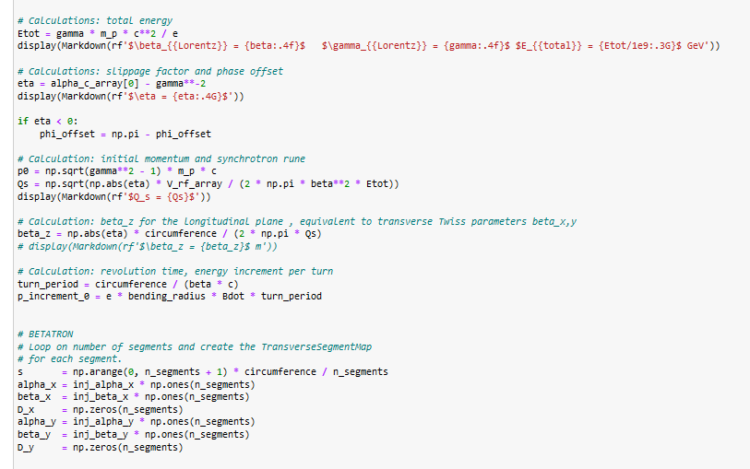
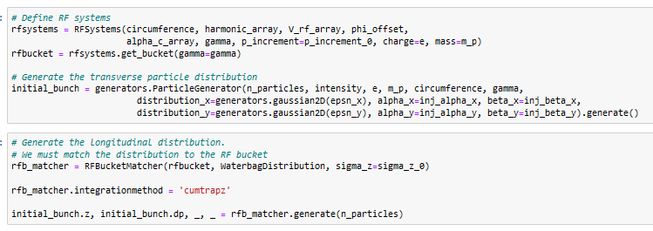
Structure of the Python notebook (3)
Total energy
Slippage factor
Calculations following the
inputs provided in the previous
slide
Momentum
Synchrotron tune
Momentum change per turn
Definition of the
initial RF system
Generate a matched
distribution corresponding
to the chosen parameters
(can take some time)

Slide 22
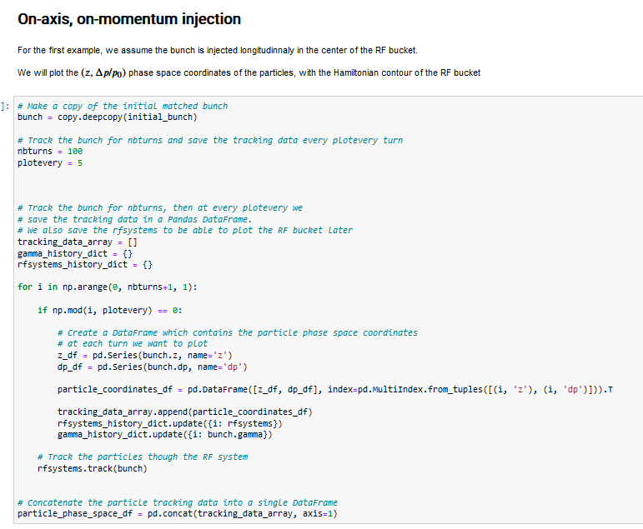
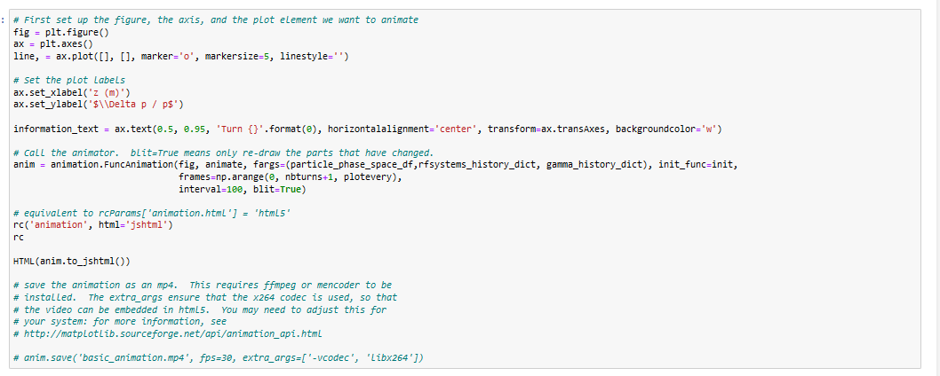
Structure of the Python notebook (3)
Slippage factor
Number of simulated turns
Skip some turns for display
Define the RF system
Loop over number of turns
Monitor
Track!
Display the saved data
in a movie

Slide 23
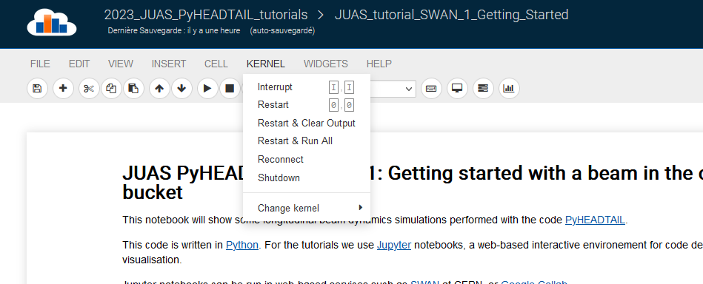
ipython cheat sheet
To restart the kernel at any point: “Kernel” → “Restart”
To only interrupt the kernel: “Kernel” → “Interrupt”
Shift-enter: execute current cell and move to next cell
Ctrl-enter: execute current cell and stay on current cell
Only aim at animating of the order of 50 frames to avoid too long waiting time

Slide 24
Agenda
Goals
Plan
Introduction to PyHEADTAIL
Structure of ipython files
Tracking examples
Setting up the environment
  Virtual box
  Ubuntu
  Anaconda
  PyHEADTAIL

Slide 25
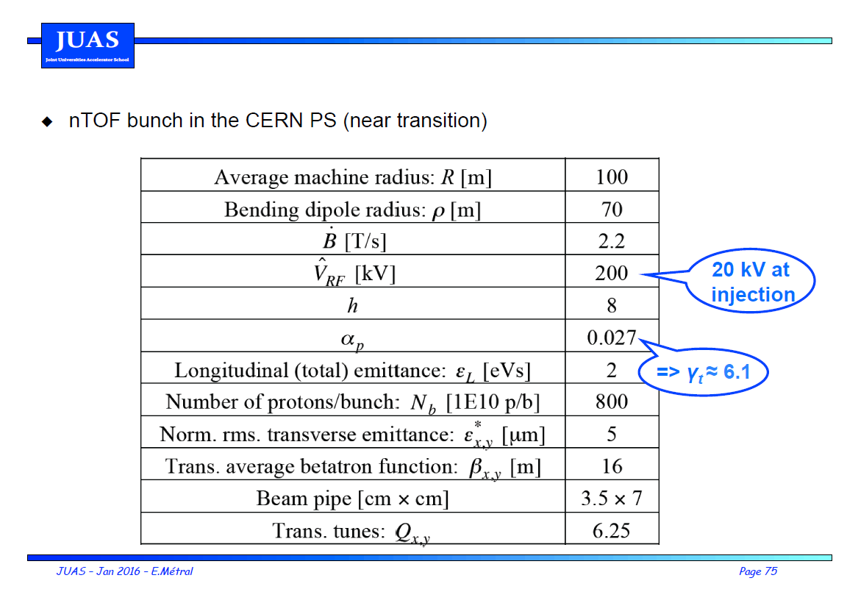
Tracking example: injection energy
0

Slide 26
Tracking example: injection energy
0

Slide 27
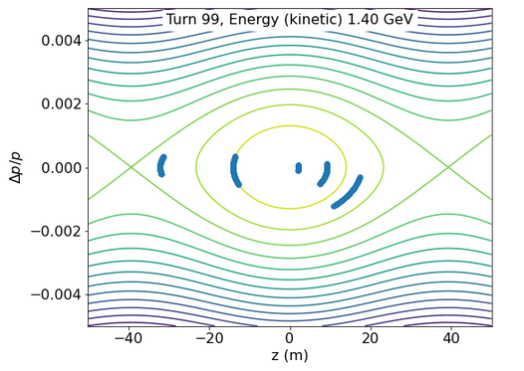
Synchrotron motion
Run the first file: 1_JUAS_PyHeadtail_tutorial_SWAN_Getting_Started.ipynb
→ Is synchrotron motion fast or slow?
Can you estimate the synchrotron tune by looking at the animated plot? How?
Is it consistent with the formula in the course?

Slide 28

Synchrotron motion
Use a large number of particles (~500) and reset the graph every time (replace “animate_permanent” by “animate” when calling the animation)
Are the particles rotating in the same direction compared to the course?
Why?

Slide 29
Top energy
Make a copy of the notebook (FILE → Make a copy)
Change beam kinetic energy to PS top energy (still no acceleration and h=8)
What changes in the plot compared to injection energy? Why?

Slide 30
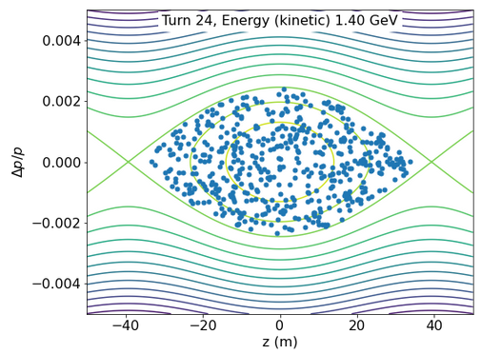
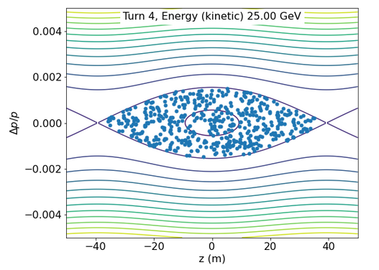
Comparison between flat bottom and top energy in the PS
Flat bottom
Flat top
Bucket height
Synchrotron tune
Rotation

Slide 31
Agenda
Goals
Plan
Introduction to PyHEADTAIL
Structure of ipython files
Tracking examples
  Impact of phase mismatch → open 2nd notebook 2_JUAS_PyHeadtail_tutorial_SWAN_Phase_Mismatch.ipynb
  Impact of voltage mismatch
  Impact of acceleration
Setting up the environment
  Virtual box
  Ubuntu
  Anaconda
  PyHEADTAIL

Slide 32

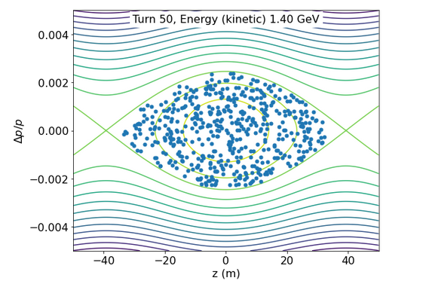
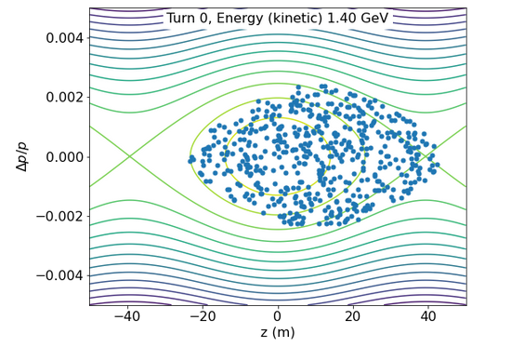
Impact of phase mismatch
Generate ~500 particles at injection energy
Add 10 m to all particles:
→ What will happen?

Slide 33
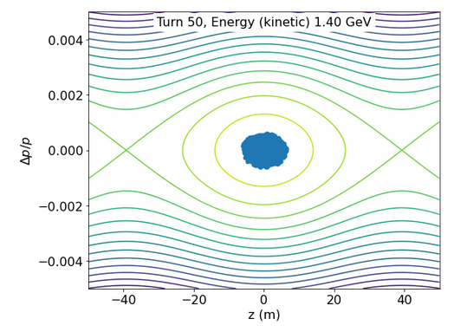
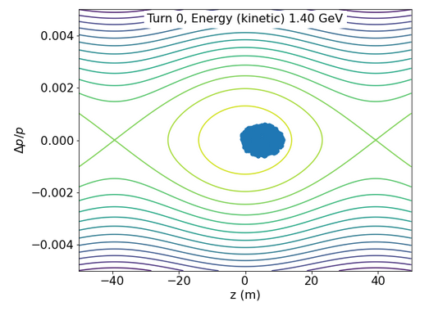
Impact of phase mismatch
Use a smaller bunch length (divide by 5)
Regenerate the bunch
Add 5 m to all particles
→ What will happen?

Slide 34
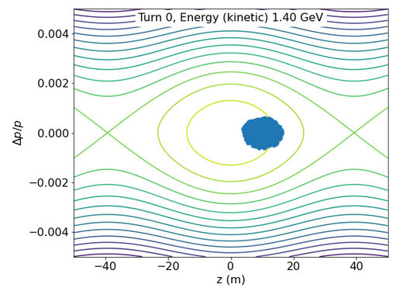
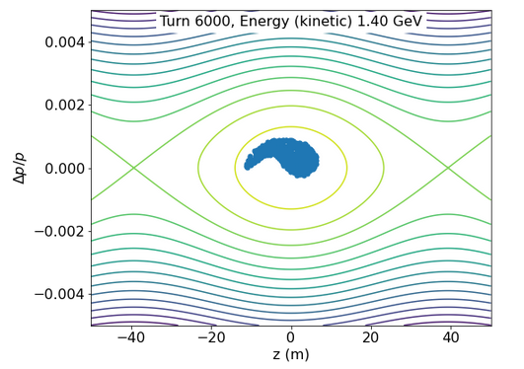
Impact of phase mismatch
Use a smaller bunch length (divide by 5)
Regenerate the bunch
Add 5 m to all particles
Filamentation and eventually?

Slide 35
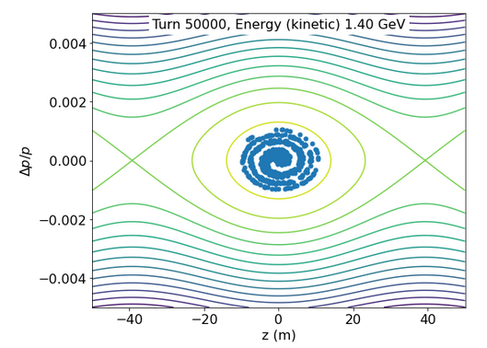
Impact of phase mismatch
Use a smaller bunch length (divide by 5)
Regenerate the bunch
Add 10 m to all particles
Filamentation and eventually emittance growth
Try also with larger mismatch (10 m)

Slide 36
Agenda
Goals
Plan
Introduction to PyHEADTAIL
Structure of ipython files
Tracking examples
  Impact of phase mismatch
  Impact of voltage mismatch→ open 3rd notebook 3_JUAS_PyHeadtail_tutorial_SWAN_Voltage_Mismatch.ipynb
  Impact of acceleration
Setting up the environment
  Virtual box
  Ubuntu
  Anaconda
  PyHEADTAIL

Slide 37
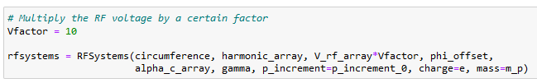
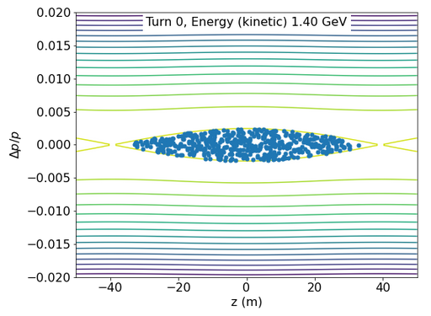
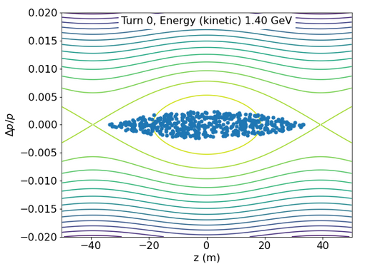
Impact of voltage mismatch (too high)
Change V_RF to V_RF*10 after the bunch is matched to V_RF
The vertical plotting limits were adapted to [-0.02;0.02]
→ What will happen?

Slide 38
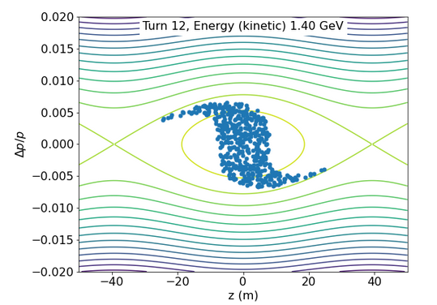
Impact of voltage mismatch (too high)
Change V_RF to V_RF*10 after the bunch is matched to V_RF
The vertical plotting limits were adapted to [-0.02;0.02]
→ Bunch rotation
Bunch shortening, if phased correctly, but…

Slide 39

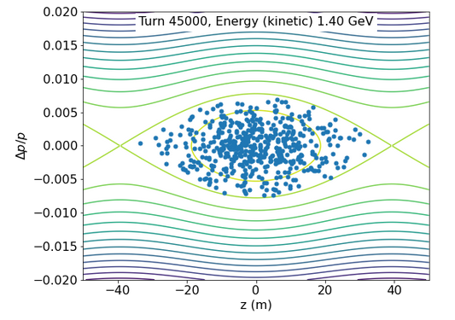
Impact of voltage mismatch (too high)
Use the nominal bunch length
Change V_RF to V_RF*10 after the bunch is matched to V_RF
But should not wait too long!
Emittance growth!

Slide 40
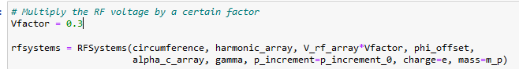
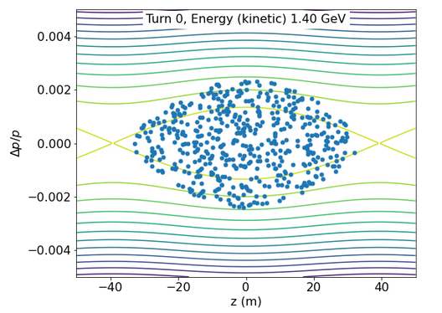
Impact of voltage mismatch (too low)
Regenerate the bunch with nominal voltage
Change V_RF to V_RF/10 after the bunch is matched to V_RF
readapt the deltap plotting limits to [-0.005;0.005]
→ What will happen?

Slide 41
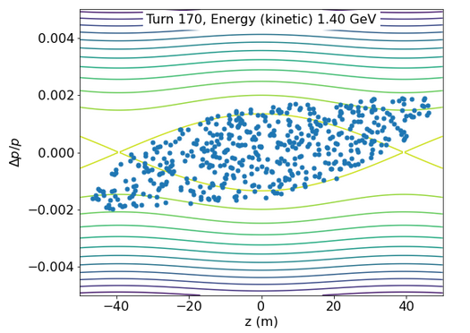
Impact of voltage mismatch (too low)
Regenerate the bunch with nominal voltage
Change V_RF to V_RF/10 after the bunch is matched to V_RF
readapt the deltap plotting limits to [-0.005;0.005]
→ What will happen?

Slide 42
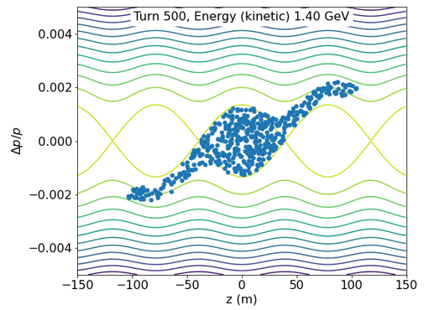
Impact of voltage mismatch (too low)
Regenerate the bunch with nominal voltage
Change V_RF to V_RF/10 after the bunch is matched to V_RF
readapt the deltap plotting limits to [-0.005;0.005]
→ What will happen?

Slide 43
Agenda
Goals
Plan
Introduction to PyHEADTAIL
Structure of ipython files
Tracking examples
  Impact of phase mismatch
  Impact of voltage mismatch
  Impact of acceleration → open 4th notebook 4_JUAS_PyHeadtail_tutorial_SWAN_Acceleration.ipynb
Setting up the environment
  Virtual box
  Ubuntu
  Anaconda
  PyHEADTAIL

Slide 44
Impact of acceleration
The start of this notebook is a copy of the 1st notebook
Which parameter do you need to change to start acceleration?

Slide 45
Impact of acceleration
The start of this notebook is a copy of the 1st notebook
Which parameter do you need to change to start acceleration?
Change Bdot to 2.2 T/s
Does it work? Why?

Slide 46
Impact of acceleration
The start of this notebook is a copy of the 1st notebook
Which parameter do you need to change to start acceleration?
Change Bdot to 2.2 T/s
Does it work? Why?
Change V_{RF} to 200 kV
Track for 100 turns
Comment on the bucket shape
Track for 40000 turns
What happens?

Slide 47
Agenda
Goals
Plan
Introduction to PyHEADTAIL
Structure of ipython files
Tracking examples
  Impact of phase mismatch
  Impact of voltage mismatch
  Impact of acceleration
Setting up the environment
  Virtual box (if you do not have Linux already!)
  Ubuntu
  Anaconda
  PyHEADTAIL

Slide 48
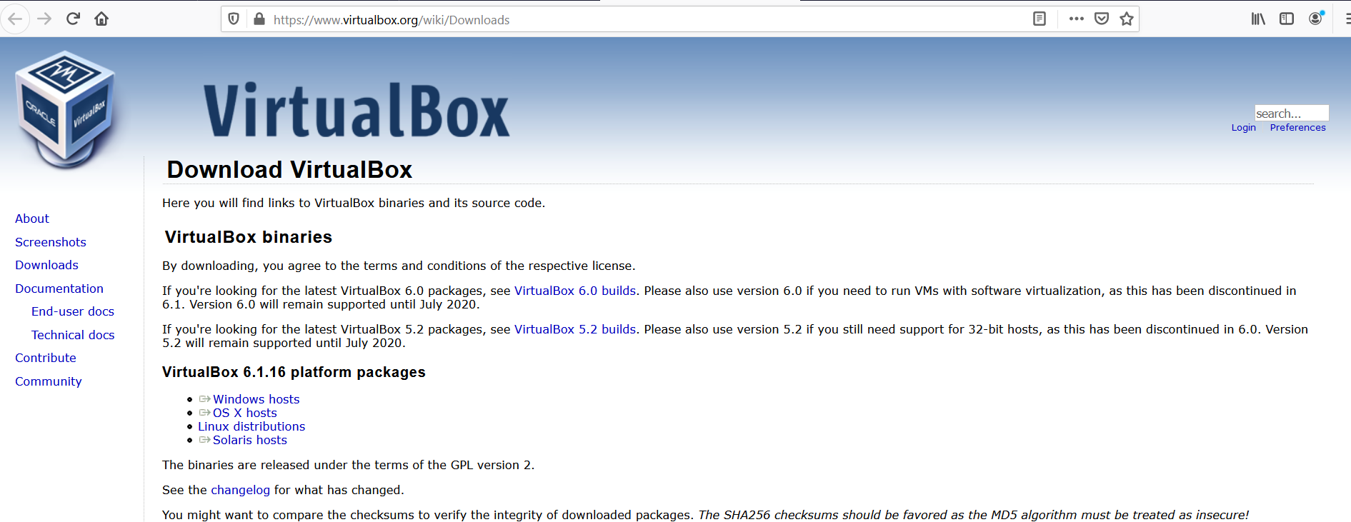
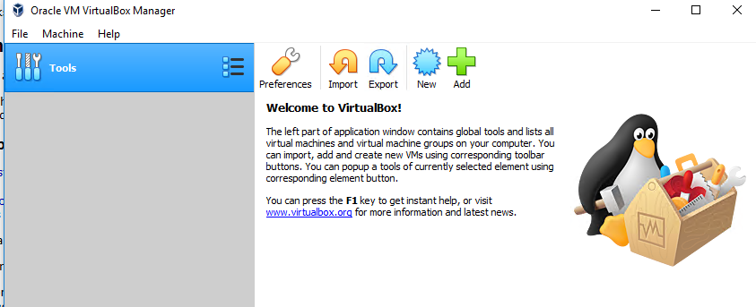
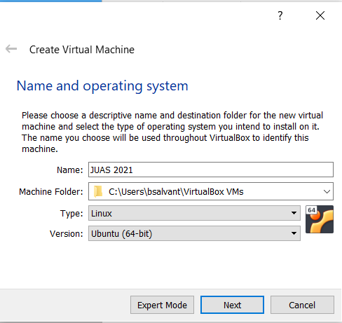
Setting up the operating system
Install a virtual box to get an Ubuntu environment
Ex: https://www.virtualbox.org/wiki/Downloads
Create a new virtual machine
with Ubuntu 64-bit

Slide 49
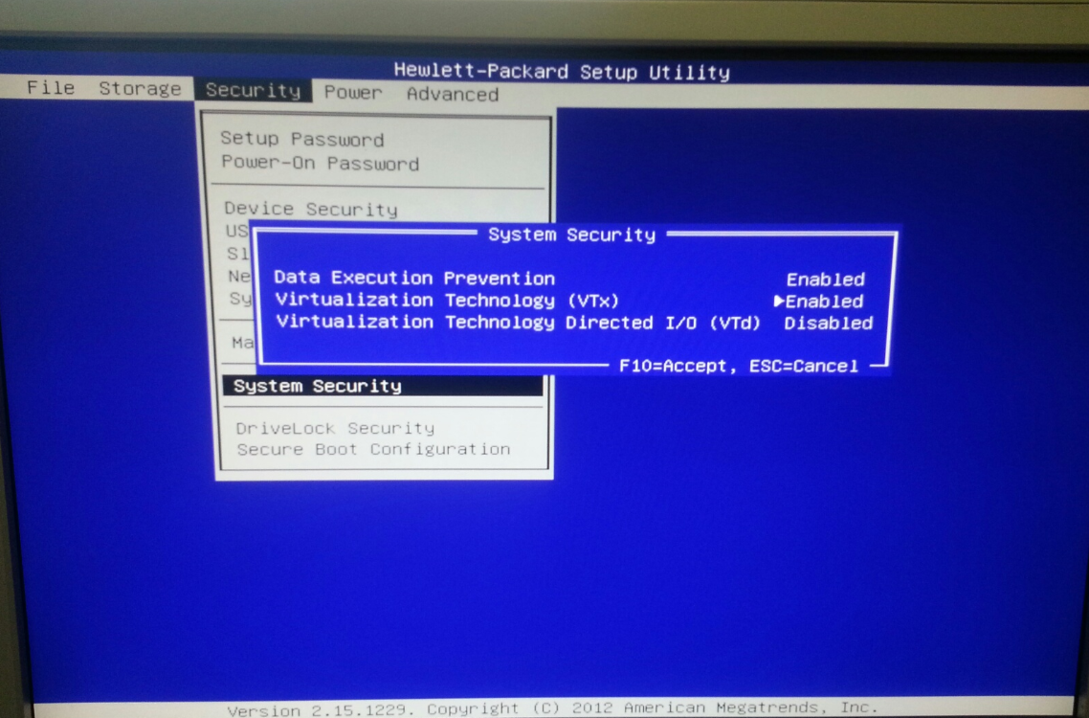
In case of a “VTx” error or an impossibility to select 64 bit operating system when launching the virtual machine, one needs to turn Virtualization Technology (VTx) on in the BIOS (see chapter 10.3 in https://www.virtualbox.org/manual/ch10.html#hwvirt )

Slide 50
Create virtual machine

Slide 51
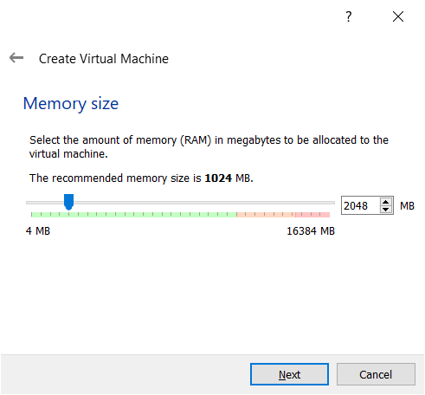
→ 2 GB is recommended by Ubuntu. This setting can be modified later.

Slide 52
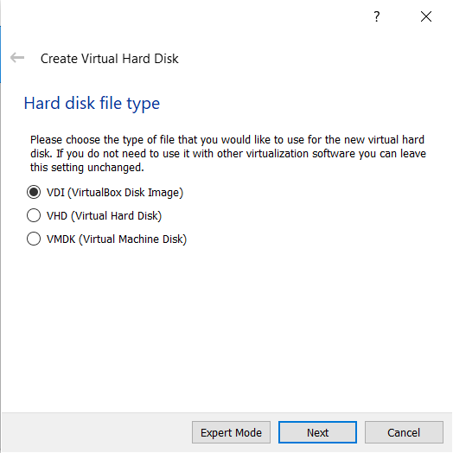

Slide 53
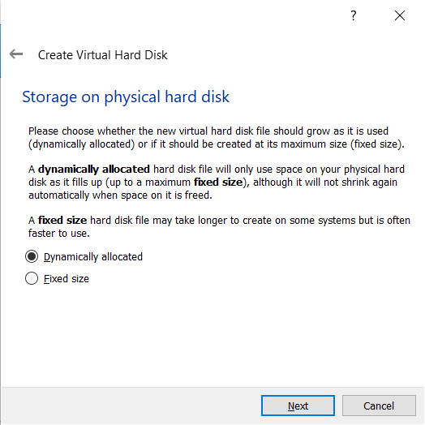

Slide 54
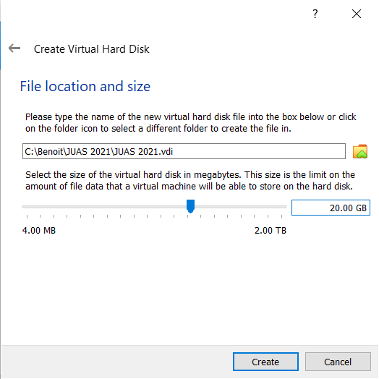
→ Assign 20 GB if possible.

Slide 55
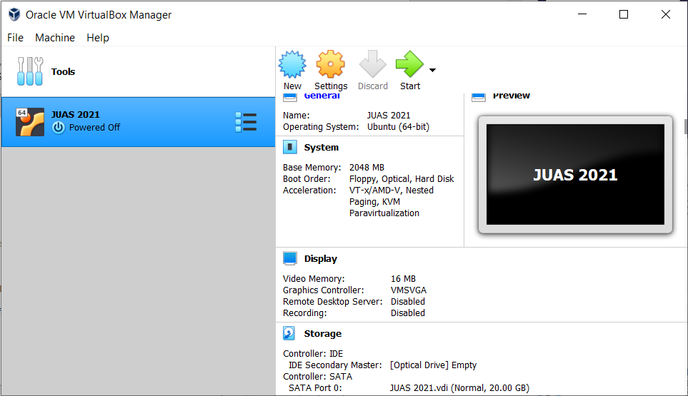

Tip: allow shared clipboard if you wish
In “settings” → “advanced”
of the newly created VM

Slide 56

Start the VM

Slide 57
Agenda
Goals
Plan
Introduction to PyHEADTAIL
Structure of ipython files
Tracking examples
  Impact of phase mismatch
  Impact of voltage mismatch
  Impact of acceleration
Setting up the environment
  Virtual box
  Ubuntu
  Anaconda
  PyHEADTAIL

Slide 58

Download ubuntu
https://www.ubuntu.com/download/desktop (beware quite large iso file – 2.6 Go)

Slide 59

Select Ubuntu start up disk
You may have to click on the small green arrow to browse
for your Ubuntu installation image

Slide 60

Install ubuntu

Slide 61

Choose the appropriate keyboard for your personal use (your physical keyboard configuration).
My keyboard is English (US)

Slide 62

Choose normal installation

Slide 63


Keep default installation and “install now” and confirm with “continue” on the pop up
Then choose time zone and login details

Slide 64


Then wait for file copy and Ubuntu installation restart the machine after it is complete
If the screen is too small,
  Change the scaling/seettings in the VM
  or
  change the display settings inside Ubuntu or
  shut down the VM
  go to the VM Settings
  » Display
  » Screen
  » Graphics Controller = VBoxVGA

Slide 65
Agenda
Goals
Plan
Introduction to PyHEADTAIL
Structure of ipython files
Tracking examples
  Impact of phase mismatch
  Impact of voltage mismatch
  Impact of acceleration
Setting up the environment
  Virtual box
  Ubuntu
  Anaconda
  PyHEADTAIL

Slide 66
Install anaconda
Download anaconda for Linux at https://www.anaconda.com/distribution/#download-section
or type
> wget https://repo.anaconda.com/archive/Anaconda3-2020.11-Linux-x86_64.sh
Then install it by typing
> sh Anaconda3-2020.11-Linux86_64.sh
In the download directory

Slide 67

Do not forget to add Anaconda to path (answer yes or add the path yourself in the “.bashrc” configuration file)
Restart the shell (“>>source .bashrc” from the home directory)
Check that “>>ipython notebook” works
→ Anaconda contains all the necessary libraries to run PyHEADTAIL.

Slide 68
Agenda
Goals
Plan
Introduction to PyHEADTAIL
Structure of ipython files
Tracking examples
  Impact of phase mismatch
  Impact of voltage mismatch
  Impact of acceleration
Setting up the environment
  Virtual box
  Ubuntu
  Anaconda
  PyHEADTAIL

Slide 69

Installing PyHEADTAIL
website for installation and information: https://github.com/PyCOMPLETE/PyHEADTAIL
Add path to the end of the .bashrc to be able to import PyHeadtail from everywhere:
This only updates once a new terminal is opened (or do source ~/.bashrc)

Slide 70
In case of issues with PyHEADTAIL installation, most likely it is that fortran and C need to be installed:
sudo apt-get install gfortran
Sudo apt-get install gcc

Slide 71

Finding the examples
From JUAS 2022 Indico site in the last tutorial of the course: https://indico.cern.ch/event/1088622/timetable
→ Download the *.ipynb files and open them browsing with “ipython notebook”

Slide 72





Changing variables
$$∆φ[rad]=−\frac{h}{R} z[m]$$
$$ΔΕ =\frac{Δp}{p}m_{0}γβ^{2}c^{2}$$
For protons
$$ΔΕ\left[GeV\right]=\frac{Δp}{p}0.938 γβ^{2}$$

