Slide 1
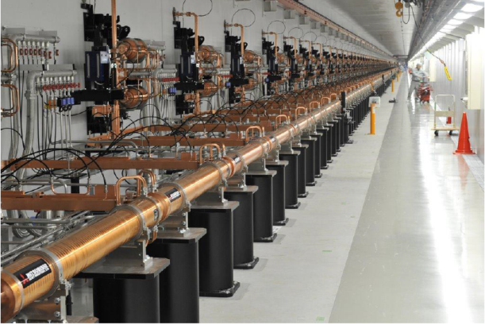
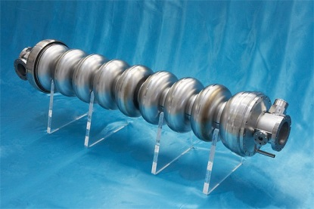
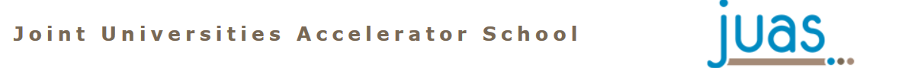
Linacs
David Alesini
(INFN-LNF, Frascati, Rome, Italy)

Slide 2
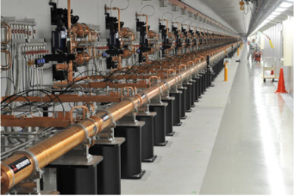
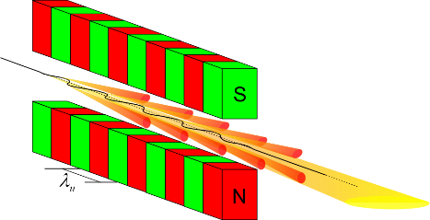
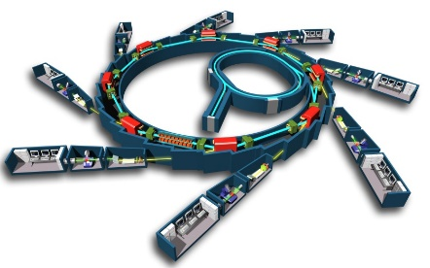
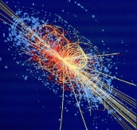
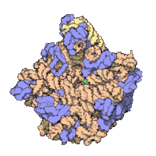
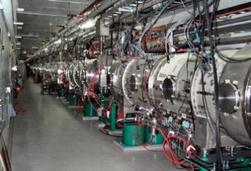
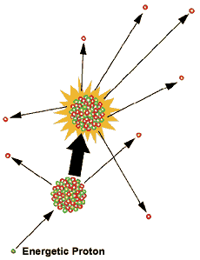
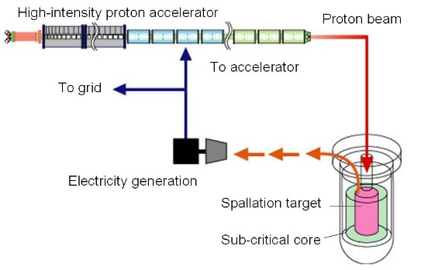
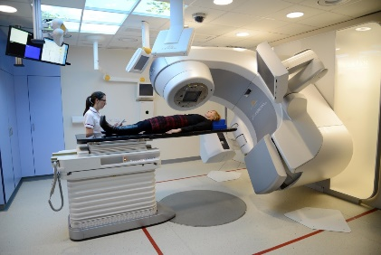
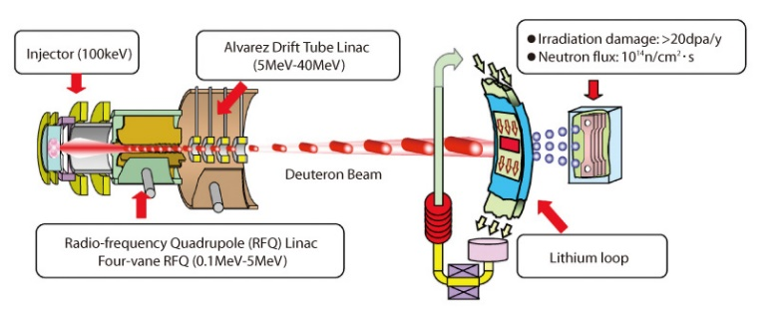
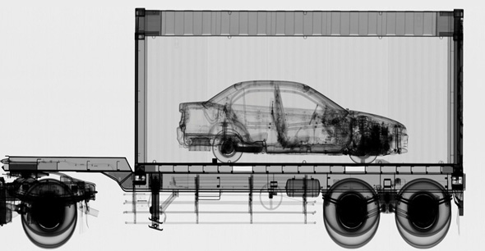
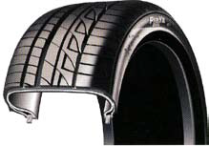


LINAC APPLICATIONS
∼10⁴ LINACs operating around the world
Free Electron Lasers
Injectors for synchrotrons
Spallation sources for neutron production
Nuclear waste treatment and controlled fission for energy production (ADS)
Medical applications: radiotherapy
Industrial applications
Material testing for fusion nuclear reactors
National security
Material treatment
Ion implantation
Material/food sterilization

Slide 3
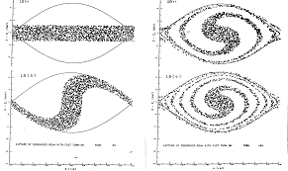
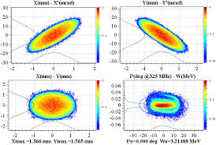
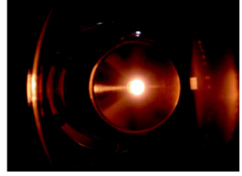
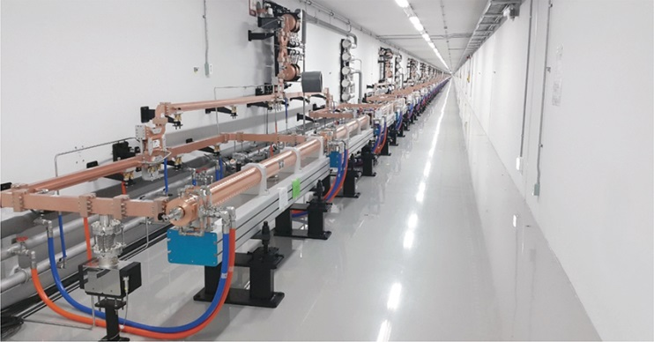
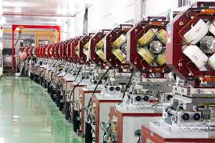
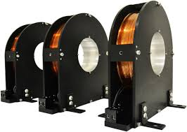
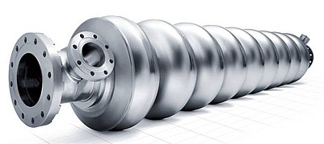
LINAC: BASIC DEFINITION AND MAIN COMPONENTS
LINAC (linear accelerator) is a system that allows to accelerate charged particles through a linear trajectory by electromagnetic fields.
2nd PART OF THE LECTURE
Longitudinal dynamics of accelerated particles
Transverse dynamics of accelerated particles
LINAC BEAM DYNAMICS
Particle source
Accelerated beam
1st PART OF THE LECTURE
Focusing elements: quadrupoles and solenoids
Accelerating structures
LINAC COMPONENTS AND TECHNOLOGY

Slide 4
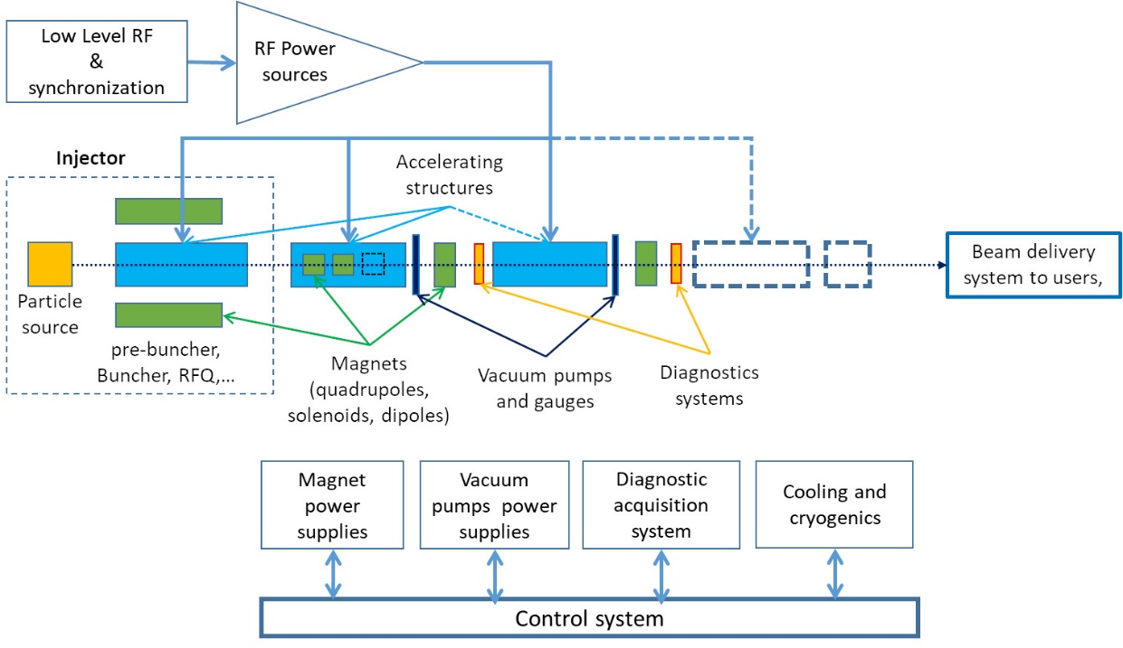
LINAC TECHNOLOGY
The overall LINAC has to be designed to obtain the desired beam parameters in term of:
-output energy/energy spread
-beam current (charge)
-long. and transverse beam dimensions/divergence (emittance)
…
Having, in general, constraints in term of:
-space
-cost
-power consumption
-available power sources
…

Slide 5
LINAC: BASIC DEFINITION AND MAIN COMPONENTS
LINAC (linear accelerator) is a system that allows to accelerate charged particles through a linear trajectory by electromagnetic fields.
Longitudinal dynamics of accelerated particles
Transverse dynamics of accelerated particles
LINAC BEAM DYNAMICS
Particle source
Accelerated beam
Focusing elements: quadrupoles and solenoids
Accelerating structures
LINAC COMPONENTS AND TECHNOLOGY

Slide 6
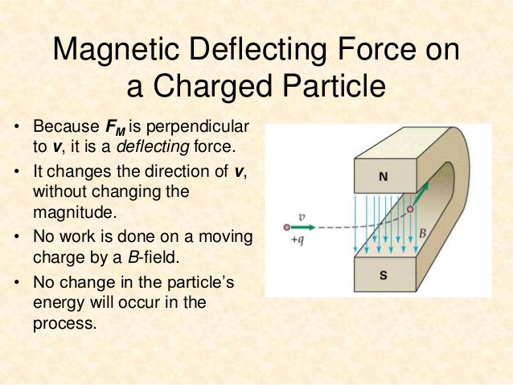
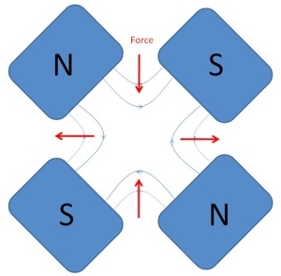
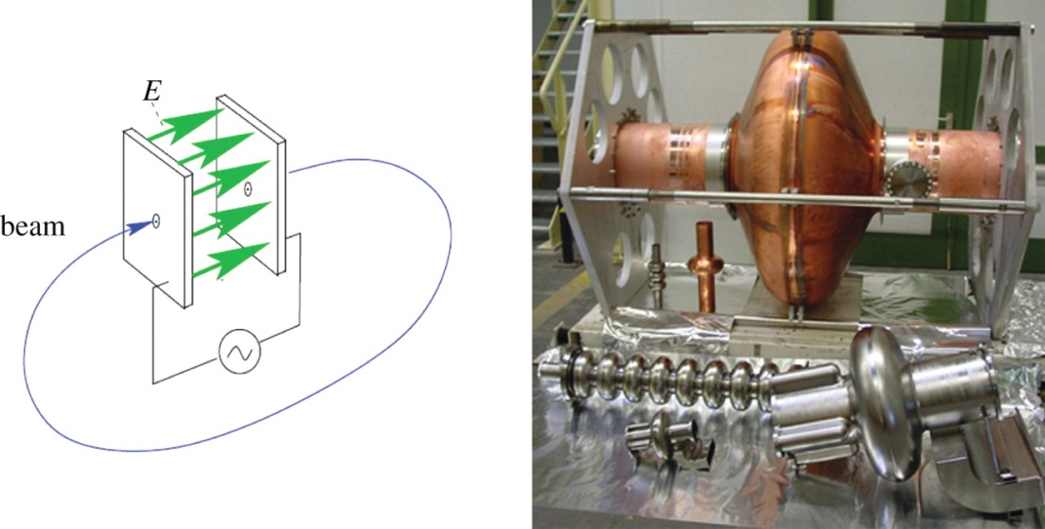
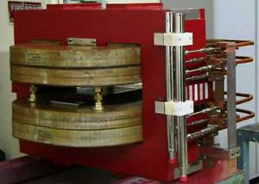
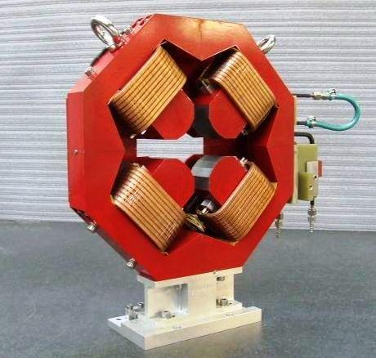

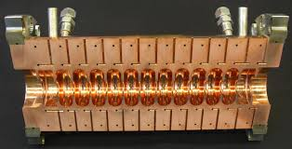
LORENTZ FORCE: ACCELERATION AND FOCUSING
The basic equation that describes the acceleration/bending/focusing processes is the Lorentz Force.
Particles are accelerated through electric fields and are bended and focused through magnetic fields.
BENDING AND FOCUSING
ACCELERATION
To accelerate, we need a force in the direction of motion
2nd term always perpendicular to motion => no energy gain
Longitudinal Dynamics
Transverse Dynamics

Slide 7
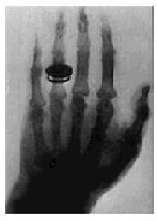

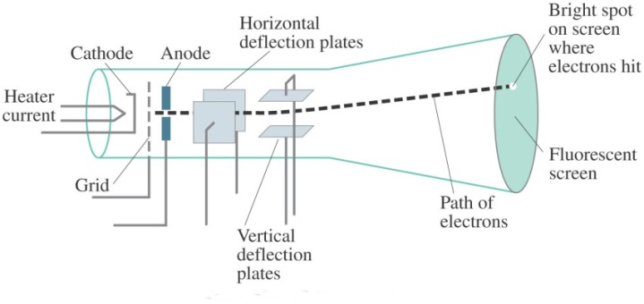
ACCELERATION: SIMPLE CASE
The first historical linear particle accelerator was built by the Nobel prize Wilhelm Conrad Röntgen (1900). It consisted in a vacuum tube containing a cathode connected to the negative pole of a DC voltage generator. Electrons emitted by the heated cathode were accelerated while flowing to another electrode connected to the positive generator pole (anode). Collisions between the energetic electrons and the anode produced X-rays.
Electric field
Anode
Cathode
+
Voltage ΔV
The energy gained by the electrons travelling from the cathode to the anode is equal to their charge multiplied the DC voltage between the two electrodes.
Particle energies are typically expressed in electron-volt [eV], equal to the energy gained by 1 electron accelerated through an electrostatic potential of 1 volt:
1 eV=1.6x10⁻¹⁹ J

Slide 8
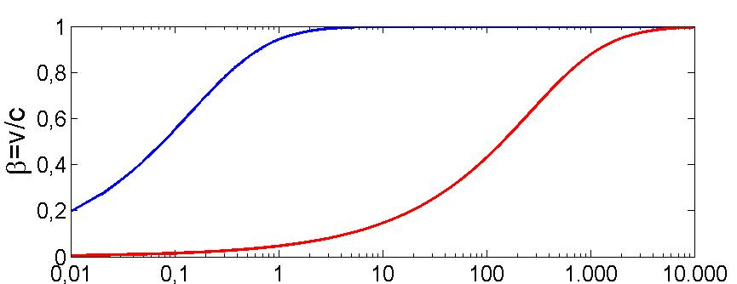
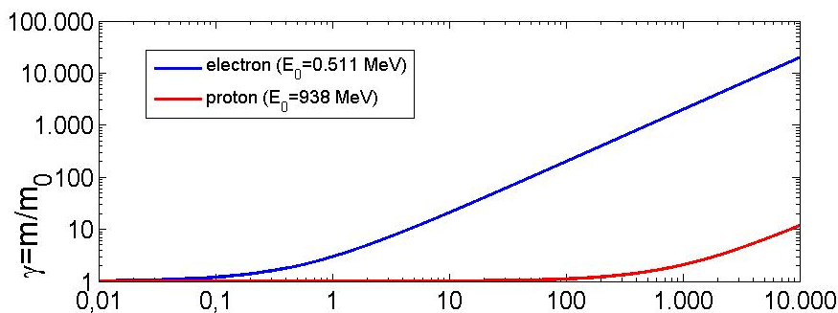
PARTICLE VELOCITY VS ENERGY: LIGHT AND HEAVY PARTICLES
rest mass m₀
rest energy E₀ (=m₀c²)
total energy E
relativistic mass m
velocity v
momentum p (=mv)
Kinetic energy W=E-E₀
Relativistic factor β=v/c (<1)
Single particle
Relativistic factor γ=E/E₀ (≥1)
+
β
1
p⁺
⇒Light particles (as electrons) are practically fully relativistic (β≅1, γ>>1) at relatively low energy and reach a constant velocity (∼c). The acceleration process occurs at constant particle velocity
⇒Heavy particles (protons and ions) are typically weakly relativistic and reach a constant velocity only at very high energy. The velocity changes a lot during the acceleration process.
e⁻
Light particles
Heavy particles
Kin. Energy [MeV]
⇒This implies important differences in the technical characteristics of the accelerating structures. In particular for protons and ions we need different types of accelerating structures, optimized for different velocities and/or the accelerating structure has to vary its geometry to take into account the velocity variation.

Slide 9
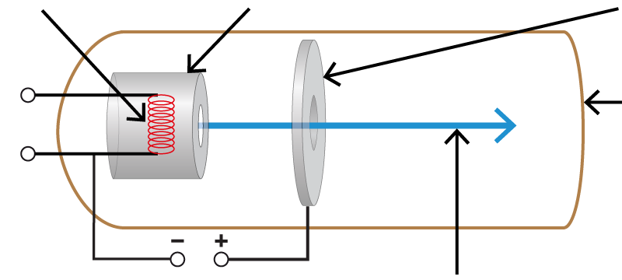

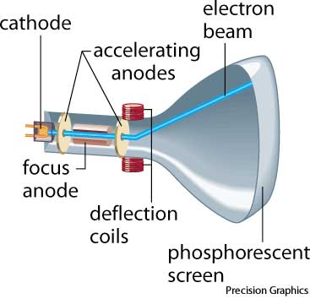

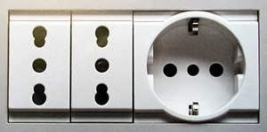
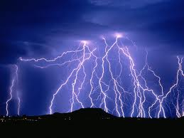
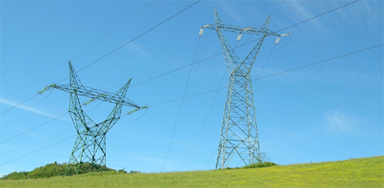

PARTICLE ACCELERATION: ELECTRIC FIELD
Particles are accelerated through electric fields
Incandescent filament
cathode
anode
E
Vacuum chamber
1000 V
Electron beam
1 V
Energy gain∝ V
10⁹-10¹⁰ V
100-200 V
10⁵ V

Slide 10
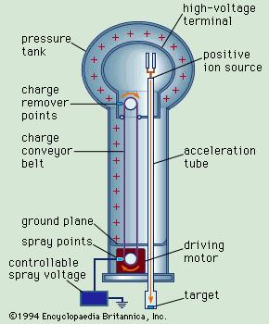
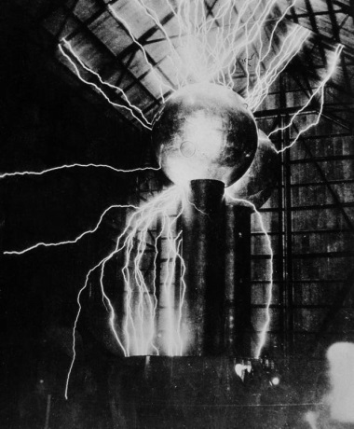
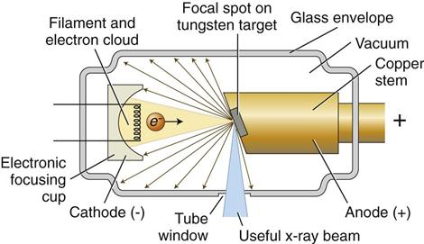
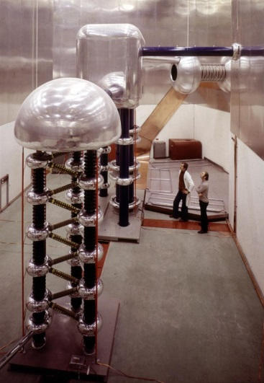
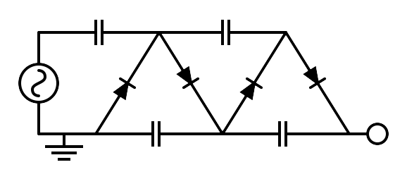
ELECTROSTATIC ACCELERATORS
To increase the achievable maximum energy, Van de Graaff invented an electrostatic generator based on a dielectric belt transporting positive charges to an isolated electrode hosting an ion source. The positive ions generated in a large positive potential were accelerated toward ground by the static electric field.
LIMITS OF ELECTROSTATIC ACCELERATORS
DC voltage as large as ∼10 MV can be obtained (E∼10 MeV). The main limit in the achievable voltage is the breakdown due to insulation problems.
APPLICATIONS OF DC ACCELERATORS
DC particle accelerators are in operation worldwide, typically at V<15MV (E_{max}=15 MeV), I<100mA.
They are used for:
⇒ material analysis
⇒ X-ray production,
⇒ ion implantation for semiconductors
⇒ first stage of acceleration (particle sources)
750 kV Cockcroft-Walton
Linac2 injector at CERN from 1978 to 1992

Slide 11
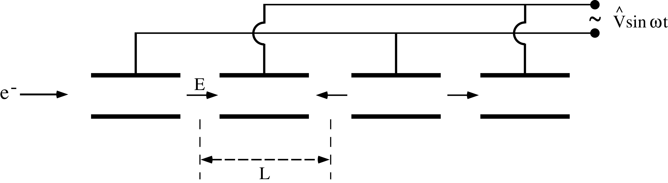
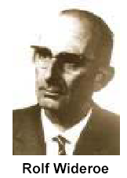
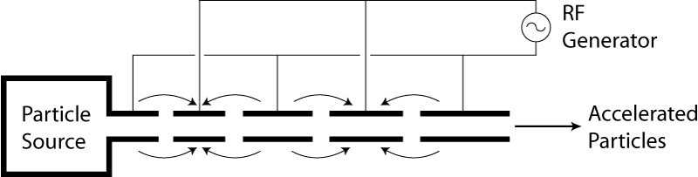
RF Accelerators : Wideröe “Drift Tube LINAC” (DTL)
(protons and ions)
Basic idea: the particles are accelerated by the electric field in the gap between electrodes connected alternatively to the poles of an AC generator. This original idea of Ising (1924) was implemented by Wideroe (1927) who applied a sine-wave voltage to a sequence of drift tubes. The particles do not experience any force while travelling inside the tubes (equipotential regions) and are accelerated across the gaps. This kind of structure is called Drift Tube LINAC (DTL).
⇒If the length of the tubes (or, equivalently, the distances between the centers of the accelerating gaps) increases with the particle velocity during the acceleration such that the time of flight between gaps is kept constant and equal to half of the RF period, the particles are subject to a synchronous accelerating voltage and experience an energy gain of ∆E=q∆V at each gap crossing.
⇒In principle a single RF generator can be used to indefinitely accelerate a beam, avoiding the breakdown limitation affecting the electrostatic accelerators.
⇒The Wideroe LINAC is the first RF LINAC
L₁
L_{n}

Slide 12
DC ACCELERATION: ENERGY GAIN
We consider the acceleration between two electrodes in DC.
+
ΔV
-
E_{z}
source
z (direction of acceleration)
gap
ΔE
E_{z}
t
z
Energy-momentum relation
Lorentz force
W=E-E₀
rate of energy gain per unit length
energy gain per electrode pair

Slide 13
RF ACCELERATION: BUNCHED BEAM
We consider now the acceleration between two electrodes fed by an RF generator
E_{z}
source
z
Only these particles are accelerated
gap
ΔE
z
t_{inj}
These particles are not accelerated and basically are lost during the acceleration process
DC acceleration
RF acceleration
charge
charge
Bunched beam (in order to be synchronous with the external AC field, particles have to be gathered in non-uniform temporal structure)
t
RF period
t

Slide 14
RF ACCELERATION: ENERGY GAIN
We consider now the acceleration between two electrodes fed by an RF generator
gap
E_{z}
source
z
-L/2
+L/2
z
Hyp. of symmetric accelerating field
t=z/v
Injection phase
Peak gap voltage
T<1
Transit time factor
Average accelerating field in the gap
Average accelerating field seen by the particle

Slide 15
EXERCISE 1: TRANSIT TIME FACTOR
Derive the general expression of the transit time factor of an accelerating gap of length L, with constant accelerating field, in which the field is oscillating at f_{RF} and that accelerate particles with relativistic factor β.
Remembering that the light wavelength in free space is given by λ_{RF}=c/f_{RF}, for which value of the accelerating gap length L, T is equal to zero?
Calculate the numerical value of T for L=10 cm, f_{RF}=1 GHz and ultra-relativistic electrons (β=1).
Calculate the accelerating voltage as a function of the gap length L assuming an injection phase on crest (φ_{inj}=0)

Slide 16
DRIFT TUBE LENGTH AND FIELD Synchronization
(protons and ions or electrons at extremely low energy)
If now we consider a DTL structure, we have that at each gap the maximum energy gain is ΔE_{n}=qV_{acc} and the particle increase its velocity accordingly to the previous relativistic formulae. It is convenient to refer to the center of each gap as follows:
-
+
+
-
v_{n}
Gap n+1
v_{n+1}
Gap n
E_{z}
E_{z}
L_{n}
L_{n+1}
L_{n+2}
L_{n}
L_{n+1}
L_{n+2}
z
z
E
qV_{acc}
⇒ In order to be synchronous with the accelerating field at the center of each gap, the distance between the centers of the gaps (L_{n}) has to be increased as:
E_{n+1}
E_{n}
z
=average particle velocity between the gap n and n+1
v
⇒The energy gain per unit length (i.e. the average accelerating gradient times q) is given by:
v_{n+1}
v_{n}
[eV/m]
z

Slide 17
ACCELERATION WITH HIGH rf FREQUENCIES: RF CAVITIES
There are two important consequences of the previous obtained formulae:
The condition L_{n}<<λ_{RF} (necessary to model the tube as an equipotential region) requires β<<1. ⇒The Wideröe technique can not be applied to relativistic particles.
Moreover when particles get high velocities the drift spaces get longer and one looses on the efficiency. The average accelerating gradient (E_{acc} [V/m]) increase pushes towards small λ_{RF} (high frequencies).
⇒The solution consists of enclosing the system in a cavity which resonant frequency matches the RF generator frequency.
High frequency, high power sources became available after the 2nd world war pushed by military technology needs (such as radar). Moreover, the concept of equipotential DT can not be applied at small λ_{RF} and the power lost by radiation is proportional to the RF frequency.
As a consequence we must consider accelerating structures different from drift tubes.
⇒Each cavity can be independently powered from the RF generator
waveguide
E_{z}
E_{z}

Slide 18
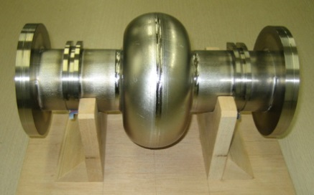
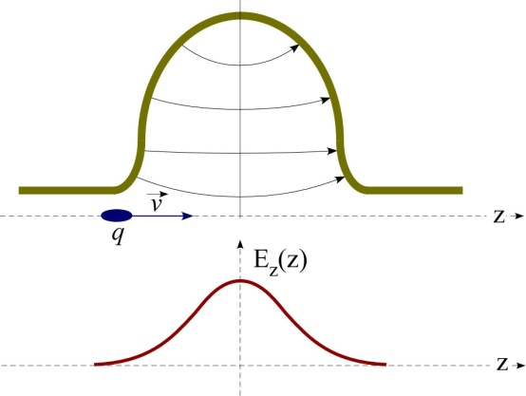
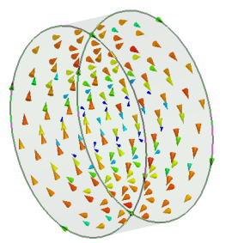
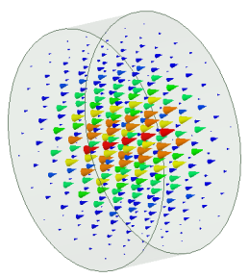




RF CAVITIES
⇒High frequency RF accelerating fields are confined in cavities.
⇒The cavities are metallic closed volumes were the e.m fields has a particular spatial configuration (resonant modes) whose components, including the accelerating field E_{z}, oscillate at some specific frequencies f_{RF} (resonant frequency) characteristic of the mode.
⇒The modes are excited by RF generators that are coupled to the cavities through waveguides, coaxial cables, etc…
⇒The resonant modes are called Standing Wave (SW) modes (spatial fixed configuration, oscillating in time).
⇒The spatial and temporal field profiles in a cavity have to be computed (analytically or numerically) by solving the Maxwell equations with the proper boundary conditions.
B
E
Courtesy E. Jensen

Slide 19



ALVAREZ STRUCTURES
Alvarez's structure can be described as a special DTL in which the electrodes are part of a resonant macrostructure.
(protons and ions)
© Encyclopaedia Britannica, inc
⇒The DTL operates in 0 mode for protons and ions in the range β=0.05-0.5 (f_{RF}=50-400 MHz, λ_{RF}=6-0.7 m) 1-100 MeV;
⇒The beam is inside the “drift tubes” when the electric field is decelerating. The electric field is concentrated between gaps;
⇒The drift tubes are suspended by stems;
⇒Quadrupole (for transverse focusing) can fit inside the drift tubes.
⇒In order to be synchronous with the accelerating field at each gap the length of the n-th drift tube L_{n} has to be:
E_{z}
z

Slide 20


Slide 21




ALVAREZ STRUCTURES: EXAMPLES
CERN LINAC 2 tank 1:
200 MHz 7 m x 3 tanks, 1 m diameter, final energy 50 MeV.
CERN LINAC 4: 352 MHz frequency, Tank diameter 500 mm, 3 resonators (tanks), Length 19 m, 120 Drift Tubes, Energy: 3 MeV to 50 MeV, β=0.08 to 0.31 → cell length from 68mm to 264mm.

Slide 22
EXERCISE 2: ALVAREZ STRUCTURES
A proton beam is injected into a DTL (Alvarez structure) working at f_{RF}=300 MHz, with a kinetic energy W_{in}=4 MeV. Calculate:
the distance between the first two centers of the accelerating gaps (L_{gaps}) assuming a constant velocity of the proton beam between the first two gaps and a negligible increase of the velocity due to the accelerating field;
if the structure is composed by 40 accelerating gaps (N_{gaps}) and the average accelerating voltage per gap is V_{acc}=0.5 MV, calculate final proton beam kinetic energy.
REMEMBER
proton rest energy m_{0_p}c²=E_{0_p}=938 MeV
velocity of light c=2.998e8

Slide 23
EXERCISE 3: ALVAREZ STRUCTURES AND TRANSIT TIME FACTOR
Particles at β=0.5 are accelerated through an ideal DTL operating at f_{RF}=400 MHz. Assuming a uniform accelerating RF field (E_{RF}) along the gap, calculate the accelerating gap length (L) that maximize the energy gain of the accelerated particles.

Slide 24



HIGH β cavities: CYLINDRICAL STRUCTURES
(electrons or protons and ions at high energy)
⇒When the β of the particles increases (>0.5) one has to use higher RF frequencies (>400-500 MHz) to increase the accelerating gradient per unit length
⇒the DTL structures became less efficient (effective accelerating voltage per unit length for a given RF power);
Cylindrical single (or multiple cavities) working on the TM₀₁₀-like mode are used
For a pure cylindrical structure (also called pillbox cavity) the first accelerating mode (i.e. with non zero longitudinal electric field on axis) is the TM₀₁₀ mode. It has a well known analytical solution from Maxwell equation.
Real cylindrical cavity
(TM₀₁₀-like mode because of the shape and presence of beam tubes and couplers)
E
H

Slide 25


SW CAVITIES PARAMETERS: V_{acc}, P_{diss}, W
To compare and qualify different cavities is necessary to define some parameter that characterize each accelerating structure.
ACCELERATING VOLTAGE
We suppose that the cavities are powered at a constant frequency f_{RF}. The maximum energy gain of a particle crossing the cavity at a velocity v (∼c for electrons) is obtained integrating the time-varying accelerating field sampled by the particle along the trajectory:
E field lines
E_{z}
B
E
z
More general form
MODE TM₀₁₀
DISSIPATED POWER
Real cavities have losses.
Surface currents (related to the surface magnetic field $\vec{J}=\vec{n}×\vec{H}$ ) “sees” a surface resistance $R_{s}$ and dissipate energy, so that a certain amount of RF power must be provided from the outside to keep the accelerating field at the desired level. The total dissipated power is:
STORED ENERGY
The total e.m. energy stored in the cavity:
  NC cavity (Cu $R_{s}≈10 \text{mΩ}$ at 1 GHz)
  SC cavity (Nb $at 2 \text{K}$ $R_{s}≈10 \text{nΩ}$ at 1 GHz)

Slide 26


SW CAVITIES PARAMETERS: R, Q, R/Q
ACCELERATING VOLTAGE (V_{acc})
DISSIPATED POWER (P_{diss})
STORED ENERGY (W)
SHUNT IMPEDANCE
QUALITY FACTOR
The shunt impedance is the parameter that qualifies the efficiency of an accelerating mode. The highest is its value, the larger is the obtainable accelerating voltage for a given power. Traditionally, it is the quantity to optimize in order to maximize the accelerating field for a given dissipated power:
  NC cavity Q∼10⁴
  SC cavity Q∼10¹⁰
SHUNT IMPEDANCE PER UNIT LENGTH
The R/Q is a pure geometric qualification factor. It does not depend on the cavity wall conductivity. R/Q of a single cell is of the order of 100.
  NC cavity R∼1MΩ
  SC cavity R∼1TΩ
Example:
  R∼1MΩ
P_{diss}=1 MW
V_{acc}=1MV
For a cavity working at 1 GHz with a structure length of 10 cm we have an average accelerating field of 10 MV/m

Slide 27


SW CAVITIES : EQUIVALENT CIRCUIT AND BANDWIDTH
The previous quantities plays crucial roles in the evaluation of the cavity performances. Let us consider the case of a cavity powered by a source (klystron) at a constant frequency in CW and at a fixed power (P_{in}).
P_{in}=1 MW
R/Q=100
Critical coupling (P_{diss}=P_{in})
f_{res}=1 GHz
The reachable V_{acc} for a given power is proportional to √Q
Frequency domain
BANDWIDTH
Modulator and klystron
waveguide
cavity
Z₀
1:n
I_{g}
Z₀
ρ_{in}
R/2
C
L
V_{acc}
Matched source
High power transfer line
coupler
cavity
P_{in}

Slide 28



SW CAVITIES : FILLING TIME AND DISSIPATED POWER
Let us now consider the case of a cavity powered by a source (klystron) in pulsed mode at a frequency f_{RF}=f_{res}. The accelerating voltage has an exponential behavior and reach the steady state regime asymptotically with a certain filling time (τ_{F}) that is proportional to the quality factor of the resonator.
Time domain
[MV]
One needs several filling times to completely fill the cavity
FILLING TIME
P_{diss} ∝1/Q
To reach a given voltage the required power is inversely proportional to the Q-factor
The reachable V_{acc} for a given power is proportional to √Q but, on the other hand, the filling time is ∝Q
Example:
  Q∼10000
f_{RF}=1 GHz
τ_{F}=3.1 μs
P_{refl} to the generator (it that has to be protected!)

Slide 29
EXERCISE 4: FILLING TIME
A SW cavity is feed by an RF generator with constant power, calculate after how much time the field in the cavity is 90% the field at full regime supposing that the cavity operate at f_{RF}=1.3 GHz and has an equivalent Q factor of 10000.

Slide 30




MULTI-CELL SW CAVITIES
P_{in}
(electrons or protons and ions at high energy)
P_{in}
R
.
nR
In a multi-cell structure there is one RF input coupler. As a consequence the total number of RF sources is reduced, with a simplification of the layout and reduction of the costs;
The shunt impedance is n time the impedance of a single cavity
They are more complicated to fabricate than single cell cavities;
The fields of adjacent cells couple through the cell irises and/or through properly designed coupling slots.

Slide 31


MULTI-CELL SW CAVITIES: π MODE STRUCTURES
(electrons or protons and ions at high energy)
0 mode
The N-cell structure behaves like a system composed by N coupled oscillators with N coupled multi-cell resonant modes.
The modes are characterized by a cell-to-cell phase advance given by:
.
E_{z}
The multi cell mode generally used for acceleration is the π, π/2 and 0 mode (DTL as example operate in the 0 mode).
The cell lengths have to be chosen in order to synchronize the accelerating field with the particle traveling into the structure at a certain velocity
z
π mode
EXAMPLE: 4 cell cavity operating on the π-mode
E_{z}
⇒For ions and protons the cell lengths have to be increased along the linac that will be a sequence of different accelerating structures matched to the ion/proton velocity.
⇒For electron, β=1, d=λ_{RF}/2 and the linac will be made of an injector followed by a series of identical accelerating structures, with cells all the same length.
z
$$d=\frac{βc}{2f_{RF}}=\frac{βλ_{RF}}{2}$$

Slide 32






π MODE STRUCTURES: EXAMPLES
LINAC 4 (CERN) PIMS (PI Mode Structure) for protons: f_{RF}=352 MHz, β>0.4
100 MeV
12 tanks
1.28 m
1.55 m
160 MeV
European XFEL (Desy): electrons
Each module has 7 identical cells
All identical β=1
Superconducting cavities

Slide 33
EXERCISE 5: π MODE STRUCTURES
A π-mode structure, operating at f_{RF}=400 MHz, is made up of N=8 cells and is used to accelerate protons. Each single cell has a shunt impedance R=3 MΩ and a length L_{cell}=15 cm. Calculate:
the total shunt impedance of the π-mode structure;
the accelerating voltage if the total dissipated power into the cavity is P_{diss}=1 MW;
the average accelerating field;
the average β of the proton beam accelerated by this structure.

Slide 34


MULTI-CELL SW CAVITIES: π/2 MODE STRUCTURES
(electrons or protons and ions at high energy)
f_{res}
Dispersion curve
⇒It is possible to demonstrate that over a certain number of cavities (>10) working on the π mode, the overlap between adjacent modes can be a problem (as example the field uniformity due to machining errors is difficult to tune).
⇒The criticality of a working mode depend on the frequency separation between the working mode and the adjacent mode
⇒the π/2 mode from this point of view is the most stable mode. For this mode it is possible to demonstrate that the accelerating field is zero every two cells. For this reason, the empty cells are put of axis and coupling slots are opened from the accelerating cells to the empty cells.
⇒this allow to increase the number of cells to >20-30 without problems
Δf_{res_π}
Δf_{res_π/2}
Multi cell cavity modes
0 mode
π/2 mode
π mode
Phase advance per cell
Side Coupled Cavity (SCC)
Axial coupled
E_{z}
z
f_{RF}=800 - 3000 MHz for proton (β=0.5-1) and electrons

Slide 35




SCC STRUCTURES: EXAMPLES
Spallation Neutron Source Coupled Cavity Linac (protons)
segment
4 modules, each containing 12 accelerator segments CCL and 11 bridge couplers. The CCL section is a RF Linac, operating at 805 MHz that accelerates the beam from 87 to 186 MeV and has a physical installed length of slightly over 55 meters.
Coupling cell
Accelerating cell

Slide 36


TRAVELLING WAVE (TW) STRUCTURES
(electrons)
P _{RF in}
⇒To accelerate charged particles, the electromagnetic field must have an electric field along the direction of propagation of the particle.
⇒The field has to be synchronous with the particle velocity.
⇒Up to now we have analyzed the standing standing wave (SW) structures in which the field has basically a given profile and oscillate in time (as example in DTL or resonant cavities operating on the TM₀₁₀-like).
E_{z}
Direction of propagation
Time oscillation
z
field profile
P _{RF in}
P _{RF out}
P _{RF TW}
⇒There is another possibility to accelerate particles: using a travelling wave (TW) structure in which the RF wave is co-propagating with the beam with a phase velocity equal to the beam velocity.
⇒Typically these structures are used for electrons because in this case the phase velocity can be constant all over the structure and equal to c. On the other hand it is difficult to modulate the phase velocity itself very quickly for a low β particle that changes its velocity during acceleration.
E_{z}
z

Slide 37

TW CAVITIES: CIRCULAR WAVEGUIDE AND DISPERSION CURVE
(electrons)
In TW structures an e.m. wave with E_{z}≠0 travel together with the beam in a special guide in which the phase velocity of the wave matches the particle velocity (v). In this case the beam absorbs energy from the wave and it is continuously accelerated.
ω=2πf (f=RF generator frequency)
CIRCULAR WAVEGUIDE
Dispersion curve
ω_{RF_2}
ω_{RF}
ω_{cut-off}
As example if we consider a simple circular waveguide the first propagating mode with E_{z}≠0 is the TM₀₁ mode.
Nevertheless by solving the wave equation it turns out that an e.m. wave propagating in this constant cross section waveguide will never be synchronous with a particle beam since the phase velocity is always larger than the speed of light c.
(propagation constant)
tan(α)=v_{ph}
k*
k₂*
k
E_{z}
z

Slide 38


TW CAVITIES: IRIS LOADED STRUCTURES
(electrons)
In order to slow-down the wave phase velocity, iris-loaded periodic structure have to be used.
CIRCULAR WAVEGUIDE
IRIS LOADED STRUCTURE
Metal irises
Beam direction
D
MODE TM₀₁
MODE TM₀₁-like
Periodic (in z) wih period D (from Floquet theorem)
⇒The field in this type of structures is that of a special wave travelling within a spatial periodic profile.
ω
ω_{RF}
⇒The structure can be designed to have the phase velocity equal to the speed of the particles.
⇒This allows acceleration over large distances (few meters, hundred of cells) with just an input coupler and a relatively simple geometry.
⇒They are used especially for electrons (constant particle velocity→constant phase velocity, same distance between irises, easy realization)
k*
π/D
k

Slide 39


PHASOR NOTATION: RECAP.
With a more general notation we can consider the phasors of the accelerating field.
Phasor of the longitudinal electric field (complex quantity)
Peak accelerating voltage
(i.e.: the maximum accelerating voltage that can be reached for a particular injection phase ($φ_{inj}+ph\left({\tilde{V}}_{acc}\right)$=0))
$$inj+ph\left({\tilde{V}}_{acc}\right)$$

Slide 40



TW CAVITIES PARAMETERS: r, α, v_{g}
Similarly to the SW cavities it is possible to define some figure of merit for the TW structures
Shunt impedance per unit length [Ω/m]. Similarly to SW structures the higher is r, the higher the available accelerating field for a given RF power.
Field attenuation constant [1/m]: because of the wall dissipation, the RF power flux and the accelerating field decrease along the structure.
Group velocity [m/s]: the velocity of the energy flow in the structure (∼1-2% of c).
Working mode [rad]: defined as the phase advance over a period D. For several reasons the most common mode is the 2π/3

Slide 41


TW CAVITIES: EQUIVALENT CIRCUIT AND FILLING TIME
In a TW structure, the RF power enters into the cavity through an input coupler, flows (travels) through the cavity in the same direction as the beam and an output coupler at the end of the structure is connected to a matched power load.
If there is no beam, the input power, reduced by the cavity losses, goes to the power load where it is dissipated.
In the presence of a large beam current, however, a fraction of the TW power is transferred to the beam.
In a purely periodic structure, made by a sequence of identical cells (also called “constant impedance structure”), α does not depend on z and both the RF power flux and the intensity of the accelerating field decay exponentially along the structure :
The filling time is the time necessary to propagate the RF wave-front from the input to the end of the section of length L is:
Differently from SW cavities after one filling time the cavity is completely full of energy
L

Slide 42
Exercise 6: TW STRUCTURES
A) Demonstrate that if we define the attenuation constant as:
the power flow along the structure scales as:
B) Demonstrate that if we define the shunt impedance per unit length as:
the average accelerating field “seen” by an ultrarelativistic particle (z=ct) along the structure can be expressed as:
C) Demonstrate that the total accelerating voltage is given by:

Slide 43
Exercise 7: TW STRUCTURES
A SLAC-type TW structure accelerate ultra-relativistic electrons. The structure length is L=3m and it can be simplified as a structure with a group velocity is v_{g}=1.1% the velocity of light. Calculate:
the filling time;
if we suppose that the structure has a field attenuation constant α=0.2 m⁻¹, calculate the total accelerating voltage if the accelerating field at the beginning of the structure is E_{INPUT}=20 MV/m;
Calculate the average accelerating field
if the average dissipated power per unit length in the structure, corresponding to the previous value of the accelerating field, is p_{diss}= 20 MW/m calculate the shunt impedance per unit length.

Slide 44
Exercise 8: TW STRUCTURES
A constant impedance TW structure, accelerates ultra-relativistic electrons (β=1). The cavity has the following parameters: α=0.25 m⁻¹ ; shunt impedance r=65 MOhm/m and a total length of 2 m. Calculate:
the input power to have an energy gain of the particles of 60 MeV
if the group velocity v_{g} is 1% the speed of light, which is the filling time of the structure?

Slide 45


TW CAVITIES: PERFORMANCES (1/2)
Just as an example we can consider a C-band (5.712 GHz) accelerating cavity of L=2 m long made in copper.
r=82 [MΩ/m]
α=0.36 [1/m]
v_{g}/c=1.7%
τ_{F}=400 ns (very short if compared to SW!)
Field attenuation due to the copper dissipations
Input power
τ_{F}
Output power (dissipated into the RF load): it is not convenient to have very long RF structures because their efficiency decreases over a certain length (2-3 m depending on the operating frequency).

Slide 46


TW CAVITIES: CONSTANT GRADIENT STRUCTURES INTRODUCTION
In order to keep the accelerating field constant along the LINAC structure, the group velocity has to be reduced along the structure itself. This can be achieved by a reduction of the iris diameters.
Reduction due to the attenuation (losses)
Reduction due to irises modulation
Constant along the linac
In general constant gradient structures are more efficient than constant impedance ones, because of the more uniform distribution of the RF power along them.

Slide 47


LINAC TECHNOLOGY: MATERIALS

Slide 48







ACCELERATING CAVITY TECHNOLOGY
⇒The cavities (and the related LINAC technology) can be of different material:
copper for normal conducting (NC, both SW than TW) cavities;
Niobium for superconducting cavities (SC, SW);
⇒We can choose between NC or the SC technology depending on the required performances in term of:
accelerating gradient (MV/m);
RF pulse length (how many bunches we can contemporary accelerate);
Duty cycle (see next slide): pulsed operation (i.e. 10-100 Hz) or continuous wave (CW) operation;
Average beam current.
…
Dissipated power into the cavity walls is related to the surface currents
NIOBIUM
COPPER
Frequency [GHz]
Between copper and Niobium there is a factor 10⁵-10⁶

Slide 49


RF STRUCTURE AND BEAM STRUCTURE: NC vs SC
The “beam structure” in a LINAC is directly related to the “RF structure”. There are two possible type of operations:
CW (Continuous Wave) operation ⇒ allow, in principle, to operate with a continuous (bunched) beam
PULSED operation ⇒ there are RF pulses at a certain repetition rate (Duty Cycle (DC)=pulsed width/period)
RF power
RF pulses
time
Bunch spacing
⇒SC structures allow operation at very high Duty Cycle (>1%) up to a CW operation (DC=100%) (because of the extremely low dissipated power) with relatively high gradient (>20 MV/m). This means that a continuous (bunched) beam can be accelerated.
⇒NC structures can operate in pulsed mode at very low DC (10⁻²-10⁻¹ %) (because of the higher dissipated power) with, in principle, larger peak accelerating gradient(>30 MV/m). This means that one or few tens of bunches can be, in general, accelerated. NB: NC structures can also operate in CW but at very low gradient because of the dissipated power.
Amplitude
10³-10⁸ RF periods
t

Slide 50
EXERCISE 9: π MODE STRUCTURES AND DUTY CYCLE
A multi cell SW cavity, operating on the π-mode at 1 GHz, accelerates protons at β=0.5. The cavity is a 9 cell structure. Assuming a negligible variation of the particle velocity through the cavity itself calculate:
the distance between the centers of the accelerating cells;
assuming a shunt impedance of the single cell (R) of 1 MΩ, calculate the dissipated power to have an effective accelerating voltage on the overall structure of V_{acc}=10 MV;
Calculate the average accelerating field;
If the cavity is fed by 4 μs rf pulses with a repetition rate of 100 Hz, calculate the Duty Cycle.

Slide 51








EXAMPLE: SWISSFEL LINAC (PSI)

Slide 52






EXAMPLES: EUROPEAN XFEL

