Slide 1
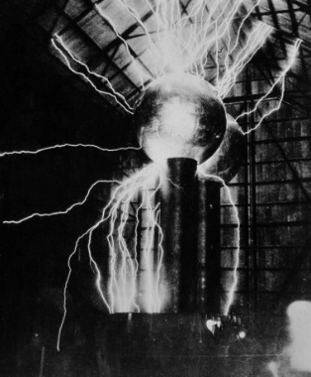
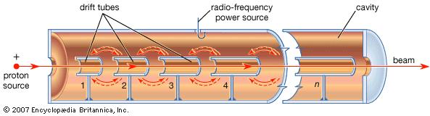
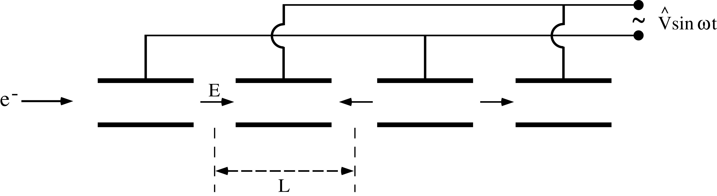
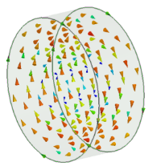
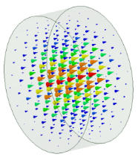
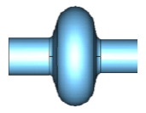
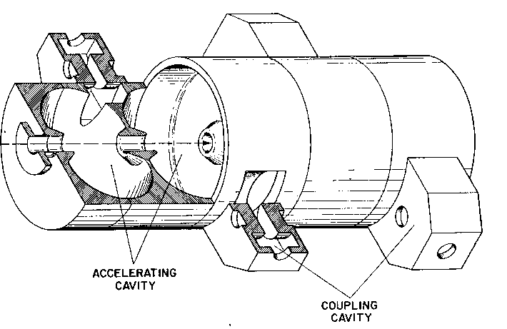
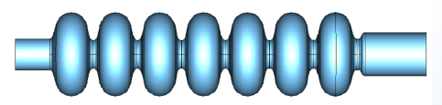




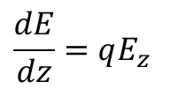
SUMMARY OF THE FIRST LECTURE (2h)
ELECTROSTATIC ACCELERATORS
ALVAREZ DTL
Wideröe : RF ACCELERATION
β=0.05-0.5, f_{RF}=50-400 MHz
Transit time factor and bunched beam
$$L_{n}={\bar{β}}_{n}λ_{RF}$$
$$ΔE_{n}=qΔV_{n}$$
$$ΔE=qV_{RF}T\cos\left(φ_{inj}\right)=q{\hat{V}}_{acc}\cos\left(φ_{inj}\right)$$
$$\frac{dE}{dz}=qE_{z}$$
B
E
$$ΔE=qΔV$$
HIGH β RF CYLINDRICAL CAVITIES (PILLBOX-like)
MODE TM₀₁₀
MULTi CELL STRUCTURES
β>0.5, f_{RF}=0.3-3 GHz (or above)
π/2 MODE
π MODE
d
nR

Slide 2
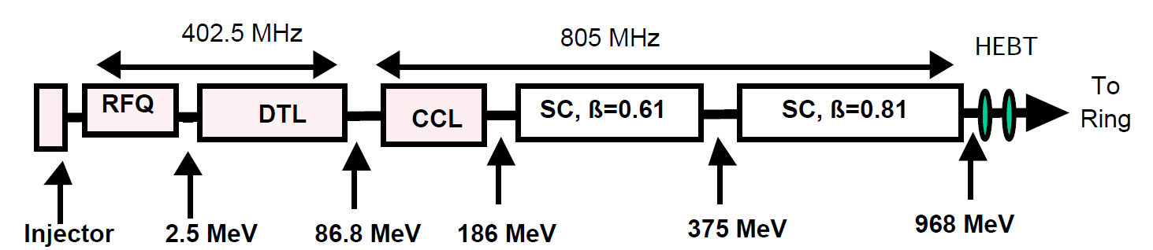
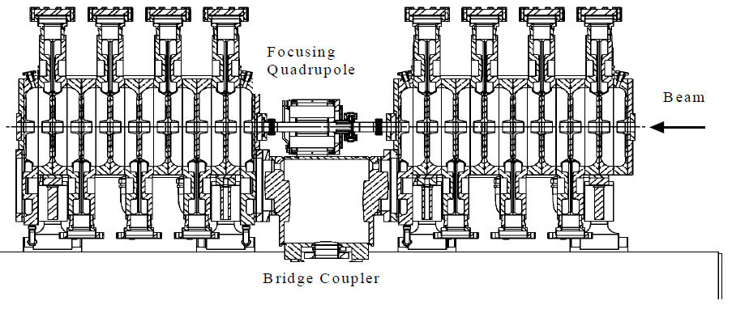
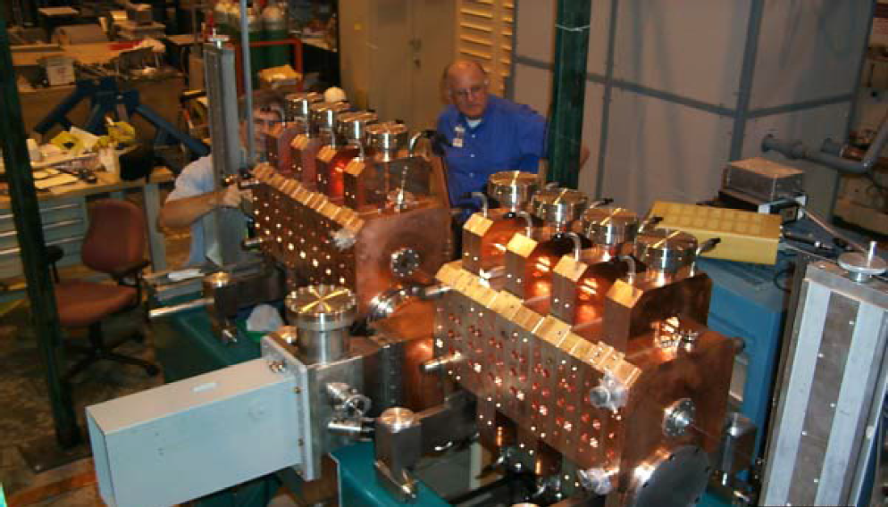
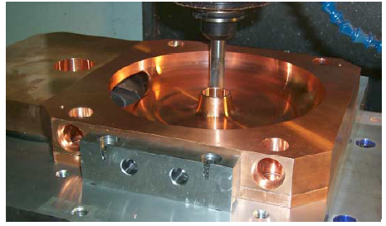
SCC STRUCTURES: EXAMPLES
Spallation Neutron Source Coupled Cavity Linac (protons)
segment
4 modules, each containing 12 accelerator segments CCL and 11 bridge couplers. The CCL section is a RF Linac, operating at 805 MHz that accelerates the beam from 87 to 186 MeV and has a physical installed length of slightly over 55 meters.
Coupling cell
Accelerating cell

Slide 3
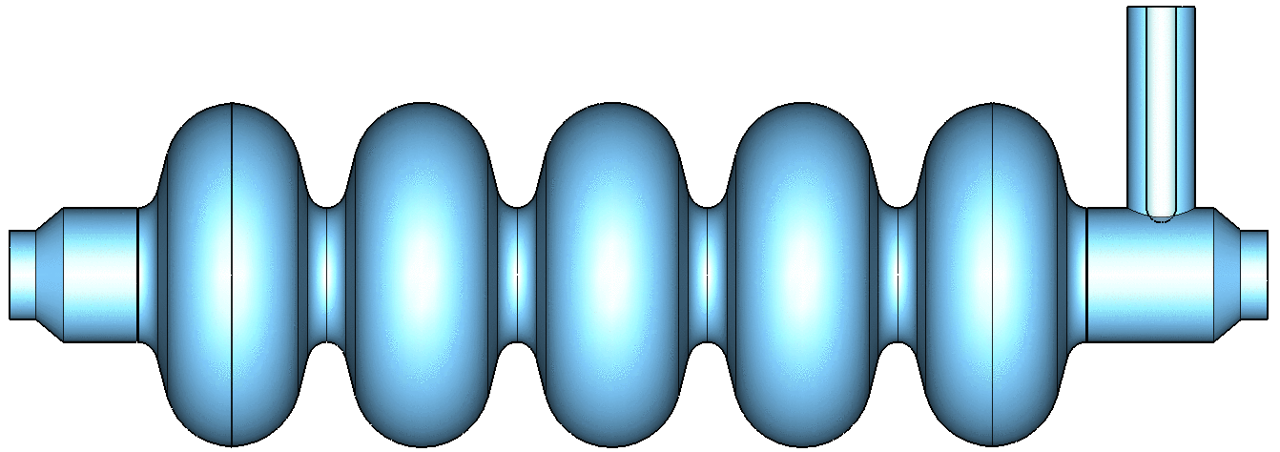
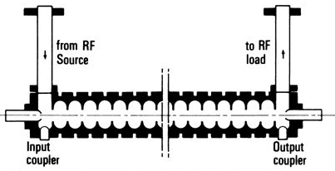
TRAVELLING WAVE (TW) STRUCTURES
(electrons)
P _{RF in}
⇒To accelerate charged particles, the electromagnetic field must have an electric field along the direction of propagation of the particle.
⇒The field has to be synchronous with the particle velocity.
⇒Up to now we have analyzed the standing standing wave (SW) structures in which the field has basically a given profile and oscillate in time (as example in DTL or resonant cavities operating on the TM₀₁₀-like).
E_{z}
Direction of propagation
Time oscillation
z
field profile
P _{RF in}
P _{RF out}
P _{RF TW}
⇒There is another possibility to accelerate particles: using a travelling wave (TW) structure in which the RF wave is co-propagating with the beam with a phase velocity equal to the beam velocity.
⇒Typically these structures are used for electrons because in this case the phase velocity can be constant all over the structure and equal to c. On the other hand it is difficult to modulate the phase velocity itself very quickly for a low β particle that changes its velocity during acceleration.
E_{z}
z

Slide 4
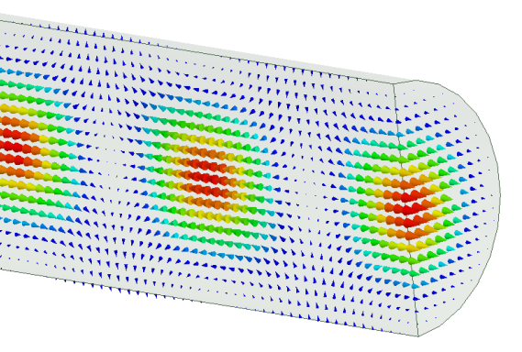
TW CAVITIES: CIRCULAR WAVEGUIDE AND DISPERSION CURVE
(electrons)
In TW structures an e.m. wave with E_{z}≠0 travel together with the beam in a special guide in which the phase velocity of the wave matches the particle velocity (v). In this case the beam absorbs energy from the wave and it is continuously accelerated.
ω=2πf (f=RF generator frequency)
CIRCULAR WAVEGUIDE
Dispersion curve
ω_{RF_2}
ω_{RF}
ω_{cut-off}
As example if we consider a simple circular waveguide the first propagating mode with E_{z}≠0 is the TM₀₁ mode.
Nevertheless by solving the wave equation it turns out that an e.m. wave propagating in this constant cross section waveguide will never be synchronous with a particle beam since the phase velocity is always larger than the speed of light c.
(propagation constant)
tan(α)=v_{ph}
k*
k₂*
k
E_{z}
z

Slide 5
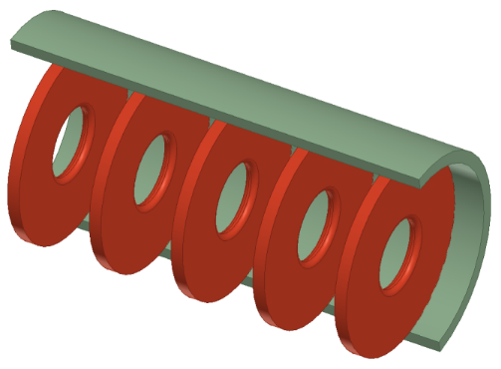
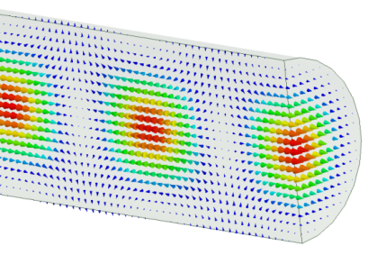
TW CAVITIES: IRIS LOADED STRUCTURES
(electrons)
In order to slow-down the wave phase velocity, iris-loaded periodic structure have to be used.
CIRCULAR WAVEGUIDE
IRIS LOADED STRUCTURE
Metal irises
Beam direction
D
MODE TM₀₁
MODE TM₀₁-like
Periodic (in z) wih period D (from Floquet theorem)
⇒The field in this type of structures is that of a special wave travelling within a spatial periodic profile.
ω
ω_{RF}
⇒The structure can be designed to have the phase velocity equal to the speed of the particles.
⇒This allows acceleration over large distances (few meters, hundred of cells) with just an input coupler and a relatively simple geometry.
⇒They are used especially for electrons (constant particle velocity→constant phase velocity, same distance between irises, easy realization)
k*
π/D
k

Slide 6

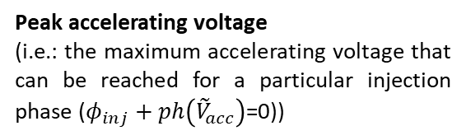
PHASOR NOTATION: RECAP.
With a more general notation we can consider the phasors of the accelerating field.
Phasor of the longitudinal electric field (complex quantity)
Peak accelerating voltage
(i.e.: the maximum accelerating voltage that can be reached for a particular injection phase ($φ_{inj}+ph\left({\tilde{V}}_{acc}\right)$=0))
$$inj+ph\left({\tilde{V}}_{acc}\right)$$

Slide 7
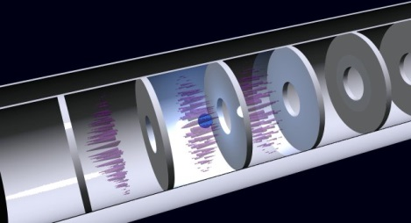
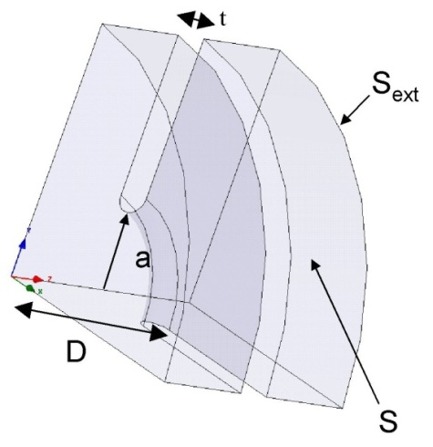
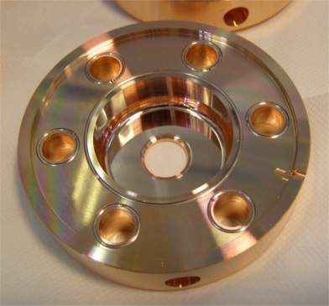
TW CAVITIES PARAMETERS: r, α, v_{g}
Similarly to the SW cavities it is possible to define some figure of merit for the TW structures
Shunt impedance per unit length [Ω/m]. Similarly to SW structures the higher is r, the higher the available accelerating field for a given RF power.
Field attenuation constant [1/m]: because of the wall dissipation, the RF power flux and the accelerating field decrease along the structure.
Group velocity [m/s]: the velocity of the energy flow in the structure (∼1-2% of c).
Working mode [rad]: defined as the phase advance over a period D. For several reasons the most common mode is the 2π/3

Slide 8
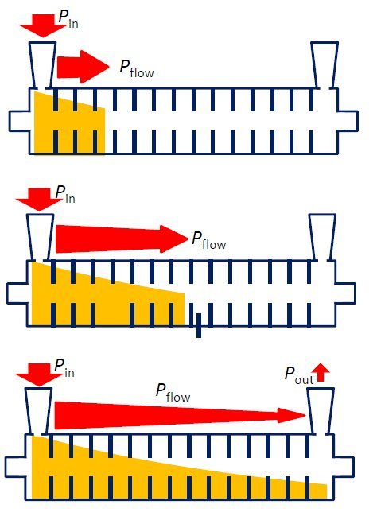
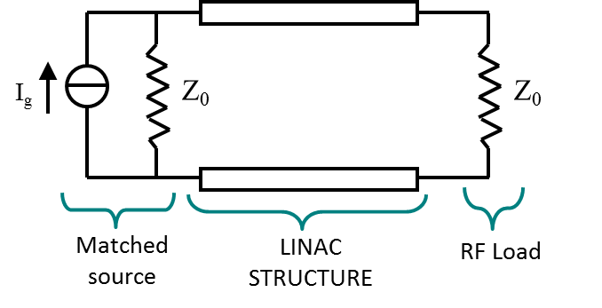
TW CAVITIES: EQUIVALENT CIRCUIT AND FILLING TIME
In a TW structure, the RF power enters into the cavity through an input coupler, flows (travels) through the cavity in the same direction as the beam and an output coupler at the end of the structure is connected to a matched power load.
If there is no beam, the input power, reduced by the cavity losses, goes to the power load where it is dissipated.
In the presence of a large beam current, however, a fraction of the TW power is transferred to the beam.
In a purely periodic structure, made by a sequence of identical cells (also called “constant impedance structure”), α does not depend on z and both the RF power flux and the intensity of the accelerating field decay exponentially along the structure :
The filling time is the time necessary to propagate the RF wave-front from the input to the end of the section of length L is:
Differently from SW cavities after one filling time the cavity is completely full of energy
L

Slide 9
Exercise 6: TW STRUCTURES
A) Demonstrate that if we define the attenuation constant as:
the power flow along the structure scales as:
B) Demonstrate that if we define the shunt impedance per unit length as:
the average accelerating field “seen” by an ultrarelativistic particle (z=ct) along the structure can be expressed as:
C) Demonstrate that the total accelerating voltage is given by:

Slide 10
Exercise 7: TW STRUCTURES
A SLAC-type TW structure accelerate ultra-relativistic electrons. The structure length is L=3m and it can be simplified as a structure with a group velocity is v_{g}=1.1% the velocity of light. Calculate:
the filling time;
if we suppose that the structure has a field attenuation constant α=0.2 m⁻¹, calculate the total accelerating voltage if the accelerating field at the beginning of the structure is E_{INPUT}=20 MV/m;
Calculate the average accelerating field
if the average dissipated power per unit length in the structure, corresponding to the previous value of the accelerating field, is p_{diss}= 4 MW/m calculate the shunt impedance per unit length.

Slide 11
Exercise 8: TW STRUCTURES
A constant impedance TW structure, accelerates ultra-relativistic electrons (β=1). The cavity has the following parameters: α=0.25 m⁻¹ ; shunt impedance r=65 MOhm/m and a total length of 2 m. Calculate:
the input power to have an energy gain of the particles of 60 MeV
if the group velocity v_{g} is 1% the speed of light, which is the filling time of the structure?

Slide 12
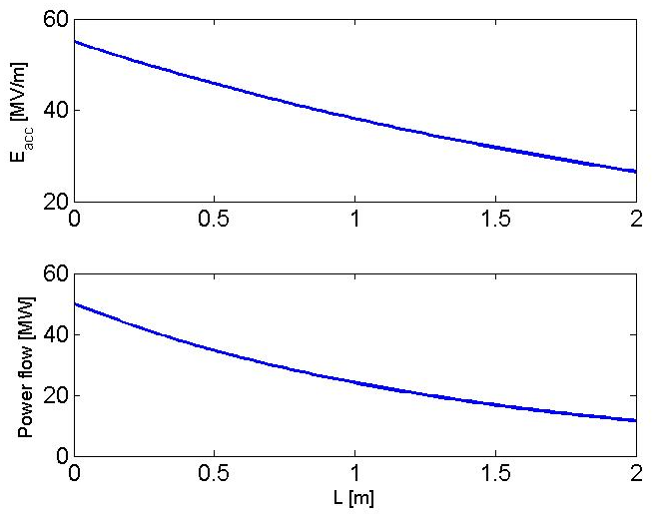
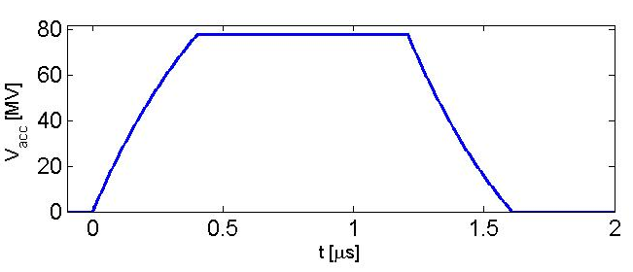
TW CAVITIES: PERFORMANCES (1/2)
Just as an example we can consider a C-band (5.712 GHz) accelerating cavity of L=2 m long made in copper.
r=82 [MΩ/m]
α=0.36 [1/m]
v_{g}/c=1.7%
τ_{F}=400 ns (very short if compared to SW!)
Field attenuation due to the copper dissipations
Input power
τ_{F}
Output power (dissipated into the RF load): it is not convenient to have very long RF structures because their efficiency decreases over a certain length (2-3 m depending on the operating frequency).

Slide 13
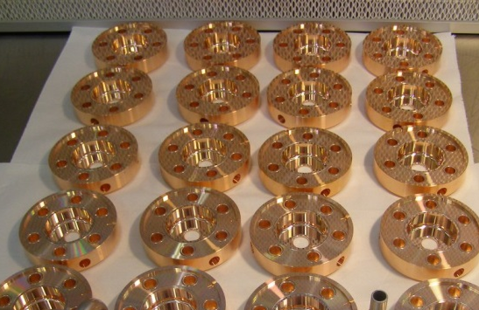
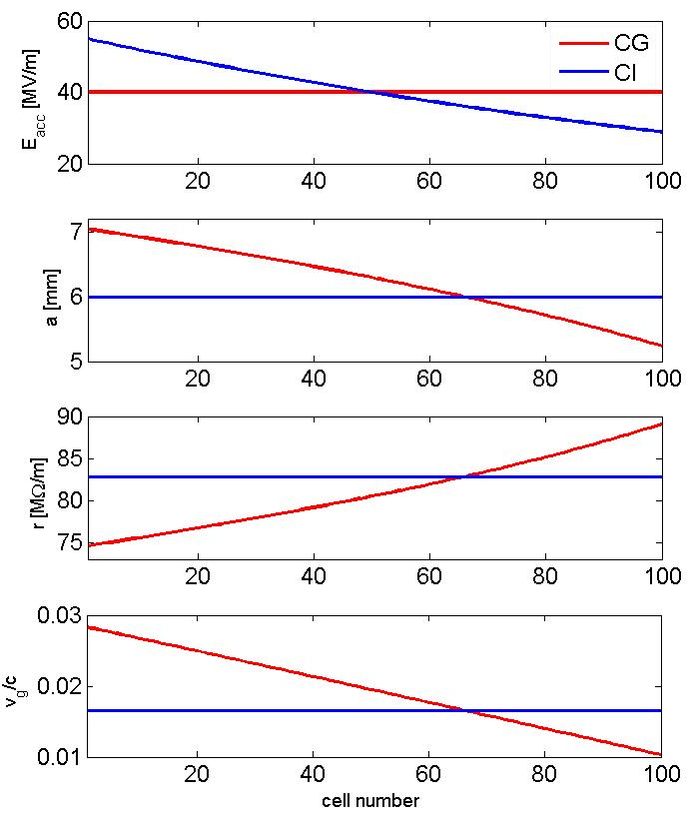
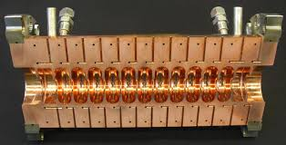
TW CAVITIES: CONSTANT GRADIENT STRUCTURES INTRODUCTION
In order to keep the accelerating field constant along the LINAC structure, the group velocity has to be reduced along the structure itself. This can be achieved by a reduction of the iris diameters.
Reduction due to the attenuation (losses)
Reduction due to irises modulation
Constant along the linac
In general constant gradient structures are more efficient than constant impedance ones, because of the more uniform distribution of the RF power along them.

Slide 14
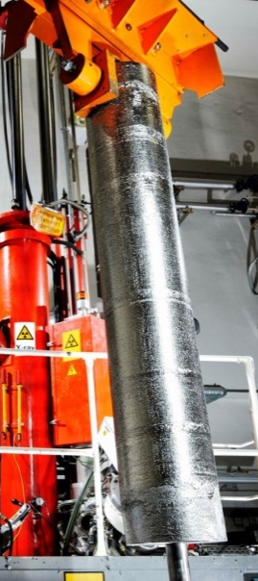
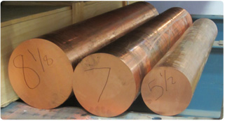
LINAC TECHNOLOGY: MATERIALS

Slide 15
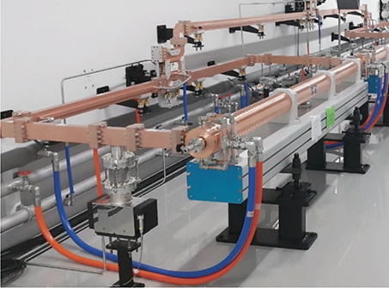
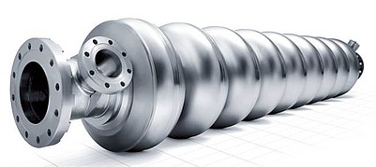
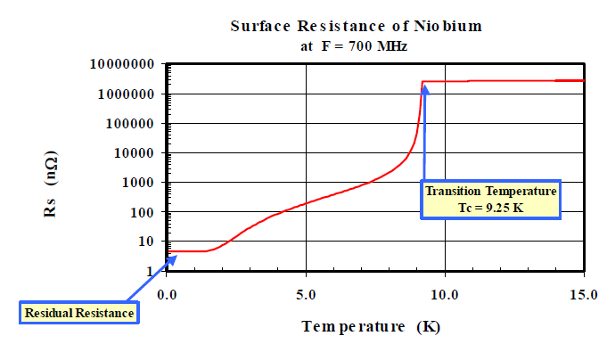
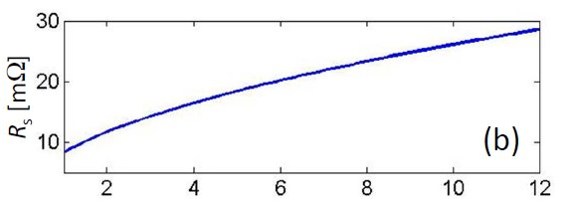

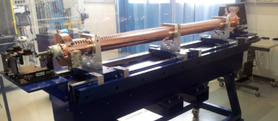
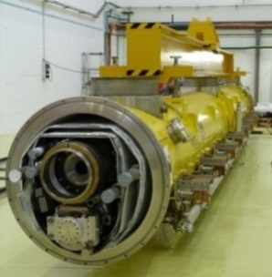
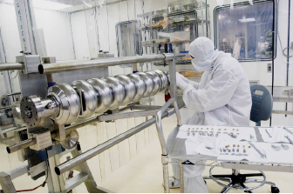
ACCELERATING CAVITY TECHNOLOGY
⇒The cavities (and the related LINAC technology) can be of different material:
copper for normal conducting (NC, both SW than TW) cavities;
Niobium for superconducting cavities (SC, SW);
⇒We can choose between NC or the SC technology depending on the required performances in term of:
accelerating gradient (MV/m);
RF pulse length (how many bunches we can contemporary accelerate);
Duty cycle (see next slide): pulsed operation (i.e. 10-100 Hz) or continuous wave (CW) operation;
Average beam current.
…
Dissipated power into the cavity walls is related to the surface currents
NIOBIUM
COPPER
Frequency [GHz]
Between copper and Niobium there is a factor 10⁵-10⁶

Slide 16
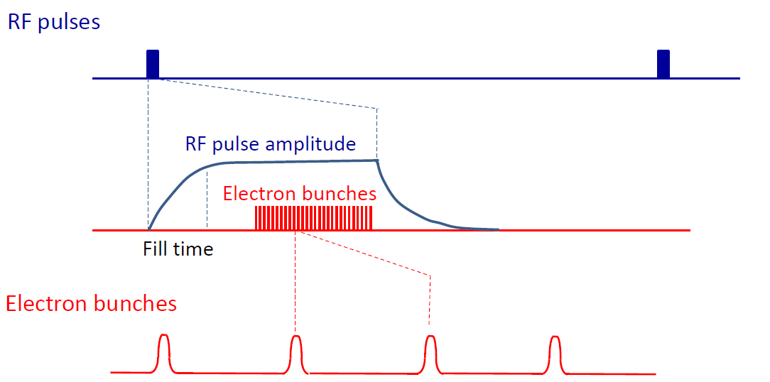
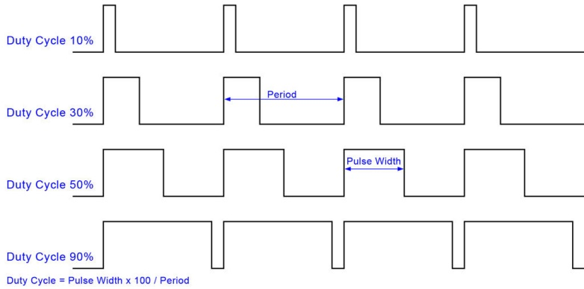
RF STRUCTURE AND BEAM STRUCTURE: NC vs SC
The “beam structure” in a LINAC is directly related to the “RF structure”. There are two possible type of operations:
CW (Continuous Wave) operation ⇒ allow, in principle, to operate with a continuous (bunched) beam
PULSED operation ⇒ there are RF pulses at a certain repetition rate (Duty Cycle (DC)=pulsed width/period)
RF power
RF pulses
time
Bunch spacing
⇒SC structures allow operation at very high Duty Cycle (>1%) up to a CW operation (DC=100%) (because of the extremely low dissipated power) with relatively high gradient (>20 MV/m). This means that a continuous (bunched) beam can be accelerated.
⇒NC structures can operate in pulsed mode at very low DC (10⁻²-10⁻¹ %) (because of the higher dissipated power) with, in principle, larger peak accelerating gradient(>30 MV/m). This means that one or few tens of bunches can be, in general, accelerated. NB: NC structures can also operate in CW but at very low gradient because of the dissipated power.
Amplitude
10³-10⁸ RF periods
t

Slide 17
EXERCISE 9: π MODE STRUCTURES AND DUTY CYCLE
A multi cell SW cavity, operating on the π-mode at 1 GHz, accelerates protons at β=0.5. The cavity is a 9 cell structure. Assuming a negligible variation of the particle velocity through the cavity itself calculate:
the distance between the centers of the accelerating cells;
assuming a shunt impedance of the single cell (R) of 1 MΩ, calculate the dissipated power to have an effective accelerating voltage on the overall structure of V_{acc}=10 MV;
Calculate the average accelerating field;
If the cavity is fed by 4 μs rf pulses with a repetition rate of 100 Hz, calculate the Duty Cycle.

Slide 18
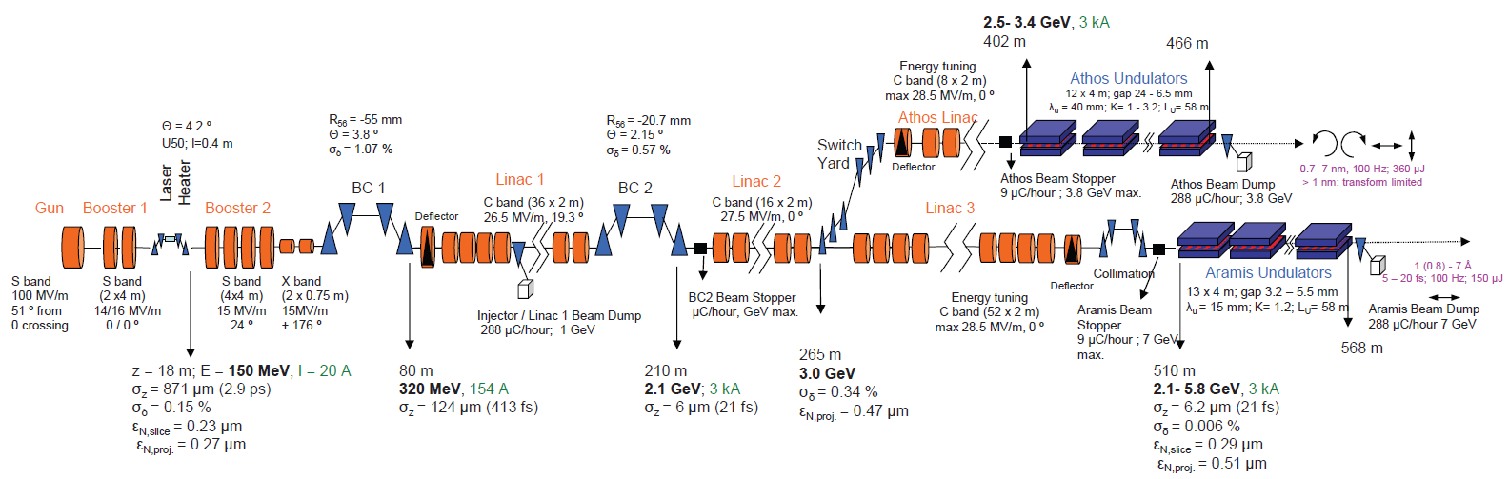
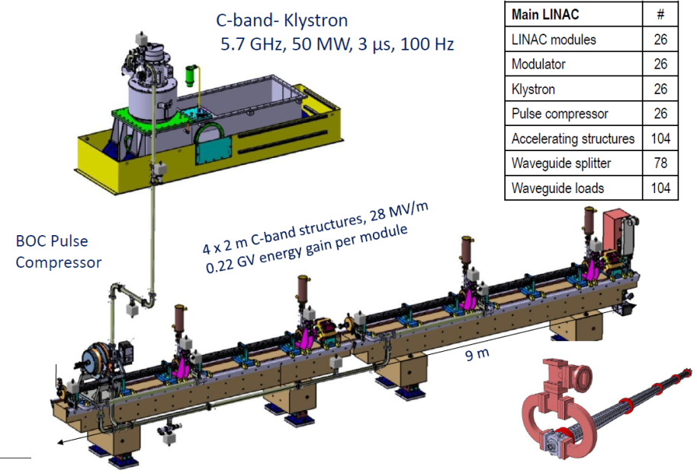
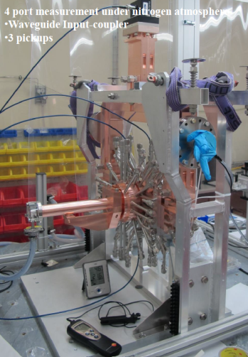
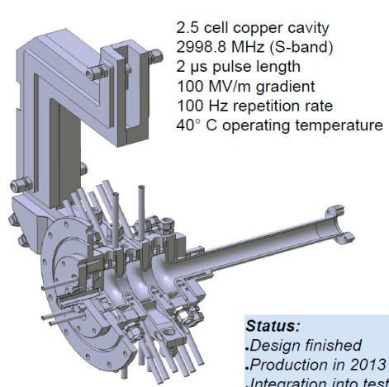
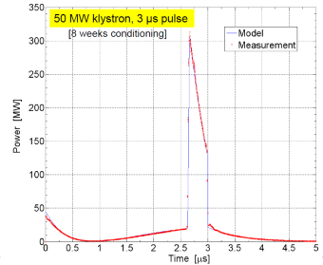
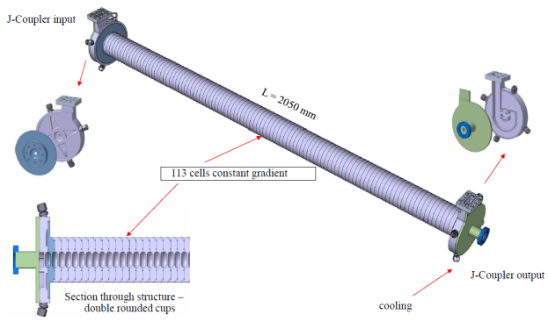

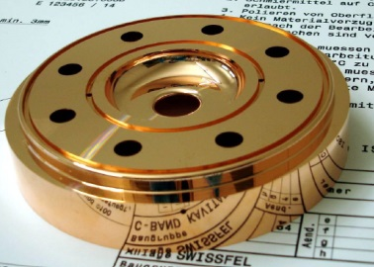
EXAMPLE: SWISSFEL LINAC (PSI)

Slide 19
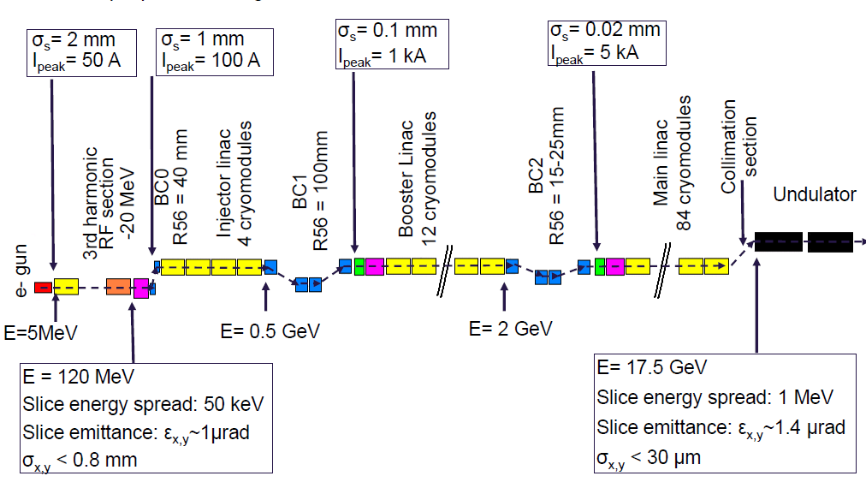
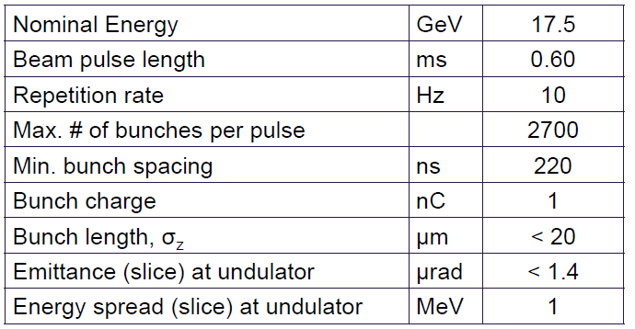
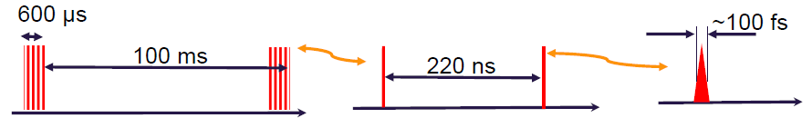






EXAMPLES: EUROPEAN XFEL

Slide 20






LINAC: BASIC DEFINITION AND MAIN COMPONENTS
LINAC (linear accelerator) is a system that allows to accelerate charged particles through a linear trajectory by electromagnetic fields.
Longitudinal dynamics of accelerated particles
Transverse dynamics of accelerated particles
LINAC BEAM DYNAMICS
Particle source
Accelerated beam
Focusing elements: quadrupoles and solenoids
Accelerating structures
LINAC COMPONENTS AND TECHNOLOGY

Slide 21


SYNCHRONOUS PARTICLE/PHASE
⇒Let us consider a SW linac structure made by accelerating gaps (like in DTL) or cavities.
⇒In each gap we have an accelerating field oscillating in time and an integrated accelerating voltage (V_{acc}) still oscillating in time than can be expressed as:
$$V_{acc}={\hat{V}}_{acc}\cos\left(ω_{RF}t\right)$$
V_{acc}
⇒Let’s assume that the “perfect” synchronism condition is fulfilled for a phase φ_{s} (called synchronous phase). This means that a particle (called synchronous particle) entering in a gap with a phase φ_{s} (φ_{s}=ω_{RF}t_{s}) with respect to the RF voltage receive an energy gain (and a consequent change in velocity) that allow entering in the subsequent gap with the same phase φ_{s} and so on.
⇒for this particle the energy gain in each gap is:
V_{acc_s}
φ_{s}
φ_{s}*
t
$$ΔE=q\underset{V_{acc_s}}{\underbrace{{\hat{V}}_{acc}\cos\left(φ_{s}\right)}}=qV_{acc_s}$$
⇒obviously both φ_{s} and φ_{s}* are synchronous phases.
T_{RF}

Slide 22


LINAC-SYNCHROTRON Phase Conventions FOR BEAM DYNAMICS CALCULATIONS
For circular accelerators, the origin of time is taken at the zero crossing of the RF voltage with positive slope
For linear accelerators, the origin of time is taken at the maximum of the positive crest of the RF voltage
circular accelerators
linear accelerators
V_{acc}
V_{acc}
φ_{s}
t
φ_{s}
t
$$V_{acc}={\hat{V}}_{acc}\sin\left(ω_{RF}t\right)$$
$$V_{acc}={\hat{V}}_{acc}\cos\left(ω_{RF}t\right)$$

Slide 23
PRINCIPLE OF PHASE STABILITY
(protons and ions or electrons at extremely low energy)
V_{acc}
⇒Let us consider now the first synchronous phase φ_{s} (on the positive slope of the RF voltage). If we consider another particle “near” to the synchronous one that arrives later in the gap (t₁>t_{s}, φ₁>φ_{s}), it will see an higher voltage, it will gain an higher energy and an higher velocity with respect to the synchronous one. As a consequence its time of flight to next gap will be shorter, partially compensating its initial delay.
⇒Similarly if we consider another particle “near” to the synchronous one that arrives before in the gap (t₁<t_{s}, φ₁<φ_{s}), it will see a smaller voltage, it will gain a smaller energy and a smaller velocity with respect to the synchronous one. As a consequence its time of flight to next gap will be longer, compensating the initial advantage.
⇒On the contrary if we consider now the synchronous particle at phase φ_{s}* and another particle “near” to the synchronous one that arrives later or before in the gap, it will receive an energy gain that will increase further its distance form the synchronous one
φ₂
φ_{s}
φ₁
φ_{s}*
t
⇒The choice of the synchronous phase in the positive slope of the RF voltage provides longitudinal focusing of the beam: phase stability principle.
⇒The synchronous phase on the negative slope of the RF voltage is, on the contrary, unstable
⇒Relying on particle velocity variations, longitudinal focusing does not work for fully relativistic beams (electrons). In this case acceleration “on crest” is more convenient.

Slide 24




Phase Stability in a Synchrotron
From the definition of the slip factor η it is clear that an increase in momentum gives, below transition (η<0), a higher revolution frequency (increase in velocity dominates) while above transition (η>0) a lower revolution frequency (v∼c and longer path) where the momentum compaction (generally > 0) dominates. LINAC phase stability is similar to the synchrotron phase stability below transition.
$$\frac{{dT}_{rev}}{T_{rev}}=η\frac{dp}{p}$$
stable synchr. particle for η > 0
above transition
Energy
Gain
eV
$$η=α_{c}−\frac{1}{γ^{2}}$$
eV_{s}
φ_{s}
π−φ_{s}
early
late
$$\text{f}={\text{w}}_{\text{RF} }\text{t}$$
η < 0
Below transition

Slide 25







ENERGY-PHASE EQUATIONS (1/2)
(protons and ions or electrons at extremely low energy)
In order to study the longitudinal dynamics in a LINAC, the following variables are used, which describe the generic particle phase (time of arrival) and energy with respect to the synchronous particle:
ΔL (accelerating cell length)
Arrival time (phase) of a generic particle at a certain gap (or cavity)
Arrival time (phase) of the synchronous particle at a certain gap (or cavity)
$$\left\{\begin{aligned}&φ=φ−φ_{s}=ω_{RF}\left(t−t_{s}\right) \\ &w=E−E_{s}\end{aligned}\right.$$
Energy of the synchronous particle at a certain position along the linac
Energy of a generic particle at a certain position along the linac
$$V_{acc}={\hat{V}}_{acc}\cos\left(ω_{RF}t\right)$$
z
The energy gain per cell (one gap + tube in case of a DTL) of a generic particle and of a synchronous particle are:
$$\left\{\begin{aligned}&ΔE_{s}=q{\hat{V}}_{acc}\cos{φ_{s}} \\ &ΔE=q{\hat{V}}_{acc}\cos{φ}=q{\hat{V}}_{acc}\cos\left(φ_{s}+φ\right)\end{aligned}\right.$$
Dividing by the accelerating cell length ΔL and assuming that:
Average accelerating field over the cell (i.e. average accelerating field)
$$\frac{{\hat{V}}_{acc}}{ΔL}={\hat{E}}_{acc}$$
subtracting
$$\frac{Δw}{ΔL}=q{\hat{E}}_{acc}\left[\cos\left(φ_{s}+φ\right)−\cos{φ_{s}}\right]$$
$$Δw=ΔE−ΔE_{s}=q{\hat{V}}_{acc}\left[\cos\left(φ_{s}+φ\right)−\cos{φ_{s}}\right]$$
Approximating
$$\frac{Δw}{ΔL}≈\frac{dw}{dz}$$
$$\frac{dw}{dz}=q{\hat{E}}_{acc}\left[\cos\left(φ_{s}+φ\right)−\cos{φ_{s}}\right]$$

Slide 26






ENERGY-PHASE EQUATIONS (2/2)
(protons and ions or electrons at extremely low energy)
On the other hand we have that the phase variation per cell of a generic particle and of a synchronous particle are:
$$\left\{\begin{aligned}&Δφ_{s}=ω_{RF}Δt_{s} \\ &Δφ=ω_{RF}Δt\end{aligned}\right.$$
Δt is basically the time of flight between two accelerating cells
v, v_{s} are the average particles velocities
subtracting
$$\frac{Δφ}{ΔL}=ω_{RF}\left(\frac{Δt}{ΔL}−\frac{Δt_{s}}{ΔL}\right)=ω_{RF}\left(\frac{1}{v}−\frac{1}{v_{s}}\right)⥂\underset{MAT}{\underbrace{≅}}−\frac{ω_{RF}}{cE_{0}β_{s}^{3}γ_{s}^{3}}w$$
$$Δφ=ω_{RF}\left(Δt−Δt_{s}\right)$$
Dividing by the accelerating cell length ΔL
Approximating
$$\frac{Δφ}{ΔL}≅\frac{dφ}{dz}$$
$$\frac{dw}{dz}=q{\hat{E}}_{acc}\left[\cos\left(φ_{s}+φ\right)−\cos{φ_{s}}\right]$$
This system of coupled (non linear) differential equations describe the motion of a non synchronous particles in the longitudinal plane with respect to the synchronous one.
$$\frac{dφ}{dz}=−\frac{ω_{RF}}{cE_{0}β_{s}^{3}γ_{s}^{3}}w$$
MAT
$$ω_{RF}\left(\frac{1}{v}−\frac{1}{v_{s}}\right)=ω_{RF}\left(\frac{v_{s}−v}{vv_{s}}\right)⥂\underset{\begin{aligned}&vv_{s}≅v_{s}^{2} \\ &v−v_{s}≅Δv\end{aligned}}{\underbrace{≅}}−\frac{ω_{RF}}{v_{s}^{2}}Δv=−\frac{ω_{RF}}{c}\frac{Δβ}{β_{s}^{2}} \text{remembering} \text{that} β=\sqrt{1−1/{γ^{2}}}⇒βdβ={dγ}/{γ^{3}}⇒−\frac{ω_{RF}}{c}\frac{Δβ}{β_{s}^{2}}≅−\frac{ω_{RF}}{c}\frac{Δγ}{β_{s}^{3}γ_{s}^{3}}=−\frac{ω_{RF}}{c}\frac{\overset{w}{\overbrace{ΔE}}}{E_{0}β_{s}^{3}γ_{s}^{3}}$$

Slide 27






SMALL AMPLITUDE ENERGY-PHASE OSCILLATIONS
(protons and ions or electrons at extremely low energy)
$$\left\{\begin{aligned}&\frac{dw}{dz}=q{\hat{E}}_{acc}\left[\cos\left(φ_{s}+φ\right)−\cos{φ_{s}}\right] \\ \\ & \\ & \\ & \\ &\frac{dφ}{dz}=−\frac{ω_{RF}}{cE_{0}β_{s}^{3}γ_{s}^{3}}w→cE_{0}β_{s}^{3}γ_{s}^{3}\frac{dφ}{dz}=−ω_{RF}w\end{aligned}\right.$$
Deriving both terms with respect to z
$$cE_{0}β_{s}^{3}γ_{s}^{3}\frac{d^{2}φ}{dz^{2}}+cE_{0}\frac{dβ_{s}^{3}γ_{s}^{3}}{dz}\frac{dφ}{dz}=−ω_{RF}\frac{dw}{dz}$$
$$\frac{d^{2}φ}{dz^{2}}+\underset{Ω_{s}^{2}}{\underbrace{q\frac{ω_{RF}{\hat{E}}_{acc}\sin\left(−φ_{s}\right)}{cE_{0}β_{s}^{3}γ_{s}^{3}}}}φ=0$$
General non linear differential equation that gives the phase evolution
$$cE_{0}β_{s}^{3}γ_{s}^{3}\frac{d^{2}φ}{dz^{2}}+cE_{0}\left(\frac{dβ_{s}^{3}γ_{s}^{3}}{dz}\right)\frac{dφ}{dz}=−ω_{RF}q{\hat{E}}_{acc}\left[\cos\left(φ_{s}+φ\right)−\cos{φ_{s}}\right]$$
Assuming small oscillations around the synchronous particle
⇒The condition to have stable longitudinal oscillations and acceleration at the same time is:
Deriving both terms with respect to z and assuming an adiabatic acceleration
$\frac{dβ_{s}^{3}γ_{s}^{3}}{dz}$<<1
The angular frequency is simply: Ω_{T}= Ω_{s}β_{s}c;
The angular frequency scale with 1/γ^{3/2} that means that for ultra relativistic electrons shrinks to 0 (the beam is frozen)
$$\left.\begin{aligned}&Ω_{s}^{2}>0⇒\sin\left(−φ_{s}\right)>0 \\ &V_{acc}>0⇒\cos{φ_{s}}>0\end{aligned}\right\}⇒−\frac{π}{2}<φ_{s}<0$$
V_{acc}
if we accelerate on the rising part of the positive RF wave we have a longitudinal force keeping the beam bunched around the synchronous phase.
V_{acc_s}
φ_{s}
t
$$\left\{\begin{aligned}&φ=\hat{φ}\cos\left(Ω_{s}z\right) \\ &w=\hat{w}\sin\left(Ω_{s}z\right)\end{aligned}\right.$$

Slide 28
COMPARISON LINAC-SYNCHROTRON FREQUENCY
Below transition
Synchrotron length

Slide 29
LONGITUDINAL BEAM DYNAMICS CONSIDERATIONS
The approach we have used so far for the longitudinal beam dynamics calculation is a simplified approach
The most accurate but computer-time consuming, consists in integrating the equation of motion (EoM) using field maps giving the amplitude of the rf accelerating field
Another possible approach is to assume concentrated energy kicks in the cavities (Panofsky approach) and integrate the equation of motion.
The approach we have used assumes basically an average effect of the acceleration (smooth approximation)
For large amplitude oscillations there are effects that only the correct approach can predict

Slide 30



LARGE OSCILLATIONS AND SEPARATRIX (SMOOTH APPROX)
To study the longitudinal dynamics at large oscillations, we have to consider the non linear system of differential equations without small oscillation approximations (but with adiabatic acceleration approximation). It is possible to easily obtain the following relation between w and ϕ (that is the Hamiltonian of the system related to the total particle energy):
$$\frac{1}{2}\frac{ω_{RF}}{cE_{0}β_{s}^{3}γ_{s}^{3}}w^{2}+q{\hat{E}}_{acc}\left[\sin{φ}−φ\cos{φ_{s}}\right]=H$$
⇒For each H we have different trajectories in the longitudinal phase space
⇒the oscillations are stable within a region bounded by a special curve called separatrix: its equation is:
⇒the region inside the separatrix is called RF bucket. The dimensions of the bucket shrinks to zero if φ_{s}=0.
⇒trajectories outside the RF buckets are unstable.
⇒we can define the RF acceptance as the maximum extension in phase and energy that we can accept in an accelerator:
φ_{s}
-φ_{s}
φ
$$\frac{1}{2}\frac{ω_{RF}}{cE_{0}β_{s}^{3}γ_{s}^{3}}w^{2}+q{\hat{E}}_{acc}\left[\sin{φ}+\sin{φ_{s}}−\left(φ+φ_{s}\right)\cos{φ_{s}}\right]=\text{0}$$
φ
Small amplitude oscillations
φ
RF bucket

Slide 31






SEPARATRIX EQUATION
To study the longitudinal dynamics at large oscillations, we consider the non linear system of differential equations without the small oscillation approximation. The system also works for the fase $φ$= $\left(φ_{s}+φ\right)$
$$\frac{d^{2}φ}{dz^{2}}=−\frac{ω_{RF}q{\hat{E}}_{acc}}{cE_{0}β_{s}^{3}γ_{s}^{3}}\left[\cos{φ}−\cos{φ_{s}}\right]=F\left(φ\right)$$
The function F act as a non linear restoring force We can then write.
$$\frac{d}{dz}\left[{\left(\frac{dφ}{dz}\right)}^{2}\right]=2\frac{dφ}{dz}\frac{d^{2}φ}{dz^{2}}=2\frac{dφ}{dz}⋅F=2\frac{dφ}{dz}⋅\frac{d}{dφ}\int_{0}^{φ}{Fdφ}=2\frac{d}{dz}\int_{0}^{φ}{Fdφ}⇒\frac{d}{dz}\left[{\left(\frac{dφ}{dz}\right)}^{2}−2\int_{0}^{φ}{Fdφ}\right]=0⇒\frac{1}{2}{\left(\frac{dφ}{dz}\right)}^{2}−\int_{0}^{φ}{Fdφ}=\text{co}\text{n}\text{s}\text{t}$$
$$\frac{dφ}{dz}=−\frac{ω_{RF}}{cE_{0}β_{s}^{3}γ_{s}^{3}}w$$
-φ_{s}
-φ_{s}
$$\frac{1}{2}\frac{ω_{RF}}{cE_{0}β_{s}^{3}γ_{s}^{3}}w^{2}+q{\hat{E}}_{acc}\left[\sin{φ}−φ\cos{φ_{s}}\right]=\text{const}=H$$
For the separatrix equation we have that when φ_{s}=-φ_{s} w=0
$$q{\hat{E}}_{acc}\left[−sin{φ_{s}}+φ_{s}\cos{φ_{s}}\right]=H_{sep}$$
$$\frac{1}{2}\frac{ω_{RF}}{cE_{0}β_{s}^{3}γ_{s}^{3}}w^{2}+q{\hat{E}}_{acc}\left[\sin{φ}+\sin{φ_{s}}−\left(φ+φ_{s}\right)\cos{φ_{s}}\right]=\text{0}$$

Slide 32










ADIABATIC DAMPING
$$\frac{1}{2}\frac{ω_{RF}}{cE_{0}β_{s}^{3}γ_{s}^{3}}w^{2}+q{\hat{E}}_{acc}\left[\sin\left(φ_{s}+φ\right)−\left(φ_{s}+φ\right)\cos{φ_{s}}\right]=H$$
For small amplitude oscillations around the synchronous phase we have
$$\frac{1}{2}\frac{ω_{RF}}{cE_{0}β_{s}^{3}γ_{s}^{3}}w^{2}+q{\hat{E}}_{acc}\left[\cos\left(φ_{s}\right)φ−\frac{1}{2}sin\left(φ_{s}\right)φ^{2}−\left(φ_{s}+φ\right)\cos{φ_{s}}\right]=H$$
$$\frac{1}{2}\frac{ω_{RF}}{cE_{0}β_{s}^{3}γ_{s}^{3}}w^{2}−\frac{1}{2}q{\hat{E}}_{acc}\sin\left(φ_{s}\right)φ^{2}=H$$
A particle with some initial conditions will perform an ellipse in the phase space. Its maximum energy w_{max} is obtained when φ= φ_{s} (i.e. $φ=0$) and correspondingly its maximum phase excursion is obained when w=0. Then:
$$φ=0→\frac{1}{2}\frac{ω_{RF}}{cE_{0}β_{s}^{3}γ_{s}^{3}}w_{max}^{2}=H$$
This ratio decrease during acceleration while the area of the ellipse should remain unchanged because there are only conservative forces (Liouville). This means that the bunch reduce its length and increase its energy spread
$$\frac{φ_{max}^{}}{w_{max}^{}}=\sqrt{\frac{ω_{RF}}{−q{\hat{E}}_{acc}sin\left(φ_{s}\right)cE_{0}β_{s}^{3}γ_{s}^{3}}}$$
$$w=0→−\frac{1}{2}q{\hat{E}}_{acc}\sin\left(φ_{s}\right)φ_{max}^{2}=H$$
$$w$$
$$w$$
$$φ$$
$$φ$$

Slide 33
EXERCISE 10: energy acceptance
A RF accelerating structure operating at f_{RF}=400 MHz, is used to accelerate protons at an input nominal kinetic energy W_{in}=10 MeV. Assuming that the nominal synchronous phase φ_{s}=-π/6 rad and that the average accelerating field is E_{acc}=2 MV/m, calculate the maximum kinetic energy of the protons that is possible to capture in the RF bucket.

Slide 34


LONGITUDINAL DYNAMICS OF LOW ENERGY ELECTRONS
⇒This is the case of electrons whose velocity is always close to speed of light c even at low energies.
⇒Accelerating structures are designed to provide an accelerating field synchronous with particles moving at v=c. like TW structures with phase velocity equal to c.
From previous formulae it is clear that there is no motion in the longitudinal phase plane for ultrarelativistic particles (γ>>1).
It is interesting to analyze what happen if we inject an electron beam produced by a cathode (at low energy) directly in a TW structure (with v_{ph}=c) and the conditions that allow to capture the beam (this is equivalent to consider instead of a TW structure a SW designed to accelerate ultrarelativistic particles at v=c).
E_{acc}
Particles enter the structure with velocity v<c and, initially, they are not synchronous with the accelerating field and there is a so called slippage.
z
After a certain distance they can reach enough energy (and velocity) to become synchronous with the accelerating wave. This means that they are captured by the accelerator and from this point they are stably accelerated.
If this does not happen (the energy increase is not enough to reach the velocity of the wave) they are lost

Slide 35

LONGITUDINAL DYNAMICS OF LOW ENERGY ELECTRONS: PHASE SPLIPPAGE
The accelerating field of a TW structure can be expressed by
The equation of motion of a particle with a position z at time t accelerated by the TW is then
It is useful to find which is the relation between β and φ from an initial condition (in) to a final one (fin)
Should be in the interval [-1,1] to have a solution for φ_{fin}
Suppose that the particle reach asymptotically the value β_{fin}=1 we have:
This limits the possible injection phases (i.e. the phase of the electrons that is possible to capture)
This quantity is >0
We always have that
E_{acc}
E_{acc}
z
φ_{in}
β_{in}
φ_{fin}
β_{fin}=1
φ

Slide 36
APPENDIX: PHASE SPLIPPAGE CALCULATIONS
The accelerating field of a TW structure can be expressed by
The equation of motion of a particle with a position z at time t accelerated by the TW is then
This is the phase of the TW wave seen by the particle at a certain time t and position z
The phase motion during acceleration is then
It is useful to find which is the relation between β and φ
The phase of the wave “seen” by the particle always increase because β<1.
We can integrate both sides between the initial and the final condition to find the dependence of phase on velocity during the acceleration process (using, as example, the new variable β=cosα)

Slide 37
LONGITUDINAL DYNAMICS OF LOW ENERGY ELECTRONS: CAPTURE ACCELERATING FIELD CALCULATION
⇒For a given injection energy (β_{in}) and phase (φ_{in}) we can find which is the accelerating field (E_{acc}) that is necessary, to have the completely relativistic beam at phase fin (that is necessary to capture the beam at phase φ_{in})
Example:
E_{in} = 50 keV, (kinetic energy), φ_{in} =-π/2, φ_{fin} =0⇒ γ_{in}≈ 1.1; β_{in}≈ 0.41
f_{RF}= 2856 MHz⇒λ_{RF}≈ 10.5 cm
We obtain E_{acc} ≅20MV/m;

Slide 38

LONGITUDINAL DYNAMICS OF LOW ENERGY ELECTRONS: CAPTURE EFFICIENCY AND BUNCH COMPRESSION
During the capture process, as the injected beam moves up to the crest, the beam is also bunched, which is caused by velocity modulation (velocity bunching). This mechanism can be used to compress the electron bunches (FEL applications).
BUNCH COMPRESSION
CAPTURE EFFICIENCY
All particles are captured
β_{in}=0.01
β_{fin}≅1
β_{in}=0.01
β_{fin}≅1
β_{in}<1
β_{fin}=1
Bunch lenght variation
E_{z}
φ
These particle are lost during the capture process
Depending on the injection phase we can have bunch compression or expansion

Slide 39
BUNCHER AND CAPTURE SECTIONS
(electrons)
Once the capture condition E_{RF}>E_{RF_MIN} is fulfilled the fundamental equation of previous slide sets the ranges of the injection phases φ_{in} actually accepted. Particles whose injection phases are within this range can be captured the other are lost.
In order to increase the capture efficiency of a traveling wave section, pre-bunchers are often used. They are SW cavities aimed at pre-forming particle bunches gathering particles continuously emitted by a source.
Drift L
Thermionic
Gun
Pre-Buncher
(SW Cavity)
Buncher and accelerating sections
(SW or TW)
Continuous beam
Continuous beam
with velocity modulation
Bunched beam
Bunched and captured beam
I
v∝ΔE
T_{RF}
I
I
t
v
t
T
RF
t
T
RF
t
t
⇒Bunching is obtained by modulating the energy (and therefore the velocity) of a continuous beam using the longitudinal E-field of a SW cavity. After a certain drift space the velocity modulation is converted in a density charge modulation. The density modulation depletes the regions corresponding to injection phase values incompatible with the capture process
⇒A TW accelerating structure (capture section) is placed at an optimal distance from the pre-buncher, to capture a large fraction of the charge and accelerate it till relativistic energies. The amount of charge lost is drastically reduced, while the capture section provide also further beam bunching.

Slide 40







SW AS A SUM OF TWO TW: RF NON-SYNCRONOUS HARMONICS
Let us consider the case of a multi-cell SW cavity working on the π-mode. The Accelerating field can be expressed as:
The accelerating field seen by the particle is given by (t=z/c):
$${\left.E_{z}\right|}_{\begin{aligned}&seen \\ &by \\ &particle \\ &z=ct\end{aligned}}={\hat{E}}_{RF}\cos\left(kz\right)\cos\left(ω_{RF}\frac{z}{c}\right)={\hat{E}}_{RF}\cos^{2}\left(kz\right)=\frac{{\hat{E}}_{RF}}{2}+\frac{{\hat{E}}_{RF}}{2}\cos\left(2kz\right)$$
P _{RF in}
Oscillating term that has an average value equal to 0
On the other hand we can the SW can be written as the sum of two TWs in the form:
E_{z}
Direction of propagation
Synchronous wave co-propagating with beam
NON-Synchronous wave (called RF non-synchronous harmonic) counter-propagating with beam (opposite direction)
z
The accelerating field seen by the particle is given by ${{k=ω}_{RF}}/c$:
$$d$$
$${\left.E_{z}\right|}_{\begin{aligned}&seen \\ &by \\ &particle \\ &z=ct\end{aligned}}=\frac{{\hat{E}}_{RF}}{2}\cos\left(ω_{RF}\frac{z}{c}−kz\right)+\frac{{\hat{E}}_{RF}}{2}\cos\left(ω_{RF}\frac{z}{c}+kz\right)=\frac{{\hat{E}}_{RF}}{2}+\frac{{\hat{E}}_{RF}}{2}\cos\left(2kz\right)$$
In order to have synchronism between the accelerating field and and ultrarelativistic particle we have to satisfy the following relation (supposing electrons $β$=1):
Oscillating field that does not contribute to acceleration but that gives RF focusing
$$d=\frac{c}{2f_{RF}}=\frac{λ_{RF}}{2}$$
t=z/c
$$k=\frac{2π}{2d}=\frac{2π}{λ_{RF}}=\frac{ω_{RF}}{c}\text{, }λ_{RF}=cT_{RF}$$
Synchronous wave: acceleration

Slide 41
LINAC: BASIC DEFINITION AND MAIN COMPONENTS
LINAC (linear accelerator) is a system that allows to accelerate charged particles through a linear trajectory by electromagnetic fields.
Longitudinal dynamics of accelerated particles
Transverse dynamics of accelerated particles
LINAC BEAM DYNAMICS
Particle source
Accelerated beam
Focusing elements: quadrupoles and solenoids
Accelerating structures
LINAC COMPONENTS AND TECHNOLOGY

Slide 42

RF TRANSVERSE FORCES
The RF fields act on the transverse beam dynamics because of the transverse components of the E and B field
⇒According to Maxwell equations the divergence of the field is zero and this implies that in traversing one accelerating gap there is a focusing/defocusing term
r
θ
z
f_{RF}=350 MHz
β=0.1
L=3cm

Slide 43







RF TRANSVERSE FORCES IN MULTI-CELL STRUCTURES: CONTRIBUTION OF THE FORWARD AND BACKWARD WAVES
For a multi-cell structure let us suppose that the field can be written as:
$$E_{z}=\underset{E_{RF}\left(z\right)}{\underbrace{{\hat{E}}_{RF}\cos\left(kz\right)}}\cos\left(ω_{RF}t\right)$$
The Lorentz force is then given by the two contributions
To have synchronism
${\left.F_{r}\right|}_{E}=−q\frac{r}{2}\frac{∂E_{RF}\left(z\right)}{∂z}\cos\left(ω_{RF}\frac{z}{βc}+φ_{s}\right)=q\frac{r}{2}{\hat{E}}_{RF}\sin\left(kz\right)\cos\left(ω_{RF}\frac{z}{βc}+φ_{s}\right)=$ $q\frac{r}{2}\frac{ω_{RF}}{βc}{\hat{E}}_{RF}\sin\left(ω_{RF}\frac{z}{βc}z\right)\cos\left(ω_{RF}\frac{z}{βc}+φ_{s}\right)=$ $q\frac{r}{4}\frac{ω_{RF}}{βc}{\hat{E}}_{RF}\left[\sin\left({−φ}_{s}\right)+cos\left({2ω}_{RF}\frac{z}{βc}+φ_{s}\right)\right]$
$$d=\frac{βc}{2f_{RF}}=\frac{{βλ}_{RF}}{2}$$
$$k=\frac{2π}{2d}=\frac{2π}{{βλ}_{RF}}\text{=}\frac{ω_{RF}}{βc}\text{, }λ_{RF}=cT_{RF}$$
${\left.F_{r}\right|}_{B}=q\frac{r}{2}ω_{RF}\frac{β}{c}{\hat{E}}_{RF}\cos\left(kz\right)\sin\left(ω_{RF}\frac{z}{βc}+φ_{s}\right)$= $q\frac{r}{4}ω_{RF}\frac{β}{c}{\hat{E}}_{RF}\left[\sin\left(φ_{s}\right)+cos\left({2ω}_{RF}\frac{z}{βc}+φ_{s}\right)\right]$
$${\left.{{\left.F_{r}\right|}_{E}+F}_{r}\right|}_{B}=q\frac{r}{2}\frac{π{\hat{E}}_{RF}}{λ_{RF}βγ^{2}}\sin\left({−φ}_{s}\right)+q\frac{r}{2}\frac{π{\hat{E}}_{RF}}{λ_{RF}}\left(\frac{β^{2}+1}{β}\right)\cos\left({2ω}_{RF}\frac{z}{βc}+φ_{s}\right)$$
Positive term (i.e. defocusing force) because $φ_{s}$<0. This term is given by the synchronous harmonic (forward wave)
The average integrated effect is zero. This term is given by the non synchronous harmonic (backward wave). In electron linacs this gives a focusing force

Slide 44

RF DEFOCUSING
From previous formulae it is possible to calculate the transverse momentum increase due to the RF transverse forces. Assuming that the velocity and position changes over the gap are small we obtain to the first order:
Transverse momentum increase
Defocusing force since sinφ<0
Gap length
Defocusing effect
φ_{s}
t
${\hat{E}}_{acc}$= ${\hat{E}}_{RF} /2$
transverse defocusing scales as ∼1/γ² and disappears at relativistic regime (electrons). In this case we have a compensation between the electric deflection and the magnetic one.
At relativistic regime (electrons), moreover, we have, in general, φ=0 for maximum acceleration and this completely cancel the defocusing effect
Also in the non relativistic regime for a correct evaluation of the defocusing effect we have to:
      take into account the velocity change across the accelerating gap
      the transverse beam dimensions changes across the gap (with a general reduction of the transverse beam dimensions due to the focusing in the first part)
      Both effects give a reduction of the defocusing force

Slide 45



COLLECTIVE EFFECTS: SPACE CHARGE AND WAKEFIELDS
Collective effects are all effects related to the number of particles and they can play a crucial role in the longitudinal and transverse beam dynamics of intense beam LINACs
SPACE CHARGE
⇒ Effect of Coulomb repulsion between particles (space charge).
⇒ These effects cannot be neglected especially at low energy and at high current because the space charge forces scales as 1/γ² and with the current I.
EXAMPLE: Uniform and infinite cylinder of charge moving along z
E_{r}
r
B_{θ}
R_{b}
r_{q}
I
z
WAKEFIELDS
w_{T}
Several approaches are used to absorb these field from the structures like loops couplers, waveguides, Beam pipe absorbers
The other effects are due to the wakefield. The passage of bunches through accelerating structures excites electromagnetic field. This field can have longitudinal and transverse components and, interacting with subsequent bunches (long range wakefield), can affect the longitudinal and the transverse beam dynamics. In particular the transverse wakefields, can drive an instability along the train called multibunch beam break up (BBU).
z

Slide 46




MAGNETIC FOCUSING AND CONTROL OF THE TRANSVERSE DYNAMICS
⇒Defocusing RF forces, space charge or the natural divergence (emittance) of the beam need to be compensated and controlled by focusing forces.
This is provided by quadrupoles along the beam line.
At low energies also solenoids can be used
⇒Quadrupoles are focusing in one plane and defocusing on the other. A global focalization is provides by alternating quadrupoles with opposite signs
F
D
F
D
F
x
s
⇒In a linac one alternates accelerating structures with focusing sections.
⇒The type of magnetic configuration and magnets type/distance depend on the type of particles/energies/beam parameters we want to achieve.

Slide 47

TRANSVERSE OSCILLATIONS AND BEAM ENVELOPE
Due to the alternating quadrupole focusing system each particle perform transverse oscillations along the LINAC.
The equation of motion in the transverse plane is of the type:
Term depending on the magnetic configuration
RF defocusing/focusing term
Focusing period (L_{p})= length after which the structure is repeated (usually as Nβλ).
Space charge term
The single particle trajectory is a pseudo-sinusoid described by the equation:
Characteristic function (Twiss β-function [m]) that depend on the magnetic and RF configuration
The final transverse beam dimensions (σ_{x,y}(s)) vary along the linac and are contained within an envelope
Depend on the initial conditions of the particle
Transverse phase advance per period L_{p}. For stability should be 0<σ<π

Slide 48
SMOOTH APPROXIMATION OF TRANSVERSE OSCILLATIONS
⇒In case of “smooth approximation” of the LINAC (we consider an average effect of the quadrupoles and RF) we obtain a simple harmonic motion along s of the type (β is constant):
L_{p}
l
G=quadrupole gradient [T/m]
l=quadrupole length
Phase advance per unit length (σ/L_{p})
Magnetic focusing elements (for a FODO)
RF defocusing term
NB: the RF defocusing term ∝f sets a higher limit to the working frequency
If we consider also the Space Charge contribution in the simple case of an ellipsoidal beam (linear space charges) we obtain:
I= average beam current (Q/T_{RF})
r_{x,y,z}=ellipsoid semi-axis
f= form factor (0<f<1)
Z₀=free space impedance (377 Ω)
Space charge term
For ultrarelativistic electrons RF defocusing and space charge disappear and the external focusing is required to control the emittance and to stabilize the beam against instabilities.

Slide 49


GENERAL CONSIDERATIONS ON LINAC OPTICS DESIGN (1/2)
PROTONS AND IONS
Beam dynamics dominated by space charge and RF defocusing forces
Focusing is usually provided by quadrupoles
Phase advance per period (σ) should be, in general, in the range 30-80 deg, this means that, at low energy, we need a strong focusing term (short quadrupole distance and high quadrupole gradient) to compensate for the rf defocusing, but the limited space (βλ) limits the achievable G and beam current
As β increases, the distance between focusing elements can increase (βλ in the DTL goes from ∼70mm (3 MeV, 352 MHz) to ∼250mm (40 MeV), and can be increased to 4-10βλ at higher energy (>40 MeV).
A linac is made of a sequence of structures, matched to the beam velocity, and where the length of the focusing period increases with energy. As β increases, longitudinal phase error between cells of identical length becomes small and we can have short sequences of identical cells (lower construction costs).
Keep sufficient safety margin between beam radius and aperture
Courtesy A. Lombardi

Slide 50


GENERAL CONSIDERATIONS ON LINAC OPTICS DESIGN (2/2)
ELECTRONS
Space charge only at low energy and/or high peak current: below 10-20 MeV (injector) the beam dynamics optimization has to include emittance compensation schemes with, typically solenoids;
At higher energies no space charge and no RF defocusing effects occur but we have RF focusing due to the ponderomotive force: focusing periods up to several meters
Optics design has to take into account longitudinal and transverse wakefields (due to the higher frequencies used for acceleration) that can cause energy spread increase, head-tail oscillations, multi-bunch instabilities,…
Longitudinal bunch compressors schemes based on magnets and chicanes have to take into account, for short bunches, the interaction between the beam and the emitted synchrotron radiation (Coherent Synchrotron Radiation effects)
All these effects are important especially in LINACs for FEL that requires extremely good beam qualities
Courtesy C. Vaccarezza
Courtesy M. Ferrario

Slide 51
Exercise 11: transverse beam dynamics
A DTL (Alvarez structure) working at f_{RF}=300 MHz accelerate protons with an injection energy W_{in}=4 MeV, permanent magnet quadrupoles are inside the drift tubes and the focusing system is equivalent to a FODO lattice, as sketched below. The quadrupoles inside the drift tubes have a length L_{Q}=5 cm.
If the average accelerating field per cell is E_{acc}=2 MV/m and the nominal synchronous phase φ_{S}=-π/6, calculate, using the “smooth approximation” approach, the quadrupole gradient (G) that is necessary to have, in the first cells, of the structure in order to achieve a transverse phase advance per period (σ) equal to π/3, supposing that the period of the FODO (L_{P}) is exactly twice the distance between two accelerating gaps.
proton rest energy m₀c²=E₀=938 MeV
velocity of light c=2.998e8

Slide 52





RADIO FREQUENCY QUADRUPOLES (RFQ)
At low proton (or ion) energies (β∼0.01), space charge defocusing is high and quadrupole focusing is not very effective. Moreover cell length becomes small and conventional accelerating structures (DTL) are very inefficient. At this energies it is used a (relatively) new structure, the Radio Frequency Quadrupole (1970).
Electrodes
Courtesy M. Vretenar
These structures allow to simultaneously provide:
Transverse Focusing
Acceleration
Bunching of the beam

Slide 53






RFQ: PROPERTIES
1-Focusing
The resonating mode of the cavity (between the four electrodes) is a focusing mode: Quadrupole mode (TE₂₁₀). The alternating voltage on the electrodes produces an alternating focusing channel with the period of the RF (electric focusing does not depend on the velocity and is ideal at low β)
2-Acceleration
The vanes have a longitudinal modulation with period = βλ_{RF} this creates a longitudinal component of the electric field that accelerate the beam (the modulation corresponds exactly to a series of RF gaps).
3-Bunching
The modulation period (distance between maxima) can be slightly adjusted to change the phase of the beam inside the RFQ cells, and the amplitude of the modulation can be changed to change the accelerating gradient. One can start at -90° phase (linac) with some bunching cells, progressively bunch the beam (adiabatic bunching channel), and only in the last cells switch on the acceleration.
The RFQ is the only linear accelerator that can accept a low energy continuous beam.
Courtesy M. Vretenar and A. Lombardi
Courtesy A. Lombardi

Slide 54






RFQ: EXAMPLES
The 1st 4-vane RFQ, Los Alamos
1980: 100 KeV - 650 KeV, 30 mA , 425 MHz
The CERN Linac4 RFQ
45 keV – 3 MeV, 3 m
80 mA H-, max. 10% duty cycle
TRASCO @ INFN Legnaro
Energy In: 80 keV
Energy Out: 5 MeV
Frequency 352.2 MHz
Proton Current (CW) 30 mA

Slide 55
THE CHOICE OF THE ACCELERATING STRUCTURE
In general the choice of the accelerating structure depends on:
⇒ Particle type: mass, charge, energy
⇒ Beam current
⇒ Duty cycle (pulsed, CW)
⇒ Frequency
⇒ Cost of fabrication and of operation
Moreover a given accelerating structure has also a curve of efficiency (shunt impedance) with respect to the particle energies and the choice of one structure with respect to another one depends also on this.
As example a very general scheme is given in the Table (absolutely not exhaustive).
Cavity Type | β Range | Frequency | Particles
RFQ | 0.01– 0.1 | 40-500 MHz | Protons, Ions
DTL | 0.05 – 0.5 | 100-400 MHz | Protons, Ions
SCL | 0.5 – 1 | 600 MHz-3 GHz | Protons, Electrons
SC Elliptical | > 0.5-0.7 | 350 MHz-3 GHz | Protons, Electrons
TW | 1 | 3-12 GHz | Electrons

Slide 56


STRUCTURE PARAMETERS SCALING WITH FREQUENCY
We can analyze how all parameters (r, Q) scale with frequency and what are the advantages or disadvantages in accelerate with low or high frequencies cavities.
linear dimensions f-1
frequency f
parameter | NC | SC
R_{s} | ∝ f^{1/2} | ∝ f²
Q | ∝ f^{-1/2} | ∝ f⁻²
r | ∝ f^{1/2} | ∝ f⁻¹
r/Q | ∝ f
w// | ∝ f²
w┴ | ∝ f³
⇒r/Q increases at high frequency
⇒for NC structures also r increases and this push to adopt higher frequencies
⇒for SC structures the power losses increases with f² and, as a consequence, r scales with 1/f this push to adopt lower frequencies
⇒On the other hand at very high frequencies (>10 GHz) power sources are less available
⇒Beam interaction (wakefield) became more critical at high frequency
⇒Cavity fabrication at very high frequency requires higher precision but, on the other hand, at low frequencies one needs more material and larger machines
⇒short bunches are easier with higher f
Wakefield intensity: related to BD issues
SW SC: 500 MHz-1500 MHz
TW NC: 3 GHz-6 GHz
SW NC: 0.5 GHz-3 GHz
Compromise
between several requirements

