Slide 1
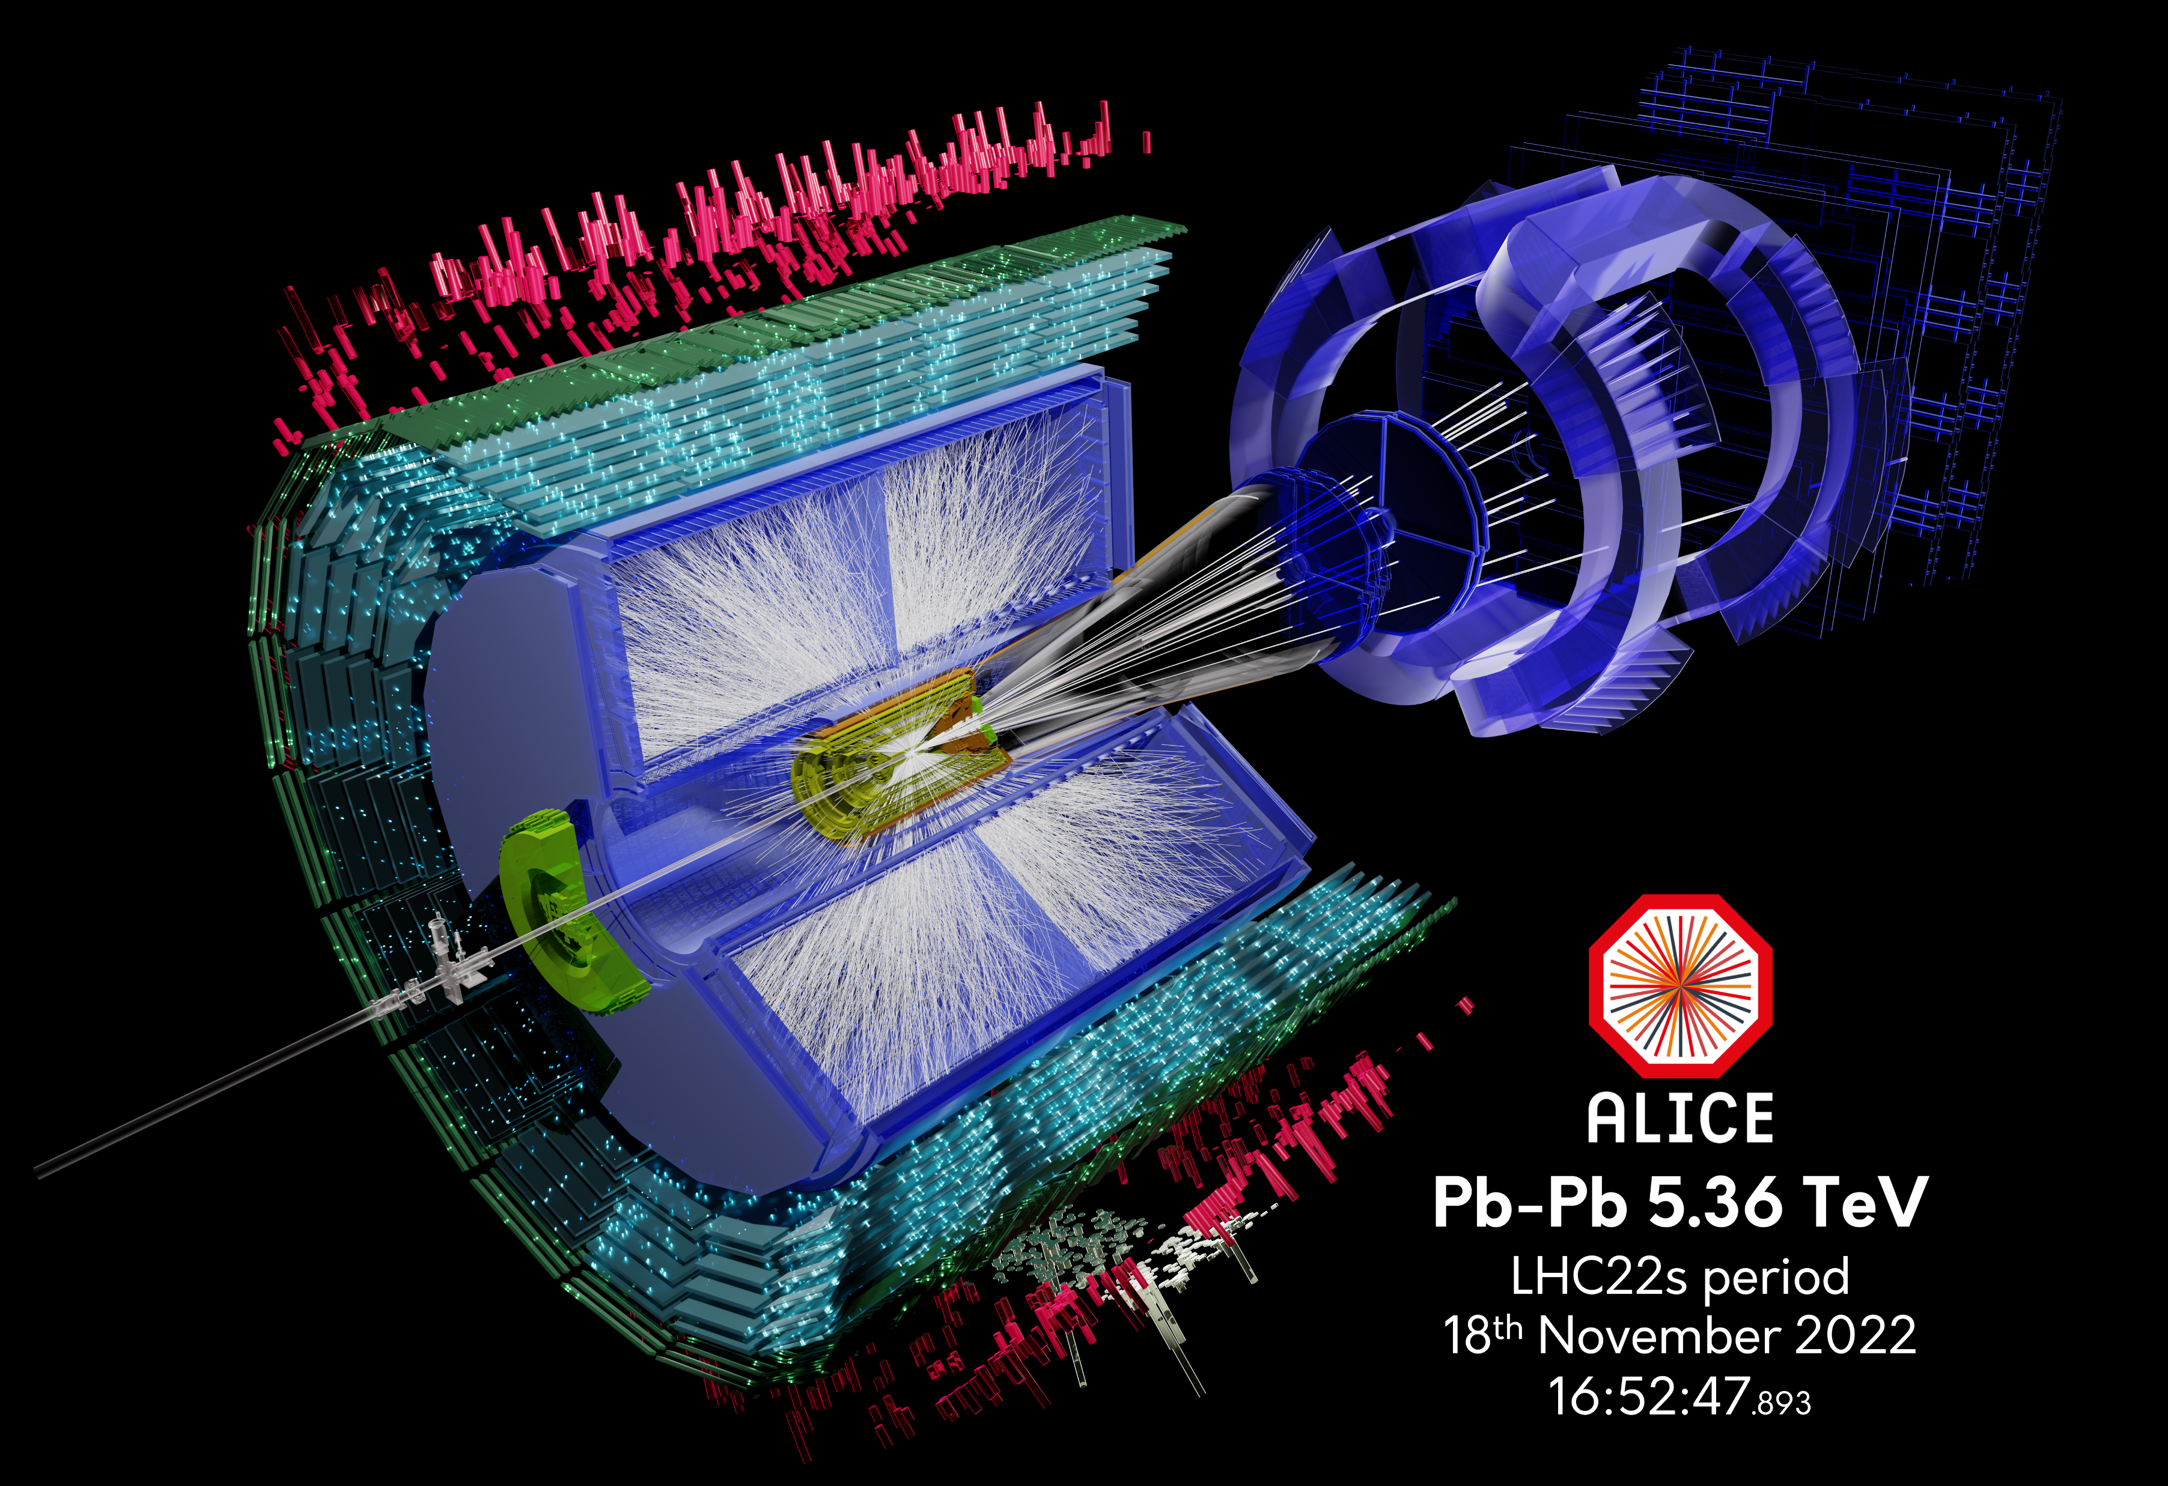


Introduction to ALICE in the LHC
John Jowett
(Formerly CERN, now ALICE, GSI group at CERN)

Slide 2
The Experiment
The collision of single lead-lead nuclei at LHC energies produces several tens of thousands of particles.
ALICE detectors measure the basic information about the majority of these particles: information on the number of particles as well as the type, mass, energy, and direction of each of the particles.
Many different subdetectors are used, each providing a separate piece of information.
From this, we can infer the existence and properties of matter under the extreme conditions created during the collision. ALICE also takes data with proton-proton, proton-lead, and collisions of other intermediate nuclei.

Slide 3
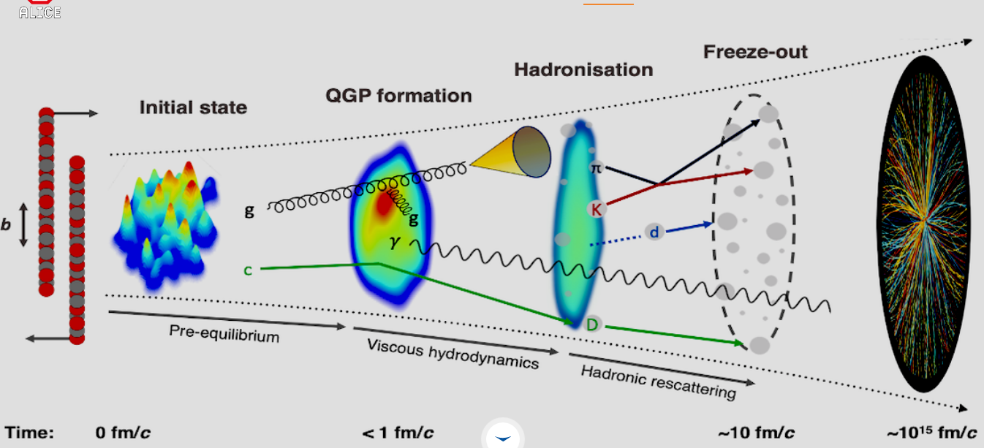
Physics of nucleus-nucleus collision
ALICE is designed to study the physics of strongly interacting matter at extreme conditions of high temperature and energy density, where a phase of matter called the quark-gluon plasma (QGP) forms. The characterization of the QGP matter require creating a sufficiently large volume of hot and dense matter and is therefore pursued in collisions of heavy nuclei at the highest possible energies at the CERN LHC.
Very rich physics, eg, the QGP is the most perfect liquid in Nature.
Under normal conditions, quarks are bound (’confined’) into composite objects called baryons (bound states of three quarks, eg proton and neutron) and mesons (bound states of a quark and antiquark pair).
Quantum Chromodynamics (QCD) predicts that at high energy density a transition occurs from ordinary nuclear matter to a plasma of free (’deconfined’) quarks and gluons – a state of matter that existed in the early Universe

Slide 4
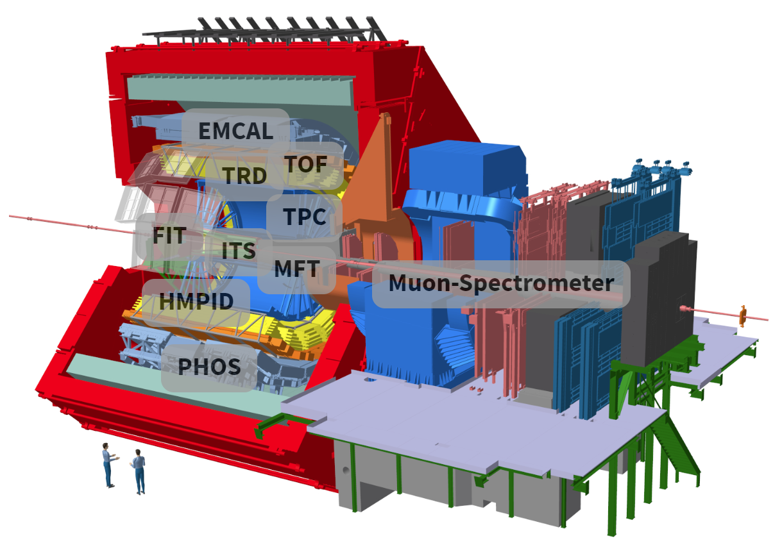
Read more at
http://alice.cern

Slide 5

LHC at CERN, Geneva area
JUAS at ESI
Circumference : 26.7 km
Max dipole field : 7.7 (8.3) T
Energy : 6.5 (7) TeV p
: 2.56 (2.76) A TeV for Pb
Species : p-p, Pb-Pb, p-Pb, Xe-Xe, …
Experiments : ALICE, ATLAS, CMS, LHCb, …

Slide 6
Goals of a collider
High collision energy: since 2015 LHC has provided
  > 13 TeV total energy in pp collisions
  > 1 PeV total (or 5. TeV per colliding nucleon pair) in Pb-Pb collisions, also p-Pb and Xe-Xe collisions
High (time-averaged) collision rate for processes of interest
More details in future lectures and seminars in JUAS Course 1
Today, we try to relate the ALICE visit to the courses on transverse beam dynamics (and MAD-X)

Slide 7
Hot and dense matter in Pb-Pb collisions at LHC
Exercise: check all these numbers
World annual electrical energy production ~ 1 mole of LHC Pb-Pb collisions
LHC is an extraordinary concentrator of energy.

Slide 8
Luminosity of a hadron collider
Parameters in luminosity
  No. of particles per bunch Ν
  No. of bunches per beam k_{b}
  No. of bunches collliding at IP k_{c}
          (k_{c} < k_{b})
  Relativistic factor γ
  Normalised emittance ε_{n}
  Beta function at the IP β *
  Crossing angle factor F
    Full crossing angle θ_{c}
    Bunch length σ_{z}
    Transverse beam size at the IP σ*
IP = “interaction point”

Slide 9
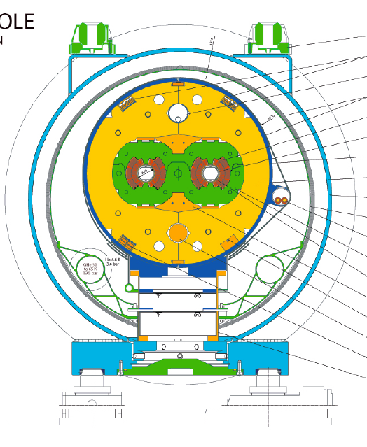
The two-in-one dipole magnet of LHC
Superconducting dipole magnet (8 T) with twin apertures, opposite fields fills most of arcs
Coils at 1.9 K
Also superconducting quadrupoles, higher multipoles, RF system
Many other systems, eg, beam collimation
More in seminars later (and in Course 2 for magnet technology)
LHC: Identical magnitude bending field in both apertures of two-in-one dipole (but opposite sign).
Arc quadrupoles are similar.

Slide 10
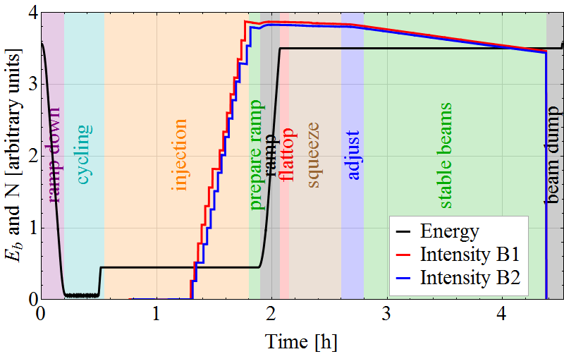
LHC Accelerator Cycle (Fill) schematic
Beam Energy
Top (max) Energy:
Store & Collide (LHC)
Low energy injection plateau:
Accumulation of beam
Acceleration
Injector cycles (e.g. PS or SPS) are analogous except that, after the ramp, beams are immediately extracted into a transfer line to the next machine rather than being collided.
A machine which ramps its magnetic fields in synchronism with a change of the RF frequency like this is called a synchrotron.

Slide 11
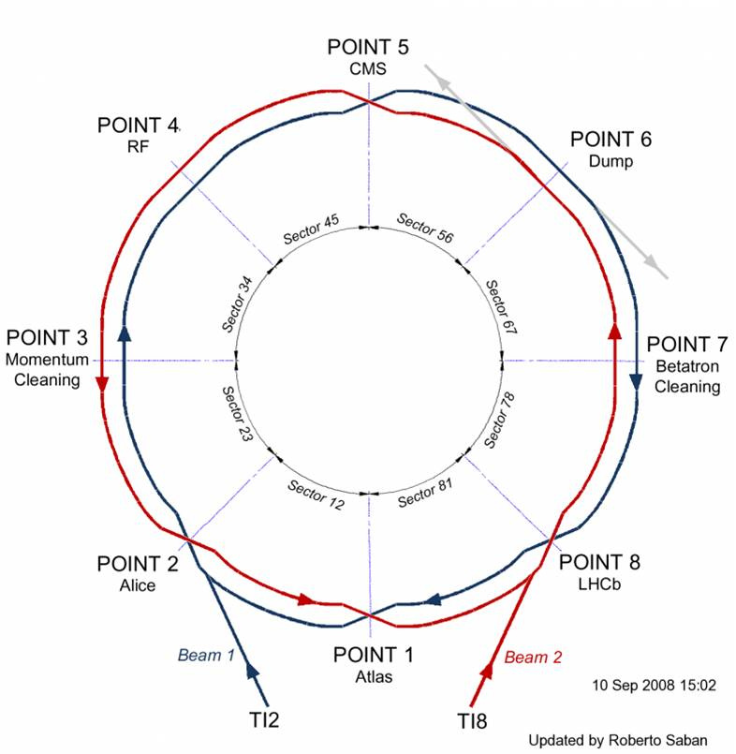
LHC orientation – schematic (1)
Four large and highly capable physics experiments:
ALICE, CMS, ATLAS, LHCb.
Beams circulate in independent beam pipes over most of circumference
Each beam has its own reference orbit in the twin-aperture magnets of the arcs but the beam pipes merge and orbits are common in interaction regions.
Interaction regions:
  IR1 (ATLAS ± 145 m)
  IR2 (ALICE ± 117 m )
  IR5 (CMS ± 145 m)
  IR8 (LHC-B ± 80 m)

Slide 12
LHC orientation – schematic (2)
s coordinate along each beam’s central orbit, clockwise from IP1
Exercise: estimate the distance between the centres of the two magnet apertures

Slide 13
Magnet polarities in the ARCS of the LHC
The two-in-one magnet design provides opposite sign fields in the two apertures
LHC beams have the same (positive) charge but are travelling in opposite directions so the bending force is always towards the centre of the ring
Similarly a horizontally focusing (F) arc quadrupole for Beam 1 (clockwise) will be a horizontally defocusing (D) quadrupole for Beam 2
So the FODO cells of the arcs will essentially have the horizontal and vertical optics switched

Slide 14
Magnet polarities in the interaction regions of the LHC
In the common interaction regions, beams pass through the same quadrupoles (~no bends)
LHC beams have the same (positive) charge but are travelling in opposite directions so a horizontally focusing (F) arc quadrupole for Beam 1 (clockwise) will be a horizontally defocusing (D) quadrupole for Beam 2
The optics cannot be the same for the two beams
Matching the optics is more complicated as it has to be done for the two beams using the same variables (strengths of common quadrupoles)
To first approximation, the IR optics are symmetric under the interchange of x and y AND left to right of the IP

Slide 15
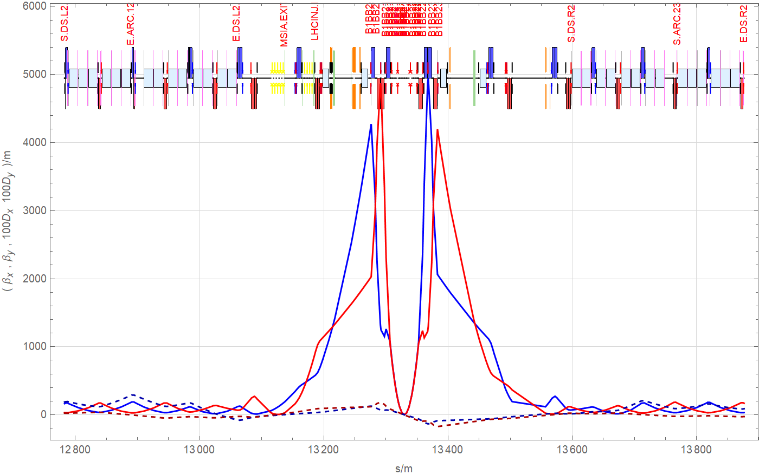
Optical functions for Beam 1 in LHC IR2, 2018 Pb-Pb run
Some common quadrupoles focus/defocus Beam 1/Beam 2.

Slide 16
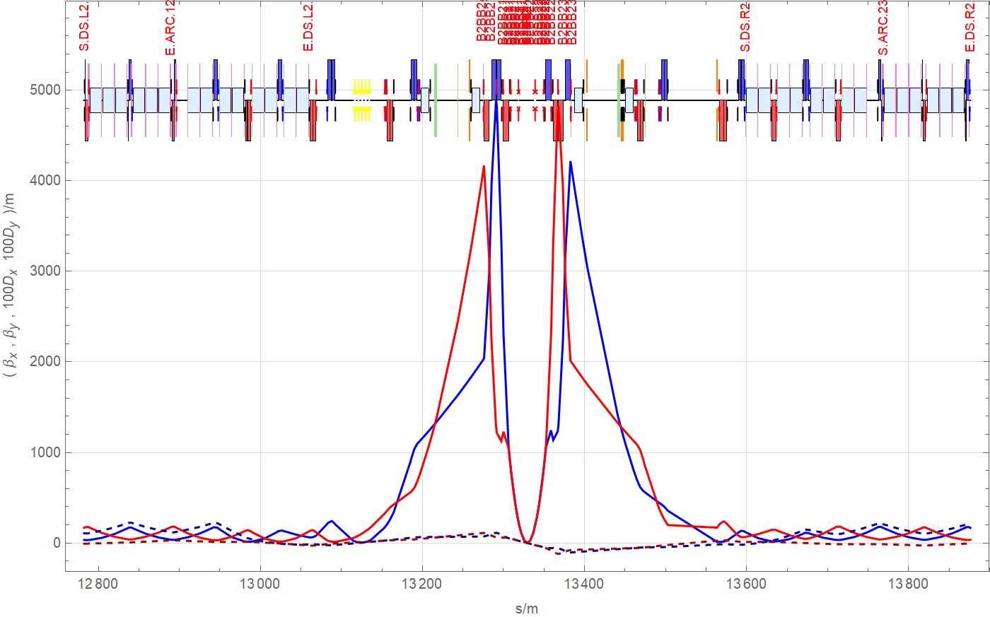
Optical functions or Beam 2 in LHC IR2, 2018
Quadrupoles in common section flip polarity (red/blue), cf previous slide for Beam 1
β-functions interchange horizontal (x) and vertical (y) (red/blue) from previous slide for Beam 1
Some common quadrupoles focus/defocus Beam 1/Beam 2.
Approximate symmetry with Beam 1 under Left <->Right and x <-> y

Slide 17
Optics modules in LHC IR2
ALICE
Arc FODO structure/ dispersion suppressor
Arc FODO structure/ dispersion suppressor
Low-β quadrupole triplets
Separation dipoles
Separation dipoles
Matching section
Matching section
Beam1 is also injected into IR2 so there are a number of special elements for that

Slide 18
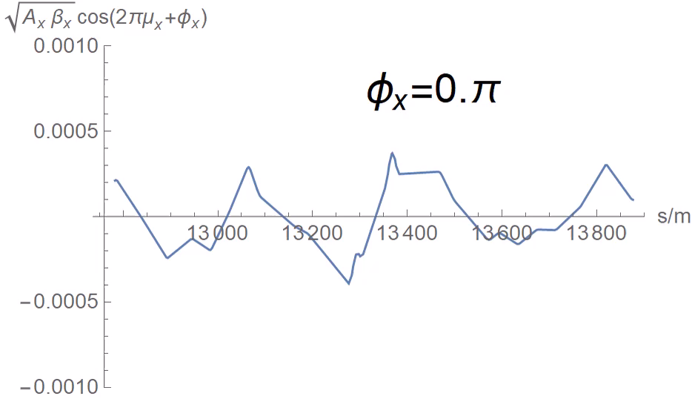
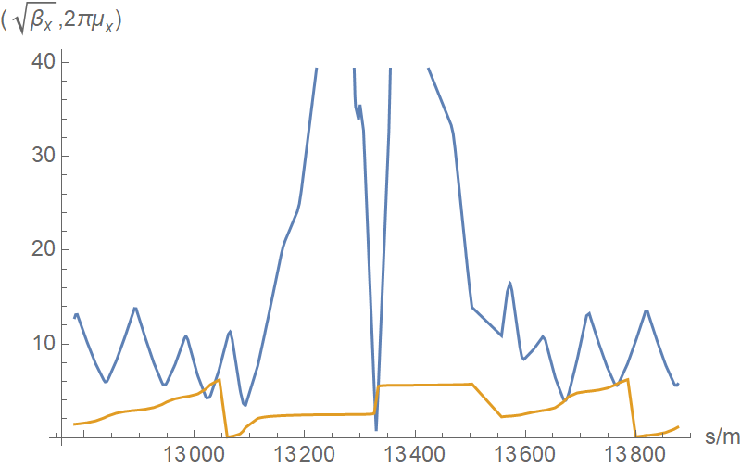
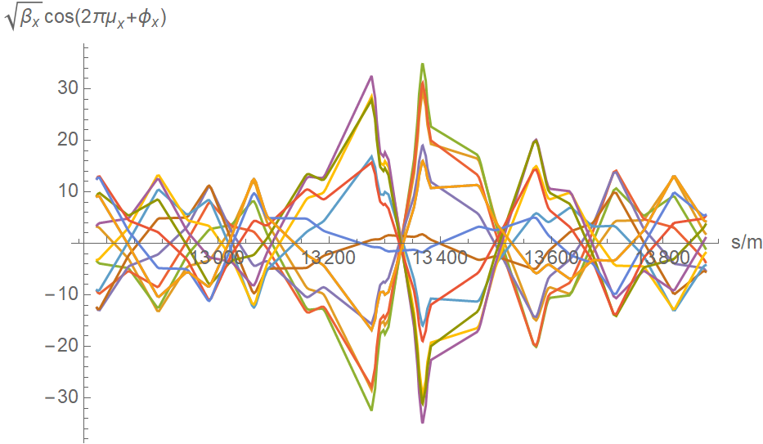
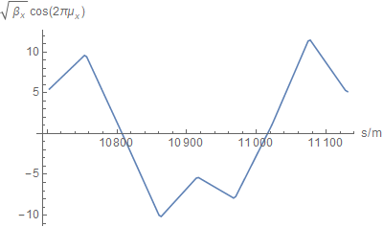
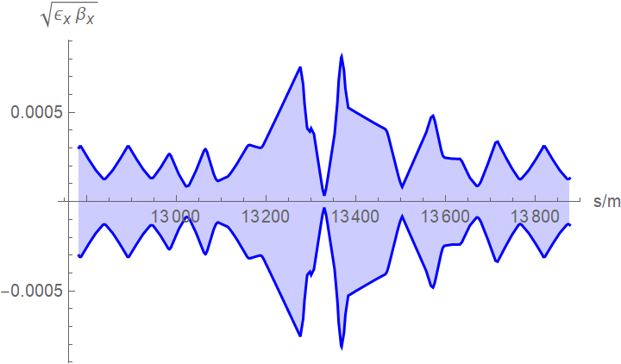
Optical functions and beam envelope in IR2
Shape of a trajectory

Slide 19
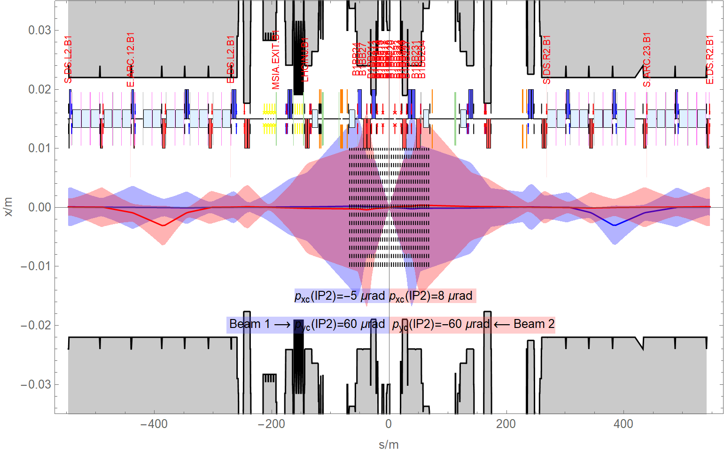
Collision conditions in LHC, IR2 horizontal plane 2018
Horizontal orbit bumps?
Aim for small β-functions at IP (called β* by convention).
Gives small beams, higher luminosity and collision rate.
Keep beam envelopes sufficiently well within beam pipe (aperture, shown in grey).

Slide 20
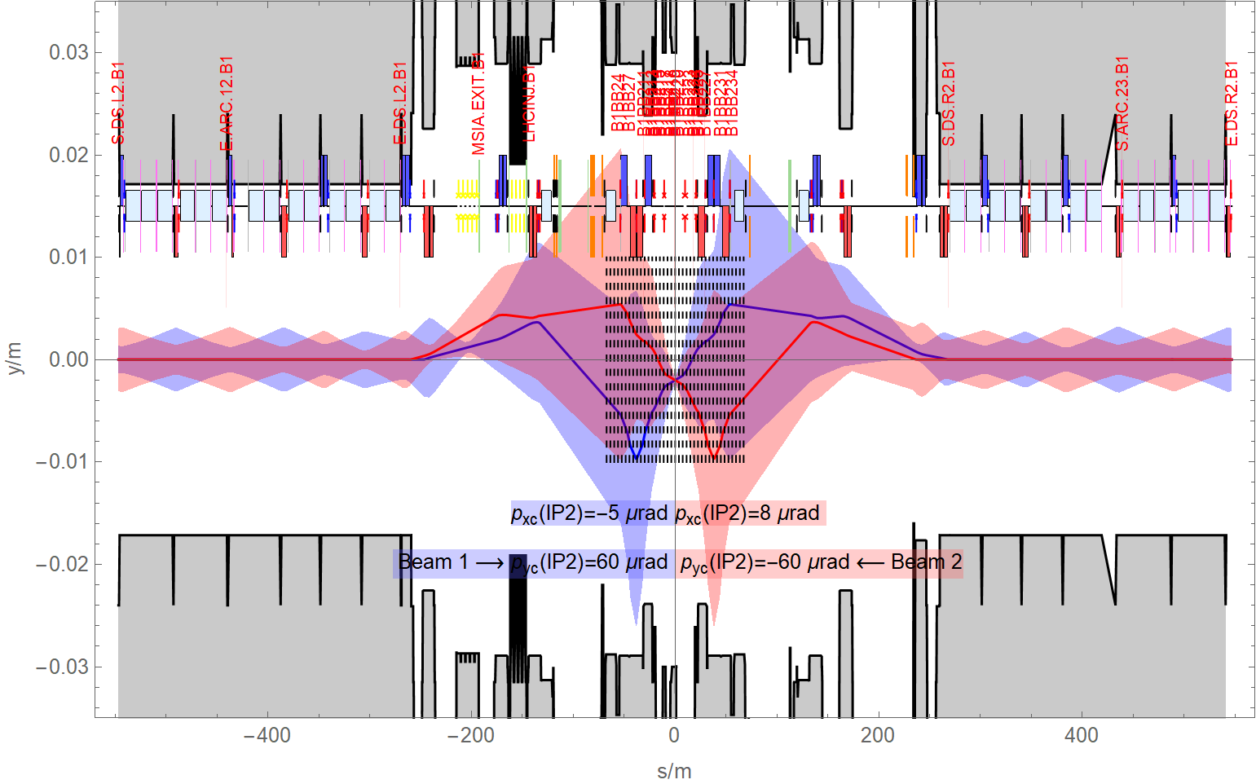
Collision conditions in LHC, IR2 vertical plane 2018
Combination of three orbit bumps (displacement from reference orbit by “small” dipole magnets called correctors, see Imperfections course later):
Compensate magnetic field of ALICE experiment spectrometer magnet
Arrange for vertical crossing angle of beams (avoid unwanted encounters)
Lower collision point by 2 mm (the experiment sank …)

Slide 21
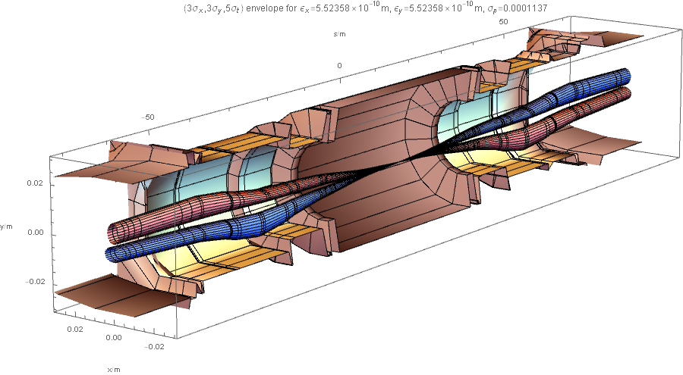
Optics for Pb-Pb collisions in ALICE
Beam envelopes around ALICE

Slide 22
Y-chamber and combined chambers in 3D

Slide 23
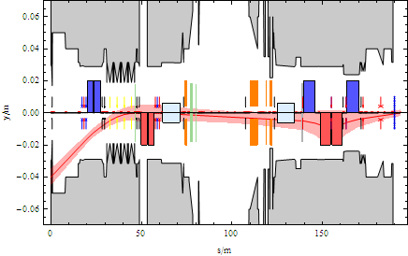
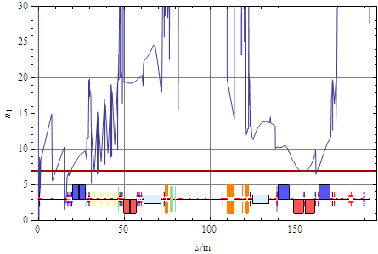
Injected beams
Moved vacuum chamber, injected beam with MKI working, 4 mm mechanical tolerance
Care must be taken to design the beam optics and the vacuum chamber to provide adequate clearance not only for circulating beams but also injected beams and various failure scenarios – protection of the LHC is a major concern.
Aperture at critical chamber markers

Slide 24
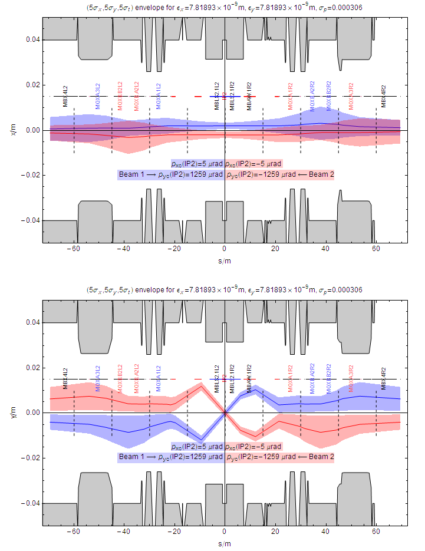
ALICE – Separation at injection, circulating beams
Crossing angle from spectrometer and external bump separates beams vertically everywhere except at IP (as also in physics).
Parallel separation also separates beams horizontally at the IP during injection, ramp, squeeze.
Beams are larger in arcs (larger geometrical emittance) but β-functions are smaller in triplets (since β*=10 m at injection).
Other experiments have different separation schemes.

Slide 25
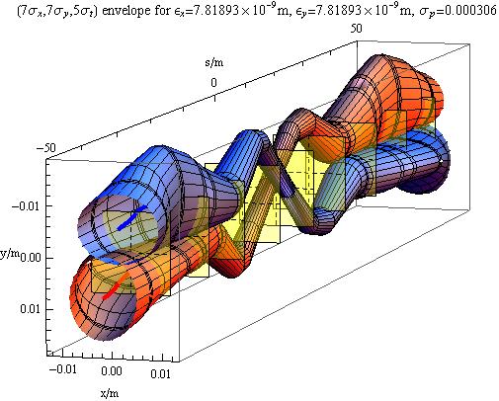
Beam envelopes around ALICE at injection
Crossing angle from spectrometer and external bump separates beams vertically everywhere except at IP (also in physics).
Parallel separation also separates beams horizontally at the IP during injection, ramp, squeeze.
Other experiments have different separation schemes …
The “ramp and squeeze” is the process of going from the injection optics at 0.45 Z TeV to the collision optics at 6.5 Z TeV through a series of matched intermediate optics).

Slide 26
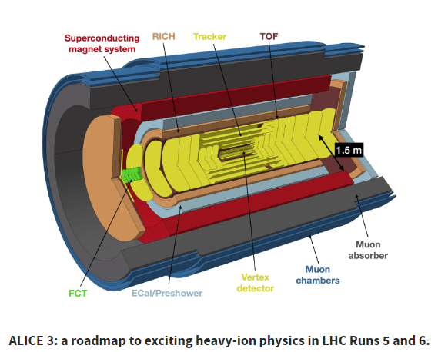
ALICE LS3 upgrades and ALICE 3
ALICE is set to be upgraded and even evolved into a new experiment, exploiting new technologies.
For the LHC Run 4 starting in the year 2029: two upgrade projects are being undertaken in ALICE:
A new Inner Tracking System (ITS3)
A Forward Calorimeter: FoCal
Beyond that, ALICE 3 is the next-generation heavy-ion experiment for
Run 5 of the LHC and beyond.

Slide 27
Summary
With a quick tour of the LHC, and the ALICE interaction region in particular, we have tried to show how the concepts from the transverse beam dynamics and optics courses give you the concepts and tools to understand a real-world hadron collider.
Much more about the LHC and other colliders in seminars tomorrow.

Slide 28
BACKUP SLIDes

