Slide 1
EIC Accelerator New Technologies and Challenges
Todd Satogata, Jefferson Lab
For the EIC Project and EIC Collaboration
JUAS Lecture
24 January 2023
EIC:
Notes:
Kierkegaard book, but Descartes!

Slide 2
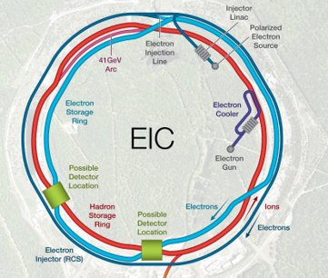
Outline
The EIC accelerator
  Requirements and present design
Accelerator technology challenges
Some project technology R&D
Luminosity limiting factors
Collider luminosity experience

Slide 3
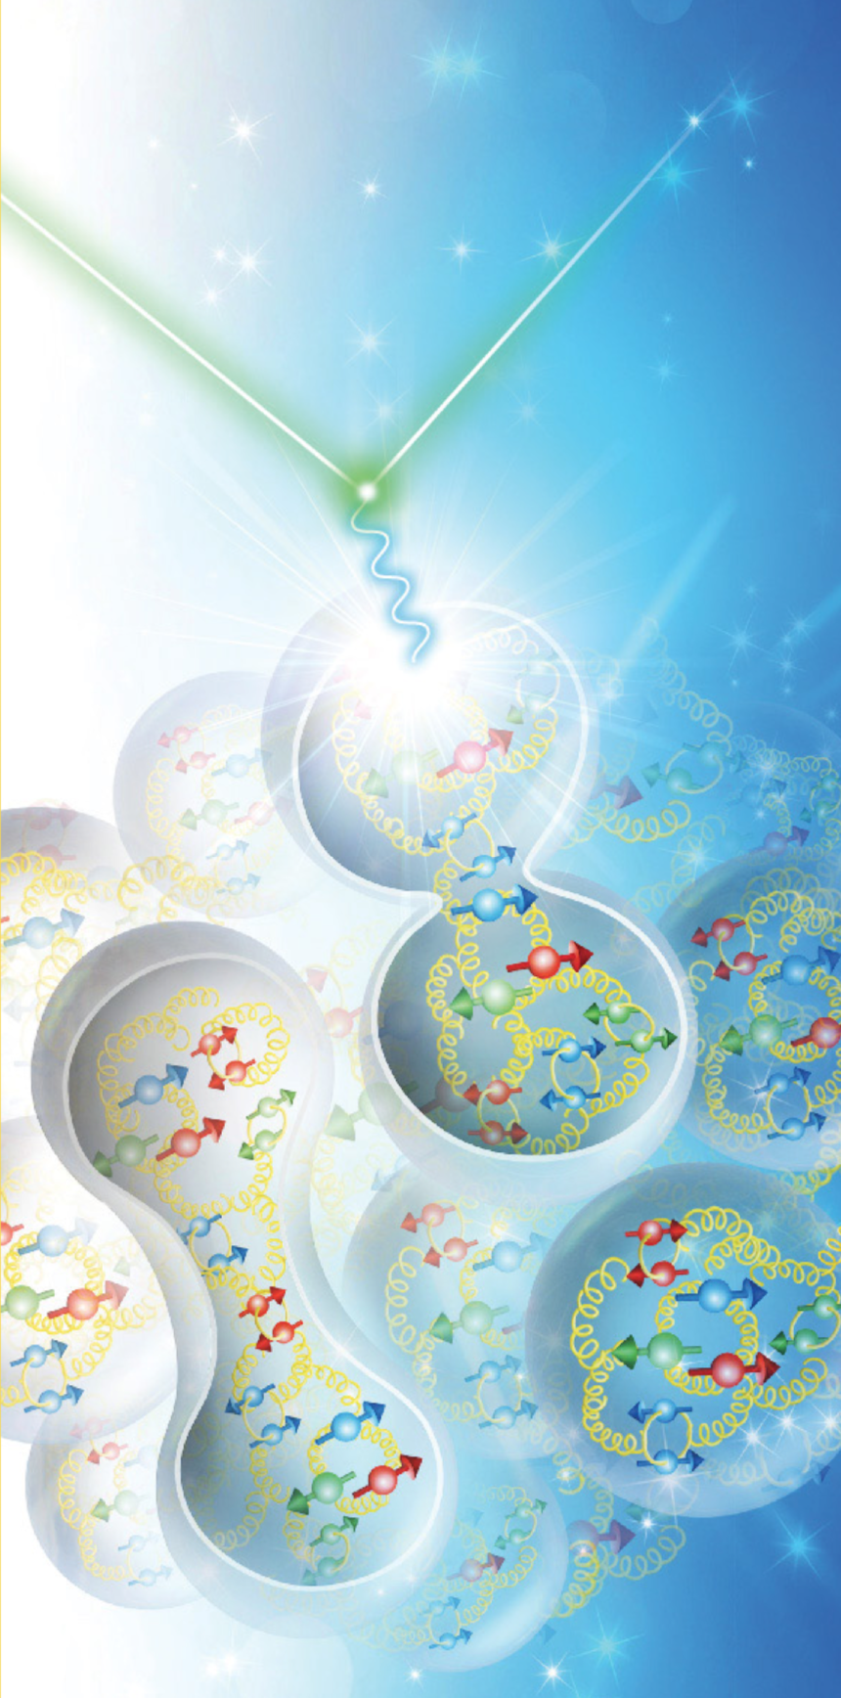
“Not Like The Others” (LHC, FCC...)
Scattered
electron
The electron-ion collider (EIC) is:
  a nuclear physics (NP) collider
    nuclear physics scattering experiments
    includes “deep inelastic” scattering, or EM-intermediated scattering of electrons and partons
    collective and single-particle effects in the strong interaction sector
  NOT a high-energy physics collider
Addresses three fundamental nuclear physics questions:
  How does nuclear mass arise?
  How does nuclear spin arise?
  What are emergent properties of dense gluon systems?
intermediate
photon
Nuclear
matter
Ultimately, nuclear tomography

Slide 4
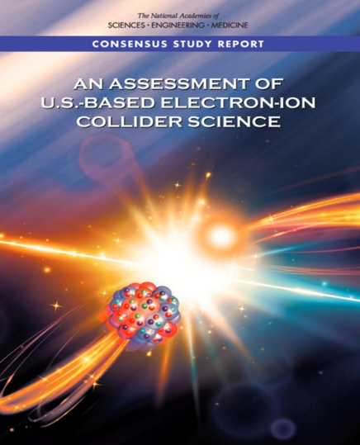
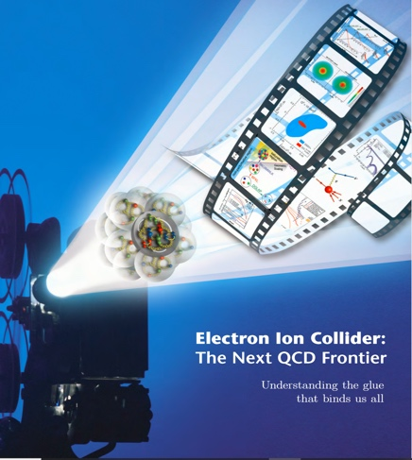

EIC Requirements
EIC design goals
  High luminosity: L = (0.1-1)∙10³⁴ cm⁻² s⁻¹
    ➔ 10-100 fb⁻¹
  Collisions of highly polarized (>70%) e and p (and light ion) beams
    with flexible bunch by bunch spin patterns
  Large range of CM energies:
    E_{cm} = 20-140 GeV
  Large range of ion species:
    Protons – Uranium
  Ensure accommodation of a second IR
  Large detector acceptances; good background
    Hadron particle loss
    IR synchrotron radiation backgrounds

Slide 5
EIC Requirements
EIC design goals
  High luminosity: L = (0.1-1)∙10³⁴ cm⁻² s⁻¹
    ➔ 10-100 fb⁻¹
  Collisions of highly polarized (>70%) e and p (and light ion) beams
    with flexible bunch by bunch spin patterns
  Large range of CM energies:
    E_{cm} = 20-140 GeV
  Large range of ion species:
    Protons – Uranium
  Ensure accommodation of a second IR
  Large detector acceptances; good background
    Hadron particle loss
    IR synchrotron radiation backgrounds
“High”
Unique
uniquely
challenging
“Low”
Diverse

Slide 6
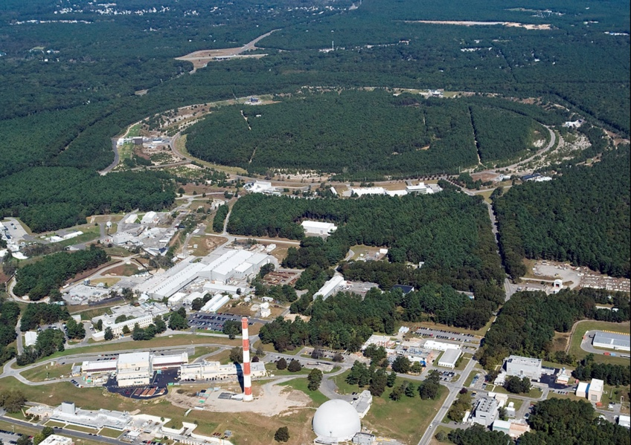
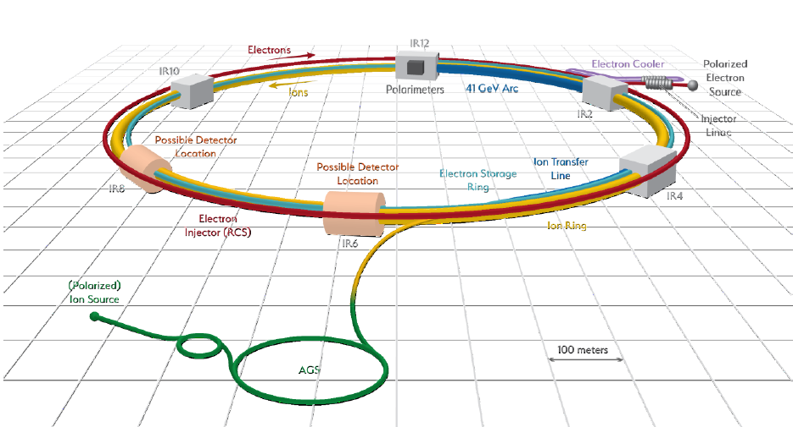
EIC Accelerator Design Overview
RHIC
Hadron storage ring (HSR): 40-275 GeV (existing)
  up to 1160 bunches, 1A beam current (3x RHIC)
  bright vertical beam emittance (1.5 nm); new vac sleeves
  strong cooling (coherent electron cooling, ERL)
Electron storage ring (ESR): 2.5–18 GeV (new)
  up to 1160 polarized bunches
    high polarization by continual reinjection from RCS
  large beam current (2.5 A) ➔ 9 MW SR power
  superconducting RF cavities
Rapid cycling synchrotron (RCS): 0.4-18 GeV (new)
  2 bunches at 1 Hz; spin transparent due to high periodicity
High luminosity interaction region(s) (new)
  L = 10³⁴ cm⁻²s⁻¹ = 10 kHz-uba, superconducting magnets
  25 mrad crossing angle with crab cavities
  spin rotators (produce longitudinal spin at IP)
Comparable to new mature
B-factory, e.g. SuperKEKB
EIC

Slide 7
Luminosity (Lumi) Limits In One Slide™
Maximize collision frequency (~90 MHz)
  Limited by kicker rise times
  Limited by parasitic collisions (crabbing)
Maximize particles per bunch (~10¹¹)
  Limited by sources, space charge
  Limited by collective effects
    Interaction of beam with impedances
    Also total currents: I_{1,2}=q_{1,2}N_{1,2}f_{coll} ~1-3A
Minimize beam sizes at IP (~250/25 um)
  Limited by IR focusing, magnets
  Limited by chromatic dynamic aperture
  Limited by emittance growth (IBS)
Every parameter optimized
separately and collectively in the
EIC design
Try multiplying out the given numbers –
should be very close to 10³⁴ cm⁻²s⁻¹

Slide 8
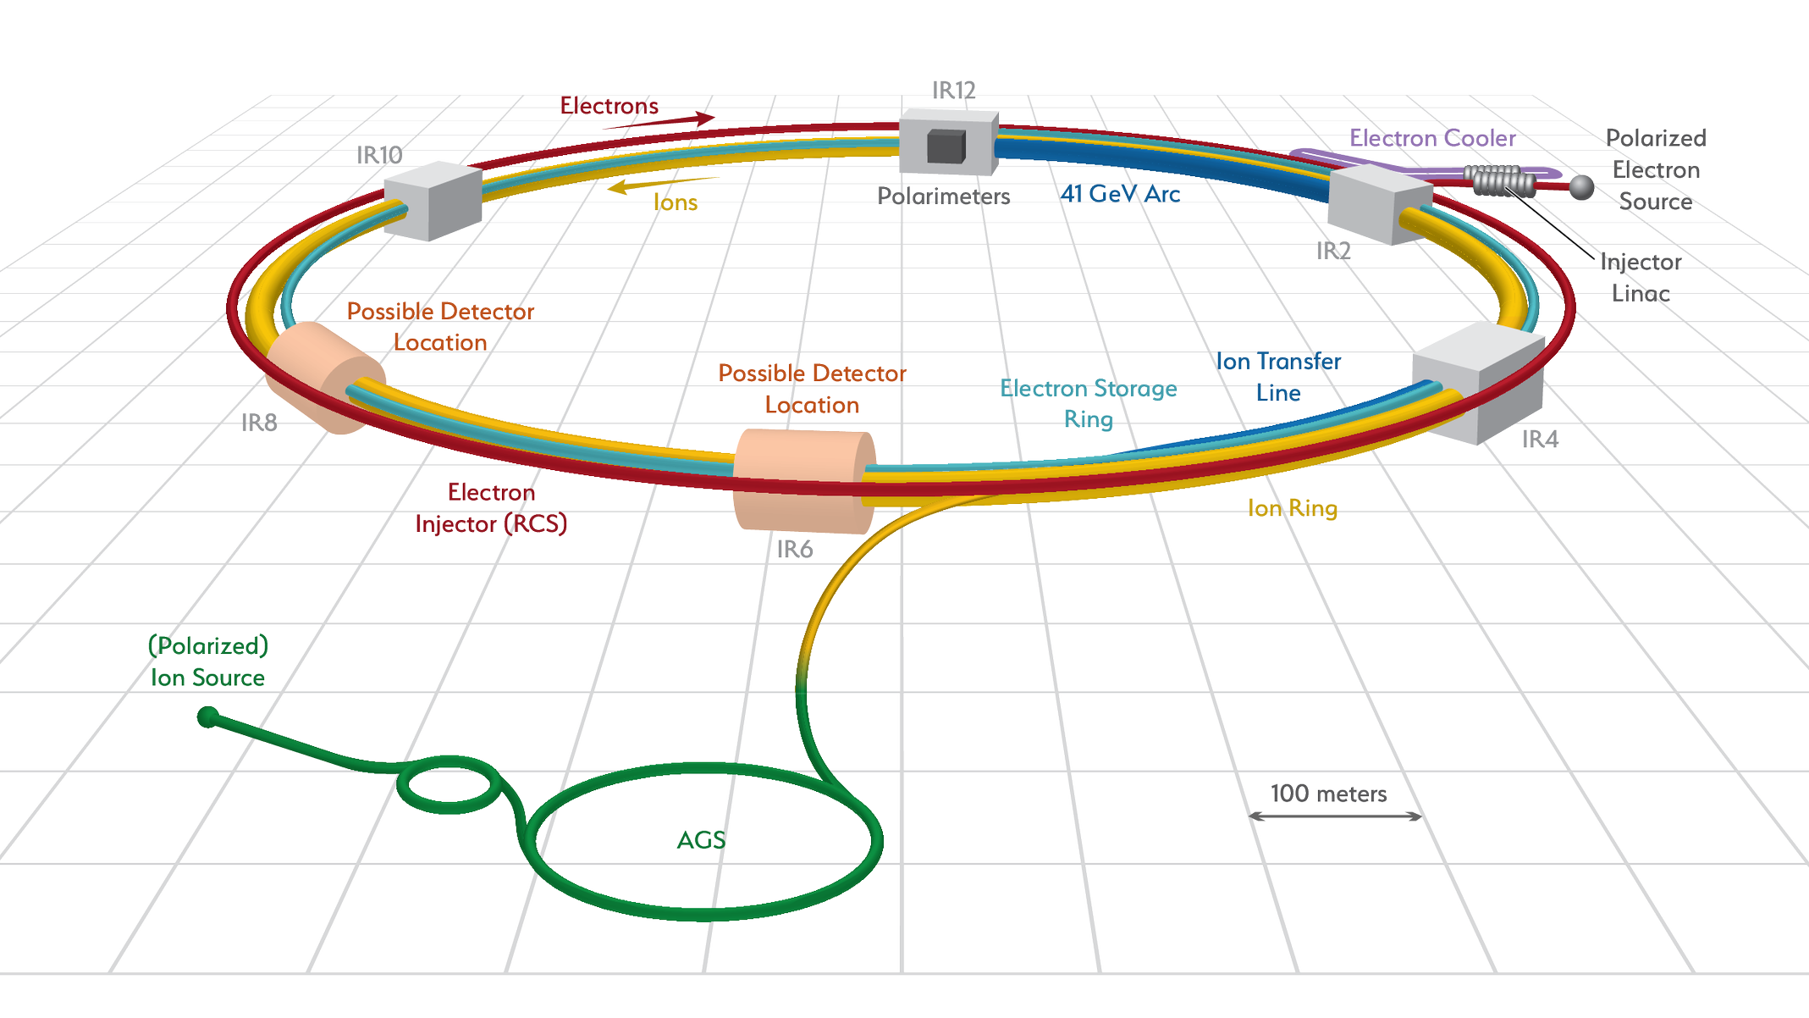
EIC Accelerator Technology Challenges, R&D
Existing tunnel and
experiment halls
ESR
Vacuum R&D
Electron Injection
Fast Kicker
Hadron Polarimetry
Cooler Electron Source
ESR Cavity
Prototype
HSR Vacuum Upgrade
ESR RF 500kW FPC
2nd IR
Polarized e⁻ Source
ePIC
ESR RF HOM Damper
Crab Cavity
Prototype
Proton Injection
Fast Kicker
IR Vacuum Chamber
IR Design and Magnet Prototyping

Slide 9
EIC Accelerator Technology Challenges, R&D
Existing tunnel and
experiment halls
ESR
Vacuum R&D
Electron Injection
Fast Kicker
Hadron Polarimetry
Cooler Electron Source
ESR Cavity
Prototype
HSR Vacuum Upgrade
ESR RF 500kW FPC
2nd IR
Polarized e⁻ Source
ePIC
ESR RF HOM Damper
Crab Cavity
Prototype
Proton Injection
Fast Kicker
IR Vacuum Chamber
IR Design and Magnet Prototyping

Slide 10
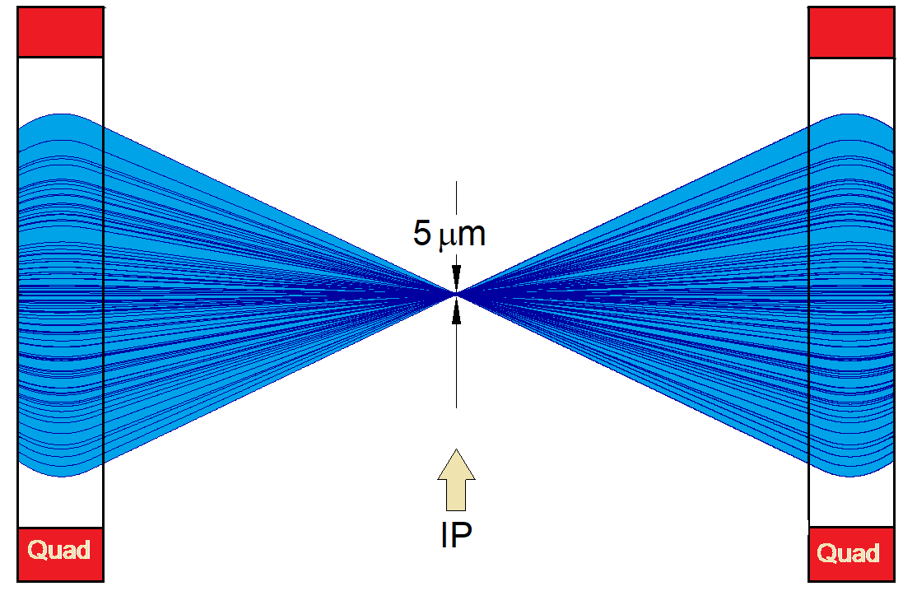
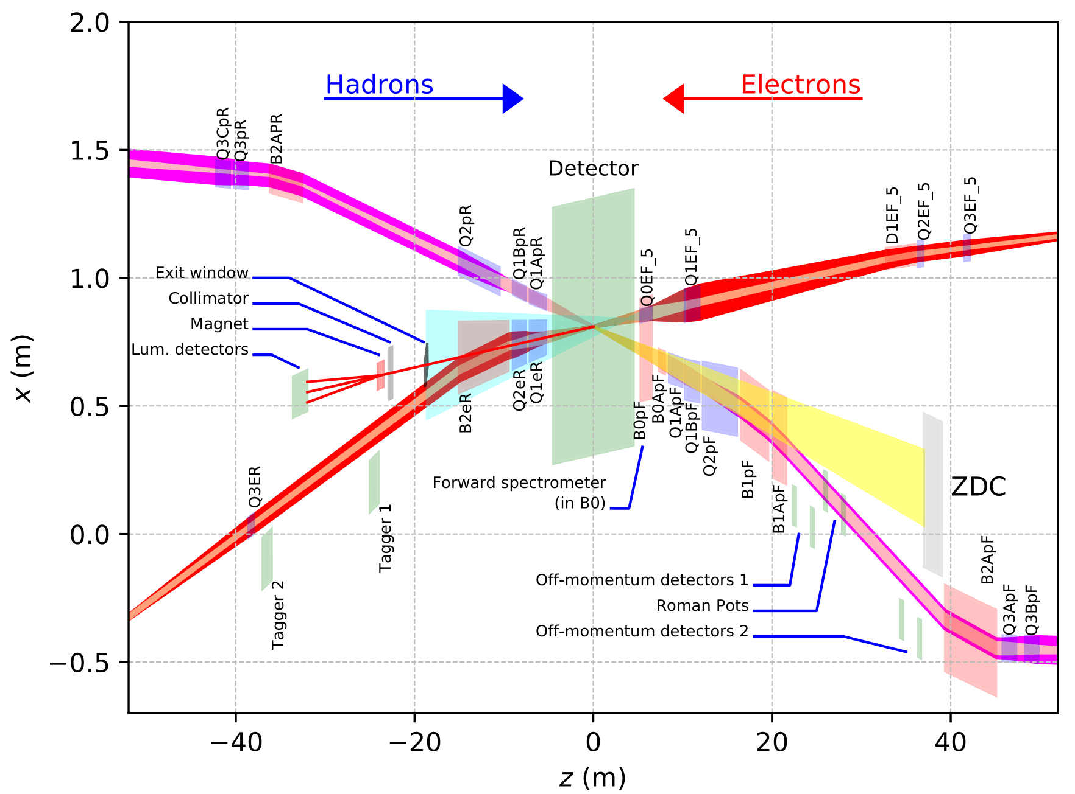
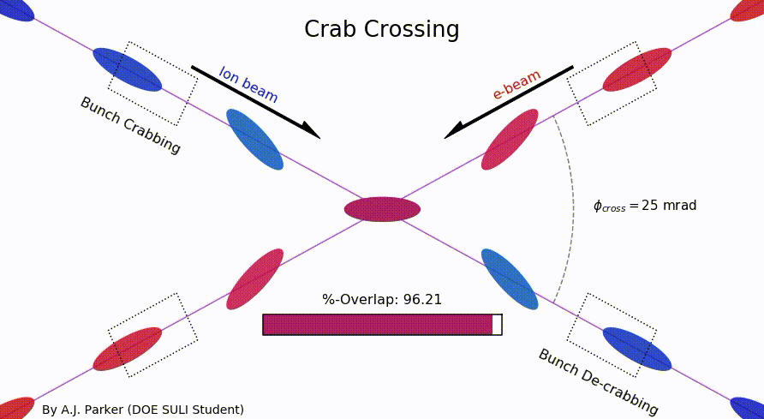
EIC Primary Interaction Region
Existing tunnel and
experiment halls
Focusing (quads)
as close to IP as
possible (~5m!)
Tensions in magnet
requirements:
high field
large apertures
e/p magnet
proximity near IP
Chromaticity:
focusing dependence
on particle energy
”Rear side”
Different
axis scales!
”Forward side”
25 mrad crab crossing
A. Parker (SULI)
D. Higinbotham

Slide 11
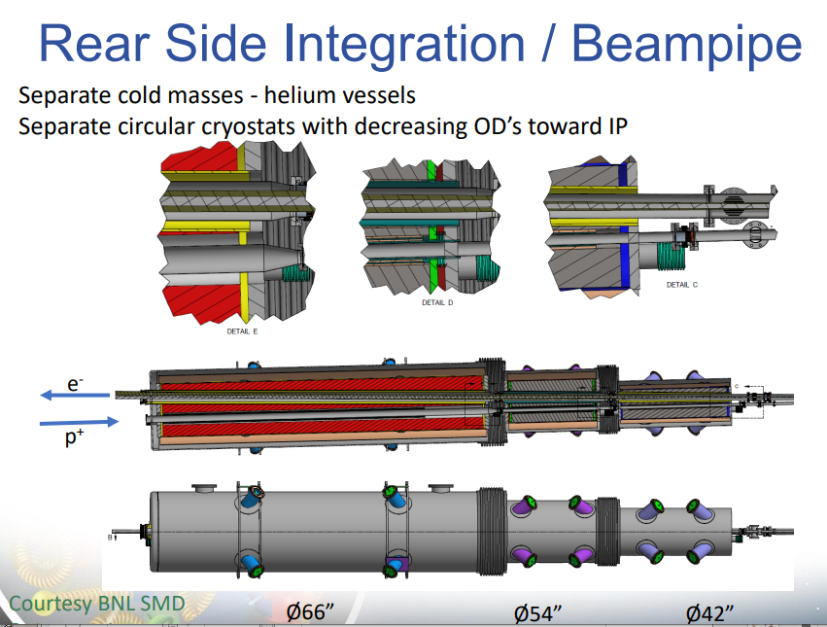
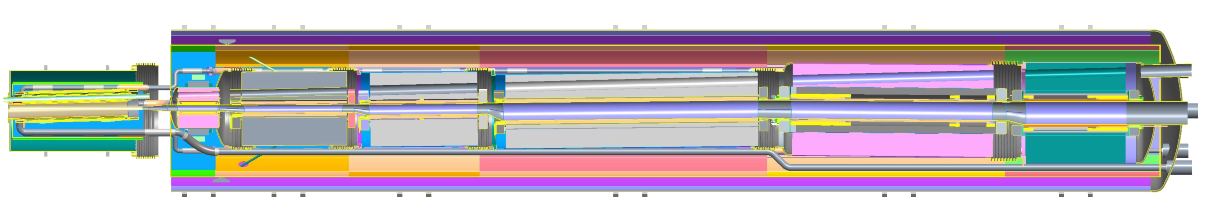
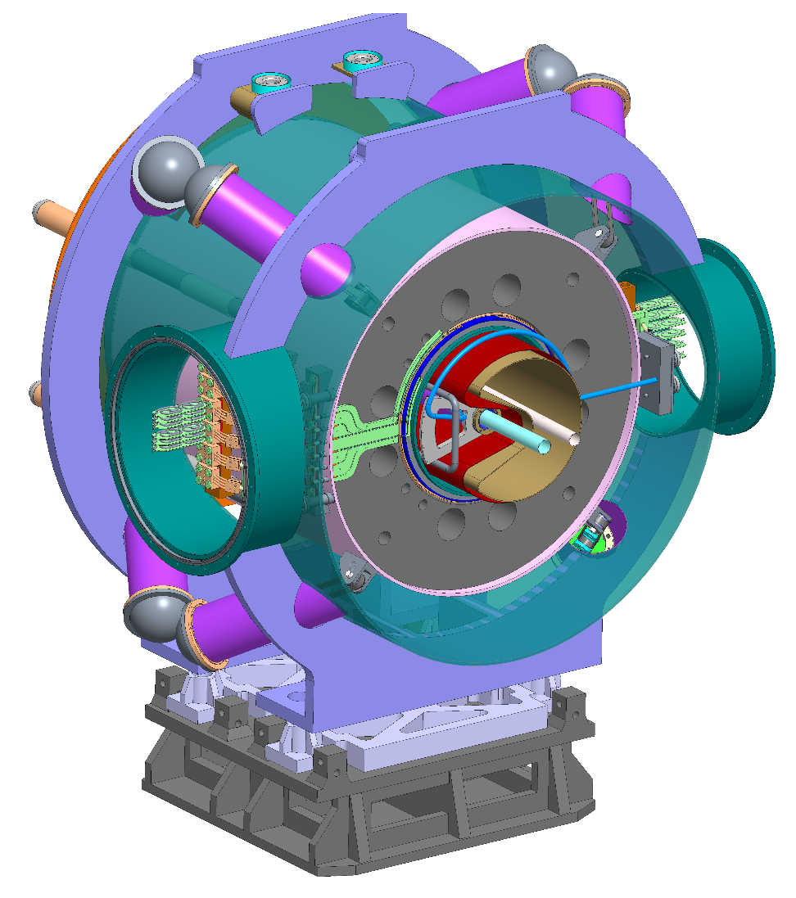
EIC R&D: IR Superconducting Magnets
Forward superconducting magnet integration
Multiple function spectrometer magnet at the forward hadron side

Slide 12
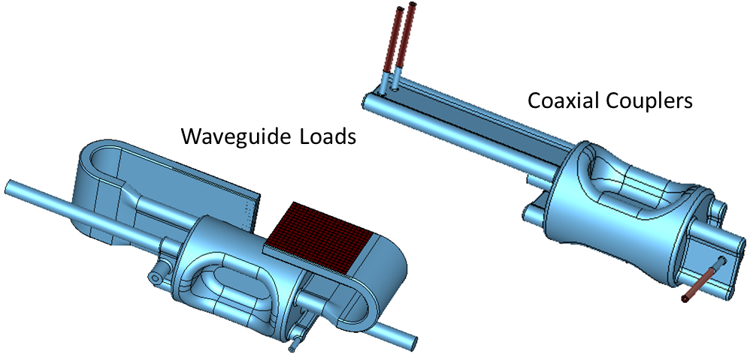
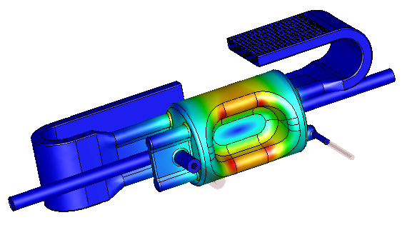
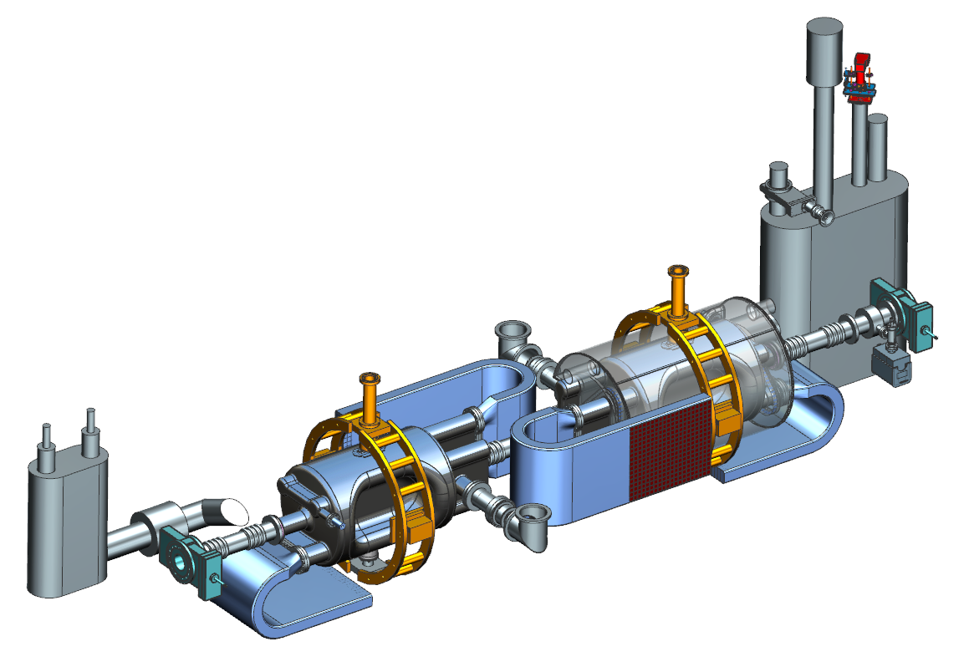
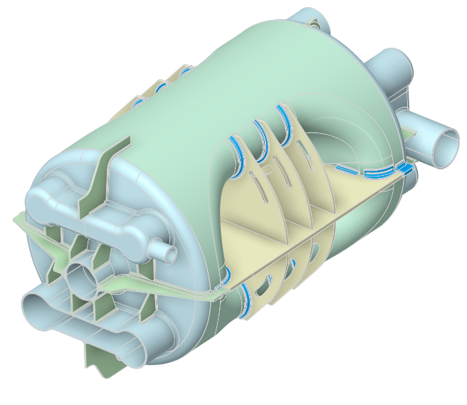
EIC R&D: Crab Cavities
Higher Order Mode (HOM) damping schemes
Hadron collider crabbing unprecedented
  Collaborating with HL-LHC
    Beam dynamics, RF control stability
    SPS tests: Phys. Rev. Accel. Beams 24, 062001 (2021)
  Electron crabbing was performed at KEKB (arXiv:1410.4036)
Superconducting “RF dipole” cavity
  ODU design
  High electric field and overall field quality requirements
197 MHz HSR crab cavity being prototyped
  Jefferson Lab/ODU/(BNL) collaboration
  Two possible HOM damping schemes: Waveguide loaded and coaxial couplers
  Stress analysis near completion, with stiffeners
RF Design
Preliminary Cryomodule Design
(2 cavities per HSR cryomodule)
Stiffeners

Slide 13
Electrons and Hadrons in Synchrotrons (EIC)
Electrons
  Larger charge/mass ratio
    Smaller B to bend/focus (E, crab)
    Normal conducting magnets
    Polarization time dependence
  Synchrotron radiation
    Photonic backgrounds
    Damping
    Dynamic aperture: Touschek
    Large RF power needs
    Flat beam aspect ratio
  Harder collimation (multi-stage)
Hadrons
  Smaller charge/mass ratio
    Larger B to bend/focus (E, crab)
    Superconducting magnets
    No depolarization (in principle)
  No synchrotron radiation
    Hadronic backgrounds
    Negligible damping (EIC energies)
    Dynamic aperture: “Diffusion”
    Modest RF power needs
    Round beam aspect ratio
  Easier collimation (single-stage)

Slide 14
Lumi Limits In (more than) One Slide^{NoTM}
Maximize collision frequency (~90 MHz)
  Limited by kicker rise times
  Limited by parasitic collisions (crabbing)
Maximize particles per bunch (~10¹¹)
  Limited by sources, space charge
  Limited by collective effects
    Interaction of beam with impedances
    Also total currents: I_{1,2}=q_{1,2}N_{1,2}f_{coll} ~1-3A
Minimize beam sizes at IP (~250/25 um)
  Limited by IR focusing, magnets
  Limited by chromatic dynamic aperture
  Limited by emittance growth (IBS)
Challenge: colliding asymmetric beams
electrons: flat
hadrons: round
SuperKEKB: 10 um x 50 nm, 200:1!
EIC collision point: 11:1 transverse aspect ratio

Slide 15
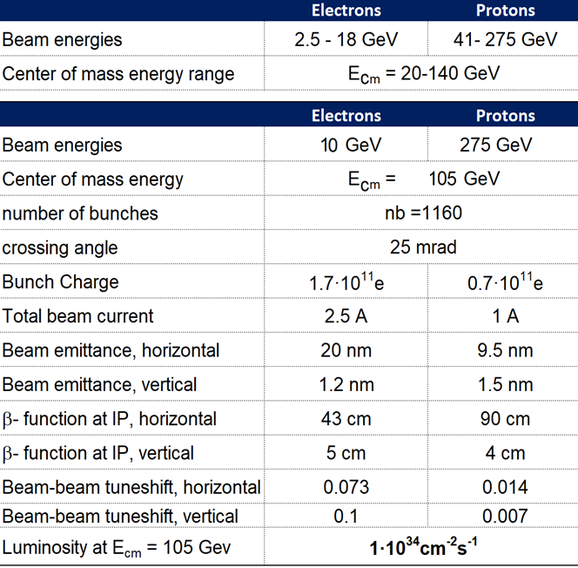
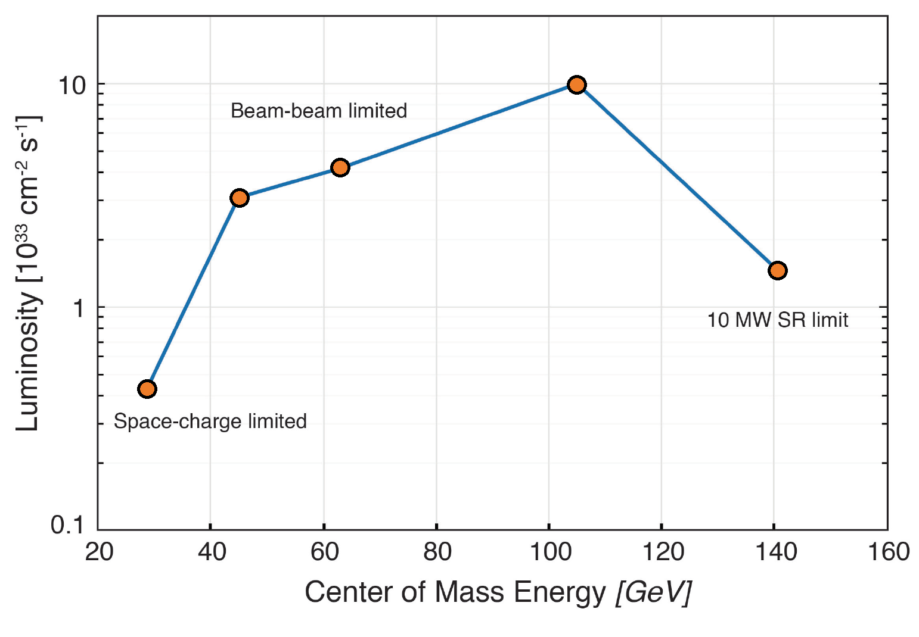

EIC CDR (CD-1) Parameters for E_{cm} and Luminosity
Beam-beam limited
beam size lumi scaling
10 MW SR limited
Space charge limited
5
5
10
10
e [GeV]
18
41
100
100
275
p [GeV]
275

Slide 16
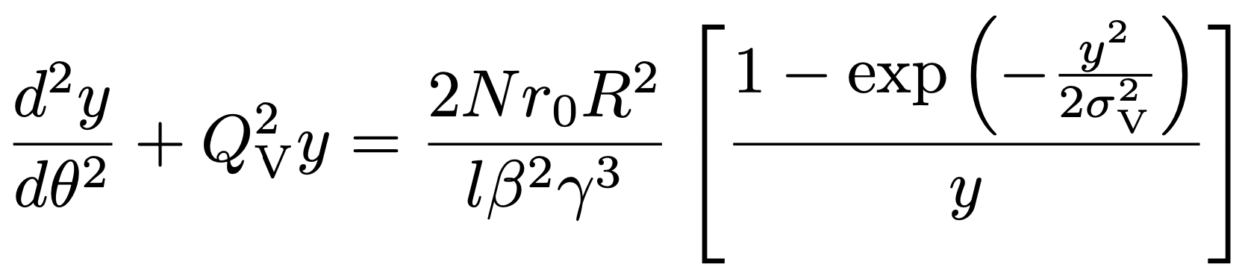
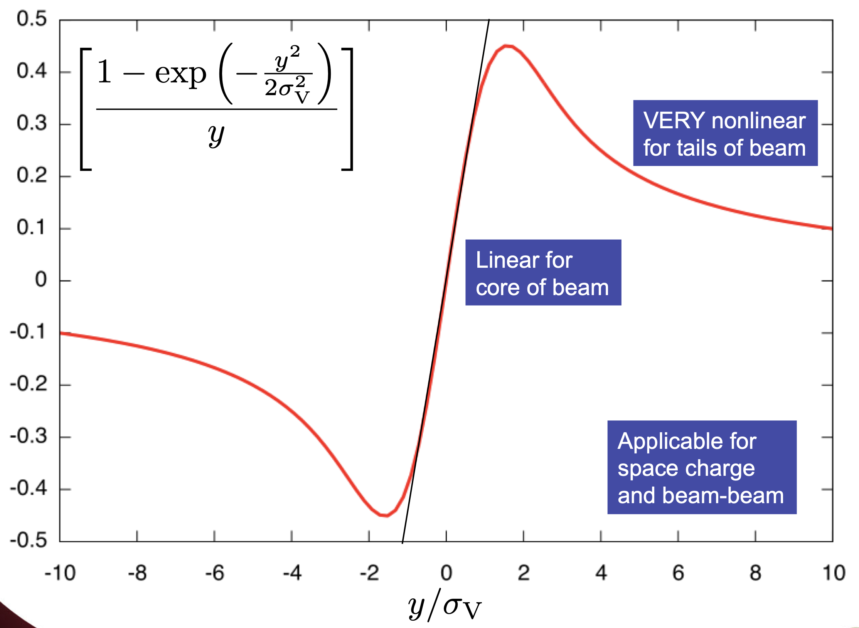
Lumi Limitations: Space-Charge (low E_{cm})
Dense charged particle bunches electrostatically repel in rest frame
Creates nonlinear space charge force and equation of motion in lab frame
Fortunately scales with 1/γ³ so worst at low energies
  Great example of time dilation
  Limits high-intensity injector emittances
  Force applies continuously within beam
Tolerable linear “space charge tune spread” of 0.05 limits total current of 41 GeV proton beam to ~0.4A.
(IBS: intra-beam hard scattering also contributes)

Slide 17
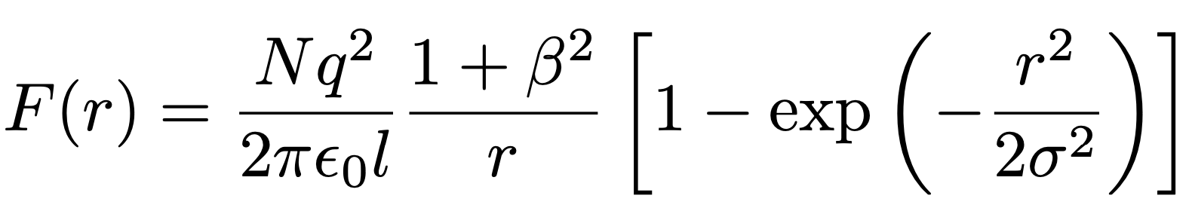
Lumi Limitations: Beam-Beam (mid E_{cm})
Colliding beams see each other’s collective charge distributions
Creates nonlinear beam-beam force and equation of motion similar to space charge
  BUT now the fields and force are in the lab frame already
  NO benefit of relativistic scaling
  Force applies only once per turn
Tolerable “beam-beam tune spead” of 0.015 limits highest EIC luminosity

Slide 18
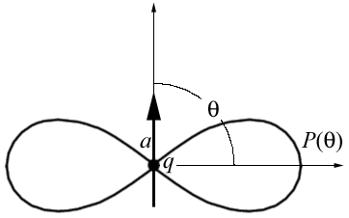
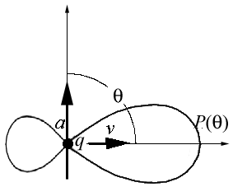
Lumi Limitations: Electron SR Power (high E_{CM})
Accelerated charged particles emit photons
  Electrons in synchrotron: radially accelerated
  Synchrotron radiation emitted in forward cone
    Cone opening angle
    Radiated power
  scaling much worse for electrons
    18 GeV e: =3.5x10⁴ vs 255 GeV p: =3x10²
Design: 9 MW @ 18 GeV (facility limit 10 MW)
Expensive: Power must be provided by SRF
Raise electron energy last (e current limit)
Dipole Radiation
Perpendicular to charge acceleration
Radial
acceleration
Relativistic Boost
Synchrotron Radiation
Relativistically boosted dipole radiation

Slide 19
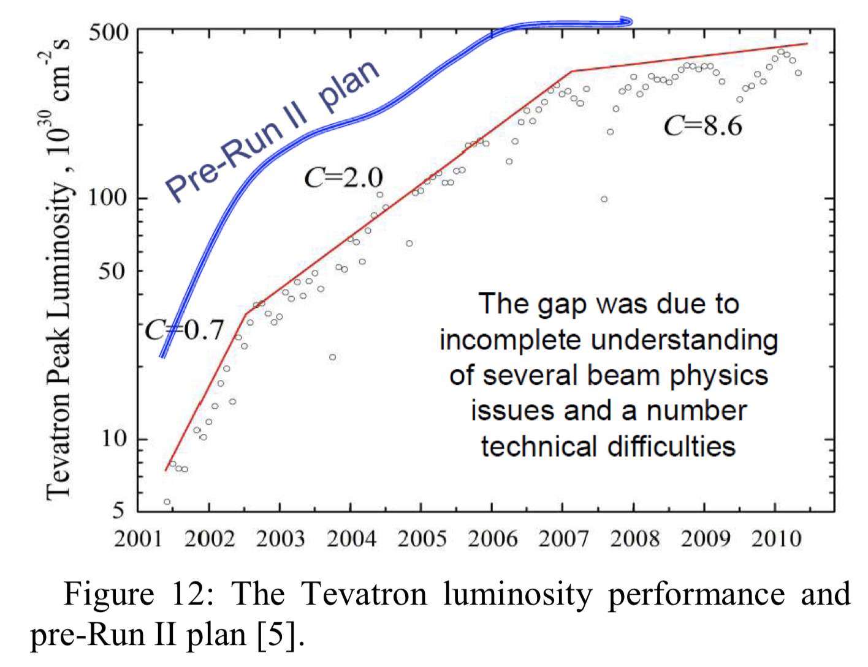
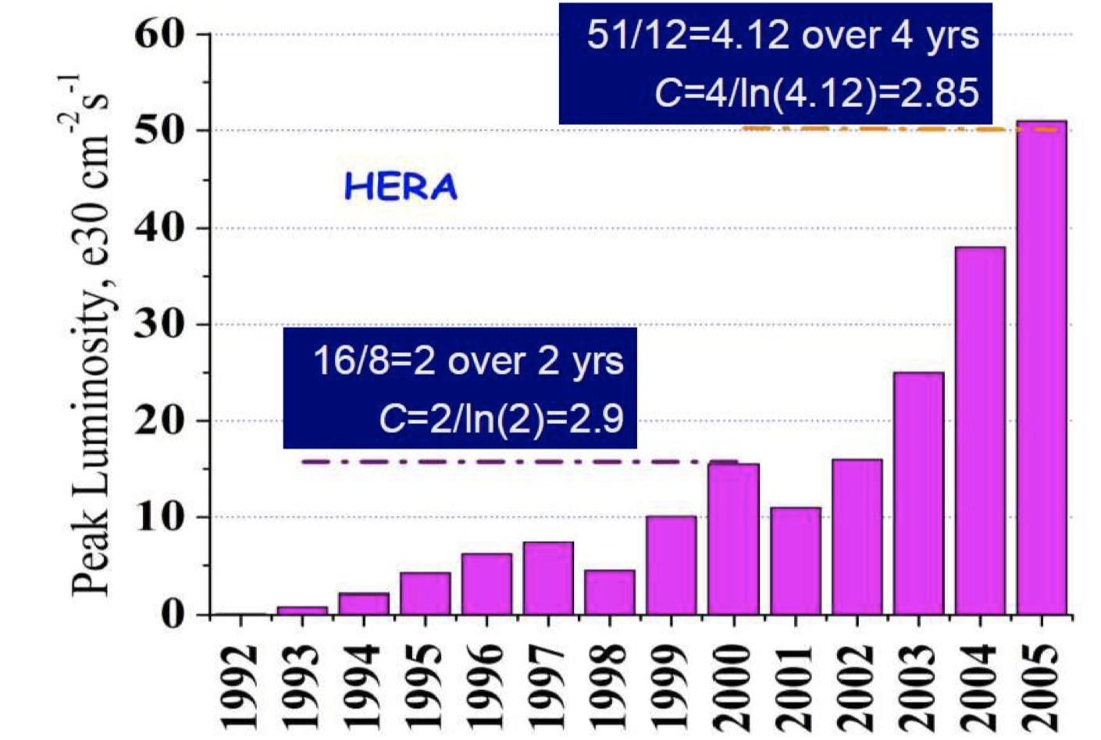
Collider Luminosity Ramp-Up
Tevatron Run-II: design 275x10³⁰
Luminosity ramp-up to design takes years
  Useful paper: arxiv 1202.3950 (V. Shiltsev)
  Contextualizes Tevatron Run-II and early LHC
  Luminosity ramp-up parameter C: complexity
    C: time (years) to increase lumi by e
    C=2: factor of e luminosity increase in 2 years
  Early commissioning can make quick strides
    C<1 (or <<1) but do not get too exuberant
  Long-term commissioning usually C~2-3
EIC will very likely take years to reach design luminosities
  But we will get there!
HERA: design 15x10³⁰

Slide 20

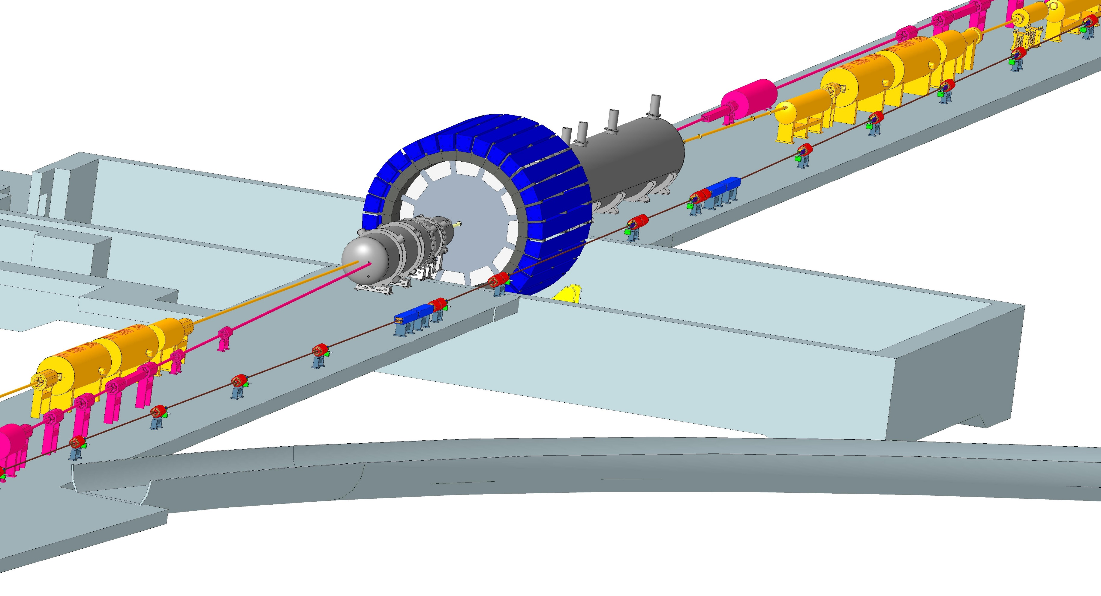
Summary
July 28-30, 2022 (BNL)
EIC design meets all design requirements
EIC luminosity is highly optimized
  Balances several individual parameter optimizations
EIC R&D progressing
  Focus: challenging technical components
e/p beam differences drive EIC choices
  e.g. luminosity vs E_{cm}, IP aspect ratio
Luminosity ramp-up will take time
  will last substantially beyond project end
  project provides excellent basis to get there!

Slide 21
Backup Slides

Slide 22
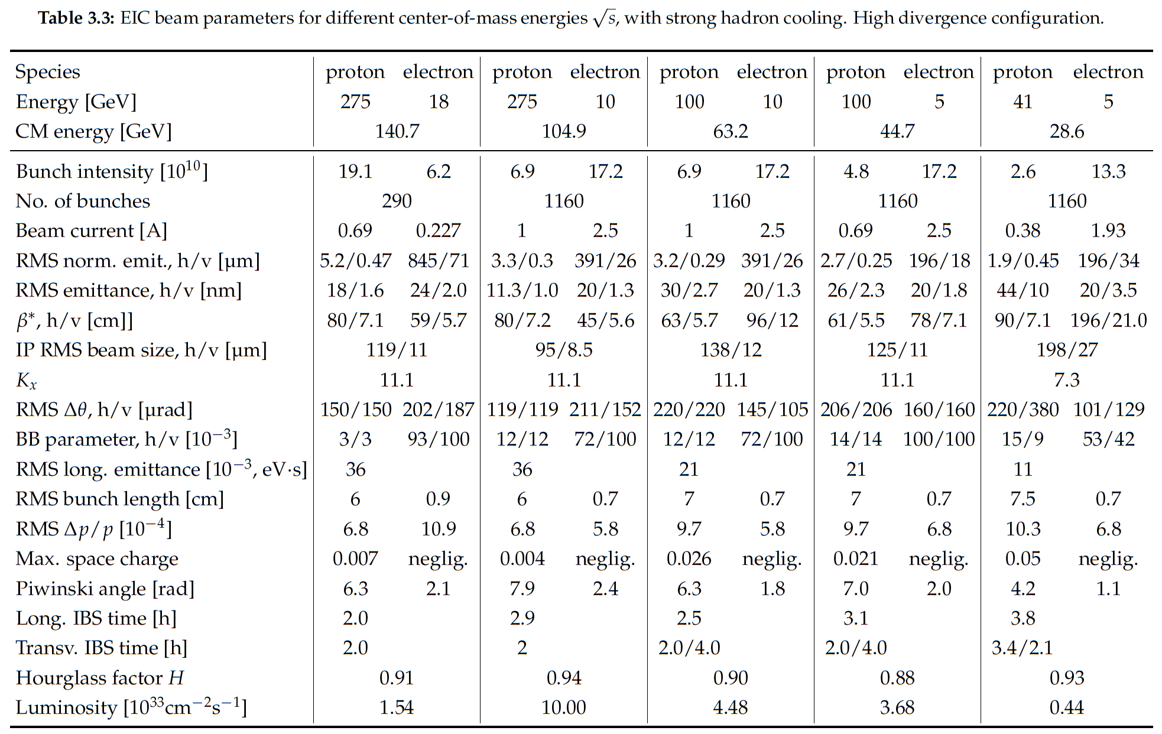

Notes:
LHC design 0.58A p (HL up to 1A), beam-beam parameter 3.4e-4 (3-5—3 HL-LHC)

