Slide 1
ASP 2022
African School of Physics 2024 in Morocco and capacity development in Morocco
Abdeslam Hoummada
Hassan II Academy of Science and Technology
Hassan II University of Casablanca
a.hoummada@academiesciences.ma
Abdeslam/Hoummada@cern.ch

Slide 2
(ASP2020)
Tuesday 2 April 2019, at the Hassan II Academy of Science and Technology - Rabat
Prof. Omar Fassi-Fehri, Permanent Secretary of the Academy, A. Hoummada (Director of Sciences)
B. S. Acharya (ICTP, Trieste Italy & King’s College London, UK - IOC) ,
H. B. White Jr. (Fermilab, Batavia Illinois USA- IAC)
R. Mazini (Academia Sinica, Taipei Taiwan - IOC) ,
S. Muanza (CNRS-IN2P3, Marseille France- IOC) ,
H. Severini (University of Oklahoma, Norman Oklahoma USA 13 Fermilab, Batavia Illinois USA - IAC) ,
E. Dabrowski (CERN, Geneva Switzerland - IOC) ,
L. Elouadrhiri (Jefferson Lab, Newport News Virginia USA - IAC) ,
A. K. A. Assamagan (BNL, Upton New York USA - IOC) ,
M. Chabab (Cadi Ayyad University, Marrakesh Morocco - LOC) ,
R. Cherkaoui El Moursli (University Mohammed V in Rabat and Hassan II Academy, Rabat Morocco - ) ,
F. Fassi (University Mohammed V in Rabat, Rabat Morocco - LOC) ,
M. Gouighri (Ibn Tofail University, Kenitra Morocco- LOC) ,
M. Mansour (Sultan My Slimane University, Beni Mellal Morocco - LOC) ,
A. Arhrib (Abdelmalek Saadi University, Tangier Morocco - LOC) ,
Y. Tayalati (University Mohammed V in Rabat, Rabat Morocco- LOC) ,

Slide 3
(ASP2024) In Morocco
Approval of : Prof. Omar Fassi-Fehri, Permanent Secretary of the Academy,
Academy’s Governing Bodies : Academy Council and Works Commission
Moroccan High Energy Physics Cluster : Representative of Morocco at ATLAS Experiment and CERN since 1995
- Cadi Ayyad University, Marrakesh ,
- University Mohammed V - Rabat
- Ibn Tofail University, Kenitra,
- Abdelmalek Saadi University, Tangier ,
- University Hassan II of Casablanca
University Mohammed 1st of Oujda
MASCIR
University Mohammed VI Polytechnic
Others institutions : …..
Local Organizing Committee
Date and duration : 2024
Venue : ???
Format and scientific program of the school : Same as 2022

Slide 4
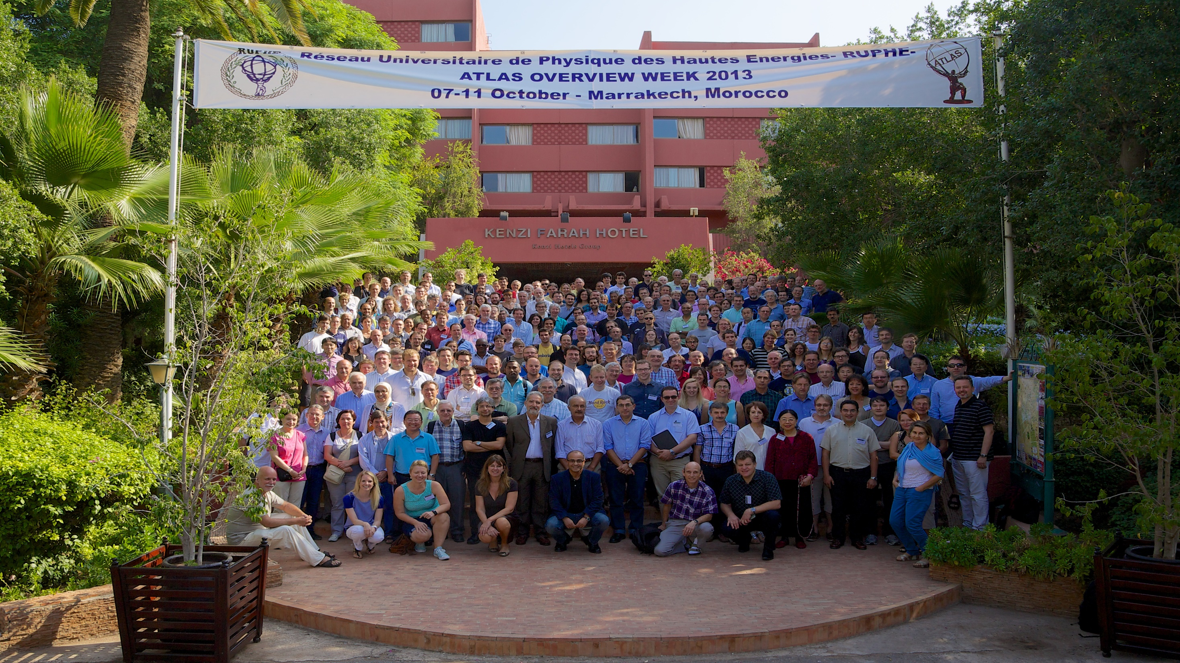
A. KETEVI

Slide 5
Moroccan capacity Development

Slide 6
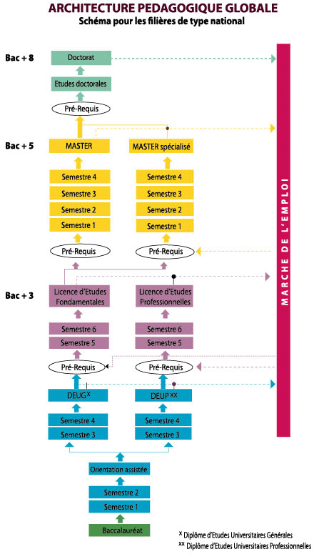
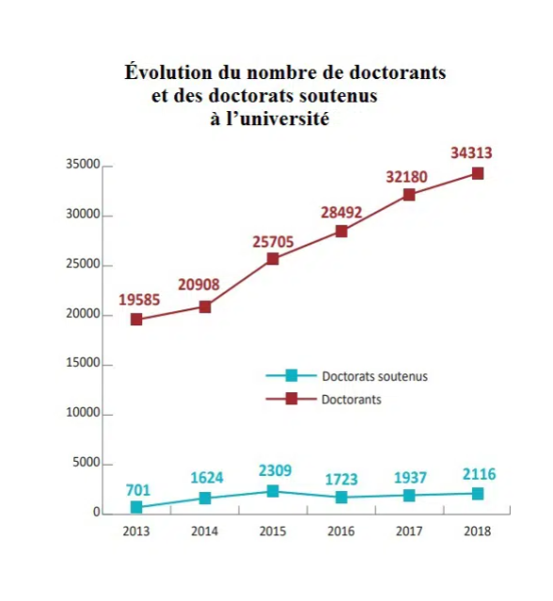

Slide 7
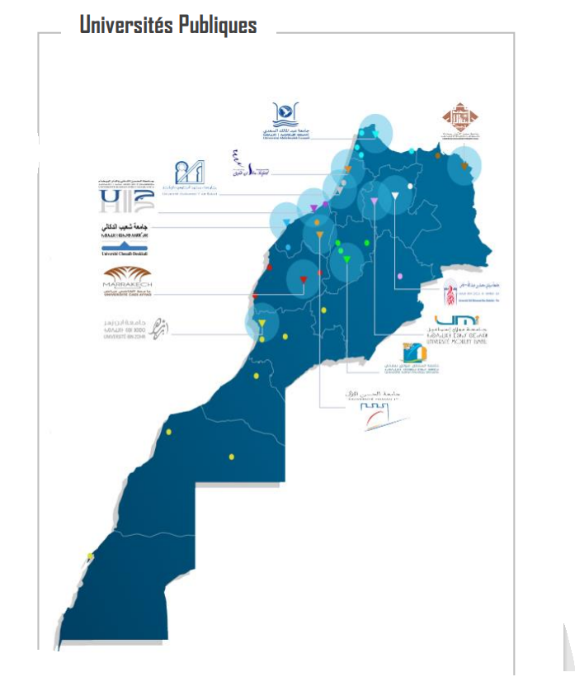

Slide 8
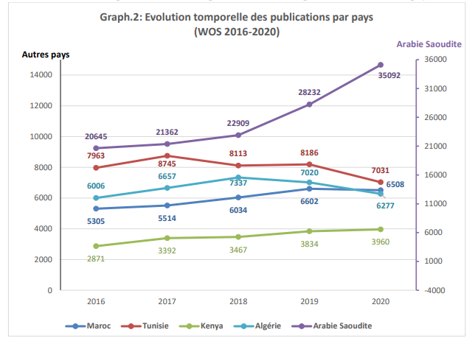
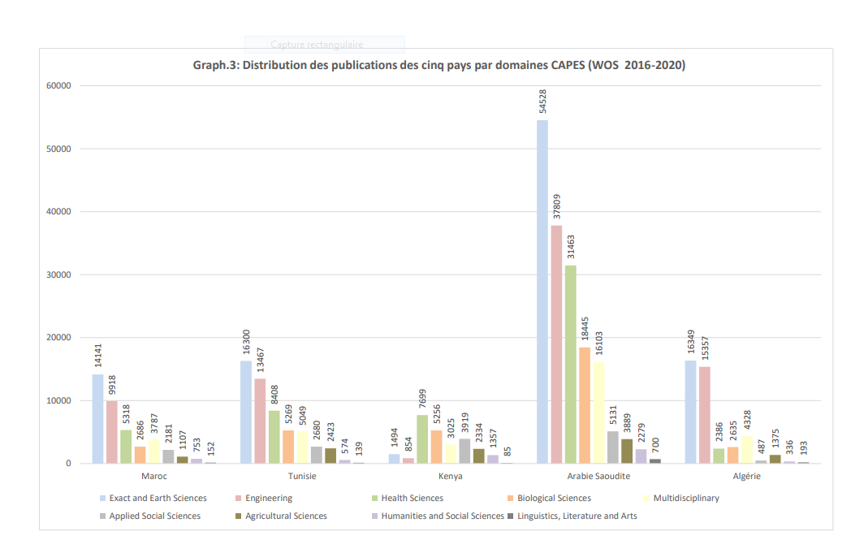
https://barometre.cnrst.ma/images/pdf/Etude_Production_Scientifique-Edition2021.pdf

Slide 9
Scholarships
- Moroccan Agency for International Cooperation – AMCI
For the 2019/2020 academic year, approximately 14,500 foreign students continued their studies in Moroccan public higher education institutions, including 12,500 students from 47 African countries have benefited of scholarships from the Kingdom of Morocco.
ASRIC-AU in partnership with Euro-Mediterranean University of Fes (UEMF)
2019, 2021 and 2022 – UEMF offered 30 scholarships for African PhD Students
The scholarship includes; tuition fees of about $9,000, an annual return ticket from the student home country with a maximum contribution of $1,000 during summer vacation, and stipend allowance of $1,000 monthly for 11 months every year.
https://blog.aau.org/call-for-applications-3rd-asric-uemf-phd-scholarships-for-african-students/
Hassan II Academy Excellence Allowance
Since 2010 the Academy in partnership with the Ministry of National Education stipend substantial allowance up to 1600 Euros per month, for 10 students, each year, having the best results at the Baccalaureate, up to now 108 students benefited of this allowance. PHD students in the best Universities of the world : Colombia University, University of Berkley, ENS Paris, Ecole Centrale, Ecole Polytechniaue, MIT, ENS Cachan, University of Montreal
CNRST Excellence Allowance
300 scholarships offered by the CNRST to the best Master students for PhD studies
Ministry of High Education Scientific Research and Innovation : 70% (30.000) of Master and PhD students benefit of 150 Euros per Month as Scholarship
Private Institutions : Private Universities, OCP, Foundations

Slide 10
Thank you for your attention
And
You are welcome in Morocco in 2024
Go ahead ASP

Slide 11

Go ahead Morocco
Go ahead Senegal
Go ahead AFRICA

