Slide 1


The Landscape of Academic
Research Computing
The African School of Fundamental Physics 2022
Nelson Mandela University, Gqeberha, SA
December 7, 2022
Dr. Jaehoon Yu
Department of Physics
University of Texas at Arlington
Jaehoon Yu <jaehoonyu1@gmail.com>
Original slides by: Rob Quick <rquick@iu.edu>
Some Slides Contributed by the University of Wisconsin HTCondor Team and Scot Kronenfeld

Slide 2
Follow Along at:
  https://osg-htc.org/dosar/ASP2022/ASP2022_Materials/
  DOSAR: Distributed Organization for Scientific & Academic Research

Slide 3
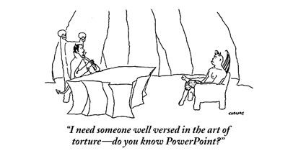
Overview of day
Lectures alternating with exercises
  Emphasis on lots of hands-on exercises
  Hopefully overcome PowerPoint fatigue

Slide 4
Some thoughts on the exercises
It’s okay to move ahead on exercises if you have time
It’s okay to take longer on them if you need to
If you move along quickly, try the “On Your Own” sections and “Challenges”

Slide 5
Most important!
Please ask questions!
  …during the lectures
  …during the exercises
  …during the breaks
  …during the meals
  …via email after we depart
  If we don’t know the answers, we’ll find the right people to answer your questions.

Slide 6
Goals for this lecture
Define Local, Clustered, High Throughput Computing (HTC), High Performance Computing (HPC), and Cloud Computing (XaaS – Anything as a Service)
Shared, Allocated, and Purchased resources
What is HTCondor? And why are we using it in this school?

Slide 7
The setup: You have a problem
Your science computing is complex!
  Monte Carlo simulations, image analysis, genetic algorithm, simulation…
It will take a year to get the results on your laptop, but the conference is in a week.
What do you do?

Slide 8

Option 1: Wait a year

Slide 9
Option 2: Local Clustered Computing
Easy access to additional nodes
Local support for porting to environment (maybe)
Often a single type of resource
Often running at capacity

Slide 10
Option 3: Use a “supercomputer” aka High Performance Computing(HPC)
“Clearly, I need the best, fastest computer to help me out”
Maybe you do…
  Do you have a highly parallel program?
    i.e. individual modules must communicate
  Do you require the fastest network/ disk/ memory?
Are you willing to:
  Port your code to a special environment?
  Request and wait for an allocation?

Slide 11
Option 4: Use lots of commodity computers
Instead of the fastest computer, lots of individual computers
May not be fastest network/disk/memory, but you have a lot of them
Job can be broken down into separate, independent pieces
  If I give you more computers, you run more jobs
  You care more about total quantity of results than instantaneous speed of computation
This is high-throughput computing (HTC)

Slide 12
Option 5: Buy (or Borrow) some computing from a Cloud Provider
Unlimited resources (if you can afford them)
Full administrative access to OS of the resources you ‘buy’
Specialized VM images reducing effort in porting
XaaS Business Model

Slide 13
These are All Valid Options
Remember the problem you have one month to publish results for your conference
  Option 1: You WILL miss your deadline
  Option 2: You might miss your deadline – But if your lucky you’ll make it (or if you know the admin)
  Option 3: If you have parallelized code and can get an allocation you have a good chance
  Option 4: If you can serialize your work-flow you have a good chance
  Option 5: You can meet your deadline for a price. Though some efforts are underway to enable academic clouds

Slide 14
Computing Infrastructures
Local Laptop/Desktop – Short jobs with small data
Local Cluster – Larger jobs and larger data but subject to availability
HPC – Prime performance with parallelized code
HTC – Sustained computing over a long period for serialized workflow
Cloud – Need deeper permission on an OS and have deeper pockets

Slide 15
Why focus on high-throughput computing? (HTC)
An approach to distributed computing that focuses on long-term throughput, not instantaneous computing power
  We don’t care about operations per second
  We care about operations per year
Implications:
  Focus on reliability
  Use all available resources
    Any Linux based machine can participate

Slide 16

Think about a race
Assume you can run a 2-minute km
Does that mean you can run a 80 minute marathon?
The challenges in sustained computation are different than achieving peak in computation speed

Slide 17
An example problem: BLAST
A scientist has:
  Question: Does a protein sequence occur in other organisms?
  Data: lots of protein sequences from various organisms
  Parameters: how to search the database.
More throughput means
  More protein sequences queried
  Larger/more protein data bases examined
  More parameter variation

Slide 18
Why is HTC hard?
The HTC system has to keep track of:
  Individual tasks (a.k.a. jobs) & their inputs
  Computers that are available
The system has to recover from failures
  There will be failures! Distributed computers means more chances for failures.
You have to share computers
    Sharing can be within an organization, or between orgs
    So you have to worry about security
    And you have to worry about policies on how you share
If you use a lot of computers, you have to handle variety:
  Different kinds of computers (arch, OS, speed, etc..)
  Different kinds of storage (access methodology, size, speed, etc…)
  Different networks interacting (network problems are hard to debug!)

Slide 19
Let’s take one step at a time
Small
Large
Local
Distributed
Can you run one job on one computer?
Can you run one job on another computer?
Can you run 10 jobs on a set of computers?
Can you run a multiple job workflow?
How do we put this all together?
This is the path we’ll take

Slide 20
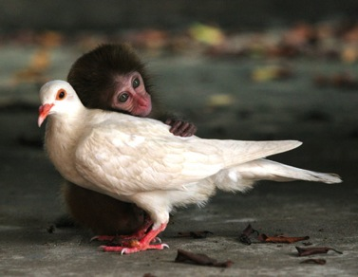
Discussion
For 5 minutes, talk to a neighbor: If you want to run a multi-job workflow in a distributed environment:
    What do you (the user) need to provide so a single job can be run?
    What does the system need to provide so your single job can be run?
      Think of this as a set of processes: what needs to happen when the job is given? A “process” could be a computer process, or just an abstract task.

Slide 21
What does the user provide?
A “headless job”
  Not interactive/no GUI: how could you interact with 1000 simultaneous jobs?
A set of input files
A set of output files
A set of parameters (command-line arguments)
Requirements:
  Ex: My job requires at least 2GB of RAM
  Ex: My job requires Linux
Control/Policy:
  Ex: Send me email when the job is done
  Ex: Job 2 is more important than Job 1
  Ex: Kill my job if it runs for more than 6 hours

Slide 22
What does the system provide?
Methods to:
  Submit/Cancel job
  Check on state of job
  Check on state of available computers
Processes to:
  Reliably track set of submitted jobs
  Reliably track set of available computers
  Decide which job runs on which computer
  Manage a single computer
  Start up a single job

Slide 23
Quick UNIX Refresher
Before We Start
$ #This symbolizes the prompt.
nano, vi, emacs, cat >, etc.
which, rpm, ps, mkdir, cd, gcc, ls
A variety of condor_* commands

Slide 24
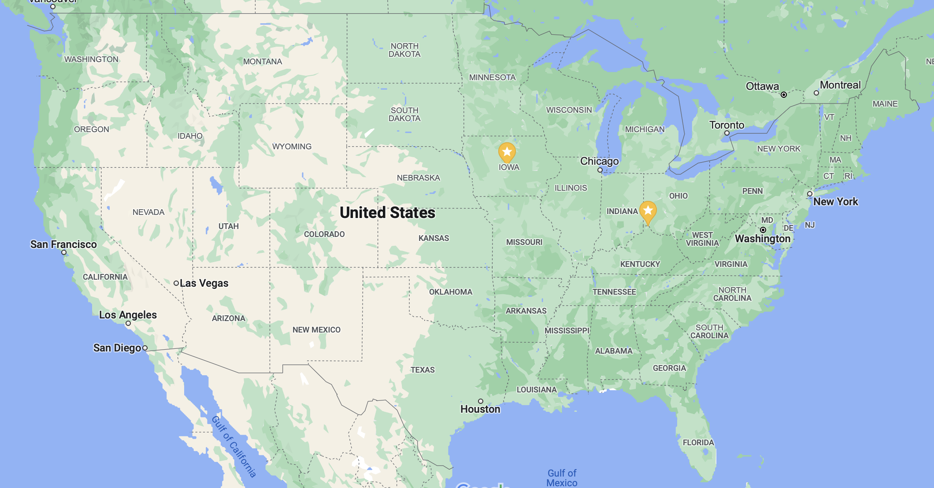


Where are your lecturers from?

Slide 25
Questions?
Questions? Comments?
  Feel free to ask us questions now or later:
  Jaehoon Yu jaehoonyu1@gmail.com
  Horst Severini hs@nhn.ou.edu
  Pat Skubic pskubic@ou.edu
  Exercises start here:
  https://osg-htc.org/dosar/ASP2022/ASP2022_Materials/
  Presentations are also available from this URL.

