Slide 1

Energy Recovery Linacs and
Super-Conducting Radio-Frequency Cavities
Luca Serafini – INFN-Milan and University of Milan
luca.serafini@mi.infn.it
Seminar Outline
Super-conducting Radio-Frequency Cavities
E.M. Fields in Radio-Frequency Cavities: multi-cell resonant modes
Symmetric Acceleration using Standing Waves
Energy Recovery in RF Super-conducting Cavities
7th African School of Physics - Port Elizabeth (ZA) - Dec. 2022

Slide 2
Why Energy Recovery Linacs ?
New Generation of Particle Accelerators towards Energy Sustainability
Unfortunately Particle Accelerators are very inefficient in transforming AC power (electrical bills…) into particle beam power
Particle Accelerators for High Energy Physics request an impressive amount of AC power (LHC 120 MW, like a mid-size city with 1 million citizens)
Energy Recovery Linacs aim at a new generation of Particle Accelerators achieving much lower AC power consumption for the same beam power delivered to users/experiments
7th African School of Physics - Port Elizabeth (ZA) - Dec. 2022

Slide 3
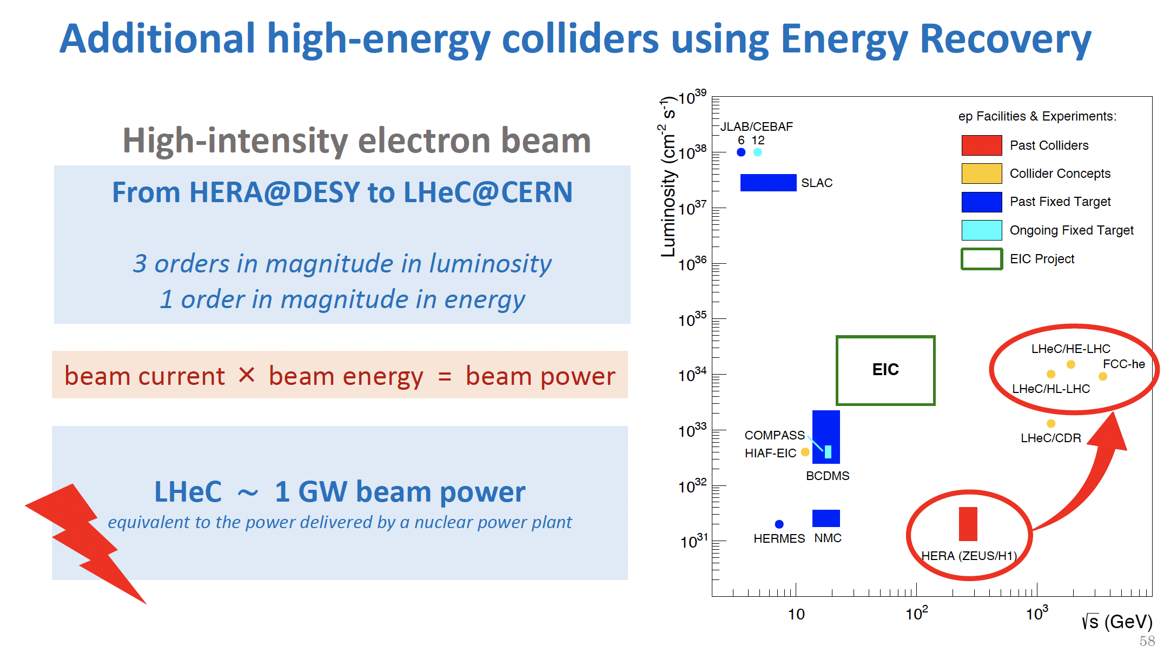
200 mA x 50 GeV = 1 GW
Courtesy of Jorgen D’Hondt
7th African School of Physics - Port Elizabeth (ZA) - Dec. 2022

Slide 4
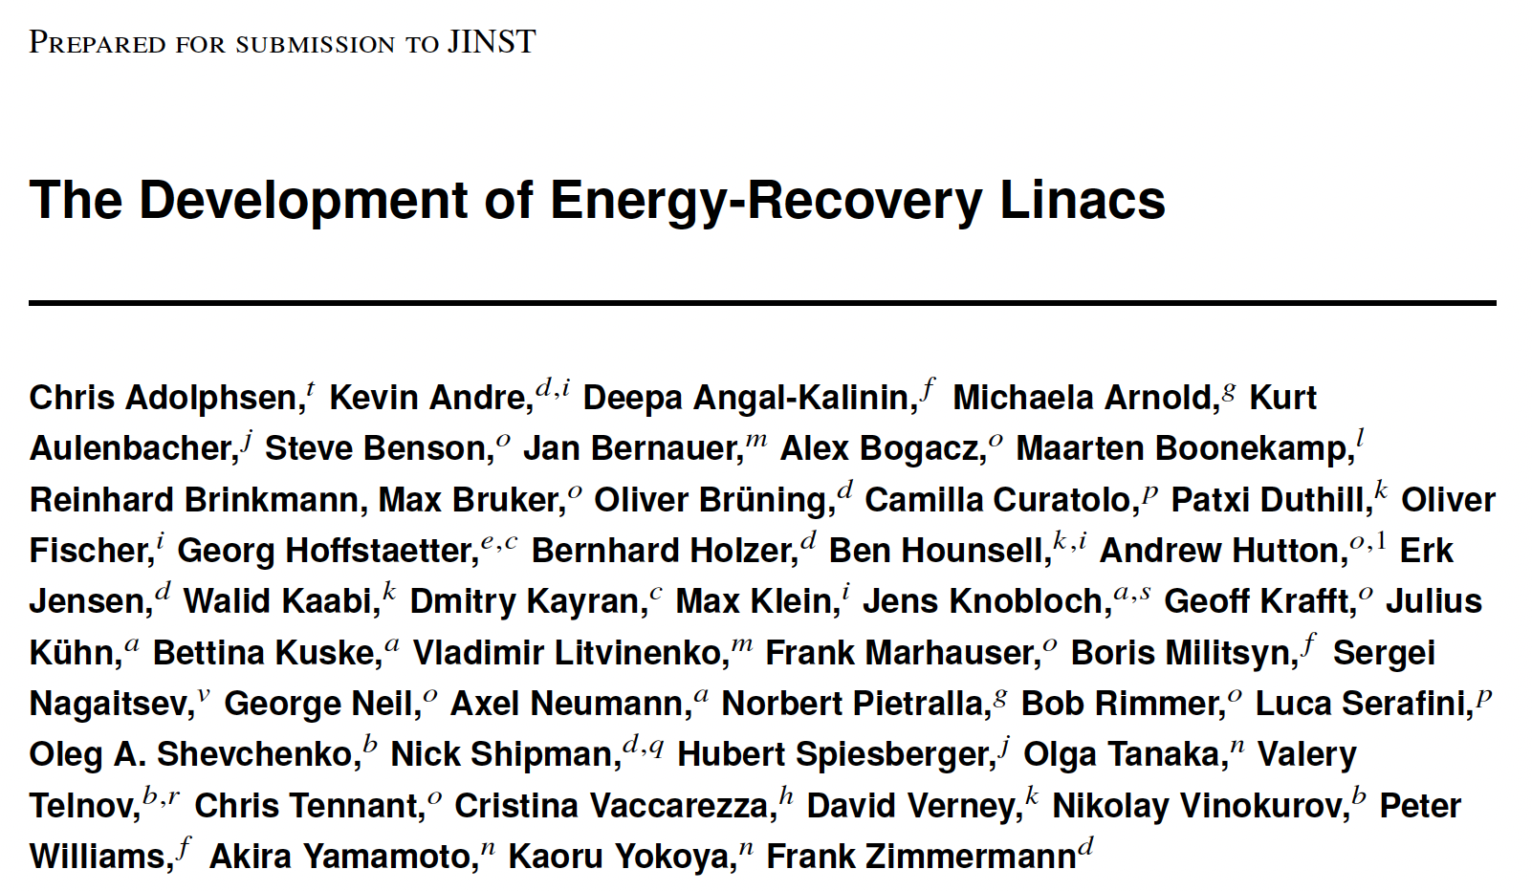
7th African School of Physics - Port Elizabeth (ZA) - Dec. 2022

Slide 5
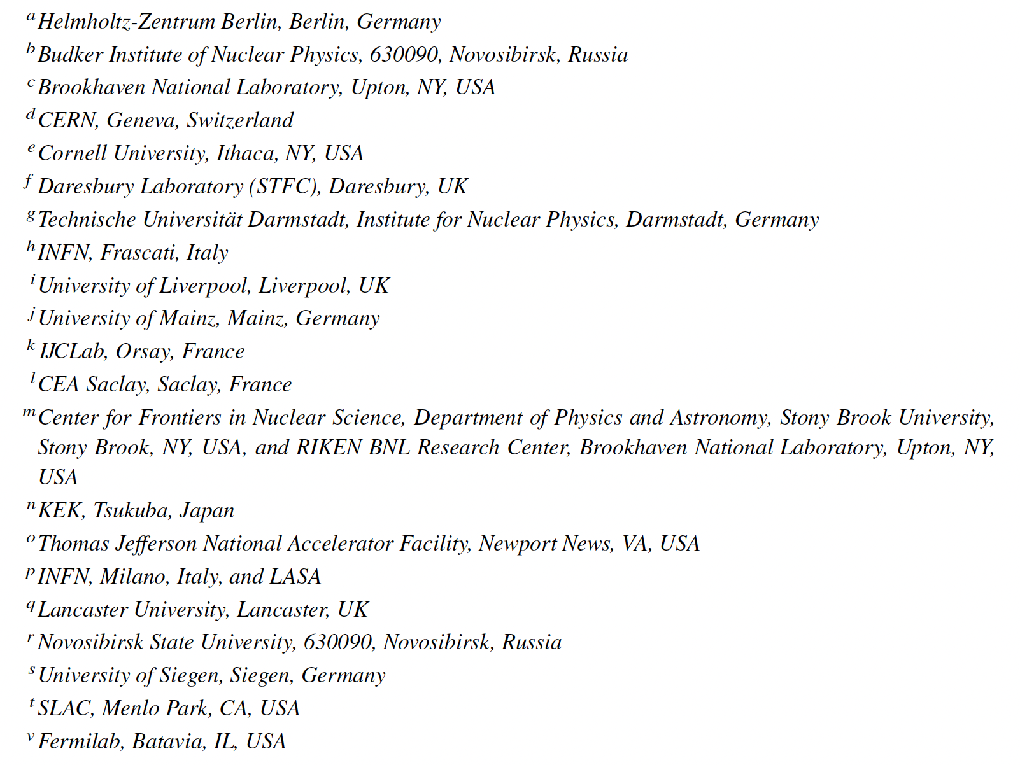
7th African School of Physics - Port Elizabeth (ZA) - Dec. 2022

Slide 6
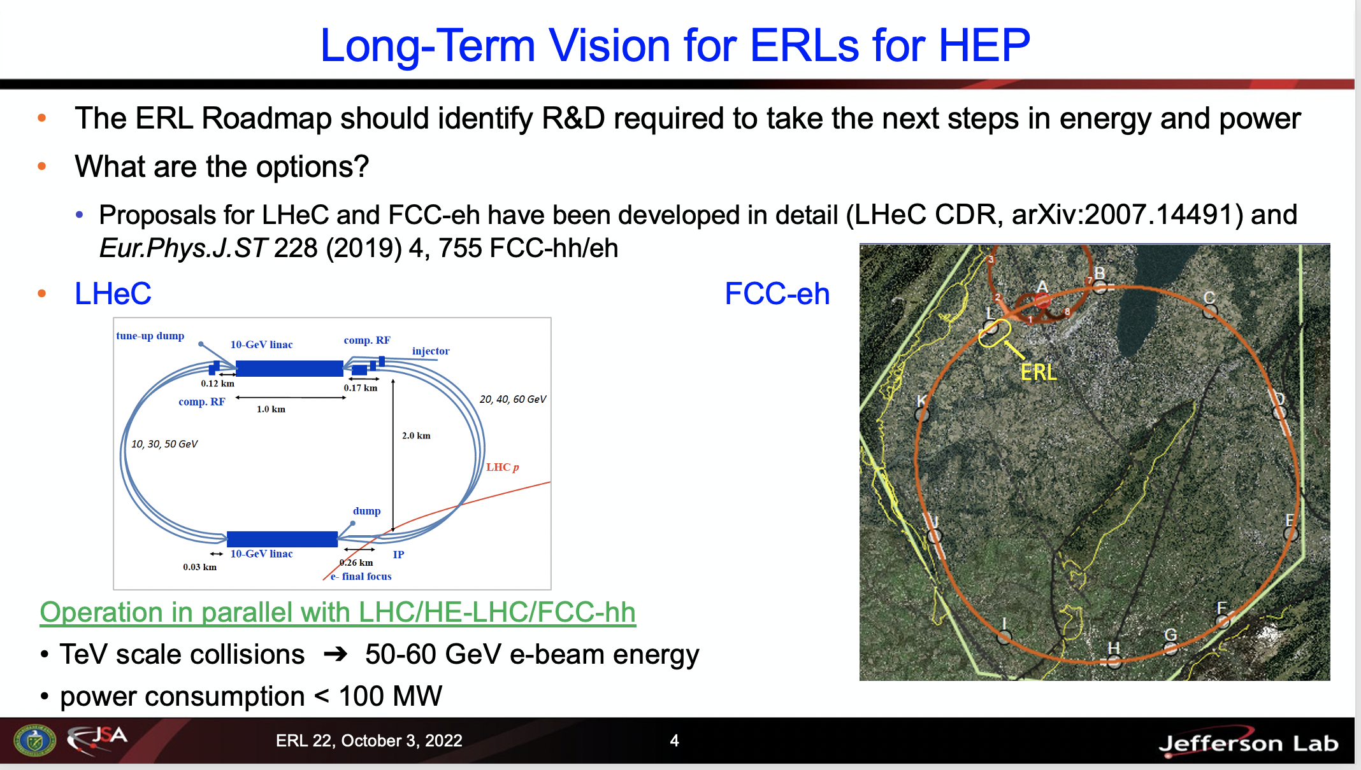
Courtesy of Andrew Hutton and Max Klein
7th African School of Physics - Port Elizabeth (ZA) - Dec. 2022

Slide 7
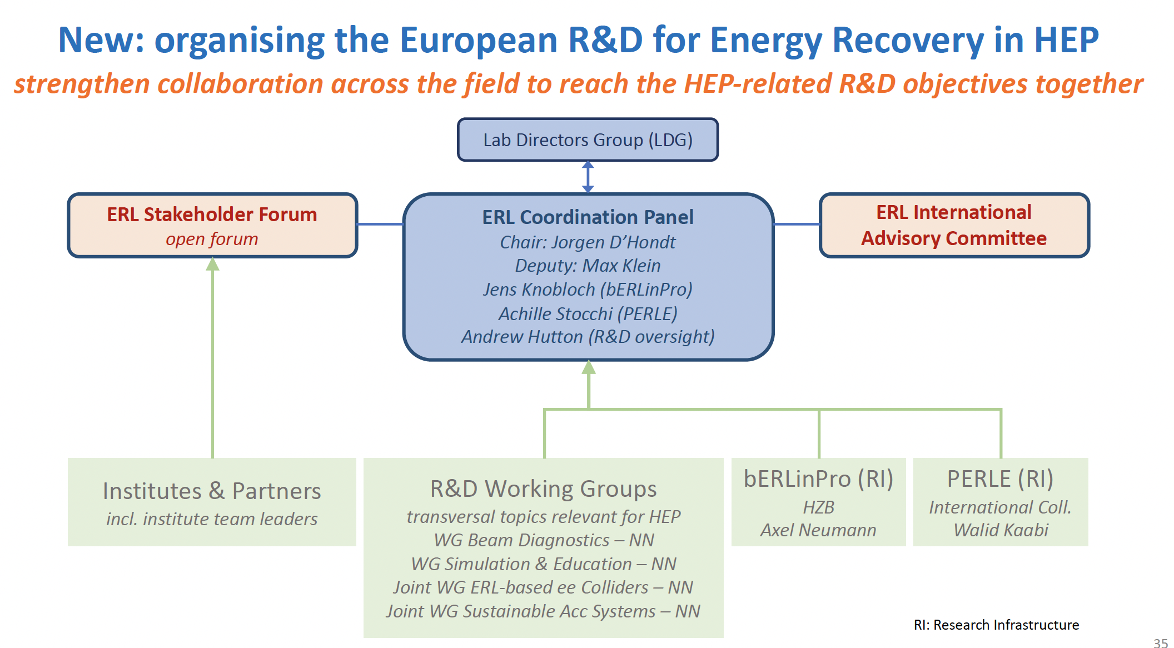
Courtesy of Jorgen D’Hondt
7th African School of Physics - Port Elizabeth (ZA) - Dec. 2022

Slide 8
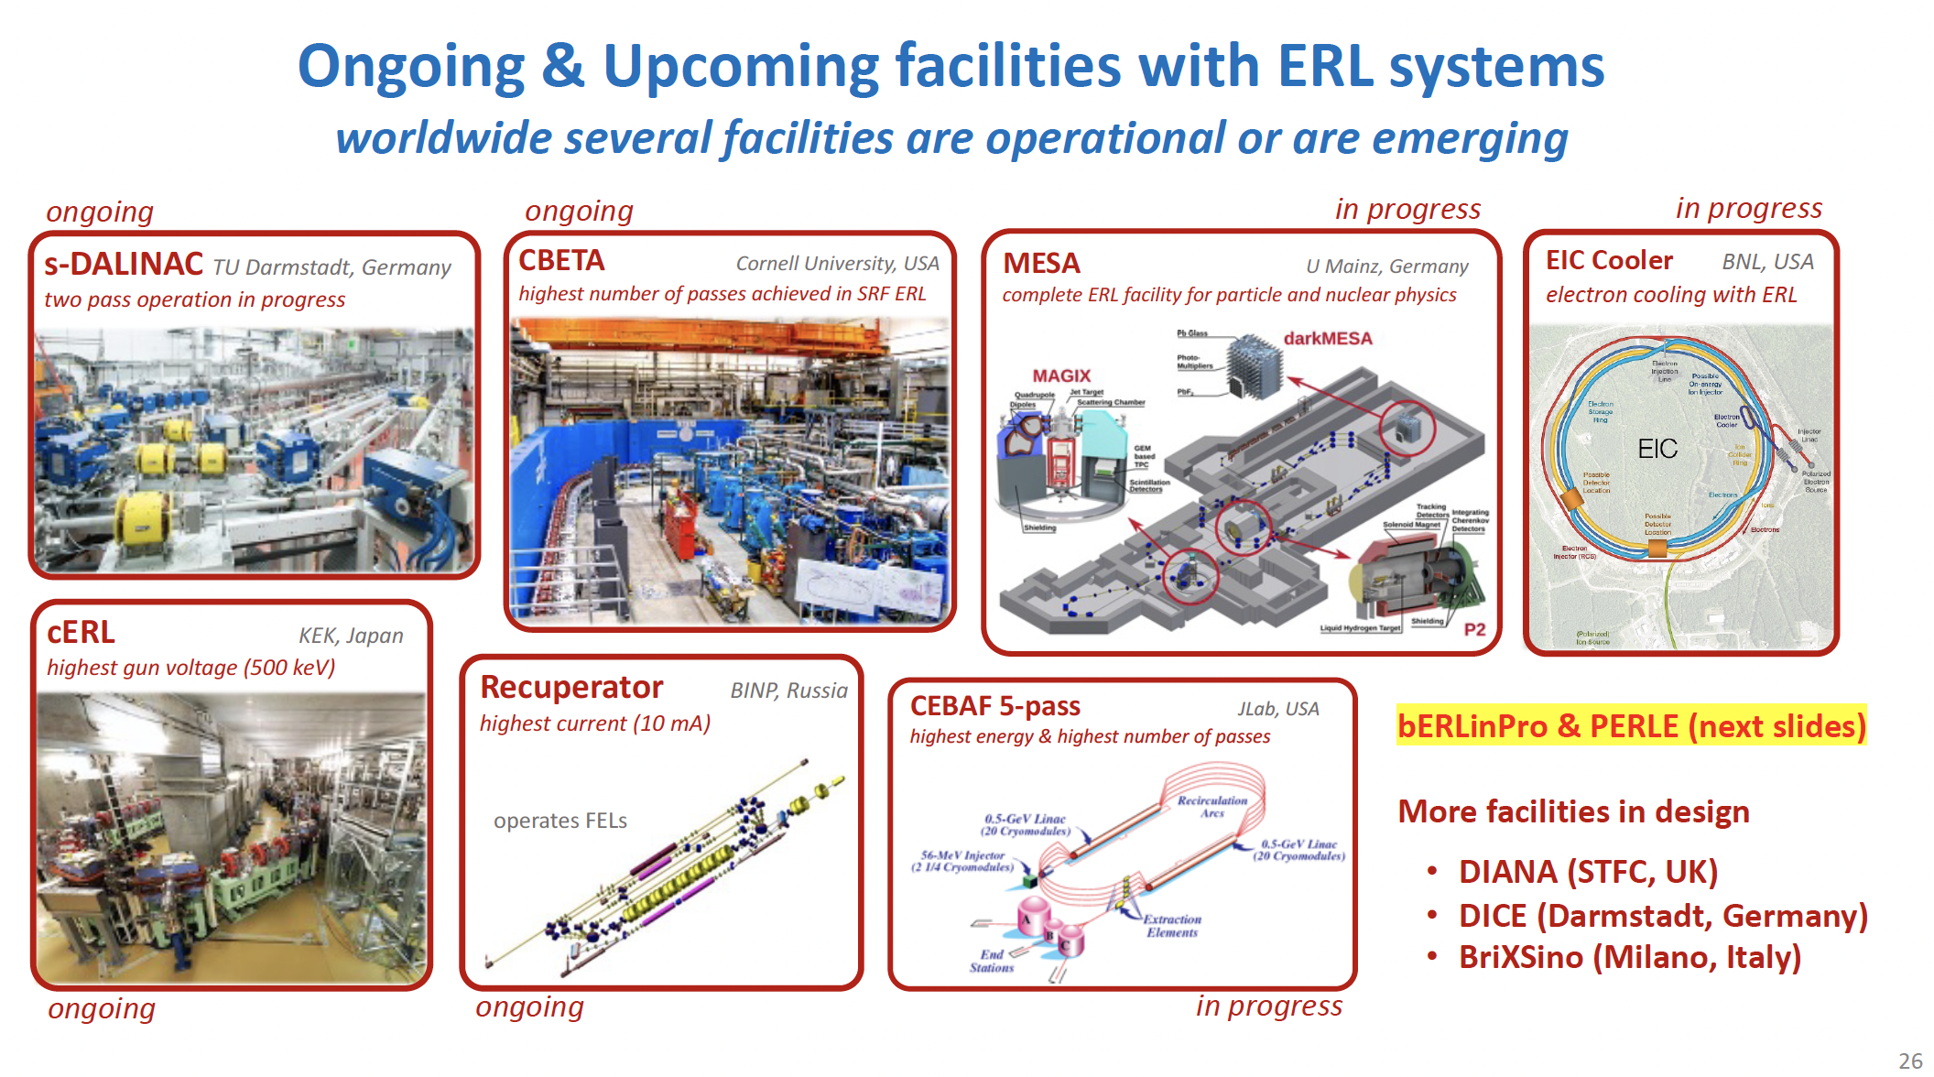
Courtesy of Jorgen D’Hondt
7th African School of Physics - Port Elizabeth (ZA) - Dec. 2022

Slide 9



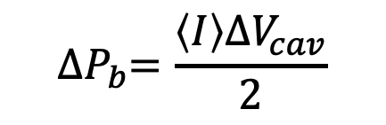
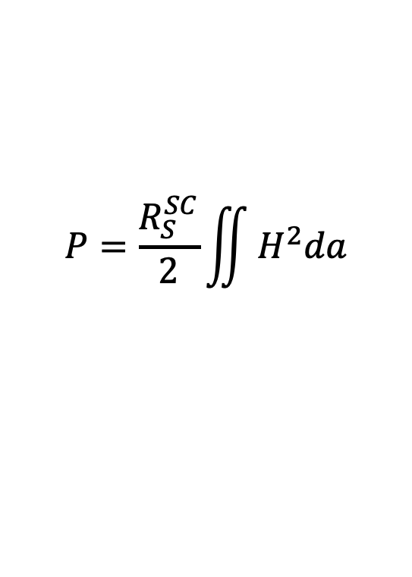
Considering the ratio η between the power P dissipated on
the walls and the power ΔP_{b} transferred to the electron beam
$$P=\frac{R_{S}^{SC}}{2}\iint{H^{2}da}$$
energy
dissipation
$$η≡\frac{P}{ΔP_{b}}$$
$${∆P}_{b}=\frac{\left\langle I\right\rangle {ΔV}_{cav}}{2}$$
energy
accumulation
Normal Conducting RF Cavities (copper)
most of RF power is lost into heat (not recoverable)
$$η≫1$$
Super Conducting RF Cavities (niobium)
$$η≪1$$
If most RF power goes into the kinetic energy of the
particle beam we may imagine to recover it somehow

Slide 10
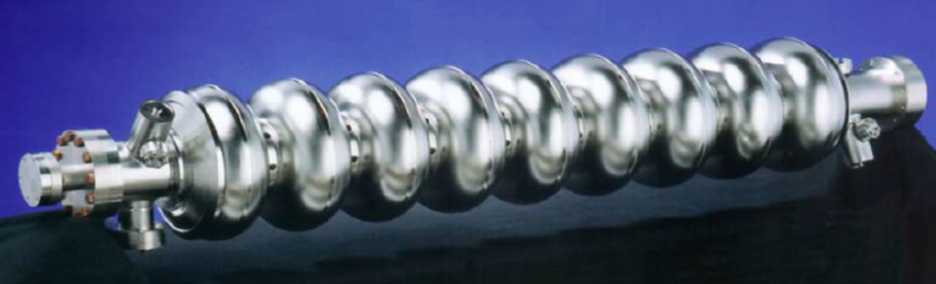
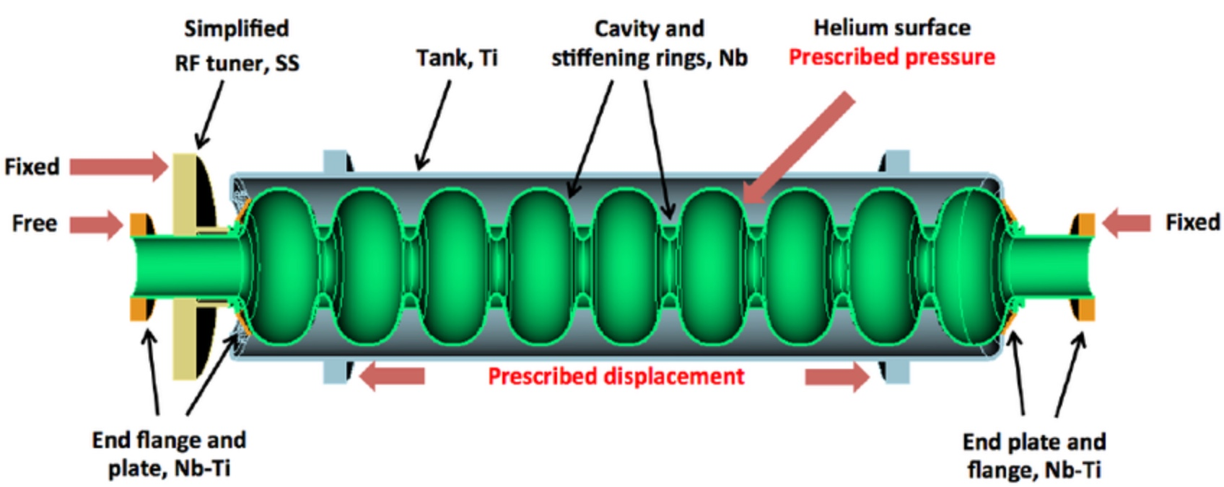
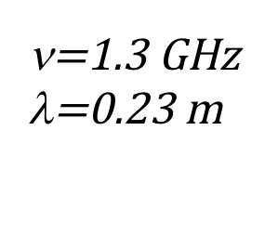
The Superconducting TESLA Radio-Frequency Cavities
ν=1.3 GHz
λ=0.23 m
1 m

Slide 11
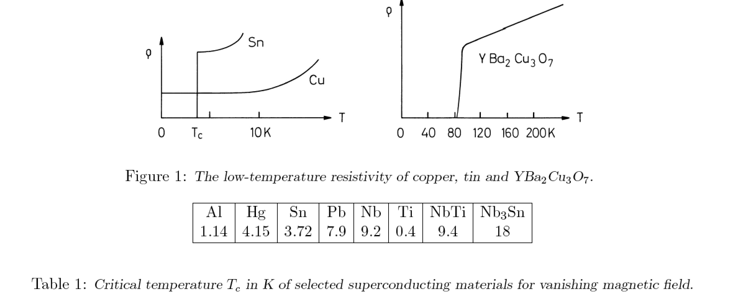
Why RF Super-conductivity is strategic? Because RF
Super-conducting cavities exhibit a much much lower
power dissipation on their metallic surface w.r.t.
normal (Copper-made) cavities.
The material mostly used for RF-SC cavities is Niobium, which has
a “transition temperature” to super-conductivity at T_{c}=9.2 K
7th African School of Physics - Port Elizabeth (ZA) - Dec. 2022

Slide 12
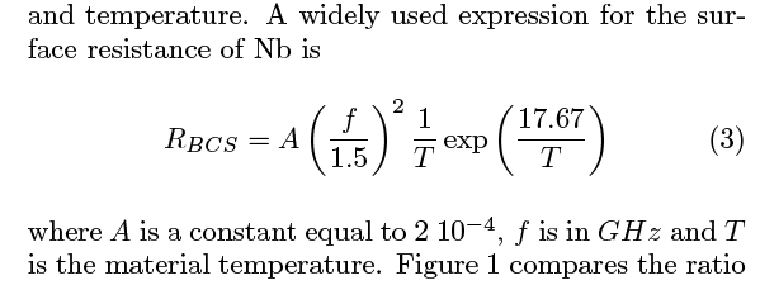
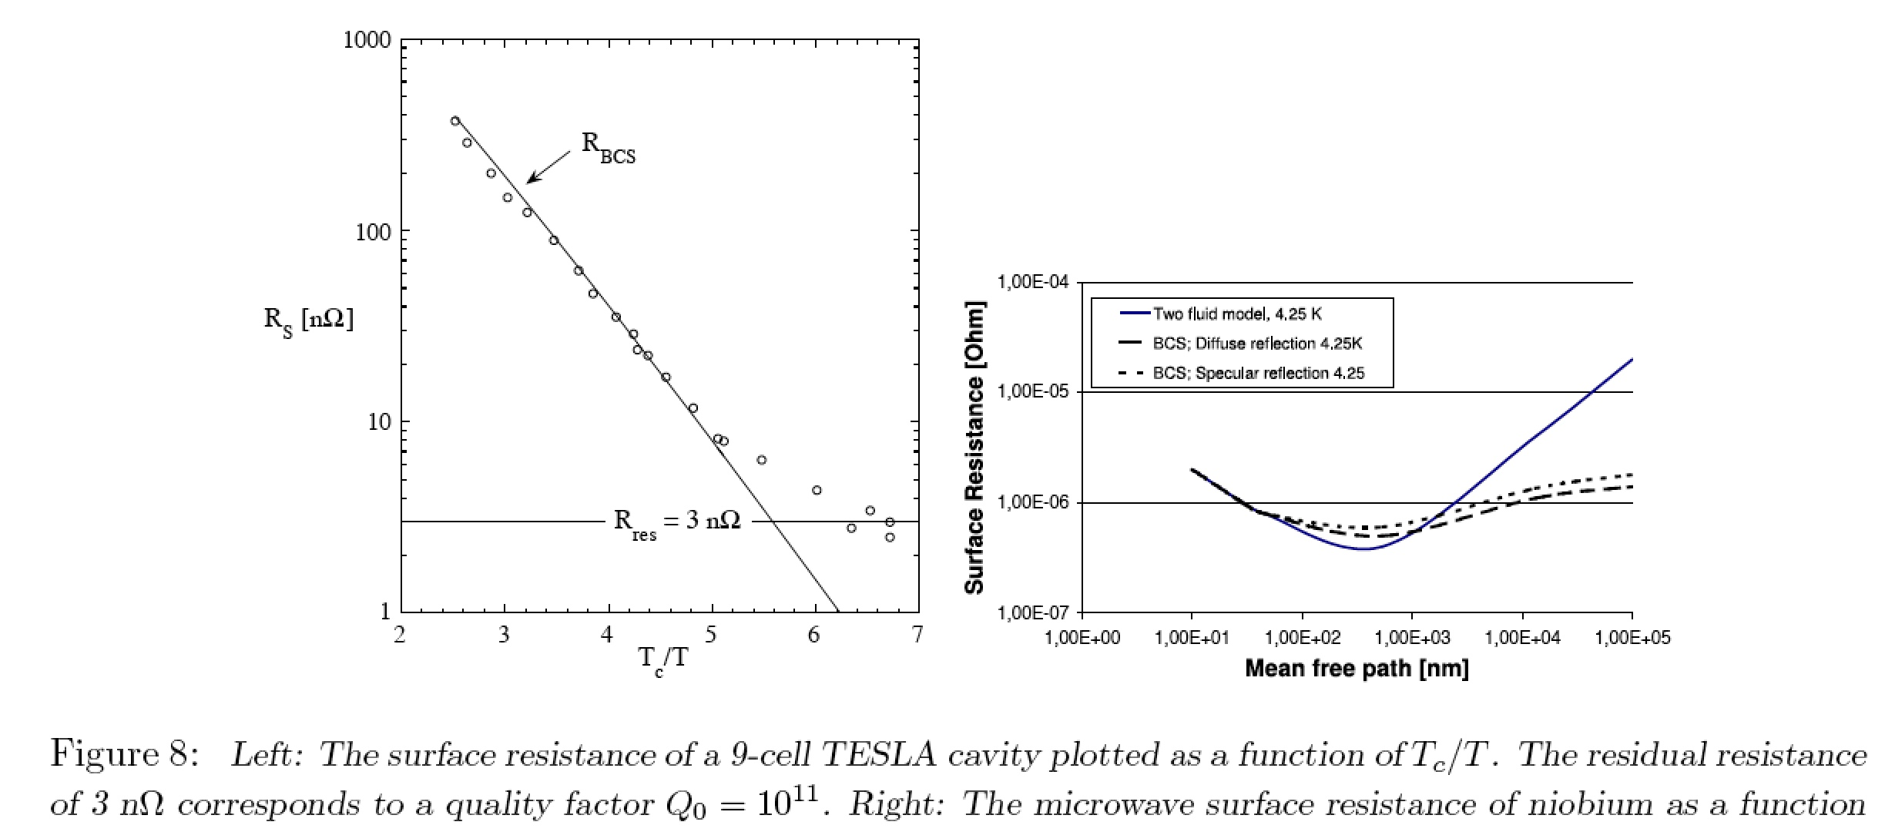
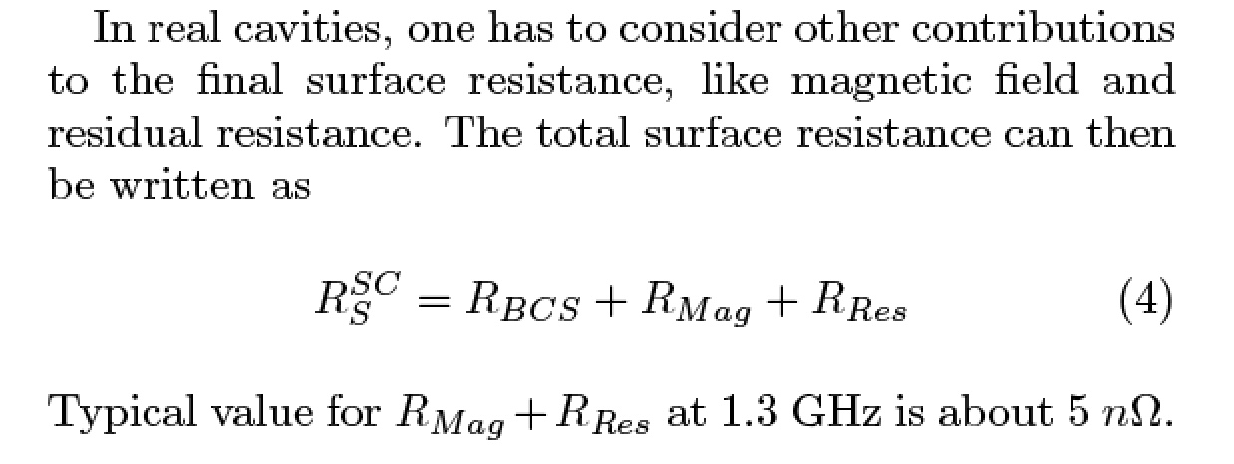
-
7th African School of Physics - Port Elizabeth (ZA) - Dec. 2022

Slide 13
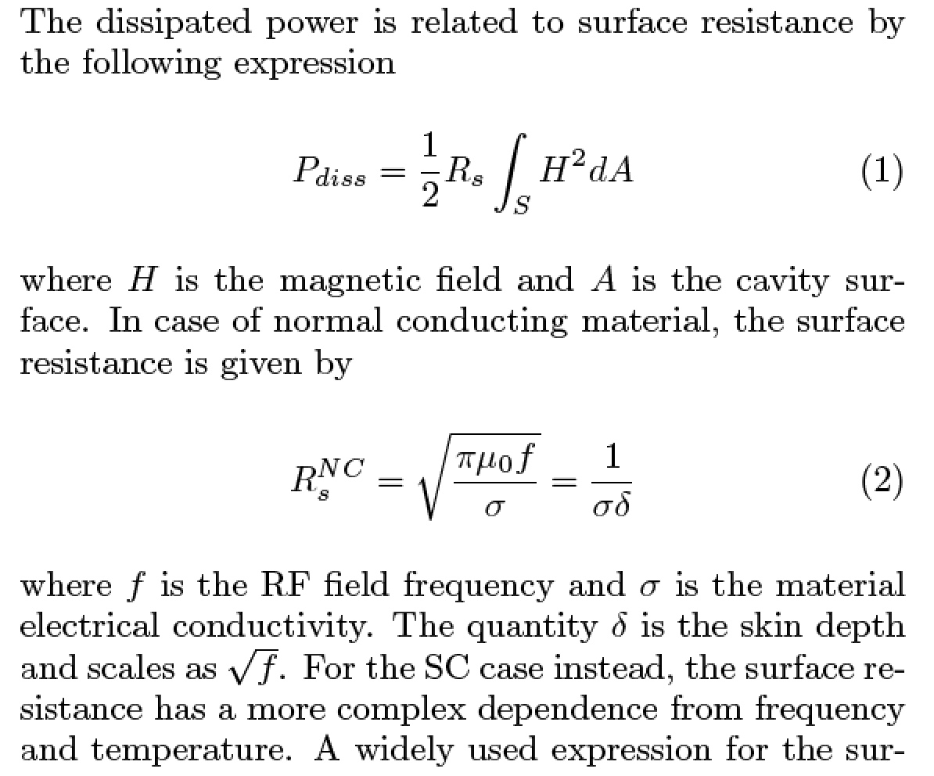
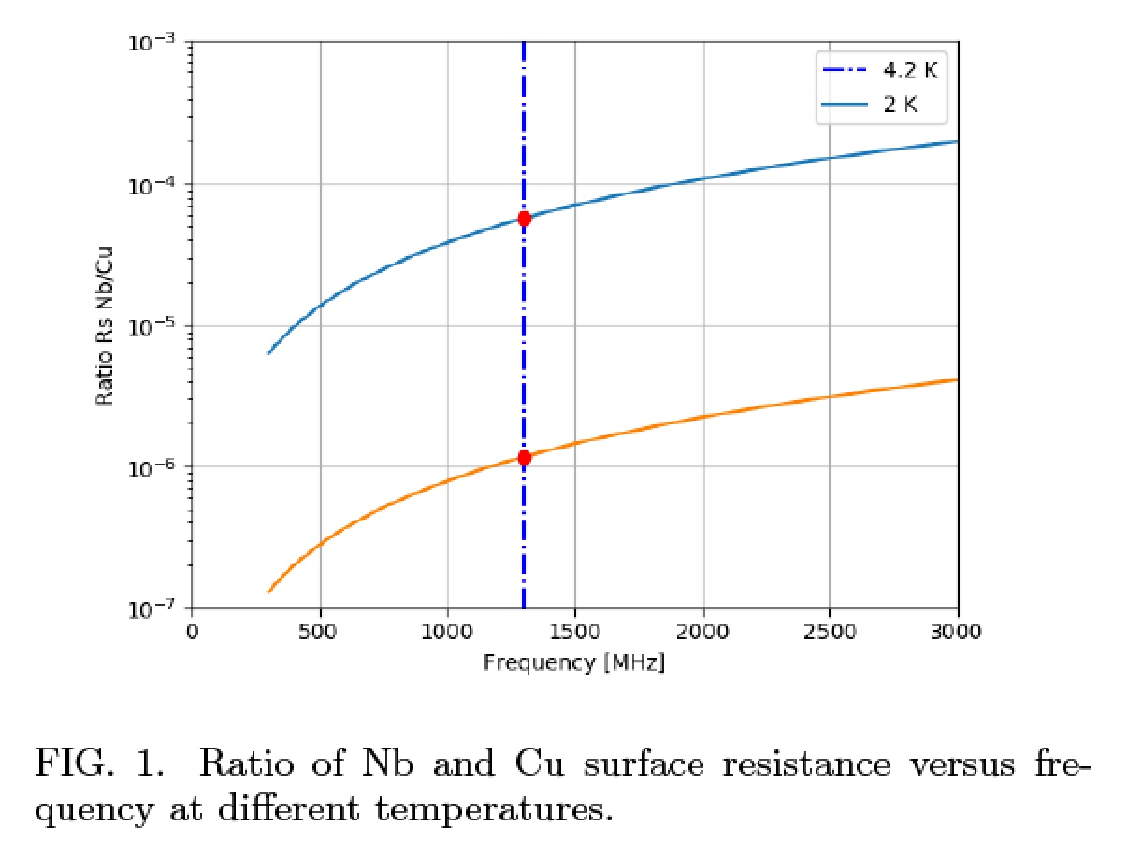
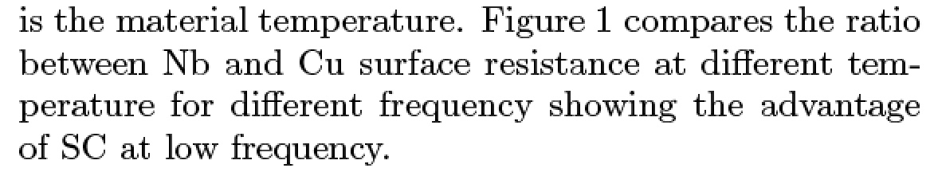
4.2 K
2 K

Slide 14
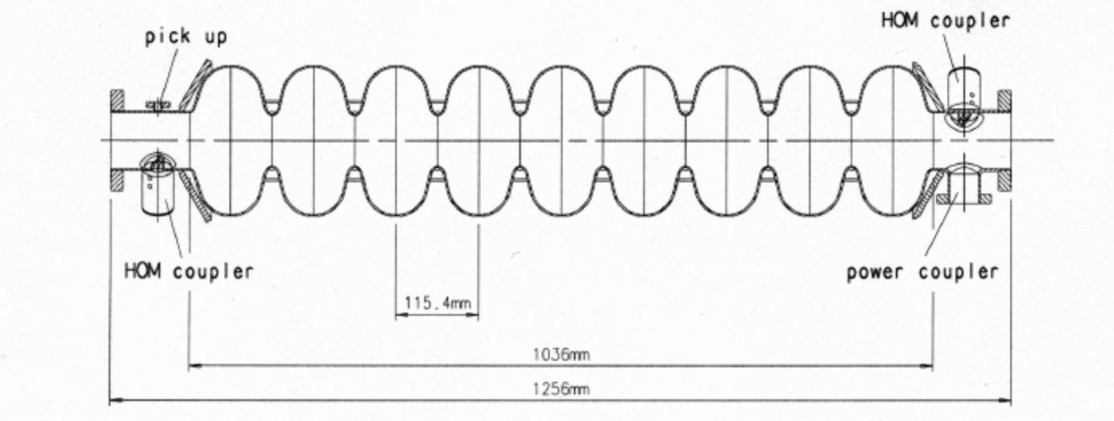
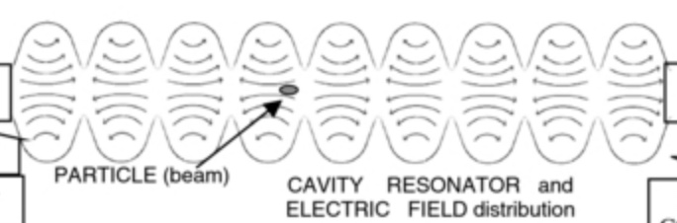
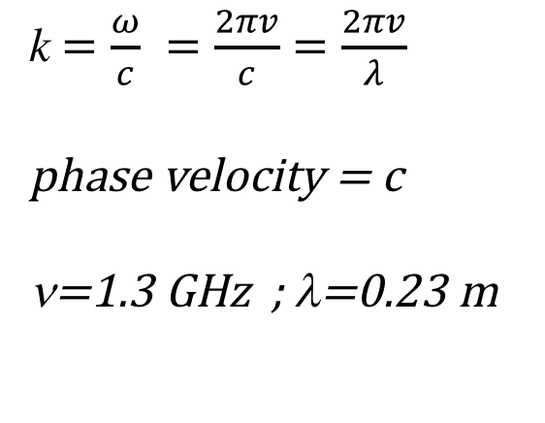
Resonant Mode TM_{010-π}
k$=\frac{ω}{c} =\frac{2πv}{c}=\frac{2πv}{λ}$
phase velocity = c
ν=1.3 GHz ; λ=0.23 m
9 cells = 4.5 λ = 1.04 m

Slide 15
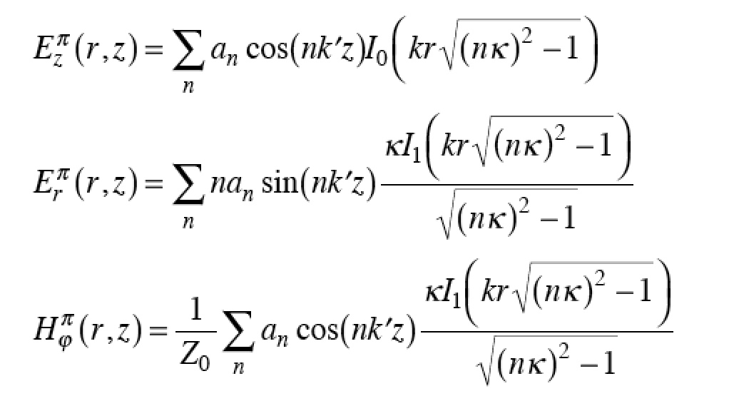



Resonant Mode TM_{010-π}
r
d
z
d=λ/2=π/k
Solution of Maxwell Eq. with periodical boundary contitions
$$E_{z}\left(r,z,t\right)=E_{z}^{π}e^{iωt}$$
$$E_{r}\left(r,z,t\right)=E_{r}^{π}e^{iωt}$$
$$H_{φ}\left(r,z,t\right)=H_{φ}^{π}e^{iωt}$$
k’=k ; κ=1

Slide 16
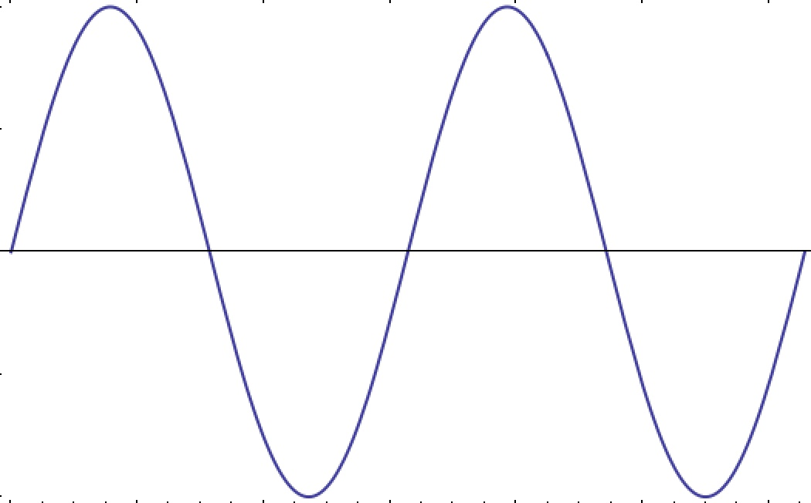
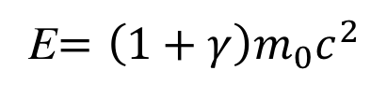
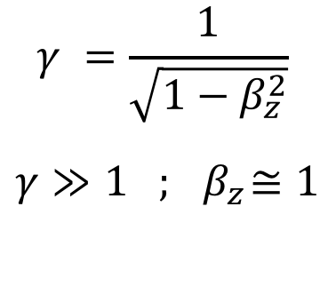
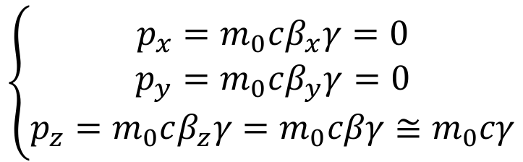
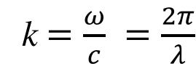
Resonant Mode TM_{010-π}
E_{z}(z,t=0)
z
z=0
z=λ/2
z=λ
z=3λ/2
z=2λ
E_{z}(r=0, z, t) = Ε₀ sin(kz)cos(ωt-φ₀)
k$=\frac{ω}{c} =\frac{2π}{λ}$
relativistic electron travelling along z-axis
$$\left\{\begin{aligned}p_{x}=m_{0}cβ_{x}γ=0 \\ p_{y}=m_{0}cβ_{y}γ=0 \\ p_{z}=m_{0}cβ_{z}γ=m_{0}cβγ≅m_{0}cγ\end{aligned}\right.$$
$$γ =\frac{1}{\sqrt{1−β_{z}^{2}}}$$
$$γ≫1 ; { β}_{z}≅1$$
E$=\left(1+γ\right)m_{0}c^{2}$

Slide 17
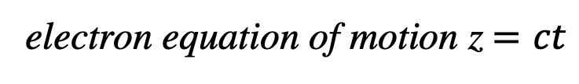
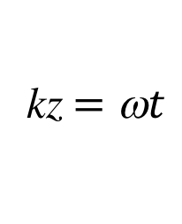
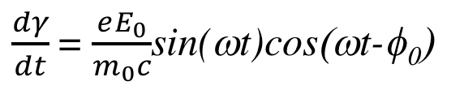
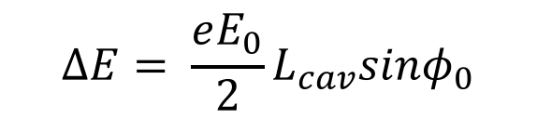
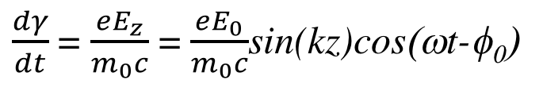
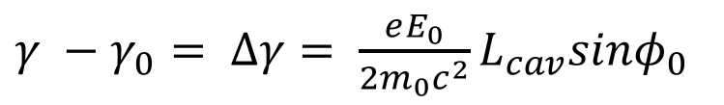
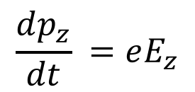
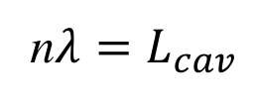
electron equation of motion z$=ct$
$$\frac{dp_{z}}{dt} =eE_{z}$$
$\frac{dγ}{dt}$ = $\frac{eE_{z}}{m_{0}c}$ = $\frac{eE_{0}}{m_{0}c}$sin(kz)cos(ωt-φ₀)
kz$=\text{w}t$
$\frac{dγ}{dt}$ = $\frac{eE_{0}}{m_{0}c}$sin(ωt)cos(ωt-φ₀)
$γ$= $γ_{0}+$ $\frac{eE_{0}}{m_{0}c}\int_{0}^{nT=\frac{2πn}{ω}}{\text{sin}\text{(}\text{w}\text{t}\text{)}\text{cos}\text{(}\text{w}\text{t}\text{−}\text{f}\text{0}\text{)}}$ = $γ_{0}+$ $\frac{eE_{0}}{m_{0}c^{2}}\frac{nλ}{2}sinφ_{0}$
n$λ=L_{cav}$
$γ −$ $γ_{0}= Δγ= \frac{eE_{0}}{{2m}_{0}c^{2}}L_{cav}sinφ_{0}$
$$ΔE= \frac{eE_{0}}{2}L_{cav}sinφ_{0}$$
electron gain (loss) of energy:

Slide 18
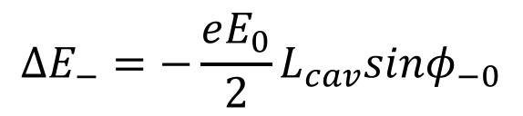
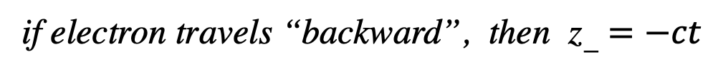
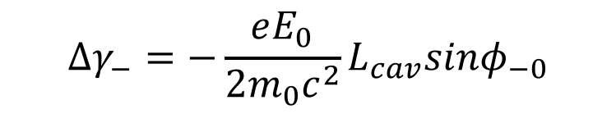
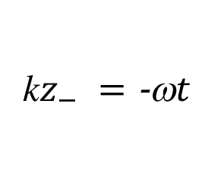
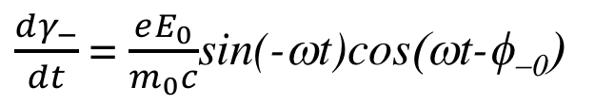
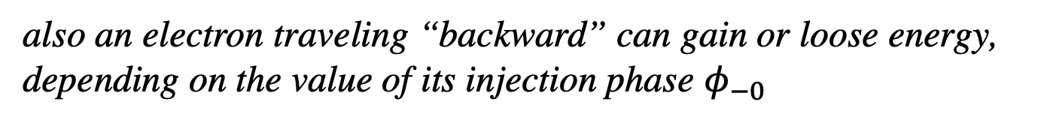
if electron travels “backward”, then z$− =−ct$
k$z_{−} =\text{−}\text{w}t$
$\frac{dγ_{−}}{dt}$ = $\frac{eE_{0}}{m_{0}c}$sin(-ωt)cos(ωt-φ₋₀)
$γ_{−}$= $γ_{−0}+$ $\frac{eE_{0}}{m_{0}c}\int_{0}^{nT=\frac{2πn}{ω}}{\text{sin}\text{(}\text{−}\text{w}\text{t}\text{)}\text{cos}\text{(}\text{w}\text{t}\text{−}\text{f}\text{−}\text{0}\text{)}}$ = $γ_{−0}−$ $\frac{eE_{0}}{m_{0}c^{2}}\frac{nλ}{2}sinφ_{−0}$
$$Δγ_{−}=−\frac{eE_{0}}{{2m}_{0}c^{2}}L_{cav}sinφ_{−0}$$
$$ΔE_{−}=−\frac{eE_{0}}{2}L_{cav}sinφ_{−0}$$
also an electron traveling “backward” can gain or loose energy,
depending on the value of its injection phase $φ_{−0}$

Slide 19
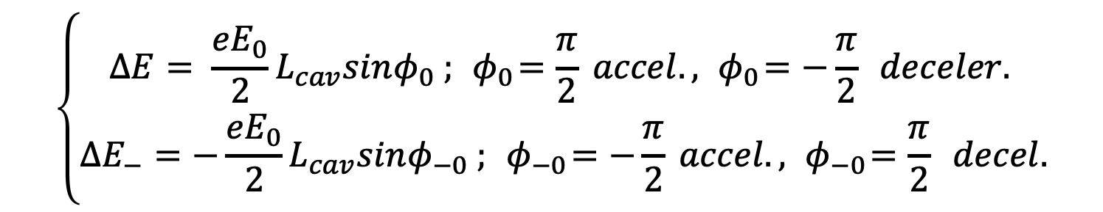
Therefore a standing wave can accelerate electrons (charge particles)
in both directions, “forward” and “backward”:
how is it possible?
$$\left\{\begin{aligned}ΔE= \frac{eE_{0}}{2}L_{cav}sinφ_{0} ;{ φ}_{0}=\frac{π}{2} accel.,{ φ}_{0}=−\frac{π}{2} deceler. \\ ΔE_{−}=−\frac{eE_{0}}{2}L_{cav}sinφ_{−0} ;{ φ}_{−0}=−\frac{π}{2} accel.,{ φ}_{−0}=\frac{π}{2} decel.\end{aligned}\right.$$
This is possible since the standing wave of RF mode TM_{010-π}
actually is composed by two traveling waves that counter-propagate
with equal amplitude but opposite phase
Ε₀ sin(kz)cos(ωt-φ₀)
7th African School of Physics - Port Elizabeth (ZA) - Dec. 2022

Slide 20
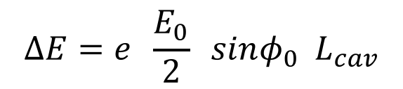
standing wave
Ε₀ sin(kz)cos(ωt-φ₀) =
(1/2) Ε₀ sin(kz-ωt+φ₀) + (1/2) Ε₀ sin(kz+ωt-φ₀)
forward traveling wave,
synchronous to z = ct
backward traveling wave,
synchronous to z = -ct
amplitude of the traveling wave
component synchronous
with the electron
$$ΔE=e \frac{E_{0}}{2} sinφ_{0}{ L}_{cav}$$
7th African School of Physics - Port Elizabeth (ZA) - Dec. 2022

Slide 21
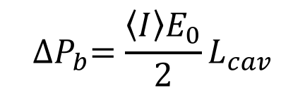
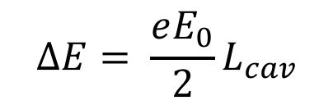
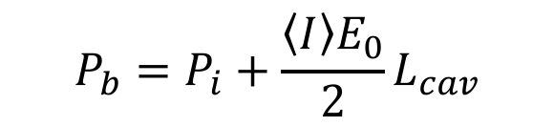

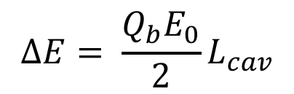
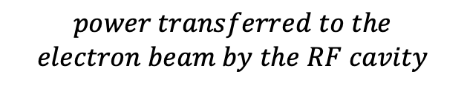
Maximum energy gain of an electron:
$$ΔE= \frac{eE_{0}}{2}L_{cav}$$
Maximum energy gain of a bunch of electrons (bunch) of charge Q_{b}:
$$ΔE= \frac{Q_{b}E_{0}}{2}L_{cav}$$
If I have a beam of electrons made by bunches that repeat in time at a
repetition rate f, this will carry an average current equal to:
$$\left\langle I\right\rangle =Q_{b}f$$
so the electron beam will carry an average Power P_{b} at Cavity exit
$$P_{b}=P_{i}+\frac{\left\langle I\right\rangle E_{0}}{2}L_{cav}$$
$$P_{i}=power carried by the electron bem at cavity entrance$$
$${∆P}_{b}=\frac{\left\langle I\right\rangle E_{0}}{2}L_{cav}$$
$$power transferred to the$$
$$electron beam by the RF cavity$$

Slide 22
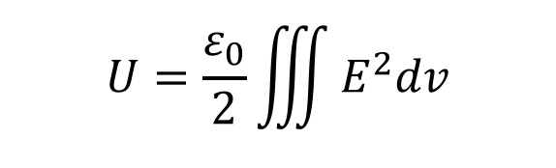
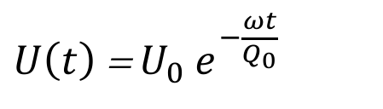

Energy Budget of a Radio-Frequency Cavity:
stored Energy U, dissipated Power on the walls P,
Quality Factor Q₀
$$U=\frac{ε_{0}}{2}\iiint{E^{2}dv}$$
$$P=\frac{R_{S}^{SC}}{2}\iint{H^{2}da}$$
$Q_{0}≡−\frac{ωU}{P}$ ; $Q_{0}$= $\frac{2πU}{U_{T}}$ ; ${ U}_{T}$ = energy dissipated in one period T=$\frac{2π}{ω}$
$U\left(t\right)$ =${ U}_{0}{ e}^{−\frac{ωt}{Q_{0}}}$
7th African School of Physics - Port Elizabeth (ZA) - Dec. 2022

Slide 23

7th African School of Physics - Port Elizabeth (ZA) - Dec. 2022

Slide 24

Bell frequency = 500 Hz ; time-lapse
ringing 10¹⁰/500=2*10⁷ seconds = 8 months
7th African School of Physics - Port Elizabeth (ZA) - Dec. 2022

Slide 25





Let us compare the power transferred by the RF e.m. field
of the Cavity to the accelerated (or decelerated) electrons,
with the Power dissipated on the walls of the Cavity:
the first one is an energy transfer that is not necessarily
dissipated into heat (entropy), the second one (ahime’) is always
converted into heat, therefore not directly recoverable
$${∆P}_{b}=\frac{\left\langle I\right\rangle E_{0}}{2}L_{cav}$$
$$P=\frac{R_{S}^{SC}}{2}\iint{H^{2}da}$$
to simplify the calculation so to better underline the dependences on
the physical parameters, we take a cavity made by 2 cells (i.e. λ long)
$${∆P}_{b}=\frac{\left\langle I\right\rangle E_{0}}{2}λ$$
$$U=\frac{ε_{0}}{2}\iiint{E^{2}dv}=\frac{{Gε}_{0}}{2}E_{0}^{2}λ^{3}$$
G is a numerical factor function only
of the Cavity cell geometry: G < 1
$$P=\frac{ωU}{Q_{0}}=\frac{πG}{Z_{0}}\frac{E_{0}^{2}λ^{2}}{Q_{0}}$$

Slide 26

E₀ =15 MV/m
P = 15 W
TESLA
a normal conducting (Cu) RF Cavity would dissipate
P = 2.10^{4.}15 W = 300 kW
7th African School of Physics - Port Elizabeth (ZA) - Dec. 2022

Slide 27





Considering the ratio η between the power P dissipated on
the walls and the power ΔP_{b} transferred to the electron beam
$$η≡\frac{P}{ΔP_{b}}$$
we derive:
$$η=\frac{2πG}{Z_{0}\left\langle I\right\rangle }\frac{E_{0}λ}{Q_{0}}$$
assuming G=0.5 e substituting Z₀=376 ohm:
$$η=0.0084\frac{E_{0}λ}{{\left\langle I\right\rangle Q}_{0}}$$
$$\left\{\begin{aligned}η≪1 energy recovery (E.R.L.) \\ η≥1 no energy recovery\end{aligned}\right.$$
$$c_{ERL}=\frac{1}{1+η}$$
Energy recovery coefficient c_{ERL}

Slide 28

Two noticeable examples: STAR and BriXS
highly asymmetric compact*
electron-photon colliders
secondary photon beams via large
lorentz boost of c.m. reference frame
MariX/BriXS @ Universita’ degli Studi di Milano and INFN
http://www.fisica.unimi.it/ecm/home/ricerca/marix

Slide 29


$$η=0.0084\frac{E_{0}λ}{{\left\langle I\right\rangle Q}_{0}}$$
$$c_{ERL}=\frac{1}{1+η}$$
BRIXS
E₀ =15 MV/m λ=0.23 m
<I> = 20 mA Q₀=1.5.10¹⁰
ΔP_{b} = 0.02.15.10^{6.}0.23 = 69 kW
η = 9.7.10⁻⁵ c_{ERL} = 99,99 %
STAR
E₀ =25 MV/m λ=0.105 m
<I> = 100 nA Q₀=5.5.10⁴
ΔP_{b} = 10^{-7.}25.10^{6.}0.105 = 0.25 W
= 4..10⁶ c_{ERL} = 0,000025 %
STAR multi-bunch
<I> = 3 micro-A
= 1.3.10⁵ c_{ERL} = 0,0008 %
If I can recover the power transferred to the beam I can sustain
higher beam currents !

Slide 30


The whole story is much more complicate… High Order Modes

Slide 31

7th African School of Physics - Port Elizabeth (ZA) - Dec. 2022

Slide 32

7th African School of Physics - Port Elizabeth (ZA) - Dec. 2022

Slide 33


BriXSinO: an innovative accelerator towards energy sustainability and advanced applications with mono-chromatic X-rays and coherent high-power THz radiation.
Luca Serafini and BriXSinO’s TDR Collaboration
INFN-Milano and LASA
7th African School of Physics - Port Elizabeth (ZA) - Dec. 2022

Slide 34


BriXSinO T.D.R. released April 2022. Available at www.marix.eu

Slide 35


MariX with bubble arc compressor (EXPO-MIND CW-FEL)
3.2-3.8 GeV
3.-3.6 GeV
1.5-1.8 GeV
Dump& post FEL users
BriXSinO with recirculation loop
BriXSinO is MariX small scale demonstrator, to investigate 2 unique advanced acceleration techniques: i) Energy Recovery and ii) Two-way Acceleration
BriXSinO is based on enabling technologies (CW SuperConducting RF, high brightness injectors, ultra-low phase noise laser systems) that allow the operation of unique sources of radiations in the X-ray and THz range

Slide 36


BriXSinO is MariX and BriXS Demonstrator
The Challenge:
sustainable CW (50 W) coherent X-ray FEL & (W-class)
ICS inside and compatible with a University Campus
multi MW electron beams with recovery/recirculation to
keep power consumption / radio-protection below 100 kW
7th African School of Physics - Port Elizabeth (ZA) - Dec. 2022
www.marix.eu

Slide 37

BriXSinO Conceptual Layout - 1
BriXSinO is a linear electron accelerator (Linac) with beam current and time structure similar to a storage ring: 5 mA, 100 MHz (Cu Linac 0.1 μA, 100 Hz)
BriXSinO must be operated in Energy Recovery mode in order to sustain the large beam power (up to 225 kW at 45 MeV, cmp. normal Linac 10-50 W )

Slide 38
BriXSinO Conceptual Layout - 2
22 kW disposed
225 kW available
Energy Recovery is accomplished recirculating back the electron beam and decelerating through the Super-Conducting RF Cavities (90% recovery effectiveness)
100s kW electron beams would not be sustainable without Energy Recovery

Slide 39
Storage Rings circulate large beam powers (hundreds of MW) but without any availability to particles and very moderate access to beam phase space (preserve beam stability – life time): only perturbative use of beam, like in synch. radiation emission
Linacs give full access to beam particles (charge, energy) and beam phase space (quality): the beam is dumped after use (low efficiency, no energy sustainability, beam power limited to W)
Energy recovery Linacs represent a good and effective compromise: no access to beam particles (charge and energy must be preserved in order to be recovered after use) but full access to beam phase space and quality (emittance and energy spread can be degraded after use since the beam travel just once through the accelerator)

Slide 40

Radiation beam power (and flux) scales with electron beam power
Free Electron Lasers (amplified radiation) can transform up to ˜ 10⁻² of electron beam power into radiation, while Inverse Compton Scattering sources (spontaneous radiation) only up to ˜ 10⁻⁴

Slide 41

Intense, High-flux Inverse Compton Sources of
Mono-Chromatic X-Rays (up to 35 keV)
7th African School of Physics - Port Elizabeth (ZA) - Dec. 2022

Slide 42

Coherent THz radiation beams (10-50 micron wavelength) with impressive kW-class average power
7th African School of Physics - Port Elizabeth (ZA) - Dec. 2022

Slide 43
Thank you for your attention
Thanks to R. Paparella, A. Bosotti, D. Sertore,
L. Monaco, P. Michelato, A. Bacci, A.R. Rossi,
I. Drebot, V. Petrillo, F. Broggi, D. Giove,
S. Cialdi, E. Puppin, S. Samsam
for providing various material for this seminar
7th African School of Physics - Port Elizabeth (ZA) - Dec. 2022

Slide 44
Additional Spare Slides
7th African School of Physics - Port Elizabeth (ZA) - Dec. 2022

Slide 45
Acceleration in opposite directions through a Linac
(two-way acceleration)
is possible if:
RF fields can accelerate in both directions
(Standing Waves can do it)
2) Focusing effective in both directions and weakly energy dependent
(RF focusing and/or solenoids)
3) No bunch crossing –> Twice the Linac Length < Bunch separation
4) RF fields must be on for a time longer than
bunch back-and-forth travel time (CW recommended)
5) Orbit position must not be dependent on magnetic rigidity
(no two-way through dipoles, except bifurcations)
MariX Seminar – ALBA/CELLS - Barcelona - Jan. 13th, 2020

Slide 46




RF Focusing effective only in Standing Wave RF Cavities
a lesson we learned long time ago
RF transport matrix

Slide 47

A Cartoon on Power consumption (or Recovery) in Accelerators
Conventional Linac

Slide 48

Storage Ring

Slide 49

Energy Recovery Linac

Slide 50

chair: 150 kg
bread bag: 150 g
mountain hut
tender

Slide 51
Linac
$P_{AC}$ = g $v_{⊥}$ $\sum_{isk}^{N_{sk}}{M_{isk}}+P_{loss}$
Storage ring
$P_{AC}$ = $P_{loss}$
E.R.L.
$P_{AC}$ = ${{ N}_{ch}M}_{ch}$g $v_{⊥} −{{ N}_{ch}M}_{ch} \text{g} v_{⊥} +P_{loss}$ + ${{ + N}_{ch}M}_{br} \text{g} v_{⊥}$
$v_{⊥}$ chair-lift vertical speed
$N_{sk}$ total number of skiers sitting on chair-lift
$M_{isk}$ mass of isk-th skier
$P_{loss}$ power loss due to internal friction
$N_{ch}$ total number of chairs per section
$M_{ch}$ chair mass
$M_{br}$ bread bag mass

Slide 52
Energy Sustainability
Efficiency of an electrical engine: ratio between the AC power used and the mechanical power generated. It is typically between 80% and 90% (very good efficiency)
Efficiency of a diesel internal combustion engine is about 40%. That is, 40% of the energy consumed burning diesel fuel goes into mechanical work, the rest into heat.
Efficiency of a gasoline internal combustion engine is about 30% (new generation -> about 40%).
Just for sake of comparison: running LHC needs 120 MW, while the effective
power that goes into creating events in p-p interaction si only 10 kW.
Efficiency = 10 / 120.000 ˜ 10⁻⁴
Just for sake of comparison: the European X-FEL, driven by a 19 GeV
Super-Conducting electron Linac has an efficiency of about 3 %

Slide 53
The AC Power P_{acc} to run a Particle Accelerator
P_{acc} = P_{RF} + P_{MAG} + P_{ANC}
P_{RF} is used by Radio-Frequency Cavities and RF Power Sources (to save power go Super-Conducting)
P_{MAG} is used by Magnets and their Power supplies (to save go Super-Conducting or permanent magnet)
P_{ANC} is needed for Electronics, Diagnostics, Computer Control, Vacuum Pumps, Ancillary Labs, Offices, etc etc (hard to save on these items)
P_{acc} is directly impacting Operational Costs (electrical bill): rule of the thumb is 1 M€ per year* every 1 MW of AC Power P_{acc}
Univ. of Milan, PhD School, Sept. 2022

Slide 54

The AC Power P_{acc} must be compared to the Beam Power P_{beam}, i.e. the power that the particle accelerator is capable to store into the beam
* Beam Power is fully available in Linacs,
while is not accessible in Storage Rings (only perturbative)
Univ. of Milan, PhD School, Sept. 2022

Slide 55
The efficiency of a Particle Accelerator is defined in two ways:
1) the ratio between the beam power P_{beam} and total AC Power necessary to run the accelerator (beam-to-plug η_{btp} = P_{beam}/P_{acc}) or
2) the ratio between the user accessible beam power P_{avail} and total AC Power necessary to run the accelerator (true eff. η_{true} = P_{avail}/P_{acc})
In case of Linacs η_{btp} = η_{true}
In case of Storage Rings only η_{true} is meaningful (since P_{beam} is not accessible)
Univ. of Milan, PhD School, Sept. 2022

Slide 56
TABLE 1 - A Comparison concerning efficiency and sustainability among
Plasma Linacs (a), RT-Linacs (b), SC-RF Linacs (c), ERLs (d), Storage Rings (e)
*limited by beam dump
**power emitted in synchr. radiation
*** 10 h life-time (U_{beam} 360 MJ / life-time 36,000 s)
ELECTRON ACCELERATOR | Energy | Average Current | Beam Power | AC Power | efficiency beam-to-plug | beam availability (beam power) | True efficiency
Eupraxia @ SPARC-Lab (a) | 5 GeV | 0.3 nA | 1.5 W | 2 MW | 7.5.10⁻⁷ | 100 % (1.5 W) | 7.5.10⁻⁷
BELLA (a) | 7.8 GeV | 5 pA | 40 mW | 200 kW | 2..10⁻⁷ | 100 % (40 mW) | 2..10⁻⁷
STAR (b) | 150 MeV | 100 nA | 15 W | 400 kW | 3.8.10⁻⁵ | 100 % (15 W) | 3.8.10⁻⁵
MARIX (c) | 3.8 GeV | 50 mA | 190 kW | 17 MW | 1.1 % | 100 % (190 kW) | 1.1 %
BriXSino (d) | 45 MeV | 5 mA | 225 kW | 450 kW | 50 % | 10 % (22 kW)* | 4.9 %
Elettra (e) | 2 GeV | 310 mA | 620 MW | 4.0 MW | n.a. | 0.015 % (90 kW)** | 2.3 %
LHC | 7 TeV | 540 mA | 3.8 TW | 120 MW | n.a. | 3.2.10⁻⁹ (10 kW)*** | ∼10⁻⁴
Linac - plasma
Linac - plasma
Linac - RF
ERL
ERL
St. Ring
St. Ring
European XFEL (Super-Conducting Linac): 19 GeV, 32 μA, 608 kW, 17.8 MW,
η_{btp} = η_{true} = 3.4 % (proven about 1%)

Slide 58

BriXS: BRIght and compact X-ray Source - Proposal at
INFN-Milan and Univ. of Milan (post EXPO-2015 initiative
submitted to regional and metropolitan area governments)

Slide 59









1. Test facilities
UH-FLUX
Advanced Compton/THz source based on novel design of coupled SC RF cavities
A. Seryi, JAI
Compton or Coherent Smith Purcell (THz)
Recovery linac
New Generation High Flux (10¹⁴-10¹⁵ ph/s) Sources in the US (BNL), Japan (KEK)
and UK (STFC) based on Energy Recovery Super-Conducting CW electron linacs
WG4 : Applications and beam manipulation, Luca Serafini, Marie-Emmanuelle Couprie

Slide 60

Quantum beam project – KEK/ATF

Slide 61

J. Urakawa at KEK-ATF
J. Urakawa, Nucl. Instr. and Meth. A (2010), doi:10.1016/j.nima.2010.02.019

