Slide 1
Iyabo Usman (Southern Africa Editor)
School of Physics, University of the Witwatersrand, Johannesburg.
Iyabo Usman (Southern Africa Editor)
School of Physics, University of the Witwatersrand, Johannesburg.

Slide 2
AFRICAN PHYSICS NEWSLETTER (APN)
THE VOICE OF PHYSICS IN AFRICA
A MEDIUM FOR COMMUNICATION AND NETWORKING IN AFRICA
54 countries …
Physicists across the
continent

Slide 3
Outline
Introduce the African Physics Newsletter (APN)
Give examples of the types of articles it has been publishing
Encourage you to subscribe and contribute articles about your physics activities
Ways to subscribe and contribute articles.

Slide 4
Introduction to the APN
Survey of African physics
  the African Physics Project:
  Collaboration APS, IoP, EPS, SAIP and ICTP
  A significant finding:
    Need for physicists to communicate across the African continent
APN’s goal
  bridge communication gaps between African physicists in a country,
  among countries and
  between the continent and its outside.
2019 : Publication started
The newsletter is created by and for the African physics community.

Slide 5
Introduction to the APN
Working Model:
–Each quarter
– news articles
– solicited by or submitted through…
– all-volunteer Editorial Board of African physicists
– collected and delivered to the APS.
      Each issue has 8-12 two-page articles, a newsletter not a journal
–APS volunteers review, format, and distribute them.
      The APS plays no role in the solicitation or identification of the articles published.ee and open to anyone, even non-physicists.tions: Newsletter of the APS’s Forum on International Physics,
the AfriSciTech.org webpage

Slide 6
Introduction to the APN
Working Model:
–Each quarter
– news articles
– solicited by or submitted through…
– all-volunteer Editorial Board of African physicists
– collected and delivered to the APS.
      Each issue has 8-12 two-page articles, a newsletter not a journal
–APS volunteers review, format, and distribute them.
      The APS plays no role in the solicitation or identification of the articles published.ee
Distribution:
–Subscribers
      Subscriptions are free and open to anyone, even non-physicists.
–Websites: African Physical Society, Ethiopian Physical Society (North American)
–Selections: Newsletter of the APS’s Forum on International Physics,
the AfriSciTech.org webpage

Slide 7
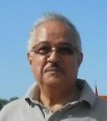
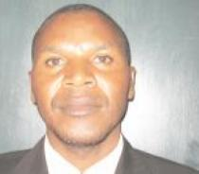
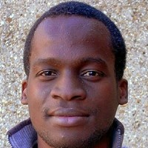
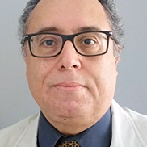
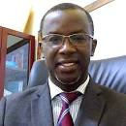
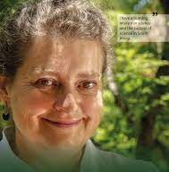
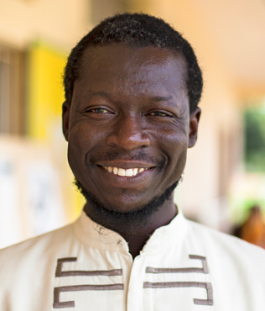
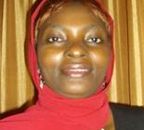

North Africa: Prof. Mohamed Abdel Harith ( mharithm@niles.edu.eg, National Institute of Laser Enhanced Science (NILES), Cairo University, Giza, Egypt) Prof. Mourad Telmini ( mourad.telmini@fst.utm.tn, University of Tunis El Manar, Tunis, Tunisia) South Africa: Prof. I. Gledhill ( igle.gledhill@wits.ac.za, University of Witwatersrand, Johannesburg, South Africa) Dr Iyabo Usman ( Iyabo.Usman@wits.ac.za, University of Witwatersrand, Johannesburg, South Africa) East Africa: Dr. Victor Odari ( odarivyc@gmail.com , Masinde Muliro University of Science and Technology, Kakamega, Kenya) Dr. Marie Chantel Cyulinyana ( mariechantal@aims.ac.za, University of Rwanda, Rwanda) West Africa: Prof. Moses Jojo Eghan ( meghan@ucc.edu.gh, University of Cape Coast, Cape Coast, Ghana) Prof. Lat Grand Ndiaye ( lgndiaye@univ-zig.sn , University Assane Seck, Ziguinchor, Sénégal) Central Africa: Editor in Chief, Prof. Stéphane Kenmoe ( stphnknm@gmail.com, Universitaet Duisburg-Essen, Essen, Germany)
North Africa: Prof. Mohamed Abdel Harith ( mharithm@niles.edu.eg, National Institute of Laser Enhanced Science (NILES), Cairo University, Giza, Egypt) Prof. Mourad Telmini ( mourad.telmini@fst.utm.tn, University of Tunis El Manar, Tunis, Tunisia) South Africa: Prof. I. Gledhill ( igle.gledhill@wits.ac.za, University of Witwatersrand, Johannesburg, South Africa) Dr Iyabo Usman ( Iyabo.Usman@wits.ac.za, University of Witwatersrand, Johannesburg, South Africa) East Africa: Dr. Victor Odari ( odarivyc@gmail.com , Masinde Muliro University of Science and Technology, Kakamega, Kenya) Dr. Marie Chantel Cyulinyana ( mariechantal@aims.ac.za, University of Rwanda, Rwanda) West Africa: Prof. Moses Jojo Eghan ( meghan@ucc.edu.gh, University of Cape Coast, Cape Coast, Ghana) Prof. Lat Grand Ndiaye ( lgndiaye@univ-zig.sn , University Assane Seck, Ziguinchor, Sénégal) Central Africa: Editor in Chief, Prof. Stéphane Kenmoe ( stphnknm@gmail.com, Universitaet Duisburg-Essen, Essen, Germany)
Editorial Board
North Africa:
Prof. Mohamed Abdel Harith ( mharithm@niles.edu.eg, National Institute of Laser Enhanced Science (NILES), Cairo University, Giza, Egypt)
Prof. Mourad Telmini ( mourad.telmini@fst.utm.tn, U.Tunis El Manar, Tunis, Tunisia)
South Africa:
Prof. Igle Gledhill ( igle.gledhill@wits.ac.za, U. Witwatersrand, Johannesburg, SA)
Prof. Iyabo Usman ( Iyabo.Usman@wits.ac.za, U. Witwatersrand, Johannesburg, South Africa)
East Africa:
Dr Robinson Juma Musembi, (musembirj@uonbi.ac.ke ,University of Nairobi, Kenya)
Dr Steve Ndengué (sndengue@eaifr.org , East African Institute for Fundamental Research, Rwanda)
West Africa:
Prof. Moses Jojo Eghan ( meghan@ucc.edu.gh , U. Cape Coast, Cape Coast, Ghana)
Prof. Lat Grand Ndiaye ( lgndiaye@univ-zig.sn , U. Assane Seck, Ziguinchor, Sénégal)
Central Africa:
Editor in Chief, Prof. Stéphane Kenmoe ( stphnknm@gmail.com,
U. Duisburg-Essen, Essen, Germany)

Slide 8
Advisory Board
Prof. Nithaya Chetty (University of the Witwatersrand, South Africa)
Prof. Florence M. D’ujanga, (Makerere University, Uganda)
Prof. Igle Gledhill (University of Witwatersrand, South Africa)
Chair, Dr. James E. Gubernatis (Los Alamos National Laboratory (retired), USA)
Prof. Sekazi K. Mtingwa (Triangle Science, Education & Economic Development, LLC, North Carolina)
Dr. Joseph Niemela, (The Abdus Salam International Centre for Theoretical Physics, Italy)
Dr. Daniel Nyanganyura (South Africa)
Prof. Ahmadou Wagué (Cheikh Anta Diop University, Sénégal)

Slide 9
Communication and Networking
■ The APN is a mechanism to communicate with a broad group of physicists in Africa, in the diaspora, and outside of the African physics community.
■ The selected highlights are examples of the spectrum of communications that occur within any physics community.
–While activities and countries are diverse and disperse, the newsletter is showing that Africa has a vibrant physics community!
■ The whole is greater than the sum of its parts!
■ Specific opportunities for the ASP community include posting
–Calls for applications
–Announcements of upcoming Alumni events,
–Networking and funding opportunities

Slide 10
Communication and Networking
■ The APN is a mechanism to communicate with a broad group of physicists in Africa, in the diaspora, and outside of the African physics community.
■ The selected highlights are examples of the spectrum of communications that occur within any physics community.
–While activities and countries are diverse and disperse, the newsletter is showing that Africa has a vibrant physics community!
■ The whole is greater than the sum of its parts!
■ Specific opportunities for the ASP community include posting
–Calls for applications
–Announcements of upcoming Alumni events,
–Networking and funding opportunities

Slide 11
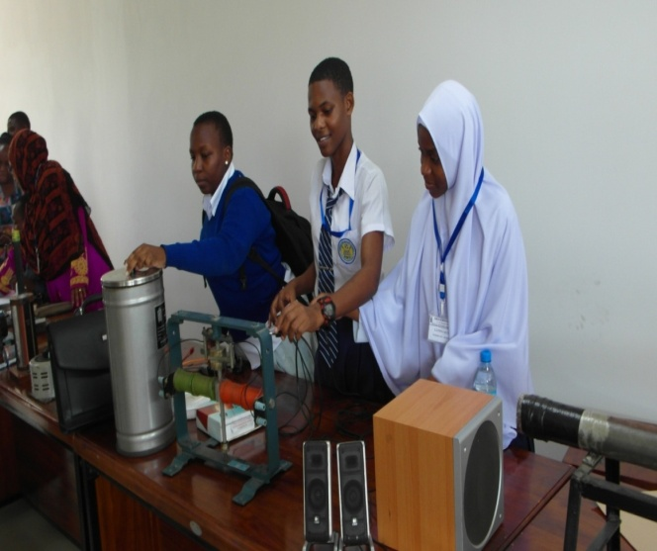
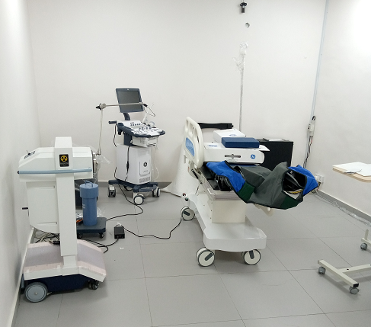
Highlights from Past Issues
■ Twenty-five Years of Laser at Cairo University ■ Special focus: Medical Physics in Africa ■ Special Focus: Quantum Computing and Information ■ Science Camp for High School Girls in Tanzania ■ Excellence in Africa: 100 PhDs for Africa Program with The Swiss Federal Institute of Technology (EPFL). https://www.epfl.ch/research/domains/exaf/ ■ The Physics Association of Botswana | ■ Building Quantum Skills and Community in Africa ■ University of Tunis El Manar Launches a Master’s in Nanophysics and Nanotechnology ■ Interview: Dr. Solomon Assefa, Vice President, IBM Research -Africa & Emerging Market Solutions ■ African Strategy for Fundamental and Applied Physics (ASFAP) ■ The Alumni of the African School of Fundamental Physics and Applications (ASP)
3D-HDR GammaMed iX Plus Brachytherapy with GE-Brivo Ultrasound device. ]
Dr. Maika Takita in the Thomas J. Watson Research Center IBM Quantum Lab.
Science camp for high school girls in Tanzania

Slide 12
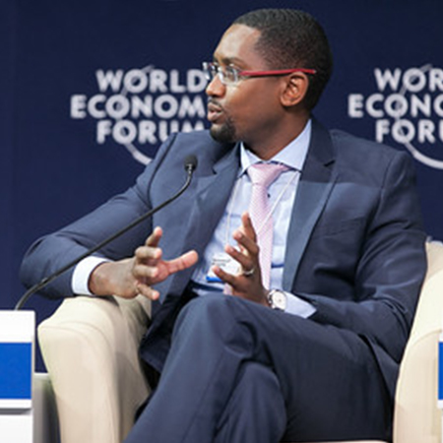
Highlights from Past Issues
■ Twenty-five Years of Laser at Cairo University ■ Special focus: Medical Physics in Africa Special Focus: Quantum Computing and Information ■ Science Camp for High School Girls in Tanzania ■ Excellence in Africa: 100 PhDs for Africa Program with The Swiss Federal Institute of Technology (EPFL). https://www.epfl.ch/research/domains/exaf/ ■ The Physics Association of Botswana | ■ Building Quantum Skills and Community in Africa ■ University of Tunis El Manar Launches a Master’s in Nanophysics and Nanotechnology ■ Interview: Dr. Solomon Assefa, Vice President, IBM Research -Africa & Emerging Market Solutions ■ African Strategy for Fundamental and Applied Physics (ASFAP) ■ The Alumni of the African School of Fundamental Physics and Applications (ASP)
Dr Solomon Assefa © World Economic Forum and Jacob Polscek
Zara Randriamanakoto and radio telescope of Arivonimamo in Madagascar

Slide 13
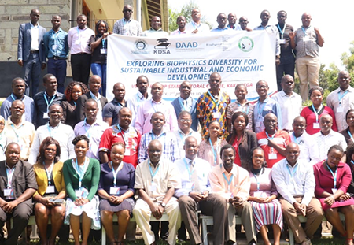
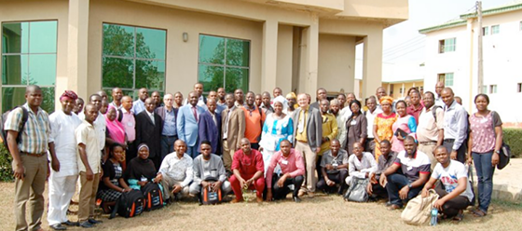
Highlights from Past Issues
■ "QPythonist” Students Learn Computational Science and Engineering through Android Smartphones ■ The Dawn of Physics Community- Kenya (PC-K) Group ■ The International Centre for Theoretical Physics (ICTP) opens the first African partner institution in University of Rwanda, Kigali ■ Women in Science in Africa; A Silent Revolution ■The Physics Department at the Federal University of Agriculture, Abeokuta, Nigeria

Slide 14
How and Where:
■ How to subscribe? – Go to https://go.aps.org/africanphysics – The next issue will be in March 2023. – Past issues are accessible by clicking a tab in the top left corner of any issue. – Latest issue https://mailchi.mp/f3e90202da1f/african-physics-newsletter_120921-15543738?e=818773bdde Acknowledgements: Advisory Board, Editorial Board, APS and APS International Affairs | ■ How to contribute news articles? – Whether a subscriber or not, – Email Prof. Stéphane Kenmoe Universität Duisburg-Essen, Essen, Germany) stphnknm@gmail.com, – Or follow the instructions given in the newsletter. ■ Length ~2 pages, plus links, & a graphic or two ■ Template available

