Slide 1
Knowledge Management at Firmenich
Presentation to SNUG members
CERN
November 2022

Slide 2
Agenda
Process presentation and definition
Process Critical Success Factors and Key Performance Indicators
Questions
What we measure
Tips and specific features at Firmenich

Slide 3

Process presentation and definition
Articles published for Information Services (IS) teams and end-users knowledge
Authored by IS exclusively
2’000+ articles published
Around 25% of published articles visible to and usable by end users
Notes:
History & Introduction (mentioned by PRH): Different kind of documents we create : policies, process, procedures, application support, naming conventions, self-help, technical SOP, ppt training
In IS Firmenich, only people from the IS team can create knowledge articles.
We create and publish knowledge articles for IS support teams AND for end users. End users’ visibility is limited to the articles published for them.
Today we have a bit more than 2’000 articles published. Among these, we have around 500 articles published and visible to end users (25%).

Slide 4
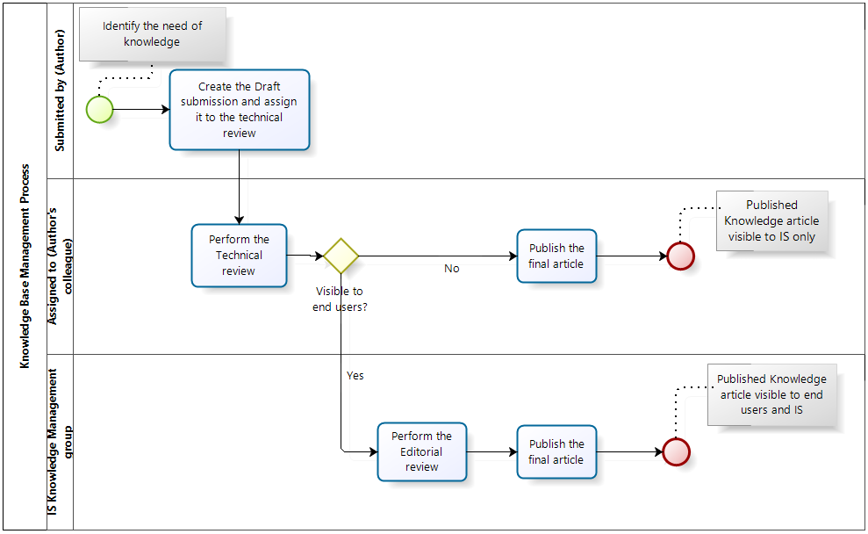
Process presentation and definition
Notes:
The process is defined as follows:
Stakeholders are the author, the reviewer, the knowledge management team and the reader
The author writes and creates. – The reviewer provides objectivity in the review of the article content before publication and publish for IS. – The knowledge management team ensures stakeholders are trained to use the process, proposes and implement improvements and ensures pending items are handled and published for end users. – The reader uses the published articles.
No article can be published without a technical review. No article, that is intended to be published for end users can be published without a technical review AND an editorial review.

Slide 5
Process Critical Success Factors and Key Performance Indicators
CSF1 – Knowledge Base is useful to support users
KPI 1.1. Number of searches are close to number of views
KPI 1.2. Percentage of viewed articles compare to published articles
CSF2 – Knowledge articles are maintained up-to-date
KPI 2.1. Regular review of knowledge articles
KPI 2.2. Average time to publish a knowledge article
CSF3 – Knowledge process and knowledge team are audited on a regular basis (collect feedback and trigger action plan)
KPI 3.1. Process is audited by users community
KPI 3.2. Knowledge team is audited by users community
Survey under construction – To be launched before the end of this calendar year
Benchmark missing to define a right target
Technical issue in defining the percentage of the target
Notes:
To ensure the process is correctly used and is a real benefit for the Firmenich community, we defined three Critical Success Factors which are:
The knowledge base must be a useful tool to support users.
The first KPI for this CSF is about to ensure the number of searches are close to the number of views. This would signify the searches are triggering good results and the content of the KB matches the users needs. If searches turn much higher than views, then it means users doesn’t easily find what they are searching for and the KB is not useful to them.
The second KPI is about comparing viewed articles to published articles. Do we have an acceptable percentage? We are still struggling to find a target for this KPIs as actually we are not able to find any benchmark or requirement.
The knowledge base must be maintained and up to date
The first KPI is about ensuring the content of the KB is reviewed on time based on best practices and requirements.
The second KPI is about ensuring articles and new or revised information is published in an acceptable timeline.
The knowledge process and the knowledge team are audited on constant improvement purposes.
The first KPI is about ensuring and vrifying the process application and usage is easy and useful to owners of knowledge.
The second KPI is about ensuring the support provided by the knowledge team is useful to owners of knowledge.

Slide 6
What me measure
Knowledge by state
  Items by state
  Items out of review
  Items published
Publishing time
  Time to publish articles
Published articles
  Articles published (by audience, by month)
  New articles vs new versions
  Viewed articles compare to published articles
  Time to manage feedbacks
  Articles reviewed in time
Content usage
  Searches compare to views
  Feedbacks and Ratings
Notes:
In addition to CSFs, KPIs and their targets, we also measures other activities, some of them more operational but also used to support the global process governance.
We use these measures to track and follow on pending items and also to identify potential «issues» and work on improvement actions.

Slide 7

Tips and specific features at Firmenich
Categorization
Data classification
Main audience
Last status change
Technical review start
Next review required
3 reminders and deletion
Monthly notification on non updated KBs
Relationship with service management lifecycle
Using PA for reporting
Notes:
Here are the features we added to the out of the box procedure.
We created a categorization to facilitate searches. But actually, the way it is technically implemented, is causing some issue in reporting.
Data classification has been implemented as a preparation for ISO 27001 certification (Firmenich certified).
Main audience is used to facilitate and speed up the search of Service Desk and local support (focusing on customer satisfaction)
Date attributes to improve the reporting about how long a KB takes to be (re)published.
Next review date is split in various periods instead of an annual review.
While tracking pending items, we send 3 reminders to owner groups or assignees. If no reaction, then we delete the KB.
Still to track pending items, we implemented a by - monthly notification for owner groups or assignees for pending items not updated since 30 days
Still to track pending items, we implemented a notification on user departure flow. Notification sent to knowledge management team when a user is assigned to a pending item and the user status turns to inactive.
Relationship with service management:
When a service is going live, recommendation is done from service transition perspective for the project team to create the information for support teams (service transition)
when a service is decommissioned, a tasks is triggered to knowledge team to archive the impacted KBs if any.
We use PA AND Reports application in dashboards.

Slide 8
Knowledge Base promotion and challenges
One shot promo
Onboarding - eLearning
Lack of management support
Two population: «KB is important» versus «I’ll do when I have time»
ITIL certification
  Then 85% certified and Now 65% certified ⇒ this leads to communication issues regarding process maturity
YOU – what / how do you do?
Notes:
Here are our main challenges while managing knowledge. But actually it can ne summarized in one question? How do we do to promote knowledge management and get people committed?»
We have management support in theory, but it’s hard to see it on a daily basis.
We created and are providing trainings on a regular basis, but people seems to quickly forget or just rely on the knowledge team.
Do you face the same challenge and how do you deal with it? Do you face the same situation in project management process and service transition? This looks quite related to the level of maturity a company may have in process understanding.

Slide 9
Questions

