Slide 1
CERN Knowledge base
Quality controls
Isabel Fernandez, SCE-SMS
Knowledge Base KPIs workshop
The 10th of November, 2022

Slide 2


KB quality controls
Information is valid, up-to-date
Information is useful

Slide 3
KB articles with valid information
Review articles content:
  Notifications send to the responsible(functional managers) and team with instructions on how to update the content or retire the article:
    Validity is expiring
    Validity warning
    Pending review: articles are reviewed once a year
  Dashboard to follow articles ‘last updates’, expiration date, users feedback and views
Broken links and images: notification sent to Knowledge managers

Slide 4
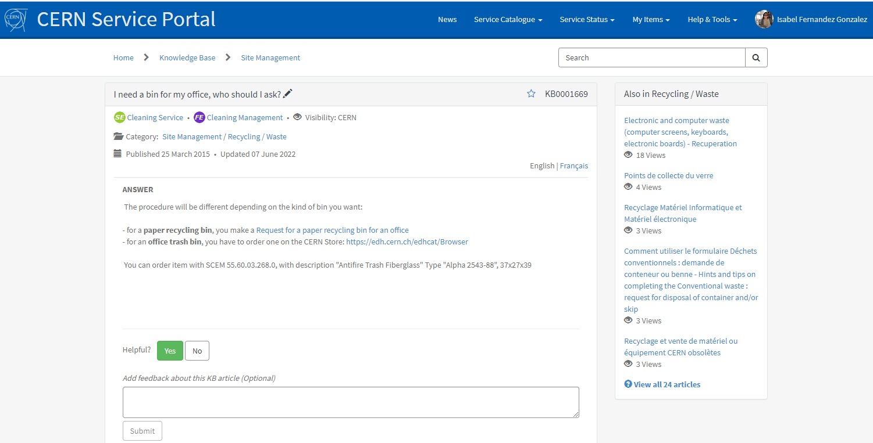

KB articles with useful information
Dashboard to follow up users' feedback and views

Slide 5
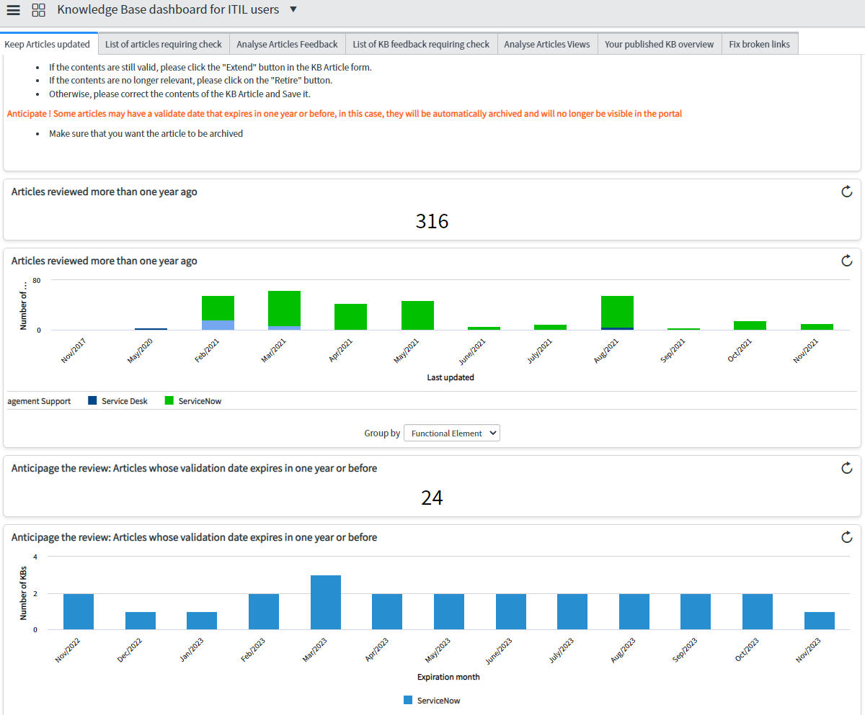
Knowledge Base dashboard for ITIL users (supporters and managers)

