Slide 1
Knowledge Base at CERN
Nicole Cremel, IT Department
Knowledge Base KPIs workshop (SNUG)
10 November 2022

Slide 2
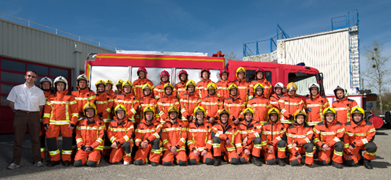
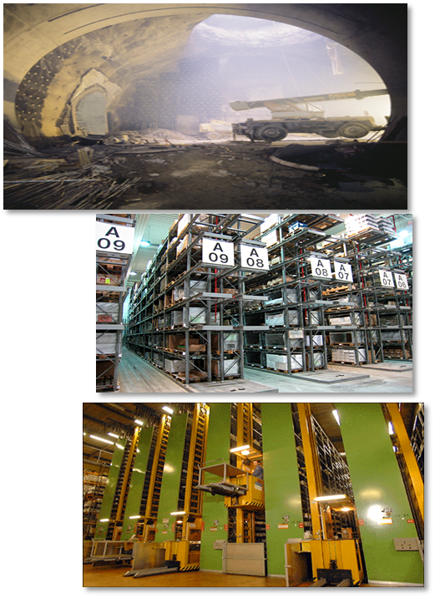
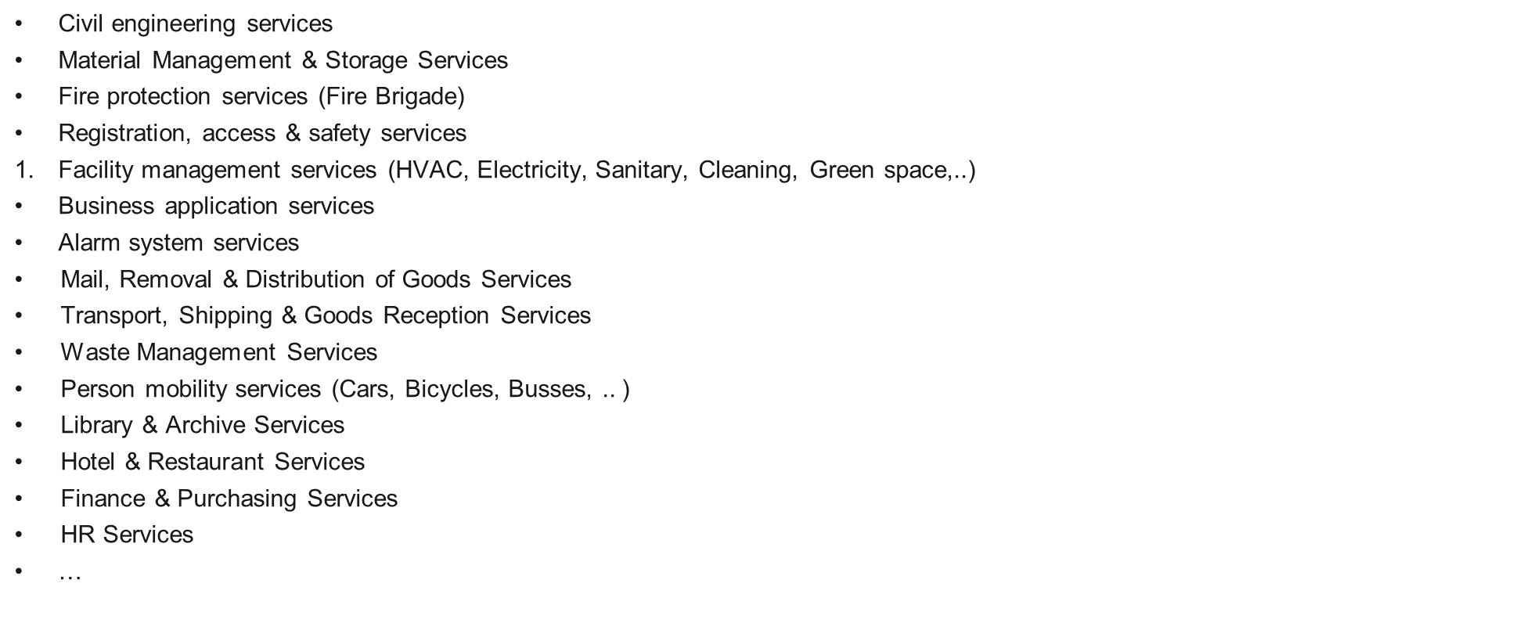
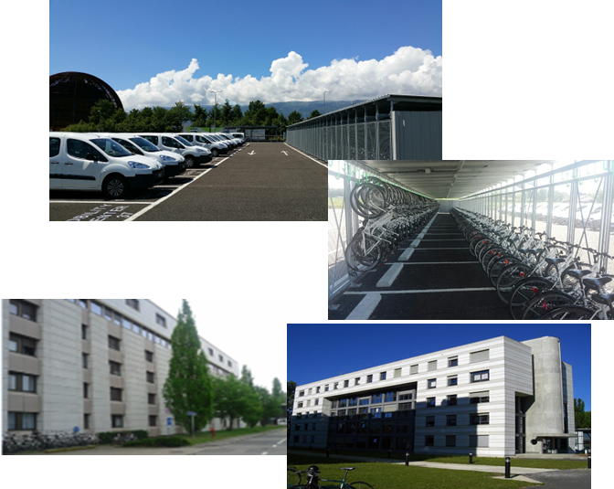
Scope: Beyond IT
KB articles in all areas and not only for IT

Slide 3

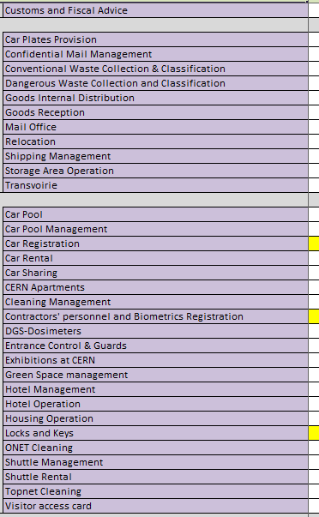
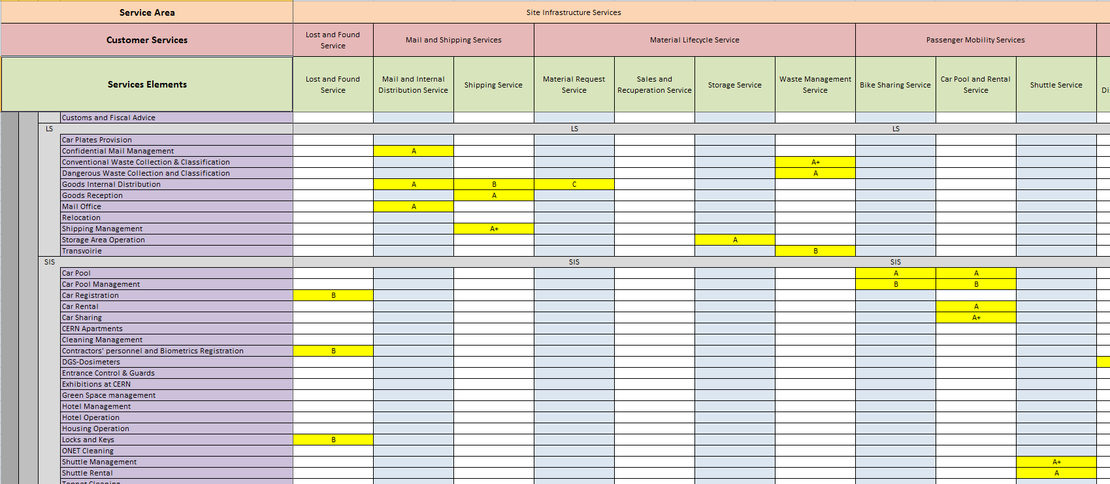
Business Service Catalogue
“Core” of ServiceNow at CERN - Matrix structure with 2 dimensions:
  Columns: Services (What, User View) Field Service Element (SE)
  Rows: Functions (How, Supporters View) Field Functional Element (FE)
  FEs are linked to Support Lines (with the people providing support)
What
How

Slide 4
CERN implementation
Only ONE Knowledge Base: CERN Knowledge
BUT KBs are organised via the Service Catalogue:
  385 Service Elements (SEs) and 794 Functional Elements (FEs)
All KBs attached to one FE:
  People registered in one FE (members of support lines) are responsible for all KBs in this FE (up-to-date / still valid)
All people can edit a KB in any FE
  but ONLY FE members can publish a KB article in this FE
Today (November 2022) we have 3,593 KB articles published in the Service Portal:
  192 «Public», 1,995 «CERN» (Cern login is required), 160 «Supporters» (for people answering tickets),
  1,246 «Specific groups» (restricted to small groups)

Slide 5
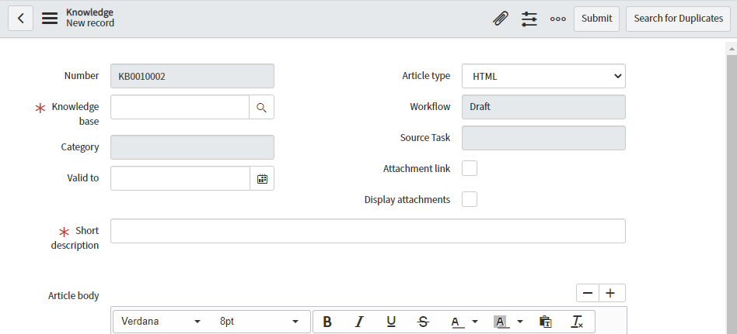
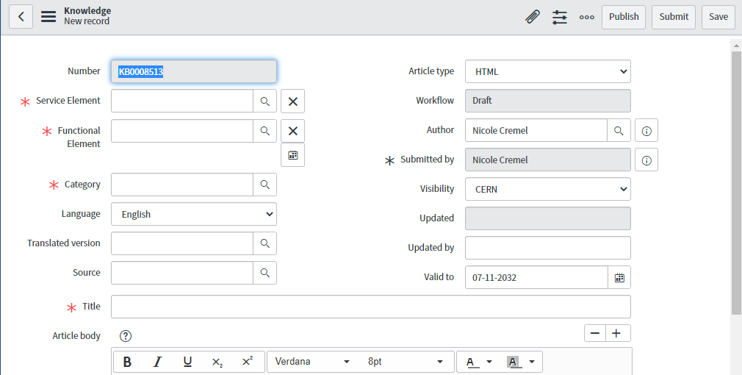
OOB versus CERN (Create New)
Out-Of-the-BOX
CERN Implementation
CERN implementation:
- Service Element (SE) and Functional Element (FE)
- Visibility
- Language / Translated version
+ Publish: only when user is a member of the selected FE for this KB article (in one support line for this FE)

Slide 6
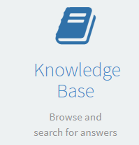
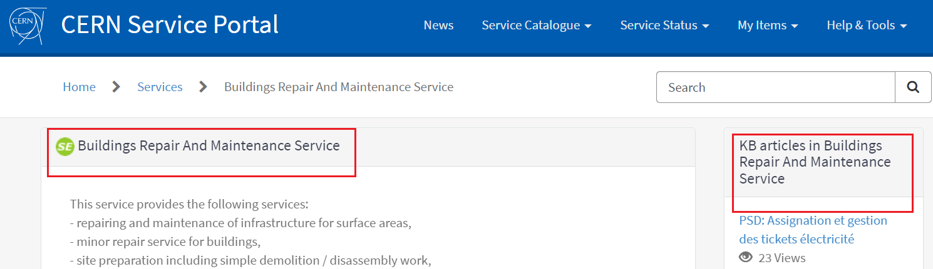
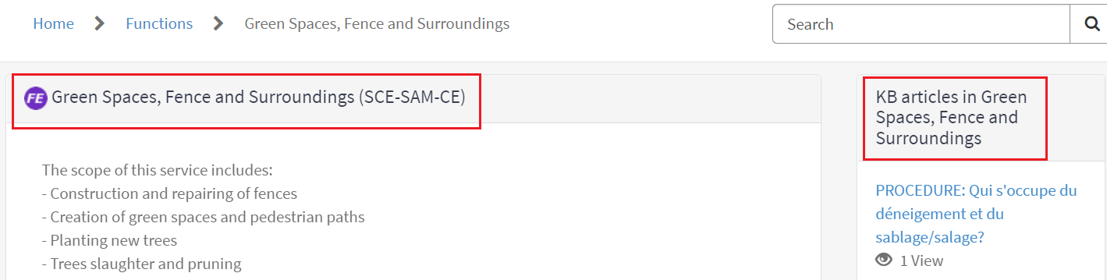
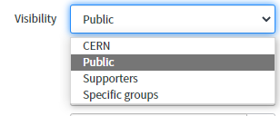
CERN Implementation
SE and FE: KB articles are linked to the Catalogue of Services
Visibility: define access to this KB article
  People will only see the articles they can access

Slide 7

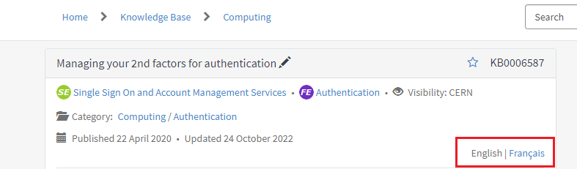
CERN Implementation
Language / Translated version
  We support 2 languages: English (default) and French
  When a KB is published there is a button “Translate” to provide the
  “French version” of this KB article.

Slide 8
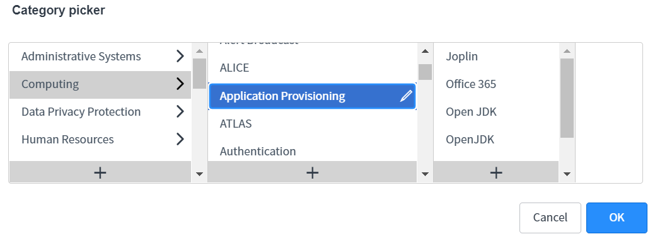
CERN Implementation
KB articles:
FAQs but also longer documentations, training, presentations,
procedures with restricted visibility, etc.
End users access KBs in the Service Portal (edition by supporters in the Tool)
Classification:
  - Services / Functions (KB articles in this SE, KB articles in this FE)
  - And also in “Categories”
  “category picker” when editing a KB

Slide 9
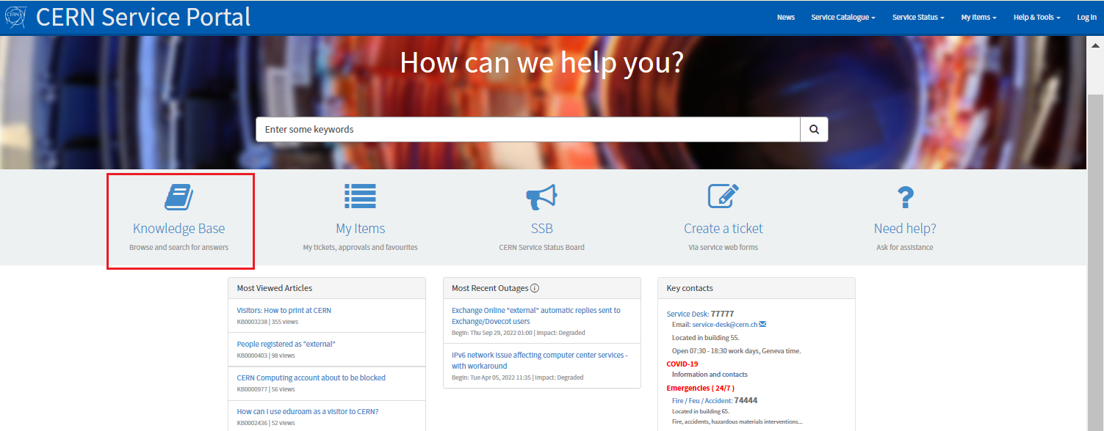
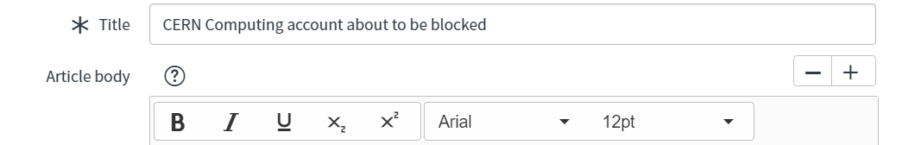
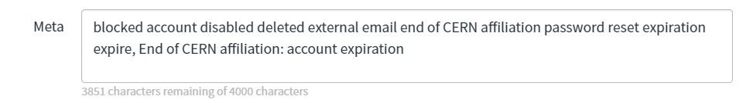
Knowledge Base in CERN Service Portal
Search:
«Global search» of ServiceNow (all catalogue items)
Fields «Title» and «Meta» (for «keywords) help promote the KB result for searches
Example:

Slide 10
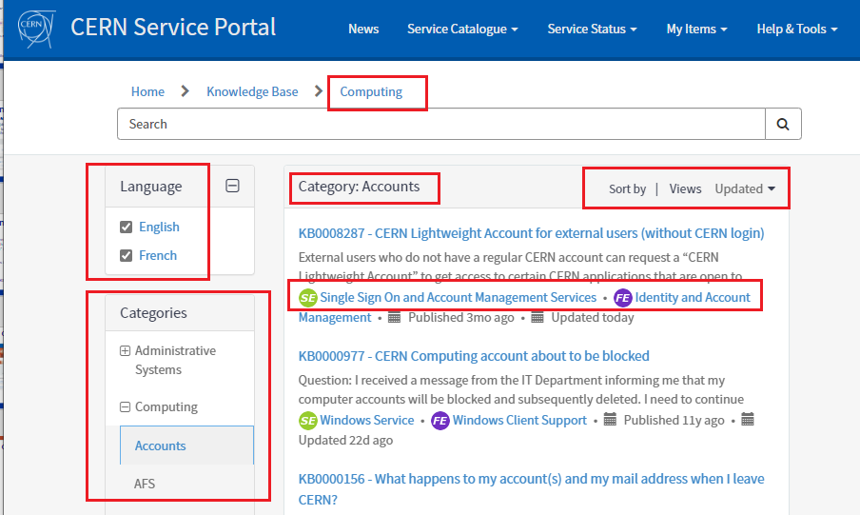
Knowledge Base in CERN Service Portal
Top category = Computing
Global search filtering KB articles
Sub-category = account
Select language
Sort by
Browse articles in SE or in FE

Slide 11
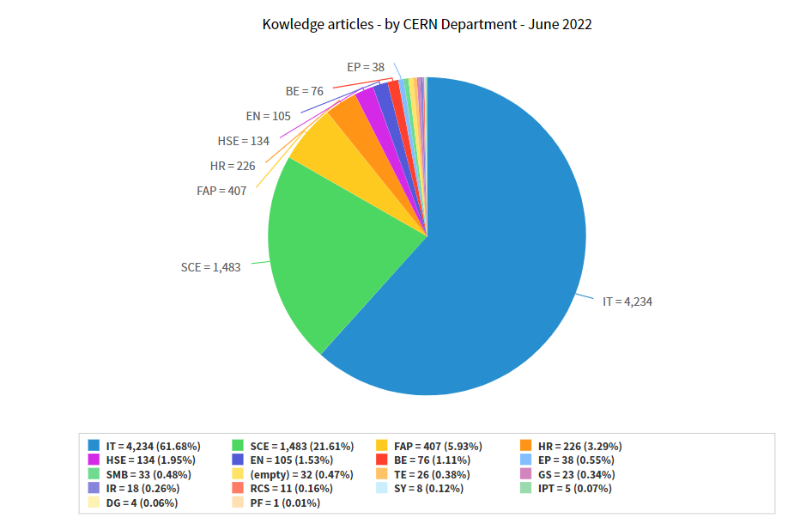
KB some figures (June 2022)
Number of KB articles published per Department (departement is an attribute of the FE)

Slide 12
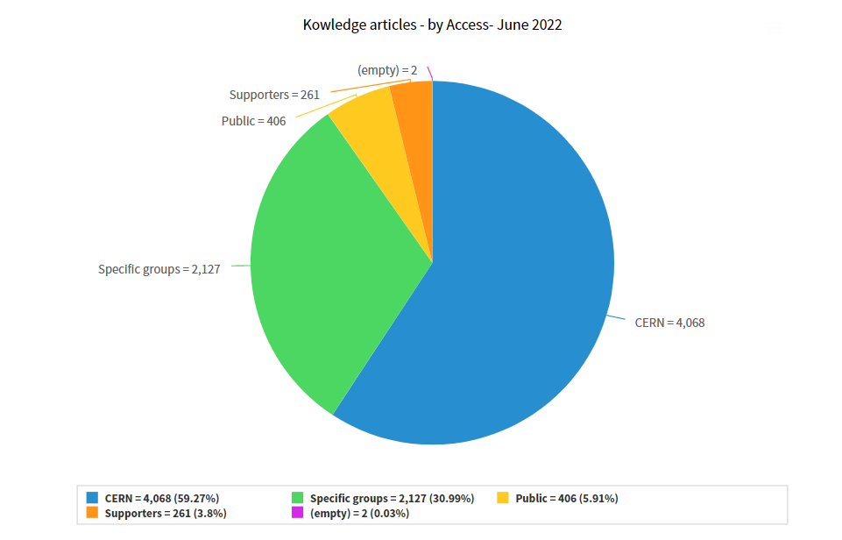
KB some figures (June 2022)
Number of KB articles
according to parameter «visibility»:
Public: all world (no login)
CERN: CERN account login
Supporters: members of FE(s)
Specific groups: restricted to some support lines

Slide 13
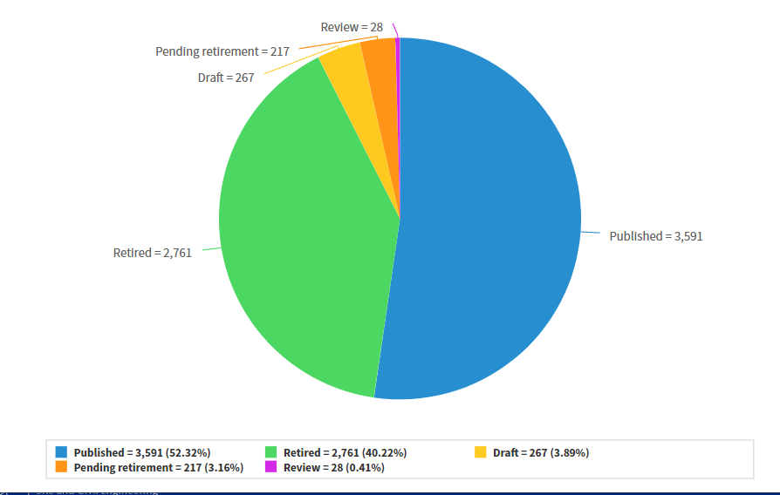
KB some figures (June 2022)
Number of KB articles
according to «workflow»:
Draft
Review
Published
Pending retirement
Retired
Only «Published» KBs are visible in the Service Portal

Slide 14


