Slide 1
BCCM: commissioning experience
and status
230th Machine Protection Panel Meeting, 21/10/22
Marek Gasior, Tom Levens
SY-BI-IQ

Slide 2
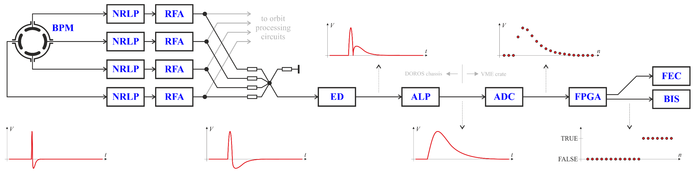
BCCM (dI/dt) system
shared BPMs:
system A: BPMYA.5R4.B1+B2
system B: BPMYA.6R4.B1+B2
NRLP – Non-Reflective Low-Pass (≈ 80 MHz)
RFA – RF Amplifier
ED – Envelope Detector
ALP – Active Low-Pass (≈ 2 MHz)
The system is based on BPM signals shared with the LHC beam position measurement system (passive RF splitters)
The beam position dependence is removed by summing the four electrode signals
Analog operations on the signals: low-pass filtering, amplification, envelope detection + rectification + level shifting, low pass filtering
Digitization: 16-bit, 40 MHz sampling synchronous to the circulating beam (one revolution period is exactly 3564 ADC clocks).
The 40 MHz ADC B1 and B2 clocks are derived from the 400 MHz RF frequencies received by optical fibers from the RF system.
One turn “raw intensity” is a sum of ADC samples above a “beam presence threshold” minus “no beam offset”, selected from one turn 3564 samples
One turn “raw dI/dt signal” is a difference of the one turn raw integrals from two consecutive turns
“Raw dl/dt signals” in the five other integration windows are calculated as running sums of the one-turn “raw dI/dt signals”
Every turn each of the “raw dI/dt signals” are compared to its corresponding raw dump threshold level and potential beam dump triggers are generated.
All real-time calculations are done in the FPGA in an integer arithmetic.
The BCCM absolute intensities in elementary charges are calculated by scaling the “raw intensities” using a “BCCM/BCT scaling factor”.
The factor is a constant for each system and is obtained by matching the beam intensity evaluated by the BCCM to the corresponding BCT readings.
The absolute dump thresholds in elementary charges are translated into “raw dump thresholds” using the same “BCCM/BCT scaling factor”.

Slide 3
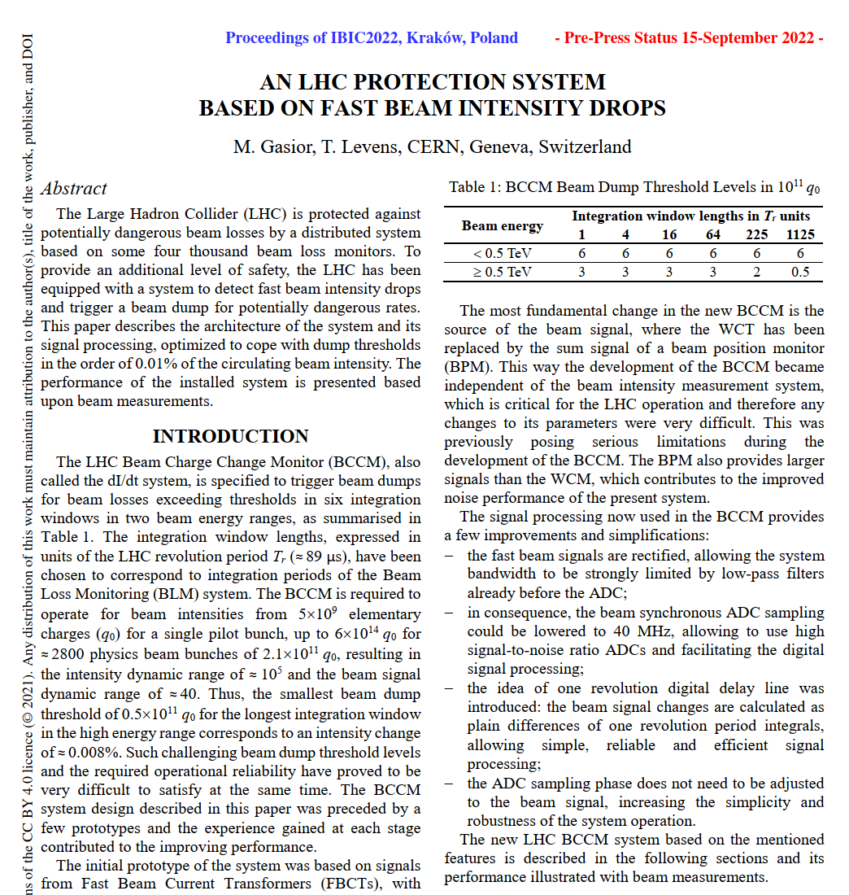
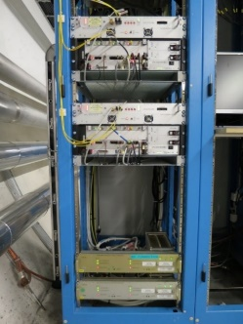
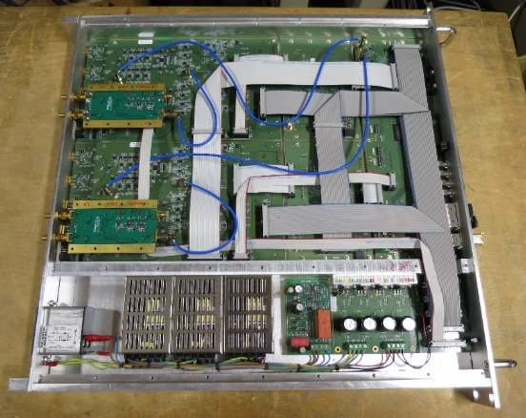
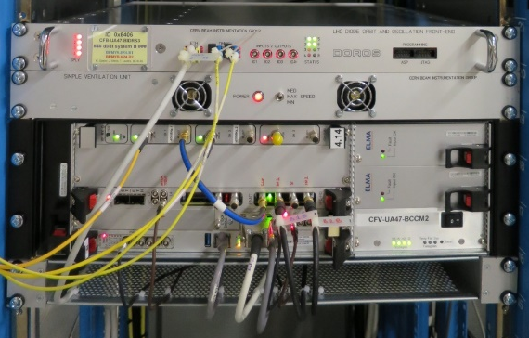
BCCM (dI/dt) system
https://ibic2022.vrws.de/papers/wep06.pdf
rack BY05.UA47

Slide 4
Dump threshold tables
OLD
NEW
Window [turn] | 1 | 4 | 16 | 64 | 225 | 1125
< 0.5 | 6 | 6 | 6 | 6 | 6 | 6
≥ 0.5 | 3 | 3 | 3 | 3 | 2 | 0.5
Energy [TeV] | Losses [1e11]
Window [turn] | 1 | 4 | 16 | 64 | 225 | 1125
< 0.5 | 6 | 6 | 6 | 6 | 6 | 10
≥ 0.5 | 3 | 3 | 3 | 3 | 5 | 10
Energy [TeV] | Losses [1e11]
Window [turn] | 1 | 4 | 16 | 64 | 225 | 1125
< 0.5 | 1 | 1 | 1 | 1 | 1 | 1
≥ 0.5 | 0.5 | 0.5 | 0.5 | 0.5 | 0.3 | 0.08
Energy [TeV] | Relative losses [‰] (FS = 6e14)
Window [turn] | 1 | 4 | 16 | 64 | 225 | 1125
< 0.5 | 1 | 1 | 1 | 1 | 1 | 1.7
≥ 0.5 | 0.5 | 0.5 | 0.5 | 0.5 | 0.8 | 1.7
Energy [TeV] | Relative losses [‰] (FS = 6e14)

Slide 5
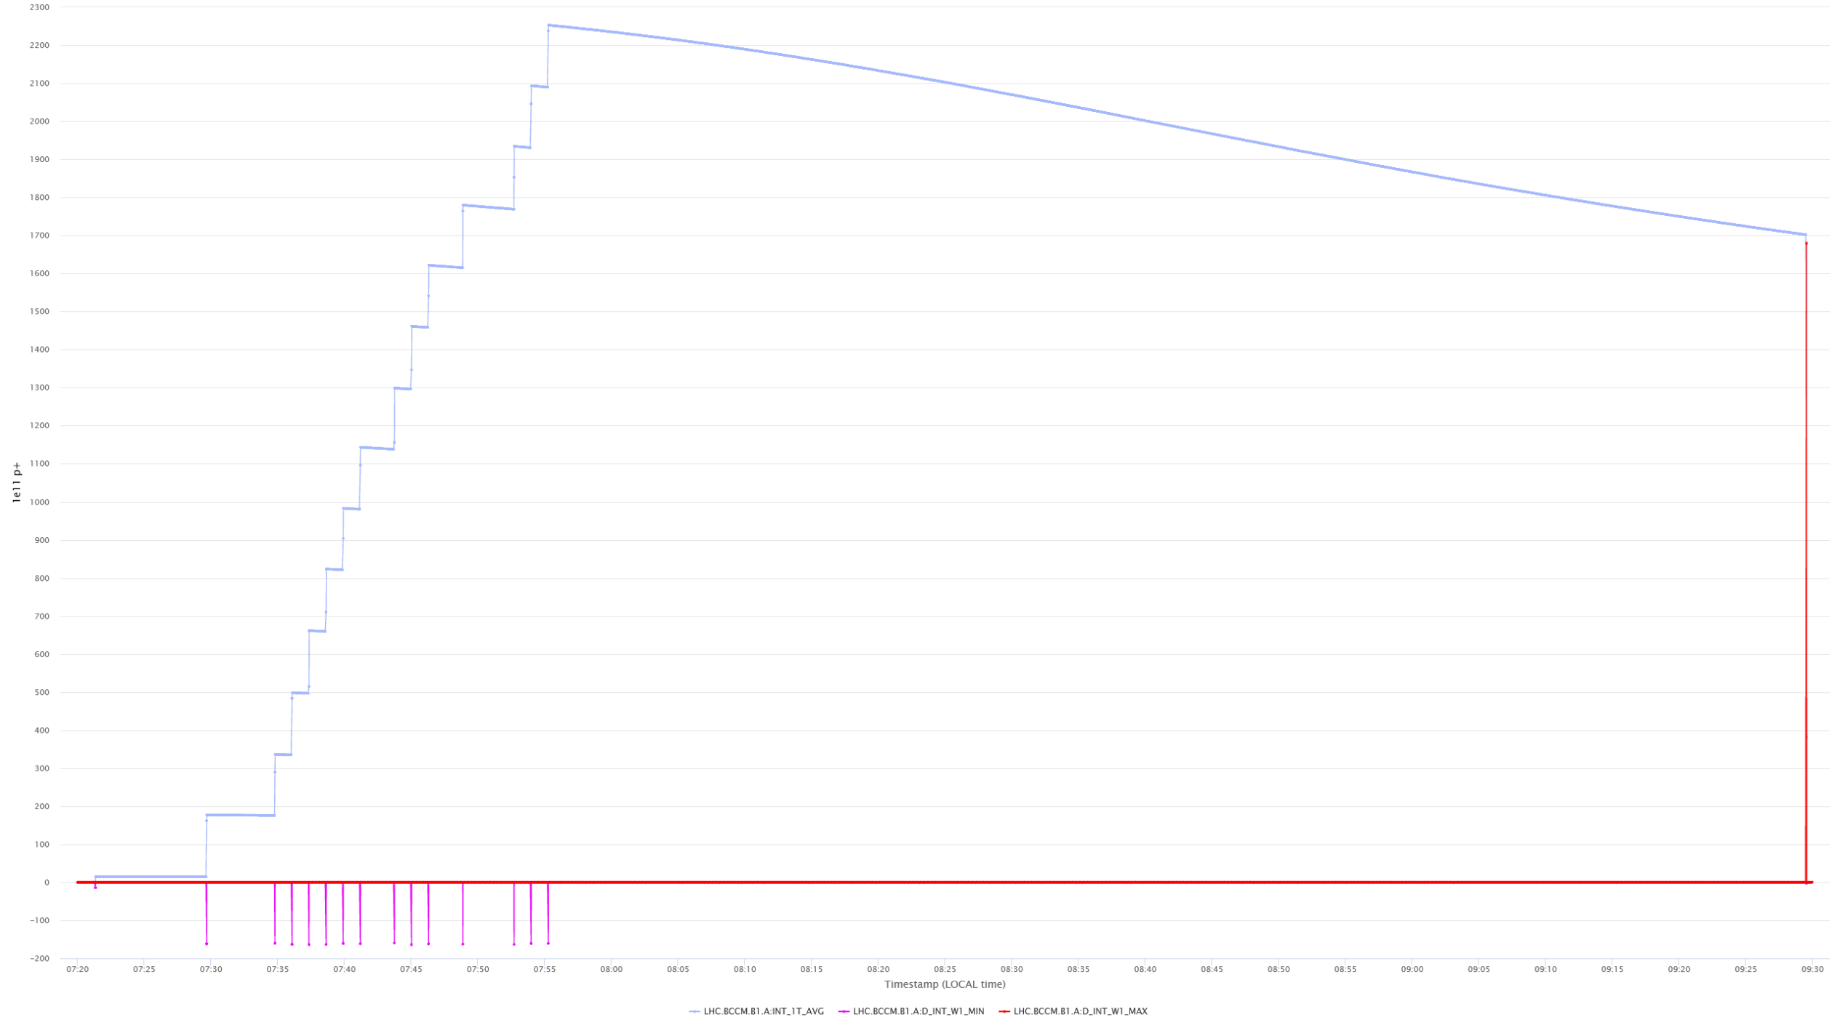
BCCM (– dI/dt) polarity convention
The focus is on beam losses,
so that on the positive “– dI/dt” signals
dI/dt positive = intensity decrease
(here the beam dump)
dI/dt negative = intensity increase
(here beam injections)

Slide 6
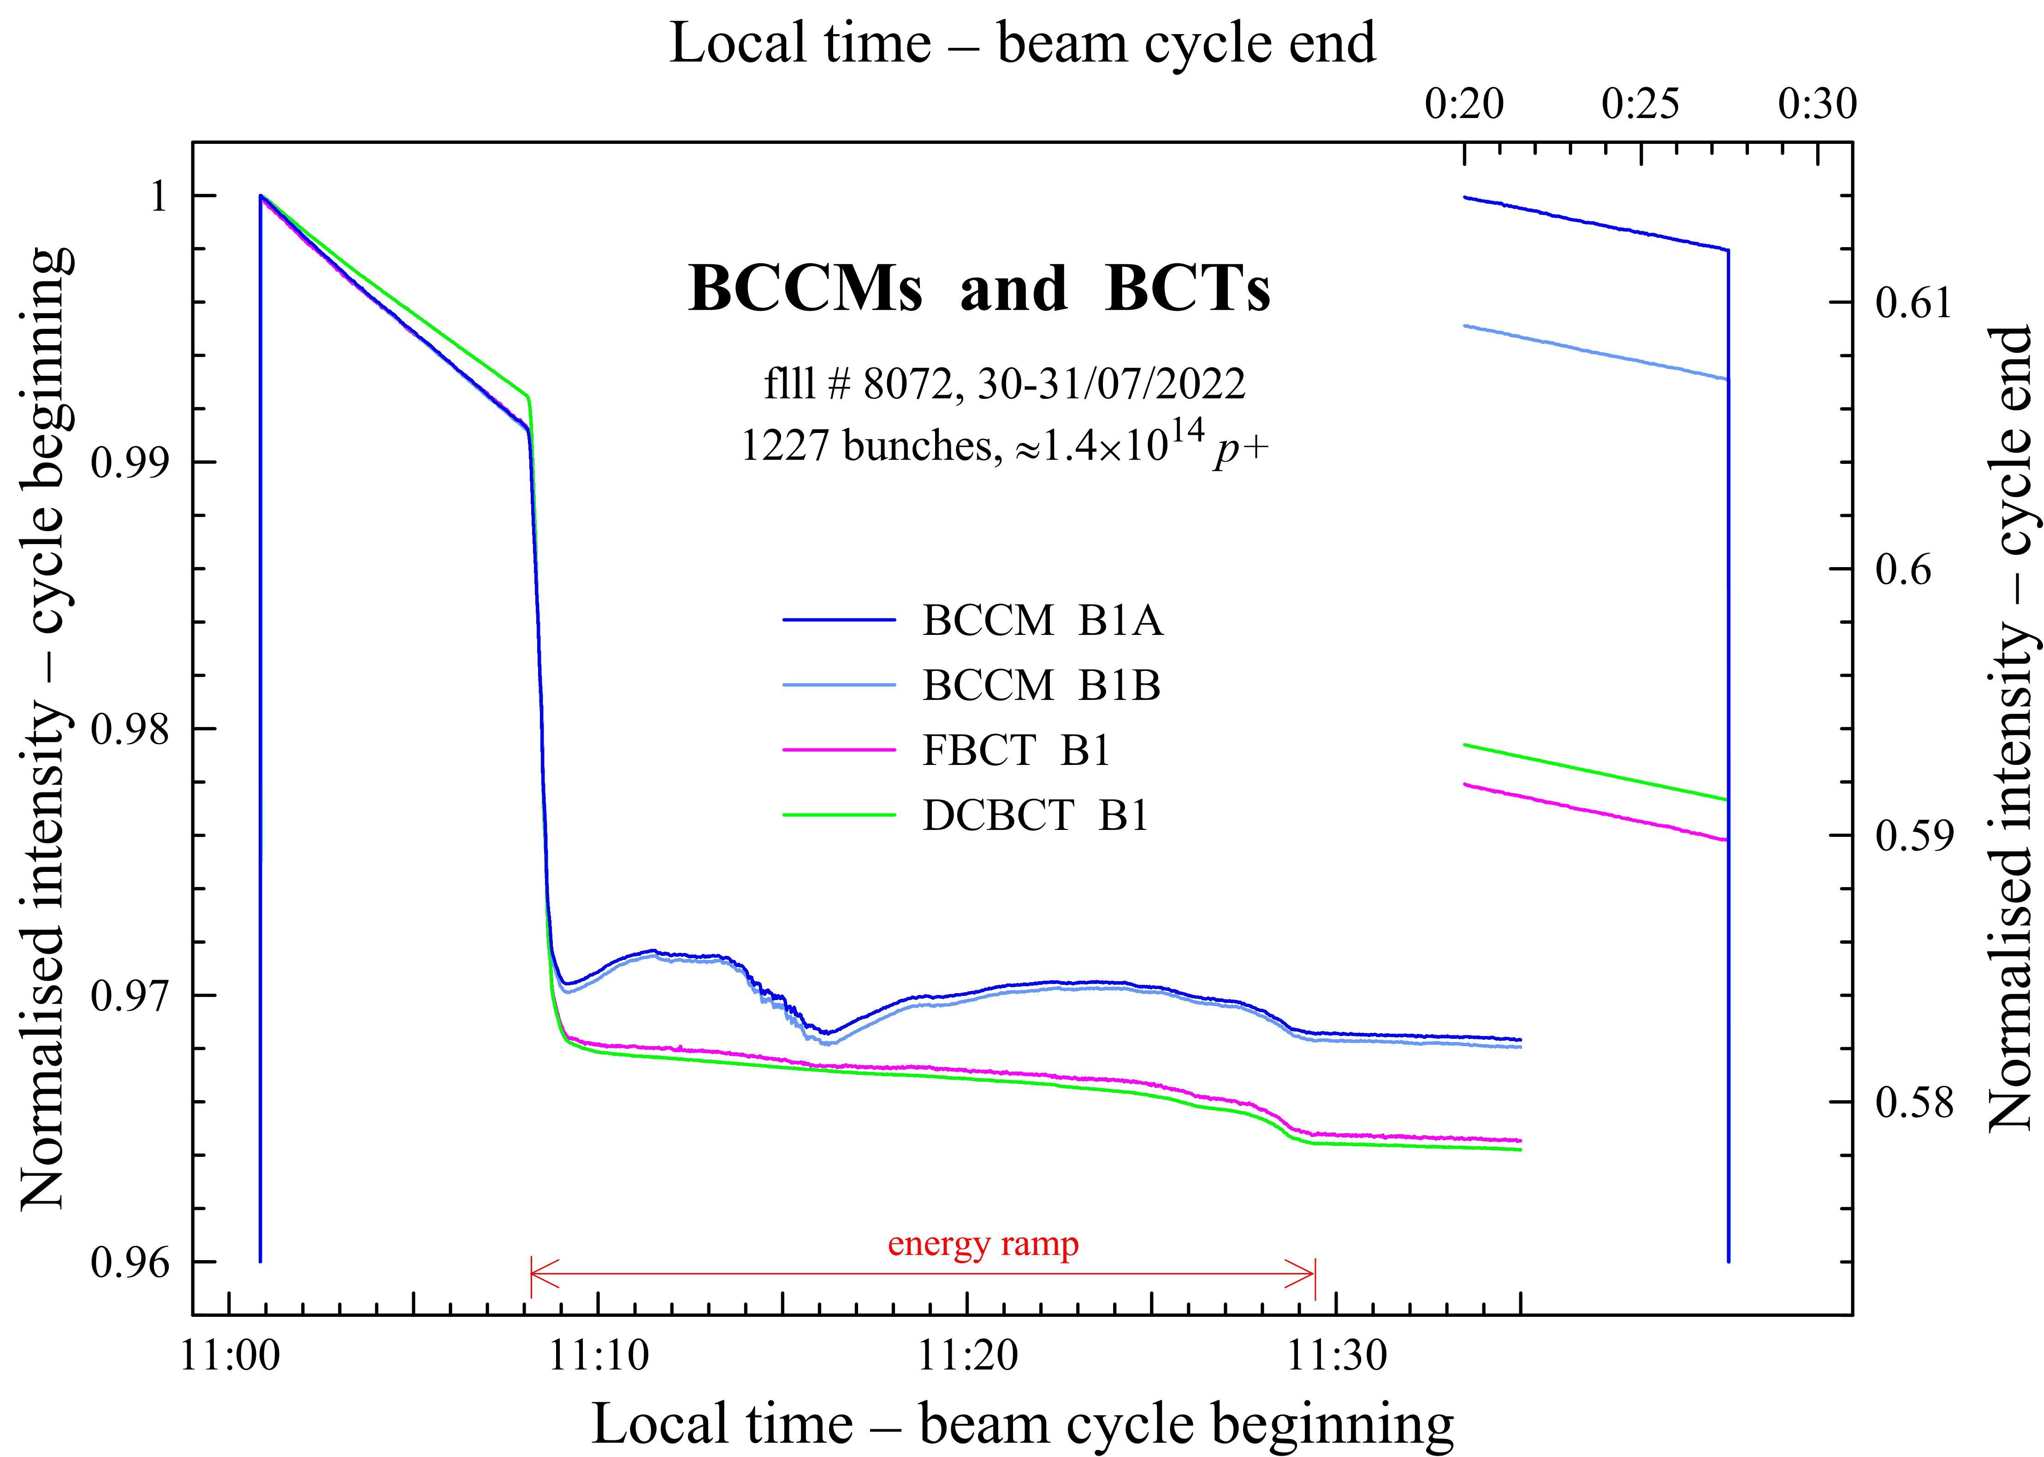
BCCM operation – absolute intensity measurement

Slide 7
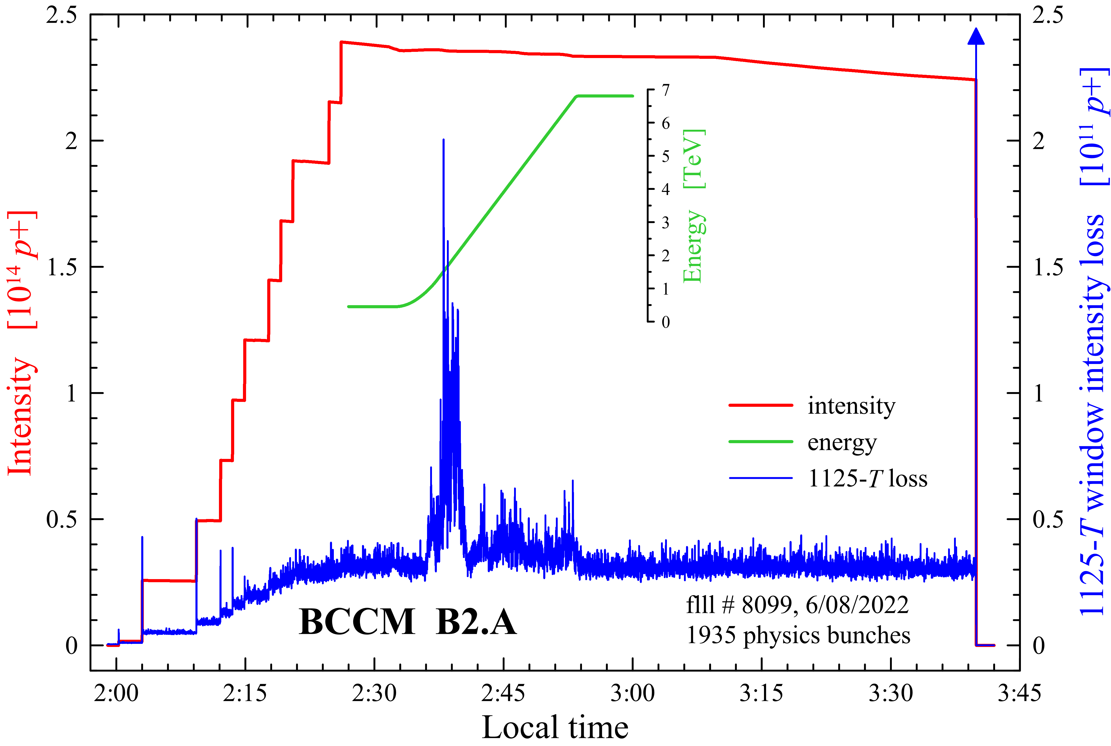
BCCM operation – perturbations during the ramp

Slide 8
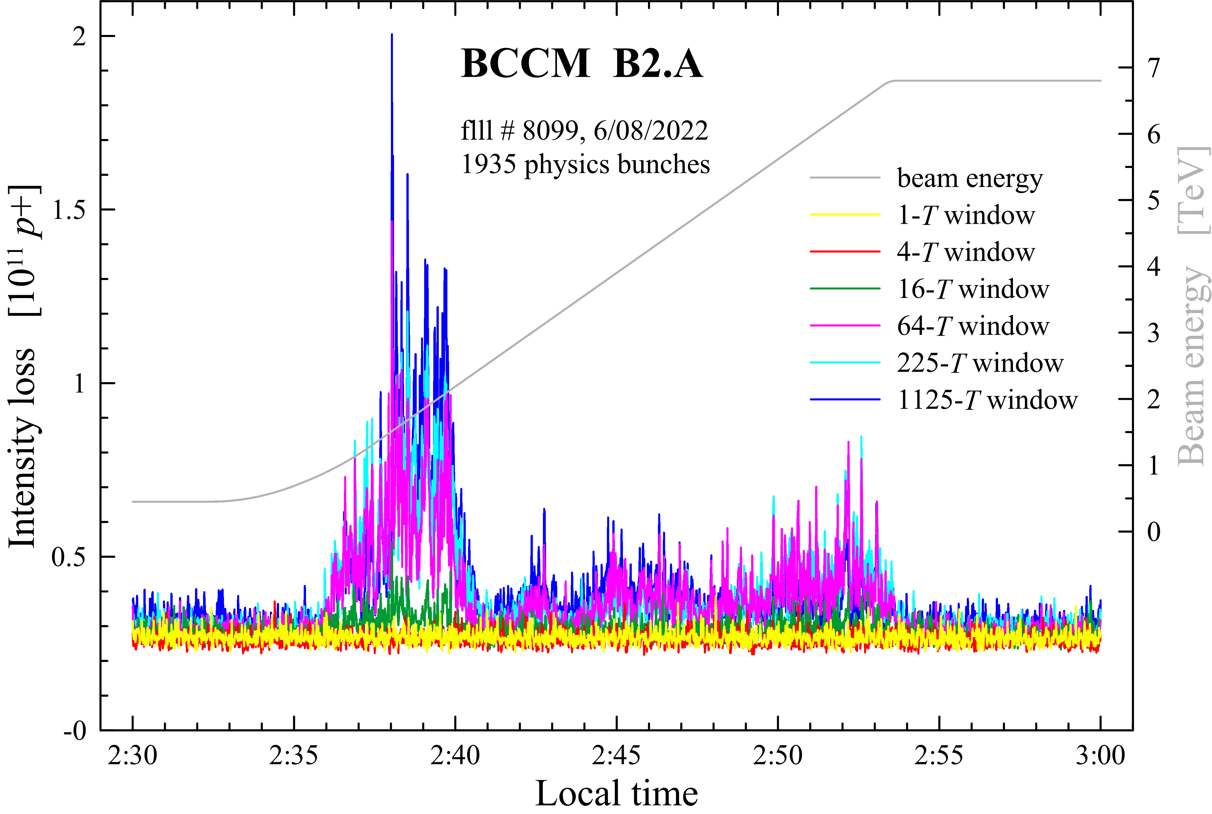
BCCM operation – perturbations during the ramp

Slide 9
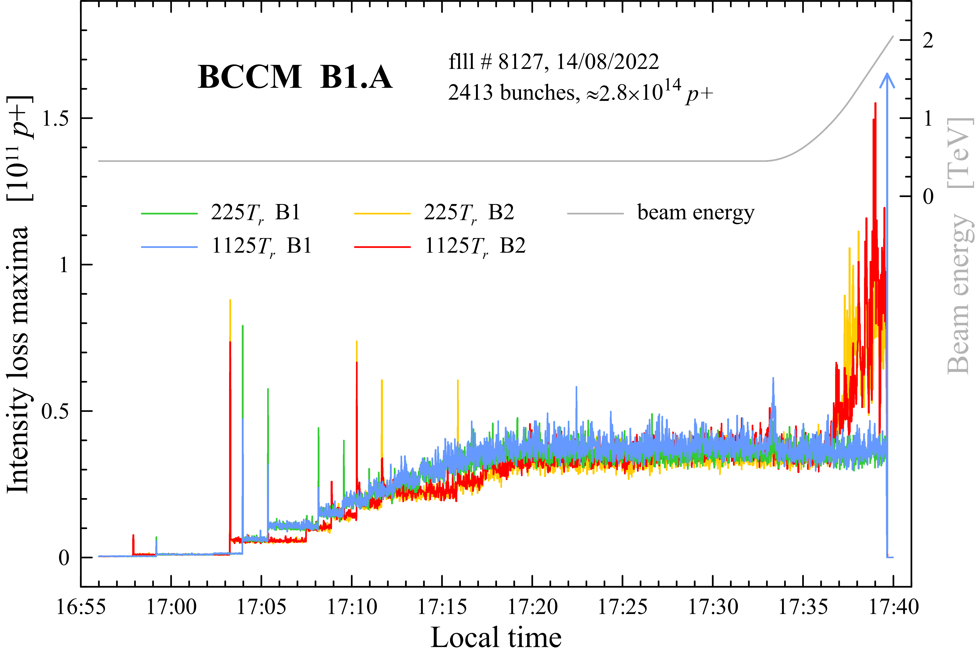
RF longitudinal blow-up: missing on B1, present on B2

Slide 10
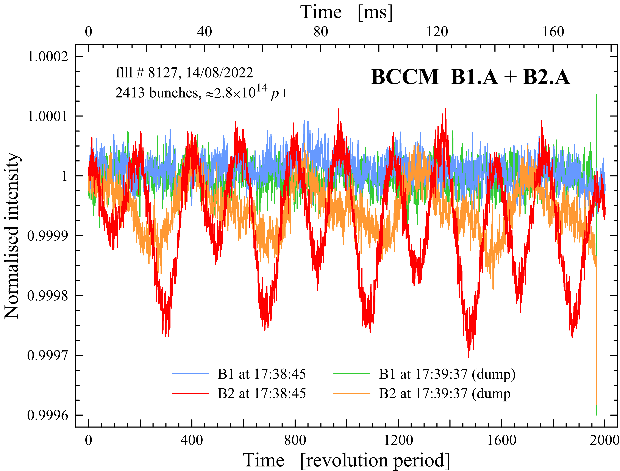
RF longitudinal blow-up: missing on B1, present on B2

Slide 11
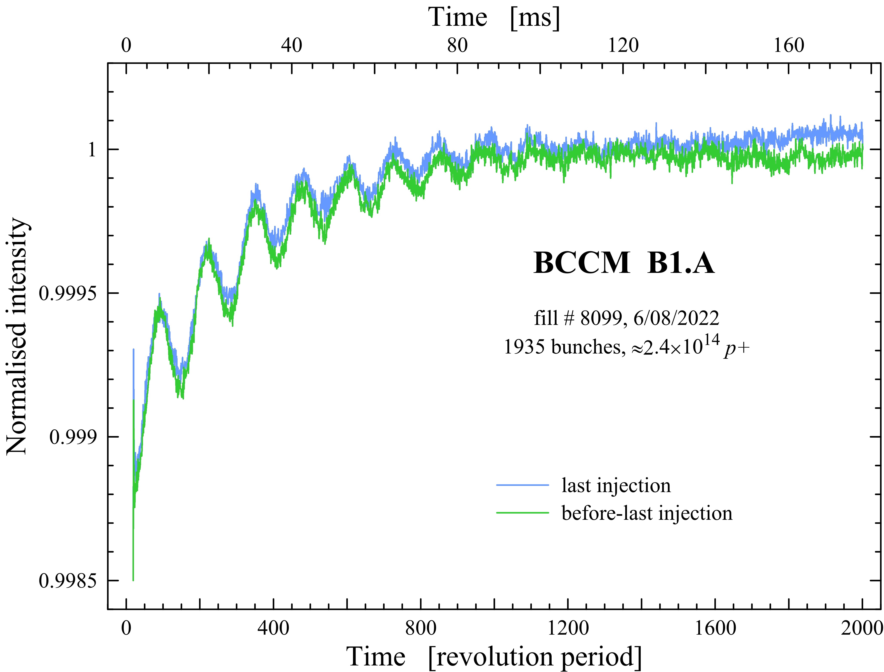
Injection longitudinal oscillations

Slide 12
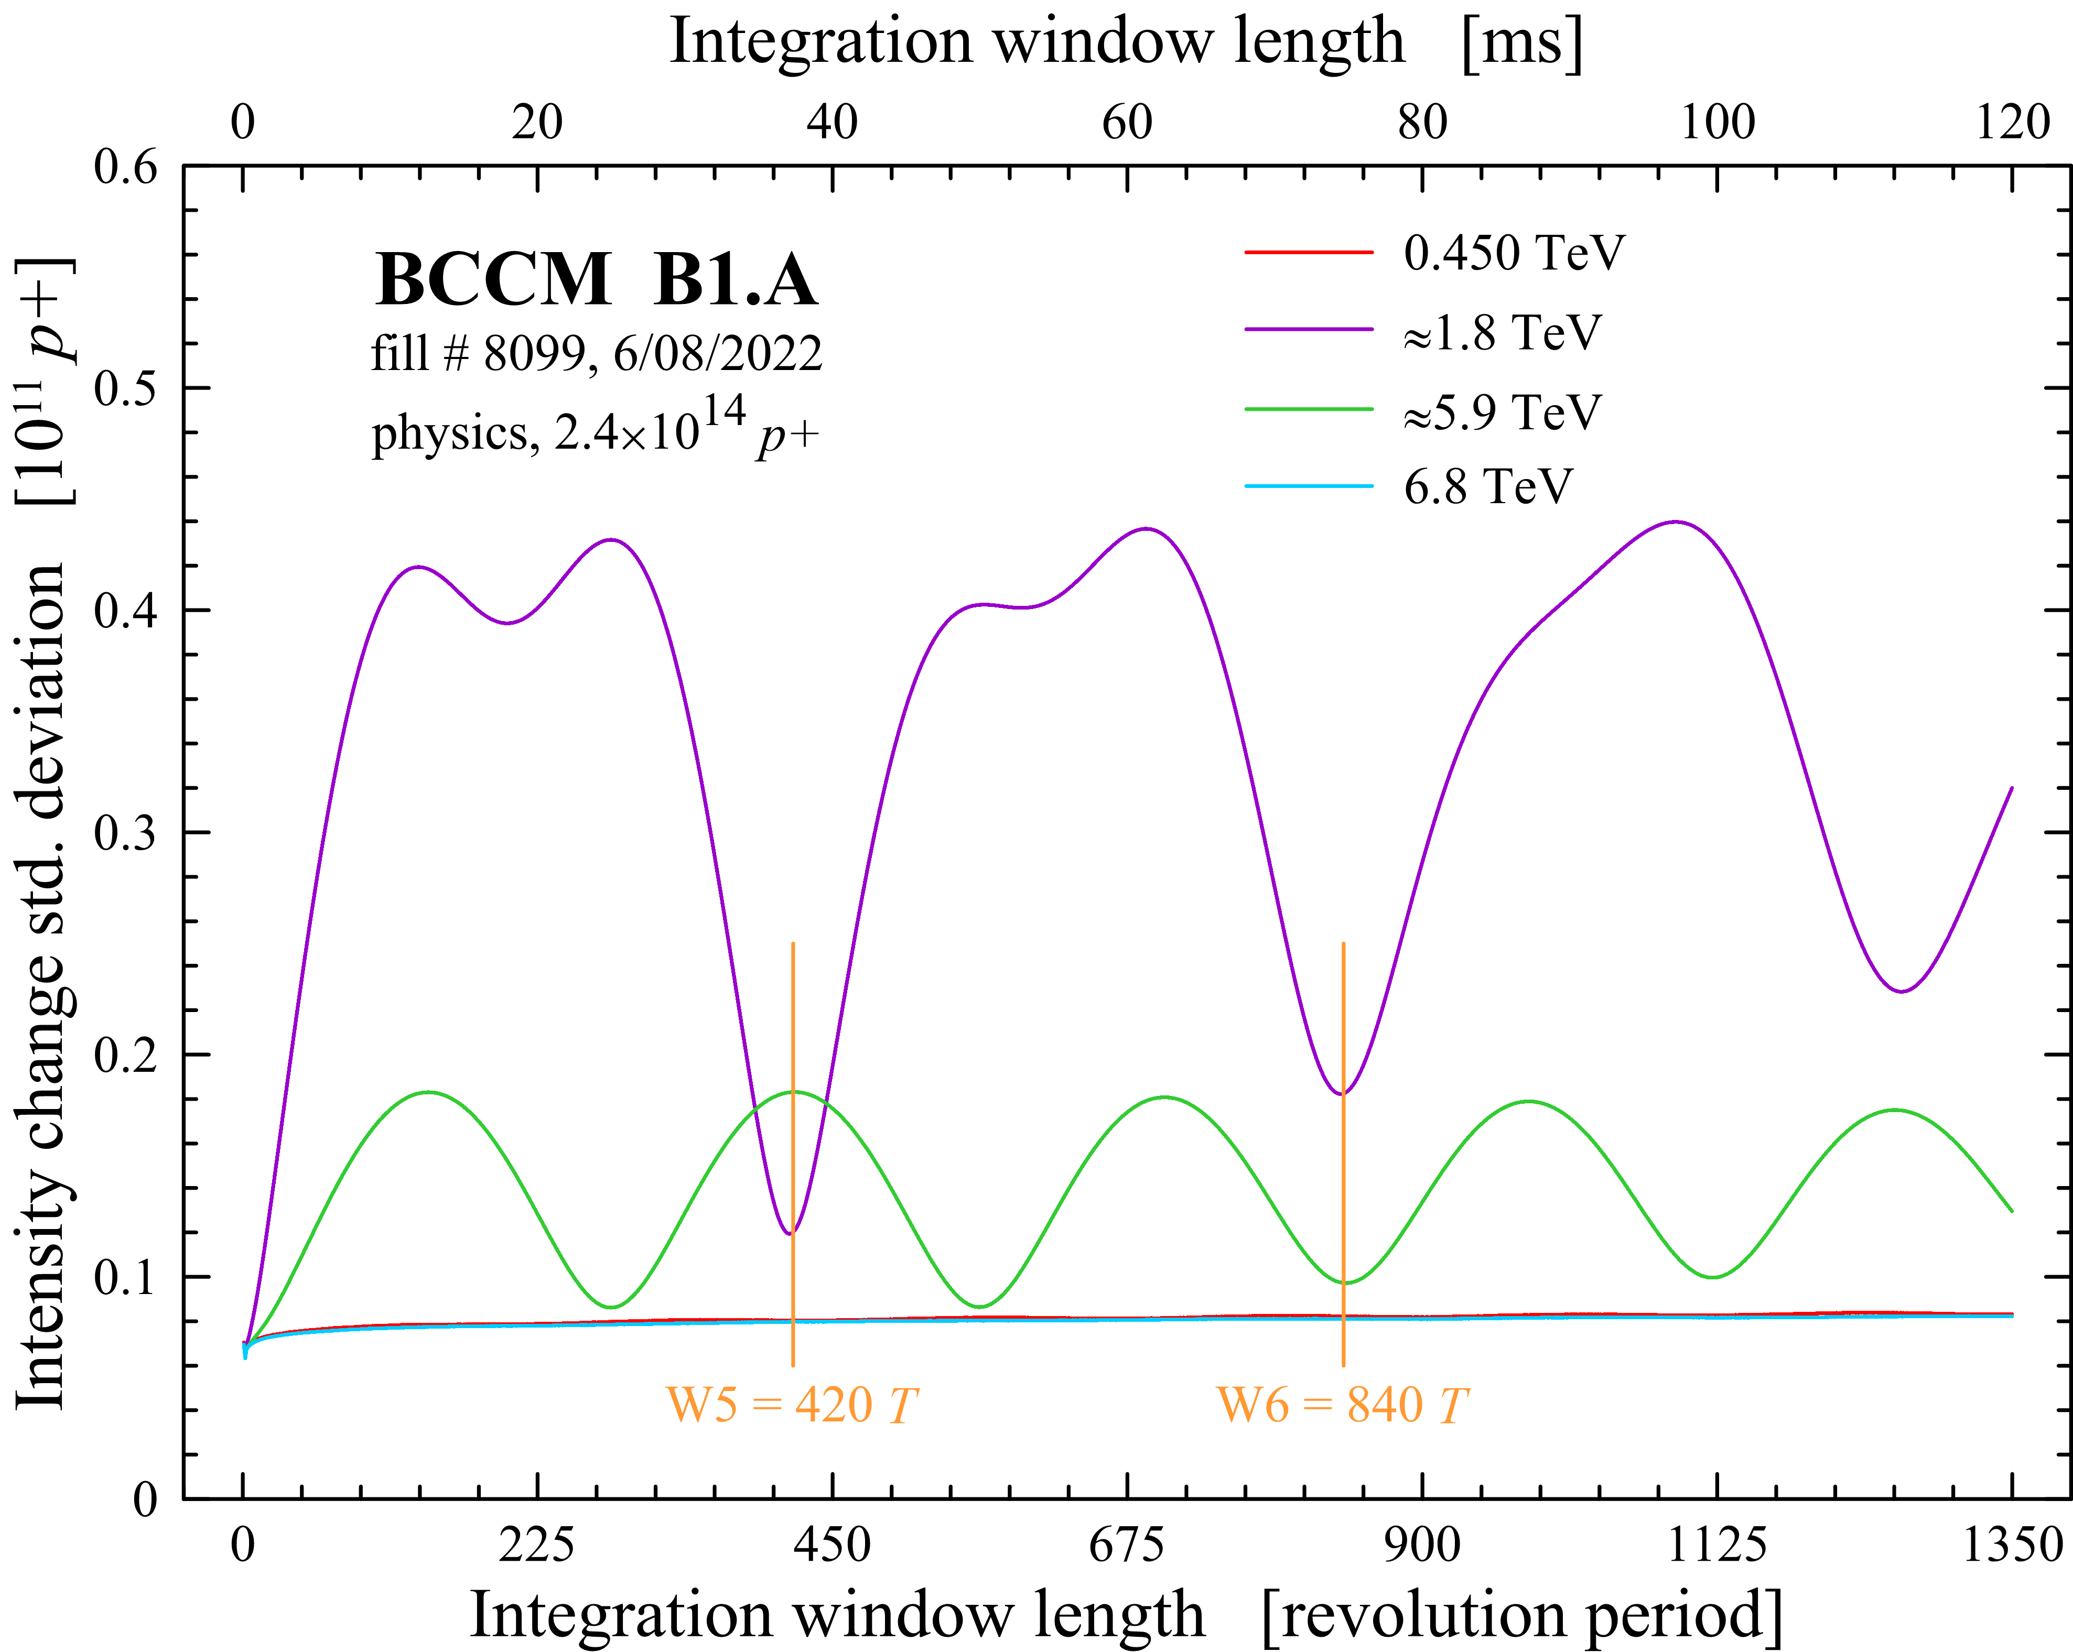
Optimization of the integration window length
Two longest integration windows set for tests to
420 and 840 turns since 15/08
Observed some 30 % reduction of the spurious beam loss maxima during the RF longitudinal blow-up

Slide 13
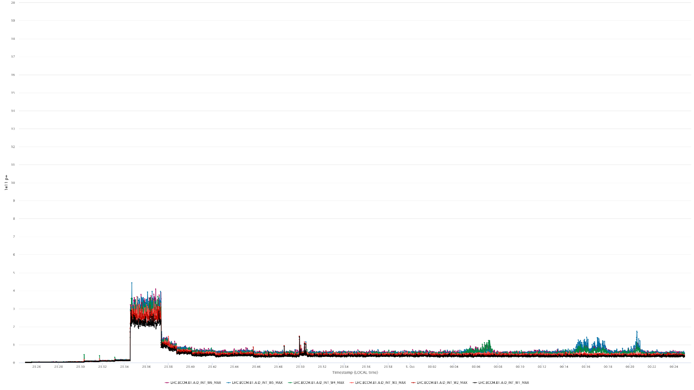
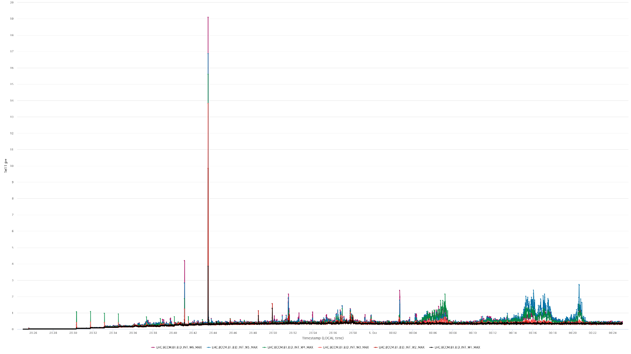
1st order low pass compensation
The BPMs used by the BCCM are high-pass systems with the cut-off ≈ 200 MHz (16 pF + 50 Ω)
Their frequency characteristic was flattened by a 1st order low-pass (≈ 12 MHz) at the expense of 80 % signal loss.
Ongoing tests of the low-pass on systems A and comparing to systems B without the compensation (since 28/09).
The low-pass is sometimes very effective
Some issues with the “stability of the signal baseline”
BCCM A.B1 with the compensation
BCCM B.B1 with no compensation
20e11

Slide 14
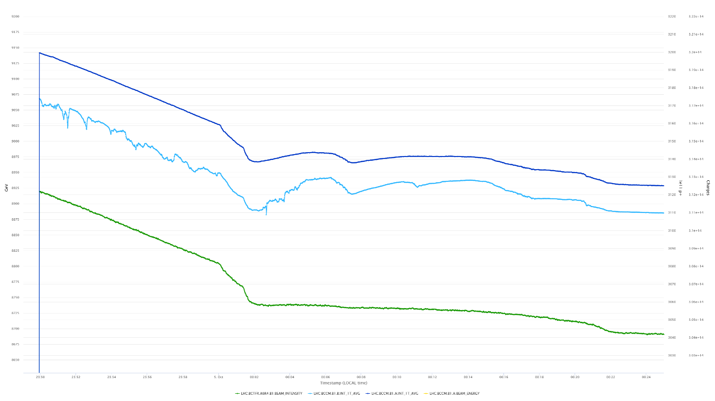
1st order low pass compensation
BCCM A.B1 with the compensation
BCCM B.B1 with no compensation
FBCT B1

Slide 15
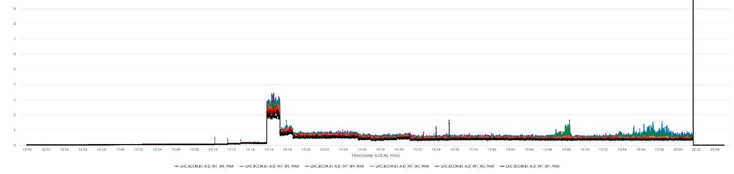
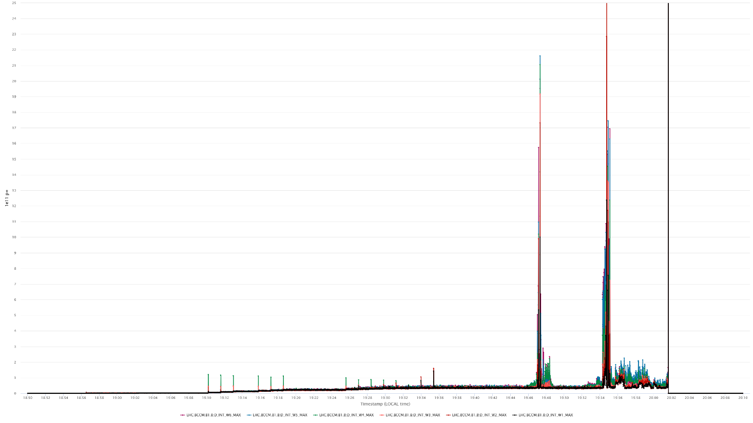
1st order low pass compensation
25e11

Slide 16
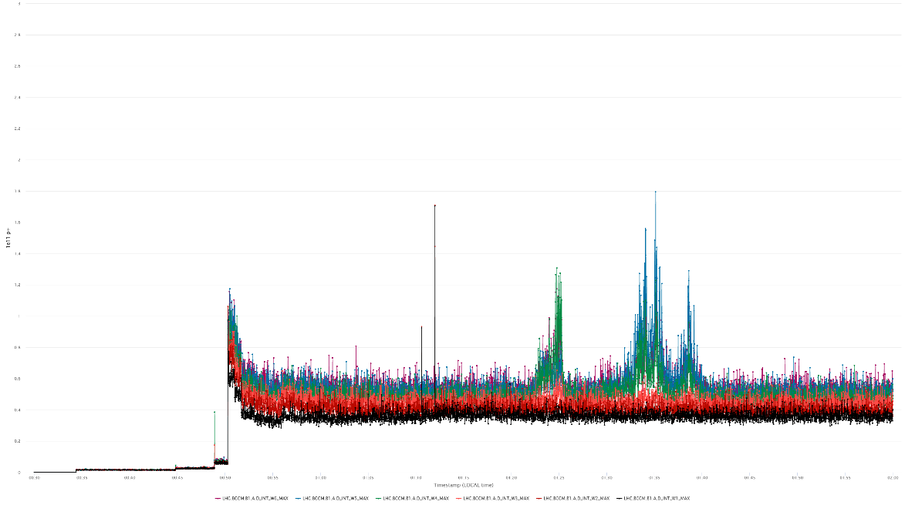
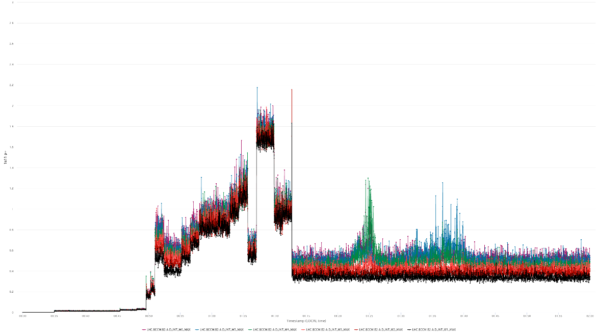
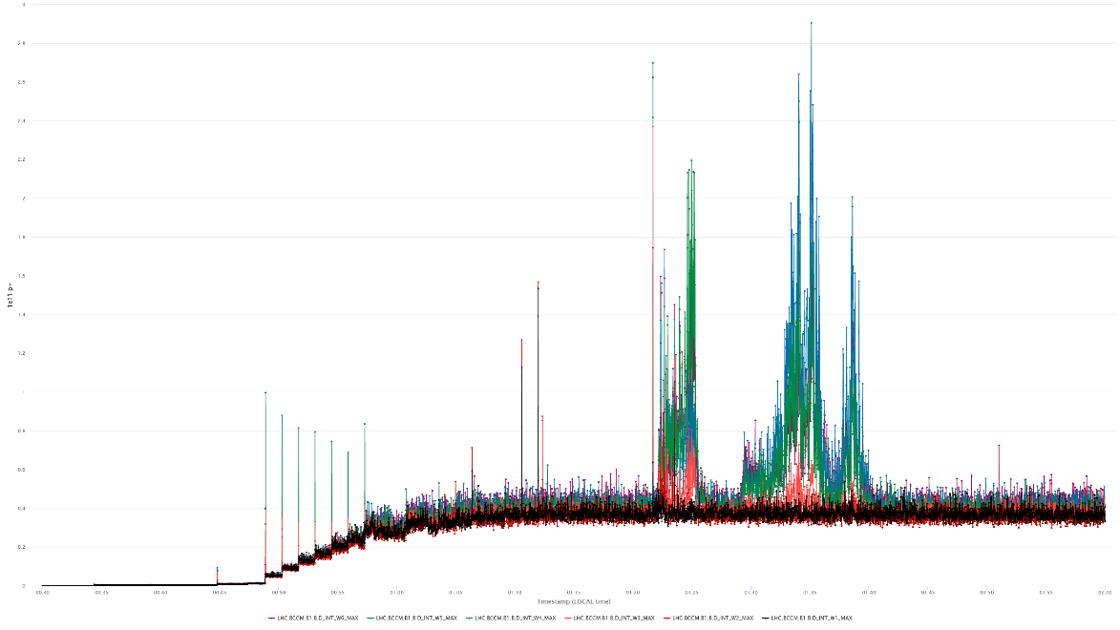
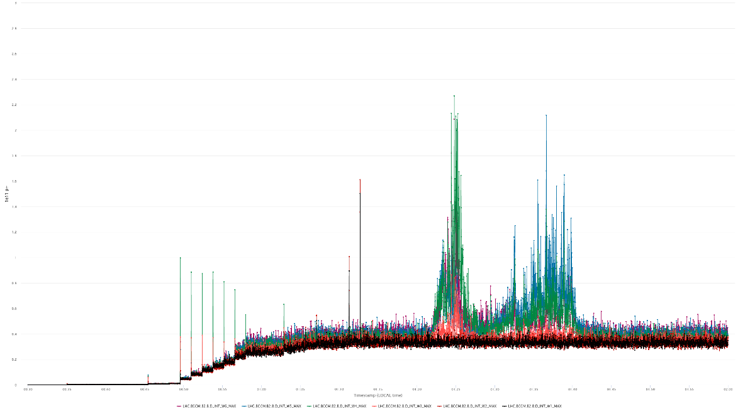
1st order low pass compensation
BCCM A.B1 with the compensation
BCCM A.B2 with the compensation
3e11
BCCM B.B1 with no compensation
BCCM B.B2 with no compensation
3e11

Slide 17
Conclusions and options to investigate
During the 2022 run the four BCCM systems have been evolving quite a bit and have been continuously tested with beam
The hardware and FESA are “almost final” and very reliable
Operational extensive data logging implemented, including continuous turn-by-turn logging of the most important data
and on-demand 73-turn snapshots of the 40 MHz raw ADC samples (currently stored also every beam dump)
The residual bunch length dependence of the BPM signals is the only known problem with the current implementation
of the system. The problem shows up during beam injections, the RF longitudinal blow-up and beam instabilities.
The new dump threshold levels for the two longest integration windows help a lot to fulfil all the system specifications
New lengths of the two longest integration windows are being tested. Still to be decided whether they are helping enough.
A 1st order low-pass filter compensating the 1st order high-pass characteristic of the BPM reduces the bunch length dependence. Unfortunately, the low-pass causes issues with the “stability of the signal baseline”.
Options to investigate:
A less aggressive 1st order low-pass, with the hope to improve the “stability of the signal baseline”
FBCTs with the flat frequency characteristic as the beam signal source

Slide 18
Spare slides

Slide 19
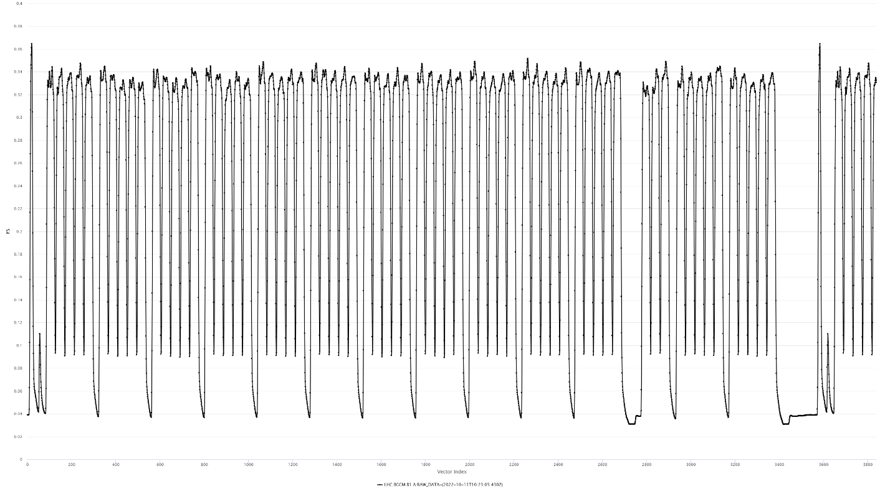
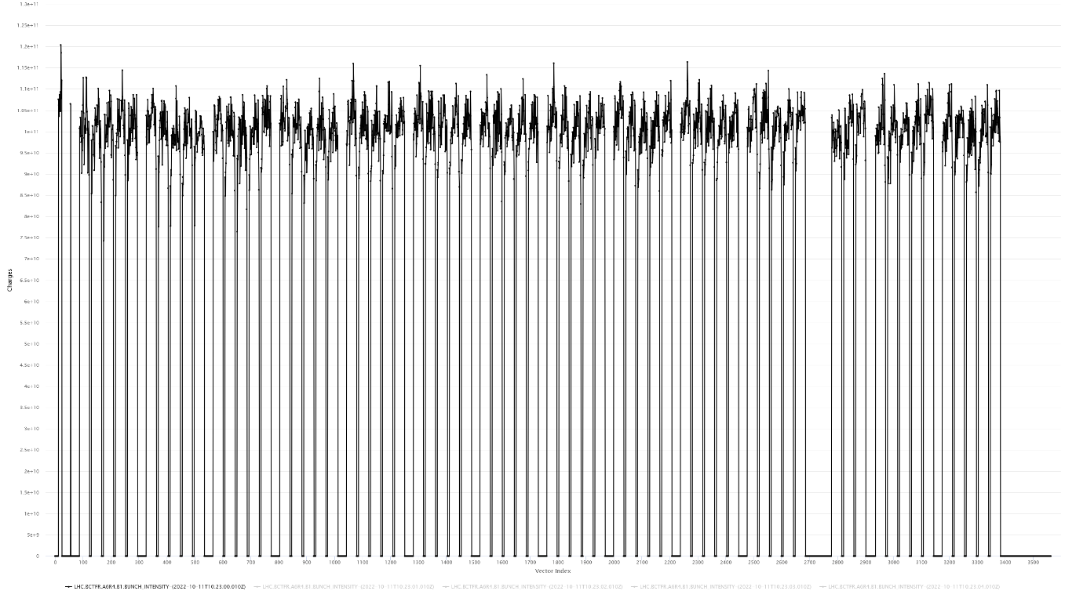
25 ns data: BCCM vs FBCT
one turn of BCCM data
one turn of FBCT data

