Slide 1
MKI-Cool RF Damper Cooling:
Interlock Strategy
M.J. Barnes
Acknowledgements
C. Baud, G. Bellotto, C. Bracco, C. Boucly, O. Crespo-Lopez,
L. Ducimetière, Y. Dutheil, T. Gharsa, L. Govertsen, C. Lolliot, N. Magnin, V. Namora, T. Stadlbauer, P. Trubacova

Slide 2
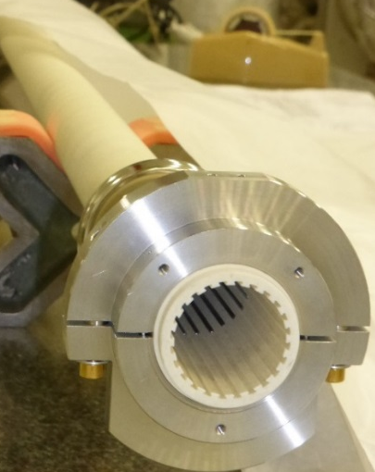
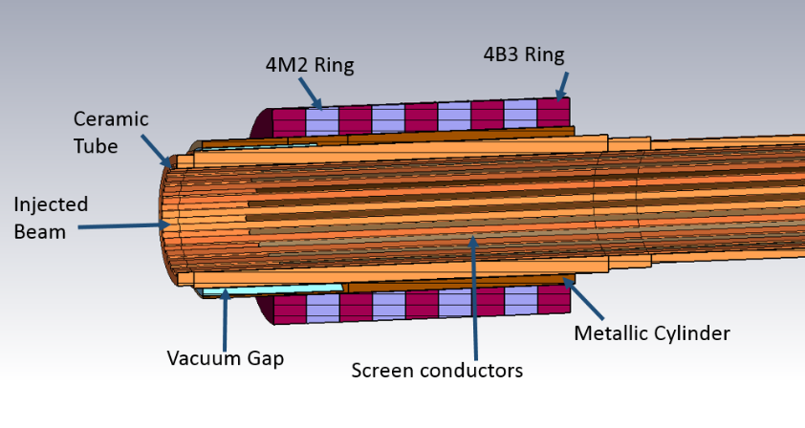
Beam Induced Heating - Reminder
To reduce beam induced heating, MKIs refurbished during LS1 have 24 screen conductors (c.f. 15 before LS1), inserted in slots on the inside of an alumina tube
An alumina tube is installed in the aperture of each MKI kicker magnet
A set of ferrite rings is installed on each end of the alumina tube
Alumina tube
(installed in MKI aperture)
Alumina tube
Alumina tube
Injected/
circulating beam
Ferrite rings
MKI magnet
Beam
Vacuum tank
Slots on alumina tube, to insert screen conductors
24 screen conductors
(one each 15 degrees, since LS1)
Highly non-linear beam induced power deposition in the ferrite yoke of an MKI
With HL-LHC type beams, the RF damper and part of the ferrite yoke would reach its Curie temperature (temporary loss of magnetic properties)

Slide 3
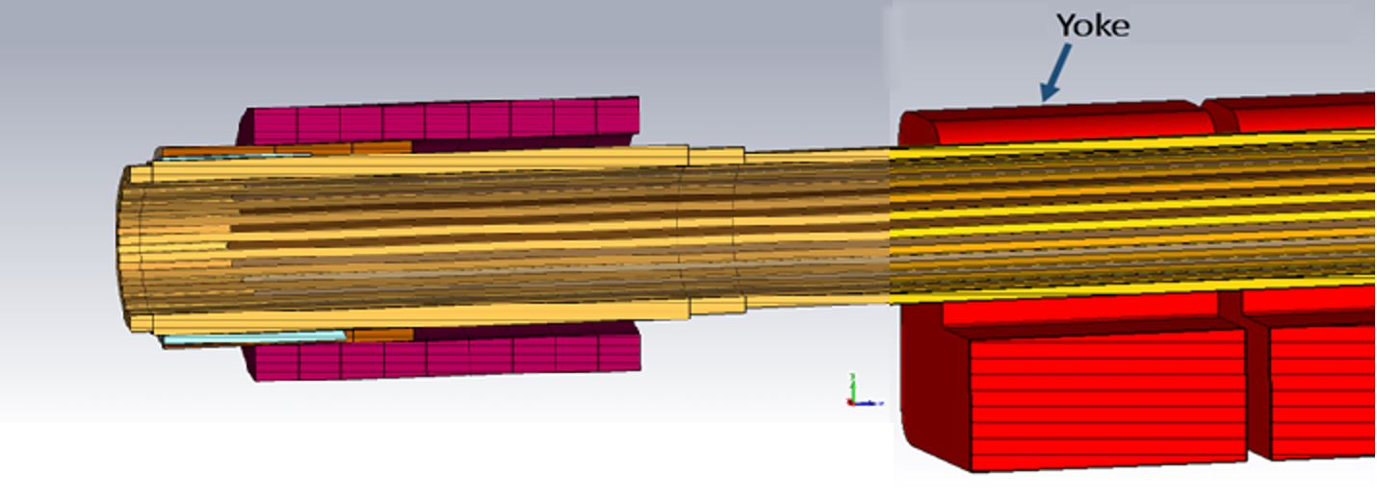
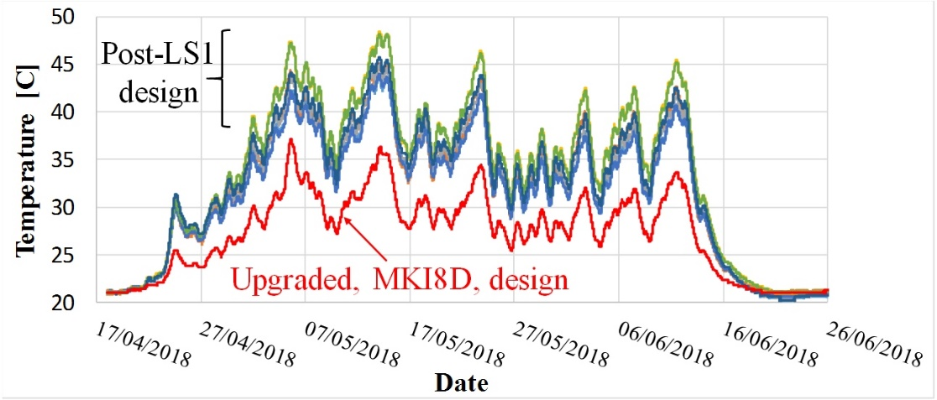
MKI8D: upgraded MKI
Upgraded MKI installed, in Point 8, during YETS 2017/18 (MKI8D):
Redesigned ferromagnetic rings (damper), on the upstream end of the alumina tube, outside of the magnet aperture, relocates beam induced power from the ferrite yoke to the damper
RF damper is not at pulsed high voltage
Reduced yoke temperature w.r.t. LS1 MKI’s – but still need to further reduce temperatures for HL-LHC type beams
Screen conductors
Conductive sleeve
Metallic cylinder
Beam
Damper
(some ferrite rings exposed to beam)
Alumina tube
Magnet

Slide 4
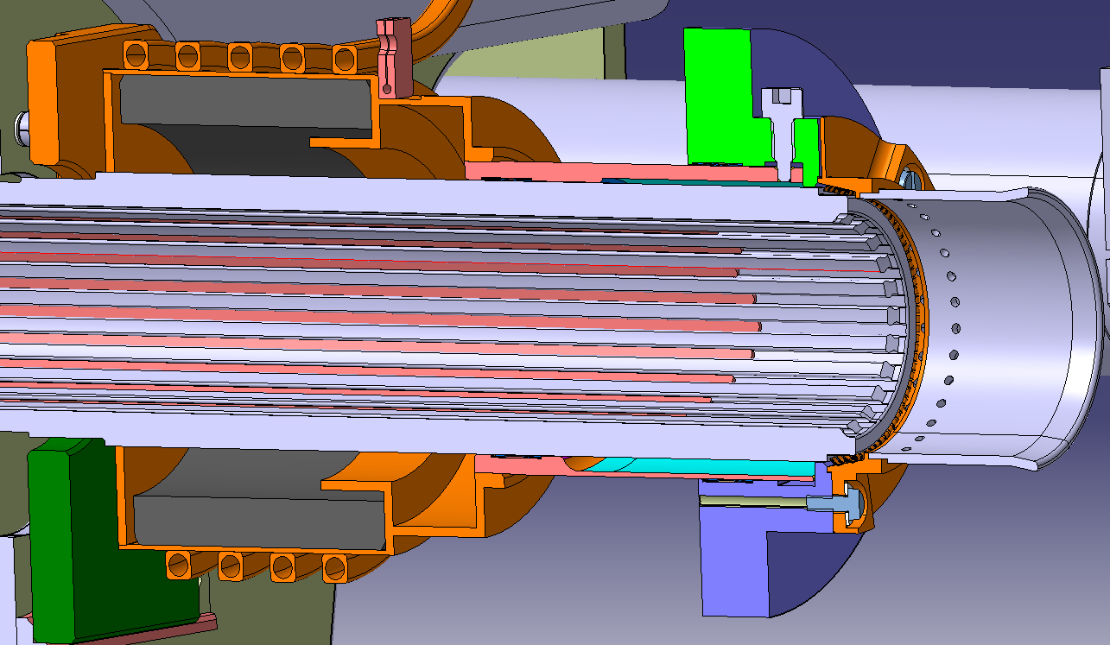
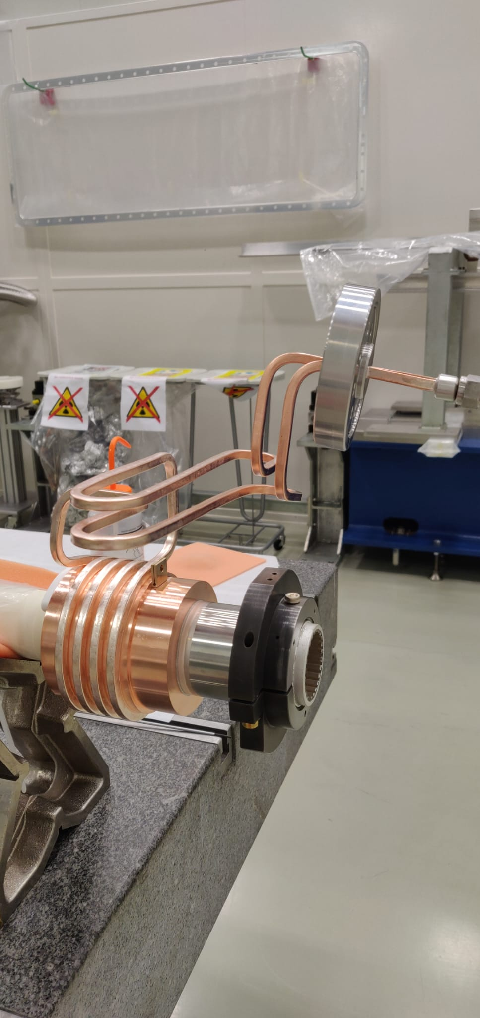
RF Damper of MKI-Cool
MKI cool = RF damping element + water cooling
Pipes for water cooling
PT100 location
(Tube_Up)
Beam
Screen conductors
Alumina tube
RF damping element
(CMD10 ferrite cylinder: Curie temperature of ~250˚C)
MKI-Cool is expected to be significantly below the ferrites Curie temperature for HL-LHC type beams.

Slide 5
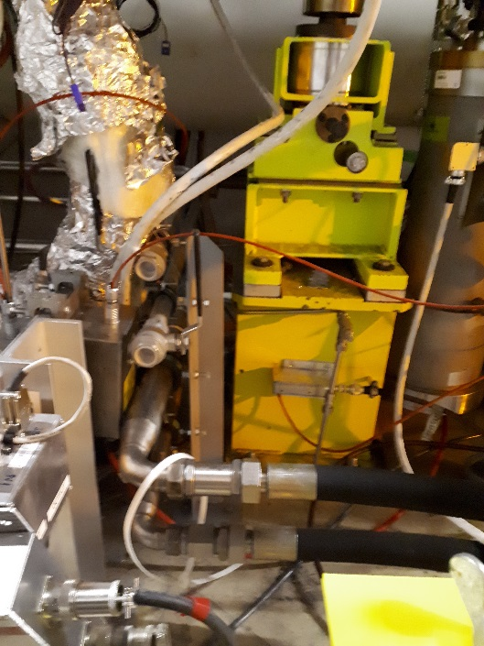
MKI-Cool cooling circuit
≤16 bar
~4 bar
Pressure regulator
200µm strainer
Heat exchanger
(Demineralized water)
Needle valve to reduce pressure
Beam
MKI8D
MKI8C
MKI8B
MKI8A
Flow: ~1.5 m/s (⇨ ~1.5 l/min)
Eletta flow monitor (with direct reading dial): with independently adjustable upper and lower flow alarm (µ-switches):
Status of low-flow micro-switch (dry contact) to be readback by SY-ABT
Status of high-flow monitor micro-switch to be readback by SY-ABT
2*PT100 on cooling pipes (outside MKI vacuum tank)
PT100 on RF damper (previous slide)
‘Turbine’ (analogue signal) to be installed to readback analogue signal α flow-rate (radiation resistant)
Manual valve
PT100
Existing water pipes
Pipes to be installed
Flow monitor (S25GSS15 A/R 0.4-2 l/min Eau EPDM)

Slide 6
MKI-Cool Additional Interlocks (c.f. ‘regular’ MKIs)
Interlocks:
The low-flow micro-switch (dry contact), from the Eletta flow-monitor, will be used as an interlock:
• Prevent injection if water flow is too low (use few s time-constant);
• Request a beam dump if water flow is to low (to prevent possible boiling of water in cooling pipe and resulting high pressure): use few s time-constant. The low-flow micro-switch will be cabled to an SY-ABT PLC for requesting a beam-dump to the BIS
The upper flow alarm will be used as a warning;
Request a beam dump if RF Damper Temperature (Tube_Up) exceeds X°C e.g. 50°C (~34°C max expected): use few s time-constant. This temperature interlock will be implemented in the ABT PLC (a Beam dump will be requested through the BIS). Since the temperature data will be in a FESA class, it is available, in the future, to also implement as an interlock in SIS.
Note: input and output water temperatures, water flow-rate, and PT100s within MKI vacuum tank to be logged (WinCC and NXCALS).

Slide 7
Thank you for your attention

Slide 8
Backup Slides

Slide 9
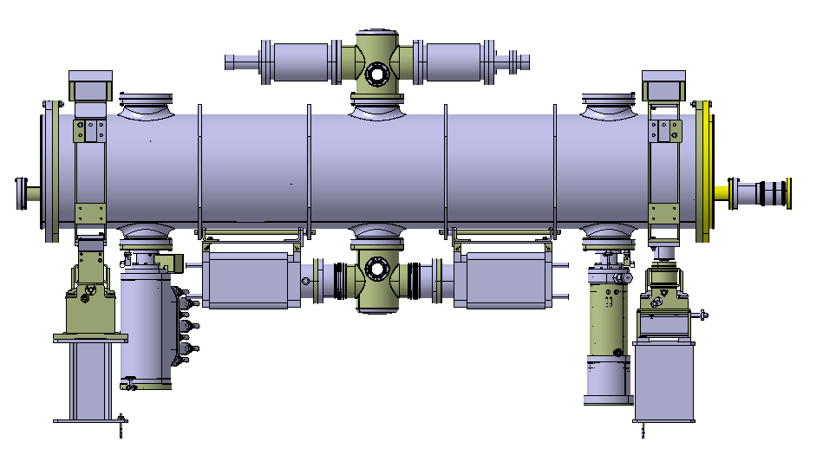
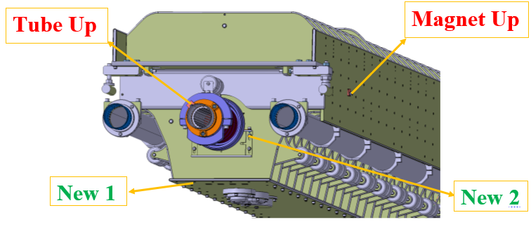
PT100 locations in MKIs
MKIs refurbished during LS1 have four PT100s under vacuum:
Magnet_Up and Magnet_Down (on side plates)
Tube_Up and Tube_Down (close to ferrite rings on alumina tube)
The MKI8D (MKIMA04-T09) and MKI Cool (MKIMA08-T11 -> MKI8C) have two additional PT100s installed under vacuum.
Tube_Down on MKI8D
Magnet_Down on MKI8D
For MKI8D: measurements of only 4 PT100s could be readback/logged.
8 additional wires to UA are required for reading back of other 2 under vacuum PT100s.
Alumina tube and screen conductors

Slide 10
MKI-Cool Readback
8 additional wires required to readback all PT100s under vacuum
8 additional wires required to readback both PT100s outside vacuum (cooling water temperature)
5 additional wires required to readback status of flow micro-switches
2 additional wires for readback of analogue flow-rate

Slide 11
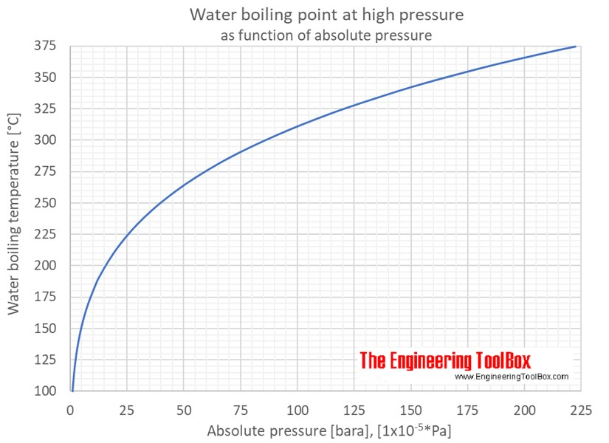

Slide 12
Selected Comments on https://edms.cern.ch/document/2010448/1.1
Accepted with Warning by WENNINGER Jorg (BE-OP)
Ok - clearly an important component test
I am however surprised to discover a SIS interlock that was never discussed before with OP. As an interlock that is supposed to dump the beam after passing through many SW layers, there is a significant risk of false dumps due to controls issues. Such an interlock requires a lot of precautions in the implementation, in particular timeout periods that should typically be set to 20 seconds, possibly with fail-unsafe logic in case of signal absence. It is not clear from the document whether this is consistent with the requirements.
In reply to the comment from Jorg Wenninger:
Thanks for your comment.
A FESA class will be created to push the temperature data to NXCALS. Hence, the temperature interlock on the RF damper will be implemented in the ABT PLC and we will request a Beam dump from the PLC (through the BIS). In any case, this is a ¿secondary interlock¿ as the primary interlock is the water flow.
Since the temperature data is in the FESA class, it is available if, in the future, we want to implement the interlock in SIS.
In reply to Markus ZERLAUTH:
Thanks for your comments and corrections.
Impedance wise the foreseen 3-4 intensity steps should be sufficient to qualify the expected performance of the MKI cool. However, even though the alumina tube is coated internally with Cr2O3 (as per the MKI8D exchanged during YETS 2017/2018) dynamic vacuum could initially limit the intensity ramp up. Lotta METHER gave a summary of the MKI8D beam conditioning at the 29th SPS MPC (in the context of beam conditioning the low impedance MKP-L). Her presentation is here:
https://indico.cern.ch/event/1208316/contributions/5081442/attachments/2526205/4345060/SPS_MPC_20221011_SPS_scrubbing_2023.pdf
Comment from Impedance Working Group:
As already stated in the previous version of this document, the Impedance Working Group supports the installation of the MKI-COOL.
Transverse beam dynamics studies were performed by Nicolas Mounet and showed that the impact of the MKI-COOL on transverse stability is expected to be negligible (https://indico.cern.ch/event/881273/). This point and its reference should be added to the document in Chapter 5. Measurements of the transverse impedance were not performed on this modified MKI-COOL, but they will be performed on the next MKI-COOL to be modified in the upcoming weeks

Slide 13
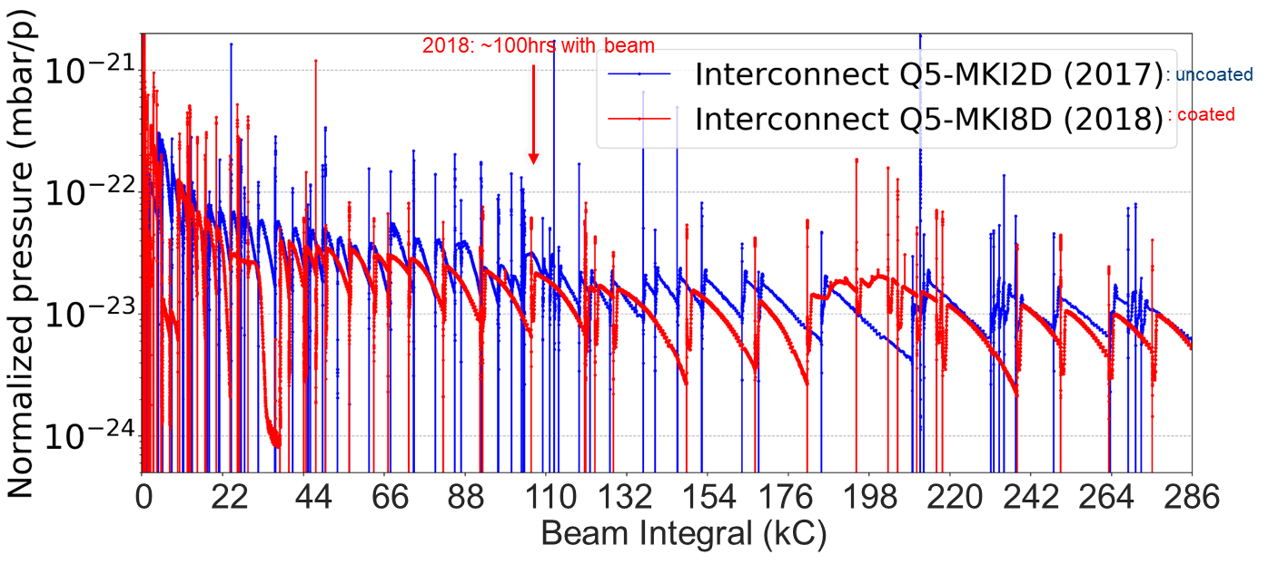
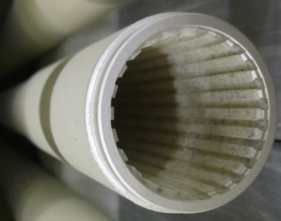
Cr₂O₃ coating in MKI8D, installed in YETS 2017/2018
Before YETS:
Pressure in MKI8D interconnect used to be a factor of ∼3 (2012, 2015 and 2017) and ∼12 (2016) higher than that of Q5-MKI2D
After YETS:
This factor is not observed anymore.
No other vacuum modifications were done, so pressure reduction is attributed to Cr₂O₃ coating 👍
Alumina tube with Cr₂O₃ coating on the inside

Slide 14
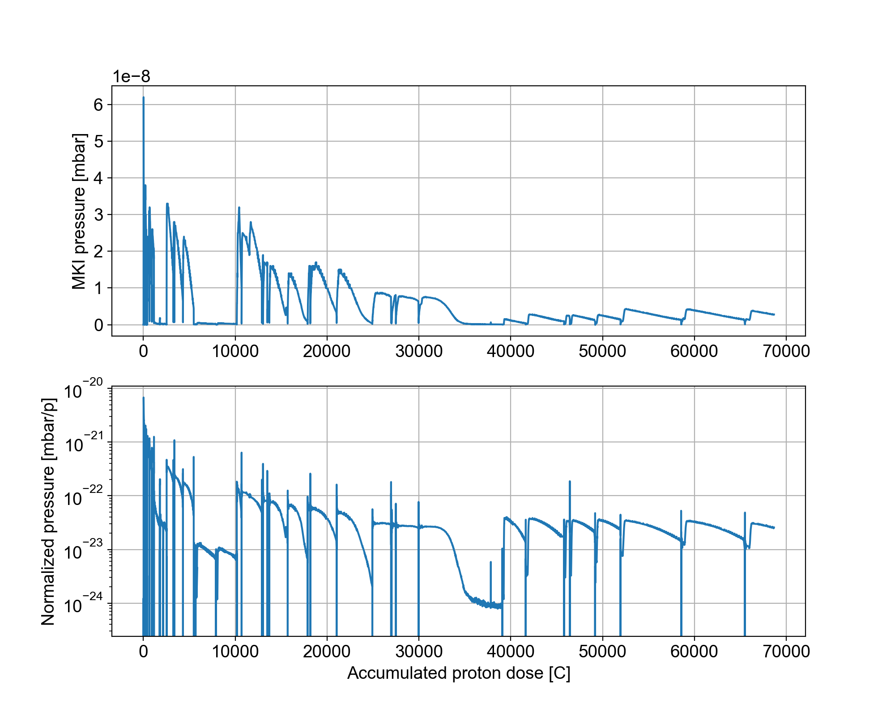
Expected conditioning of coated alumina tube
From: https://indico.cern.ch/event/1208316/contributions/5081442/attachments/2526205/4345060/SPS_MPC_20221011_SPS_scrubbing_2023.pdf
With current MKP-L, no evident conditioning after installation in 2014, nor after LS2
Cr₂O₃ coated alumina also used in MKI8D, installed in LHC during YETS 17/18
  Clear conditioning visible after installation in 2018
In MKI8D area scrubbing slowed down after ~30 kC of proton dose, with the dynamic pressure rise reduced by 2 orders of magnitude

Slide 15
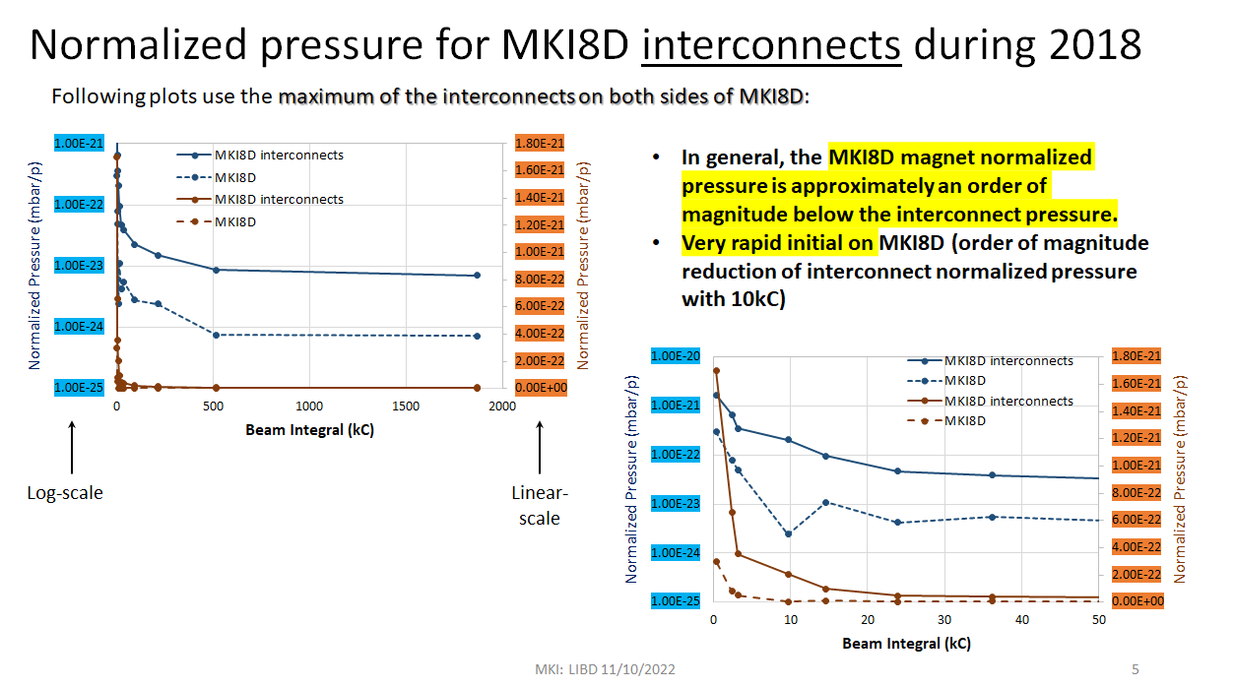
From: https://indico.cern.ch/event/1195594/contributions/5086753/attachments/2524482/4341538/MKICool-Conditioning_LIBD_11102022.pdf

Slide 16
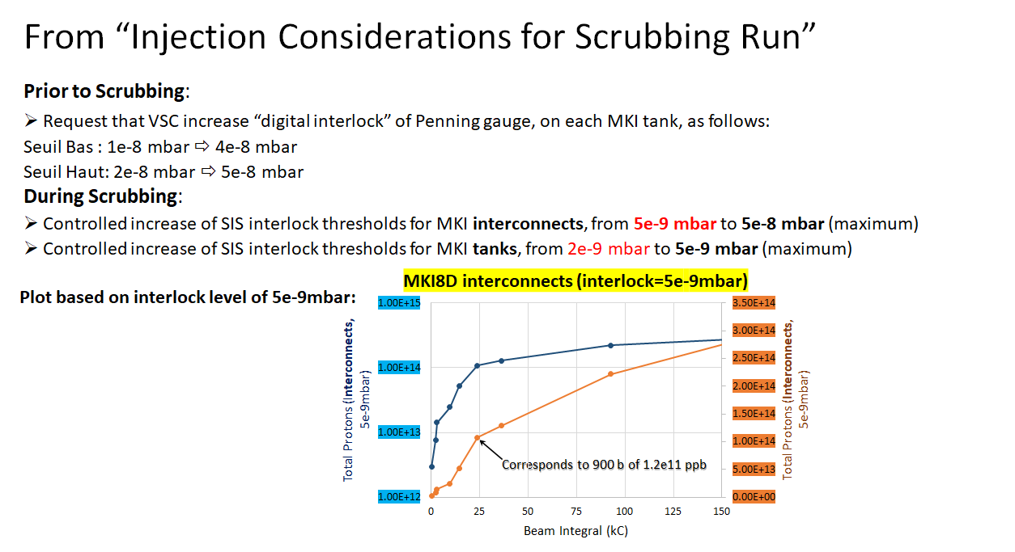
From: https://indico.cern.ch/event/1195594/contributions/5086753/attachments/2524482/4341538/MKICool-Conditioning_LIBD_11102022.pdf

Slide 17
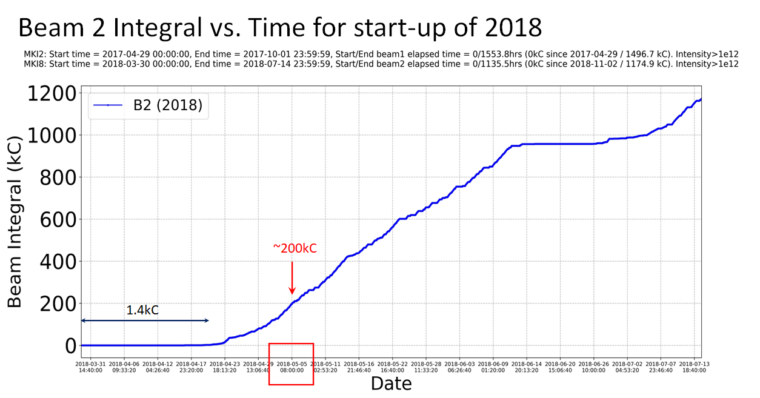
From: https://indico.cern.ch/event/1195594/contributions/5086753/attachments/2524482/4341538/MKICool-Conditioning_LIBD_11102022.pdf

Slide 18

Slide Courtesy of L. Vega Cid (PhD thesis defense: 15/1/2021)
Cooling ferrite rings with reduced overlap length
Decision: Combined solution of reducing the overlap length and installing a cooling system around the rings.
15/01/2021
Notes:
Heat:
Reduction from 616 W to 450W.
Relocation of the power loss from the yokes to the rings, cooled more easily, as not at pulsed high voltage. First yoke is reduced by a factor of 13, while it is increased by a factor of 15 in the hottest ring, Ring#5.
Cooling:
No cooling: This is still a high temperature considering that the power generated has been reduced to 4W. This can be explained by the increased temperature of the rings, higher than 500ºC which causes significant thermal conduction via the alumina tube, and radiation to the yokes.
Cooling: For simplification purposes the cooling was represented in the thermal model by setting the external surface of the rings at 20

Slide 19
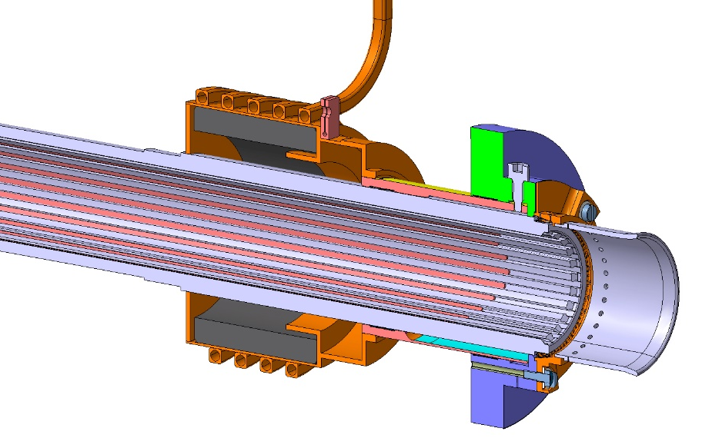
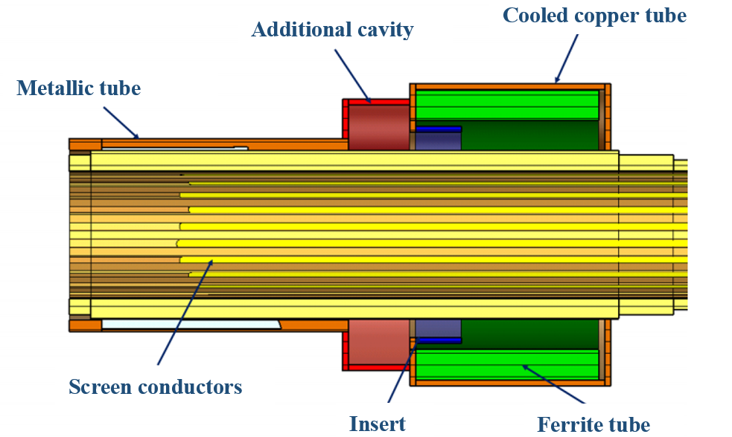
Slide Courtesy of L. Vega Cid (PhD thesis defense: 15/1/2021)
Final proposal
15/01/2021

