Slide 1
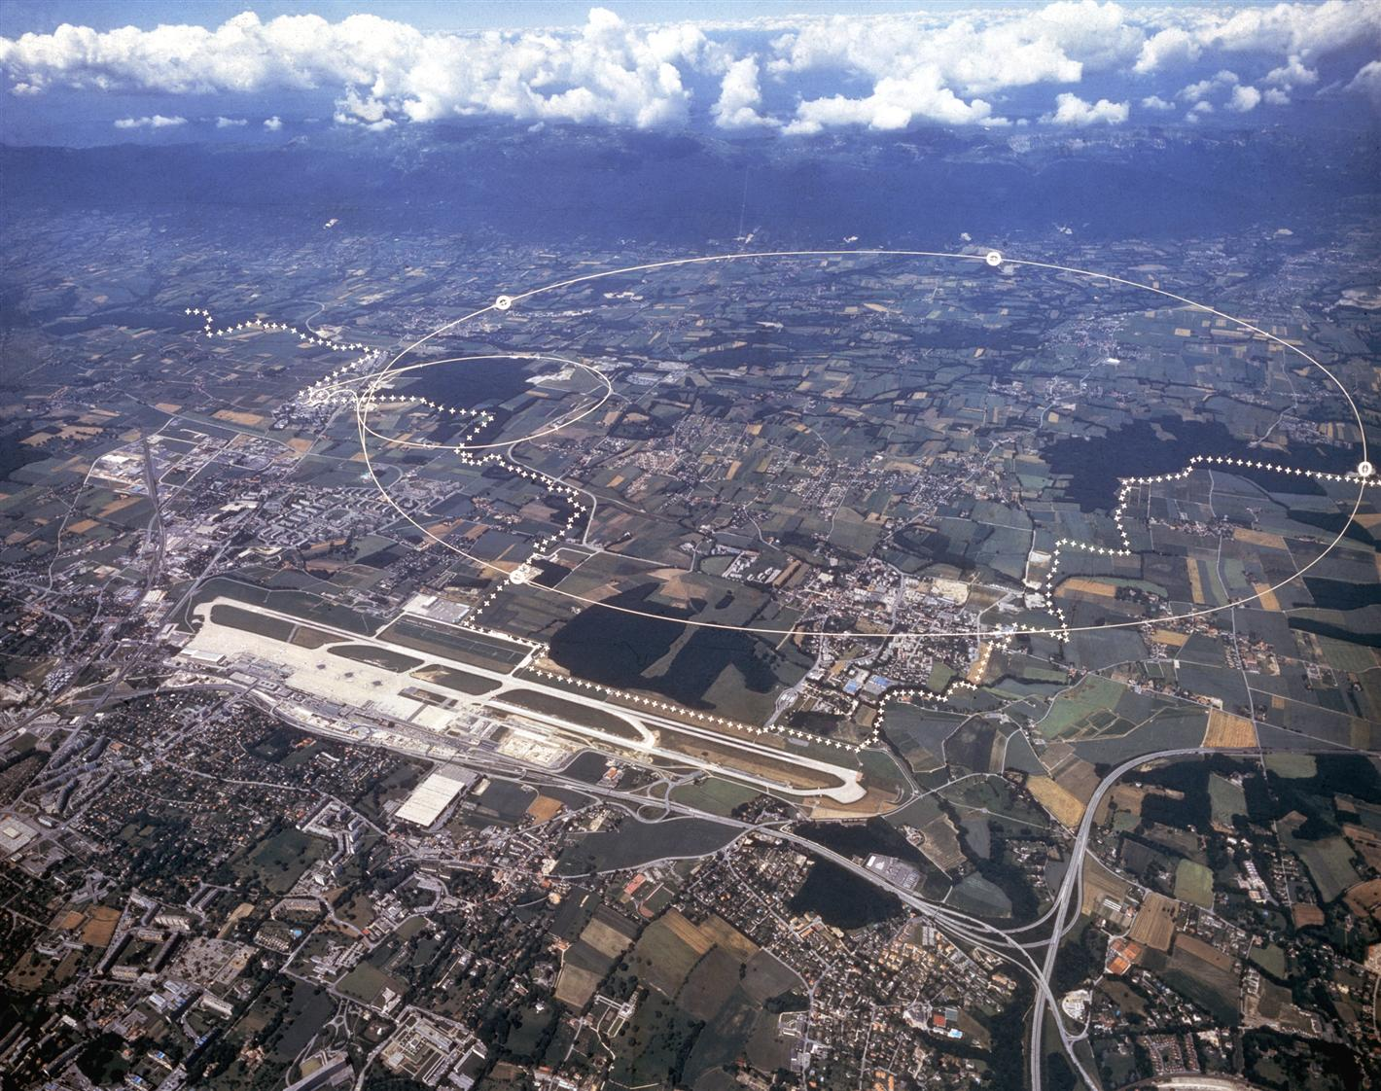

Planning for the 2022 Pb ion test
R. Bruce
With essential inputs from R. Alemany, T. Argyropoulos, H. Bartosik, C. Bracco, A. Butterworth, R. Cai, M. D’Andrea, A. Frasca, P. Hermes, C. Hernalsteens, J. Jowett, S. Kostoglou, D. Mirarchi, F. Moortgat, G. Papotti, B. Petersen, S. Redaelli, M. Solfaroli, G. Sterbini, H. Timko, J. Uythoven, J. Wenninger, D. Wollmann

Slide 2
Outline
Introduction
  Goals of test
  Overview of plannning
Detailed plan of test
  Commissioning
  Crystal collimation test
  Slip-stacking test
  Stable beams
Conclusions

Slide 3
Pb ion test
Initially planned 2022 Pb-Pb run postponed to 2023
2-day LHC Pb ion test slotted in on November 17-18
General goals of test
  Give some first Pb-Pb collisions to the experiments, in particular the new ALICE detector
  Learn as much as possible on the machine side to finalize the energy choice, and for future performance estimates and optimizations
More specifically
  Stable beams with Pb-Pb collisions at all IPs → New record-high energy for Pb-Pb collisions!
  Crystal collimation tests
  Tests slip-stacked beams in the LHC
    Ideally test colliding slip-stacked trains at top energy
  Anything else we can learn parasitically
    Achieved Pb beam parameters through LHC cycle – be careful with extrapolation though
    Test of ALICE ZDC acceptance?
    Beam-beam?
    Tests of newly installed TCLDs in IR2 for Pb collision products?
Test to be done at low intensity (< 3E11 charges / beam) using standard proton cycle to minimize time used for commissioning and validation

Slide 4
Overview of planning
Plan (Total: 36h)
  Commissioning → 6h
  Slip-stacking tests at injection → 2h
  Crystal collimation test → 12h
  Stable beams, 2 fills → 16h
  Have 2 days allocated, i.e. we have some contingency in case of unexpected problems, machine downtime etc.
Advantages of doing things in this order:
  If beam quality is satisfactory, we can do stable beams with short slip-stacked trains
    Request from ALICE and ATLAS - can learn more with the new detector conditions closer to standard physics
    We can study the transmission, beam parameters and luminosity with slip-stacked beams in the LHC throughout the cycle, and hence make better performance estimates for the future
    We can potentially get experience of long-range beam-beam and lifetime with slip-stacked beams in collision
  If there are no issues, we can do stable-beam Pb ion operation with crystal collimation (first time ever!)

Slide 5
Outline
Introduction
  Goals of test
  Overview of plannning
Detailed plan of test
  Commissioning
  Crystal collimation test
  Slip-stacking test
  Stable beams
Conclusions

Slide 6
Needed commissioning
Transfer lines SPS-LHC
  Need steering of transfer lines (different optics in SPS, Q26)
  Typically done with protons, but can be done with single-bunch ion injections in this case (low total injected intensity)
  If we see significant losses or emittance blowup, consider realigning transfer line collimators or re-check transfer line optics
LHC injection / RF
  Need different RF frequency for ions
  Need to commission RF capture, stable phase and RF buckets for ions
No further commissioning foreseen – will use standard proton cycle
Total time estimated: Around 6h
  Could also be faster if things go smoothly

Slide 7
Outline
Introduction
  Goals of test
  Overview of plannning
Detailed plan of test
  Commissioning
  Crystal collimation test
  Slip-stacking test
  Stable beams
Conclusions

Slide 8
Crystal collimation tests
Reminder:
  Planned to rely on crystal collimation in all future LHC Pb ion operation
  Present system: Two new crystals installed in LS2 + two “old” devices remaining since Run 2
  Plan to exchange also the remaining two in the YETS with the new design
  Hope to improve availability and minimize “10-Hz” dumps with improved cleaning efficiency
    Discussions with experiments about possibly making Run 3 physics at 6.37 Z TeV instead of 6.8 Z TeV to increase margins
Goals of crystal collimation studies in beam test
  Characterize crystals with Pb beams, in particular the new ones, and demonstrate channeling
    In particular, investigate skew planes for B1V
  Study cleaning performance improvement w.r.t. standard collimation system
    Would give very important inputs for decisions on beam energy
  Study cleaning performance with a few different settings of crystal-based system
Conditions for test
  Will need about 20 non-colliding bunches per ring (staying below 3E11 charges)
    possibly with batches of 3 individual bunches per SPS cycle as in previous tests to minimize injection time
  Use standard proton cycle at flat top (β*=1.3m at IP1/5)
  With Pb beams, need to switch LHC BPM gain to higher sensitivity – could induce some orbit variation, but expected to be very small

Slide 9
Program for crystal collimation test
Total estimated: 10.5h
  Additional time for cycle, ramp-down: count 12h
Preparations: hardware and controls experts to move in crystals and move out replacement chamber
Duration (hrs) | Task
0.5 | Injection
2 | Beam based alignment of all four crystals at injection Angular scan at injection to find channeling
0.5 | Injection
0.5 | Ramp
1 | Check offsets on BPM collimators BPM alignment of IR7 and TCTs, move in TCTs BLM alignment if needed of a few key collimators
2 | Beam based alignment of all four crystals Angular scans at flat-top to find channeling
1 | Linear scans (especially B2V to study skew planes)
1.5 | Loss maps in different configurations: Standard system without crystal Crystal at 4.75 sigma Crystal at 4.5 sigma Collimators upstream of crystal open TCLAs to 8 sigma Retracted secondary to test mis-cut and asymmetry Some other TCLA settings to test if we have bunches left
1.5* | OP work, miscellaneous

Slide 10
Outline
Introduction
  Goals of test
  Overview of plannning
Detailed plan of test
  Commissioning
  Crystal collimation test
  Slip-stacking test
  Stable beams
Conclusions

Slide 11
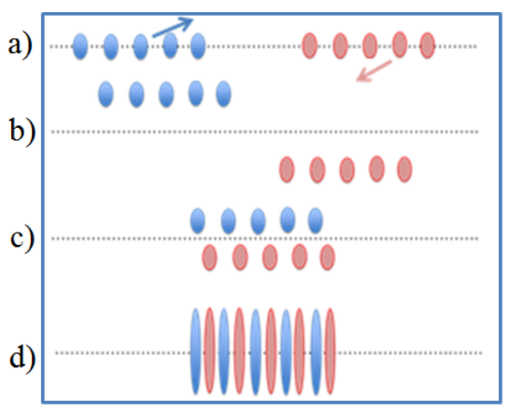
Slip-stacking tests
From LIU technical design report, vol. 2
Reminder: Future LHC Pb ion physics program relies on new slip-stacked beams from the injectors
  Interleave 100 ns bunch trains in the SPS through RF manipulations to achieve a 50 ns bunch structure
  Result: 70% more bunches than in 2018 (had 75 ns spacing)
  Injectors have done great progress on the commissioning of slip-stacked beams in 2022
Goal of test: set up, inject and study short slip-stacked train of 8 bunches
  Study beam quality and characteristics on circulating beam at injection - any quick adjustments needed?
  If test successful, can use slip-stacked beams for stable beams at top energy
  If SPS can produce longer trains we can try to inject (up to 4*8 to stay below setup beam flag) but not likely
  (Optional: Could leave beam circulating at injection for some ~20-30 minutes to study blowup and lifetime)
Estimated time: 2h

Slide 12
Outline
Introduction
  Goals of test
  Overview of plannning
Detailed plan of test
  Commissioning
  Crystal collimation test
  Slip-stacking test
  Stable beams
Conclusions

Slide 13
Stable beams
All experiments interested in collisions - especially ALICE eager to test new detector
Plan to do two stable-beam fills with different filling schemes – total time about 16 h
  First fill relying on single bunches as in Xe run – can have four non-colliding bunches for loss maps. Goal to validate on the fly in the same fill – see next slide
  Second fill with two slip-stacked 8-bunch-trains per ring, combined with a few single bunches
Use standard pp cycle, go to end of squeeze, β*= [0.6 , 10 , 0.6, 1.5] m
  Can piggy-back on the proton OP cycle and collision beam process – easiest option for OP
  No β*-levelling foreseen – stay at 60 cm
Compared to standard proton cycle, need to change ALICE crossing angle
  In standard pp operation, use 200 urad external angle, which adds to spectrometer angle (net angle 272 urad)
  For ZDC acceptance, max net angle is 100 urad → Need to reverse spectrometer polarity so they subtract, decrease external angle of max 172 urad
  Before trimming crossing angle, need to open IR2 TCTs symmetrically
If crystal tests are satisfactory, propose to insert crystal as primary collimator in physics fill
  Nice achievement to have Pb-Pb stable beams with crystal collimation
  Standard collimation system still to stay in place with standard pp settings

Slide 14
MP validation for stable beams
Standard proton cycle and collimator settings as used in 2022 for high-intensity proton operation - aperture is fully protected. Only difference is the beam species, intensity, ALICE crossing, possibly the insertion of crystal
Beam: setup beam of <3E11 charges, about 18-20 bunches with around 1.5E10 charges / bunch – like a “fat pilot” with protons
  In filling scheme with single injections, cannot hit more than one bunch with an asynch dump
  In filling scheme with 2*8 bunch-train, more bunches could be affected. Still, 5o ns spacing, about 1.5E10 charges/bunch
Propose “light” validation given setup beam of <3E11 charges, and that we use nominal proton cycle
  Do it on the fly in stable-beam fill – need to add 2 non-colliding bunches per beam (take 4 to have contingency)
  As in 2017 Xe test: betatron loss maps were done just before stable beams, in same fill
  If first fill will end with OP dump, can do it with an asynch dump
Validation in crystal fill not optimal - not planned to use collision configuration and changed ALICE crossing angle
Proposed procedure:
  Go to end of squeeze
  Insert crystal, open IR2 vertical TCTs symmetrically, open TCLIA to max gap 29.5 mm
  Go in collision (change of ALICE crossing in beam process), optimize
  Do betatron loss maps, validate on the fly
  Declare stable beams
To be worked out: which interlocks need masking?
  Want to be as safe as possible, but must also avoid dumping on spurious interlocks

Slide 15
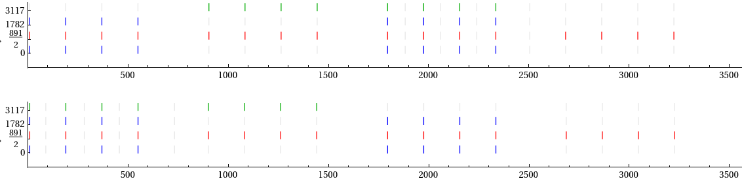
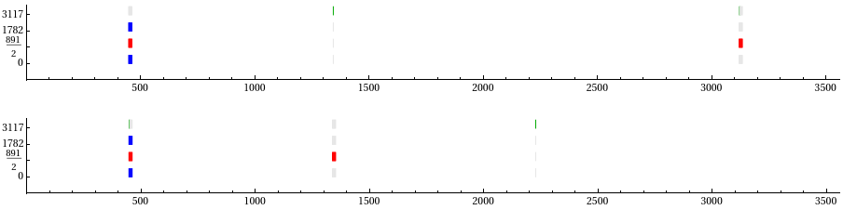
Filling schemes
20b_8_16_8_8
ALICE will have much larger β* (factor ~17)
  to compensate, ALICE should get more colliding bunches in filling scheme
First stable-beam fill: Propose same scheme as in 2017 Xe test: 20b_8_16_8_8
  Has four non-colliding bunches for loss maps
In second stable-beam fill: Propose filling scheme with slip-stacked trains of 8 bunches
  Option a: 2 trains collide with each other in ALICE, adding single bunches that collide with given bunch in train at ATLAS/CMS and LHCb : Scheme 18b_2_16_2_2
  Option b: 2 trains collide with each other in ALICE, 1 train colliding at ATLAS/CMS. Adding single bunches that collide at LHCb : Scheme 18b_2_16_2_2
  Depending on achieved intensity, Further single bunches may be added
17b_8_16_8_2

Slide 16
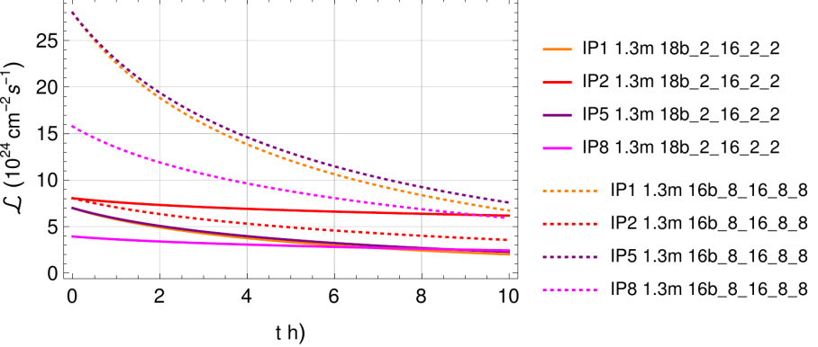
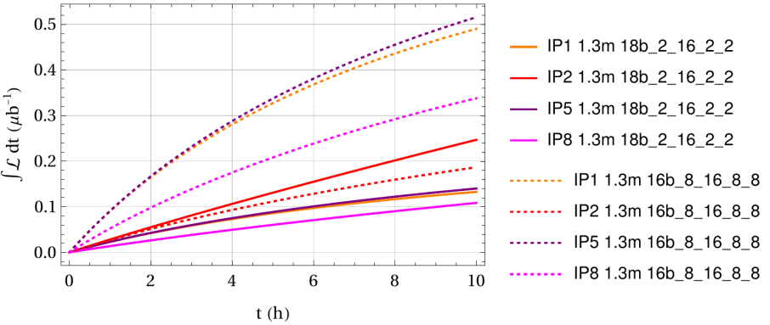
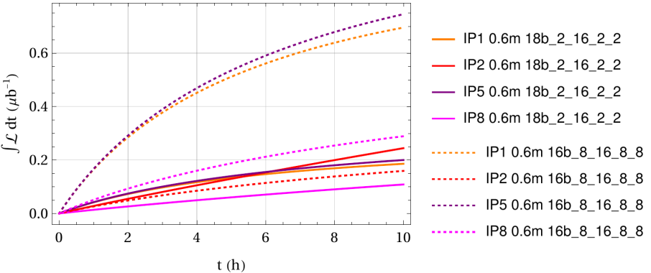
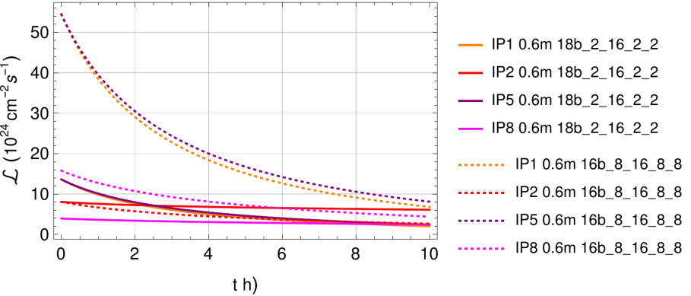
Beam evolution
Instantaneous lumi
Integrated lumi
1.3 m
0.6 m

Slide 17
Expected luminosity
Assume we keep each fill 5h, assign 6h for injections, turnaround etc
Very rough estimate of integrated luminosity
  0.1 μb⁻¹ per fill in ALICE, could get 0.4 μb⁻¹ at ATLAS/CMS
  ALICE loses integrated luminosity due to fast beam burnoff at ATLAS/CMS, where β* is small - consider separation levelling in ATLAS/CMS to give a more balanced sharing
Very high error bar!
  Beam parameters still uncertain – estimates to be taken with significant unertainty
  Very sensitive to actual machine availability

Slide 18
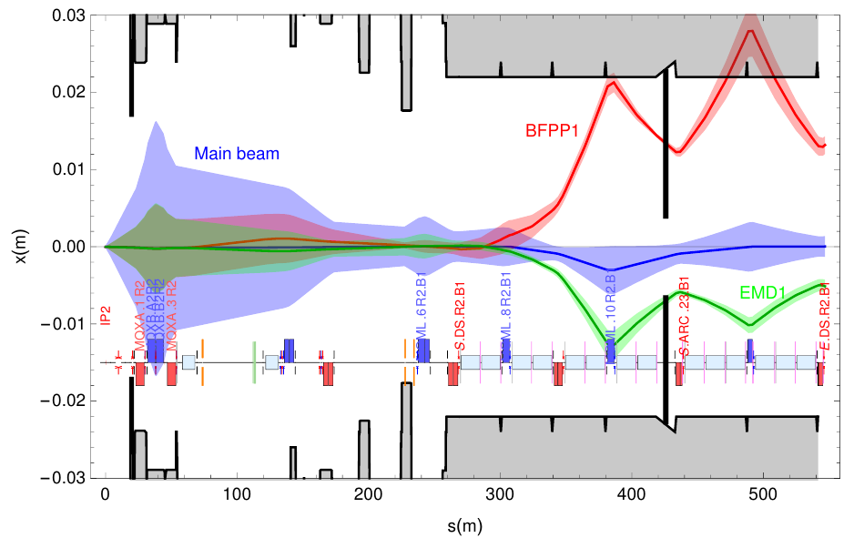
Other activities – optional, under discussion
Is ALICE ZDC acceptance OK for 100 urad?
  If accepance would not be OK, very important to know this early on for the 2023 run
  Could imagine doing some steps down in crossing angle – 100 urad is the limiting case, and with smaller angles we should be fine
  In touch with ALICE to understand if this is wished
  Should check with MP if this is OK (but aperture is >40 sigma at 10m, and will only be better for smaller crossing angle)
  Leave TCT constant at symmetric settings
If we anyway do crossing angle scan at ALICE, where slip-stacked trains collide, could potentially learn something about the beam-beam limits
  Important for future ion operation to learn more about the beam-beam limit, in order to work out a machine configuration with maximum performance
  Weak beam-beam expected with β*=10m, but might still see effects if we go to very small effective beam-beam separations
  Could maybe still learn something by benchmarking simulations, which can then be used to estimate limit in real physics run
  Alternative proposal: consider a crossing angle scan in ATLAS/CMS, with β*=0.6m, if fine for experiments. Maybe end of fill?
IR2 TCLDs installed in LS2 to intercept BFPP ions
  Could parasitically move them in to verify that they work
  Possible caveat: BLM signals from BFPP beam will be very low
  (expect 8E-7Gy/s from approximate scaling)
  If so, need also to apply BFPP bump in IR2 – some preparation work needed
  Should ideally be done before loss maps, but could also be done as end-of-fill
  going back in ADJUST
  Would need some time to tune the bump and the collimator setting – 30 minutes?
    Done with collisions on

Slide 19
Outline
Introduction
  Goals of test
  Overview of plannning
Detailed plan of test
  Commissioning
  Crystal collimation test
  Slip-stacking test
  Stable beams
Conclusions

Slide 20
Conclusions
2022 heavy-ion physics run postponed, short test scheduled on November 17-18
Main goals
  Collisions to experiments
  Crystal collimation tests
  Tests of slip-stacked beams
  Anything else we can learn from the machine side to prepare future ion runs
Program proposed, using setup beams (<3E11 charges) and the standard pp cycle
  Minor modifications: ALICE crossing angle, crystal as primary collimator
  Finish with 16h allocated for two stable-beam fills
  Machine protection validation on the fly in the first fill
  Second fill to be done with short slip-stacked trains
Extra/parasitic activities still under discussion
Several other talks on this topic foreseen next week

Slide 21
Thanks for the attention!

Slide 22
Update 4/11: ALICE crossing angle
Proposal from ALICE to have different crossing angles in the two fills
  First fill: -72(internal) + 172(external) = +100 urad net angle
    This allows testing the ALICE ZDC acceptance at the max foreseen crossing angle
  Second fill: -72(internal) + 128(external) = +56 urad
    Smaller angle, close to what we had in 2018
Validation will be done only in first fill with 100 urad
  In second fill, angle is smaller, so we should have more aperture and be safer
  Similar strategy as for VdM validation
TCT settings will be constant in mm in both fills
  From standard pp setting, open the inner TCT jaw symmetrically. Aperture should still be protected on both sides
  Nominal TCT setting is 37 sigma, aperture with standard 200 urad external angle is above 40 sigma. We expect more aperture in the test, where the angle is smaller

Slide 23
Update 4/11: masking of interlocks
For the crystal test, same masking needed as for standard collimator alignment
The following interlocks will be masked in the stable-beam fills:
  Crystal interlock: Plan to insert crystal as primary collimator in stable beams
  Collimator movement and energy limit in IR2: Need to open the IR2 TCTs symmetrically to accommodate ALICE crossing change
  Collimator BPM in IR2 (TCTs will be off-centered)
  Orbit remains interlocked, but margin in IR2 needs to be adapted to accept change of crossing angle in ALICE
  PC interlock is automatically masked with SBF=True. Could investigate if there is a way to un-mask
If we do TCLD test as end-of-fill, we would go back in ADJUST and then mask as for collimation setup (check also orbit from BFPP bump)

