Slide 1
The Role of Volunteers in
CERN’s Teacher and Student Programmes

Slide 2
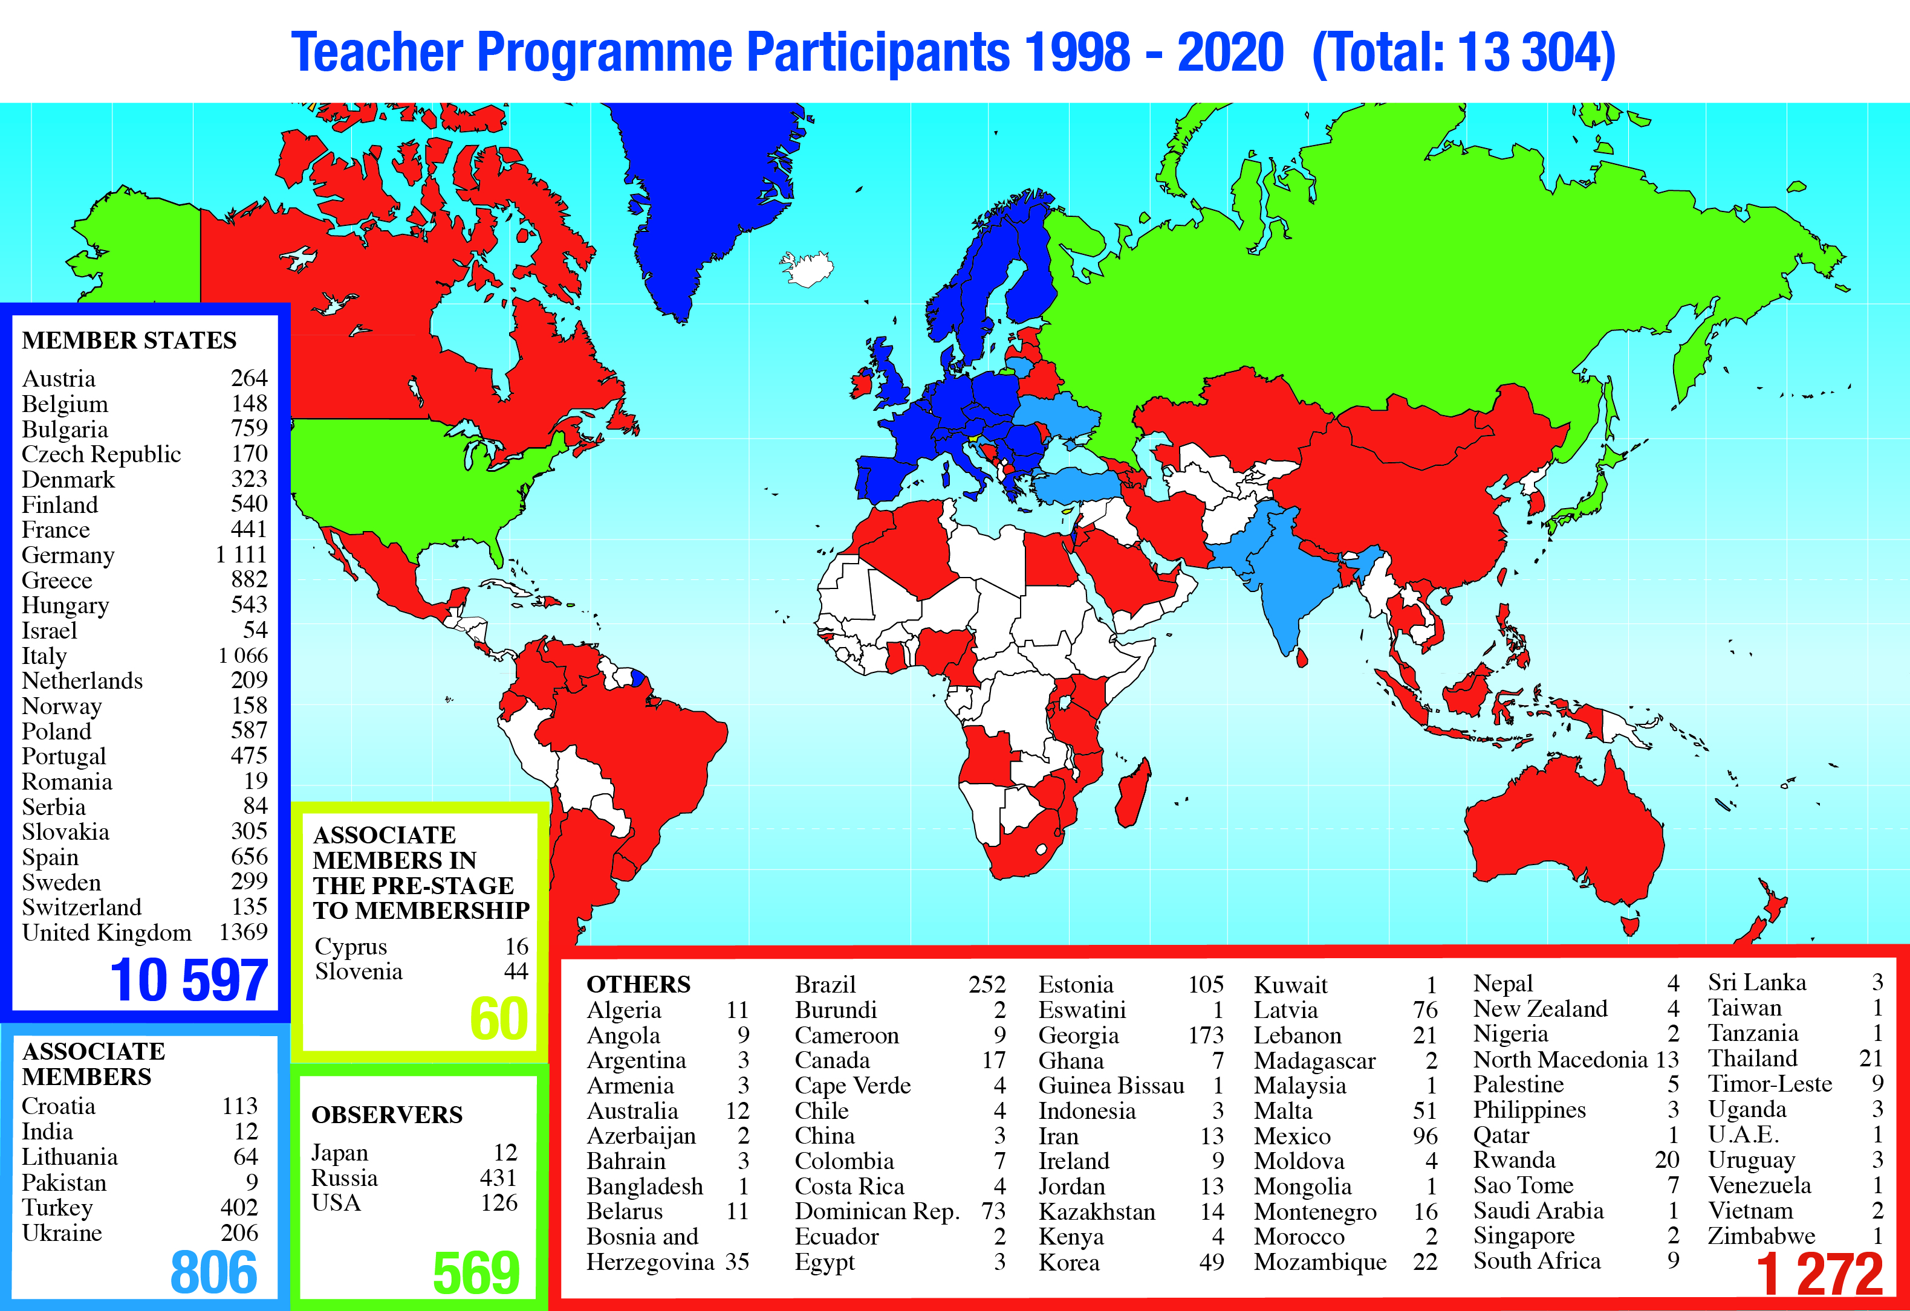
























Why do we need colleagues?
Internship Programmes
volunteering in CERN’s Programmes for Teachers and Students

Slide 3
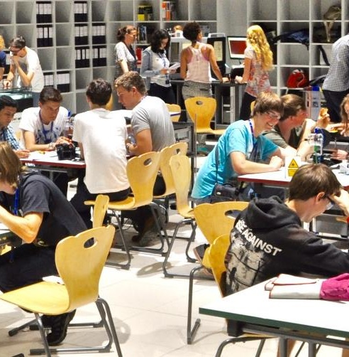
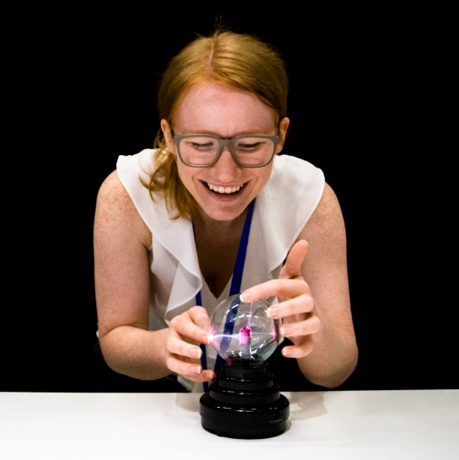

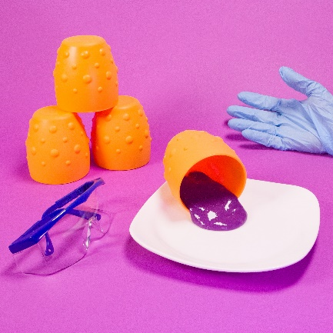
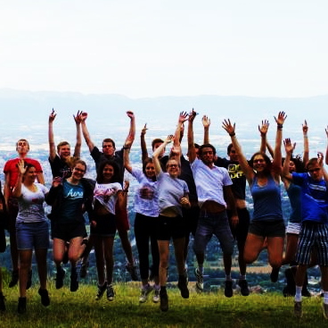
Where do we have and plan to use volunteers?
future Education Labs
Science Shows
CERN-Solvay
Education Programme
Notes:
Labs at SGW (future), S’Cool LAB
Science Shows (Globe now, SGW future)
Solvay camp (reviewing and ranking applications, lecturers, work group leaders) + Solvay explainers (review scripts, hosts)

Slide 4
How many slots and how many volunteers?
future Education Labs
Science Shows
CERN-Solvay
Education Programme
Up to 10 workshops of
45-90 min per day
(+ preparation & follow-up)
Contribute to development of lab workshops
Up to 3 shows of
30-45 min per day
(+ preparation & follow-up)
Contribute to development of shows
Reviewing scripts and videos, 60 hours/year
Approx. 100 hours for reviewing applications
once per year
6 supervisors to organise and lead team research projects,
approx. 6 x 30 h
Lecturers, approx. 5 x 2 h
6 facilitators at any given time on days of operation
mix of employed people (education team) + volunteers
on average 50:50
Sundays and public holidays only run by volunteers
(limited offer)
Notes:
Labs: Up to 10 workshops of 45-90 min (+preparation & follow up) per day, 2-3 science shows of 30-45 min (+preparation & follow up) per day
Total: 6 people at any time needed per day of operation
Mix of education team (MPE, MPAt) + volunteers Tue-Sat
Sundays and public holidays: purely volunteer-led activities (with low risk of problems)
S’Cool LAB: up to 4 workshops per day (90 min + prep/follow-up), Mon-Fri
Mix of education team (MPE, MPAt) + volunteers, for workshops with advanced equipment: 1 education team member + 1 volunteer per group
Solvay: no slots

Slide 5
Training for Science Gateway activities
Labs
  short hybrid (online/onsite) training on basics & safety
  workshop with volunteers as students
  join at least one workshop led by education team member to learn on the job as “assistant”
Shows
  watch 1 show as participant
  training session 3-4 h reviewing script and experiments
  perform once without audience
  join one show led by an education team member as “assistant” to learn directly on the job
Additionally for all
short briefing before and feedback after every workshop/show if run together with education team member
additional training offers for selected education and communication skills/topics such as
  Storytelling
  learning psychology
  inquiry based learning
  approx. 1 every 3 months
informal exchanges between volunteers via a mattermost channel
Notes:
how do you train these
S’Cool LAB: 1 hybrid general safety training (online + onsite component), 1 workshop with volunteers as if they were students, shadow at least one workshop
SGW, plan:
Labs: 1 short hybrid training on basics of workshop at SGW, 1 workshop with volunteers as if they were students, join at least one workshop led by education team member to learn on the job
Shows: watch 1 show as participant, 1 training session 3-4h reviewing script and experiments, perform once without audience, join one show led by an education team member as “assistant” to learn directly on the job
+ short briefing before and feedback after every workshop/show if run together with education team member
+ additional training offers for selected education and communication skills/topics such as storytelling, learning psychology, inquiry based learning, … approx. 1 every 3 months
+ informal exchanges between volunteers via mattermost chat channel

Slide 6
Challenges
Huge turn over, very small “core” group of volunteers
Many activities + need for many different languages make it very challenging to train/find enough volunteers, lack of volunteers for certain languages
Only few volunteers have experience interacting with young learners in an education context
Volunteers struggle with group/discipline management, especially with young learners
Considerable amount of person power needed to recruit, train, & maintain volunteer community
We would love to add more training time, but people at CERN are very busy
We have currently no systematic evaluation of the performance of our volunteers
Many volunteers are only “active” a few times per year, no training effect due to repeated facilitation
Certain activites (e.g. science shows) require a lot of training before facilitation is great

Slide 7
7 team members + 3 volunteer facilitators:
Volunteer-led Sundays & public holidays
 |  | Tuesday | Wednesday | Thursday | Friday | Saturday | Sunday
Facilitation (Origin: 50%, others: 25%) | Lab 1 | ✅ | ✅ | ✅ | ✅ | ✅ | ☑️ volunteer-led
 | Lab 2 | ☑️ | ☑️ | ☑️ | ✅ | ✅ | ☑️ volunteer-led
 | Shows | ✅ | ✅ | ✅ | ✅ | ✅ | ☑️ volunteer-led
Operation ≈ 50% | ✅ | Scheduling, volunteer training & development, activity & equipment maintenance, team coordination, communication, monitoring)
R&D (DOCT: 50%, others: 25%) | ✅ | New activities & formats, support material for educators, empirical evaluation of activities, special events such as birthday parties, training of team members
Legend |  | Comments
✅ | All activities possible & guaranteed 2 people per activity, at least 1 of them a team member | 2 weeks of winter shutdown needed
☑️ | Simple activity requiring only 1 team member + NO volunteer
☑️ volunteer-led | Simple activity requiring 2 volunteers + NO team member, needs to be cancelled in case of no-shows
Notes:
More volunteers needed on Sundays to compensate for missing team members, therefore a) higher volunteer need (3.5 per day on AVG) or b) some activities without volunteers during the week

