Slide 1
Introduction to the Greek Participation at CERN
Costas Foudas – Scientific delegate of Greece at CERN

Slide 2
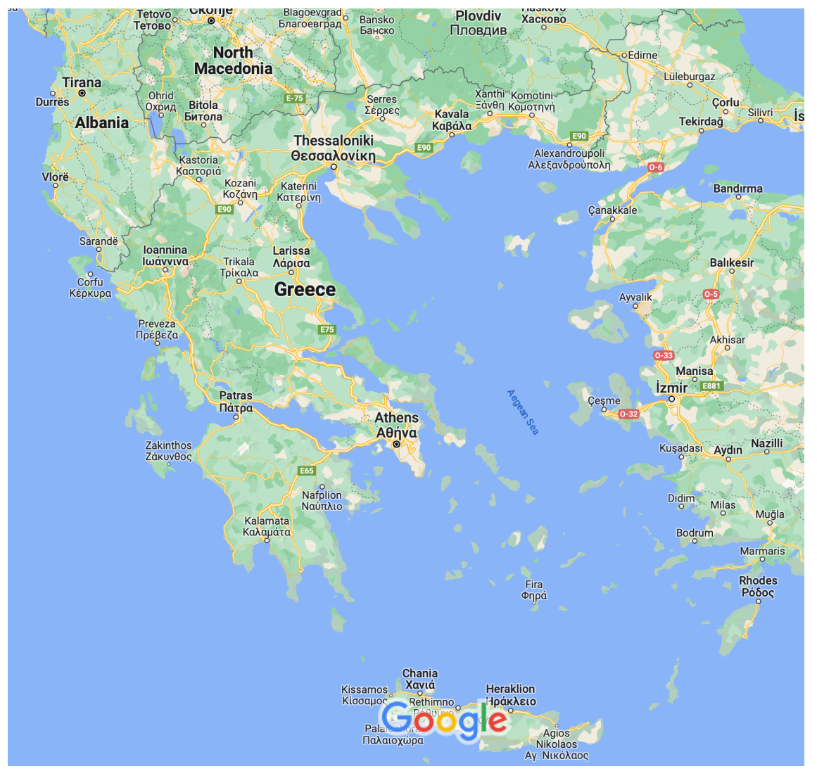
Physics Departments in Greece with HEP Communities
National Kapodistrian University of Athens - NKUA
National Technical University of Athens - NTUA
University of Crete - UoC
Institute of Nuclear and Particle Physics – Democritos - INPP
Aristotle University of Thessaloniki - AUTH
University of Ioannina - UoI
University of Patras - UoP
Faculty from Open University and University of Thessaly are participating via AUTH and faculty from University of Aegean are participating via NKUA
37 hep-ex Faculty in:
  ATLAS: 15
  CMS: 15
  ALICE: 1
  KM3Net: 3
  nTOF: 3
25 hep-th/ph Faculty in:
  AUTH: 2
  NKUA: 6
  NTUA: 5
  UoI: 5
  UoP : 2
  UoC: 3
  INPP: 2
The community has been decimated during the financial crisis when there was a hiring freeze and of those retiring were not replaced.

Slide 3
Experiments and R&D
ATLAS: Data Analysis, Muon Detector, New Small Wheel, L1 Trigger/DAQ – NKUA, NTUA, AUTH, INPP
CMS: Data Analysis, Preshower, Silicon Tracker, L1 Muon Trigger – NKUA, NTUA, INPP, UoI
ALICE: Data analysis – NKUA
CAST: Completed in 2022, significant contributions to Axion physics – Up, INPP
nTOF: Neutron cross section measurements for nuclear astrophysics, energy and medical applications: UoI, NTUA
RD-51: R&D in Gaseous detectors: NTUA, INPP, AUTH, NKUA
RD-50: R&D in Silicon detectors: INPP
L1 Trigger R&D: UoI, NKUA
Accelerator: AUTH
DRD3 Silicon detectors: NTUA,INPP, UoI, NKUA
DRD1 Gaseous detectors: NTUA, INPP, AUTH

Slide 4
Physics Education in Greece:
Statistical data

Slide 5
Undergraduates admitted in Physics Departments
HEI/Year | 2017 | 2018 | 2019 | 2020 | 2021 | 2022
NKUA | 267 | 290 | 318 | 282 | 241 | 230
NTUA | 46 | 63 | 78 | 50 | 68 | 58
UoI | 160 | 160 | 160 | 160 | 160 | 52
AUTH | 253 | 245 | 284 | 260 | 213 | 161
UoC | 167 | 181 | 173 | 56 | 63 | 57
UoP | 200 | 200 | 200 | 200 | 200 | 156
TOTAL | 1093 | 1139 | 1213 | 1008 | 901 | 714
The decrease observed in 2022 has two reasons
  The departments were allowed to set admission thresholds themselves and they are still optimizing their criteria
  There may be other reasons such as competition with other disciplines which may offer better job opportunities but this is under investigation

Slide 6
Undergraduates Selecting HEP/Nuclear Physics
HEI/Year | 2017 | 2018 | 2019 | 2020 | 2021 | 2022 | FIELD
NKUA | 36 | 57 | 52 | 55 | 52 | N/A | HEP/NUC
NTUA | 31 | 25 | 26 | 35 | 20 | N/A | HEP/NUC
UoI | 50 | 82 | 75 | 83 | 70 | 63 | HEP/NUC
AUTH | 35 | 36 | 46 | 55 | 35 | 38 | HEP/NUC
UoC | 26 | 24 | 26 | 37 | 38 | 27 | HEP-TH
UoP | 10 | 10 | 10 | 10 | 10 | 10 | HEP-TH
TOTAL | 188 | 234 | 235 | 275 | 225 | N/A
The number of students selecting HEP or Nuclear appears to be stable integrating over all departments.
Given that these course are at later years, the effect of the decrease of the number of students entering is not yet seen here.

Slide 7
Students entering MSc in HEP/Nuclear Physics
 | 2017 | 2018 | 2019 | 2020 | 2021 | 2022
NKUA | 10 | 9 | 15 | 8 | 9 | 15
NTUA | 21 | 9 | 18 | 11 | 11 | 11
UoI | 6 | 9 | 2 | 3 | 3 | 3
AUTH | 3 | 2 | 3 | 9 | 10 | 9
UoC | 3 | 1 | 3 | 0 | 1 | 0
UoP | 3 | 3 | 3 | 3 | 3 | 3
TOTAL | 46 | 33 | 44 | 34 | 37 | 38
MSc is a 1.5 years program which practically means 2.0 years
A large fraction continues for a PhD afterwards…..

Slide 8
Msc Students Entering a PhD in HEP/Nuclear
 | 2017 | 2018 | 2019 | 2020 | 2021 | 2022
NKUA | 10 | 2 | 6 | 8 | 4 | 3
NTUA | 2 | 13 | 9 | 11 | 4 | 4
UoI | 7 | 4 | 4 | 3 | 2 | 2
AUTH | 6 | 7 | 2 | 2 | 4 | 5
UoC | 0 | 0 | 1 | 2 | 1 | 0
UoP | 0 | 1 | 0 | 1 | 0 | 1
TOTAL | 25 | 27 | 22 | 27 | 15 | 15
Number of entering PhD candidates is lower for the years 2021 and 2022

Slide 9
Current PhD and Master Students in HEP Nuclear Physics
Institution | PhD Candidates | Master Candidates
AUTH (Thessaloniki) - EXP | 9 | 5
AUTH (Thessaloniki) - TH | 6 | 6
NKUA (Univ. of Athens) - EXP | 7 | 11
NKUA (Univ. of Athens) - TH | 30 | 15
NTUA (Nat. Tech. Univ. of Athens) - EXP | 16 | 8
NTUA (Nat. Tech. Univ. of Athens) - TH | 19 | 0
INPP Democritos - EXP | 4 | 2
INPP Democritos - TH | 4 | 0
Univ. of Ioannina - EXP | 10 | 7
Univ. of Ioannina - TH | 6 | 6
Univ. of Patras - TH | 3 | 6
Km3Net | 3 | 0
Total | 117 | 66
The vast majority of these candidates work from Greece and are mostly underfunded or not funded at all.

Slide 10
Female Students in Physics for BSc, MSc, PhD
 | 2017 | 2018 | 2019 | 2020 | 2021 | 2022
%BSc | 35% | 41% | 41% | 44% | 42% | 40%
%MSc | 35% | 35% | 46% | 43% | 37% | 37%
%PhD | 25% | 29% | 12% | 20% | 20% | 36%
The ratio is essentially the same for the BSc and MSc levels, ranging between 35% and 44%
It drops to ~25% for PhDs

Slide 11
Greece at CERN

Slide 12
Greek Funding for CERN and CERN Experiments
The funding comes from the General Secretariat for Research and Innovation (GSRI)
GSRI belonged to the Education Ministry until 2019 and after that it belongs to the Development Ministry
The Greek contribution to CERN is ~ 1% of the CERN yearly budget as computed using the GDP of Greece in the 3 years prior to the year of payment. Over the past 6 years it has been in the range between 10.6 – 12.2 MCHF (see table below)
The contributions of GSRI to the CERN experiments with Greek participation (M&O-A/B) is ~ 600 KCHF a year.
In addition GSRI is paying yearly old arears coming from unpaid CERN contributions prior to 2016.
  In 2016 Greece owed to CERN 33.9 MCHF. CERN council allowed Greece to pay them back in 15 yearly payments
  In 2016 the Council reduced the Greek contribution by 15% for the years 2017, 2018, 2019 but did not wave it. Instead it will be paid back in 3 yearly payments after the end of the previous payments and are indexed.
  These yearly payments due every 1st of December amount to 2.2 – 2.4 MCHF
  After the Dec 2023 payment Greece will still owe to CERN 19.3 MCHF to CERN (last payment on 1.12.2034)
Funding for CERN and the CERN Experiments (M&O-A/B) has been paid every year punctually since 2016
A lot of credit here goes to the GSRI personnel who get things moving every year and make sure that Greece does not fall behind in payments
Year | Greek Contribution (MCHF) | Greek Arears (MCHF)
2017 | 11.4 * | 2.3
2018 | 10.7 * | 2.3
2019 | 10.6 * | 2.3
2020 | 12.3 | 2.4
2021 | 12.2 | 2.4
2022 | 11.9 | 2.4
2023 | 11.9 | 2.4 (due on 1.12.23)
* Reduced by 15% per CERN Council decision, difference to be paid together with arears

Slide 13
Greeks @ CERN
There is a large Greek community at CERN
  225 Greek citizens are at CERN
  115 Greeks are at CERN with affiliation to Greek institutions
CERN is supporting the research and education of a rather significant number of young and senior Greek scientists, engineers, etc
Year | Fellows | Doctoral Students | Technical Students | Administr. Students | Staff
2016 | 36 5.55% | 13 6.50% | 36 19.78% |  | 30 1.22%
2017 | 51 6.46% | 14 7.04% | 27 13.71% |  | 33 1.27%
2018 | 54 6.47% | 13 5.75% | 34 18.18% | 5 20.00% | 43 1.62%
2019 | 54 6.83% | 12 5.43% | 19 11.73% | 12 27.00% | 48 1.81%
2020 | 56 7.76% | 13 6.19% | 17 11.64% | 4 16.67% | 51 1.94%
2021 | 51 6.59% | 15 6.28% | 31 15.50% | 3 9.38% | 56 2.10%
2023 | 48 7.62% | 11 3.96% | 12 8.00% | 2 6.23% | 66 2.48%

Slide 14
Funding for research in Greece

Slide 15
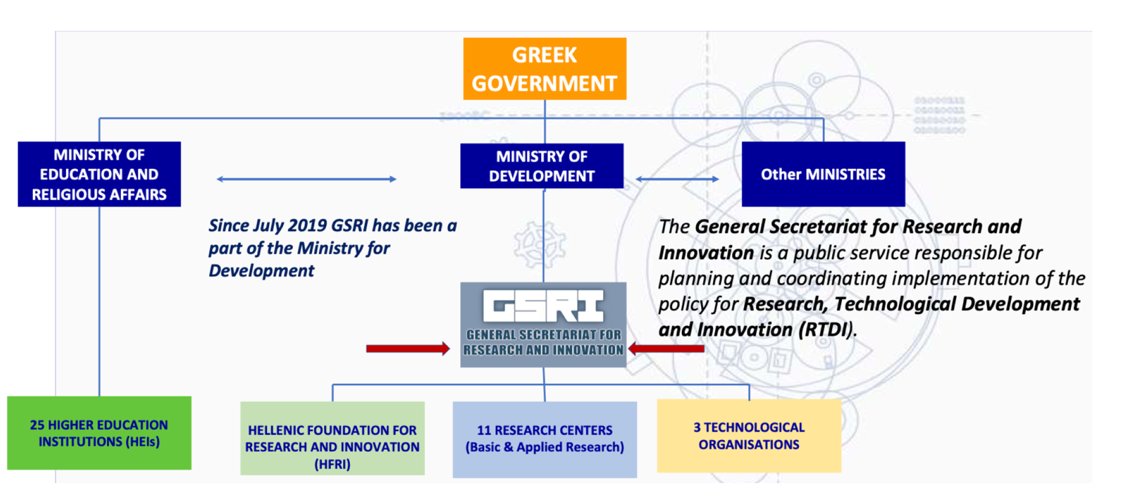
Greek funding for Research in Sciences
HFRI was funded in 2016 and has been the main source of research funds in Greece it is supervised by GSRI
Started with 350 MEuro. 220 MEuro came from a loan (European Bank for Investment - 1% interest) and 130 MEuro were from Greek state funds. This is the first time in history that Greece had a foundation to support research.
It has provided scholarships for PhD students and Postdocs, supported young researchers to return to Greece and Faculty research projects (250 KEuro/project) as well as provided funds to researchers to procure lab infrastructure.
Given the years of underinvestment in research the HFRI funds could hardly cover the needs of sciences but nevertheless it provided some breath to our research groups.
Unfortunately, since 2016 no new money has been invested on HFRI and every year it provides less and less. It is expected that its funds will run out very soon.

Slide 16
Organization of the High Energy and Nuclear Physics Community in Greece
Greek Delegation at CERN: I. Ghikas (Ambassador-GVA Permanent Mission), C. Foudas (Scientific delegate), A. Christodoulea (GVA Permanent Mission)
Greek Delegation to the CERN Finance Committee: N. Manthos, C. Foudas
Greek Industrial Liaison Officer (ILO): N. Manthos
Greek delegation to Resource Review Board: C. Foudas, G. Tsipolitis
CERN Committee of GSRI: Monitors the CERN program and makes recommendations to the General Secretary. Chaired by the General Secretary Prof. A. Kyriazis
CERN Greece Liaison Committee (- 2021): Monitored progress in Greek personnel at CERN as well as Industrial return.
Greek Society for High Energy Physics: K. Zachariadou (Chair). It represents the Greek High Energy Physics Community. It organizes yearly scientific conference and the Greek Scientific delegate as well as the ILO report there. Most community discussions take place in meetings of this society.
Greek Society for Nuclear Physics and Applications: C. Chabaris (Chair). Similar functions as above.

Slide 17
Requested budget for CMS Upgrades for HL-LHC
CMS-GR Budget for HL-LHC Upgrades
Contribution | Amount
Percent of Greece in CMS | 1.3% (3.457 MCHF)
Si-Tracker | 1.4 MCHF
L1-Trigger | 1.0 MCHF
EndCap Calorimeter HGCAL | 0.35 MCHF
Common Fund | 0.326
TOTAL | 3.076 MCHF
ATLAS-GR Budget for HL-LHC Upgrades
Contribution | System | Amount
Event Filter-Pattern Recognition Mezzanine (PRM) | TDAQ | 0.80 MCHF
RPC - DCT boards | MUONS | 0.85 MCHF
Power Systems | MUONS | 0.65 MCHF
MDTS Mezzanine boards | MUONS | 0.50 MCHF
L1DDC, Electronics | MUONS | 0.49 MCHF
Muon CF | MUONS | 0.21 MCHF
TOTAL |  | 3.50 MCHF

Slide 18
ATLAS AND CMD REVIEW PANEL
Review Committee for ATLAS and CMS HL-LHC Upgrades
J. Karyotakis (Indep. Member)
K. Jakobs (ATLAS)
T. Camporesi (CMS)
Y. Semertzidis (Indep. Member)
P. Jenni (ATLAS)
J. Virdee (CMS)
ATLAS and CMS have submitted their plans for HL-LHC according to the money matrices of the two experiments
These will be submitted to this panel which should make the final recommendation to the General Secretary of GSRI

Slide 19
Industrial Return

Slide 20
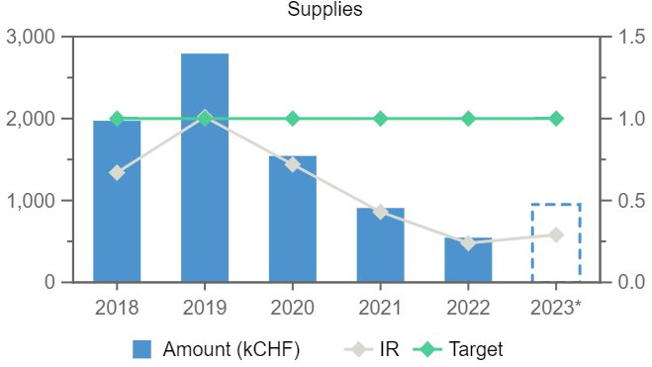
Inflow of Contracts from CERN to Greek Companies
Supplies Services
CERN
Supplies Services
Greece
CERN Budget and Greek Contribution
2023 (NOV) : 1 230 381 850, 11 887 650 (0.99%) 267 860 000, 143 306 000 950 000 416 000
2022 : 1 206 283 950, 11 894 950 (1.01%) 226 311 000, 127 469 000 546 000, 376 000
2021 : 1 168 922 250, 12 232 750 (1.05%) 206 717 000, 133 358 000 908 000, 430 000
2020 : 1 168 922 250, 12 308 750 (1.05%) 207 407 000, 131 216 000 1 544 000, 446 000
2019 : 1 171 420 100, 12 453 650 (1.06%) 261 375 000, 167 528 000 2 793 000, 449 000
2018 : 1 148 237 250, 12 567 300 (1.09%) 267 860 000, 146 760 000 1 973 013, 487 000
GR-Industrial return/Cern Contribution in %
2023 (Nov) 1 366 000/ 11 887 650 = ~ 11.5%
2022: 926 000/ 11 894 950 = ~ 8%
2021: 1 416 000/ 12 232 750 = ~ 12%
2020: 2 046 000/ 12 308 750 = ~ 17%
2019: 3 403 000/ 12 453 650 = ~ 27%
2018: 2 665 832/ 12 567 300 = ~ 21%
The Greek industrial return kept increasing up to and including 2019.
The 2019 industrial return was satisfactory for first time in history.
However, after 2019 the industrial return is declining mainly in supplies but also in total.
We are investigating to find the possible caused for this.

Slide 21
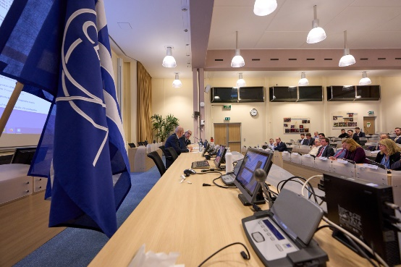
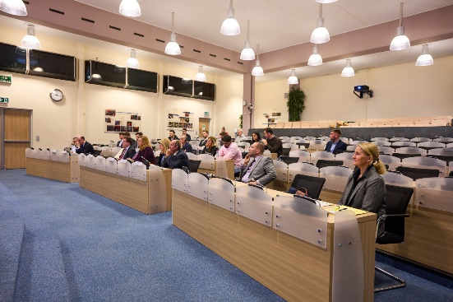
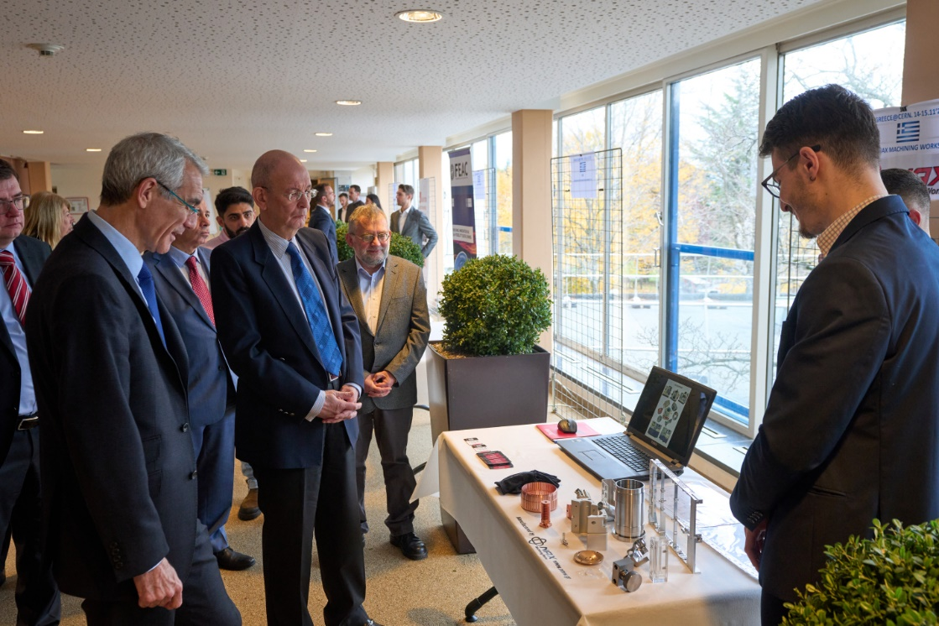
ILO Activities aiming to increase the industrial return
Invitation of potential Greek firms to enrich the firm database (increase by ~15%).
Workshop “Doing business with CERN”, Doing business with CERN, 18 Nov 2021 , with potential Greek firms organized by GSRT in Greece to advertise the CERN “market” including talks by CERN procurement service experts). ~100 participants (~50 firms). B2B meetings with CERN procurement group: ~20 firms.
Exhibition at CERN (Greece@CERN), 14-15.11.2022. 10 Greek firms. Participation of the Greek Delegate at UN, GSRI officers and the following firms: NAX GP, TEMMA SA, INN NCSR, PYLON SA, ISD SA, ADM SA, ELFON LDT, FEAC engineering, ALEXMOLDS SA, PRISMA SA.
27 official + #>20 unofficial B2B meetings with CERN
personnel

Slide 22
Summary:
Greek researchers are making key contributions to the CERN experiments and due to this have raised further the profile of the country at CERN despite all difficulties.
The support to CERN via the Greek yearly contribution and to the experiments via the yearly payment of the M&O contributions has been stable over the past 7 years (thanks to GSRI and hard work of the personnel there).
Support is desperately needed in Greece for physics exploitation of the experiments that we support as well as for instrumentation R&D. It is encouraging that groups have been formed to participate in DRD1 and DRD3.
New positions need to be opened which combined with adequate financial support can reverse the brain drain and create the new generation of HEP researchers.
HFRI has making marked contributions to research in Greece and it would a major loss not to fund it further.
The young generation working on LHC must start contributing to the future of our field by participating in R&D for Fcc.
The news on industrial return are not good and this despite of the intense effort of our ILO to register companies to CERN and encourage them to participate in tenders. We hope to find the reasons for this soon and take the corresponding actions.

