Slide 1
RECFA open session – 10th November 2023 – Athens, Greece
Astroparticle and Neutrino Physics
Christos Markou
Director,
Institute of Nuclear and Particle Physics,
NCSR ‘Demokritos’

Slide 2
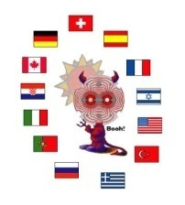
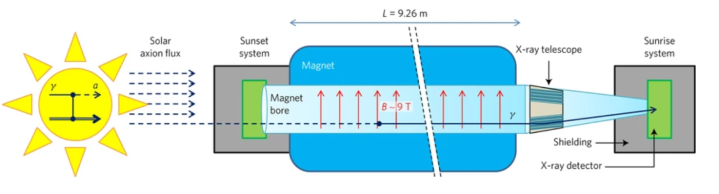
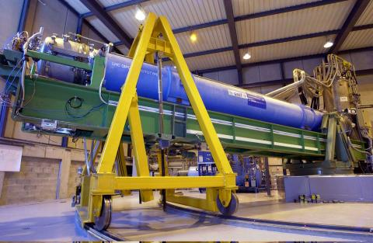
The CAST (Cern Axion Solar Telescope) collaboration
2002 - 2018
13 Countries,
20 Institutions,
In Greece:
Aristotle University of Thessaloniki,
NCSR Demokritos,
University of Patras
CAST people in Greece
K. Zioutas, V. Anastassopoulos, A. Gardikiotis, A. Liolios, T. Papaevangelou, I Savvidis, T. Vafeiadis, A. Nikolaidis, G. Fanourakis, Th. Geralis, K. Kousouris, K. Zachariadou, E.N. Gazis, A. Liolios.
Funding
About at total 30k €, for the duration of the project from NCSR Demokritos internal funds.
GSRT funded the Operating expenses (~30k € / year)
Christos Markou, RECFA open session, 10/11/2023, Athens

Slide 3
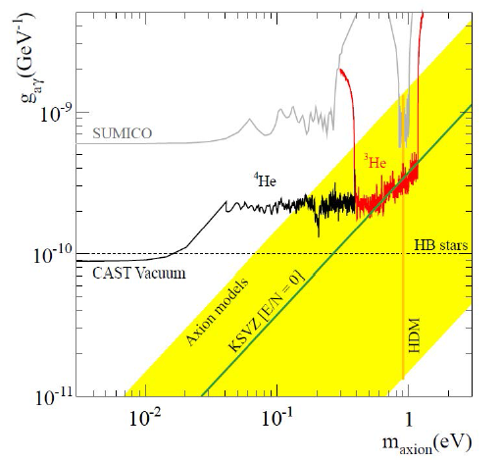
The CAST collaboration
CAST has given quite stringent limits for axion production (m_{a}=10⁻¹¹ to ~1 eV)
  Greek Involvement in:
  Concept – Design
  Management
  Micromegas detectors
  DAQ systems
  MC simulations
  Novel Analysis Techniques
  Setting up and Running the experiment
Christos Markou, RECFA open session, 10/11/2023, Athens

Slide 4
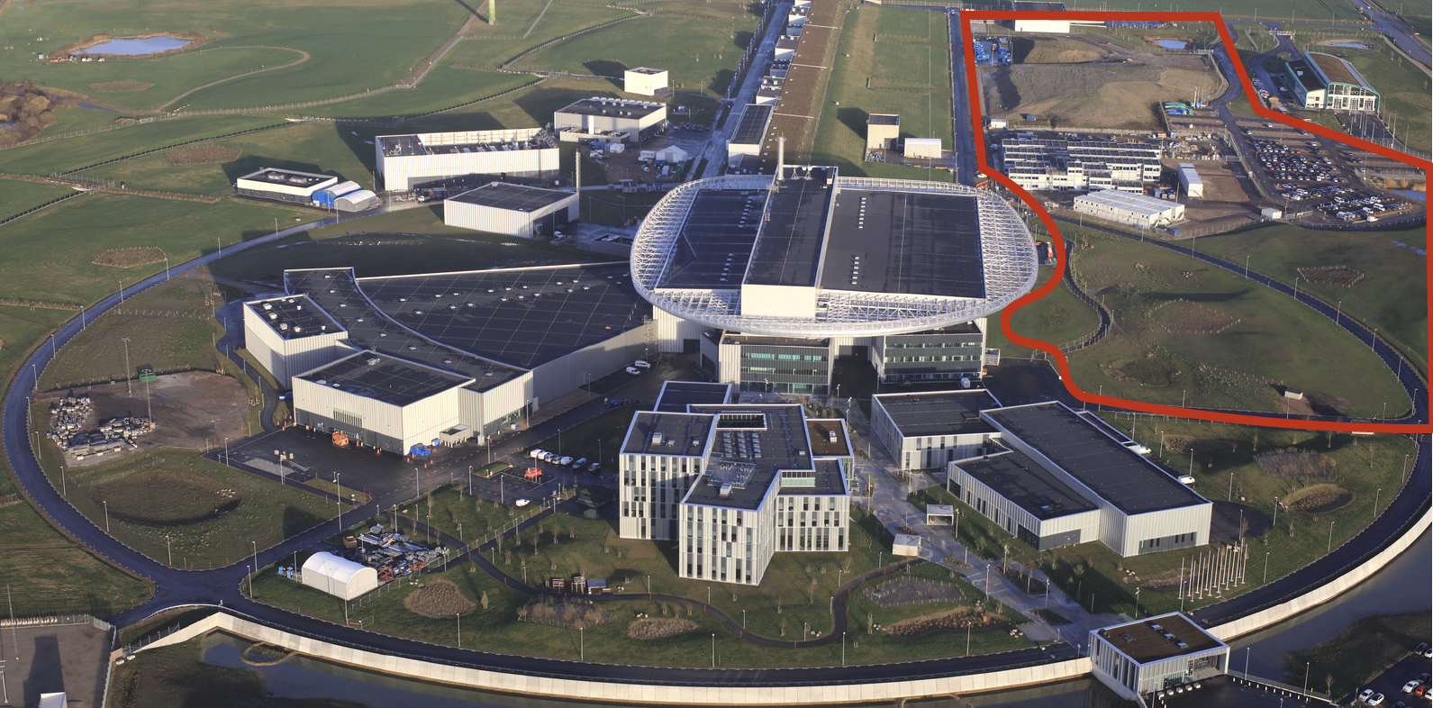

European Spallation Source Neutrino Super Beam
The European Spallation Source as a Neutrino Facility
(in addition to its current mission)
ν
Christos Markou, RECFA open session, 10/11/2023, Athens

Slide 5
European Spallation Source Neutrino Super Beam
H2020 - INFRADEV
Feasibility Study for employing the uniquely powerful ESS linear accelerator to generate an intense neutrino beam for leptonic CP violation discovery and measurement.
15 Partner Institutions, NCSR Demokritos from Greece
The Conceptual Design Report of ESSnuSB is published in: Eur. Phys. J. Spec. Top. (2022) 231:3779–3955
It Includes:
Modifications to ESS Linac
Design of the accumulator, the target/horn system and the decay tunnel to create a powerful Neutrino Super Beam
Design of a Near detector complex and a Far Water Cherenkov detector
The choice of the underground mine to house the Far detector such as it sits at the Neutrino Oscillation second maximum, allowing the measurement of the CP violating phase with an unprecedented precision.
The Physics reach of the proposed facility
Info on : http://essnusb.eu/
Publications:
The ESSnuSB Design Study: Overview and Future Prospects, A. Alekou et al., Universe 9 (2023) 8, 347
Updated physics performance of the ESSnuSB experiment, A. Alekou et al., Eur.Phys.J.C 81 (2021) 12, 1130
The Conceptual Design Report of ESSnuSB, A. Alekou et al., Eur. Phys. J. Spec. Top. (2022) 231:3779–3955
Christos Markou, RECFA open session, 10/11/2023, Athens

Slide 6
European Spallation Source Neutrino Super Beam
Being followed by a Design Study funded by HORIZON-INFRADEV-2022: ESSνSB+
(2023-2025)
Study of the use of the ESS facility to accurately measure the neutrino cross-sections for
ESSνSB leptonic CP violation measurements and to perform sterile neutrino searches
and astroparticle physics.
20 Collaborating Institutes – 10 Countries (Including NCSR Demokritos and AUTH)
Aims :
To Design two new facilities to precisely measure Neutrino Cross Sections
To design a Near-Near detector to form a Short Base Line experiment with the ESSnuSB Near Detector
To further improve the Physics of ESSnuSB and study the non beam Physics of the far detectors of ESSnuSB
ESSnuSB people in Greece
G. Fanourakis, Th. Geralis, G. Stavropoulos, A. Psallidas, E. Fasoula, S. Tzamarias, E. Kasimi, K. Kordas, A. Leisos, Ch. Petridou, D. Sampsonidis, A. Tsirigotis, O. Zormpa.
Funding: Horizon 2020 and Horizon Europe
ESSnuSB project (2018-2022): ~65k €
ESSnuSB+ project (2023-2026): ~ 115k €
Christos Markou, RECFA open session, 10/11/2023, Athens

Slide 7
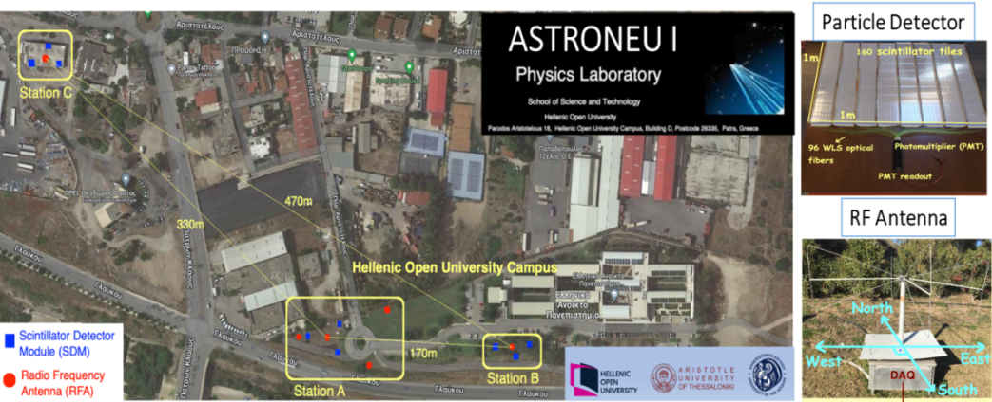
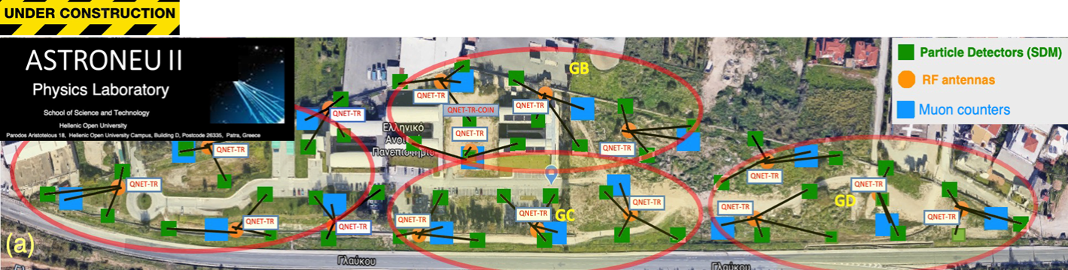
Radio detection of CRs
ASTRONEU
Astroneu I 1st Phase (2014-2016) and 2nd Phase (2017-2022)
Funded by NSRF 2007 – 2013 (540k €) and internal HOU funds ( 30k €)
Pilot array of autonomous stations to detect Extensive Air Showers in noisy urban environment
4 Staff members (A. Leisos, S. Tzamarias- in AUTH, I. Gialas -in U.Aegean and K. Papageorgiou -in U.Aegean )
2 Post-Docs (A. Tsirigotis and S. Nonis)
https://astroneu.eap.gr/index.php/publications/
Astroneu II (since 2023)
Funded via the Public Investment program with 300k €
A denser array with 16 stations each one with 3 particle detectors, 1 RF antenna and a large muon counter.
A test bench for R&D developments related to the GRAND experiment (antenna characterization, software and analysis algorithms development, DAQ tests etc)
Christos Markou, RECFA open session, 10/11/2023, Athens

Slide 8
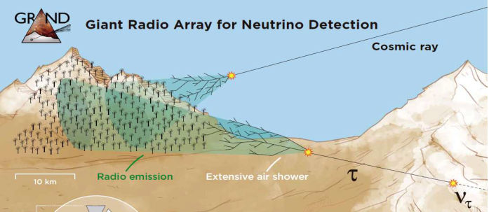
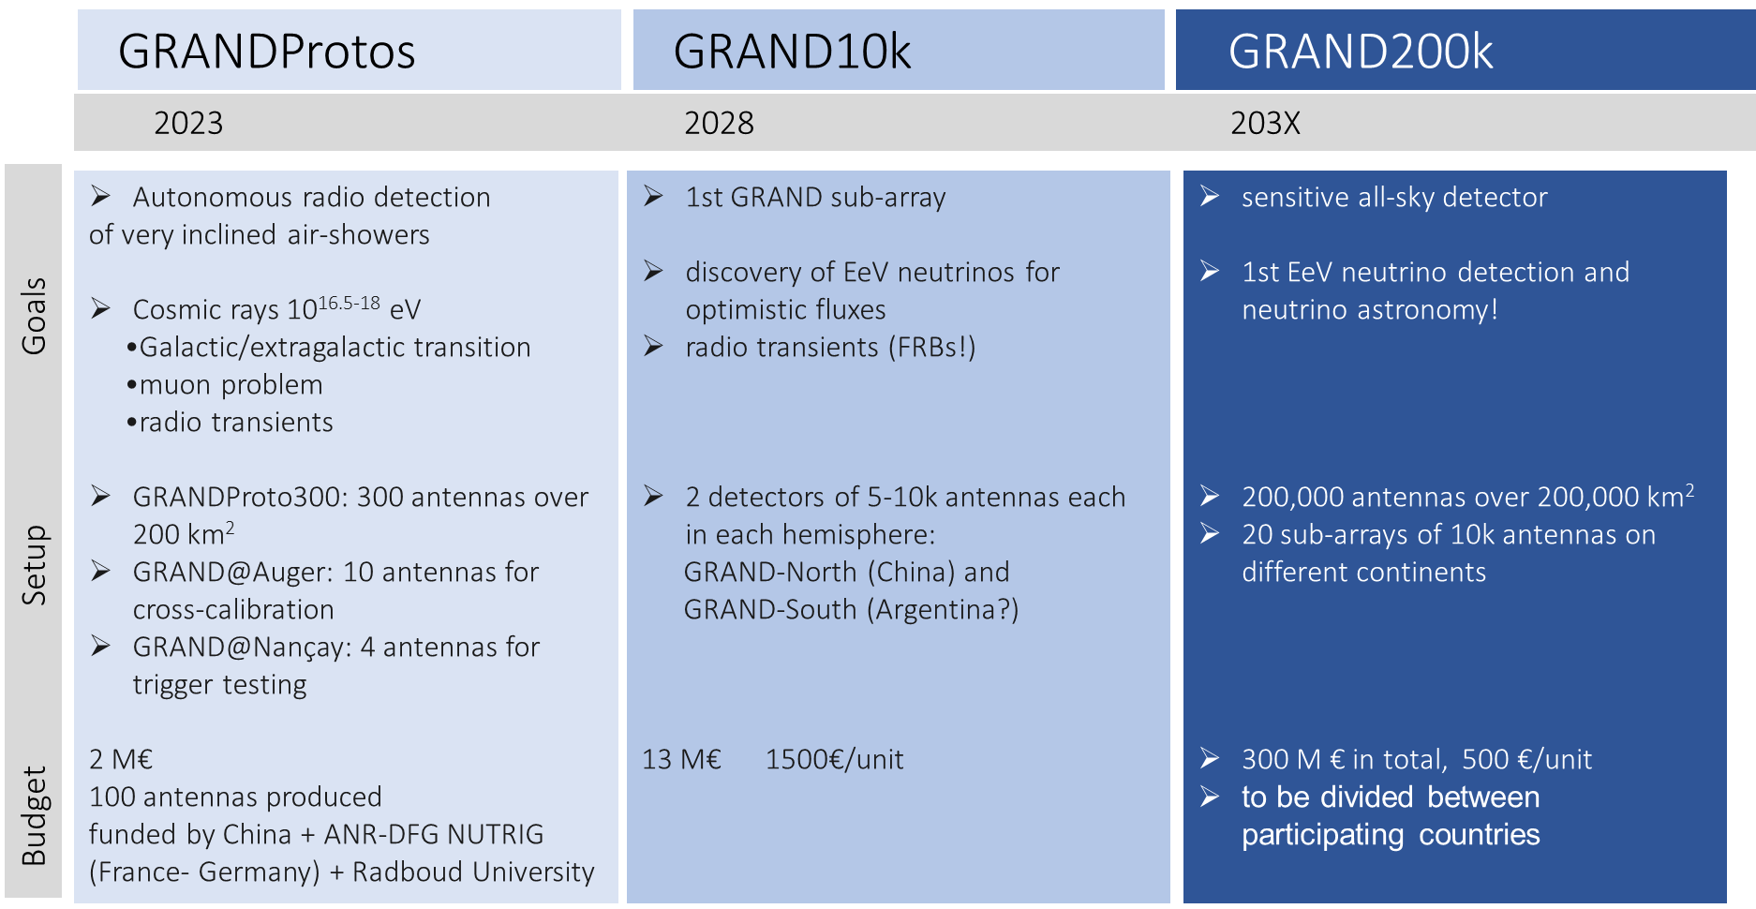
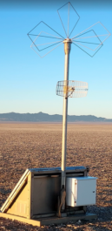
Radio detection of UHE neutrinos
GRAND
Proposal for a telescope for UHE neutrinos with excellent direction resolution, large field of view & sensitivity
9 Countries, 14 Institutions, Hellenic Open University (GR)
2 Staff members:
A. Leisos and K. Papageorgiou (UoAegean),
2 Post-docs: A. Tsirigotis, S. Nonis
1 Ph.D. Student: Vittakis
Horizon Antenna
in the field
Christos Markou, RECFA open session, 10/11/2023, Athens

Slide 9
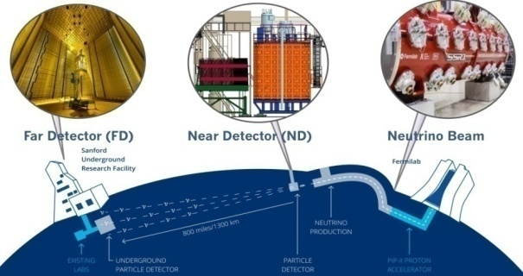
Deep Underground Neutrino Experiment (DUNE)
Impressive progress in several fronts : Far and Near site construction, Beamline, Far and Near detectors for Phase I.
  First neutrino test beam data in 2024.
  Start of DUNE science in 2028, with beam in early 2031
Christos Markou, RECFA open session, 10/11/2023, Athens

Slide 10
DUNE NKUA Team
Prof. Niki Saoulidou :
  Chair of LBNC https://lbnc.fnal.gov/, charged by the Fermilab Director to oversee DUNE in a similar way LHCC oversees LHC experiments.
  Member of the Scientific/Steering Board of Dr. Papoulias H.F.R.I Grant.
  Founding member of the Fermilab DUSEL project (2006-2009) which evolved into DUNE.
Postdoctoral Researcher Dr. Dimitrios Papoulias :
  Awarded competitive research grant by the Hellenic Foundation for Research and Innovation (H.F.R.I) to perform Beyond the Standard Model searches (BSM) with the DUNE Near and Far detectors. (110 k €)
PhD Student Pantelis Melas, co-supervised by Dr. Papoulias and Prof. Saoulidou
  Member of the H.F.R.I research grant of Dr. Papoulias, currently analyzing ProtoDUNE-HD data
  Awarded Fermilab Neutrino Physics Center (FNC) Fellowship, to participate and contribute to the Prototype DUNE ND installation, commissioning and analysis with neutrino data from the NUMI Beam.
Christos Markou, RECFA open session, 10/11/2023, Athens

Slide 11
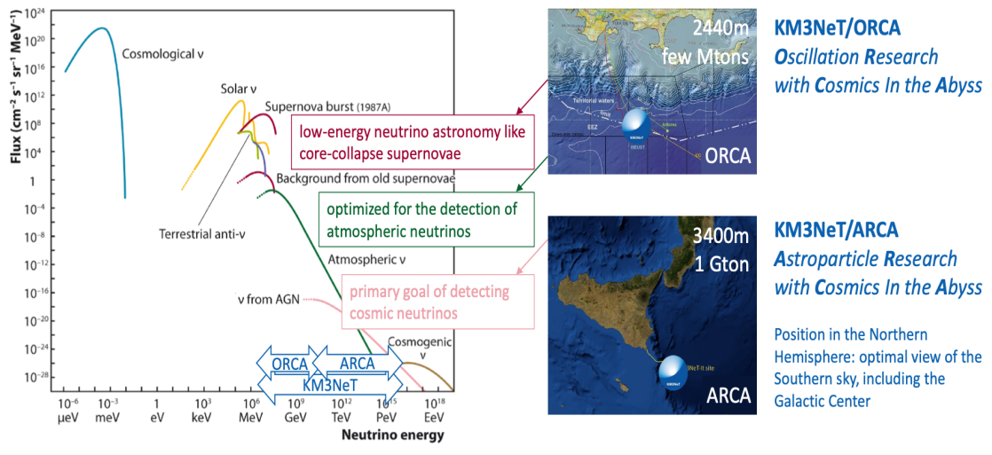
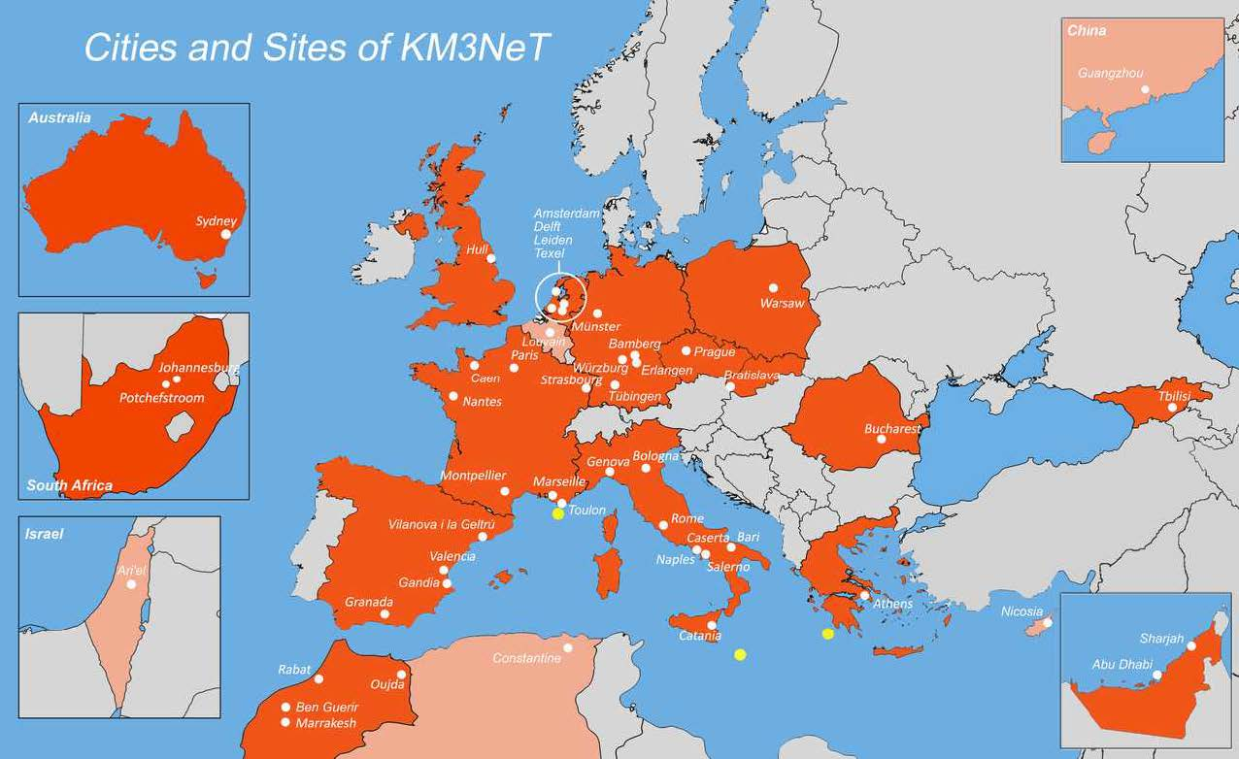
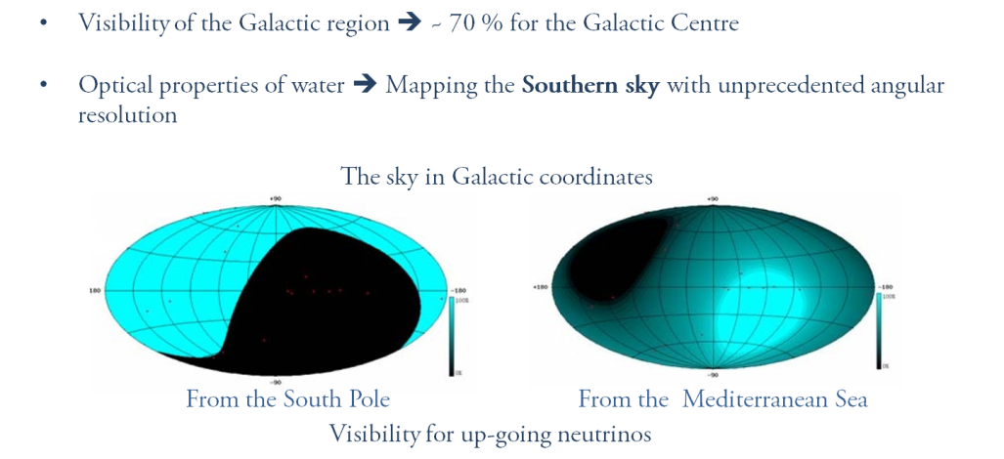
KM3NeT
21 countries, 57 institutions, 273 physicists
From Gr, Institute of Nuclear and Particle Physics (INPP) NCSR “Demokritos’’
Christos Markou, RECFA open session, 10/11/2023, Athens

Slide 12
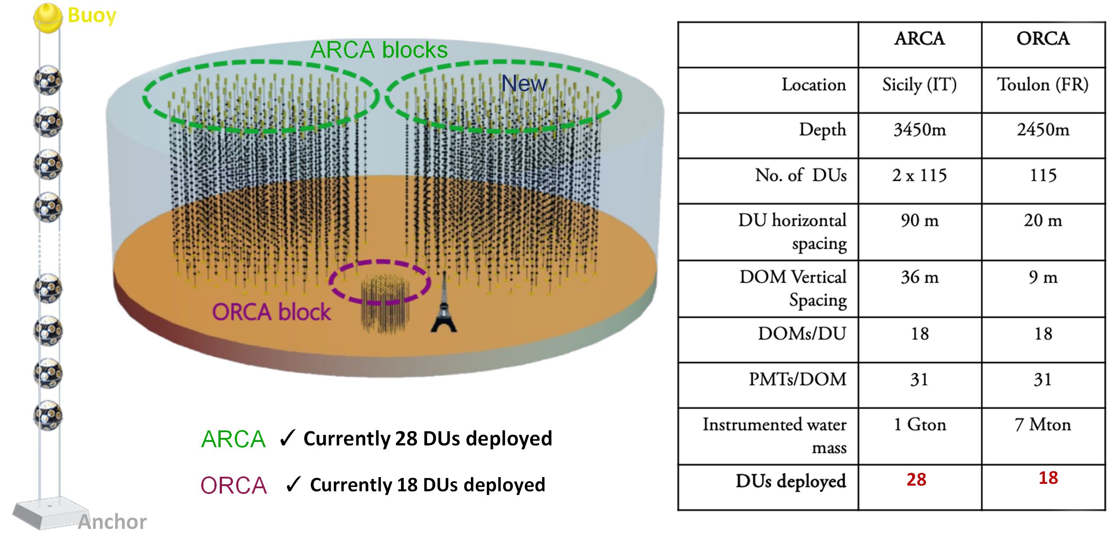
KM3NeT
Christos Markou, RECFA open session, 10/11/2023, Athens

Slide 13
KM3NeT
KM3NeT – INPP people
Ekaterini Tzamariudaki - Director or Research, Head of the group, Co-chair of the Publication Committee,
EDI committee, Management team (2016 – 2020)
Evangelia Drakopoulou - Researcher, Open Science Committee
Christos Markou - Director of INPP, Chair of the KM3NET Institution Board (2016-2020),
Chair of the Conference Committee, Management Team (since 2021),
Publication Committee, RRB.
G. Androulakis (Deceased) – KM3NeT QA/QC manager (2016 – 2021)
L. Kalousis, Post-Doctoral associate
C. Bagatelas, S. Tsagkli – Scientific Personnel
A. Vougioukas, Y. Kiskiras (part-time) – Technicians
3 Ph.D. candidates : D. Stavropoulos, V. Tsourapis, G. Zarpapis
2 M.Sc. Students
Several undergraduate students (interns and diploma students)
3 Ph.D. theses completed in the previous years (E. Drakopoulou, K. Pikounis, A. Sinopoulou)
Christos Markou, RECFA open session, 10/11/2023, Athens

Slide 14
KM3NeT
Funding
No support on investment from GRSI in the last 10 years for KM3NeT.
Competitive funding from :
    E.U. in H2020 (480k € ) and Horizon Europe (225k €)
    NSRF 2007 – 2013 (540k €)
    NSRF 2015 – 2020 (250k €)
    V. Tsourapis is supported by a research grant by the Hellenic Foundation for Research and Innovation (H.F.R.I)
Christos Markou, RECFA open session, 10/11/2023, Athens

Slide 15
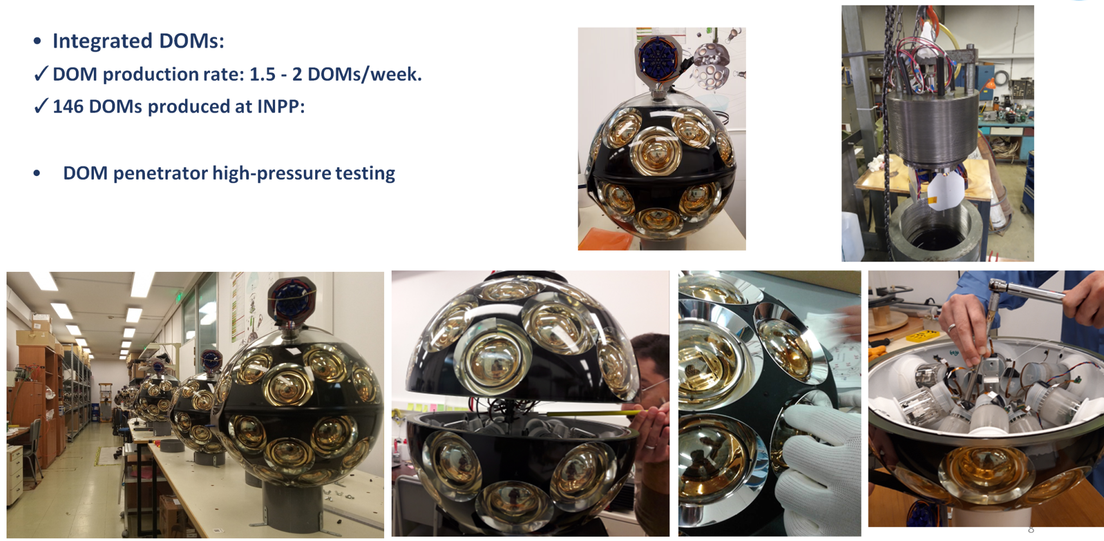
KM3NeT
Digital Optical Modules production facility
Christos Markou, RECFA open session, 10/11/2023, Athens

Slide 16
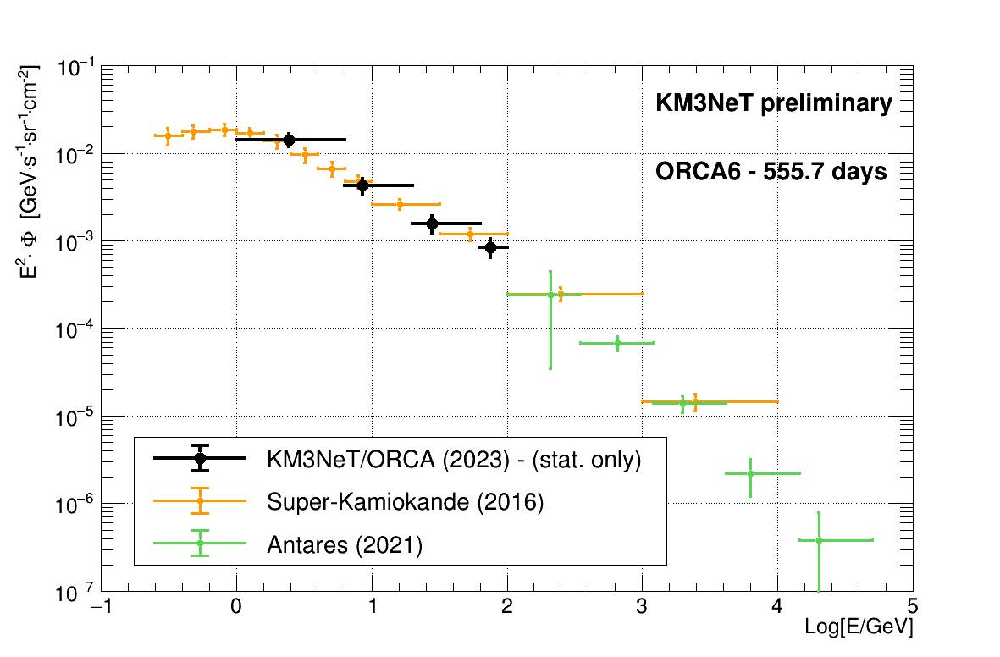
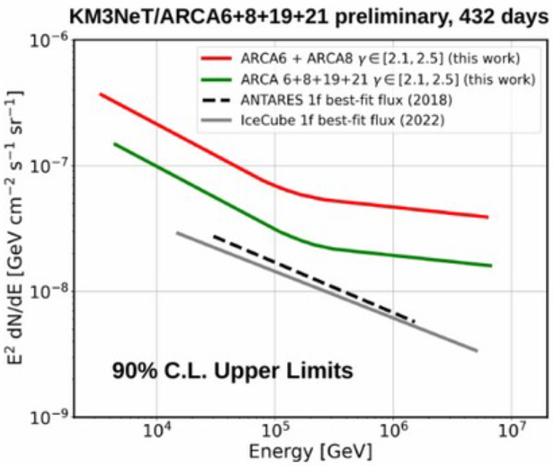
KM3NeT – a glimpse on recent results
Measurement of atmospheric ν_{μ} flux with ORCA6
All sky diffuse cosmic neutrino flux with ARCA
Work by D. Stavropoulos
Work by V. Tsourapis
PoS ICRC2023 (2023) 1093
PoS ICRC2023 (2023) 1195
Christos Markou, RECFA open session, 10/11/2023, Athens

Slide 17
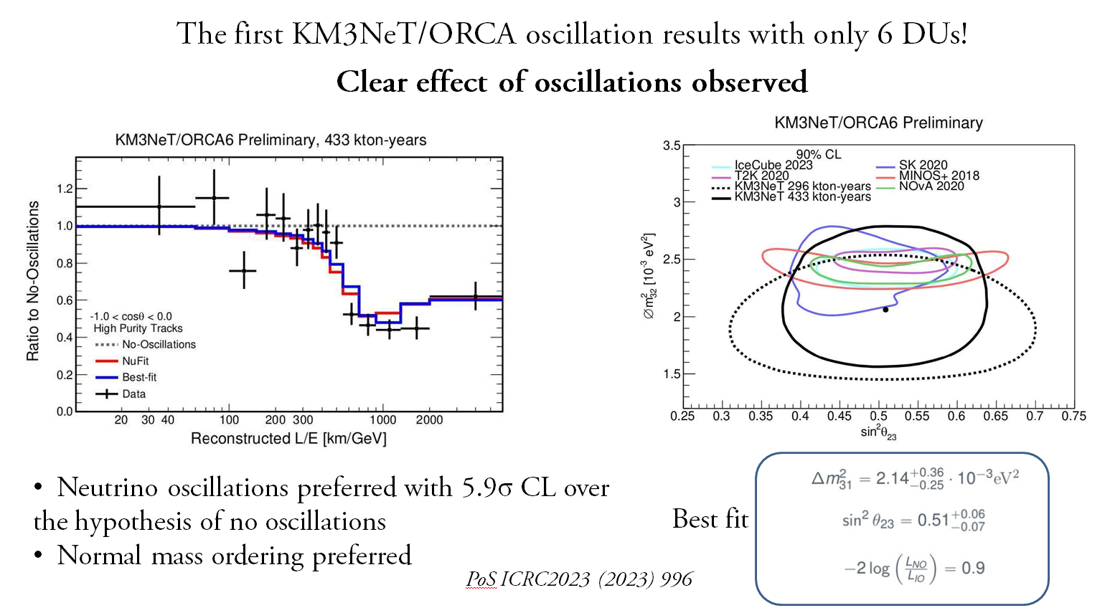
KM3NeT – a glimpse on recent results
Christos Markou, RECFA open session, 10/11/2023, Athens

Slide 18
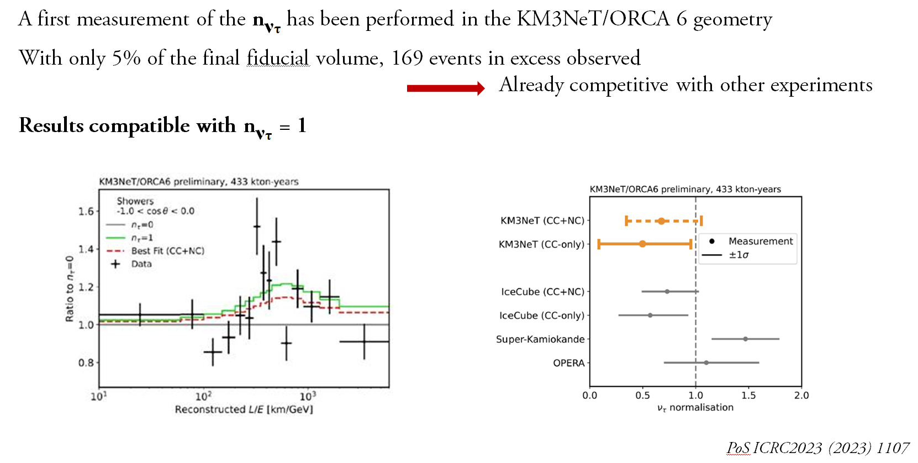
KM3NeT – a glimpse on recent results
Christos Markou, RECFA open session, 10/11/2023, Athens

Slide 19
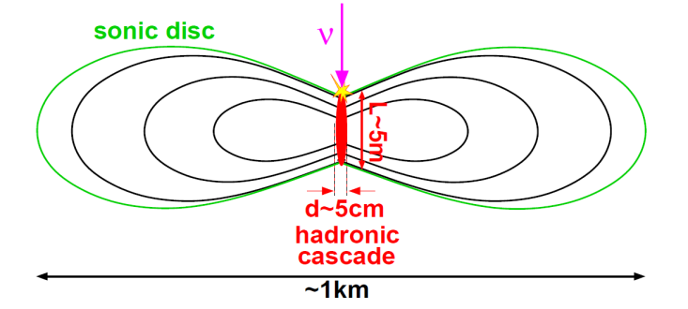
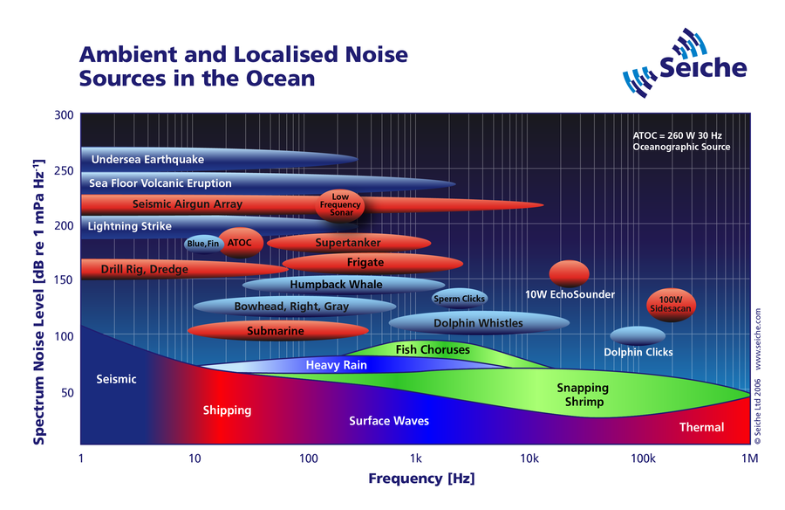
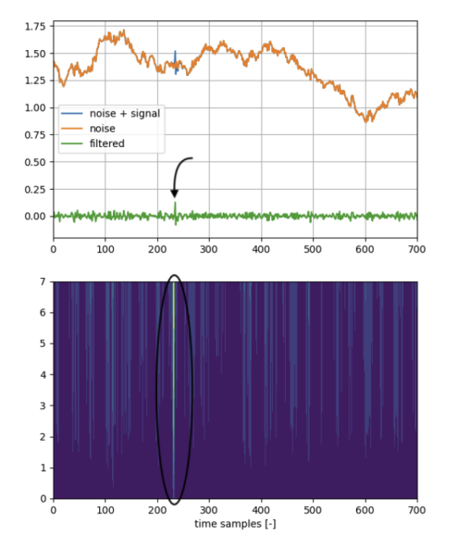
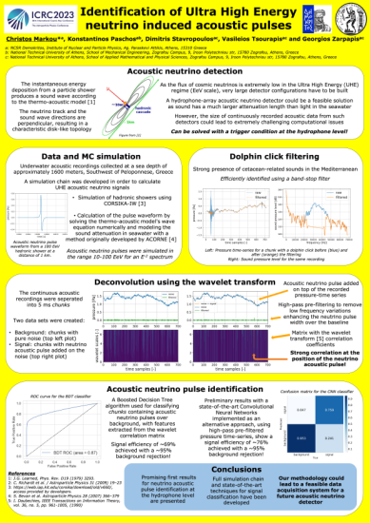
KM3NeT – neutrino acoustic detection
A most promising detection of ultra high energy neutrinos (UHE)
Image from K. Graff International ARENA Workshop 2005
expected signal from neutrino interactions
Machine and Deep learning algorithms were used to classify
acoustic recordings containing acoustic neutrino pulses
over background.
First results are promising. Our methodology could lead
to a feasible data acquisition system for a future acoustic
neutrino detector.
Christos Markou, RECFA open session, 10/11/2023, Athens

Slide 20
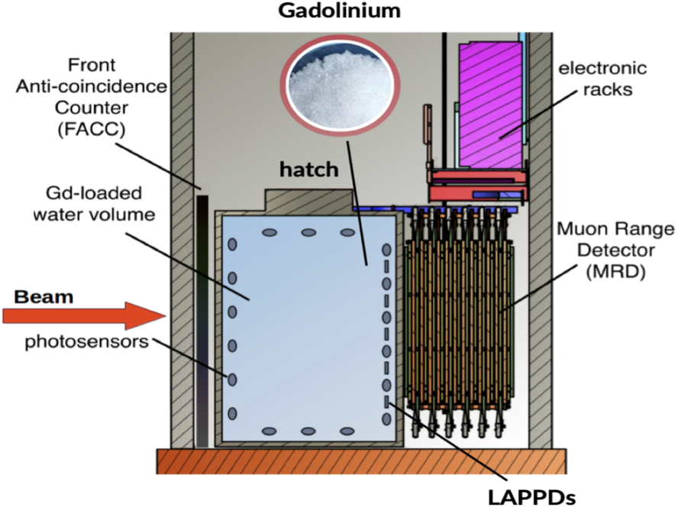
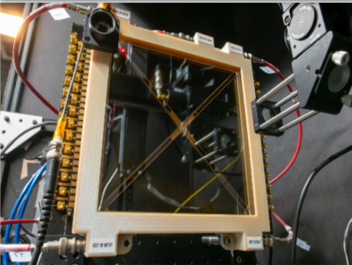
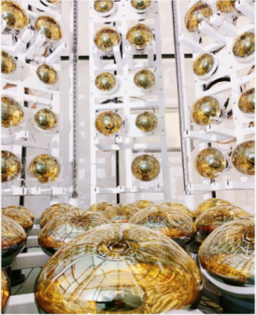
ANNIE
Accelerator Neutrino Neutron Interaction Experiment (ANNIE):
a 26-ton Gd-doped water Cherenkov detector installed in the Booster Neutrino Beam at Fermilab
INPP, NCSR Demokritos joined ANNIE in September 2021.
ANNIE is the first experiment using the fast-timing (~60 psec time resolution) Large Area Picosecond Photo Detectors (LAPPDs) for event reconstruction.
Neutrino Beam
ANNIE is seeing neutrinos with the first LAPPD deployed in the water tank.
Christos Markou, RECFA open session, 10/11/2023, Athens

Slide 21
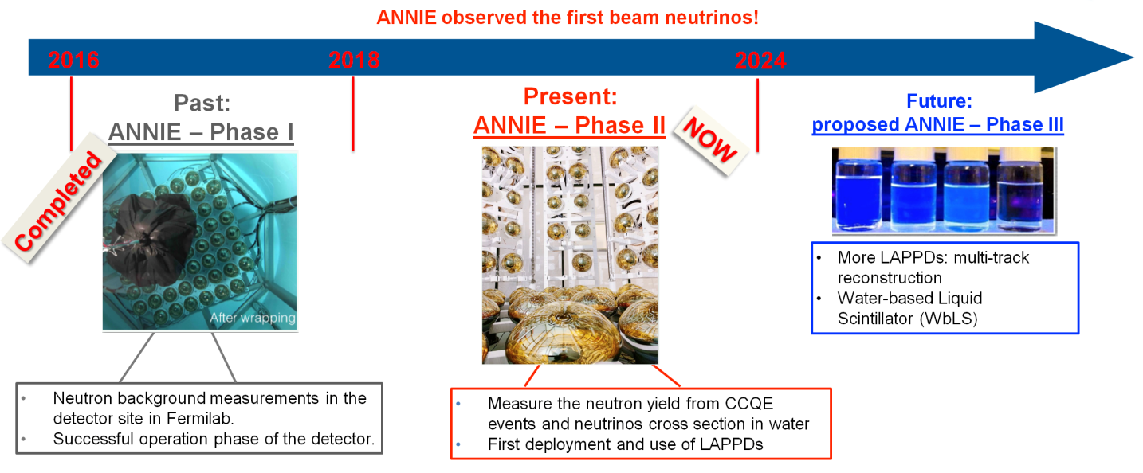
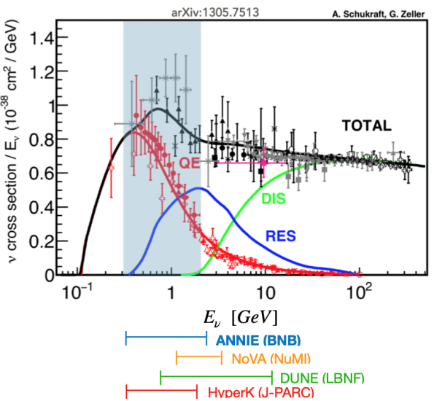
ANNIE
Two main goals:
Better understanding of neutrino-nucleus interactions.
Measure the neutron yield from Charged Current neutrino-nucleus interactions in water to reduce the systematic uncertainties in neutrino oscillation experiments (e.g. Hyper-Kamiokande(HK) in Japan)
measurement of cross-sections, ν_{μ} CC and potentially NC
R&D platform to test new neutrino detection technologies and techniques.
Demonstrate the use of fast-timing (~60 psec time resolution) Large Area Picosecond PhotoDetectors (LAPPDs) for event reconstruction
Christos Markou, RECFA open session, 10/11/2023, Athens

Slide 22
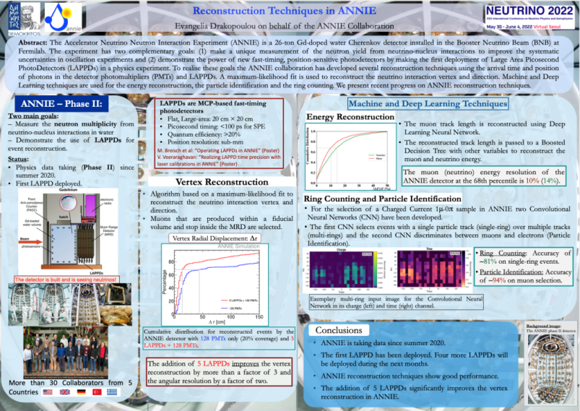
ANNIE
ANNIE people in INPP
E. Drakopoulou, P. I.
I. Vitsikanos, G. Stravropoulou, E. Sakkou (Intern students)
Removing background noise from data using Deep Learning methods
C. Karagiannis (Intern student, Associate researcher)
Apply a machine learning-based method to
reconstruct the muon energy in ANNIE.
Funded up to now, by internal NCSR D funds
Christos Markou, RECFA open session, 10/11/2023, Athens

Slide 23
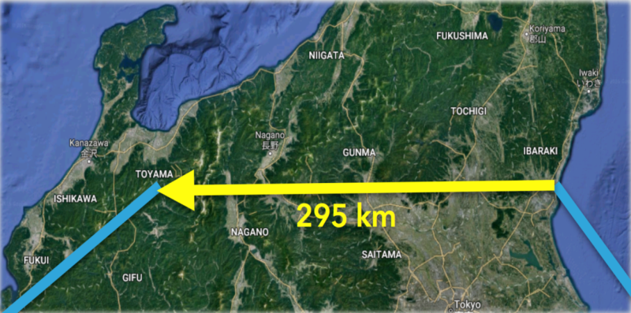
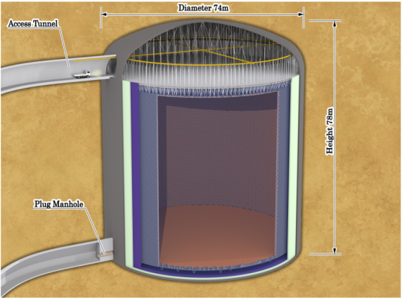
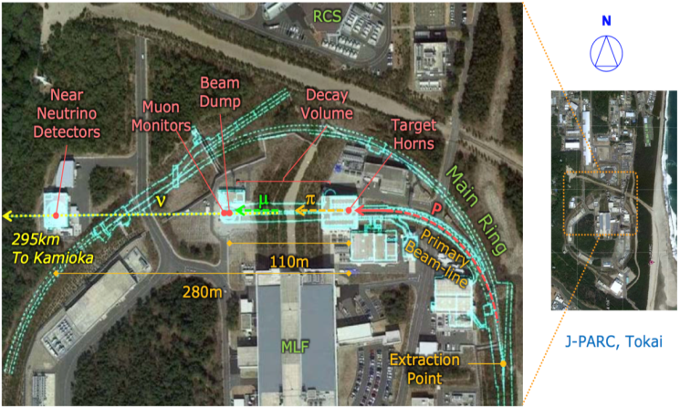
HYPER-K
Neutrino beam
Hyper Kamiokande (Hyper-K) detector
Upgrade of J-PARC neutrino beam to 1.3 MW beam power
Christos Markou, RECFA open session, 10/11/2023, Athens

Slide 24
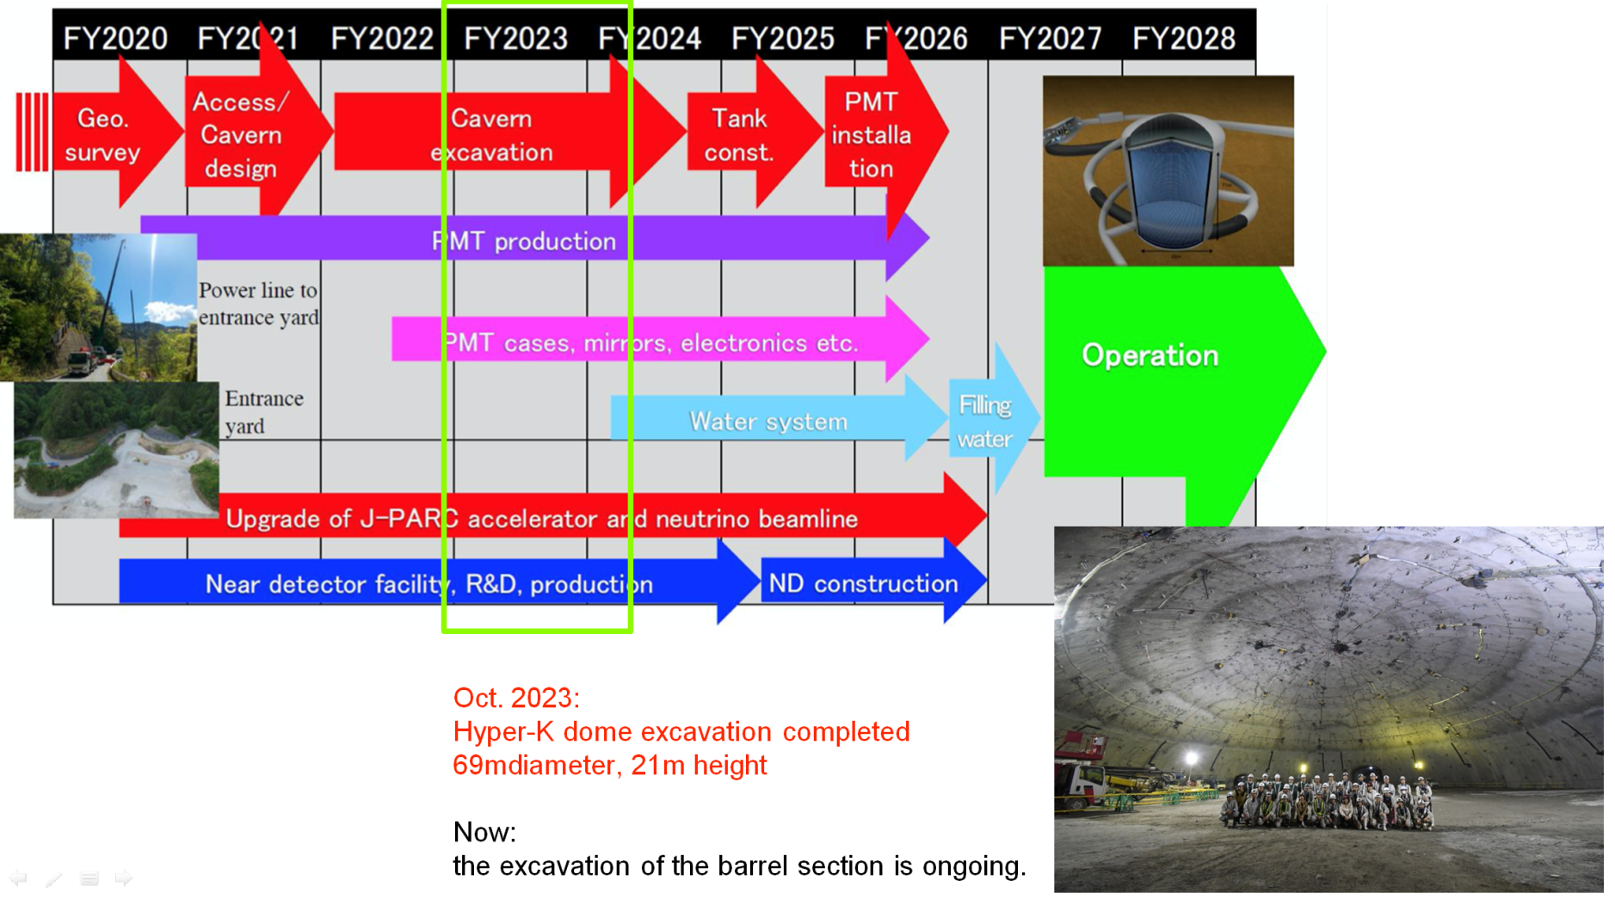
HYPER-K
Christos Markou, RECFA open session, 10/11/2023, Athens

Slide 25
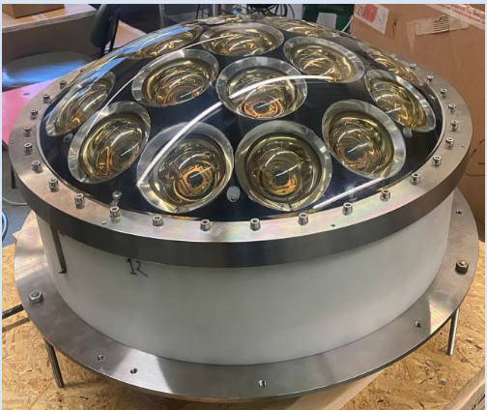
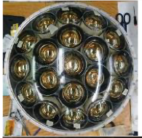
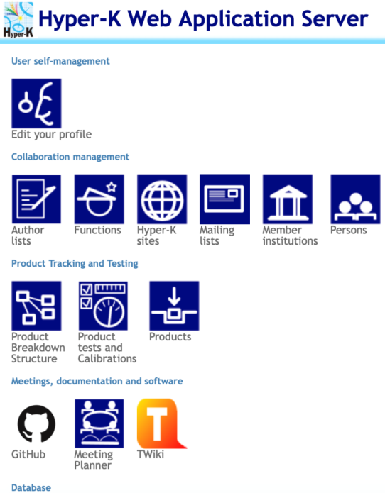
HYPER-K
INPP/Demokritos joined HYPER-K in 2023
Testing and QA/QC on the Far Detector mPMT detector.
Hyper-K database development and maintenance
HYPER-K people in INPP
C.Markou,
E. Drakopoulou,
E. Tzamariudaki,
L. Kalousis (post-Doc)
Funded for the moment by internal NCSR D funds
Christos Markou, RECFA open session, 10/11/2023, Athens

Slide 26
Summary - Outlook
Several diverse activities and experiments in Astroparticle and Neutrino Physics
Participation in high visibility, large, International Collaborations
Significant contributions to hardware, operations and physics analyses
Attractive to bright and motivated young physicists
Christos Markou, RECFA open session, 10/11/2023, Athens

Slide 27
Summary - Outlook
Several diverse activities and experiments in Astroparticle and Neutrino Physics
Participation in high visibility, large, International Collaborations
Significant contributions to hardware, operations and physics analyses
Attractive to bright and motivated young physicists
The evident statement “Lack of funding and limited HR resources are a significant handicap” refers to the effects of more fundamental problems in the Research
Christos Markou, RECFA open session, 10/11/2023, Athens

Slide 28
Summary - Outlook
Several diverse activities and experiments in Astroparticle and Neutrino Physics
Participation in high visibility, large, International Collaborations
Significant contributions to hardware, operations and physics analyses
Attractive to bright and motivated young physicists
The evident statement “Lack of funding and limited HR resources are a significant handicap” refers to the effects of more fundamental problems in the Research
Research and Education overseen by two different government ministries!
Lack of specific, short, medium or long term scientific plan in the country, coupled with budgets which are respected and followed.
No interlocutor in the overseeing agency, able to assess and respond to the needs of the research community.
No methodology/rules/procedures to participate to any international research structure (ERIC, RI, etc) with the support/backup/commitment of the Greek State.
Christos Markou, RECFA open session, 10/11/2023, Athens

Slide 29
Thank you for your attention!
Christos Markou, RECFA open session, 10/11/2023, Athens

Slide 30
Additional material
Christos Markou, RECFA open session, 10/11/2023, Athens

Slide 31
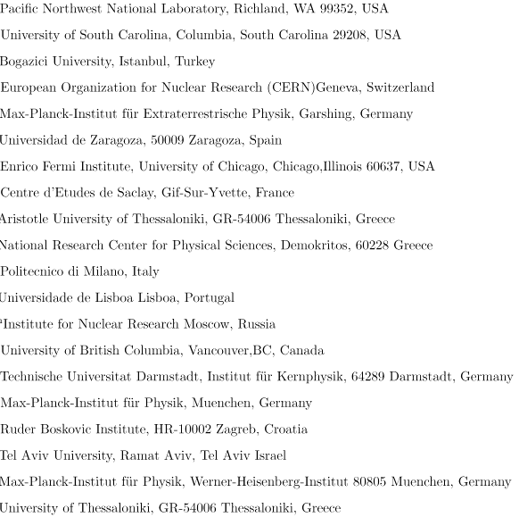
The CAST collaboration
13 Countries,
20 Institutions
University of Patras
Christos Markou, RECFA open session, 10/11/2023, Athens

Slide 32
The CAST collaboration
CAST publications
Improved Search for Solar Chameleons with a GridPix Detector at CAST, V. Anastassopoulos et al. JCAP 01 (2019) 032
New CAST Limit on the Axion-Photon Interaction, V. Anastassopoulos et al. Nature Phys. 13 (2017) 584-590
Search for chameleons with CAST, V. Anastassopoulos et al., Phys.Lett.B 749 (2015) 172-180
New solar axion search using the CERN Axion Solar Telescope with ⁴He filling, M. Arik et al., Phys.Rev.D 92 (2015) 2, 021101
Search for Solar Axions by the CERN Axion Solar Telescope with ³He Buffer Gas: Closing the Hot Dark Matter Gap, M. Aric et al., Phys.Rev.Lett. 112 (2014) 9, 091302
CAST search for sub-eV mass solar axions with ³He buffer gas, S. Aune et al., Phys.Rev.Lett. 107 (2011) 261302
Search for solar axion emission from ⁷Li and D(p,γ)³He nuclear decays with the CAST γ-ray calorimeter, S. Andriamonje et al., JCAP 03 (2010) 032
Search for 14.4-keV solar axions emitted in the M1-transition of Fe-57 nuclei with CAST, S. Andriamonje et al., JCAP 12 (2009) 002
Probing eV-scale axions with CAST, E. Arik et al., JCAP 02 (2009) 008
An Improved limit on the axion-photon coupling from the CAST experiment, S. Andriamonje et al., JCAP 04 (2007) 010
Prospects for the CERN Axion Solar Telescope Sensitivity to 14.4-keV Axions, K. Jakovcic et al., Nucl.Instrum.Meth.A 580 (2007) 37-39
First results from the CERN Axion Solar Telescope (CAST), K. Zioutas et al., Phys.Rev.Lett. 94 (2005) 121301
Christos Markou, RECFA open session, 10/11/2023, Athens

Slide 33
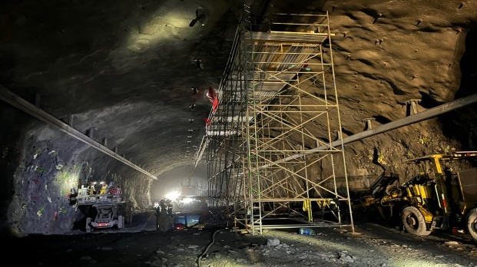
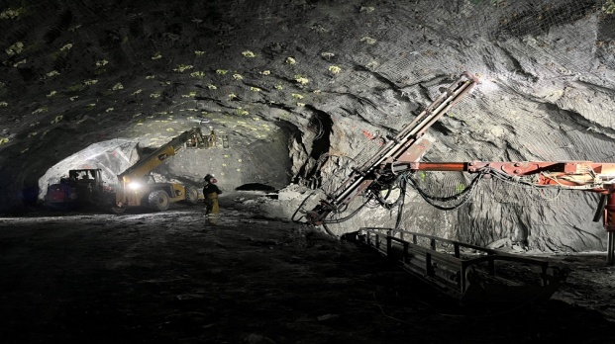
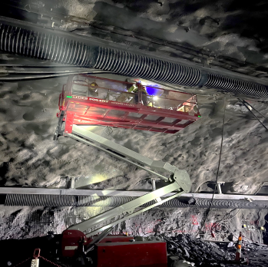
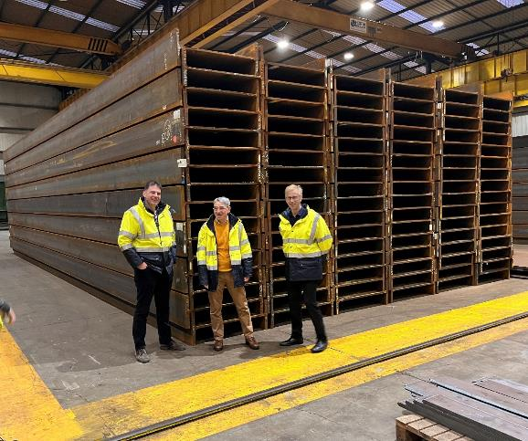
LBNF/DUNE-US: Status and recent achievements
From Lia Merminga, RRB, March 30th 2023
Far site excavation ~60% complete proceeding on time and on budget
DOE approved the CD-1R “Reaffirmation” milestone, reaffirming strong commitment to the project
DOE approved the CD-2/3 milestone for the buildings and site infrastructure (BSI) subproject in SD
Detector installation begins 2024; fabrication by CERN and partners is underway
Science starts in 2028, “beam on date” in early 2031
First draft of DUNE Host Lab Plan completed, final in June
Next major milestone: FDC CD-2/3 approval
Christos Markou, RECFA open session, 10/11/2023, Athens
Source: N. Saoulidou

Slide 34

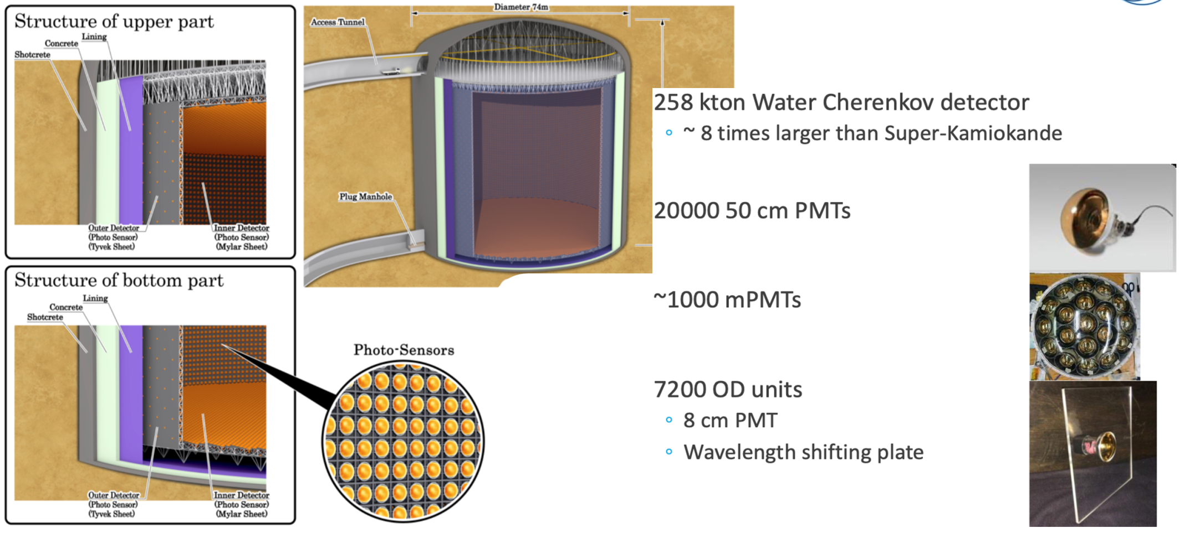
HYPER-K
Christos Markou, RECFA open session, 10/11/2023, Athens

