Slide 1
R&D, Accelerators, Aplications
Yorgos Tsipolitis
NTUA

Slide 2
Contents
R&D
  RD50
  RD51
  Future
Accelerators
Applications

Slide 3

GR-RD50
Activity centered around the “Silicon Instrumentation Laboratory” of the National Research Center DEMOKRITOS (NCSR “D”)
The MIDAS Project
A consortium led by a Greek Company:
ADVEOS Microelectronics Systems Company
With participation of laboratories from:
Greek Atomic Energy Commission,
National Center of Scientific Research Demokritos
Physics Department of the University of Cyprus
Main activity : Monolithic CMOS sensors
The Demokritos Personel
-- Dimitrios Loukas
-- Aristoteles Kyriakis
-- Ioannis Kazas
-- Panagiotis Assiouras (until 2021)
-- Patrick Asenov (until 2020)

Slide 4
GR-RD50
Based on the The LFoundry HVCMOS commercial process
Concept : Develop on the same Si substrate the sensor and the preamplification stage

Slide 5
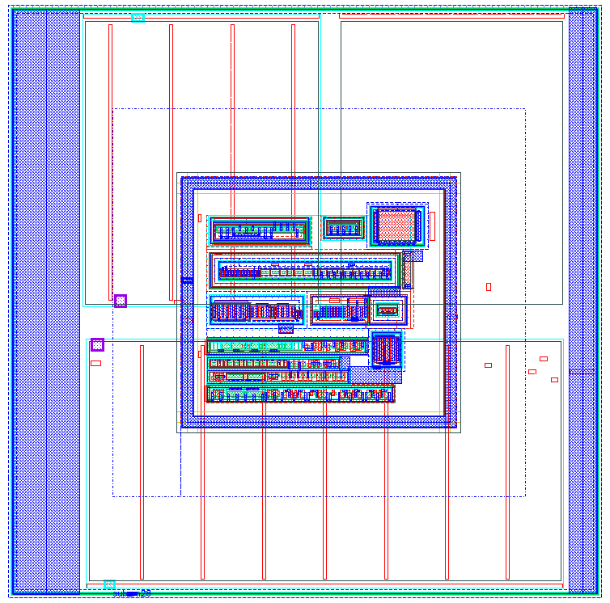
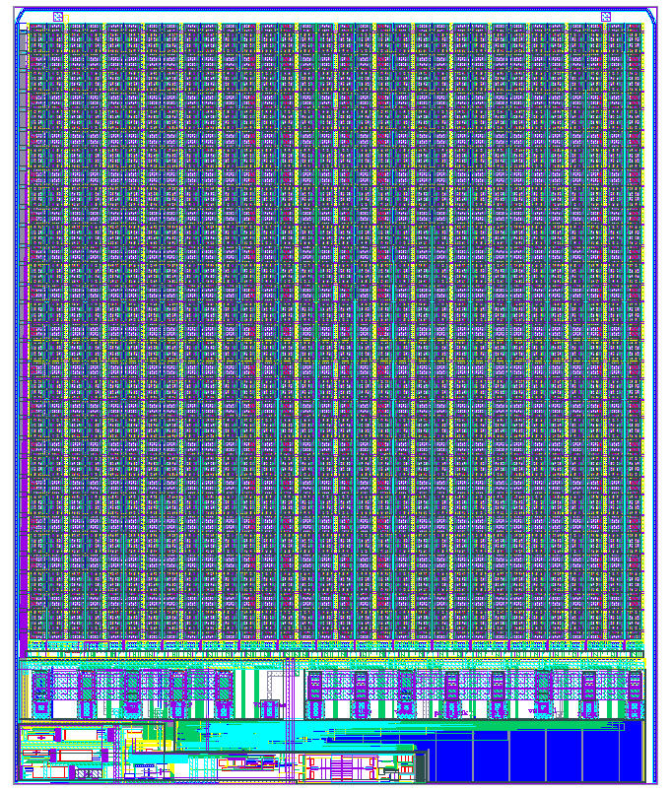
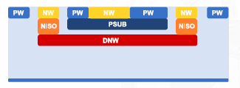
GR-RD50
The MIDAS v1 monolithic chip
32 rows x 32 columns
105.5 um pixel pitch
Charge signal dynamic range: Min:0.5 fC, Max:6 pC (80db)
Pixel consumtion < 10 mW/cm²
Embedded ADC (11 bits)
Only hit pixels are readout
2-3 events/cm²/sec for Galactic Cosmic Rays
10³ events/cm²/sec for Solar Event Particles
Information output: Hit flag and from pixels hit: Serially, 10 bits address, 22 bits charge signal
Pixel

Slide 6
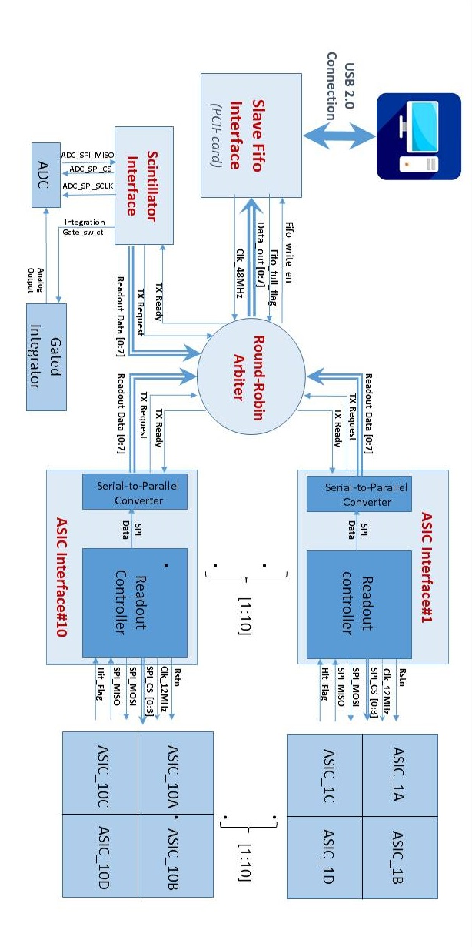
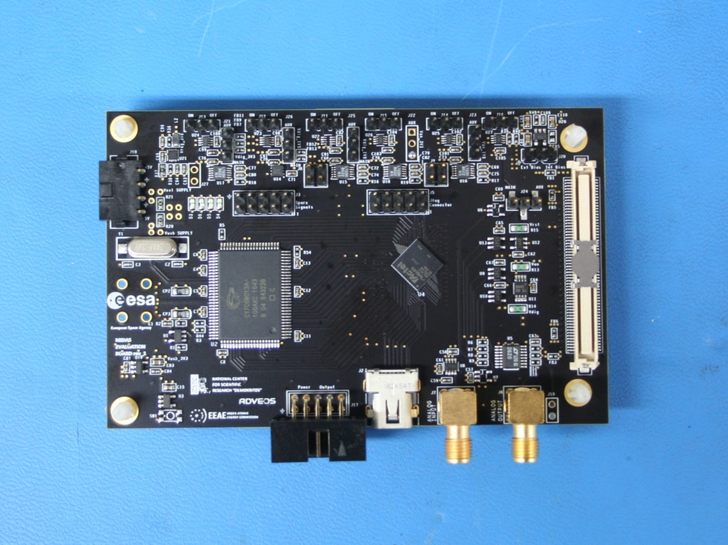
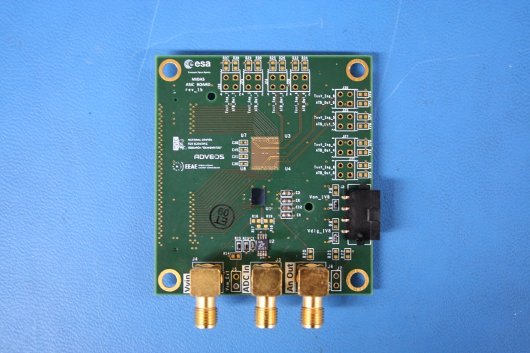




GR-RD50
TCAD Simulation of the HVCMOS sensor
DAQ
$$particle$$
$$bias −30 volts$$
$$100 μm$$
$$Depletion Region$$
The DAQ card
Test Board
2D: pixel response to mips

Slide 7
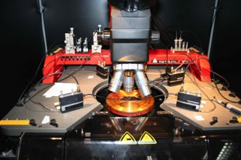
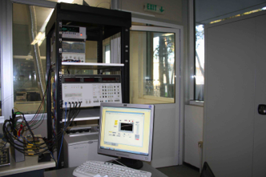
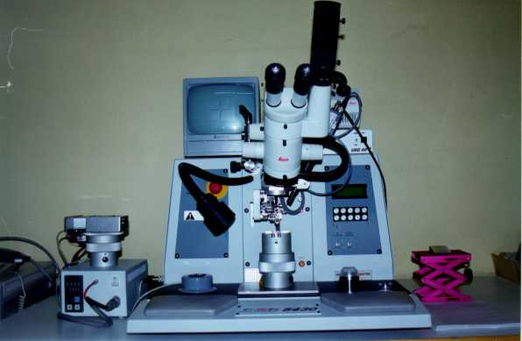
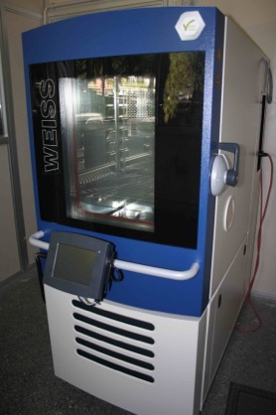
INP Local Instrumentation & Funding
Probe Station : Carl Suss PA 150
Electrical characterization equipment
EDA Tools : Access via Europractice
Cadence IC
Synopsys TCAD
OrCad)
Wire Bonding (Delvotec 5430)
Funding
European project. :
Highly Miniaturized ASIC Radiation Detector: 43 k€
ELIDEK:
New Generation of sensors and electronics for LHC: 41 k€
Climatic Chamber

Slide 8



GR-RD51
Participating teams
Mainly on micromegas detector R&D. Started in 2009 with the development of the resistive micromegas which continued as an ATLAS R&D project that resulted to the ATLAS-NSW (see talk by D. Sampsonidis.
Now focus mainly on the PICOSEC micromegas.
NKUA
AUTH
Responsibilities/Coordination:
G. Tsipolitis :
Co-Coordination of the WG7 – Common Test facilities (2009 – today)
Member of the Management board (2016 – today)
Deputy CB chair (2020 – 2022 )
NCSR “Demokritos”
NTUA

Slide 9
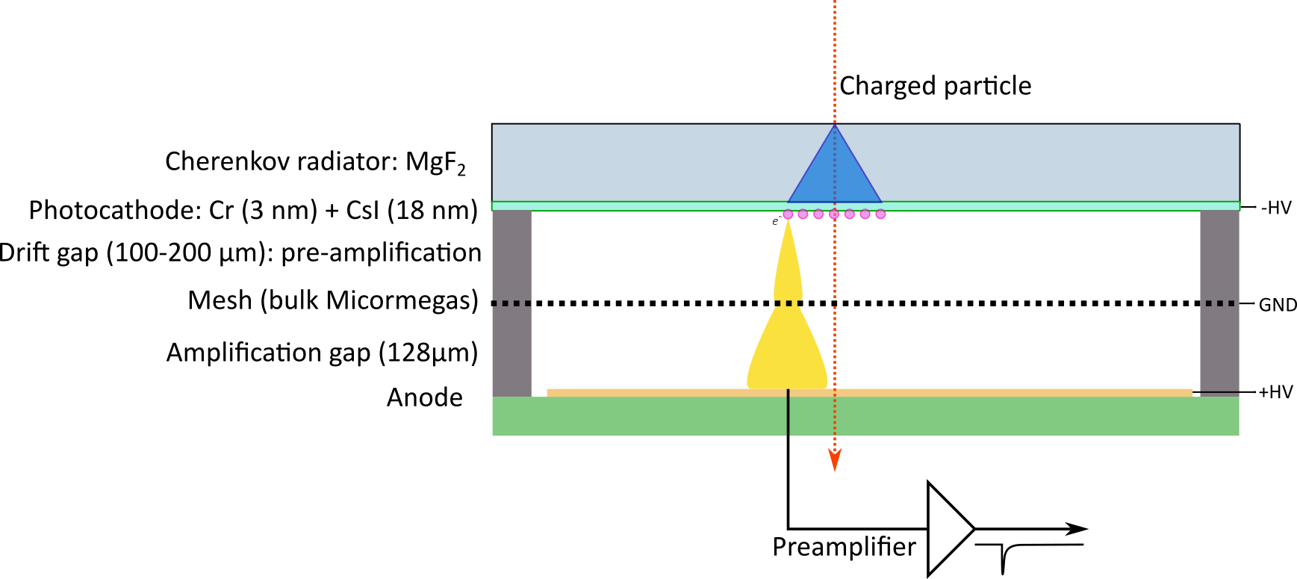
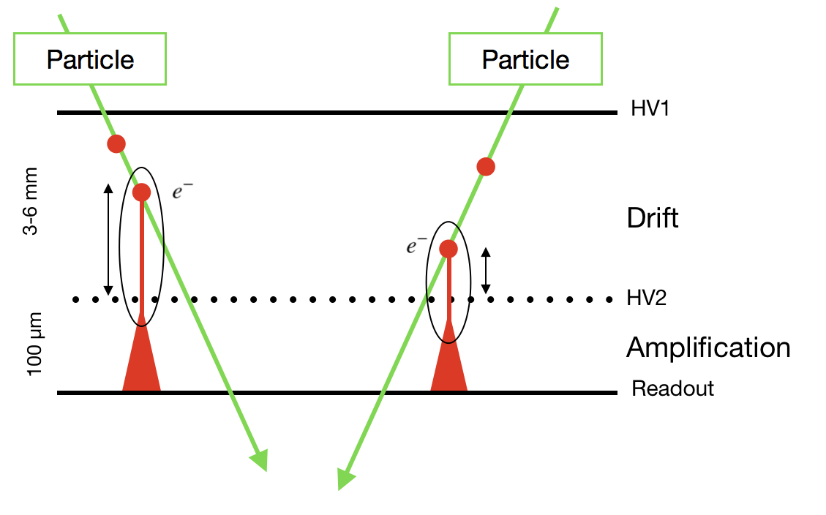
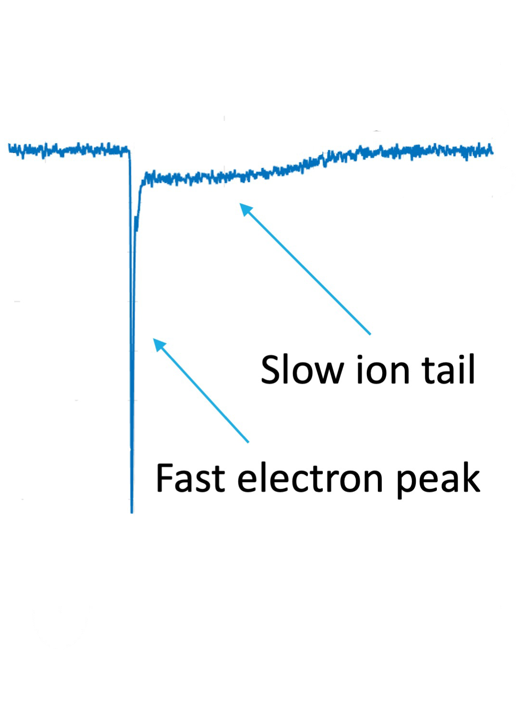
GR-RD51 PICOSEC
Standard Micromegas
Reduce the drift gap (100 – 200 nm)
  limit diffusion
  Preamplification possible
    Reduce the effect of the longitudinal diffusion
    Limit contribution of gas ionization
Use a Cerenkov radiator
  Photoelectrons from the photocathode (all produced at the same distance from the mesh)

Slide 10
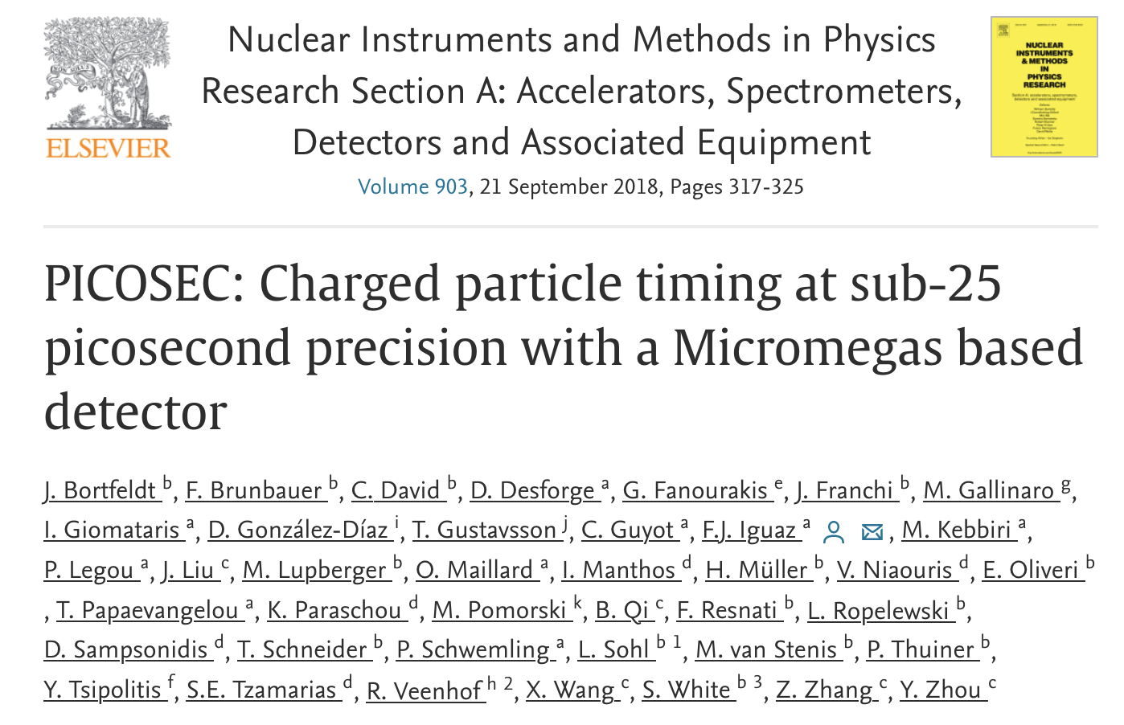
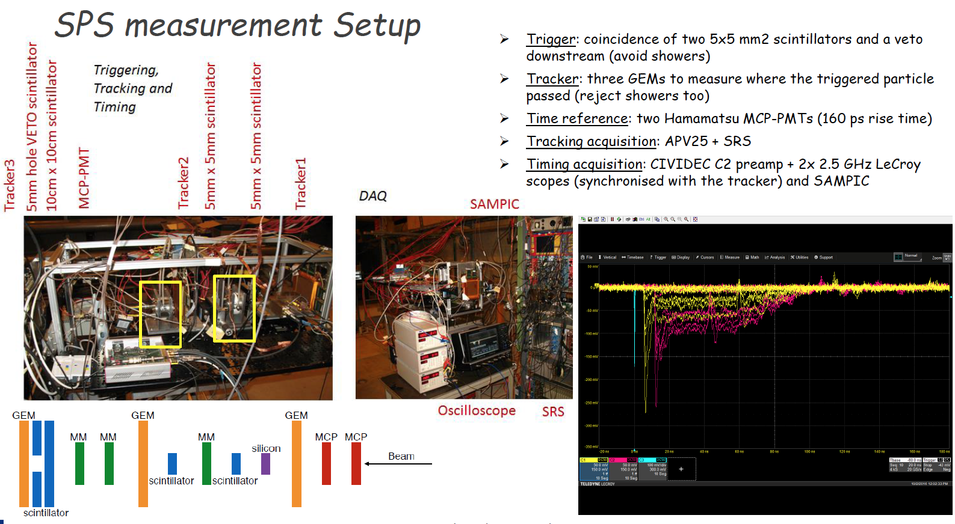
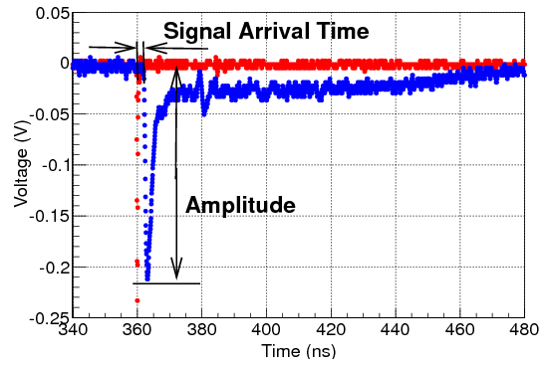
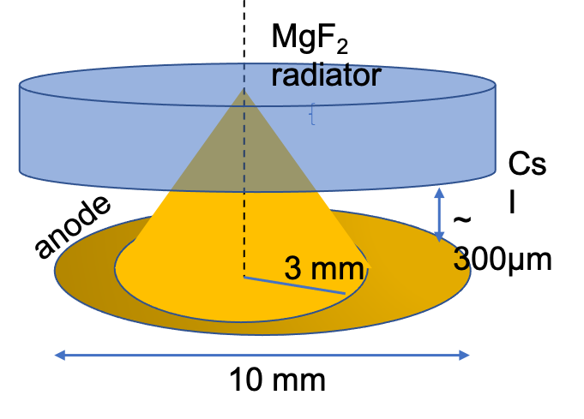
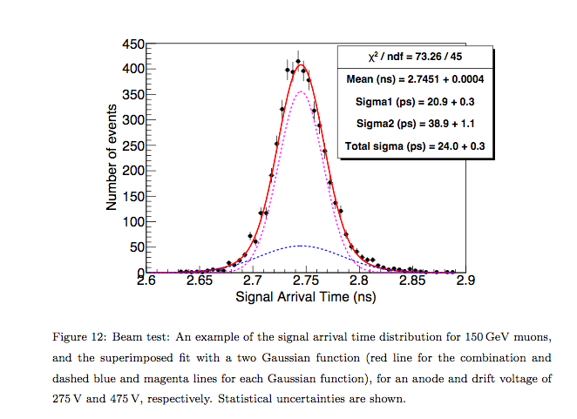
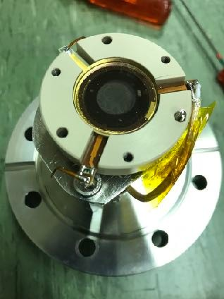
GR-RD51 PICOSEC
Hamamatsu MCP
PICOSEC
The First Prototype
24 ps Timing Resolution

Slide 11
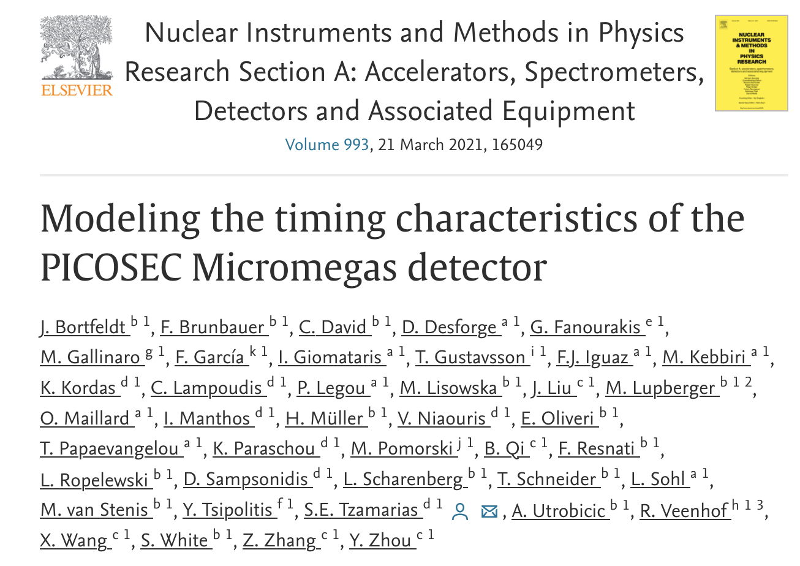
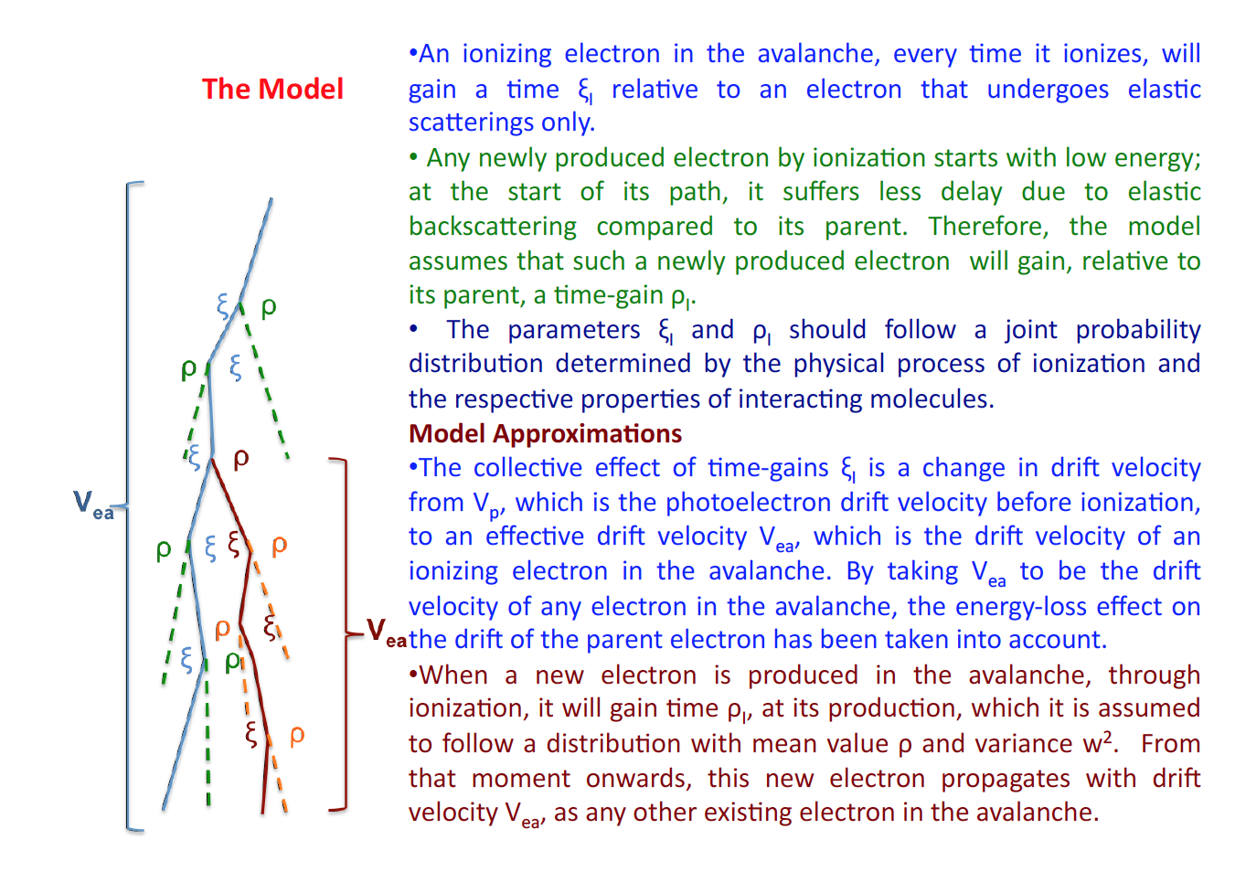
Phenomenological model: A deeper look under the hood
Identify the main microscopic parameters that correspond to the macroscopic (experimental) observables: SAT and Resolution
Identify the processes which are responsible for varying the main microscopic parameters
Build a phenomenological model to describe the mechanisms of variation and compare with the Garfield++ predictions
An ionizing electron in the avalanche, every time it ionizes, will gain a time ξ relative to an electron that undergoes elastic scatterings only.
A new produced electron by ionization starts with low energy, suffers less delay due to elastic backscattering compared to its parent. Relative to its parent it will have a time-gain ρ
Parameters ξ and ρ should follow a joint probability distribution determined by the physical process of ionization and the respective properties of interacting molecules

Slide 12
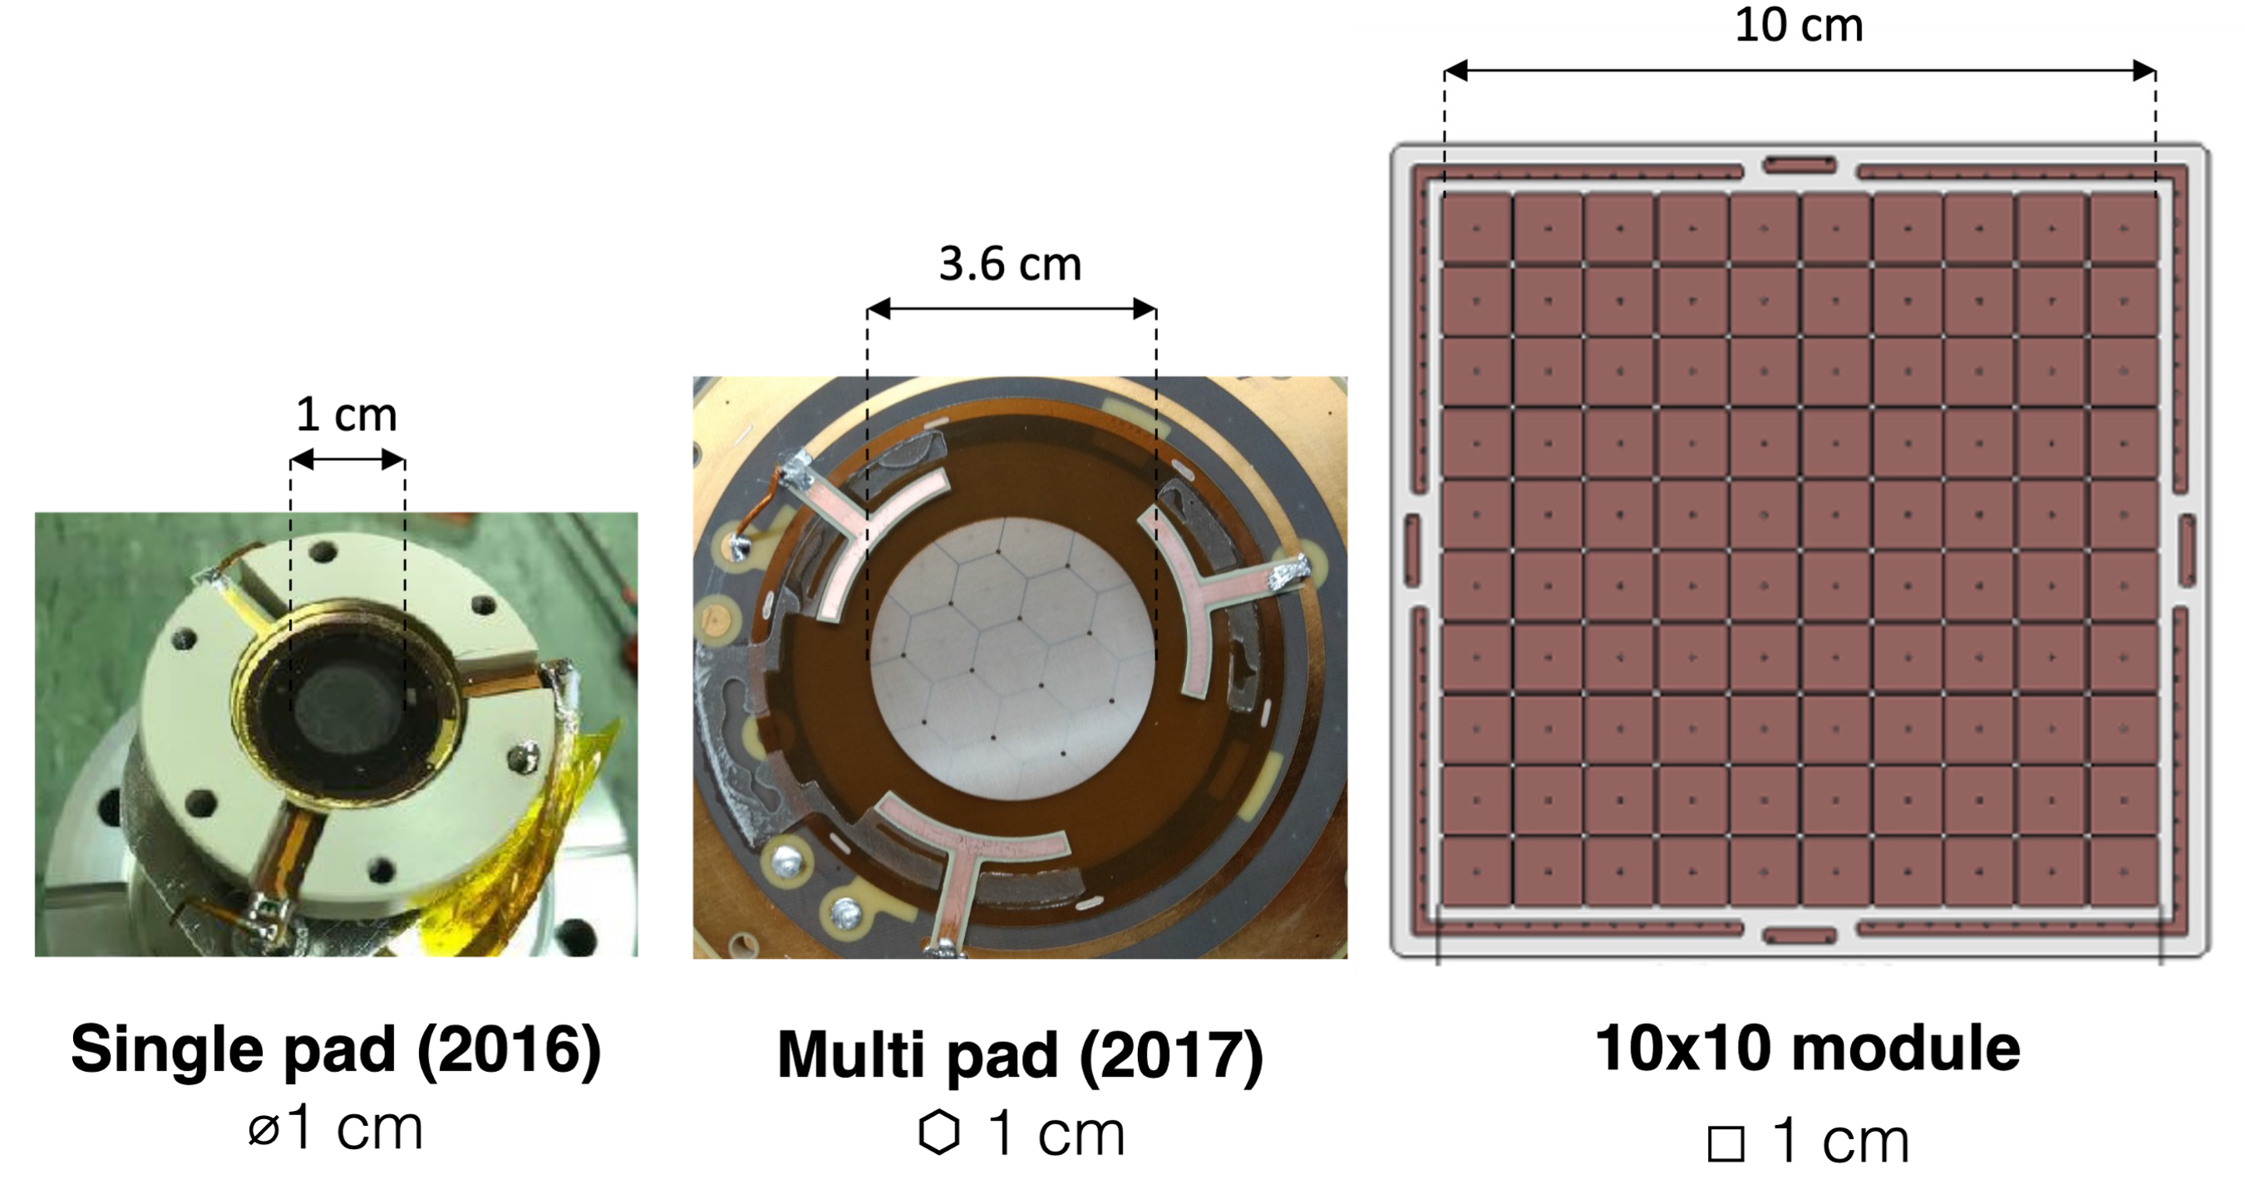
Towards PICOSEC MM detector for HEP experiments
Next steps: Multiple directions in detector development
Large area coverage
Developemnt of large area prototypes and readout electronics
Detector optimisation
Detector fields
Operating gas
Gaps thickness
  Improvement of stability
  Development of detector prototypes with resistive MM
Robustness
Research on various photocathode materials
Development of a large area 100 channel detector.
Development of a 100 ch. readout electronics.
Timing techniques for a large area detector and Detector timing improvement.

Slide 13
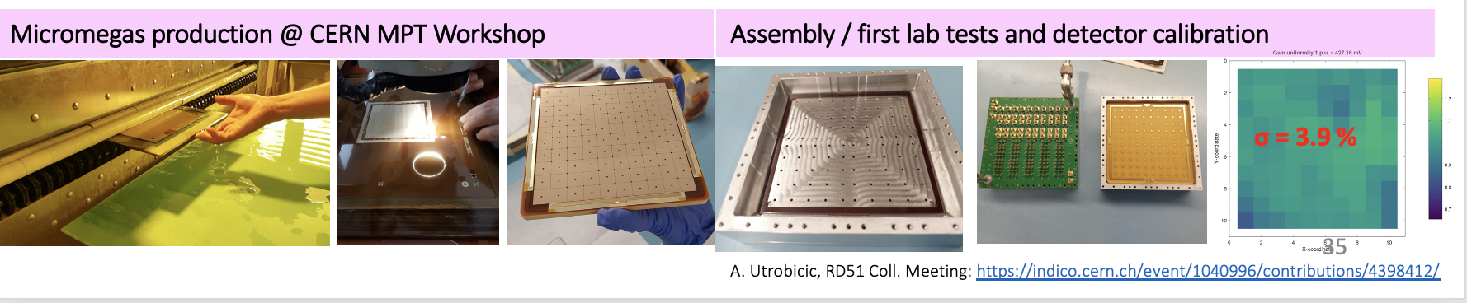
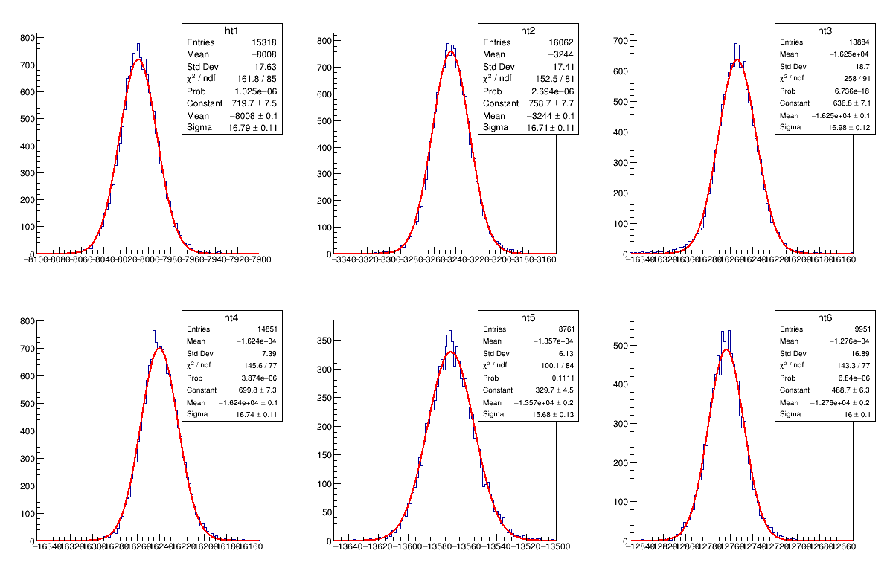
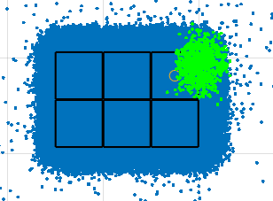
LARGE scale PICOSEC
Pad 28
Pad 29
Pad 27
RD51 test beam October 2022: pads scan, V_{c}=-460 V, V_{a}=+275 V
16.79 ps
16.71 ps
16.98 ps
Pad 37
Pad 38
Pad 39
15.68 ps
16. ps
16.74 ps
Time resolution of a large
(10x10 - 1x1cm² pads)
detector is found below 17 ps per muon for all measured pads.

Slide 14
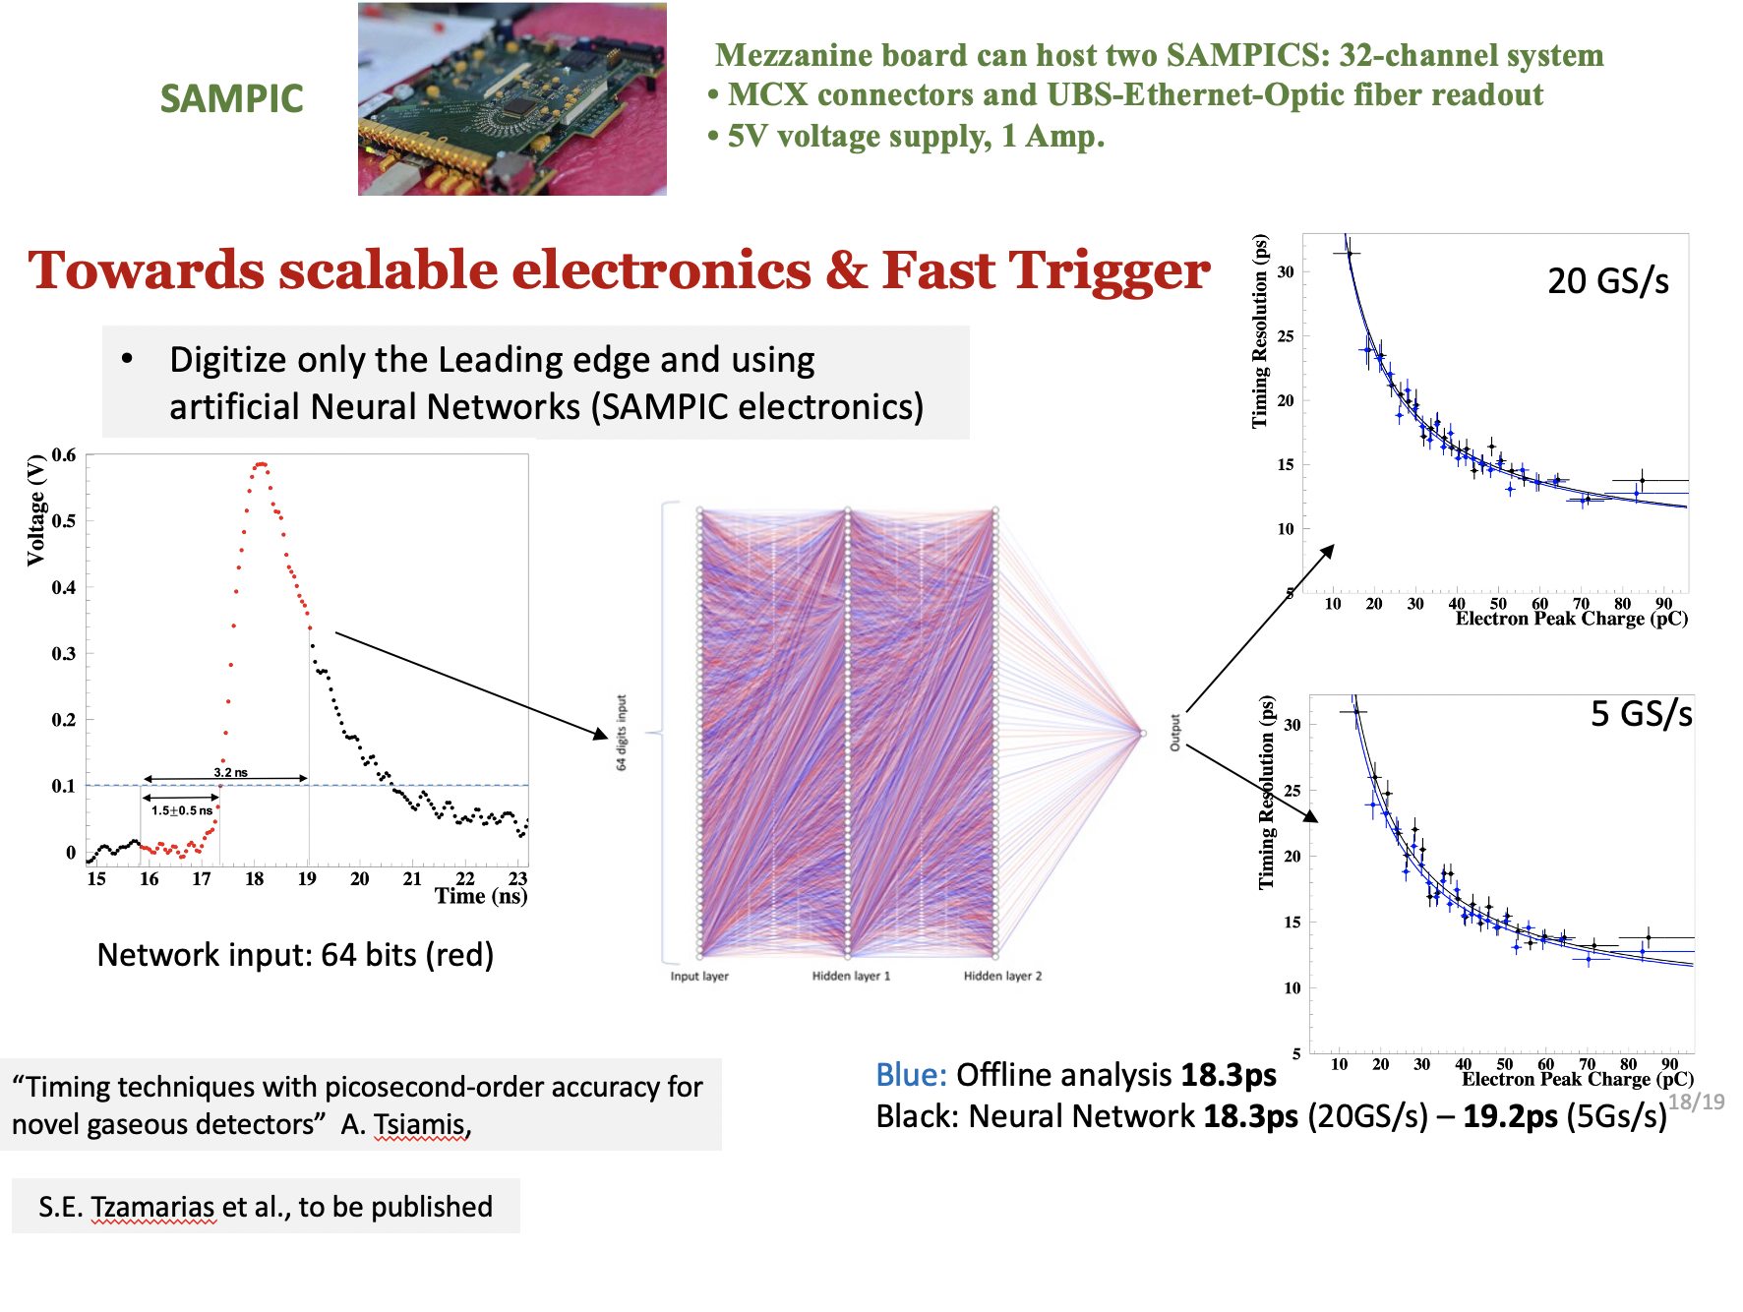
Using A.N.N. embeded in the Digitization Electronics (SAMPIC) the PICOSEC-MicroMegas can provide very fast, accurate timing for event selection

Slide 15
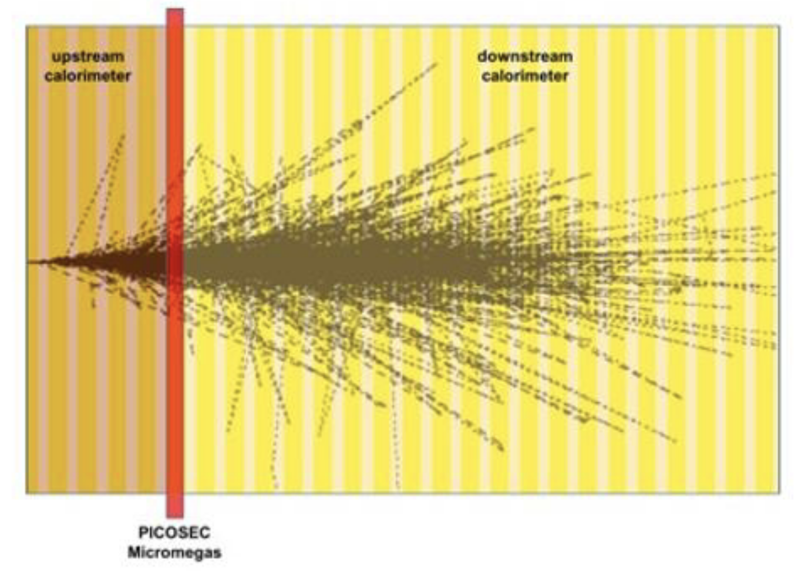
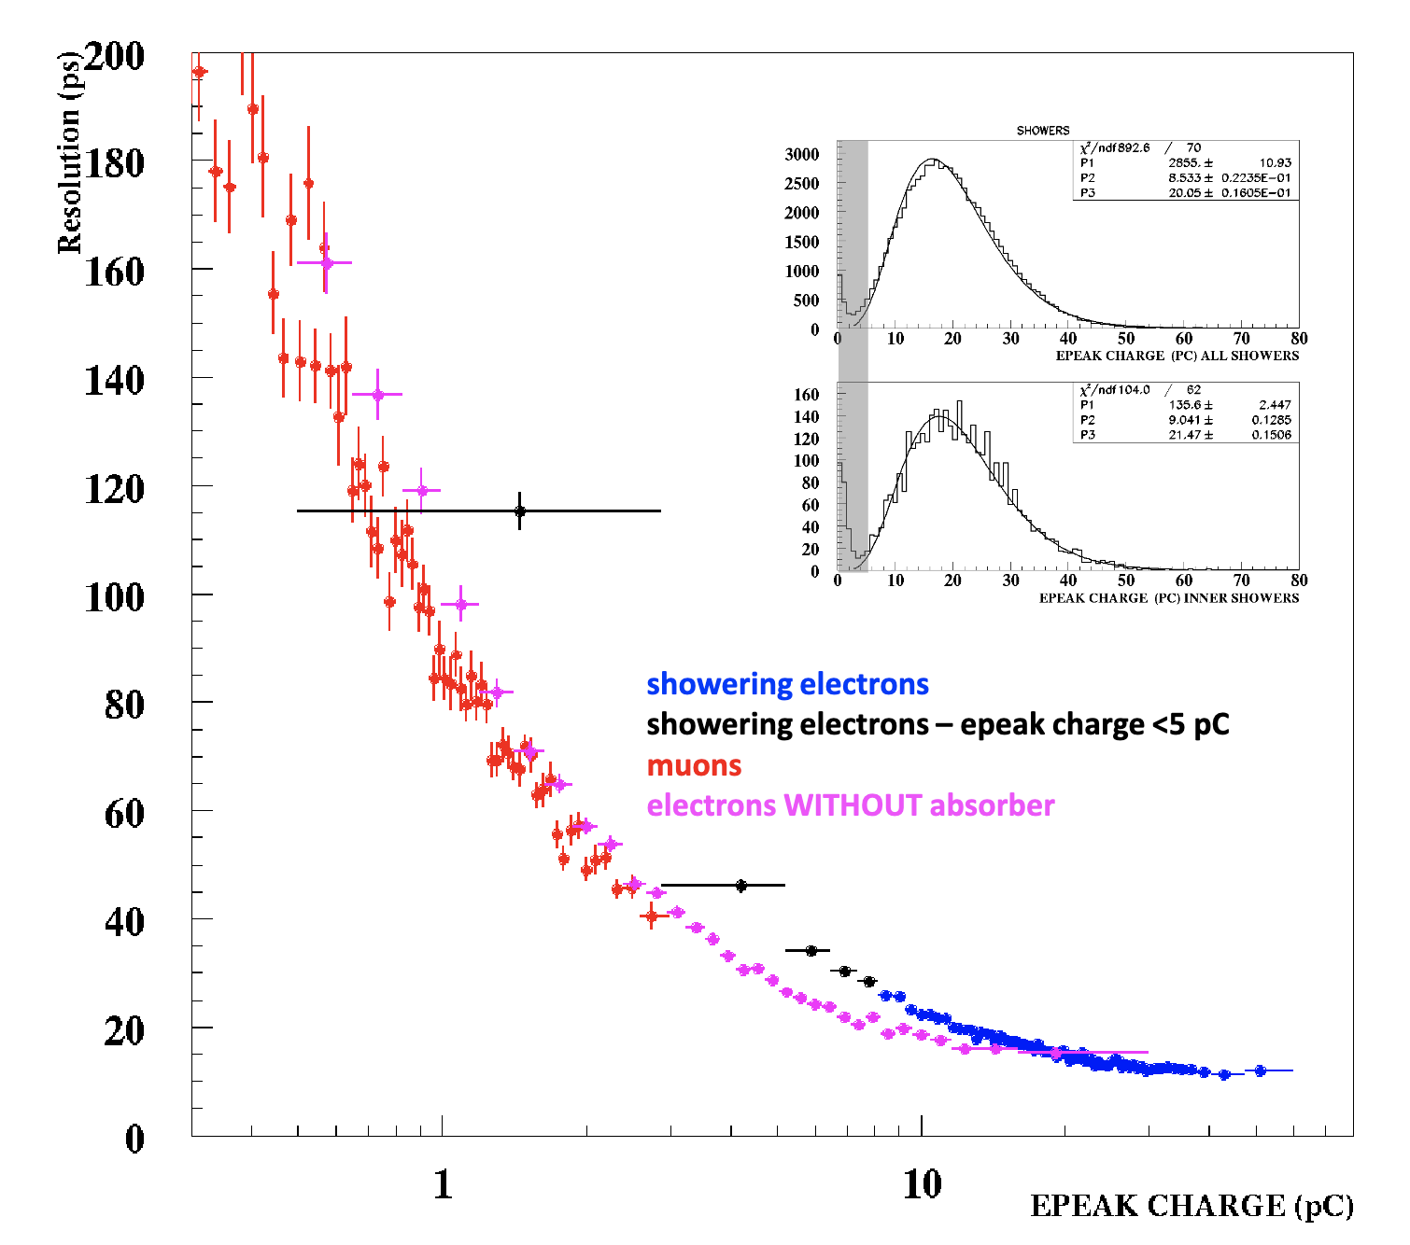
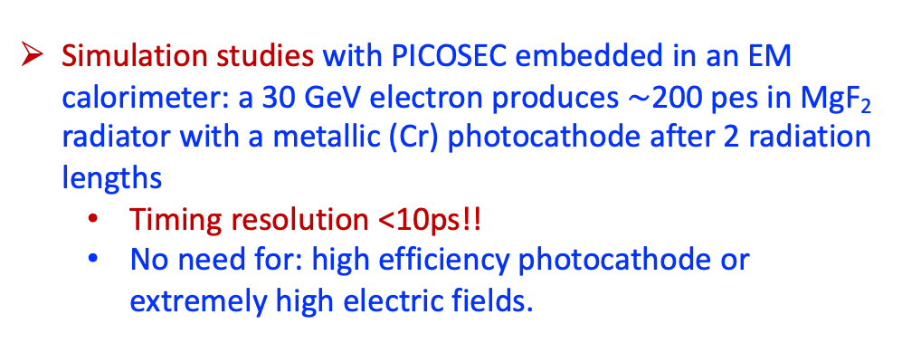
Simulation studies with PICOSEC embedded in an EM calorimeter: a 30 GeV electron produces $\sim$200 pes in MgF₂ radiator with a metallic (Cr) photocathode after 2 radiation lengths
  Timing resolution <10ps!!
  No need for: high efficiency photocathode or extremely high electric fields.
Funding
Sc-1
Sc-2
ELIDEK:
Micromegas detector in New Physics Searches 30 k€
Development of innovative instrumentation and new methods for the selection/analysis of experimental data for New Physics research at the HL-LHC. 41 k€
Absorber
MCP
PICO
PRELIMINARY Electron Test Beam Results – Metalic Photocathode – 14ps Resolution

Slide 16
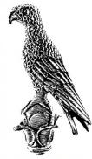
FUTURE
DRD1
(Development of Gaseous Detectors Technologies)
https://drd1.web.cern.ch
Proposal submited (31/10/2023)
DRD3
(Solid State Detectors)
Proposal in preparation
NCSR “Demokritos”
National
Technical
University of
Athens
University of
Ioannina
Aristotle
University of Thessaloniki
NCSR “Demokritos”
National
Technical
University of
Athens

Slide 17
Accelerators

Slide 18






Greek Accelerator Team
E.N.Gazis, E. Adamidi, Th. Xenofontos, E. Trachanas
1. Institute Accelerating Systems & Applications-IAS
A. Georgakilas, T. Alexopoulos, S. Maltezos, I. Kominis
2A.National Technical University of Athens-NTUA, School of Applied Sciences
V. Spitas, E. Tsolakis, Y. Vassileiou, C. Vakouftsis
2B. NTUA-School of Mechanical Engineering
E. Hristoforou, K. Politopoulos, S. Kokossis, N. Voudoukis, E. Alexandratou
2C. NTUA-School Electrical & Computing Engineering
V. Kostopoulos
3. Univ. Patras, Mechanical & Aeronautical Engineering
D. Bantekas, N. Vordos
4. International Hellenic University-IHU, Physics Department
I. Andreadis, G. Syrakoulis
5. Democritus Univ. of Thrace-DUTH, Electrical & Computing Engineering
T. Apostolopoulos, K. Pramatari, D. Kotsopoulos, A. Karagiannaki
6. Athens Univ. of Economics & Business – AUEB, School of Information Sciences & Technology
D. Sampsonidis, S. Tzamarias, C. Lampoudis
7. Aristotle University of Thessaloniki, Laboratory for Accelerator Physics and Instrumentation

Slide 19

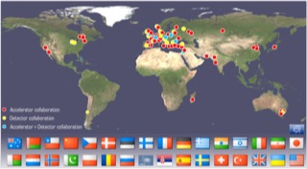
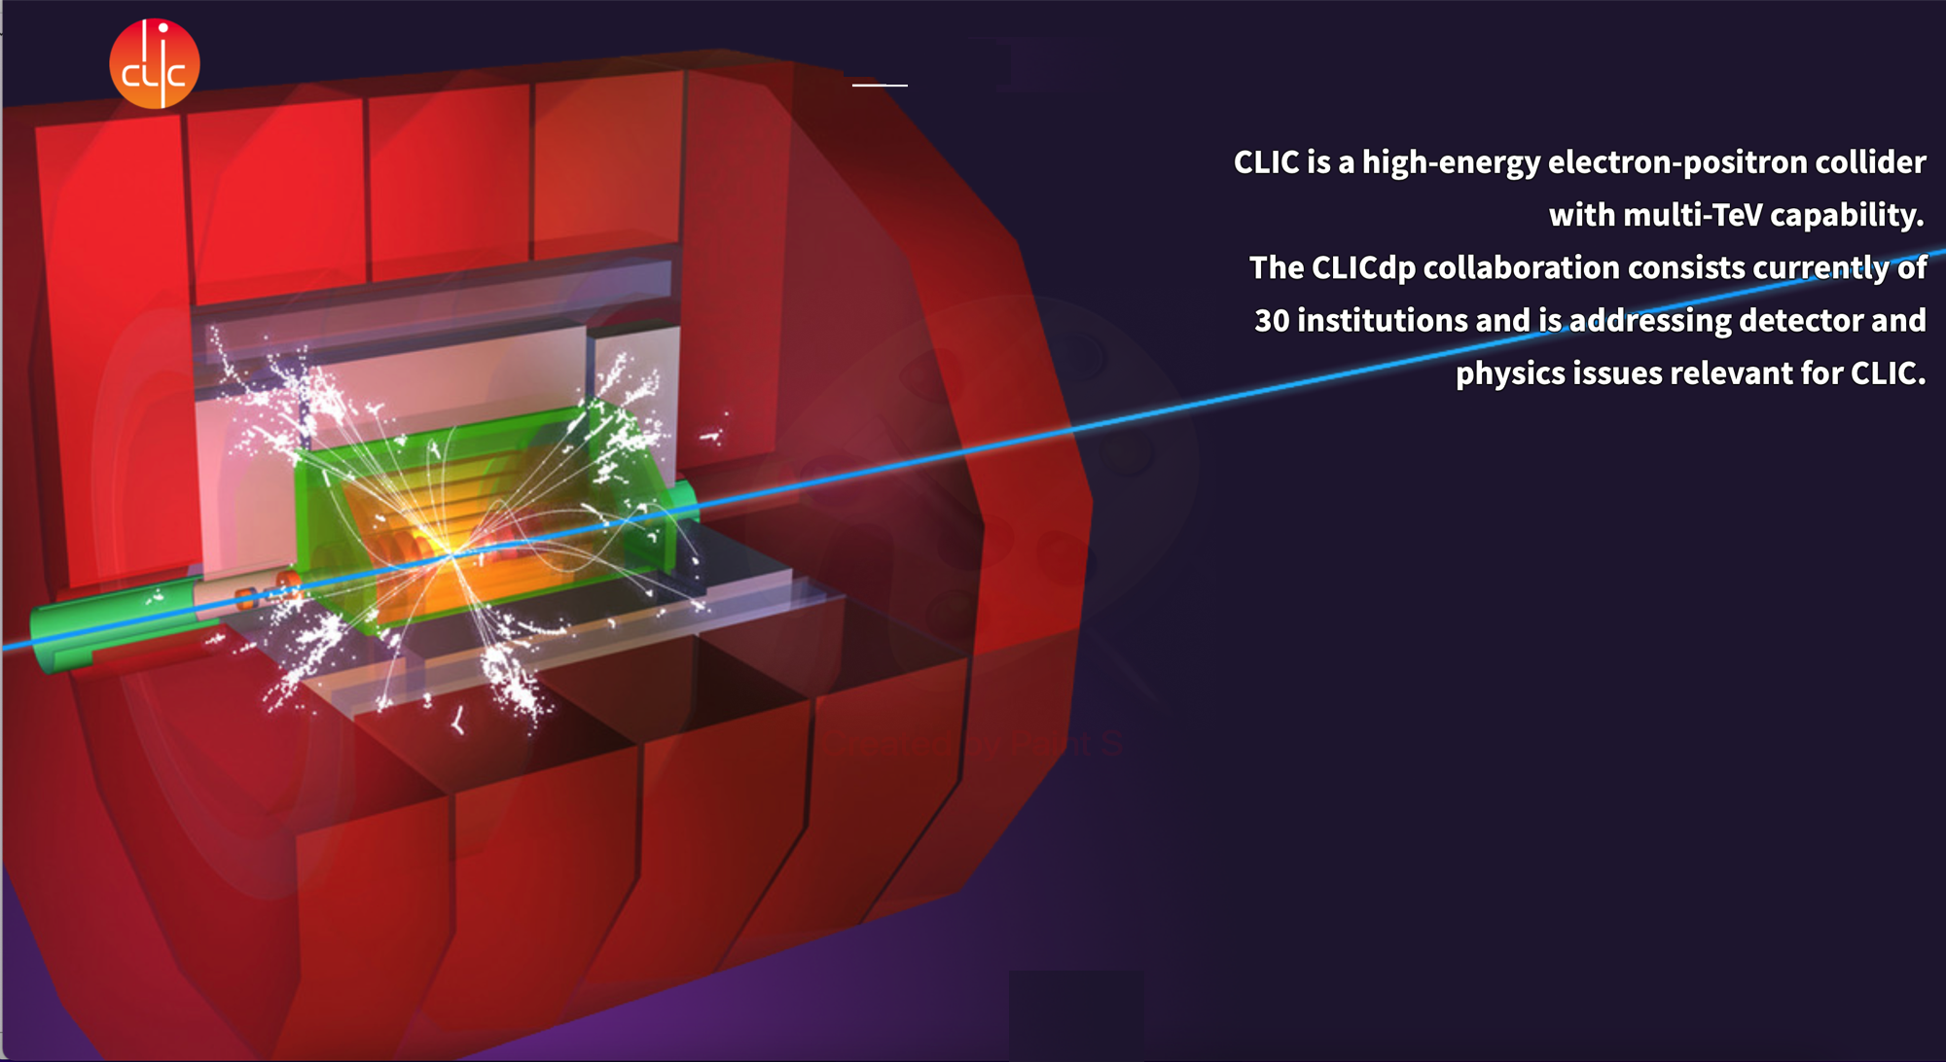
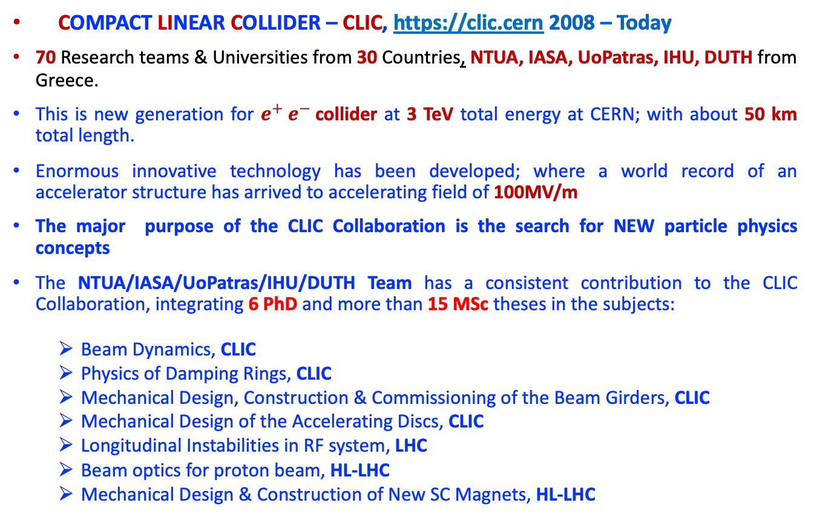
CLIC/CTF3/CLeAR Collaboration 2008 - Today
COMPACT LINEAR COLLIDER – CLIC, https://clic.cern 2008 – Today
70 Research teams & Universities from 30 Countries, NTUA, IASA, UoPatras, IHU, DUTH from Greece.
This is new generation for $e^{+} e^{−}$collider at 3 TeV total energy at CERN; with about 50 km total length.
Enormous innovative technology has been developed; where a world record of an accelerator structure has arrived to accelerating field of 100MV/m
The major purpose of the CLIC Collaboration is the search for NEW particle physics concepts
The NTUA/IASA/UoPatras/IHU/DUTH Team has a consistent contribution to the CLIC Collaboration, integrating 6 PhD and more than 15 MSc theses in the subjects:
  Beam Dynamics, CLIC
  Physics of Damping Rings, CLIC
  Mechanical Design, Construction & Commissioning of the Beam Girders, CLIC
  Mechanical Design of the Accelerating Discs, CLIC
  Longitudinal Instabilities in RF system, LHC
  Beam optics for proton beam, HL-LHC
  Mechanical Design & Construction of New SC Magnets, HL-LHC
Funding of the project (NTUA):
2008 – 2018 : 200 k€
2012 – 2022 : 50 k€

Slide 20
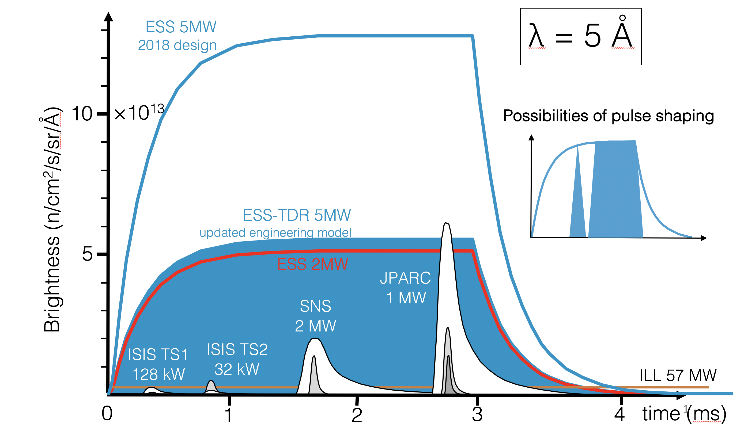
ESS Project, in Kind-Contribution 2017 - 2023
European Spallation Source - ESS
3 Research teams & Universities from 5 European Countries, NTUA, IASA, IHU from Greece.
The ESS scientists and engineers have developed a new generation of neutron source based on proton beam accelerator and spallation technology, a much more efficient approach with advanced specifications.
The NTUA/IASA/IHU Team has a fruitful contribution to ESS Project, BY IN-KIND contribution with 2 Electrical Engineers: Chris. Kourkoutis, Emm. Trachanas) have worked for 2 years.
The Greek Team contribution is the proton source commissioning, the RFQs installation and commissioning and the Non-Destructive Material Tess needed for the possible material beam damage of the accelerator.
Single-pulse source brightness as a function of time at a 5 Å at ESS, ILL, SNS, J-PARC and ISIS target stations 1 and 2.
Total funding of the project:
ESS + NTUA 76.5 k€

Slide 21
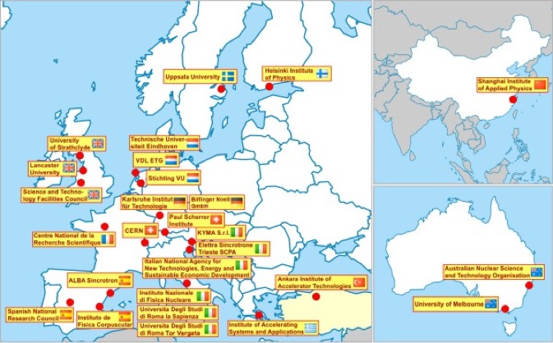
COMPACT LIGHT COLLABORATION – XLS, https://www.compactlight.eu/, 2018 – 2022, funded H2020
22 International Laboratories, 3 Industries and 7 associate partners from Europe, Asia and Australia, IASA/IHU, main partner, plus NTUA and AUEB associate partners from Greece.
The Greek Team has contributed to Data Management Plan, Photocathode selection, e-gun Design, Beam Dynamics Simulations, 3D CAD FEL baseline layout design and 3D machine tunnel design and Financial Analysis (Risk-, SWOT-, Cost-to-Benefit- and Market- Analysis, Technology Transfer and Parameters List of design included to the delivered by the reports D2.2 CDR and D7.2_XLS_Integration_Cost_Analysis
A Conceptual Design Report – CDR was delivered among
many other innovative reports, Greek team contribution:
D1.2 CompactLight Data Management Plan V.1.3
D2.2 Conceptual Design Report - CDR
D3.1 Preliminary assessments and evaluations of the optimum
e-gun and injector solution for the CompactLight design
D3.4 Photocathode and Laser System
D7.1 CompactLight global integration and cost analysis
D7.2 Compact Light Integration Cost Analysis

Slide 22
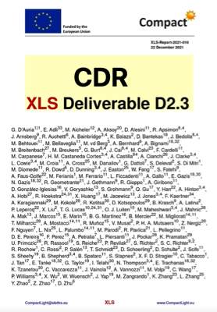
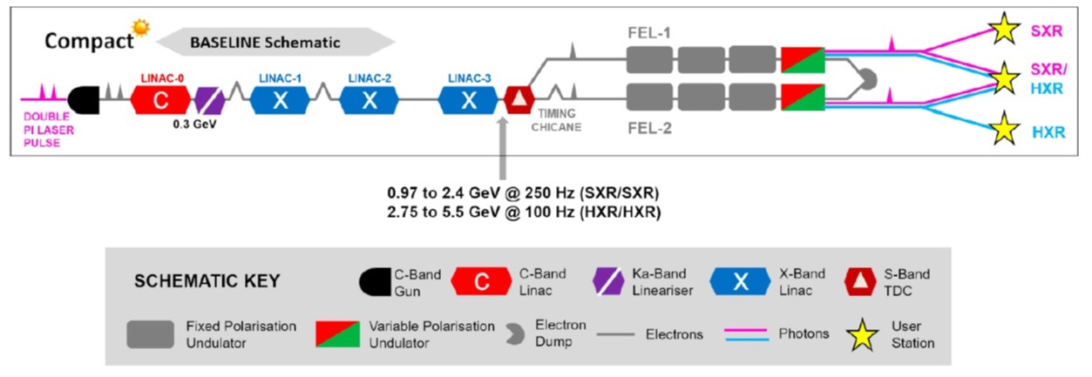
COMPACT LIGHT COLLABORATION – XLS
https://www.compactlight.eu/, 2018 – 2022, funded H2020
IASA/IHU/NTUA/AUEB RESPONSIBILITIES
WP1: Co-coordination of the project : Data management plan
WP3: Laser/Photocathode (coordinator) : Photocathode options selection, e-Gun, Injector mechanical design
WP6: Beam dynamics simulation and generic : algorithms (ASTRA, GIOTTO)
WP7: 3D Model design & Parameters List plus:
                Solenoid shielding and Magnet design
                Cost, SWOT, Risk & Market Analysis
                Cost to Benefit Analysis
                Transfer Technology to industry & Society
Total funding of the project:
EU-H2020 3 M€/ 25 partners
GREEK share: 67.5 k€

Slide 23

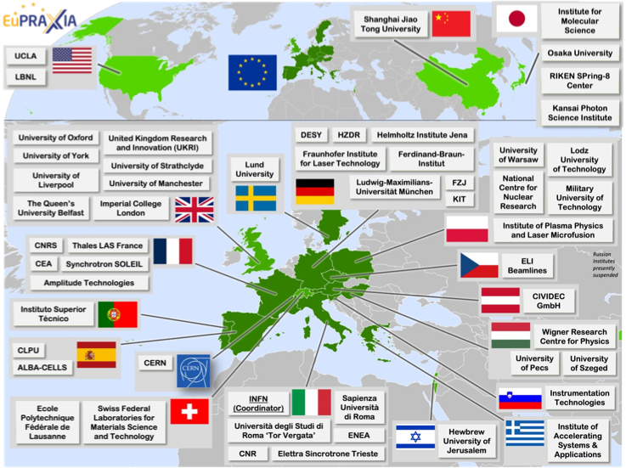
EuPRAXIA PLASMA ACCELERATION 2022 – 2026,
funded by EUESFRI Project
15 International Laboratories + 25 Associate Laboratories from Europe, China, USA
IASA, main partner, plus NTUA, IHU and AUEB associate partners from Greece
The Greek Team is contributing to the Beam Dynamics, Injector design, 3D CAD layout design,
Applications in Medicine & Biology research and Advance Materials, Extension of the Collaboration,
Financial Analysis of the project.
Building a facility with very high field Plasma Accelerators, driven by lasers or beams obtain 1 – 100 GV/m accelerating field
Total funding of the project:
EU-2020 2.5 M€/ 34 partners
GREEK share: 30 k€

Slide 24
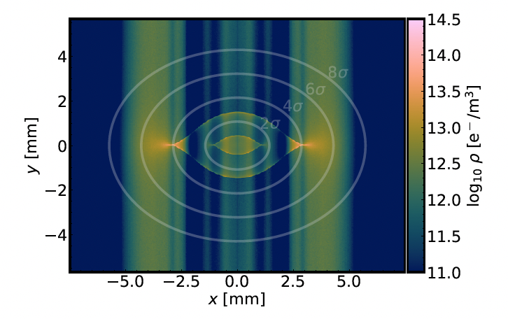
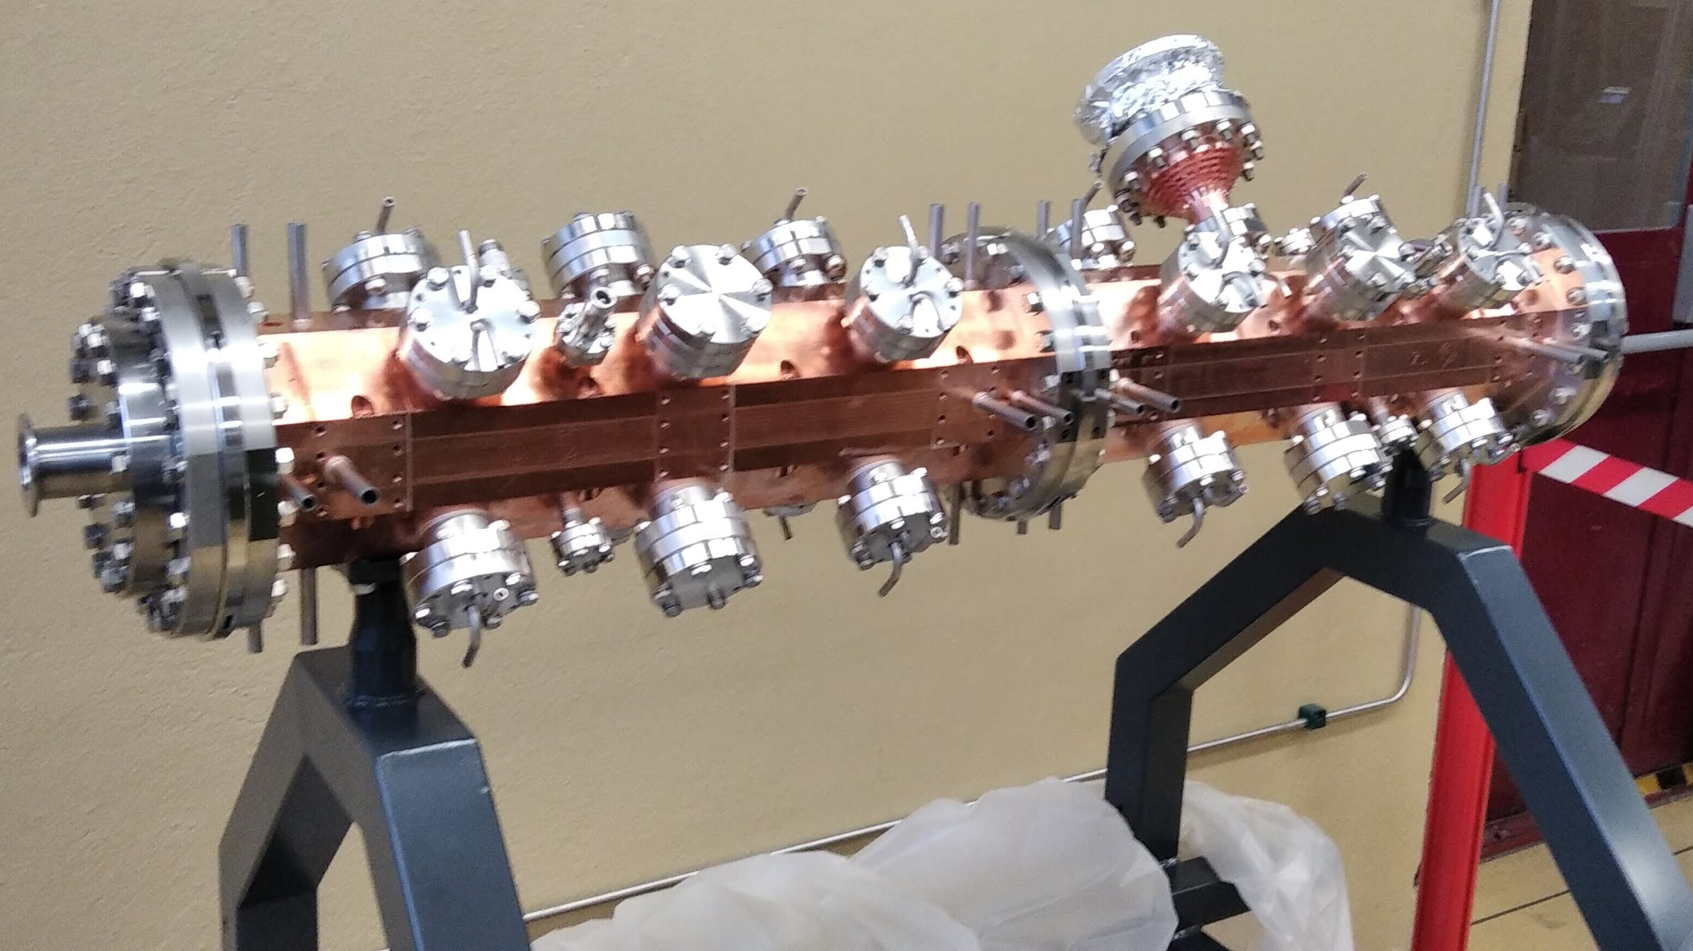
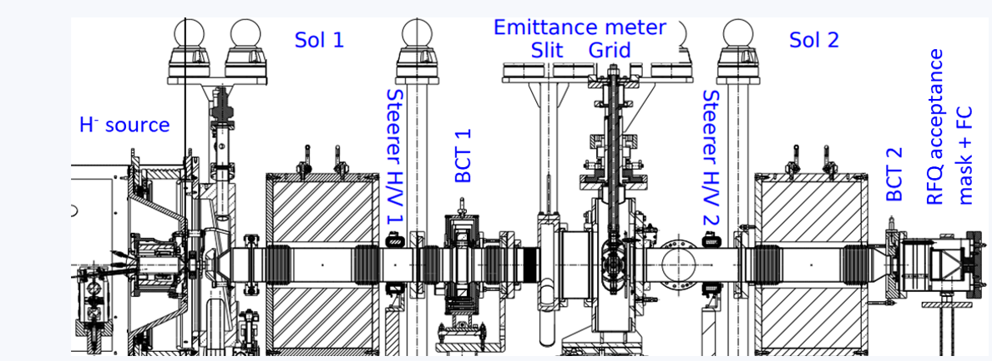
Accelerator Physics and Technological Applications
Studies of Incoherent effects for the Upgrade of the LHC and Detector Applications (K. Parschou, PhD finished 2023)
Studies for optimizing optics cycles for the High-Luminosity LHC (I.Angelis, PhD ongoing)
Optimization of pre-injector systems in hadron accelerators (A. Mamaras, PhD on going)
Fisibility Studies for the Construction of Movable Small Size Accelerator with Applications in Art and Medicine.
Aristotle University of Thessaloniki, Laboratory for Accelerator Physics and Instrumentation

Slide 25
Applications

Slide 26
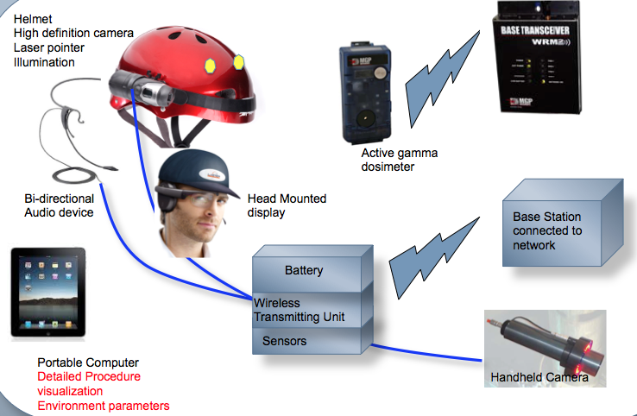
Participation in the EDUSAFE Project 2015 - 2019
EDUcation in advanced VR/AR SAfety Systems For Maintenance in Extreme Environments – EDUSAFE https://https://edusafe.web.cern.ch/site.php
13 Research teams & Universities from 5 European Countries, NTUA, IASA, AUEB, DUTH from Greece.
The scientific objective of EDUSAFE is research into advanced Virtual Reality VR and Augmented Reality AR technologies for a personnel safety system platform, including features, methods and tools.
The NTUA/IASA/AUEB/DUTH Team has a consistent contribution to the EDUSAFE Project, integrating 4 PhD’s.
The Greek Team responsibility was the entire development of the DAQ and Control System and part contribution of the VR/AR technology for the final product
Total funding of the project:
EU-MARIE CURIE3.1 M€/ 8 partners
GREEK share: 70 k€

Slide 27
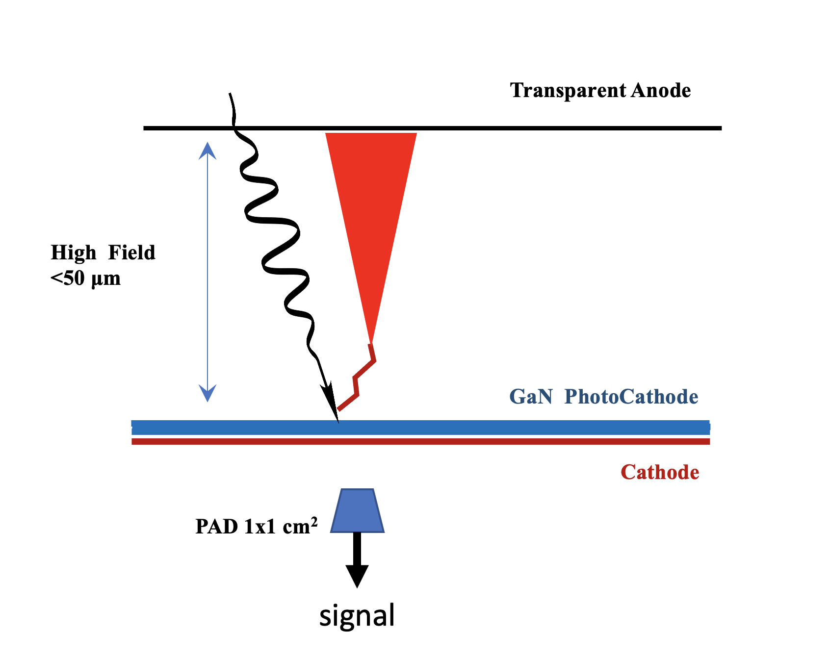
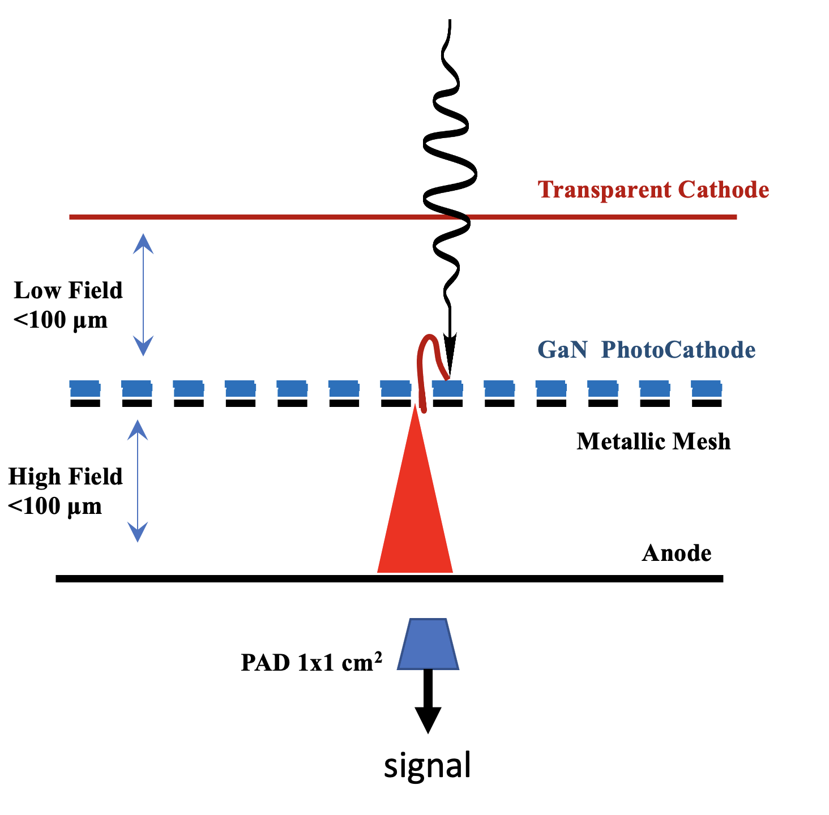
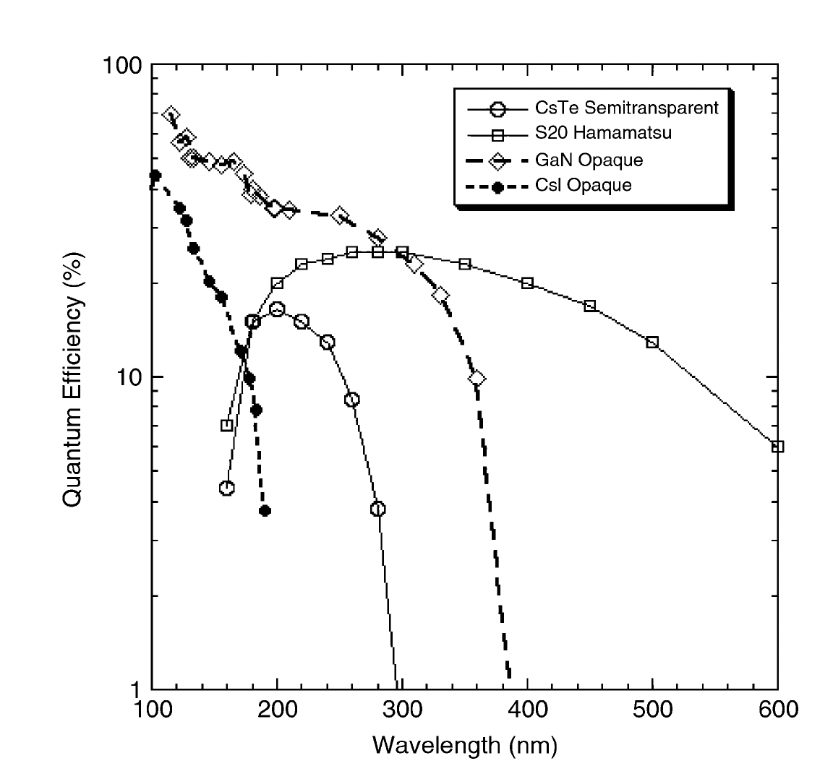
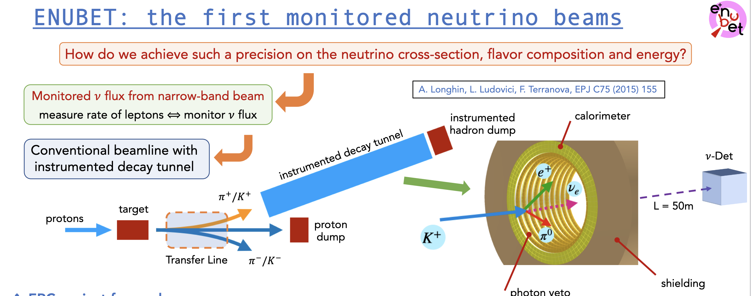
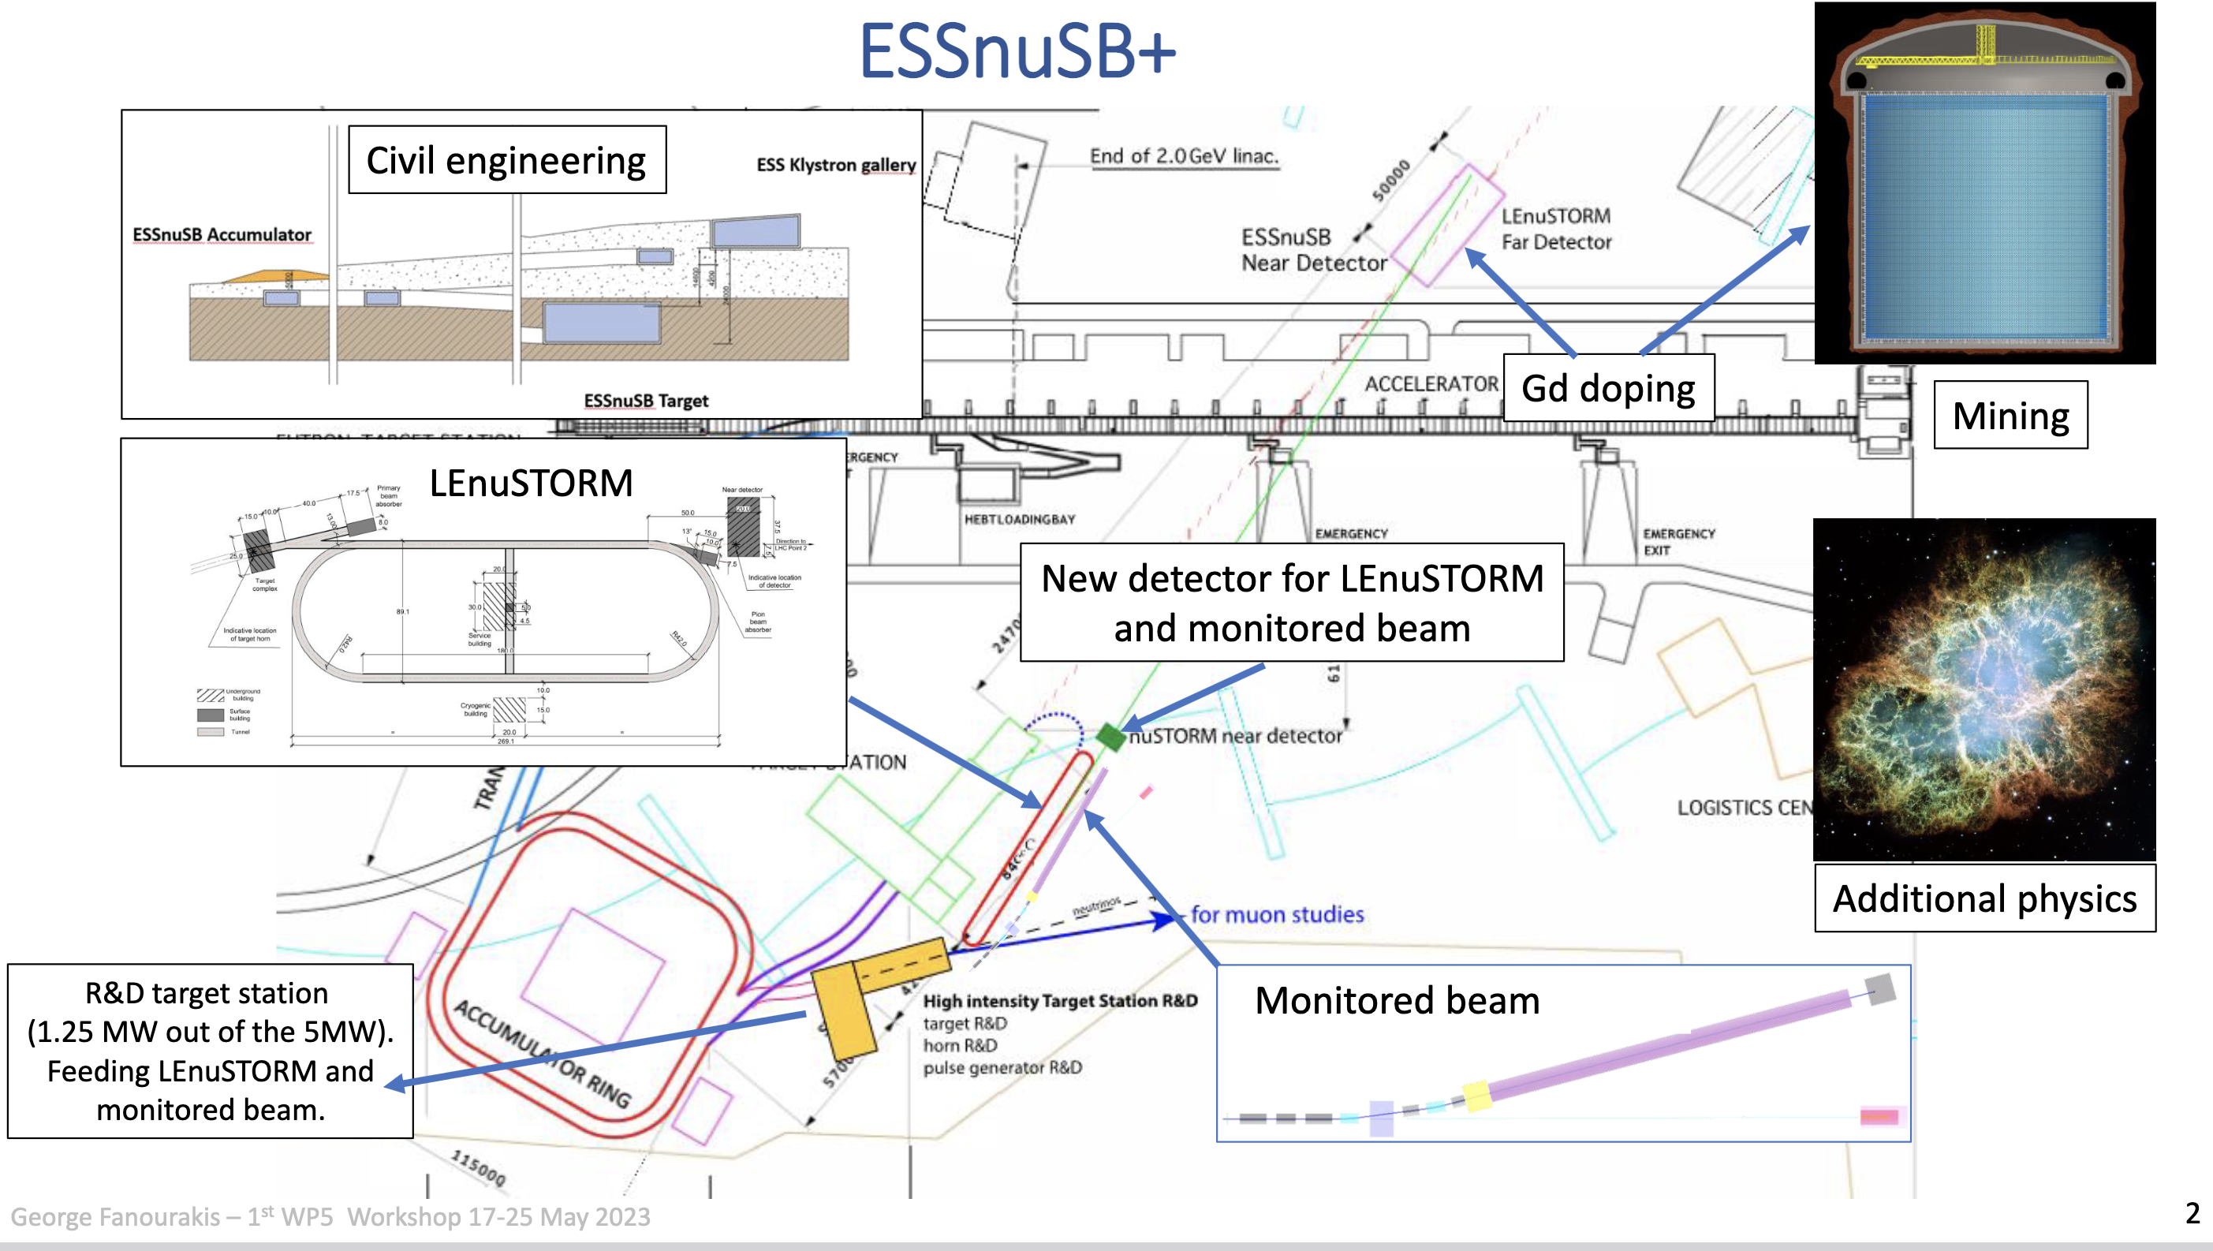
PICOSEC Prototypes for Cherenkov Photon Detection at 300 nm range
Two New Prototypes with reflective (GaN) Photocathods
Photodectors for the ENUBET and ESSnuSB+ Neutrino Projects

Slide 28
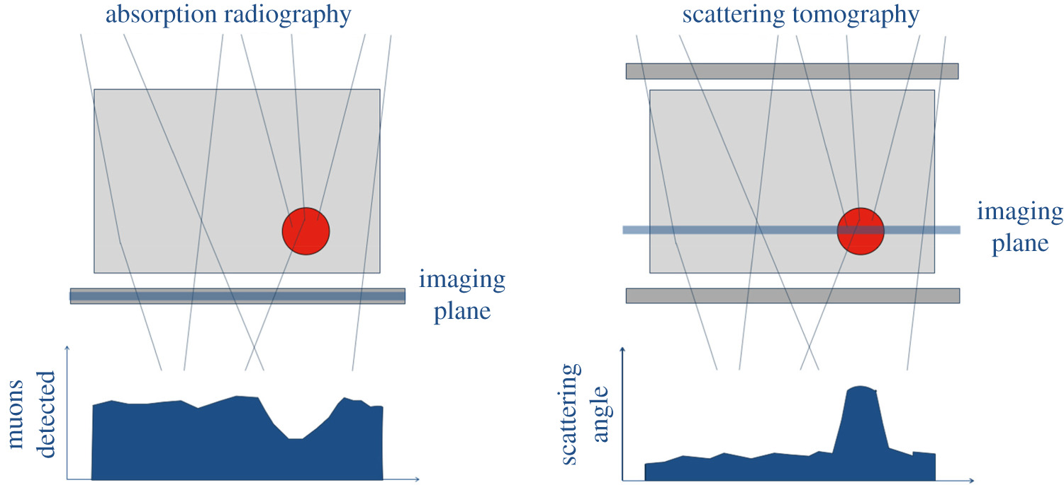
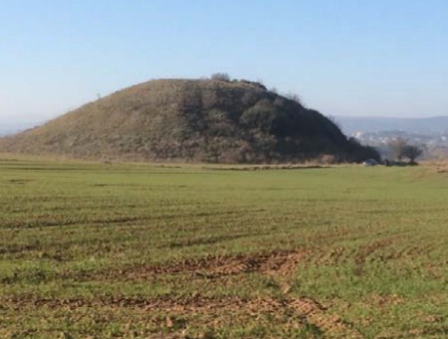
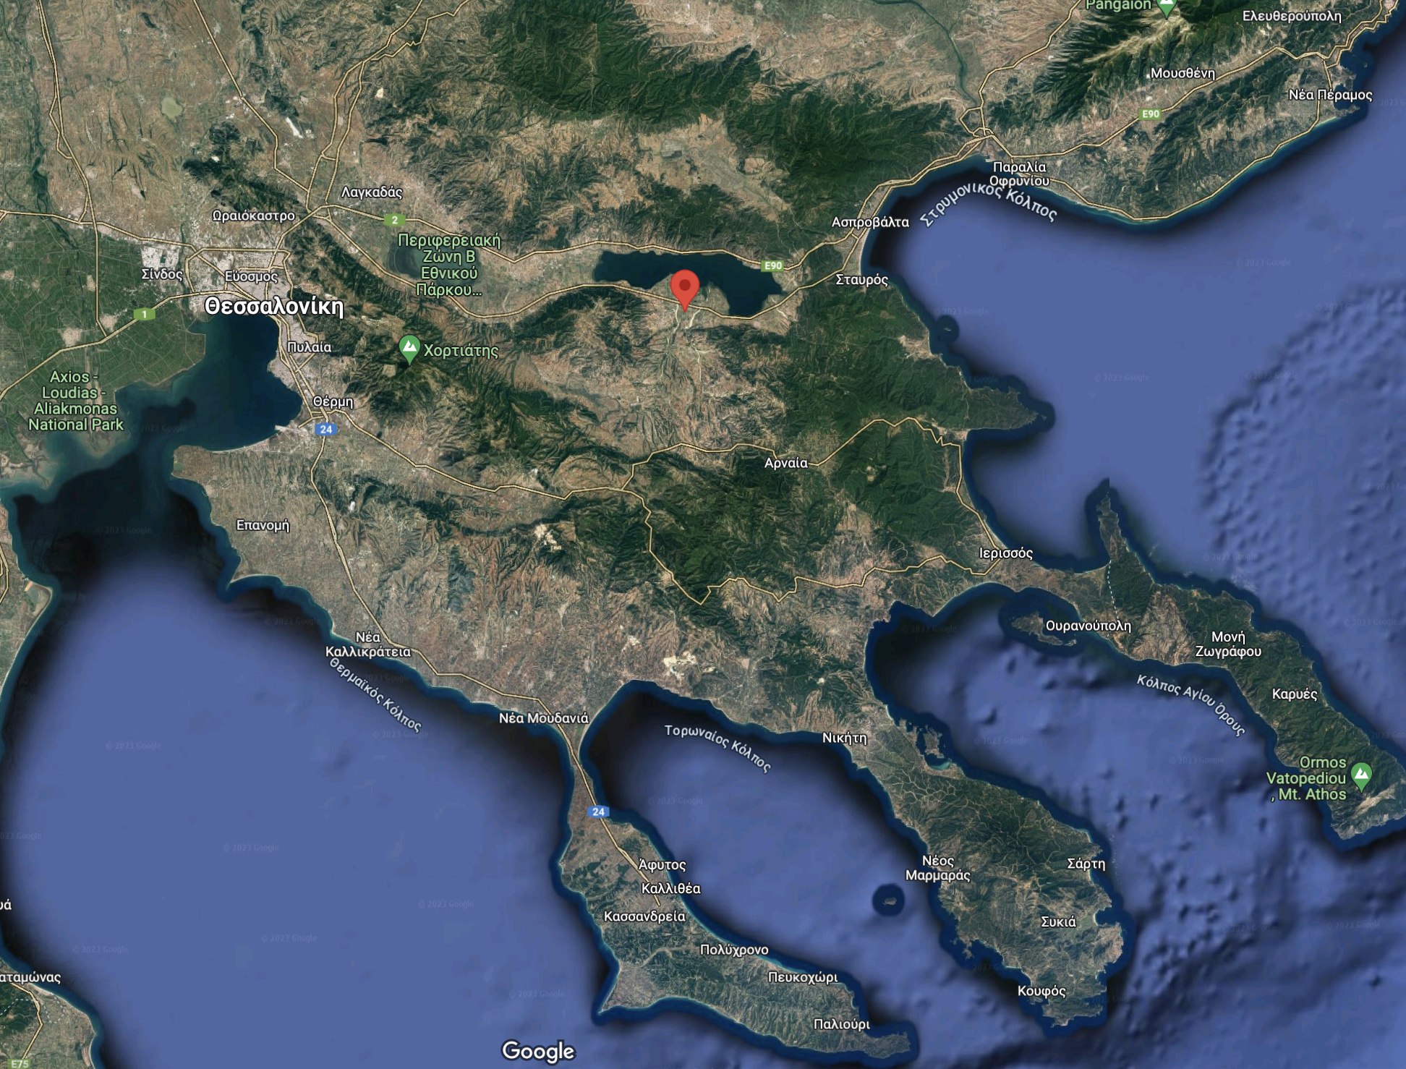
Muon Tomography: imaging method based on muon detection
Thickness of a mountain: George (1955)
Hidden chambers in Chephren (or Khafre) pyramid: Alvarez (1970)
Volcanology: Nagamine (1995), Tanaka (2001),
Diaphane collaboration (2008)
The application of Muon Tomography developed in the framework of EKATY project for : Innovative imaging of the subsurface of archaeological sites and the interior of structural elements of monuments in 3 and 4 Dimensions.
The project aims to develop innovative methods, instruments and methodological protocols for the detection, imaging and mapping of buried antiquities. The detection of structures under the tumuli is specifically addressed.
Application → at the Great Tumulus of N. Apollonia
Collaboration of Lab of Nuclear Physics (AUTh), Lab of Geophysics (AUTh), Ministry of Culture, Greek Industry
Imaging via absorption
principle is similar to conventional X-ray radiography
Imaging via scattering
analyze the angles of deflection before and after passing through a volume
Great tumulus of Apollonia

Slide 29



A small-scale muon tomography experimental set-up
The “mini” Micromegas telescope (@ CIRI – AUTh)
Experimental set-up for imaging of lead cube using both techniques
Muon Transmission Radiography
  The lead cube’s position: 130 mm from the top Micromegas detector.
  Cube size: 50mm x 50mm x 50mm
  Data taking with and without the cube placed above the detectors.
  Double Coincidence events with Veto.
  Events within the acceptance of the three scintillators are selected
  Back projection method applied
Muon Scattering Tomography
  The cube was placed in the middle of four Micromegas detectors.
  The cube’s hight reduced to 2.5 cm.
  Two tracks were reconstructed, the incoming(two upper detectors) and the outgoing (two bottom detectors) one.
  The deflection angle was calculated.
  The Point of Closest Approach (POCA) algorithm used
The lead cube
1st Scintillator
4 Micromegas
2nd Scintillator
Absorber (20 cm lead)
3rd Scintillator
4 Micromegas (10 x 10 cm² active area)
anode board: XY 2-dimensional ~ 384 strips
detection medium: Ar – CO₂ gas 93%-7%
APV25 readout cards (x6 per XY plane)
signal reception via SRS (Scalable Readout System)
trigger using 2 scintillators in coincidence
Absorber to veto the high energy muons with 3rd scintillator

Slide 30









Results
Muon Transmission Radiography (absorption)
Object size: 50mm x 50mm x 50mm at distance 130 mm
Width-to-pitch ratio along the x (left) and y (right) axis as a function of the distance of the projection plane from the top detector.
d = 0mm
d = 80 mm
Distance Dx = 84.32 ± 3.16 mm
Dy = 131 ± 4.97 mm
The 2σ of the projections along x(left) and y(right) as a function of the distance.
d = 120 mm
d = 200 mm
Back projection planes at four distances.
Size (in X) 56.97 ± 1.4mm,
(in Y) 61.64 ± 1.3 mm
Muon Scattering Tomography
Object size: 50mm x 50mm x 25mm
Object Size (in X) ~ 51 ± 6.4 mm
(in Y) ~ 50 ± 5.7 mm
(in Z) ~ 28 ± 3.7 mm
Two dimensional image of the cube

Slide 31


MM Telescope: First Application at the Apollonia tumulus
Power: Solar panels & battery array
Full system powered ON
Addition of temperature sensors
Telescope set @ 20 degs
Test (trigger system + MM pedestal runs + data)
Ready for Data Collection
Work carried out in the framework of the project EKATY (Τ6ΥΒΠ- 00211), in Operational Programme Competitiveness, Entrepreneurship and Innovation 2014- 2020 (EPAnEK) funded after the decision 97476/I2/18-06-2019 (ΑΔΑ:ΩΕ1Ω4653ΠΣ-ΒΑΓ) of the Greek GSRT
(Total budget 880K€, for Muon Tomography 425 K€).
EKATY Collaboration :
Geophysics Lab, School of Geology AUTh, Nuclear & Particle Phys. Lab, School of Physics AUTh, Ministry of Culture, (10 Ephorates of Antiquities ), Greek Industry ( 4 Companies)

Slide 32
SPECT-Lab Group at the Physics Department
of the NKUA & IASA
Efstathios Stiliaris
Development of small field, sensitive γ-Camera prototypes with a sub-millimeter (0.95±0.05mm) spatial resolution and 0.20μCi sensitivity on a tomographic level for pre-clinical studies of Single Photon Emission Computed Tomography (SPECT).
The research focuses on:
Hand-held small field γ-Camera for clinical scans (LAIKON and ALEXANDRA Hospitals)
Infra-Red Optical Tomography
Development of reconstruction algorithms for Compton Camera systems
Human Support |  | Financial Support
PhD Theses (completed) | 3 | National Programmes 80 k€ (last 5 years)
PhD Theses (in progress) | 2
MSc Theses | 12
Diploma Theses | ~100

Slide 33





Hand-held Small Field γ-Camera with Real-Time Motion Correction
Small Field γ-Camera with CsI(Tl) & Position Sensitive PMT
3g Accelerometer (g_{x} - g_{y} - g_{z})
Euler Angle Reconstruction and Real-Time Correction
DAQ System Flowchart
Detection of the g_{x} g_{y} g_{z} Components
¹³⁷Cs Emission Collimator Pattern
(a) Random movement of the γ-Camera
(b) Corrected pattern through Euler angles
(c) Contour pattern
a
b
c
M. Zioga et al. (IEEE) https://doi.org/10.1109/NSSMIC.2016.8069436 , https://doi.org/10.1109/NSSMIC.2012.6551576

Slide 34






Single Photon Emission Computed Tomography (SPECT)
with Time-Resolved Optical Tomography
Infra-Red (IR) Tomography
Time-of-Flight filtering of the Ballistic Component
Double Modality SPECT and Optical
Thermal Phantom
Infra-Red (IR) Tomography
3D Reconstruction
Ballistic Component
A.-N. Rapsomanikis et al. (IEEE) https://doi.org/10.1109/NSS/MIC42101.2019.9059612 , https://doi.org/10.1109/NSSMIC.2016.8069547 https://doi.org/10.1109/NSSMIC.2012.6551834

Slide 35



Reconstruction Algorithms for Compton Camera Events
GEANT4/GATE Simulation of a Compton Camera
Conic Sections Geometrical Approach
Stochastic Algorithms (Max Likelihood – MLEM)
M. Mikeli, M.-E. Tomazinaki et al. Computers in Biology and Medicine 166 (2023) 107502 https://doi.org/10.1109/NSS/MIC44867.2021.9875470

Slide 36
Where do we stand
R&D groups are in the shadow/protection of big experiments
There is a lot of work done with minimal or NO funding
Funding appears in random times, it is minimal and there is no continuation
There is no real support to equip R&D labs

