Slide 1



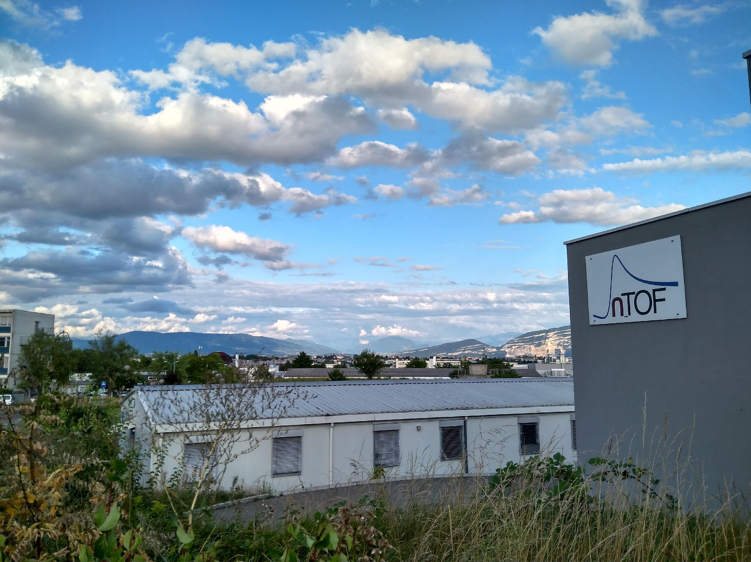
Nuclear Physics in Greece
RECFA, Athens-Greece, 10/11/2023
Nikolas Patronis
n_TOF Physics Coordinator
CERN & Univ. of Ioannina

Slide 2







The Hellenic Nuclear Physics community
Institutes:
National and Kapodistrian University of Athens, Department of Physics
National Technical University of Athens, Department of Physics
Aristotle University of Thessaloniki
University of Ioannina
Hellenic centre for marine research, Anavysos
NCSR “Demokritos”, Athens
Faculty members, Researchers: 25
Our younger colleagues:
BSc: ~40; MSc: ~15; PhD: ~25; post-docs:~10

Slide 3

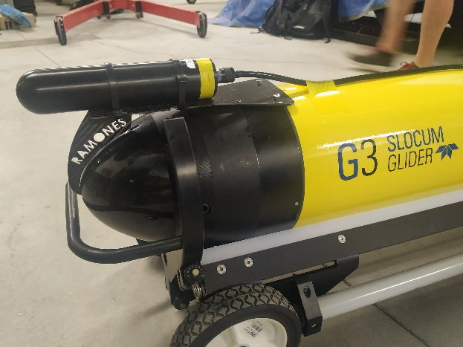
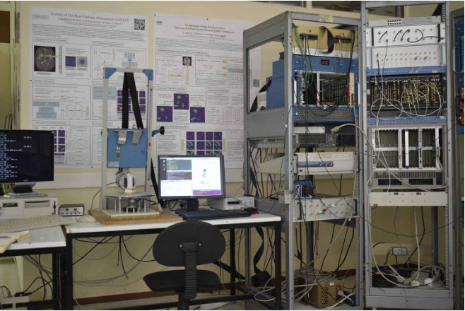
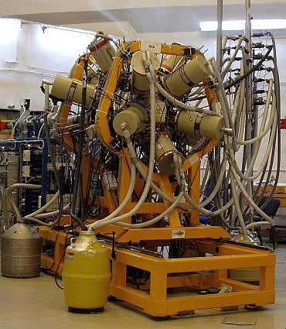
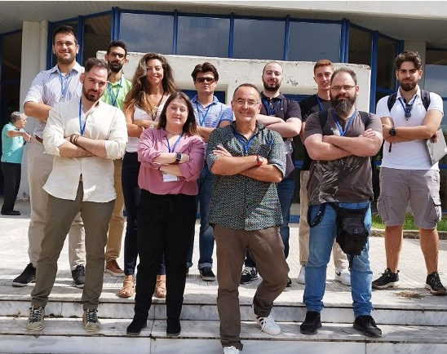
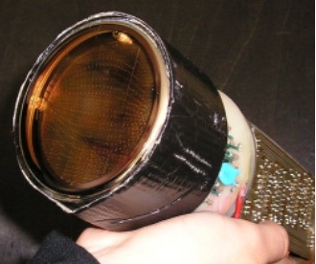
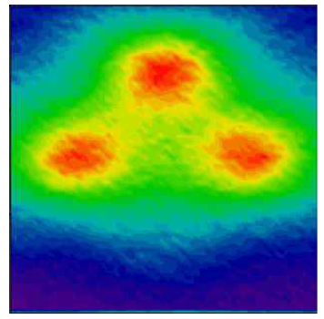
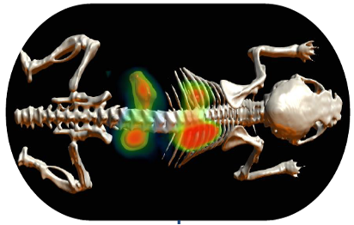
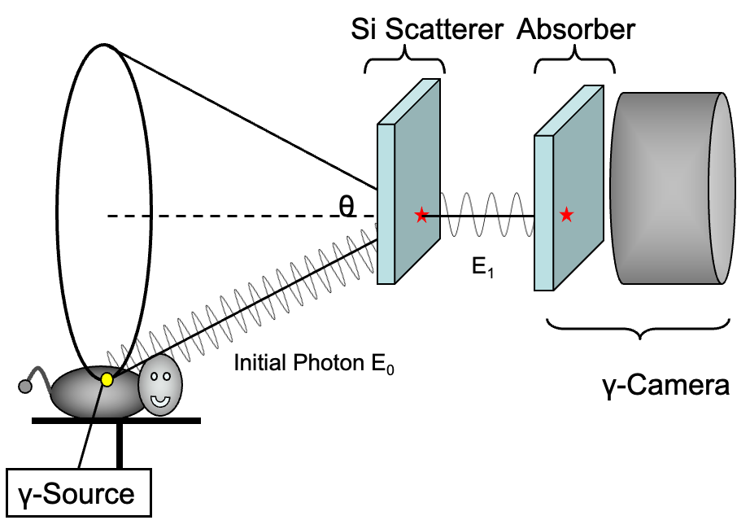
National and Kapodistrian University of Athens
Nuclear Medical Imaging (SPECT-Lab, E. Styliaris)
  Instrumentation for Emission Tomography (small field γ-camera, Compton Camera, Optical tomography)
  Image Reconstruction Algorithms (iterative, stochastic)
  Simulations on the GEANT4/GATE environment
Nuclear Structure, Reactions and Application Group (NuSTRAP, T. Mertzimekis)
  Nuclear Structure (shape coexistence, in exotic and stable nuclei, electromagnetic properties, symmetry, …)
  Nuclear Reactions (Reaction studies with stable & RIB, Nuclear Astrophysics/p-process, …)
  Instrumentation (detector developments for applied and fundamental research, sensors for marine radioactivity studies, …)

Slide 4
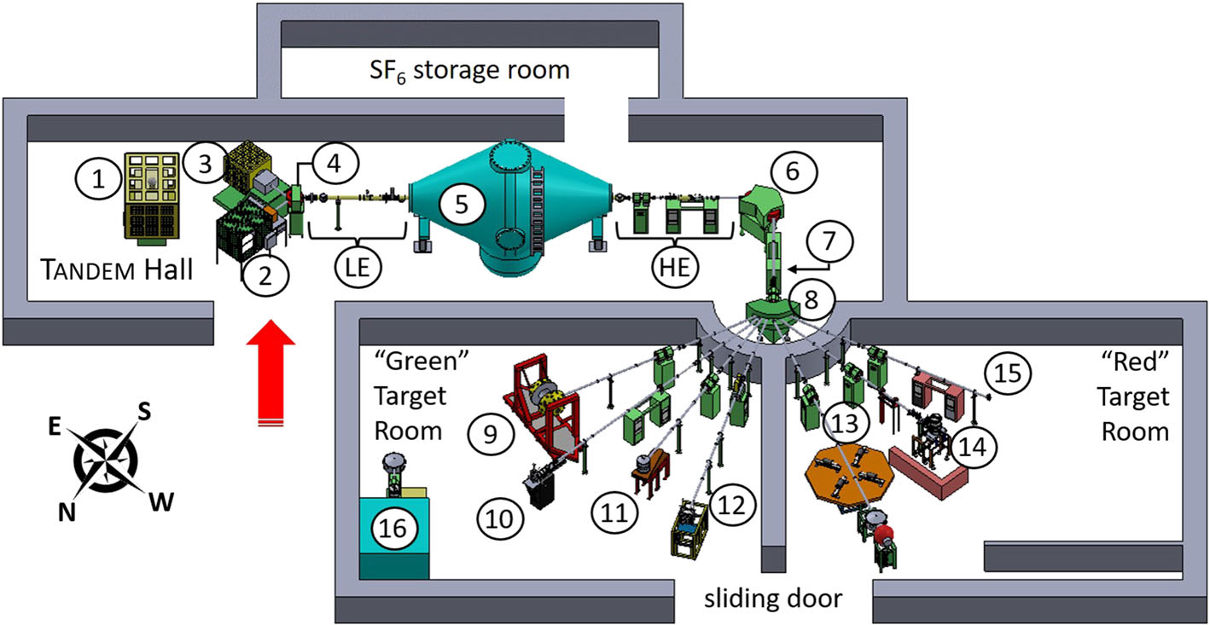
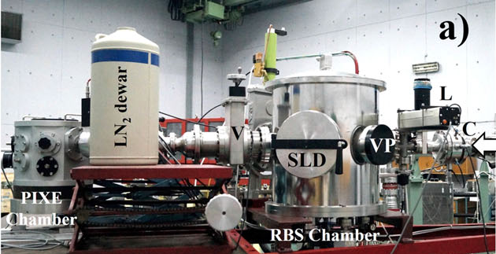
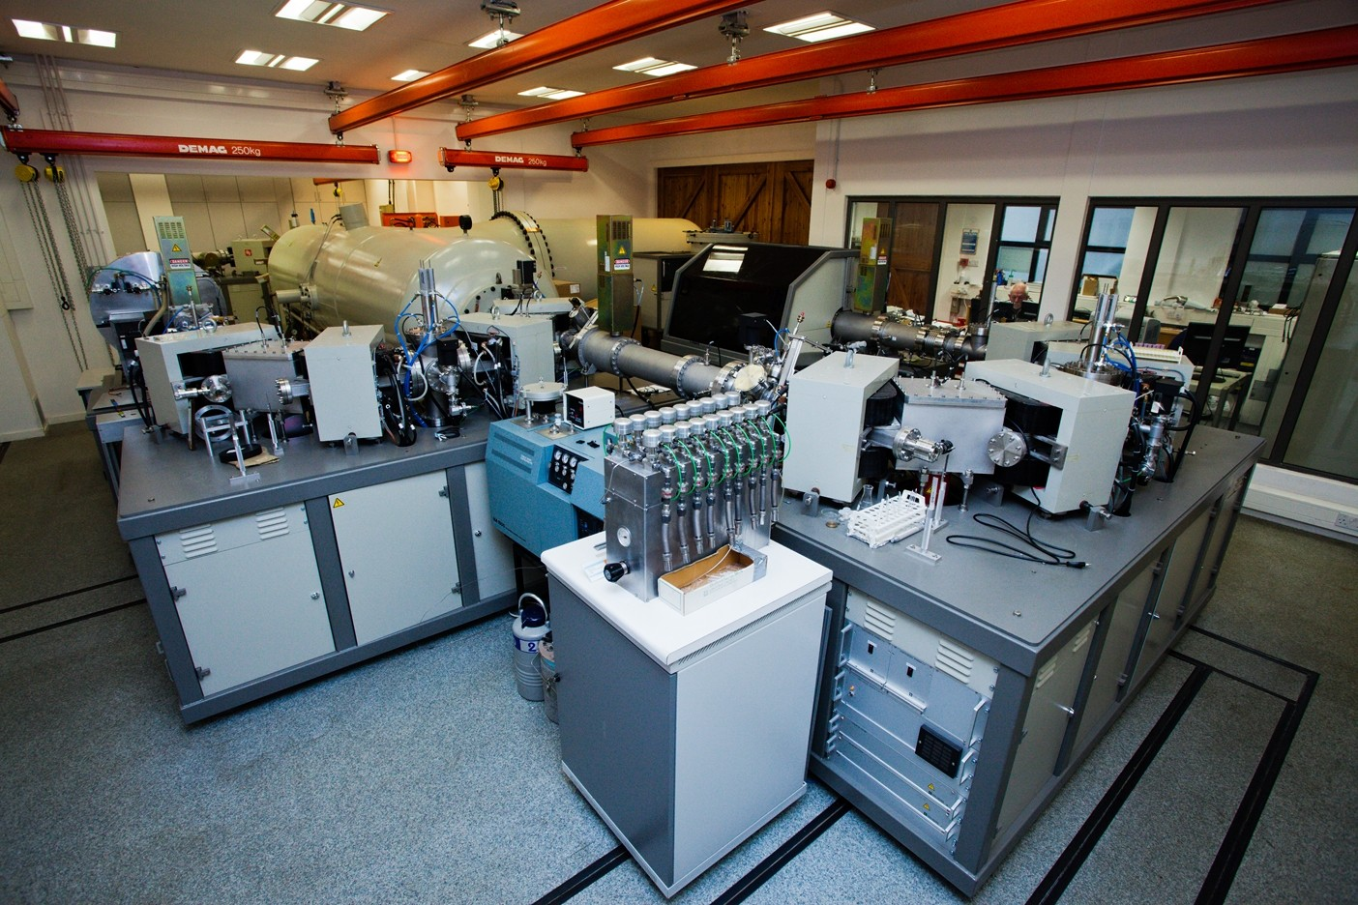
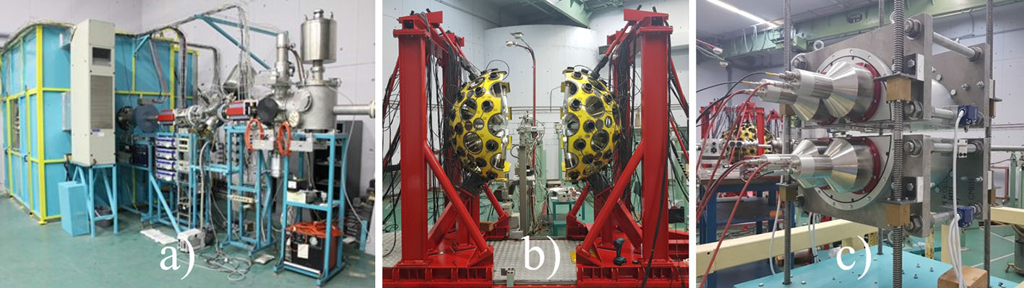
NCSR “Demokritos”
Unique accelerator facility for fundamental and applied research (neutron beams keV-25 MeV, ion beams, dedicated experimental setups for particle and γ-ray spectroscopy, state of the art XRF lab)
Nuclear Physics group (S. Harissopulos, A. Lagoyannis, A. Karydas, M. Axiotis)
  Nuclear Astrophysics (p-process,...)
  Nuclear Reaction studies ((n,x), (p,x), (d,x),...)
  Nuclear Applications (IBA, NRA, RBS, XRF,...)
Nuclear theory Group (D. Bonatsos)
  Shape/phase transitions and nuclear shape coexistence
  Symmetries in nuclear structure
AMS (U. Oxford, under installation)

Slide 5

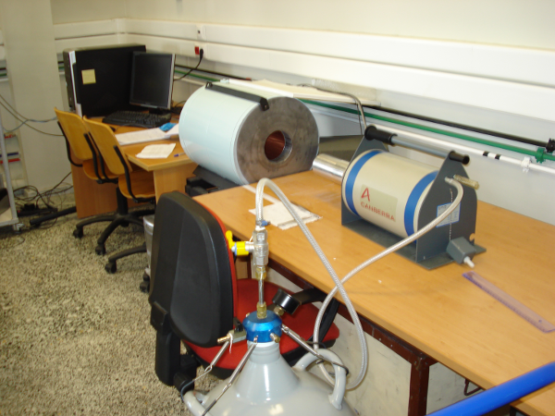
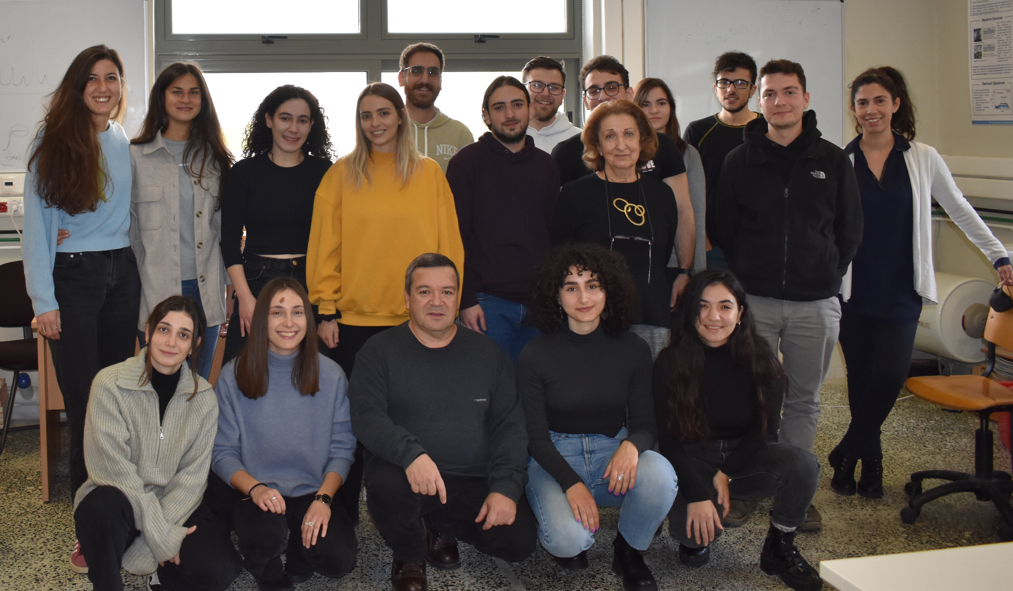
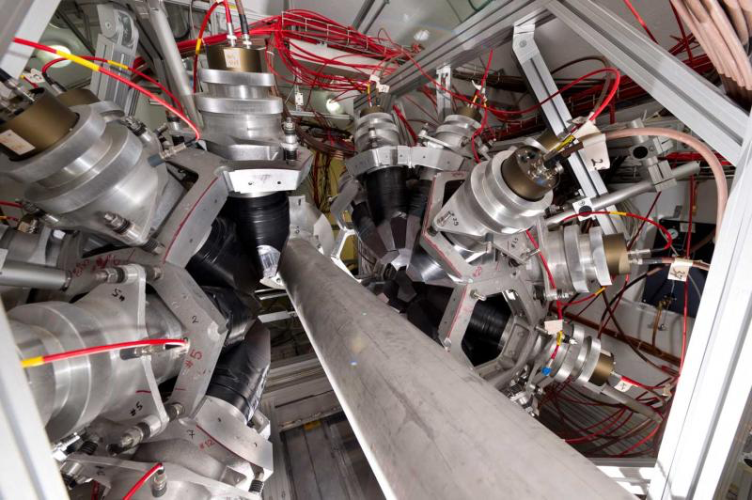
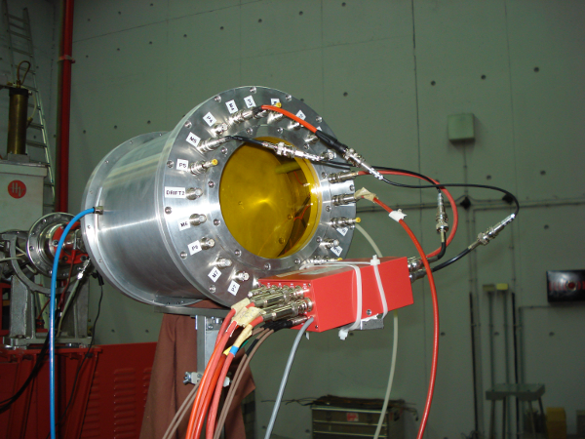
National Technical University of Athens
Nuclear Physics Group (M. Kokkoris, M. Diakaki, R. Vlastou)
  Nuclear Reactions (IBA, NRA, …)
  Benchmarking and evaluation of nuclear reaction cross sections for IBA
  Neutron Physics (fission reaction studies, (n,xn), …)
  Instrumentation (detector developments for applied and fundamental research, …)
  Radiological studies in aquatic environment

Slide 6
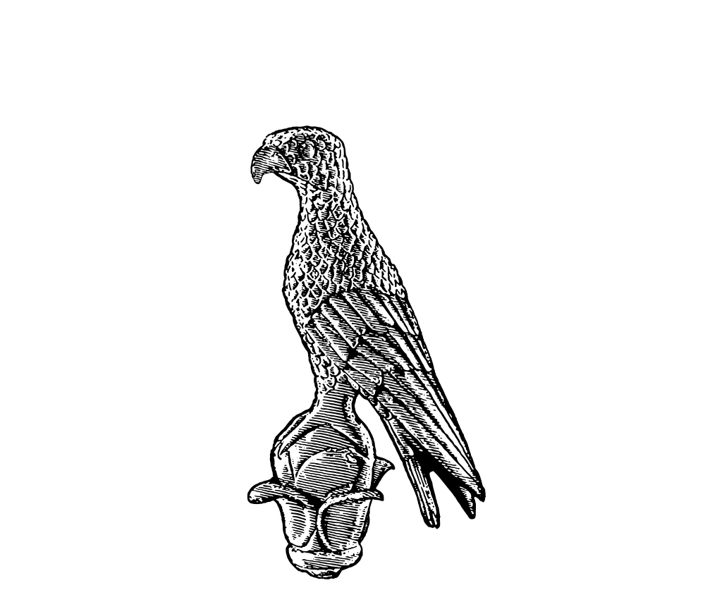
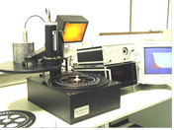
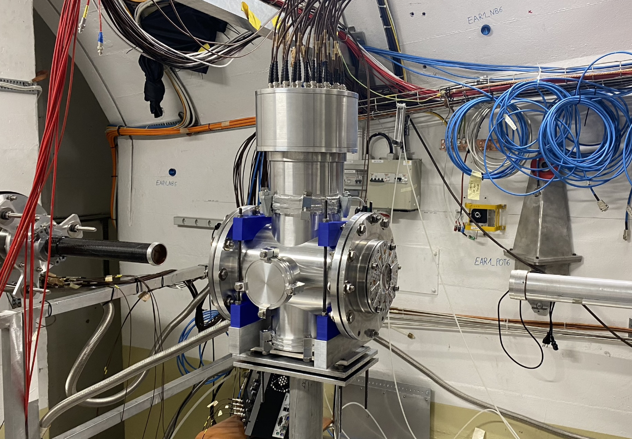
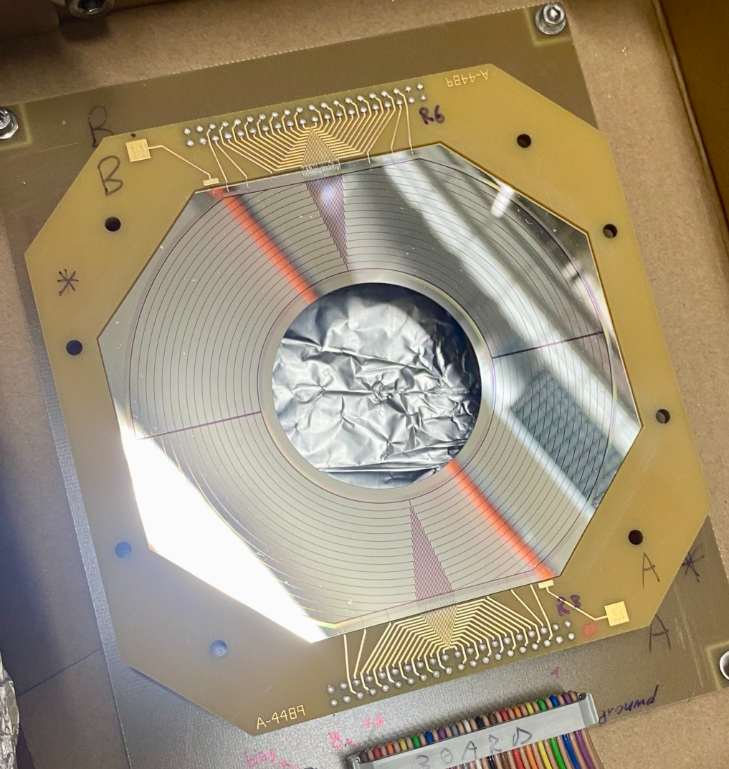
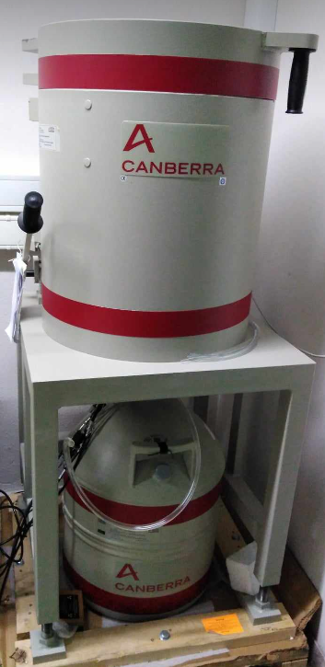
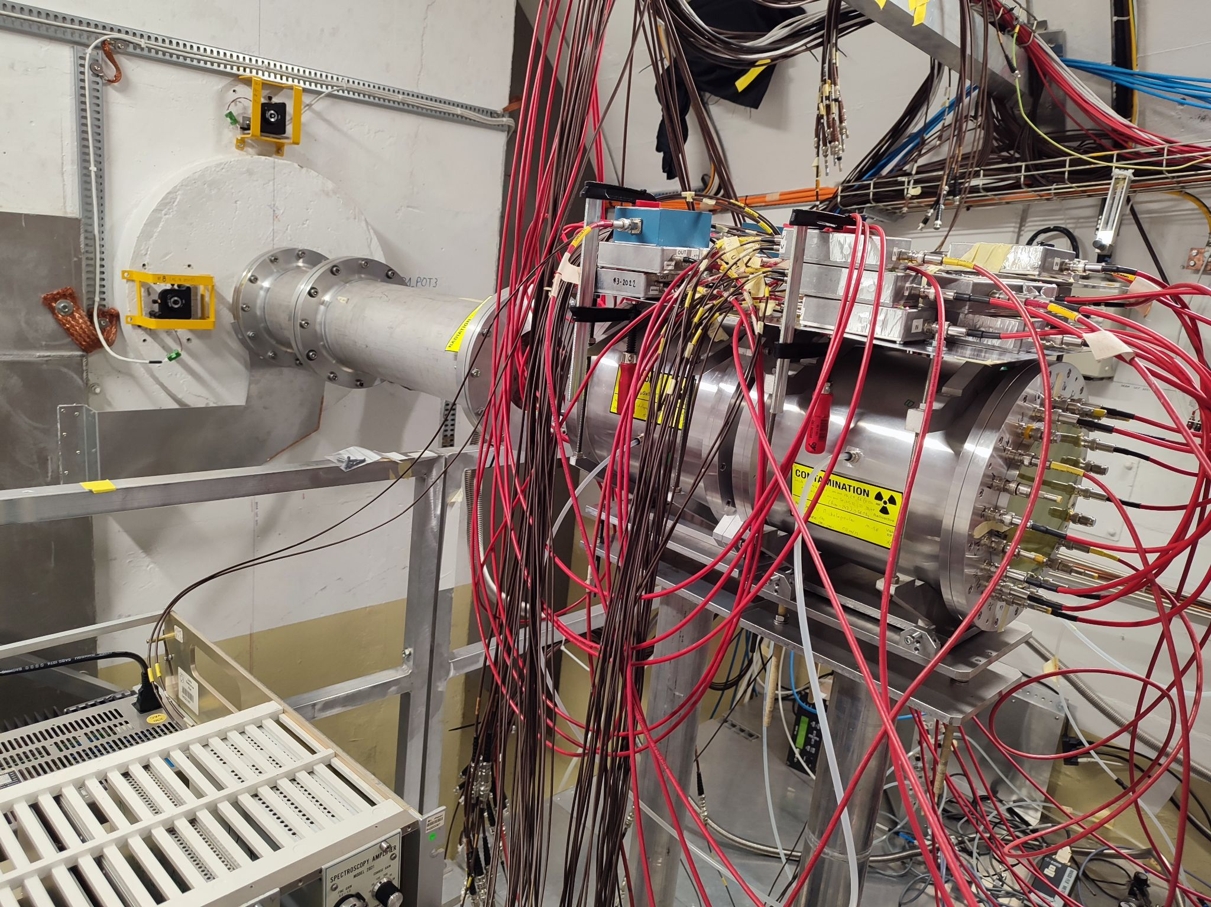
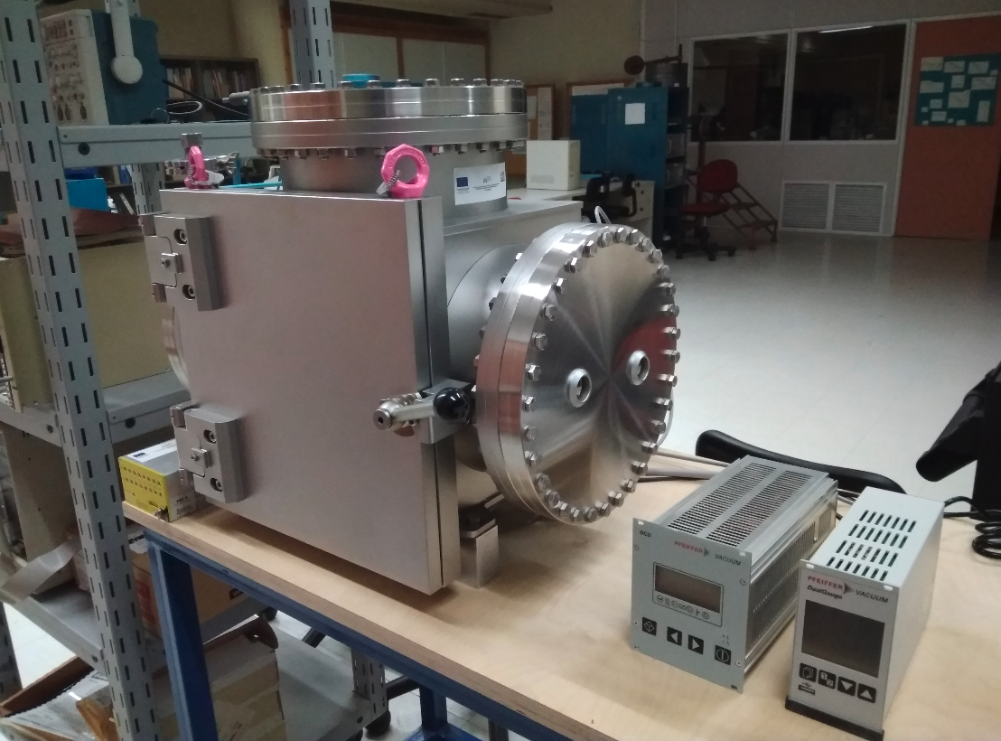
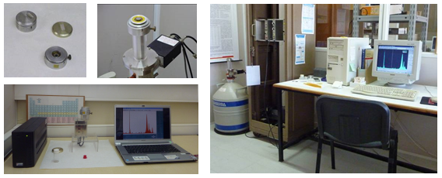
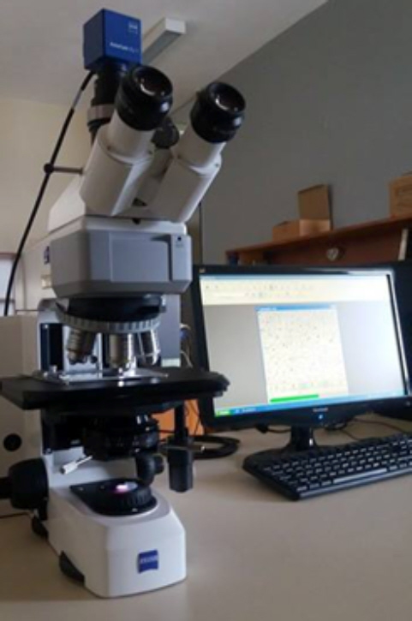
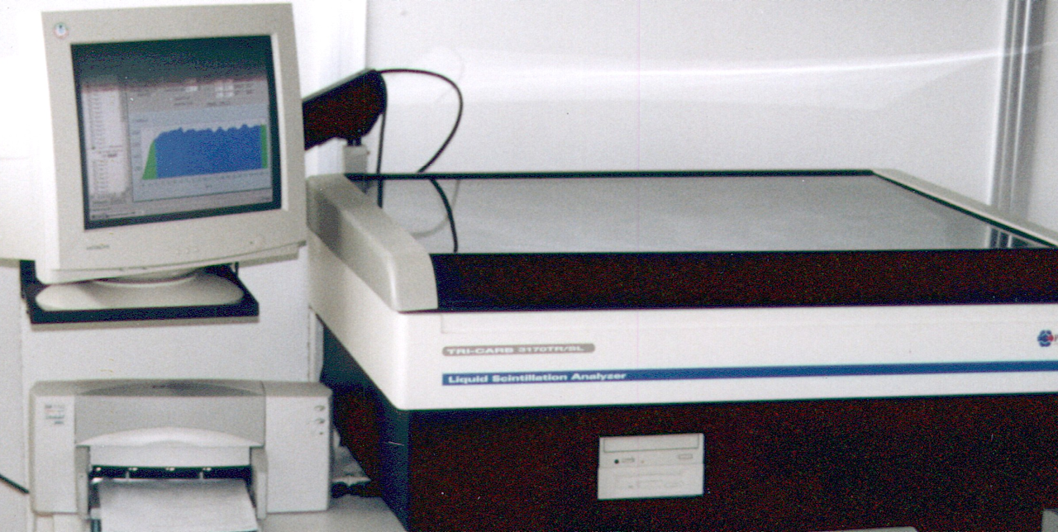
University of Ioannina
Nuclear Physics Group (N. Patronis)
  Neutron physics (Fission reaction studies, (n,xn), (n,cp), …)
  Nuclear Astrophysics (s-process, p-process)
  Nuclear Structure (transfer and Coulex reaction studies at ISOLDE)
  Instrumentation (detector developments for fundamental research, …)
Nuclear Applications (Ch. Papachristodoulou, K. Stamoulis)
  Radioecology, Radioprotection
  XRF lab (material characterization)
  Archeometry lab

Slide 7

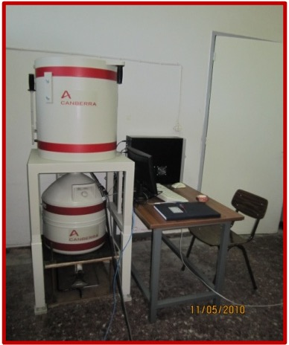
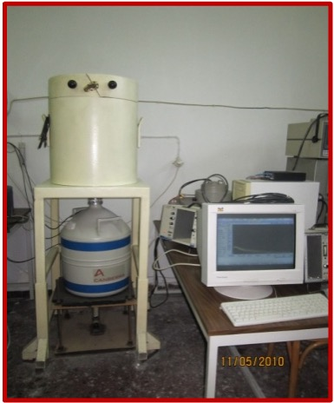
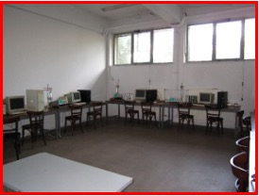
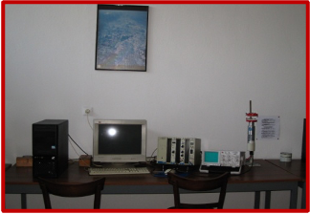
Aristotle University of Thessaloniki
Nuclear Physics and Nuclear Applications group (A. Ioannidou, I. Savvides, S. Stoulos)
  Environmental radioactivity and radioprotection
  Nuclear Astrophysics
  Nuclear fission reaction studies
  γ-spectroscopy (characterization, detector development, in-situ spectroscopy,...)
Nuclear theory group (Ch. Moustakidis, T. Gaitanos)
  Nuclear matter theoretical calculations (Nuclear Physics of neutron stars,...)
  Nuclear structure theoretical calculations

Slide 8
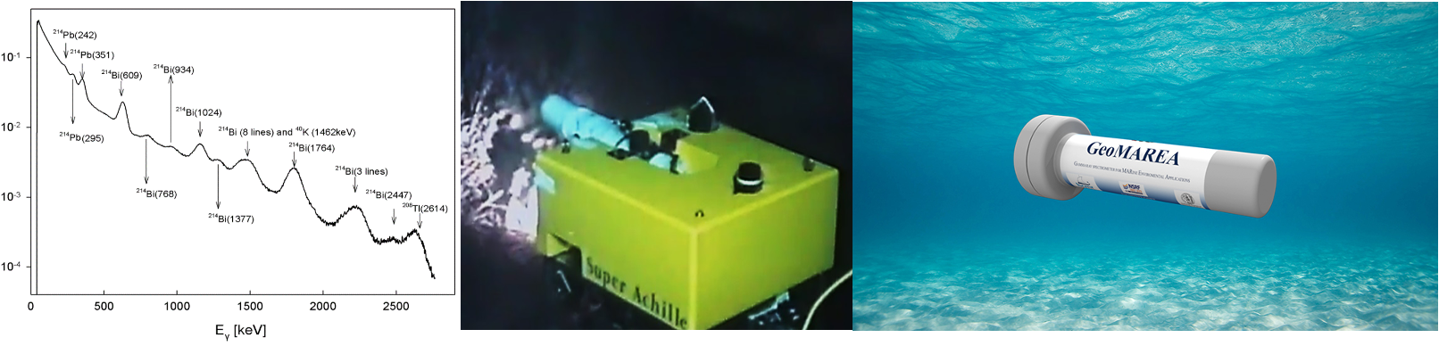
Hellenic Center for Marine Research
Nuclear Marine applications group (Ch. Tsabaris. D. Patiris)
  Instrumentation for radiation measurements in marine environment
  Sea water radiation measurements and monitoring
  Radiation measurement and monitor in mineral and thermo-mineral springs
  Detection systems:
    KATERINA marine sensor (stability, continuous operation, operation in deep water, …)
    GeoMAREA marine sensor (autonomous mode of operation, self calibration, ohigh sensitivity, …)

Slide 9




Distinctions and funding of the Hellenic Nuclear Physics Community
Distinctions
  UoI: Prof. N. Patronis: n_TOF/CERN Physics Coordinator
National and European funding
  CALIBRA/3400 k€
  EU H2020 EIC Pathfinder RAMONES / 4000 k€
  EU Horizon Europe Widening “Nexus monARC” / 1500 k€
  HFRI (Scholarships & research funding)/(600+200 + 60) k€
  EU Horizon SANDA Project/ 3500 k€
  G4G -ESA/ 500 k€
AMS (U. Oxford, under installation)

Slide 10
The n_TOF facility
Is the “gluon” of the Greek Nuclear Physics Society:
UoI and NTUA Nuclear Physics Groups are active and well involved members of the n_TOF collaboration
AUTH members have already expressed interest to join
Currently: >5 faculty members, 3 Post-docs, 4 PhD students, 4 MSc students, 4 BSc students
Previous years: >7 PhD, >15 MSc thesis, …
Join forces for:
Fission reaction studies (239Pu, 241Am, 230Th, …)
(n,cp) reactions (medical applications, fusion technology, basic research)
Nuclear astrophysics

Slide 11
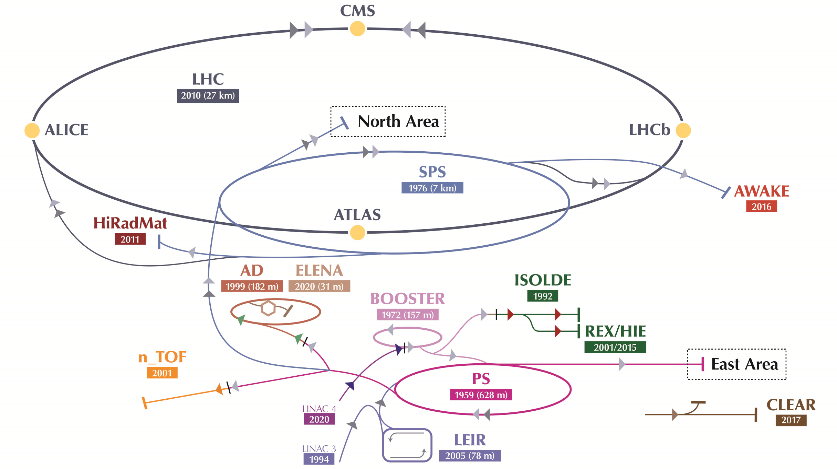
The n_TOF facility
Motivation:
High precision neutron induced cross section measurements for:
Nuclear astrophysics
ADS systems and G4 Fast neutron reactors
Medical physics
Basic research
Fusion technology
140 researchers
40 research institutions/teams
20 PhD students/year

Slide 12
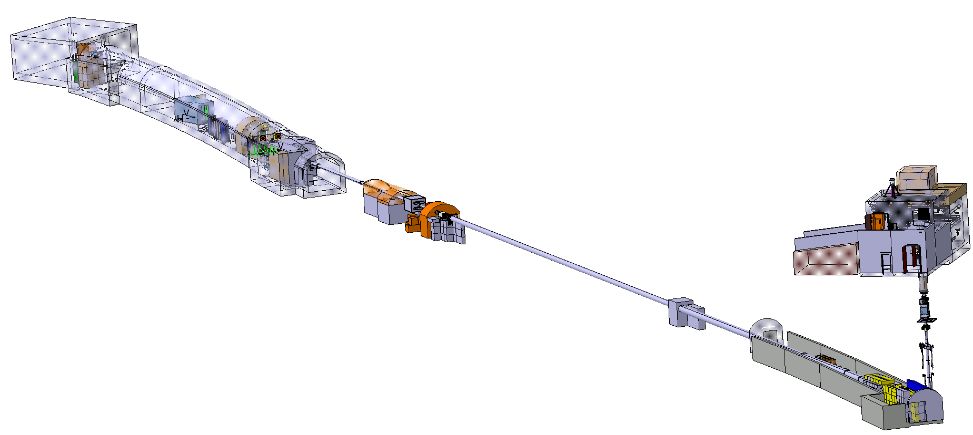
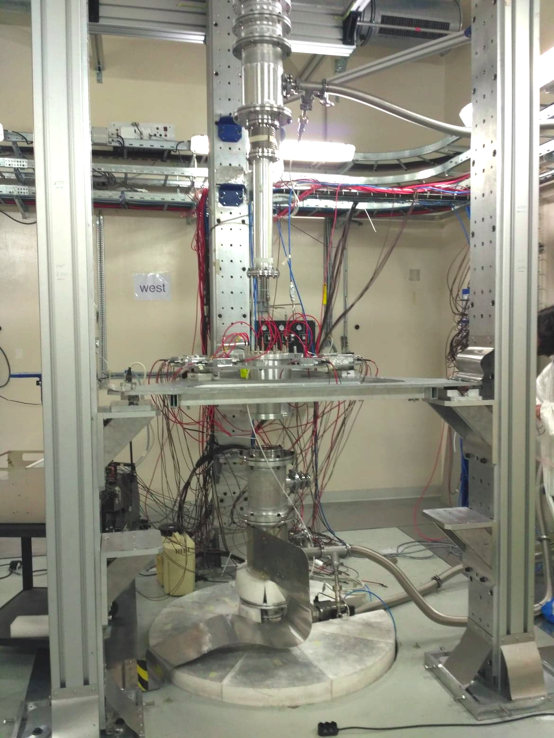
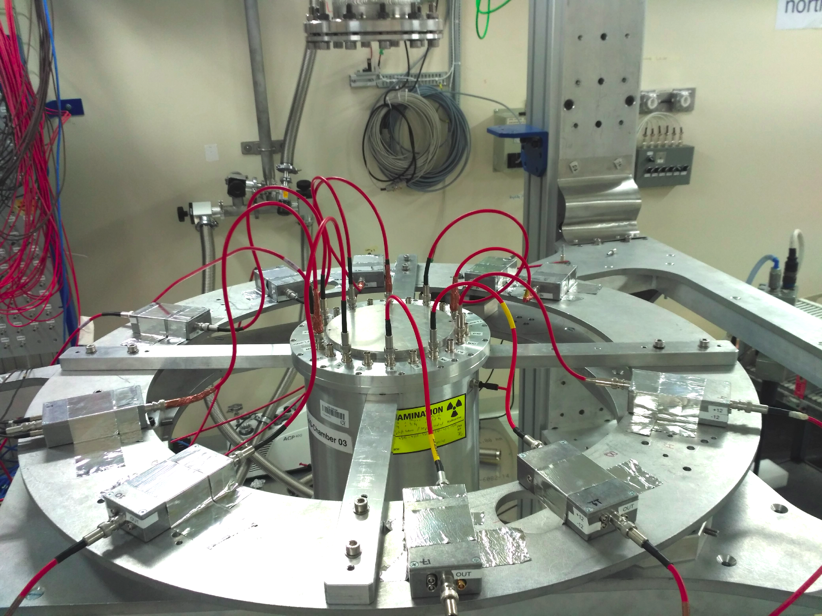
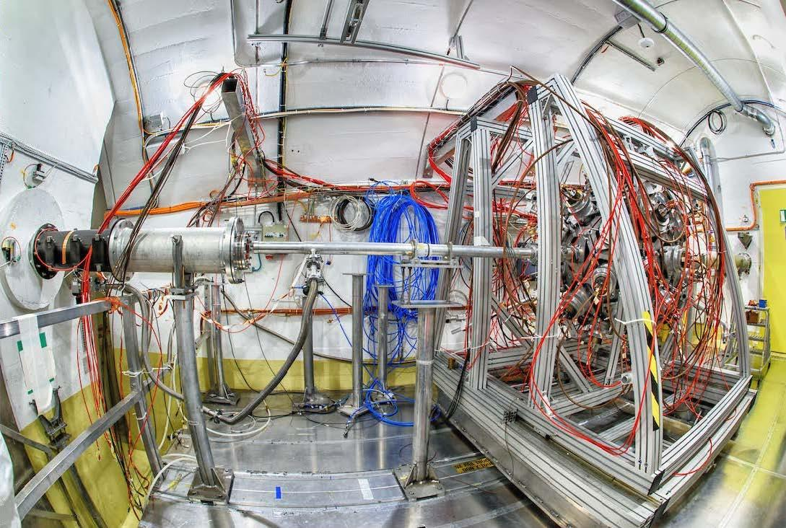
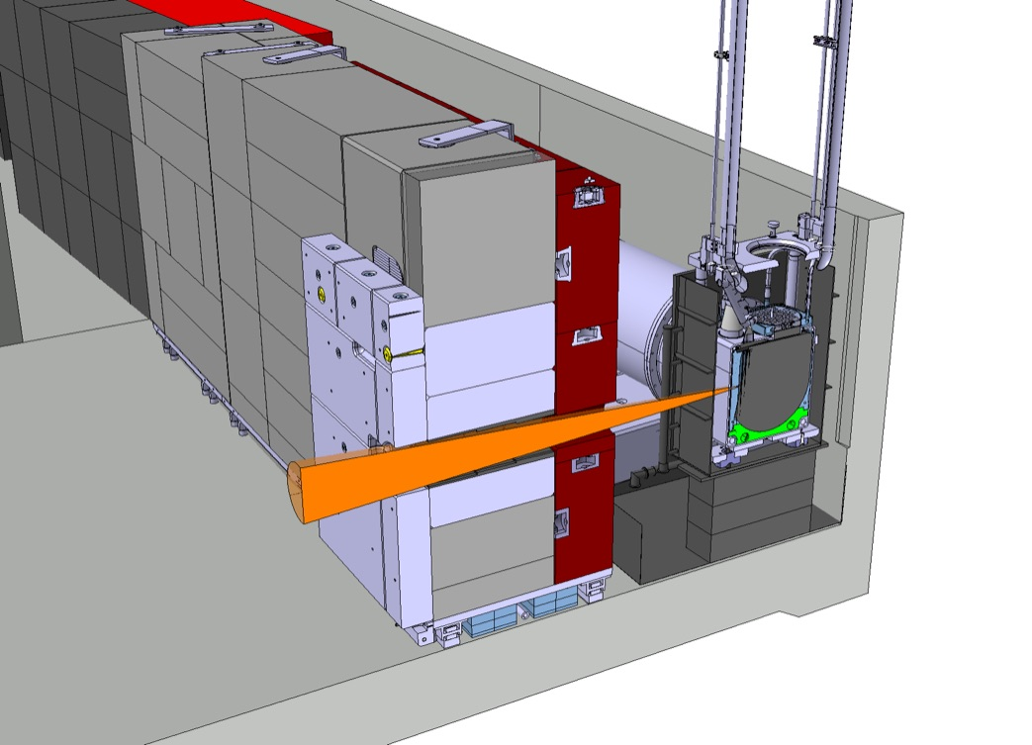
The n_TOF facility: EAR1 + EAR2 + NEAR
NEAR
proton beam from the PS

Slide 13
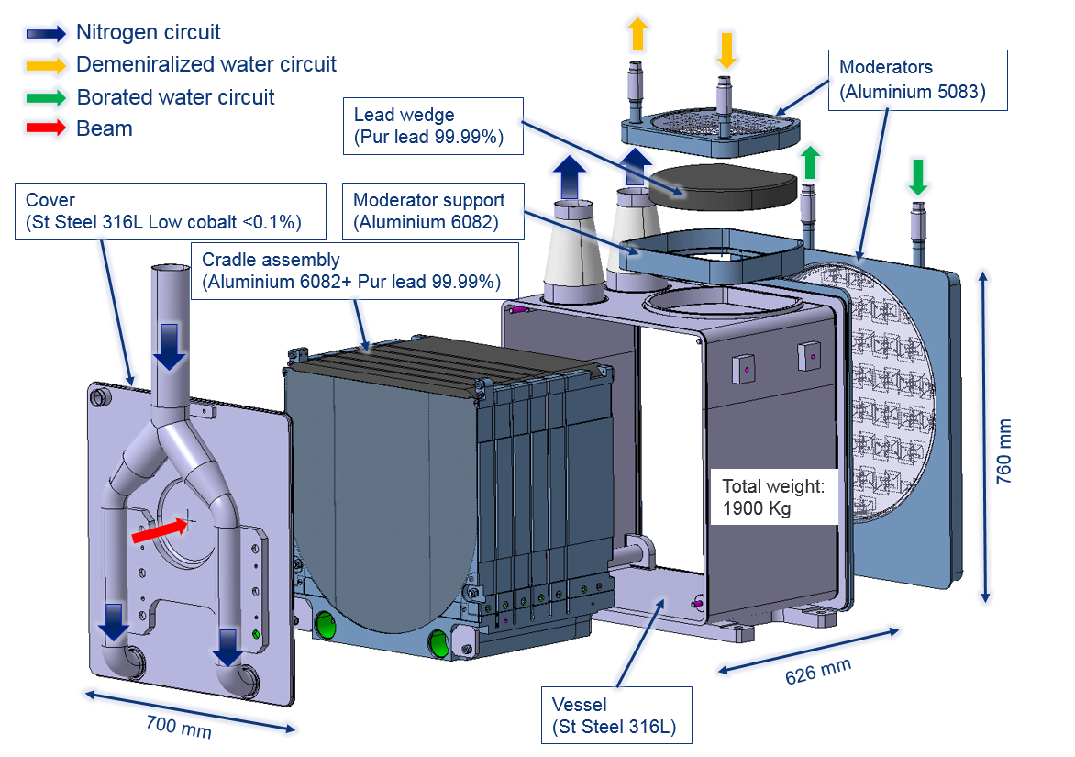
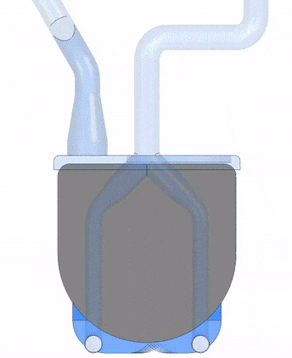
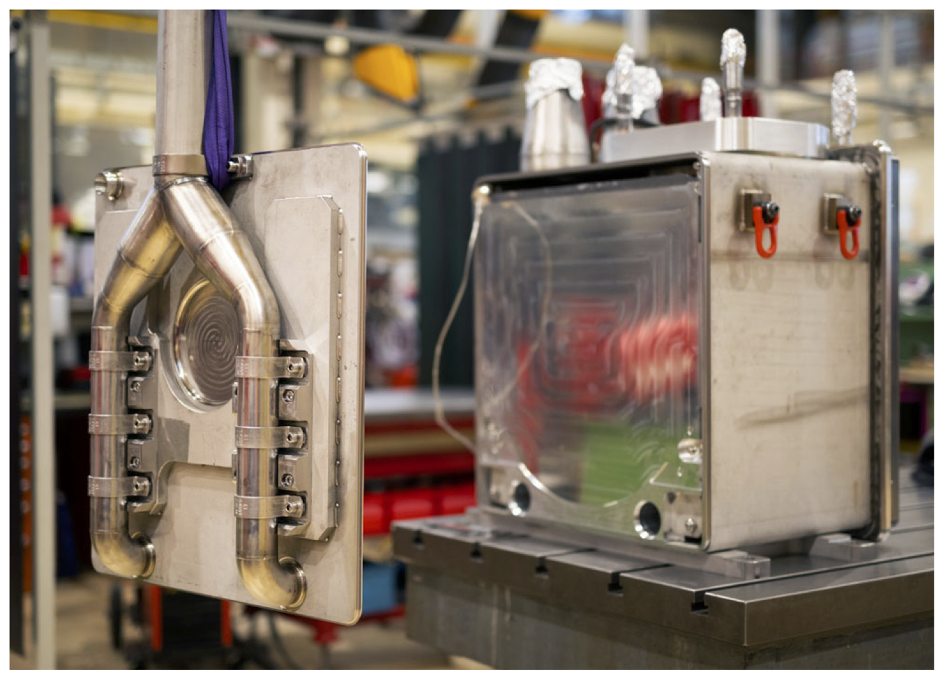
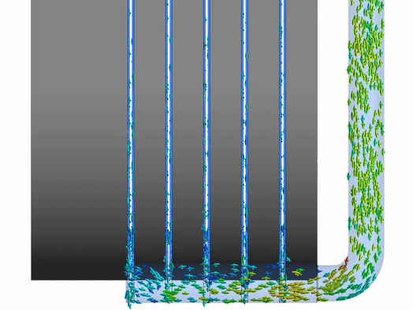



The n_TOF facility
3rd generation target
proton beam
N₂ gas cooling to avoid Pb corrosion and contamination of the cooling circuit
R Esposito et al. Phys. Rev. Accel. Beams 24, 093001 (2021)

Slide 14
The n_TOF facility
proton beam momentum | 20 GeV/c
intensity (dedicated mode) | 8.5 x 10¹² protons/pulse
repetition frequency | 1 pulse/1.2s
pulse width | 7 ns (rms)
n/p | 300
lead target dimensions | 70x76x63 cm³
cooling & moderation material | N₂ & H₂O (borated)
moderator thickness in the exit face | 5 cm
neutron beam dimension in EAR-1 (capture mode) | 2 cm (FWHM)

Slide 15
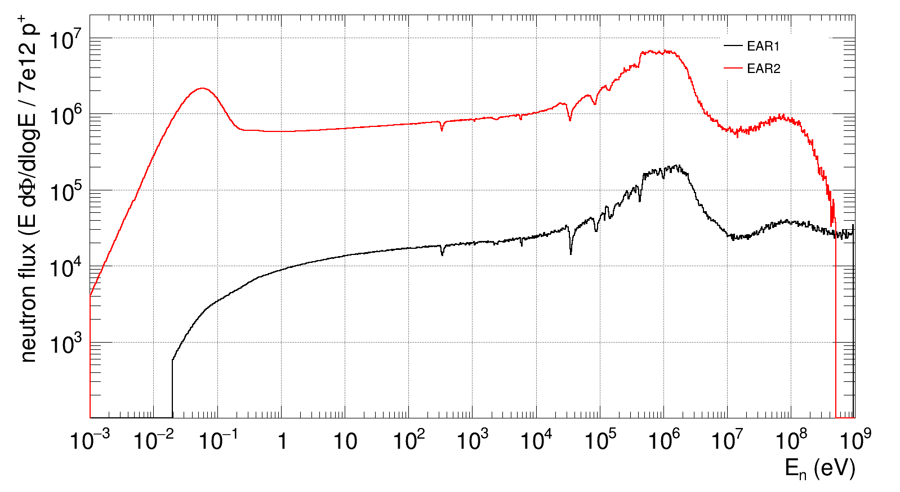
The n_TOF facility
EAR1: 8.6E5 n/pulse
EAR2: 3.4E7 n/pulse
NEAR: 9E8 n/cm²/pulse
Pulse = 850E10 protons
Max average proton intensity = 220E10 protons/s
Neutron physics data for 11 orders of magnitude of neutron energies

Slide 16
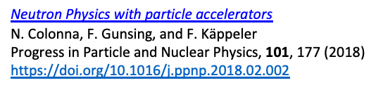
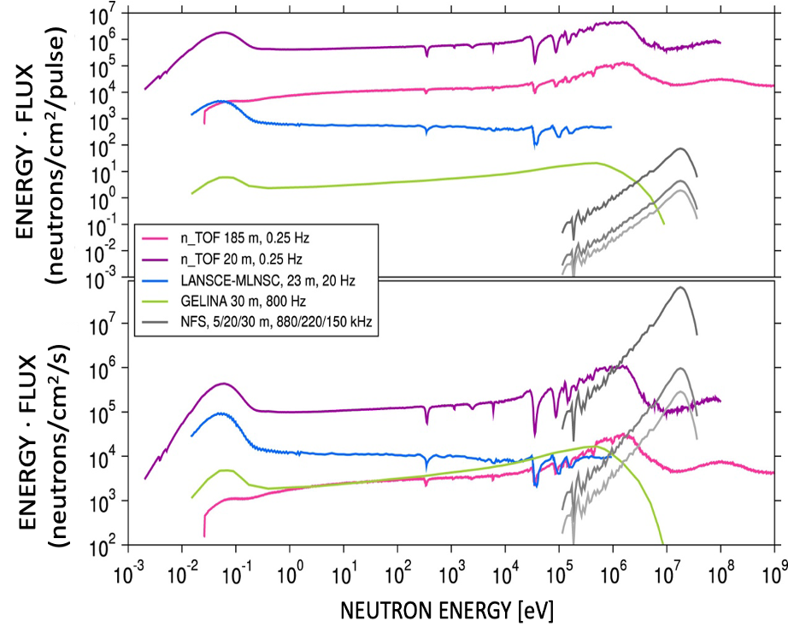
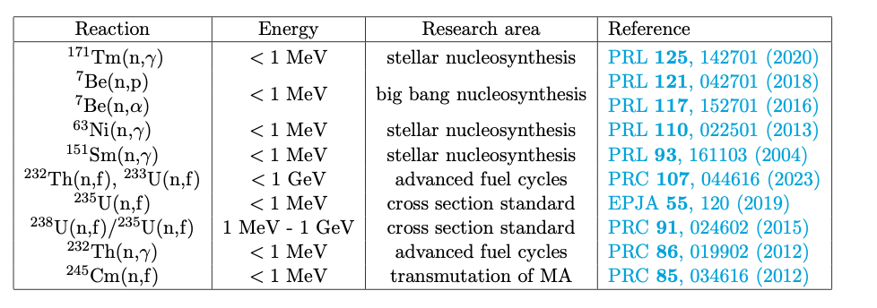
The n_TOF facility: Is a unique neutron facility
neutron source instantaneous intensity and energy distribution
repetition rate of the driver
time (or neutron energy) resolution
background conditions
n_TOF is @ CERN: ISOLDE a few tenths meter away, …
Neutron physics data for 11 orders of magnitude of neutron energies

Slide 17
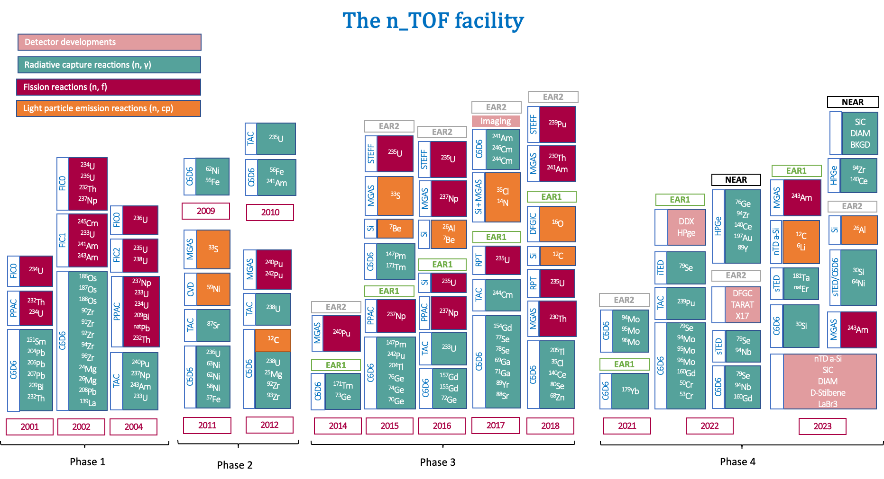
The n_TOF history in a nutshell

Slide 18
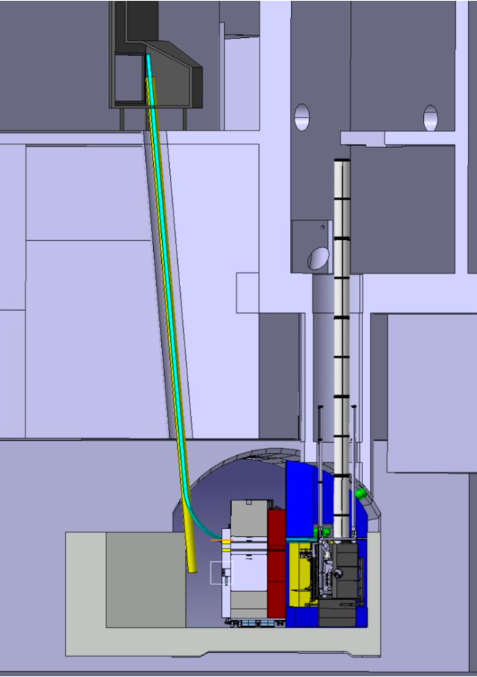
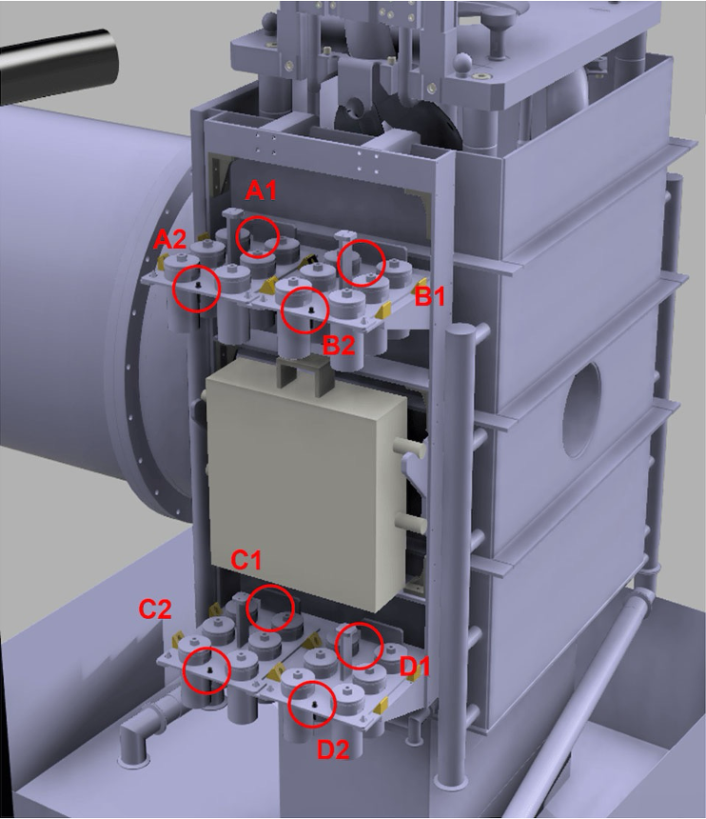
The n_TOF (bright!) future
Short term
Ready to launch new type of physics measurements ((n,n’), (n,xn), (n,cp), (n,tot), ...)
Ready to go ahead with other applications (imaging, R2E, …)
Mid term
Rabbit and gamma spectroscopy station (funding for Clover HPGe ensured)
Moderator for NEAR beam
Long term
Discussions for next (high power?) #4 n_TOF target (LS4)
REAR station? (post LS4)
…

Slide 19
Conclusions
The Hellenic Nuclear Physics community is a continuously growing and dynamic community from the point of view of attracting young researchers and postgraduate students.
Concerning Faculty/Researchers: A strong reduction in the number of permanent positions has occurred in the past ten years (hirings << retirements).
The funding of Nuclear Physics Research is also significantly reduced.
Research items within the Hellenic Nuclear Physics community:
  Fundamental research in nuclear structure and nuclear reaction mechanisms
  Applied nuclear physics research
  Nuclear theory
NCSR “Demokritos” is the hub for the Greek Nuclear Physics Community offering training and hands-on involvement (especially in neutron beams) for younger colleagues and students. Dedicated and movable setups are there along with a variety of ion beams and different energies of neutron beams
The n_TOF/CERN collaboration unites us in shared projects and research initiatives. The ongoing synergies between Greek institutes and international partners contribute to the continual growth, strengthening, and enrichment of the nuclear physics program within the n_TOF framework.

Slide 20
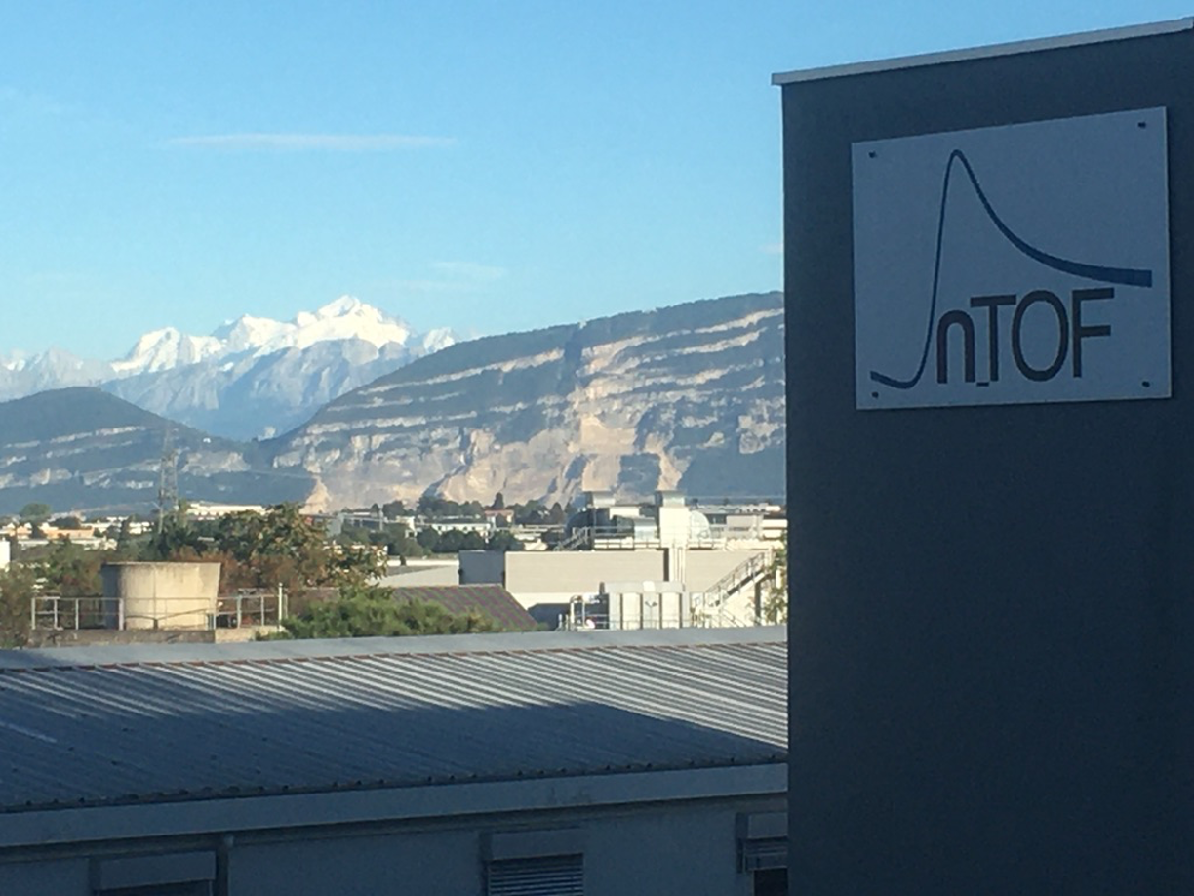
Thank you so much for your attention!

Slide 21
Extra Slides

Slide 22






The NEAR station
The NEAR Station is the n_TOF facility’s new high-flux irradiation station.
Two regions of activities
The irradiation area i-NEAR. Located next to the lead spallation target: high neutron dose material studies
The activation area a-NEAR. Located just outside the target bunker shielding, at only 3m distance from the target: nuclear astrophysics studies
We can make integrated reaction rate measurements by shaping the neutron spectrum to look as close as possible to the stellar one
The proof-of-principle study of shaping the n_TOF-NEAR neutron spectrum towards the extraction of stellar reaction rates was explored for the first time
Boron carbide filters were used for the shaping the n_TOF - NEAR neutron spectrum
Really promising results (!) showing that we can indeed obtain the stellar reaction rates even for the most challenging and unexplored physics cases
Boron Carbide filters
Irradiation at NEAR

Slide 23


Understanding the ²⁶Al “Galactic snapshot” at n_TOF
²⁶Al is a radioactive nucleus produced in massive stars
The ²⁶Al half-life time (=720 10³ y) is still very small with respect to the age of Universe.
Each ²⁶Al nucleus decay produce one highly energetic γ-ray at 1.8 MeV. The interstellar medium is transparent to this ”light”
By recording these γ-rays we have a ”snapshot” of on-going nucleosynthesis in our Galaxy. Accordingly, we can trace the dynamics of the Milky Way (rotational speed, expansion, chemical element production, etc)
By studying the 26Al(n, p/a) reactions up to 500 keV we can determine the 26Al destruction rates in massive stars which are the major source of 26Al in our galaxy
The distribution of the ²⁶Al “light “(=1.8 MeV γ-ray) across the Milky Way. This is a “snapshot” of the ongoing chemical elements production
Production of chemical elements in our Galaxy
Aim of the measurement is to extend cross section data up to 500 keV
ESA INTEGRAL mission detects ²⁶Al γ-rays
Many thanks to Claudia LEDERER-WOODS and U. of Edinburgh team!

Slide 24





Understanding the ²⁶Al “Galactic snapshot” at n_TOF
Setup/Conditions
Sample*: 6 × 5 cm²; 2.58(12) × 10¹⁷ atoms of ²⁶Al on a 7.5-μm Ni foil
20 um SSD + 150 um DSSSD @ 90 deg
*damaged in later a test
https://edh.cern.ch/Document/General/IncidentDeclaration/9967462
ESA INTEGRAL mission detects ²⁶Al γ-rays
Many thanks to Claudia LEDERER-WOODS and U. of Edinburgh team!

Slide 25

First n_TOF transmission measurement: MArEx
Transmission test measurements (Al/Bi) using beam filters
Transmission test measurements (Al, C) before second collimator
First n_TOF gas target (Ar) transmission measurement successfully realized!
METHOD
Transmission measurement using beam filters (Al, Bi)
Transmission measurements with standard samples (Al, C) placed before 2nd collimator
Transmission measurement with Ar gas target realized before the second collimator
SETUP
PTB LMFC (U5) (Fission Chamber)
  6 samples: 1.9 mg/cm2, 42 mm
  2 blanks (front, back)
  gas Ar/CF4 90/10
MGAS (10B)
  18.82 ug/cm2
  8 ugr/cm2
C6D6 (Au,Ta)
  4 x C6D6 @ 9 cm
  Au/Ta sample ~45 mm diameter
ESA INTEGRAL mission detects ²⁶Al γ-rays
Many thanks to MArEx team!

Slide 26




First n_TOF transmission measurement: MArEx
Transmission test measurements (Al/Bi) using beam filters
Transmission test measurements (Al, C) before second collimator
First n_TOF gas target (Ar) transmission measurement successfully realized!
ESA INTEGRAL mission detects ²⁶Al γ-rays
Many thanks to MArEx team!

Slide 27

First n_TOF transmission measurement: MArEx
Ar gas target transmission measurement (before 2nd collimator)
50bpd
ESA INTEGRAL mission detects ²⁶Al γ-rays
Many thanks to MArEx team!

Slide 28



^{Detector tests}
DDX:
Double-Differential Charged-Particle
detection setup for XS measurements from 20 to 200 MeV
X17 detection setup:
TPC
LYSO
Plastic
n beam
n beam

Slide 29


Resolution function – setup
4x C6D6 detectors

