Slide 1
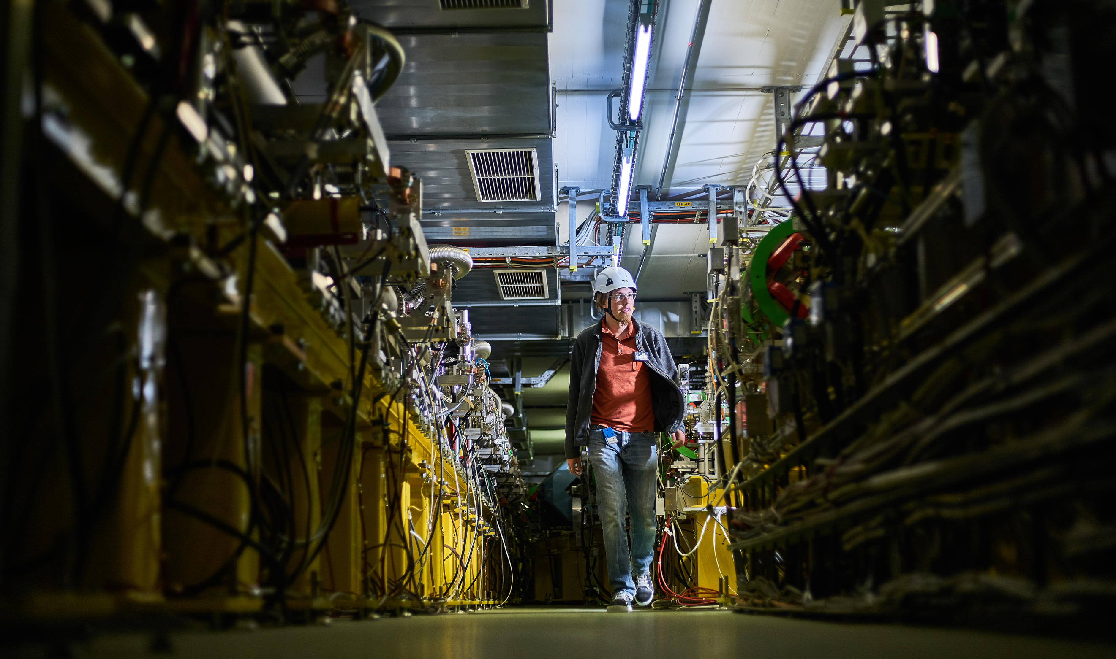
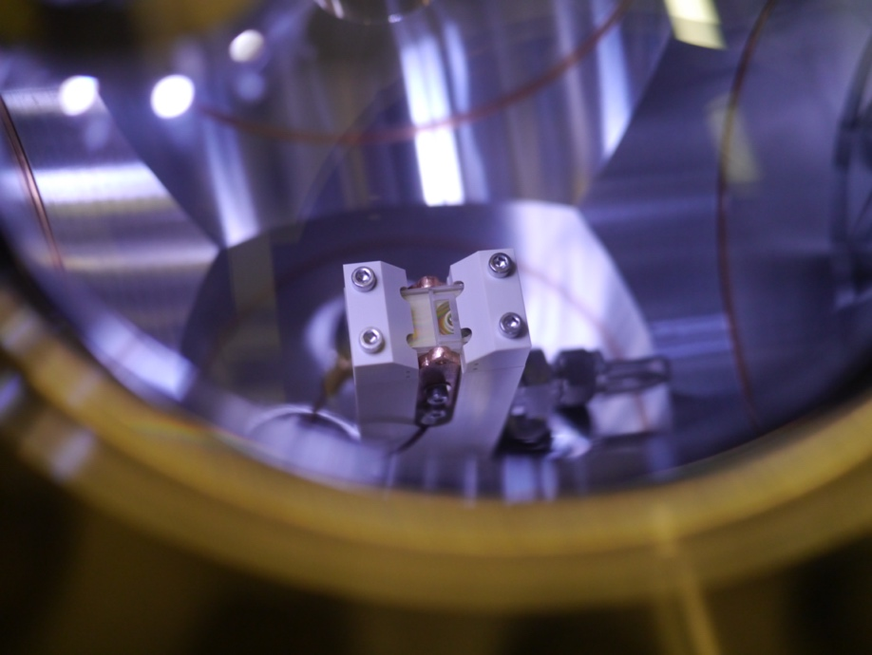
CLEAR Facility Organisation and Approval Procedure
R. Corsini
CERN Linear
Electron Accelerator
for Research

Slide 2
CLEAR Scientific Board
The CLEAR Scientific Board (CSB) periodically reviews the progress of the experimental program, steers the experimental program and gives recommendations on proposed experiments and activities on the basis of their scientific interest and the availability of the facility. The Scientific Board members participate to the formal approval process of the beam time requests.
Members:
Giovanni ANELLI (CERN)
Hans BRAUN (PSI)
Philip BURROWS (JAI/Oxford U.) chair
Roberto CORSINI (CERN) ex officio
Ilias EFTHYMIOPOULOS (CERN)
Angeles FAUS-GOLFE (CNRS/In2p3-Orsay)
Massimo FERRARIO (INFN-LNF)
Eugenia HATZIANGELI (CERN)
Giuseppe LERNER (CERN)
Steinar STAPNES (CERN)
Marie-Catherine VOZENIN (UNIL/CHUV)
- The CSB will act in concertation with the local CLEAR Technical Board (CTB), responsible for assessing the technical, safety and radioprotection aspects of each proposal before the experiments are submitted for final approval to the CSB and to the safety/RP representatives, and for the detailed beam time scheduling.
- The CSB will meet once per year, before the start of operation (in February/March) in order to assess the execution of the experimental program in the previous year, examine the new experiment proposals received until then and give recommendations on the new year experimental program, indicating priorities if needed. The formal approval of each individual request for beam time is done through a remote procedure, and further proposals, received after the CSB yearly meeting, will be accepted during the year following such procedure.

Slide 3
CLEAR Technical Board
The CLEAR Technical Board (CTB) is responsible for assessing the technical, safety and radioprotection aspects of each proposal before the experiments are submitted for final approval to the CSB and the safety and RP representatives, and follows-up the beam time scheduling.
Members:
Roberto CORSINI (BE-ABP), Facility Coordinator
Davide GAMBA (BE-ABP) Facility Safety Officer (ad-interim), Technical Support
Markus WIDORSKI (HSE-RP), Radio Protection Officer
Wilfrid FARABOLINI (BE-ABP), Beam Expert, Operation
Pierre KORYSKO (BE-ABP and Oxford University), Beam Expert, Operation
Kyrre SJOBAK (BE-ABP and Oslo University) Beam Expert and User Representative
Stefano Mazzoni (SY-BI), User Representative

Slide 4
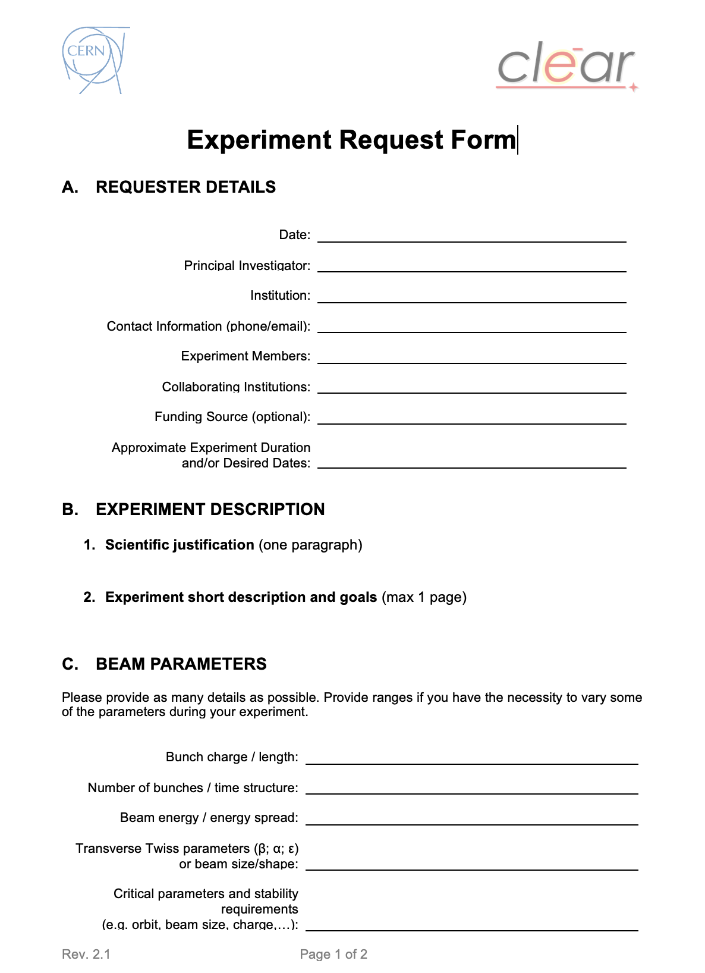
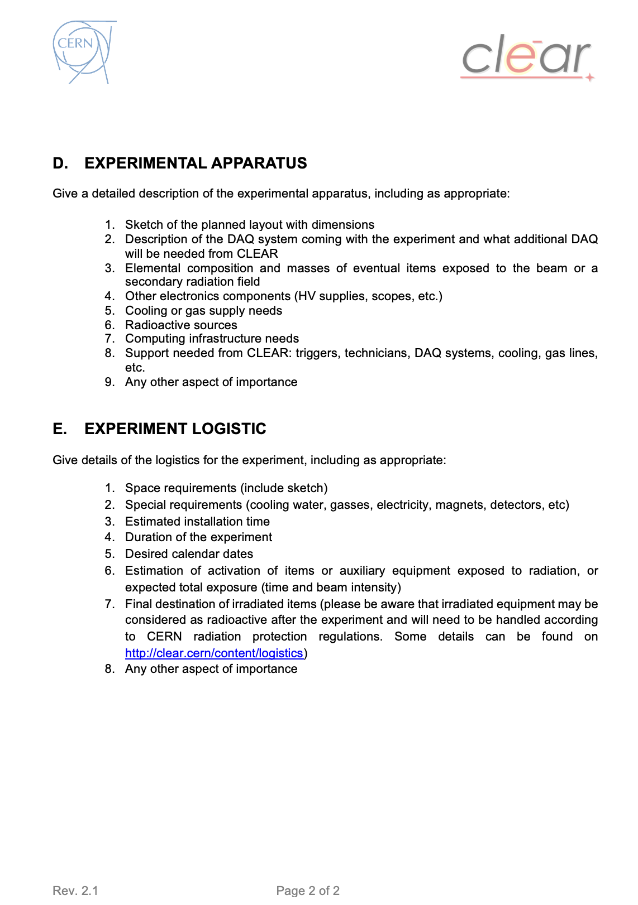
Beam time request form

Slide 5
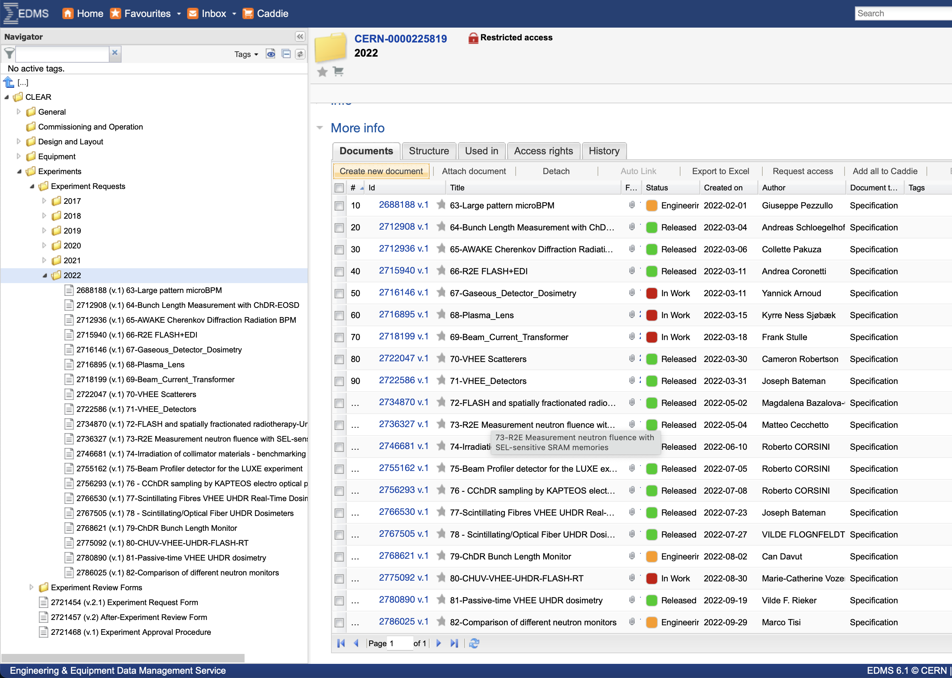
EDMS approval
https://edms.cern.ch/ui/#!master/navigator/project?P:100569561:100569561:subDocs

Slide 6
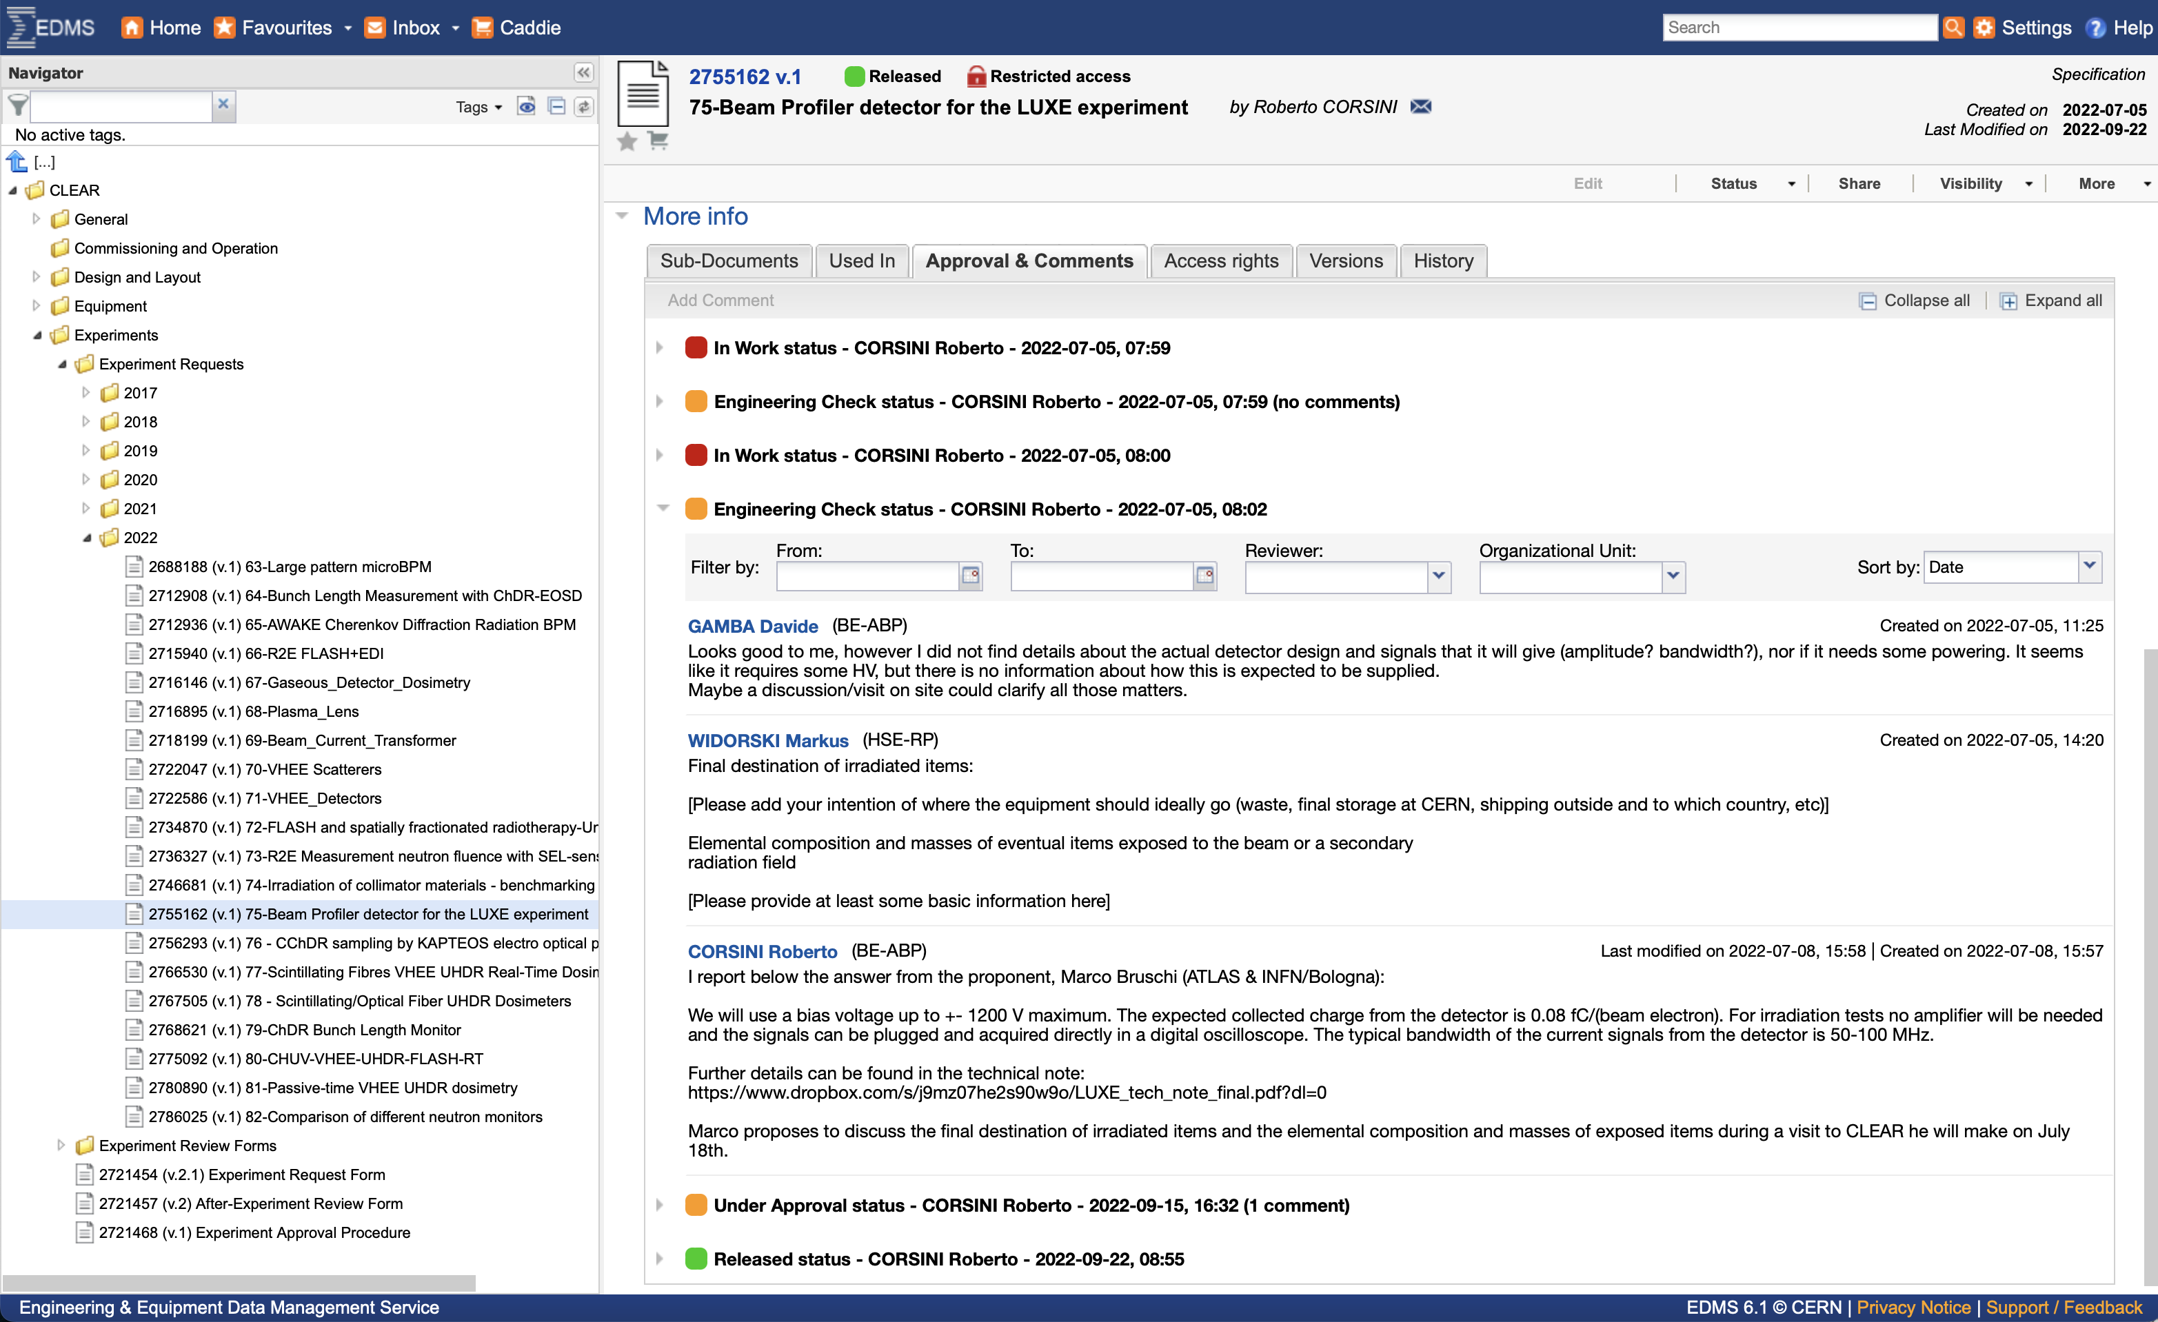
EDMS approval
https://edms.cern.ch/ui/#!master/navigator/project?P:100569561:100569561:subDocs

Slide 7
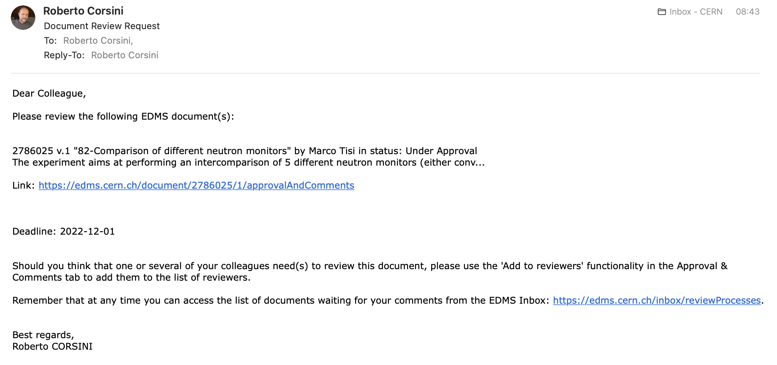
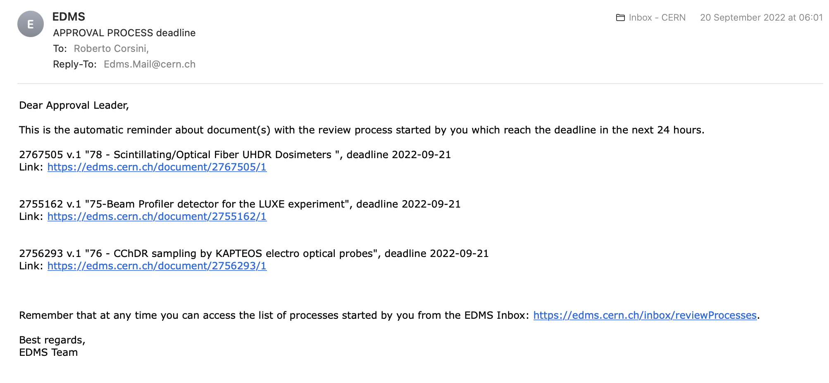
EDMS approval
https://edms.cern.ch/ui/#!master/navigator/project?P:100569561:100569561:subDocs

Slide 8

Thanks for your attention!

