Slide 1
Main Construction Characteristics/Criteria of the Inner Triplet Corrector Magnets
Inner Triplet Task Force 28 Oct 2022
M. Karppinen
TE-MSC-NCM

Slide 2
Inner Triplet Correctors:
Q3
Q2
Q1
MC
S O
X
MCBXA
MQXA
MQ
S
X
MQXB
MCBX
MQXB
MCBX
MQXA
B
PM
B
PM
LMQXB
LMQXC
LMQXA
B4 / A4 / A3
A1 / B1
B6 / B3
A2
A1 / B1
A1 / B1
To IP →
FNAL supplied
KEK supplied
CERN supplied

Slide 3
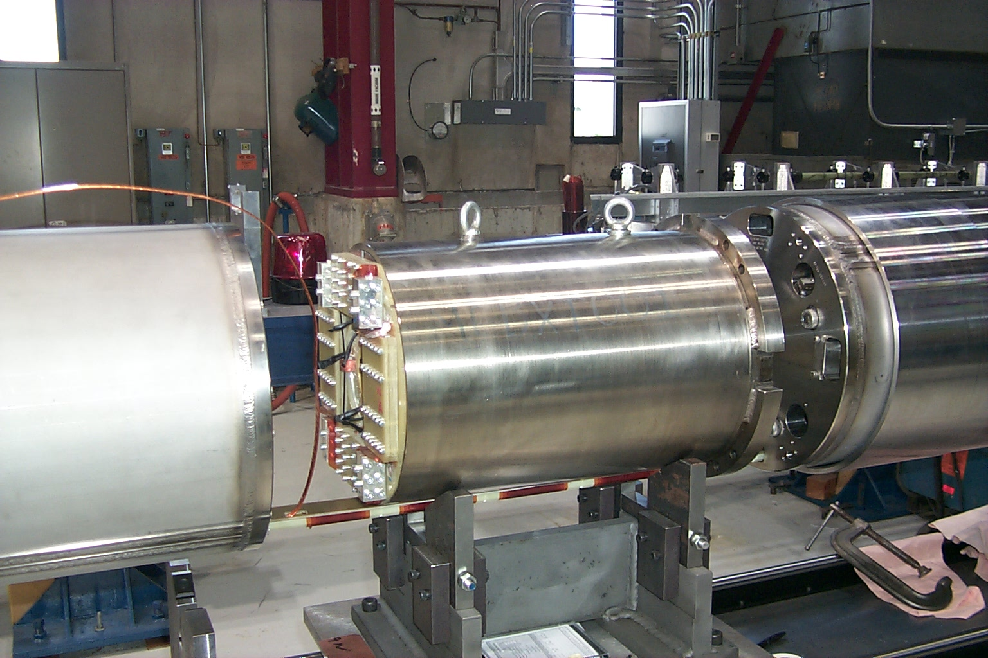
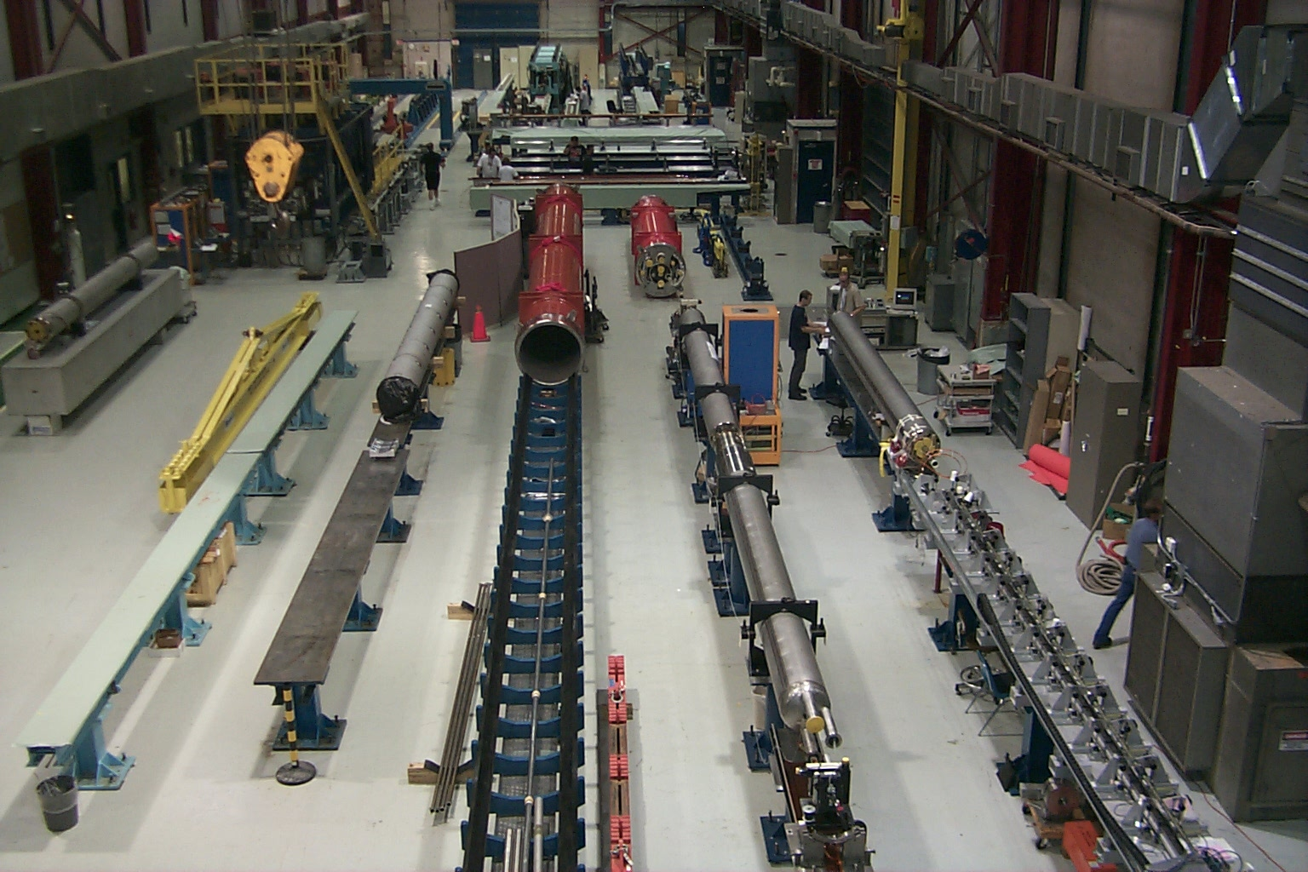
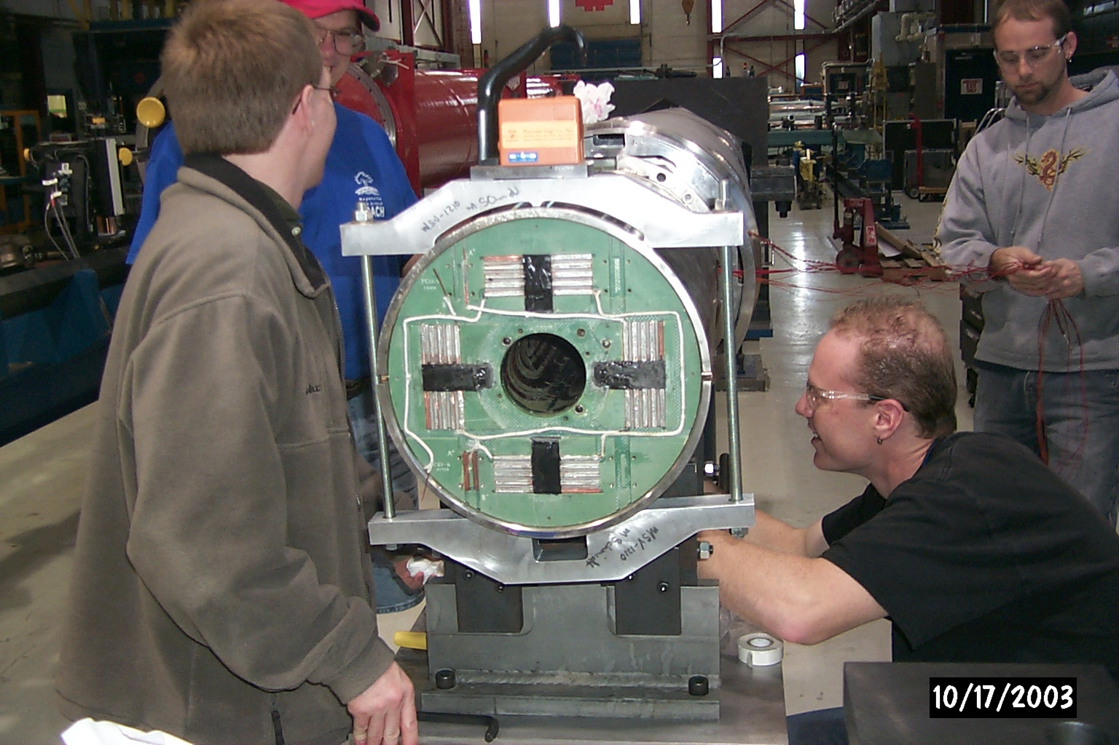
CM Integration at FNAL

Slide 4
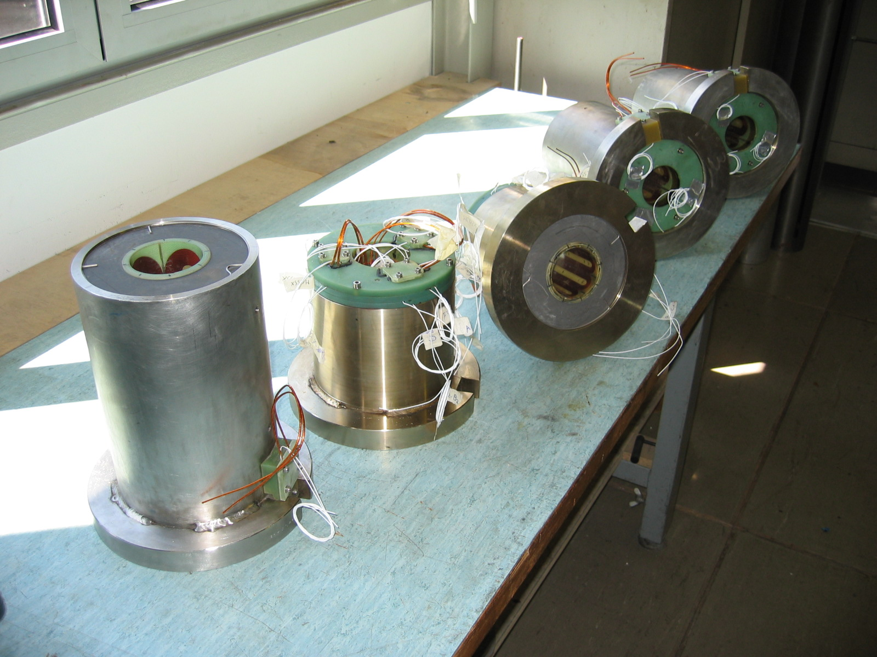
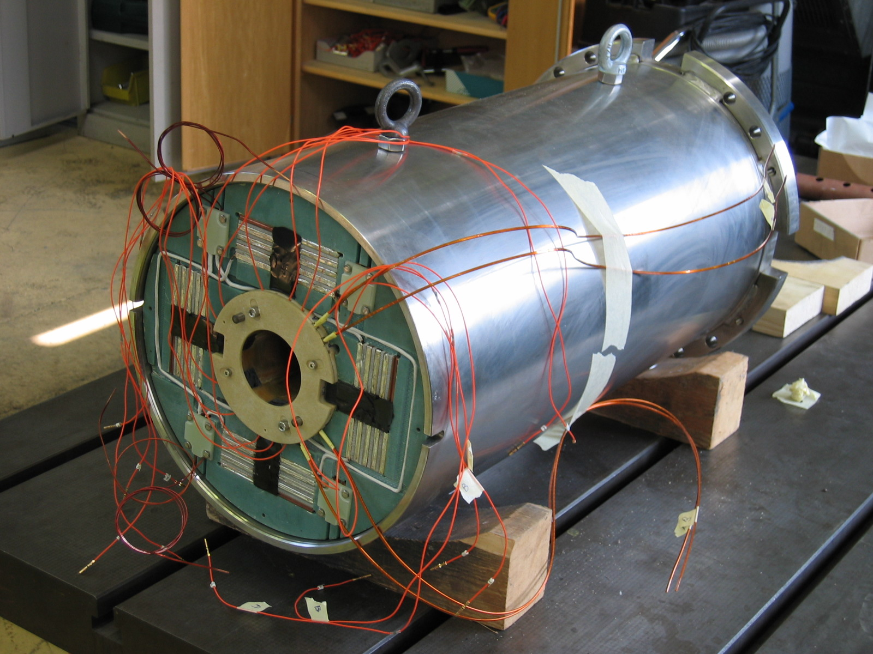
Inner Triplet Corrector Assemblies
MQSX & MCSOX
MCBXA (MCBX & MCSTX)

Slide 5
Inner Triplet Corrector Parameters
Magnet Assembly | Contract | Assembly type | Number of assemblies in LHC | Aperture (mm) | Outer Diam support (mm) | Overall Length (mm) | Mass (kg) | Corrector | Strand Type | Nominal Strength B=S.x^{n-1} | Current (A) | fraction of Ic at 1.9K (4.2K) | Magn. Length (mm)
MCBX | F375 | Single, nested | 16 | 90 | 350 | 700 | 400 | MCBXV MCBXH | 4 4 | 3.26 T 3.35 T | 550 550 | 0.44 (0.59) 0.47 (0.63) | 480 450
MCBXA = MCBX+ MCSTX | F375 and CERN | Single, nested | 8 | 70 | 350 | 700 | 400 | MCBXV MCBXH MCSX MCTX | 4 4 2 2 | 3.26 T 3.35 T 104 T/m² 7.22E6T/m⁵ | 550 550 100 80 | 0.44 (0.59) 0.47 (0.63) 0.46⁽¹⁾ 0.38⁽¹⁾ | 480 450 576 615
MQSX | CD 1000630 | Single | 8 | 70 | 380 | 300 | 50 | MQSX | 3 | 80.2 T/m | 550 | 0.59 (0.82) | 223
MCSOX | CD 1000630 | Single, nested | 8 | 70 | 380 | 175 | 30 | MCOSX MCOX MCSSX | 2 2 2 | 9666 T/m³ 9229 T/m³ 377 T/m2 | 100 100 100 | 0.37 (0.55) ⁽²⁾ 0.38 (0.56) ⁽²⁾ 0.39 (0.57) ⁽²⁾ | 138 137 132
With the other MCSTX layer powered at the nominal current and in background field of 3.9 T from the MCBX. The nominal current of the MCSX was increased from 50A to 100A, without design change.
With two other layers of MCSOX powered at the nominal current.

Slide 6
SC Wires
 | Type 1 | Type 2 | Type 3 | Type 4
Overall dimensions insulated (mm) (tolerance +0.0/-0.01mm) | ∅ 0.435 | 0.38 x 0.73 | 0.73 x 1.25 | 0.97 x 1.65
Metal dimensions (mm) | ∅ 0.375 | 0.32 x 0.67 | 0.61 x 1.13 | 0.85 x 1.53
Insulation Thickness (µm) | 30 | 30 | 60 | 60
Critical current at 4.2K, 5T (A) Perpendicular to wire axis Perpendicular to broad face Parallel to broad face | >55 | >100 >110 | >630 >700 | >1190 >1320
Cu/Sc volume ratio | 4.1 | 4.1 | 1.68 | 1.65
Nr of filaments | 684 | 1110 | 7068 | 8898
Filament diameter (μm) | 6.4 | 6.5 | 6.7 | 8.3
Total length (km) | 5620 | 2110 | 1420 | 82
Copper Matrix RRR | > 100
Wire twist direction | Counterclockwise
Superconductor | NbTi with Ti = 47.0 % by weight
High voltage insulation (V) | 1000
Insulation material | PVA Enamel
Wire #3
  Nb47%Ti
  PVA insulation
  RRR >100
  Filament diameter 6-7 µm

Slide 7
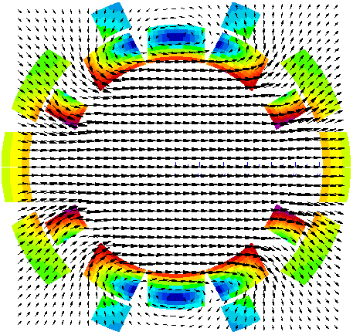
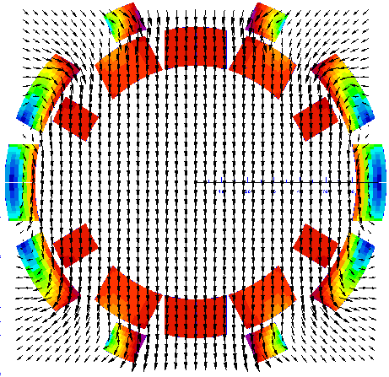
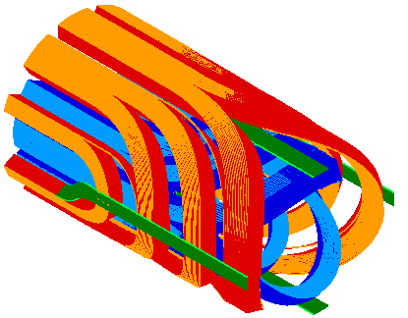
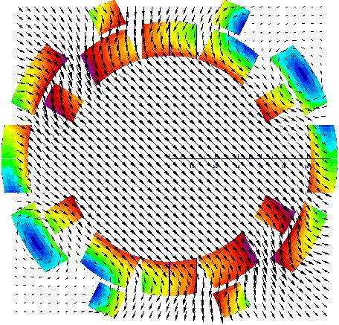
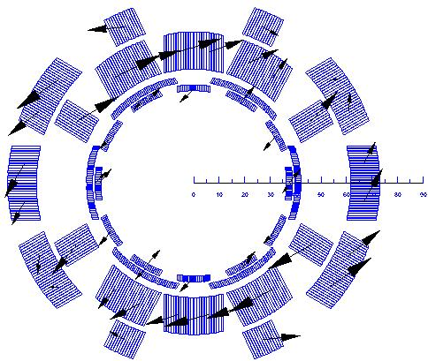
MCBX(A)
28 Oct 2022
M. Karppinen
7

Slide 8
MCBX: Parameters
 | Unit | MCBXV | MCBXH
Integrated field | Tm | 1.56 | 1.51
Nominal field | T | 3.26 | 3.35
Mag. length | m | 0.48 | 0.45
Nominal current | A | 550 | 550
Stored energy | kJ | 26.5 | 43.4
Self inductance | mH | 175.2 | 287.2
Wire section (metal) | mm | 1.53 x 0.85 | 1.53 x 0.85
Cu/Sc |  | 1.71 | 1.71
Total length | m | 0.72
Aperture | mm | ø90
Total mass | kg | 465
FUNCTION:
Correction of MQX misalignment
Crossing angle correction
Low-E bumps

Slide 9
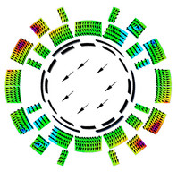
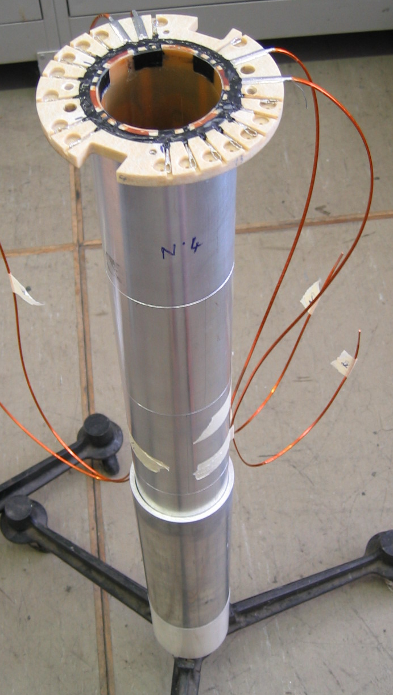
MCSTX: Parameters
MCBXA = MCBX + MCSTX
120 A

Slide 10
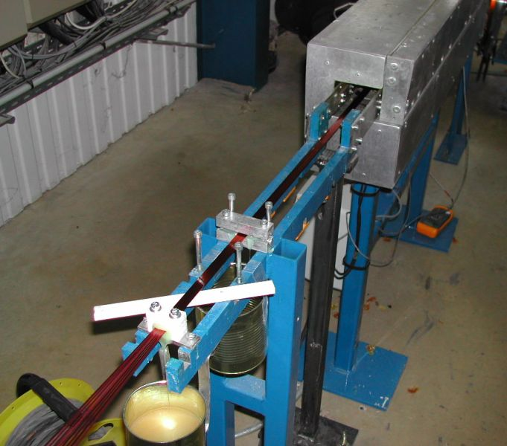
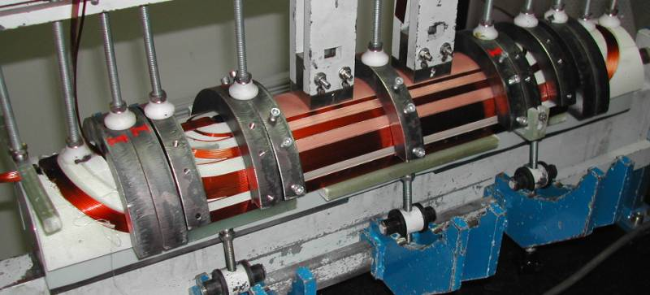
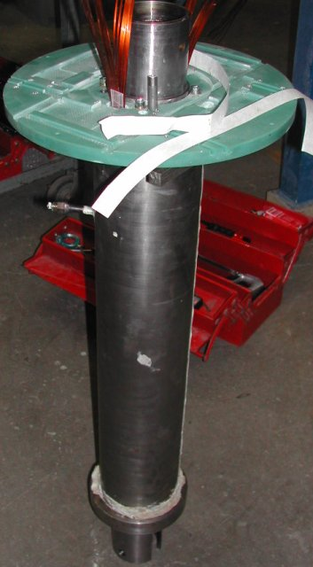
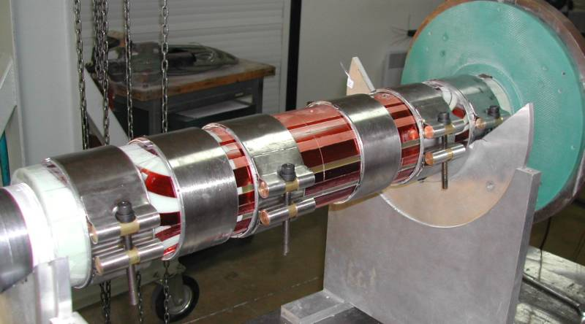
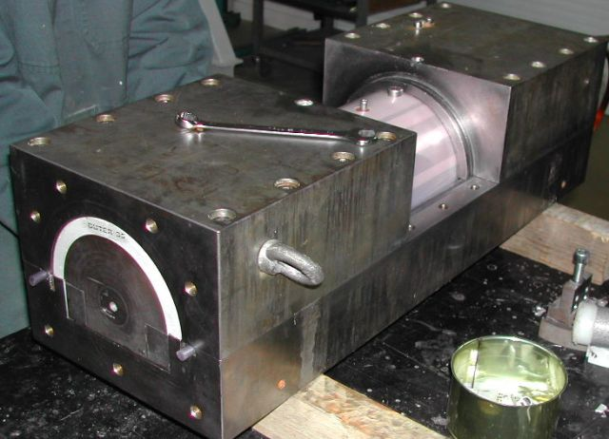
MCBX: Coil Fabrication
Winding with 8-way ribbon of wire #4
Vacuum impregnation (GY285 - D400)
Coil assembly (vacuum impregnation)

Slide 11
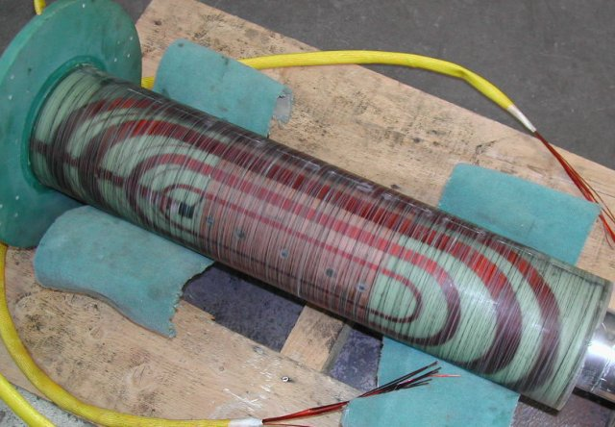
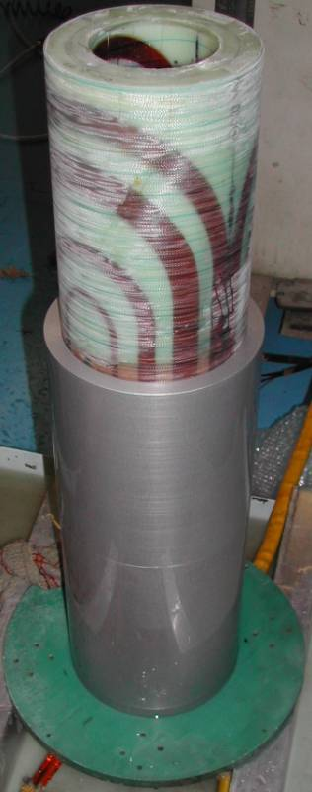
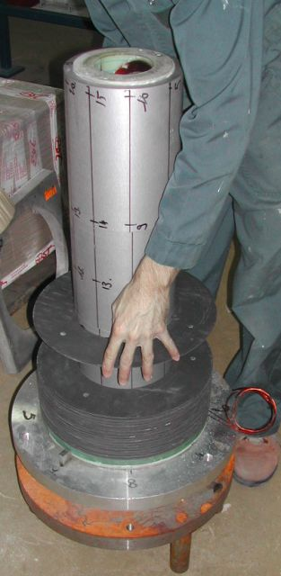
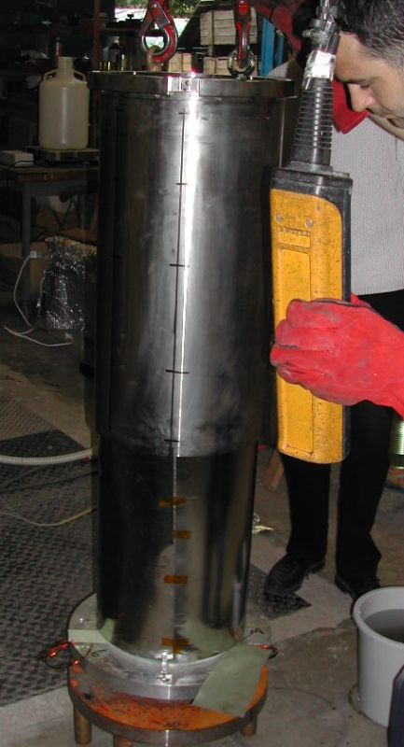
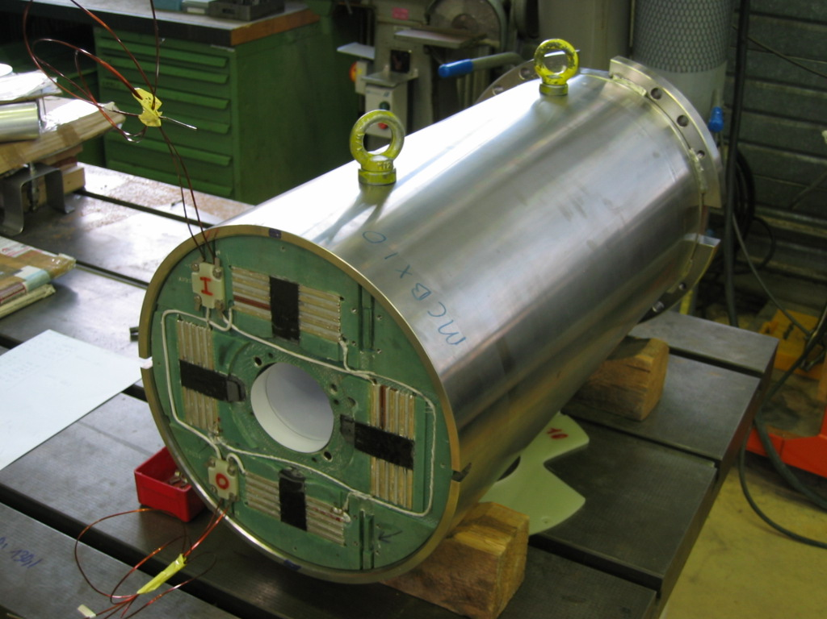
MCBX: Assembly

Slide 12
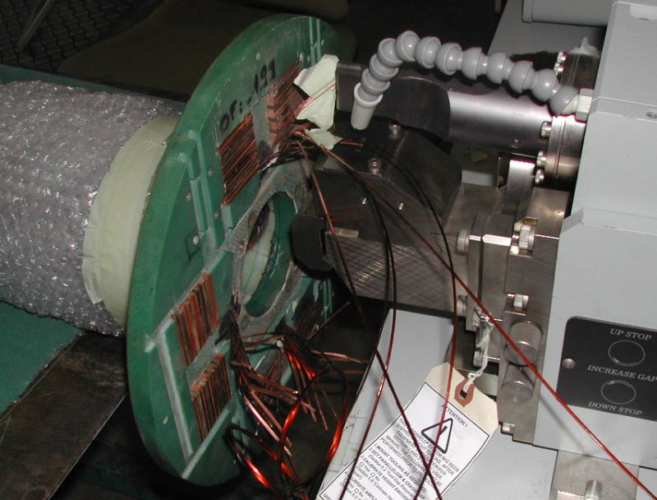
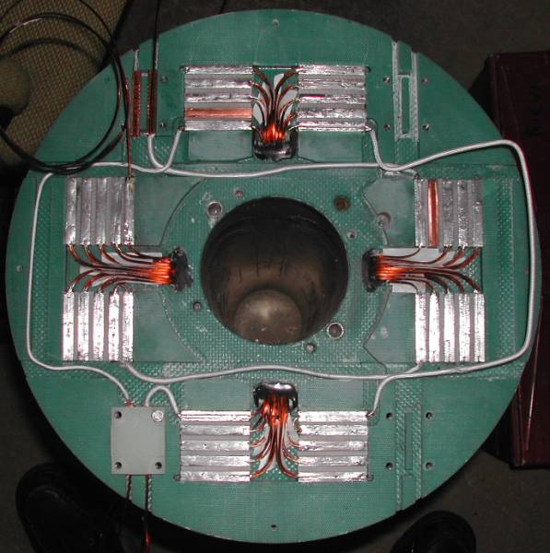
MCBX: Electrical Connections

Slide 13
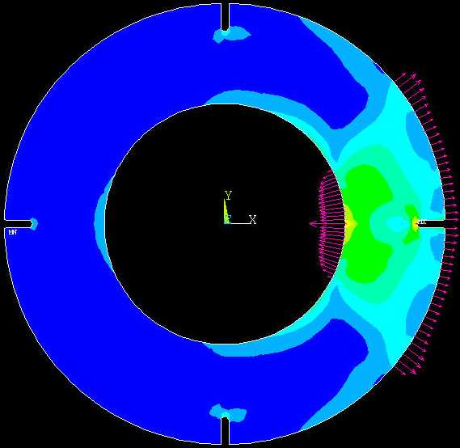
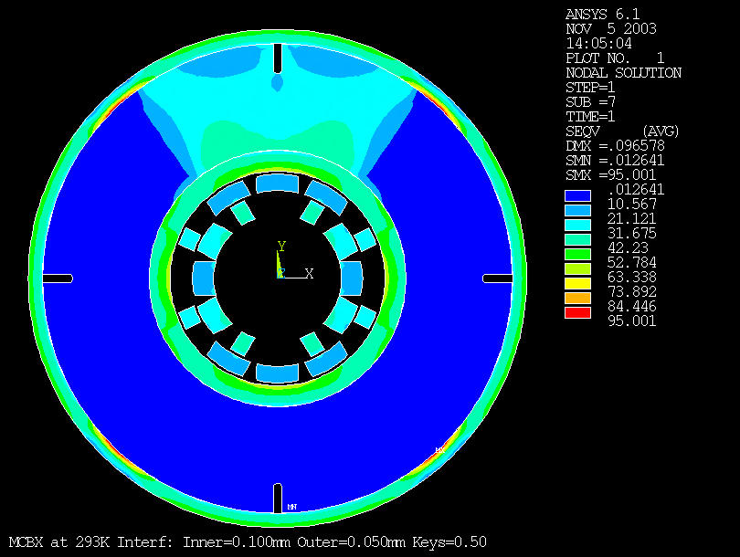
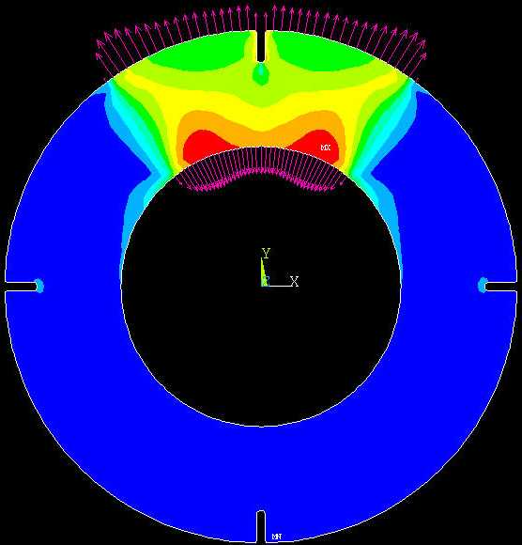
MCBX Coil Pre-stress

Slide 14
MCBX: Cold Tests
Acceptance criteria at 4.3K
 | MCBX
 | MCBXH | MCBXV
Inom | 550 A | 550 A
Ic at 4.3K | 940 A | 880 A
Training (Individual and Combined) | Quench 1 > 350 A 650 A max 10 Q. | Quench 1 > 350 A 650 A max 10 Q.
Re-training | Quench 1 > 600 A | Quench 1 > 600 A
Individual training H & V
Diagonals I_{H} = +/- I_{V}
Rotating field:
  50%
  75%
  100%

Slide 15
MCBX: Individual powering of MCBXV (inner dipole)

Slide 16
MCBX: Individual powering of MCBXH (outer dipole)

Slide 17
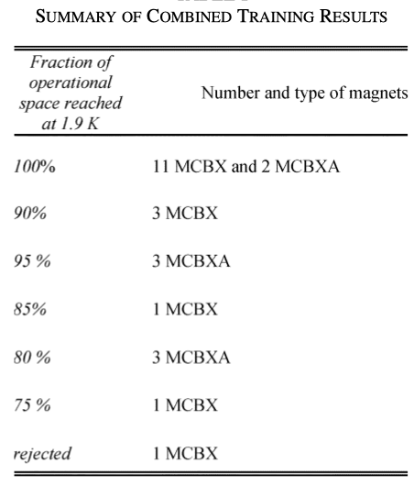
MCBX Combined Training

Slide 18
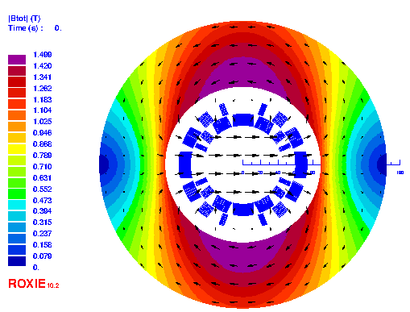
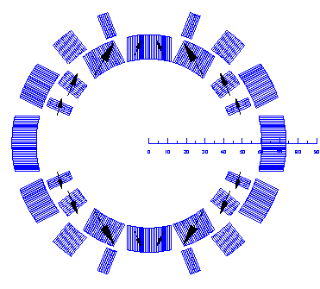
MCBX COMBINED POWERING

Slide 19
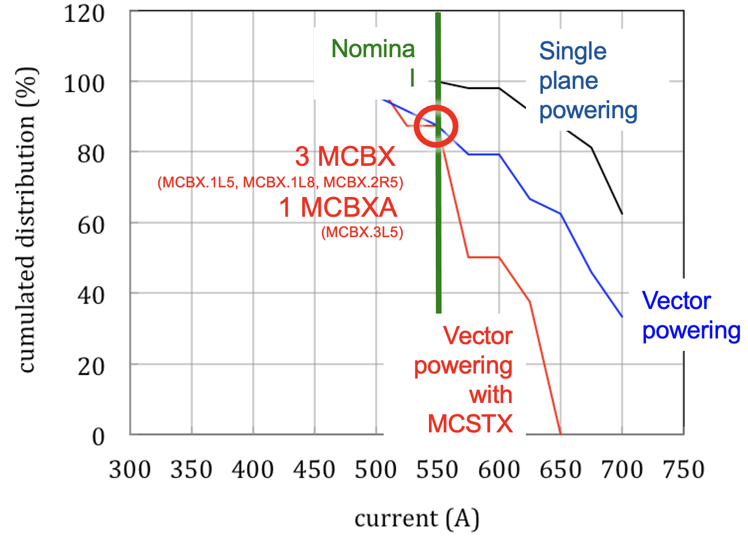
Basis for allowables and statistics
All MCBX trained at 4.2 K as single plane to at least 550 A (HCMCBX_001-SP000010, MCBX1.L5), in most cases (> 60 % of MCBX) up to 700 A
All MCBX underwent vector powering at increasing current vector amplitude I₀ = (I_{H}² + I_{V}²)^{1/2}
  I_{H}=I₀ cos(θ)
  I_{V}=I₀ sin(θ)
All MCBXA (with MCSTX) underwent vector powering (as above) with the MCSTX at 100 A.
The value of I₀ reached was in all cases above 493 A (with or without MCSTX)
M. Karppinen, A. Musso, S. Chemli
Presented by L. Bottura
LMC 2.7.2014

Slide 20
Allowables for operation
All MCBX can be powered to 550 A in single plane mode
A percentage reduction has been applied to the nominal conditions of I₀=550 A for vector powering, based on the observed percentage reduction of maximum training current in single plane mode (at 4.2 K), either due to
  combined planes powering, or
  MCSTX corrector powering
10 out of 24 magnets are affected by a reduction up to 75 % (worst case) of nominal current
M. Karppinen, A. Musso, S. Chemli
Presented by L. Bottura
LMC 2.7.2014

Slide 21
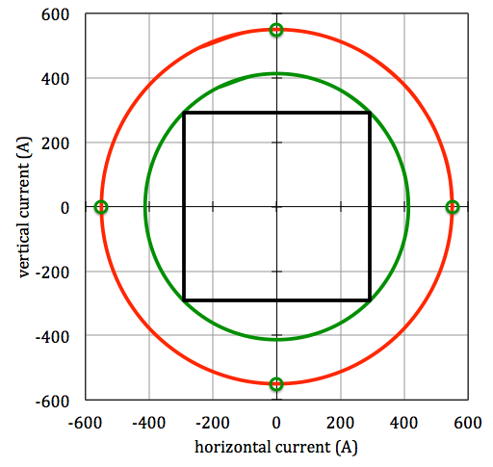
Example of MCBX.1L8 (NCR EDMS 391087)
Magnet trained at 4.2 K up to 700 A in both planes
Powered without quench at 4.2 K up to 525 A (75 % of 700 A)
Powering allowables:
  Single plane up to 550 A
  Vector up to 413 A (75 % of 550 A), which corresponds to 292 A on each plane for a 45° vector
nominal
allowed
413 A
present
292 A
550 A
M. Karppinen, A. Musso, S. Chemli
Presented by L. Bottura
LMC 2.7.2014

Slide 22
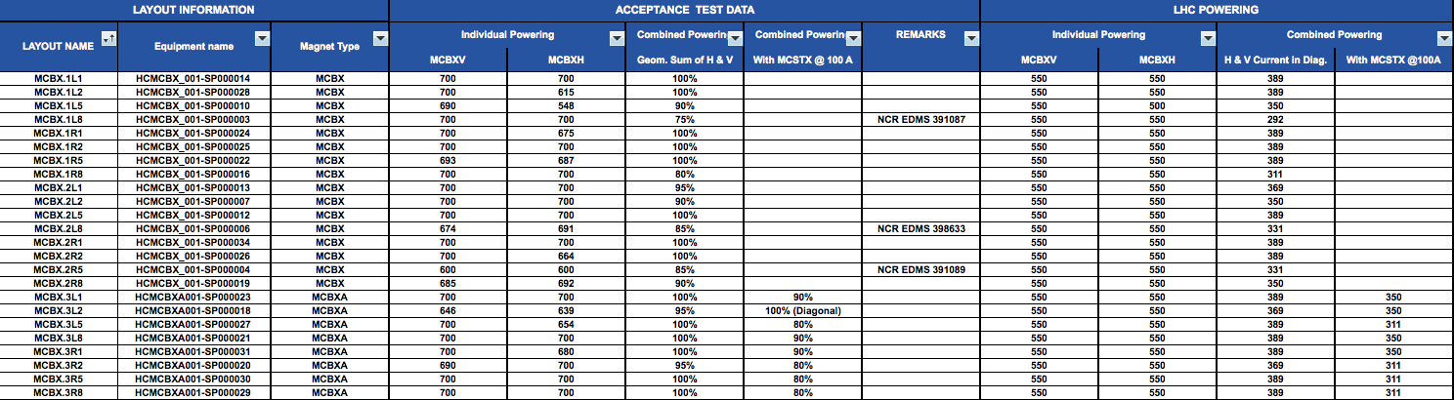
Reference currents
Specifications are given on a magnet-by-magnet basis in EDMS xxxxxxx
The allowable current reported is the projection on each axis of the maximum allowed I₀ for a powering vector at 45°
It is possible to extend significantly the powering space by introducing a control on the total current vector
Without MCSTX, or MCSTX not powered
With MCSTX powered
M. Karppinen, A. Musso, S. Chemli
Presented by L. Bottura
LMC 2.7.2014

Slide 23
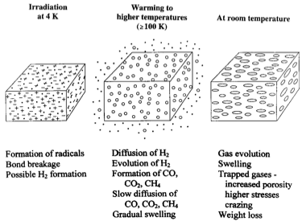
MCBX & Radiation
Design goal to withstand 7 MGy
Absence of radiation resistance data for PVA
Radiation effects on epoxy and epoxy-glass well documented (embrittlement, loss of UTS and ILSS etc..)
Radiation under applied stress at low temperatures
  increases sensitivity (US/ITER/model coil)
  results in low temperature creep (Osaka U.)
Higher energy neutrons (14 MeV) are more deleterious than predicted (LASL)
Dick Reed, Rad-Hard Insulation Workshop Fermilab, April 20, 2007

Slide 24
MCBX & Radiation: Commissioning tests
Due to radiation damage on epoxy and PVA, increased re-training is to be expected and does occur. This does not mean that magnet is failing.
In combined H/V-powering the mechanism is due to redistribution of coil stress with changing EM-force vectors and NOT due to torque between the layers.
During commissioning the powering tests, in particular the rotating field, shall be limited to what is really needed for the operation with some (10 %?) margin
Would be nice to have:
  Summary of training quenches (commissioning): Arjan’s LMC slides
  Summary of operational quenches : TBC or provided
  Records of ELQA in terms of possible changes in inductance or leakage currents
  Summary talk on present understanding of radiation hardness of polymers and composites used in SC magnets (of the LHC)

Slide 25
Training quenches 600 A triplet circuits
Arjan Verweij, LMC, 11 May 2022
 | MCBXH 24 circuits 24 magnets | MCBXV 24 circuits 24 magnets | Comment
2008 | 25 | 6
2009 | 2 | 2
Feb 2013 | 11 | 3
2014/5 | 13 | 4 | Post LS1
2016 | 2 | 0
2017 | 11 | 6
2018 | 1 | 0
2021/2 | 39 | 31 | Post LS2
Comments:
MCBXH/V: not including the quenches due to combined powering
Available?

Slide 26
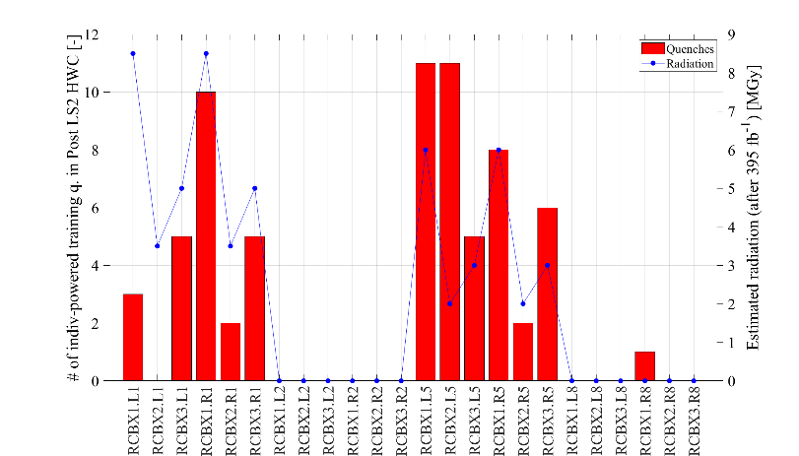
RCBX
Arjan Verweij, LMC, 11 May 2022
Comments:
Radiation in Pt2 and Pt8 is small, but not zero as shown in the plot
Radiation values from presentation "TRIPLET LUMINOSITY LIFETIME" by F. Cerutti at Evian 2021”

Slide 27
Training quenches 600 A
Arjan Verweij, LMC, 11 May 2022
Conclusion:
Most 600 A circuit types show increased training w.r.t. 2008 and Post-LS1, but no signs of permanent degradation are visible due to fatigue, thermal cycling, current cycling, or age
RCBXH/V circuits show significant increase in training in 2021, which seems correlated with the radiation level [see MP3 meeting of 24/11/2021], possibly the same for the RQSX3 circuits.

Slide 28
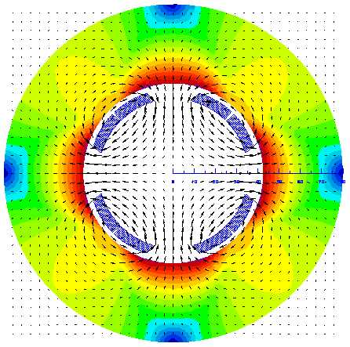
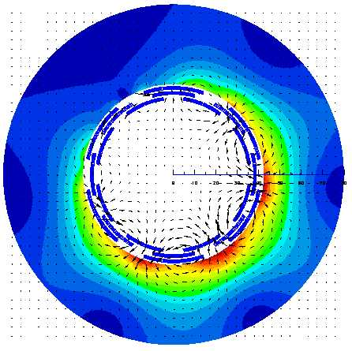
MQSX & MCSOX
Skew octupole (MCSOX)
Skew sextupole (MCSSX)
Skew quadrupole (MQSX)
Octupole (MCOX)

Slide 29
MQSX & MCSOX: Present Parameters

Slide 30
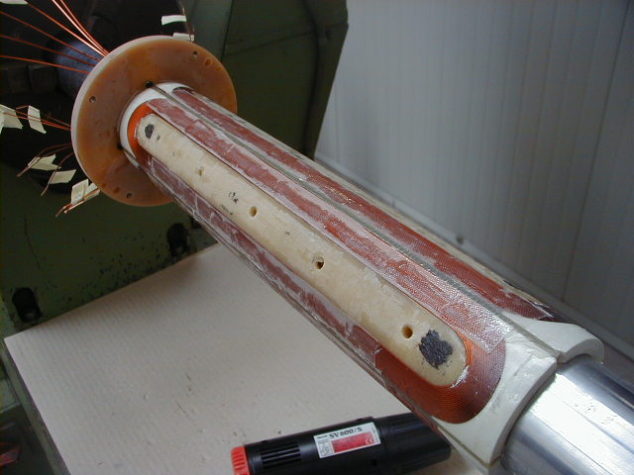
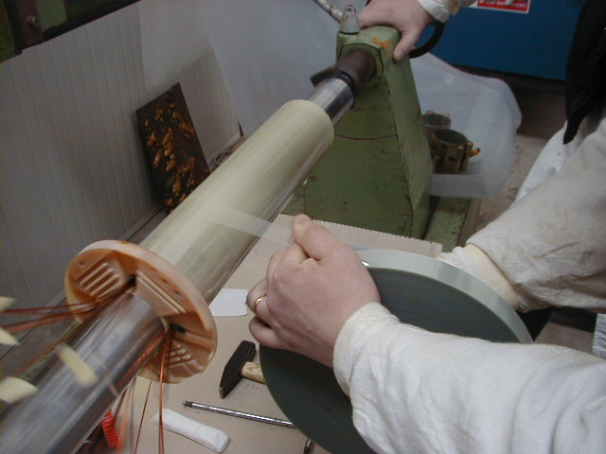
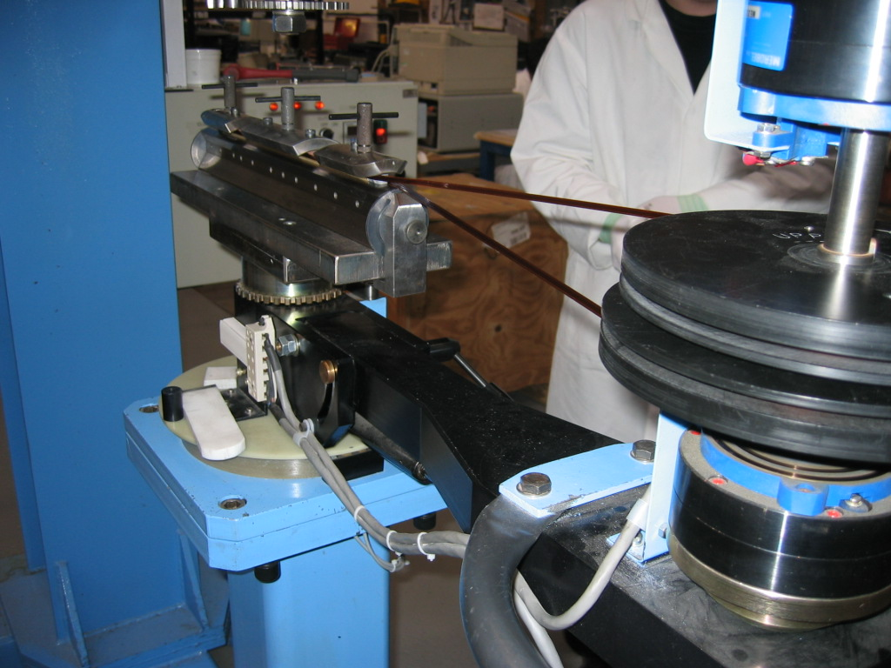
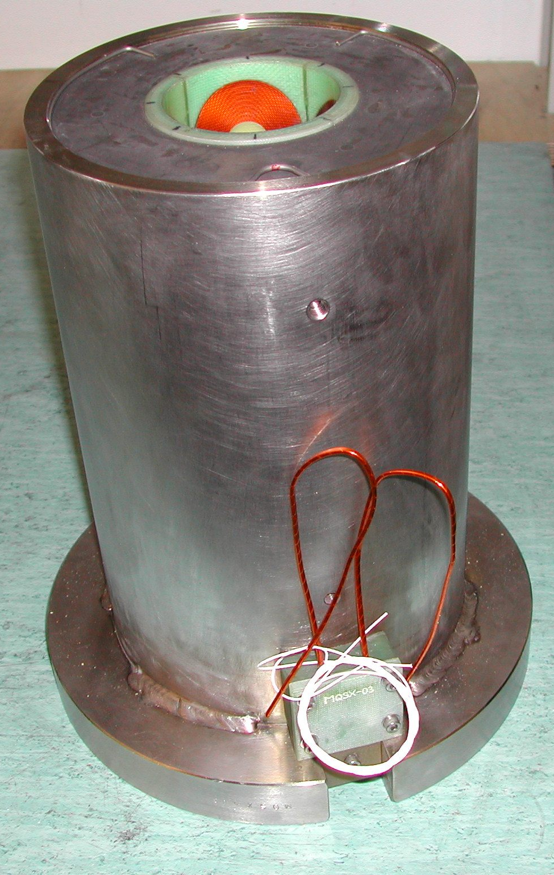
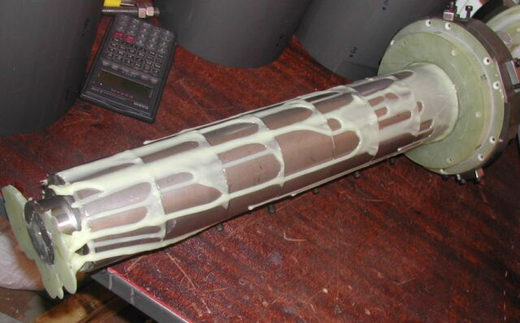
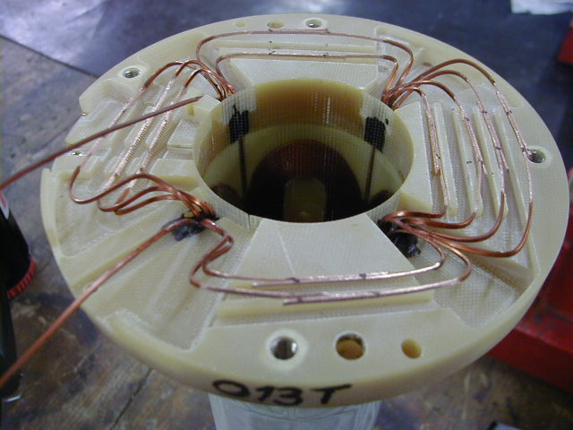
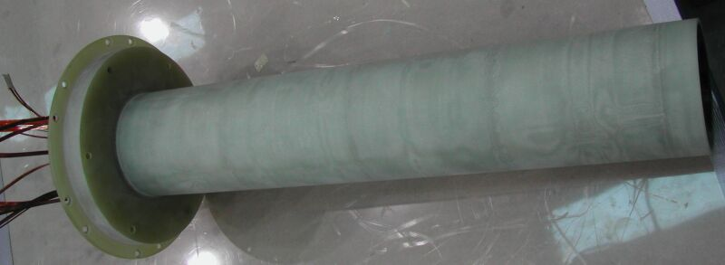
MQSX
Counter-winding 3-way ribbon of wire #3

Slide 31
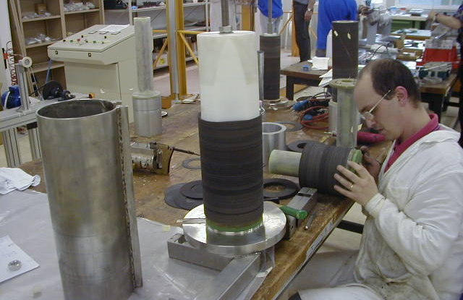
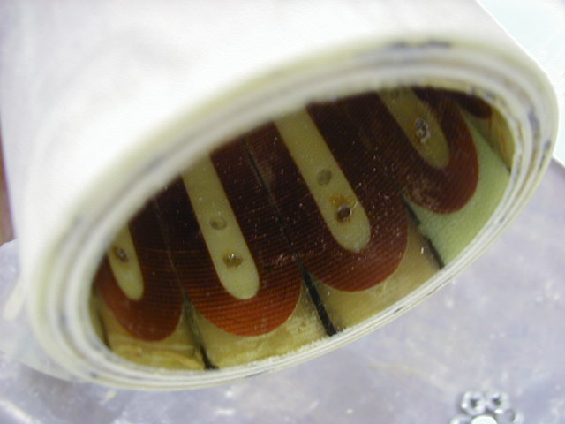
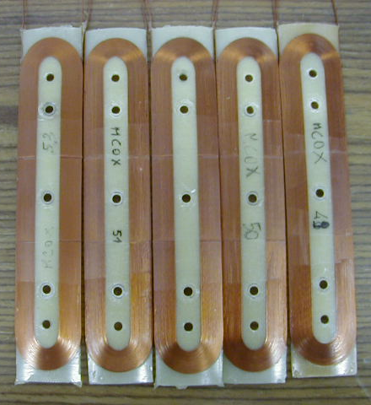
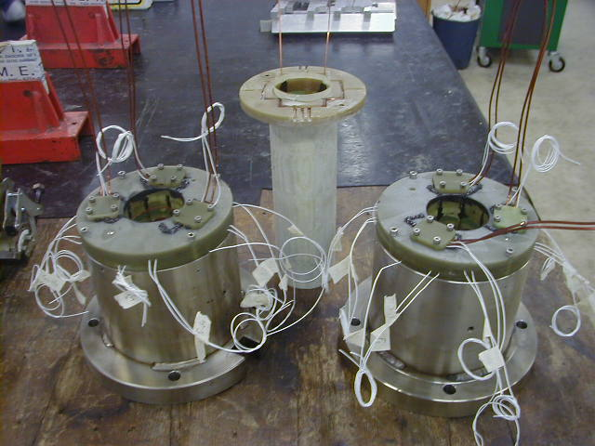
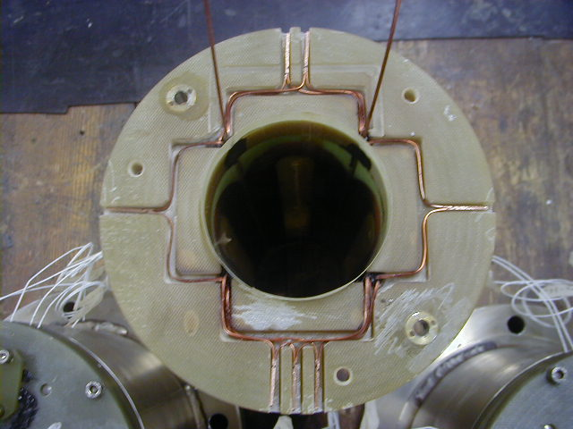
MCSOX
Wet-laying with wire #2

Slide 32
MQSX and MCSOX: Cold Tests
Acceptance criteria at 4.3K
 | MQSX | MCSOX
 | MQSX | MCOSX | MCOX | MCSSX
Inom | 550 A | 100 A | 100 A | 100 A
Ic at 4.3K | 940 A | 181 A | 179 A | 176 A
Training | Quench 1 > 350 A 650 A max 10 Q. | 150 A max 10 Quenches (Individual and Combined)
Re-training | Quench 1 > 600 A | Quench 1 > 120 A (Combined powering)

Slide 33
MQSX & MCSOX #3 (first “split” assembly)
1st run

Slide 34
MQSX & MCSOX #3 (first “split” assembly)
2nd run

Slide 35
MQSX & MCSOX #3 (first “split” assembly)
3rd run

Slide 36
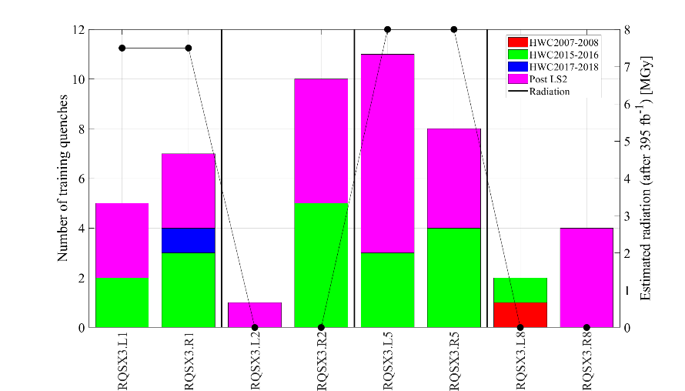
RQSX3
Arjan Verweij, LMC, 11 May 2022
No quenches during operation
No clear correlation with radiation
No clear sign of degradation
Comments:
Radiation in Pt2 and Pt8 is small, but not zero as shown in the plot
Radiation values from presentation "TRIPLET LUMINOSITY LIFETIME" by F. Cerutti at Evian 2021”

Slide 37
Training quenches 80-120 A circuits
Arjan Verweij, LMC, 11 May 2022
 | # circuits | # magnets | 2008-2009 | 2013-2018 | 2021/22
RCOSX3, RCOX3, RCSSX3, RCSX3, RCTX3 | 40 | 40 | 0 | 8 | 2
Comments:
Triplet correctors tested with additional margin of 5 A as of 2013
Old issues:
4 triplet circuits condemned
3 triplet circuits with reduced nominal current
New issues:
1 triplet circuit with reduced nominal current
Conclusion: In general, no clear sign of an increase in training, and no sign of permanent degradation.

Slide 38
MQSX & Radiation: Commissioning tests
Due to radiation damage on epoxy and PVA increased re-training is to be expected and does occur. This does not mean that magnet is failing.
Powering tests, shall be limited to what is really needed for the operation with some (10 %?) margin
Would be nice to have:
  Records of ELQA in terms of possible changes in inductance or leakage currents

Slide 39



Pierre Thonet April 22

Slide 40
Summary
IT corrector magnets are all based on similar materials and construction concept based on epoxy impregnated coils with PVA insulated sc-wires.
The design dose of 7 MGy was based on conservative estimates of radiation damage. No data was available for PVA.
Re-training is to be expected and does not mean that the magnet is failing. Would need data (L, I_{leakage}) from electrical tests.
So far, no sign of real degradation (out-of-spec performance).
It is recommended to limit the powering tests to what is needed for the operation with some margin.
A study of NC skew quad is underway and single aperture magnet appears feasible.

