Slide 1
Some Construction Characteristics of the Inner Triplet Quadrupoles
Inner Triplet Task Force 28 Oct 2022
Based on material from
F. Nobrega, J. Kerby (FNAL)
A. Yamamoto (KEK)
M. Karppinen
TE-MSC-NCM

Slide 2
Inner Triplet Quadrupoles:
Q3
Q2
Q1
MC
S O
X
MCBXA
MQXA
MQ
S
X
MQXB
MCBX
MQXB
MCBX
MQXA
B
PM
B
PM
LMQXB
LMQXC
LMQXA
B4 / A4 / A3
A1 / B1
B6 / B3
A2
A1 / B1
A1 / B1
To IP →
FNAL supplied
KEK supplied
CERN supplied

Slide 3
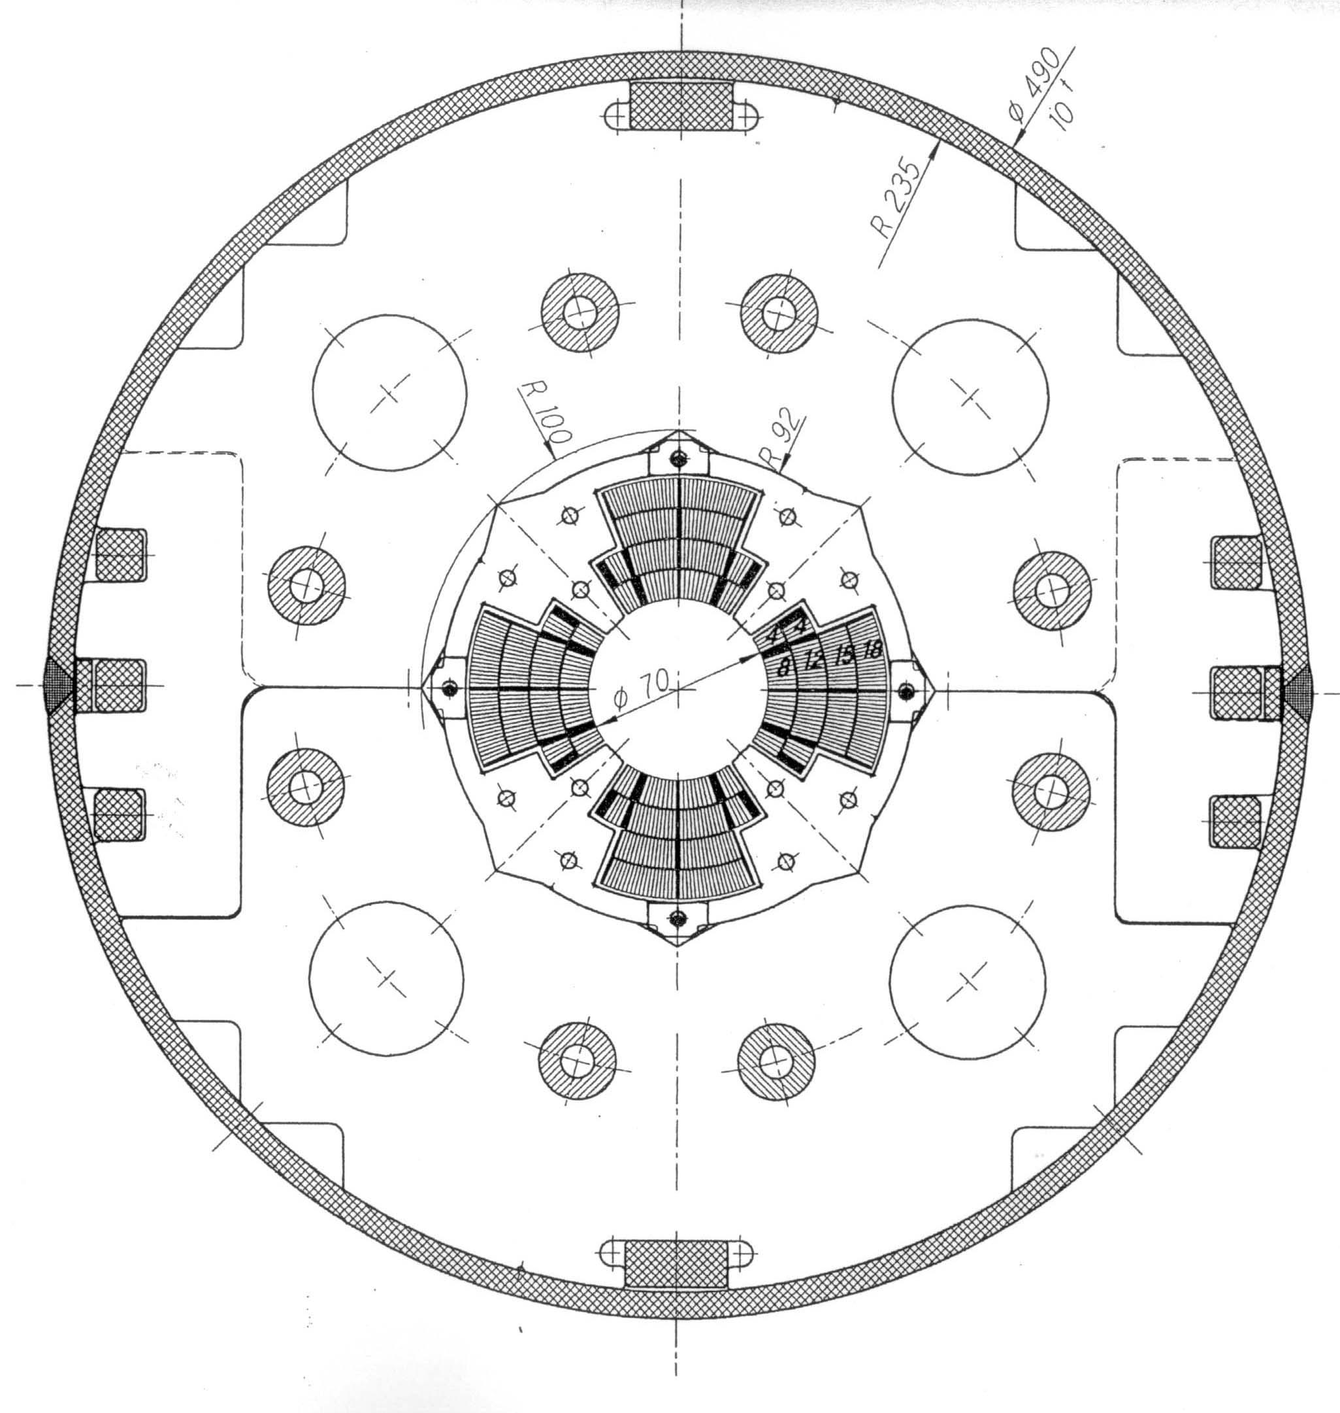
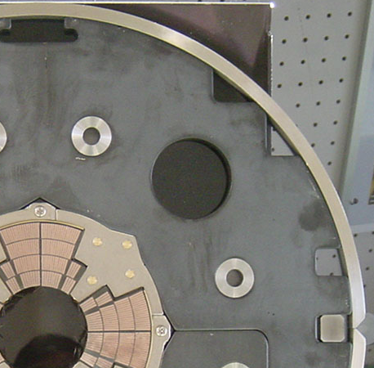
MQXA
G = 215 T/m, (B-peak = 8.4 T)
Aperture = 70 mm
Multipoles (b₆, b₁₀₎: < 1 unit (10⁻⁴)
Beam Heating: 5 ~ 10 W/m
A. Yamamoto (KEK)

Slide 4
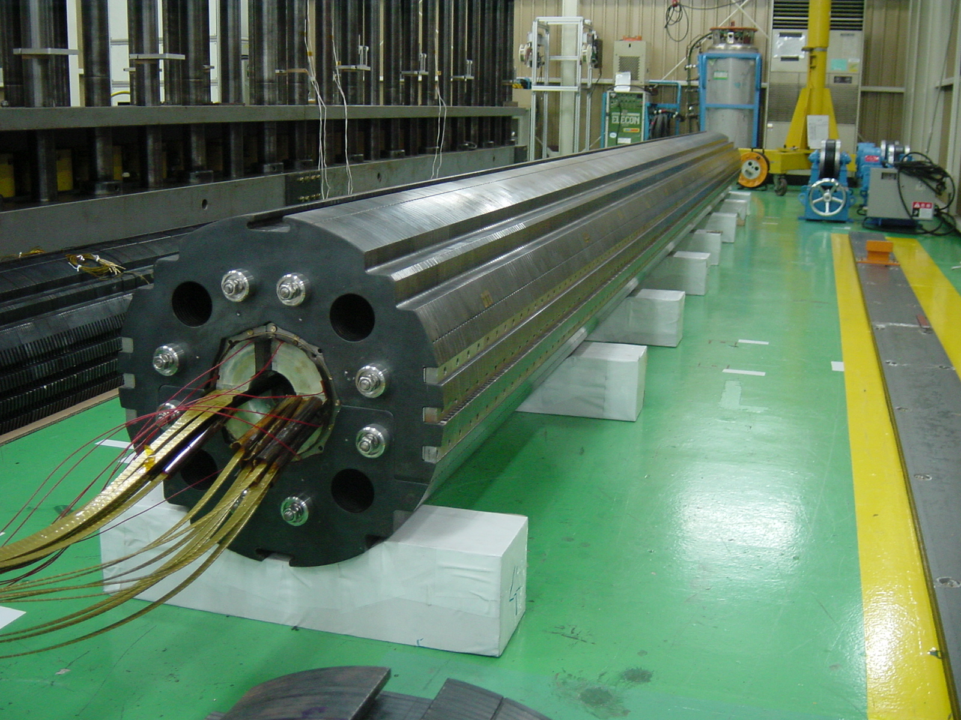
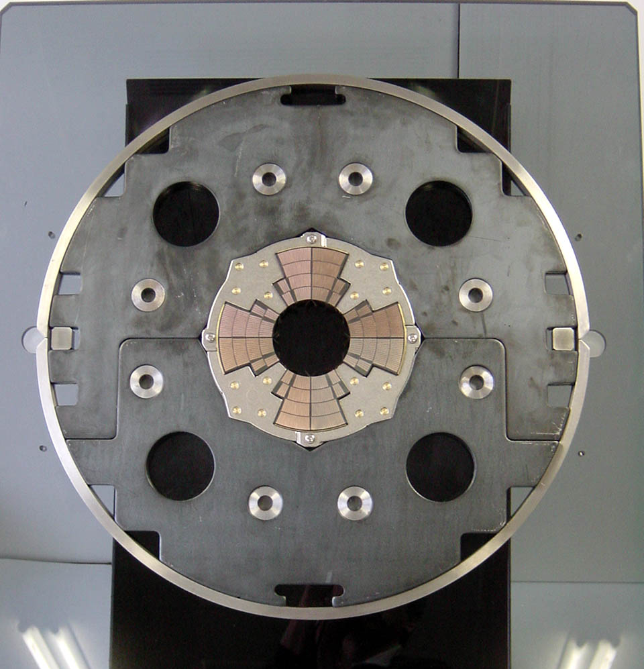
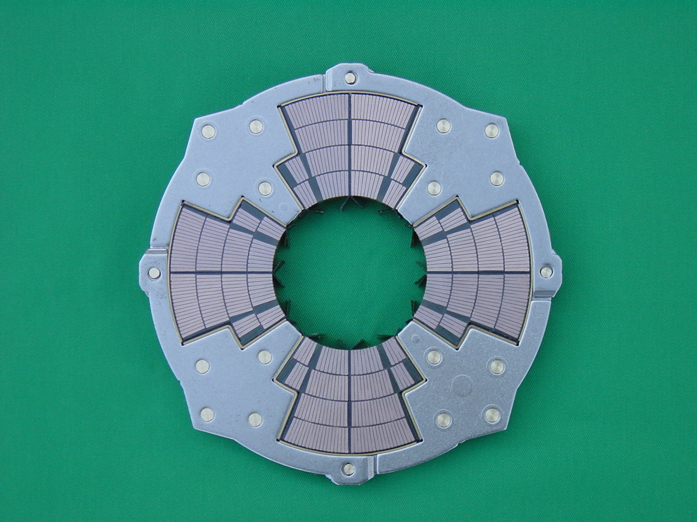
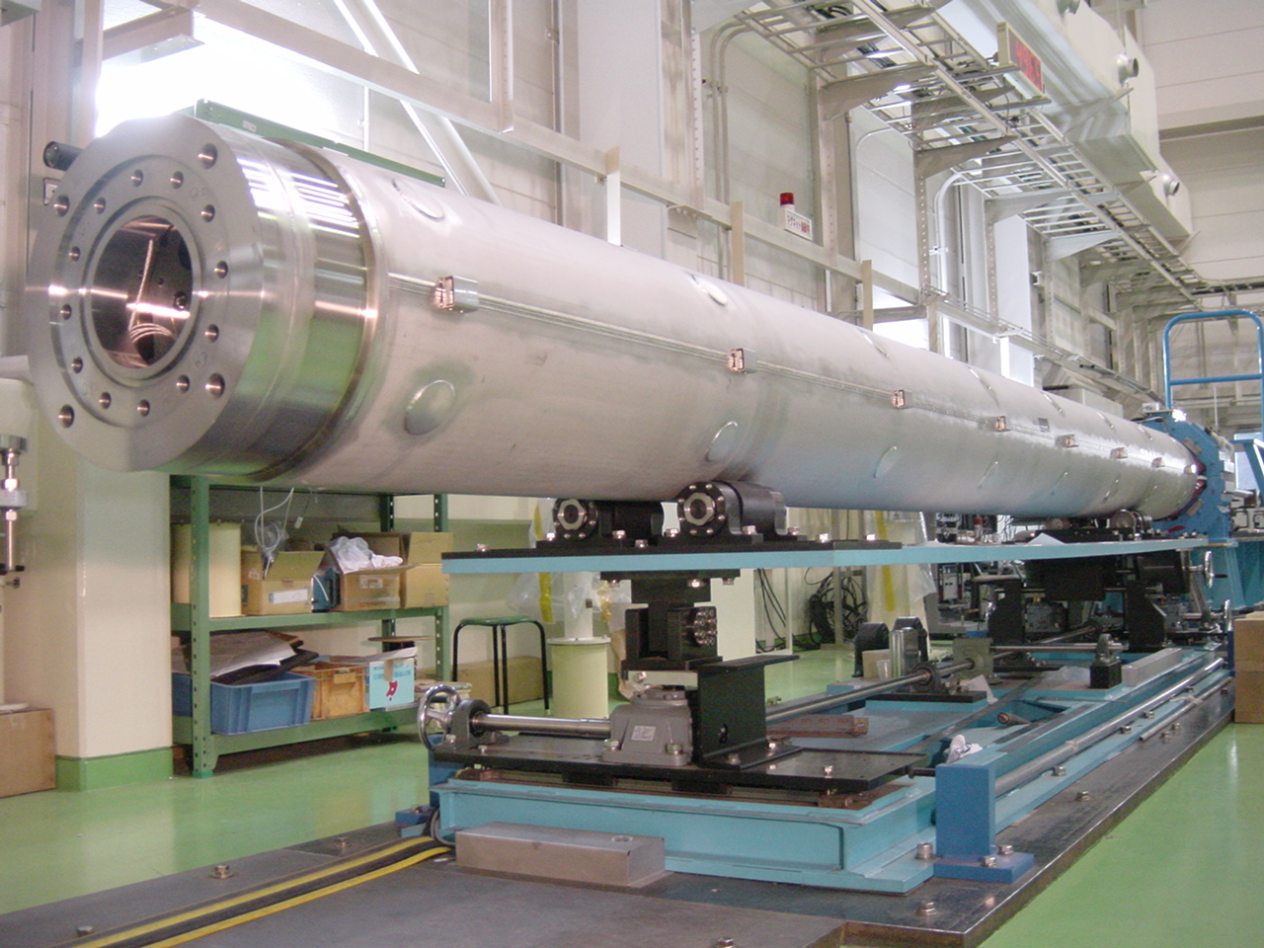
MQXA Magnet
A. Yamamoto (KEK)

Slide 5
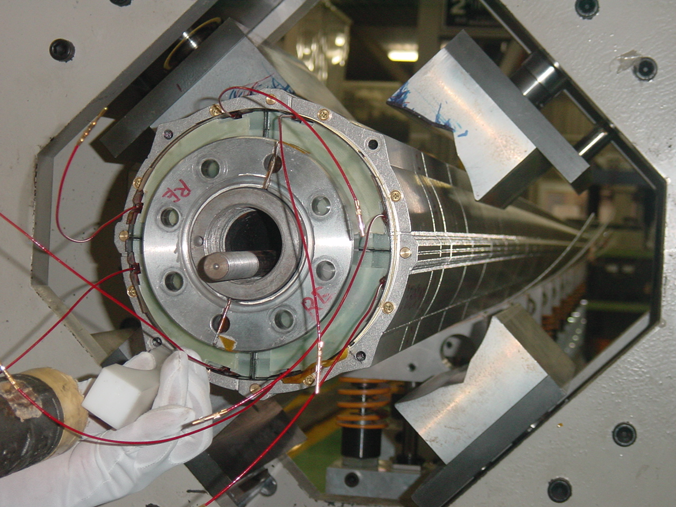
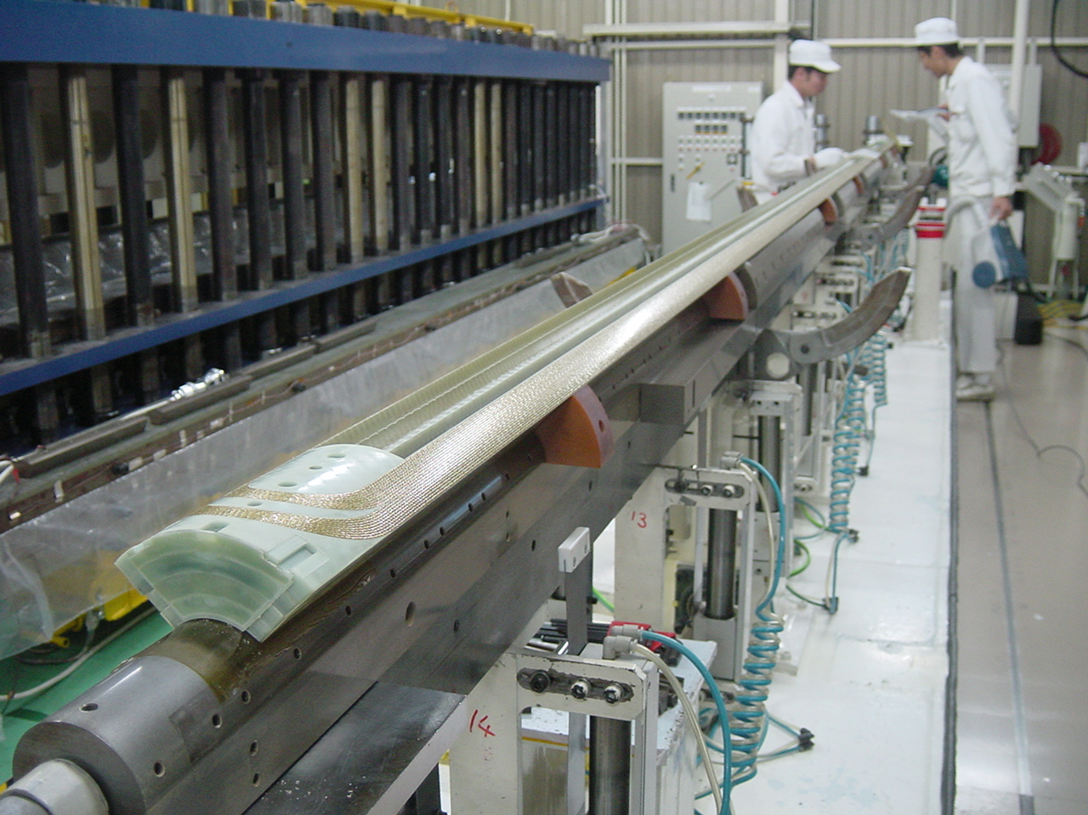
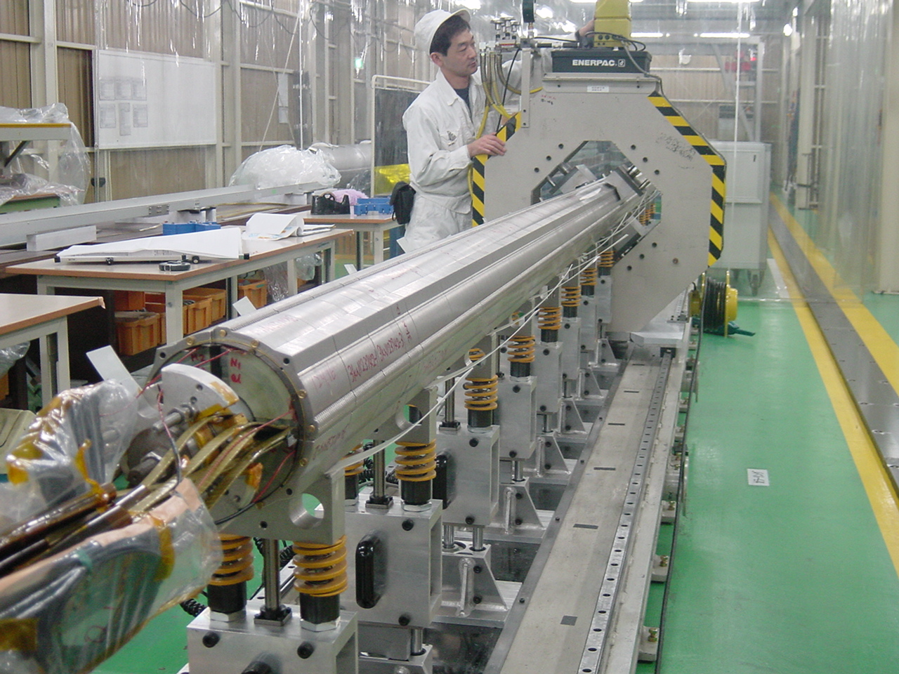
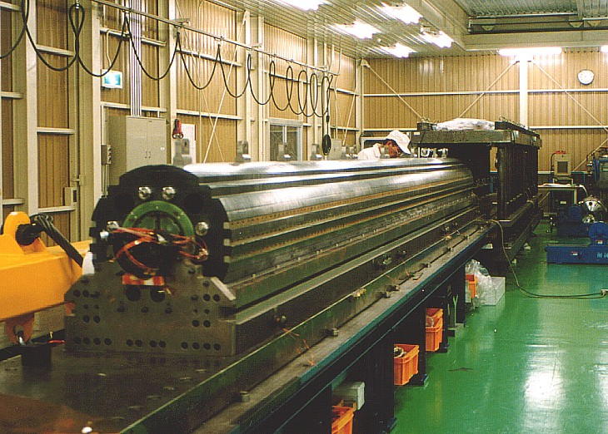
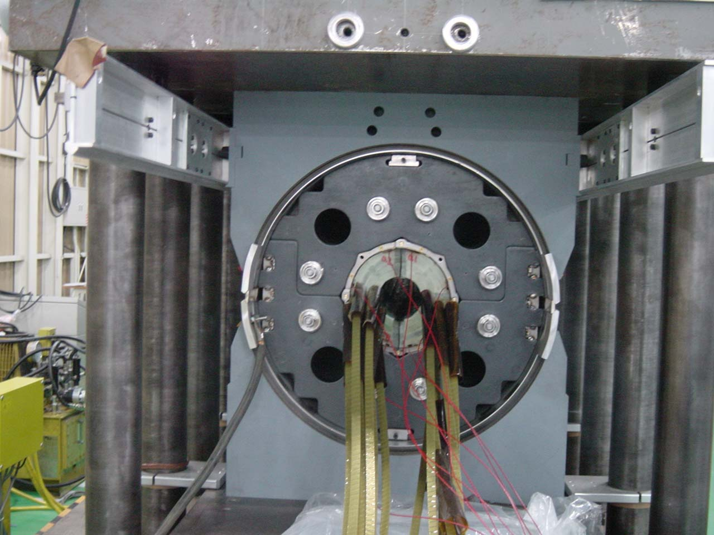
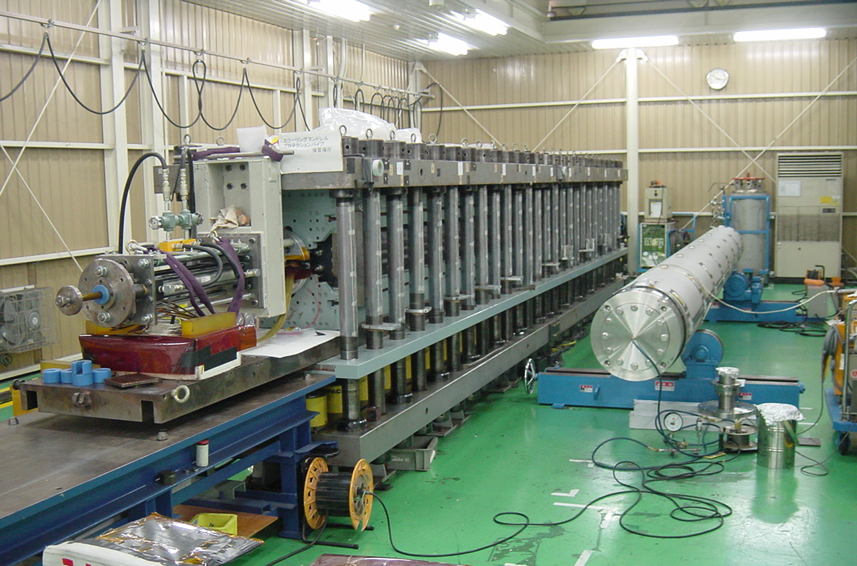
MQXA Production
A. Yamamoto (KEK)

Slide 6
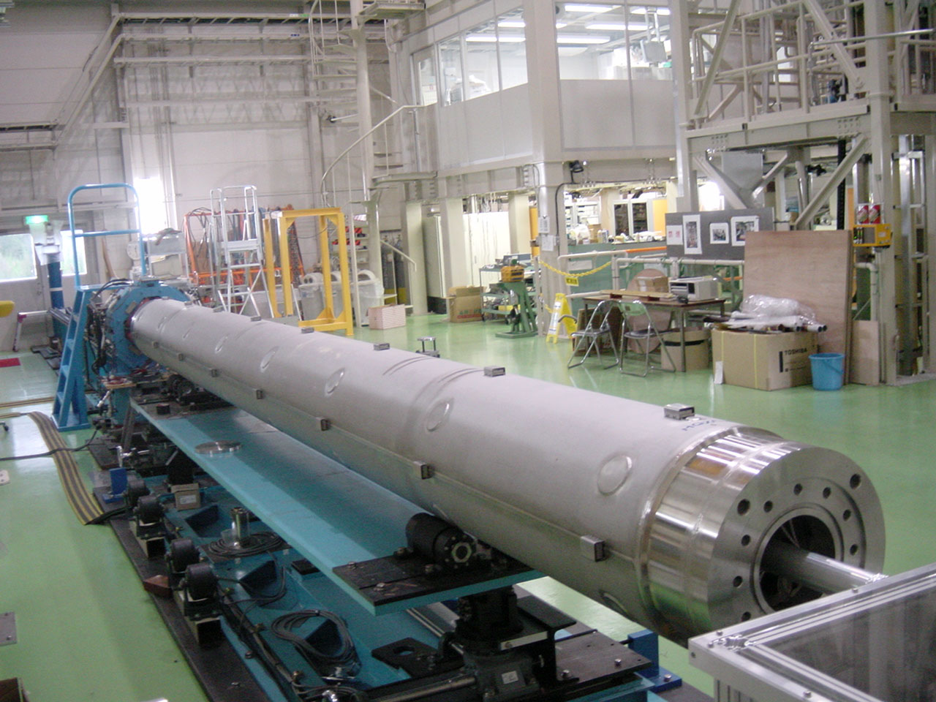
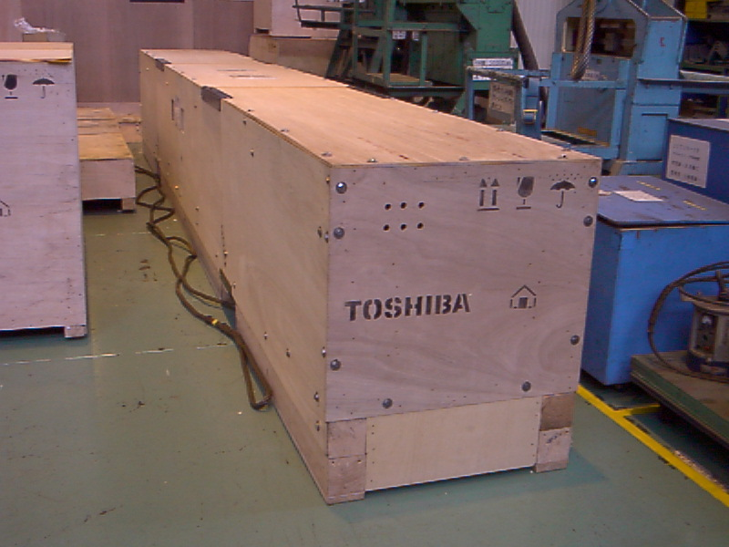
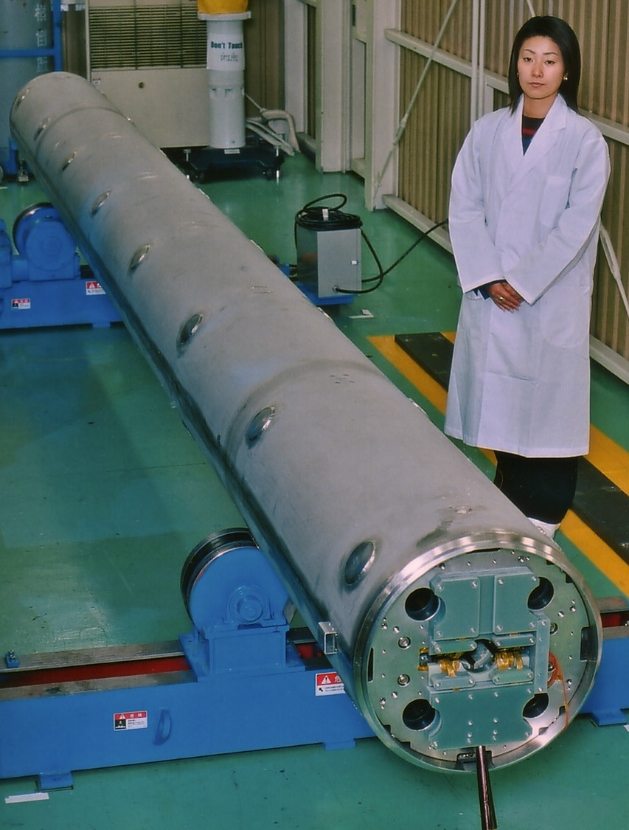
MQXA: Production to Shipment
A. Yamamoto (KEK)
Production at TSB
Warm Measurements
Cold Test
@ KEK
Warm Measurements
Shipping Preparation at TSB
Cold-Mass Shipped to Fermilab

Slide 7
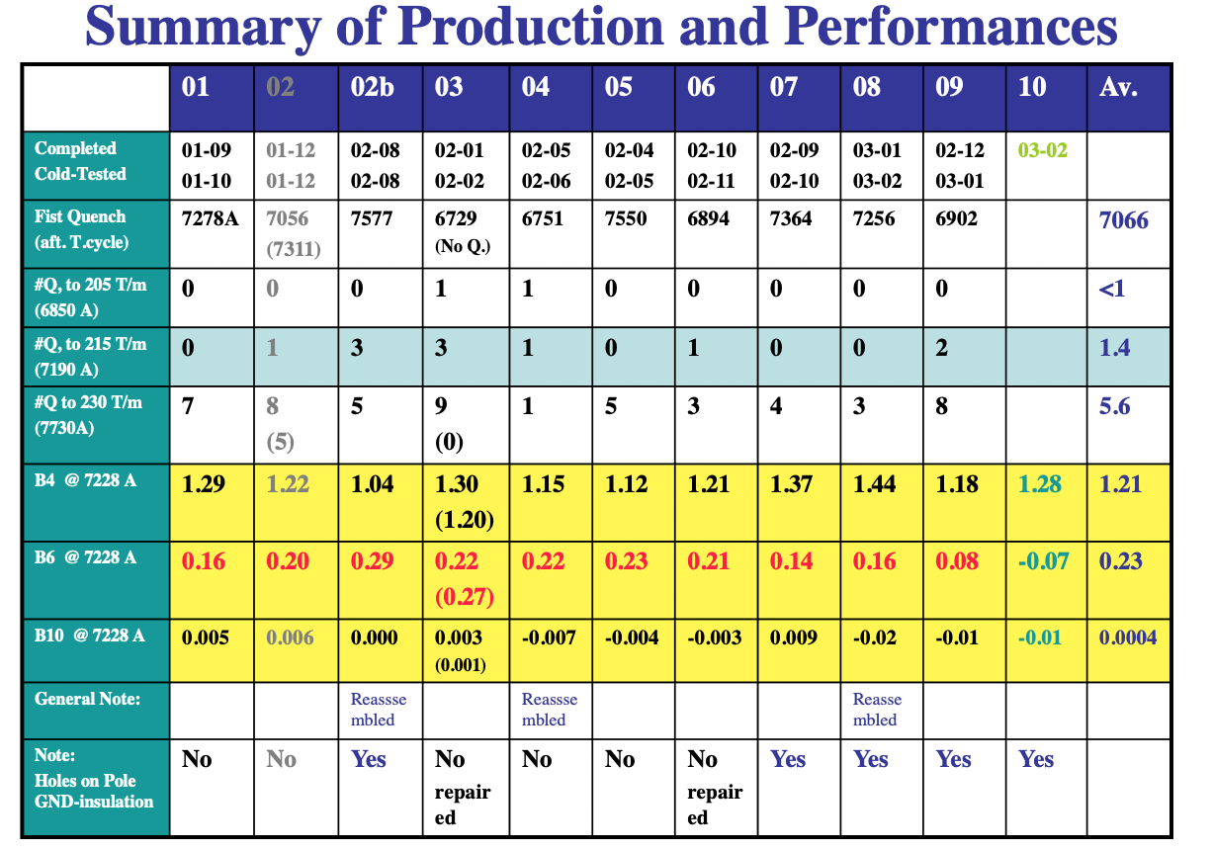
MQXA
A. Yamamoto (KEK)

Slide 8
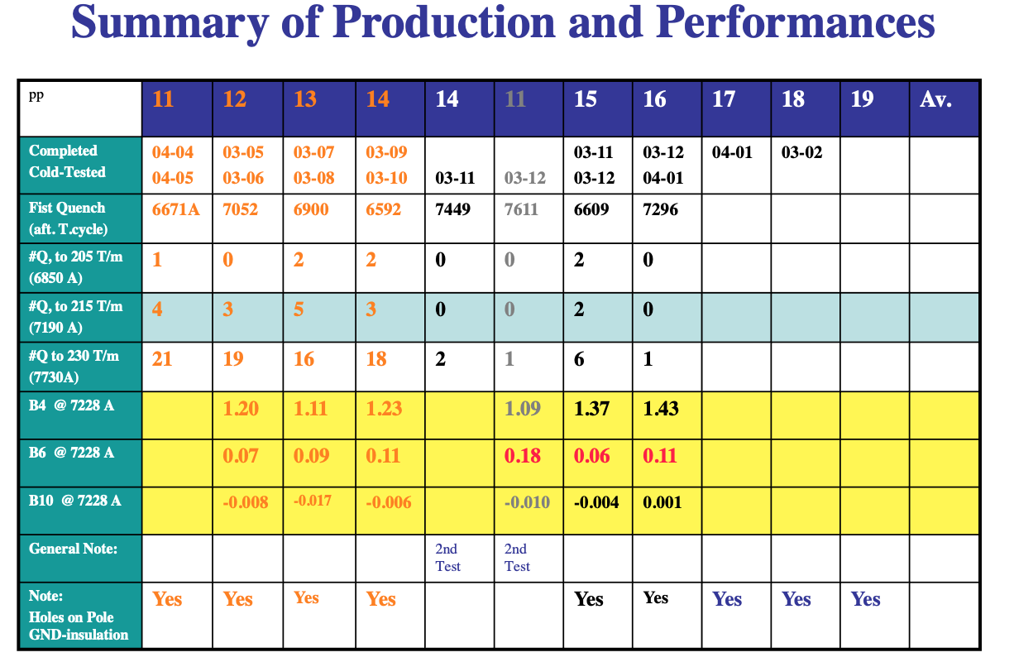
MQXA
A. Yamamoto (KEK)

Slide 9
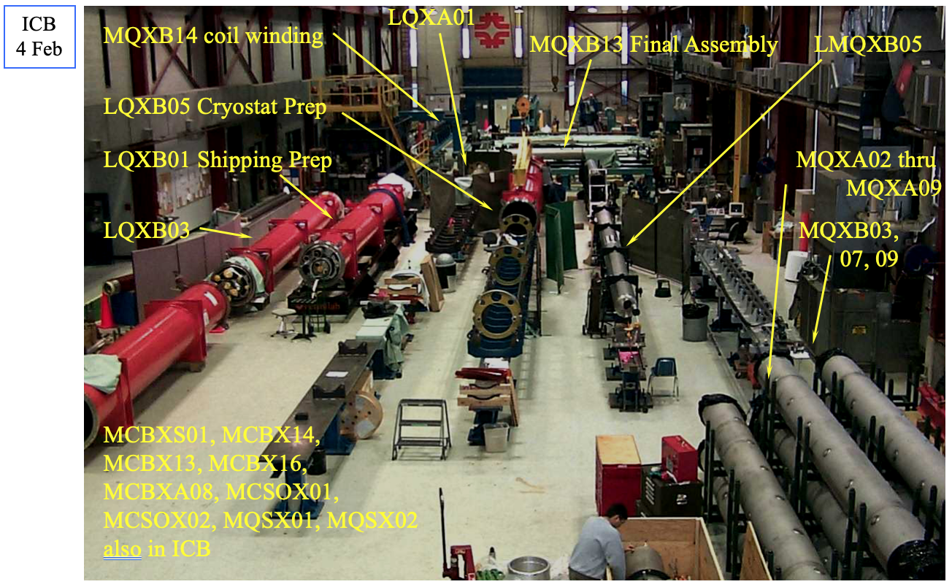
J. Kerby (FNAL)

Slide 10




Prototype Magnet Design
Fred Nobrega
MQXB Engineering Design Review
16 March 2000
Cable
Coils
Collar-Coil Assembly
Cold Mass Final Assembly

Slide 11
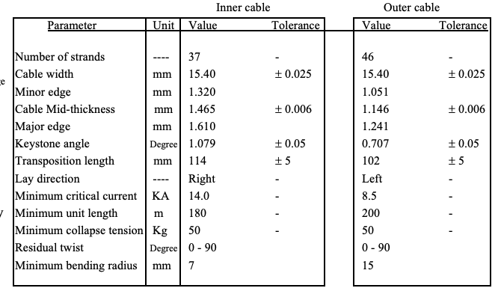
Cable Parameters
Inner cable size changed 6, 8, 12 μm respectively
Keystone angle changed from 0.9771°
# of inner strands decreased to 37
Inner left lay cable was unstable with a coil rejection rate of ~25% due to popped strands causing turn – turn shorts.
→ Bought billet w/ left twist strand.
Notes:
Inner left lay cable was unstable with a coil rejection rate of ~25% due to popped strands causing turn – turn shorts. → Buy billet w/ left twist strand.
Conductor can’t be any larger as it goes unstable.

Slide 12
Cable Insulation
F. Nobrega (FNAL)
Insulation design optimized over the course of the model magnet program.
Inner cable: 25 μm x 9.5mm Kapton w/ 58% overlap surrounded by 50 μm x 9.5mm w/2mm gaps using QIX → Kapton w/ a polyimide-epoxy adhesive.
Outer cable: 25 μm x 9.5mm Kapton w/ 48% overlap surrounded by 25 μm x 9.5mm w/46% overlap using QIX → Kapton w/ a polyimide-epoxy adhesive.

Slide 13
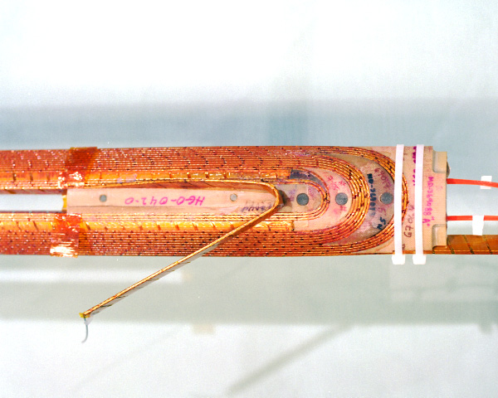
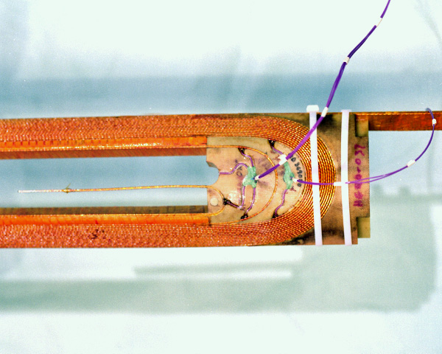
Coil End Design
F. Nobrega (FNAL)
Cured Lead End Inner Coil
Ends optimized to minimize physical length, peak field and integrated harmonics
Internal Splice
G-11CR end part material- structural and radiation resistance
5 block end design for improved mechanical support
Cured Lead End Outer Coil

Slide 14
Coil Size and Length Specifications
F. Nobrega (FNAL)
for Prototype and MQXB
(5231mm for MQXB)
Coil Size Specifications
Inner coil size: 275 um +/- 50um
Inner coil MOE: 9Gpa +/- 1GPa
Outer coil size: 275um +/- 50um.
Outer coil MOE: 9Gpa +/- 1 GPa
(5613 mm for MQXB)
(5231mm for MQXB)
(5613 mm for MQXB)

Slide 15
Collar-Coil Ground Wrap Insulation
F. Nobrega (FNAL)
All layers of kapton are 125 μm unless otherwise specified.
The figures show the coil insulation system
for the first long prototype. It is not identical
to any of the short models. It is closest to the
systems used for HGQ08 and HGQ09. The
differences between the prototype and HGQ08/9 are:
• The HGQ09 system is identical to this one,
except that the “flaps”, on the inner layer of the
inner coil, were not removed on HGQ09, and are
on the prototype.
• On HGQ08, the flaps were removed, but the strip heater, instead of being 200 μm thick, was only 125 μm thick, with a 75 μm layer of Kapton between the strip heater and the outer coils. It is identical in all other respects.

Slide 16
Collar-Coil Ground Wrap Insulation (continued)
F. Nobrega (FNAL)
Three layers of Kapton, each 125μm, cross each pole, covering the inside surface of the collar laminations. To allow heat flow between the beam tube and the openings between the collars, slots are provided in the Kapton.

Slide 17
Collar-Coil, Quench Heaters
F. Nobrega (FNAL)
Each magnet consists of 4 strip heaters packages as shown.
Each package consists of two heater strips covering approximately 12 turns of two azimuthally adjacent coils.
Each element is 25 μm thick x 15mm wide stainless steel intermittently coated with a thin (4μm) layer of copper on one side. The coated areas are 210mm long, alternating with 105mm long areas of bare stainless steel.
The stainless steel length corresponds to one transposition pitch.
The two strips will be connected in series at the return end of the magnet.
The two elements are sandwiched between 100 μm layers of polyimide film and adhesive.
Heater assemblies are being supplied by CERN.

Slide 18
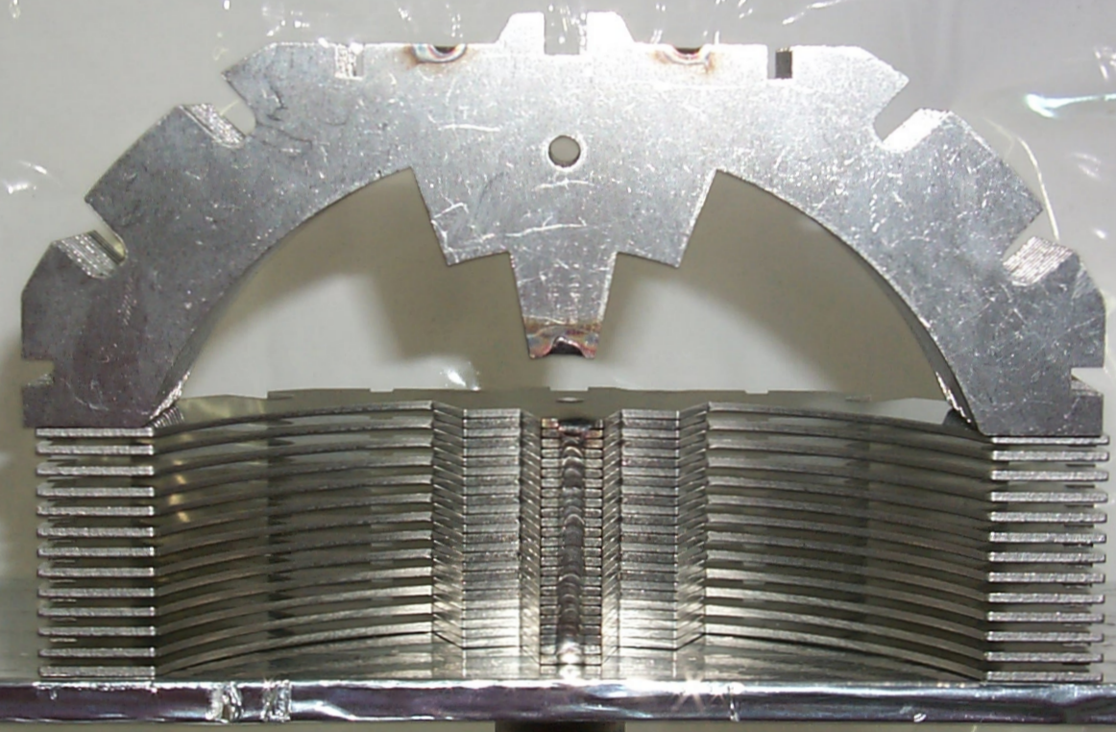
Collar-Coil Assembly, Collar Packs
F. Nobrega (FNAL)
The collars are stamped and provide a repeatability from part to part of +/- 15 μm.
Large and small laminations are alternated, with the small laminations filling the gaps at the pole. The small laminations strengthen the collar structure longitudinally, and provide continuous azimuthal support for the coil.
The introduction of the small lamination allowed the bearing strips, used on earlier short models, to be eliminated. Magnets HGQ08/9 were built without bearing strips and performed well.

Slide 19
Collar-Coil Assembly, Collar Packs (continued)
F. Nobrega (FNAL)
The laminations are welded into packs longitudinally in 3 places as shown. The packs are approximately 4 cm long.
Collars are held together using two tapered, full hard phosphor bronze keys per quadrant. Collar packs are constructed with a “large” lamination on each end.
This configuration provides a 1.5 mm gap, where no small lamination appears, in each quadrant, every 4 cm.
This allows heat to pass from the beam tube through slots at the pole in the ground insulation, through the collars, to cooling holes in the yoke.

Slide 20
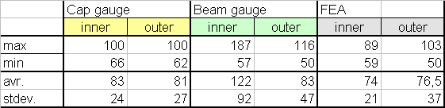
Collar-Coil Warm Prestress (continued)
F. Nobrega (FNAL)
Preload estimates from the various methods are in sufficient agreement to allow us to make an estimate of coil pressure. Prestress targets for long magnets are chosen as 75+/- 20 MPa (Cap, FEA) for inner and outer coils.
Prestress verified by instrumentation packs and collar deflection measurements for P1 and P2.
Prestress for MQXB verified by collar deflection measurements only.
LHC IR MQXB Prototype Collared Coil Specifications
Collar Material: Nitronic 40 Stainless Steel, Minimum yield strength 655 MPa
Collar radial deflection, Midplane: Maximum 140 μm, Minimum 100 μm
Collar radial deflection, Pole: Maximum 180 μm, Minimum 100 μm
End can outside radial deflection, Maximum 150μm, Minimum 125 μm

Slide 21
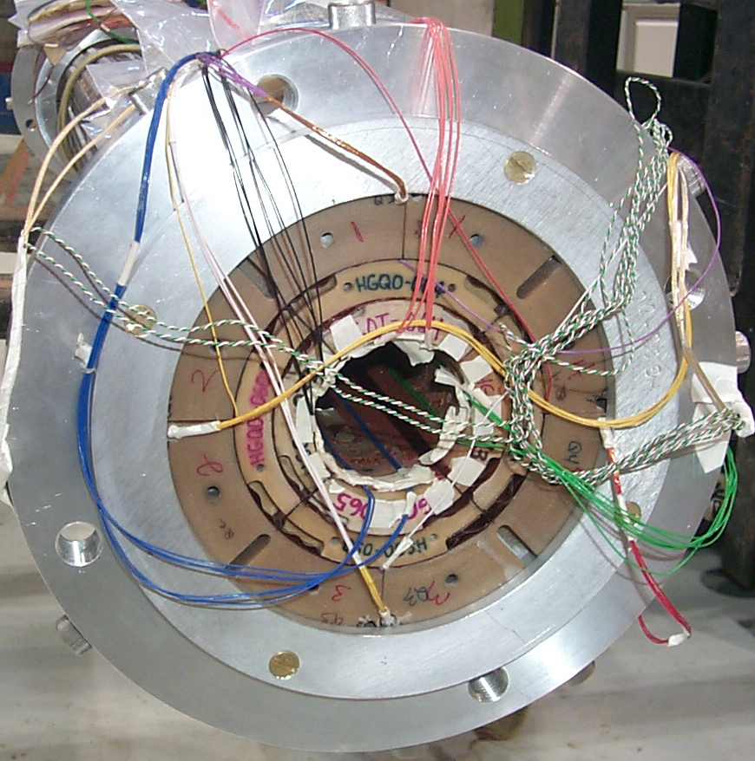
Collar-Coil Assembly, End Collets
F. Nobrega (FNAL)
Measurements of the stressed and un-stressed end can diameter and tests with pressure sensitive film (Fuji film) confirmed FEA predictions. From this the appropriate amount of radial shim needed in the end regions was determined, which resulted in end can radial deflections of 125-150 μm.
The desired prestress range at the transition region from straight section to the ends is 75-90 MPa.

Slide 22
Cold Mass Final Assembly, End Restraint
F. Nobrega (FNAL)
Lead End
Return End
bullets
bolts
Al-ring
end can
yoke
Starting from magnet HGQ-05, the collared coil assembly was secured axially to the end plate using load bolts. Calculations and experiments were conducted in order to verify that the end cans do not slip off the ends of the coils during the axial loading of the collared coil assembly. The figure above shows the axial loading mechanism used to load the collared coil assembly.
An aluminum ring is bolted to the aluminum end can at both the lead and non-lead ends. Load bolts are used to axially tie the collared coil assembly to the end plate through the aluminum ring. Gaps between coil end-saddles and pusher plate are filled with “green putty” to provide a uniform transfer of load to the coils from the end bullets.
A force of 9.8 kN (2,200 lbs.) is applied to each bullet at both the lead and non-lead end of the magnet.

Slide 23
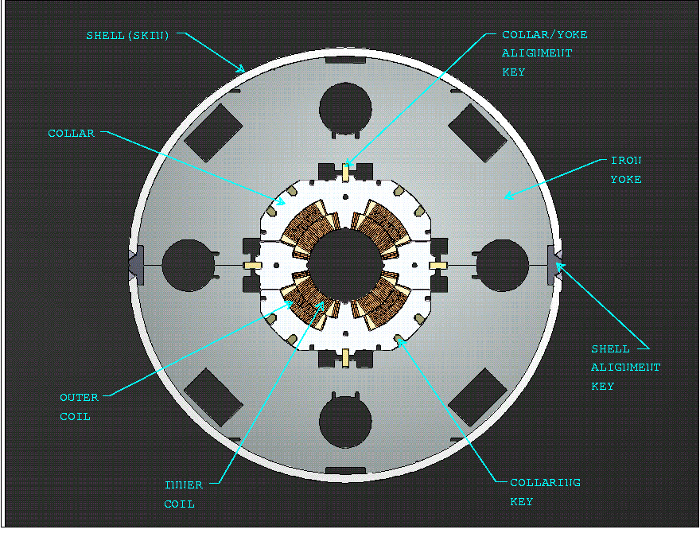
Cold Mass Final Assembly, Yoke Redesign
F. Nobrega (FNAL)

Slide 24
Cold Mass Final Assembly, End Plate
F. Nobrega (FNAL)
An end plate thickness of 50mm was selected for the initial baseline design based on the assumption that the total longitudinal force on the coils is transferred to the end plate.
Bullet end load data from the model magnets show about 20-25% of the axial Lorentz load reacting against the end plate.
Strain gauges placed on the skin of the cold mass indicate no additional load transfer to the skin from, for example, any possible collar-yoke interference.
Based on analysis and test results of HGQ09, a 35mm end plate will be used.

Slide 25
Summary
Main construction features summarised
Radiation damage can be expected in:
  Epoxy-glass end spacers
  Epoxy-glass end collets providing radial support for the end region
  Polyimide insulation is expected to withstand +30 MGy

