Slide 1
Triplet Task Force, 28 October 2022
Residual lifetime of the triplet correctors
Davide Tommasini

Slide 2
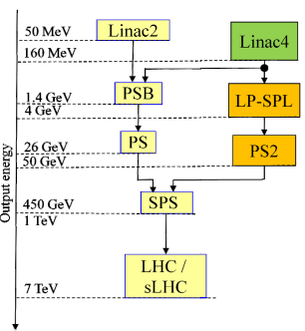
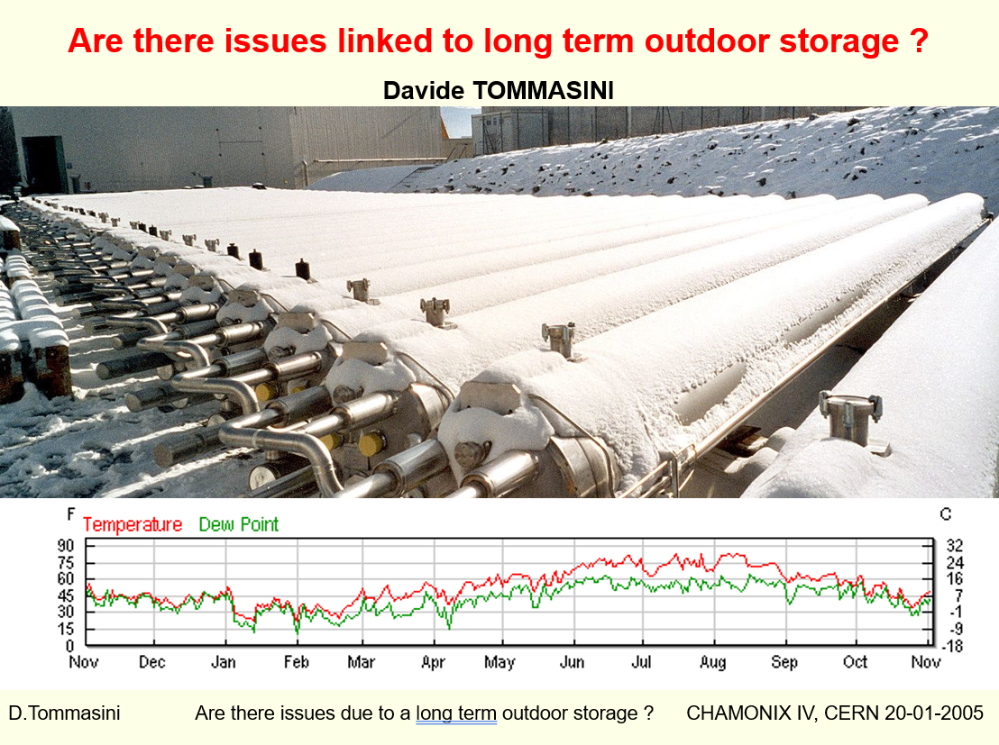
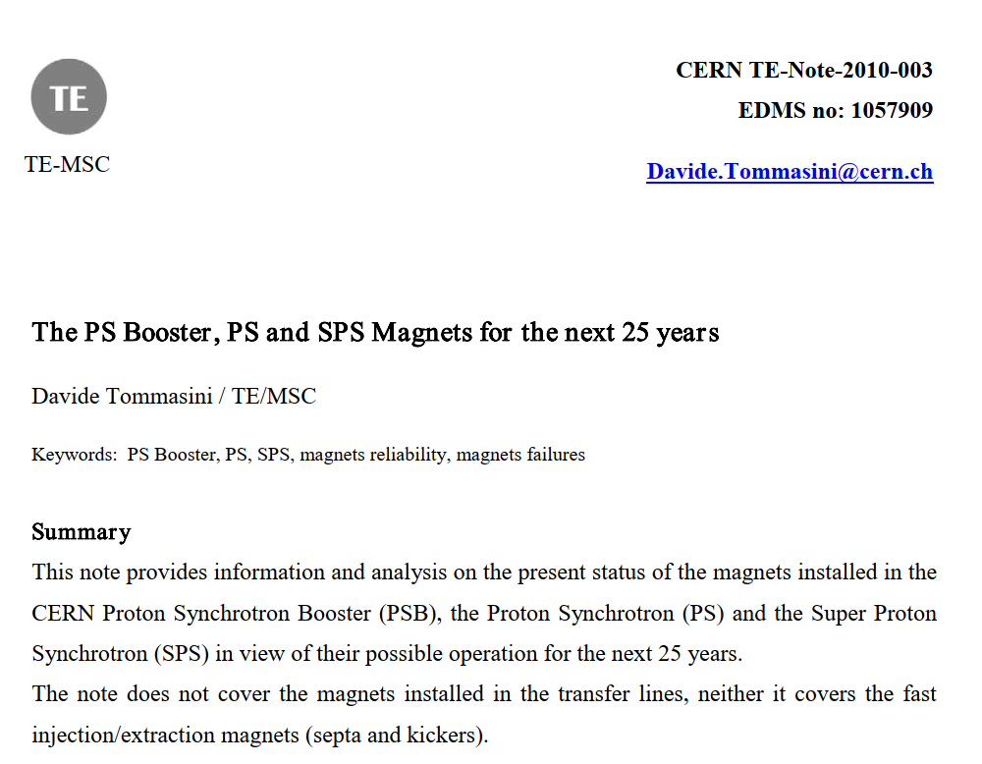
Setting the scene
Chamonix 2005
Chamonix 2010
I=5.8 kA
V= 730 V
P=4.2 MW
Steve Myers summarized my talk as:
“Magnets are like good wine, they become better with time”
Design Report: CERN/LHCC/2000-007

Slide 3
2022: Triplet task force
Is there a risk of critical failure of the correctors around the triplet region due to radiation induced degradation?
I=5.8 kA
V= 730 V
P=4.2 MW
This time I am worried: here I will explain why
Design Report: CERN/LHCC/2000-007

Slide 4
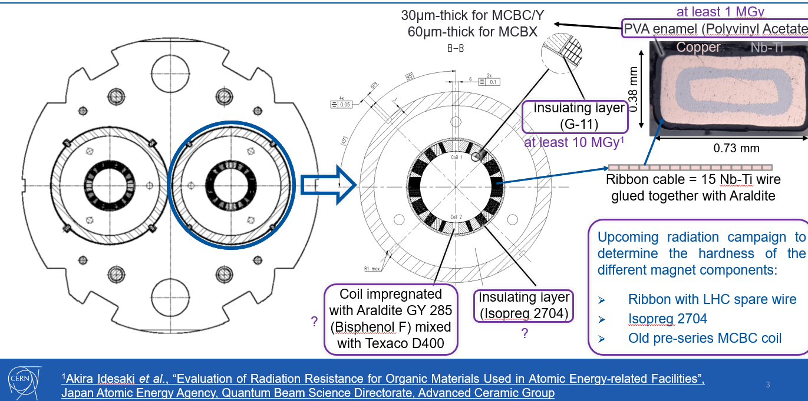
Magnet components
courtesy Daniel Schoerling, January 2019

Slide 5
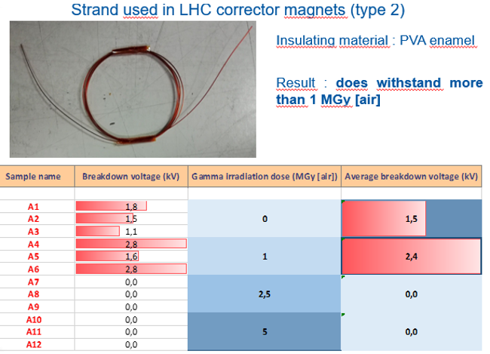
Information available from previous investigations
Strands irradiated with gamma rays up to 5 MGy at BGS / Fraunhofer (DE)
Samples made of 1-m of wire spooled in several turns of 5 cm diameter
3 samples per radiation step
Breakdown voltage measured in water
All samples passed the 1 MGy level, none the 2.5 MGy
courtesy Daniel Schoerling, January 2019

Slide 6
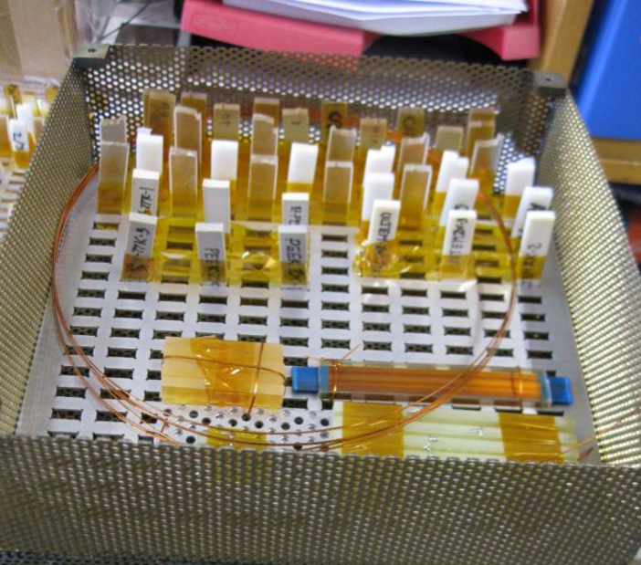
Irradiation Programme (organized by Christian Scheuerlein)
Ambient air: end of the first irradiation campaign to 10 MGy expected by Feb 2023
Liquid helium : tools and set-ups being developed in collaboration with the Cryolab and the IRRAD teams.
On April 2022 we have placed an order (CA 9125673) to STERIS* for irradiation in air up to 10 MGy.
Five sample holders 200 mm x 200 mm x 60 mm, stacked onto each other, have been prepared for irradiation to 2 MGy, 4 MGy, 6 MGy, 8 MGy, 10 MGy.
Four Perspex dosimeters (the dose is determined from the irradiation induced colour changes of the red Perspex dosimeter) are attached at different locations outside and inside the sample holders.
An initial dose measurement is used to determine the dose rate. This is used to calculate the irradiation time required to reach the targeted dose steps.
Additional dose measurements after every month and at the end of the irradiation.
I=5.8 kA
V= 730 V
P=4.2 MW
*At its Marcoule site the company Synergy Health Marseille SAS (a STERIS company) operates a ⁶⁰Co irradiation facility, the so-called Gammatec, which is dedicated to gamma irradiations for research and development activities (see also visit reports EDMS-No.2658884 and EDMS-No.2753561).

Slide 7
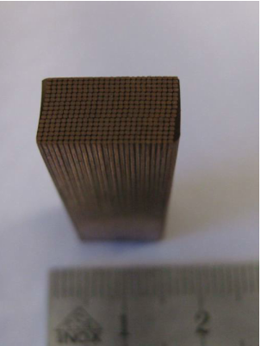
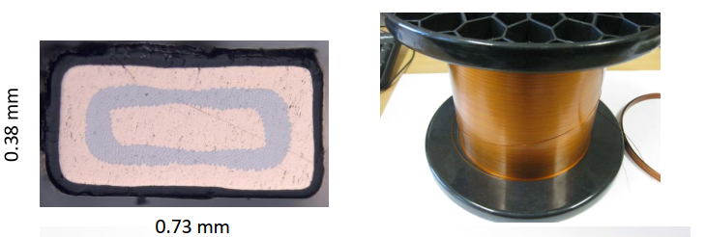
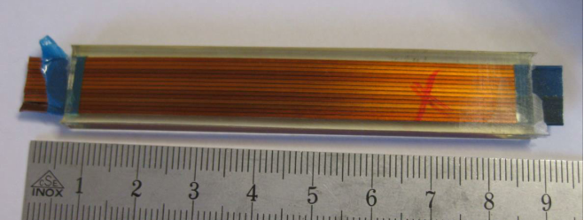
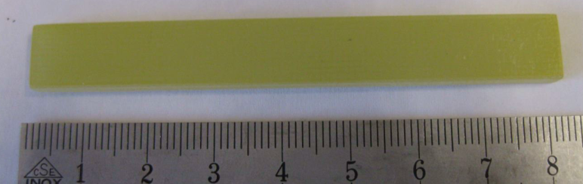
What we are measuring
PVA insulated Nb-Ti wire
Epoxy impregnated ribbon cable. Impregnation with Araldite GY285 + Jeffamine D400
Coil block samples cut from pre-series MCBC coil
ISOPREG 2704 as used for the MCBY outer insulating layer
I=5.8 kA
V= 730 V
P=4.2 MW
Design Report: CERN/LHCC/2000-007

Slide 8
Some considerations
Results presented by Daniel Schoerling in 2019 show a full degradation of the dielectric properties of the PVA wire insulation in a range between 1 MGy and 2.5 MGy. However:
it is not excluded that the impregnation may possibly attenuate the effect of the degradation
in absence of oxygen, at cold, situation may improve, even considerably
we do not know if this degradation may result in a magnet failure
the results of new irradiation campaigns may considerably change this picture
The dose already reached by the corrector magnets in operation in the LHC, according to the presentation of Francesco at this task force on October 14th 2022, often exceeds 5 MGy and, for certain units, even approaches the order of 10 MGy.
From above it looks like these magnets may fail, in case a quench occurs, at any moment as from now
… the results of on-going irradiation tests may change the picture …
… or not …

Slide 9
Recommended immediate actions
The objective shall be to decrease the probability of failure of a weakened dielectric insulation.
I suggest to identify operation schemes to:
not power, where possible, the inner coil layers to possibly preserve operation of the external layers;
2. where powering is mandatory, reduce the current in order to:
reduce the probability of a quench, the principal trigger for a magnet failure
reduce all stresses (thermo-mechanical and dielectric) in case a quench nevertheless occurs
Additional actions
Avoid actions which may trigger a failure: thermal cycles, dielectric tests, provoqued quenches
Identify solutions for balancing radiation dose among magnets (including, possibly, swapping of magnets units)
Identify solutions/mitigations for a possible generalized loss of correctors

