Slide 1
Instrumentation
Juan Casas
CERN – TE/CRG Group
Technical Training: Cryogenic Engineering for Helium Superconducting devices
CERN, 7-9 November 2022

Slide 2
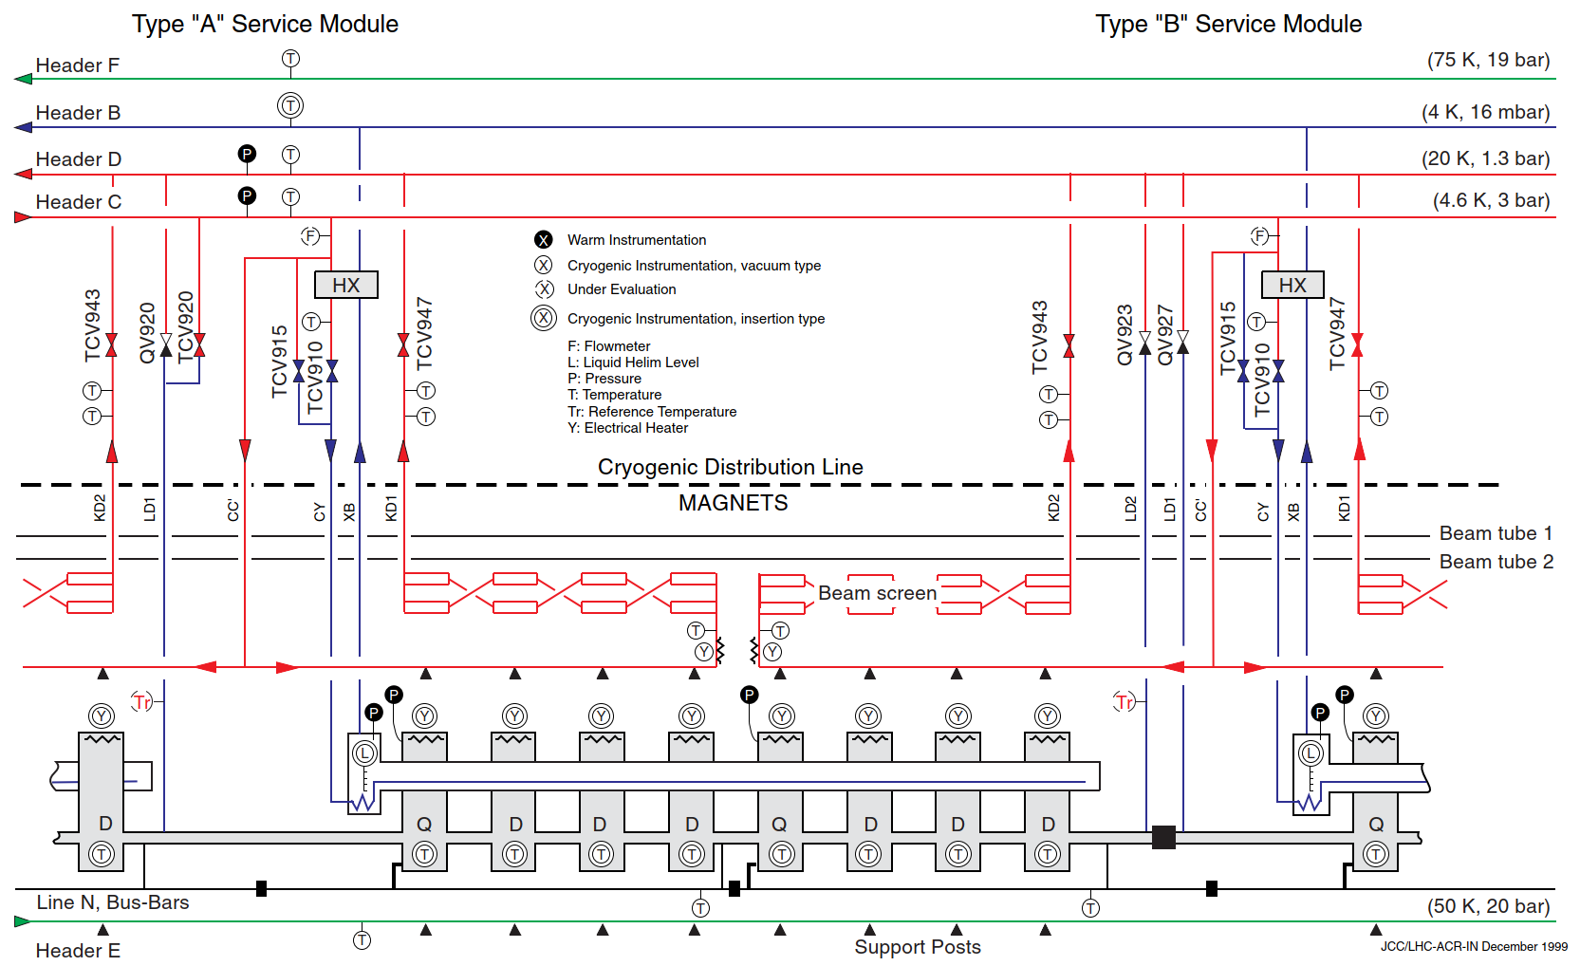
Instrumentation: what is it for?
The instrumentation is “one” of the set of apparatuses that permit the operation, optimization and diagnostics of, in this case, a large scale cryogenic facility.
The components are sensors & actuators with its ancillary equipment.
The instrumentation is shown on a P&ID (example: LHC cell 1999 version).

Slide 3
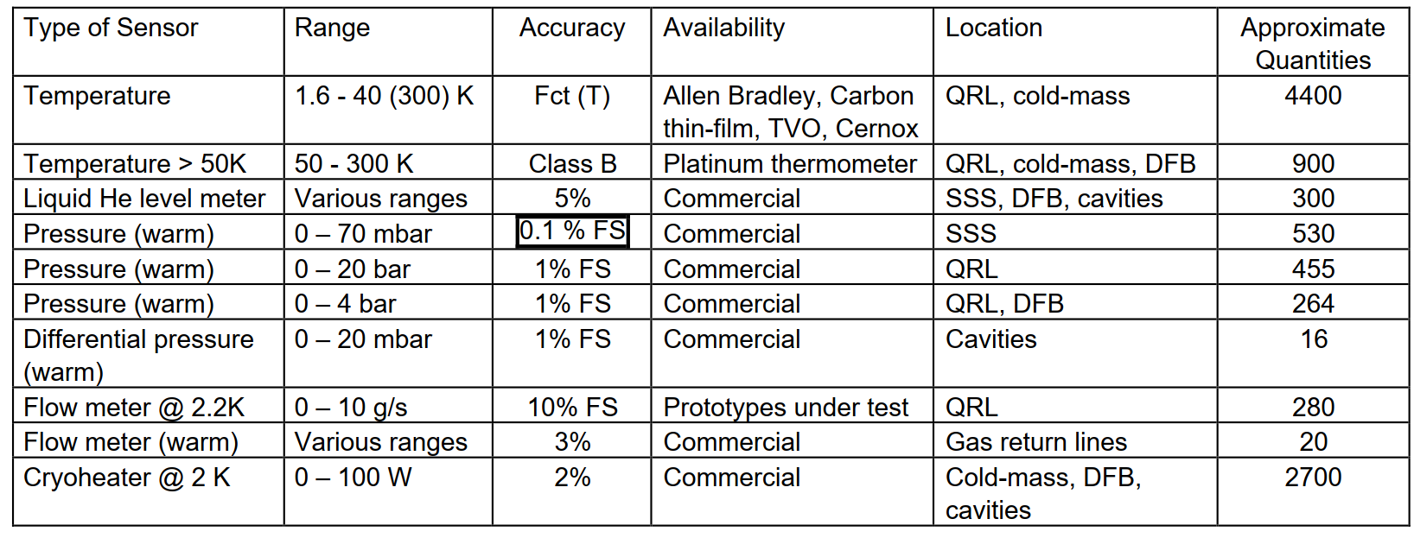
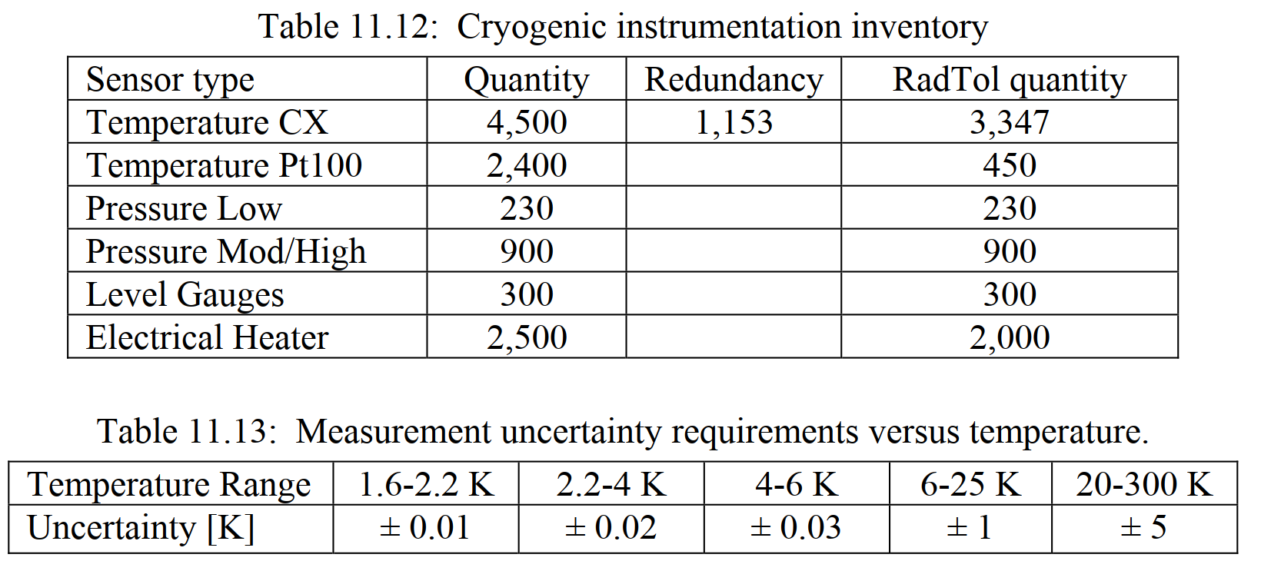
Instrumentation: Requirements then Selection
The ideal workflow is:
Design engineer provides a set of requirements
  Quantity including criticality (redundancy)
  Measurement uncertainty
  Environmental conditions
Instrumentation specialist selects appropriate candidates
  Final selection include qualification for non-standard (commercial) environments
  Acquisition chain is critical and shall be part of the cost optimization
LHC: selected requirements
LHC: preliminary analysis

Slide 4
Instrumentation: Metrology
Measurement is the process of obtaining experimental values attributed to a quantity or property.
Measurement of fundamental properties shall be reproducible worldwide.
National standard laboratories compare their measurement standards to provide consistent reproducibility of measurements worldwide and over time.
Major standard laboratories (non exhaustive) are:
National Physical Laboratory (UK)
Physikalisch-Technische Bundesanstalt – PTB (GE)
Laboratoire National de métrologie et d'Essais – LNE (FR)
Istituto Nazionale di Ricerca Metrologica – INRIM (IT)
National Institute of Standards and Technology – NIST (USA)
….
International organization responsible for worldwide coordination:
- Bureau International des Poids et Mesures – BIPM (located in Sèvres, France)

Slide 5
Instrumentation: Metrology
The metrological traceability is a property of a measurement
result whereby the result can be related to a reference
through a documented unbroken chain of calibrations.
Uncertainty defined by the GUM (Guide to the expression
of Uncertainty in Measurement):
Uncertainty: quantification of the doubt about a measurement result
  width of the margin (+/-) and confidence level (%)
Random errors Type A, systematic Type B
Practical measurements rarely use the formality stated in the GUM.
The GUM requires:
A mathematical model of the measurement process
Type A & B evaluation of standard uncertainty <= statistical analysis
Primary Reference Standards
Transfer Standards
Working Standards
Gauges, Instruments and
Equipment used to measure process
and Product Characteristics

Slide 6




Instrumentation: Metrology (Technical)
Objective of a measurement is to determine a value of the measurand, in other words, to sample one value out of a universe of possible values.
Accuracy: agreement of measurement with respect to the true value
Precision: spread of measurements (not related to true value, ~ repeatability)
Reproducibility: results can be attained by a different research team, using the same methods.
Bias: total systematic error as contrasted to random error
Trueness: closeness between the test results and an accepted reference value.
The measure of trueness is normally expressed in terms of bias.
Inaccurate & imprecise
(unrepeatable)
Precise but inaccurate
(repeatable)
Accurate but imprecise
Accurate & precise
Figures from a poster made by NPL

Slide 7
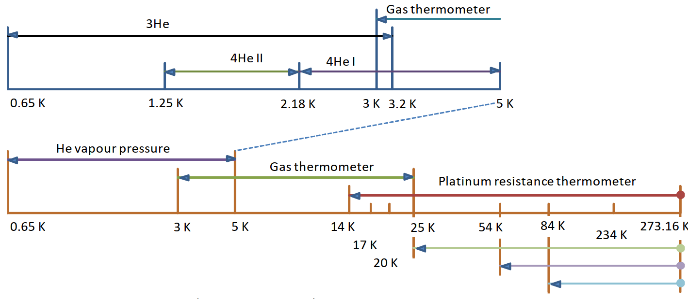
Absolute Temperature Scale (ITS 90)
Temperature (as pressure) is an intensive quantity and its measurement is done via the use of a transducer that measures a temperature dependent quantity.
An intensive property does not depend on size or mass.
The International Temperature Scale of 1990 extends upwards from 0.65 K.
Between 0.9 mK & 1 K it exists a provisional temperature scale (PLTS2000)
T [K] | Substance
13.8033 | e-H₂ (T)
17 | e-H₂ (V)
20.3 | e-H₂ (V)
24.5561 | Ne (T)
54.3584 | O₂ (T)
83.8058 | Ar (T)
234.3156 | Hg (T)
273.16 | H₂O (T)
³He, ⁴He from 4.2 K

Slide 8
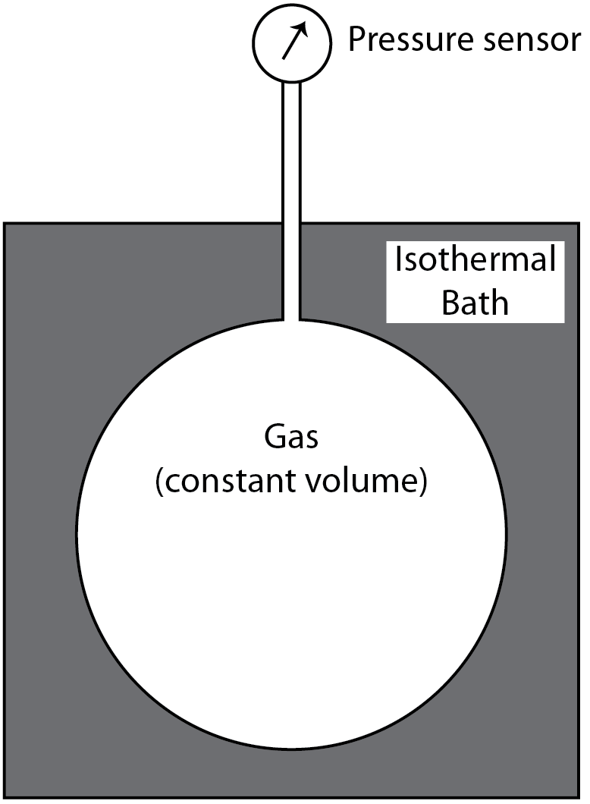
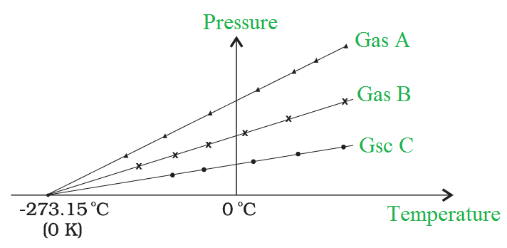
Absolute Temperature Scale
The origin for the value of the lowest attainable temperature is related with:
Freezing (ice point) temperature of water (0 °C)
Boiling temperature of water (100 ºC)
Law of perfect gases & constant volume gas thermometer
  Temperature % Pressure
Vanishing pressure ⬄ lowest temperature
The SI unit for temperature is K (Kelvin)
  0 ºC = 273.15 K

Slide 9
Absolute Temperature Scale
Constant volume gas thermometer: p . V = n . R . T => p % T
Stop working when reaching the gas liquefaction temperature
Virial expansion required to model non ideal gas behavior
p . V = n . R . T (1 + B(T) . (n/V) + C(T) . (n/V)² + …. )
Not as easy to use as it looks, it is an “approximation” technique:
  Real gas is not an ideal gas
  Temperature gradient along capillary
  Accuracy of pressure sensor
  ……

Slide 10
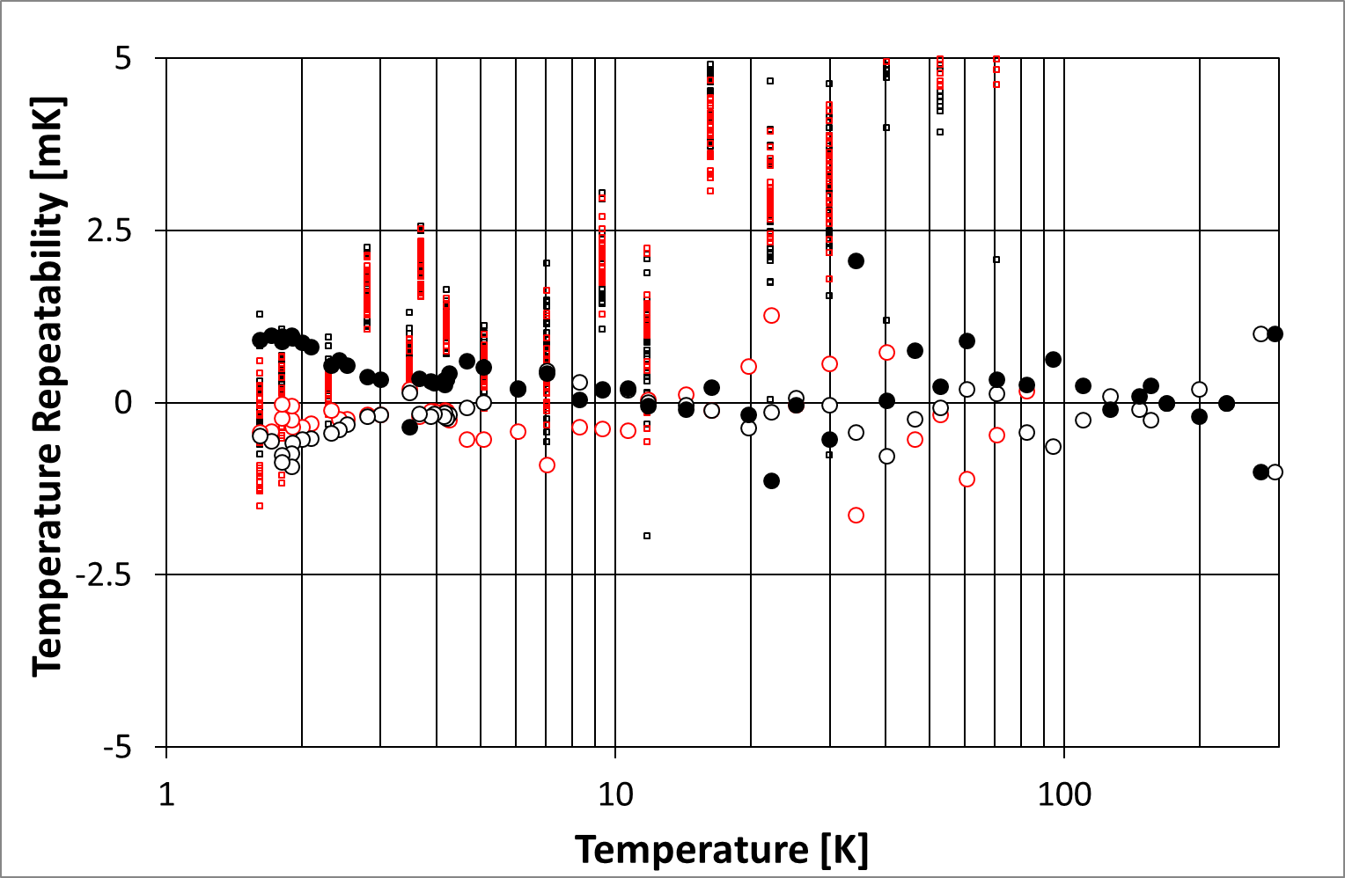

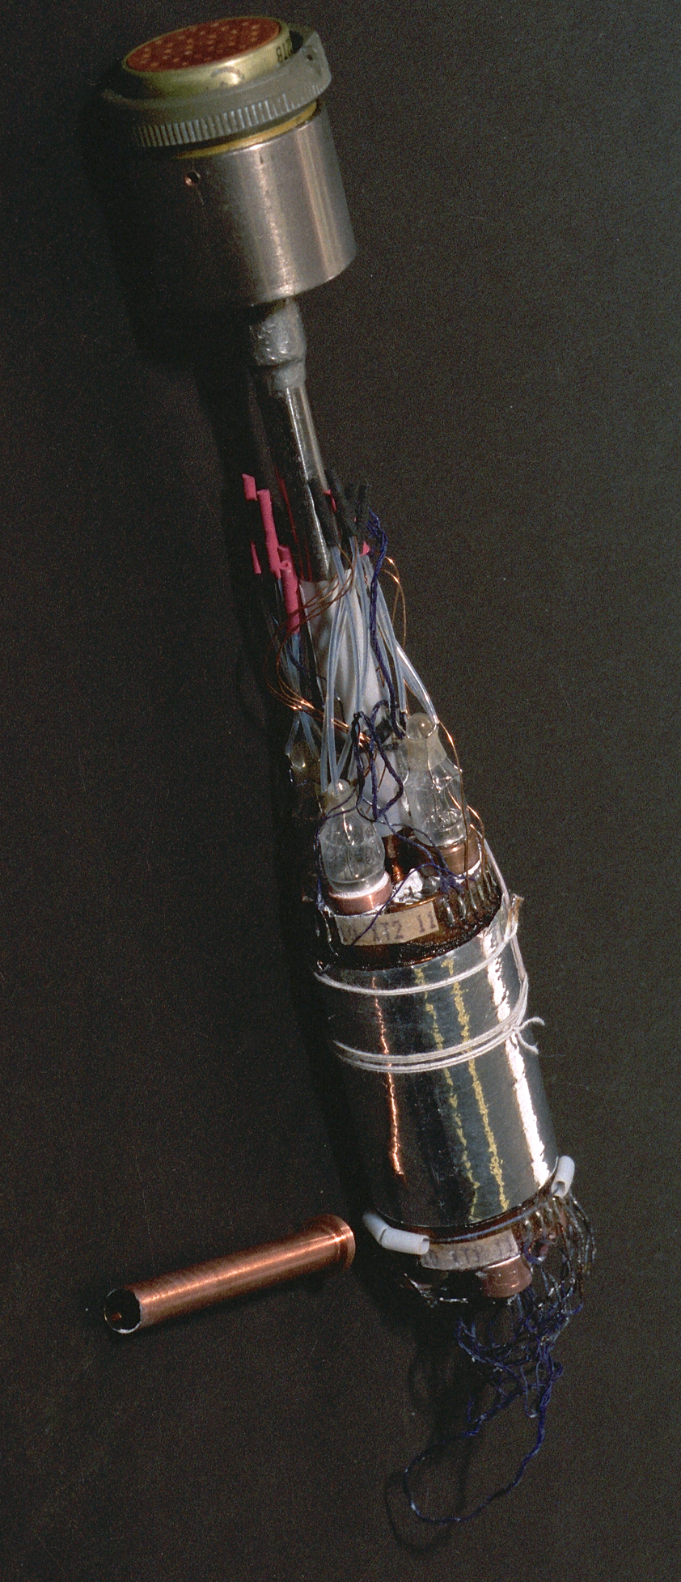
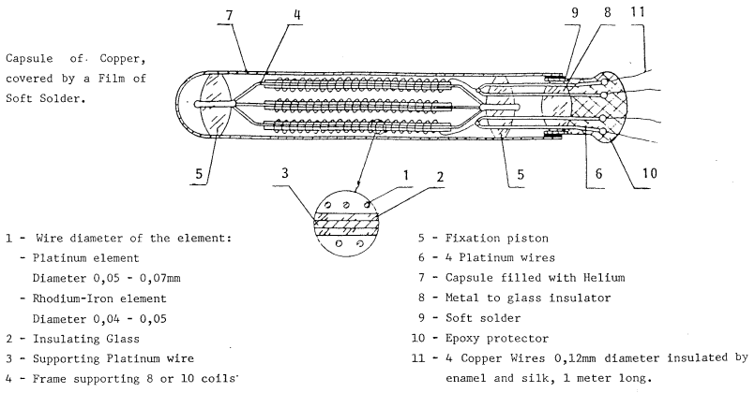
Absolute Temperature Scale: CERN standards
Rhodium IRon Thermometers (RIRT): used as secondary & working standards.
2^{ary} standards are compared to primary standards by a reference laboratory.
Working standards are installed in the series calibration insert & compared from time to time (yearly basis) to the secondary standards (in a separate insert).
RIRT standard made by Tinsley (UK)
RIRT standard made by VNIIFTRI (RUS)
VNIIFTRI standard comparison insert
: RIRTs in CERN calibration insert
: cernox sensors

Slide 11
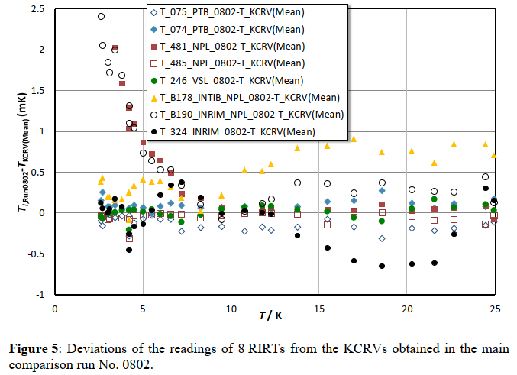
Standards/Calibration Certificates
The LHC requirements for the measurements below 4 K are very tight
Not far off from the national standards laboratories results:
Working & secondary standards are
not required for:
Pressure
Voltage
Current
etc.
industrial calibration certificates of
apparatuses is sufficient; these are:
DMM
Portable calibrators
Bench instruments
…..
From <<EURAMET Key Comparison No. EURAMET.T-K1>> (2016)

Slide 12
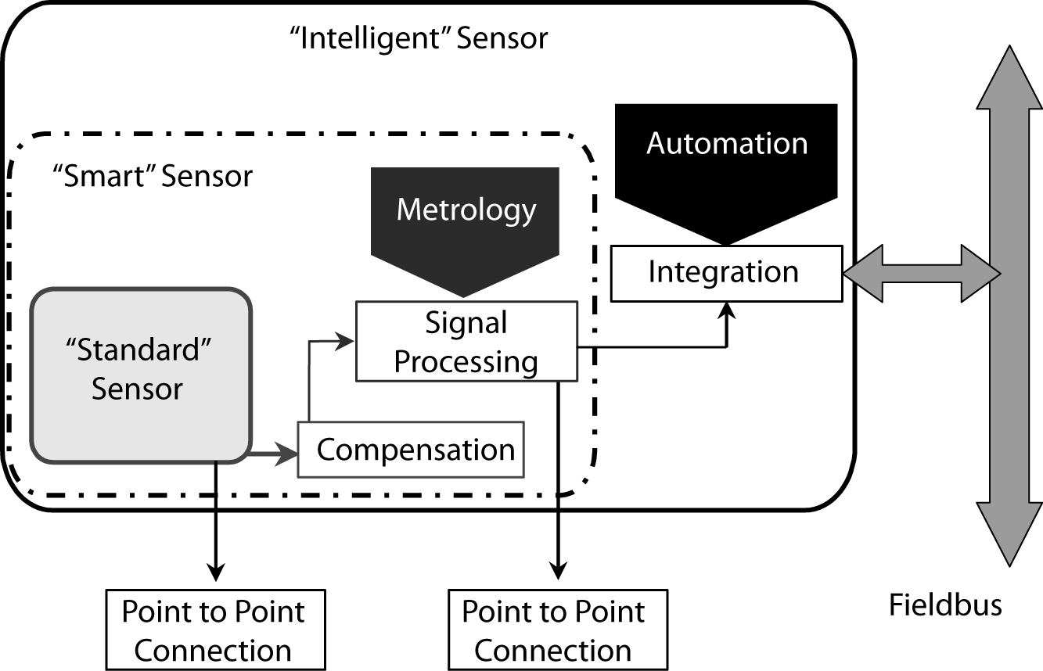
Instrumentation Chain: “Sensor” View
The market for sensors is moving towards more complex sensors that include all possible linearizations/compensations.
“Smart” commercial instrumentation for cryogenics is usable only @ warm.
Accelerators usually impose passive (dumb) sensors:
Too low temperature
Exposure to ionizing radiation
Many “smart” sensor are presently
being used in test areas and are
connected via fieldbuses:
Pressure
Flow
Valve actuators
…

Slide 13
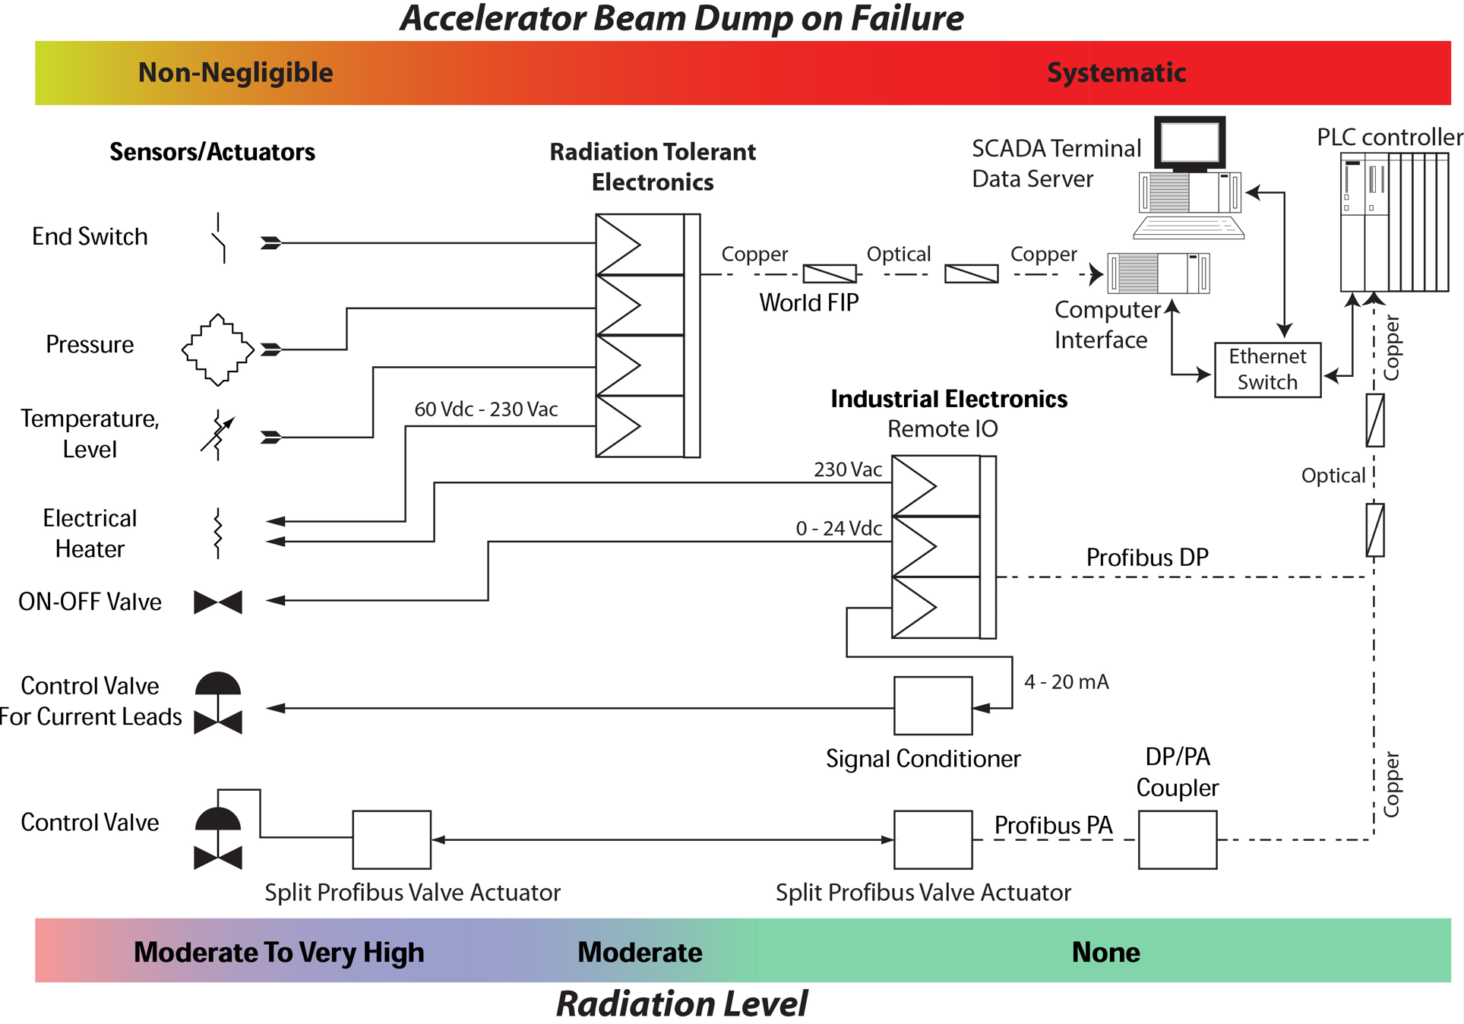
Instrumentation Chain: Particle Accelerator
Particle accelerator usually involve environmental radiation
More challenging than a typical industrial installation
Equipment need to be qualified by the end user
Critical equipment need to be located appropriately or provide adequate redundancy
Long distance require mechanisms to cope with EMI
20+ year operation design
  ¡ obsolescence !
LHC example

Slide 14
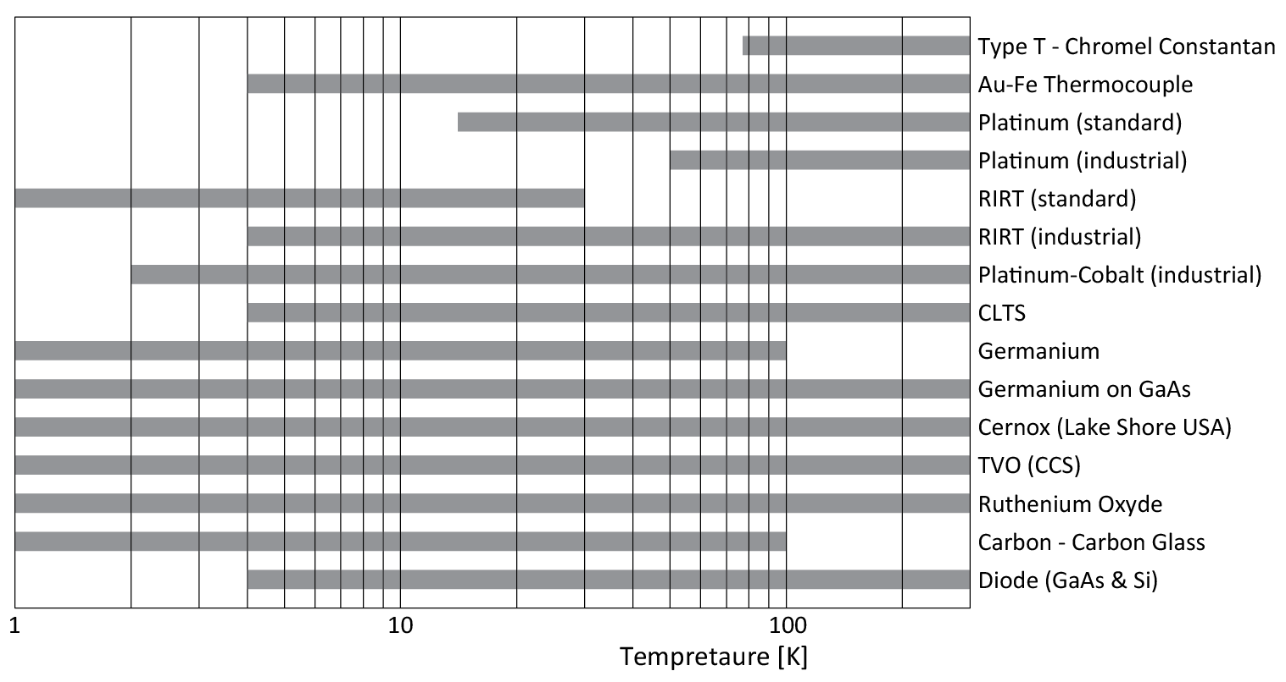
Temperature Measurement: Electrical Sensors
Most of the temperature measurements are based in electrical sensors.
Wide variety makes difficult to find a single one fitting all applications.
All are several decades old and some are becoming obsolete  or difficult to obtain .
✰
✰



Slide 15
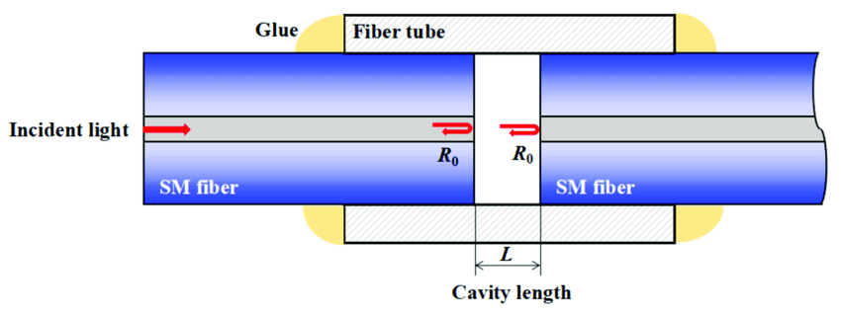
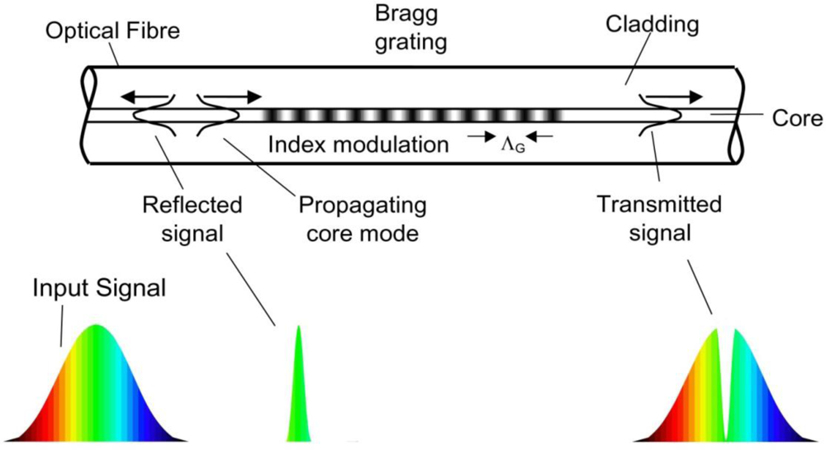
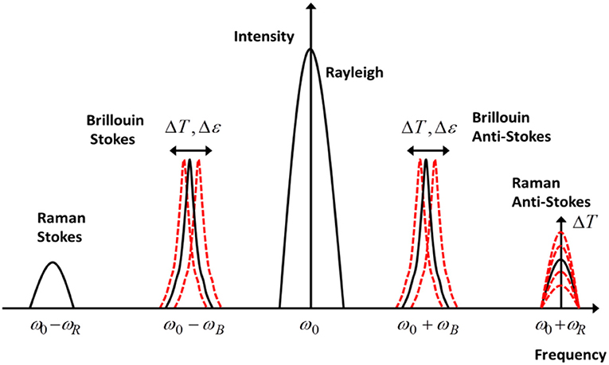
Temperature Measurement: Optical Sensors
“Bare” optical Fiber Sensing (OFS) technologies have a lower measurement temperature of about 50-80 K.
Distributed optical sensors is a mature technology
used to measure stress and temperature in civil
engineering, oil & gas, marine, etc.
Fabry-Perot

Slide 16
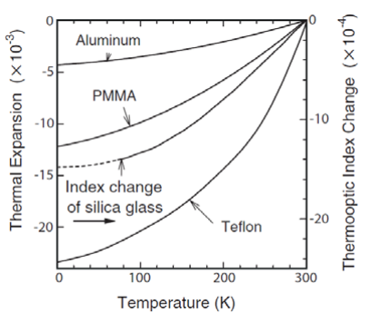
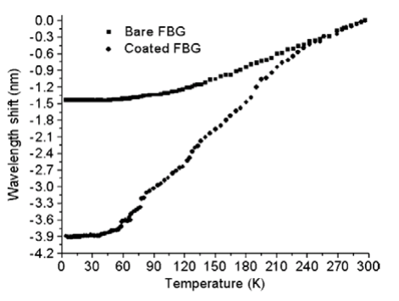
Temperature Measurement: Optical Sensors
The lower temperature measurement range can be extended by coating the fibre with appropriate cladding materials, the coating shall provide a significant thermal contraction well below 80 K.
Temperature is therefore measured through thermally-induced strain in the optical ﬁber => stress and temperature cannot be differentiated when using such technique.
No impact on Raman scattering as it is only temperature dependent.

Slide 17
Temperature Measurement: Optical Fiber Sensors (OFS)
OFS cryogenic applications are indeed being developed.
For instance ITER intend to deploy OFS to measure stress (FBG), displacement (FBG & FP) and temperature (FBG).
Some published data indicate measurement of temperature down to LHe temperatures, although the associated uncertainty is difficult to understand.
As for any temperature sensor, they require to be appropriately anchored and are affected by thermal cycles.
Main advantages are distributed measurements over long distances (several km), immunity to electro-magnetic noise, high voltage insulation, etc.
Measurements require a reading unit that provides the optical signal (laser) and process the reflected and/or transmitted light.

Slide 18
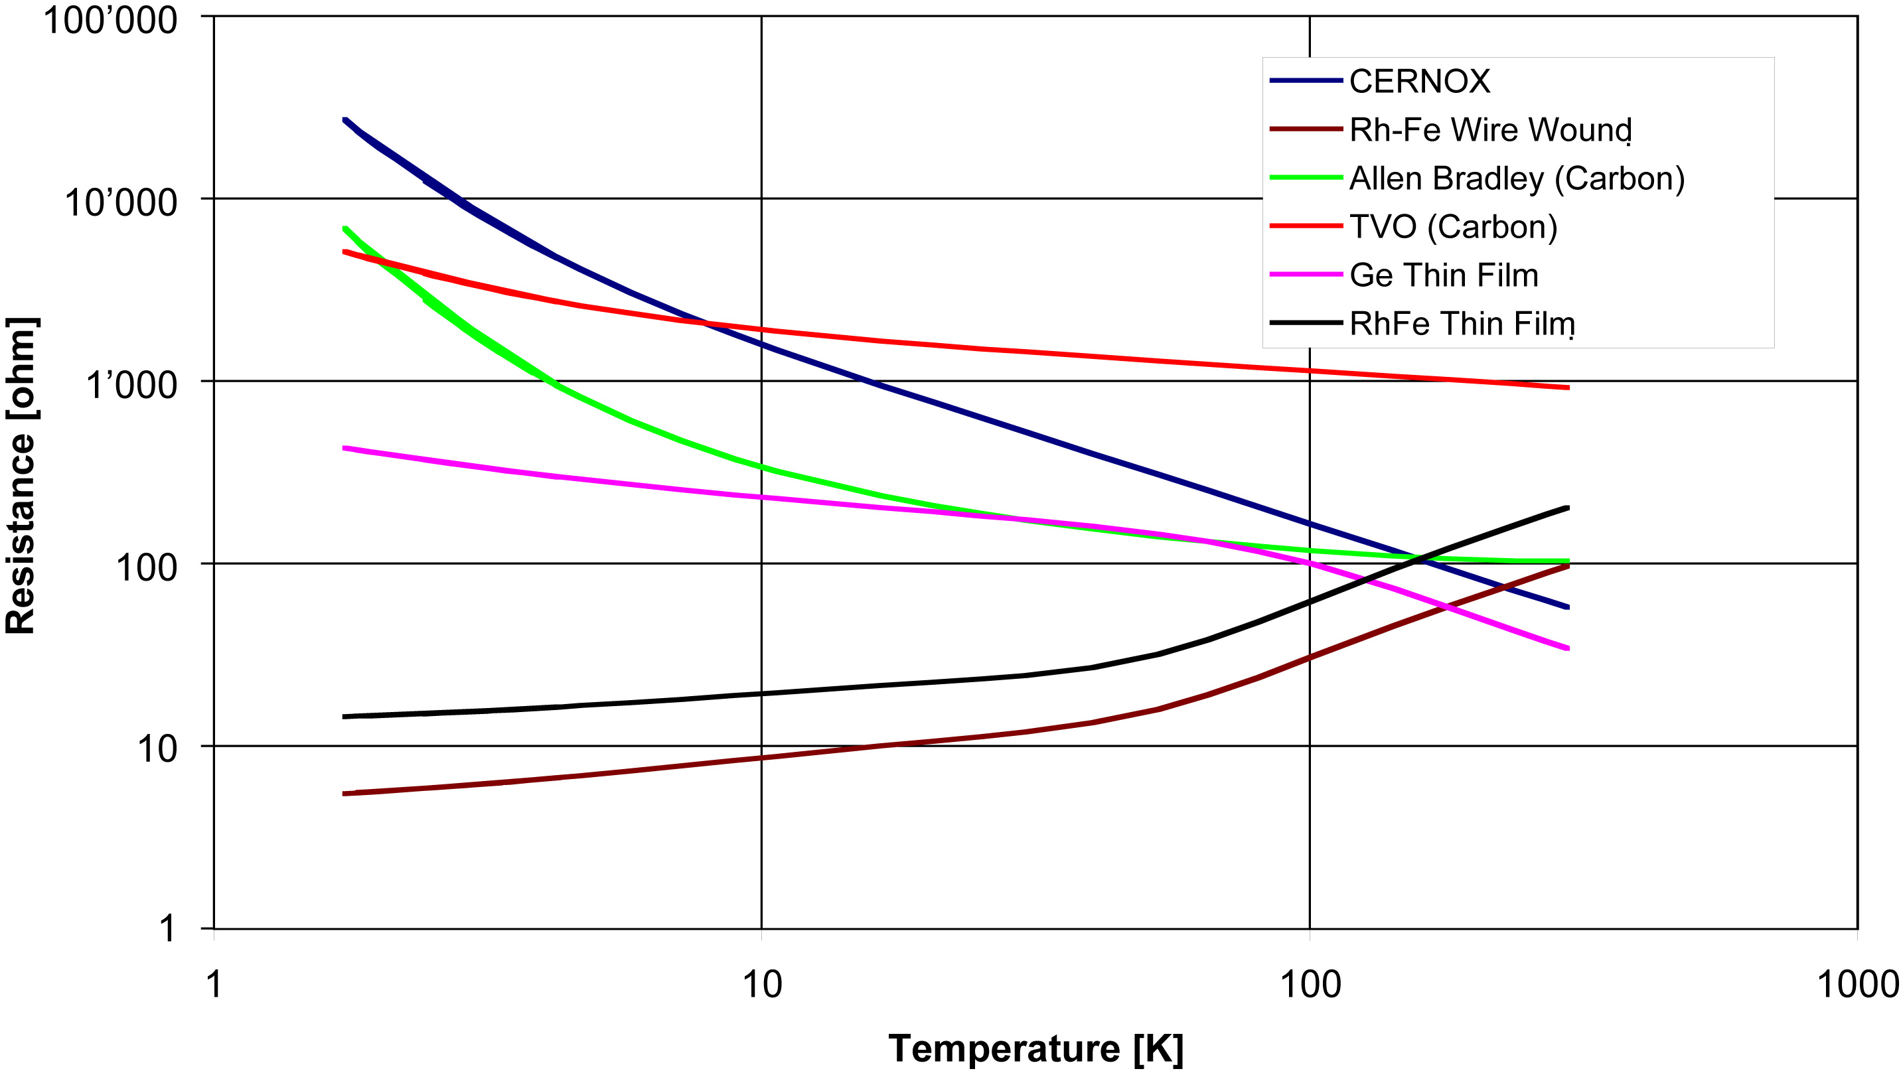
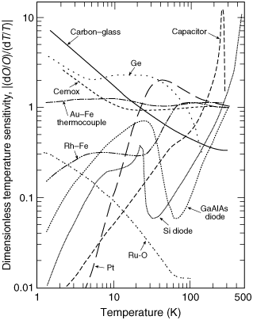
Temperature Measurement: Electronic <-> Sensor Matching (LHC)
The LHC temperature requirement:
The TYPICAL resistance versus temperature of the LHC candidates had both positive (RhFe & Pt 100) and negative (cernox, Allen-Bradley, TVO, Ge) dR/dT

Slide 19
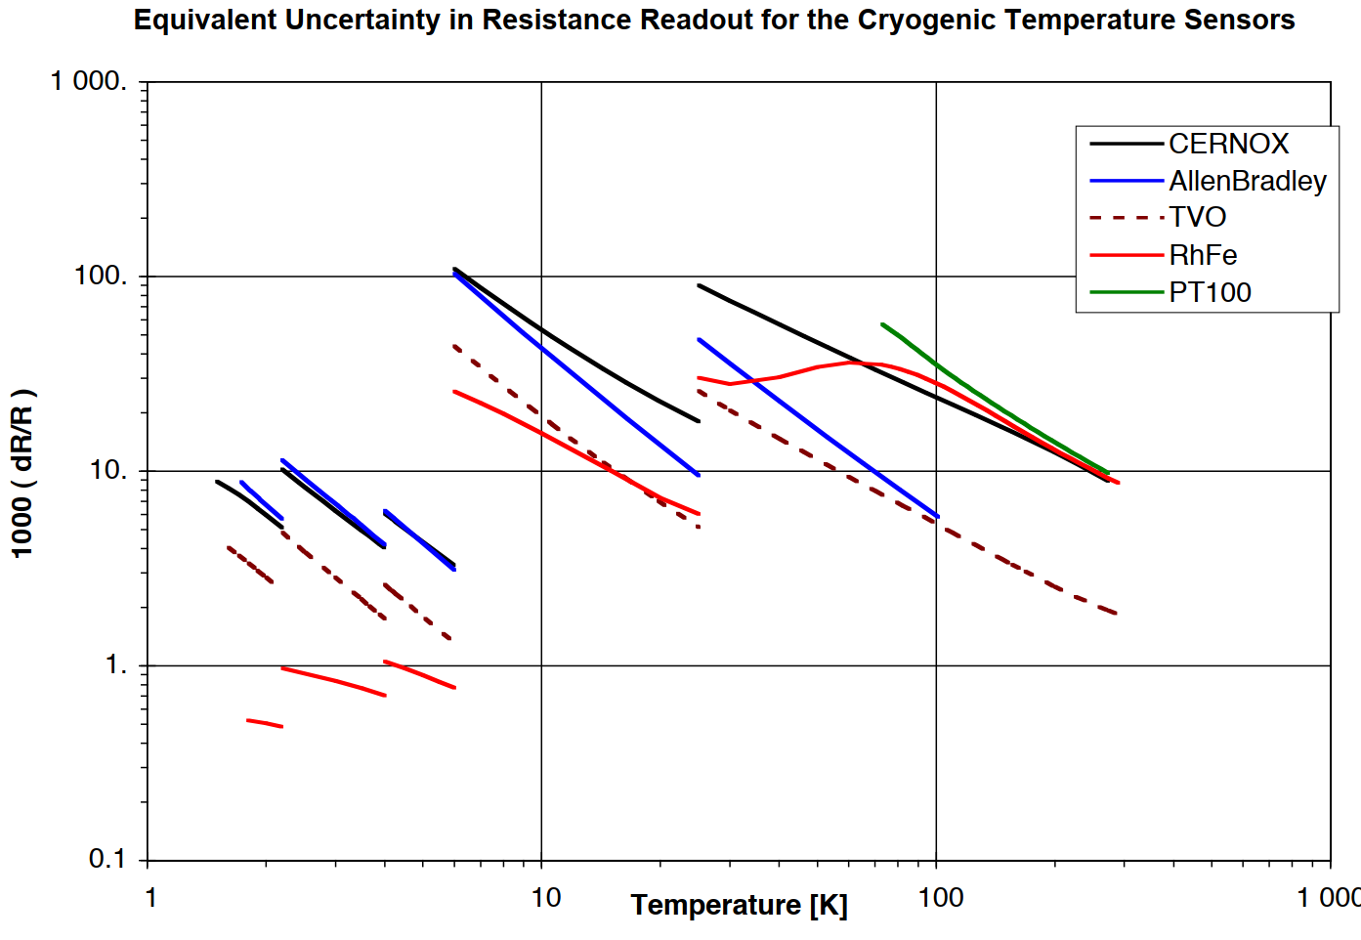
Temperature Measurement: Electronic <-> Sensor Matching (LHC)
The LHC temperature requirement:
The precision budget was shared in equal parts between the sensor & electronics.
Requirements are tough below 6 K.
RhFe: demanding signal conditioning
Very small sensitivity
All sensors are slightly different:
QA system to track sensor installation
Sensor <-> location need to be known
0.25 % RDG
CRYO ACQ
Electronics shall provide better accuracy

Slide 20

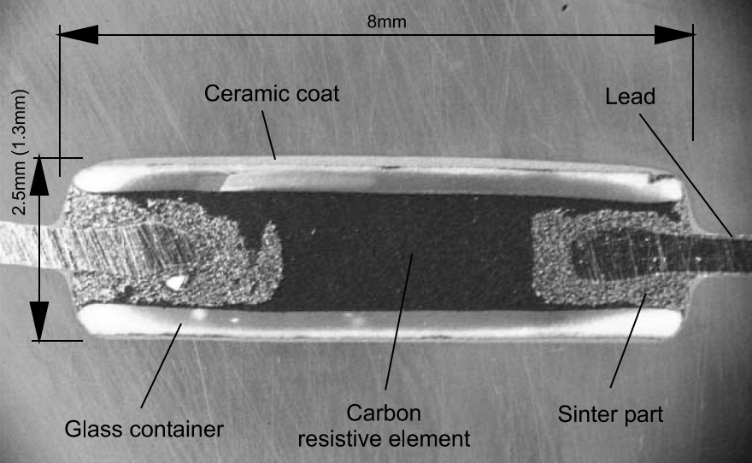
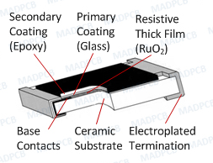
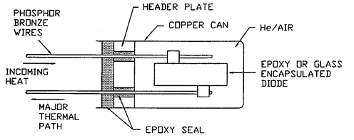
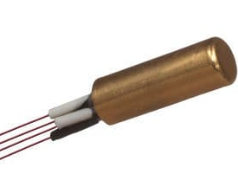
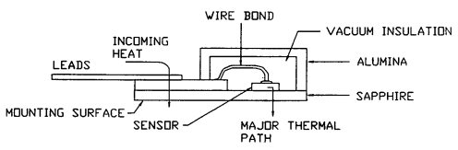
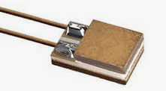
Temperature Measurement: packaging for electrical sensors
Commercial resistors
TVO, Allen Bradley, Ruthenium oxide
Anchoring via wires & body
Robust package
Canister mounting
Ge, carbon glass, cernox, ..
Anchoring via wires
Canister anchoring quite useless ⬄ vacuum
Fragile package:
epoxy seal damage
=> sensor damaged if not passivated
Specific mounting (SD Lake Shore)
Cernox, diode, etc
Anchoring via wires (& body)
Robust package but wires (leads) are fragile.
TVO
RuO2 (SMD)
Canister
SD

Slide 21
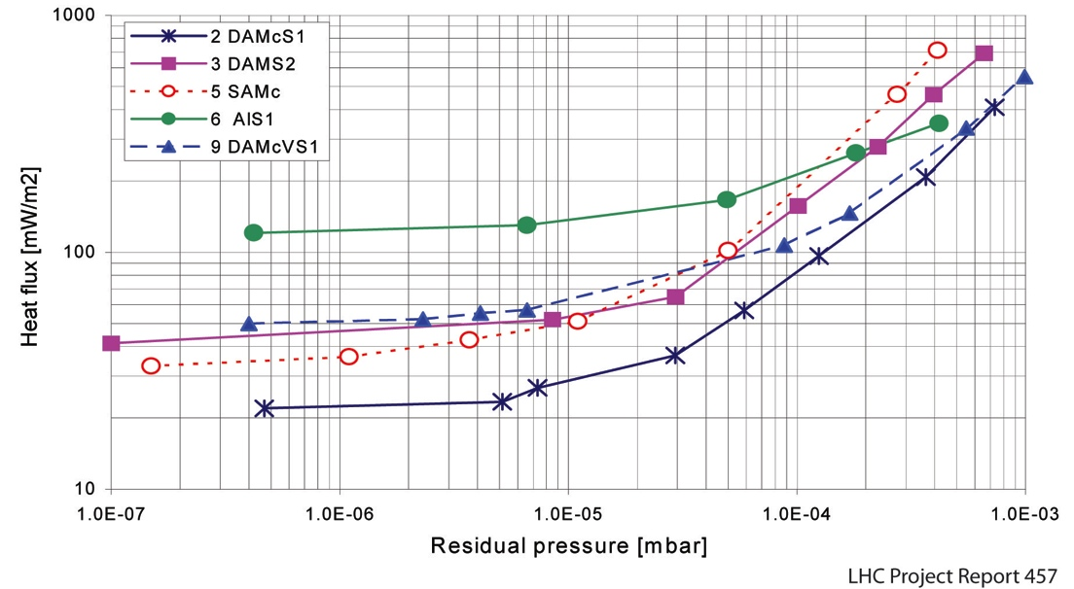
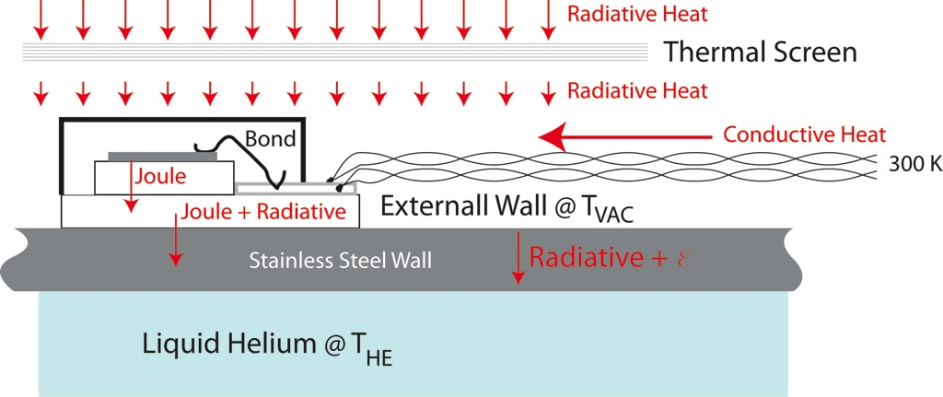
Temperature Measurement: Thermal Anchoring under vacuum
Need to cope with photon radiation, heat transfer through solids & Joule effect.
Radiated Heat Flux In Vacuum envelope
PARAMETER: Type of Superinsulation
Thermal Conductance
Measurement

Slide 22
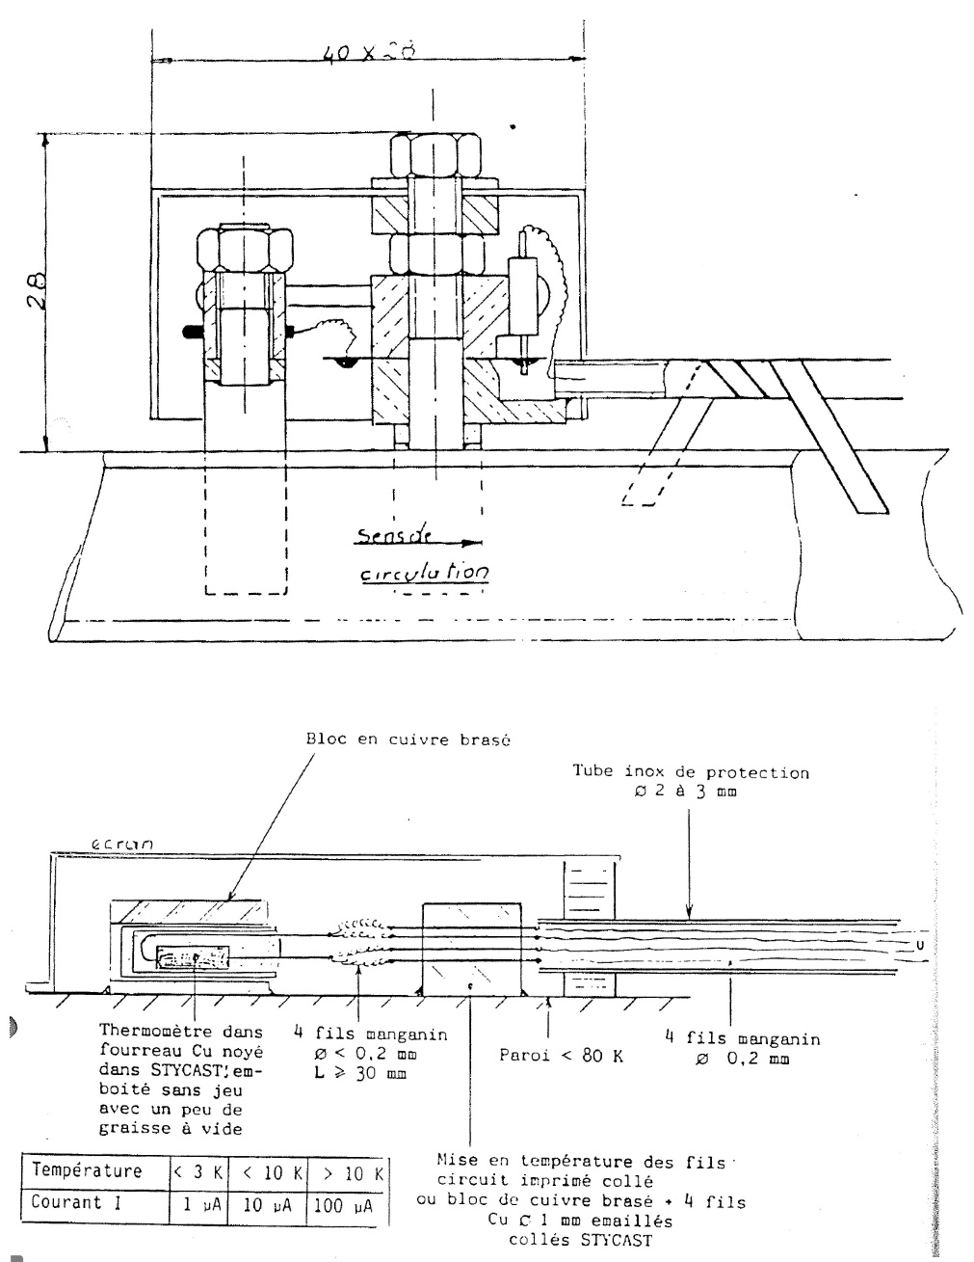
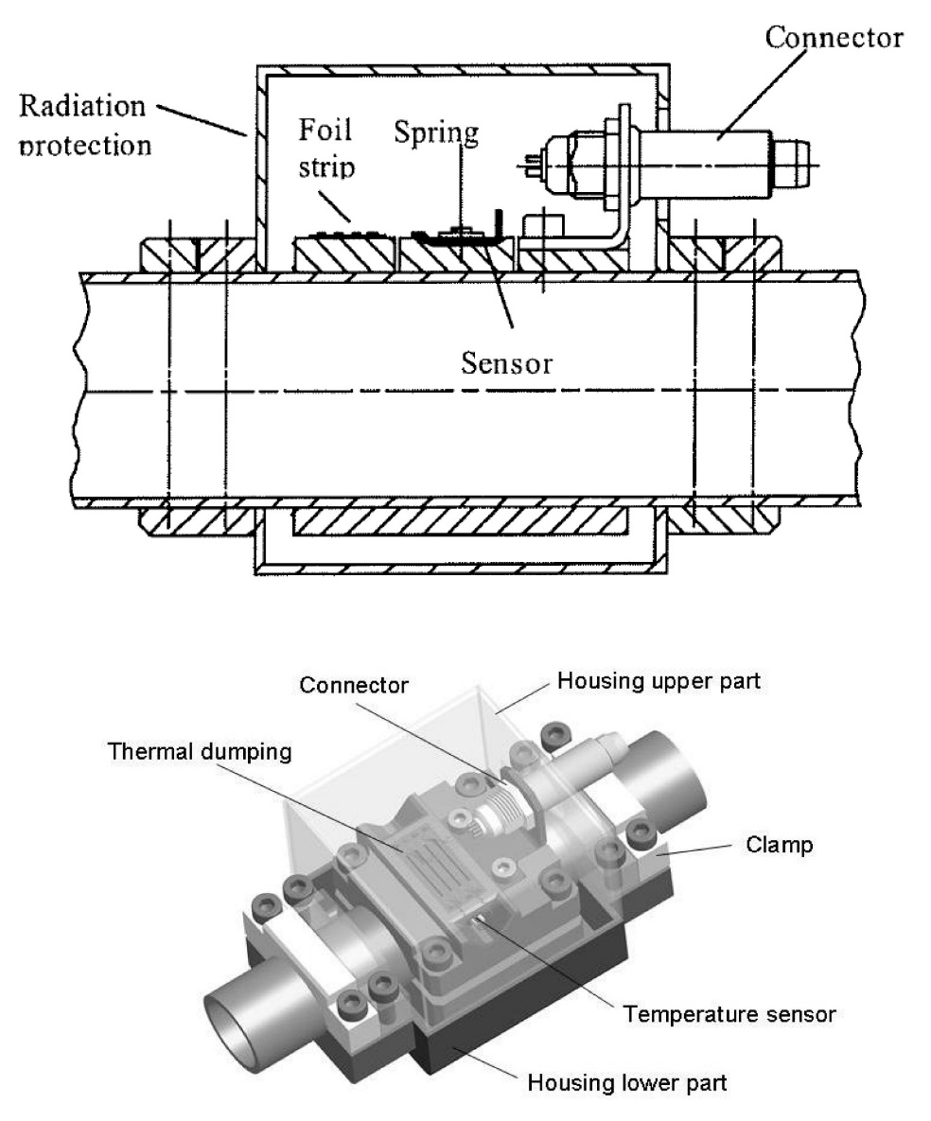
Temperature Measurement: Thermal Anchoring under vacuum
Existing industrial approaches, both examples rely on two anchoring “islands”:
1st island anchors the incoming wires to reduce the heat reaching the sensor
2nd island anchors the sensor body and wire
CEA – 1998
Independent thermal anchor for sensor & wires
Brazed assembly
KFK - 2010
Independent thermal anchor for sensor & wires
Clamped assembly

Slide 23
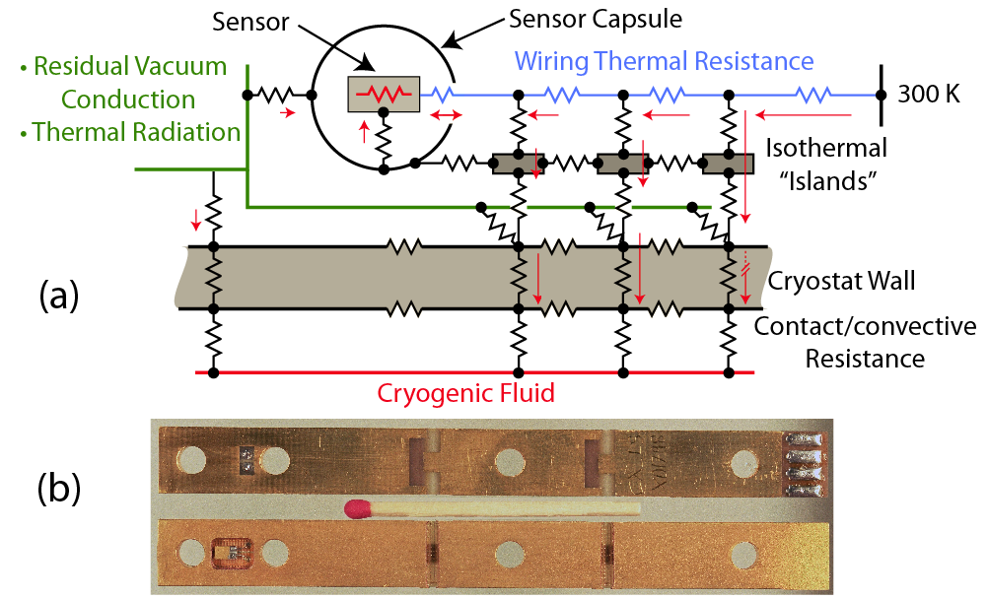
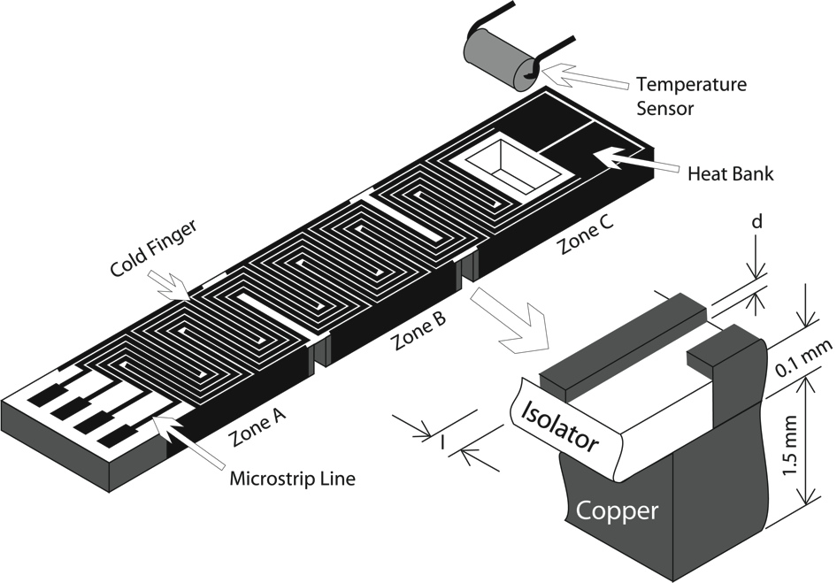
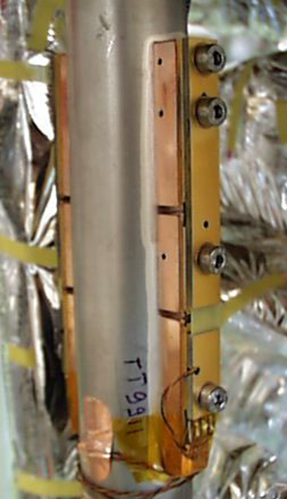
Temperature Measurement: Thermal Anchoring under vacuum
LHC vacuum thermometer based on a triple anchoring support
increases robustness in case one anchor “island” is loose
“islands” are thermally decoupled ⬄ do not short on copper support
Reduce heat from warm feedthrough => long & resistive (non-copper) wires
Calibration performed on full assembly before screwing in final position

Slide 24
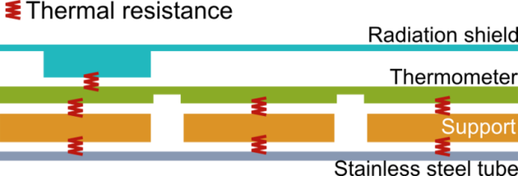
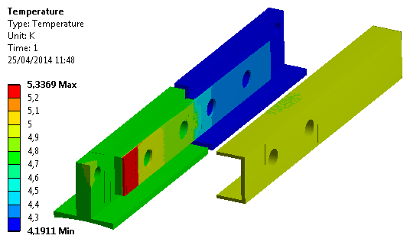
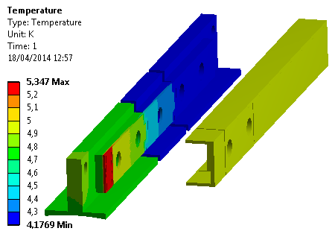
Temperature Measurement: Thermal Anchoring under vacuum
ITER-CEA has adopted the LHC long thermometer block for vacuum applications.
CEA used finite element model to simulate 2 & 3 island configurations:
3 islands provides better accuracy
confirms CERN’s (much) simpler calculations
Main contributors to external wall temperature increase:
  Thickness of stainless steel wall
  Photon radiance
  Thermal transport through wires <= copper
Measurand = external wall temperature
Helium
Copper block
Sensor
location
2 Islands
3 Islands
3 islands ->
ΔT = 15 mK
ΔT = 2 mK
2 islands ->
ΔT = 43 mK
ΔT = 8 mK

Slide 25
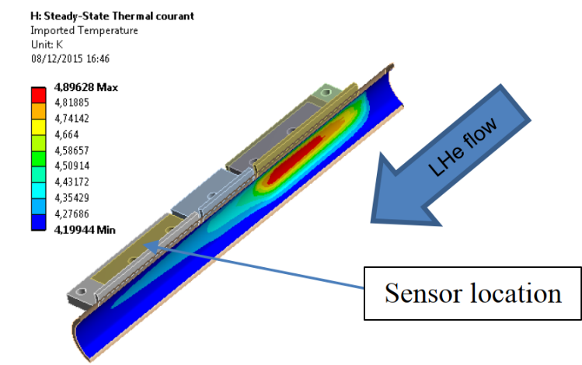
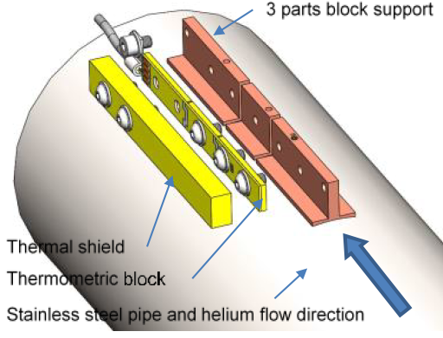
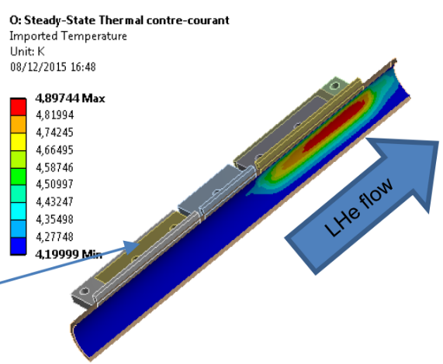
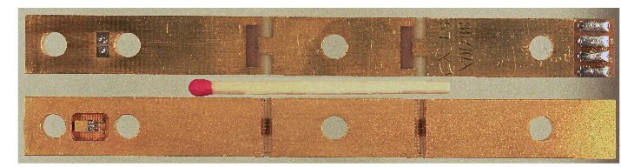
Temperature Measurement: Thermal Anchoring under vacuum
As confirmed by finite element modelling the sensor should be upstream
see light blue temperature propagation with flow
CERN design is asymmetrical => support structure shall be properly orientated
CEA design is symmetric => orientation has to be checked on assembly or repair

Slide 26
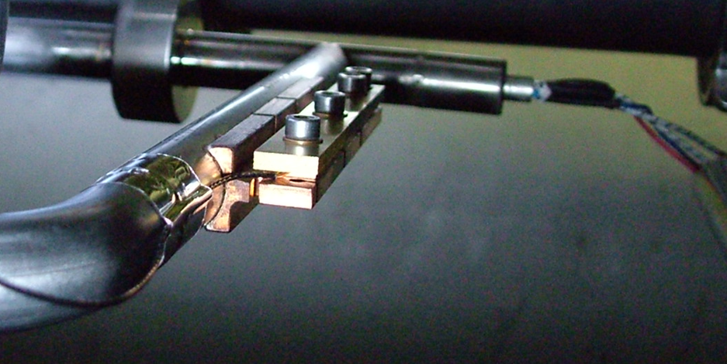
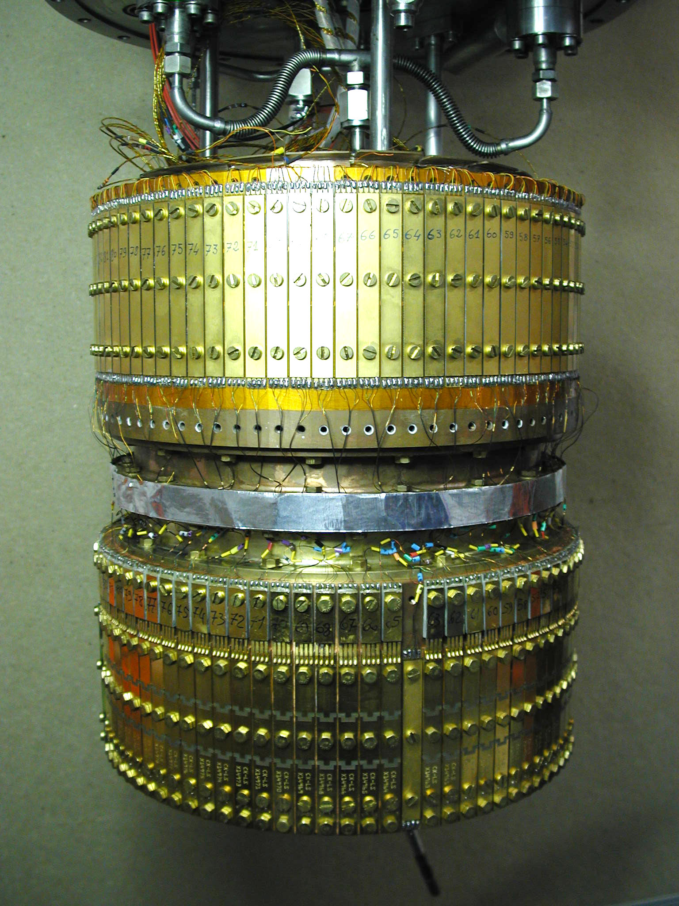
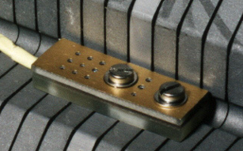
Temperature Measurement: Thermal Anchoring under vacuum
Calibration performed under vacuum with sensors on final holder:
Long block for vacuum applications
Short block for immersion in LHe
Bare sensor for insertion thermometry
}
<= Sensor not manipulated after calibration
Series calibration insert
Capacity: 74 sensors

Slide 27
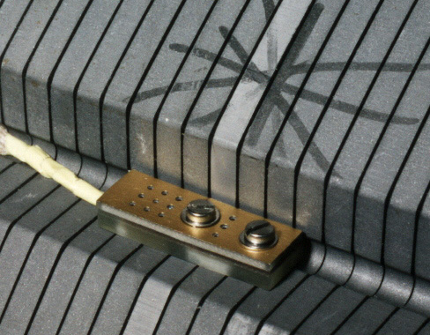
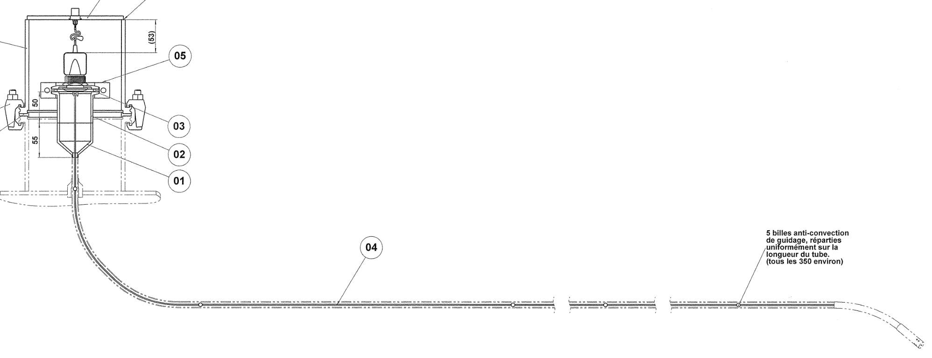
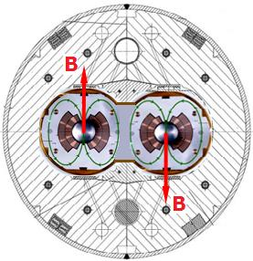
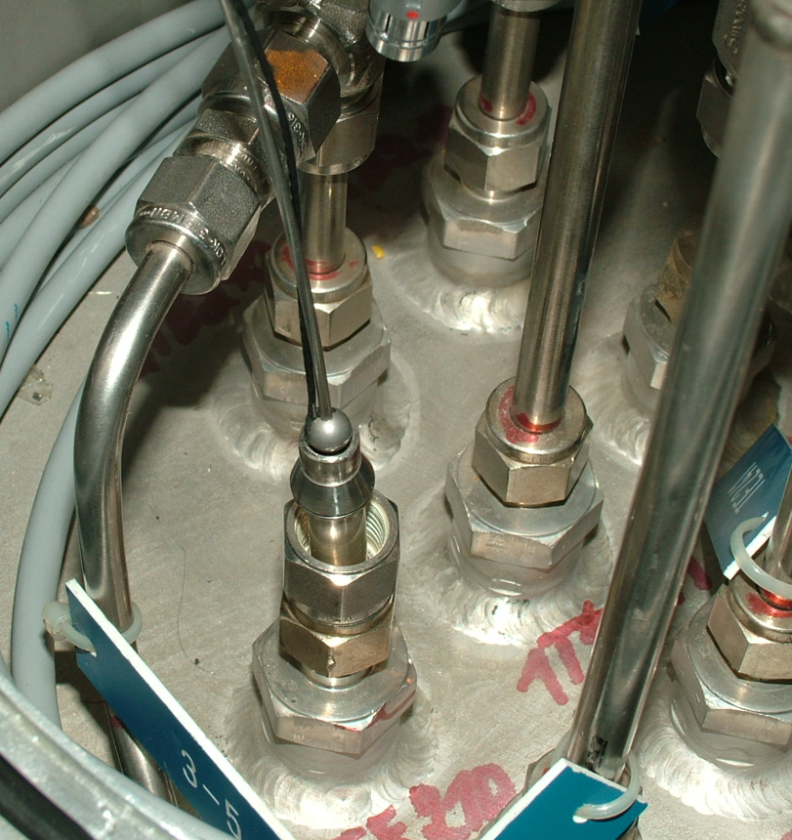
Temperature Measurement: Insertion thermometry
Through wall thermometry (vacuum) for low pressure gaseous helium complicated due to poor heat exchange between helium and inner pipe walls.
Low pressure gaseous helium => insertion thermometers:
Added advantage: exchangeability
Liquid helium thermometers have their cables anchored at the fluid temperature
Possible problem is sensor mechanical protection during fast flow transients
Wires thermalized by LHe ⬄ wires bring heat.
LHC cold mass thermometer.
Mechanical protection for cable and fast flow
Insertion Thermometer
Example: LHC QURC, wire with alignment balls
Negligible effect
from stray field

Slide 28
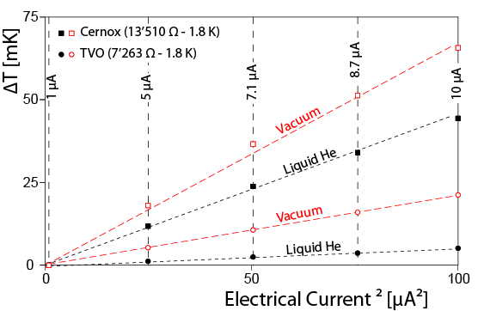
Temperature Measurement: Electrical Perturbances – Joule self-heating
Resistance measurements using a DMM will result in a too high temperature:
100 µA (or higher) is common for portable and benchtop DMMs
Measurements below 5 K require:
a low current source and a volt-meter.
bipolar excitation current to compensate thermoelectric effects.
CERN data for sensors:
vacuum: thermalization only through wires
LHe: immersion of sensor & wires
TVO

Slide 29
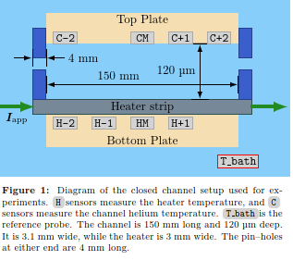


Temperature Measurement: time response
Examples of fast temperature transients can be found in:
LHC string test that at the time had a variety of sensors (20 Hz BW)
Heat transfer in confined He II using bare-chip cernox sensors (10 kHz BW)
SM18 String test 13.1 kA quench
Ghini et al 2022
Confined HeII
Heater Temperature sensors
Channel Temperature sensors

Slide 30




Temperature Measurement: time response (courtesy Ph. Roche)
Within the framework of EUHIT (European High-performance Infrastructures in Turbulence) fast thermometers (> 70 kHz) were developed:
very low mass & adequate resistance to cope
with stray capacitance.
Low heat capacity is crucial!
2nd sound spectra
Thermal wave amplitude
LHe-II
Heater (emitter) frequency
Heater or AuSn thermometer based on SC transition
AuSn thermometer deposited on 20 µm thick Si

Slide 31



Temperature Measurement: time response
Reported time response vary from author to author and it is often difficult to understand how the stated value is obtained.
However some authors do provide experimental data:
Bloem: sensor attached to Cu under vacuum
Louie: thermo-acoustic temperature oscillations
In most cases the temperature response time is
dominated by the specific heat of the part under test.
Lower heat capacity (mass) ⬄ faster thermometer
Bloem 1984
Louie 1986
Author | Sensor Type | Response Time[s]
Datskov et al 2013 | TVO | 0.001
Datskov et al 2013 | Cernox | 0.015
Kar et al 2007 | Cernox | 0.002
Bloem 1984 | Carbon thin film | < 0.001
Louie et al 1986 | Film on sapphire | 10 n

Slide 32




Temperature Measurement: time response estimation for cernox
From the Joule self-heating (current vs ΔT figure), sapphire density (3980 kg/m3), C_{p} specific heat (2.3x10-3 J/(kg.K) @ 1.8 K) and assuming (overestimation) that it is a cube of sapphire (3.175 mm x 1.905 mm x 1.08 mm) the temperature evolution can be estimated by solving:
$$\frac{dT(t)}{dt}=\left(T_{b}−T\left(t\right)\right)×\frac{R×i^{2}}{{∆T}_{joule}}×\frac{1}{C_{p}×mass}$$
Response time: a few ms
Cernox chip: 40 less mass & better contact
Temperature [K]
Transient response for LHe 0.1 K step
T(0) = 1.8 K (calculation).
Joule self heating from 2 different sensors
Time [s]

Slide 33






Temperature Measurement: Environmental Perturbances – magnetic field
Variable temperature resistance sensors exhibit magnetoresistance
Capacitance, gas, … thermometers are insensitive to magnetic field
However are less practical thermometers
$\vec{B}$ versus ΔT in principle
repeatable.
Cernox magnetoristance, Brandt et al (1999)
$$\vec{B}$$
Ge magnetoresistance, Haruyama et al (1996)
$$\vec{B}$$
= &  orientations

Slide 34


Temperature Measurement: Environmental Perturbances – magnetic field
If the magnetic field is known the temperature reading can be corrected
An individual sensor correction is preferable
LHC stray fields are low and no effects are seen on the temperature reading.
High magnetic stray fields may exist in high current lines & magnets
Error for cernox single B correction, Brandt et al (1999)
magnetoresistance, Brandt et al (1999)
It is assumed that for other measurements the sensors can be moved away from magnetic fields
Most sensors will exhibit magnetic induced deviations

Slide 35


Temperature Measurement: Environmental Perturbances – Radiation
Radiation affects in a non predictable way the characteristics of any sensor.
Pre-LHC radiation qualification, several sensors were reported for radiation resistance effects; they were TVO, Allen-Bradley, Ge on GaAs, cernox…
LHC specific radiation tests were carried to understand effects from heavier and more energetic particles and thermal annealing when irradiating @ superfluid helium

Slide 36

Temperature Measurement: Environmental Perturbances –Radiation
Radiation tests are very demanding on resources.
Furthermore health hazards need to be tackled carefully.
Ideally radiation tests shall be done in the nominal operating conditions:
For LHC cryogenic temperature sensors it means between 1.8 & 300 K.
In the early LHC design days the radiation background was well known for the arcs. The guidelines were:
Arc TID x 10 = TID for DS
Arc TID x 100 = TID for IT
Sensor shall be located according to
radiation maps:
yoke used to attenuate de TID
Avoid areas with gaps respect to the
radiation source
LHC annual dose (ARC)
300 Gy @ 25 cm
1,5 10¹³ n.cm⁻²
60 Gy @ 45 cm
3 10¹² n.cm⁻²
10.000 Gy @ 6 cm
5 10¹⁴ n.cm⁻²

Slide 37



Temperature Measurement: Environmental Perturbances –Radiation
The LHC radiation qualification was performed in the SARA and CERI cyclotrons.
The test cryostat was shared between ATLAS (LAr) & CERN/tunnel (LHe).
To reduce the thermal budget the cryostat was made of aluminum
Density much lower when compared with stainless steel
Absorbed radiation % mass => produce heat
Operating temperature between 1.6 and 4.2 K.
LHC temperature sensors radiation qualification set-up
Cyclotrons: SARA (Grenoble) or CERI (Orleans)

Slide 38

Temperature Measurement: Environmental Perturbances –Radiation
The radiation dose rate induces an additional sensor heating -> temperature rise
Similar for a given sensor type (% mass, cross section & thermal contact)
Can be compensated on the condition that the dose rate is known
LHC radiation dose rate is comparatively extremely low
  => no observable heating due to radiation
Radiation dose heating for a TVO sensor
Yearly LHC radiation dose accumulated in a few hours ->

Slide 39

Temperature Measurement: Environmental Perturbances – Radiation
Neutron irradiation expected to cause larger damage to ordered structures:
RIRT and platinum performance improves with stress free structure
=> neutron damage probably causes additional stress
Allen Bradley, TVO and cernox are amorphous materials

Slide 40


Temperature Measurement: Environmental Perturbances – Radiation
Sensor damage/drift not only depends on the Total Integrated Dose (TID)
But also in its history => Thermal annealing of defects
Ge on GaAs (Germanium) was reported @ LN2 to be radhard; BUT
  1.8 K neutron irradiation provokes a very fast drift of its resistance
  4.2 K to 273 K completely restores initial characteristics
Thermal annealing not observed for cernox & TVO.
Ge on GaAs could have been adopted for the LHC
Cold test was crucial in this particular case
ΔT [K]
Beam OFF
300 K
Beam ON
1.8 K
Beam ON
1.8 K

Slide 41

Temperature Measurement: Sensor ageing (resistive type)
Cryogenic temperature sensors may change their characteristics over time
Historical data is very important for standard laboratories
Thermal cycles is the accepted method for accelerated ageing
  Shall be within the expected range of operation
Moisture is a concern in particular for non sealed sensors
Drift for industrial Pt100 sensor is not a concern, the standard curve (ie sensor interchangeability) is adequate for most applications.
Cernox exhibits better stability
with increasing temperature.
AB “improved” packaging
no observable improvement.
After 100 cycles between 4.5 K & 270 K in GHe

Slide 42



Temperature Measurement: Protection of low level signals
Temperature measurement: very low amplitude & usually low frequency
Electrical signals require EMC emission protection:
Cables shielded (double shielded ideally)
  External shield GND on both sides (HF)
    shield taken on full circumference
    No pigtails, it degrades immunity
  Internal shields GND on only electronic side (LF)
Twisted signal pairs
Cryostat is a Faraday cage ⬄ no need for shields
  Check neighbors for noise emission


Slide 43
Temperature Measurement: Environmental Perturbances - EMI
SM18 – String test (2006)
Cross talk from magnets current => erroneous 30 mK temperature increase
Solution: power converter filter circuit modified
Most probably cross-talk happens inside the LHe magnet vessel

Slide 44


Temperature Measurement: Environmental Perturbances
LHC case: shared grounds with power converter and quench protection
May result in collateral damage (sensor, electronics, ..)
  Dielectric breakdown can happen during HV tests
Can result in noise (difficult to understand)
May require additional filtering
Temporary GND connection
Caused voltage offset & fluctuations
a.c. noise => non-linearity => d.c. offset!

Slide 45

Temperature Measurement: Catastrophic Events
During the assembly of the LHC magnets, sensors were destroyed during:
LHe vessel longitudinal welding (magnetic coupling)
HV coil tests (capacitive coupling)
=> Appropriate procedure mitigated the problem

Slide 46



Temperature Measurement: Catastrophic Events
Routine high voltage tests on LHC circuits may destroy a temperature sensor:
Platinum filament is about 2 µgr
2041 K is the melting temperature of platinum
  => 0.45 J to melt 2 µgr in adiabatic conditions (fast transient)
  Verified experimentally in the lab with 700 nF
  Magnetic circuits stray capacitance: 700 nF up to 50 µF
=> “HOT” lines shall provide adequate voltage insulation
Pt100 sensor from main SC lead
Damaged Filament !

Slide 47
Temperature Measurement: Signal Conditioning
Resistance based temperature sensors electronics & processing:
Thermo-voltage compensation (variable excitation current)
  It can be in the range of tens of µV
Low excitation current (otherwise sensor self-heating need compensation)
  Repeatable self-heating temperature increase (varies slightly from sensor to sensor)
Low noise amplifier
Typically some analog to digital conversion (ADC, analog to time,..)
  or analog output (4-20 mA, 0-10 Vdc, ..)
Resistance to temperature conversion
  CERN:
    calibration data stored in a database
    Calibration data automatically loaded
    during control system configuration

Slide 48



Temperature Measurement: Signal Conditioning
Measurement of resistance based temperature sensors is based on a comparison bridge:
Comparison resistor
  low temperature drift (10 ppm/ºC) & RadHard
  repeatable resistor value (< 0.1%) avoids individual adjustments
Non linearity on amplifier or ADC cannot be compensated

Slide 49


Temperature Measurement: Signal Conditioning
Electronics shall be compatible with the LHC tunnel environment (DS & ARC).
For analog circuits effects from temperature and from radiation are very similar.
Robustness of comparison bridge method permits to sample the sensor resistance within better than 0.25% in spite of gain variations exceeding +/- 3%.

Slide 50


Temperature Measurement: Signal Conditioning
Radiation qualification campaign shall test every single component:
CERN TCC2: radiation of passive components
Radiation effects are observable on analog and mixed digital-analog integrated circuits
1 kGy was the target for operational accumulated radiation dose
  Verified in the CHARM irradiation area

Slide 51



Temperature Measurement: Signal Conditioning
Single Event Effects (SEE) happen in digital circuits, may be catastrophic (mainly for power components) or produce soft errors.
Soft errors may provoke anomalous readings on the operator screens.
Soft errors on WFIP memory
Reat temperature
Setpoint 50 K
Setpoint 50 K

Slide 52


Temperature Measurement: The full picture
It is impossible to check or recalibrate the LHC sensors, however for the cold mass they are immersed in superfluid helium:
=> in between plugs the temperature is ~ isothermal
=> Most 1600 cernox sensors are within +/- 5 mK
QRL He supercritical supply line
Magnets temperature-LHe2

Slide 53


Liquid level Measurement: Techniques
Hydrostatic head is probably the most robust method for large reservoirs:
Capacitance mainly applicable to liquid nitrogen (gas & liquid He have similar ε)
LHe:  LN2: 
LHe: ? LN2: 
LHe: ? LN2: 
LHe:  LN2: 
Liquid shall no go up the bottom capillary!
Design not so trivial.
Assumes density vapor << liquid

Slide 54

LHe level Measurement: Techniques
For a depth exceeding 1 m the best is to use the hydrostatic head.
Superconducting level gauges are widely used
They work as a variable resistor
Membrane based level gauges are a cryogenic laboratory curiosity
Based on thermo-acoustic oscillations
Audible sound pitch change
suddenly on gas-liquid interface
Among the sole applications where
thermo-acoustics are welcomed!
LHe:  LN2: 
LHe:  LN2: ?

Slide 55

LHe level Measurement: superconducting wire
Liquid helium level can be measured with a superconducting wire, it behaves as a variable resistance.
Immersed => superconducting => R= 0 ohm
In gas => normal wire => R= length x ohm/cm
On the gaseous part the excitation current shall be “high” enough to propagate the quench (destruction) of the superconducting state.
On the liquid part the excitation current shall be “low” enough to not propagate the quench.
Excitation current has a narrow range of values.

Slide 56


LHe level Measurement: superconducting wire
Optimal operating conditions depend on:
the superconducting wire diameter
the heat exchange with gaseous & liquid helium
  !! @ 50 mbar (λ transition)
  !! approaching critical point
Look @ plateaus ONLY
i.e. “CERN sensing current”

Slide 57

LHe level Measurement: superconducting wire
For measuring liquid helium level a NbTi SC wire is used
Typical wire diameter: 50 µm
  Critical field @ 4.2 K is about 8 T => current to quench 800 A!
  Critical current density limit is about 7 A @ 3T, maybe 60 A @ 0T
Typical measurement current is about 50 to 80 mA
  ? How can the wire be quenched????
Heating resistor is absolutely required
  Need to raise temperature above 10 K (NbTi T_{c})
  Wire resistance in the normal state: typ 0.3 Ω/mm
  Quench is propagated by exceeding a certain heat flux

Slide 58
LHe level Measurement: superconducting wire
The level gauge operates as long as:
Current is high enough to propagate the normal state in the vapor part
Current cannot exceed the critical heat flux in the liquid
  Critical heat flux is about 1 W/cm² (0.01 W/mm²)
  Above this heat flux a gas blanket may form along the wire
    Careful with heaters, once the blanket appears it may cause catastrophic damage!
  For a 50 µm diameter wire & 0.3 Ω/mm => 72 mA
  Coherent with excitation current usually being used

Slide 59


LHe level Measurement: superconducting wire
In superfluid LHe the position of the SC-normal interface depends on the power density (peak flux).
Gaseous blanket when density exceeds peak flux.

Slide 60




LHe level Measurement: Perturbations
Thermo-acoustic oscillations induce heat and evaporation
LHC: sensor connected @ top/bottom with pipes
TOP one too long & too narrow => low outgassing pushes level down
=> Required consolidation!

Slide 61

Pressure Measurement: Basics
Cryogenic facilities require to measure:
insulation vacuum in the range
10⁻⁹ (ie 10⁻⁶ mbar) till 1 bar
  Based mostly on thermal & ionization effects
Cryogenic fluids in the range
0.01 till 25 bar
  Based mostly on mechanical displacement
Accelerator beam vacuum
10⁻⁹ mbar & lower
Out of scope.
Pressure range for cryostats
www.omega.com

Slide 62


Pressure Measurement: Vacuum
Pirani gauges:
Measurement range: 10⁻⁴ till 1000 mbar
Heat loss: conduction + radiation + convection
Filament temperature set @ 293 K
Radiation hardness 10⁷ Gy with remote electronics
Cable is part of the sensor => calibration for lengths exceeding 20 m
Accuracy: +/- 30 % of read value
Enclosure
Support
Qconv
Qrad
Support
Filament
Qend
Qgas = f(p)
Qend
Controller
Twisted pairs single shielding
VOUT
~ 500m
-
+
Gauge
Vacuum
VFIL
Courtesy N. Chatzigeorgiou (CERN)

Slide 63

Pressure Measurement: Vacuum
HV triaxial cable
~ 500m
Penning gauges:
Measurement range: 10⁻¹¹ till 10⁻¹¹ mbar
Ionization of gas molecules ⬄ discharge current
current range 10⁻⁶ - 10⁻¹² A (impedance !)
Cable is part of the sensor => calibration for lengths exceeding 20 m
Accuracy: +/- 50 % of read value
Original Penning cell
Inverted magnetron (higher sensitivity)
Cylindrical anode
3 kV
3 kV
Cathode
Magnet
+
+
-
-
N
N
N
S
B
A
B
A
S
S
Cathodes
Anode
Magnet
Courtesy N. Chatzigeorgiou (CERN)

Slide 64



Pressure Measurement: Fluid range
0.01 to 25 bar (or more) measurements are typically based on:
Elastic deformation of a “thin” membrane/diaphragm
Elastic displacement is measured through:
  Strain gauges
  Capacitive or inductive displacement sensors
Excessive pressure across membrane
  Inelastic displacement => permanent damage
  Burst => membrane destruction => loss of containment
“smart” industrial sensors are suitable for most applications
Sensor Type | Side 1 of membrane | Side 2 of membrane
Gauge | Process pressure | Ambient pressure
Differential | Process pressure 1 | Process pressure 2
Absolute | Process pressure | Vacuum

Slide 65





Pressure Measurement: passive types – strain gauge based
Operation in cryogenic conditions or in radiation => passive sensor.
Passive sensors are becoming a rarity, most manufacturers embed electronics.
Smart sensors embed temperature corrections to improve accuracy:
Passive sensor + temperature + correction formulae ~ smart sensor
Strain Wheatstone bridge based sensor
VACUUM
Metallic strain gauge
Process Inlet

Slide 66



Pressure Measurement: passive types – variable reluctance
Variable reluctance sensors use comparatively larger membranes and can be a good alternative to measure saturated LHe-II pressures.
Furthermore are based on magnetic components that usually are very robust in radiation environments.
However the connecting cable is part of the sensor
⇨ calibration in-situ or with “final” cable
Sensor made by NICHE
Validyne sensors

Slide 67



Pressure Measurement: passive types – Cryogenic conditions
Cryogenic pressure measurements are desirable when measuring fast transitions, avoid capillary hydrostatic head and time response reduction, etc.
Resistance bridge based sensors have been reported to work properly, however they are not manufactured any more (Fujikura, Siemens, etc.).
Unfortunately qualifying new sensors for cryogenic operation is very tedious.
Constant voltage excitation
290 K
77 K
4.2 K
Merit strain gauge based sensor
1 GΩ impedance @ 4.2 K
=> Stray capacitance limits bandwidth (1/(R.C))
Constant current excitation

Slide 68


Pressure Measurement: peculiarities for cryogenic equipment
Pressure sensors require routine calibration, may fail and require replacement.
⇨most applications install warm conventional sensors and the process pressure is connected via sensing capillaries with a wide temperature gradient.
The sensing capillary introduce artifacts due to:
Hydrostatic head (depends on temperature/density profile)
Thermoacoustic oscillations
Pressure drop due to fluid flow
Additional dynamic pressure if it looks like a Pitot tube
Limits the measurement frequency bandwidth

Slide 69
Mass Flow Measurement: Basics
Flow measurement is an essential tool for many industries and public utilities.
In cryogenic facilities flow metering is used for
the assessment of cryogenic loads
process monitoring and control
detection of faults and wear on pumping machinery
Apart from oil contamination in the ambient temperature circuits, most of the gaseous fluids used in cryogenics are pure, clean and are well described by the ideal gas law. Oil contamination can be a problem for hot wire anemometers.
However when a fluid rate is to be measured at cryogenic temperatures care is necessary in order to avoid the presence of two-phase flow or cavitation.
The main fluid properties for gas flow rate meters are: temperature, pressure, density and viscosity

Slide 70
Mass Flow Measurement: Techniques
There is a variety of techniques, some suitable for cryogenic conditions ():
Positive displacement (accumulated volumetric flow)
Variable area or rotameter
Thermal 
Differential pressure 
Vortex
Coriolis 
Turbine 
…

Slide 71



Mass Flow Measurement: Basics
The transport of fluid through a pipe is described by the equation of continuity (1), Bernoulli's theorem (2) and the Reynolds number Re (3).
(1): $\frac{∂ρ}{∂t}+∇\left(ρ.\vec{v}\right)=0$
ρ and v are respectively the fluid density and velocity.
$$\left(2\right): ρ\frac{v^{2}}{2}+p+ρ.g.z=constant$$
p, g & z are respectively the pressure, gravity and
vertical distance
The Reynolds number R_{e} defines the flow regime:
$${\left(3\right): R}_{e}={\tilde{v}.D}/ν$$
D & $ν$ are respective the pipe diameter &
kinematic viscosity. Flow regimes are laminar,
intermediate and turbulent.
non compressible => volumetric flow conservation
non compressible & no viscocity

Slide 72





Mass Flow Measurement: Basics
Most flow measurements require non-perturbed flow
Requirement for minimum length of upstream & downstream piping
Straight piping shall be smooth (it means no valves)
Cost of piping need to be taken into account, in particular for large diameters.
From ABB: industrial flow measurement

Slide 73



Mass Flow Measurement: Differential pressure
Differential pressure flow meters are widely used in both ambient and cryogenic conditions.
The volumetric flow is:
$$\dot{Q}=C\frac{π}{4}D_{2}^{2}\frac{\sqrt{2(p_{1}−p_{2})}}{\sqrt{δ\left[1−{\left(\frac{D_{1}}{D_{2}}\right)}^{4}\right]}}$$
The flow is overestimated because non-reversible
processes are ignored.
The discharge coefficient factor C (it is a multiplying
factor) is added to improve accuracy. It is an empirical
term that corrects for friction, geometrical contraction or
imperfections, etc.
ITER venturi flowmeters
discharge coefficient =>
Varin et al (2019)

Slide 74

Mass Flow Measurement: Differential pressure
ITER has foreseen the use of more than 200 venturi flowmeters to measure the cold flow on the tokamak magnets, their temperature range is 4.2 to 6 K.
ISO 5167 describes the manufacturing and uncertainty calculations for venturi and orifice flowmeters.
In CERN cryogenic facilities Venturi and V-cone flowmeters read respectively the ATLAS and SM18 test benches current leads flow and many orifice meters are deployed in the refrigerators.
Venturi flowmeters for cryogenic applications
require extremely tight dimensional
tolerances due to their small size.
Venturi for LHe metrology.
Manufactured by Colonetti (IT)

Slide 75




Mass Flow Measurement: Thermal
There are two main types of thermal flowmeters:
heat loss from a heated element (resistance wire, thermocouple, etc.) to the flow stream
$q=∆T\left[k+2\sqrt{kC_{v}ρπdv}\right]$
k,d and v are the fluid thermal conductivity, wire diameter and fluid average velocity
temperature rise of a fluid passing over a heated element
$\dot{m}=\frac{W}{∆H}$
Thermal flowmeters are widely used to measure gases above 273 K.
Heaters, temperature and pressure sensors permit to estimate flow along cryogenic lines.
King equation
= power / enthalpy difference

Slide 76




Mass Flow Measurement: Thermal
Output signal depends on gas characteristics.
For most application GN2 is an adequate surrogate calibration fluid for GHe applications.
Conversion factor depends slightly on vendor or model.
Exist also as thermal mass flow controller.
WEKA is developing a device suitable for cryogenic operation.
From Teledyne-Hastings

Slide 77







Mass Flow Measurement: Coriolis
As it is indicated by its name the Coriolis flowmeters are based in:
$$\vec{F_{c}}=−2 m \vec{ω}×\vec{v}$$
ω and v are the tube angular motion and the flow velocity.
The Coriolis forces (flow) are of opposite directions
⇨arm twist amplitude depends on mass flow
Excitation coil induces vibration at natural frequency
Left and right pick-up coils measure twist
Phase shift is proportional to flow rate
Signal conditioner (it is a computer) makes correction for:
Changes of elasticity (Young modulus)
Dimensional variations
Corrections rely on a temperature sensor
⇨temperature sensor saturates @ about 70 K
⇨CRYO =>replace with “fixed” value and perform corrections.
Coriolis force

Slide 78



Mass Flow Measurement: Coriolis
Mass flow rate is not affected by the tube vibration frequency.
However vibrating at the natural frequency has two advantages:
Least amount of energy to keep the tube vibrating (as a tuning fork)
Natural frequency depends on the mass contained within the tube
  Fluid density ρ can be measured
  $Natural Frequency∝1/{\sqrt{M_{tube}+ρ.Volume}}$
Coriolis flowmeters are best suited for dense fluids, they measure
the mass flow rate directly and have a turn down ration better than 100 x.
For warm helium service Coriolis flowmeters are limited to high pressure (> 100 bar) applications due to the relatively large pressure drop.

Slide 79



Mass Flow Measurement: Coriolis
Coriolis flowmeters can be used for liquid and supercritical helium.
Calibration is performed with water as surrogate fluid.
Cryo applications require remote electronics:
10, 300, 700 or 1’000m cable length have been shown to not affect the reading
Suitable for accelerator applications => deployed in the LHC
  Flow measurements on some beam screen circuits and QURCs
CMF 010 used in the LHC beam screen circuits
Range 27 g/s
LHC cryogenic range 1.5 g/s
Cryogenic range due to pressure drop

Slide 80
Adding Heat: Electrical Resistors
Electrical heaters used to evaporate liquid helium, perform calorimetry tests, etc.
For precise heating measurements it is preferable to assume that heat is only transferred from the heater body; however:
Wires are required and they do transfer heat:
  Cross section as small as possible to reduce conduction heat transfer
  Cross section large enough to avoid burn-out due to Joule heating
  4-wire power measurement if you are able to estimate previous 2 terms
The current-carrying capacity of a wire is the amount of current the wire can carry in its operating environment without causing the insulation temperature to exceed its rating (usually never higher than 200 ºC).

Slide 81



Adding Heat: Electrical Resistors – Wire Current Capacity
Wire temperature increase from 22 ºC depending on wire size and current
in vacuum:
$$ε. σ. \left(T_{wire}^{4}−T_{backgnd}^{4}\right)=\frac{ρ(T_{wire}){.i}^{2}}{2.π^{2}{.r}^{3}}$$
ε: emissivity (0.9)
σ: 5.67 10⁻⁸ [W/(m² K⁴]
r: wire diameter
Assume infinite long wire
NASA TM-102179
Thermal Radiation

Slide 82


Adding Heat: Electrical Resistors – Wire Current Capacity
Electrical wiring is mostly used in bundles.
Bundles reduce the current carrying capacity => derate by at least 30%
Overheating is catastrophic:
Sputters plastic or metal
Damages turbo-molecular pumps,..
Current [A]
50 K temperature increase
30 K temperature increase
From: “Derating Standards and Thermal Modelling Tools for Space Harness Designs” ICES-2015-59
Single Wire Cross section [mm2]

Slide 83

Adding Heat: Electrical Resistors – Voltage rating
Vacuum and liquid helium environments have good dielectric characteristics.
However gaseous helium need care in order not to exceed the dielectric breakdown voltage!
Depends on closest distance between bare conductors
Check warm electrical feedthrough!
Gaseous helium pressure
Best is to not exceed 100 V
Remember 100 Vac =>141 Vdc p-p
GHe will catch the peak!
Dielectric breakdown protection require
extremely fast fuses.

Slide 84
Adding Heat: Electrical Resistors – Heat Transfer Density
Transfer of heat to liquid is done through (increasing heat flux density):
Convective heat transfer
Nucleate pool boiling
Film boiling
Heat will always be extracted:
Heater too small
Very large temperature rise
burnout
For immersed heater in LHe do not exceed the heat density of 1 W /cm².

Slide 85



Actuators: Regulating valves
The flow coefficient (K_{v}) describe the relationship between the pressure drop and the corresponding flow rate (IEC 60534)
K_{v} is the m3/h of H₂O at 5-40 °C flowing at ∆p = 1 bar
Non-compressible volumetric flow though a valve:
$$Q=K_{v}\sqrt{{∆p.ρ_{water}}/{ρ_{fluid}}}$$
Cryogenic valves are characterized by long stems with thermal intercepts.
Knowledge of fluid parameters permit to recalculate flow (virtual flowmeter)

Slide 86




Actuators: intelligent valve actuators
CERN cryogenic facilities are using SIPART intelligent valve positioners:
Reduce air consumption
Provide fail safe operation & diagnostics
Adjust position according to potentiometer
LHC version: split design to cope with radiation

Slide 87



Actuators: intelligent valve actuators
LHC split SIPART intelligent valve positioners:
Electronics in radiation free area
Piezo actuators & rotary valve potentiometer
exposed to radiation
Interconnection cable length up to about 2 km
Piezo actuators qualified to HiLumi operation
Radiation results
Tested 10 piezo actuators
“cooling” => 111 days without radiation
First failures from 137 kGy
Laboratory
Functional
test
Radiation test

Slide 88
Reading Material
- J. Casas, "LHC thermometry: laboratory precision on an industrial scale in a hostile environment: tutorial 52," in IEEE Instrumentation & Measurement Magazine, vol. 17, no. 1, pp. 57-64, February 2014, doi: 10.1109/MIM.2014.6782999.
- F. Pavese, Lessons learnt in 50 years of cryogenic thermometry, Chapter in “Cryogenic Engineering: Fifty Years of Progress”, Timmerhaus and Ross eds., Springer, New York, 2006, ch.10, pp. 179-221.

