Slide 1
Helium Cryostats for Superconducting Devices
Vittorio Parma
CERN – SY/RF Group
Technical Training: Cryostat Engineering for helium superconducting devices
CERN, 7-9 November 2022

Slide 2
Content
Helium cryostats for SC devices, functions and requirements
Examples of cryostats
Mechanical design and construction of cryostats:
  Materials for cryostats and their properties
  Pressure/vacuum vessels, codes, and norms
  Supporting systems
Heat transfer mechanisms at cryogenic temperatures:
  Thermal radiation and thermal design solutions (thermal shielding, MLI)
  Thermal conduction and thermal design solutions (feedthroughs, heat intercepts)
Notions of cryogenic safety
Calculation tool: Cryostat Toolbox v.1.1
1 h
1 h
1 h

Slide 3
Mechanical design and construction of cryostats

Slide 4
Materials in cryostats
Helium tank (for SC device, ph.separator, etc.):
  austenitic st.steels (Fe-Cr-Ni): 304L(1.4307), 316L(1.4404), 316LN
  titanium alloys (Grade 7, Grade-5 (Ti-6Al-4V)) in SRF
Internal (cold) supporting system
  Composites (e.g. GFRE, CFRP, ULTEM)
  St.steel, titanium alloys (tie rods)
Thermal shielding:
  aluminum alloys (series 5xxx, 6xxx, 7xxx)
  Copper (Cu OF, Cu OFE)
Vacuum vessel:
  Low carbon steels (e.g. DIN GS-21 Mn5)
  st.steels (304L)
Cryogenic piping and expansion joints (bellows):
  st.steel (304L)
  Cu (HX tubes)
RF Couplers/HOM (for SRF):
  St.steel Cu plated, Nb, ceramics, etc.
Current leads (for SC magnets)
  Cu, HTS, st.steel, elect. insulating (Kapton), thermal insulating (G10),etc.
Magnetic shielding (for SRF, as needed)
  μ-metal, Cryoperm®, etc.

Slide 5
Useful material standards for cryostats
Plates and sheets | • EN 10028-1:2007+A1:2009 Flat products made of steels for pressure purposes - Part 1: General requirements • EN 10028-3:2009 Flat products made of steels for pressure purposes - Part 3: Weldable fine grain steels, normalized • EN 10028-7:2007 Flat products made of steels for pressure purposes - Part 7: Stainless steels
Tubes | • EN 10216-5:2004 Seamless steel tubes for pressure purposes - Technical delivery conditions - Part 5: Stainless steel tubes • EN 10217-7:2005 Welded steel tubes for pressure purposes - Technical delivery conditions - Part 7: Stainless steel tubes
Forged blanks | • EN 10222-1:1998 Steel forgings for pressure purposes - Part 1: General requirements for open die forgings • EN 10222-5:1999 Steel forgings for pressure purposes - Part 5: Martensitic, austenitic and austenitic-ferritic stainless steels
Castings | • EN 10213:2007 Steel castings for pressure purposes
Pipe fittings | • EN 10253-4:2008 Butt-welding pipe fittings - Part 4: Wrought austenitic and austenitic-ferritic (duplex) stainless steels with specific inspection requirement
Bars | • EN 10272:2007 Stainless steel bars for pressure purposes
Aluminium | • EN 12392:2000 Aluminium and aluminium alloys – Wrought products – Special requirements for products intended for the production of pressure equipment (choose materials included in the list given in EN 13445-8 section 5.6)

Slide 6
Relevant mechanical failure mechanisms in cryostats
Helium tanks:
  Rupture (rare!) or permanent deformation due to excessive mechanical stress (pressure loads)
  Helium leaks in welds or material micro-crack
Cryogenic lines/expansion joints:
  Buckling of expansions joints with or without rupture/leaks
  Helium leaks in welds or material micro-crack
Vacuum vessels:
  Buckling under external pressure
  Permanent deformations due to excessive stress concentrations
Internal supporting systems:
  Failure due to excessive mechanical stress
  Failure due to thermo-mechanical stress
  Buckling under compressive load
Thermal shields:
  Permanent deformation due to thermo-mechanical stress (CD/WU transients)
Alignment jacks:
  Break of floor/fixations due to excessive load

Slide 7

Tensile test material properties
F/2
Stress
σ=F/s₀ (N/m²≡Pa)
cross section s₀
ΔL
Ultimate tensile strength
UTS
Fracture
F/2
Yield tensile strength
YS
σ_{0.2}
0.2% offset line
→ stiffness k=EA/L
Slope: Young modulus E
Plastic deformation
Necking
$$σ=E ∙ ε$$
Strain
Elastic deformation
ε = ΔL/L (%)

Slide 8
Ductile vs. brittle
  Brittle behaviour
  (think about glass)
Ductile behaviour
  (think about lead, gold...)
Stress
Stress
Strain
Strain

Slide 9
Low temperature effect of tensile properties
T₁
>
T₂
>
T₃
Fragile fracture
F/S₀
F/S₀
F/S₀
F/S₀
UTS
YS
A%
A%
A%
T
T₃
T₂
T₁
Ductile materials tend to become brittle (fragile) at cryogenic temperatures
Increase of the yield and ultimate strength
Young modulus also (marginally) increases.

Slide 10
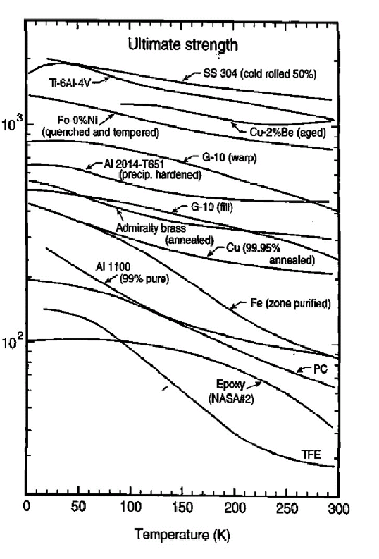
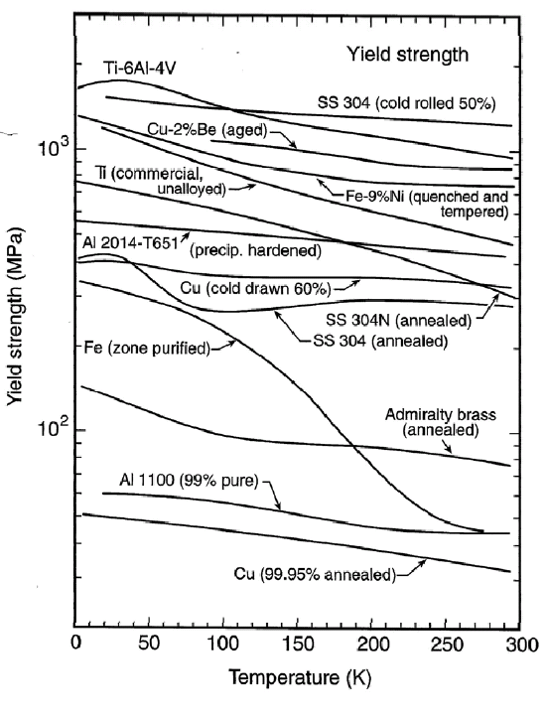
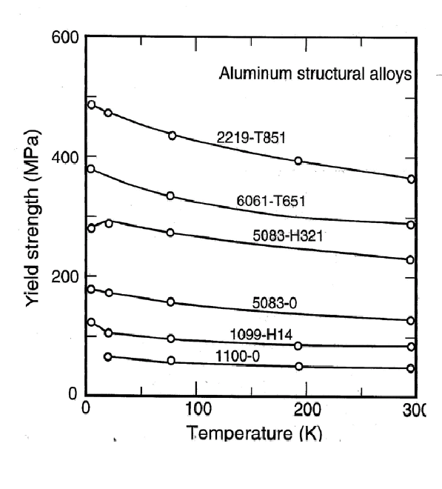
Mechanical Properties at cryogenic temperatures
Yield, ultimate strength
  Yield and ultimate strengths increase at low temperature
From: Ekin, J.W. Experimental Techniques for Low Temperature Measurements

Slide 11
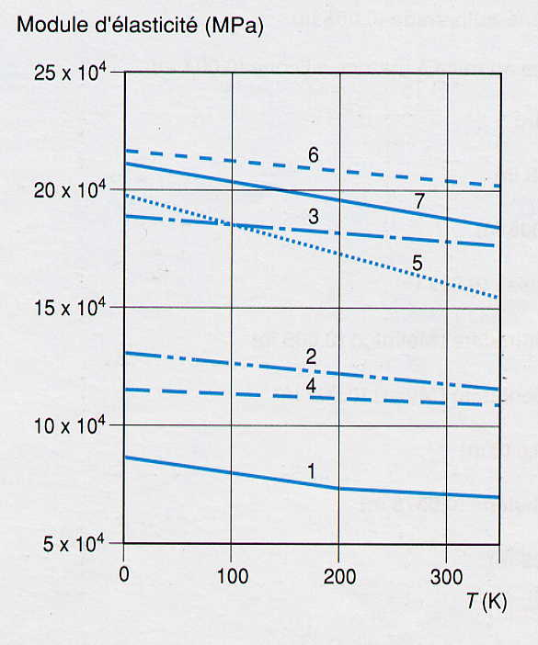
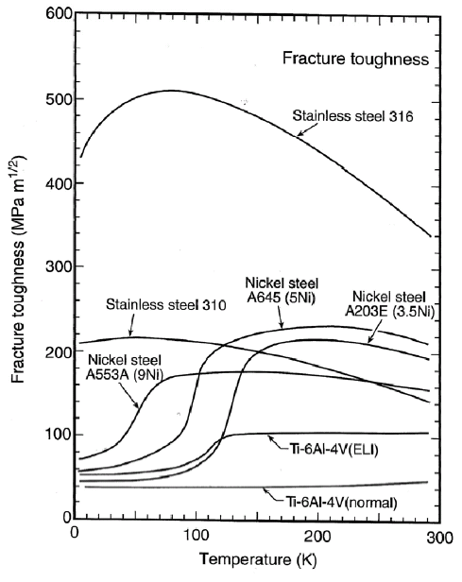
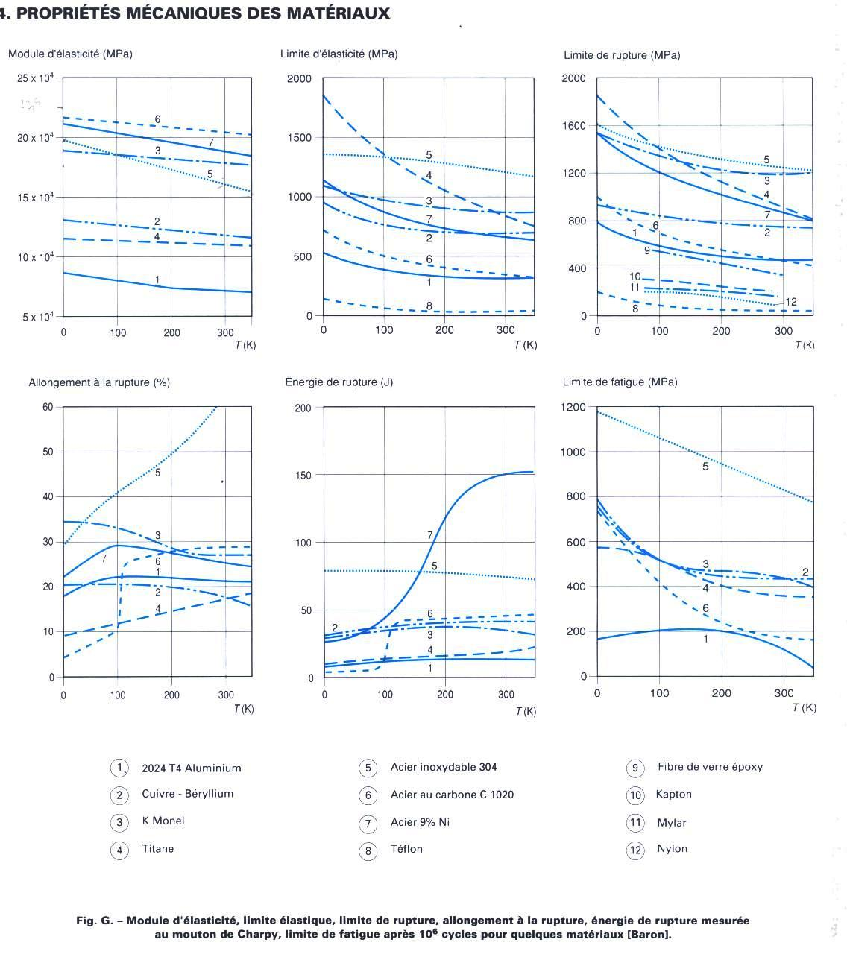
Mechanical Properties at cryogenic temperatures (cont.d)
Young modulus
Fracture toughness
Young Modulus
1 : 2024 T4 aluminium
2 : copper-beryllium
3 : K monel
4 : Titanium
5 : SS 304
6 : Carbon Steal C 1020
7 : Steel 9% Ni
From: Ekin, J. Experimental Techniques for Low Temperature Measurements
From: Technique de l’Ingénieur

Slide 12
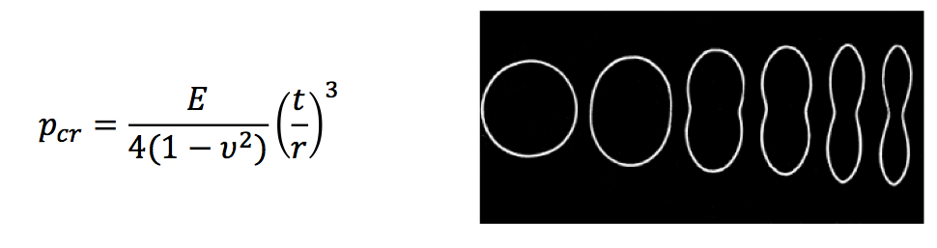
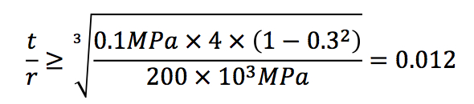
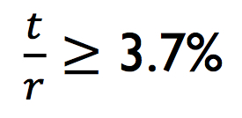
Thin shells under external pressure
Buckling:
Non-linear phenomenon. Actual critical pressure depends on initial imperfections: Safety factor needed!
Buckling critical pressure for a thin tube of infinite length
A conservative rule of thumb for stainless steel tubes under vacuum:
If we use a safety factor of 3:
Alternatively, we need to add reinforcements (e.g LHC vessels, t=12 mm)
Example:
r = 500 mm
t > 18.5 mm

Slide 13
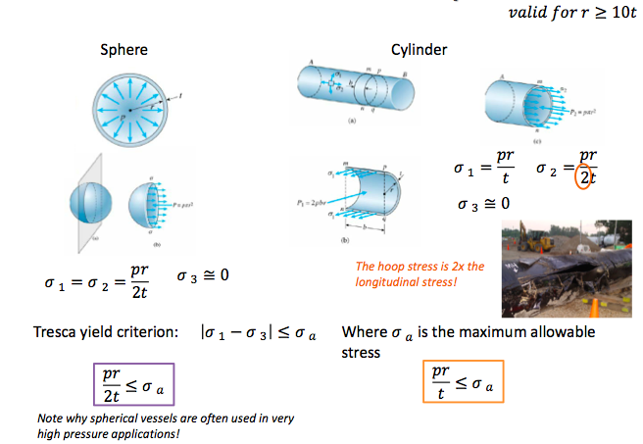
Thin shells under internal pressure
For preliminary calculation
For detailed calculation see EN 13458-2 Cryogenic vessels – static vacuum insulated vessels
Example: cyl.helium tank
r = 400 mm
p = 4 barg (0.4 MPa)
σ_{a}= 160 MPa (304L, Rp_{0.2}= 240 MPa, SF=1.5)
t ≥ 1 mm
(Note: under vacuum (previous calculation) → t ≥ 15 mm !)

Slide 14
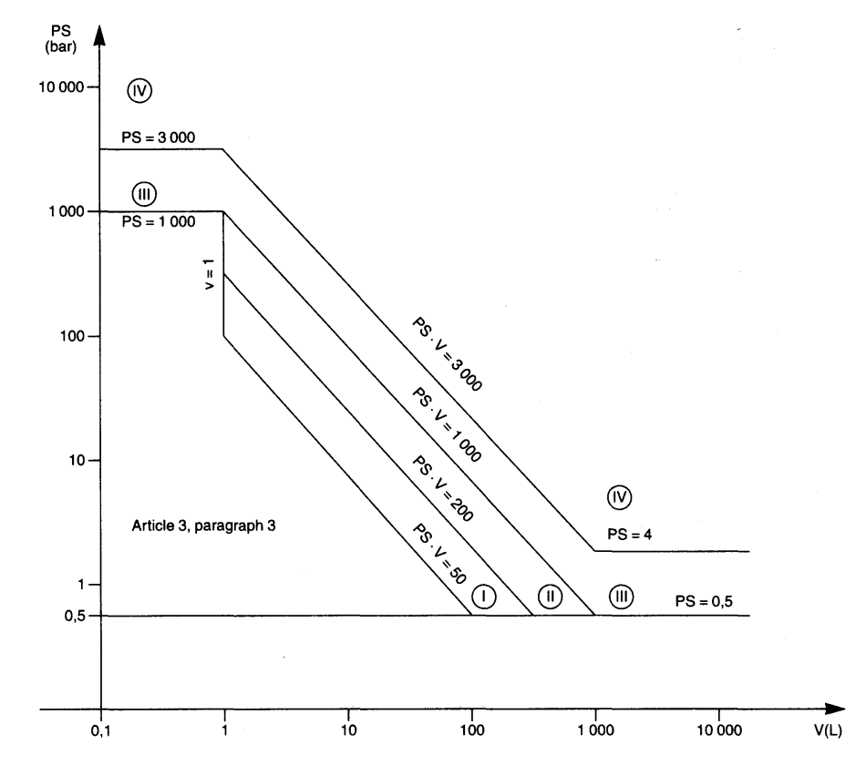
Pressure vessel codes regulations
Pressure European Directive 2014/68/EC (PED) is a legal obligation in the EU since 2002
  Applies to internal pressure ≥ 0.5 bar gauge
  Vessels must be designed, fabricated and tested according to the requirements defined
  Establishes the conformity assessment procedure depending on the vessel category, which depends on the stored energy, expressed as Pressure x Volume in bar.l
Category | Conf. assessment module | Comment
SEP | None | The equipment must be designed and manufactured in accordance with sound engineering practice. No CE marking and no involvement of notified body.
I | A | CE marking with no notified body involvement, self-certifying.
II | A1 | The notified body will perform unexpected visits and monitor final assessment.
III | B1+F | The notified body is required to approve the design, examine and test the vessel.
IV | G | Even further involvement of the notified body.
Pressure vessels
Article 4, paragraph 3
Vacuum vessels
For vessels with non-dangerous gases (cryogenic liquids are treated as gas)

Slide 15
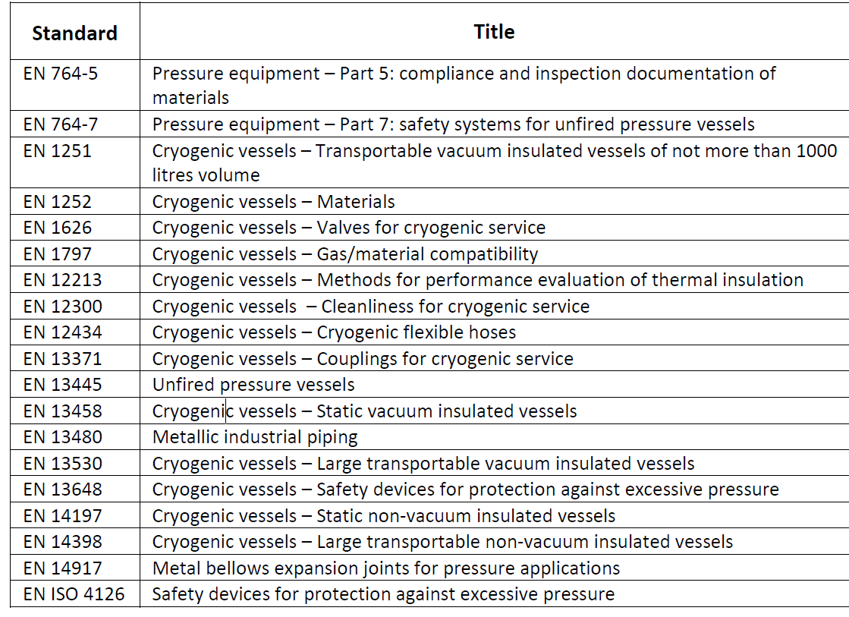
Harmonised codes and standards
Harmonised standards give presumption of conformity with the PED, within their scope. Useful codes for cryostat design and fabrication, including safety devices:
Very useful
guidelines and design rules

Slide 16
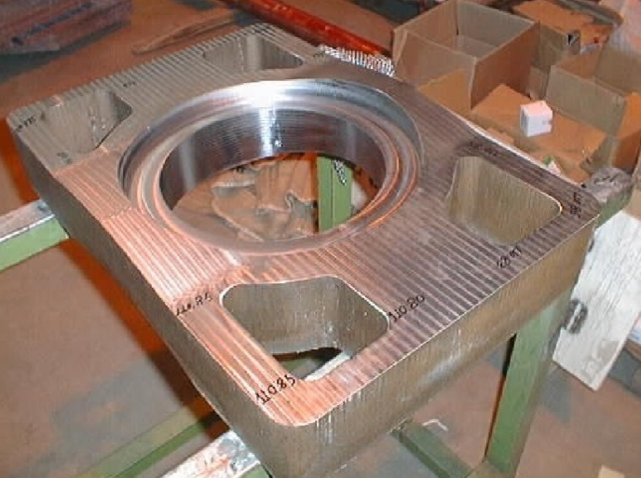
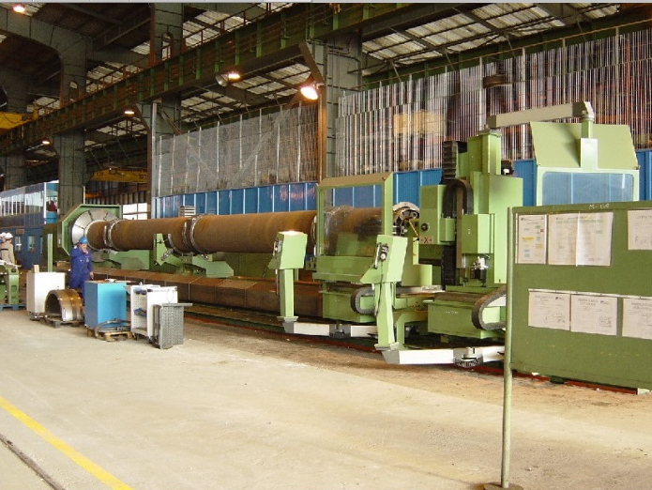
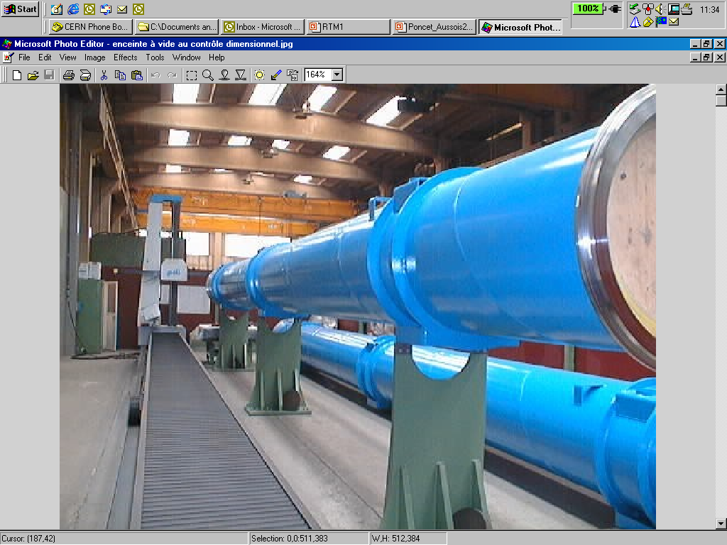
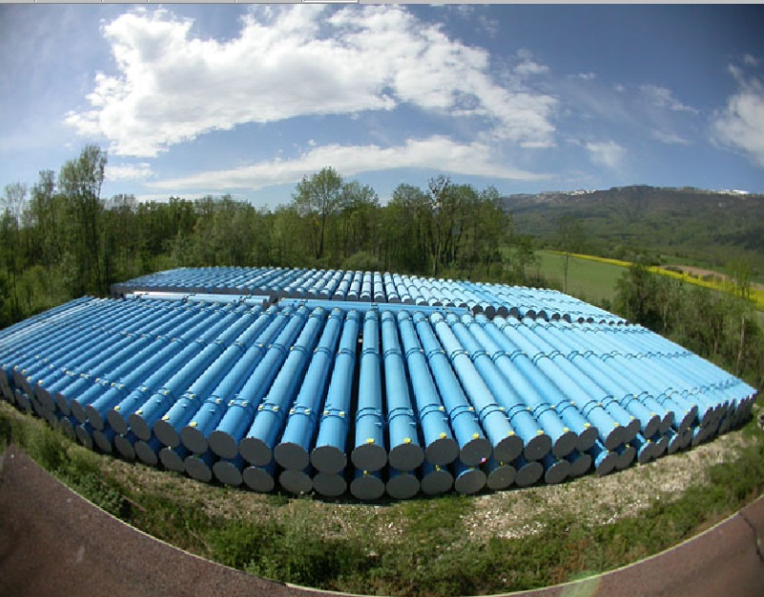
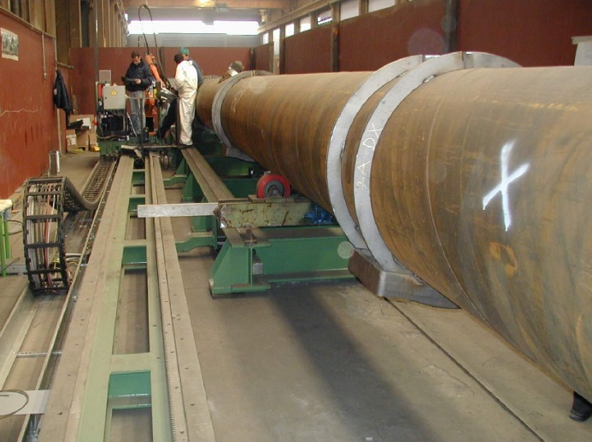
LHC dipole Vacuum Vessels
Main features:
Pipeline standard size: 36-inch OD (1013 mm), 12-mm thick, low carbon steel (DIN GS-21 Mn5) tubes
St. steel extremity flanges
Material resilience: > 28 J/cm2 at -70ºC
Forged cradles, welded rings reinforcements
Dimensional stability:
  Stress relieving
  Final machining to achieve tolerances at interface
Production:
1250 units
2 firms
4 yrs of production
Forged cradle
Final lathe machining
Out-doors storage at CERN
Stress relieving

Slide 17
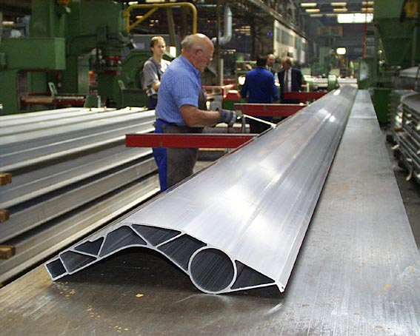
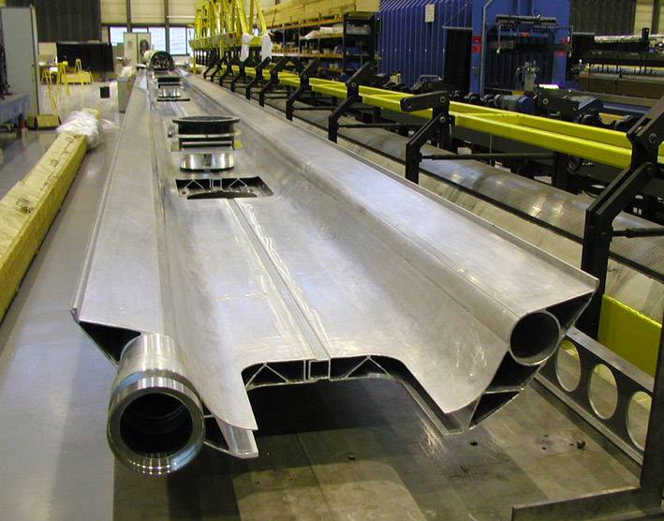
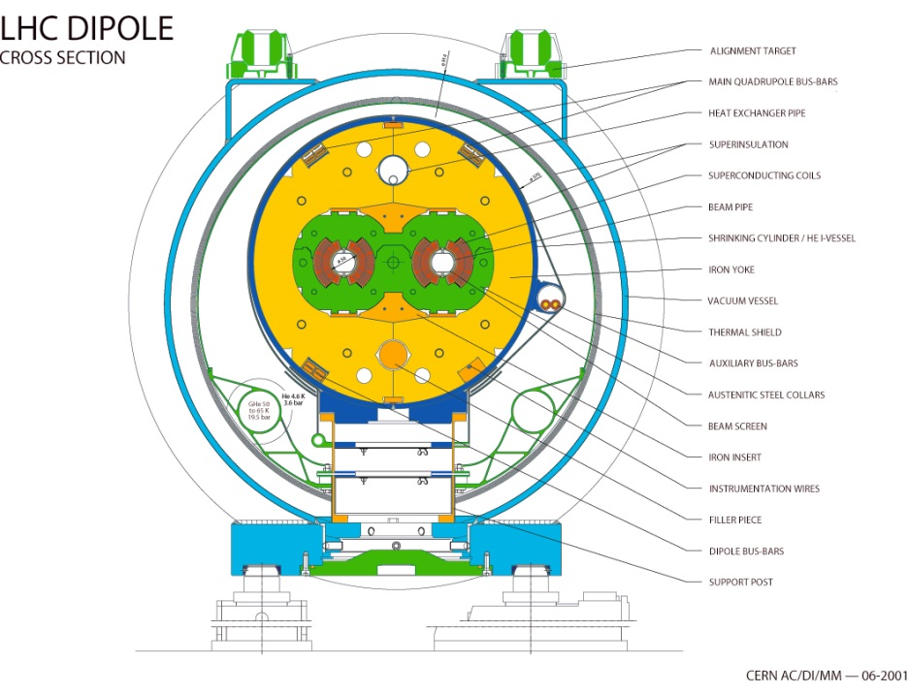
LHC thermal shields
Aluminium alloy 6063 extrusions and 1100 top sheets
LHC Main Cryostat
(Cross-Section)
Al 1100 sheets
He cooling (50-65K)
Al 6063 extrusions

Slide 18
Thermo-mechanical considerations

Slide 19
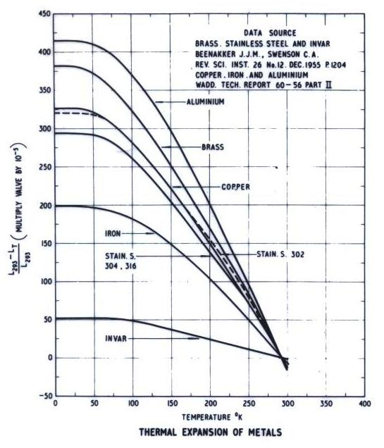
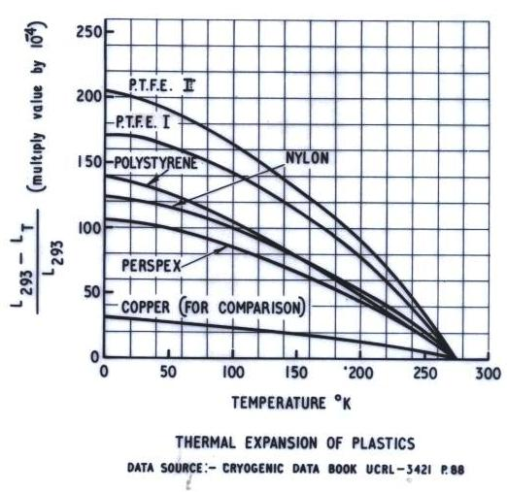
Thermal expansion of some materials

Slide 20
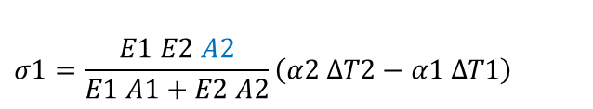
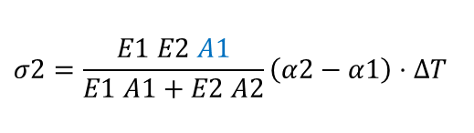

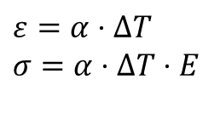
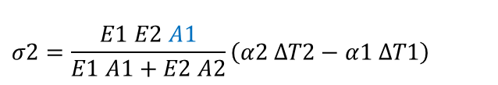
Thermal stress in composite material assemblies: 3 cases
ΔT
A) Restrained component
$$ε=α⋅ΔT$$
$σ=$ $α⋅ΔT⋅E$
B) Assembly of different materials
ΔT
Material 1: α1, E1, A1
restrained
Material 2: α2, E2, A2
$$σ1=\frac{E1 E2 A2}{E1 A1+E2 A2}\left(α2−α1\right)⋅ΔT$$
$$σ2=\frac{E1 E2 A1}{E1 A1+E2 A2}\left(α2−α1\right)⋅ΔT$$
C) Different cooling ΔT₁(t) ≠ ΔT₂(t) (different material diffusivity or different cooling)
ΔT₁(t)
Material 1: α1, E1, A1
restrained
ΔT₂(t)
Material 2: α2, E2, A2
$$σ1=\frac{E1 E2 A2}{E1 A1+E2 A2}\left(α2 ΔT2−α1 ΔT1\right)$$
$$σ2=\frac{E1 E2 A1}{E1 A1+E2 A2}\left(α2 ΔT2−α1 ΔT1\right)$$

Slide 21
LHC cryostats: longitudinal thermal contractions
Cold mass, thermal shield, support posts and vacuum vessel must be free with each other to cope with longitudinal thermal contractions
One fixed point per each component
Leave plays to cope with all extreme T cases (ex. Cold mass cold, thermal shield warm)
Guided sliding of cold mass onto vacuum vessel → slot/key
Flexible thermalisation anchors
(example of an LHC special quadupole)
Fixed post
Sliding posts
Δl _{cold mass}= 30 mm (10m x 3mm/m)
Δl _{thermal shield}= 40 mm (10m x 4 mm/m)

Slide 22
Supporting systems

Slide 23
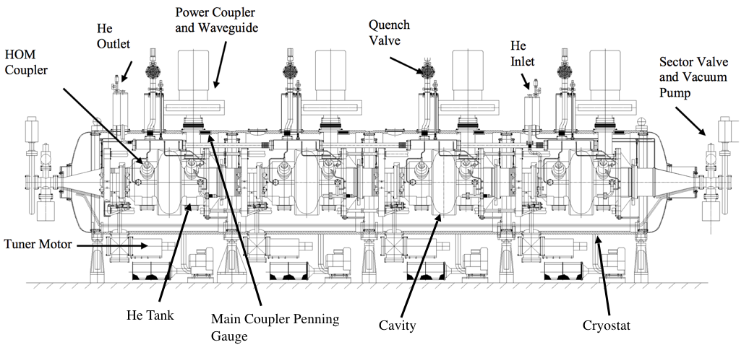
LHC Cryomodule, 400 MHz cavities (Nb on Cu) at 4.5 K

Slide 24
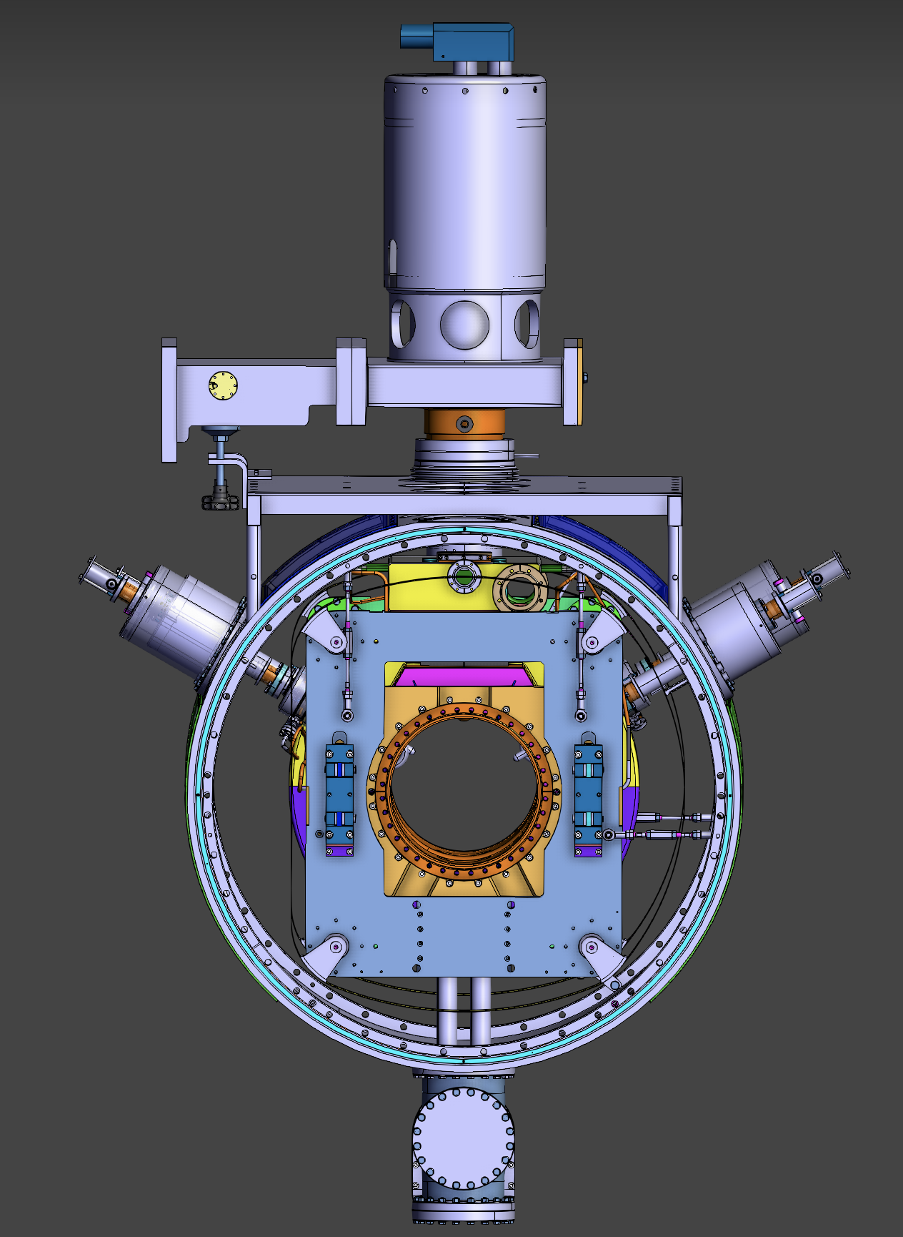
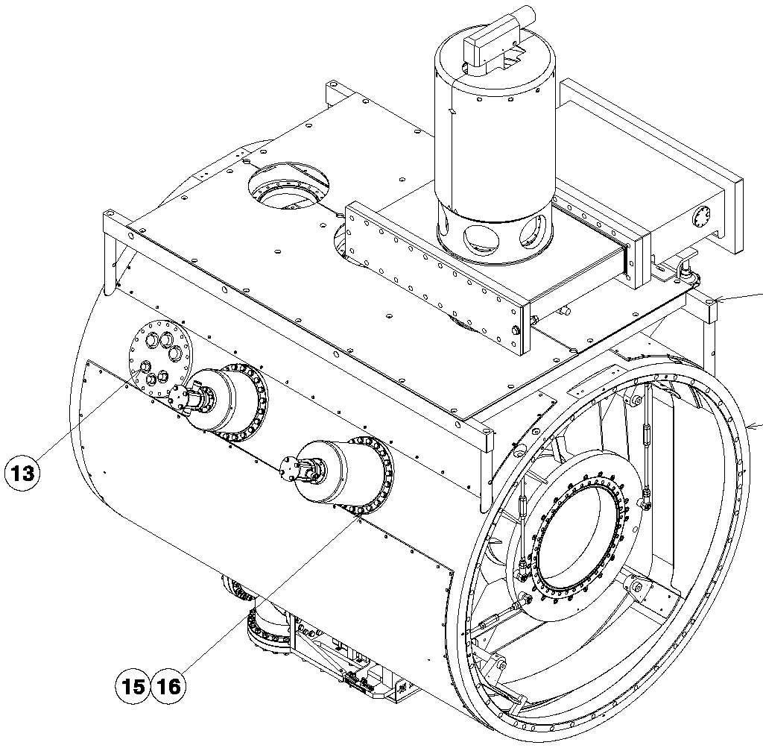
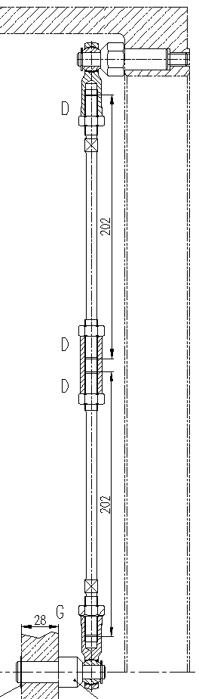
LHC Cryomodule Supporting System
For each cavity assembly (about 500 kg):
7 adjustable st.steel tie rods:
4 vertical
2 horizontal
1 longitudinal

Slide 25

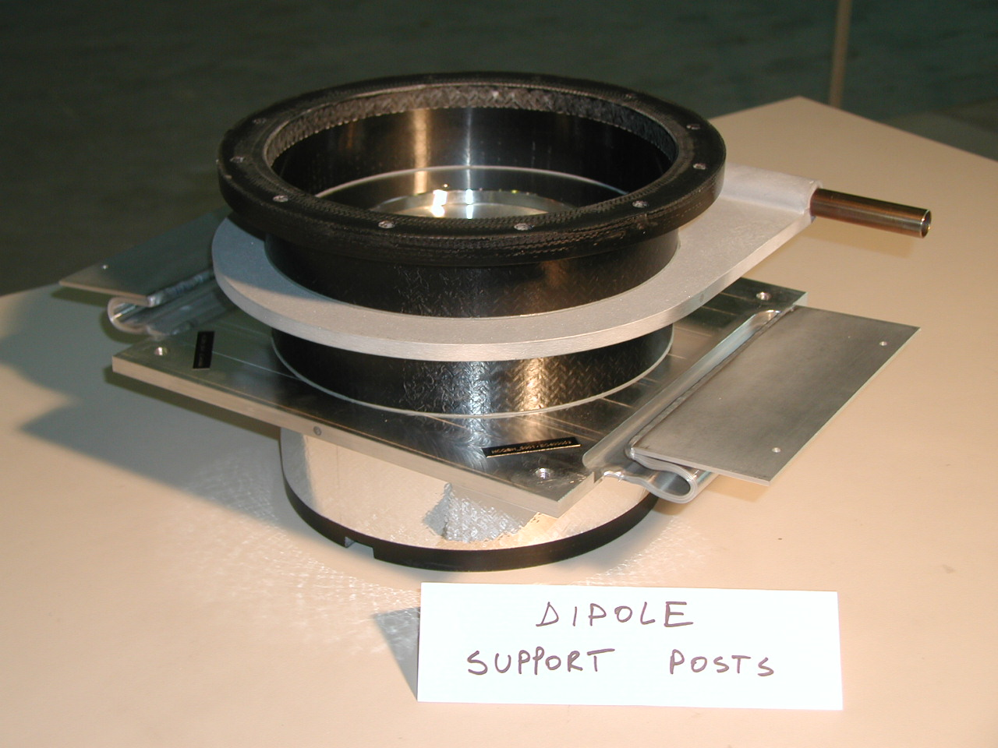
LHC magnet Cryostats
Main dipole
Cold mass interface flange: 2 K
5-10 K heat intercept
50-65 K heat intercept
GFRE composite
column
Vac.vessel
Interface: 293 K
4-mm thickness, glass-fiber epoxy
Manufactured by Resin Transfer Moulding (RTM):
  Suited to a large-scale industrial production (4’700 units)
  High reproducibility in thermo-mechanical properties

Slide 26
LHC Supporting system
The design is a trade-off between 2 conflicting requirements:
High flexural stiffness (for mechanical stability) → thick and bulky structure
Low heat in-leaks → thin and slender structure and low conductivity material
→ Flexural stiffness/conductivity as figure of merit in the choice of the material
(F is mainly the result of
interconnect forces
and gravity component)
F = 5 kN
x = 0.1 mm
ᶿ = 1 mrad
F
θ
(The acceptable x and θ
are alignment requirements)
x
Q
(Q is to be within budget)

Slide 27
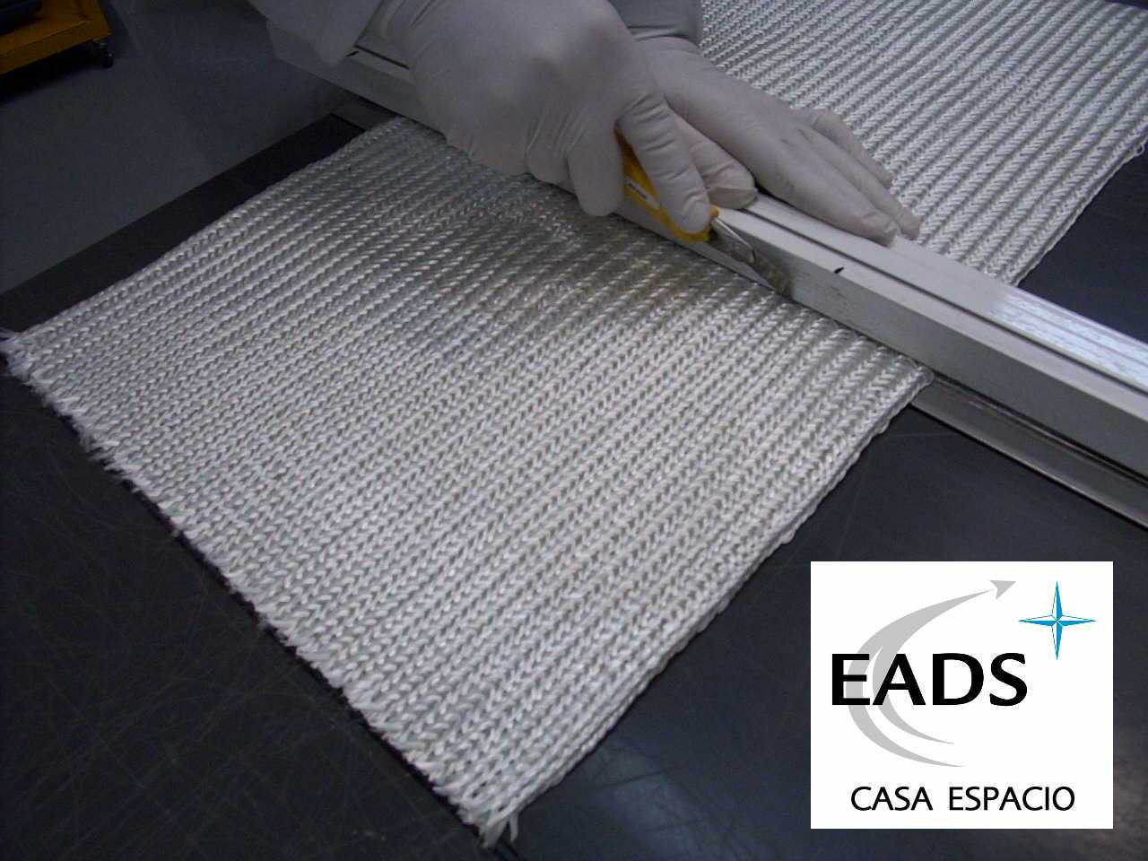
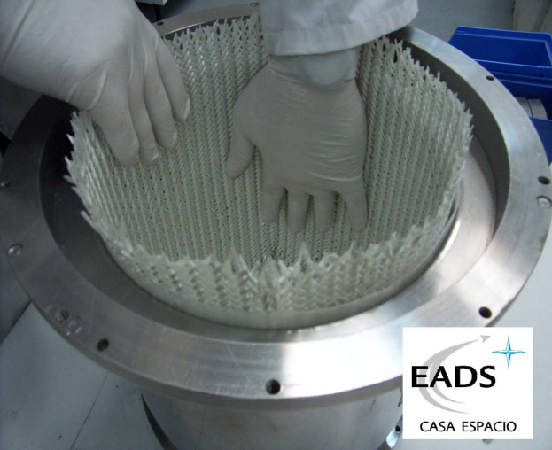
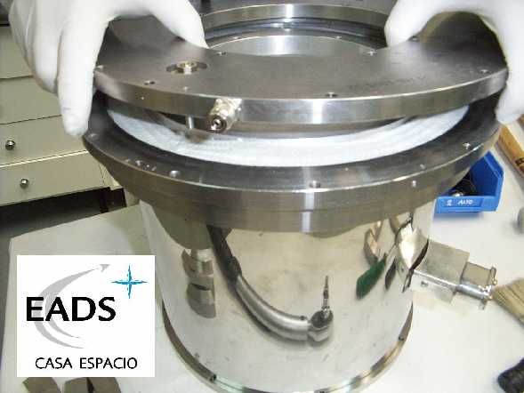
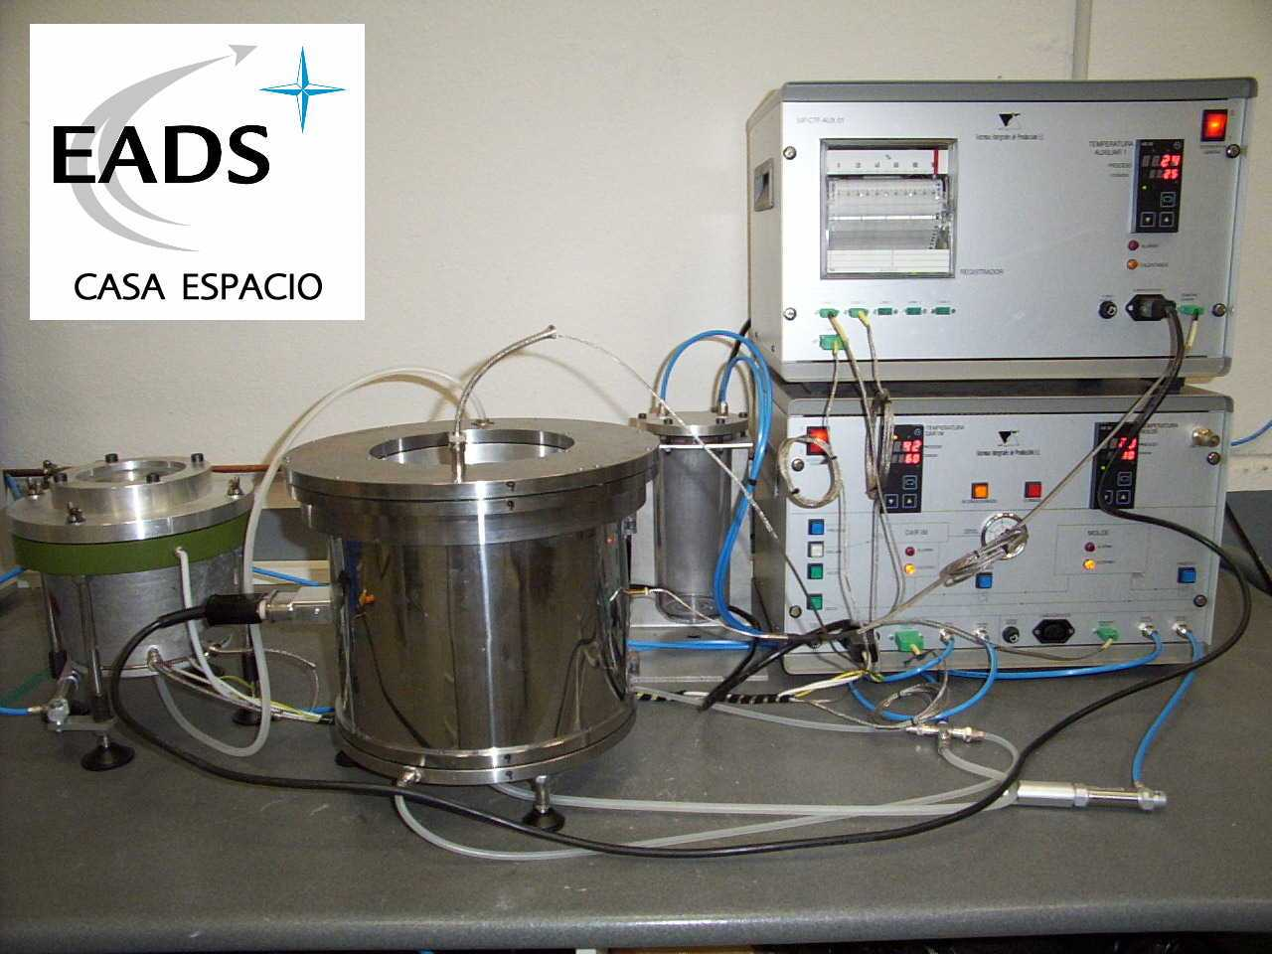
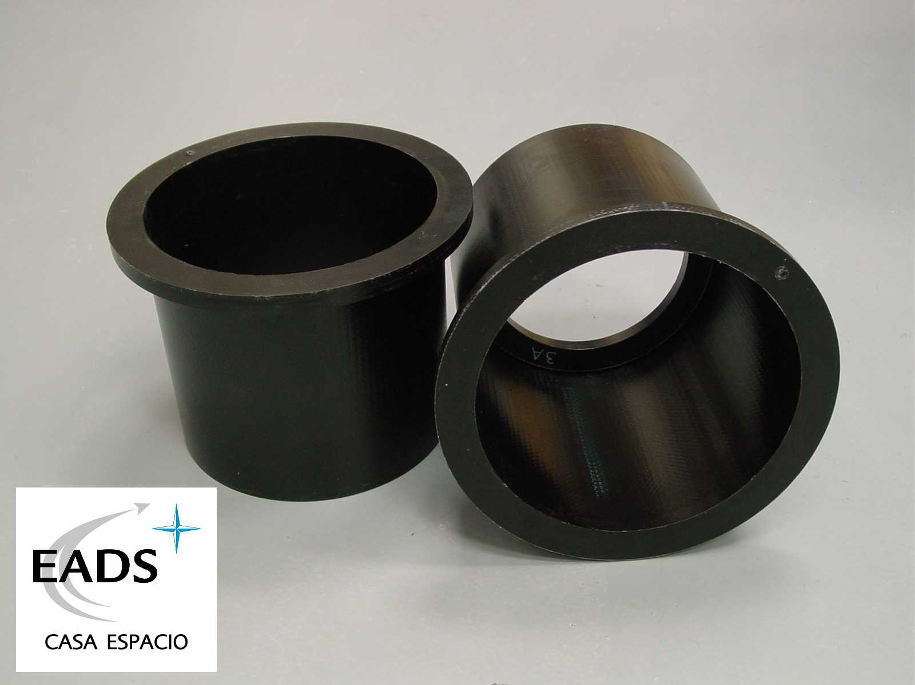
Resin Transfer Moulding
Cutting the fabrics to length
Lay-up stacking
Sealed closing of mould
RTM processing
(complete manufacture cycle: 4 hrs)
Columns as de-moulded

Slide 28
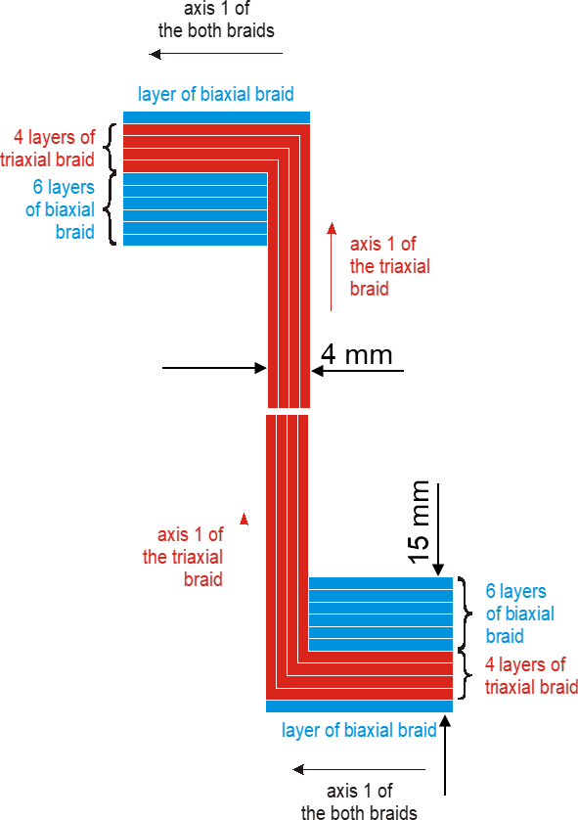
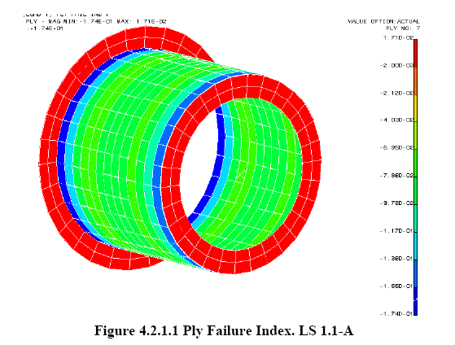
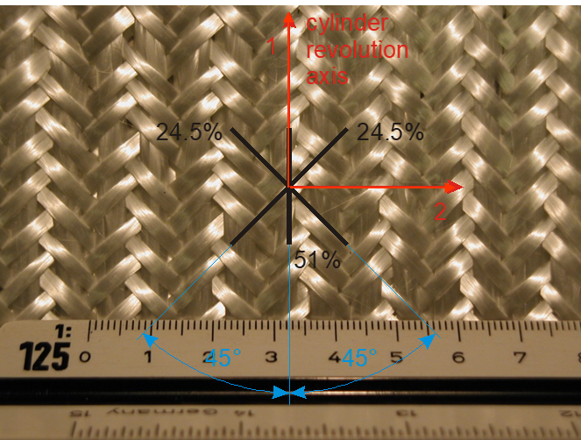
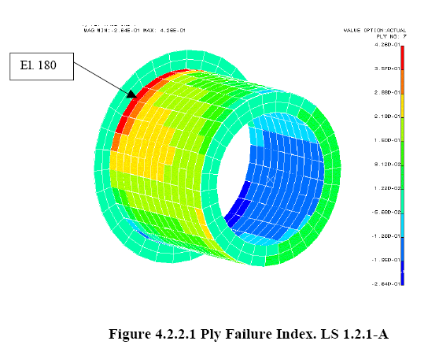
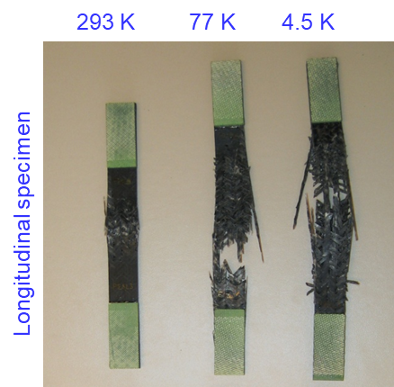
Lay-up, calculated safety factors, material properties
Compression load: 175kN (175% gravity load, transport limit)
Tsai-Wu ply failure: Safety Factor = 6
E modulus: 24 GPa
Triaxial braid and % fiber volumes
layup
Bending cantilever 40 kN. (vacuum barrier load)
Tsai-Wu ply failure: Safety Factor = 2.7

Slide 29
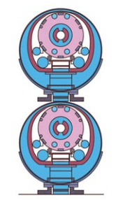
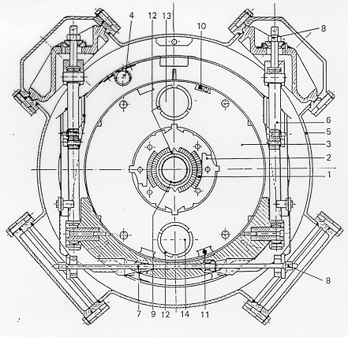
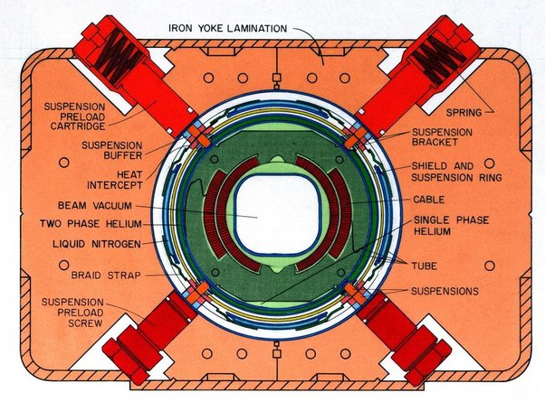
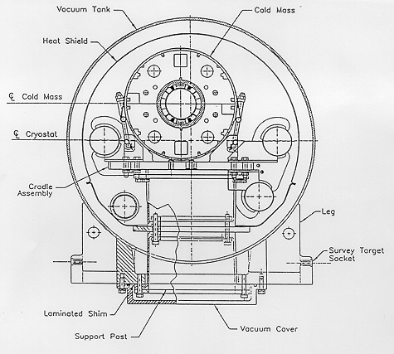
SC magnet supporting systems from other machines
Tevatron
Hera dipole
SCC
RHIC dipole

Slide 30
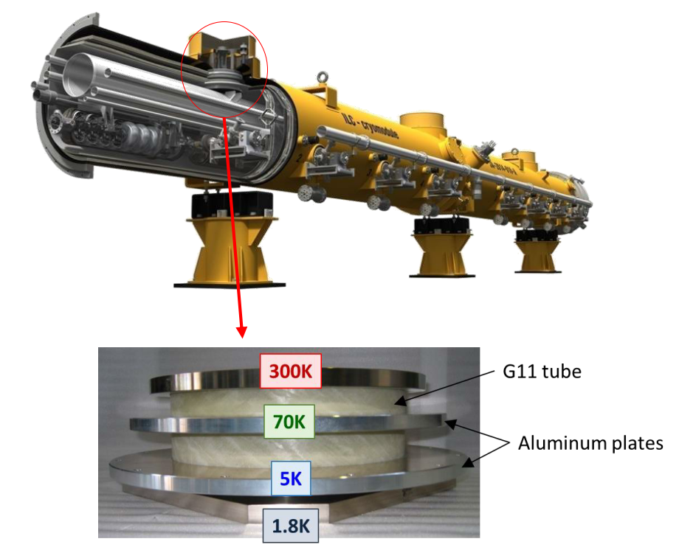
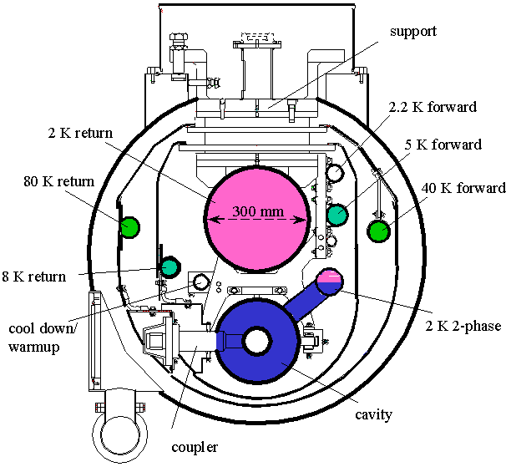
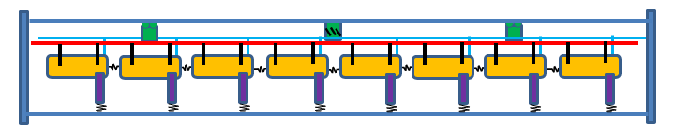
Supporting system of Tesla/TTF/ILC Cryomodule
2 K
RF coupler (with bellows)
Fixed support
Invar longitudinal positioner
Sliding support
DN 300 as back-bone
External supports (jacks)

Slide 31
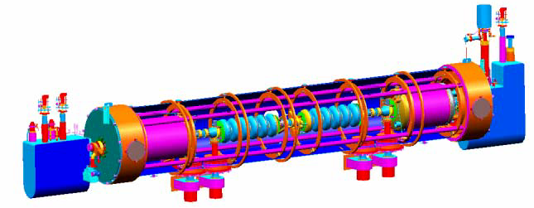
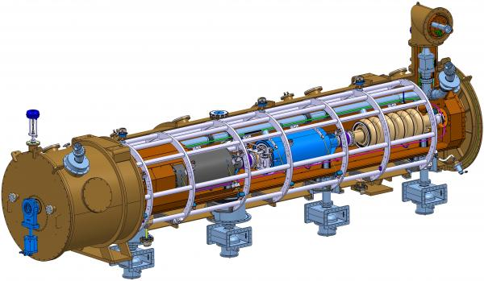

Supporting system of SNS and ESS high β Cryomodules
SNS
“Space-frame” and tie rods
ESS

Slide 32

Supporting system of PIP II Cryomodule
“strongback”:
rigid supporting plate in vacuum at RT
strongback

Slide 33




SPL cryomodule: RF Coupler as support
Vacuum vessel
Vertical loading of cavities string

Slide 34
Heat transfer mechanisms and thermal design

Slide 35

Heat transfer mechanisms
Thermal radiation
Thermal conduction
Heat intercepts

Slide 36
Thermal Radiation

Slide 37










Thermal Radiation
Stefan-Boltzmann’s law
$$σ=5.67 {10}^{−8} W m^{−2}{ K}^{−4}$$
Q $=σ {A T}^{4}$
$$black body$$
Stefan-Boltzmann’s constant
Q $=ε σ {A T}^{4}$
$$gray body, ε<1$$
A, T $area and temperature$
$of the body$, 𝜀 emissivity
$$exchange between black bodies$$
F, geometrical view factors${ F}_{1−2}$(<1) between $A_{1}$and $A_{2} (or F_{2−1}$ between $A_{2}$ and $A_{1}$), with $A_{1}E_{12}$= $A_{2}E_{21}$.
E, effective emissivity, a function of view factors and emissivity $ε1$and $ε2$of the bodies
$$Q_{1−2}=F12A1 σ \left({T_{1}}^{4}−{T_{2}}^{4}\right)=F21A2 σ \left({T_{1}}^{4}−{T_{2}}^{4}\right)$$
$$exchange between gray bodies$$
$$Q_{1−2}=E12 σ A1\left({T_{1}}^{4}−{T_{2}}^{4}\right)=E21 σ A2\left({T_{1}}^{4}−{T_{2}}^{4}\right)$$
Figures source: “Heat Transfer”, A.Bejan, John Wilney & Sons, Inc.

Slide 38







Black body radiation
hemispherical emissive power (monochromatic)
Hemispherical monochromatic emissive power [W/m∙m2] (energy per unit time, wave-length, and surface area)
$$λmax=\frac{2898}{T} \left(μm/K\right)$$
$E_{b,λ}$= $\frac{C1 λ^{−5}}{e^{(\frac{C2}{λ T}) }−1}$
Planck’s law
$$Ebλmax (T){=}12.87⋅10\text{−6} \text{W}\text{/}{\text{m}}^{3}⋅K^{5})⋅T^{5}$$
$C1$= 2 π h $c^{2}=3.742 {10}^{−16} W m2$
$C2$= $\frac{\text{h} c}{k}=1.439 {10}^{−2} K m$
In cryogenics: far infrared region
(725 μm at 4 K)
Total emissive power (integrating over λ):
$$Eb(T)=\int_{0}^{∞}{E_{b,λ}dλ} =σ⋅T^{4} \left(\text{W}\text{/}{\text{m}}^{2}\right)$$
$$with: \\ σ=\frac{2π^{5}k^{4}}{15 h^{3} c^{2}}=\text{5.67 10−8 }\left(\text{W}\text{/}{\text{m}}^{2}⋅K^{4}\right) \text{Stefan}\text{−}\text{Boltzmann}\text{′}\text{s} \text{constant}$$
(k, Boltzmann constant, h, Planck constant, c, speed of light )
In practice: Blackbody emits ~ 420 W/m² at 293 K , and only ~2 W/m² at 77 K (200 times less!)
Figures source: “Heat Transfer”, A.Bejan, John Wilney & Sons, Inc.

Slide 39






Black and diffuse-gray model
Black model
$$α → absorptivity \\ ρ→ reflectivity \\ τ→ transmissivity$$
Practical application in cryostats: every gap in shields is a black surface
(1 cm² gap exposed to 293 K, ɛ = 0.2 → ~10 mW)
Black surface: α = 1
Diffuse-gray model
Diffuse-gray model (good approximation for real surfaces in engineering):
Gray: $ε_{λ}$(λ,T) ≈ $ε$(T)
Diffuse emitter/absorber (not directional)
Opaque ($\text{τ}$ = 0)
$α$(T) = $ε$(T)
Figures source: “Heat Transfer”, A.Bejan, John Wilney & Sons, Inc.

Slide 40



Emissivity
𝜀 depends on wave-length and direction (neglected in gray-diffuse model). In metals emissivity rises sharply and up to more than 40% above 50 deg. incidence from the surface normal
Clean, well-polished metallic surfaces have smaller 𝜀, non-metallic materials have higher 𝜀
Metals: 𝜀 decreases with decreasing temperature, almost linearly at cryo temperatures
Non-metals: 𝜀 may decrease or increase with decreasing temperature (increases for organic materials)
Engineering approach. Due to uncertainties on real 𝜀 values, take conservatively high values for preliminary design. Measurement validation may be necessary
normal
Φ_{Ω}
Directional distribution
Ref. https://neutrium.net/heat-transfer/emissivity/
Ref. R.B.Scott, Cryogenic Engineering, (Van Nostrand, New York, 1959; Y.S.Touloukian, Thermophysical Properties of Matter, (Plenum Press, New York, 1995))
Ref. Cryogenie, ses applications en supraconductivite.Techniques de l’ingenieur, Ed.1995

Slide 41


Radiation between 2 diffuse-gray enclosures
Radiation balance between A1 and A2 surfaces:
For 2 enclosed cylinders or spheres (not necessarily concentric!), F₁₂=1 :
$$q_{1−2}=\frac{σA1(T1^{4}−T2^{4})}{\frac{1}{ε1}+\frac{A1}{A2}\left(\frac{1}{ε2}−1\right)}$$
A1
A2
  For cryostats, to reduce heat load to inner cold surface:
  Limit size of A₁ (SC device vessel)
  Reduce A2 (vac.vessel as small as possible)
  Small emissivities: ε1 reduced by low T; ε2 at RT & moderated by A1/A2
(see numerical application in Annex )
Figures source: “Heat Transfer”, A.Bejan, John Wilney & Sons, Inc.

Slide 42
Radiation between 2 diffuse-gray flat plates
Radiation balance between A1 and A2 (A1=A2=A), F₁₂=1 :
T1
T2

Slide 43






Radiation with an intermediate floating shield
Radiation balance between A1 and A2:
Ts
A1 to S gap
S to A2 gap
For flat surfaces approximation, and same ɛ :
T1
T2
$q_{1−s}=\frac{σ A (T1^{4}−Ts^{4})}{(\frac{2}{ε}−1)}$ = $\frac{σ A (Ts^{4}−T2^{4})}{(\frac{2}{ε}−1)}=q_{s−2}$
${\text{T}\text{s}}^{4}$= $\frac{{T_{1}}^{4}+{T_{2}}^{4}}{2}$
…
$$q_{1−2}=\frac{σ A (T1^{4}−T2^{4})}{2(\frac{2}{ε}−1)}$$
1
…N
→ with 1 shield ½ of the rate without shield
→ Can be generalized to N shields
$$q_{1−2}=\frac{σ A (T1^{4}−T2^{4})}{(N+1)(\frac{2}{ε}−1)}$$
→ with N shield 1/(N+1) of the rate without shield

Slide 44

N shields → Multi Layer Insulation (MLI)
T
Tw
Working principles:
Low emissivity of aluminium layer
Multi-layer to enhance radiation protection:
  N+1 radiation shielding
Minimal thermal conduction between reflective layers → interposing of isolating layers (e.g polyester net):
Enhanced performance at low T → use actively cooled shield:
  Lower emissivity of reflective material layers at low T
  Reduce radiation from inner-most layers, cooled at T of shield
  Extract heat at higher thermal shield T → thermodynamic efficiency
T_{ext layer}
Tc
x
Interleaved reflectors and spacers
Tw
Tc < Tw
Warm wall
Colder wall (actively cooled
thermal shield)
Q_{c}
Q_{r}
Reflective film
Insulating spacer

Slide 45





MLI material
LHC MLI:
Reflecting film: 6 µm thick polyethylene teraphthalate (PET) film coated with 400 Å minimum aluminium on each side (Physical Vapor Deposition process)
Spacer: polyester net of very low weight (< 5 g/m2)
10 or 15 layer pre-assembled blankets (outermost layer reinforced with a polyester net)
Blanket overall thickness: > 2 (3) mm for 10 (15) layers
Perforated layers for outgassing: 0.05-0.15 % surface
MLI in Space applications
Decoration Al films
Interleaved reflectors and spacers
Velcro™ fasteners
Blanket manufacturing
MLI in residential construction

Slide 46




LHC MLI blankets
Features:
1 blanket (10 reflective layers) on cold masses (1.9 K)
2 blankets (15 reflective layers each) on Thermal Shields (50-65 K)
Reflective layer: double aluminized polyester film (2 km²)
Spacer: polyester net
Stitched Velcro™ fasteners for rapid mounting and quality closing
Mock-ups for complex geometries
Diode box
MLI on Cold-to-Warm
transitions
1 blanket on CM, 2 on thermal shield
Vacuum Barrier

Slide 47

MLI: How many reflective layers (N)?
No straightforward answer ! Not just a matter of N !
Complex system to model, with parameters needing experimental qualification
Radiation vs. conduction
  Radiation reduces as 1/N
  Conduction proportional to packing density (N/mm)
Residual helium gas conduction
  Negligeable at res. pressure p < 10⁻⁴ Pa (10⁻⁶ mbar)
  Sizeable contribution at res. pressure 10⁻⁴ Pa < p < 10⁻³ Pa (10⁻⁵ mbar)
  Dominates at res. pressure p > 10⁻² Pa (10⁻⁴ mbar)
Packing density should be limited → typically 20-25 N/cm
  Avoid “compressed” blankets (do not put as much MLI as you can fit!)
  Reserve space allocation for MLI blankets
  Consider differential thermal contractions wrt support (Al shields, cold mass…): blankets must remain quite loose at cold
Overall performance depends very much on:
  Application design solutions
  Craftsmanship quality
Arbitrary units
Total heat flow
Radiation
Conduction
No. layers/cm

Slide 48









MLI application: important tips
Thermal path warm to cold layers
Handle MLI with gloves
(fingerprints are a black body!)
loose at RT
(MLI contracts more than metal support)
T_{hot}
Velcro TM
Reflective layer
T_{cold}
T_{hot}
T_{cold}
Some tapes are
resin coated = black body !
Check conductivity
Not tool much MLI
(risk of thermal shorts)
(images: courtesy of Meyer Tool & MFG.)

Slide 49
Performance measurements on MLI samples
300 K - 77 K, abundant literature (see a few ref. [1], [2])
77 K - 4 K, fewer results. CERN experimental work (see a few ref.[3],[4],[5] )
Some values, in good vacuum (<10⁻⁴ Pa) [3]:
T_{w} = 300 K
N | T_{c} = 5 K-80 K
10 | ~ 1.0 W/m²
20 | ~ 0.5 W/m²
30 | ~ 0.4 W/m²
Virtually no Tc dependency, T_{w} radiation dominates
(compare with 1 W/m² calculated in exercise)
T_{w} = 80 K
N | T_{c} = 4.2 K
1 or more | ~ 30-60 mW/m²
Virtually no N dependency
(compare with 110-140 mW/m² calculated in exercise)
[1] T.Nast, Multilayer Insulation Systems, in Handbook of Cryogenic Engineering, ed. J.G.Weisend II, Taylor & Francis, Philadelphia (1998),
[2] M. G. Kaganer, Thermal Insulation in Cryogenic Engineering, Jerusalem, Israel Program for Scientific Translation, (1969),
[3] L.Mazzone et al., Measurements of Multi-Layer Insulation at high boundary temperature, using a simple non-Calorimetric method. Proceedings ICEC 19, 2002, Grenoble, France.
[4] Ph.Lebrun et al., Investigation and qualification of thermal insulation systems between 80 K and 4.2 K, Proceedings ICEC/ICMC, 1992, Kiev, Ukraine
[5] V.Venturi, Thermodynamic and technological optimization of complex insulation systems. PhD thesis, 2019, WUST University, Poland.

Slide 50
Practical MLI performance values
MLI samples measured performance is considerably degraded in applications due to the engineered solutions and installation procedures:
  pre-assembled blankets vs. rolled MLI
  complex (non developable) geometries
  junctions, stitches, VelcroTM fasteners, etc.
  higher than ideal packing density (e.g. self-weight compaction)
  thermal shorts between cold and warm layers (e.g. overlapped blanket closure)
  quality of assembly (lab vs. industrial scale)
Engineering values: what values should one use for HL first estimates?
  Take generous margins. Rule of thumb → x 2 sample measurements
LHC cryostat (+) (a thermally well optimized large-scale application), average measure on 2.7 km length sector :
  293 K to 50 K thermal shield with 30 MLI layers: → ~1 W/m²
  50 K to 2 K magnet with 10 MLI layers: → ~ 54 mW/m²
(+) C. Maglioni, V. Parma: “Assessment of static heat loads in the LHC arc, from the commissioning of sector 7-8”, LHC Project Note 409, 2008.

Slide 51

Summary of radiation HL exercises (for details see spare slides)
(th.shield at 50 K)
x 1000 reduction !
(th.shield at 143 K)
(th.shield at 260 K)
Notes:
45 minuti
Pausa QA: 10’

Slide 52
Thermal Conduction

Slide 53

Thermal Conduction
Tc
Tw
When a T gradient exists in a body, there is a heat transfer from the high T region to the low T region (Fourier Law):
For one-dimensional problems (ex. a bar or tube):
k is the thermal conductivity (W m⁻¹ K⁻¹), normally a function of P,T, material structure, non-homogeneity, anisotropy (ex. Composite materials).
k is strongly T-dependent and non-linear at low T
“good conductors” vs. “poor conductors” → k range ~ 5-6 orders of magnitude
6 decades

Slide 54

Thermal conductivity of various materials
Metals: mainly free electron contribution
Resistivity from electron scatter with phonons (lattice vibrations) α T² and with impurities α 1/T
Increasing effect of impurities in less pure metals and dominates in alloys
Maximum of conductivity reduces and shifts towards higher T with increasing impurities
Al and st.steel alloys: conductivity α T
Non cristalline materials and insulators dominated by phonon contribution

Slide 55



Thermal conductivity in epoxy-based composite materials
Low conduction (little electron conduction), essentially phonon driven
Anisotropic structure, (fibers/matrix) with constituents-specific thermal conductivity properties
Conductivity highly depends on:
  Material (fiber) orientation
  Ratio between fibre and matrix (Vf)
Glass-fiber is the “conductive” fraction and also the “structural” constituent
Epoxy is the “isolating” fraction material and is the “less structural” constituent
Vf typically around 40-70%
Cryogenic grade G10-CR and G11 are widely used standard laminates in various forms (plates, tubes, rods). Properties data can be found in: https://trc.nist.gov/cryogenics/index.html
(Data from Schwartzberg F.H., Cryogenic Material Data Handbook,
Martin Marietta Corrp, Denvers, Co, 1970)
Longitudinal and transversal conductivity laminate studies for LHC supports, (based on data from Schwartzberg F.H.), collaboration CERN-ESIGEC (Univ.Savoie), 1997
Glass-fiber dry fabric
Standard G10-CR plate and rods

Slide 56


LHC supports
Two intercepts, 5K & 75K
One intercept, 75K
No intercepts
Support posts measurements
  49 ± 10% mW @ 1.9K
  450 ± 10% mW @ 4.5-10K
  7.1 ± 5% W @ 50-65K
conductivity acceptance criteria at low T

Slide 57

The conduction equation (unidirectional case)
(Fourier law of heat conduction)
(change of internal energy)
Longitudinal
conduction
Internal
heat
generation
Thermal
inertia

Slide 58

No heat deposition and steady-state
with boundary conditions:
x=0, T=T₀
X=L, T=T_{L}
If k constant with T:
If k = k(T):
T₀
$$\dot{q}$$
T_{L}
L
(Linear solution)
Thermal conductivity
Integral (conductance)
T
For metal alloys (ex.steels) at low T:
T₀
T_{L}
(quadratic solution)
L
x

Slide 59
Thermal conductivity integrals (conductance) for some materials [W/m]
4.2K
Tw
Qc
Highest T (Lowest T =4.2 K) | 20 K | 80 K | 290 K
OFHC Copper | 11000 | 60600 | 152000
DHP Copper | 395 | 5890 | 46100
Aluminium 1100 | 2740 | 23300 | 72100
Aluminium 2024 | 160 | 2420 | 22900
Stainless steel AISI 304 | 16,3 | 349 | 3060
Typical Glass-fiber/Epoxy Composite G-10 | 2 | 18 | 153

Slide 60

…more conductivity integrals

Slide 61
Electrical network analogy
The inverse of the thermal conductance → thermal resistance:
For variable k, define an average value k_{AV}:
Analogy with the electrical resistance (replace q with I, T with V):
We can therefore model a complex thermal conductivity problem by elementary thermal resistances Ri, and solve the network by using Kirckhoff’s laws.

Slide 62

Thermal conduction with uniform heat deposition
t
To
x
Beam of length L, thickness t, width w (= 1m);
beam thermalized on one side at To
uniform heat deposition from one side, q (W/m²)
considering k constant with T
Boundary conditions: a) for x= 0 T=To (heat sink); b) q=0 for x=L (isolated tip)
Integrating and imposing the 2 boundary conditions:
T
T_{L}
T₀
L
practical interest:
calculate minimum thickness to limit ΔT_{max}
$$t=\frac{q⋅{L^{2}}^{}}{2⋅k⋅ΔTmax }$$
x

Slide 63










Thermal diffusivity
$$\frac{∂}{∂x}\left(k\frac{∂T}{∂x}\right)= ρ c \frac{∂T}{∂t}$$
Conduction equation (no heat generation)
For small variations of k with x:
Solid bar cooled at one tip
T perturbation $δ$ travels towards warm end:
t_{c}, critical time for T perturb. to reach warm tip:
$$\frac{∂^{2}T}{{∂x}^{2}}= \frac{1}{α} \frac{∂T}{∂t}$$
$$with α= \frac{k}{ρ c}$$
$$δ(t)≈ \sqrt{α t}$$
Thermal diffusivity [m²/s]
$$tc≈ \frac{L^{2}}{α}$$
T
T_{i}
$$tc$$
t _{increase}
T₀=T∞
$$t → ∞$$
$$\dot{q}$$
T∞
$$δ(t)$$
$$δ\left(tc\right)=$$
L
x

Slide 64



Heat capacity
Specific heats:
For (incompressible) substances:
Change of internal energy U (or enthalpy):
  $ΔU=Q=m \int_{T1}^{T2}{c(T) dT}$
Cooling (or heating) power:
  $P(T)=m c(T)\frac{dT}{dt}$
Specific heats/unit vol.
sometimes preferred
Below 10 K enthalpy of
helium overtakes all solids
(from J. Ekin, Experimental Techniques for Low-Temperature Measurements)

Slide 65
Measuring Thermal Performance of Cryostats

Slide 66






Measure of Heat Loads to liquid helium tanks
Isothermal cooling (2-phase helium tanks)
He boil-off along saturation line
  Latent Heat (L_{v}) of vaporisation
  Isothermal cooling (T constant if P constant)
  Measure p, and
  Liquid/gas volumetric corrective factor
SC level gauge
vapor
liquid volume replaced by fraction of boil-off vapor (no filling)
$$\overset{•}{m}$$
$$\overset{•}{q}=\overset{•}{m}⋅Lv⋅(\frac{vg}{vg−vl})$$
Latent heat of vaporization
Example:
  Mass flow measurement: 7 g/s
  P measured: 1.78 bar
  (T on saturation line (phase diagram): 4.8 K)
  L_{v} = 14’116 (J/kg) (tables, or state equations)
  𝑣_{𝑔} = 3.0 10-2 (m3/kg); 𝑣_{l} = 9.3 10-3 (m3/kg); (phase diagrams)
  → $\overset{•}{q}=7.0 10−3⋅14116⋅(\frac{3.0 10−2}{3.0 10−2 − 9.3 10−3})$ = 143 W
measure
from diagrams
He boil-off liquid level measurement:
  Measure level l with SC level gauge
  Boil-off mass flow measure through reservoir geometrical correlation between level and volume: f(l), and knowledge of density ρ and L_{v}
1.45 !
Density of saturated liquid helium
$\overset{•}{q}= f(Δl)$ $⋅ρ⋅Lv$

Slide 67

Measure of Heat Loads to liquid helium tanks (cont.d)
Non-isothermal cooling
Calorimetry in superfluid helium (LHeII):
  LHe II very high thermal conductivity → isothermal bath
  Measure internal energy change (closed system) in time Δt
  Needs precise measure of helium content
  and sub-mK resolution measurement of T at T< 2.17 K
$$\overset{•}{q}=\frac{ΔU(t)}{Δt}=\frac{m⋅Δu(t)}{Δt}$$

Slide 68


Measure of Heat Loads to Thermal Shields
Non-isothermal cooling
Forced internal (conduit) convection of single-phase fluid:
  Non-isothermal cooling: enthalpy change of fluid (here c_{p} assumed constant)
  Needs the measure of mass flow, and T at entry and exit of conduit
T_{in}
T_{out}
$$\overset{•}{m}$$
$\overset{•}{q}=ΔH=\overset{•}{m}⋅cp$ $⋅$ (T_{out} – T_{in})

Slide 69




Forced Convection heat transfer in conduits
D
U
L
Forced flow of coolant fluid in round tube cooling lines
Considering hydro-dynamically and thermally fully developed flow
Uniform wall heat flux (linear T profiles)
Convection heat transfer from wall to fluid:
Enthalpy balance along the line L:
Reynolds No.:
ReD>2000 → turbulent flow,
ReD<2000 → laminar flow
Nusselt No.:
$$k=therm. conductivity$$
For laminar flow: constant
$$NuD=\frac{h⋅D}{k}=4.364$$
For turbulent flow, NuD=f(ReD, Pr):
(Dittus and Boelter formula)
$$NuD=0.023⋅{\operatorname{Re}{D}}^{4/5}{Pr}^{2/5}{}$$

Slide 70

Frictional pressure drop in a tube
Pressure drop along tube
Experimental plots or semi-empirical formulations (ex. Colebrook formulation)
Ref. “Heat Transfer”, A.Bejan, John Wilney & Sons, Inc.

Slide 71
Feedthroughs and heat intercepts

Slide 72



Feedthroughs in cryostats
Solid conduction paths:
Supporting systems
Current leads
RF main coupler
Instrumentation feed-throughs
Beam tubes Cold-to-Warm (CWT) transitions
Necks (vertical cryostats)
LHC Main dipole
Magnet Support Posts (GFRE)
Current leads
LHC instrumentation capillary at assembly
CWT SPL cryomodule
Neck

Slide 73
Heat intercepts (heat sinking) at intermediate temperatures
Tw=293K
simple solid conduction
A
L
Tc=2K
1 heat intercept at optimal distance
L₁
A
Q @ 80K
L
→ L₁
2 heat intercepts at optimal distance
L₁
A
Q @ 80K
L₂
L
Q @ 8K
→ L₁, L₂

Slide 74

LHC supports
Cold mass interface flange: 2 K
5-10 K heat intercept
Two intercepts, 5K & 75K
Minimizing using efficiency factors:
C₁ = 16 w/w @ 75 K
C₂ = 210 w/w @ 5 K
C₃ = 990 w/w @ 1.9 K
One intercept, 75K
50-65 K heat intercept
No intercepts
GFRE composite
column
Vacuum vessel
Interface flange: 293 K
4-mm thickness, glass-fiber epoxy
Manufactured by Resin Transfer Moulding (RTM):
  Suited to a large-scale industrial production (4’700 units)
  High reproducibility in thermo-mechanical properties

Slide 75


Vapour cooling in solid conduction
Vapor cooled wall
Assuming perfect exchange (T_{vapor} = T_{wall})
Tw
$$k(T)⋅A⋅\frac{dT}{dx}=\overset{•}{Q}+\overset{•}{m}⋅Cp⋅\left(T−Tl\right)$$
A
If , which is the residual heat to the bath, is equivalent to the evaporation (i.e. self-sustained):
L
x, T(x)
@ T_{l}
attenuation factor (w.r.t. solid conduction)
Large enthalpy in He vapours (1550 kJ/kg from 4.2K to 300K) → usable cooling capacity
Reduced heat conduction in self-sustained helium cooling for selected technical materials
(ref. G. Vandoni, Heat Transfer, CAS, Erice 2003)

Slide 76


SPL cryomodule: actively cooled RF main couplers
Vapor cooled RF coupler (double-walled tube). Effective cooling with gas regulation:
Conduction heat loads (RF off)
Conduction + RF EM resistive heating (RF on)
Double-walled tube:
~Φ 100 mm
Inner wall: st.steel, 1.5-mm thick
External wall: st.steel, 2-mm thick
260

Slide 77
Notions of Cryogenic Safety

Slide 78








Cryostats and safety
Cryostats include inventory of cryogenic fluids, potentially unstable stored energy, and sometimes large electro-magnetic stored energy in superconducting devices
Managing safety in cryostat covers multiple aspects: safety of personnel and equipment
  Risk assessment: cryostat as part of a cryogenic system in an environment
  Safety hazard from relief of cryogens to the environment: ODH, burns, escape paths, safety training, use of personnel protection equipment, risk to adjacent equipment, etc.
  → Understanding pressure hazards and making the correct choice of the pressure relief devices to protect from overpressure of the cryostat envelopes

Slide 79
Liquid helium (and nitrogen) stored energies
Property | Unit | ⁴He | N₂
T_{boil.}(at 1’013 mbar) | [K] | 4.2 | 77.3
Liquid density (at T_{boil.}) | [kg/m³] | 125 | 804
Density ratio ρ_{liquid}/ρ_{gas} (gas at boiling temperature and 1’013 mbar) | - | 7.4 | 175
Gas/liquid volume ratio (gas at 273 K, 1’013 mbar) | - | 702 | 652
Latent heat of evaporation (at T_{boil.,} and 1’013 mbar) | [kJ/kg] | 21 | 199
Latent heat of evaporation per unit vol. (at T_{boil.,} 1’013 mbar) | [kJ/l] | 2.6 | 160
Enthalpy change from T_{boil.} to 300 K per unit vol. (at 1’013 mbar) | [kJ/l] | 194 | 189
Total liquefaction energy in 1 liter of liquid | [kJ/l] | 196.6 | 349
Expansion work (isobar at 1’013 mbar, reversible) for 1 liter of liquid | [kJ/l] | 71 | 66
One LHC dipole:
Magnetic stored energy: ~7 MJ
Helium content: 375 liters
Total stored energy (in liquid): 74 MJ (x10 times stored magnetic energy!)
Total magnet cold surface: ~4 m²
Latent heat per unit volume: He x60 lower than N₂ → (roughly) venting a cryostat with ~6 liter air (~N₂) boils off He in 1 dipole
Air condensation power on cold surface with MLI: 6 kW/m² (40 kW/m² on bare surface !)
Vacuum insulation breach: peak power deposition: 24 kW → ~40 s to boil-off liquid, ~50 min. to deplete liquid stored energy,
Cryogenics fluid
Vacuum
Air
→ Large volumetric inventories and energies released in reduced time ! → pressure relief devices !

Slide 80
Pressure hazards in cryostats
Potential pressure hazards:
  Compressors connected to cryo lines
  Heating of “trapped” volumes (typically in a circuit between valves) during warm-ups
  Helium leak to insulation vacuum, with consequent increased conduction/convection heat loads to cryogenic liquid vessels
  Cryo-condensed air leaks on cold surfaces and consequent pressure increase and increased conduct/convection heat loads during warm-ups
  …
  A) Heating/vaporization of cryogens from sudden release of stored energy in SC device (e.g. quench or arcing in a SC magnet circuit)
  B) Accidental release of cryogenic fluid to higher T surfaces (thermal shield and vacuum vessel), and consequent pressure increase and increased of conduction/convection heat loads to cold surfaces
  C) Accidental air venting of insulation vacuum with sudden condensation on cold surfaces, helium boil-off and pressure build-up
Usually the most critical
Cryogenics fluid
Cryogenics fluid
Cryogenics fluid
Vacuum
Air
Vacuum
Air
Vacuum
Air
A) Quench (or el.arc)
B) Rupture of helium tank
C) Air venting
(Snowball effect A) + B) + C) → LHC event of Sept.2008)

Slide 81





How things can go wrong…LHC 19th sept. 2008
vacuum relief device clogged with MLI
…5 MW arc in an interconnect
~2 t of helium in first 2 minutes, estimated He peak mass flow of 20 kg/s
Report of the Task Force on the incident of 19 September 2008
at the LHC, CERN EDMS 992622
…~50 t of longitudinal;pressure force, ~50 magnets displaced …
…uprooting of jacks

Slide 82




General approach for sizing of safety devices
Risk analysis & mitigation:
Make a thorough risk analysis and evaluate risk hazards
Identify mitigation measures (e.g. protections of exposed bellows and flanged connections)
Identify severity of consequences and appreciate probability of the event
Define the maximum credible incident(s) (MCIs) and design the safety relief system accordingly
The safety relief system must be designed to keep pressure rise within the limits of the Maximum Allowable Working Pressure (MAWP)
Design steps for the MCI:
Estimate the heat flux to helium and its conversion to mass flow rates to be discharged
Choose the type of safety device (burst disks, valves, plates) and size the safety device (orifice area and set pressure). Make use of standards and safety device manufacturers datasheet
Check the sizing of piping (generally designed for normal operation) to the relief device and increase if necessary (pressure drop limited to a few % of total discharge Δp)
$\dot{Q}$ → $\dot{M}$
$$Ath=\frac{\dot{M}}{ρth vth}$$
Heat flux (W) → Relieving mass flow rate (kg/s)
$$ρth vth , density and velocity giving the$$
$$\dot{m} in the throat$$
→ Methodology explained in a new standard EN 17527 just issued devoted to Helium cryostats - Protection against excessive pressure

Slide 83

EN 17527 Helium cryostats - Protection against excessive pressure
Scope includes:
SC magnet cryostats
SRF cavity cryomodules
Ultra-low T refrigerator systems
Coldboxes of helium refrigerators and liquefiers
Helium distribution systems including valve boxes
Overall concept:
Standardization of the approach
Specification of procedures and minimum requirements
Risk assessment, definition of scenarios
Protection concepts (single-stage, multi-stage)
Dimensioning rules of pressure relief devices (HEM Model)

Slide 84



Safety devices
Safety valves
Burst discs
Pressure relief plate
2.
3.
1.
  A few suppliers
  Herose, Rembe, Ramseyer, Leser…

Slide 85
EN Standards for Safety Relief Devices
EN 764-7:2002 Pressure equipment. Part 7: Safety systems for unfired pressure equipment
EN ISO 4126-1:2013 / Safety devices for protection against excessive pressure - Part 1: Safety valves (ISO 4126-1:2013) 12/08/2016
EN ISO 4126-2:2013 / Safety devices for protection against excessive pressure - Part 2: Bursting disc safety devices
EN ISO 4126-3:2006 / Safety devices for protection against excessive pressure - Part 3: Safety valves and bursting disc safety devices in combination (ISO 4126-3:2006) 12/08/2016
EN ISO 4126-4:2013 / Safety devices for protection against excessive pressure - Part 4: Pilot-operated safety valves (ISO 4126-4:2013) 12/08/2016
EN ISO 4126-5:2013 / Safety devices for protection against excessive pressure - Part 5: Controlled safety pressure relief systems (CSPRS) (ISO 4126-5:2013) 12/08/2016
EN ISO 4126-7:2013 / Safety devices for protection against excessive pressure - Part 7: Common data (ISO 4126-7:2013) 12/08/2016
EN 13648-1:2008 / Cryogenic vessels - Safety devices for protection against excessive pressure - Part 1: Safety valves for cryogenic service 12/08/2016
EN 13648-2:2002 / Cryogenic vessels - Safety devices for protection against excessive pressure - Part 2: Bursting disc safety devices for cryogenic service 12/08/2016
ISO 21013-3:2016 Cryogenic vessels -- Pressure-relief accessories for cryogenic service -- Part 3: Sizing and capacity determination
EN ISO 4126-6:2013 / Safety devices for protection against excessive pressure - Part 6: Application, selection and installation of bursting disc safety devices
EN ISO 4126-10:2013 / Safety devices for protection against excessive pressure - Part 10: Sizing of safety valves for gas/liquid two-phase flow
EN 13648-3:2002 Cryogenic vessels. Safety devices for protection against excessive pressure. Determination of required discharge. Capacity and sizing
ISO 21013-1:2008 Cryogenic vessels -- Pressure-relief accessories for cryogenic service -- Part 1: Reclosable pressure-relief valves
(ISO/AWI 21013-1 Cryogenic vessels -- Pressure-relief accessories for cryogenic service -- Part 1: Reclosable pressure-relief valves [Under development])
ISO 21013-2:2007 Cryogenic vessels -- Pressure-relief accessories for cryogenic service -- Part 2: Non-reclosable pressure-relief devices + ISO 21013-2:2007/Amd 1:2018
ISO 21013-4:2012 Cryogenic vessels -- Pilot operated pressure relief devices -- Part 4: Pressure-relief accessories for cryogenic service + ISO 21013-4:2012/Amd 1:2019
EN 17527 Helium cryostats - Protection against excessive pressure NEW (May 2022)

Slide 86











Thank you for your attention

Slide 87
References and selected bibliography
A.Bejan, Heat Transfer, J.Wiley & Sons, Inc
CRYOGENIE, SES APPLICATIONS EN SUPRACONDUCTIVITE, IIF/IIR 1995, Techniques de l’ingenieur.
Superconducting Magnets, M.Wilson, Oxford Science Publications
R.R.Conte, Éléments de Cryogénie, Masson & Cie, Éditeurs.
Steven W.Van Sciver, Helium Cryogenics (Second Edition), The International Cryogenics Monograph Series, Springer.
K. Mendelssohn, The quest for absolute zero, McGraw Hill (1966)
R.B. Scott, Cryogenic engineering, Van Nostrand, Princeton (1959)
G.G. Haselden, Cryogenic fundamentals, Academic Press, London (1971)
R.A. Barron, Cryogenic systems, Oxford University Press, New York (1985)
B.A. Hands, Cryogenic engineering, Academic Press, London (1986)
S.W. van Sciver, Helium cryogenics, Plenum Press, New York (1986)
K.D. Timmerhaus & T.M. Flynn, Cryogenic process engineering, Plenum Press, New York (1989)
Proceedings of CAS School on Superconductivity and Cryogenics for Particle Accelerators and Detectors, Erice (2002)
  G. Vandoni, Heat transfer
Proceedings of CAS School on Superconductivity, Erice (2013)
  B. Boudoy, Heat transfer and cooling techniques at low temperature
J.Ekin, Experimental Techniques for Low-Temperature Measurements: Cryostat Design, Material Properties and Superconductor Critical-Current Testing
CRYOCOMP® is a database code of the state and thermal properties for technical materials.
NIST Cryogenic Materials database: http://www.cryogenics.nist.gov/MPropsMAY/material%20properties.htm

Slide 88
Acknowledgments
The content of the training includes contributions from many colleagues from CERN and from external institutes. I wish to thanks them for their precious contributions.

Slide 89
Annex: numerical calculations exercises

Slide 90



Exercise: calculate a thermal shield thickness in an LHC-type cryostat
L, $ΔTmax$
q
$$t=\frac{q⋅{L^{2}}^{}}{2⋅k⋅ΔTmax }$$
q_{x}(x)
Symmetry: point opposite of cooling line is an isolated tip
Take ½ shield: L = $\frac{1}{2}\frac{As}{1 m }$ = ½ 2.35 m = 1.17 m
Uniform heat deposition: $q= \frac{\text{q}\text{shield}}{As}$ $=\frac{2.55 W}{2.35 m2}=1.08 W/m2$
Let’s set the maximum $ΔTmax$ = 5 K
Take k aluminium (Al6061) at ~80 K: 85 W/(K m)
→ t = 1.7 mm
As, Ts ɛs
q_{shield}
Ae, Te , ɛe

Slide 91

Exercise: calculate helium heat transfer in a thermal shield in an LHC-type cryostat
Non-isothermal cooling along an L=3 km long thermal shielding line
Cooling line: D=80 mm, roughness aluminium drawn tube (ɛ = 0.05 mm)
T_{in} = 60 K, T_{out} < 75 K
p_{in} = 5 bar
Calculate mass flow, heat exchange parameters, and pressure drop
Assumptions: T_{m}(x) = ½(T_{out}+T_{in}) = const. ; ΔT_{in} = ΔT_{out} (wall with uniform heat flux $\dot{q}$)
Take T_{out} = 75 K
T_{m} = ½ (75 K + 60 K) = 67.5 K
$\dot{q}$ = q_{shield} ∙ L = 2.55 W/m ∙ 3000 m = 7’650 W (see previous calculation of thermal shield heat load)
From enthalpy balance (with T_{in} = 60 K, T_{out} = 75 K, and C_{p}(67.5 K) = 5300 J/kg/K) → $\dot{m}$ = $\frac{\dot{q}}{Cp (Tout−Tin)}$ = 0.096 kg/s
Calculate flow properties and thermal convection heat exchange (use Cryostat Toolbox):
  Re = 1.9 10+5 , turbulent OK !
  V = 5.4 m/s
  Pr = 7.03
  Nu = 345
  h = 247 (W/m²/K)
  ΔT_{in} = ΔT_{out} = 0.04 K (T_{w} ≈ T_{m})
Calculate pressure drop (use Cryostat Toolbox):
  Δp = 380 mbar (~8%)

Slide 92
Radiation calculation exercises for
an LHC-like cryostat

Slide 93

Exercise: Radiation in LHC-like cryostat
Thermal radiation HL for a 1-m cryostat unit length
Vacuum vessel diameter: 1m (A₂= π x 1= 3.14 m²)
Cold mass diameter: 0.5 m (A₁= π x 0.5 = 1.57 m²)
T₁ cold mass: 2 K
T₂ vac.vessel: 293 K
Ɛ1 = 0.12 (st.steel, mec.polished, 2 K)
Ɛ2 = 0.2 (low carbon.steel, mec.polished, 293 K)
q₁₋₂ = 63.5 W (41.6 W/m²)
Sensitivity wrt Ɛ uncertainties:
  Ɛ1 = 0.18 (+50%), Ɛ2 = 0.20 → q₁₋₂ = 87 W (+37%)
  Ɛ1 = 0.12, Ɛ2 = 0.30 (+50%) → q₁₋₂ = 69 W (+9%)
  Ɛ1 = 0.18 (+50%), Ɛ2 = 0.30 (+50%) → q₁₋₂ = 98 W (+54%)
  Note: assuming black bodies (Ɛ₁ = Ɛ₂ = 1) → q₁₋₂ = 656 W ! (x10!)
→ Influence of Ɛ₁ is 4 times more important than Ɛ₂
A1, ɛ1
A2, ɛ2
$$q_{1−2}=\frac{σA1(T1^{4}−T2^{4})}{\frac{1}{ε1}+\frac{A1}{A2}\left(\frac{1}{ε2}−1\right)}$$

Slide 94



Exercise: Radiation in LHC-like cryostat (cont.d)
$$q_{1−2}=\frac{σA1(T1^{4}−T2^{4})}{\frac{1}{ε1}+\frac{A1}{A2}\left(\frac{1}{ε2}−1\right)}$$
D_{i}
D_{e}
(D_{i}=0.5m, D_{e}=1m)
$\frac{dq_{1−2}(De)}{dDe}$ = 12.3 W/m
Sensitivity with vac.vessel diam. (D_{e}): ~12 W/m
(m)
Sensitivity with inner vessel diam. (D_{i}): ~ 100 W/m
(D_{i}=0.5m, D_{e}=1m)
$\frac{dq_{1−2}(Di)}{dDi}$ = 102 W/m
→ D_{i} x 8 times more sensitive than D_{e} (for similar D ratios)
(m)

Slide 95
Exercise: Radiation in LHC-like cryostat (cont.d)
Floating Al shield
As, ɛs
A1, ɛ1
A2, ɛ2
Floating Al shield:
Thermal shield diameter: 0.75 m (A_{s}= π x 0.75 = 2.35 m²)
F_{1s}= 1; F_{2s}= 1
T_{s} = 80 K (first guess)
Ɛs,1 = Ɛs,2 = 0.1 (Aluminum, mec.polished, 80 K)
q₁₋₂ = q_{1-s} = q_{s-2} = 28.5 W
Calculate Ts by trial and error to obtain power balance q_{1-s} = q_{s-2}
T_{s} = 260 K → increase Ɛs,1 = Ɛs,2 (0.15?) and recalculate
q₁₋₂ = q_{1-s} = q_{s-2} = 35.4 W (to be compared to 63.5 W without shield)
q_{1-s} = 35.4 W (22.5 W/m²), q_{s-2} = 35.4 W (15 W/m²)
→ 1 floating thermal shield reduces to almost ½ the radiation to the low T (close to flat plates approximation for this geometry)

Slide 96


Exercise: Radiation in LHC-like cryostat (cont.d)
MLI with N reflectors, floating shields
Radiation between shield and vac.vessel (flat plat approximation):
$$q_{s−e}=\frac{σAav(Ts^{4}−Te^{4})}{(N+1)(\frac{2}{εav}−1)}$$
Ai, Ti , ɛi
N = 30
T_{s} = 80 K (first guess)
Ɛe = 0.2 (low carbon.steel, mec.polished, 293 K)
Ɛs = 0.08 (Aluminium reflector, electrolytical deposition, 80 K)
Ɛ_{av} = ½ (Ɛs+ Ɛe) (average emissivity)
$Aav$ = ½ ($As$+ $Ae$) (average area)
q_{s-e} = 2.7 W (0.14 W/m²) (with T_{s} = 80 K )
As, Ts ɛs
Ae, Te , ɛe
Radiation between shield (80 K) and helium vessel (formula between enclosed cylinders):
q_{i-s} = 0.23 W (0.012 W/m²) (with T_{s} = 80 K )
Calculate T_{s} by trial and error (and tune Ɛs) to obtain power balance q_{s-e} = q_{i-s} (floating shield condition)
T_{s} = 143 K, → Ɛs= 0.1
q_{s-e} = q_{i-s}
q_{s-e} = 2.6 W (1.65 W/m²)
q_{i-s} = 2.6 W (0.96 W/m²)
→ MLI (30 layers) reduce the HL to the thermal shield (and cold surface) by a factor x25 wrt no shield

Slide 97


Exercise: Radiation in LHC-like cryostat (cont.d)
MLI with N reflectors, actively cooled shield
Radiation between shield and vac.vessel (flat plat approximation):
$$q_{s−e}=\frac{σ Aav (Ts^{4}−Te^{4})}{(N+1)(\frac{2}{εav}−1)}$$
q_{s-e}
q_{i-s}
Ai, Ti , ɛi
N = 30
T_{s} = 80 K (now an input)
Ɛs = 0.08 (Aluminium reflector, electrolytical deposition, 80 K)
Ɛ_{av} = ½ (Ɛs+ Ɛe) (average emissivity)
$Aav$ = ½ ($As$+ $Ae$) (average area)
q_{s-e} = 2.78 W (1.0 W/m²)
As, Ts ɛs
q_{shield}
Ae, Te , ɛe
Radiation between shield (80 K) and helium vessel (2 K) (formula between enclosed cylinders):
q_{i-s}* = 0.23 W (0.14 W/m²) (x10 times less than with floating shield !)
Radiation heat extraction from thermal shield (not to be forgotten!):
q_{shield} = q_{s-e} - q_{i-s} = 2.55 W
Actively cooled shield with MLI dramatically reduces radiation to the low T: this is a standard practice in cryostats!
(*) can be further reduced to 0.18 W (0.11 W/m² ) with Ɛi = 0.08 (for example 1 or more MLI layers on cold mass)

Slide 98
Exercise: Residual gas conduction in LHC-like cryostat
Typical dimension (space between surfaces): d = 0.25 m
Good insulation vacuum:
  p = 10⁻⁶ mbar (10⁻⁴ Pa) (“standard” good vacuum in cryostats)
Calculate λ_{molecule} (between shield and inner vessel):
  λ_{molecule} = 20 m (~ x100 d) → molecular regime
Calculate residual gas conduction with Kennard’s law:
  Q_{res} = 0.034 W (0.02 W/m²)
Negligeable additional contribution wrt previously computed radiation:
  q_{i-s} = 0.23 W (0.14 W/m²)
_{Qres}
q_{s-e}
q_{i-s}
Ai, Ti , ɛi
As, Ts ɛs
q_{shield}
Ae, Te , ɛe
Degraded insulation vacuum:
  p = 10⁻⁵ mbar (10⁻³ Pa) (degraded vacuum from helium leak in cryostats)
Calculate λ_{molecule} (between shield and inner vessel):
  λ_{molecule} = 2 m (~ x10 d) → still molecular regime
Calculate residual gas conduction with Kennard’s law:
  Q_{res} = 0.34 W (0.22 W/m²)
→ gas conduction contribution (Q_{res} = 0.22 W/m²) now higher than radiation (q_{i-s} = 0.14 W/m²). Total HL to cold surface: 0.34 W/m²

Slide 99
Summary of radiation HL exercises
(th.shield at 50 K)
(th.shield at 143 K)
(th.shield at 260 K)

Slide 100
Spare slides

Slide 101
Material mechanical properties at cryogenic temperatures
Source: Techniques de l’ingenieur

Slide 102

Material mechanical properties at cryogenic temperatures
Source: Techniques de l’ingenieur

Slide 103
Thermal conductivity in solids (& metals)
e-
The conductivity is attributed to the movement of conduction electrons (“electron gas”), ke, and the effects of phonon lattice vibrations, kl :
N+
In metals, the electron contribution dominates :
The movement of conduction electrons is impeded by scatter: interactions with phonons, and interactions with impurities/imperfections. We can introduce thermal resistivities:
Therefore for metals, the resistivity can be expressed as:
And has a maximum, which shifts at higher T with increasing impurity (see coppers ) and vanishes for highly impure alloys (see steels), as impurity scatter dominates, and for which at T < RT:
For metals, analogy between electron thermal and electrical diffusion → Wiedemann-Franz law :
  Good agreement at T<< RT >> T
  Better agreement from T<< to T>> with increasing impurities
Lorentz constant

Slide 104
Vacuum in cryostats
Good insulation vacuum
2-4.5 K surfaces have high pumping speed & capacity.
Gas species have very low vapour pressure except helium.
Without helium leaks, equilibrium pressures ≤ 10⁻⁶ mbar are obtained

Slide 105







He gas conduction
λ_{molecule} = mean free path
$$λ_{\text{molecule}} = \frac{η}{p}\sqrt{\frac{π R T}{2 M}}$$
$$η= gas viscosity in [Pa.s] \\ p = pressure in, [Pa] \\ T = temperature, K$$
R = gas constant [J.K⁻¹.mol⁻¹]
$M = molar mass$ [kg/mol]
T₁
A₁
T2 (>T1)
A₂
Viscous regime (λ_{molecule} << d):
  At “high” gas pressure: classical conduction (Fourier law-like)
  independent of pressure
  (natural convection should be added !)
Molecular regime (λ_{molecule} >> d):
  At “low” gas pressure
  Kennard’s law
  Conduction is proportional to p
  A1 is the surface receiving the flow
  α(T) → accommodation coefficient depending on gas species, T1, T2 and surface geometry (applicable for flat parallel surfaces, coaxial cylinders and spheres)
$$Qc=A1⋅k⋅\frac{(T2−T1)}{d}$$
d
with $k =\frac{1}{3}ρ\sqrt{\frac{8RT}{π M} }$λ C_{v}
ρ $= gas density in [kg/m3]$
$$R =ideal gas constant \\ \text{λ}=mean free path [m]$$
$\text{C}\text{v}$ $=$ specific heat at constant pressure $[\text{J}\text{.}\text{kg}\text{−1}\text{K}\text{−1}\text{.}]$
$$Qres=A1⋅α⋅\left(\frac{γ+1}{γ−1}\right)⋅{\left(\frac{R}{8 π}\right)}^{1/2}⋅\frac{p}{\sqrt{M T}}⋅(T2−T1)$$
$with γ\text{ = }\text{C}\text{p}$/$\text{C}\text{v}$
Accommodation coefficient α_{i}
Temp. [K] | Helium
300 | 0.3
80 | 0.4
20 | 0.6
4 | 1

Slide 106
Thermal conductivity in solids (& metals)
e-
The conductivity is attributed to the movement of conduction electrons (“electron gas”), ke, and the effects of phonon lattice vibrations, kl :
N+
In metals, the electron contribution dominates :
The movement of conduction electrons is impeded by scatter: interactions with phonons, and interactions with impurities/imperfections. We can introduce thermal resistivities:
Therefore for metals, the resistivity can be expressed as:
And has a maximum, which shifts at higher T with increasing impurity (see coppers ) and vanishes for highly impure alloys (see steels), as impurity scatter dominates, and for which at T < RT:
For metals, analogy between electron thermal and electrical diffusion → Wiedemann-Franz law :
  Good agreement at T<< RT >> T
  Better agreement from T<< to T>> with increasing impurities
Lorentz constant

Slide 107

2 main mechanisms of interest for cryostats
Vaporisation in pool boiling (2-phase)
  Latent Heat (Lv) of vaporisation
  Isothermal cooling (T constant if P constant)
Vaporisation under 1 W heat load
Cryogen | Latent Heat (at 1tm) [kJ/kg] | [mg/s] | [l/h] (liquid) | [l/min] (gas NTP)
Helium | 21 | 48 | 1.38 | 16.4
Nitrogen | 199 | 5 | 0.02 | 0.24
Vapor
$$\overset{•}{q}=\overset{•}{m}⋅Lv$$
Forced internal (tube) convection of single-phase fluid:
  Non-isothermal cooling: enthalpy change of fluid (c_{p} assumed constant)
  Depends on thermo-hydraulics of the flow (see next slide)
  Used in cooling of thermal shields (supercritical He)
T_{in}
T_{out}
U
For more cooling mechanisms see dedicated lectures

Slide 108


Helium as a coolant for SC devices
Property | Units | ⁴He | N₂
Boiling T (at 1 atm) | K | 4.2 | 77.3
Critical temperature | K | 5.2 | 126.1
Critical pressure | 10⁵ Pa | 2.23 | 33.1
Latent Heat of evaporation (at 1 atm) | kJ/kg | 21 | 199
Enthalpy between T boiling and 300K | kJ/kg | 1550 | 233
Liquid density (boiling at 1 atm) | kg/m3 | 125 | 810
Saturated vapor density (at 1 atm) | kg/m3 | 17 | 4.5
Gas density (at 1 atm 273.15K) | kg/m3 | 0.18 | 1.25
Liquid viscosity (at boiling T) | μPa.s | 20 | 17
(5.2 K, 2.27 bar)
(2.17 K, 49.7 mbar)
(1.8 K, 16 mbar)
(2 K, 30 mbar)
4.2 k
Specific heat of saturated liquid
Pressurized He II, Magnets: LHC, Tore Supra
Pressurized He I, Magnets, HERA, Tevatron
Saturated He II, SRF: CEBAF, TTF, SNS, EXFEL, ESS, ILC
Pool boiling He I, SRF: HERA, LEP, KEKB
Supercritical helium: cooling of thermal shielding
Latent heat of vaporization
Density of saturated liquid helium
(ref. S. Van Sciver, Helium Cryogenics)

Slide 109
Heat capacity
Specific heats:
For (incompressible) substances:
Change of internal energy U (or enthalpy):
  $ΔU=Q=m \int_{T1}^{T2}{c(T) dT}$
Cooling (or heating) power:
  $P(T)=m c(T)\frac{dT}{dt}$
Specific heats/unit vol.
sometimes preferred
Below 10 K enthalpy of
helium overtakes all solids
(from J. Ekin, Experimental Techniques for Low-Temperature Measurements)

Slide 110


Design stresses for some materials
Design stresses for plates less than 12 mm thick applicable to membrane stress (safety factor 1.5 included) according to EN 13445-3
For stainless steels:
Material | R_{p1.0} (MPa) | f (MPa) | f_{test} (MPa)
1.4306 (304L) | 240 | 160 | 228
1.4435/1.4404 (316L) | 260 | 173 | 247
1.4406/1.4429 (316LN) | 320 | 213 | 304
AW 5083-O/H111 |  | 83
For aluminium-magnesium alloys:
Material | R_{p1.0} /R_{m} (MPa) | f (MPa) | f_{test} (MPa)
AW 5083-O/H111 | 125/270 | 83 | 119

Slide 111
Best practices
Using a coherent set of standards throughout the lifecycle of the cryostat is the simplest and safest approach. As an example when using only EN harmonised standards:
  Error margins of pressure relief devices are taken into account in the design rules
  The design rules are only applicable if the material has enough ductility
  Materials certified for pressure vessels have measured minimum fracture toughness
  Safety factors included in buckling formulae take into account shape imperfections up to the allowable tolerances layed out in the manufacturing section of the standards
  The extent of welding inspection must be compatible with the joint coefficient used in thickness calculations
  Coherence of test pressure and testing procedure with the design rules

Slide 112


Liquid helium pumping
Pressure reduction by pumping above helium liquid at 4.2 K, with latent heat L(T) and specific heat c(T):
$$L\left(T\right) dm=m c\left(T\right) dT$$
Neglecting external heat loads and vessel heat capacity
Integrating over T and m, with m₀ initial helium mass:
$log\frac{m}{m0}=\int_{4.2 K}^{T}{ \frac{c(T)}{L(T)}}dT$
100%, 4.2 K
50%, 1 K
(ref. R.R.Conte, Elements de Crogenie)

Slide 113


LHC dipole cryostat assembly
Assembly bench
Towing through, sliding on vacuum vessel

Slide 114


Expansion joints (bellows) for cryogenic lines
Compensation of longitudinal thermal contractions
Compensation of transversal and angular offsets (not twist!)
→Extensive use in cryo-magnet interconnections
Beware of bellows stability issues in pressurised lines:
  Stiff guiding
  Limit transversal and angular off-sets
RHIC, BNL
LHC String 1, CERN

