Slide 1
Cryostat Engineering for Helium Superconducting Devices
Welcome !
Introduction to the training

Slide 2
Aims of the training
This course aims at acquiring knowledge in engineering design and construction of cryostats for accelerator superconducting devices operated with helium. It includes understanding the technical requirements and operational aspects of a cryogenic systems for helium liquefaction and refrigeration. The course is aimed at acquiring calculation tools for cryostat design and for heat transfer to helium (including superfluid).
Target audience: engineers/scientists (and tech. engineers with relevant background)
Pre-requisites: basic knowledge in thermodynamics, heat transfer and fluid mechanics, basic knowledge on superconducting devices and related technology

Slide 3
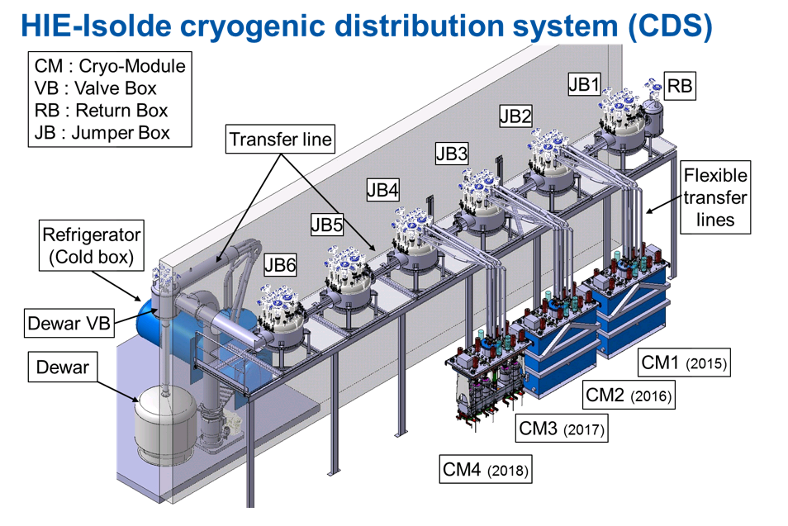
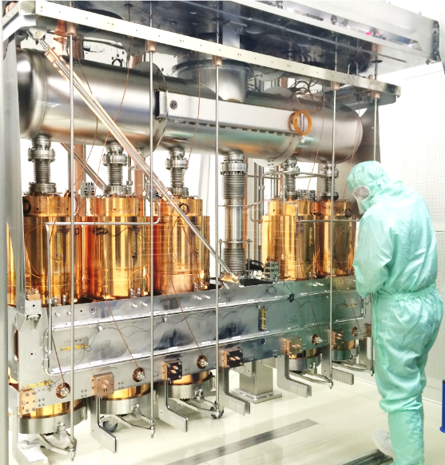
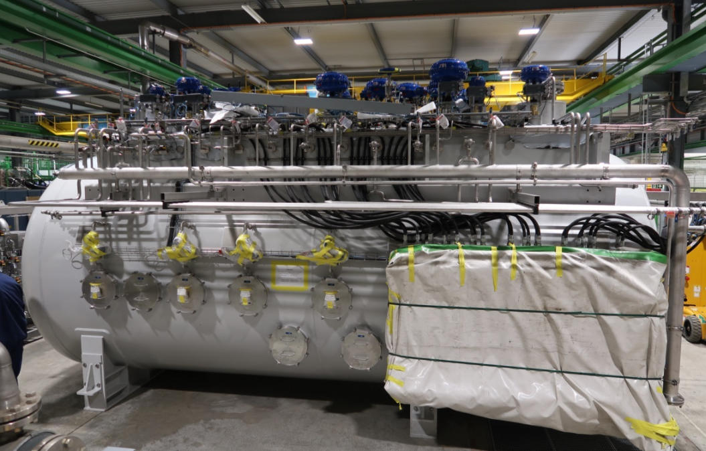
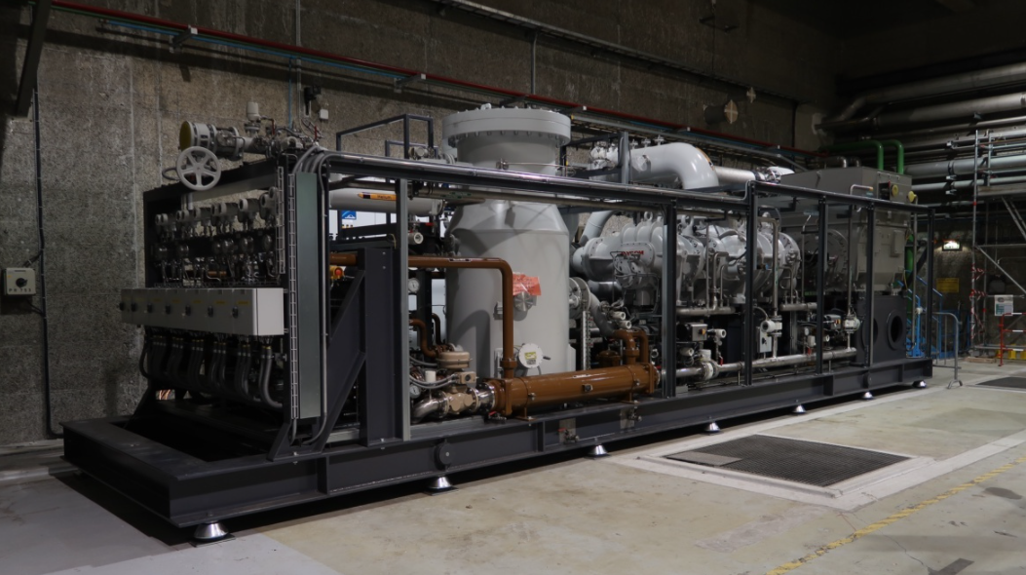
Cryostats for helium SC devices in accelerators
Integrated cryogenic system
Cryoplant
Cryostat for
SC device
Cryogenics transfer line
Linde 35 g/s coldbox
Warm compressor station (Mayekawa)
Inside a HIE Isolde Cryomodule

Slide 4
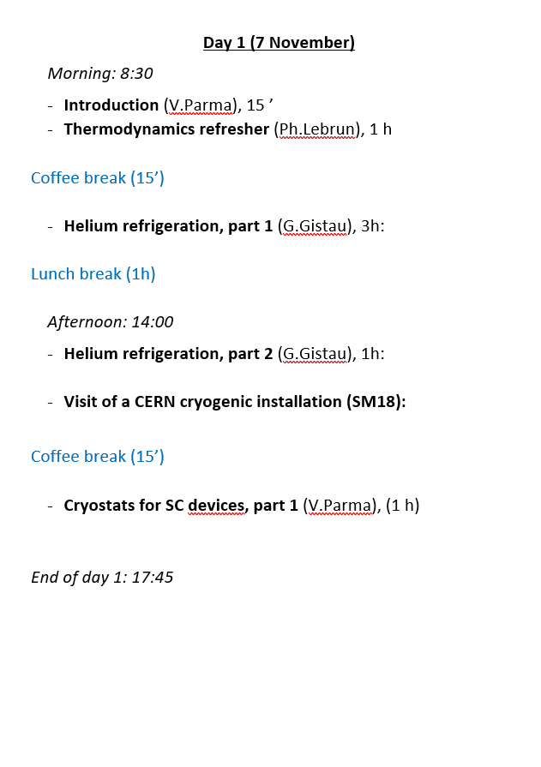
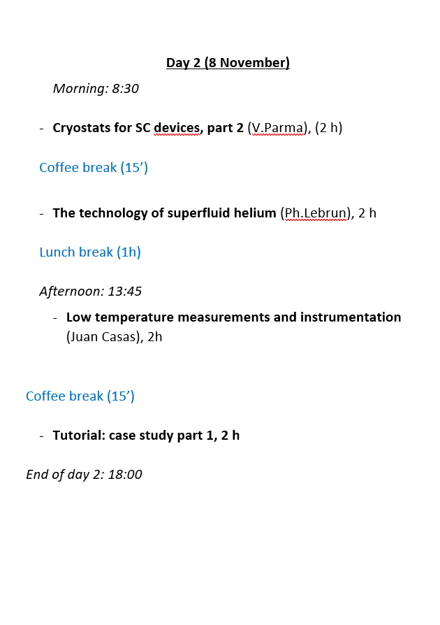
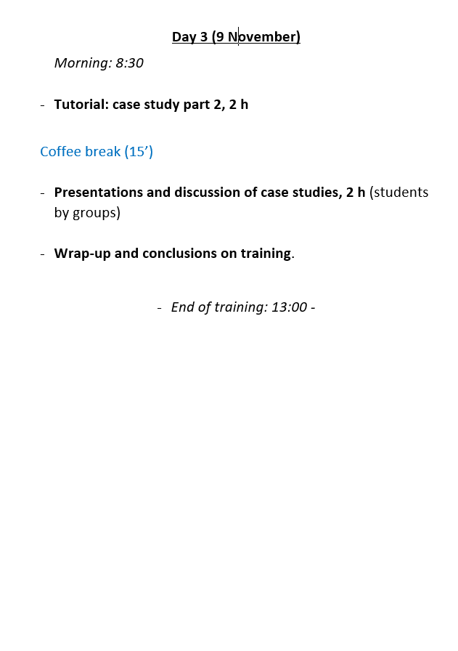
Training schedule and material
Indico page: https://indico.cern.ch/event/1211961/
Classroom: 593-R-010
Classroom: 572-R-010
Classroom: 593-R-010
Classroom: 593-R-010
Classroom: 593-R-010
Classroom: 593-R-010
Classroom: 572-R-010

Slide 5
Tutorial by teams
A real case study: design of a cryostat for FCCee
Set up 4 teams (2 x 3 and 2 x 4 students)
4 hours of teamwork in training room with PCs (Cryostat Toolbox S/W available)
You can use your laptops and any S/W you wish
2 hours for teams’ presentation (1/2 h per team)

Slide 6


Slide 7
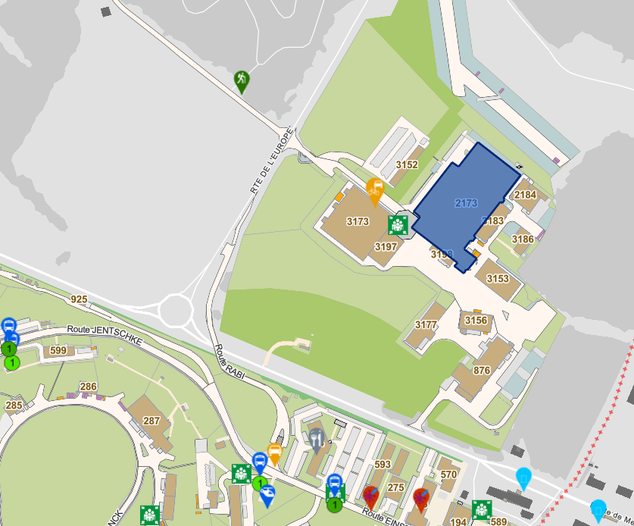
Visit of SM18
meeting point
Time: 15:00

Slide 8
Questions ?

