Slide 1
Tutorial
Technical Training: Cryostat Engineering for SC devices
CERN, 7-9 November 2022

Slide 2
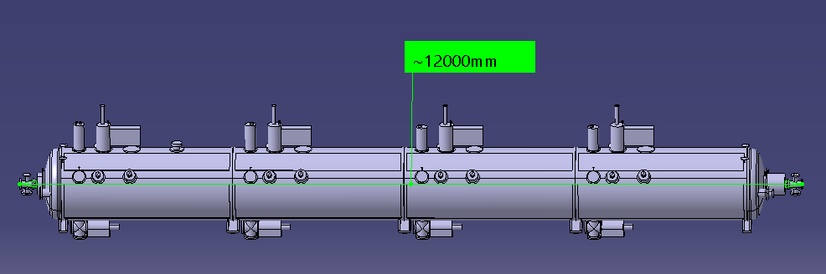
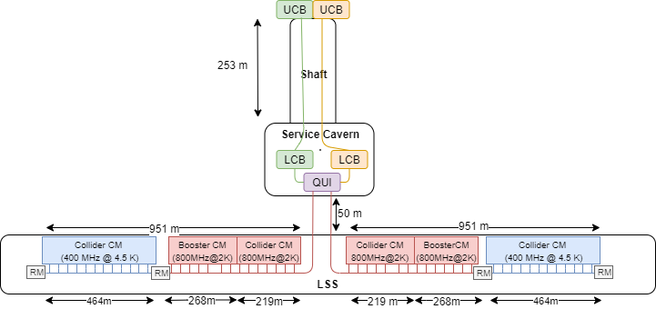
FCCee, RF cryogenic layout, 400 MHz Cryomodule
1 of 35 cryomodules per side

Slide 3
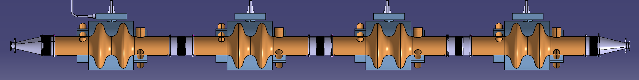
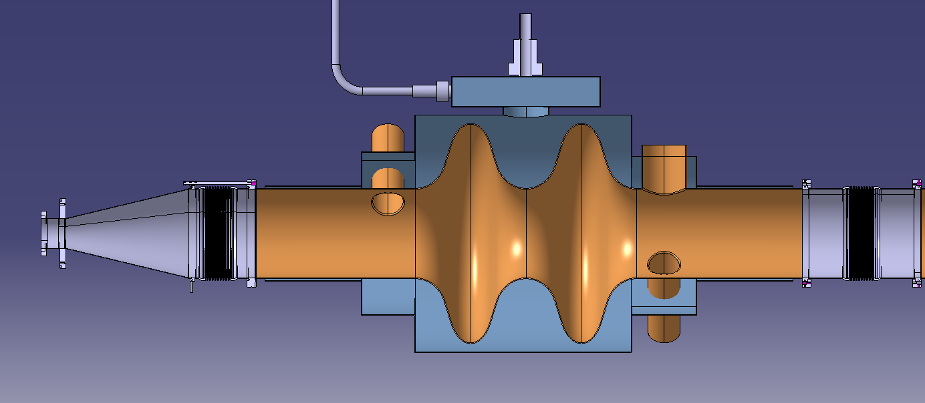
400 MHz cavities, 2-cell
He vapor collector ø50
4.2 K saturated liquid helium, 1.0 bar
~10m
vapor out
Liquid in
ø50
RF Coupler
Ø200 x 2
Cavity: copper, 3-mm thick
Cavity mass: 150 kg
Helium vessel: thickness TBD, st.steel (304L grade)
Helium vessel mass: (304L): 200 kg
Beam tube cone (304L)
RF coupler tube (304L)
Approximate mass of cavity/helium tank/RF coupler assembly: 500 kg
Interconnections
400
Cavity 1850
Cavity
ø300
tube length: 500
Inlet
ø100
500
730
Beam tube cone,
thickness: 1 mm
Cavity
ø740
He tank ø800
He tank volume ~0.28m3

Slide 4
Task 1. Cryostat design
Conceptual design of a cryostats for the 400 MHz cryomodule containing 4 cavities. Make a schematic design (simplified sketch, use ppt or any other S/W tool), and make a preliminary engineering design as follows:
  Calculate helium tank thickness, for a maximum allowable pressure of 4 bar
  Calculate vacuum vessel: material, diameter and thickness
  Calculate thermal shielding: material, diameter, thickness. Propose a possible supporting principle.
  Design of the supporting system. Choose type (column, tie rods, etc.), make a conceptual design (materials and sizing for mechanical and thermal requirements). Consider maximum loads from road transport: vertical: 7 m/s²; lateral: 4 m/s²; longitudinal: 6 m/s² and a minimum Safety Factor on 2 on σ_{0.2}.
  Propose a possible assembly method of the cavities string inside the vacuum vessel
Calculate the static thermal performance (Heat Loads) and total cooling mass flow needs, for the following :
  Supporting system (no heat intercept)
  RF couplers (with active vapor cooling or not)
  Beam tubes cold to warm transitions (cones between 300 K and 4.2 K, no heat intercept). (neglect conduction path of bellows)
  Thermal radiation from vacuum vessel and thermal shielding (flat plate approximation). Calculate the radiation load in the absence of a thermal shield.
  Calculate liquid boil-off mass flows, liquefaction load for ideal vapor cooling of couplers, and thermal shield mass flow assuming T_{in}=50 K and T_{out}= 55 K.

Slide 5
Task 1.1. Table of design parameters
Item | Description | Value | Comments
1 a.
1 b.
1 c.
1 d.
1 e.

Slide 6
Task 1.2. Table of Static Heat Loads and mass flows
Source of HL | HL (W) @ 4.2 K |  | HL (W) @ 50 K | 4.2 K liquid boil-off (g/s) | Liquefaction load (g/s) | Thermal shield mass flow (g/s) (with T_{in}=50K, T_{out}=55 K )
Supports conduction |  |  | - |  | - | -
Beam tube cones conduction |  |  | - |  | - | -
RF Couplers conduction (uncooled) |  | - | - |  | - | -
RF Couplers conduction (ideal vapor cooling) | -
Radiation, with thermal shield @ 50 K |  |  |  |  | -
Radiation, without thermal shield |  |  | - |  | - | -
Radiation from beam tube cones |  |  | - |  | - | -
Totals

Slide 7
Task 2. Cool-Down
The cool down from 293 K is obtained by boil-off of liquid helium at 4.2 K (1 bar) entered from the bottom of the helium vessels.
Calculate the liquid helium need (mass in kg) for cooling down to 4.2 K helium the mass of cavity+helium tank. Consider, during the CD process, an average effectiveness in the use of the sensible heat of helium vapor between 4.2 K and 100 K (exhaust temperature at the exit of the cavity). How correct is this assumption? (Neglect, in the calculation, the contribution from static heat loads to the power balance).
Calculate the average cooling power for a cool down from 293 K to 100 K in 12 h, assuming that cavity/helium vessel are isothermal in the cooling process

Slide 8
Task 2 Results
Item | Value | Comments
a.
b.

Slide 9
Task 3. RF operation, helium boil-off and pumping
During RF operation of a cryomodule, a dynamic heat load 175 W is added to the static heat load calculated previously. Vapours are pumped back to the refrigerator through a 1’000 m long, DN200 smooth pipe, routed in a shielded and vacuum insulated transfer line.
Calculate the total boil-off rate in saturated helium at 4.2 K and 1 bar (g/s) for one cryomodule
Calculate the pumping pressure drop along the line, neglecting static heat loads along the line
Calculate the total pressure drop for 35 cryomodules all operating with the same dynamic load
If the cavities operate at 2K, 30 mbar, calculate the pressure drop along the line

Slide 10
Task 3 Results
Item | Value | Comments
a.
b.
c.
d.

