Slide 1
FCC-ee Cavity
Cryostat Design
Technical Training: Cryostat Engineering for SC devices
CERN, 7-9 November 2022

Slide 2
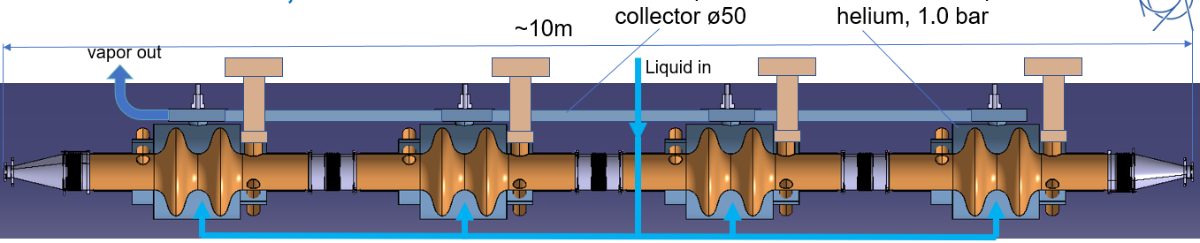
Gas Out
Fixed
Slider
Slider
Vacuum Vessel
Central Supporting Tube

Slide 3
Design
Vacuum Vessel
200 x 2 mm
1450 mm
150 mm
100 mm
1450 mm
1150 mm
300 mm
800 mm
Helium Tank

Slide 4
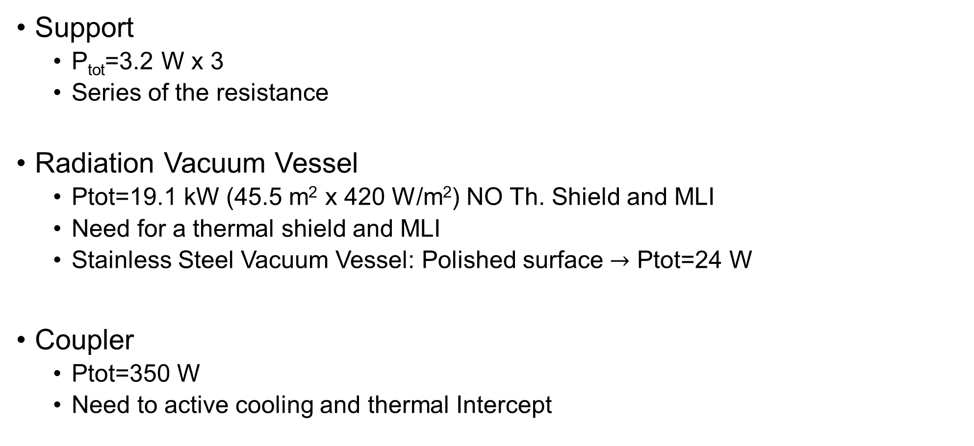
Thermal Analysis
Support
  P_{tot}=3.2 W x 3
  Series of the resistance
Radiation Vacuum Vessel
  Ptot=19.1 kW (45.5 m² x 420 W/m²) NO Th. Shield and MLI
  Need for a thermal shield and MLI
  Stainless Steel Vacuum Vessel: Polished surface $→$ Ptot=24 W
Coupler
  Ptot=350 W
  Need to active cooling and thermal Intercept

Slide 5
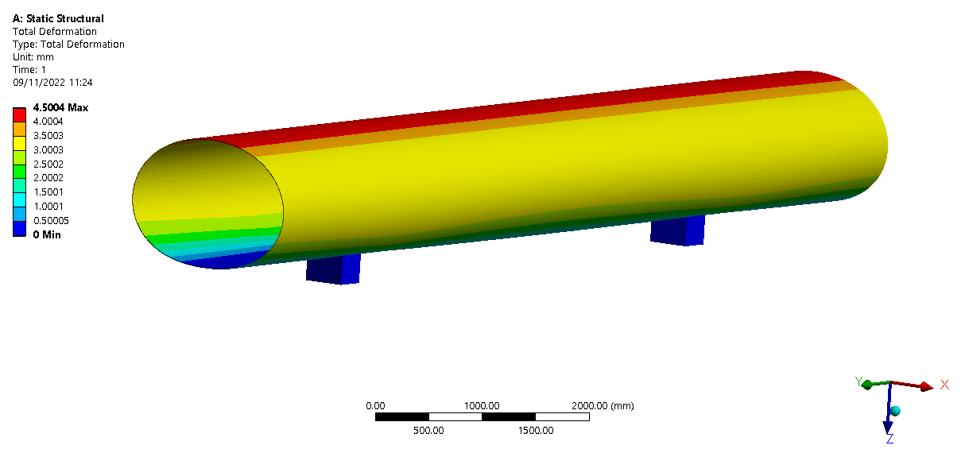
Vacuum vessel deformation

Slide 6
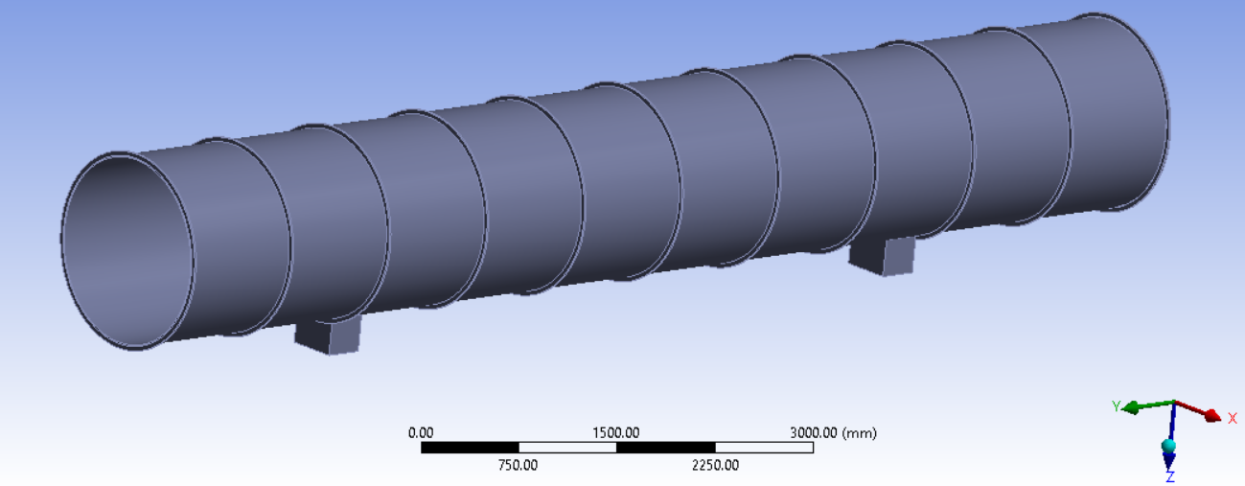
Reinforcements needed for buckling

