Slide 1
Simulation for CLEAR
(How to improve machine)
Avni Aksoy

Slide 2
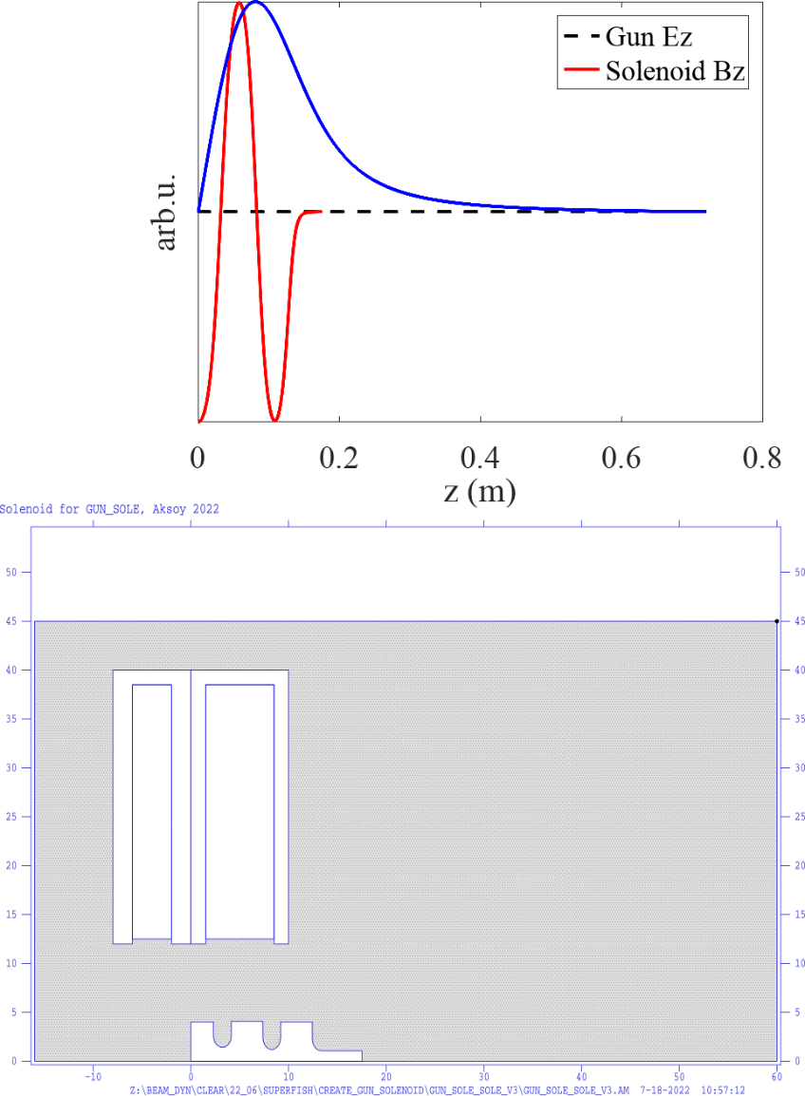
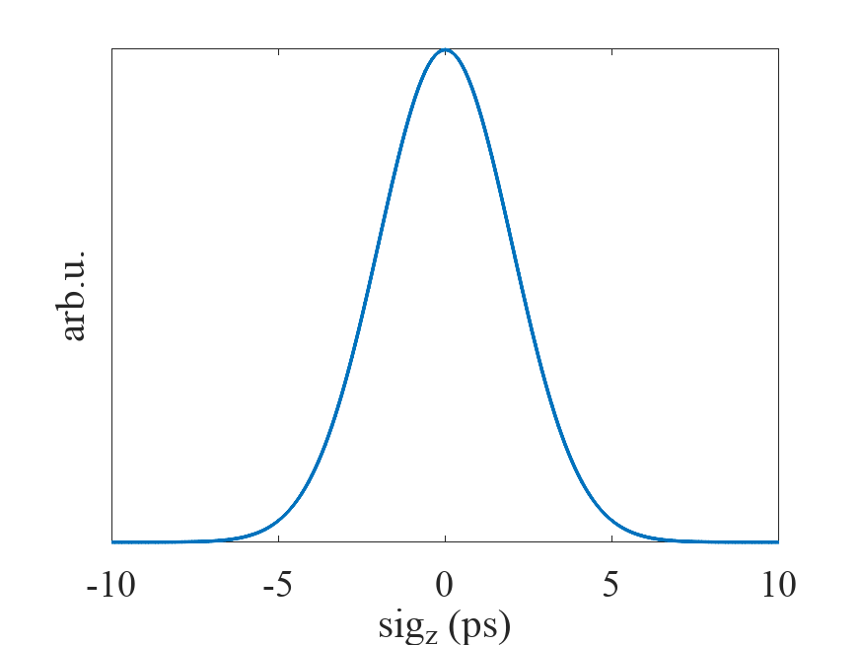
CLEAR Layout
3 GHz RF Gun
2.6 Cell, 100 MV/m
3 GHz Traveling wave structures
132 cells, ~4.5 m, 15MV/m, 120 degree
Laser
σ_{z} = 2 ps (RMS)
σ_{x,y} = variable
Laser longitudinal parameters can not be changed. Fixed profile and temporal length!

Slide 3
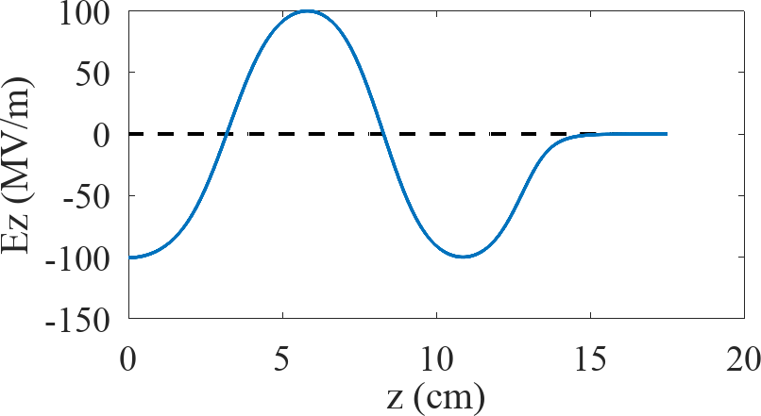
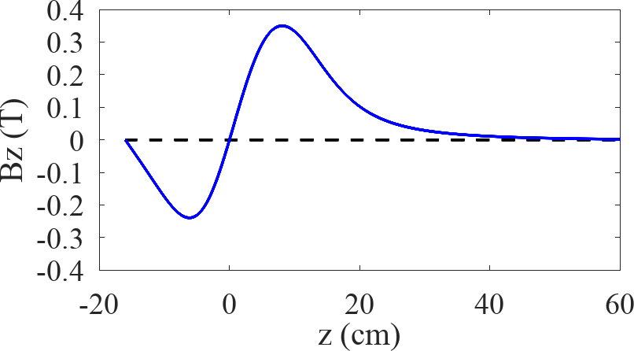
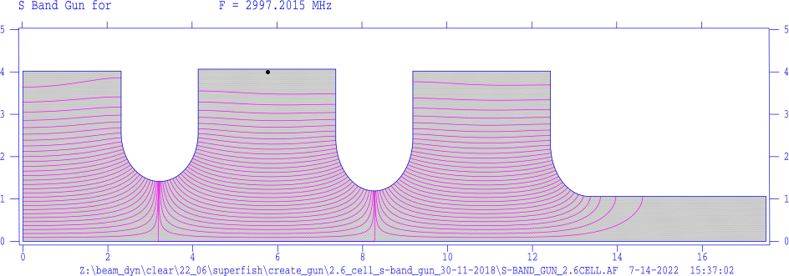
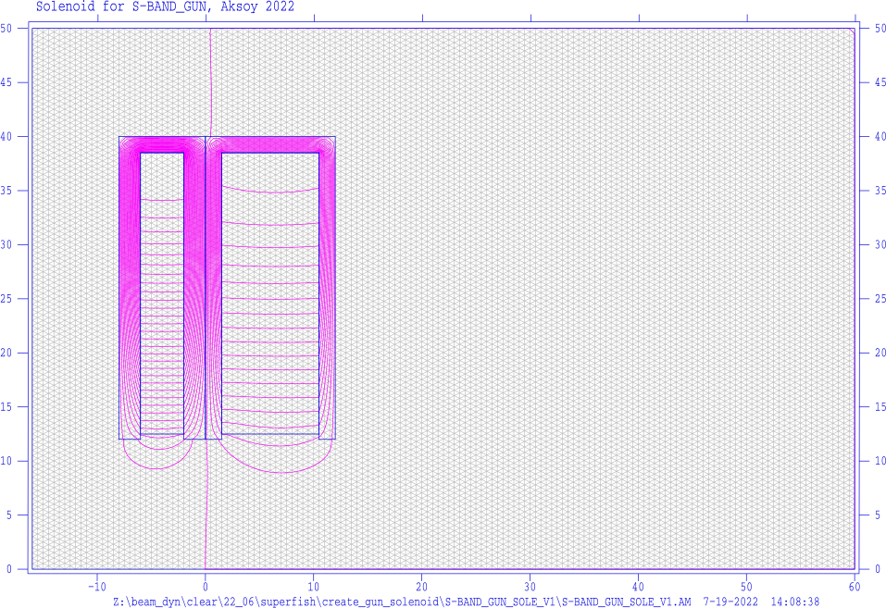
S-Band gun and Solenoid
3 GHz RF Gun
2.6 Cell, 100 MV/m
3 GHz Traveling wave structures
132 cells, ~4.5 m, 15MV/m, 120 degree
Parameter | Value | Unit
Frequency | 2.997 | GHz
Gradient | 100 | MV/m
Cell number | 2.6 | #

Slide 4
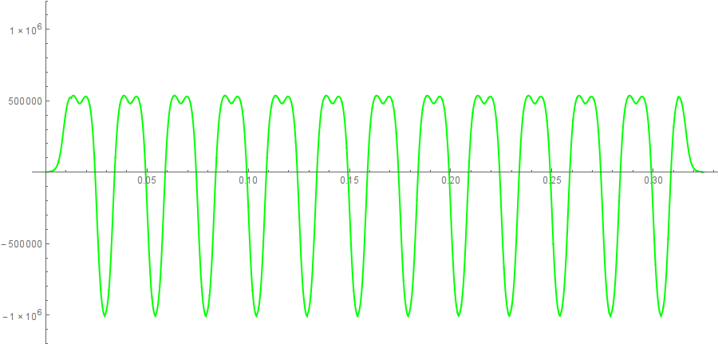
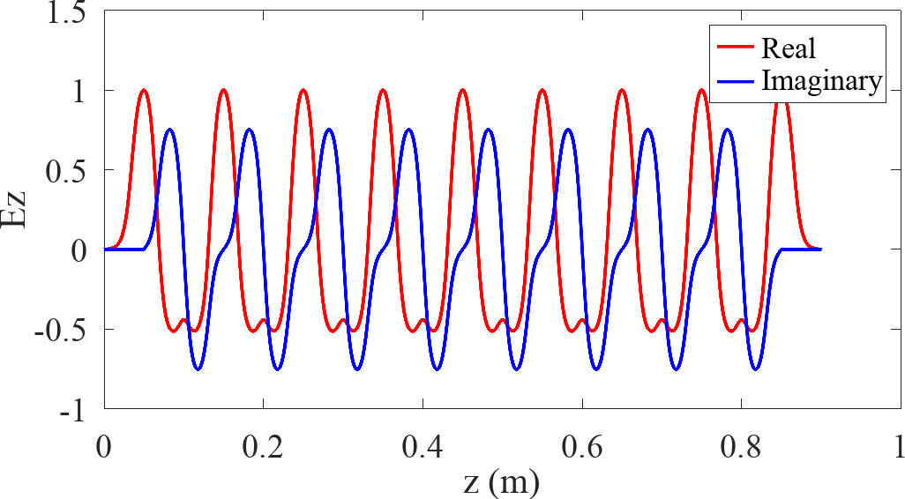
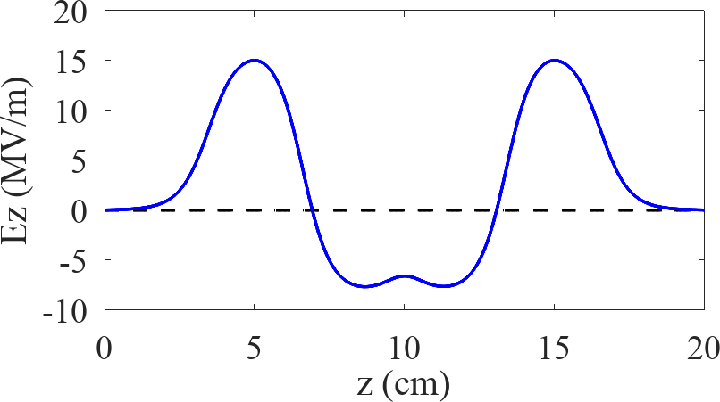
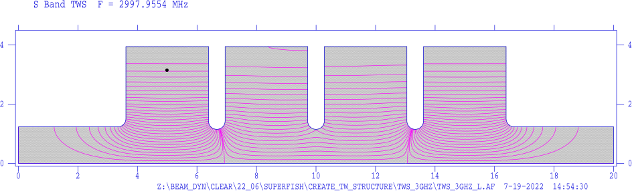
Accelerating Structure
Parameter | Value | Unit
Frequency | 2.997 | GHz
Gradient | 15 | MV/m
Total lengt | 4.5 | m
Cell number | 132 | #
3 GHz RF Gun
2.6 Cell, 100 MV/m
3 GHz Traveling wave structures
132 cells, ~4.5 m, 15MV/m, 120 degree
Coupler TWS Coupler

Slide 5
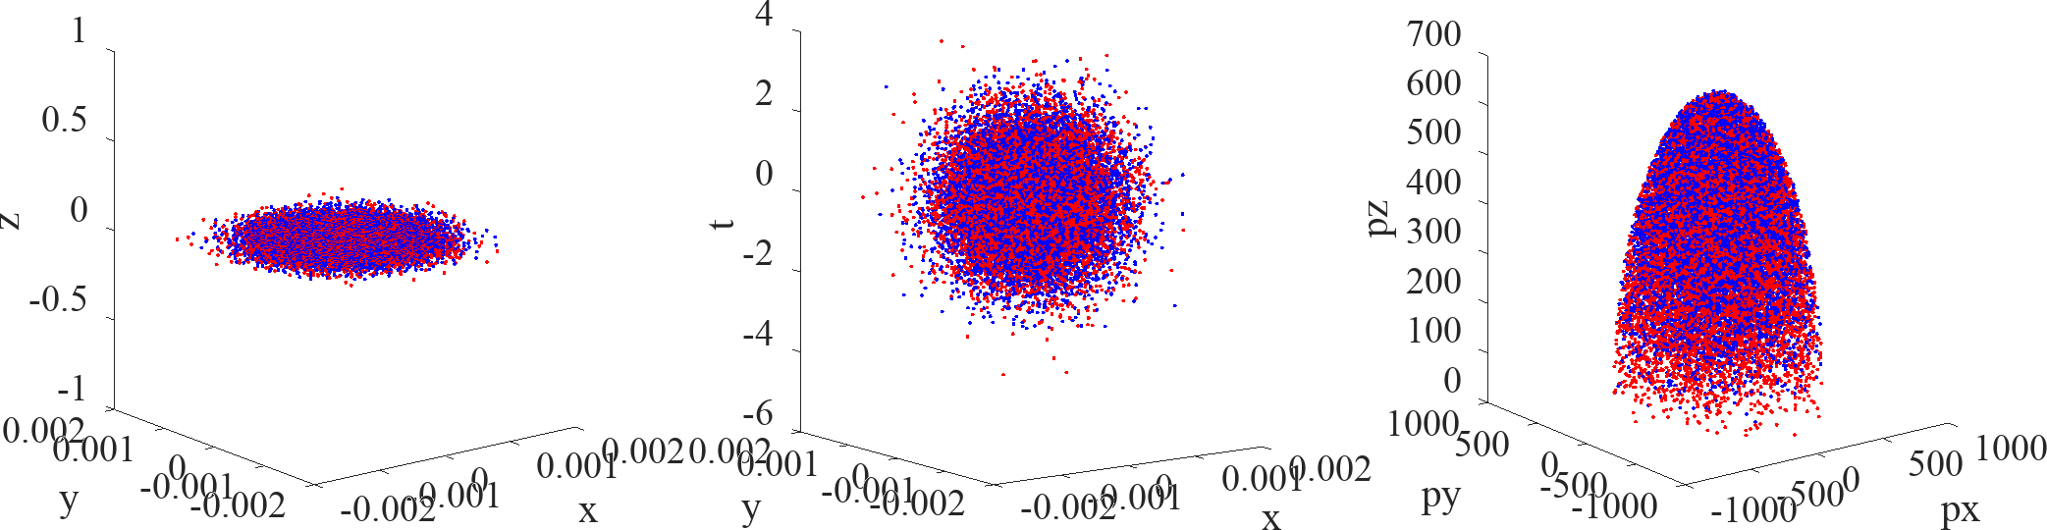
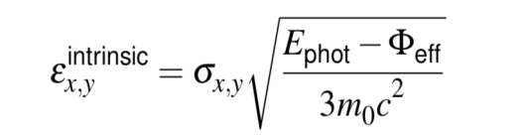
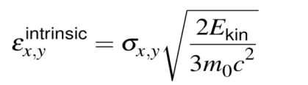
Emission Process
The photo-emission process determines the beam intrinsic emittance at the cathode, a key parameter that represents the lowest emittance value one can get at the injection
FERMI-DIRAC distribution
The particles emerging from the cathode at room temperature have an intrinsic velocity spread and so an intrinsic emittance described as
ISOTROPIC distribution
The beam distribution emerges from the cathode with isotropic emission angles into a half sphere over the cathode according to with the intrinsic emittance
where σx,y is the rms laser beam size, Φeff is the effective work function and Ephot is the photon energy Ekin represents the beam kinetic energy
David H. Dowell and John F. Schmerge, PRSTAB 12, 074201 (2009)

Slide 6


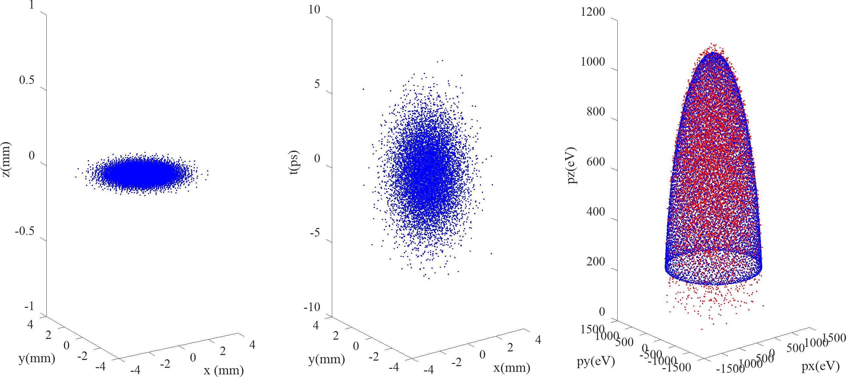
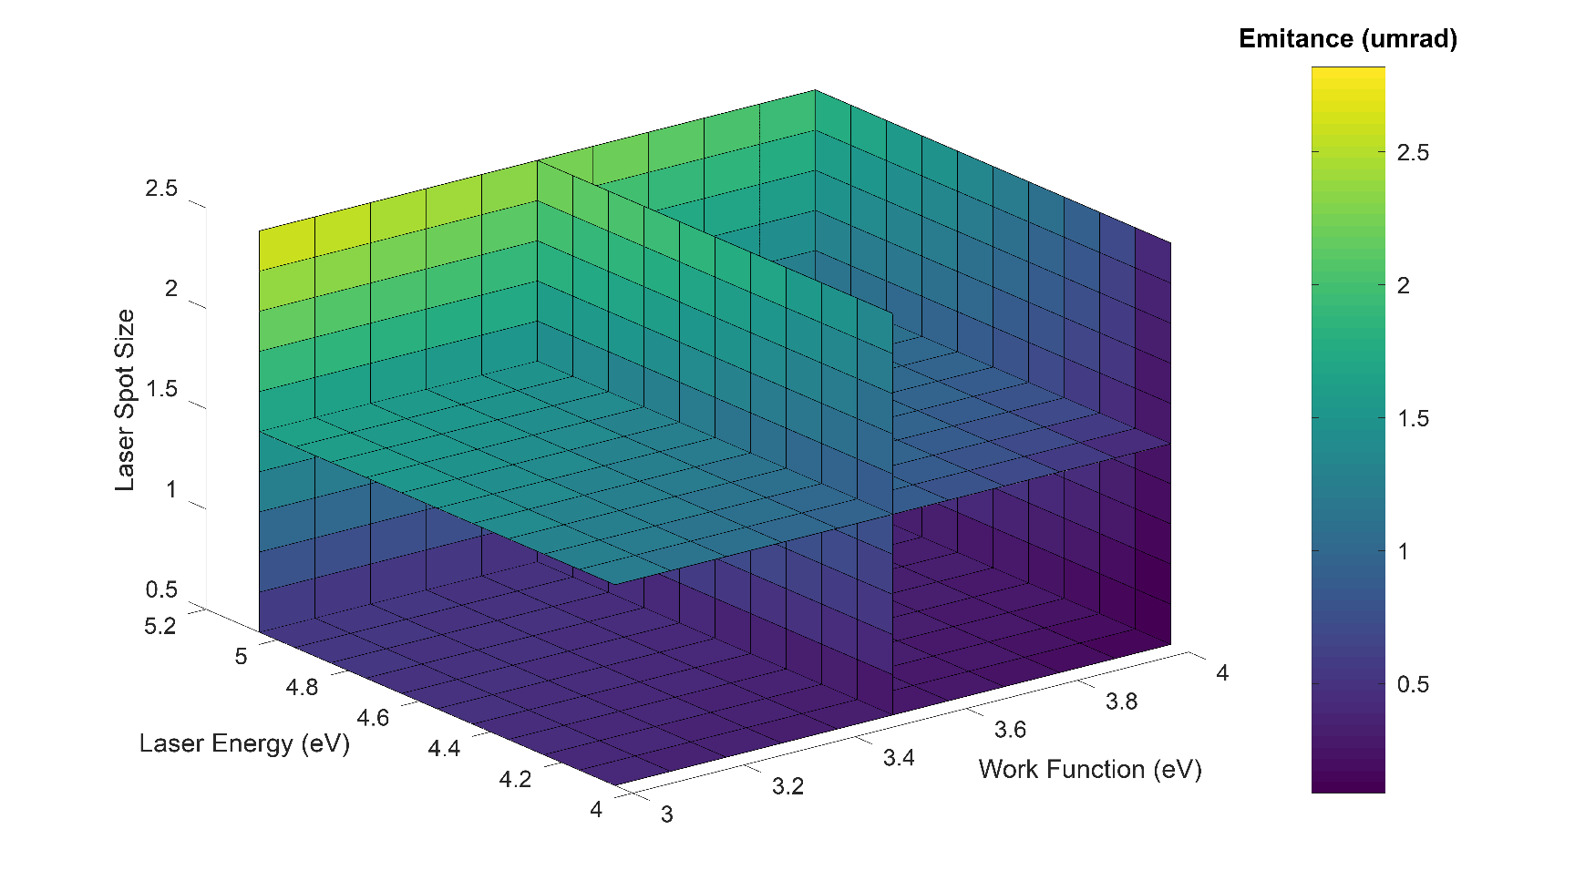







Distributions
Fermi Diract Distribution
Isotropic Distribution
Parameter | FD | Isotropic
σx (mm) | 1 | 1
εx (mm.mrad) | 0.9 | 1.2
E_mean (eV) | 0.8 | 1.15
σt (ps) | 2 | 2

Slide 7
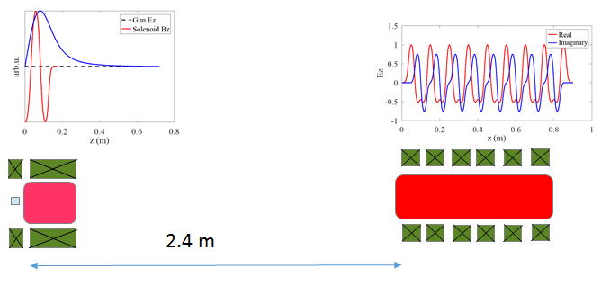
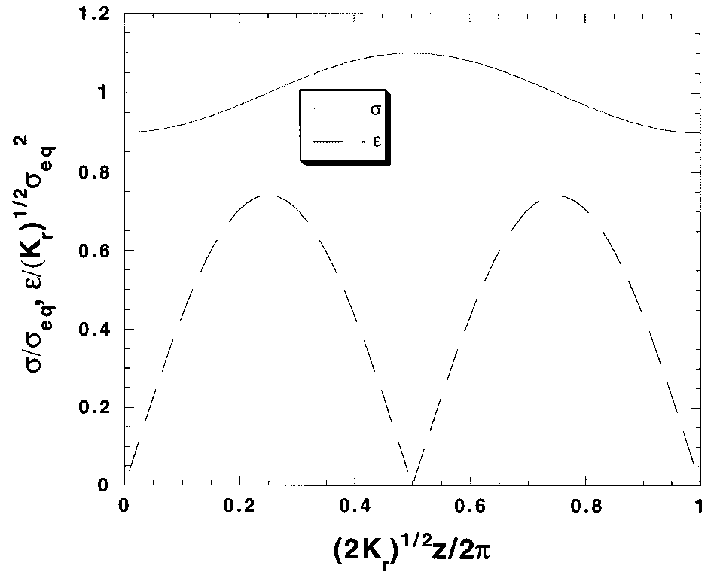

Before Simulations
The theory of invariant envelope and derived matching conditions.. (L. Serafini, J B. Rosenzweig PR-E V.55, N.6,1997, SLAC-PUB 8400)
Kr: focusing channel strength, κ_{s:} Beam perveance
The basic point in the design of a photoinjector is to match properly the beam at injection into any accelerating section according to the criteria:
σ’=0
implying waist at injection..
The focusing element arround gun is too short and the space to the structure is too long.. It is imposible to get a waist at injection…

Slide 8
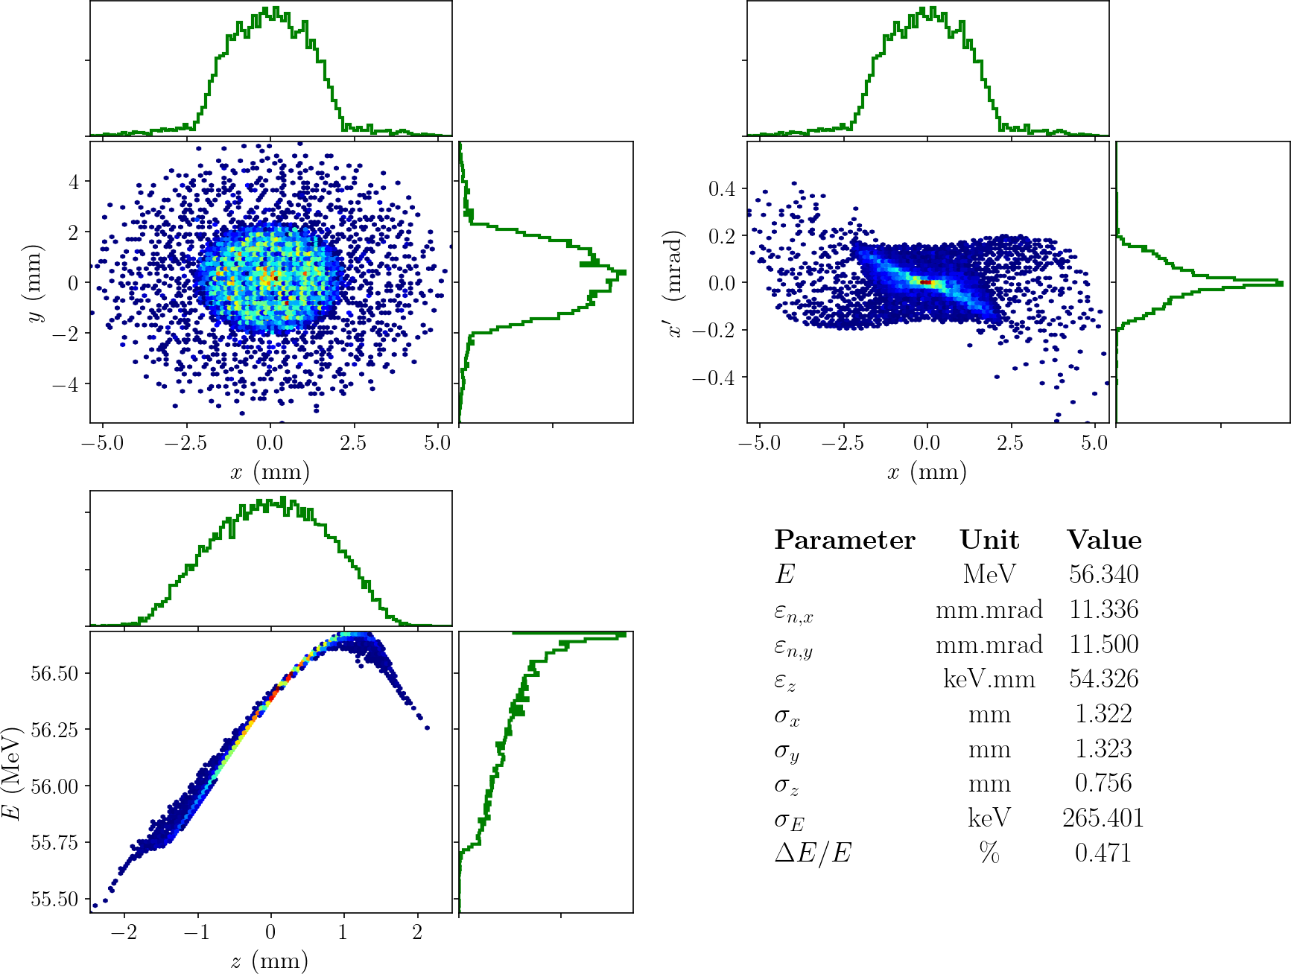
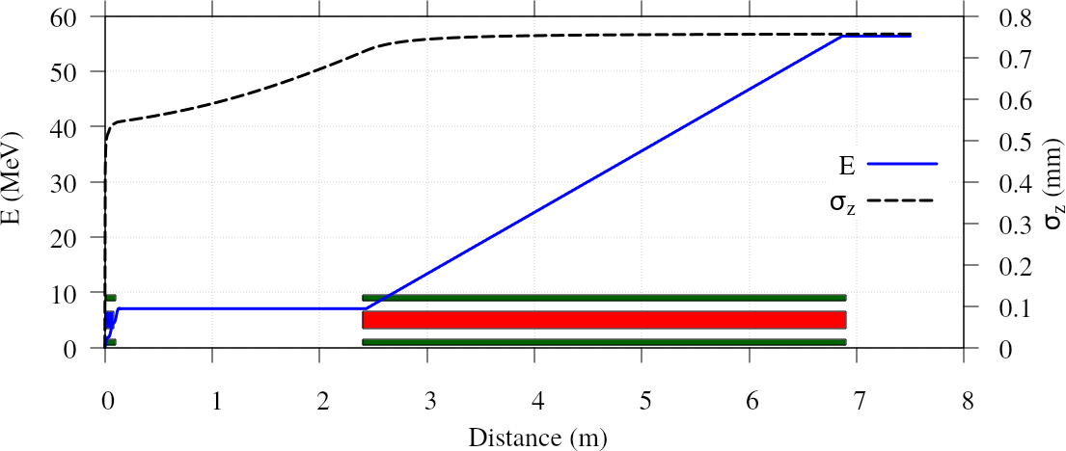
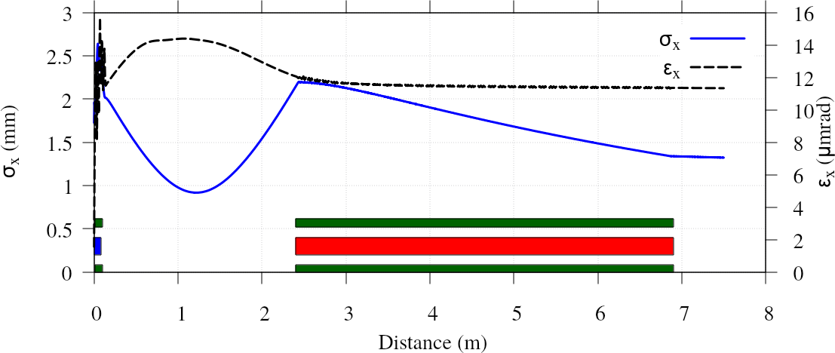
Simulation (as it is)
Parameter | Unit | Value
Sigma_x | mm | 2.006
B_solenoid | T | 0.259
Phase_gun | degree | 44.534
Phase_cavity | degree | 49.594
Optimization criteria
  No beam loss at the entrance of TWS (30 mm aperture)
  Minimum emittance..
Optimization parameters
  Laser spot size (if large, large initial emittance)
  Strength of solenoid
  Phases of structures
  1nC bunc charge, accelerating voltage of gun (100 MV/m) and TW structure (15 MW/m) and laser temporal length (2ps) are fixed.

Slide 9
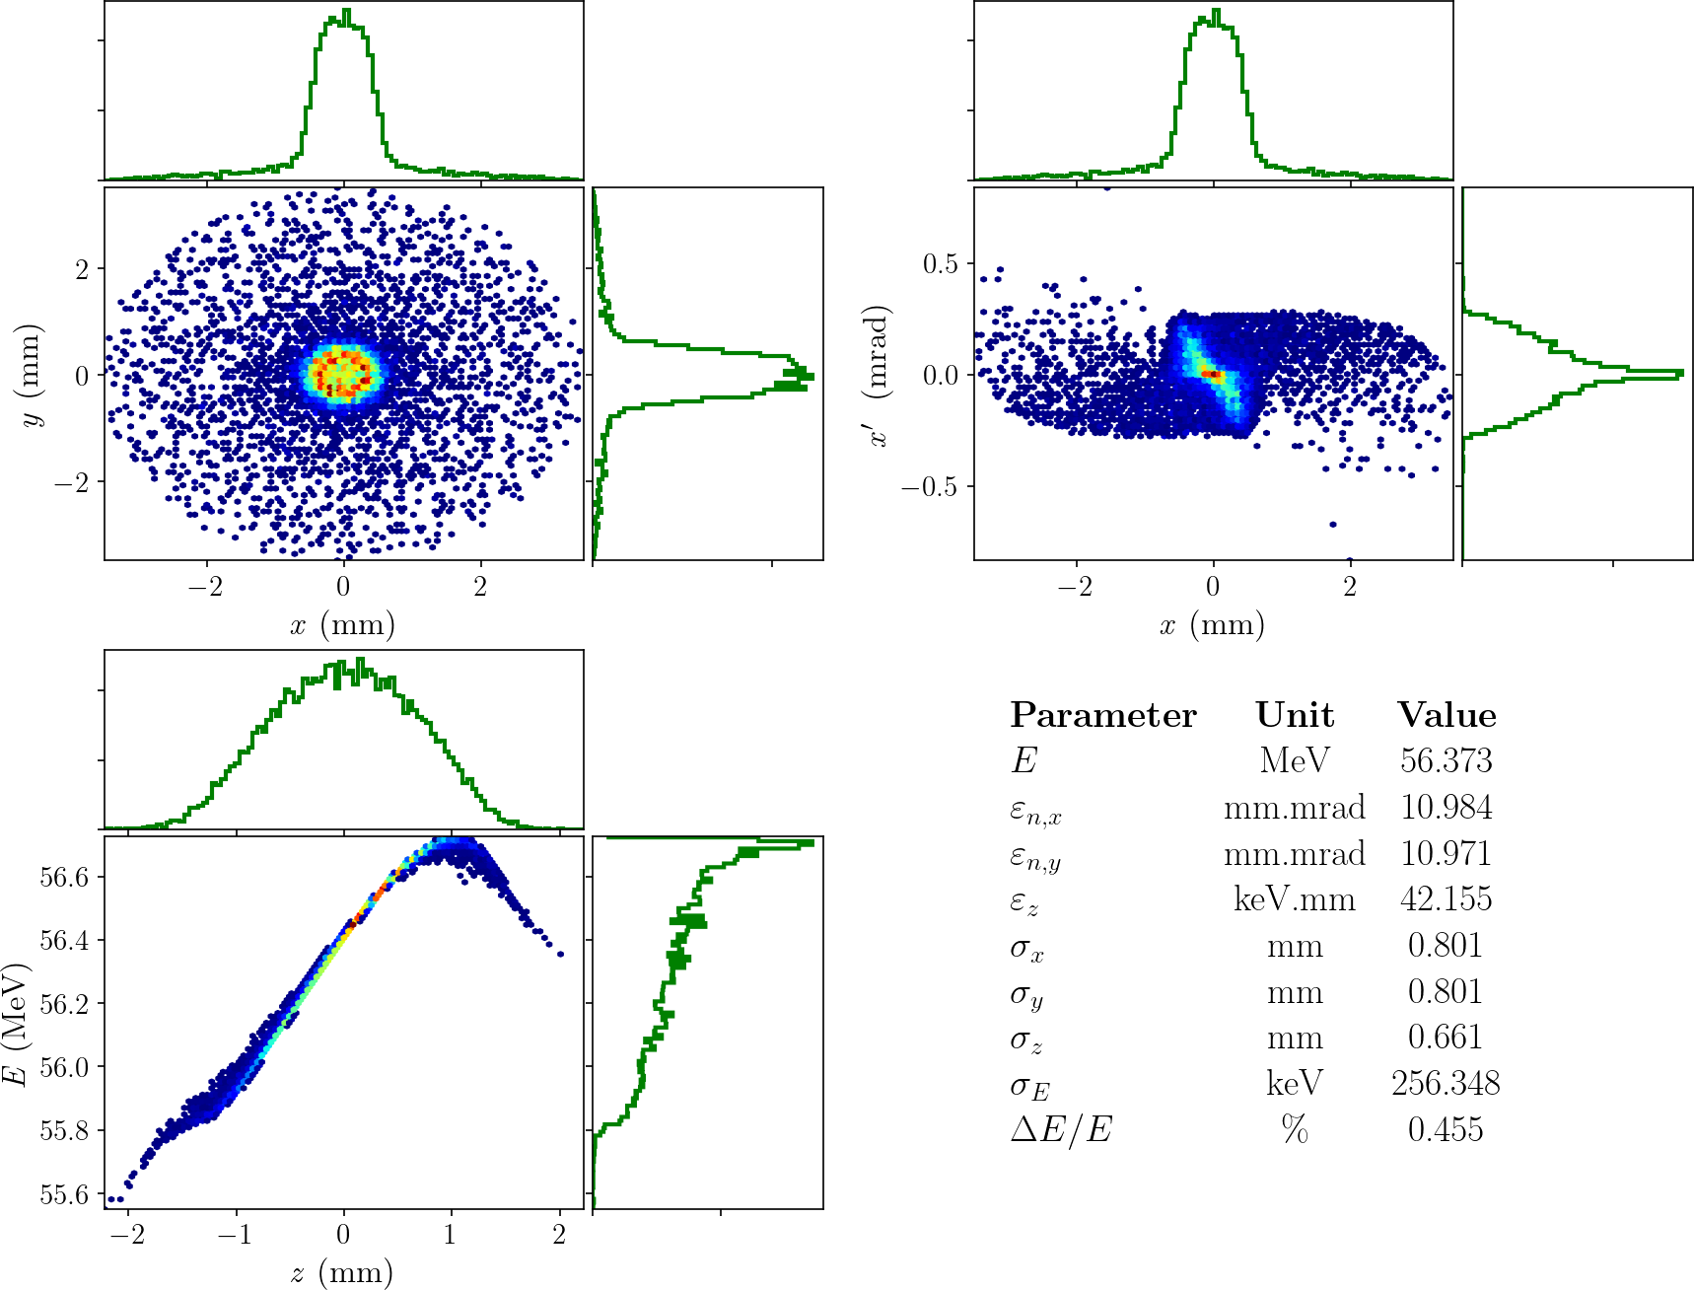
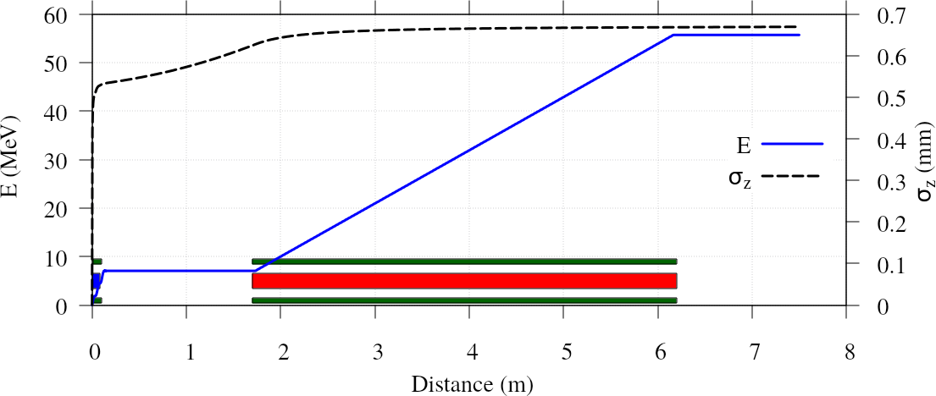
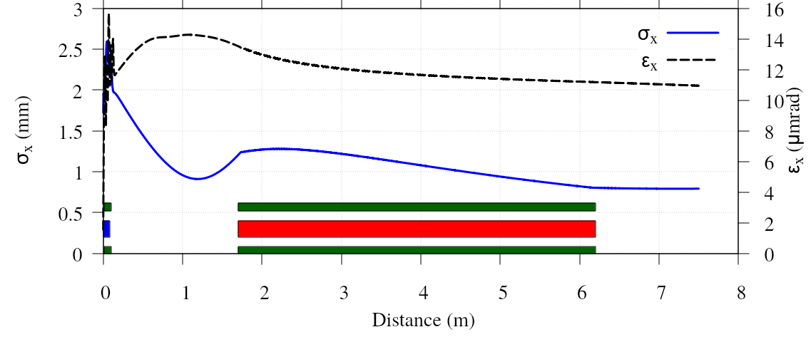
Simulation (shortenning the space)
Parameter | Unit | Value
Sigma_x | mm | 1.274
B_solenoid | T | 0.2783
Phase_gun | degree | 42.359
Phase_cavity | degree | 63.486
The distance between gun and accelerating structure is reduced to 1.7 m
Optimization criteria
  No beam loss at the entrance of TWS (30 mm aperture)
  Minimum emittance..
Optimization parameters
  Laser spot size (if large, large initial emittance)
  Strength of solenoid
  Phases of structures
  1nC bunc charge accelerating voltage of gun (100 MV/m) and TW structure (15 MW/m) and laser temporal length (2ps) are fixed.

Slide 10
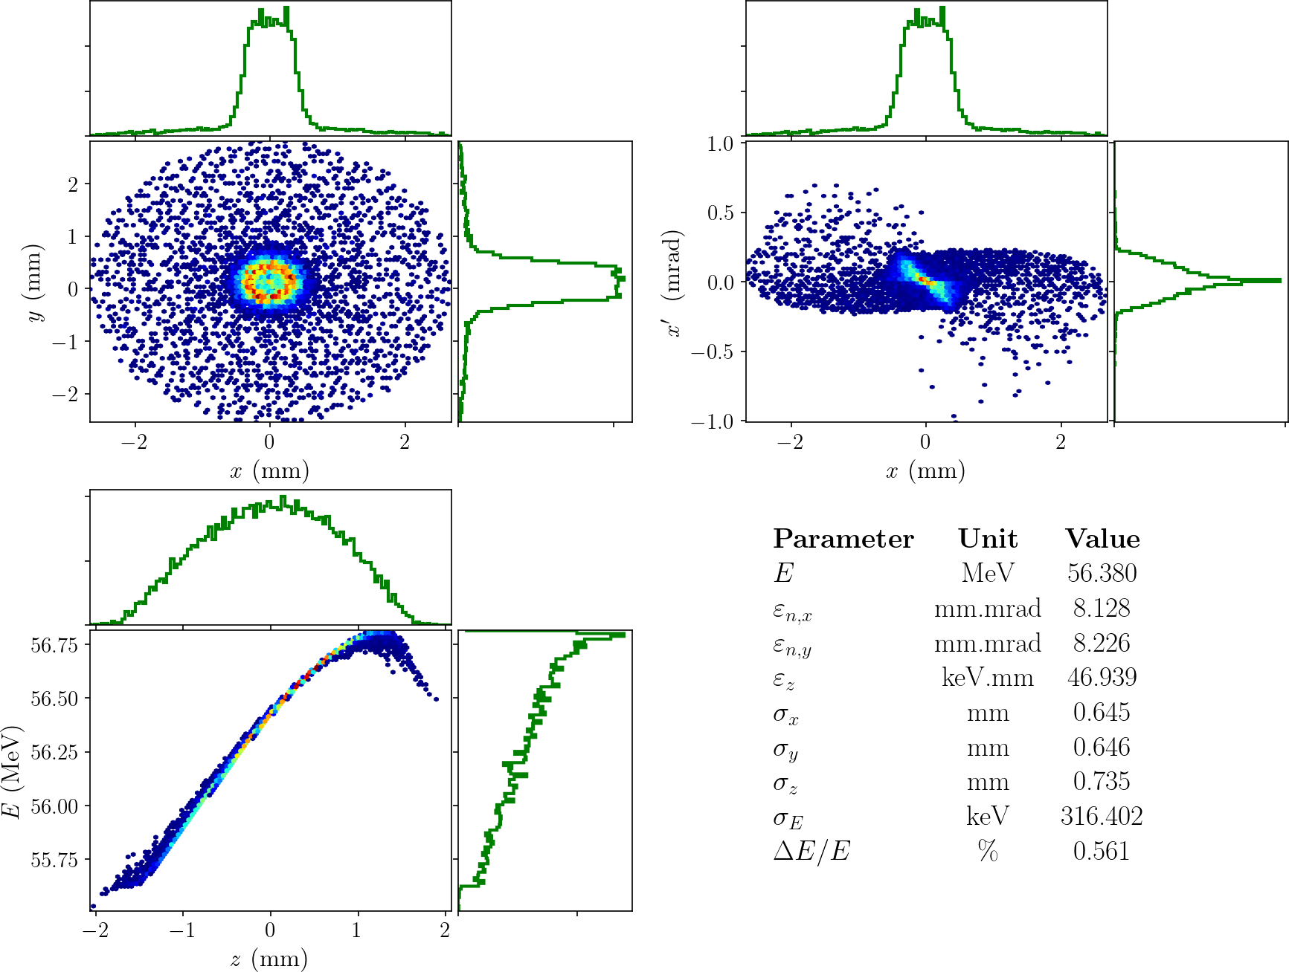
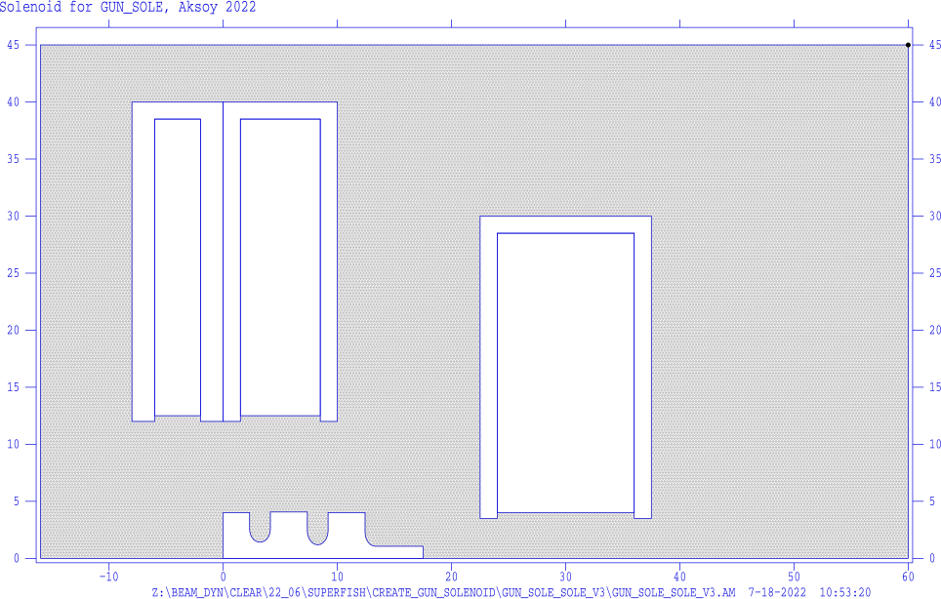

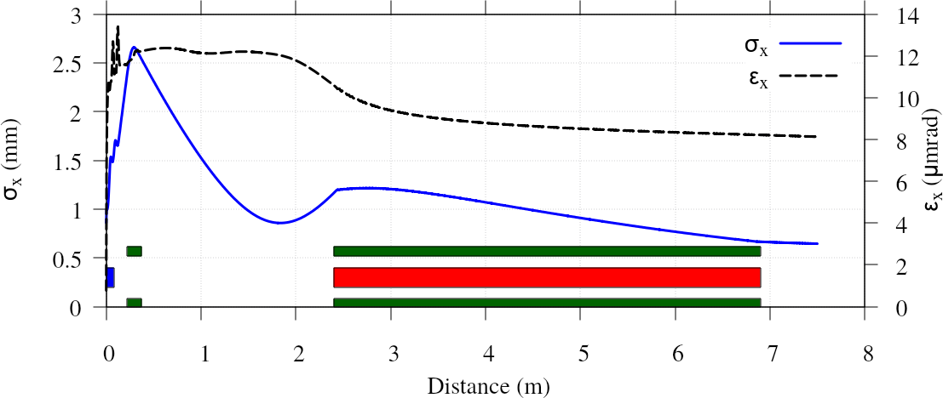
Simulation (Increasing the focusing strength)
In orrder to have a waist at the entrance of TWS, another solenoid just located 10 cm downstream of gun (22.5 cm to cathode) is proposed..
Parameter | Unit | Value
Sigma_x | mm | 1.020
B_solenoid | T | 0.321
Phase_gun | degree | 34.637
Phase_cavity | degree | 55.594
The space between gun and TWS is 2.4 m
The existing focusing solenoid not needed to be used, but back coil can be used for zero filed at cathode.
The new solenoid needs to be about 15 cm length with maximum filed of 0.4 T
Existing Solenoid
Gun
New Solenoid

Slide 11
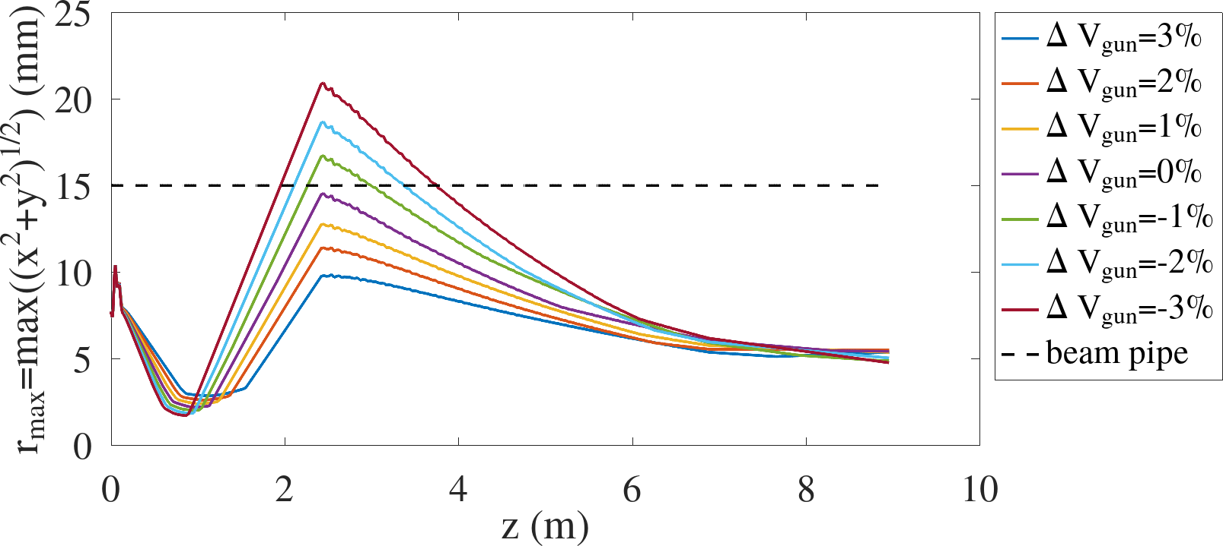
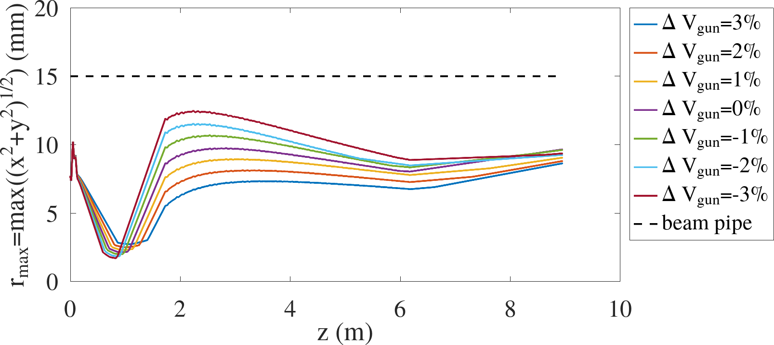
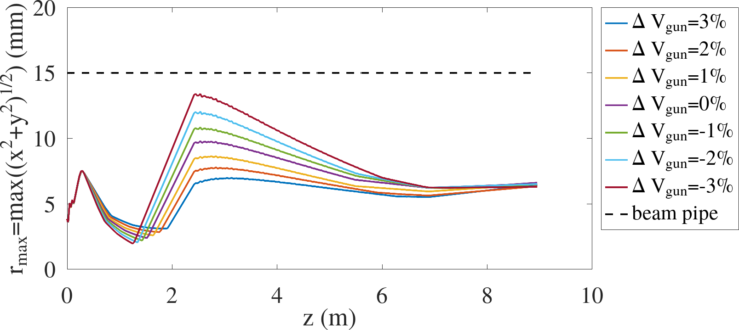
Sensitivity to energy changes
Existing setup
Short Injector
New Solenoid

Slide 12
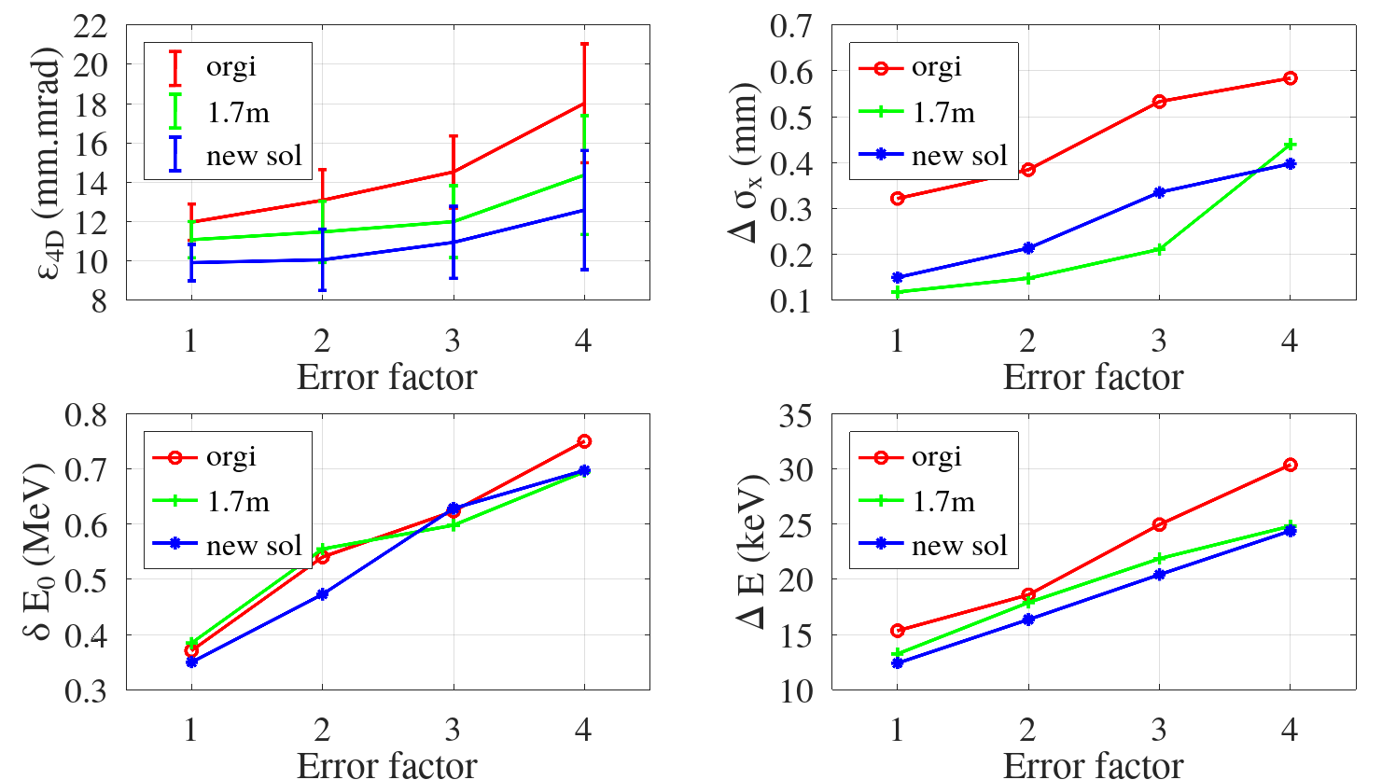
Sensitivity to RMS errors
There can be many sources of error.. Considered ones..
  Laser position error δx₀=50 µm, δx₀=50 µm
  Laser power error → charge error δQ₀=2.5%
  RF phase error δφ₀=1 degree
  RF gradient error δV₀=1%
By increasing the amplitude of these RMS erros the injectore has been compared..

Slide 13
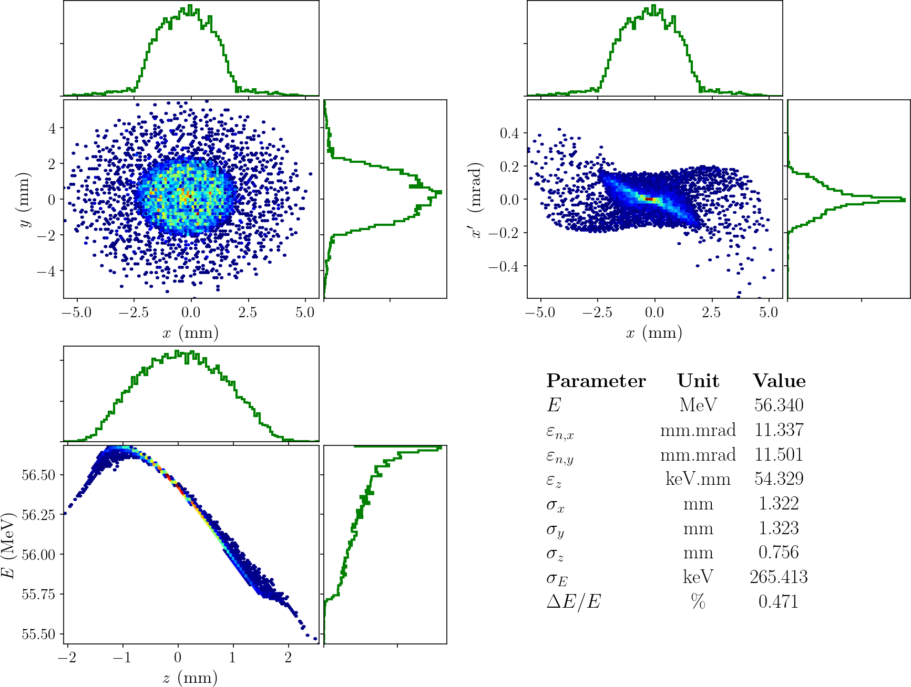
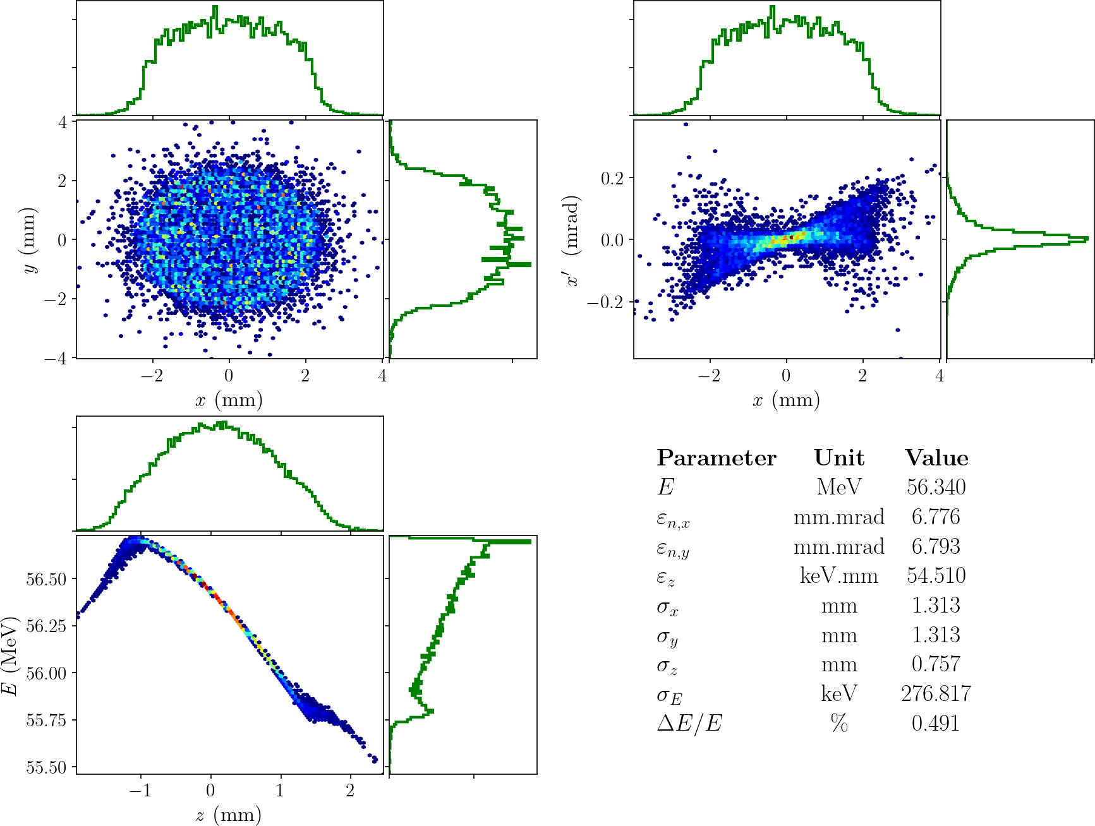
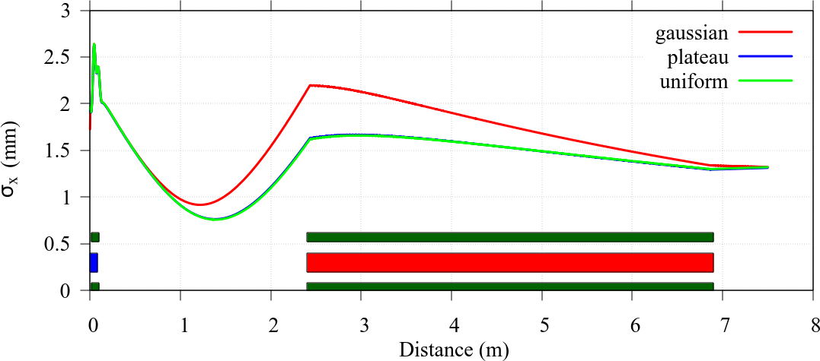
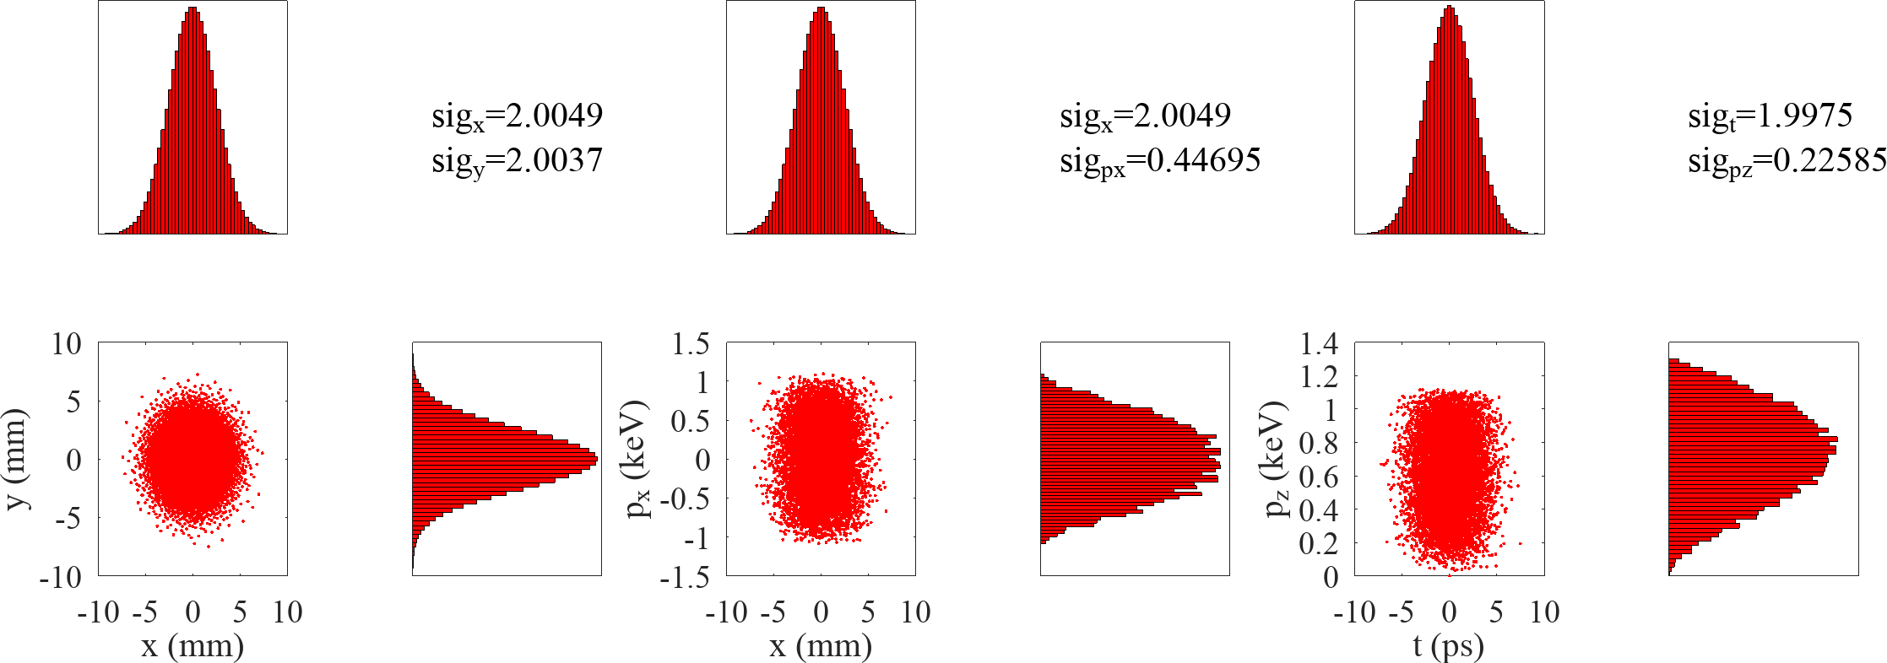
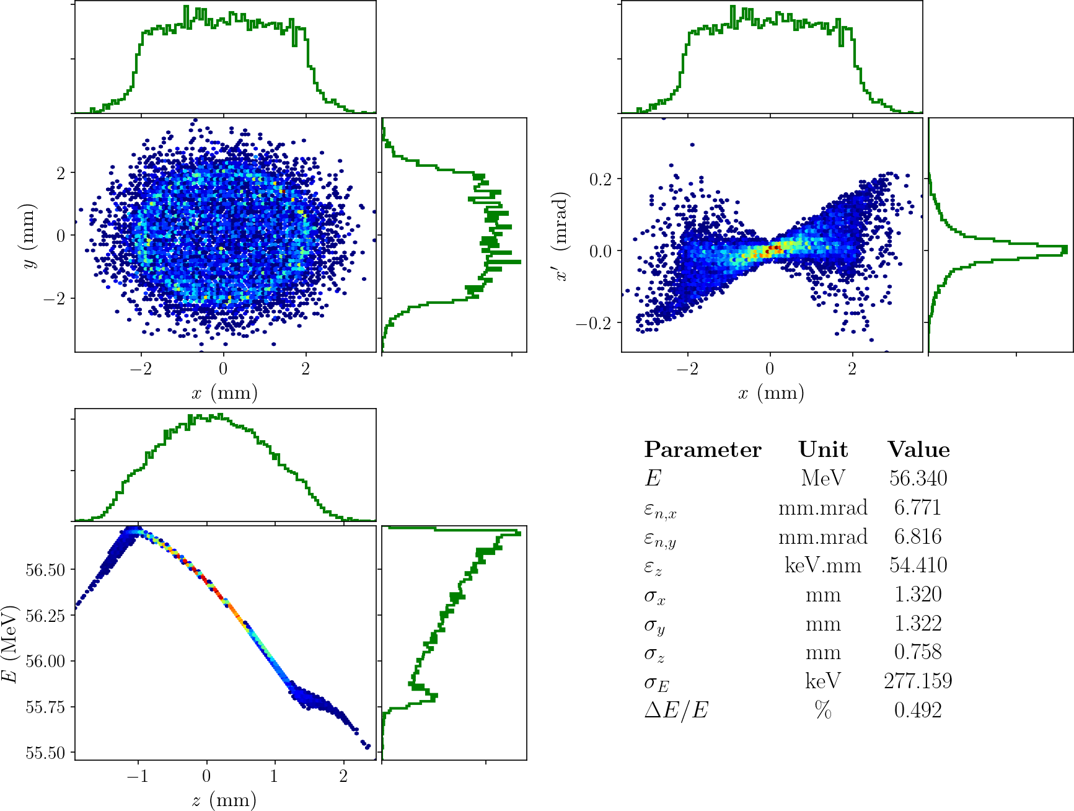
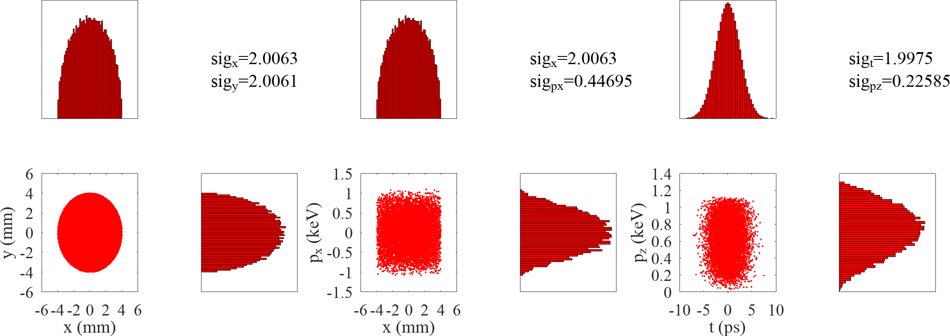
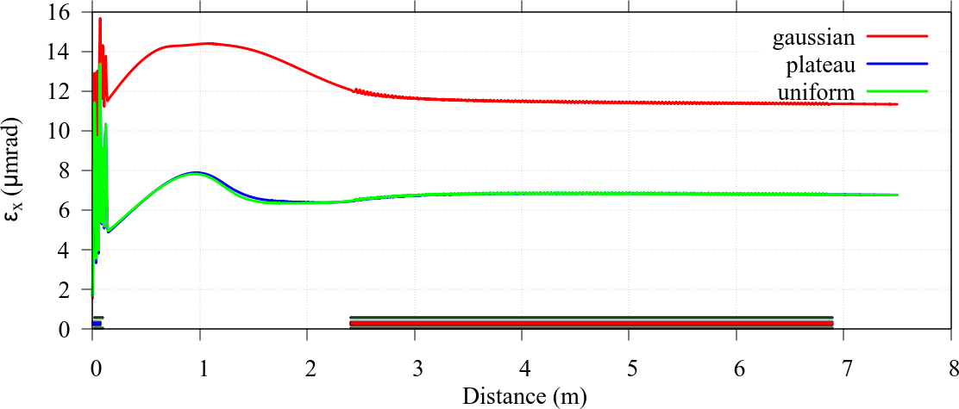
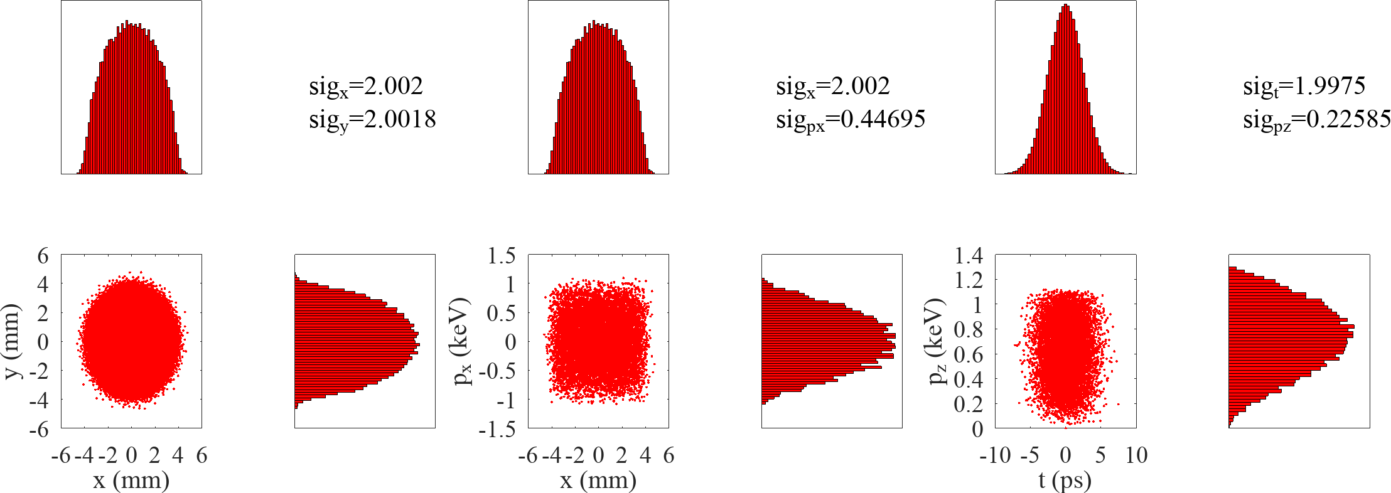
Different transverse inital distribution (only for existing setup)
Transverse Gaussian
Gaussian
Plateau
Transverse Uniform (radial)
Uniform
Transverse Plateau

Slide 14
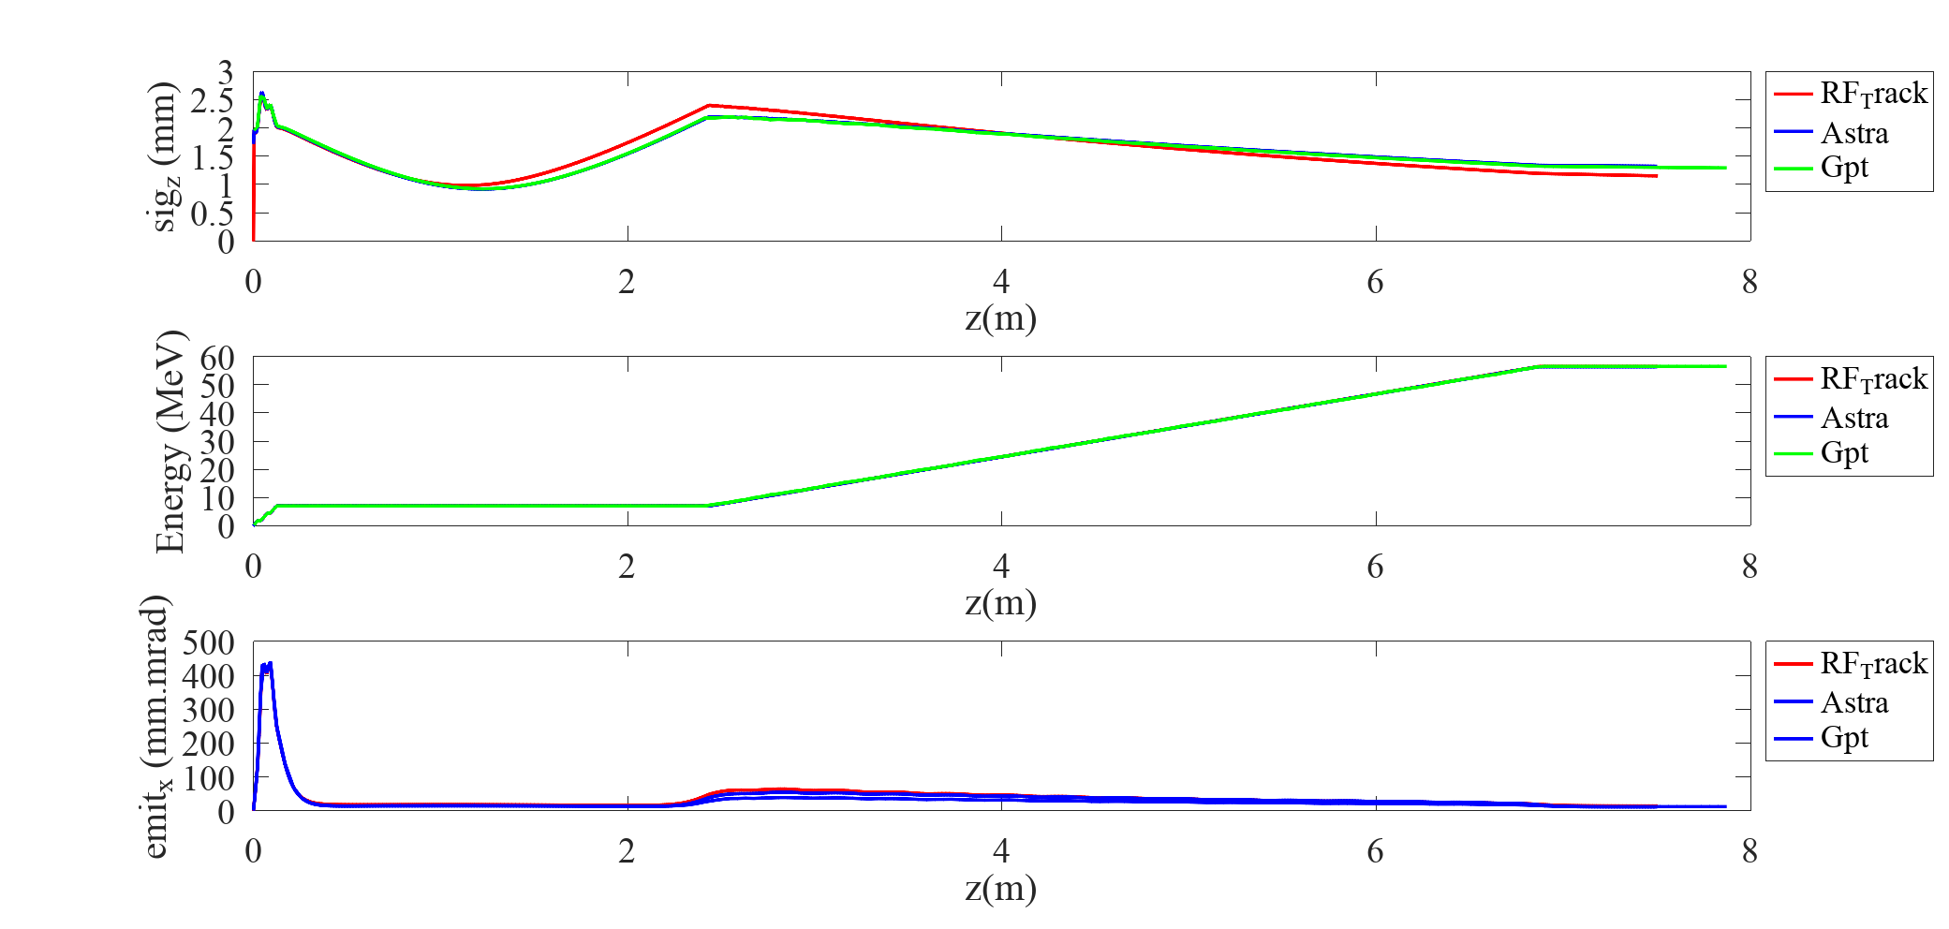
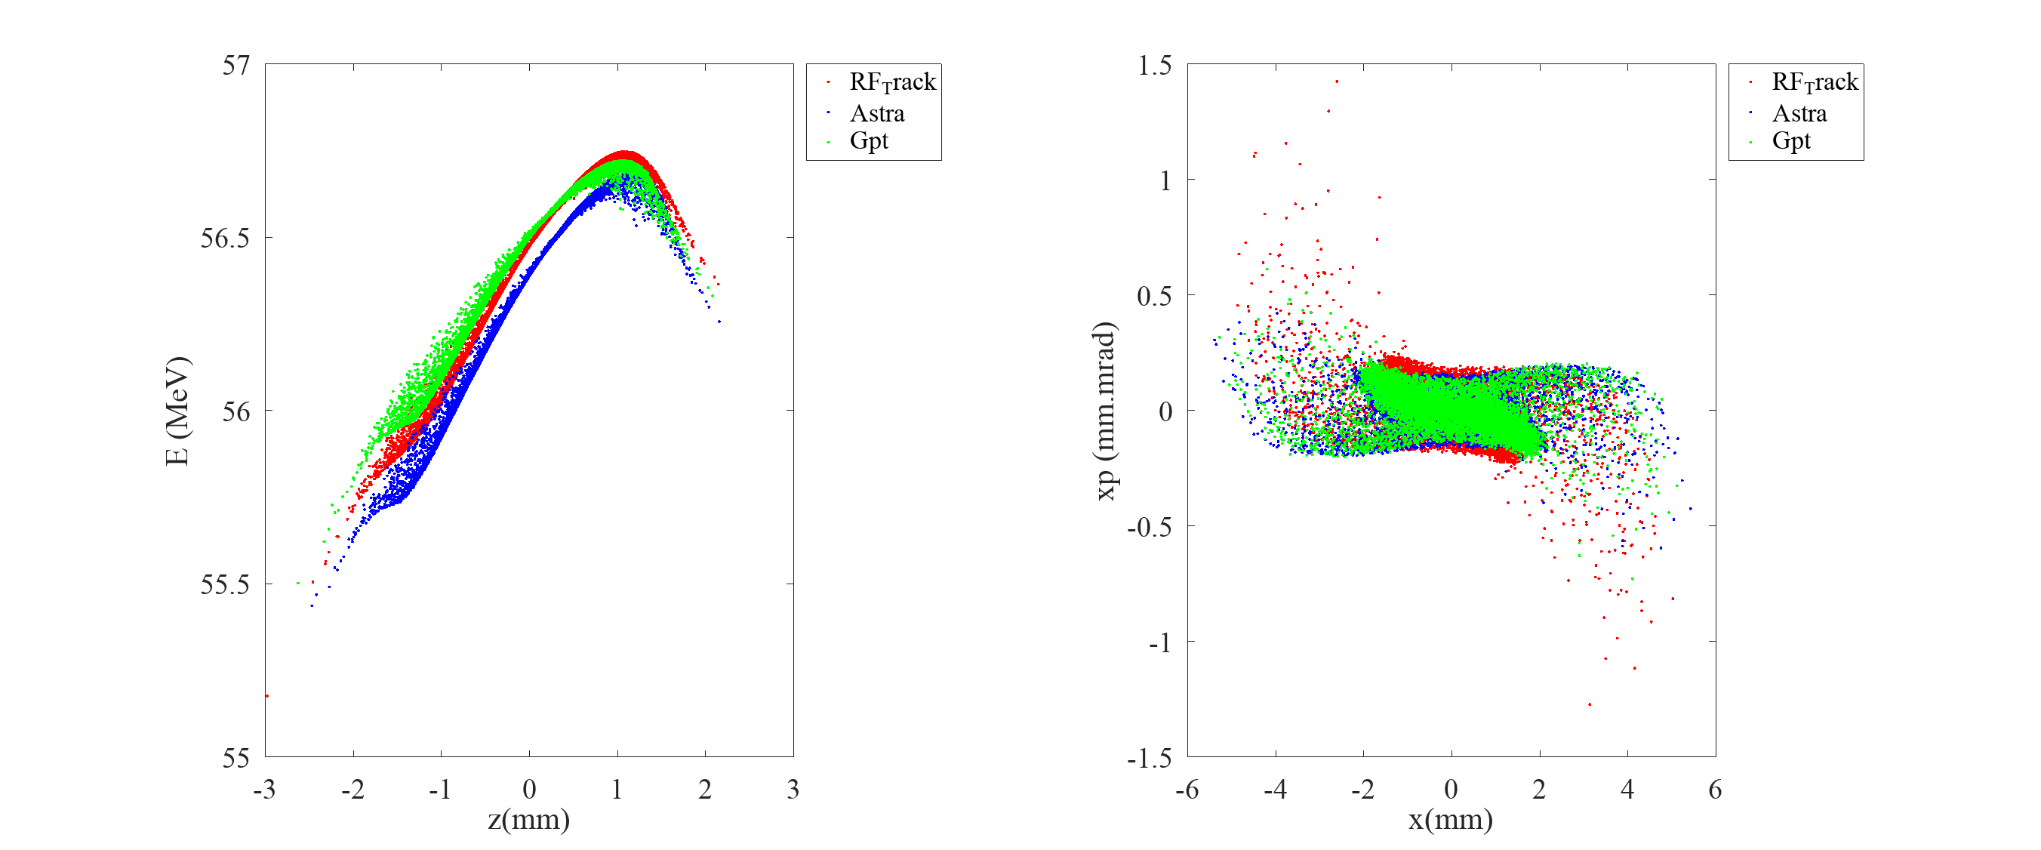
Benchmarking of codes

Slide 15
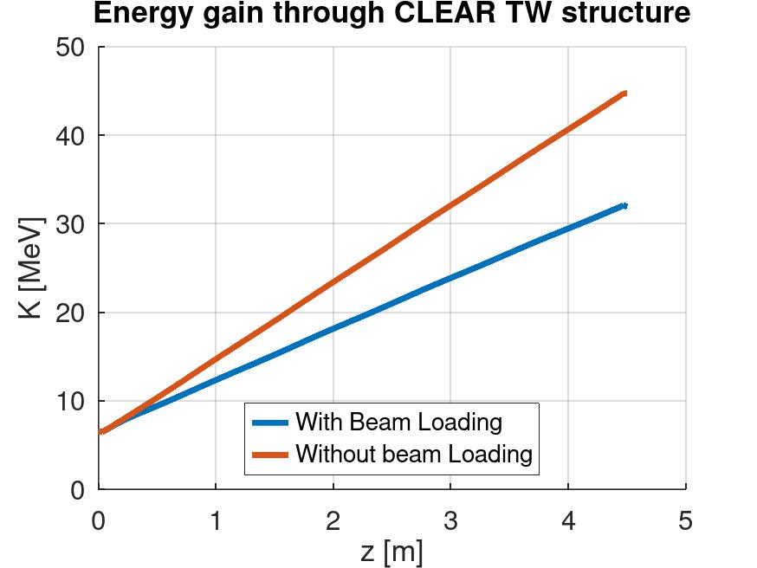
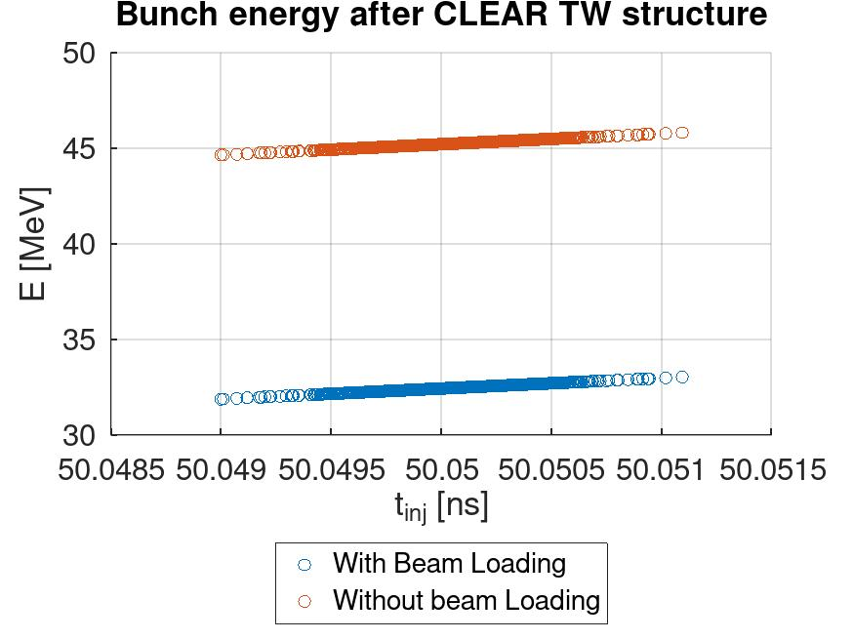
Beam Loading Simulations
J. Olivares Herrador
Energy gain through TW structure and energies of 150th bunch 150 bunch of train with 0.5 nC. Bunch spacing is 1/Freq

Slide 16
Conclusion
Good agreement between simulation tools
  some of them user friendly some of them not ☺
Present CLEAR injector and inital laser parameters do not allow good matching to the accelerating section..
  Even we have good transverse beam spot there is no way to avoid beam loss due to beam loading..
Shortenning injector helps
  But still the solenoid does not provide enough focusing for waist
Installing a solenoid provides best results..
  Also bunch transverse shaping allows good transverse distribution..

Slide 17
Thank you for your attention..
  Special thanks to Javier and Andrea

