Slide 2


Are you ready?
Take a seat, the session will start shortly…

Slide 3

Welcome @ CERN
1 November 2022
© CERN Photo

Slide 4
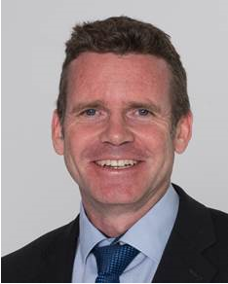
Bienvenue
Welcome
James PURVIS
Chef du département des ressources humaines
Head, Human Resources Department
Link to video on Indico

Slide 5
Welcome Bienvenue
Kyriaki
FAKOURELI
HR Department,
Learning & Development
Elizabeth
BARZDO
HR Department,
Learning & Development

Slide 6

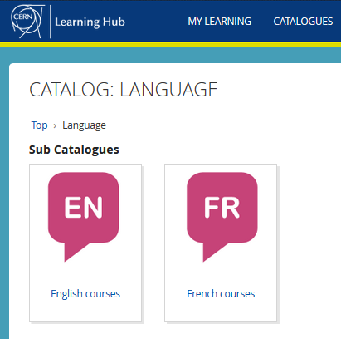

Logistics - language
Classroom courses
cern.ch/learninghub
Tandem
link
Find a partner
to practice speaking
each other’s language

Slide 7

Logistics - slides
Available at any time
direct link : https://indico.cern.ch/category/10150/

Slide 8
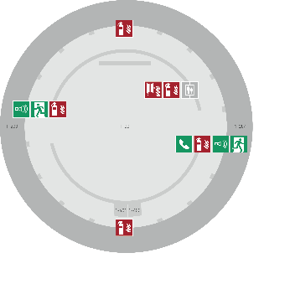
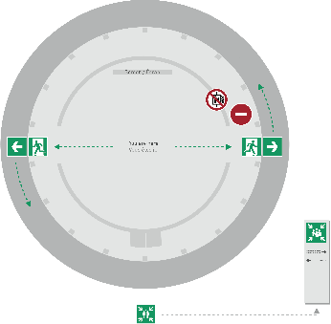
Emergency Procedure d’Urgence
When the alarm sounds
Lorsque le signal d’évacuation retentit
Evacuate immediately
Évacuez immédiatement
Don’t use the lift
N’utilisez pas l’ascenseur
Follow the signs
Suivez le balisage
Go to assembly point
Rendez-vous au point de rassemblement
74444
Escape routes
Voies d’évacuation
Fire hose
Lance d’incendie
Extinguisher
Extincteur
Assembly point
Point de rassemblement

Slide 9
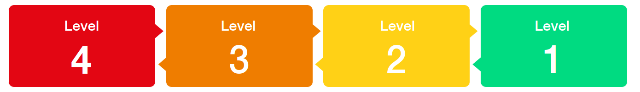
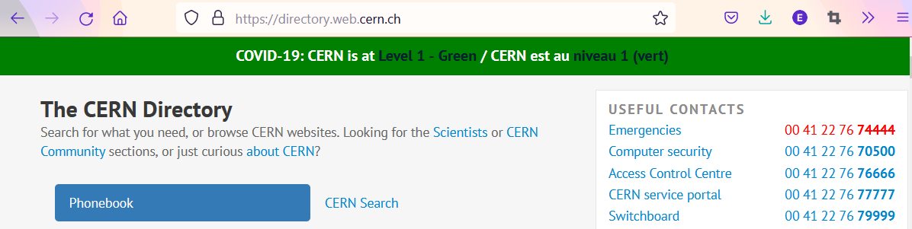

COVID -19
Since
14 March
Mask wearing?
left to the decision of individual ; provided by CERN on request

Slide 10
Programme of the morning
08.45 Welcome by James Purvis, Head HR Department
08.55 Quiz – CERN as organization
09.20 Group photo, coffee break and networking
09.55 Quiz – daily life at CERN
10.30 Meet colleagues from your department
Transfer to department
11.00 Welcome in your department

Slide 11


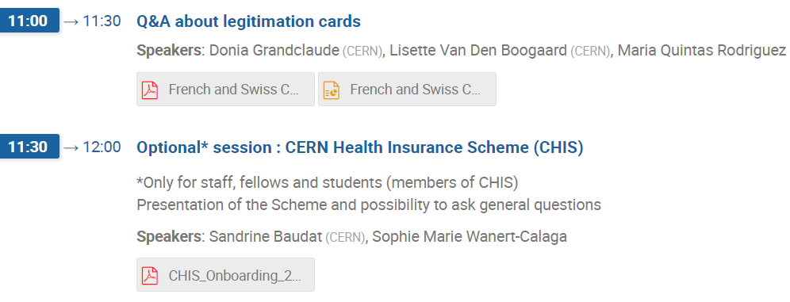
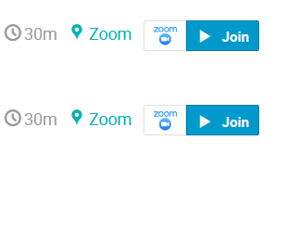
Programme Wednesday 2 November

Slide 12

Ready to learn
more about CERN
via a quiz ?

Slide 13
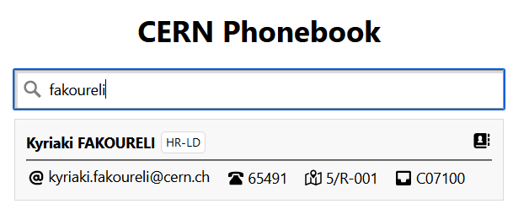

Building 5
Ground floor
Office 001
R = ground floor (Rez de chaussee)
S = basement (Sous-sol)

Slide 14

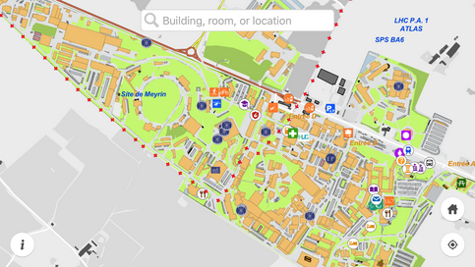
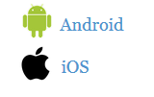


MapCERN

Slide 15
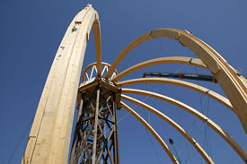
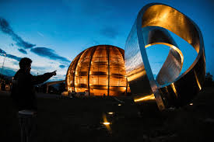
© CERN Photo
https://visit.cern/globe/history-globe
© CERN Photo

Slide 16

CERN as an international organization
Quiz – part 1

Slide 17






CERN MoP
~16 200
Contractors
> 4 500
Employed MPE
~ 3 450
Associated MPA
~ 12 750
Staff
~ 2 670
Fellows
~ 780
Users
~ 11 200
Associates
~ 1000
Students
~ 550

Slide 18
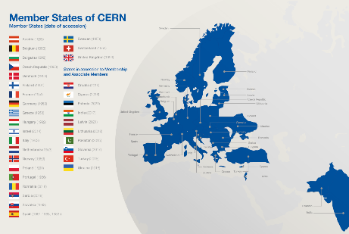
Revenues 2022
Member State contributions 84 %
Associate Member State contributions 2 %
Special contributions 3.7%
(to HL-LHC, specific experiments, from EU)
Other 10 %
(e.g. knowledge transfer, donations, …)
Principle =
proportional to Gross National Income
→ equal effort for every country

Slide 19
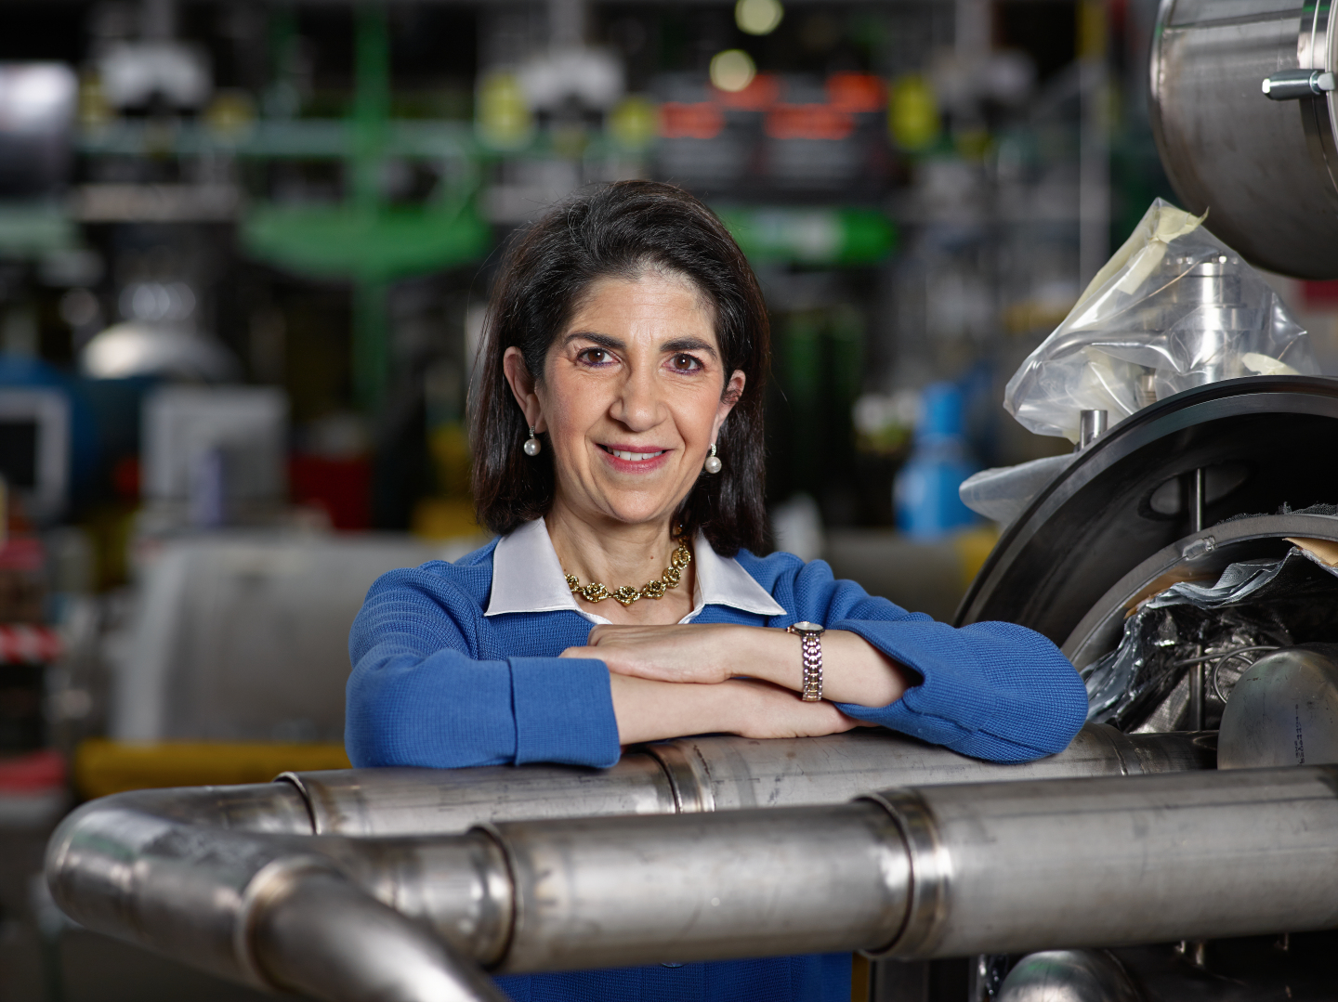
Link to biography
© CERN Photo, 2015

Slide 20
Working at CERN when Nobel prize
1992 : Georges Charpak
1988 : Carlo Rubbia & Simon van der Meer
1984 : Jack Steinberger (with Lederman and Schwartz)
Working at CERN after Nobel prize
1952 : Felix Bloch
1976 : Sam Ting
Nobel prize thanks to discoveries at CERN
2013 : Peter Higgs & Francois Englert

Slide 21
Welcome to HR-PXE colleagues
Opportunity to ask questions during coffee break
Collective induction session by type of contract
  Fellows
  Tech & Admin students in the 2nd week
  Doctoral students
Individually contacted by HRA : Staff

Slide 22











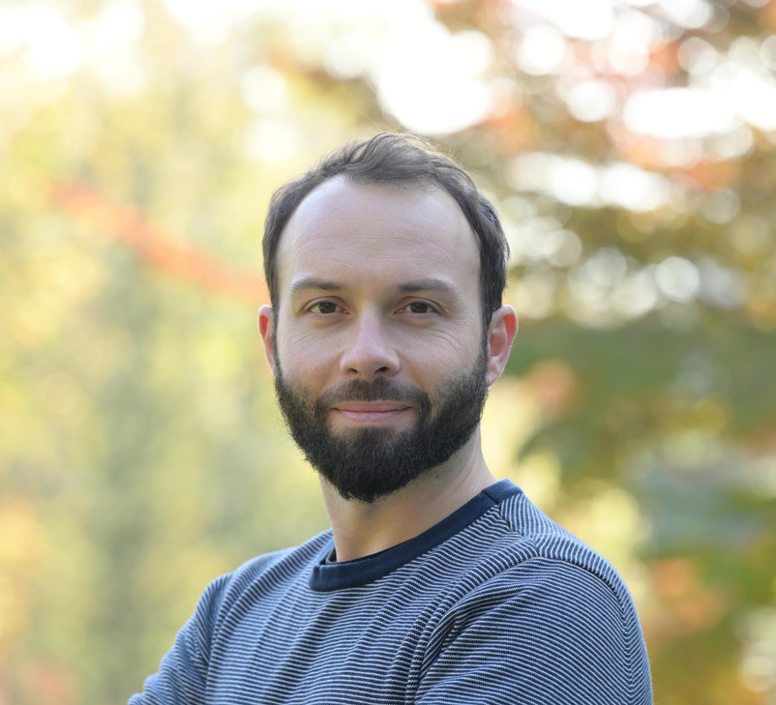



Your contact points at HR PXE
Leadership of the group
=
Human Resources Advisor
Main contact for staff members
Lore Taillieu
Marie-Luce Falipou
=
Contact for
Students and Fellows
Accelerators and Technology Sector
Administrative Sector
Accelerators and Technology (ATS)
Beams (BE)
Director General Office (DG)
Finance and Administrative Processes (FAP)
Human Resources (HR)
Anne-Laure Tantot &
Céline Delieutraz
Aurélie Choy &
Oxana Goponova
Aurélie Choy &
Jenni Suutala
Nina Koivunen &
Jenni Suutala
Marie-Luce Falipou &
Jenni Suutala
Engineering (EN)
Systems (SY)
Technology (TE)
BE
Health, Safety & Environment
(HSE)
Pension Fund (PF)
Pension Fund (PF)
Industry, Procurement and Knowledge Transfer Department
(IPT)
EN
SY
Katharine Thomas-Chevreux &
Oxana Goponova
Sara Krige &
Céline Delieutraz
Anne-Laure Tantot &
Céline Delieutraz
Nina Koivunen &
Jan von der Brelie
Sara Krige &
Jenni Suutala
TE
Benjamin Salignat &
Jan von der Brelie
Sara Krige &
Jenni Suutala
Research & Computing Sector
Site & Civil Engineering
(SCE)
Research & Computing
Sector (RCS)
Experimental Physics (EP)
Anne-Laure Tantot &
Jan von der Brelie
Benjamin Salignat &
Jan von der Brelie
Stefano Fattori, Ronald Moerbeek & Leatitia Breavoine
International Relations Sector
Information
Technology (IT)
Theory Department
(TH)
International Relations (IR)
For Marie Sklodowska Curie fellows & ITN
Benjamin Salignat &
Jan von der Brelie
Stefano Fattori &
Laetitia Breavoine
Marie-Luce Falipou &
Jenni Suutala
Ingrid Haug

Slide 23
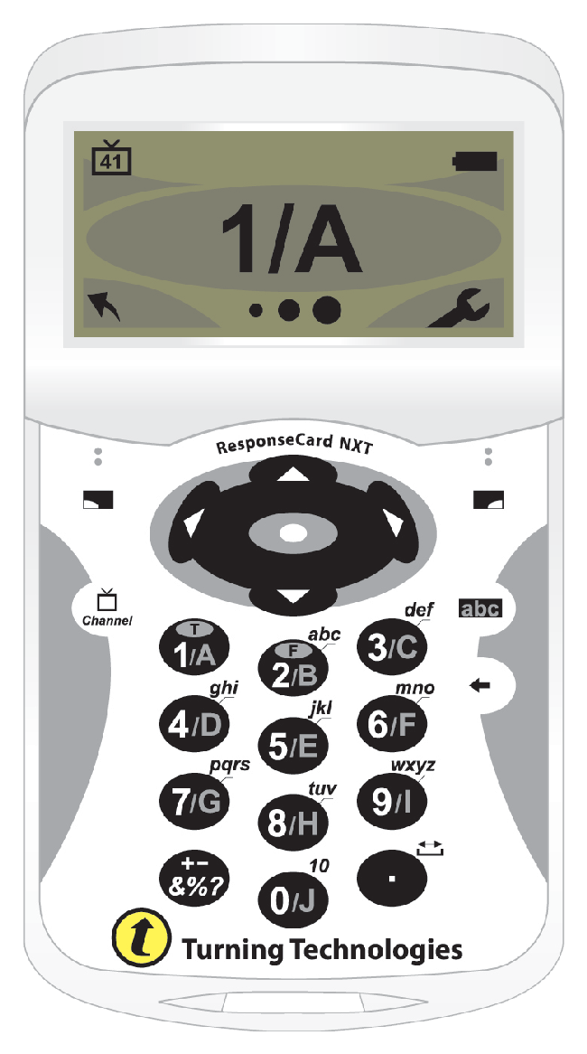
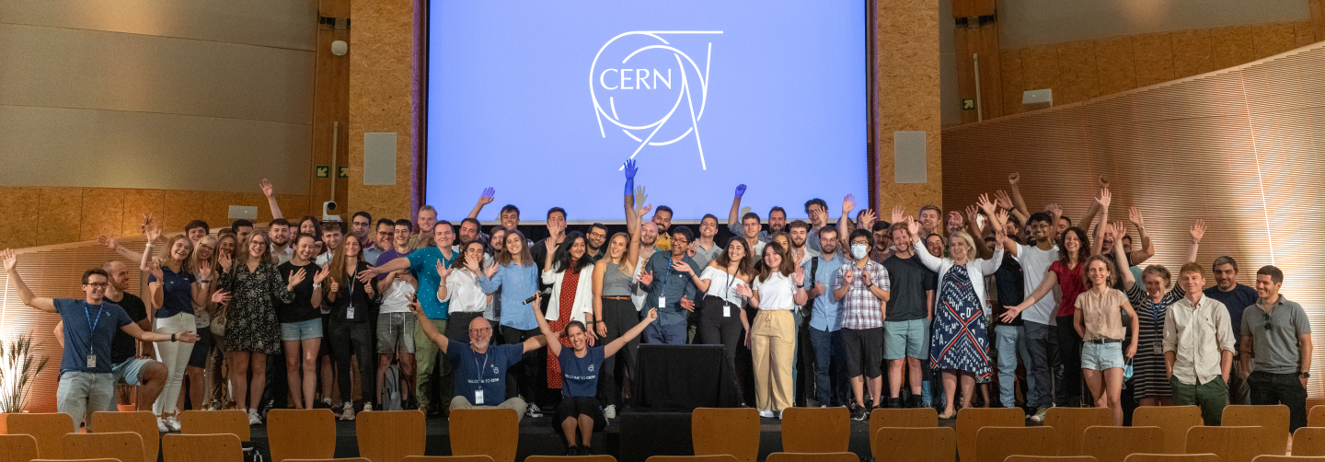
Time for a group photo !
© CERN Photo

Slide 24



Slide 25

30
MINUTES
BREAK TIME

Slide 26
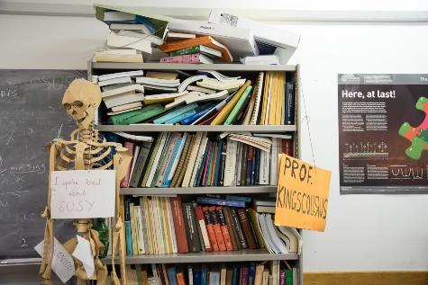
Daily life at CERN
Quiz part 2

Slide 27
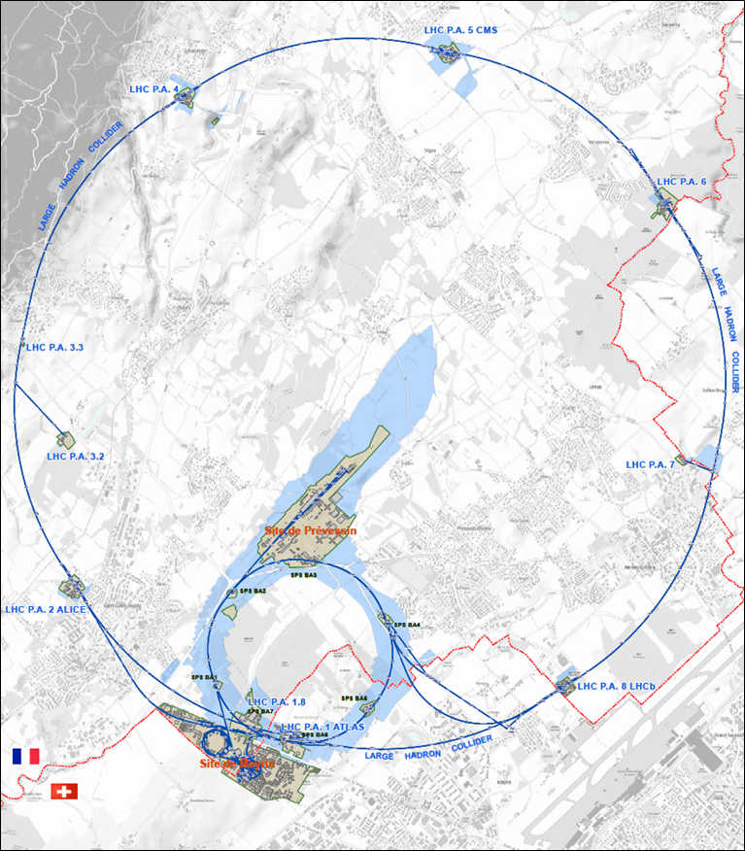




625 ha
515 ha
fenced : 220
110 ha
… 700+ buildings
accounting for
500.000 m²
5 900 parking spots
101 ha
green
spaces
30 km roads

Slide 28
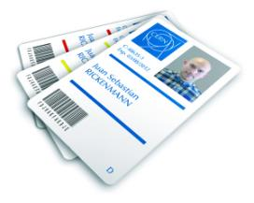
CERN access card
Visitors badge
Validity :
2 working days
CERN access card
Building 55
Working days
from 7:30 to 17:30, non stop
Also
vehicle registration
biometrics registration
https://sce-dep.web.cern.ch/security/access

Slide 29
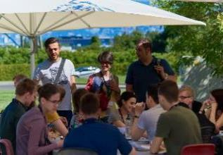
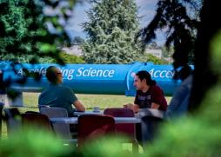
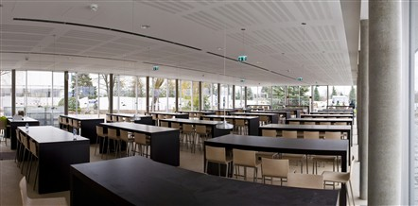
Restaurants
2 in Meyrin (resto 1 & 2)
1 in Prevessin (resto 3)
Cafeteria (snacks)
Building 13, 30, 40, 54, …
© CERN Photo

Slide 30
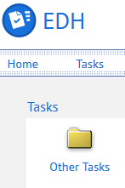
CERN Car
Requires
CERN driving authorization :
Valid driving licence
OK Department Head
Private vehicle
Not requiring registration
  Bike, “trottinette”
Requiring registration
  Registered in member state or EU country
  “Tourist” cars only
  Not allowed :
  Scooter, moto, lorry, bus, …

Slide 31
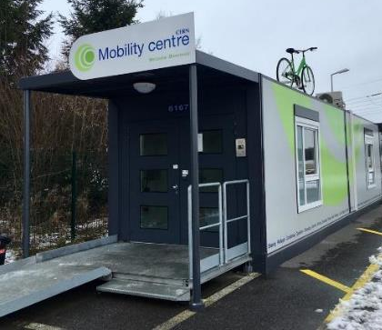
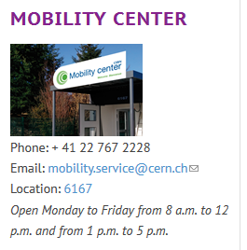
CERN Mobility Centre
Located next to Entrance A
Services offered
Bike rental
Car rental
Car sharing
Bike sharing
Shuttles
….
https://sce-dep.web.cern.ch/campus-life/mobility

Slide 32






Mobility apps
Car sharing
glide.io
login with CERN SSO
Bike sharing
Urban connect

Slide 33
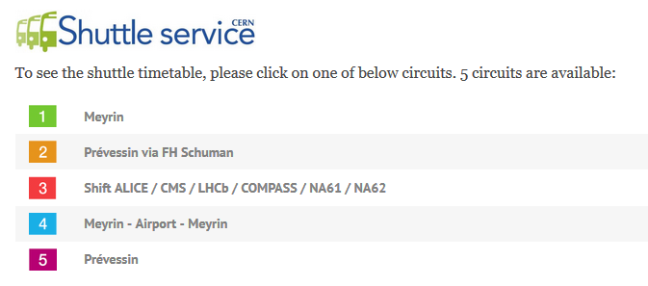
https://sce-dep.web.cern.ch/cern-shuttle-service

Slide 34







CERN Service Desk
Phone: +41 22 76 77777
Email: service-desk@cern.ch
Monday to Friday
from 7.30 to 18:30
( Geneva time )
CERN Service Portal
Services
Service overview in a glance
Online forms
Report an incident, submit a request
Knowledge articles
Find your answer!
Feedback
Your feedback matters!
https://cern.ch/service-portal

Slide 35
Accident on site – different cases
In all cases
Inform supervisor
In case of
Injury
Environmental hazard
Disruption traffic
3rd party involved
CERN Fire & Rescue 74444
(+ 41 22 767 44 44)
+
Internal accident report (EDH)
+
European Union Car Accident form

Slide 36
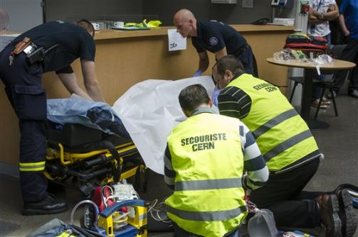
CERN Fire and Rescue Service
assisted by local First Aiders
Find out who
are closest to
your office / usual work places
© CERN Photo

Slide 37
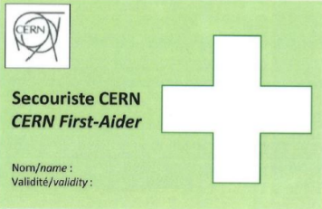
First Aider door sticker
Your safety contacts : http://safety.cern.ch/FirstAid.html
Training available for all All personnel working at CERN : First Aid - Life-Saving Actions (Covid-19)

Slide 38


Defends all personnel
on a collective and on an individual basis
Become member : Website
Network of people who work(ed) at CERN
Become member : Website

Slide 39
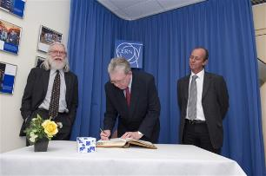
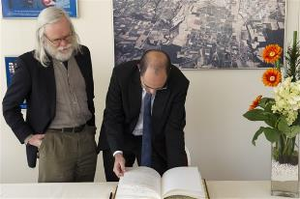
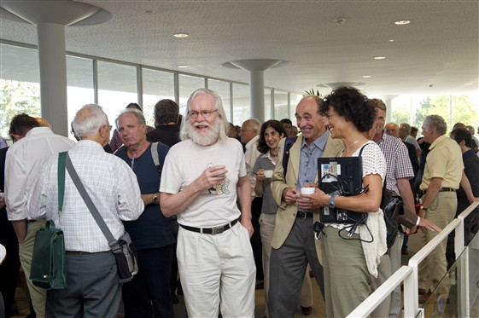
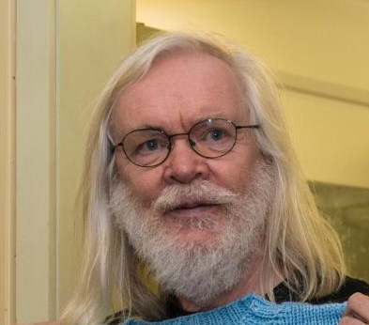
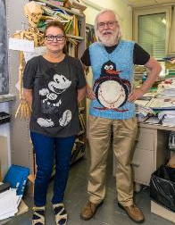
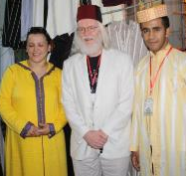
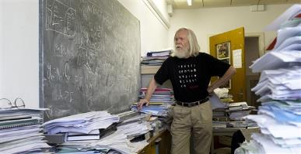
© CERN Photo

Slide 40

Code of Conduct
cern.ch/codeofconduct

Slide 41
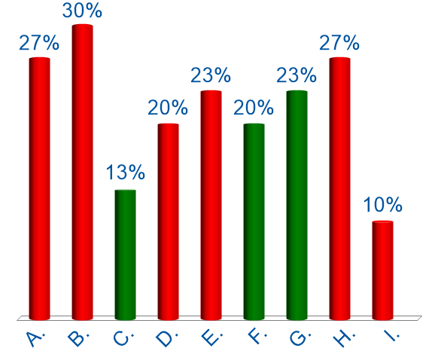
Tools for working remotely
Which tools have you already used?
Vidyo
MS Teams
Zoom
Cisco WebEx
Skype for Business
Mattermost
CERN Phone
Other
None of the above
Several answers → Click OK

Slide 42



CERN tools
Phone (audio only) : CERNphone
  Mobile client (iOS and Android)
  Desktop client (Windows, macOS, Linux)
Videocalls and videoconferencing cern.zoom – FAQ
Messaging – individual and public/private ”channels”
integration with Zoom
dedicated channel New @ CERN

Slide 43
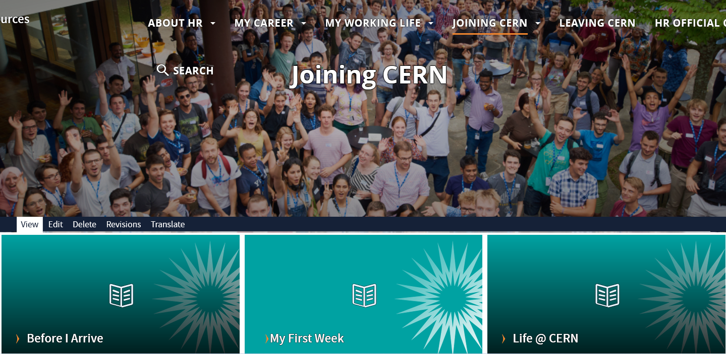
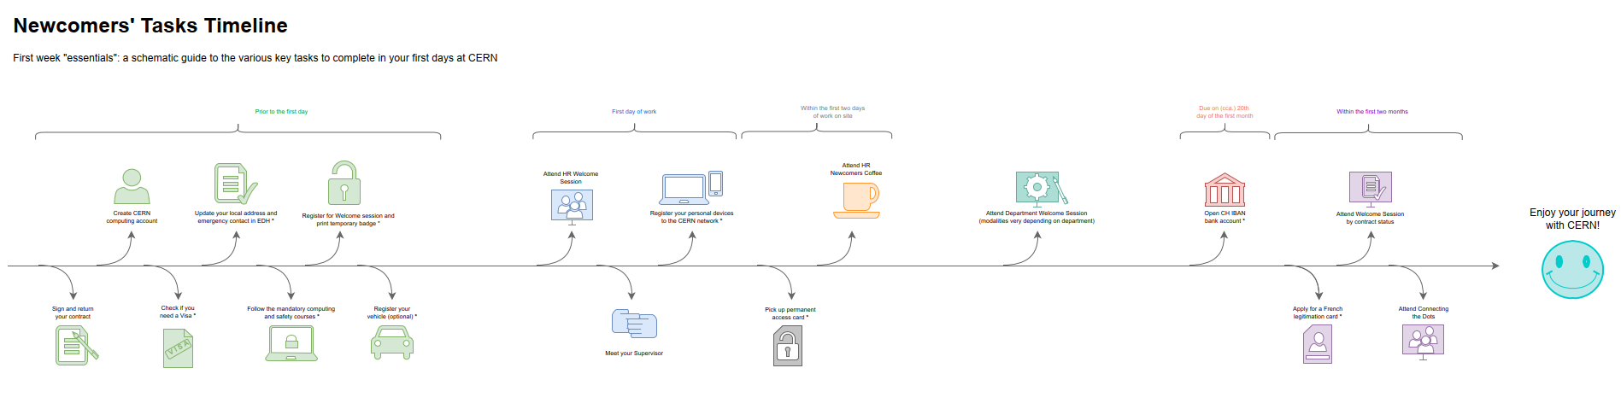
Newcomers website
https://hr.web.cern.ch/joining-cern

Slide 44



Many questions, answers are …
  Your departmental secretariat
  Your supervisor, your colleagues
  Specific question for personal situation?
  → Make appointment with the expert services
  Pension Fund, Health Insurance, Installation Service, Housing Service, Social Service, …
  HR Website > Welcome > my first week

Slide 45

Public meetings
Click for past and future events (agenda, slides, recordings)
Directorate every 3 months
Highlights of Council Week and other recent news.
HR ad hoc
Focus on one topic (eg. flexibility)
Staff Association every month
Latest information on priorities and current issues

Slide 46


Recap from quiz - recommended
Download CERN map on your smartphone
Enter full number Fire and rescue service in your phone
Find out who are closest first-aiders
+ 41 22 76 74444

Slide 47
Onboarding continues with …
Welcome session in your department
Meet the experts (online – Zoom)
  Legitimation cards Wed 2 November, 11.00 – 11.30
  CERN Health Insurance (CHIS) Wed 2 November, 11.30 – 12.00
More short sessions with experts (online – Zoom)
  Computer security* Friday 11 November, 13.30 - 14.00
  Pension Fund* Thursday 8 December, 13.30 - 14.00
Connecting the dots* Monday 28 November, 14.00 - 18.00 register Learning Hub
Collective induction session or Individual contact by HRA
Visit* of CERN installations – register via Indico
Spouse* welcome session
Part of Welcome session
see Indico
* You will be invited
* You need to register

Slide 48
Before joining your Department
Notes:
Kyriaki
************************
For the next step, it is important that you know to which department you belong.
It is not because you are a computing engineer that your department is automatically IT.
Let us look at the organigram of CERN.

Slide 49
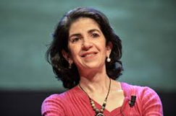
Director General
Health, Safety & Environment
Internal Audit
Legal Service
UNIT
Translation, Minutes & Council support
Accelerators & Technology
Beams
Technology
Finance & Human Resources
International Relations
Research & Computing
Engineering
Finance & Administrative Processes
Industry, Procurement & Knowledge Transfer
Human Resources
Site & Civil Engineering
Experimental Physics
Theory
Information Technology
Systems
Sector
Diplomatic & Stakeholder Relations
Department
Education, Communication, Outreach
Group

Slide 50
DG
HSE
Fabiola Gianotti
Benoit Delille
UNIT
ATS
BE
TE
FHR
IR
RCS
EN
FAP
IPT
HR
SCE
EP
TH
IT
SY
Sector
Mike Lamont
Raphael Bello
Charlotte Warakaulle
Joachim Mnich
Rhodri Jones
Florian Sonneman
Manfred Krammer
Department
J. Miguel Jiménez
Christopher Hartley
Gian Giudice
Katy Foraz
James Purvis
Enrica Porcari
Brennan Goddard
Mar Capeans

Slide 51
Sector
Director
Department
Department Head
DAO
DPO
DSO
DTO
…
Group
Group
Group
Group Leader
Section
Section
Section
Section Leader

