Slide 1
WELCOME!
RF for Accelerators
18 June – 1 July 2023
Seminaris CampusHotel, Berlin, Germany

Slide 2
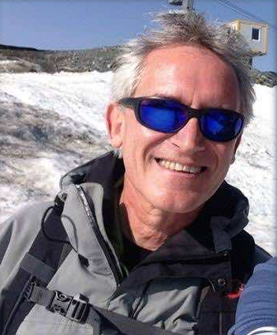
Roger Bailey (1954-2023)
We share the news of Roger Bailey's passing with heartfelt sorrow.
Roger was the Head of the CERN Accelerator School from 2011 to 2017 and had dedicated more than 30 years to working at CERN. He was also the head of LHC Operations and my supervisor.
Roger's remarkable contributions to the accelerator physics community will forever be remembered.
Our heartfelt sympathies go out to his loved ones, colleagues and friends during this tough time.
19/3/1954 – 1/6/2023

Slide 3
The CERN Accelerator School - CAS
Established at the beginning of 1983 => 40 years this year!
  To preserve and transmit knowledge accumulated, at CERN and elsewhere, on particle accelerators and colliders of all kinds
This provided a framework for a series of courses
  General accelerator physics
    Introduction to Accelerator Physics
    Advanced Accelerator Physics
  Specialized topics in the field (RF, BI, magnets, vacuum, colliders, beam dynamics, plasma,…)
  50 to 70 hours teaching in ~2 week intensive residential courses
About 90 courses held so far
Occasional courses in the framework of the US-CERN-Japan-Russia Joint Accelerator School (JAS), from 2022: IAS (International Accelerator School)
  14 schools held so far (since 1985), Superconductivity course upcoming in July 2023

Slide 4
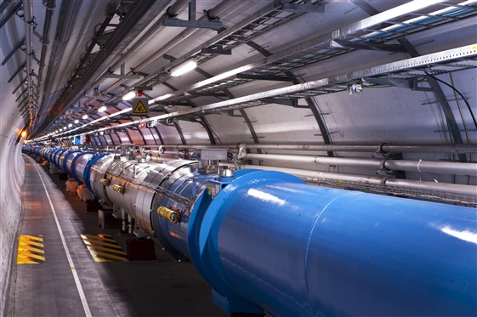
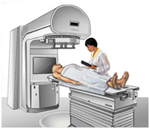
Scope
Accelerator Physics
Relativity / Electro-Magnetic Theory / Transverse Beam Dynamics / Longitudinal Beam Dynamics / Linear Imperfections and Resonances / Synchrotron Radiation / Electron Beam Dynamics / Multi-Particle Effects / Non-Linear Dynamics Beam Instabilities / Landau Damping / Beam-Beam Effects
Accelerator Systems
Particle Sources / RFQ / LEBT
RF Systems / Beam Measurement / Feedback Systems / Beam Injection and Extraction / Beam Transfer Power Convertors / Warm Magnets / Superconducting Magnets / Vacuum Systems Machine Protection Systems Radiation and Radioprotection
Accelerators
Linear Accelerators
Synchrotron Light Machines
FELs
FFAGs
Cyclotrons
Synchrotrons
Colliders
Applications
High Energy Physics
Nuclear Physics
Industrial Applications
Medical Applications
Cancer Therapy

Slide 5
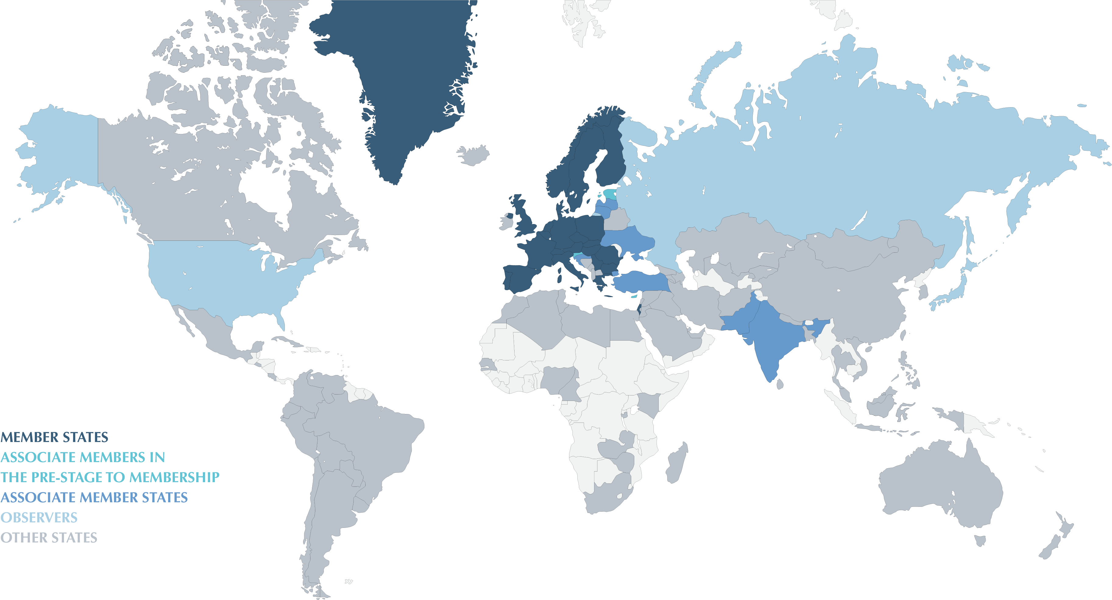

Why are we in Germany now?
CERN is financed by 23 member states and 10 associated member states
CAS visits all CERN member states and associated member states in turn
Previous residential CAS
in Germany in 2016
In collaboration with
Many thanks to
Axel Neumann
Roswitha Schabardin
Jens Knobloch

Slide 7
Residential CAS Courses
Typically 2 weeks duration
Networking is an essential part of each CAS course!
Introduction to Accelerator Physics (yearly – in September)
  25 Sep – 8 Oct 2023 (in Santa Susanna, Spain)
  2024 in Serbia
  Hands-on in transverse and longitudinal beam dynamics
Advanced Accelerator Physics
  next in Nov 2024
  Hands-on in RF, Beam Instrumentation and Beam Optics
2023+: Magnets, Mechanical and Material Engineering, …
Basic course (non-residential, 5 days) near CERN – open for external participants

Slide 9
This course
107 participants (25 CERN, 77 external, 6 5 grants)
34 (!) colleagues for lectures and hands-on, 3 more for the CAS team
Lectures 45-50 minutes + discussion
Discussion sessions with lecturers and hands-on colleagues
Hands-on courses for
  RF measurements (I + II), RF simulations, Longitudinal Tracking
Special lecture “Electromagnetic simulations with CST” tomorrow
by Frank Demming-Janssen (SIMUSERV GmbH)
entertaining seminar:
“Quantum Entanglement – Spooky Action at a Distance”
on Wednesday by Prof. Oliver Benson and Julian Rypalla

Slide 10
This course
Lunch and coffee breaks between the lectures
arrival at dinner buffet 19:30 – 20:30, buffet until 21:30, beer, wine, soft drinks
use this for networking
1 slide – 1 minute today followed by Welcome drink
Poster session this Friday after hands-on
HZB visits
  Thu 22/6: Bus leaves at 14:00, please let participants eat first
  Wed 28/6: Bus leaves at 8:30
Excursion by boat on Sunday, followed by free time - buses leave at 9:00!
Cinema evening next week on Tuesday

Slide 11
Hands-on courses
4 different topics, 4 groups rotate through every 2 days
  Group assignment shown this afternoon
RF measurements 1 (1st floor: Harvard 1 and 2)
RF measurements 2 (2nd floor: Oxford 1 and 2)
  12 experiments about 1 hour each, rotate through them
RF simulations
  CST Microwave Studio (on your own computer, we have a few laptops)
  in this auditorium (in the back)
Longitudinal Tracking
  in this auditorium
  in Python (on your own computers, we have a few laptops)

Slide 12
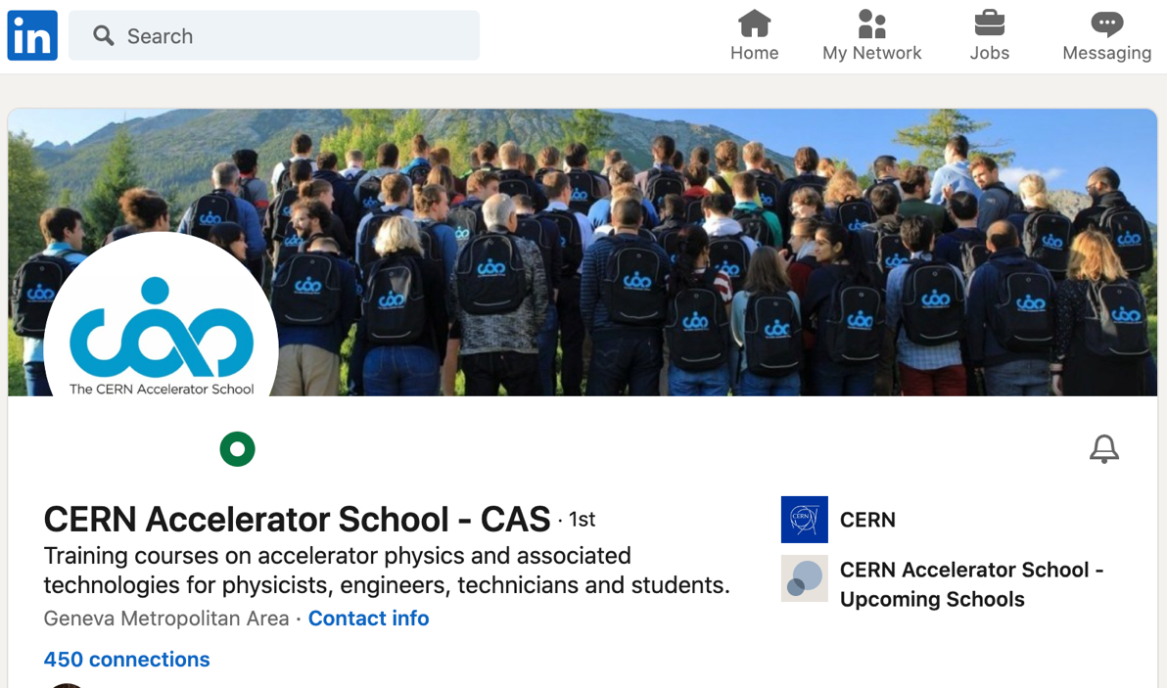
Networking
Next to the course teaching the most important aspect of the school
“ digital training cannot replace CAS courses”
- people socialising (and even working)
up to late in the evenings
- lots of interactions students <-> teachers
- cinema evening
- excursion
LinkedIn
  From the CAS web page
  CAS profile: https://www.linkedin.com/in/cern-accelerator-school-a61367233

Slide 13
COVID-19
We want to hold the course in safe conditions
No particular measures imposed
In case of symptoms
  Don’t come to the course
  Please test yourself first

Slide 14
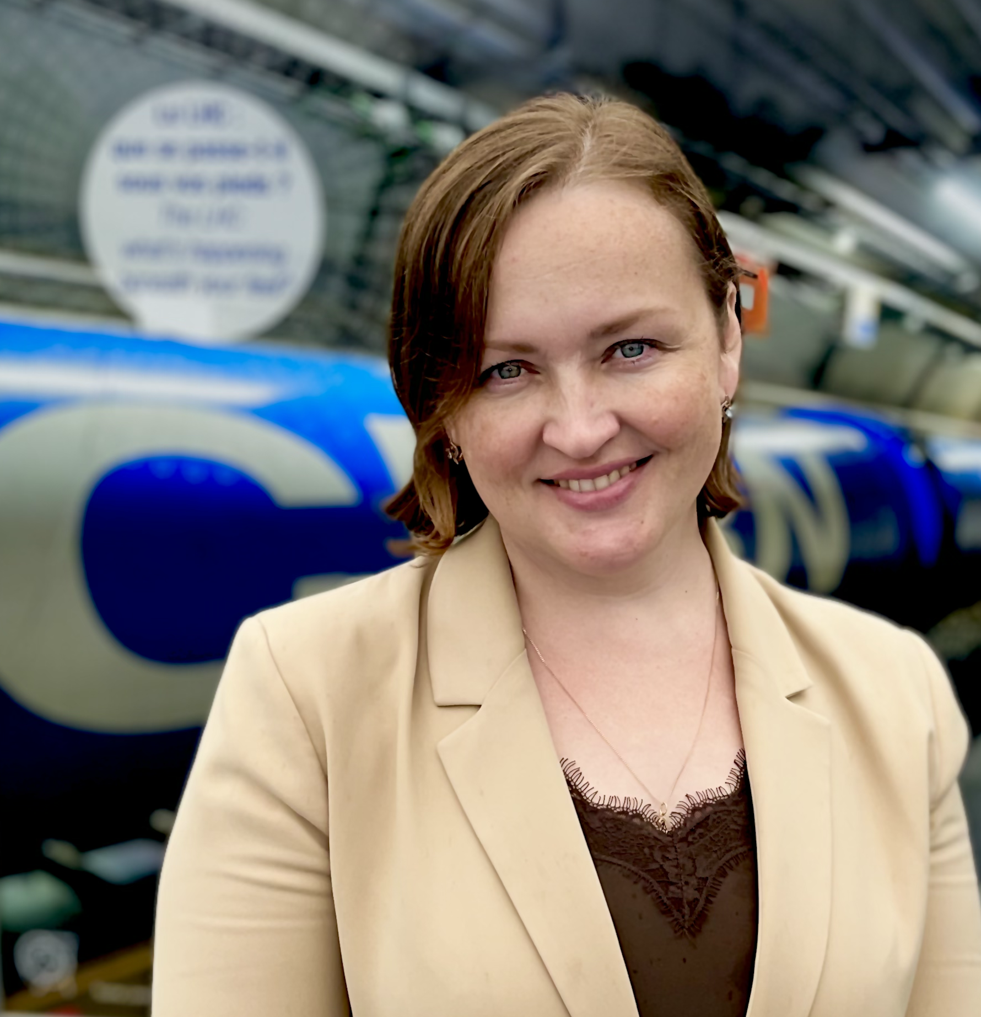
The CAS Team
Anastasiya Safronava
Web pages
Noemi Caraban Gonzalez
CASopedia, Social media
Christine Völlinger
Deputy Director
Maria Filippova
Administrative Assistant
Frank Tecker
Director
Delphine Rivoiron
Administrative Manager
Ron Suykerbuyk
Filming

Slide 15
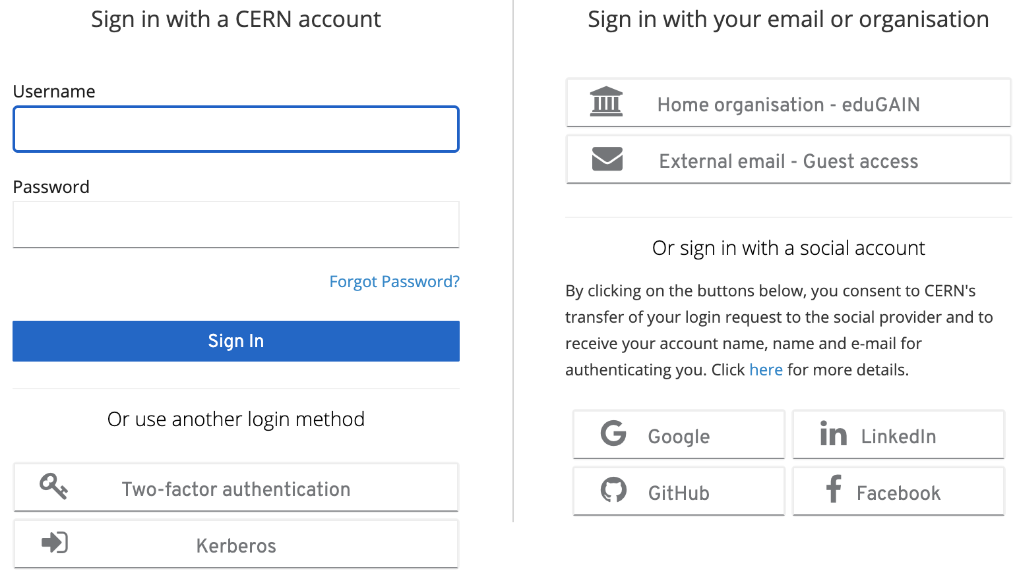
Online Evaluation Form
Important to maintain / improve the high quality of teaching
https://cas.web.cern.ch/evaluation/berlin-2023
Log in with CERN account
or many other ways
(Google, LinkedIn, …)

Slide 16
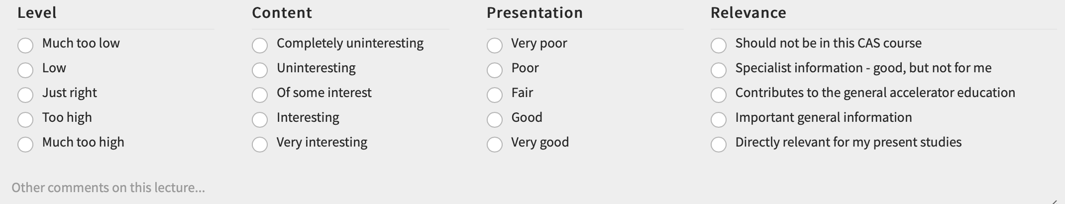

Online Evaluation Form
Please fill it in ideally daily during the course, when your memory is fresh
You can save it and come back to it later at any time
Just DON’T submit it until you have completed your evaluation at the end

Slide 17
Enjoy the course! http://cern.ch/cas
RF for Accelerator

